Slide 1
ESS Project Update
John Haines
ESS Project Manager
IKON 16
European Spallation Source ERIC
11 Feb 2019

Slide 2
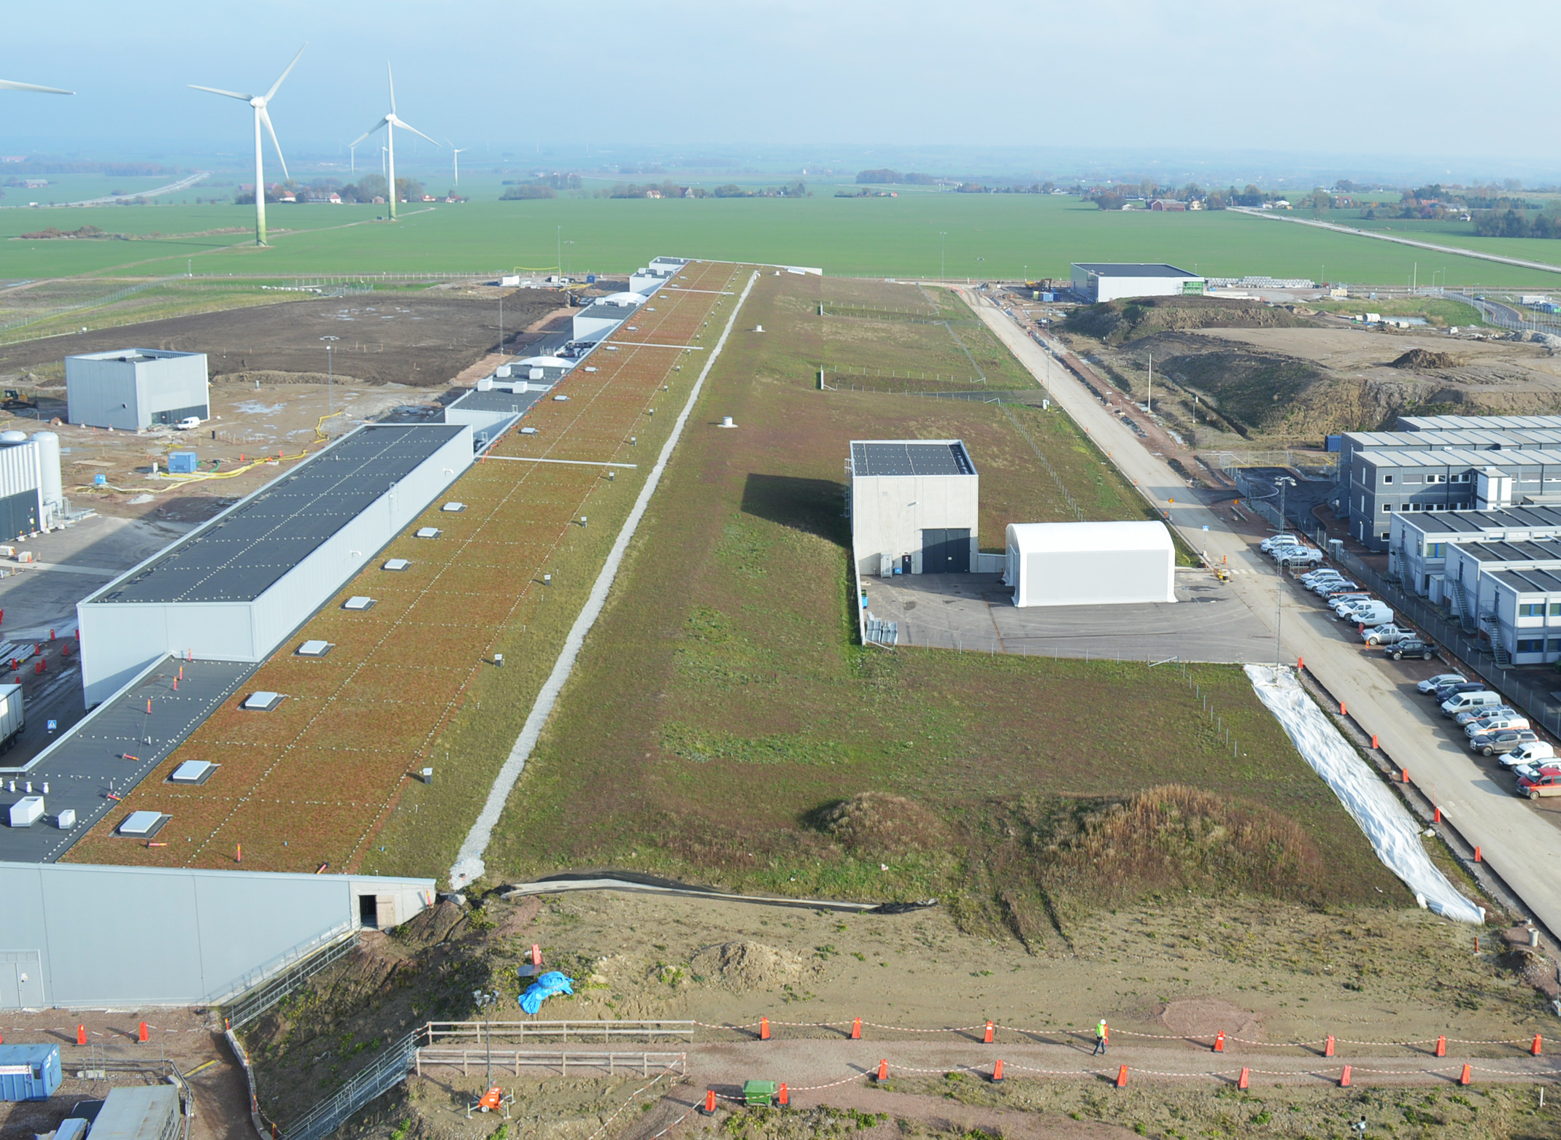
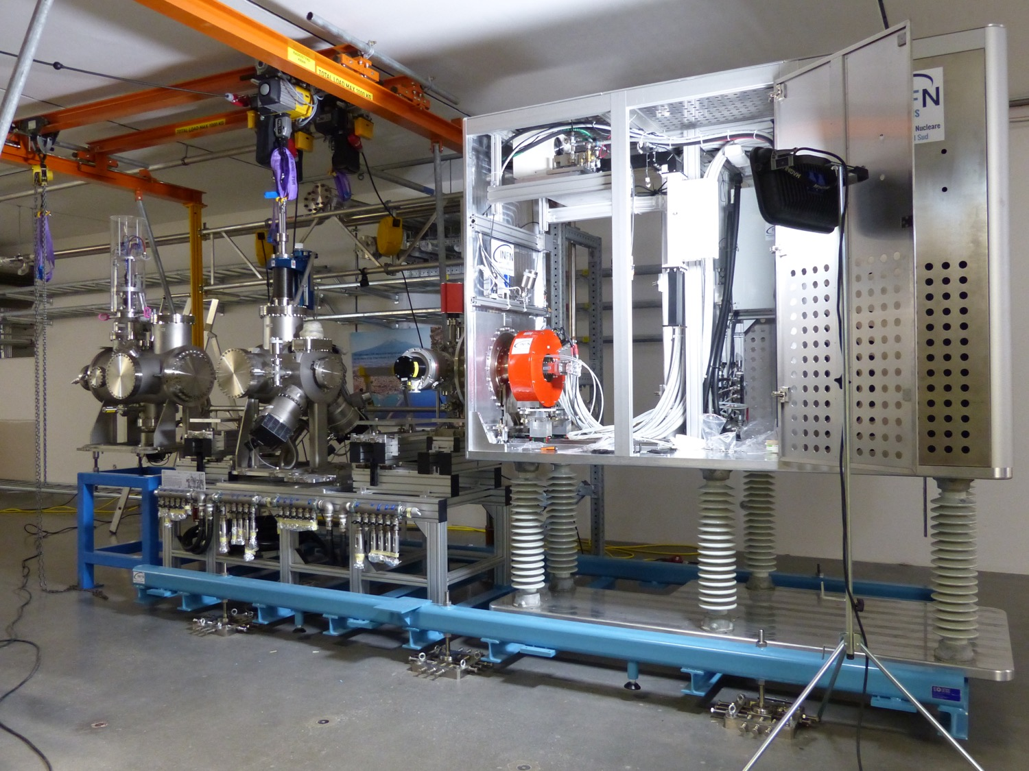
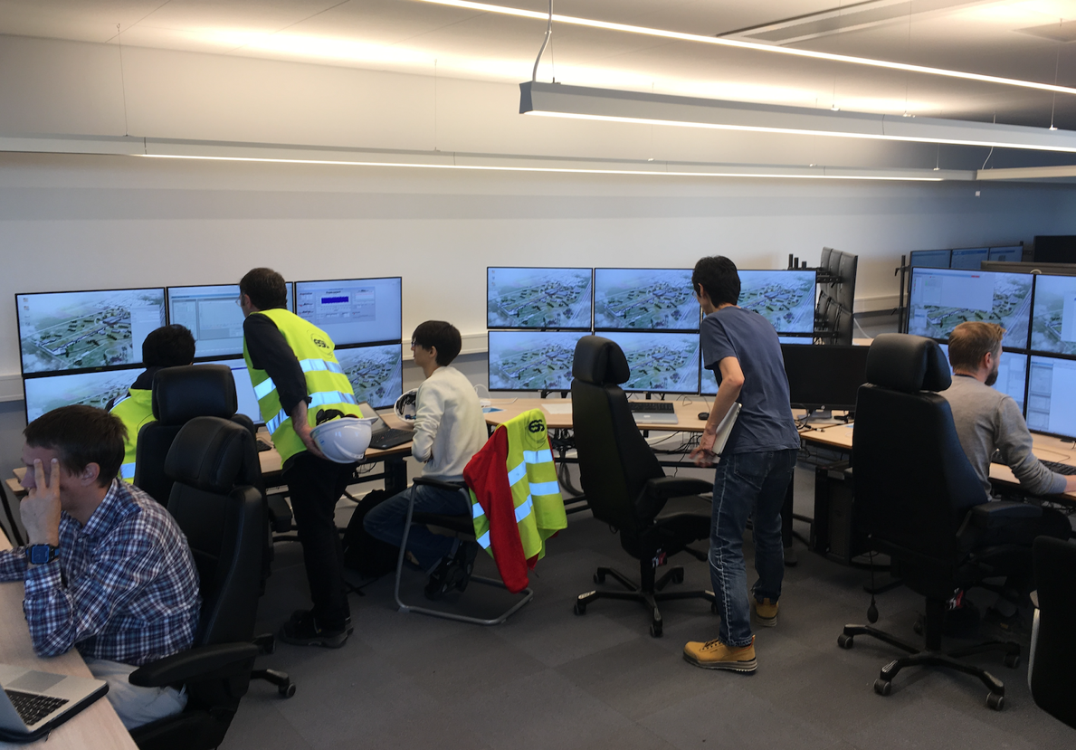
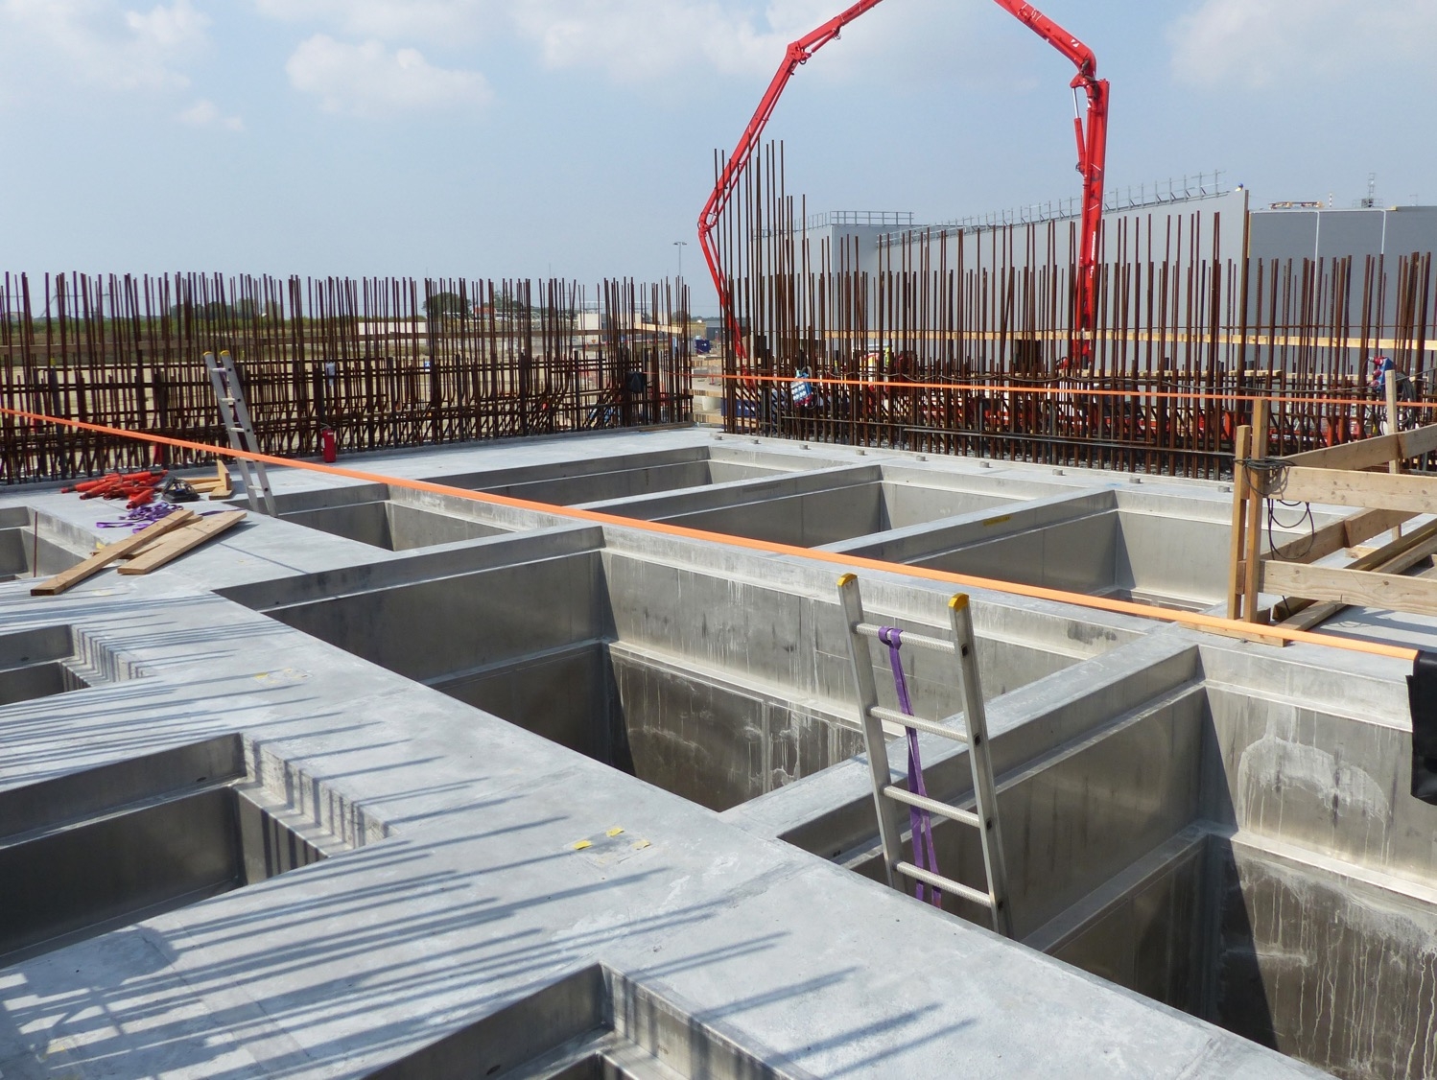
2018 project highlights
Established new ESS-wide baseline plan to improve coordination, communication, execution, and tracking of work
Handed-over klystron gallery and two more buildings from construction partner to ESS
Structural design of Target Building and Instrument Halls no longer on critical path
Formed new Infrastructure Subproject to be ready for Accelerator equipment deliveries and commissioning
Began commissioning Ion Source and LEBT and three helium cryo-plants
Installed Active Cell infrastructure embedded in buildings - waste pits, Active Cell liner
Held successful Bunker Critical Design Review

Slide 3
ESS Construction Project is 57% complete
Schedule Variance (SV) - 22 M€
Cost Variance (CV) - 2 M€
Schedule Perf. Index (SPI) 0.98
Cost Perf. Index (CPI) 0.99
“Excellent” cost and schedule performance reflect our re-baselining in May 2018
Schedule Variance is mainly due to In-Kind work delays - more discussion of critical in-kind delays later
SV

Slide 4
We have managed to keep Estimate-at-Completion stable since Re-Baseline
Sub-Project | Costs in M€
 | May 2018 BAC | Changes² | Oct 2018 BAC | Oct 2018 EAC
Accelerator | 496.7 | 9.1 | 505.8 | 526.7
Target | 189.7 | 3.6 | 193.3 | 223.2
ICS | 79.3 | 3.5 | 82.8 | 89.6
NSS | 361.0 | 0.0 | 361.0 | 367.2
CF | 714.9 | 2.8 | 717.7 | 778.4
Central Support¹ | 180.2 | 2.9 | 183.1 | 185.8
Total | 2022 | 22 | 2044 | 2171
EAC was 2174 M€ after May-2018 re-baseline
¹ Central Support includes Admin Directorate, Technical Management & Support, ESH&Q, and DG Office
² Changes include extra costs for installation (11.5 M€ for Accelerator, Target, and ICS), accelerator testing (3.6 M€), unforeseen ESH&Q workforce (2.9 M€), and target monolith shielding (1.5 M€)

Slide 5
Available contingency is more than forecast increases, but little remains for unforeseen items
Item | M€
Available Budget, i.e. Total Project Cost (TPC)* | 2210
Budget at Completion (BAC) (No contingency) | 2044
Contingency available (TPC- BAC) | 166
Estimate-at-Completion (EAC) | 2171
Forecast Increase (EAC-BAC) | 127
* Per Council resolution 13.06.a assumes full initial funding (1843 M€₂₀₁₃ plus additional host state contribution) plus additional 135 M€₂₀₁₃ based on unforeseen costs for handling seismic and antagonistic threat requirements
Forecast increases are less than available contingency, but leaves only 39 M€ for unforeseen items

Slide 6
Summary Schedule and Critical Path for Remaining Work
BOT - Beam on Target
ES - Early Science
SOUP - Start of User Programme
EOC - End of Construction project
RXXX - Ready for XXX
2018
2019
2020
2021
2022
2023
2024
2025
BOT
ES
SOUP
EOC
Warm LINAC Commissioning Steps
1.3 GeV Capability Installed
CF, Target, and NSS (Bunker) teams holding zero-float Critical path to BOT
Float to Accelerator RBOT reduced from 14 months to 11 months due to IK delivery slippage
Accelerator + ICS
Hi-Beta Install
Beam on Dump
(570 MeV)
Accel RBOT
Accelerator Schedule Float
CF + Target + NSS (Bunker+TBL) + ICS
Bunker and Test Beam Line RBOT
Access for Monolith Installation
Target RBOT
15th Instrument Complete (Ready for hot commissioning)
NSS Instruments + ICS
Instrument Hall Access for Start of Installation
Red line indicates critical path
Start beam commissioning for 1st Instruments

Slide 7
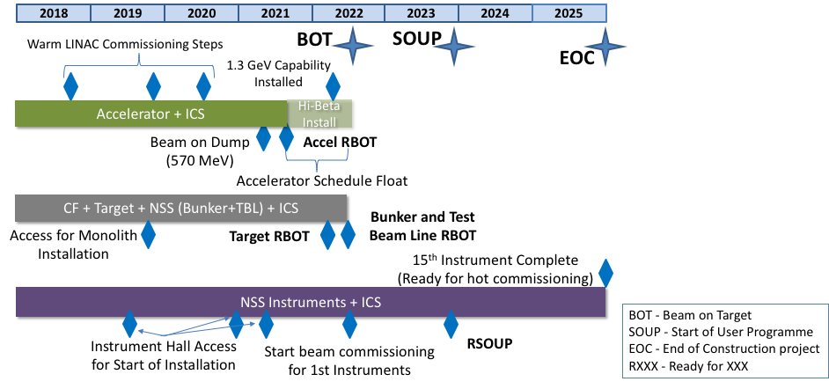
Staged Licensing process enables operation according to commissioning stages
Normal Conducting
Linac Permit
Cold Linac Permit
Ion Source & LEBT Permit
Licensing Approved
Regulator review of license request
Beam on Target Permit

Slide 8
In-Kind Deliveries that are on or within 40 days of the Critical Path
Critical Path to Target RBOT, which has three months float to BOT
Monolith vessel - ESS Bilbao
Assembled Target Wheel - ESS Bilbao
Proton Beam Window - ESS Bilbao
Note that delivery of the Monolith Port Blocks, which is being self-performed by ESS-Lund, is near critical path
Critical Path to Accelerator RBOT, which has 14 11 months float to BOT
RF distribution systems and DTL klystrons - ESS Bilbao
Spoke cavities/cryomodules and cryo-distribution system + controls for all cryo-distribution - IPNO
Spoke RF equipment - Elettra and INFN
Med Beta cryomodules - CEA because of LASA-INFN
High Beta cryomodules - CEA because of STFC
Elliptical CM cryo-distribution system - Wroclaw UT
DTL - INFN
RFQ - CEA
Red indicates recent changes to list
This list represents only 10 of 226 In-Kind packages;
> 95% of deliveries are expected to be at ESS when needed

Slide 9
Working to Mitigate Top Project Risks
Risk: IKC delivery delays could threaten critical path
Mitigation:
Frequent interactions at various levels with partner institute’s management and governance to raise visibility and seek solutions
Reporting at Monthly integrated Project Review Meetings to raise ESS management awareness
Highlighting at Technical Board and Collaboration Board Meetings with partner institutes - peer pressure
Highlighting highest risk items at Governance Meetings (IKRC, AFC, Council) to seek help from “owners”
Risk: Installation delays due to lack of readiness to perform work
Mitigation:
Hired ESS installation Manager to coordinate work and establish processes
Hired installation coordinators for all sub-projects, and other key support positions
Awarding framework contracts to access mechanical and electrical installation suppliers
Established new sub-project to perform accelerator and ICS infrastructure design, procurement, and installation work

Slide 10
High-level Project goals for 2019
Secure license for Warm Linac commissioning
Accelerator, ICS, and Infrastructure
IK partners deliver RFQ, MEBT, and DTL1
Complete Accelerator & ICS infrastructure installation for warm linac
Start commissioning from Ion Source through DTL1
CF, Target, and Instruments
Achieve Access to Target Building and E-Buildings
IK partners deliver Tuning Beam Dump, Moderator and Reflector Plug, and Monolith Vessel
Begin installation of Target Monolith and Instrument components
Incorporate detailed plans for all early instruments, including resource-loading for installation
Manage cost and schedule to ensure project success - focus on “first science” goal
Achieve balance between available contingency and estimated contingency needed
Maintain BOT milestone in 2022 and Early Science & SOUP milestones in 2023

Slide 11
Concluding Remarks
Project is 57% complete
Critical civil construction progressing as planned - Target Building design ramping-down
Commissioning Ion source and LEBT and three cryo-plants
Estimate at Completion projection essentially unchanged since May 2018 Re-Baseline
However, concern that contingency is only 39 M€ more than forecast increases has led us to kick-off new cost reduction, staffing plan, and risk analysis efforts
Baseline plan implemented
Holding zero-schedule float BOT and SOUP milestones so far
Concerned about multiple in-kind deliveries on or near critical path - highlighting these with governance bodies to support issue resolution

