Slide 1
The Bunker Project
Overview
Zvonko Lazic
www.europeanspallationsource.se
February 2019

Slide 2
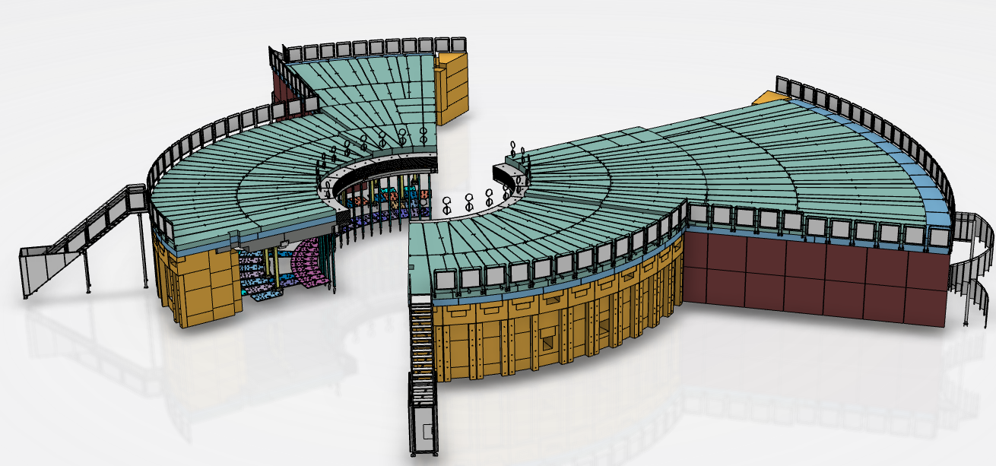
The bunker - content
Project overview
Production status

Slide 3
The Bunker - Overview
Contract signed Dec. ‘18
Production design phase ends 30.Apr. ‘19
Production commences upon ESS approval of the design phase completion.
First components arriving toward the end of ’19.
Shielding blocks scheduled to be delivered following ESS integrated installation schedule.

Slide 4
The Bunker - Overview
CDR 2.0 (2018)
Bulk material changed from steel/HDPE laminate to heavy concrete
Zoning requirements changed
Seismic requirement changed
Neutronics redone and released

Slide 5
The Bunker - Overview
Milestone | Date
Document fire safety requirements | March 2018 ✓
Agree & document seismic requirements | February 2018 ✓
Complete requirements | March 2018 ✓
Complete Value Engineering | August 2018✓
Release manufacturing tender | July 2018✓
Complete mechanical design | September 2018✓
Critical Design Review | October 2018✓
Award manufacturing contract | December 2018✓
Ready to start assembly of bunker (R6) | October 2019
Credit: Sofie O.

Slide 6
The Bunker - Tender
ESS scope
Tendering requirements
Supplier’ scope:
Concept design evaluation (done)
Detailed design (in progress)
Design validation where required (internal reinforcement, lifting features,…)
Manufacture
FATs
Delivery to site
Installation oversight
SATs oversight
Design life requirements
Delivery schedule
QC requirements
Concept design
Manufacturing QC oversight
Interfaces definition
Installation
Open book, collaborative contract
Notes:
Explain better design deliverables (what is it we have defined and what is it contractor will deliver)

Slide 7
Contract award
Mirrotron
Chief engineer
QA team
QA
QA
Chief engineer
Chief engineer
Partner Ltd
[pre-form concrete]
Csomiép-Enter Ltd
[steel structure]

Slide 8
Project realisation
Transport
Mirrotron chief eng.
Production
Installation controller
Blocks design for manufacturing
[Partner Ltd]
Steel structure
Wall blocks
Frame design for manufacturing [Csomiép-Enter Ltd]
Roof blocks
Installation Manager
Design approval
QA
Installation
Manufacturing QC & FATs
Acceptance tests
Contractor
ESS

Slide 9
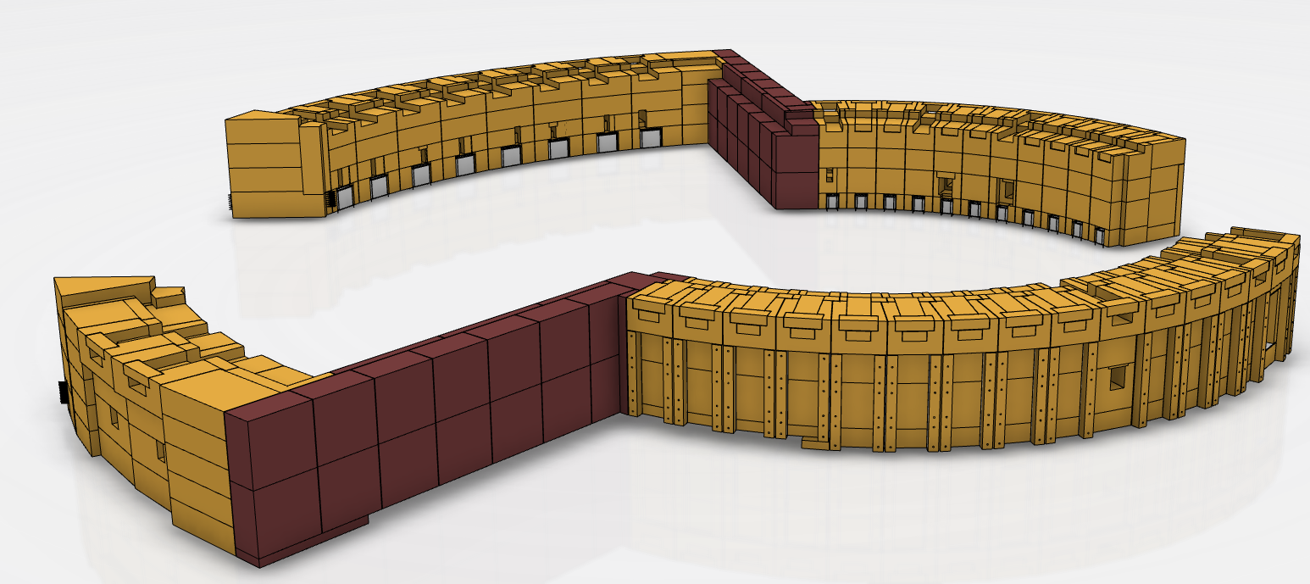
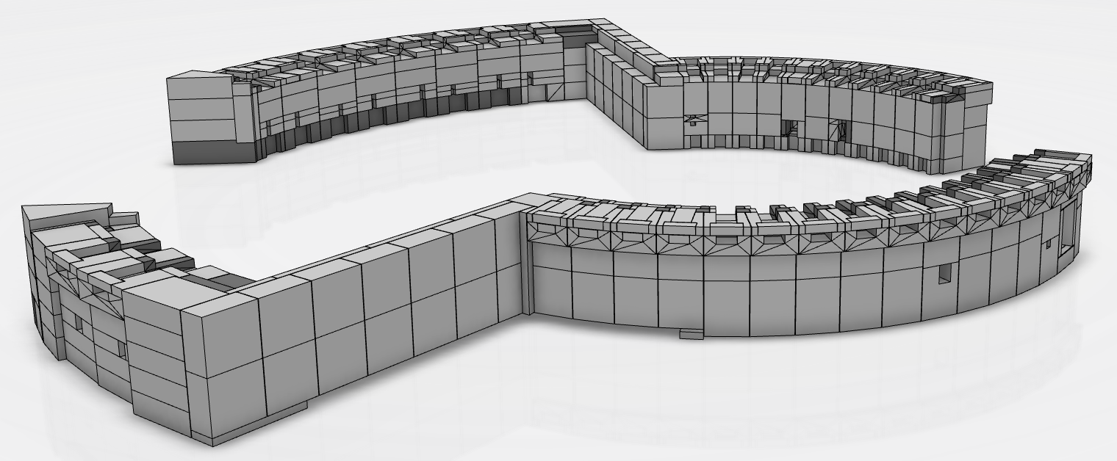
The bunker – Design status
We supply models to the manufacturer.
The manufacturer imports the files and “productionalises” the design.
The manufacturer sends back their resulting design for check and approval.

Slide 10
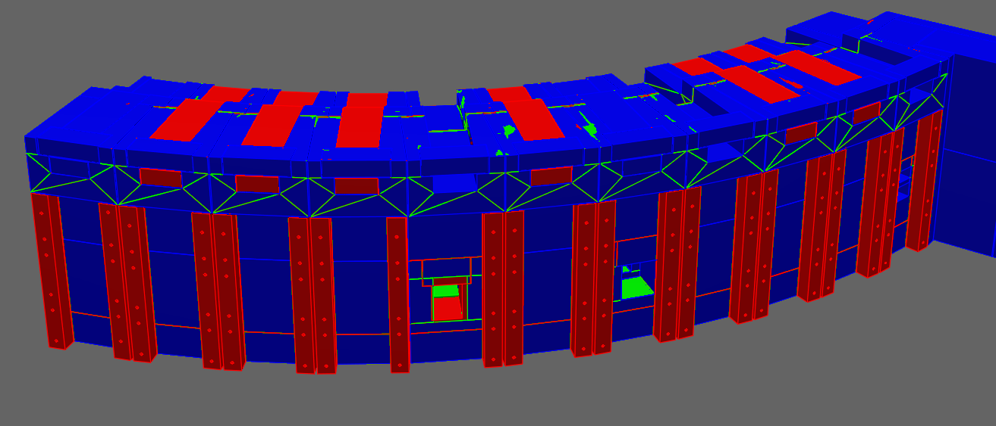
The bunker – Design status
We review the production design, give feedback and request iteration(s) when needed.
For example, the image below is an illustration of one of the iteration requests: “Downstream pillars are missing for north, west and east sectors (shown in red). Please update in accordance with the model provided 31st of January” (credit Dawid P.)

Slide 11
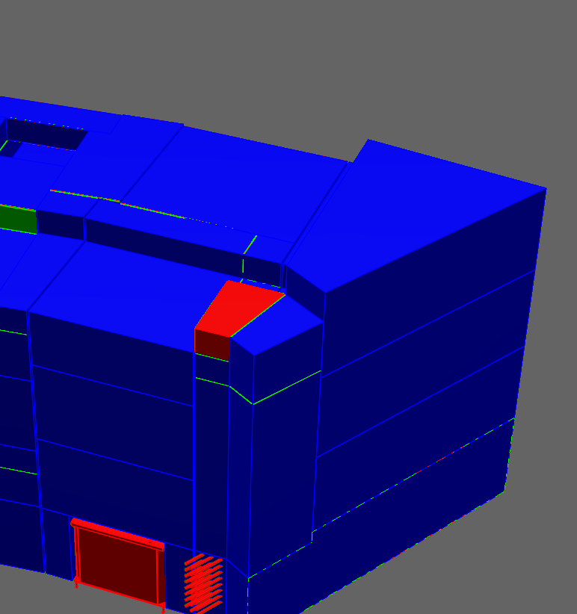
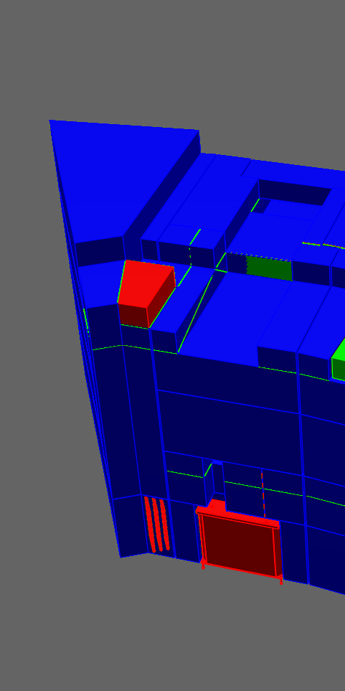
The bunker – Design status
We review the production design, give feedback and request iteration(s) when needed.
For example, the images here are an illustration of one of the iteration requests: “As described in the presentation uploaded on the confluence page (The Bunker Project design input v 1.0), corners at the CF walls must be redesigned so interfaces between wall and roof in these areas are correct. Please see The Bunker Project design input v 1.0.” (credit Dawid P.)

Slide 12
The Bunker - outlook
Outlook
Production process (initial production detailed design) is progressing well.
Documentation is being rounded up
  Hazard analysis is being completed, this will feed into PSS solutions, fire protection, etc..

Slide 13
The Bunker Overview
Q/A
End of presentation
Q/A

