Slide 1
Common Shielding Project
Status following PDR
IKON-16
Lund, 11th of February 2019
Ken Andersen, Zvonko Lazic, Senad Kudumovic, Phil Bentley

Slide 2
Scope of proposal in April 2018
Offer: guide shielding for long and medium instruments
  from bunker to cave
  include shielding around choppers
  Include all long instruments (West sector)
  No short instruments: LOKI, FREIA, ESTIA
    strongly integrated with neighbouring beamlines
  Include medium instruments: ODIN, DREAM, VESPA, SKADI
Use engineering resources from bunker team
Use whatever neutronics resources we can get our hands on
  Mainly from instruments which have signed up
8 instruments signed up:
  Long instruments: CSPEC, BIFROST, MAGIC, T-REX, HEIMDAL
  Medium instruments: ODIN, DREAM, VESPA

Slide 3
Scope of Phase 1 Project
December 2018:
  mechanical design completed
    Instrument-specific solutions
    analysis of compatibility with logistics
    3D model
    integration drawing(s)
  preliminary neutronics calculations completed
    validating and driving mechanical design
    reports issued
  cost offer for each instrument
  manufacturing and purchasing strategy agreed
January 2019: Preliminary Design Review

Slide 4
Priorities for Guide Shielding
1. Shielding performance
  Reaching 3 µSv/hr
2. Activation
  Choose standard components, so they count as spare parts, not waste
  Apply ALARA for decommissioning
  Maintenance access within 24 hours
3. Instrument background
  Primarily addressed by cave design
  Long distance (60-170m) also helps: chopper pits act as expansion zones
  Boron-rich inner layer reduces albedo back-shine
Expected outcome: cost-effective solution which instruments will choose to sign up to
Modular design: inner steel layer + outer concrete layer
  Shrink to minimise cost
  High degree of standardisation
  Vary steel and concrete thickness as required

Slide 5
Phase 1 Project Organisation
Ken Andersen
Project Sponsor
Zvonko Lazic
Project Manager
Phillip Bentley
Physics Lead
Mark Ridgley
Systems Documentation
Senad Kudumovic
Design Engineer
Tsito Randriamalala
Ext. Neutronics
Rodion Kolevatov
Ext. Neutronics
Valentina Santoro
Neutronics
Nataliia Cherkashyna
Neutronics
Damian Martin Rodriguez
Neutronics
Florian Grünauer
Ext. Neutronics
Giuseppe Scionti
Ext. Neutronics
Uwe Filges
Ext. Neutronics
Gabor Laszlo
Engineering Advisor

Slide 6
Phase 1 Project Organisation
Ken Andersen
Project Sponsor
Zvonko Lazic
Project Manager
Phillip Bentley
Physics Lead
Mark Ridgley
Systems Documentation
Senad Kudumovic
Design Engineer
Tsito Randriamalala
Ext. Neutronics
Rodion Kolevatov
Ext. Neutronics
Valentina Santoro
Neutronics
Nataliia Cherkashyna
Neutronics
Damian Martin Rodriguez
Neutronics
Florian Grünauer
Ext. Neutronics
Giuseppe Scionti
Ext. Neutronics
Uwe Filges
Ext. Neutronics
Gabor Laszlo
Engineering Advisor
Phase 1 Project Budget: 150k€
Instrument Contributions
10k€ each
DREAM & T-REX
BIFROST & HEIMDAL
ODIN & CSPEC
MAGIC
VESPA

Slide 7
What happened in Phase 1?
2018 | April | May | June | July | August | Sep. | Oct. | Nov. | Dec.
Proposal Development
ICB10 Meeting
Sign-up
Preparation
Project kick-off
Engineering design
Neutronics workshop
Neutronics start
Neutronics work
Design work complete
Costing & documentation
Project completion
Agreed work-flow
  Weekly minuted meetings for progress update and sharing of tasks
  Documentation written as work progressed and shared on-line
Work progressed according to schedule

Slide 8
Neutronics Work
Guides: within/outside line-of-sight
Chopper pits: within/outside line-of-sight

Slide 9
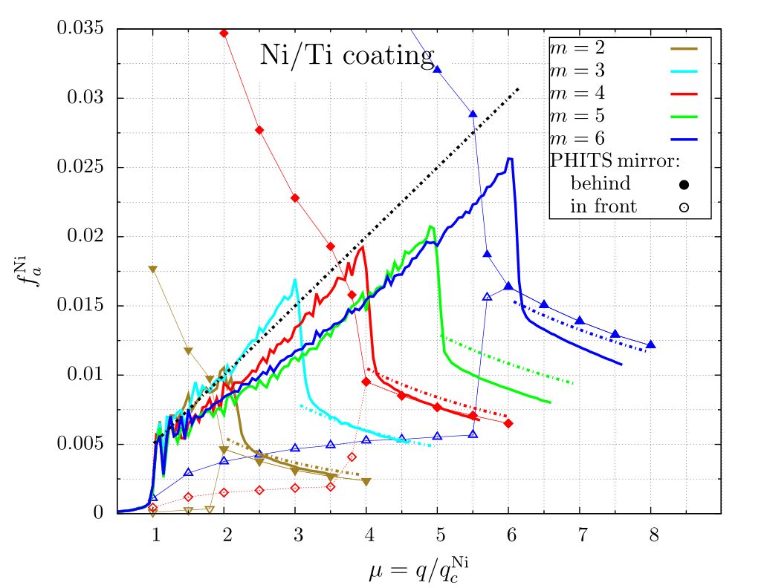
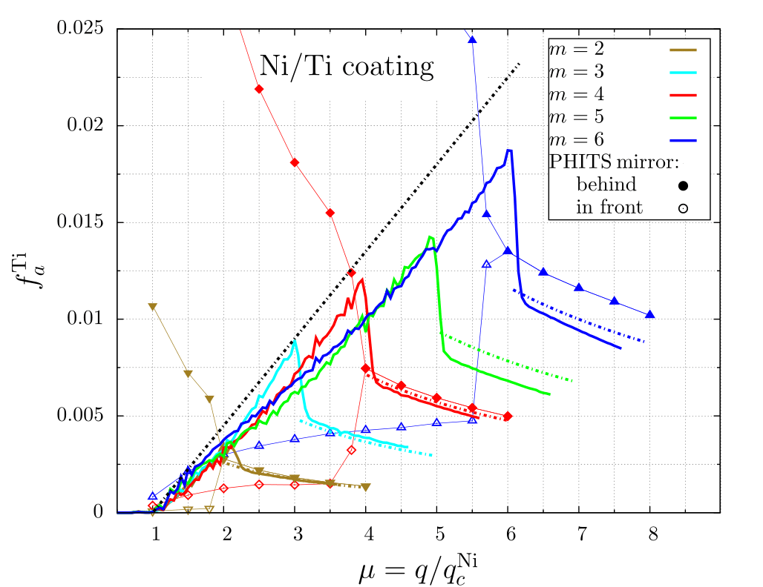
Neutronics Work
Guides: within/outside line-of-sight
Chopper pits: within/outside line-of-sight
Outside line-of-sight:
(Rodion Kolevatov)

Slide 10
Neutronics Work
Guides: within/outside line-of-sight
Chopper pits: within/outside line-of-sight
Within line-of-sight:
(ODIN, Florian Grünauer)

Slide 11
Neutronics Work
Guides: within/outside line-of-sight
Chopper pits: within/outside line-of-sight
Within line-of-sight:
(DREAM, Tsito Randriamalala)

Slide 12
Neutronics Work
Guides: within/outside line-of-sight
Chopper pits: within/outside line-of-sight
In each case, extract required materials thicknesses

Slide 13
Neutronics Work
 |  | 30 | 40 | 60 | 80 | 100 | 120 | 140 | 150 | 160
CSPEC | B₄C cement steel concrete | 2 10 75 | 2 10 75 | 2 10 75 | 2 10 50 | 2 10 50 | 2 10 50 | 2 10 60 | 2 10 60 | 2 10 100
BIFROST | B₄C cement steel concrete | 2 10 65 | 2 10 50 | 2 10 40 | 2 10 40 | 2 10 40 | 2 10 40 | 2 10 40 | 2 10 40 | 2 0 110
MAGIC | B₄C cement steel concrete | 2 10 50 | 2 10 50 | 2 10 50 | 2 20 80 | 2 0 50 | 2 0 50 | 2 0 50 | 2 0 50 | 2 0 50
T-REX | B₄C cement Steel B₄C cement concrete | 2 10 2 60 | 2 10 2 60 | 2 10 2 60 | 2 10 0 50 | 2 10 0 50 | 2 10 0 50 | 2 10 0 50 | 2 10 0 50 | 2 10 0 80
DREAM | B₄C cement Steel B₄C cement concrete | 2 10 2 60 | 2 10 2 60 | 2 10 2 60 | 2 10 0 60

Slide 14
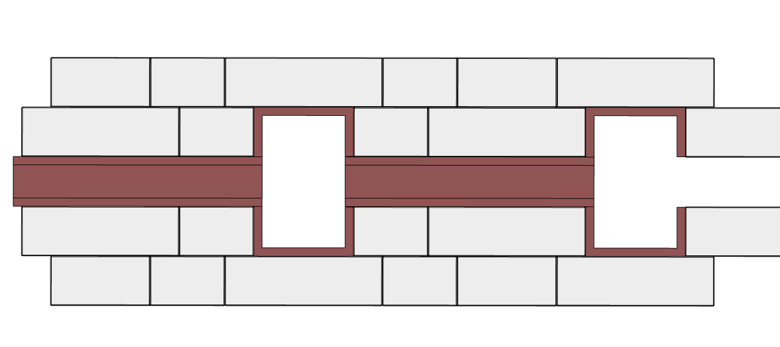
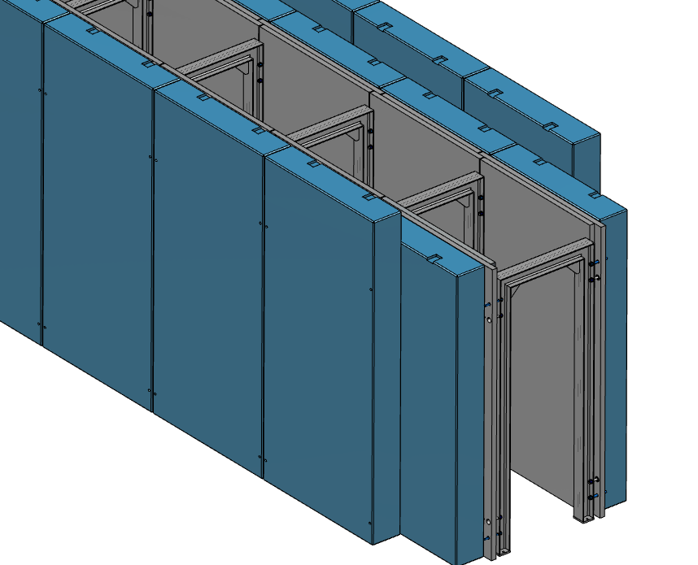
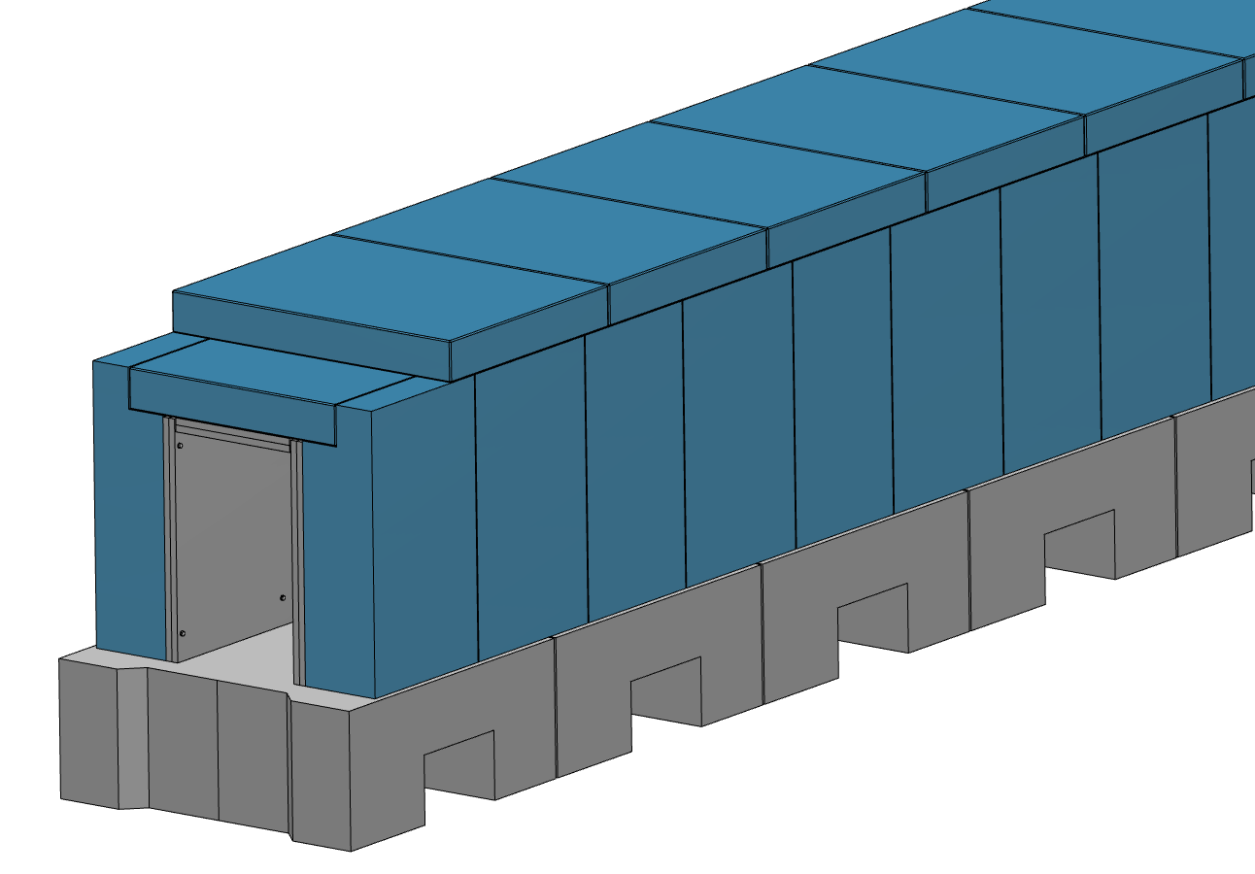
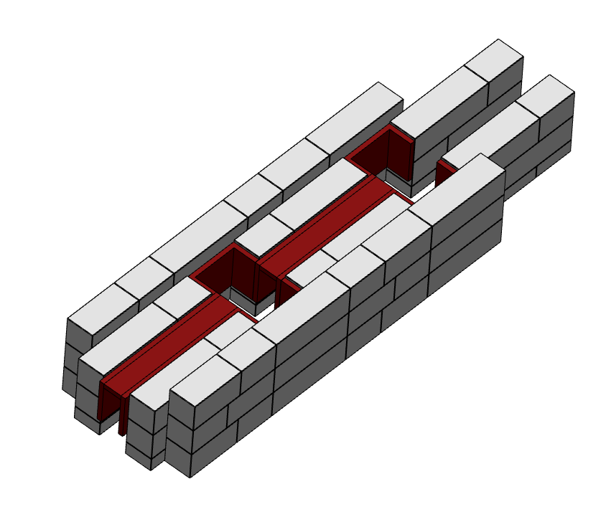
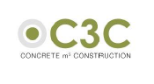
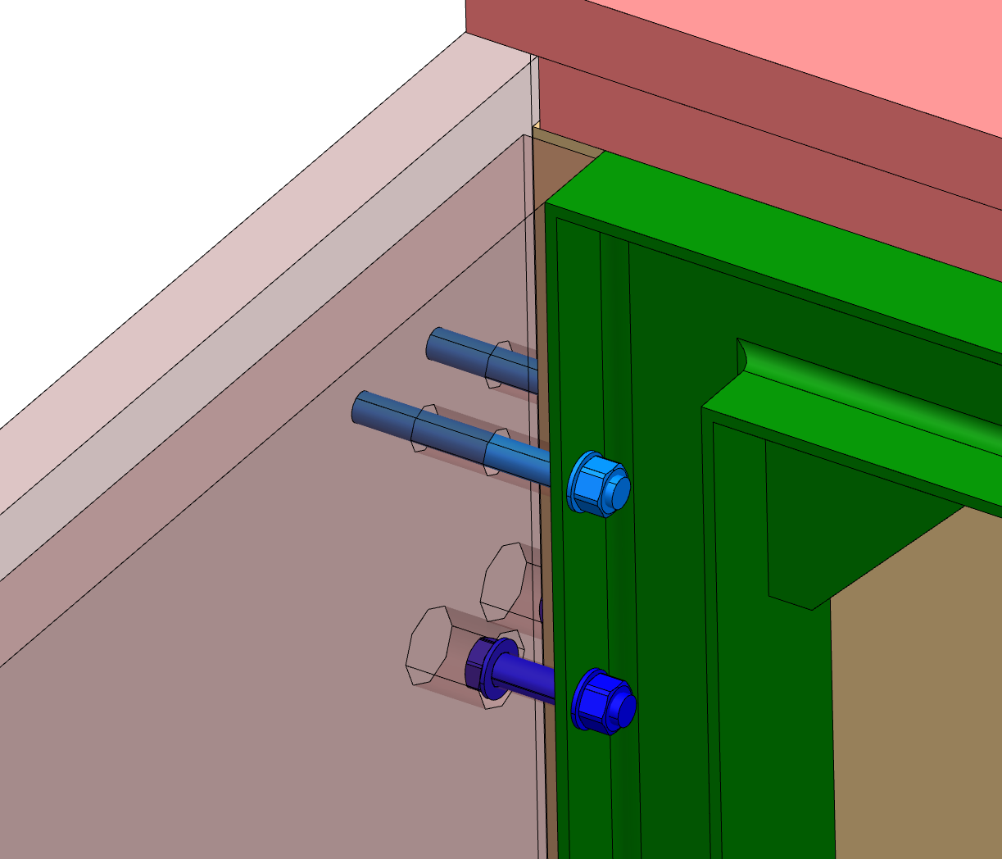
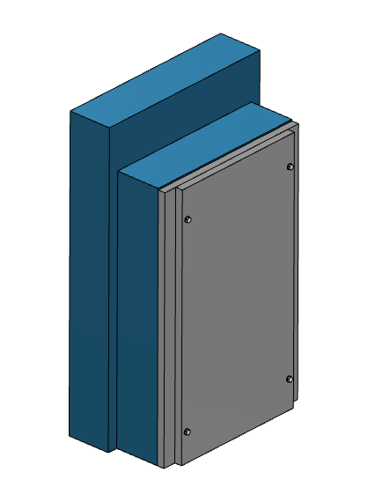
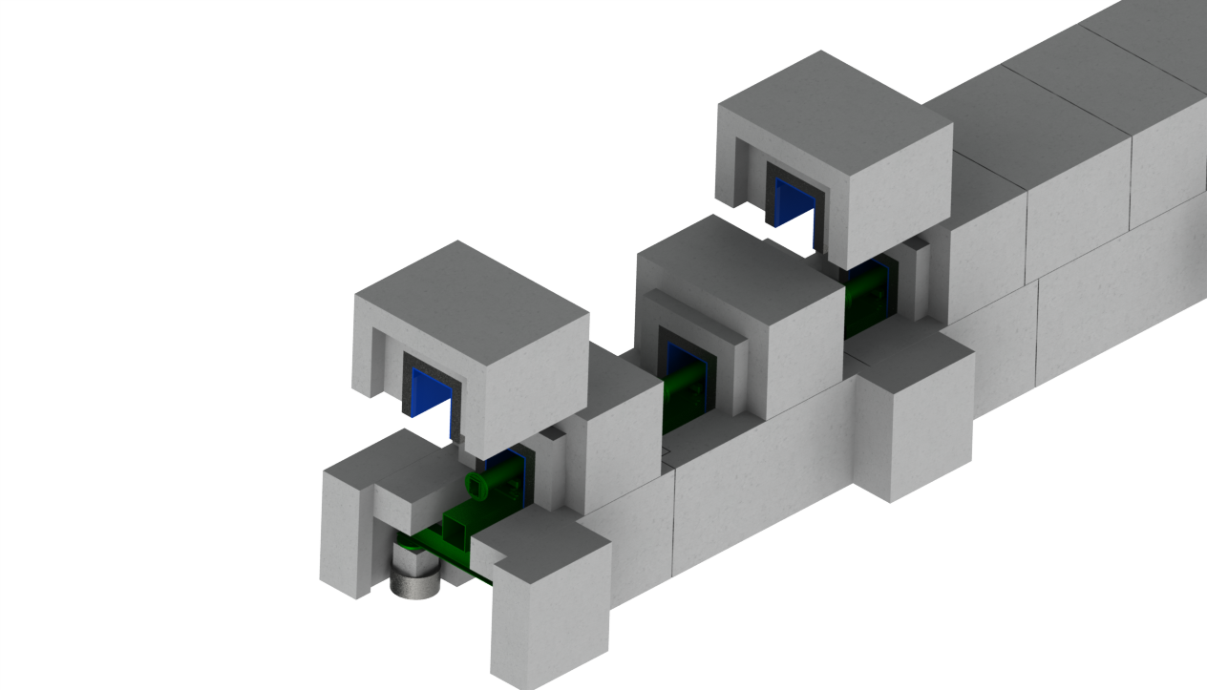
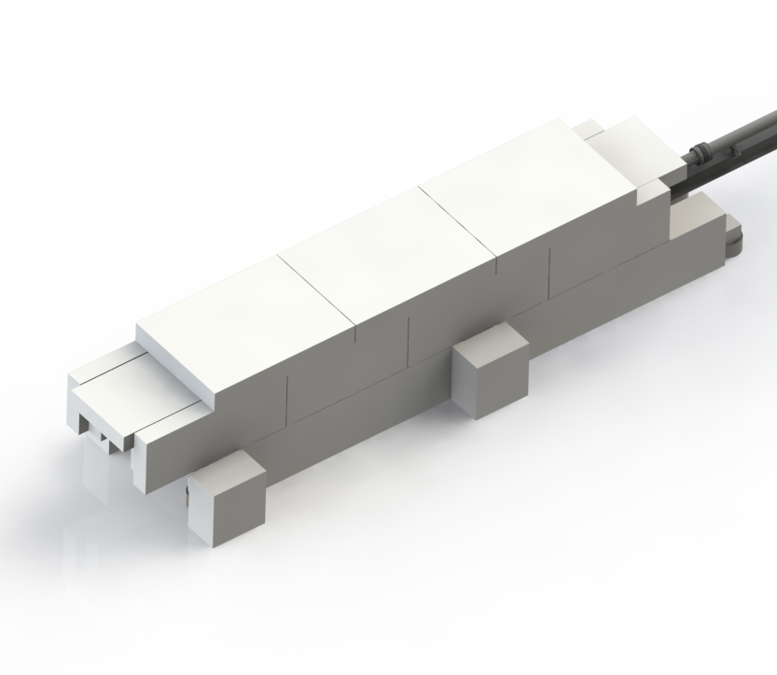
Shielding Evolution
Concept 1
Concept 2
Concept 3
Current Concept
Concept 4

Slide 15
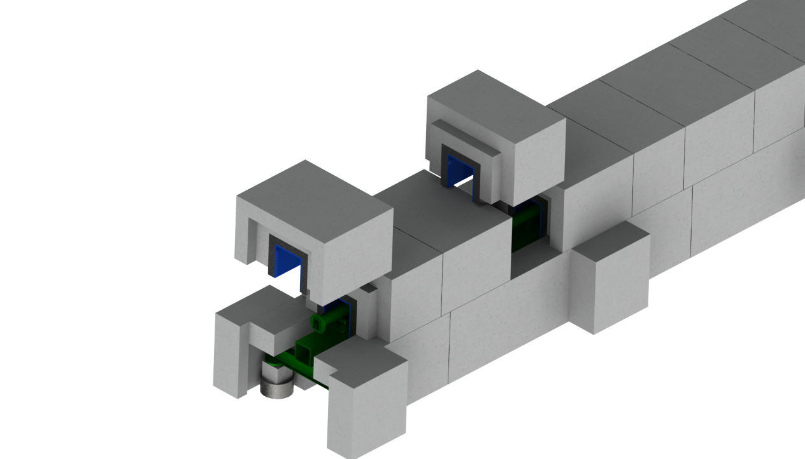
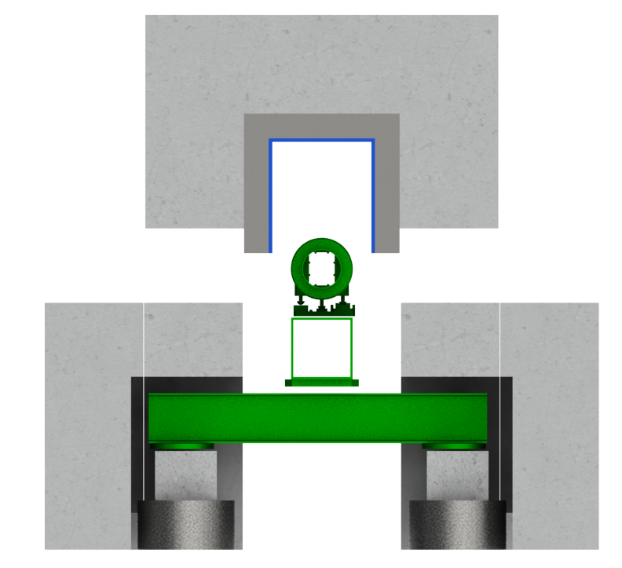
Structural/Construction
Designed to be installed / maintained
Shielding close to the instrument guide
Load effect minimisation
Lower shielding is static (not removed for maintenance)
Minimising load removal effects on miss/re/alignment

Slide 16
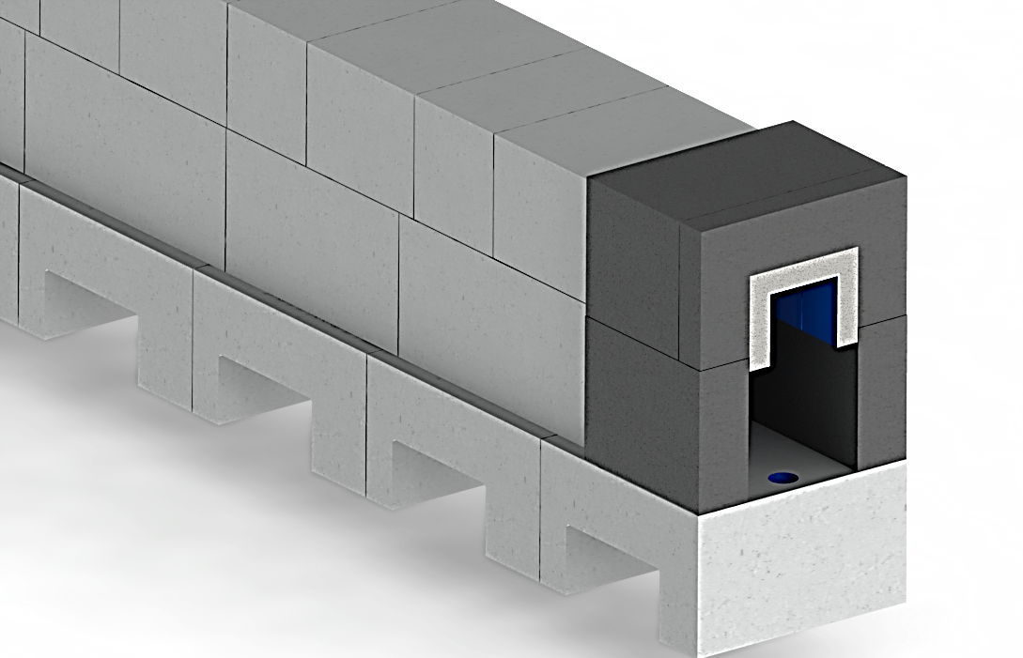
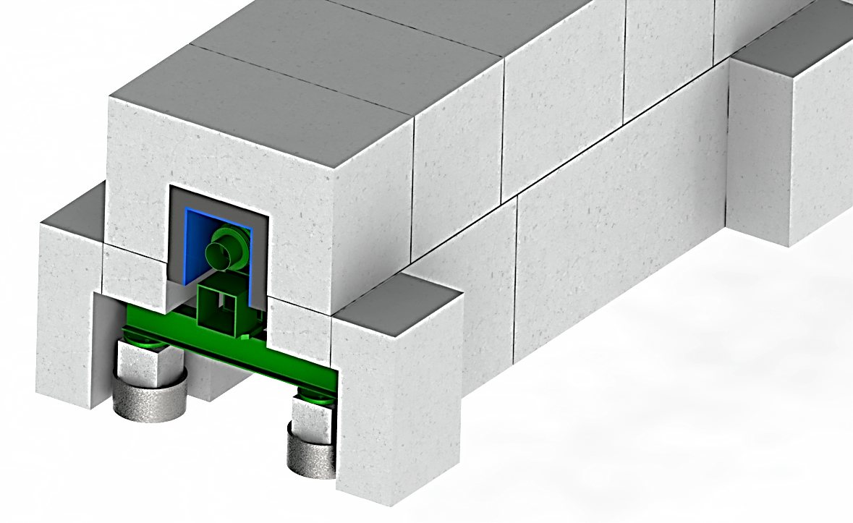
Structural/Construction
D01/D03 vs E02
E02
1 m
D01/D03
Identical upper shielding blocks in D01/D03 and E02
Similar lower shielding blocks in D01/D03 and E02
E02
D01/D03

Slide 17
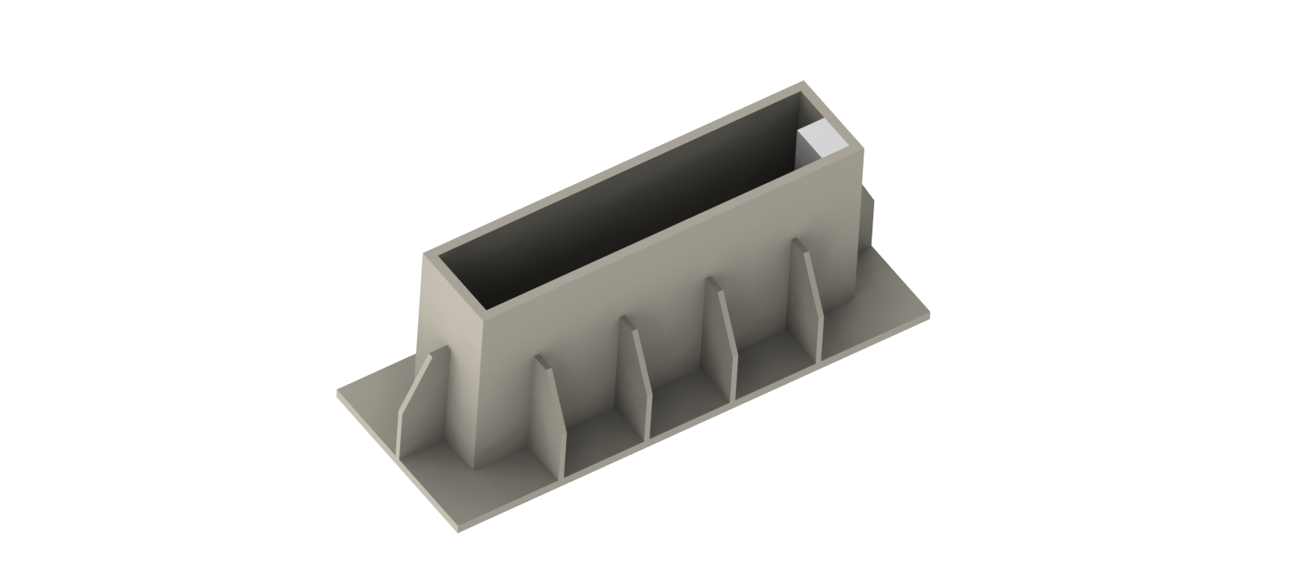
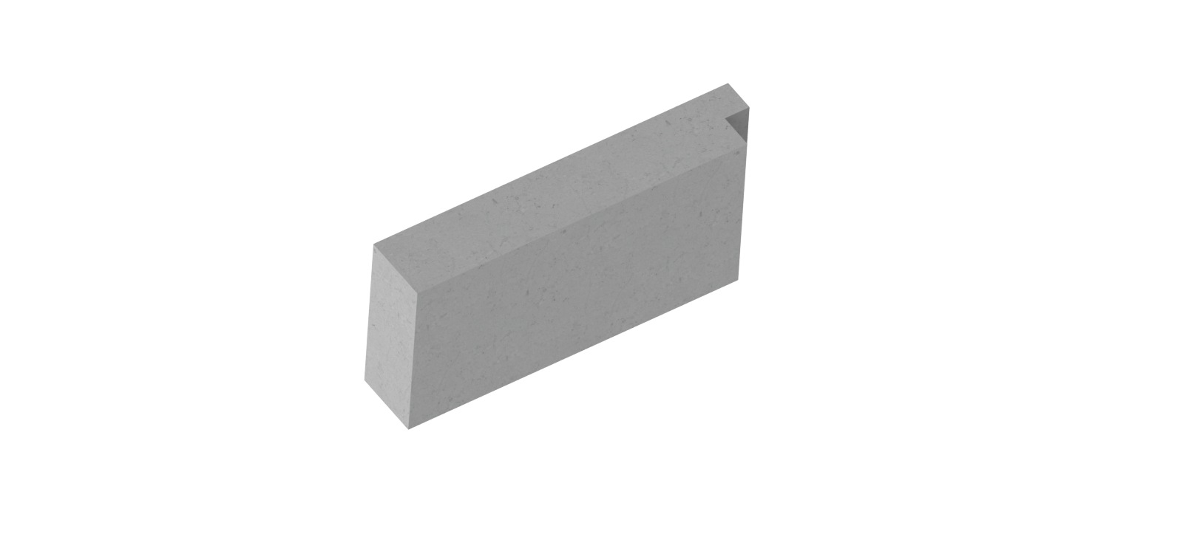
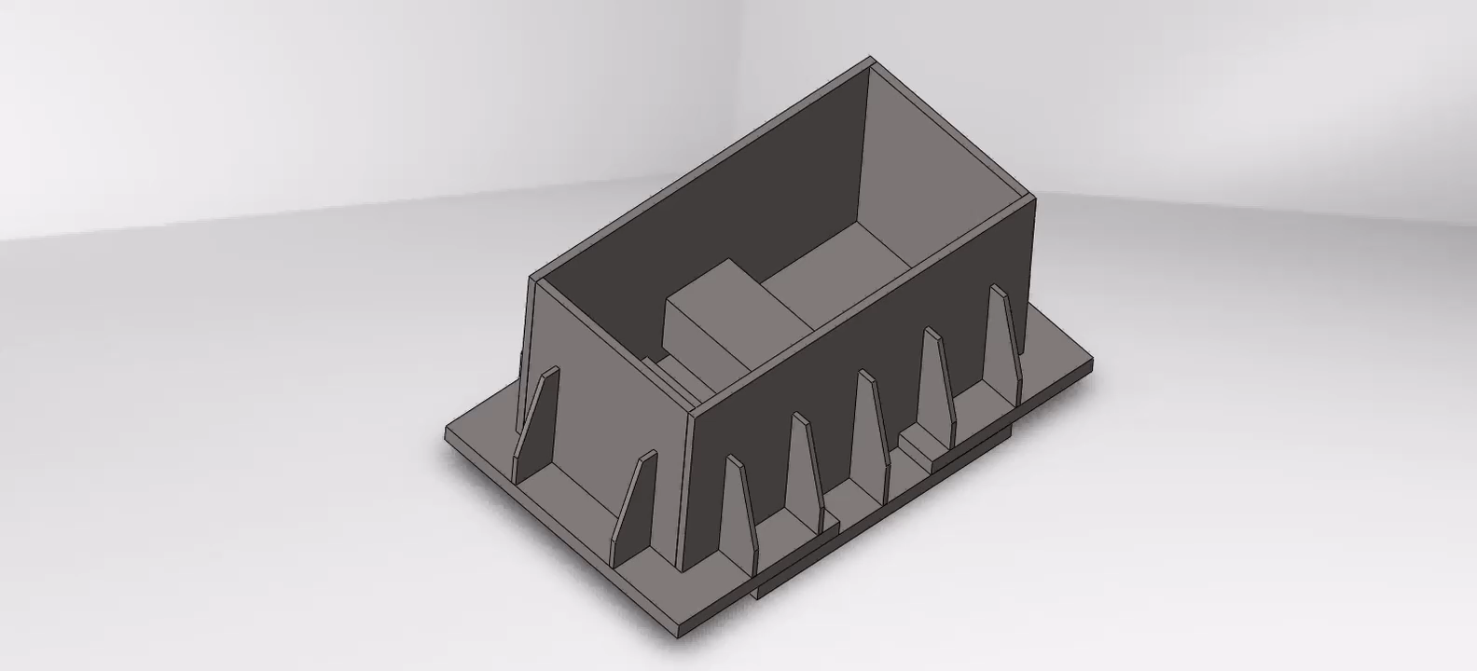
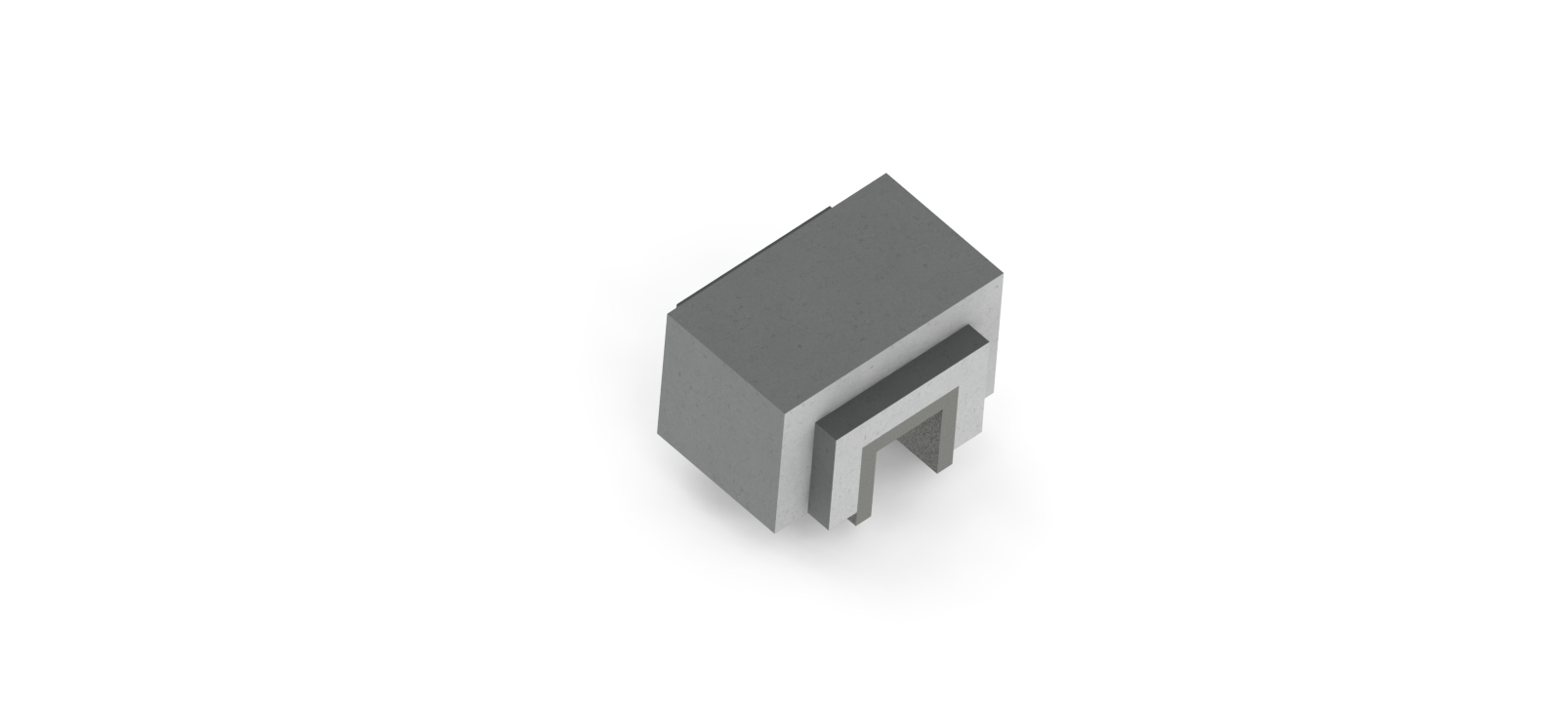
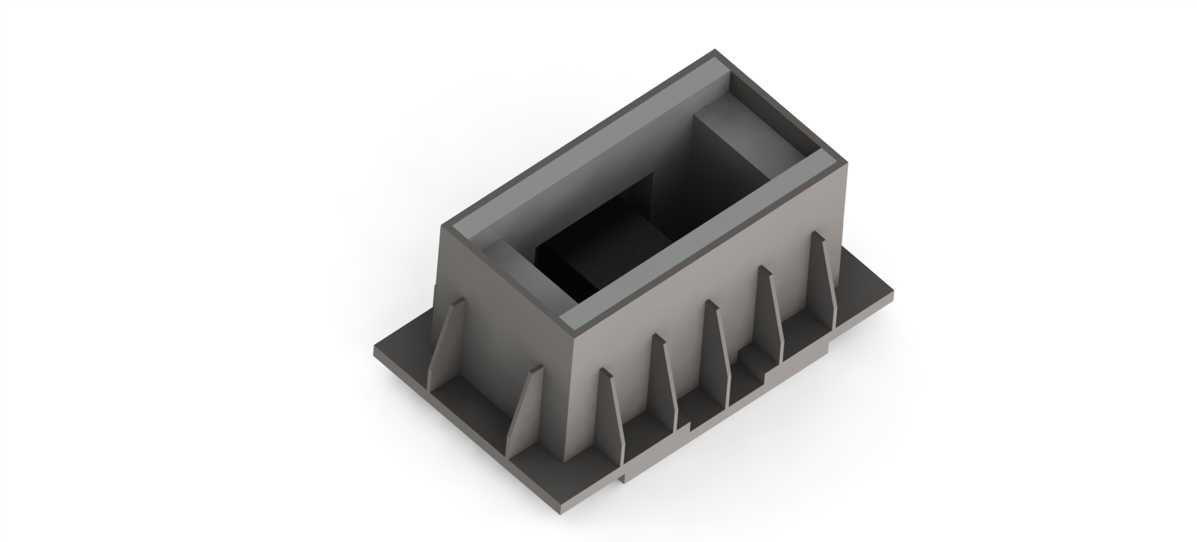

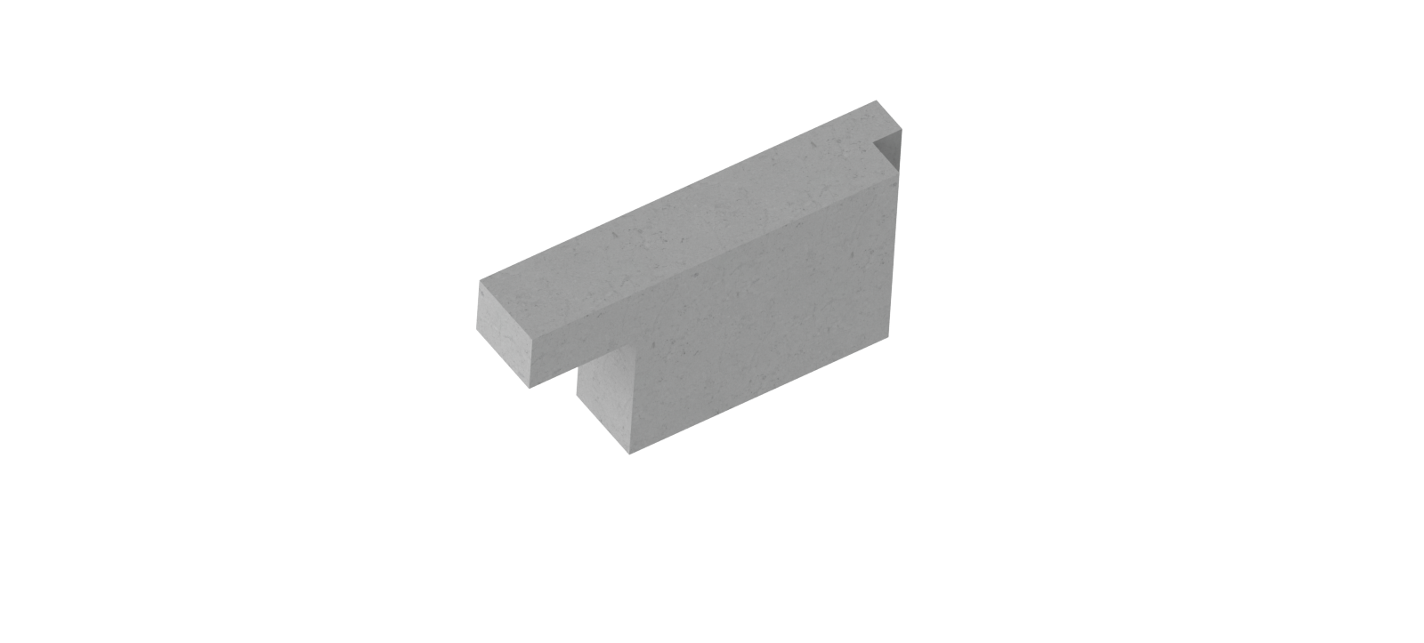
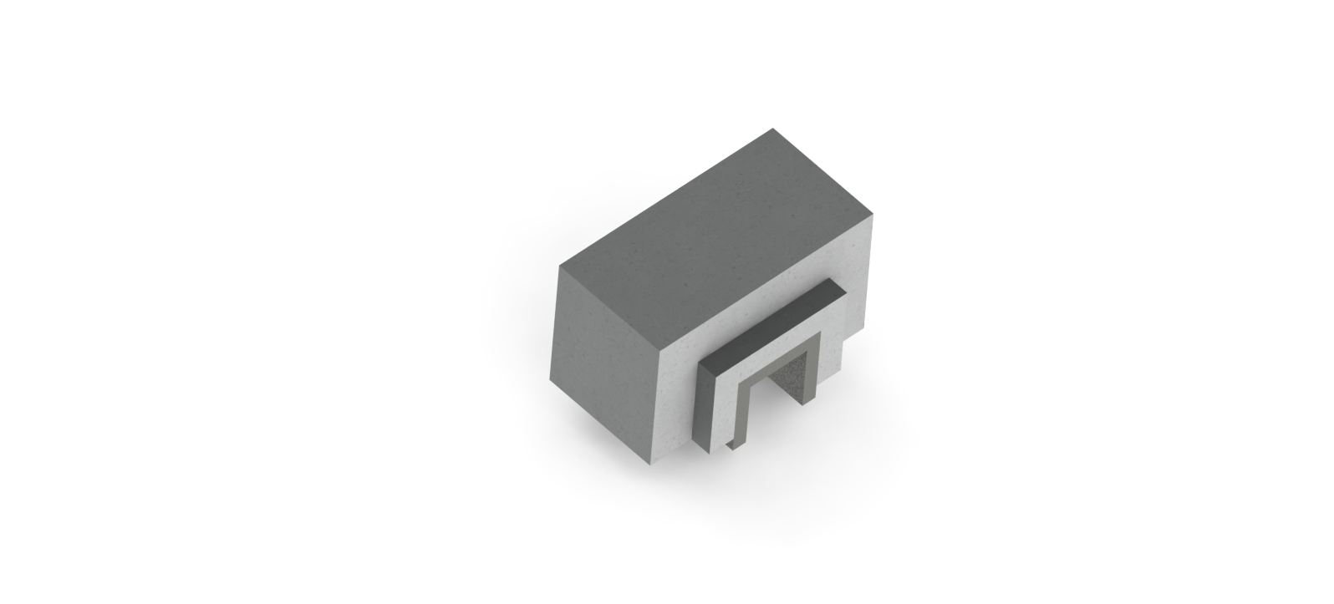

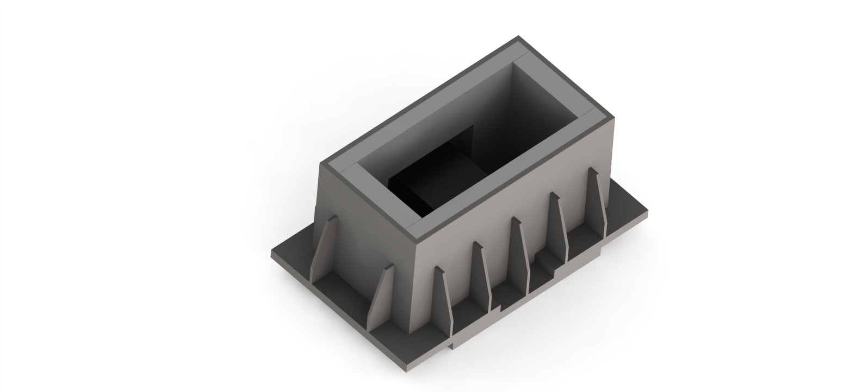
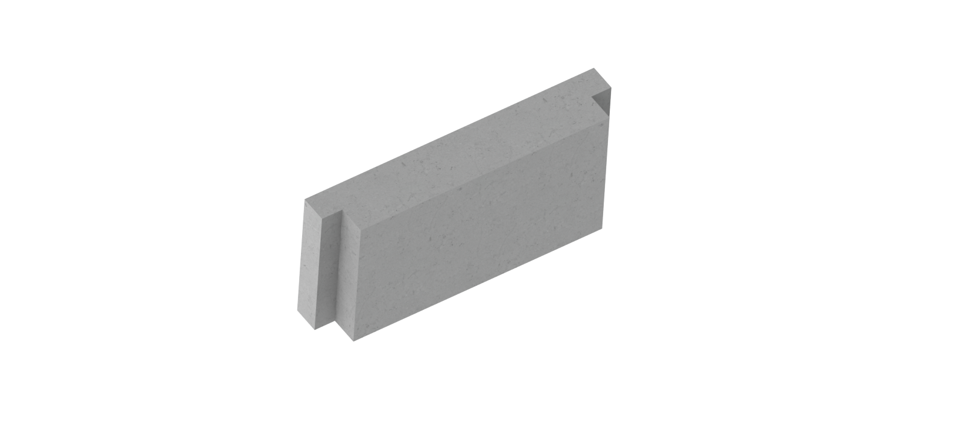
Structural/Construction
Same formwork – different blocks

Slide 18
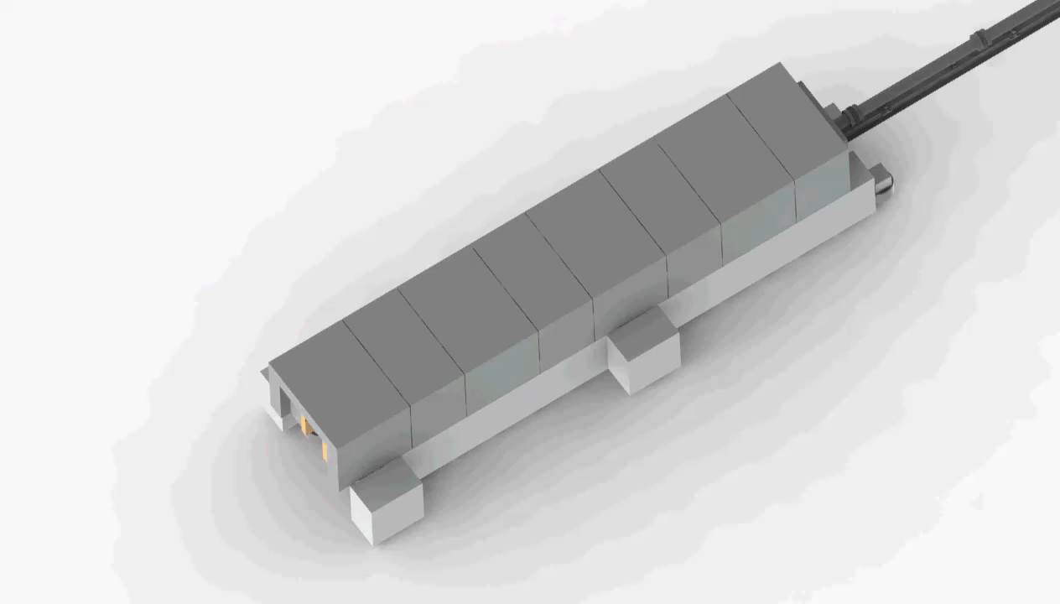
Survey and Alignment E02
Lifting optimisation
Blocks designed so as to place ”pocket” blocks in line with the piles
only ONE lift needed to access alignment features
”extrude” block
”pocket” block

Slide 19
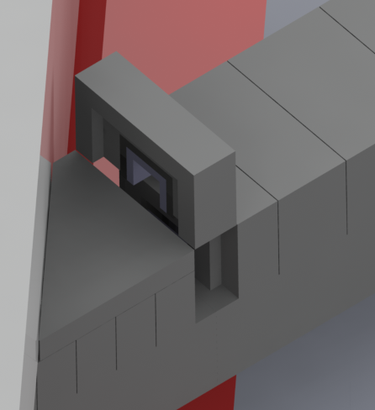

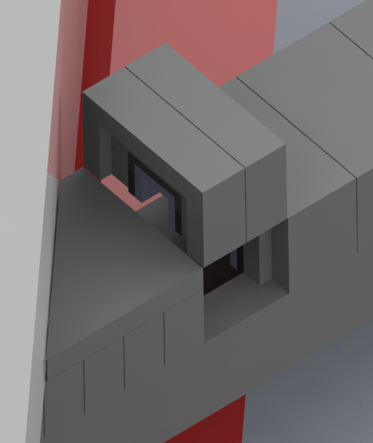

Survey and Alignment D01/D03 – E02
Lifting optimisation
Blocks designed so as to place ”pocket” blocks in line with the piles
only ONE lift needed to access alignment features
”pocket” block
”extrude-pocket” block

Slide 20
Preliminary Design Review 24/01/2019
Review Committee: Masa Arai (chair), Sigrid Kozielski/Ricardo Bevilacqua, Daniel Lyngh, Luca Zanini, Fabien Rey, Iain Sutton
System requirements
System verification plan
Preliminary design report
Risk Analysis
Conceptual shielding designs
  Guide shielding in D01/D03
  Guide shielding E02
  Chopper pits
Neutronics reports
  Within line-of-sight: DREAM and T-REX, T. Randriamalala
  Prompt gamma shielding, R. Kolevatov
  ODIN shielding, F. Grünauer
  BIFROST up to 35m, R. Kolevatov
  HEIMDAL, R. Kolevatov
Information given in presentations
  Answers to questions

Slide 21
Main Issues Identified at PDR
Interfaces at CF wall and instrument cave: include installation and maintenance schemes
Ensure imposition of 4m guide sections is compatible with all instruments at the CF wall
Cost-effectiveness of steel+concrete compared to heavy concrete, steel and lead
Revisit mounting of optics D01/D03
  On support blocks or on floor
Floor loading
  We had misunderstood load limits in E02 provided by CF
Clarify scheme for recycling the shielding blocks
  Take instrument lifetime and new instruments into account
Clarify the cost estimates

Slide 22
Project Timeline
 | 2018 H1 | 2018 H2 | 2019 H1 | 2019 H2 | 2020 H1 | 2020 H2 | 2021 H1 | 2021 H2
Proposal Development
ICB10 Meeting
Concept Development
PDR
Detailed Design
IDR & TG3
Procurement
Contract Signature
Manufacturing
First Delivery
Installation
Phase 1
Phase 2: Instrument-specific
Register interest:
pay 10 k€ towards Phase 1
Decision point:
cost offer made
commit expenditure from instrument budget
Earliest possible start of installation

Slide 23
Price Offers
Fixed price offers are being made
  December 2018: ODIN, DREAM, CSPEC, BIFROST, T-REX
  MAGIC (February), HEIMDAL (March), VESPA (May)
  Agreement to include MIRACLES. Discussions starting
ESS will guarantee shielding performance
  Deficiencies to biological shielding will be fixed at no added cost to instruments
  ESS takes the risk on cost overruns and performance issues
Delivery options for discussion with instruments
  1. ESS will act as provider to instrument partner delivering shielding
  2. Guide shielding removed from costbook value of IK contribution
Discussions on-going with individual instruments
  Agreements in principle to be reached quickly
  TAs will be modified accordingly, if needed

Slide 24
What happens next
Finalise preliminary design and costing for MAGIC, HEIMDAL, VESPA
Get decisions from all instruments
  Exchange information and discuss terms and conditions
Establish prioritisation on installation timescale
  1. CSPEC, BIFROST, MAGIC
  2. DREAM, ODIN
  3. T-REX
  4. HEIMDAL
  5. VESPA
Establish detailed operational requirements
  Start with early instruments
  Modify design and costing if required
Agree on timescale for detailed design
  To be agreed individually with each instrument
  Establish dates for IDRs and sub-TG3s
Secure needed resources
  Engineering resources mostly secured
  Neutronics resourcing: use internal and external resourcing, following prioritisation

Slide 25
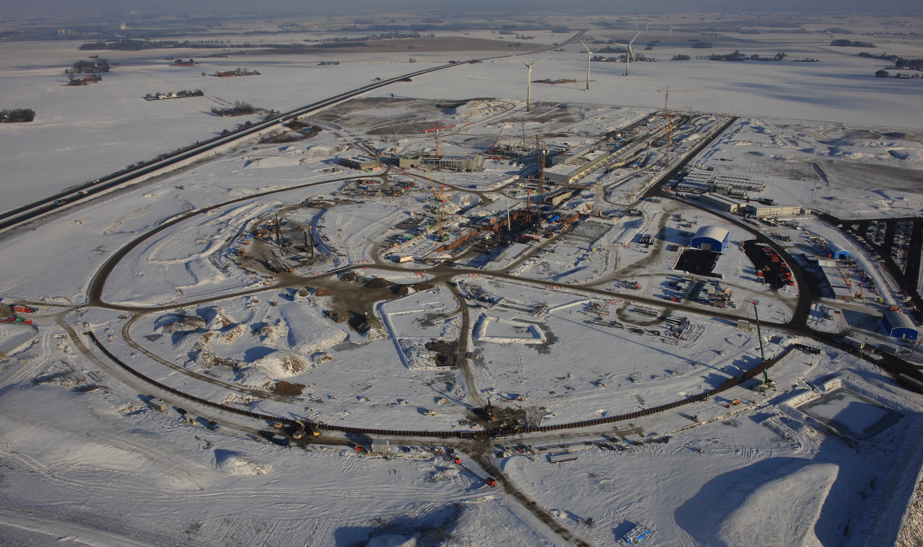
Thank you!
ESS site 2016
5th June 2015

Slide 26
Purchasing & Manufacturing plan
Stage I (tender publication):
Following publication of the tender, the supplier is selected.
The supplier and NSS enter the contract, based on open book, collaborative set-up (OBC).
The OBC ensures cost tracking, allows the latest changes to be implemented during the contractor’ manufacturing design stage.
Stage II (manufacturing design):
ESS provides design & manufacturing QA engineer.
The manufacturing takes place at contractor’ facility; the system components are produced and delivered according to ESS integrated schedule.
Stage III (installation):
NSS provides installation manager and installation resources (hardware and workforce).
The contractor provides the installation supervisor.
Following successful installation, with sign-off from both, the NSS installation manager and the contractor installation supervisor, the contract is closed.
Cold box arrival to ESS

Slide 27
Purchasing & Manufacturing plan
The project structure could look like this:
Supplier – manages ‘production office*’ (houses common shielding production project personnel, drafting personnel; calls for any ‘open book contract’ discussions)
*This office is responsible for ordering all materials, production of detailed drawings, managing logistics and assembly of individual blocks; manages delivery of completed components to the ESS site.
NSS Common Shielding office – oversees the drafting and production effort. Enables collaboration model to work (ensures communication is maintained, key milestones are reviewed, and calls for any discussions relating to managing the open book contract).

Slide 28
Costing
We have market prices for bulk materials, and for cutting/manufacturing cost.
  We have obtained bulk material pricing from the companies involved in current ESS projects,
  The steel bulk unit prices are obtained from a Norwegian and Danish steel suppliers.
    Median numbers are taken into calculation for the final sum.
Uncertainties include:
  Raw material utilization (especially for plate materials).
  Logistics cost.
  Installation model (NSS is responsible for securing installation resources. All available data is correct today, but changes are expected as the installation time approaches).
Cold box arrival to ESS

Slide 29
The Common Shielding Project - Tender
ESS scope
Tendering requirements
Supplier’ scope:
Concept design evaluation
Detailed design
Design validation where required (internal reinforcement, lifting features,…)
Manufacture
FATs
Delivery to site
Installation oversight
SATs oversight
Design life requirements
Delivery schedule
QC requirements
Concept design
Manufacturing QC oversight
Interfaces definition
Installation
Open book, collaborative contract
Notes:
Explain better design deliverables (what is it we have defined and what is it contractor will deliver)

Slide 30
Storyboard
The Common Shielding Project
Manufacture
Transportation
On Site Activities
Installation
Decommissioning
The Common Shielding Project tender has to be placed taking into account ESS installation schedule.
Being a large project (by volume), the plan is to stage the production and delivery in the order of the NSS need, as dictated by the ESS integrated schedule. For example, the first shielding blocks for the first instrument in line for installation will be delivered by mid-2020
Notes:
NBPI is under design CDR is not done yet so this storyboard is our plan during detailed design and might be subject to change as time progress
Decommissioning is for inserts/plugs, not the facility

Slide 31
Installation Schedules
T-REX, HEIMDAL, VESPA to be determined…

Slide 32
Manufacturing & Installation
Manufacture
Transportation
On Site Activities
Installation
Decommissioning
Design for manufacturing (detailing)
Transport
Production
Installation controller
E02.1 blocks
Design approval
E02.2 blocks
Installation Manager
D01/03 blocks
Installation
Manufacturing QC & FATs
Contractor
Acceptance tests
ESS

Slide 33
The Common Shielding Project Overview
Outlook
Mechanical Design – Conceptual design finalized
Physics – The first round of simulations, providing input for the conceptual design, has been completed
Documentation – PDR required documentation completed.
Purchasing/schedule – Following this PDR, we will prioritize work and schedule delivery of the final design(s) in the order of instrument installation priorities. Timing for the (first) CDR will be determined following the PDR and sign up (to the project) of a number of instruments.
Budget - Current cost estimates are on budget.

Slide 34
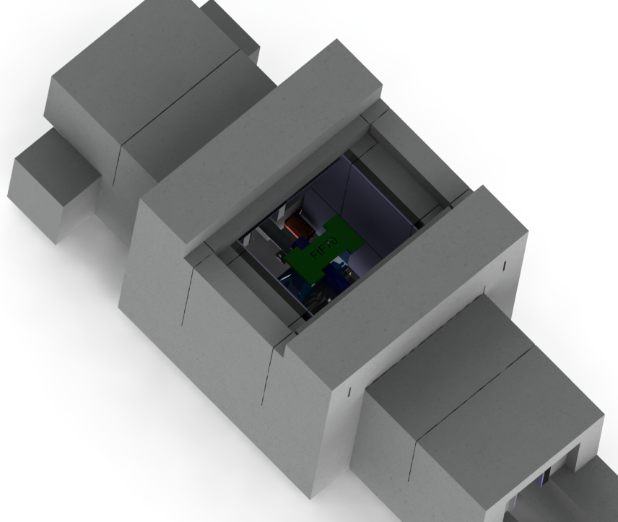
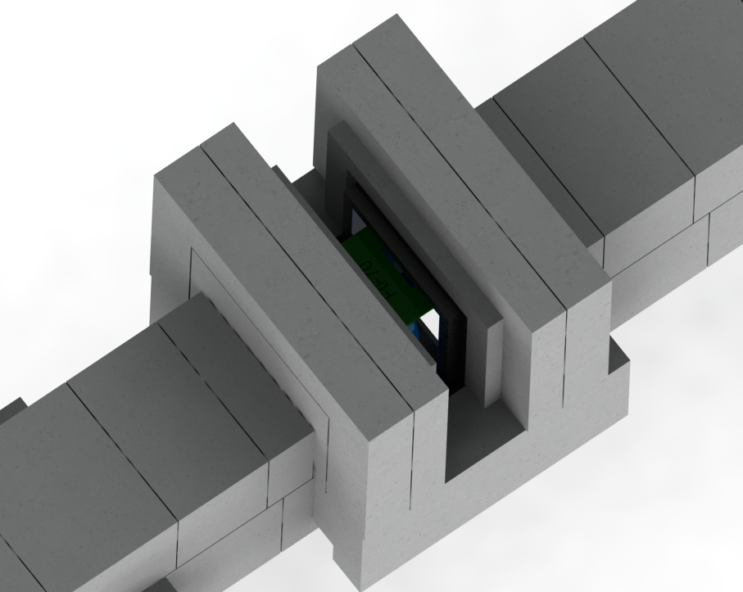
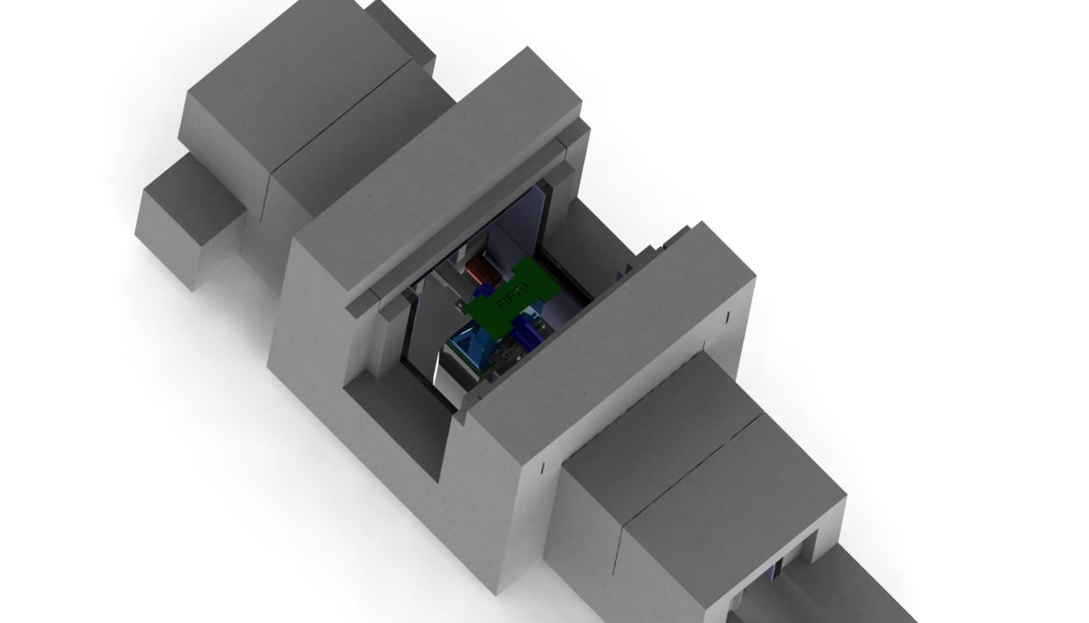
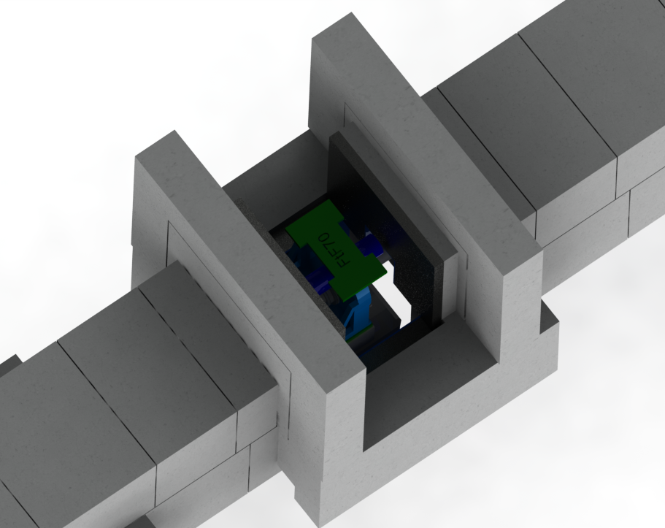
Structural/Construction: Chopper Pit
2 lifts for wide opening in the roof (≈1 m)
or
2 lifts for narrow opening from 3 sides (≈0,3 m)
4 lifts for full access

Slide 35
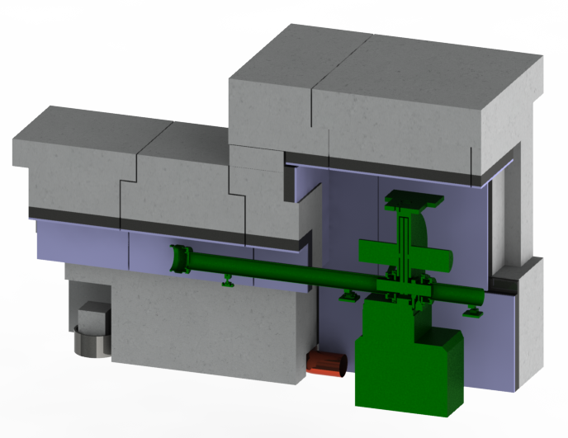
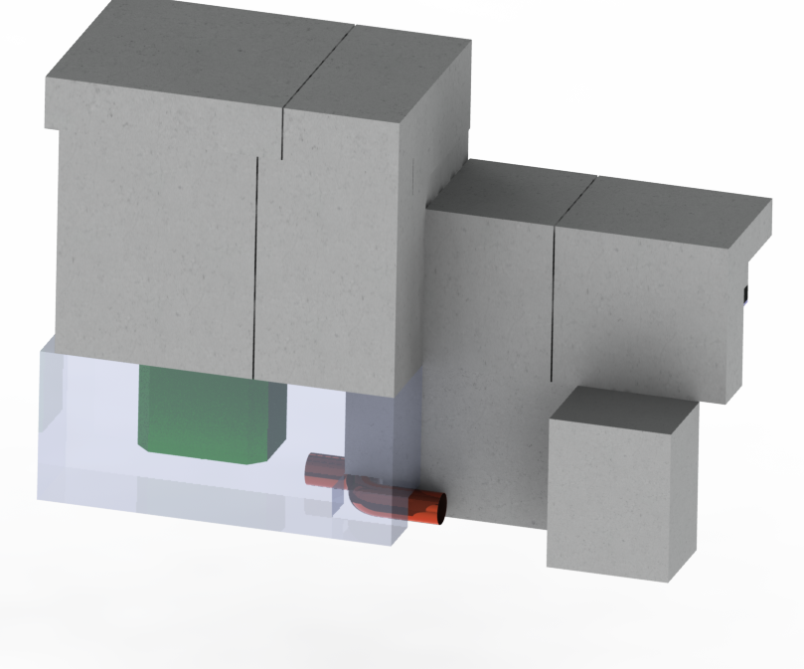
Feedthroughs: Chopper Pit
Feedthroughs for Chopper pits are intended to go through the lower shielding. Opening is 250 x 250 mm² which will allow installation of the feedthrough pipe Ø200 mm with bending radius 110 mm. (size to be checked and validated during detailed design for each chopper with Chopper group).

Slide 36
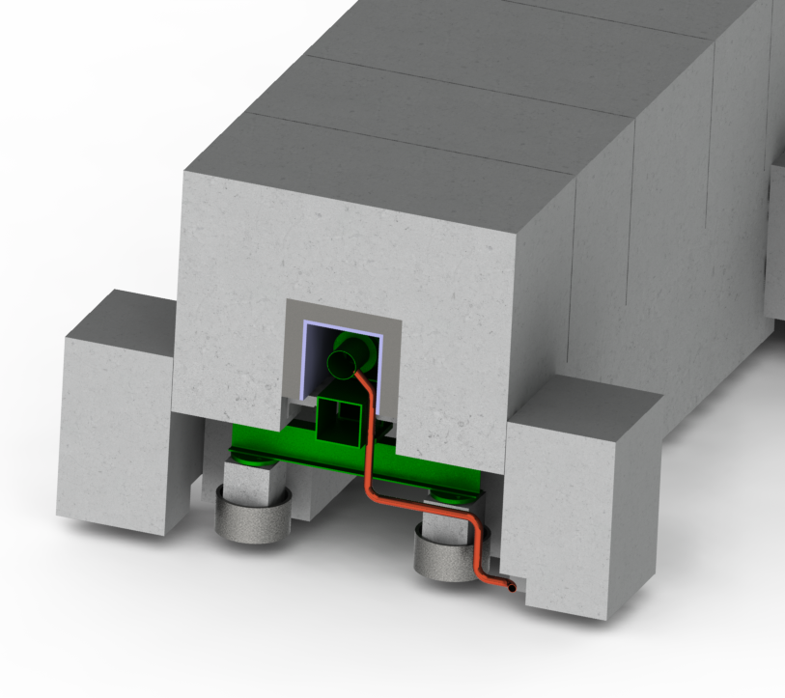
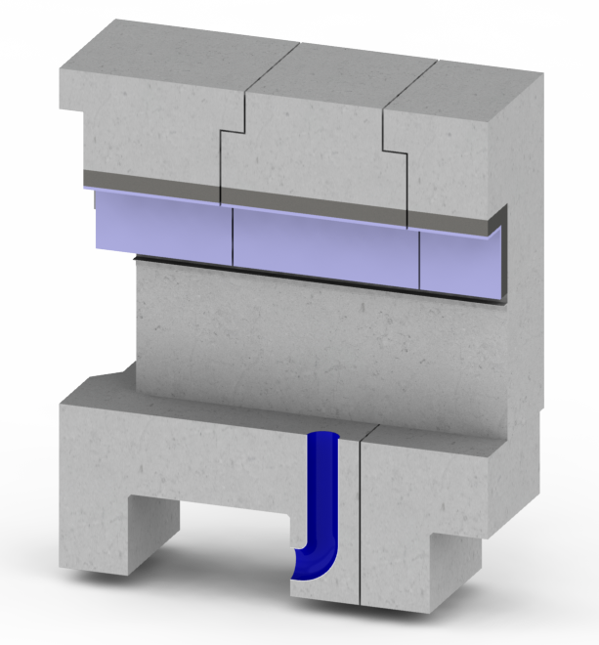
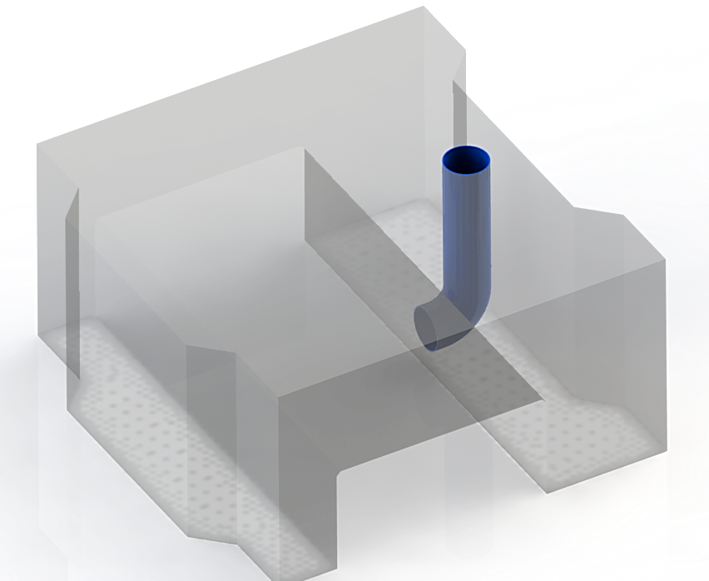
Feedthroughs: Vacuum Pipes
Feedthroughs for vacuum pipes inside the E02 portion of the shielding are intended to be through the side blocks next to the piles. Current opening inside the side block is 150 x 150 mm². (to be checked and validated during detailed design with Vacuum group)
E02
D01/D03

Slide 37
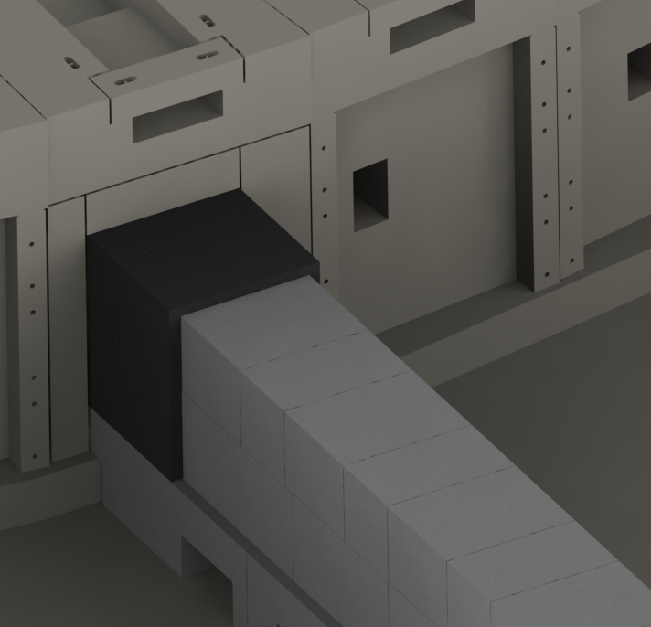
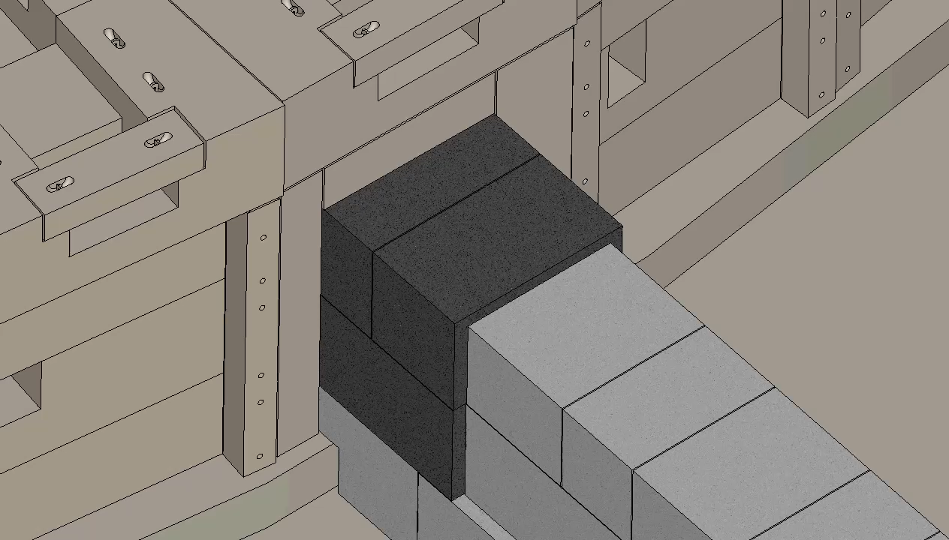
Interfaces: Bunker Wall
Customized heavy concrete panels around guide shielding connected to the bunker wall
3 Lifts to reach Bunker Guide Insert.

Slide 38
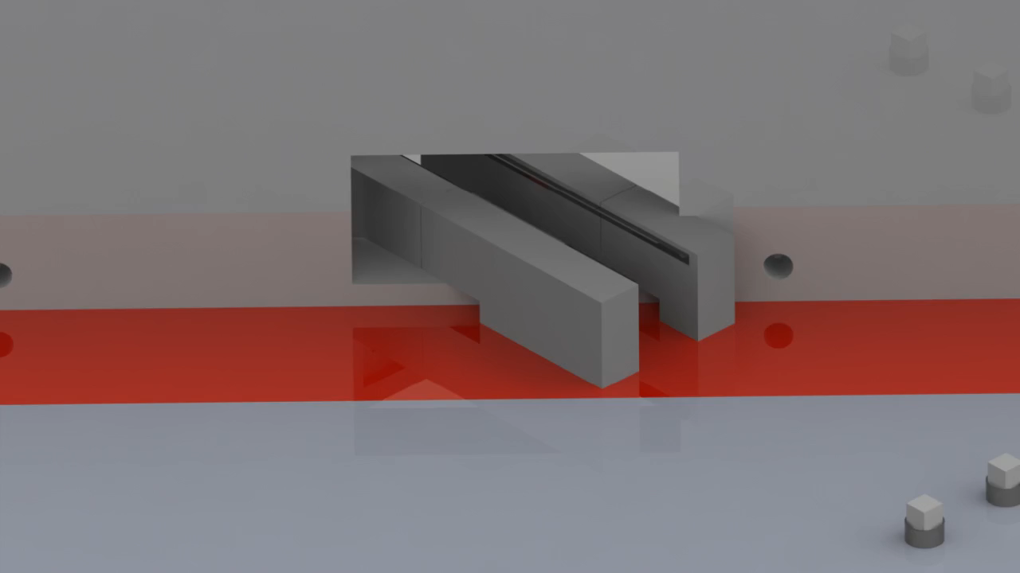
Interfaces
CF Wall
Guide shielding through and next to the CF wall will be bricked. Driven by that, alignment guide features should be as far as possible from the CF wall to minimize lifts during realignment.
Two customized blocks outside the bricked portion of the shielding, reachable with cantilever spreader bar

Slide 39
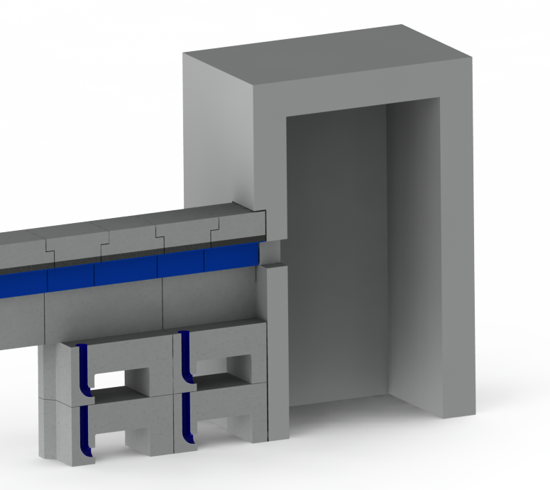
Interfaces
Caves
Cave interface to be defined in detailing phase in collaboration with cave designers. General plan is to have simple opening for guide shielding providing necessary chicanes.
Gap between E02 floor and cave in E01 to be bridged using D01/D03 supporting blocks stacked in two levels

