Slide 1
Spatial Integration for Instruments
Fabien Rey
European Spallation Source ERIC
13 02 2019

Slide 2
Some chronological aspects
2017
EIS Division
Integration Group
Integration activities coordinated independently in each sub project.
EIS Division
Creation of MES group
Machine Engineering Service Group
Survey, Alignment and Metrology
Spatial Integration
Manufacturing
ESS Technical Board
Introduction to Spatial Integration
Accelerator
Front End Building
Task Force
We commonly realized how crucial was to align our ways of designing, integrating and documenting.
Facility Documentation Management
ESS Ways of Working
SSM Regulations
ESS Technical Board
Spatial Integration – Real Plans
ACC and ICS DIVISIONS
JOINS CENTRAL
SPATIAL INTEGRATION SECTION
2018

Slide 3
Some chronological aspects
2018
Spatial Integration
Section
Accelerator
Front End Building
Task Force
Facility Documentation Management
ESS Ways of Working
SSM Regulations
TARGET DIVISION
JOINS CENTRAL
SPATIAL INTEGRATION SECTION
Accelerator
Installation and Commissioning
Accelerator
Infrastructure Project
Spatial Integration REQUESTS
Levels of Maturity
VIRTUAL REALITY
NSS DIVISION
JOINS CENTRAL
SPATIAL INTEGRATION SECTION
2019
IKON 16
Introduction to Spatial Integration

Slide 4
Outline
Spatial Integration Section
What is it?
How do we work?
How do we communicate?
Application for Instruments
CAD Structure in CATIA v6
CHESS structure for Facility Breakdown Structure FBS
Review/Approval Process
How we move on….

Slide 5
What is Spatial Integration?
CONFIGURATION MANAGEMENT OF THE SPACE AVAILABLE
Process for establishing and maintaining consistency of a product's physical attributes with its requirements, design, and operational information throughout its life
ONLY MANAGE VOLUMES AND 3D INTERFACES
- NOT DETAILED DESIGN -
Our inputs parameters :
1 CAD tool : CatiaV6
Plant Lifecycle Management System : CHESS
ESS Breakdown Structures
Facility Breakdown Structure
Location Breakdown Structure
ESS Handbook for Engineering Management
(ESS-0092276)
Massive flow of 3D models
5

Slide 6
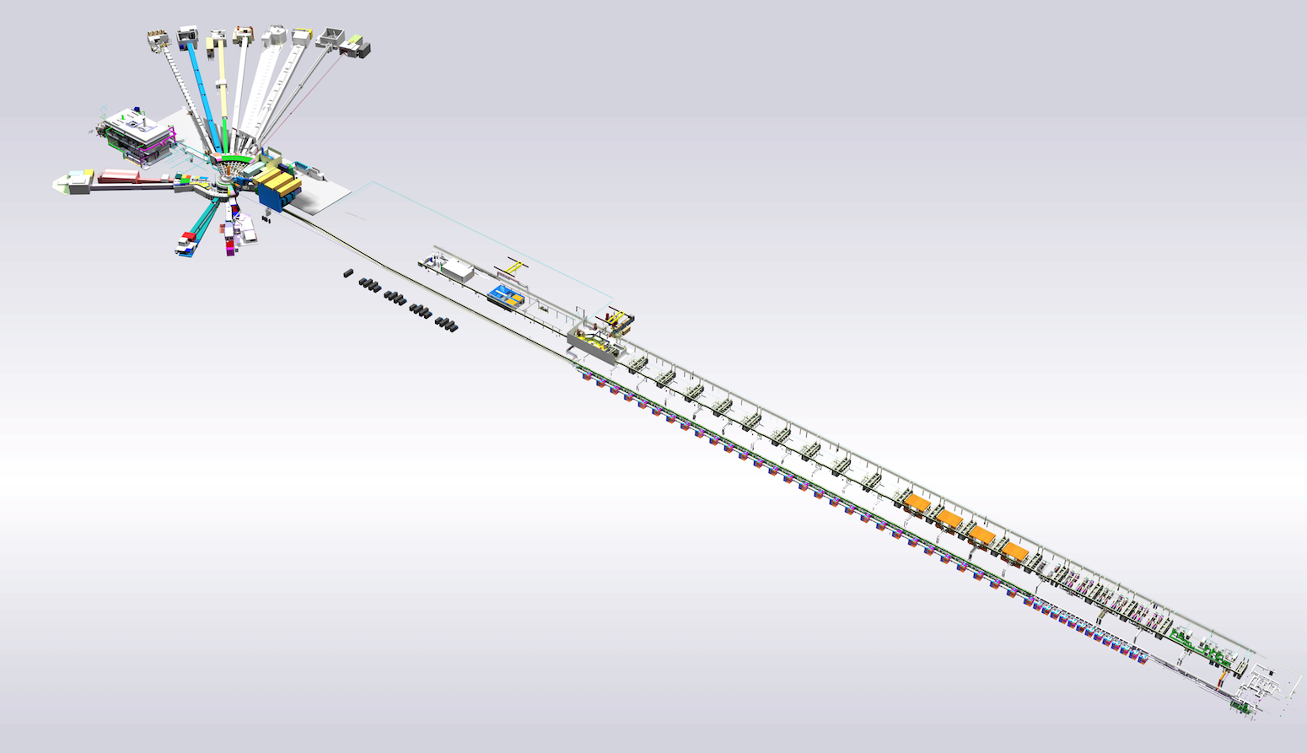
Our mandate
System owner of the integrated
3D Master model (ESS Plant Layout)
ESS-0500000
Configuration Management for
volume allocations and 3D interfaces
Capture Lifecycle of CAD representations
Place 3D data under configuration control
Perform Integration and Clash Analysis
Conduct Spatial Integration Meeting
and submit unresolved clash to upper management
6

Slide 7
Challenges around our 3D data
1.5 year ago….
ESS Plant Layout (EPL) ESS-0016885
Configuration Management
Missing clear Breakdown Structure
Very little data released
Very heavy models
3D data not connected to the PLM
CF models
Communication
Swedish Nuclear Authority (SSM)
What are we exporting/showing ?
Collaborators – Inkinds- Manufacturers
Facility Documentation Management

Slide 8
Actions
REBUILT THE ESS Plant Layout (EPL) ESS-0500000
Note: ESS-0016885 becomes ESS Conceptual Assembly
Following ESS Breakdown Structures
naming and connection to CHESS (PLM)
Based on Light Versions
Lighter to open and work on it
Possibility to load full detailed models
Showing only Released Data ( with level of maturity)
Reliable information understanding design maturity
Source for Exports
Other platforms - External users - Partners
Redefine central rules and interactions with sub projects
Implementation of Spatial Integration REQUEST
in Confluence
Spatial Integration Configuration Management
New rules in order to enter in the EPL

Slide 9
Spatial Integration Configuration Management
V3: 23-10-2018
Sub Project
TG 1
TG 2
TG 3
TG 4
TG 5
TG 6
Mechanical Design
A
B
C
D
P
R
ASB
ASC
Electrical
Process Piping
Design
Issued for
System Design
Issued for
Detailled Design
Detailed design
Issued for Quotation
Issued for Construction
Issued for Installation
As-Built
As-Scanned
CHESS
Release
Development Phase
Production Phase
Release Models
with Level Of Maturity
Including Space Reservation for
Designer
Installation
Operation
Remote Handling
Maintenance
Work Package/ Project Leader
Central Support
Spatial Integration Request
Model Management
Integrate design in ESS Plant Layout: ESS-0500000 Produce light model Connect to CHESS: Facility Breakdown Structure Location Breakdown Structure
Communication
Confluence Page for each Work-Package Status Integration Report on Clash Analysis Single point of truth for Exported Models In-Kind Partner and other disciplines Navisworks Coordination Visualization Rendering and Captures Virtual Reality Room
Analysis
Integration with: Other Systems Conventional Facility Models Point clouds – Laser Scanning Model Quality Check Interface Simulation Clash Analysis

Slide 10
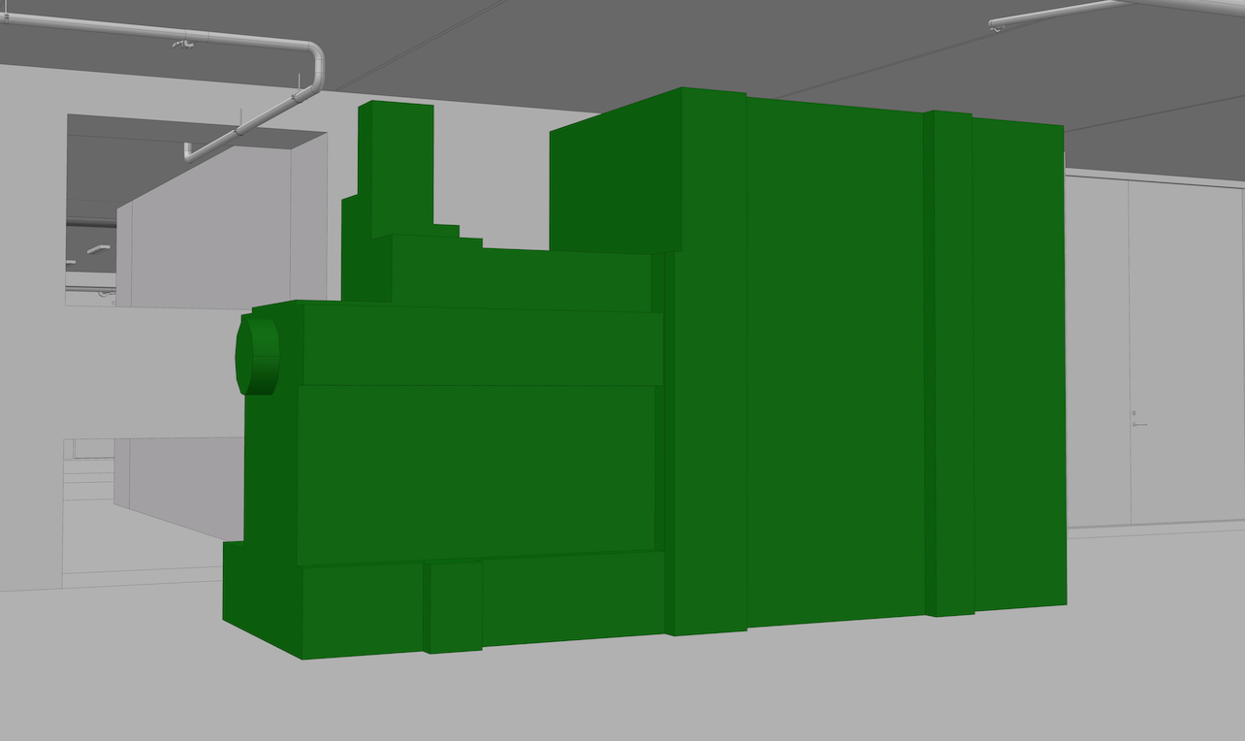
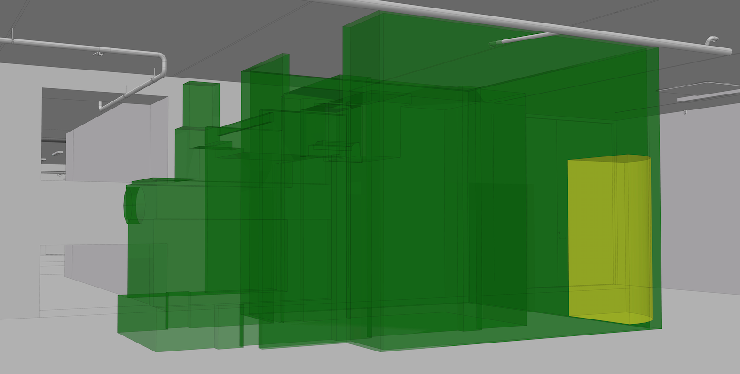
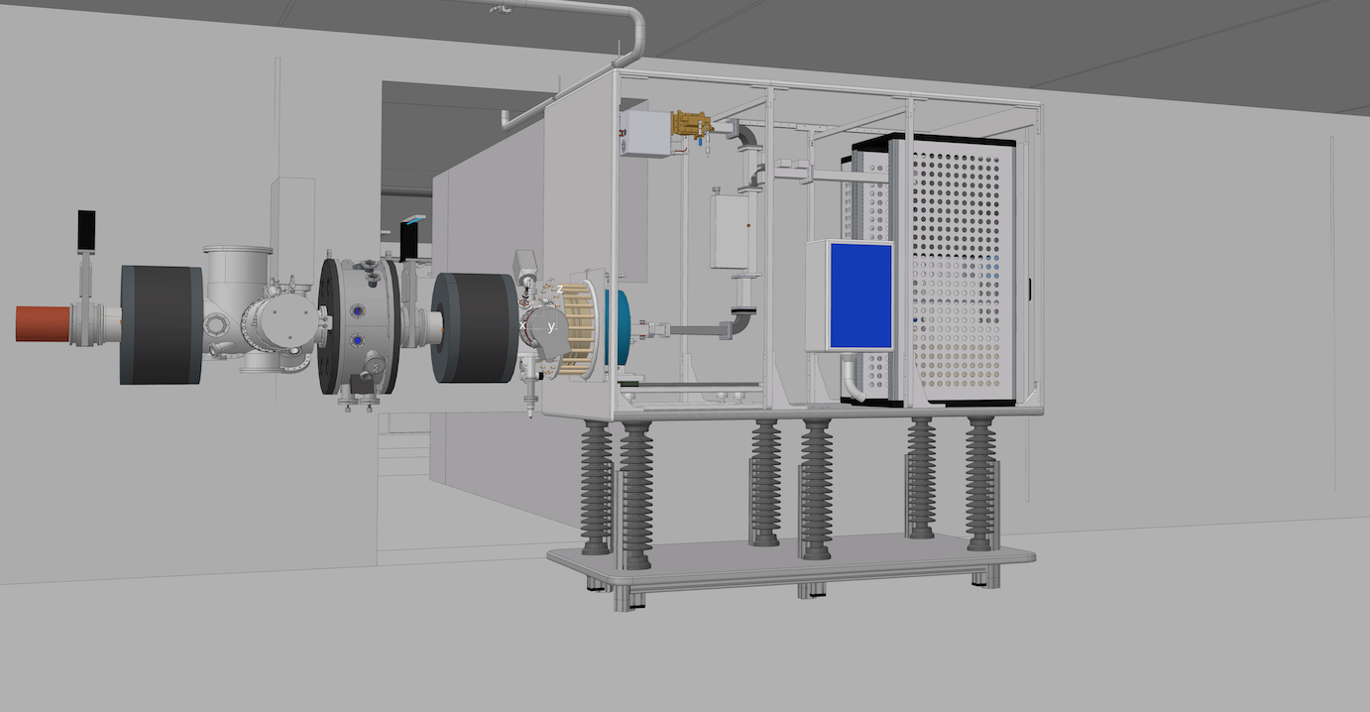
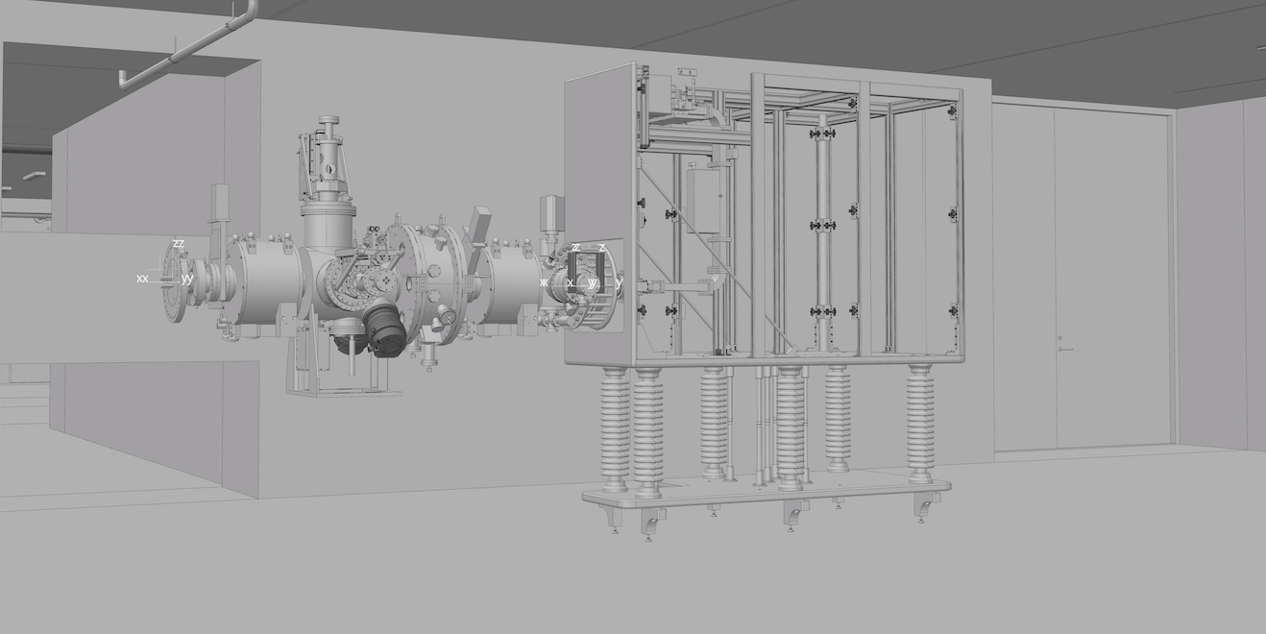
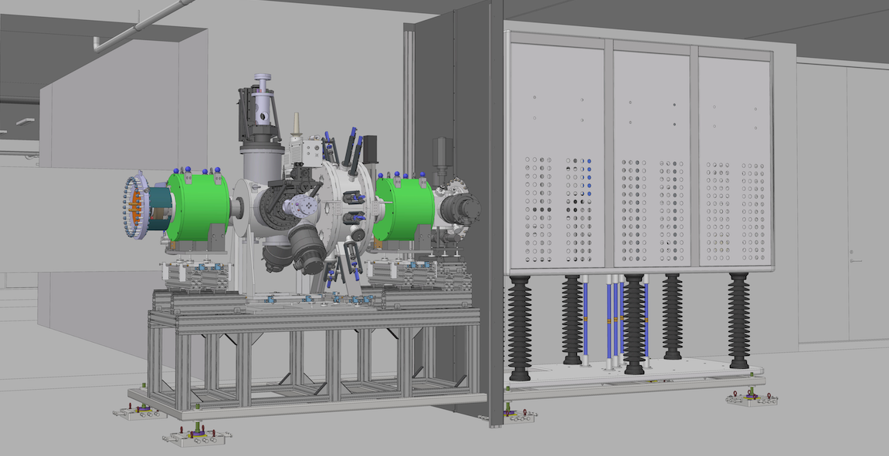
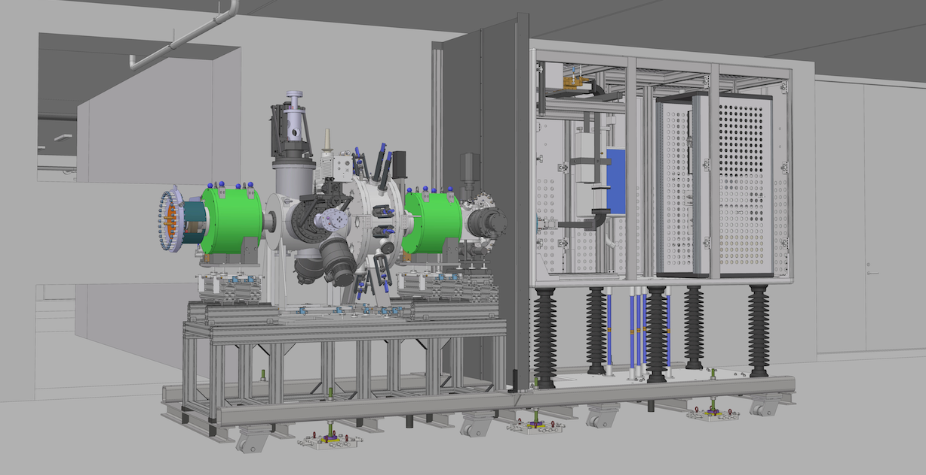
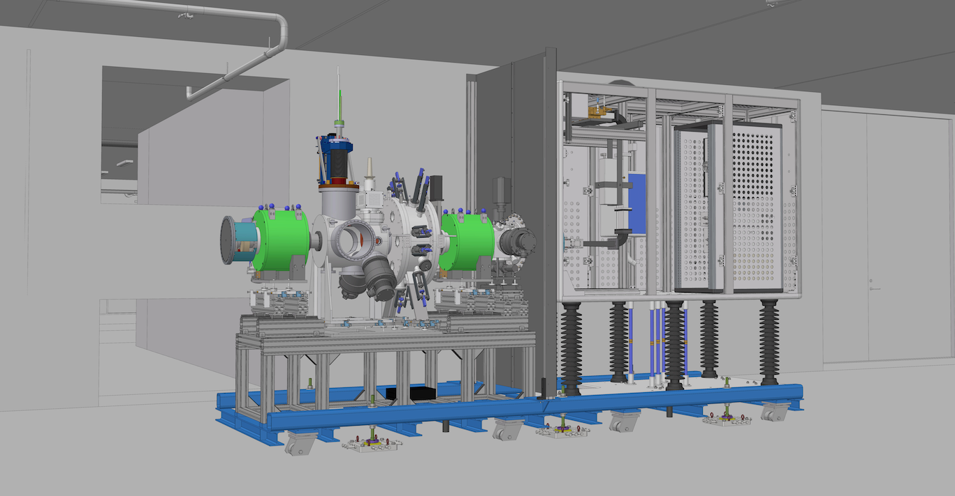
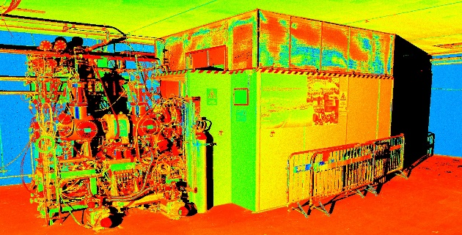
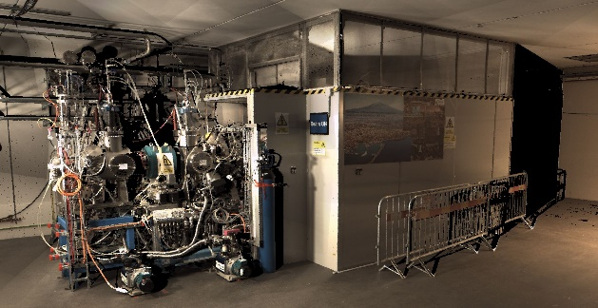
Spatial Integration Lifecycle
Ion Source - LEBT
1- Initial Space Claim - Oct 2013
2- Functional Review - Sept 2014
3- Preliminary Design Review - Feb 2015
4- Detailed Design - Oct 2015
5- Issued for Quotation - Nov 2015
6- Critical Design Review - Feb 2016
7- Installation Readiness Review - Sept 2017
8 - As-built - Test Readiness Review- May 2018
9 – As-Scanned Intensity 3D Point Clouds - Jan 2019
10 – As-Scanned Coloured 3D Point Clouds - Jan 2019

Slide 11
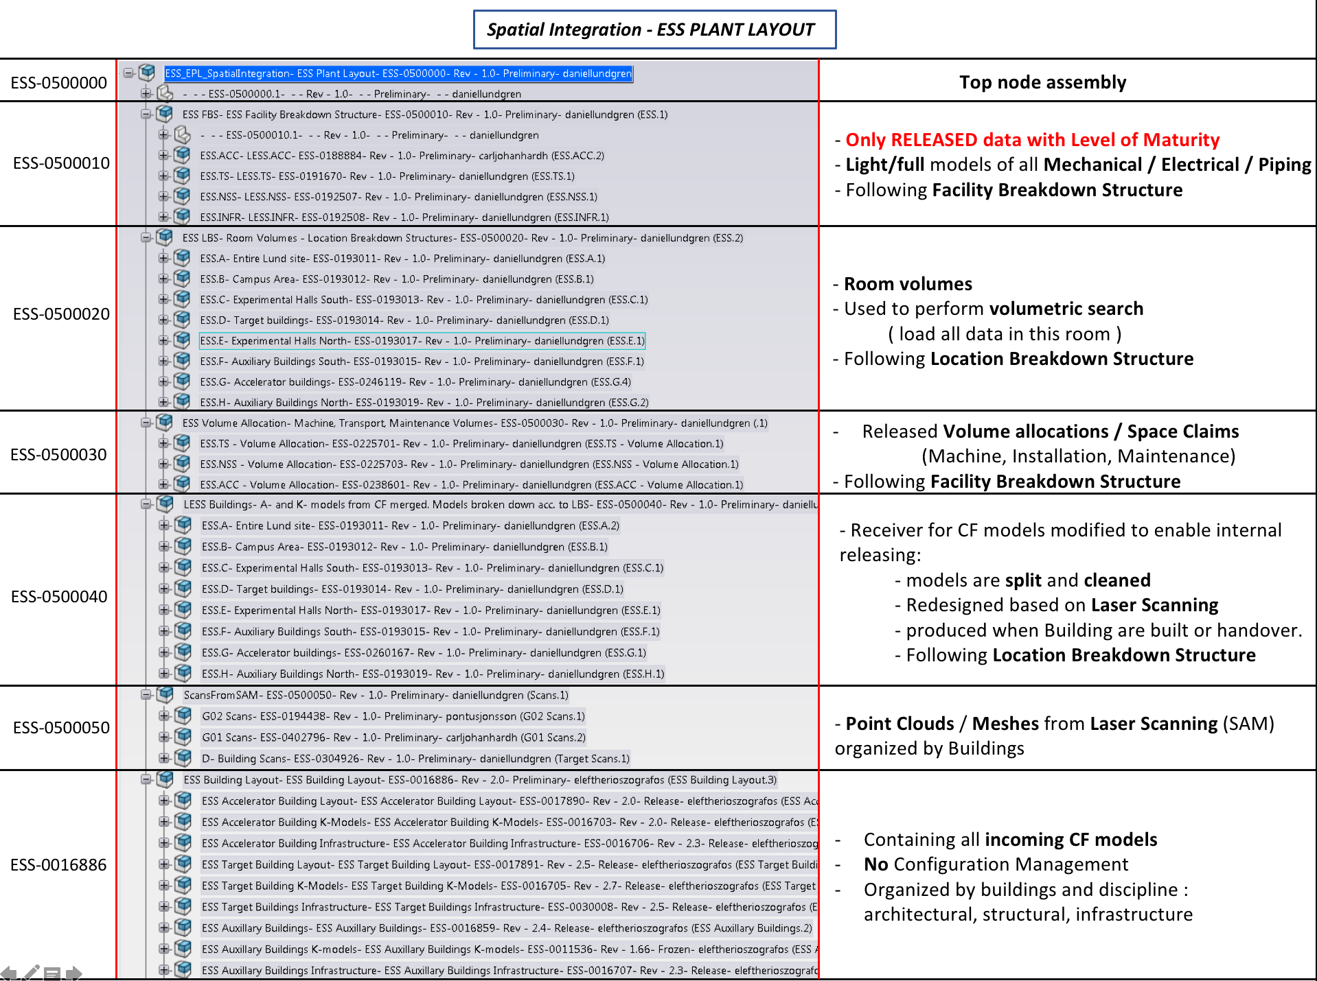

Slide 12
How do we communicate?
In confluence
Description and General Information about the Section
Spatial Integration Request
A dedicated page for your system with:
Status description of the maturity of the system
Illustrations and notifications of changes
Clash analysis

Slide 13
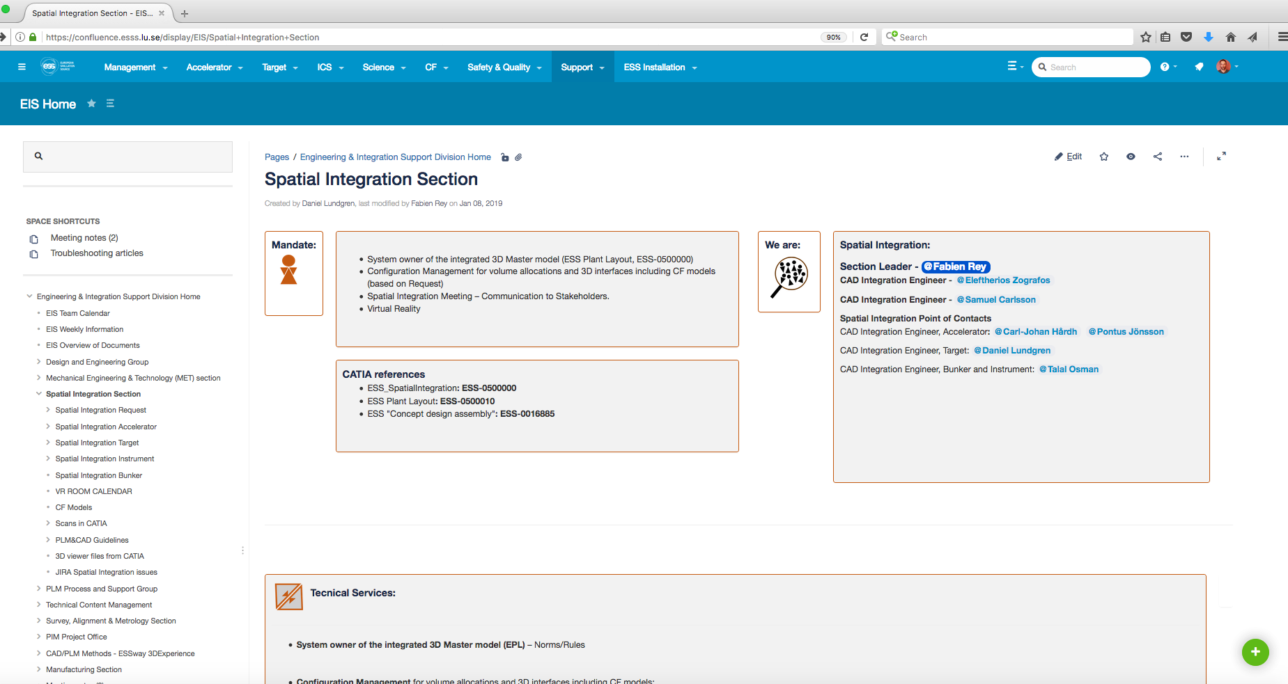
How do we communicate?
Spatial Integration Section main page

Slide 14
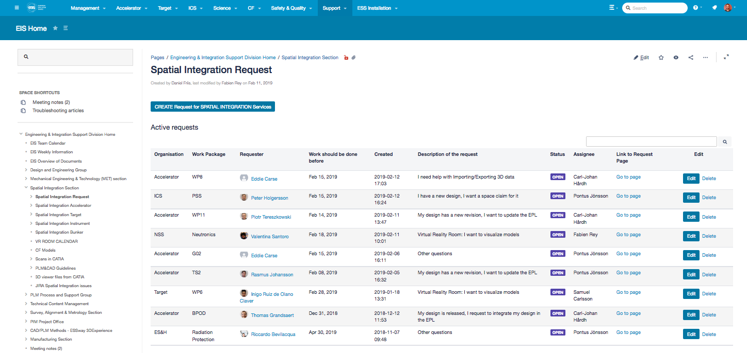
How do we communicate?
Spatial Integration Request page

Slide 15
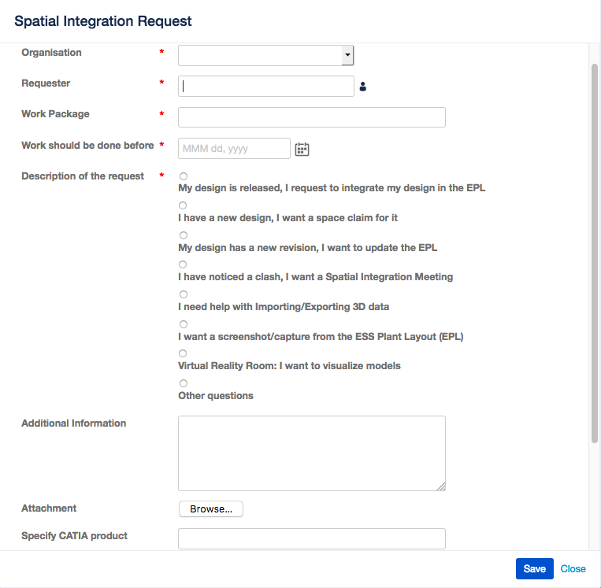
How do we communicate?
Spatial Integration Request

Slide 16
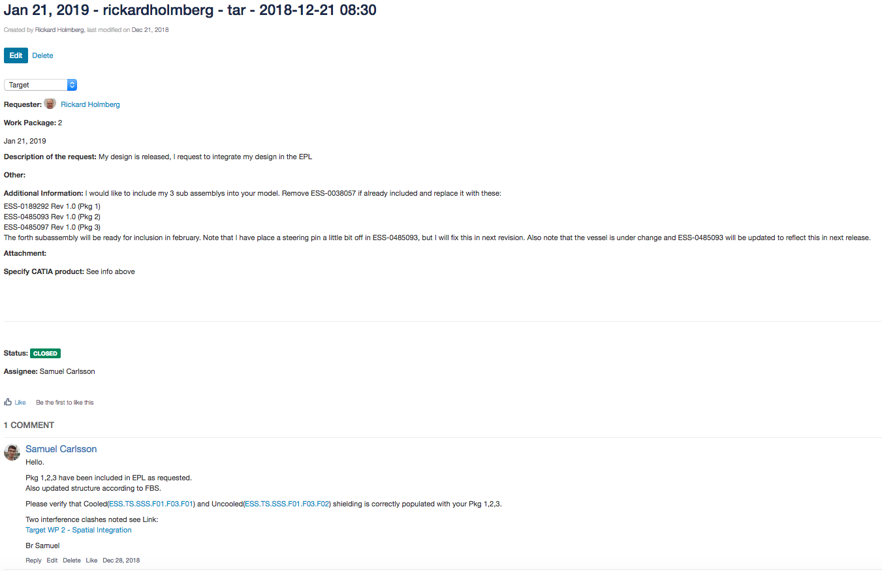
How do we communicate?
Page created by the request

Slide 17
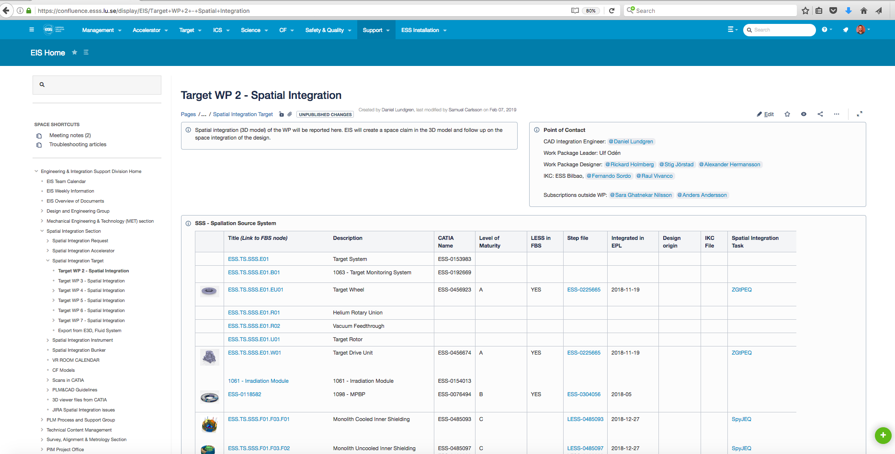
How do we communicate?
System Description

Slide 18
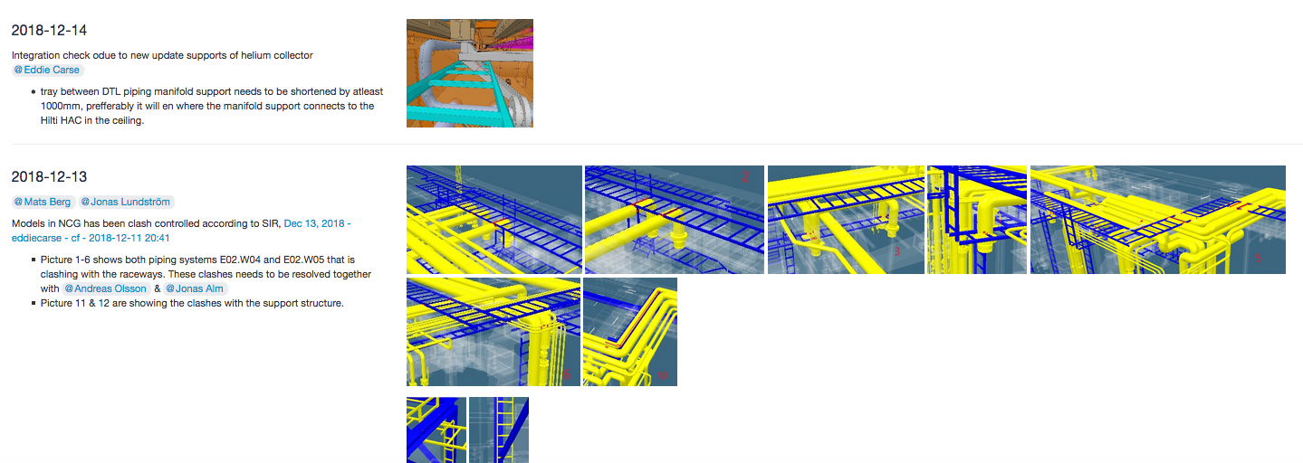
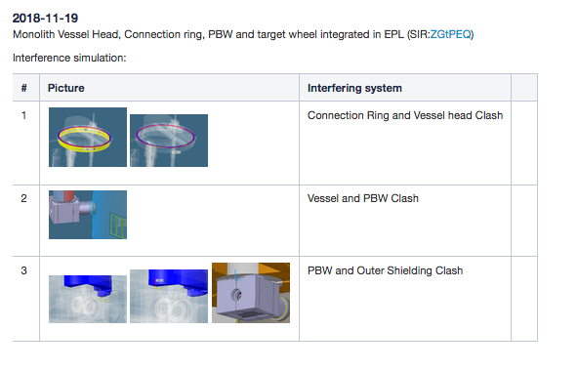
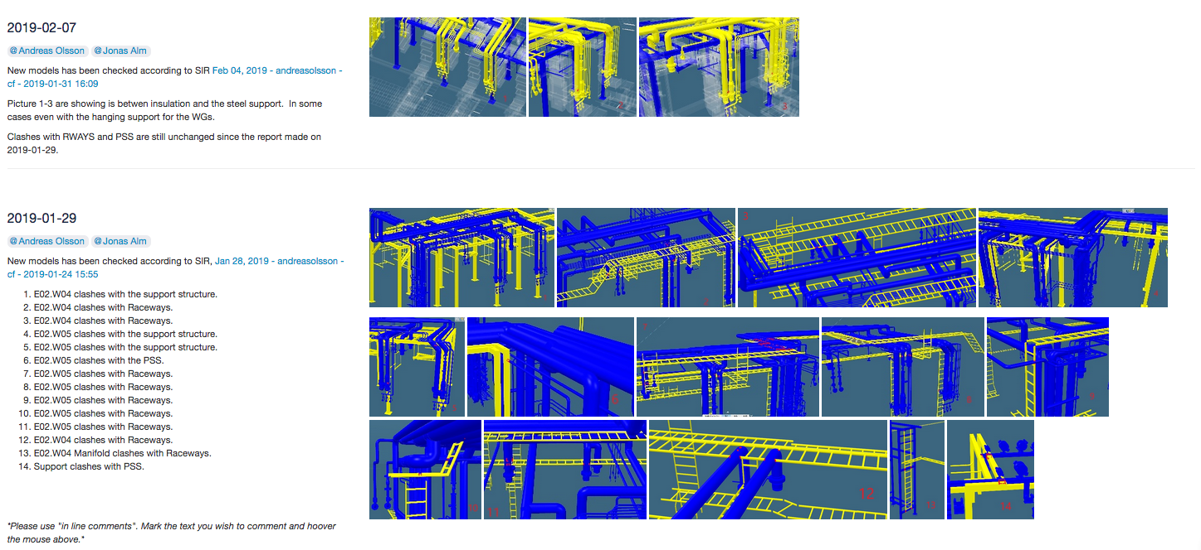
How do we communicate?
Clash Analysis and Communication

Slide 19
Application for Instruments
We have to work together on :
The CAD structure of your instrument
Assembly and Skeleton
The breakdown structure of your instrument in CHESS
“The ESS facility breakdown structure is a functional-based hierarchical tree structure to be used for systems and components for the purpose of design, procurement, logistics, installation, commissioning, operations,
maintenance and decommissioning.”- ESS-0036752
Review/Release Process
Communication

Slide 20
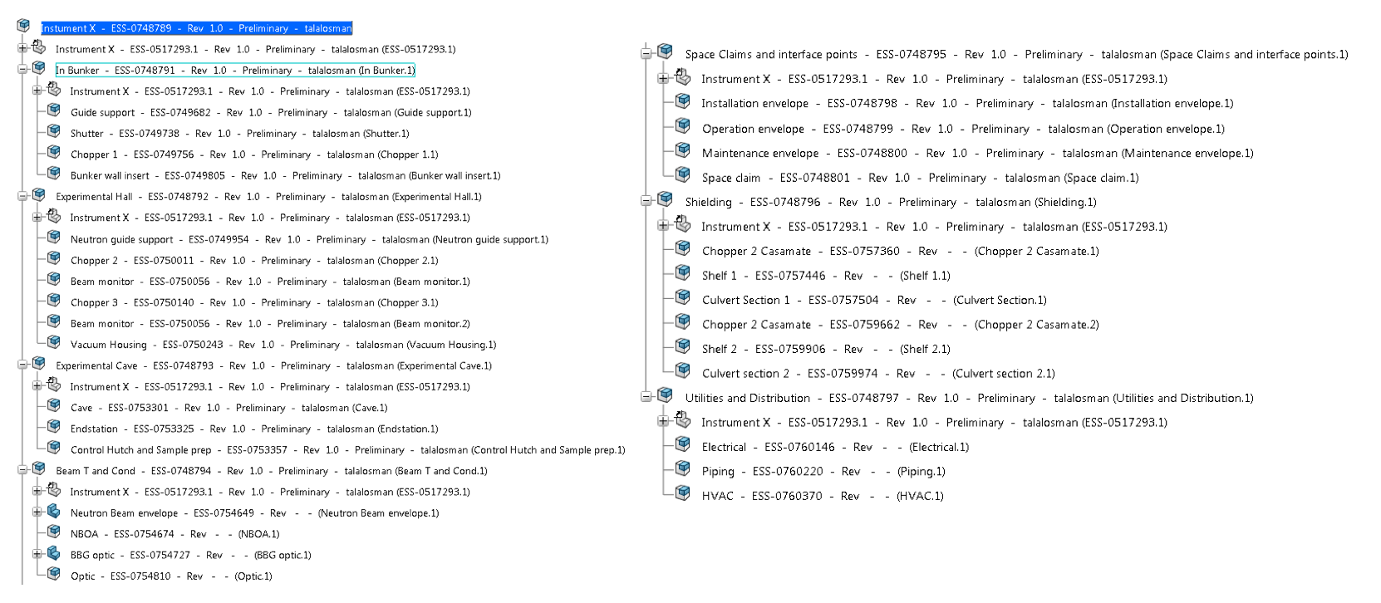
Application for Instruments
CAD Structure our proposal

Slide 21
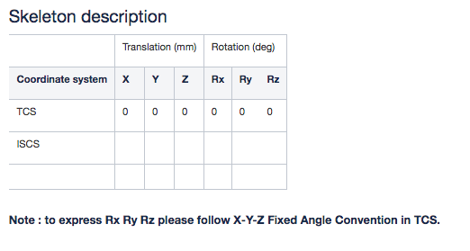
Application for Instruments
Skeleton

Slide 22
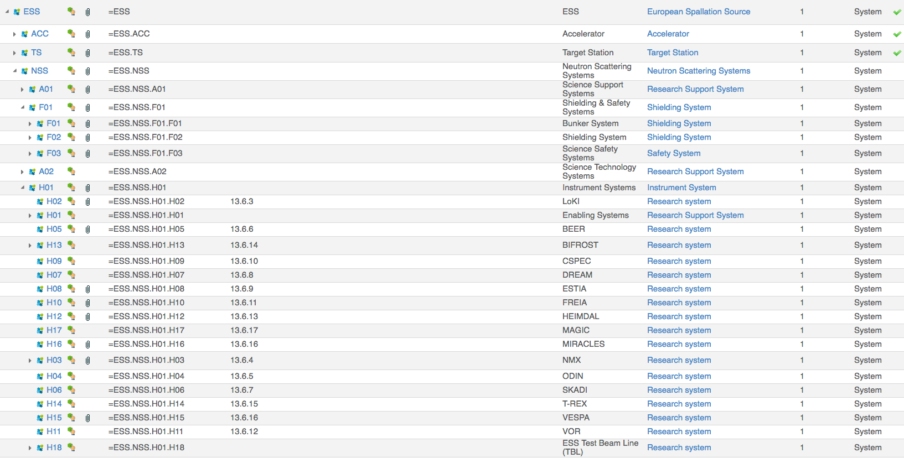
Application for Instruments
Facility Breakdown Structure
To be developed at your convenience
NMX as a good illustration

Slide 23
Spatial Integration 3D Model Workflow
Partners using Catia V6
Partner
Review and release with
Level of Maturity
Import
Review
Integrate
Communicate
Spatial Integration Request
My design is released, integrate my design in the EPL FBS tag information
Communication in Confluence
Integration report on Clash Analysis Information provided to all affected stakeholder
Spatial Integration
Integration
Clash Analysis
vs
Other systems
CF models
3D Scans
Create Light Version
Attach to EPL
ESS-0500000
Connect to FBS
Communicate

Slide 24
Spatial Integration 3D Model Workflow
Partners not designing in Catia V6
(using .step file) (but we know that you have licences)
Partner
Review and release with
Level of Maturity
NSS Integration
Review and release with
Level of Maturity
Import
Review
Integrate
Communicate
Spatial Integration Request
I need to import (indicate Level of Maturity)
Spatial Integration Request
My design is released, integrate my design in the EPL FBS tag information
Communication in Confluence
Integration report on Clash Analysis
Spatial Integration
Spatial Integration
Integration
Clash Analysis
vs
Other systems
CF models
3D Scans
Import
Transfer ownership
Create Light Version
Attach to EPL
ESS-0500000
Connect to FBS
Communicate

Slide 25
Application for Instruments
In the immediate future
Identify for each instrument 2 responsible contacts:
CAD (Design Engineer)
Approver (Lead Engineer)
Rearrange your top assembly according to instructions
Declare your skeleton
Work on FBS
Spatial Integration Request to integrate your systems

Slide 26
Conclusion
We must demonstrate a better level of Configuration Management of our CAD data
We are ready to receive and integrate your design.
Spatial Integration in Confluence
https://confluence.esss.lu.se/display/EIS/Spatial+Integration+Section
Spatial Integration Request
https://confluence.esss.lu.se/display/EIS/Spatial+Integration+Request
Spatial Integration Instrument Page
https://confluence.esss.lu.se/display/EIS/Spatial+Integration+Instrument
Handbook for Engineering Management, ESS-0092276
Engineering Graphical Workflow, ESS-0093443
Facility Breakdown Structure
https://chess.esss.lu.se/enovia/link/21308.51166.47073.2921
Location Breakdown Structure
https://chess.esss.lu.se/enovia/link/21308.51166.47073.2921

Slide 27
BACK UP SLIDES

Slide 28
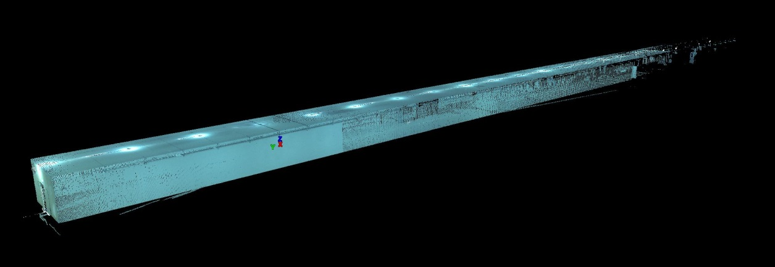
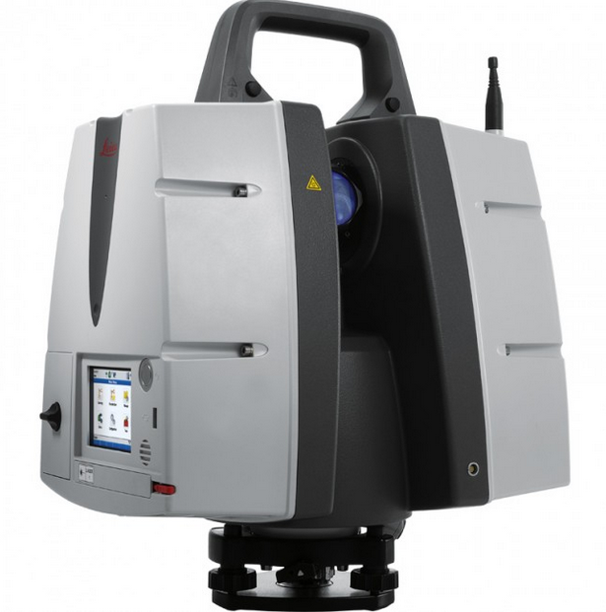
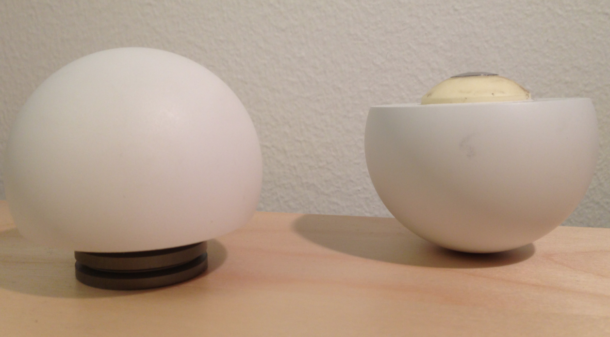
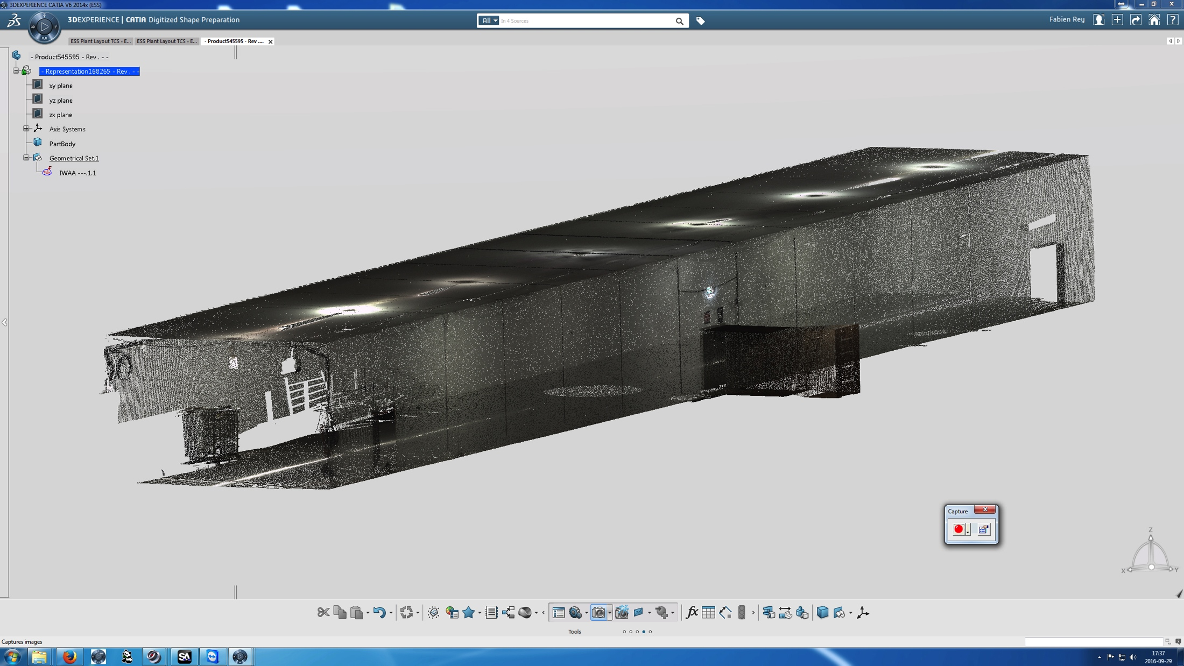
---- Laser Scanning----
Focus on 3D Scans
Analysis in Cyclone
Raw data Acquisition
Data Cleaning
Orientation of Scans ( registration)
Geometries created on demand
Concentric Spheres
P30
V6
For Reverse Engineering and Integration
Non CAD users
Visualization/Simple measurments
28
28

Slide 29
---- Laser Scanning----

Slide 30
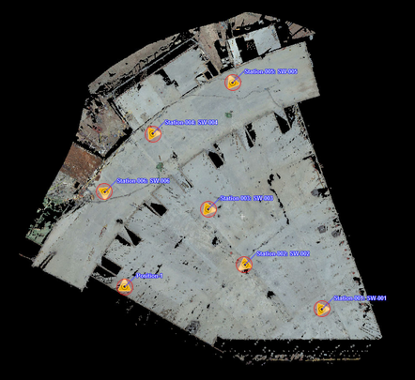
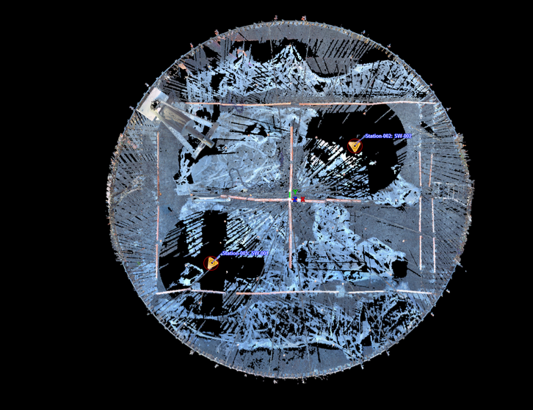
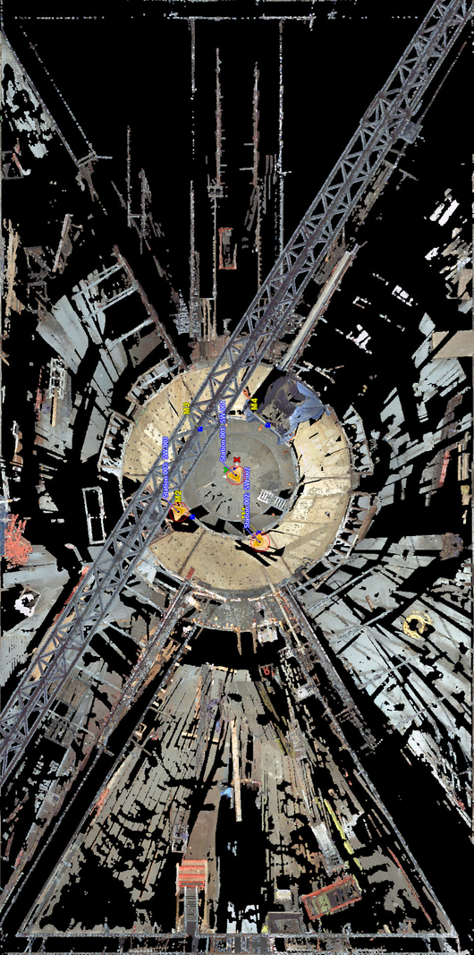
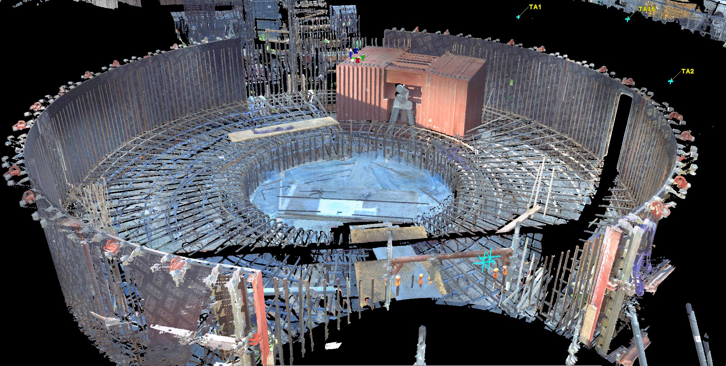
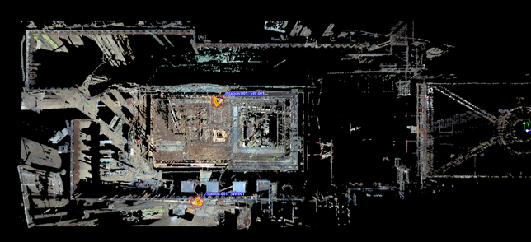
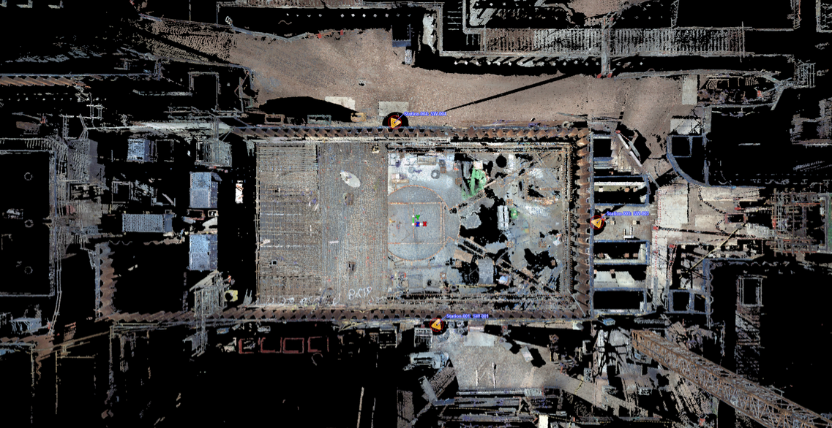
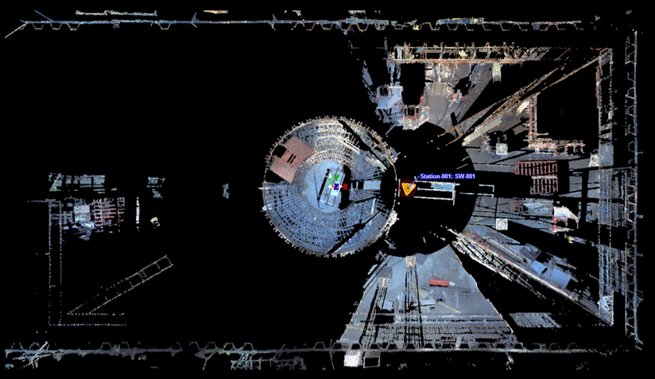
---- Laser Scanning----
30

Slide 31
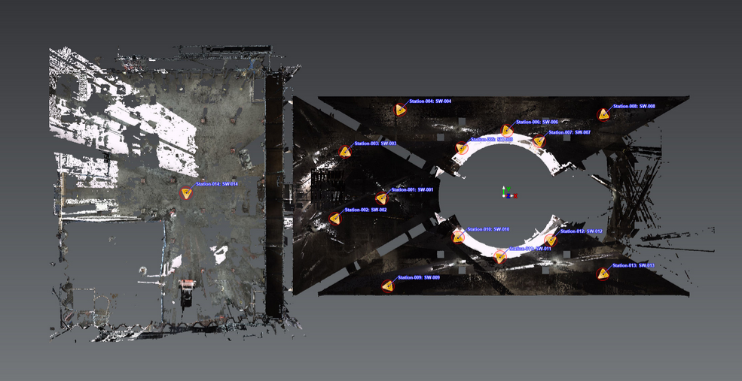
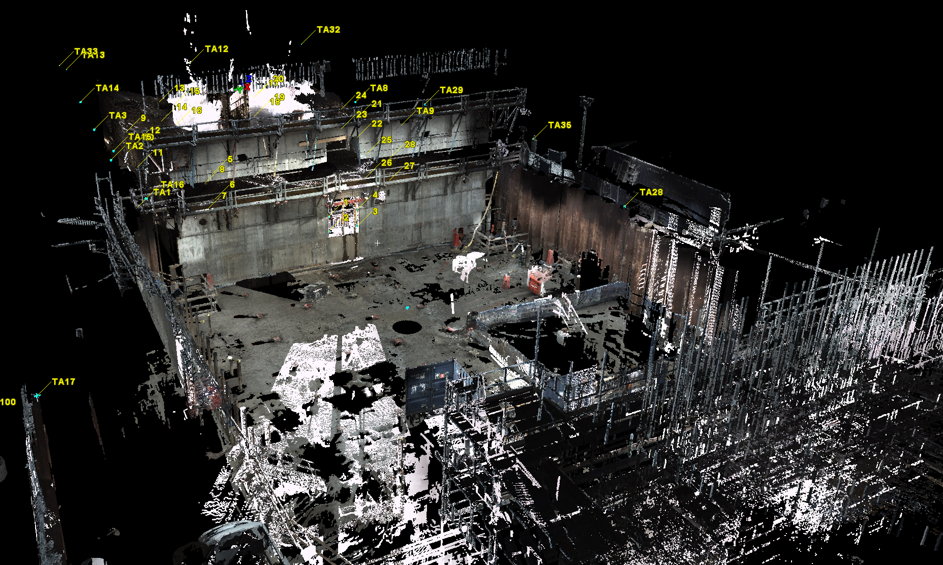
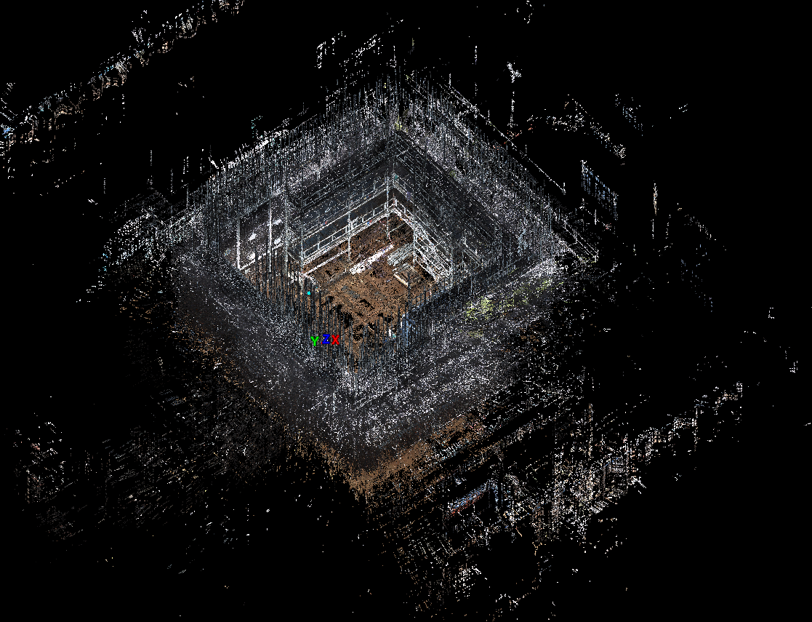
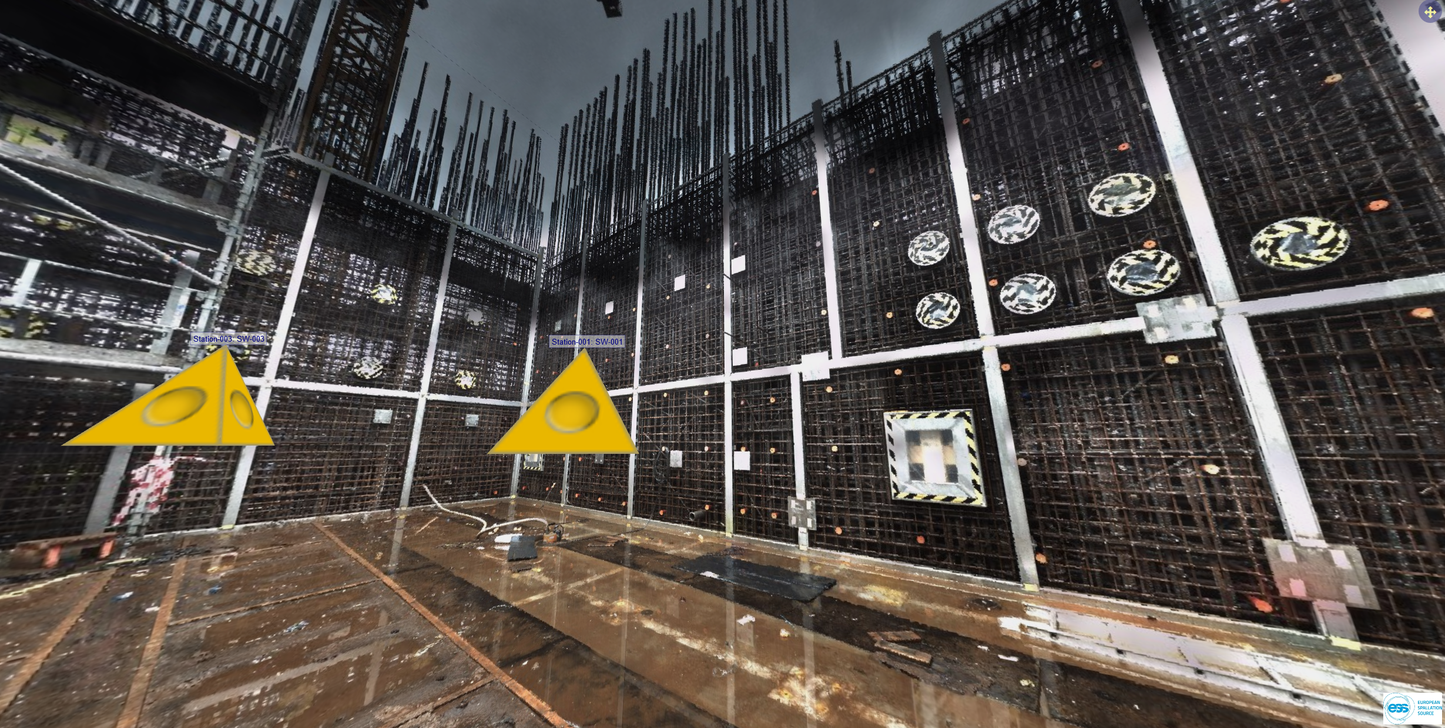
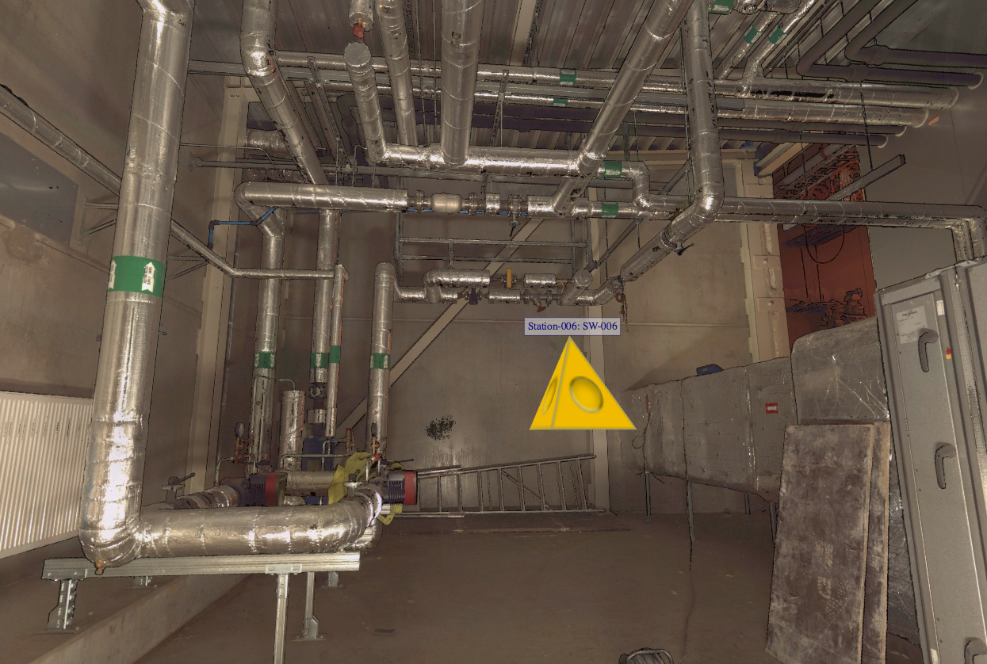
---- Laser Scanning----

Slide 32
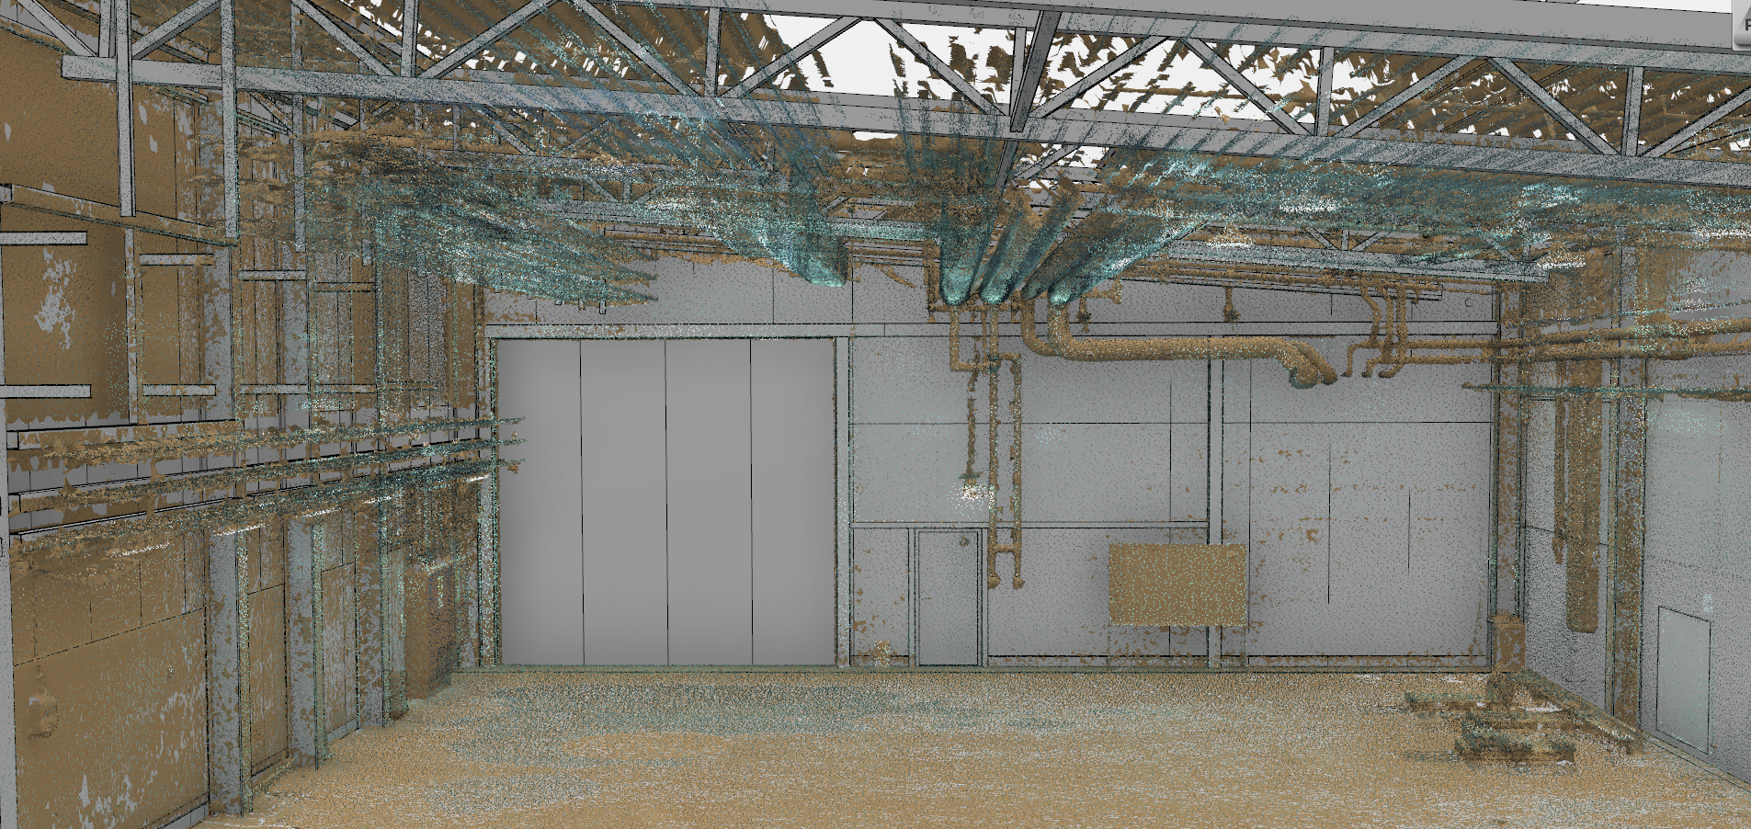
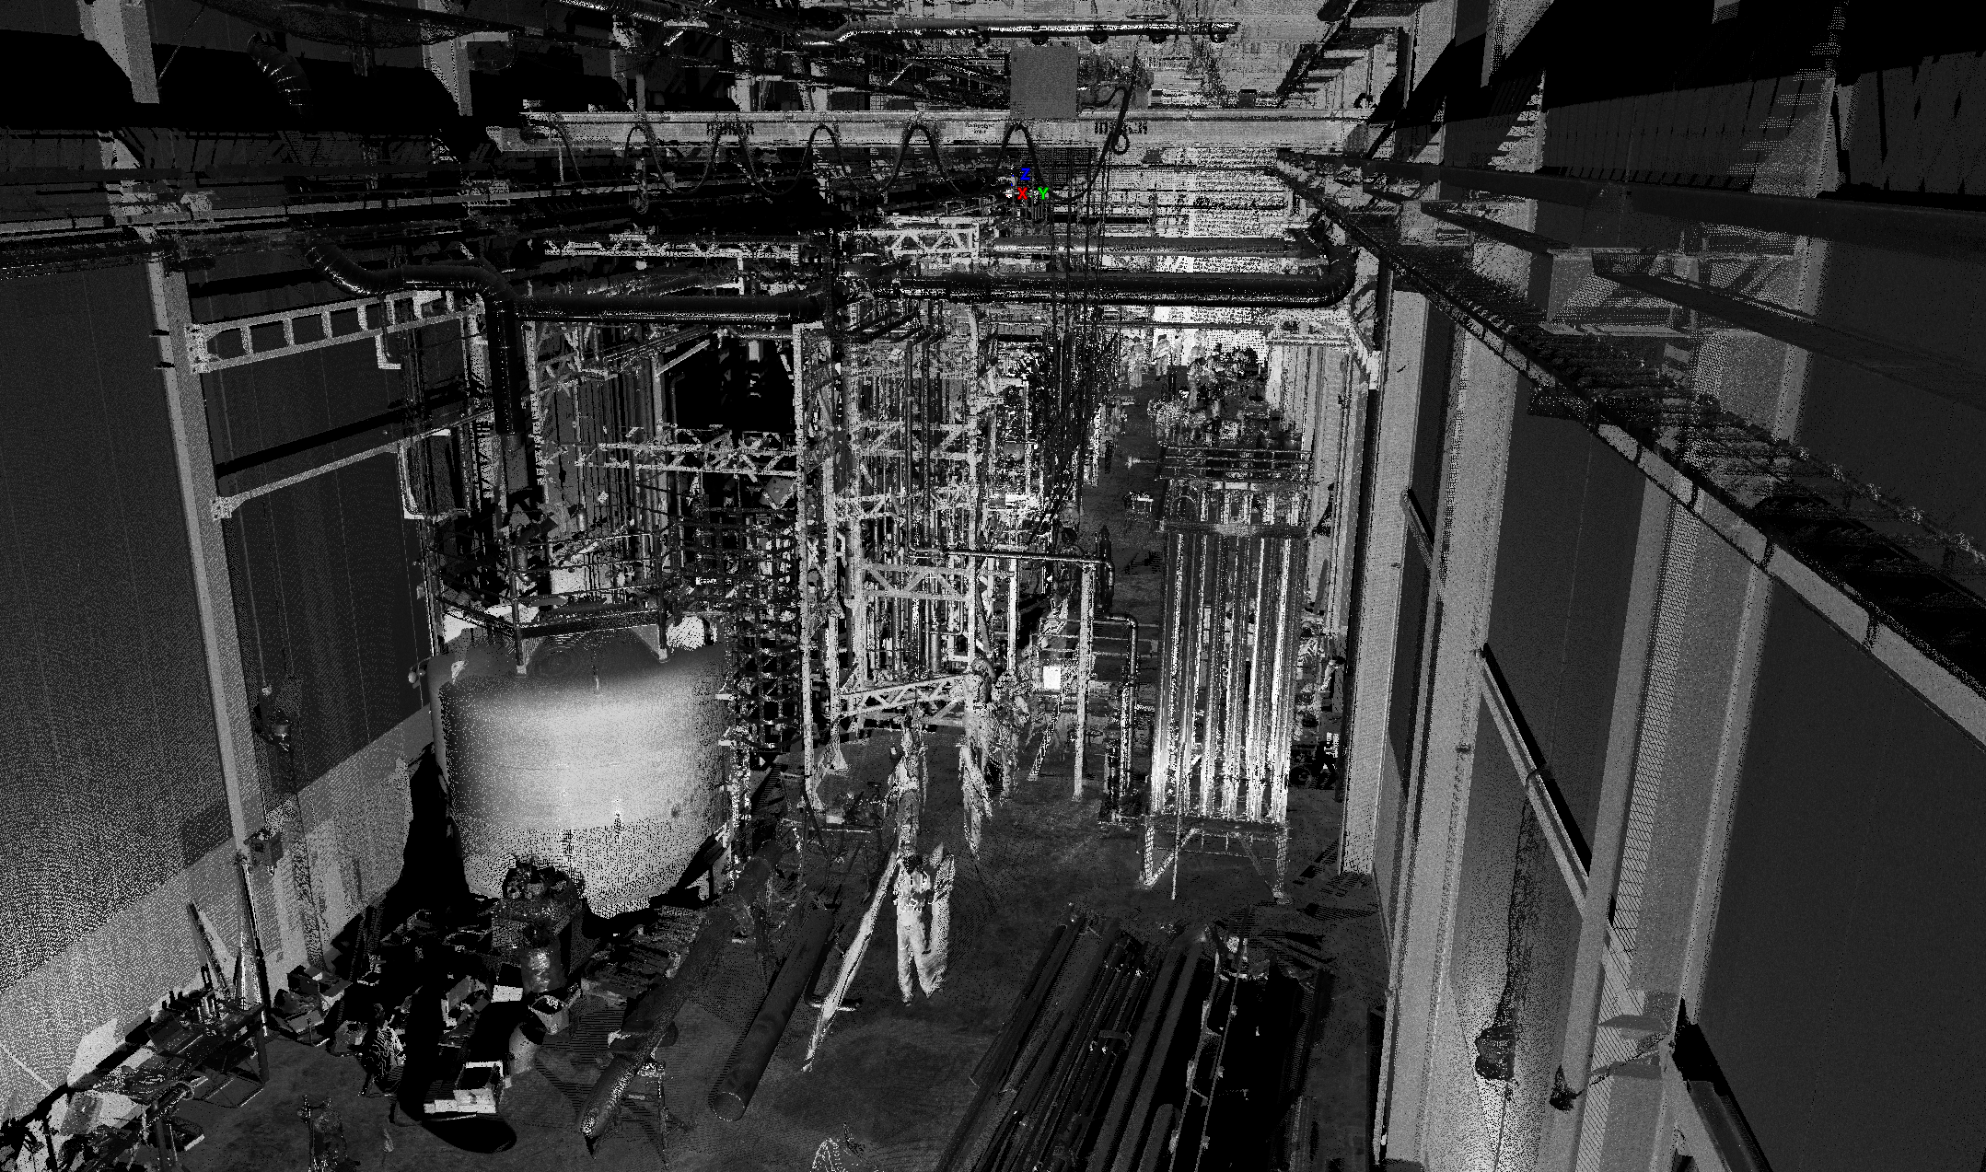
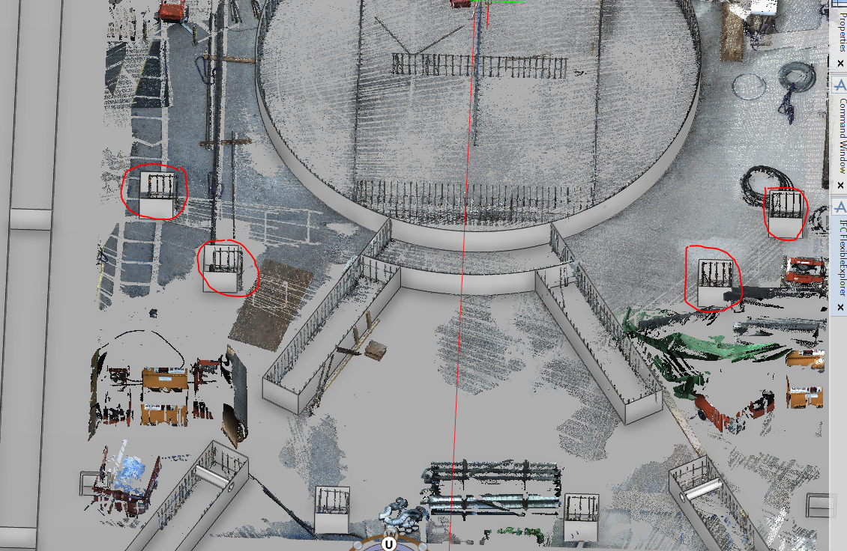
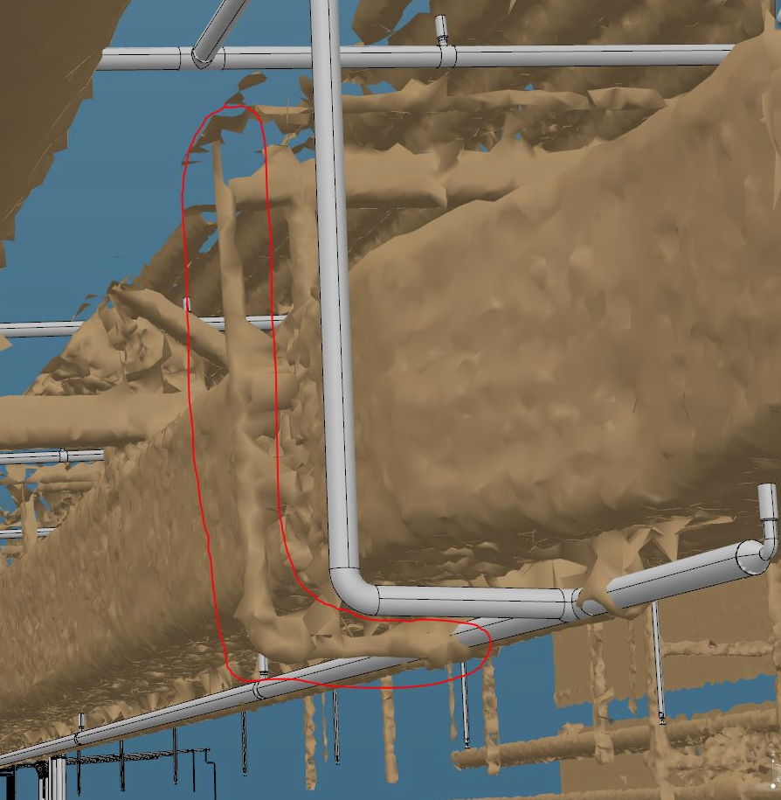
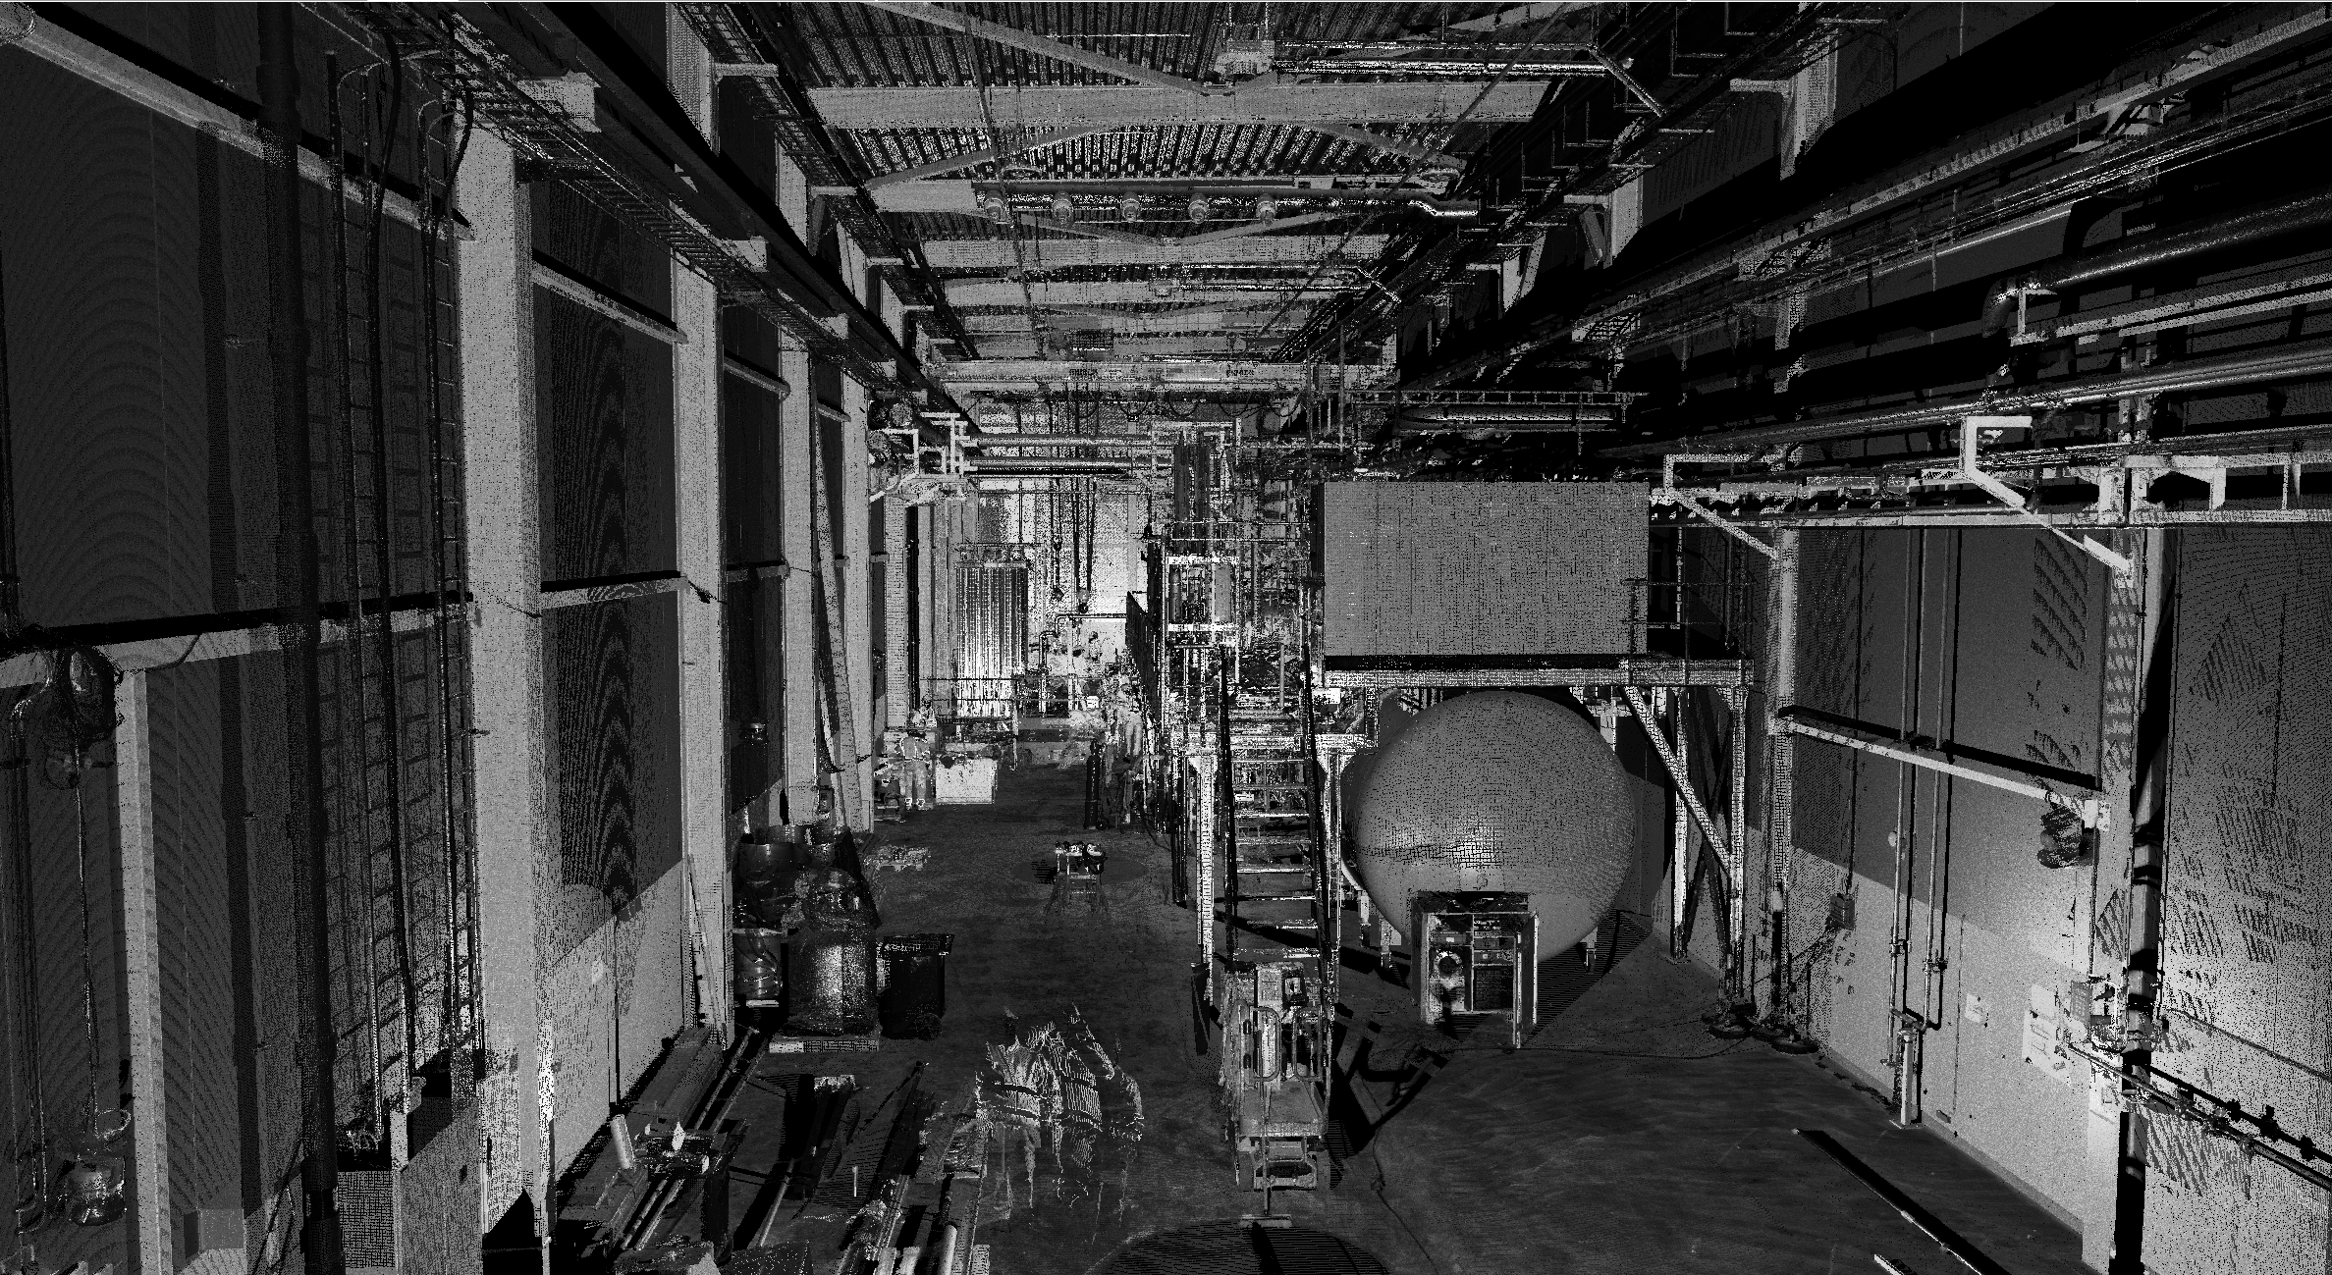
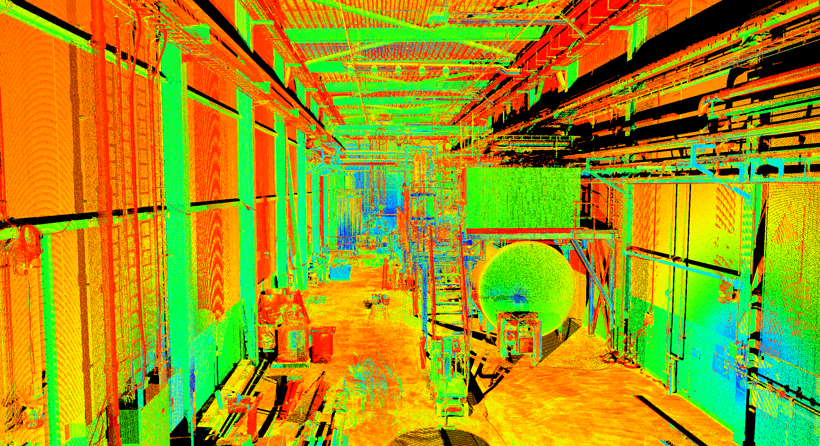
---- Laser Scanning----

Slide 33
CF Models
Clear 3D model representation of what :
CF is planning to built
CF is building
CF has finally built
How it works today:
Iterative 3D Design
Update of 3D model too long or non existing!!
CF model
3D
2D Detail design starts for Production Drawings
Changes in 2D not reflected in 3D
As built drawings
2D
Drawings sent for Construction
As built data sent to Detail design team
Construction
Construction
Construction finished
Building Handover

Slide 34
CF Models
Building not handed over
How we should try to work from now:
Spatial Integration Model (FBS)
Production
Construction
As-built
V1.3
V1.4
V2
V3
V4
Iterative 3D Design
Changes communicated to S-I
3D
2D Detail design starts for Production Drawings
Changes in 2D reflected in 3D
As built drawings
2D
and communicated to S-I
Drawings sent for Construction
As built data sent to Detail design team
Construction
Construction finished
Building Handover

Slide 35
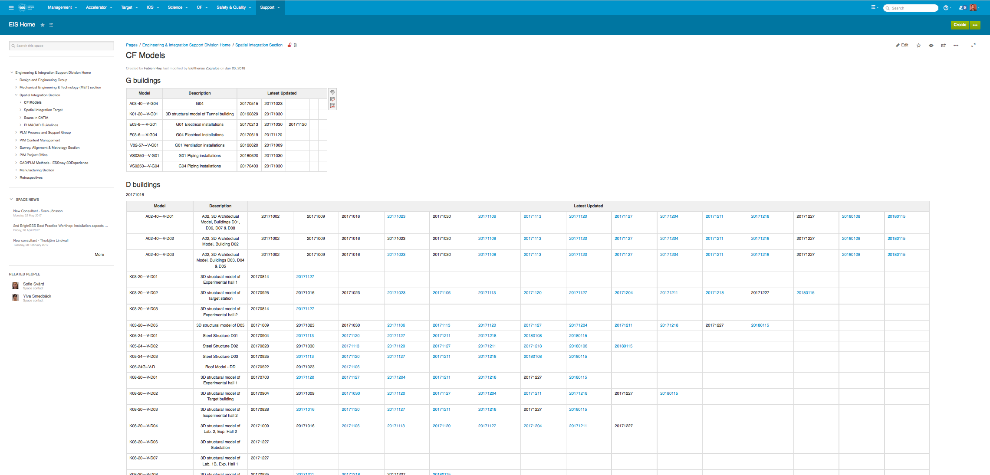
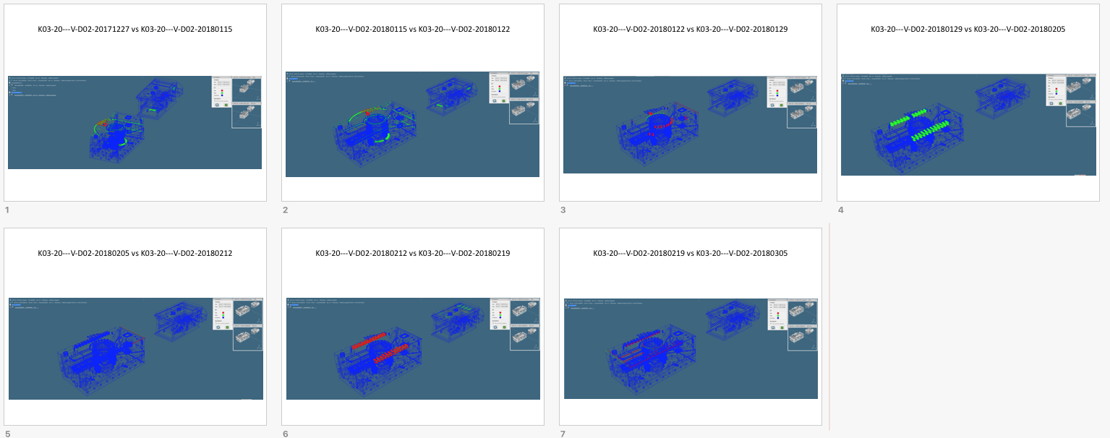
CF Models
https://confluence.esss.lu.se/display/EIS/CF+Models
CF MODELS
Huge effort to provide :
Overview of CF design lifecycle
Understanding of changes ( new vs old) via captures
Only produced for Target Systems
Complete overview of changes along Design Process
35

Slide 36
Connect part and LESS to FBS node
Find system in FBS in CHESS Connect Part
Connect Reference Documents
Part: Connect part
SIS Request
Create LESS
Assemble
Spatial Integration
FBS

Slide 37
Connect part and LESS to FBS node
Reference Documents: Connect as specification the LESS model Physical Product
SIS Request
Create LESS
Assemble
Spatial Integration
FBS

Slide 38
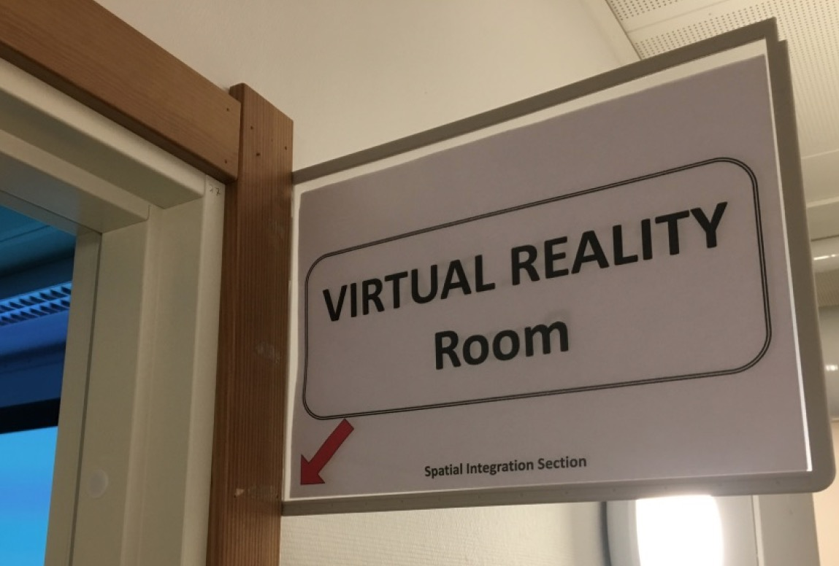
VR at ESS
Spatial Integration Section
Since mid September

Slide 39
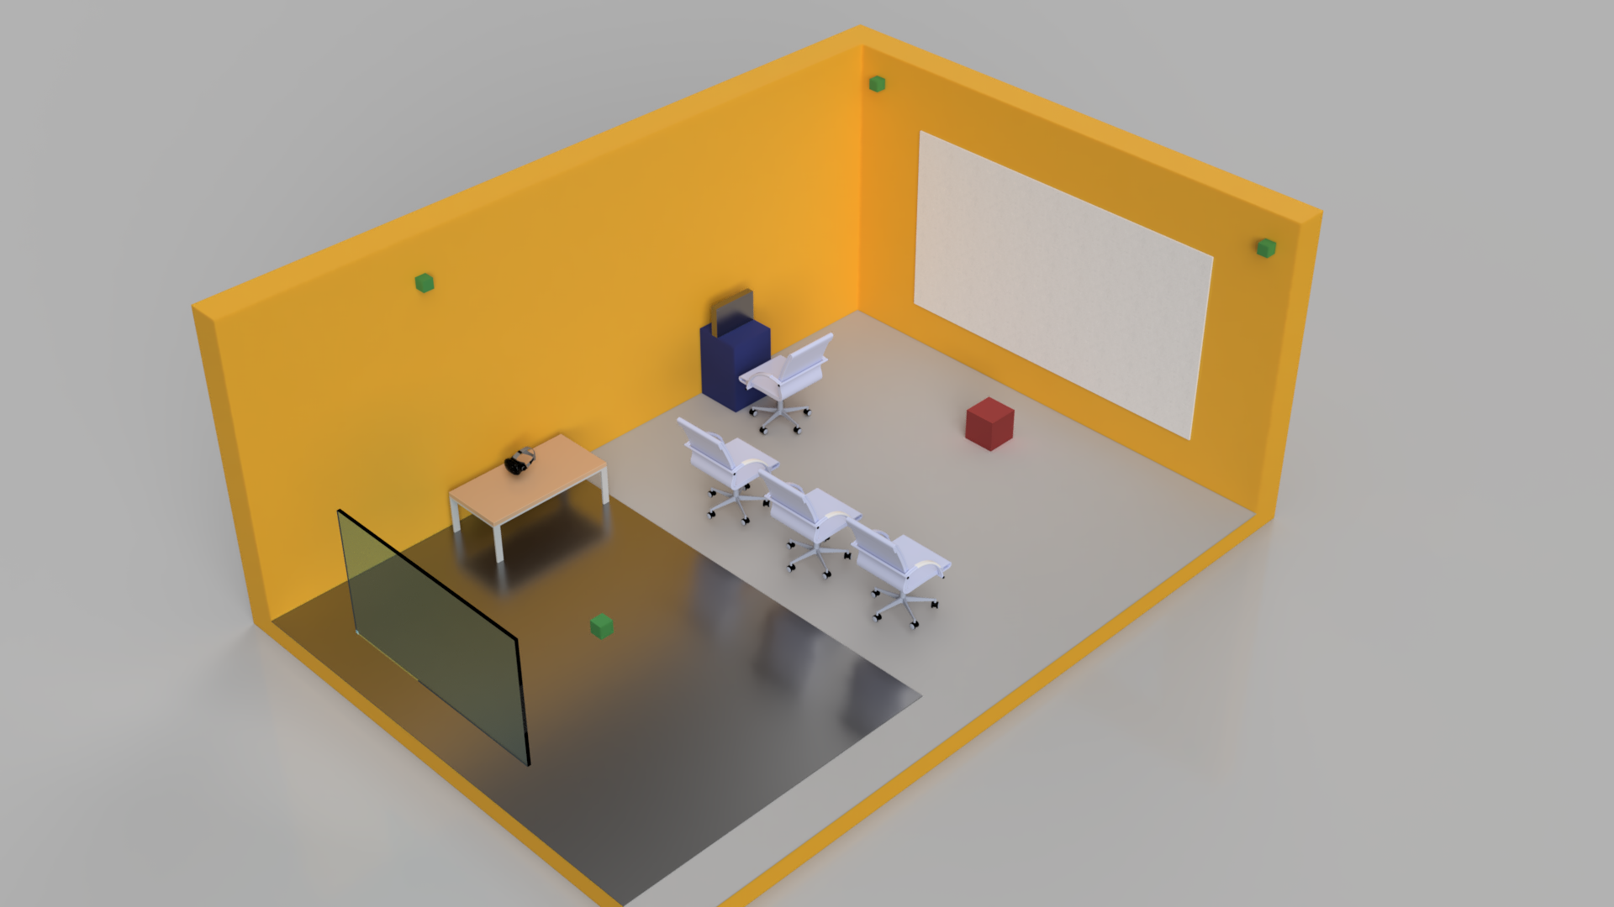
VR at ESS
Tracking System
Computers
Immersive Helmet
Cinema Screen
Tracking
System
Projector
wide angle lens
Monitor
ESS
Virtual Reality Room
Tracking area

Slide 40
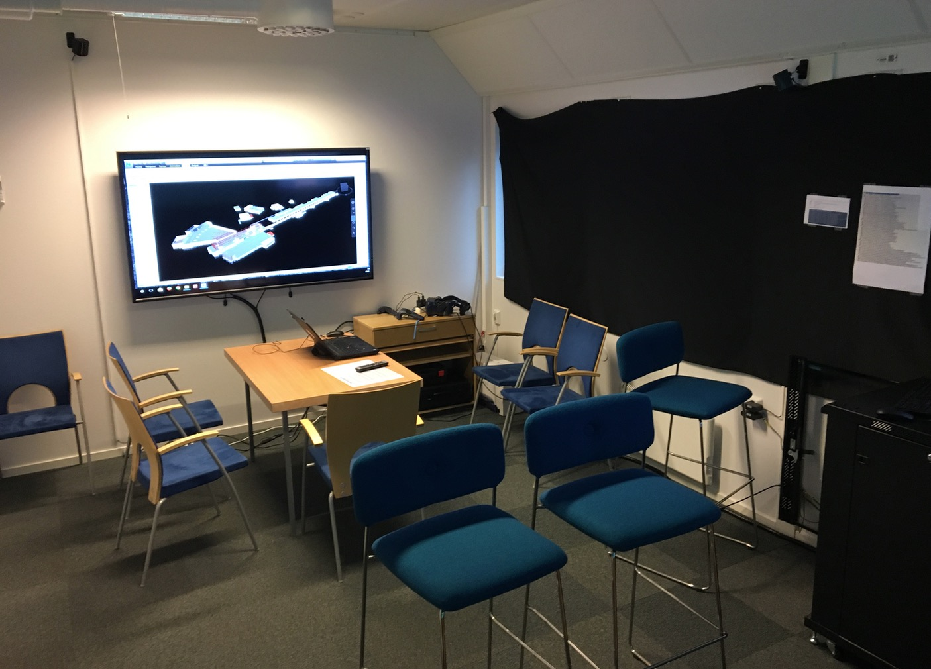
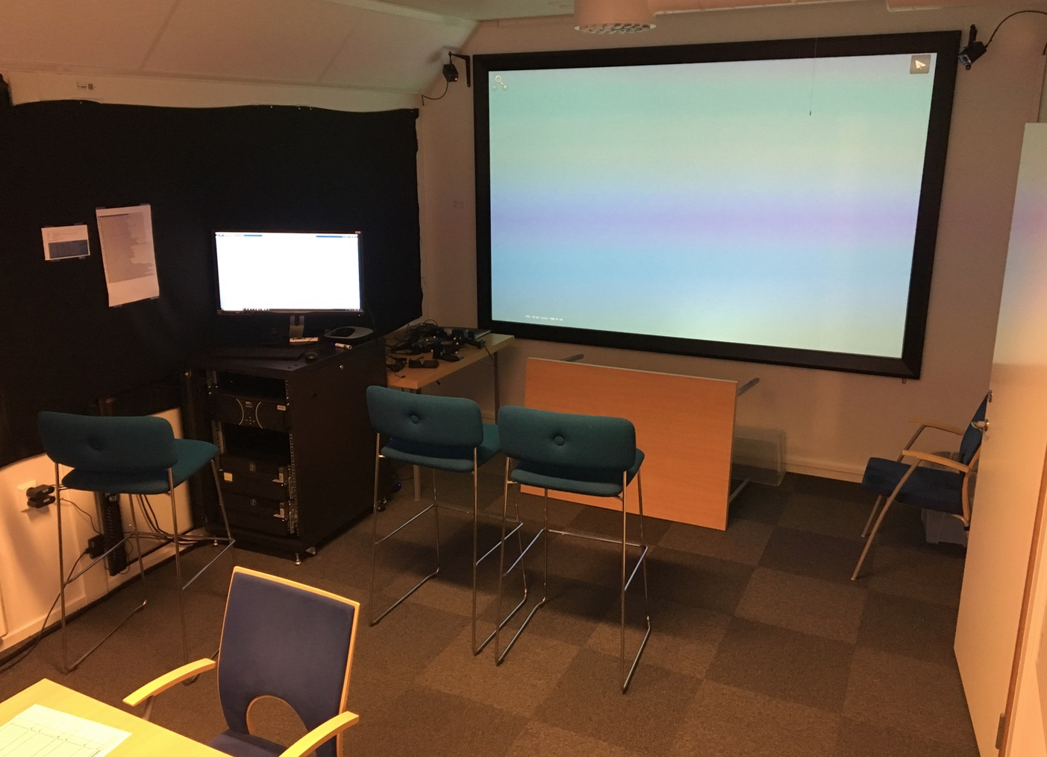
VR at ESS

Slide 41
VR at ESS
Spatial Integration Section

Slide 42
VR at ESS
Spatial Integration Section

Slide 43
VR at ESS
Spatial Integration Section
Live Visualization of CAD models
Master Computer
Rendering Computer
Projector
TechVIZ
Graphic CARD
Wouuuu !!!
OpenGL 3D data
Catia V6
Naviswork
In our data we trust!!
Engineering 3D Aveva

Slide 44
VR at ESS
Spatial Integration Section
Different applications:
Power Wall
Immersive Helmet
Collective Experience
One man Experience
Engineering Design
Engineering Design
Spatial Integration
Confined/ complex Area
Communication
Safety / Training
Safety / Training

Slide 45
VR at ESS
Spatial Integration Section
In the last month …….
many engineering visualization with design teams
Spatial Integration Meeting
REVIEWS
Many external visits
Communication
SSM

