Slide 1
ESS-Instrument Technical Interfaces
IKON 16
Gabor Laszlo
NSS Lead Instrument Engineer
www.europeanspallationsource.se

Slide 2
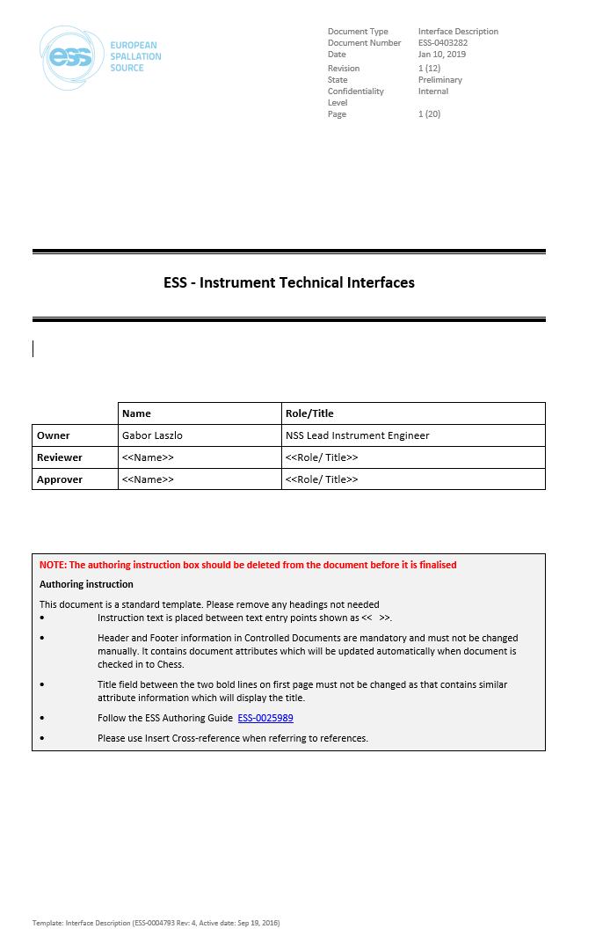
New Interface Document
ESS-0403282 - ESS - Instrument Technical Interfaces.

Slide 3
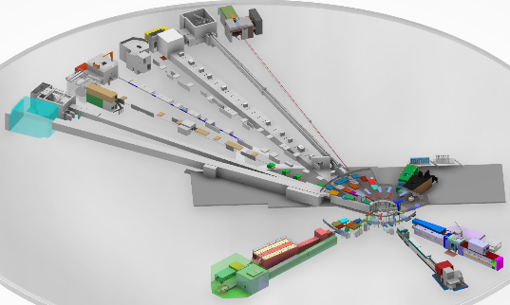
Content
1. Coordinate system (TCS)
2. Geometry interfaces
- Instrument models (Will change!)
ESS-0017897

Slide 4
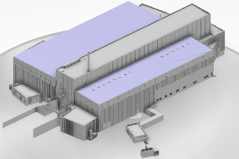
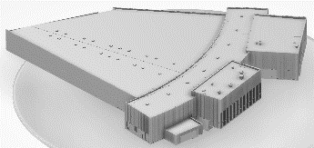
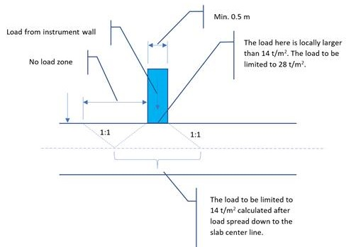
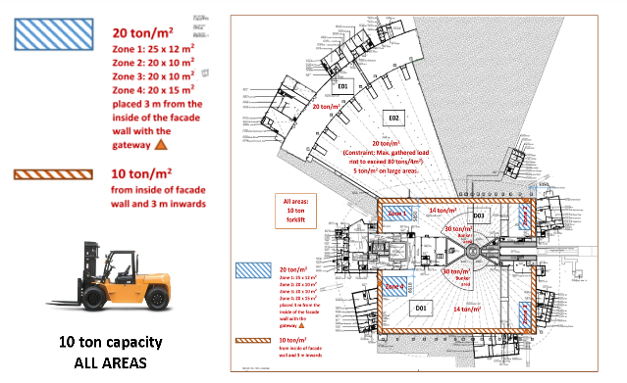
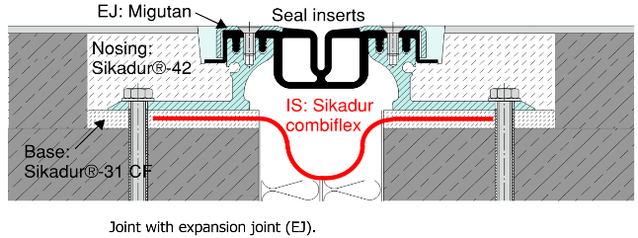
Geometry interfaces 1.
Building models, drawings, tolerances
ESS-0017891
Floor
  Geometry and treatment
  Load capacity and calculation
  Expansion joints,
  Anchoring
  Non magnetic area
  Piles
ESS-0029995

Slide 5
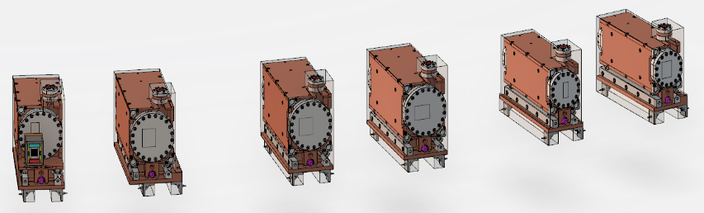
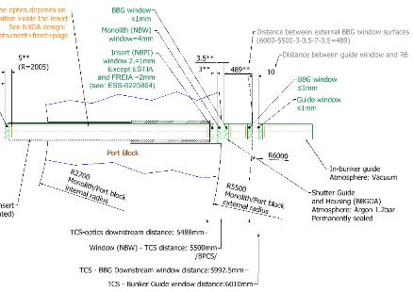
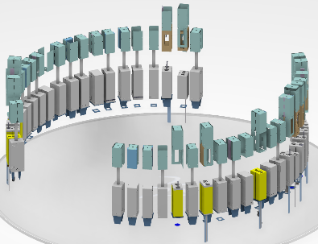
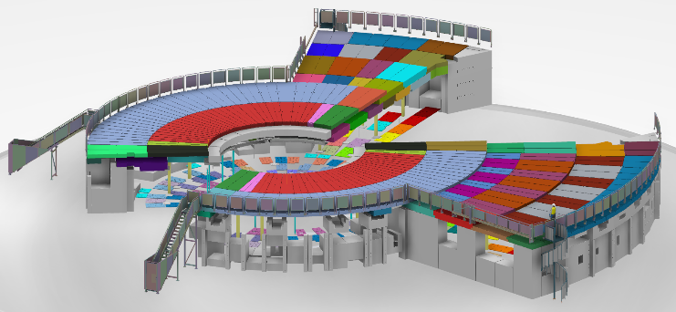
Geometry interfaces 2.
Monolith and Gamma Shutter components (Model and drawing references)
ESS-0358984
ESS-0376748
ESS-0053469
Bunker
  (Model and drawing references)
ESS-0047079

Slide 6
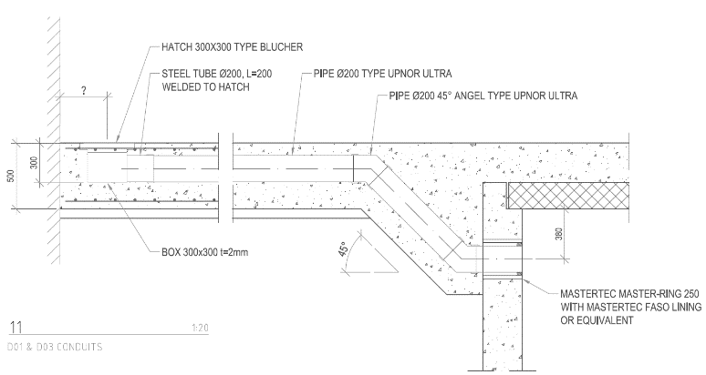
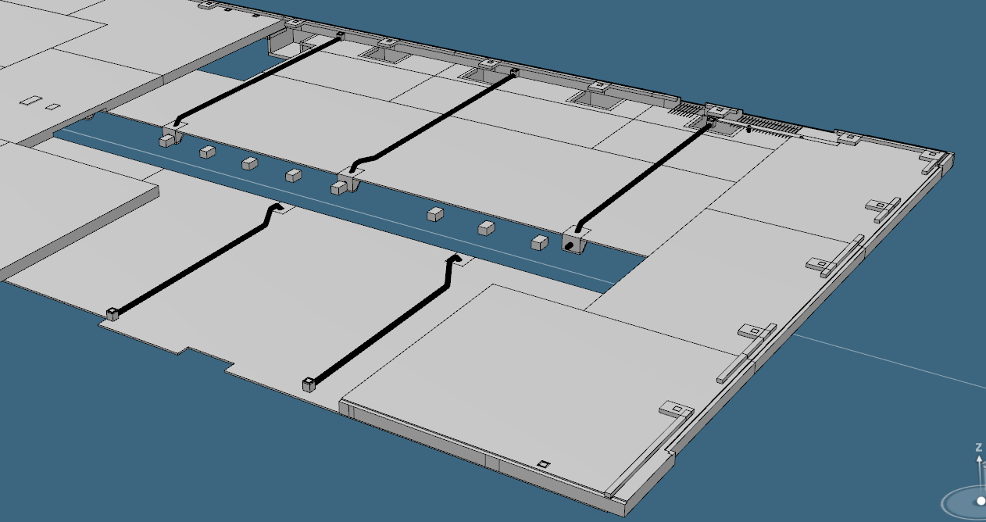
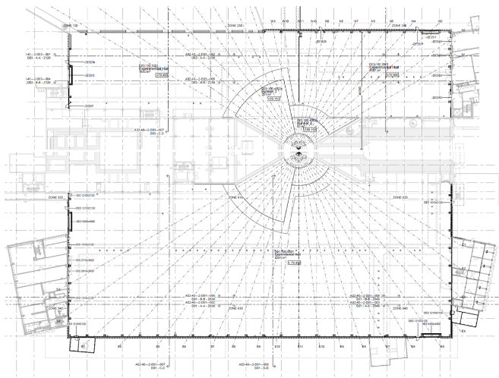
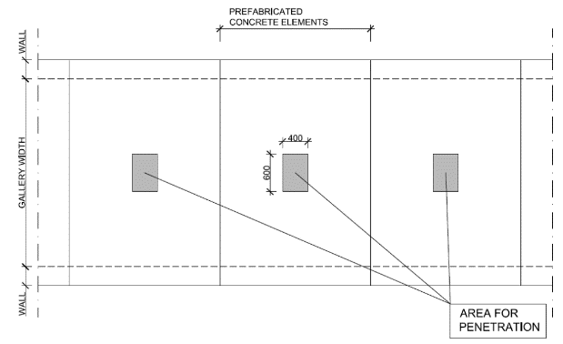
ESS Facility Infrastructure and utilities 1.
Relevant models, drawings, reference documents
Conduits
ESS-0346214
Floor penetrations

Slide 7
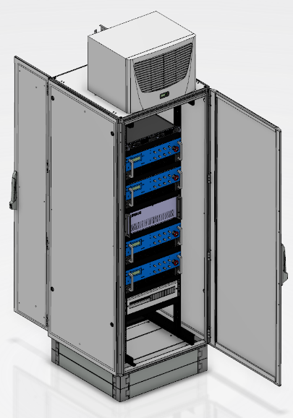
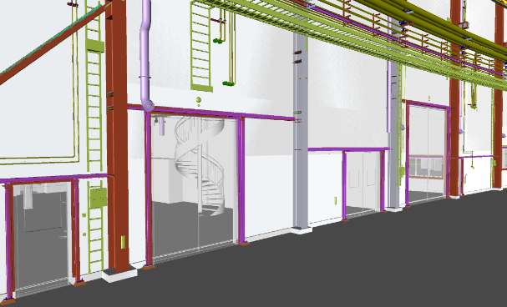
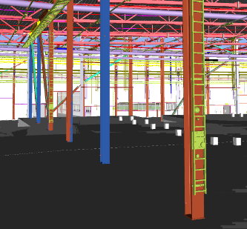
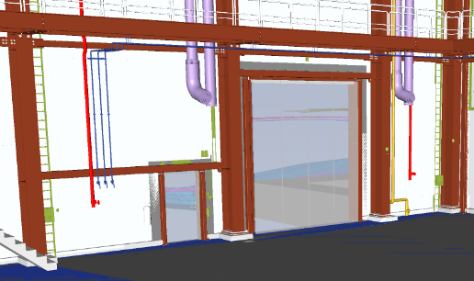
ESS Facility Infrastructure and utilities 2.
Standard ESS racks (To be detailed…)
Conventional Power
E01 connections
E02 connections
D03 connections

Slide 8
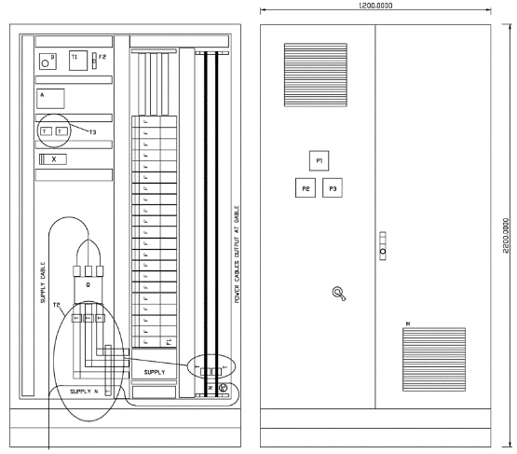
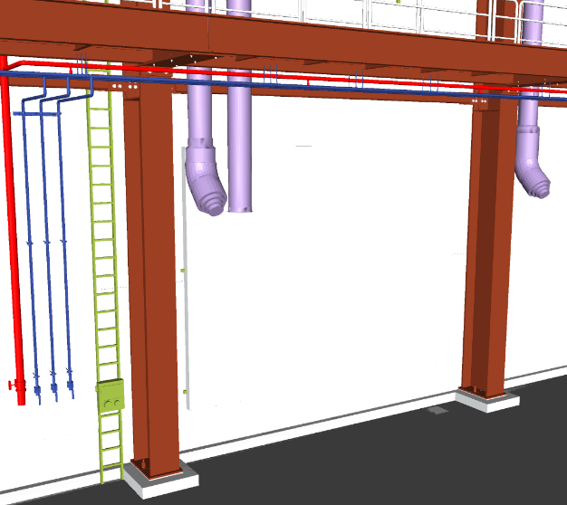
ESS Facility Infrastructure and utilities 3.
Instrument Power
Ventilation System
  Conventional
  Containment (Rad.waste)
  Fume hoods (Chemical waste)

Slide 9
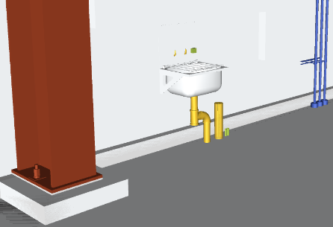
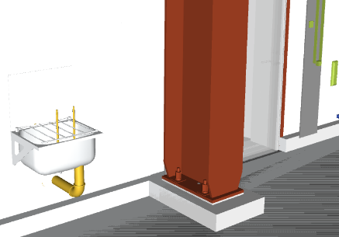
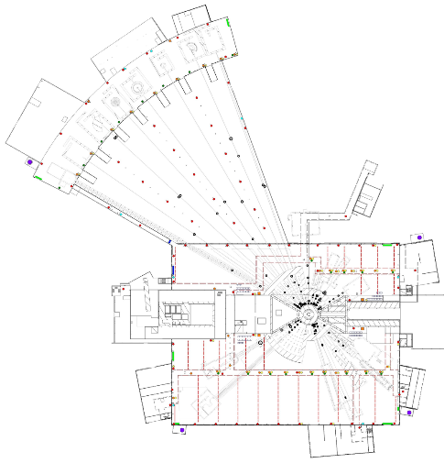
ESS Facility Infrastructure and utilities 4.
Domestic and waste water
West sector
2 water connections in E01 on the wall +
2 in E02 on the wall + 1 in D03 on the wall
2 drains to risk water system in E01
2 drain to radiological waste water system in E02

Slide 10
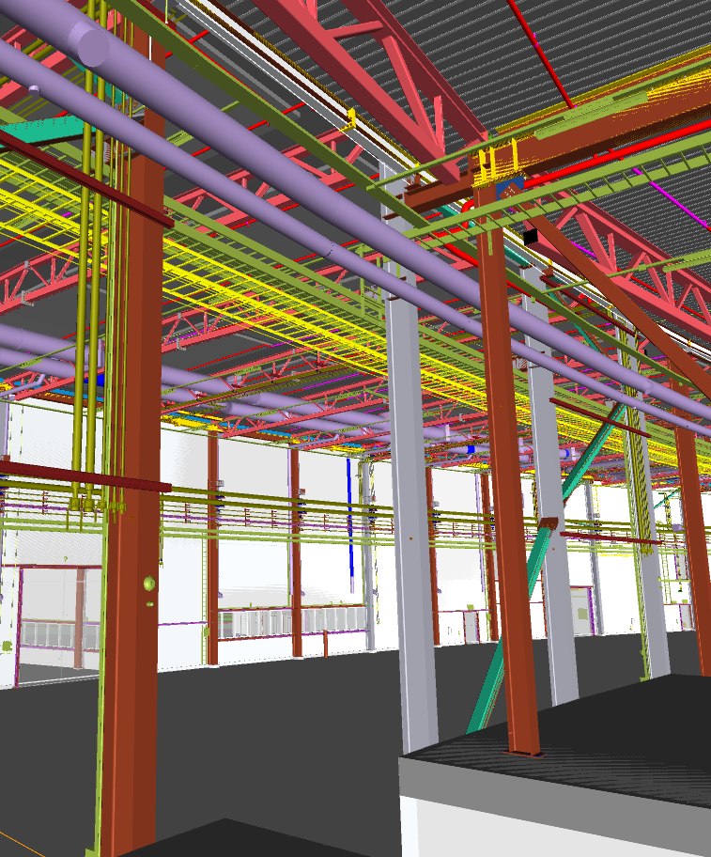
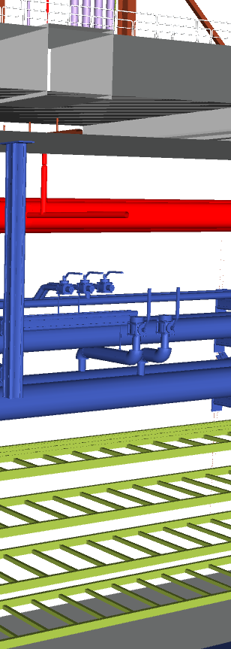
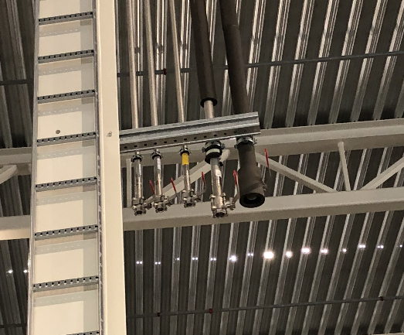
ESS Facility Infrastructure and utilities 5.
Cooling water system
Deionized water
Compressed air
Nitrogen
Deionized
  water (d25)
Cooling
  water (d40)
Nitrogen (d25)
Comp. Air (d25)
Klinger ball valve, Type KHA-SL

Slide 11
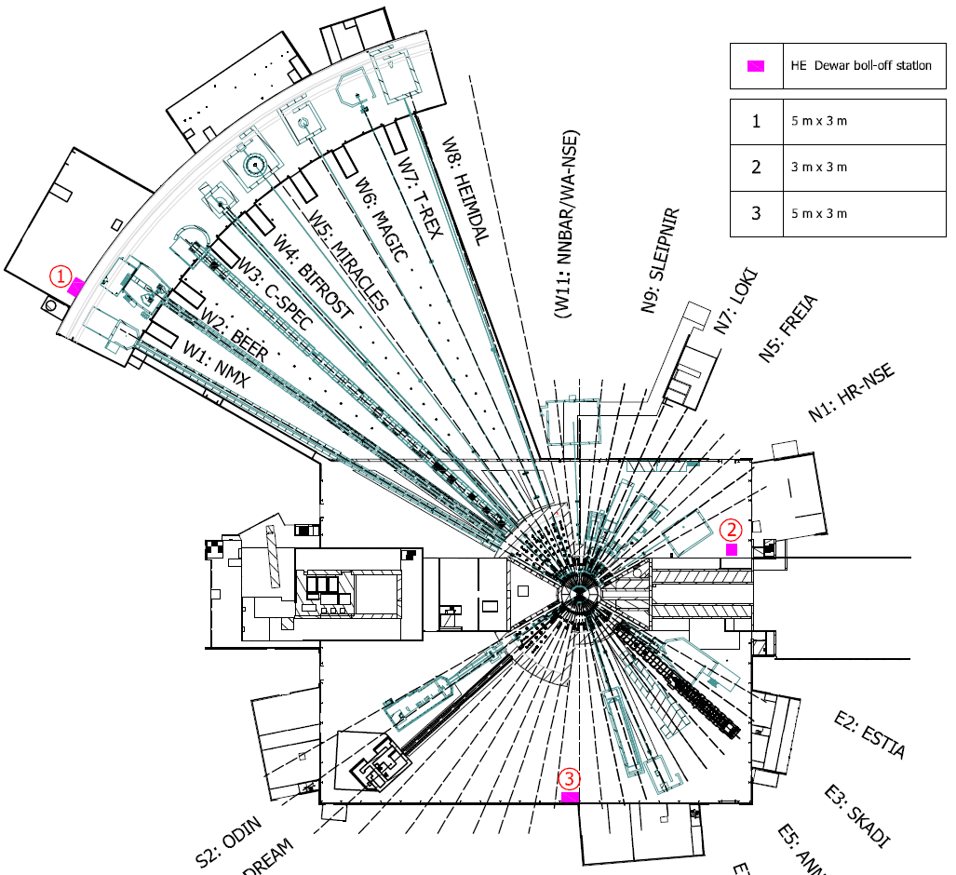
ESS Facility Infrastructure and utilities 6.
Argon gas
Liquid Helium
Helium gas
Hydrogen
Vacuum
Sprinkler system
LAN and ICS Networks

Slide 12
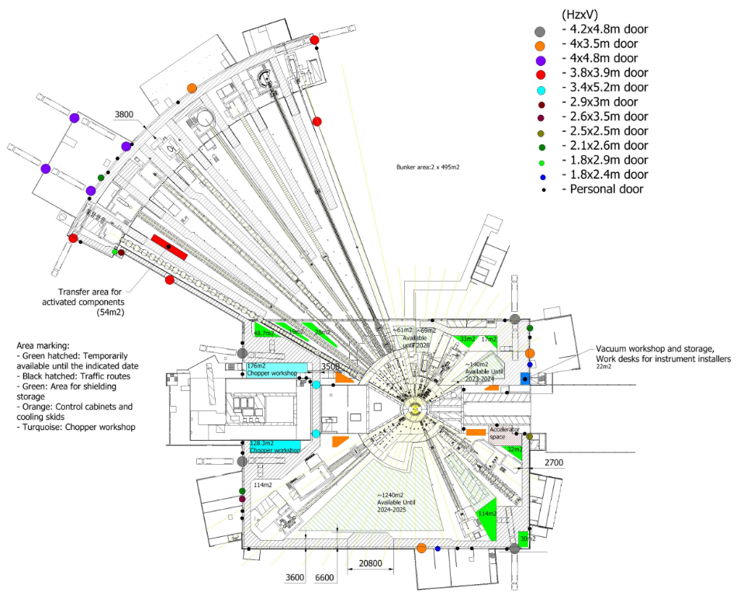
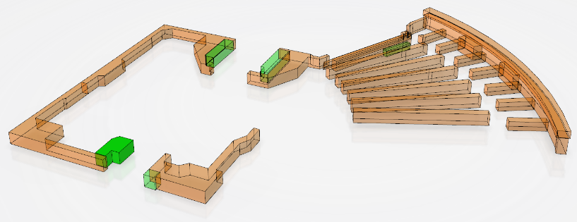
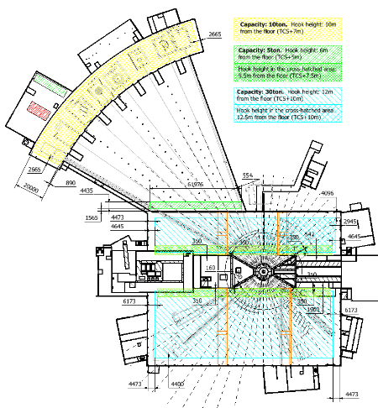
ESS Facility Infrastructure and utilities 7.
Logistics
ESS-0207007
Cranes

Slide 13
Thank you!

