Slide 1
DTL Faraday Cups Mechanical Design
Thomas Grandsaert
Development Engineer
www.europeanspallationsource.se
13 December, 2018

Slide 2
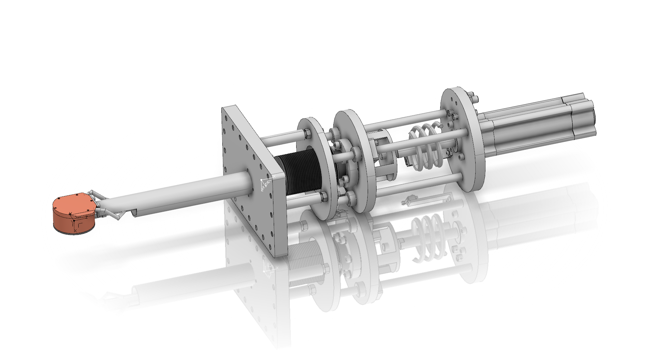
DTL Faraday Cups Full system
Spring
Bellows
Pneumatic actuator with at
least 120mm stroke
ComVAT WS flange
FC
Catia #’s for conceptual models: DTL4 FC - ESS-0489247 (LOM D)
DTL2 FC - ESS-0242320 (LOM D)

Slide 3
Fluka >> ANSYS Geometry
5 mm length
35 mm length

Slide 4
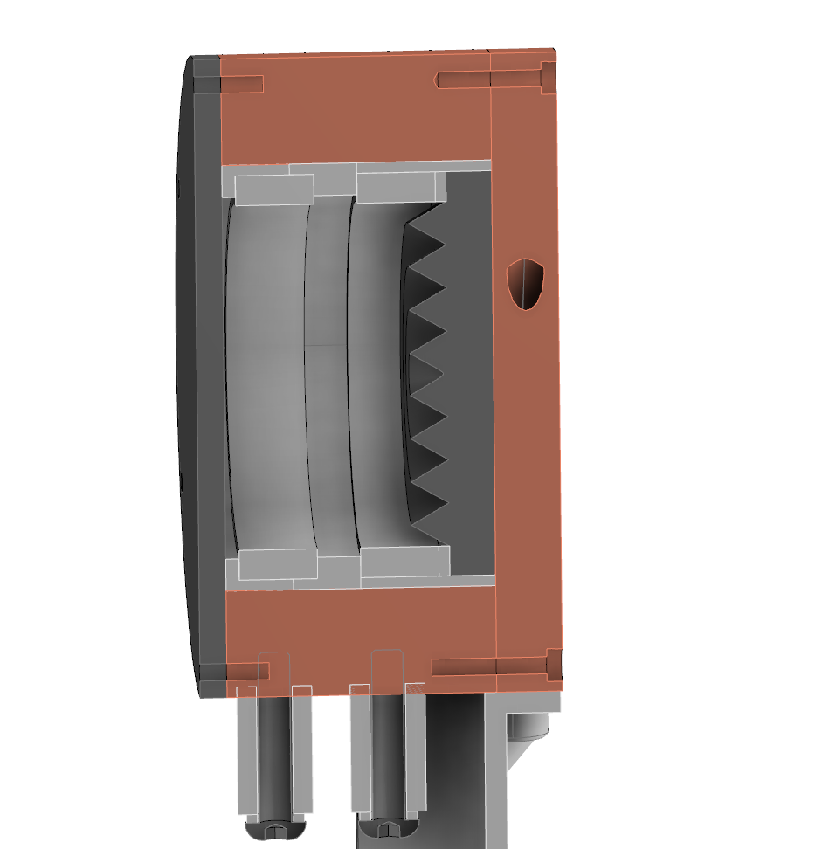
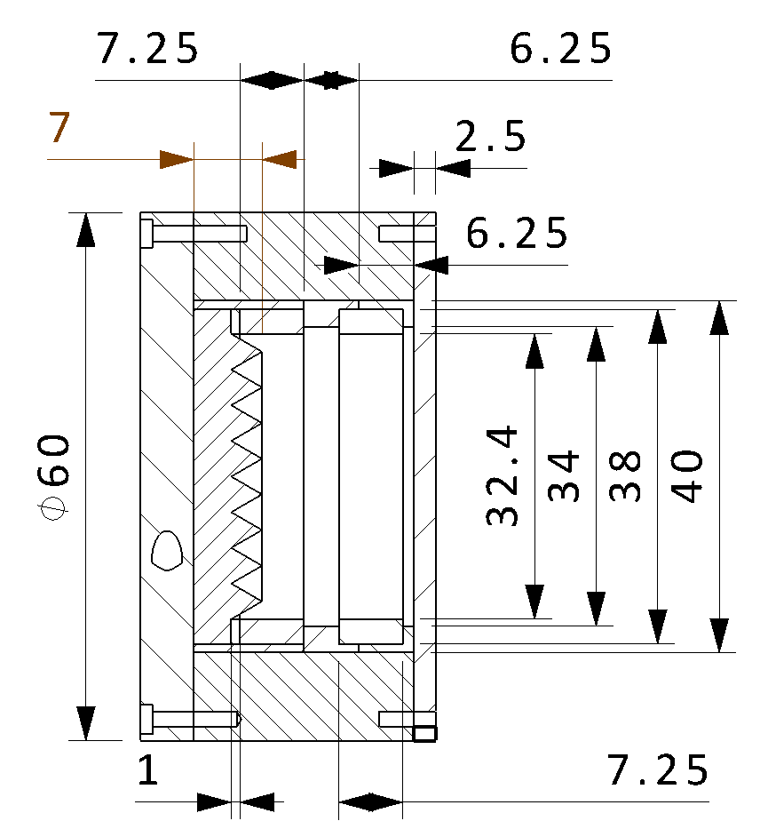
DTL Faraday Cups DTL2 Design
Copper wall and spring wafer
Repeller electrode
Cooling plate
Graphite collector
Graphite foil
degrader
Macor insulator
Redundant “cargo-culted” alumina insulator removed

Slide 5
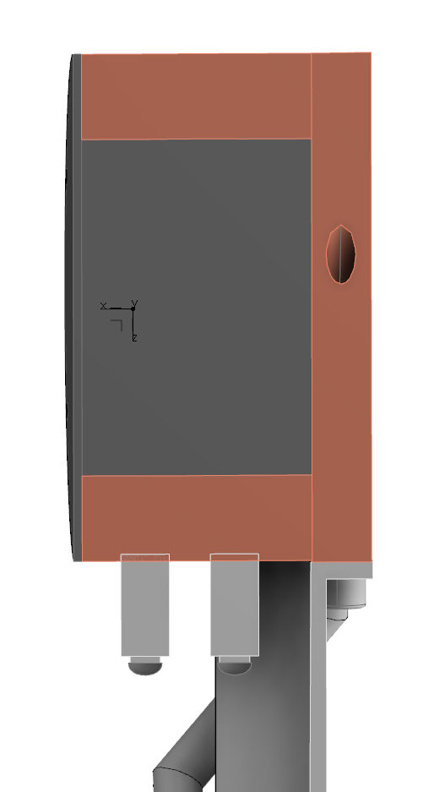
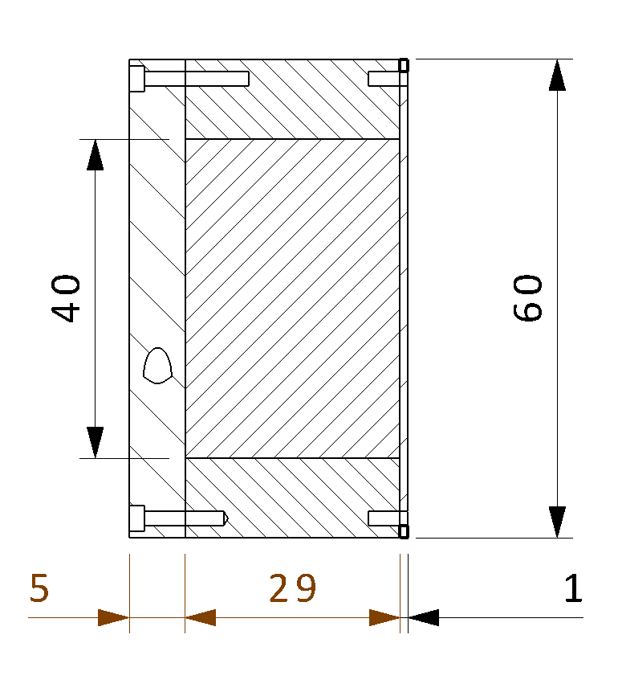
DTL Faraday Cups DTL4 Design
Copper wall
Cooling plate
Back plate thickened to 5mm to help with heat conduction
Graphite collector
TZM foil
degrader

Slide 6
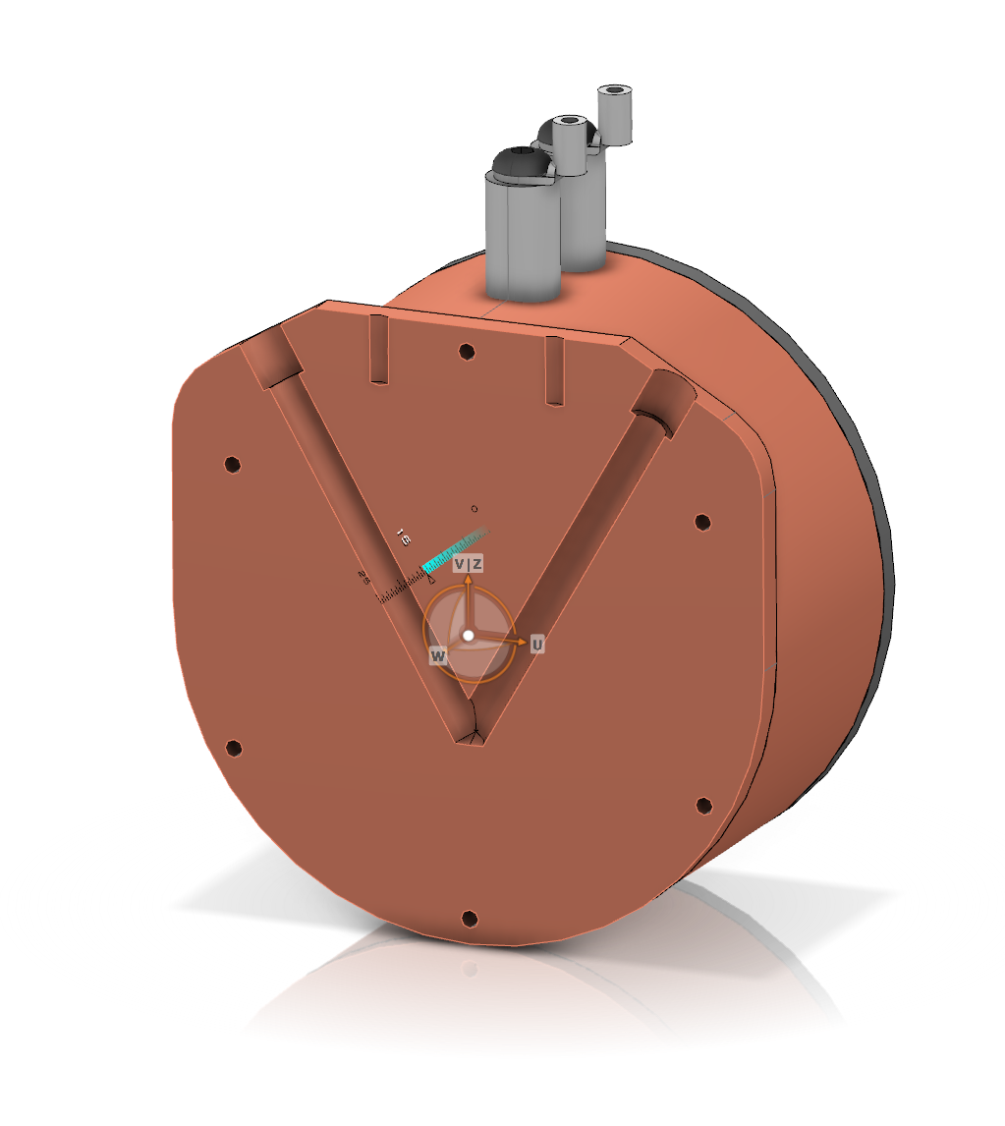
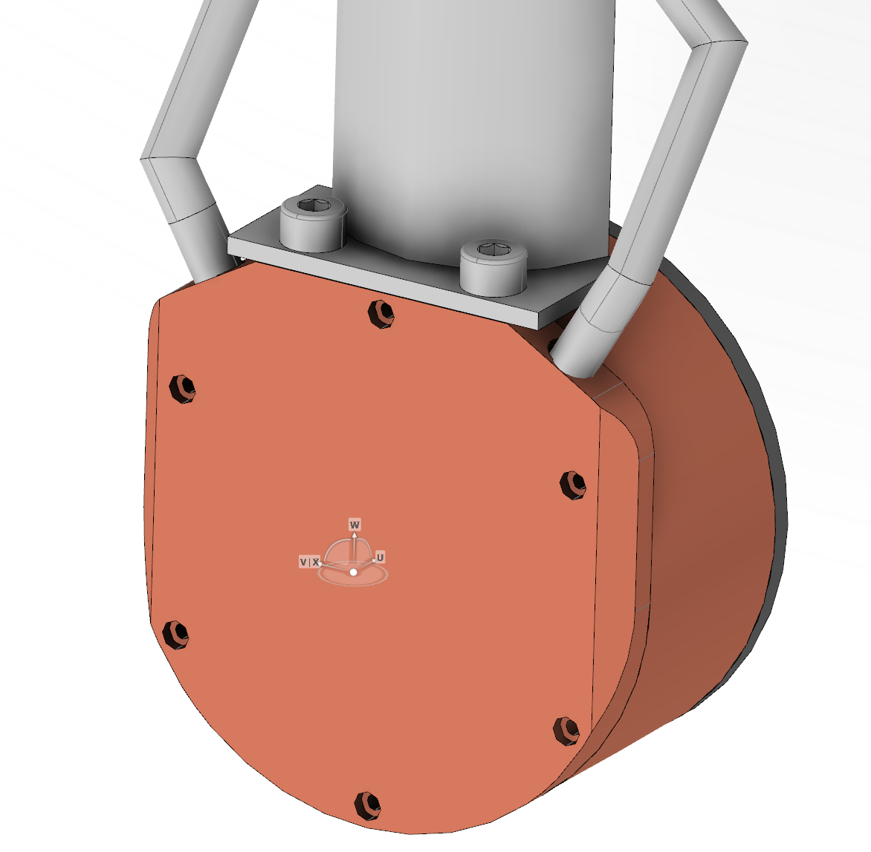
Mechanical Design Cooling
V-shaped cooling channels

Slide 7
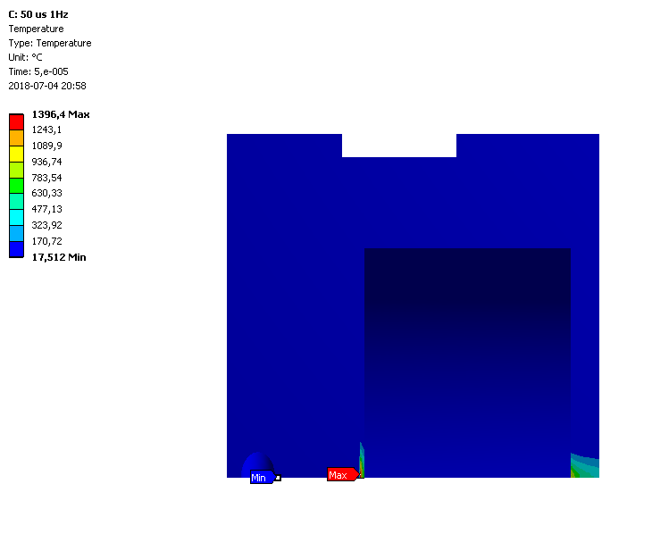
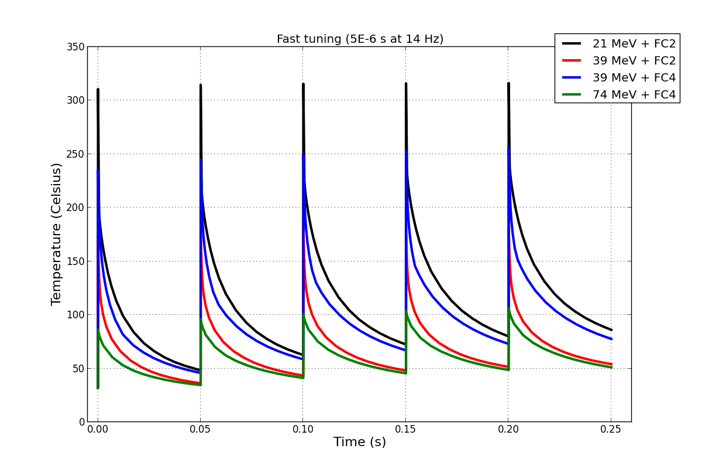
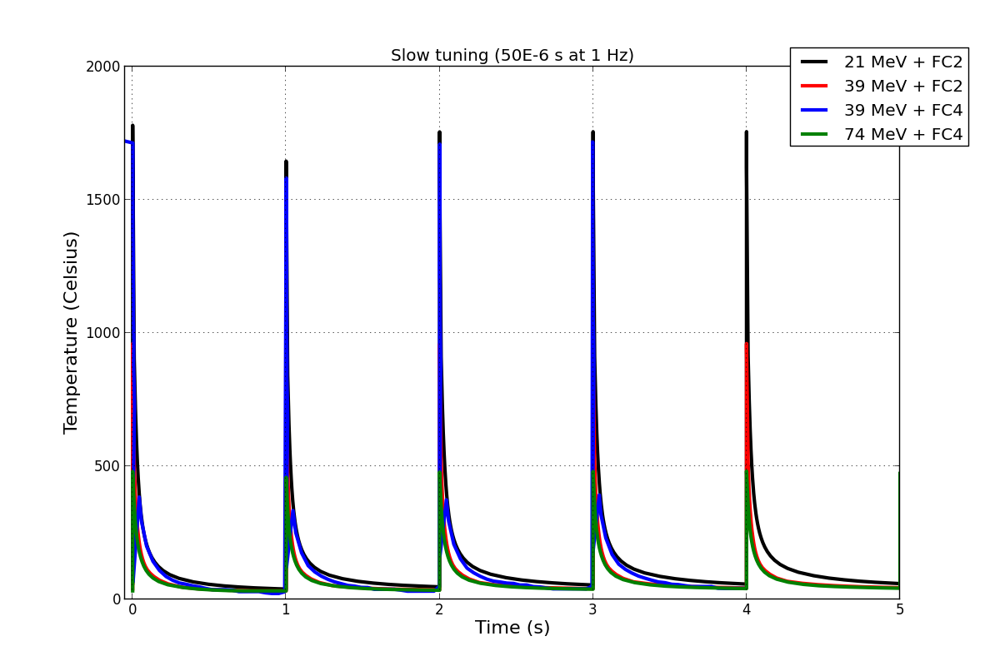
Mechanical Design Cooling
At the suggestion of Angel from Bilbao, a more detailed cooling channel simulation was modeled for the worst case from the DTL2, for which the peak temperature dropped about 8%

Slide 8
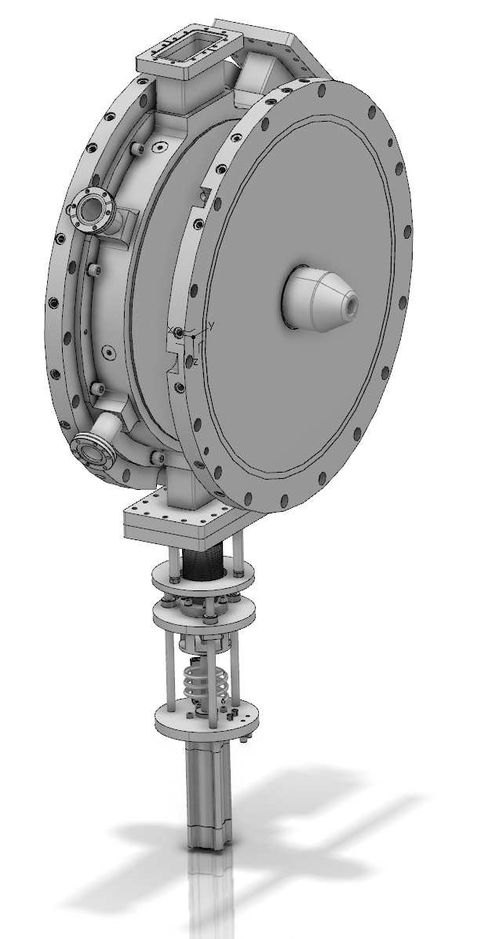
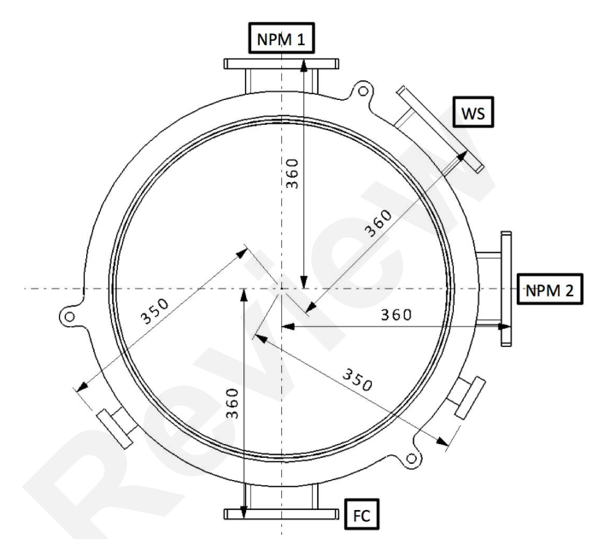
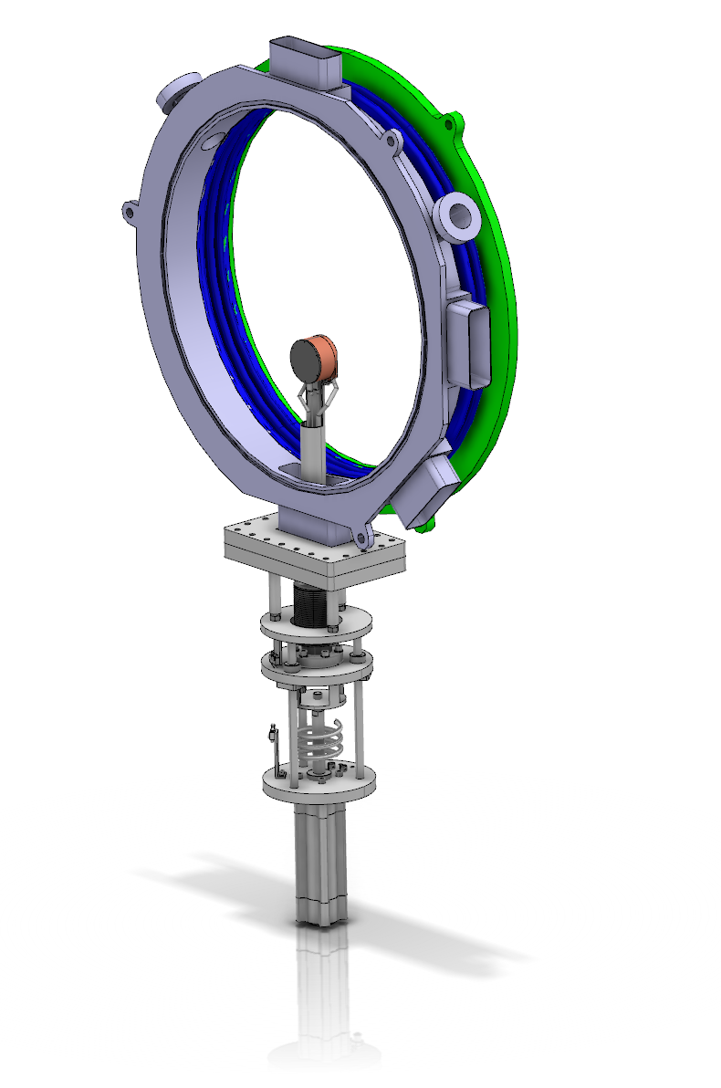
DTL Faraday Cups Intertank integration (11/20/18)
previously…

Slide 9
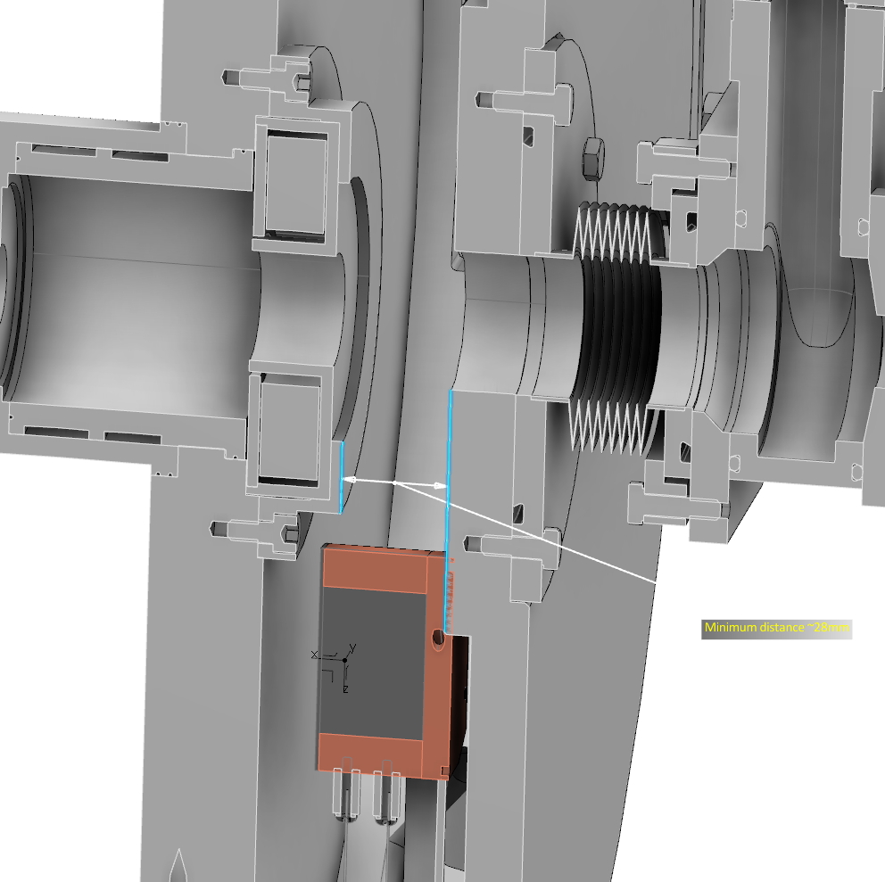
DTL Faraday Cups Intertank integration (11/20/18)
Upon request, Macro Nenni has helped us by increasing the intertank aperture to
45 x 113 mm.
Although the FC now easily fits through the intertank aperture, there is a clash in the center of the intertank with the BCM and the downstream wall.

Slide 10
DTL Faraday Cups Intertank integration (11/20/18)
Possible solutions:
Reduce size of both faraday cups and change materials of DTL4 configuration
Supplicate Legnaro team for more space in the intertank

