Slide 1
CDR DTL FCs
Electronics, motion control and verification
www.europeanspallationsource.se
Lund, December 13rd 2018

Slide 2
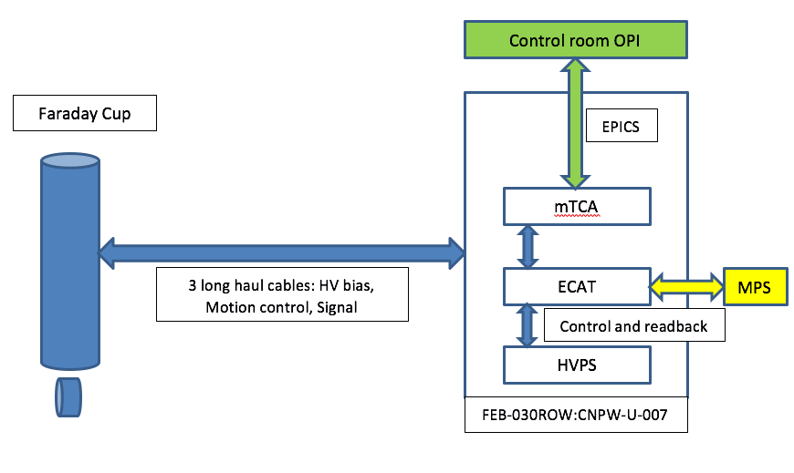
Electronics – system overview
All LINAC FC electronics located in FEB-030ROW:CNPW-U-007
Based on mTCA upgrade of the LEBT FC system
Motion control, Interface with HVPS and MPS: EtherCAT
Additional feature on DTL FC: Low latency link with BCM for differential measurements

Slide 3
Electronics – system overview
One mTCA crate for all systems, equipped with:
MRF EVR
CPU
PS
MCH
Signal acquisition: Struck SIS8300 AMC and SIS8900 RTM
Same hardware family as the BCM. Facilitates the low latency link implementation
Front End: Consists of a resistor and surge protection (added after Catania experience) at rack patch panel level. Cable length on DTL FC is double the one of the LEBT FC (60m vs 30m). FE Electronics in the tunnel is avoided if possible.
One ISEG HV module per FC
One Ethercat crate for all systems
Interface with MPS:
Movement permit in
Cooling status out
Controller health status out

Slide 4
Electronics – Front End
Requirements:
Accuracy: 10 % FS (→ 10 mA)
Bandwidth: 300 kHz
mainly limited by cable length
LEBT cable length: 30m, DTL: 60m
Overvoltage protection: using a surge arrestor and protection diode at the back of the RTM
Based on simulations and measurements results on the LEBT FC system, extrapolating for twice longer cables:
→ Better than 2 MHz bandwidth
→ Better than 1 mA pkpk noise
To Do: verification tests with long cables in lab. We can use a twinax cable reference for lower capacitance

Slide 5
Ethercat – system overview
Each Faraday Cup uses the following modules
ES3602: analog input, bias current and voltage read back from ISEG (2 channels module)
ES4134: analog output, ISEG bias current and voltage setpoints (4 channels module)
ES2124: digital output 5V, ISEG bias output control (4 channels module)
ES2004: digital output 24V, move FC, MPS outputs (4 channels module)
ES1014: digital input 24V, in and out switches readout, water flow sensor, MPS input (4 channels module)
EL3214: 4-channel input terminal PT100
To and from mTCA: Ethernet
ECAT
+ To and from MPS PP, 3 cables
To and from HVPS (ISEG, SUBD9)

Slide 6
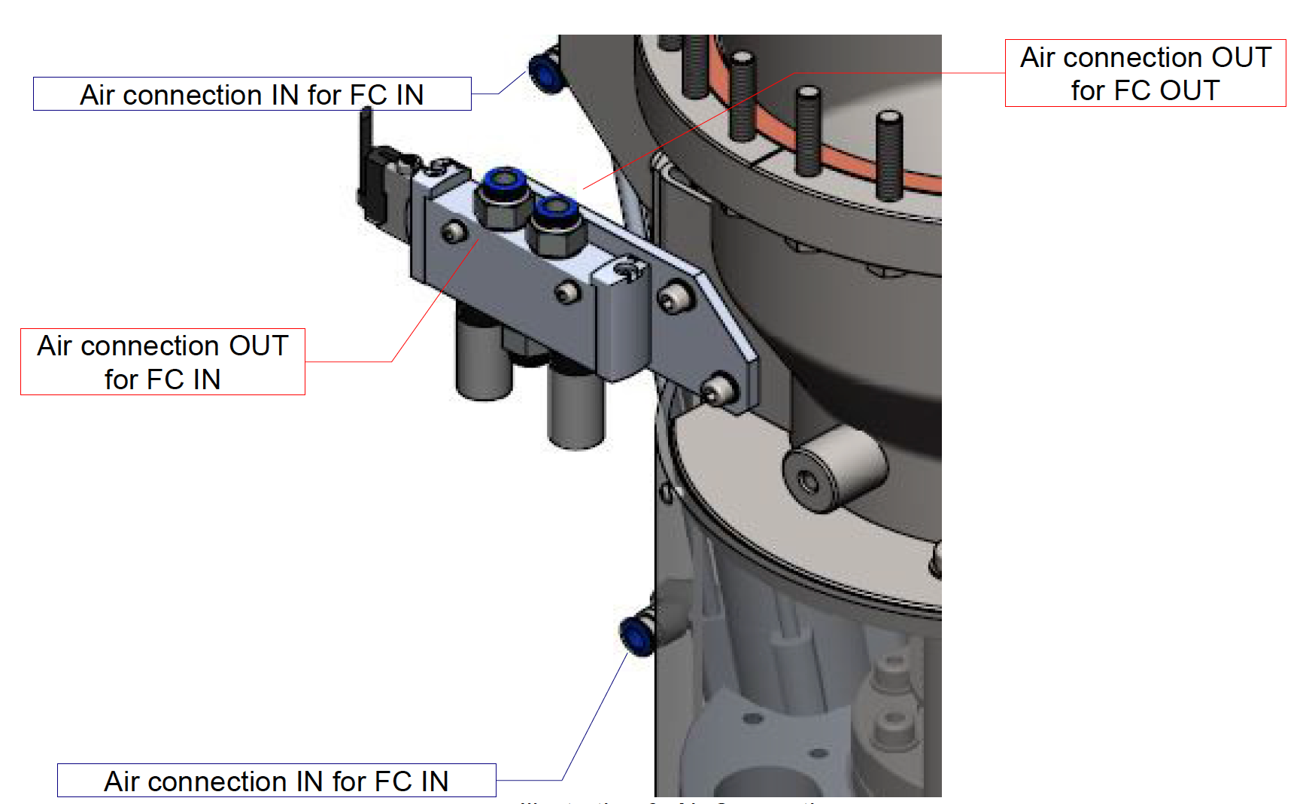
Ethercat - motion
Faraday Cup motion: pneumatic actuator
Based on a Festo electrovalve reference
2 sets of end of stroke switches:
one directly connected to MPS
one connected to EtherCAT control system
FC moves out of beam if we loose power on the LEBT system

Slide 7
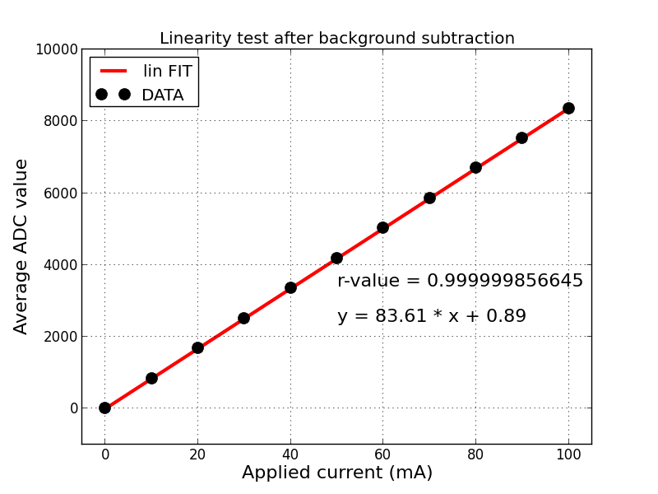
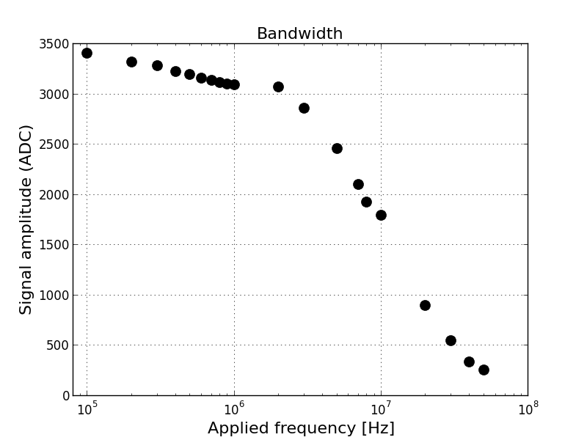
Verification
LEBT FC verified before first beam
Handed over to operation, although verification with beam not complete
First beam measured in september
Same verification will be performed sequentially on the DTL FC channels
Verification in BD lab
cold check-out
commissioning with beam
Differential measurements tests with BCM added to verification plan

