Slide 1
DTL Faraday Cups ICS Contribution
Thomas Fay & Saeed Haghtalab
ICS
www.europeanspallationsource.se
2018-12-13

Slide 2
Background – PDR Conclusions
Pretty good idea what to do .. but lots of assumptions and open questions to iron out
Re-use proven solutions if possible (LEBT FC)
Use ESS ICS supported modules (Ethercat, EVR)
Provide modular FC system software (ready for integration into ICS EPICS environment).
By CDR be ready to hand over to ESS ICS.

Slide 3
Background – CDR Objective
The revisit the assumptions of the PDR.
Important Milestones
1) LEBT FC now running.
2) New ICS Epics Environment E3 running (subset of systems).
3) ECMC E3 module released internally with ESS.

Slide 4
Background -PDR Comments on platform and work split
From Hinko
Prefer ESS supported software support for standard platform and its constituents (if stable).
Application specific software is expected to be developed by ESS AD/BI section.
Platform specific software and support is expected to be delivered by ESS ICS.
From ICS
Facility integration support (to ICS) from ICS.

Slide 5
System Requirements
From ESS-0489440 – Design of DTL Faraday Cups

Slide 6
ICS standard components (WP04) – Control Box

Slide 7
ICS standard components (WP04) EtherCAT
0 EK1100 EtherCAT-Coupler
1 EL3602 AI ±10Volt, Diff. 24bit
2 EL4134 AO ± 10V. 16bit
3 EL2004 DO 24V, 0.5A
4 EL1014 DI 24V, 10ms
5 EL9505 Power Supply, 5V
6 EL2124 DO 5V, 20mA
This setup has been verified on LEBT installation.

Slide 8
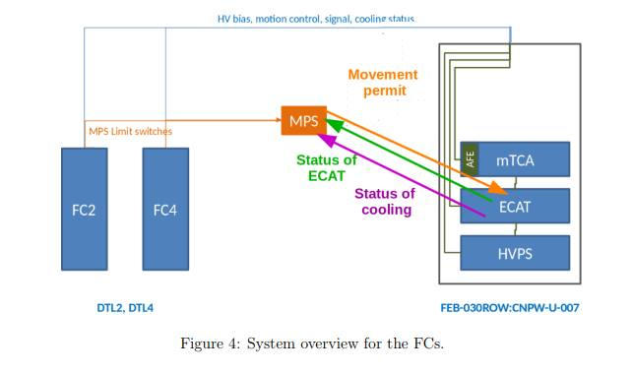
MPS Interface

Slide 9
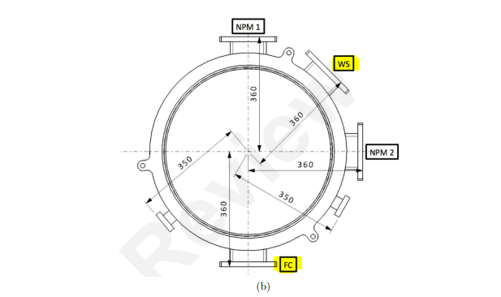
Collision Avoidance System Requirement

Slide 10
Collision Avoidance System Requirement
It is preferred this collision avoidance system is implemented on the same PLC framework that the EtherCAT motion control utilises.
Note that this differs from LEBT approach.
On LEBT Siemens PLC hosts this system.

Slide 11
Comments of PDR for ICS
“There is no standard solution enforced or foreseen for EtherCat master. Any CPU running linux would be used.”
The preference would be to use the same Concurrent CPU board as for LEBT. Be advised that “Concurrent Technologies will soon discontinue i7 gen3 CPU family. Replacement with Xeon CPU.”

Slide 12
Recommendations of PDR for ICS (1 of 4)
“Assurance that the timestamps of the Timing System are used by the IOC.”
LEBT FC verification should provide this assurance.
“Add differential current measurement between DTL2 FC and upstream BCM in documentation (including MPS).”
At time of CDR this is not implemented.

Slide 13
Recommendations of PDR for ICS (2 of 4)
“Deploy local protection features on LEBT FC to gain operational experience.”
At the time of the CDR the local protection features for collision avoidance are not yet fully tested.
“Clarify how the MPS motion blocking function will be implemented.”
No spring loading of actuator. So MPS permit rules the motion functions.

Slide 14
Recommendations of PDR for ICS (3 of 4)
“Assure that there is agreement within ICS on software for interlocks. For example, it appears that things like comparing temperature against a threshold could easily be implemented in software.”
This is demonstrated with ICS designs for software interlocks in DTL temperature monitoring.

Slide 15
Recommendations of PDR for ICS (4 of 4)
“Verify if devices need to be designed to be fail safe, i.e. ensure passive shutdown of machine when burnt through.”
MPS will shutdown machine in advance of burn through of FC.

Slide 16
Application handover from BI to ICS
Captured in JIRA and documentation in Confluence
WP7FC-8
https://confluence.esss.lu.se/display/BIG/LEBT+FC+Release+2.0
From ICS side we see no showstoppers for this handover.
Main Tasks
1) Migration of application into ICS Epics Environment E3.
2) Low latency link between DTL2 FC and upstream BCM.

Slide 17
Verification Plans
As for LEBT excepting:
Collision avoidance system platform change.
However, the verification method can be agnostic of platform.

Slide 18
Questions
???

