Slide 1
Summary of Target Station
Accident Analyses
Linda R. Coney
Group Leader – Target Controls & Safety – TD
TSS CDR1
www.europeanspallationsource.se
Dec 10, 2018

Slide 2
Outline
Hazard Analysis Scope & Accident Analysis Procedure
  Qualitative (HA) & Quantitative (AA)
Accident Analyses Results
  Monolith
  Active Cells Facility
Safety Function identification
  Safety SSC selection
Conclusions

Slide 3
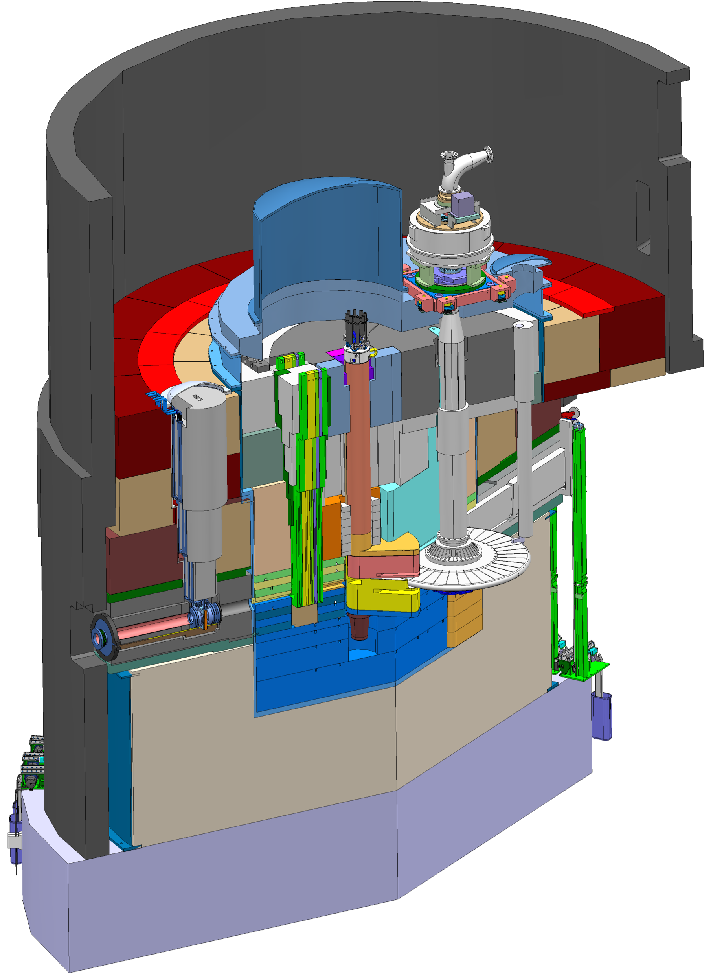
Key features of the ESS Target Station
Moderator and reflector
Target Safety System
Monitors target coolant flow, pressure and temperature, monolith pressure,
& target wheel rotation
Prohibit beam on target if parameters are outside specified limits
proton beam instrumentation plug
Helium cooling of target material
Mass flow 3 kg/s
Pressure 11 bar
Temperature inlet/outlet 40 °C/240 °C
monolith vessel
neutron beam extraction port
Rotating solid tungsten target
36 sectors
Mass, total 11 tonnes, whereof 3 tonnes of W
Rotates 23.3 rpm, synchronized with pulsed proton beam 14 Hz
proton
beam
target wheel
target monitoring plug
proton
beam window
Diagnostics and instrumentation
Controlled and integrated commissioning and operation of the accelerator and target
Fluorescent coating of PBW and target front face
Optical paths, grid profile monitor, aperture monitor
Wheel monitoring including position, temperature, vibration, as well as internal structure
Moderators
Provisional locations of moderators above and beneath the target wheel, i.e. monolith centre
1st MR plug exploits the upper space, offering:
  Cold, 30 mm high, liquid H₂ moderators, 17 K
  Thermal, 30 mm high, H₂O moderator, 300 K

Slide 4
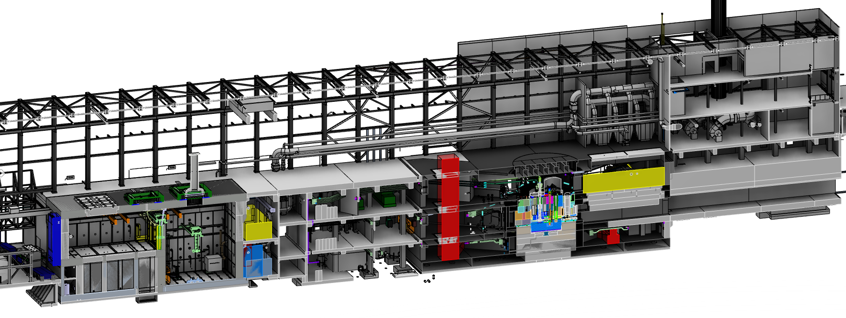
Key features of the ESS Target Station
Utilities and cooling plant
Helium cooling of target wheel
Water cooling of moderators, plugs and shielding
Intermediate water loops between primary circuits and conventional facility utilities
Helium cryoplant for refrigeration of cold moderator system
Nuclear grade HVAC system
Remote handling systems
Large active cells for safe storage and processing of spent radioactive target components
Shielded casks for transfer of spent components from monolith to active cells
High bay
22 m
130 m
Transport hall
37 m
Target
monolith
Active cells
Utilities block
Beam expander hall

Slide 5
Hazard Analysis Scope
Moderator Systems
Water Moderator
Reflector System
Cold Moderator
Target Moderator Cryoplant System
Fluid Systems
Active Liquid Purification system
Primary Water Cooling Systems
Intermediate Water Cooling Systems
Intermediate Water Cooling for Water Systems
Contaminated Tanks
Gas Delay Tanks
Target Systems
Target Wheel & He Cooling
He Purification
Target HVAC System
Remote Handling Systems
Active Cells Operations
Monolith Systems
Monolith vessel incl. covers and penetrations, NBW, PBW
Shielding systems
Tuning Beam Dump

Slide 6
Accident Analyses – Quantitative HA
Identify set of formalized design basis accidents from hazard analysis
  350 Top Events from qualitative HAs
  Selected 22 bounding scenarios for further study g Accident Analyses
  At least one event from each of the major types identified in HA
  If prevented or mitigated, the group does not require additional safety functions
Accident Analysis inputs
  Inventories
    Tungsten ✔ Target cooling helium ✔
    Moderator water ✔ Reflector beryllium ✔ Reflector water ✔
    Active Cells Facility contamination level during cutting ✔
    Dose map from activated wheel in ACF ✔
  Dose calculation procedures (ESH) ✔
    For both dose to worker and to reference member of the public
  Allowable dose limits ✔
    Public (SSM)

Slide 7
Accident Analysis Input – Dose Limits
Protect public from unsafe levels of radiation
Prevent the release of radioactive material beyond permissible levels
Defining consequence = dose to public
ESS Safety Objectives
 | SSM
Operating conditions Initiative event likelihood | Public limit (effective dose)
Normal operation - H1 | 0.1 mSv/year (0.05 mSv/year GSO)
Anticipated events - H2 F > 10⁻² | 0.1 mSv/occurrence
Unanticipated events - H3 10⁻⁴ < F < 10⁻² | 1 mSv/occurrence
Improbable events (DBA) – H4 10⁻⁶ < F < 10⁻⁴ | 20 mSv/occurrence
Highly improbable events – H5 10⁻⁷ < F < 10⁻⁶ | 100 mSv/occurrence
7

Slide 8
Accident Analyses
Bounding Events for Operations
Monolith/Utility Block Events
Active Cells Facility Events
Target wheel rotation stop during beam on
Beam Event: Focused & non-rastered beam
Loss of target wheel cooling during beam on
Leakage from target cooling circuit into monolith
Global bypass or local blockage of wheel cooling
Increased radiation level in target helium cooling system
Leakage between target He cooling system & intermediate water system
Loss of confinement in target He system – release into utility rooms
Moderator hydrogen combustion
Water leakage in monolith
Water leakage in connection cell and utility rooms
NBG/Chopper failure – projectile effect on monolith system
High power beam on beam dump
Earthquake scenario – monolith
Fire in He purification getters
Active Cells: Worker inside maintenance cell when intrabay door opens
Active Cells: Worker exposed to worst case inventory in process cell
Active Cells: Worker exposed to worst case inventory in maintenance cell
Active Cells: Loss of HVAC (loss of dynamic confinement)
Active Cells: Loss of confinement – open doors/hatches
Active Cells: Fire
Active Cells: Earthquake scenario
Target & He Cooling
New:
AA23 Fire analysis in D02 & rooms with TSS
AA24 Lightning: describing the impact lighting has on all other AAs – similar to seismic AAs

Slide 9
Accident Analyses
Bounding Events for Operations
Monolith/Utility Block Events
Active Cells Facility Events
Target wheel rotation stop during beam on
Beam Event: Focused & non-rastered beam
Loss of target wheel cooling during beam on
Leakage from target cooling circuit into monolith
Global bypass or local blockage of wheel cooling
Increased radiation level in target helium cooling system
Leakage between target He cooling system & intermediate water system
Loss of confinement in target He system – release into utility rooms
Moderator hydrogen combustion
Water leakage in monolith
Water leakage in connection cell and utility rooms
NBG/Chopper failure – projectile effect on monolith system
High power beam on beam dump
Earthquake scenario – monolith
Fire in He purification getters
Active Cells: Worker inside maintenance cell when intrabay door opens
Active Cells: Worker exposed to worst case inventory in process cell
Active Cells: Worker exposed to worst case inventory in maintenance cell
Active Cells: Loss of HVAC (loss of dynamic confinement)
Active Cells: Loss of confinement – open doors/hatches
Active Cells: Fire
Active Cells: Earthquake scenario
Target & He Cooling
Orange: Beam OFF events – now all PIEs that cause LOCA with beam are included in AA3
AA23 Fire analysis in D02 & rooms with TSS
AA24 Lightning

Slide 10
Accident Analyses
Evaluate unmitigated events
Describe system
  Determine baseline assumptions for event – safety functions present during normal operations
Describe evolution of event
  Include simulations, calculation of effect on local & neighboring systems
Consider all PIEs identified in Qualitative HA
  Quantitative determination of probability for occurrence (H2,H3,H4,H5)
Identify inventory
  Determine amount of radioactive material released during accident
  Source term = MAR_{(material at risk)}* DR _{(damage ratio)}* ARF_{(airborne release fraction)}
Identify all leak paths for released material
  Identify flow rates along leak path
  Identify areas with potential dose to worker risk
Identify point of emission – 10 m, 20 m, 30 m, 45 m

Slide 11
Accident Analyses
Evaluate unmitigated events
Calculate dose consequence to public reference person
  Apply point of emission
  Duration based on release & flow rates
  Apply conservative assumptions for dose calculations
    Most direct leak path
    Assume HVAC operational – increases emission rate, increases dose
    Consider worst case weather conditions
Risk ranking for unmitigated event
  Identify need for risk reduction measures to prevent or mitigate event
Process follows: ESS Guideline for Radiological Hazard Analysis (ESS-0041755)

Slide 12
Outline
Hazard Analysis Scope & Accident Analysis Procedure
  Qualitative (HA) & Quantitative (AA)
Accident Analyses Results
  Monolith
  Active Cells Facility
Safety Function identification
  Safety SSC selection
Conclusions

Slide 13
Accident Analyses
No Impact on Public
Monolith/Utility Block Events
Active Cells Facility Events
Target wheel rotation stop during beam on
Beam Event: Focused & non-rastered beam
Loss of target wheel cooling during beam on
Leakage from target cooling circuit into monolith
Global bypass or local blockage of wheel cooling
Increased radiation level in target helium cooling system
Leakage between target He cooling system & intermediate water system
Loss of confinement in target He system – release into utility rooms
Moderator hydrogen combustion
Water leakage in monolith
Water leakage in connection cell and utility rooms
NBG/Chopper failure – projectile effect on monolith system
High power beam on beam dump
Earthquake scenario – monolith
Fire in He purification getters
Active Cells: Worker inside maintenance cell when intrabay door opens
Active Cells: Worker exposed to worst case inventory in process cell
Active Cells: Worker exposed to worst case inventory in maintenance cell
Active Cells: Loss of HVAC (loss of dynamic confinement)
Active Cells: Loss of confinement – open doors/hatches
Active Cells: Fire
Active Cells: Earthquake scenario
Target & He Cooling

Slide 14
Accident Analyses
Clear away those with No Impact on Public
Monolith/Utility Block Events
Active Cells Facility Events
Target wheel rotation stop during beam on
Beam Event: Focused & non-rastered beam
Loss of target wheel cooling during beam on
Leakage from target cooling circuit into monolith
Global bypass or local blockage of wheel cooling
Increased radiation level in target helium cooling system
Leakage between target He cooling system & intermediate water system
Loss of confinement in target He system – release into utility rooms
Moderator hydrogen combustion
Water leakage in monolith
Water leakage in connection cell and utility rooms
NBG/Chopper failure – projectile effect on monolith system
High power beam on beam dump
Earthquake scenario – monolith
Fire in He purification getters
Active Cells: Worker inside maintenance cell when intrabay door opens
Active Cells: Worker exposed to worst case inventory in process cell
Active Cells: Worker exposed to worst case inventory in maintenance cell
Active Cells: Loss of HVAC (loss of dynamic confinement)
Active Cells: Loss of confinement – open doors/hatches
Active Cells: Fire
Active Cells: Earthquake scenario
Target & He Cooling

Slide 15
Accident Analyses
H3 or H4 Events w/Acceptable Impact on Public
Monolith/Utility Block Events
Active Cells Facility Events
Target wheel rotation stop during beam on
Beam Event: Focused & non-rastered beam
Loss of target wheel cooling during beam on
Leakage from target cooling circuit into monolith
Global bypass or local blockage of wheel cooling
Increased radiation level in target helium cooling system
Leakage between target He cooling system & intermediate water system
Loss of confinement in target He system – release into utility rooms
Moderator hydrogen combustion
Water leakage in monolith
Water leakage in connection cell and utility rooms
NBG/Chopper failure – projectile effect on monolith system
High power beam on beam dump
Earthquake scenario – monolith
Fire in He purification getters
Active Cells: Worker inside maintenance cell when intrabay door opens
Active Cells: Worker exposed to worst case inventory in process cell
Active Cells: Worker exposed to worst case inventory in maintenance cell
Active Cells: Loss of HVAC (loss of dynamic confinement)
Active Cells: Loss of confinement – open doors/hatches
Active Cells: Fire
Active Cells: Earthquake scenario
Target & He Cooling
AA7, AA8 2017 – H2, dose 0.08
AA19 2017 – H2 event, dose 0.3
AA21 ACF Seismic – 0.48 mSv – combine with AA14

Slide 16
Accident Analyses
Clear away Acceptable H3/H4 Events
Monolith/Utility Block Events
Active Cells Facility Events
Target wheel rotation stop during beam on
Beam Event: Focused & non-rastered beam
Loss of target wheel cooling during beam on
Leakage from target cooling circuit into monolith
Global bypass or local blockage of wheel cooling
Increased radiation level in target helium cooling system
Leakage between target He cooling system & intermediate water system
Loss of confinement in target He system – release into utility rooms
Moderator hydrogen combustion
Water leakage in monolith
Water leakage in connection cell and utility rooms
NBG/Chopper failure – projectile effect on monolith system
High power beam on beam dump
Earthquake scenario – monolith
Fire in He purification getters
Active Cells: Worker inside maintenance cell when intrabay door opens
Active Cells: Worker exposed to worst case inventory in process cell
Active Cells: Worker exposed to worst case inventory in maintenance cell
Active Cells: Loss of HVAC (loss of dynamic confinement)
Active Cells: Loss of confinement – open doors/hatches
Active Cells: Fire
Active Cells: Earthquake scenario
Target & He Cooling
AA7, AA8 2017 – H2, dose 0.08
AA19 2017 – H2 event, dose 0.3
AA21 ACF Seismic – 0.48 mSv – combine with AA14

Slide 17
Accident Analyses
Acceptable H2 Impact on Public
Monolith/Utility Block Events
Active Cells Facility Events
Target wheel rotation stop during beam on
Beam Event: Focused & non-rastered beam
Loss of target wheel cooling during beam on
Leakage from target cooling circuit into monolith
Global bypass or local blockage of wheel cooling
Increased radiation level in target helium cooling system
Leakage between target He cooling system & intermediate water system
Loss of confinement in target He system – release into utility rooms
Moderator hydrogen combustion
Water leakage in monolith
Water leakage in connection cell and utility rooms
NBG/Chopper failure – projectile effect on monolith system
High power beam on beam dump
Earthquake scenario – monolith
Fire in He purification getters
Active Cells: Worker inside maintenance cell when intrabay door opens
Active Cells: Worker exposed to worst case inventory in process cell
Active Cells: Worker exposed to worst case inventory in maintenance cell
Active Cells: Loss of HVAC (loss of dynamic confinement)
Active Cells: Loss of confinement – open doors/hatches
Active Cells: Fire
Active Cells: Earthquake scenario
Target & He Cooling
AA4, AA10, AA11, AA13 – these are H3 events but the dose is also ok for H2
AA21 ACF Seismic – 0.48 mSv – combine with AA14

Slide 18
Accident Analyses
Clear away Acceptable H2 Events
Monolith/Utility Block Events
Active Cells Facility Events
Target wheel rotation stop during beam on
Beam Event: Focused & non-rastered beam
Loss of target wheel cooling during beam on
Leakage from target cooling circuit into monolith
Global bypass or local blockage of wheel cooling
Increased radiation level in target helium cooling system
Leakage between target He cooling system & intermediate water system
Loss of confinement in target He system – release into utility rooms
Moderator hydrogen combustion
Water leakage in monolith
Water leakage in connection cell and utility rooms
NBG/Chopper failure – projectile effect on monolith system
High power beam on beam dump
Earthquake scenario – monolith
Fire in He purification getters
Active Cells: Worker inside maintenance cell when intrabay door opens
Active Cells: Worker exposed to worst case inventory in process cell
Active Cells: Worker exposed to worst case inventory in maintenance cell
Active Cells: Loss of HVAC (loss of dynamic confinement)
Active Cells: Loss of confinement – open doors/hatches
Active Cells: Fire
Active Cells: Earthquake scenario
Target & He Cooling
These 6 events are the ones that require RSFs in the Safety Group to be executed by Safety SSCs

Slide 19
Outline
Hazard Analysis Scope & Accident Analysis Procedure
  Qualitative (HA) & Quantitative (AA)
Accident Analyses Results
  Monolith
  Active Cells Facility
Safety Function identification
  Safety SSC selection
Conclusions

Slide 20
Safety Function Selection:
Prevent or Control events
Determine required safety functions
  Hierarchy applied with preference to passive engineered safety features over active, engineered over active or administrative controls, and preventative over mitigative
Consider several options and optimize
  Technical feasibility, reliability, efficiency, impact on operations, impact on other systems, cost
Specify safety SSCs (structures, systems and components) for each event
Reassess evolution and dose consequences with safety measures implemented, check compliance with GSO

Slide 21
Safety Function Selection
AA1, AA2, AA3 requires Safety SSC to:
  Monitor helium temperature g prevent beam to Target
  Monitor helium flow g prevent beam to Target
  Monitor helium pressure g prevent beam to Target
  Monitor monolith pressure g prevent beam to Target
  Monitor wheel rotation g prevent beam to Target
AA22: requires Safety SSC fire enclosure around getter connected to relief path to height
AA19: 2017 version requires I&C Safety SSC on doors and hatches (RACE)
  updated analysis: dose to public is ok g becomes WRSF
AA14/AA21: Earthquake
  2017 version: required Safety SSCs from other analysis to function during earthquake
  2018 version: accelerator off during H3, H4 seismic event – PSA in progress with AD, ESH

Slide 22
RSF category
Define if RSF is executed by Safety-Related SSC in the Operational Group or Safety SSC in the Safety Group
Found in Categorization documents (5)
  Rikard’s presentation

Slide 23
Comments from pre-CDR
Relevant for this CDR1
#1 “Clarify how the 350 initiating events from the original risk analysis has been are covered by the 22 Accident Analyses (AA).”
  To be documented in updated HA spreadsheets – not complete yet
#4 “The TSS does not currently have an interface to the beam dump. Analysis shall be done in order to verify whether this is needed or not.”
  Covered by AA13 – ready for final CHESS review – blocked by unreleased underlying reference documents
#2 wheel rotation, #13 “The mapping of physical parameters to detect on slide 27 in the presentation “TSS Systems requirements and TSS design / FMEA” is of large and basic importance for the design of TSS, but it was understood that for instance wheel rotation might not be included in the end. There must be a final set-up of all parameters and this shall be confirmed before the CDR”.
  Wheel rotation considered included in TSS, according to Kristoffer’s presentation
  But analyses are still ongoing…

Slide 24
TSS documentation map
Life-cycle process
ESS classification
ESS-0016468
Categorization Monolith Events
ESS-0454232
ESS rules for I&C classification & design
ESS-0054158
Hazard analysis process
ESS-0041755
Safety PLC function specification
ESS-0043617
TSS classification
ESS-0218018
Concept
ESS-0037596
Hazard analysis overview
ESS-0050077
System requirements
ESS-0002776
Architecture & HW design
ESS-0045067
System design description
ESS-0321310
Gateway PLC function specification
ESS-0464719
V&V
ESS-0048372
Target Station
RSFs & DiD
ESS-0050185
Accidents reports
ESS-0040075
ESS-0044348
ESS-0050081
TSS trip limits
ESS-0287373
ICD-R:s
ESS-0016380
ESS-0022915
ESS-0030063
ESS-0030068
ESS-0042356
ESS-0048755
FMEA
ESS-0047128
Electrical design (ePLAN)
Categorization Monolith Events
ESS-0454232

Slide 26
Conclusions
The Hazard Analysis process is a well-defined, systematic way to identify, evaluate, and control potential radiation hazards and accidents related to the Target Station.
  It is in alignment with the overall ESS process and regulatory body (SSM) conditions
All 22 Accident Analyses for Operations of the target station systems have been completed – event evaluated, impact assessed, Safety SSCs and supporting safety-related SSCs defined, first iteration of DiD analysis completed
Ongoing: Refine safety function & defense in depth analysis, close the loop with original qualitative analysis, equivalent analyses for Maintenance activities

Slide 27
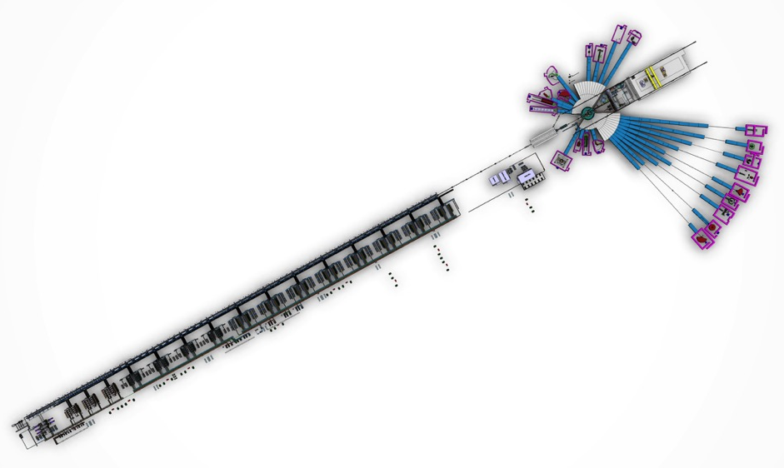
The ESS facility layout
Main parts
Neutron Science Systems
22 planned and budgeted neutron scattering instruments
Neutron beam line lengths ranging from 10 m to 150 m from source
Proton Linear Accelerator
Long pulse proton beam 2,86 ms
Pulse frequency 14 Hz
Proton energy 2 GeV
Beam power, time averaged 5 MW, within pulse 125 MW
Beam current 62,5 mA
Target

Slide 28
Hazard Analysis Purpose
Protect the public from accidents with potential radiological consequences
Hazard Analysis is a systematic process to identify, evaluate, and control potential hazards and accidents related to the Target Station.
  Identify hazardous events associated with the facility processes, operations, work activities, and natural phenomena
    High power beam impacting the tungsten target will create an inventory of nuclides
    3000 kg of tungsten, 5 MW beam, 5 year target wheel lifetime
  Understand potential hazardous scenarios
  Define necessary mitigating measures
    Input to system design requirements – Target systems, building features, TSS
    Identify need for safety functions
Identify g evaluate g control these events

Slide 29
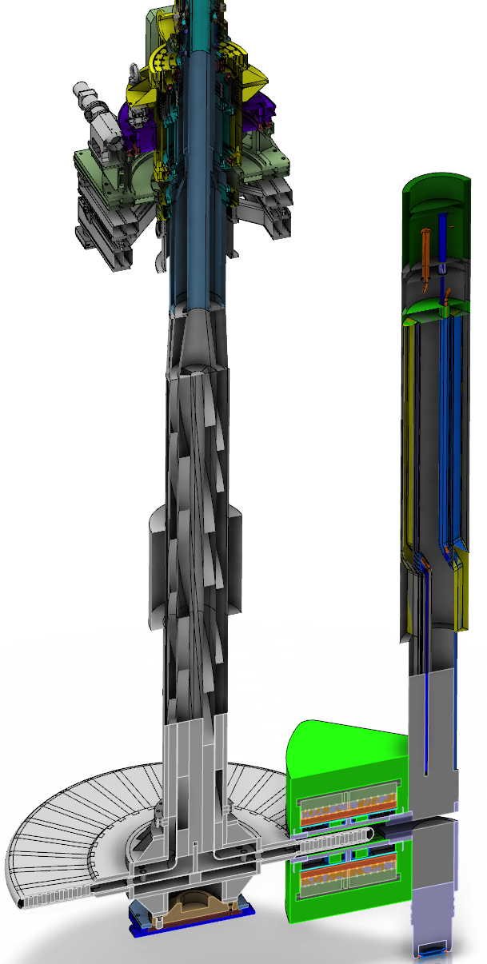
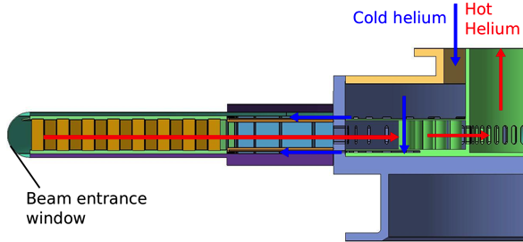

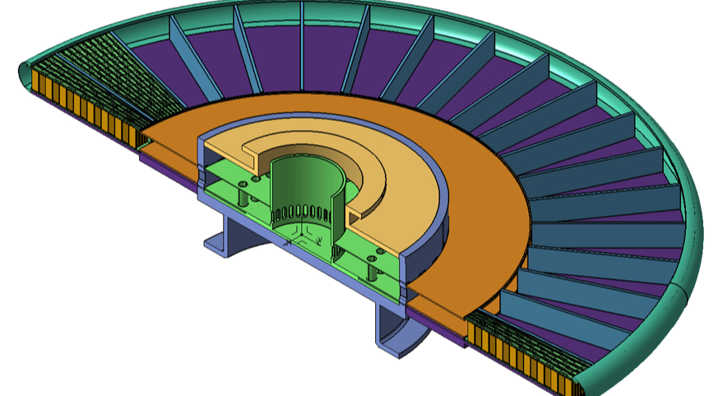

ESS Target Station Parameters
5 MW long pulse spallation source
  2.86 ms proton bunch at 14 Hz rep rate
  Raster pattern where protons incident upon Target wheel
Rotating tungsten target
  5.4 tons (4900 kg) wheel only, (11 tons wheel + shaft)
  rotating at 23.3 rpm (sector receives beam pulse every 2.4 seconds)
  5 year lifetime, He gas cooled
Cold Moderators
    Liquid hydrogen with 2-5 year lifetime
Inventories
  High power beam impacting the tungsten target will create an inventory of nuclides
  Primary inventory is in wheel (monolith and storage in active cells)
Keeping in Mind:
  450 – 500 employees, 2000 – 3000 users/year
  facility is located in 100,000 inhabitant region

Slide 30
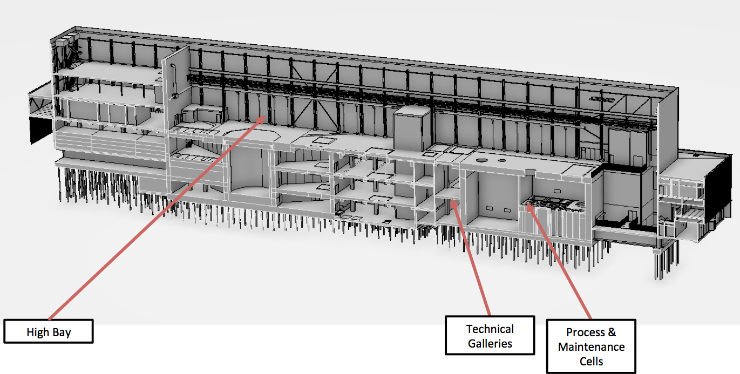
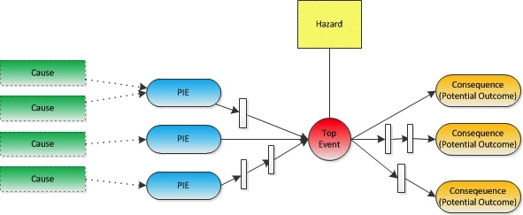
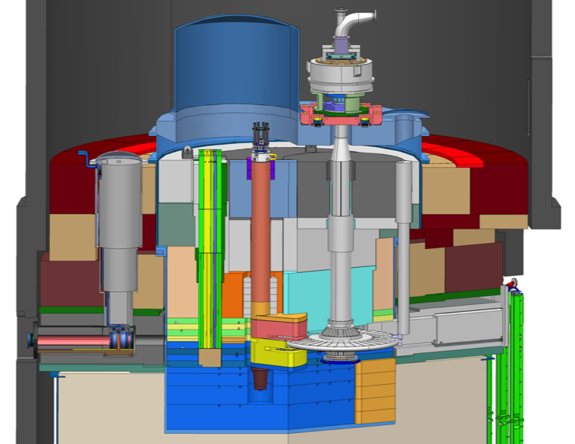
Hazard Analysis Overview
SSM;
Nuclear Authority
Design Facility
Hazard Analysis
Scenario Analyses
Safety Functions
Classification
Systems
Buildings
Operation
Events
(Severity
& Probability)
PIEs and Top
Enveloping
Unmitigated
Mitigated
SSCs:
- Safety
- Safety-related
Disciplines:
- Mechanical
- Ventilation
- Electrical
…
Physical evolution
Release Factors
Leaks, diffusion
Internal spread
External spread
Severity Probability | <.01 | 0.01 -0.1 | 0.1 -1 | 1 -20 | 20 -100 | >100 mSv
H1 Normal
H2 Expected
H3 Unexpected
H4 Unlikely
H5 Very unlikely
Dose to public (SSM)
Radiological impact
Inventory
Dose Factors

Slide 31
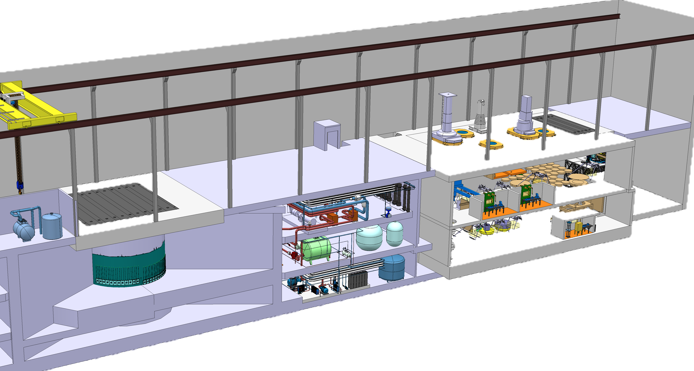
External Event – Earthquake (AA14, AA21)
Earthquake of varying severity and probability hits ESS
Initiates all possible events in all areas – Many share inventories
  AA3 – loss of wheel cooling – dominates dose
  AA11 – water leaks (3 systems) in utility block
  AA22 – getter fire
ACF doors, hatches, floor valves open, HVAC fails, confinement lost, fire
H2, H3, H4 event
Worker 4 h
Emission 10 m
 | AA14 | AA21 ACF | Total Dose
Worker | 600 Sv | 1.3 Sv | 601.3 Sv
Public | 80 mSv | 0.5 mSv | 80.5 mSv
 | AA14 | AA21 ACF | Total Dose
Worker | 600 Sv | 1.3 Sv | 601.3 Sv
Public | 80 mSv | 0.5 mSv | 80.5 mSv
Active cells
Target monolith
Utility Block

Slide 32
Safety Functions – Earthquake
Event | H2 | H3 | H4
AA14 – Public | 0.08 mSv | 80 mSv | 80 mSv
AA21 – Public | 0.00007 mSv | 0.48 mSv | 0.48 mSv
Event | H2 | H3 | H4
AA14 – Public | 0.08 mSv | 0.59 mSv | 6.8 mSv
AA21 – Public | 0.00007 mSv | 0.48 mSv | 0.48 mSv
Event | H2 | H3 | H4
AA14 – Public | 80 mSv | 80 mSv | 80 mSv
AA21 – Public | 0.48 mSv | 0.48 mSv | 0.48 mSv
Event | H2 | H3 | H4
AA14 – Worker | 600 Sv | 600 Sv | 600 Sv
AA21 – Worker | 1.3 Sv | 1.3 Sv | 1.3 Sv
Event | H2 | H3 | H4
AA14 – Worker | 0 mSv | 600 Sv | 600 Sv
AA21 – Worker | 0.02 mSv | 1.3 Sv | 1.3 Sv
Event | H2 | H3 | H4
AA14 – Worker | 0 mSv | 2 mSv | 2 mSv
AA21 – Worker | 0.02 mSv | 20 min 14.3 mSv | 20 min 14.3 mSv
Target building functional in H2, and all other safety SSCs functional in H2 g mitigated AA3 and AA18 values
Monolith Civil Structure (MCS) and ACF available up to and including H4, building not threaten safety SSCs in these areas
H3 – Helium purification getter firebox, evacuation alarms, TSS, shielding function in ACF maintained
H4 – Evacuation alarms functional, TSS functional or fail-safe, shielding function in ACF maintained

Slide 33
Defence in Depth and safety functions grouping according to SSM

Slide 34
Defense in Depth analysis
Holistic approach to optimize selection of safety functions and SSCs
  Collect all safety functions identified in accident analyses
  Evaluate how different options fit with other analyses
  Check consistency in approach and balance between prevention and mitigation
  Based on outcome optimize choice and combination of safety functions and ranking within DiD
DiD analysis example – Spread of contamination from ACF
Notes:
Explain SF for normal ops
Events – unmitigated consequences
Additional safety functions – mitigated consequences
Why no need for DiD level 4

Slide 35
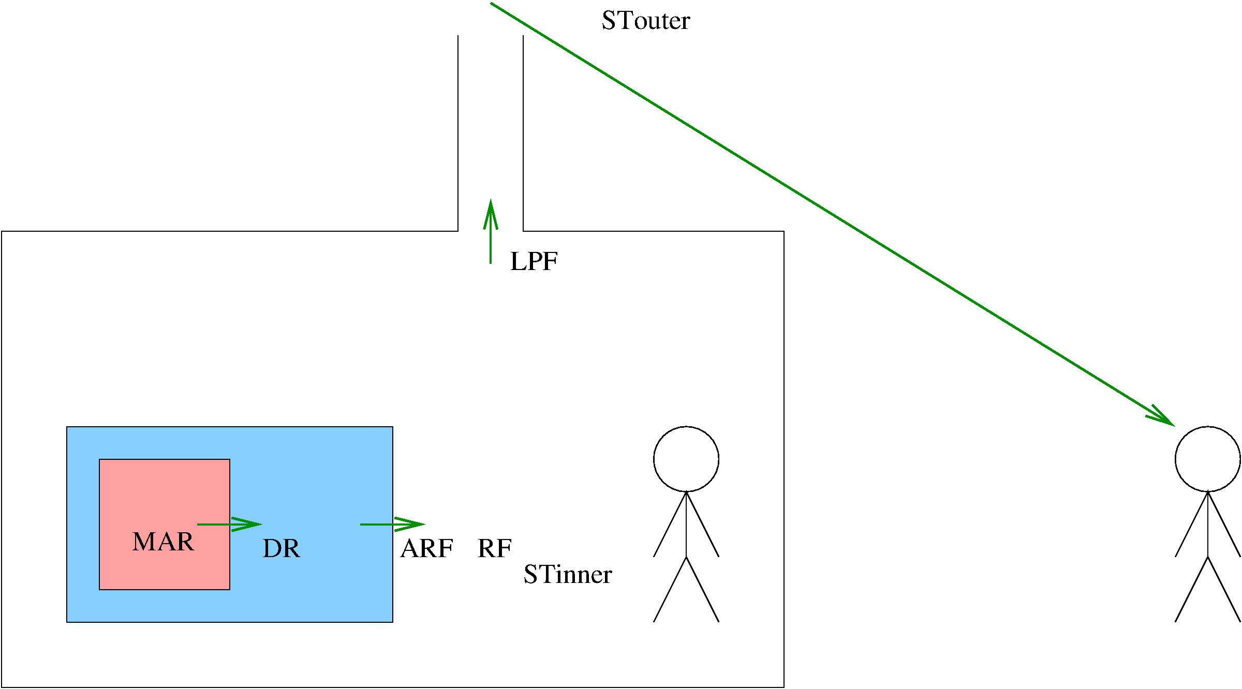
DOE Release Calculation
ST = MAR * DR * ARF * RF * LPF
Accident Analysis (AA) Dispersion model
ST: Source Term ST_{Inner} = MAR * DR * ARF LPF
MAR: Material at Risk
DR: Damage Ratio
ARF: Airborne Release Fraction
RF: Respirable Fraction (1)
LPF: Leakpath Factor (Detailed calculation)

Slide 36
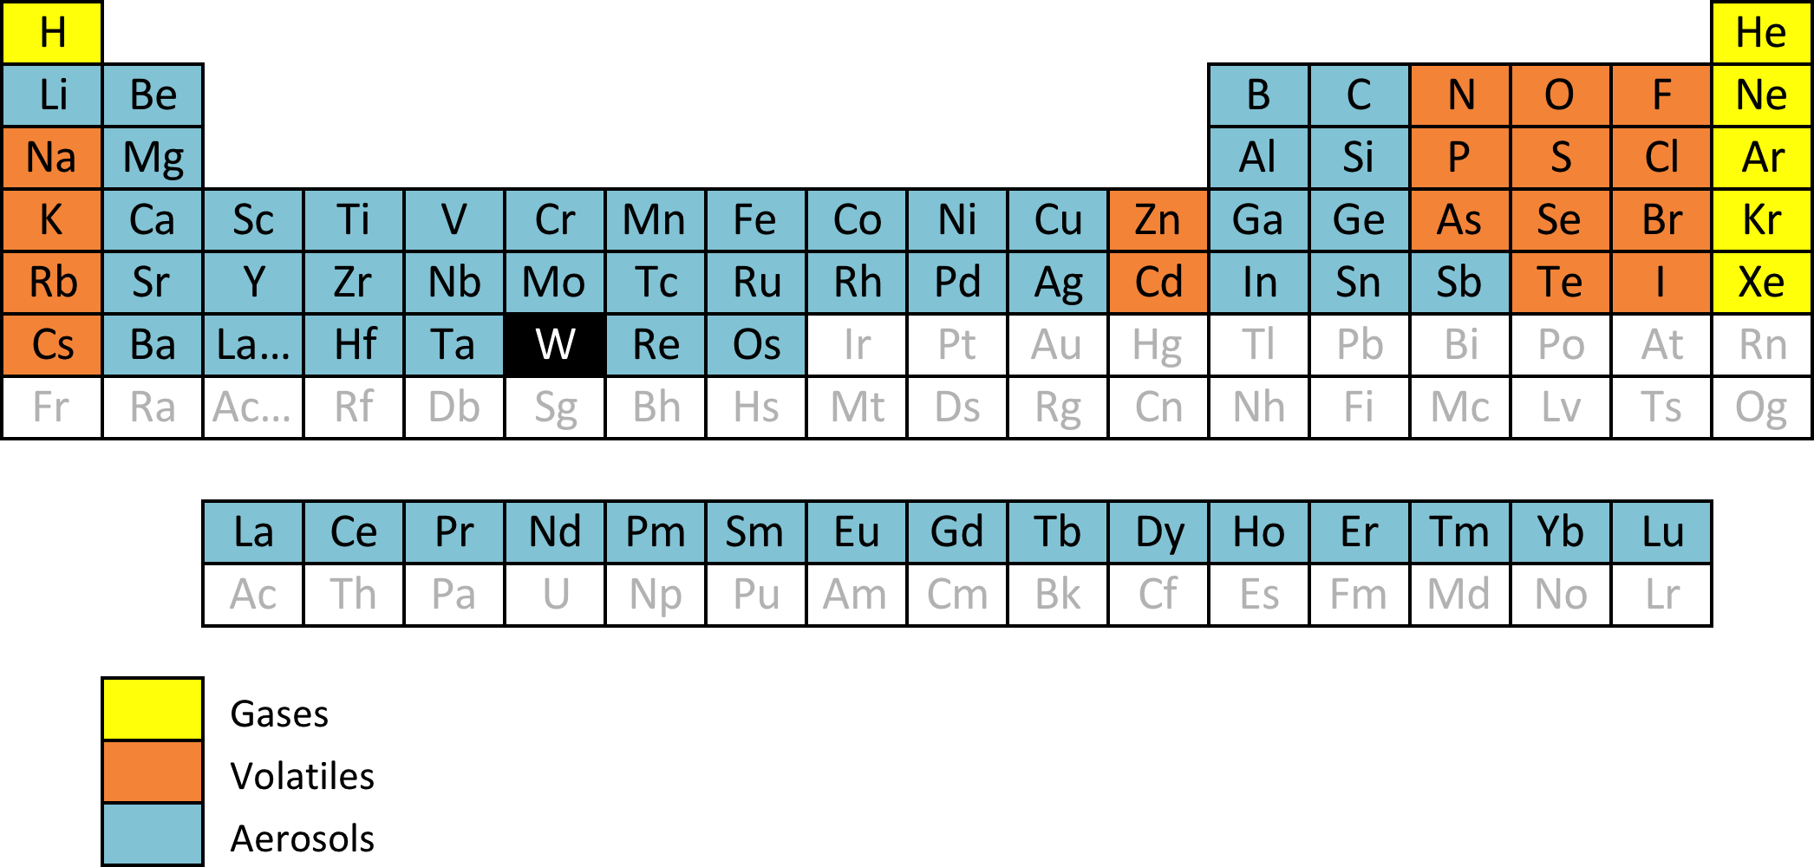
Analysis of Airborne Release Fractions (ARF) for Damaged Tungsten, ESS-0085946
For gases ARF_{G} = 1
For volatiles ARF_{V} = 0.1
For aerosols from oxidation ARF_{AO} = 0.005
For aerosols from melting ARF_{AM} = 0.01
Based on experimental data in literature
(NRC, DOE, LANL, ORNL, others)
Reactors as well as other applications

Slide 37
Activity transport model (L. Spanier)
Lumped parameter
  4 rooms, V0, V2, V4 , V6
  Flows between, f _{i,j}
  Emission from each, e₀, e₂, e₄, e₆
  Time dependent source, S, in V0
Differential equation solved in MathCad
What is calculated
  Number of nuclides in the volumes
  Number of nuclides reaching emission point
  As function of time
Source term, emitted activity calculation, dose
  Fraction of the activity released from the source, that is emitted (normalised)
  Release start and duration
  Effective dose to representative person from Gaussian dispersion model

Slide 38
Principal transport model

Slide 39
Inhalation dose to workers
Model
  Introduce inhalation dose calculation volumes in V1, V3, V5.
  Flow between rooms pass this volume.
  Assure a robust inhalation dose assessment
  Back flow into the dose volume finally level out concentrations
What is calculated
  Time average concentration in the volumes
  (from time dependent number of nuclides in the volumes)
  Unmitigated case worker stays 4 hours in the volume
  With alarm reduced to 2 minutes (exceptions)
  No ventilation assumed when calculating workers dose
Dose
  Effective dose from inhalation

