Slide 1
Status of AA3, AA1 and AA2
(In order of maturity)
Kristoffer Sjögreen

Slide 2
Status
AA3 in review. Remaining questions are: reported dose in relation to conservatism in analysis, and iteration with operational limits. Close to release.
AA1 in prereview within working group. The changes on AA1 regarding conservatism and reported dose will follow the outcome of the AA3- discussion. Source term is final, but dose calculation not yet updated.
AA2 not yet reached review state. Some calculations remaining before source term is finally defined. Dose calculation not yet updated.

Slide 3
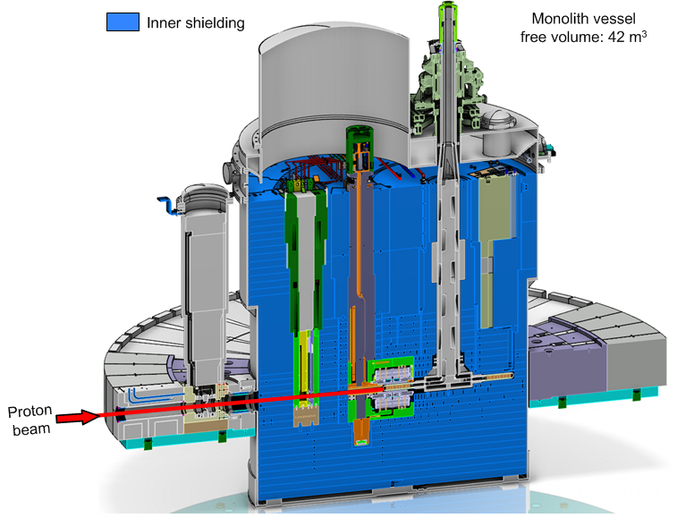
General description of ESS Target

Slide 4
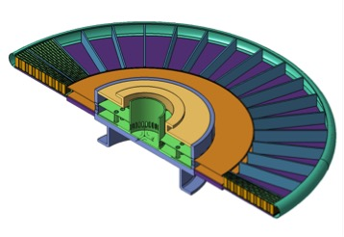
Target vessel

Slide 5
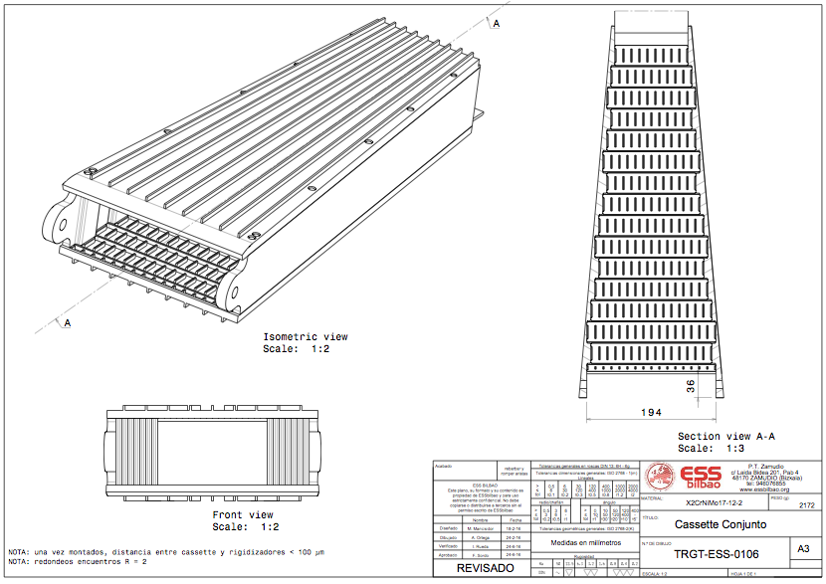
Cassette and spallation material

Slide 6
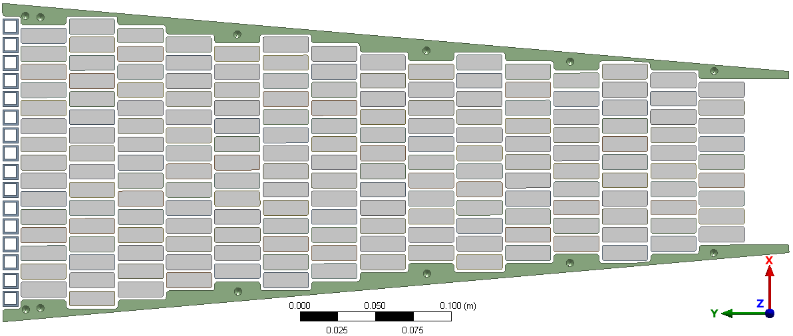
Cassette and spallation material

Slide 7
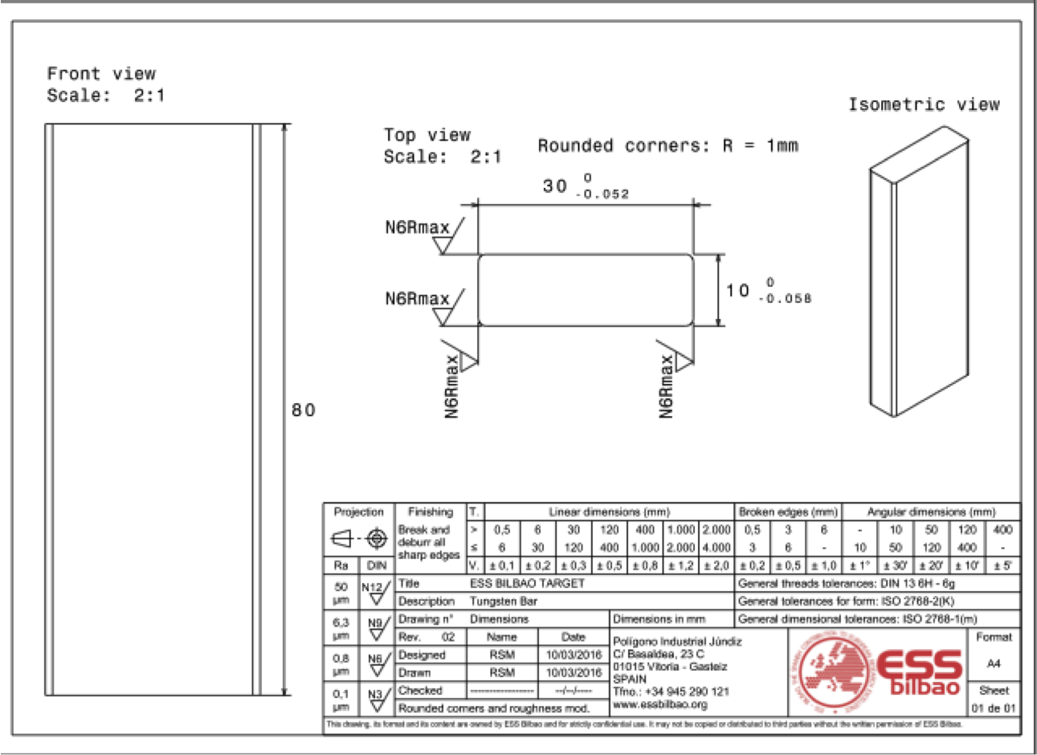
Tungsten brick

Slide 8
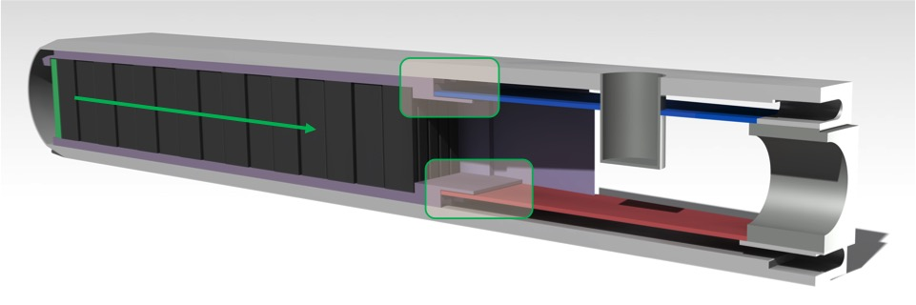
Section view

Slide 9
AA3
Cooling concept
Event and event categorisation
Event progression
Source term
Dose to public

Slide 10
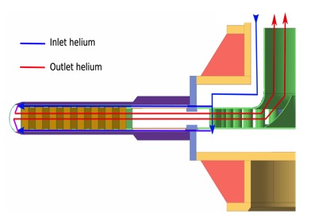
Cooling principle

Slide 11
Machine protection functions for AA3
Function | Description | Failure frequency | Remark
PF1 | Low inlet pressure | 10⁻⁶/hr
PF2 | High inlet temperature | 10⁻⁶/hr
PF3 | High outlet temperature | 10⁻⁶/hr
PF4 | Low massflow | 10⁻⁵/hr
PF5 | High local target temperature | 10⁻⁵/hr | Not credited

Slide 12
Event frequencies AA3
Event 1: Helium compressor stop
Event 2: Failure of pressure control
Event 3: Unintended isolation
Event 4: Heat exchanger malfunction
Event 5: Large leakage
Event 6: Ingress of water
All events require failure of 2 or more credited machine protection functions, the event class has been deduced to be H3.
For the unmitigated case, the bounding event is deduced to be a complete loss of the cooling function.

Slide 13
Loss of cooling
Cooling lost
Beam entrance window breaks
Moderator damaged
Helium leaks out
Tungsten falls out, ingress into moderator
Oxidation in steam starts
Shroud melts, friction increase, wheel stops
Beam penetrates two sectors
Beam penetrates monolith
Steam generation cease
Air leaks in and causes hydrogen explosion
Beam damages proton beam window cooling equipment outside monolith
Event stops

Slide 14
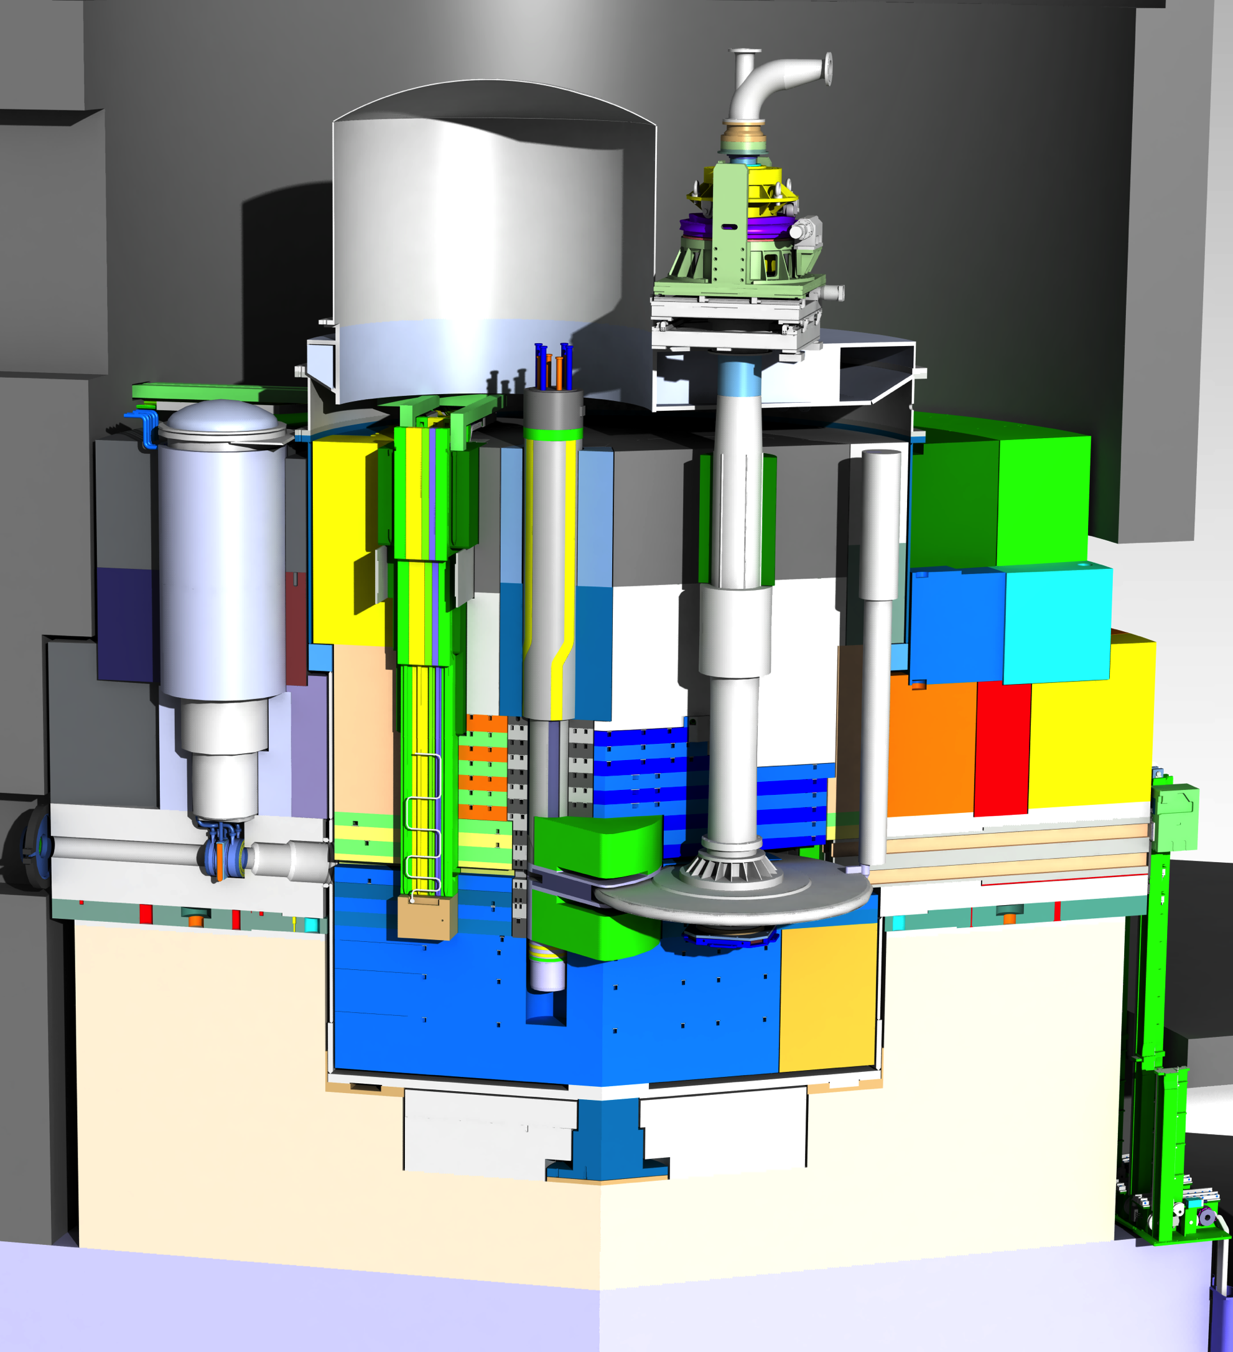
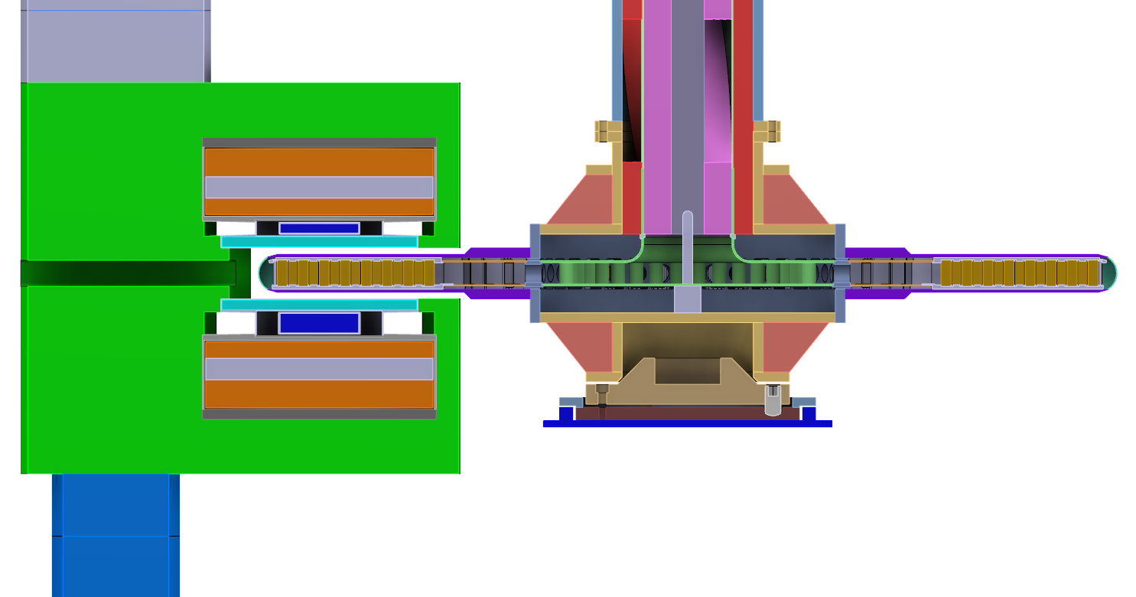
2. BEW Failure
1. Wheel Cooling
Failure
2. Wheel BEW
Failure
4. Wheel Shroud
Collapse
5.Tungsten Block
Crash
6. Wheel Rotation Stop
7. Two Sectors Damaged
8. Beam Through Monolith
9. Beam Reach
AC Pits
3. Water Moderator Damage
t=0s
T=1s
BEW fails all around
due to thermal load
Helium coolant
released
Tungsten
exposed
14
Notes:
Divided, all paths simultaneously

Slide 15
3. Water Moderator Damage
1. Wheel Cooling
Failure
2. Wheel BEW
Failure
4. Wheel Shroud
Collapse
5.Tungsten Block
Crash
6. Wheel Rotation Stop
7. Two Sectors Damaged
8. Beam Through Monolith
9. Beam Reach
AC Pits
3. Water Moderator Damage
t=0s
T=1s
BEW Edges mechanically damage
Water Moderators
Water released
15
Notes:
Divided, all paths simultaneously

Slide 16
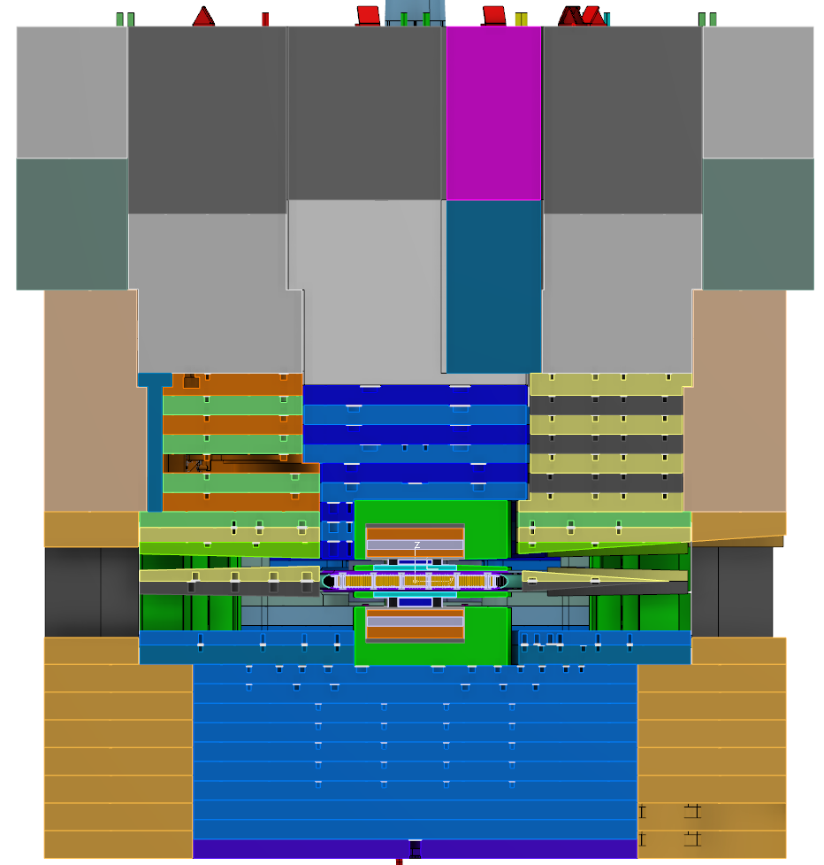
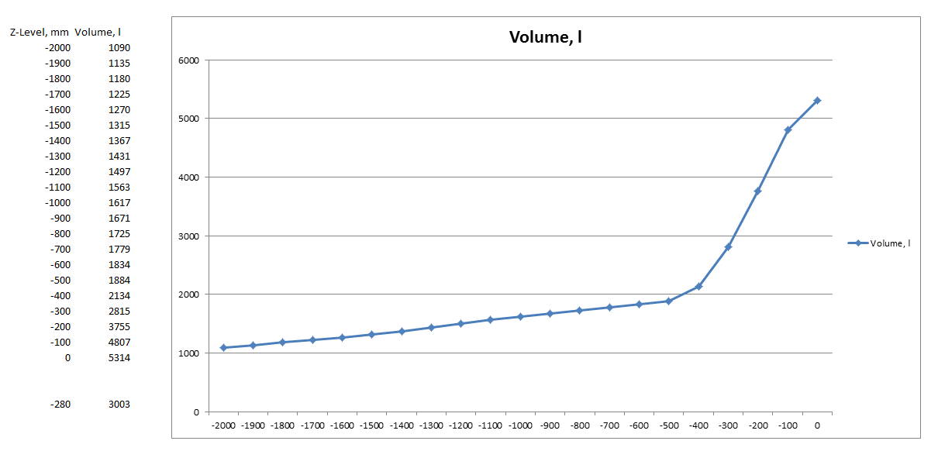
3. Water Moderator Damage: Monolith
1. Wheel Cooling
Failure
2. Wheel BEW
Failure
4. Wheel Shroud
Collapse
5.Tungsten Block
Crash
6. Wheel Rotation Stop
7. Two Sectors Damaged
8. Beam Through Monolith
9. Beam Reach
AC Pits
3. Water Moderator Damage
t=0s
T=1s
Void volume in monolith vessel, below vertical position (l)
Water level at lower surface
of neutron void
~2 m3 void
16
Position below proton beam centre (mm)
Notes:
Divided, all paths simultaneously

Slide 17
Mitigation
In the mitigated scenario, TSS stops the event from progressing beyond this point.
Credited TSS functions are designed to cover all initiating events.
Low massflow
High temperature
Low pressure

Slide 18
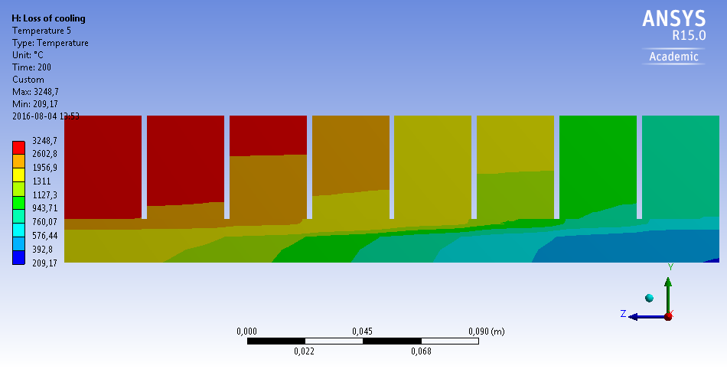
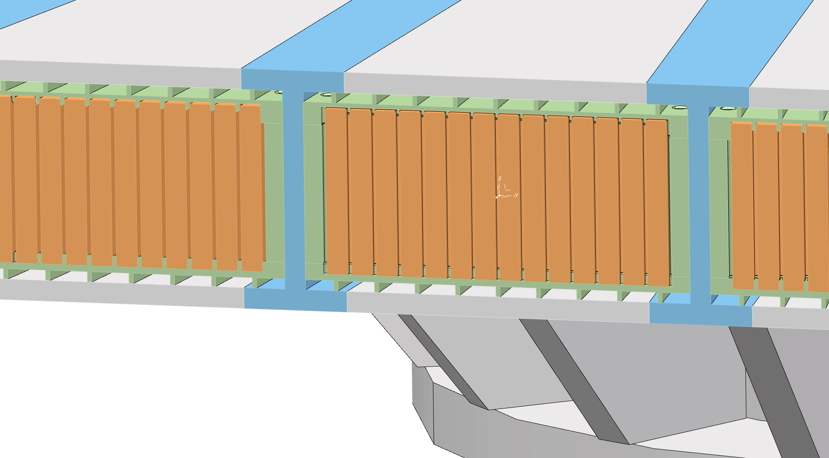
4. Wheel Collapse
1. Wheel Cooling
Failure
2. Wheel BEW
Failure
4. Wheel Shroud
Collapse
5.Tungsten Block
Crash
6. Wheel Rotation Stop
7. Two Sectors Damaged
8. Beam Through Monolith
9. Beam Reach
AC Pits
3. Water Moderator Damage
t=0s
t=280s
Lower part of cassette and shroud deforms
due to thermal load
Wheel starts braking
- rotation slows down
Blocks escape
beam partially
18
Notes:
Divided, all paths simultaneously

Slide 19
5. Tungsten block crash
1. Wheel Cooling
Failure
2. Wheel BEW
Failure
4. Wheel Shroud
Collapse
5.Tungsten Block
Crash
6. Wheel Rotation Stop
7. Two Sectors Damaged
8. Beam Through Monolith
9. Beam Reach
AC Pits
3. Water Moderator Damage
t=0s
t=200s
4. Some blocks in
outer rows fall out
Heat added to
water in moderator
Blocks more
exposed to steam
Blocks escape
beam partially
19
Notes:
Divided, all paths simultaneously

Slide 20
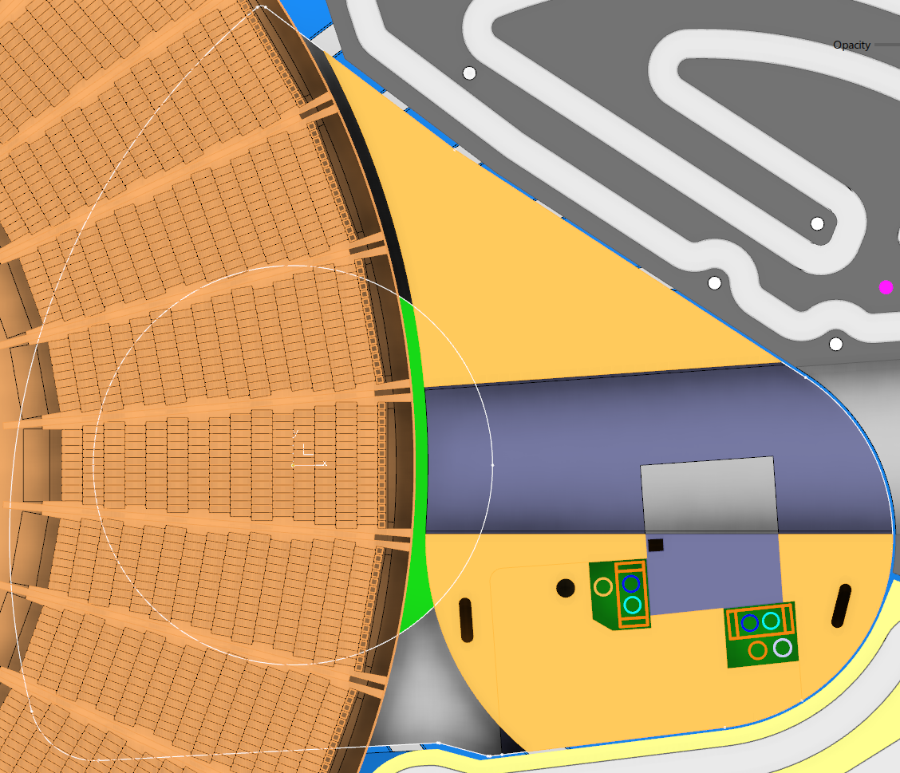
6. Wheel Rotation Stop
1. Wheel Cooling
Failure
2. Wheel BEW
Failure
4. Wheel Shroud
Collapse
5.Tungsten Block
Crash
6. Wheel Rotation Stop
7. Two Sectors Damaged
8. Beam Through Monolith
9. Beam Reach
AC Pits
3. Water Moderator Damage
t=0s
t=200s
34 * 4 rows entirely lost
2 sectors (front and back)
Beam ->
1100 kg Tungsten
Moderator edge
MR Plug edge
20
Notes:
Divided, all paths simultaneously

Slide 21
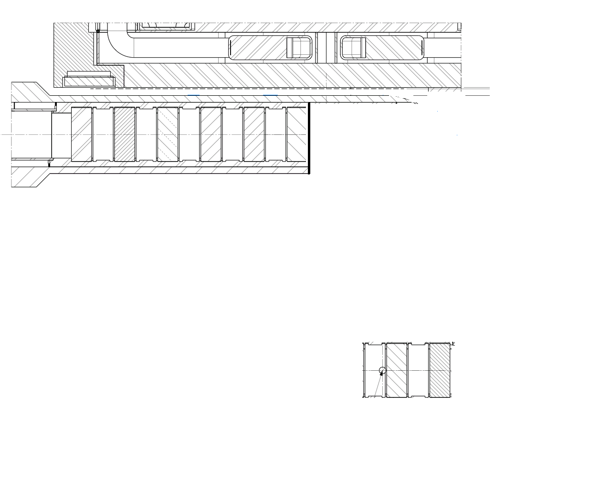
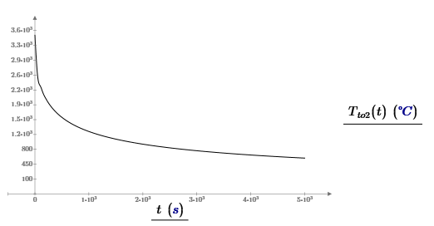
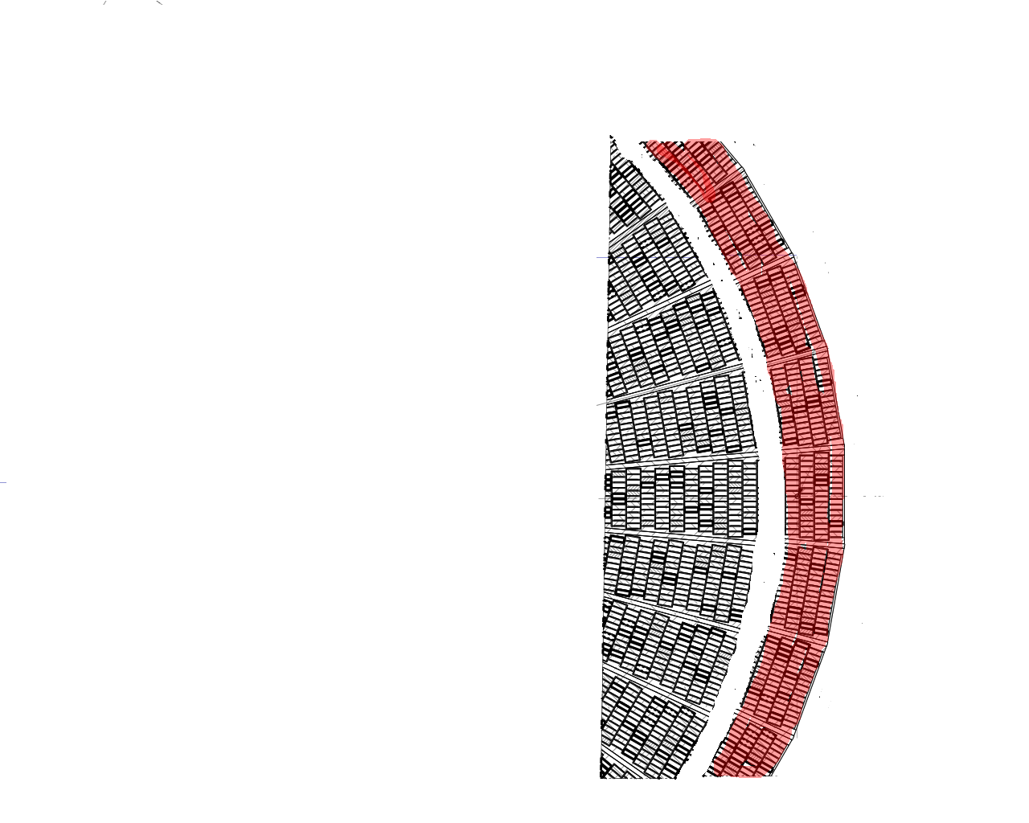



The unmitigated release is dominated by airborne tungsten oxides

Slide 22

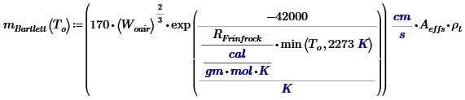
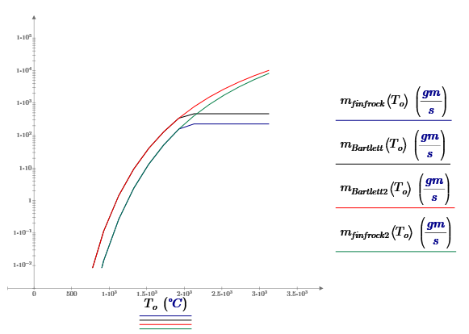
Limitation
Oxidation is limited based on maximum temperature

Slide 23





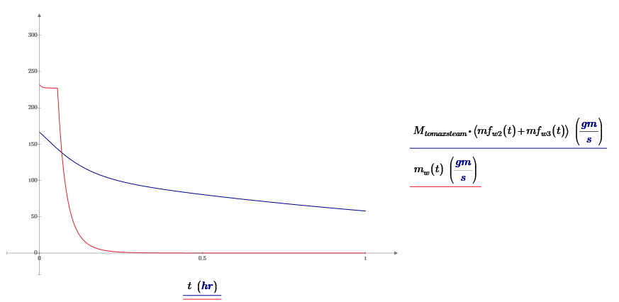
Limitation
Oxidation is limited based on access to steam and temperature

Slide 24
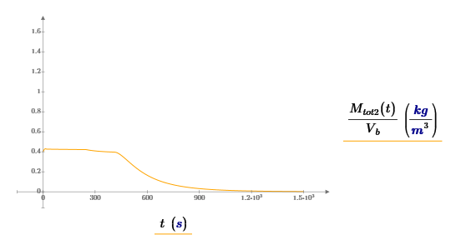
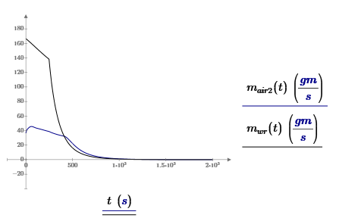
Limitation
Oxidation is limited based on maximum particle concentration in monolith
K_{max} = 500 g WO₃/m³
m_{airborne}= K * steamflow
m_{settling}= (K-K_{max})*Airborne mass/1s

Slide 25
Source term AA3 unmitigated
Material | Mass damaged | Airborne release fraction | Release time
Helium | 30 kg | 1 | 10s
Filter particles from helium loop | 10 g | 0.01 | 10s
Tungsten | 53.8 kg | 0,38 | 1000s
Moderator cooling water | 700 kg | 0.46 | 20000s
Steel | 131 kg | 0,01 | 1000s
Deposited tungsten oxides (hydrogen explosion) | 33.1 kg | 0.005 | Instantly after 5000 s
Diffusion from tungsten | 1100 kg | 8.3e-4 | 1000s

Slide 26
Source term AA3 mitigated
Material | Mass damaged | Airborne release fraction | Release time
Helium | 30 kg | 1 | 10s
Filter particles from helium loop | 10 g | 0.01 | 10s
Tungsten | 1.2 g | 0,5 | 1000s
Moderator cooling water | 700 kg | 0.24 | 20000s

Slide 27
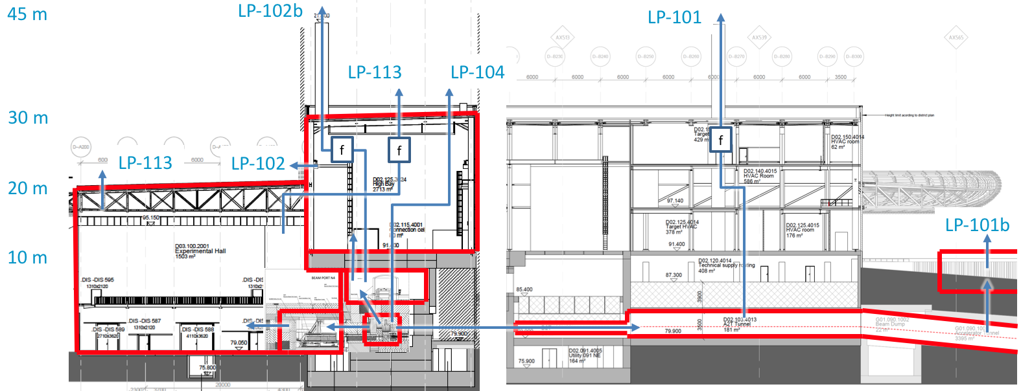
Leak paths
A comparative analysis showed that the leak path giving the highest dose was directly out through monolith relief path.

Slide 28
AA3- Dose to public
Unmitigated dose to reference person = 156 mSv
Mitigated dose to reference person = 0,08 mSv

Slide 29
AA1
Motion control concept
Event and event categorisation
Event progression
Source term
Dose to public

Slide 30
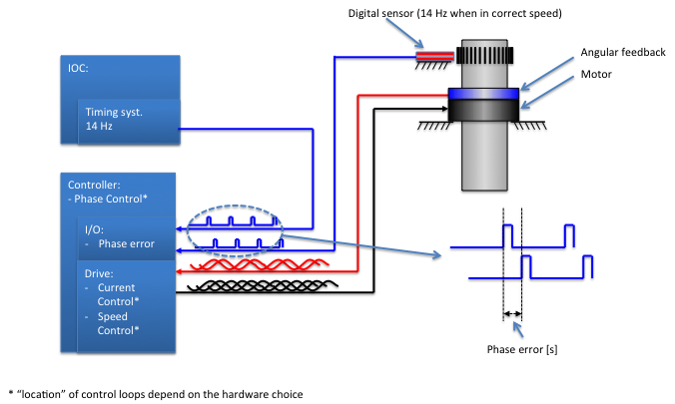
Motion control concept- target rotation

Slide 31
Machine protection functions
Function | Description | Failure frequency | Remark
PF7 | Low or high target speed | 10⁻⁶/hr
PF8 | Syncronisation with timing system | 10⁻⁶/hr
PF9 | Bearing temperature | 10⁻⁵/hr | Not credited
PF10 | Bearing vibration | 10⁻⁶/hr | Not credited
PF2 | Inlet helium temperature | 10⁻⁶/hr

Slide 32
Event frequencies AA1
Applied to the unmitigated case
Event 1: Target wheel stop but rolls out slowly.
If the rollout is slow it will lead to target failure before target has stopped and therefore become an initiating event for AA3 for the unmitigated case. Release will be less than for AA3.
If the wheel rolls out faster than the threshold where target breaks due to unsyncronised beam, the unmitigated consequences will be the same as for the direct stop.
Event category is H3.
Event 2: Target rotation stops directly.
It is judged to only happen as a result of an undetected change in operating conditions, ie increased helium inlet temperature.
Event category is H4.

Slide 33
Event frequencies AA1
Applied to the mitigated case- mitigation based on wheel rotation
Event 1: Target wheel stop but rolls out.
If the rollout is slow the wheel stop will be detected by TSS before substantial target damage.
If the wheel rolls out faster than TSS reaction time, there will be target damage but less than that for a direct stop.
Event 2: Target rotation stops directly.
Target will be stopped and suffer direct stationary impact from proton beam during TSS reaction time.

Slide 34
AA1 event timeline
Loss of rotation
Beam entrance window ruptures
Coolant starts flowing out
Premoderator breaks
Beam penetrates two sectors
Shroud beneath two sectors melt
Two complete sectors spill out
Ingress into lower moderator
Oxidation in steam
Proton beam penetrates monolith
Release through relief path by chimney effect of airborne particles
Hydrogen explosion affect settled particles
End
Melting starts

Slide 35
Wheel Rotation Stop- unmitigated scenario similar to AA3
Wheel Rotation Stop
Two Sectors Damaged
Beam Through Monolith
t=0s
T=10s
Two sectors
(front and back)
are heated by beam
Beam ->
Moderator edge
MR Plug edge
35

Slide 36
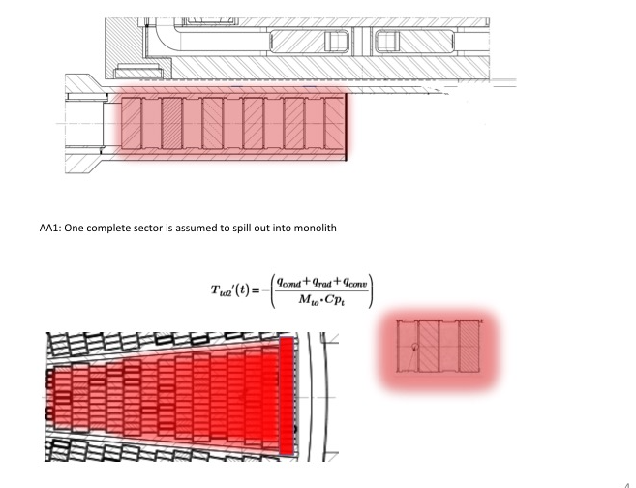
Source term- AA1 unmitigated
Dominated by aerosols

Slide 37
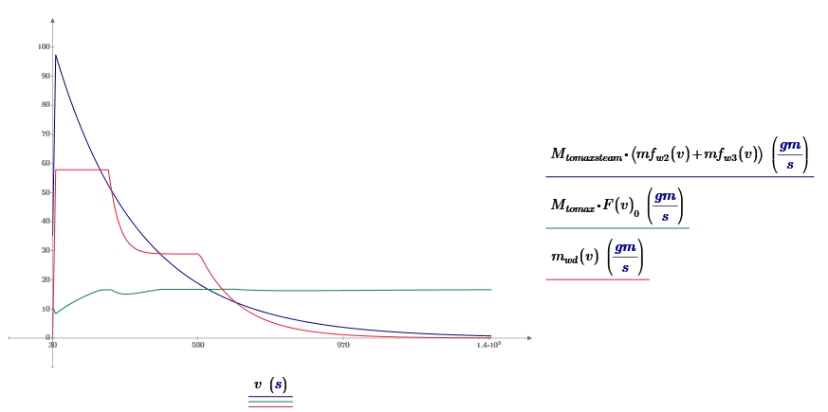
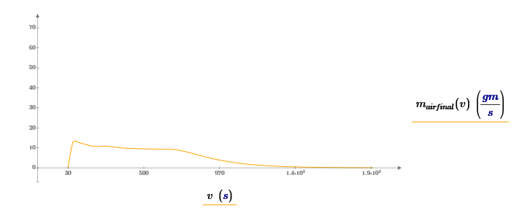
Oxidation rate and mass transport for AA1 unmitigated

Slide 38
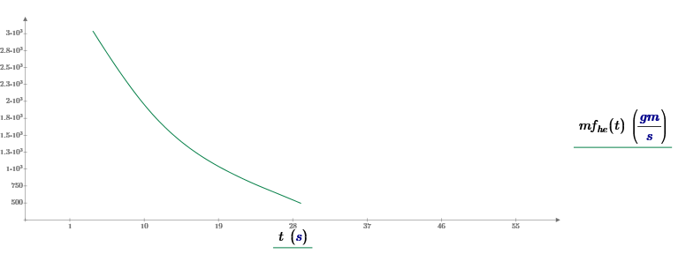
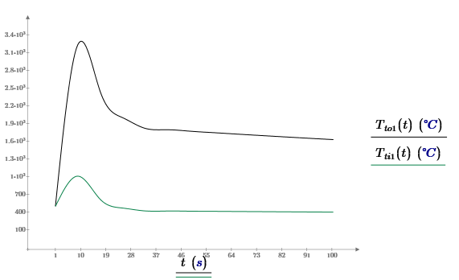
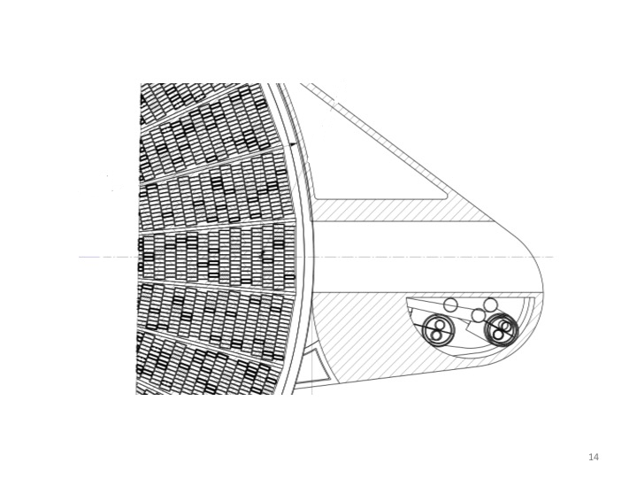
Source term- AA1 mitigated- 3 seconds to melting starts in the first row
Tungsten cooling due to outflow of helium credited
Total helium massflow
Estimated fraction of helium possible to be used for cooling is 10 %.

Slide 39
Source term AA1 unmitigated
Material | Mass damaged | Airborne release fraction | Release time
Helium | 30 kg | 1 | 10s
Filter particles from helium loop | 10 g | 0.01 | 10s
Tungsten | 24 kg | 0,38 | 1400s
Steel | 13 kg | 0,01 | 1400s
Beryllium | 9.5 kg | 0.01 | 1400s
Deposited tungsten oxides (hydrogen explosion) | 15 kg | 0.005 | Instantly after 5000 s
Diffusion from tungsten | 172 kg | 0.001 | 1400s

Slide 40
Source term AA1 mitigated
Material | Mass damaged | Airborne release fraction | Release time
Helium | 30 kg | 1 | 30s
Filter particles from helium loop | 10 g | 0.01 | 30s
Tungsten | 2,9 kg | 0.01 | 30s

Slide 41
Dose to public- AA1
Release is judged to follow the same path as for AA3- directly out through monolith relief line.
Unmitigated dose was calculated to be 56 mSv but recalculation is being done with contribution from melted steel.
Expected dose is around 60 mSv.
Mitigated dose is being calculated but is expected to be lower than threshold for H4 (20 mSv).

Slide 42
AA2
Beam parameters
Event and event categorisation
Event progression
Source term
Dose to public

Slide 43
AA2- Beam parameters
 | Proton beam window | Target
RMS beamlet size | 11.2x4.2 mm | 13.5x5.05 mm
Rastering | 49.4x16.6 mm | 60x20 mm
Rastering frequency | 39.55x29.05 kHz
Average current density | 84 uA/ cm² | 53 uA/ cm²
Beam footprint size |  | 160x60 mm

Slide 44
AA2- Worst case beam footprints
 | Proton beam window | Target
Rastering failure (RMS) | 11.2x4.2 mm | 13.5x5.05 mm
Focusing failure (RMS) | 49.4x16.6 mm | 60x20 mm
Combination of above | 0.5x0.5 mm | 0.5x0.5 mm

Slide 45
AA2- Machine protection functions
Function | Description | Failure frequency | Remark
PF1 | Defect focusing system (quadropoles) | 10⁻⁷/hr | State of quadropoles
PF2 | Beam size or position | 10⁻⁶/hr | Aperture monitors, grid monitors, beam position monitors
PF3 | Defect rastering system (raster magnets) | 10⁻⁷/hr | State of rastering magnets
PF4 | Target speed | 10⁻⁶/hr
PF5 | Target syncronisation | 10⁻⁵/hr
PF6 | Beam mode consistent with beam destination | 10⁻⁷/hr | Pulse length, rep rate and beam current
PF7 | Beam current monitors | 10⁻⁷/hr | Beam current

Slide 46
Event frequencies AA2
Event 1: Focusing failure including failure of PF1 and PF2 = H3
Event 2: Rastering failure including failure of PF2 and PF3 = H3
Event 3: Combination of failures above including failure of PF1, PF2 and PF3 = H4.
Event 4: Target wheel out of sync with accelerator including failure of PF4, PF5 and PF6 = H4.
Event 4 will be an initiating event for AA3.
Event 1 and Event 2 will not lead to dangerously high beam current densities on target (from a radiation safety perspective)
Only Event 3 is analysed in detail

Slide 47
Event progression for unrastered small beamlet on target
1. Focusing and rastering system failure
t =0
2. Wheel BEW
Failure
t=0 s
4. Tungsten melting
t= 0 s
5. Passive shutdown
t= 0.7 s
3. Proton beam window failure
t=0 s
The time for the passive shutdown is being revisited

Slide 48
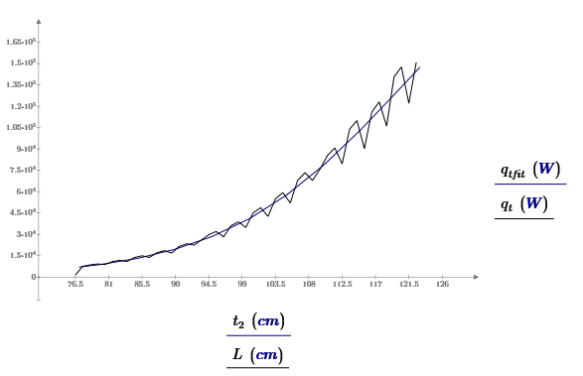
Radial heat distribution on spallation material
Curve fitting to radial heat distribution;
Estimation of tungsten damage for
different beam footprints

Slide 49
Beam footprints for accidents
For unrastered beamlet, the double gaussian distribution gives power as function of standard deviation and focusing. Example below for proton beam window.

Slide 50
Beam footprints for accidents
Rastered beam footprint
Deposited power in
rastered beam is 90%,
For nominal beam.

Slide 51
Pencil beam on tungsten
Even with small beam footprint,
The power will spread in the
Tungsten.

Slide 52
Source term, AA2, unmitigated was the same as source term for the mitigated case
Combined failure of focusing and rastering
Material | Mass damaged | Airborne release fraction | Release time
Helium | 30 kg | 1 | 10s
Filter particles from helium loop | 10 g | 0.01 | 10s
Tungsten | 1 kg | 0,01 | 1000s
Source term will be revisited. It will probably get higher
since the estimation of accelerator passive shutdown is different.

Slide 53
Hole in proton beam window
The proton beam window is
a water- cooled double walled
aluminium structure.
Leakage
Proton beam

Slide 54
Dose to public for AA2
Unmitigated from 10 meters (assuming all is released through beam pipe) 0.4 mSv.
Mitigated from 45 meters (assuming all is relelased through stack) is 0.04 mSv.
Both values will change.

