Slide 1
Postulated TSS limits
ESS-0287373
Per Nilsson
CFD Specialist
www.europeanspallationsource.se
10 December, 2018

Slide 2
Outline
General remarks on setting limits
Target helium cooling
Target rotation
Monolith pressure
Procedure to set limits

Slide 3
TSS limits – limits operation space
E.g. pressure or temperature
Operation limit
MPS: Machine Protection
TSS: Safety

Slide 4
Simple solution to complicated problem
For easy understanding and explaining
For robustness
Keep measurements simple
Avoid combinations and control

Slide 5
Limits
Quantity | Limit | Time
Mass flow rate | 1.75 kg/s | 25 s
System pressure | 8 bar(a) | 25 s
Inlet temperature | 70 C | 25 s
Rotation speed | 9 rpm | 3 s
Monolith vessel pressure | 0.5 bar(a) | 2.5 s

Slide 6
Helium Cooling System AA3 Problem : Insufficient cooling

Slide 7
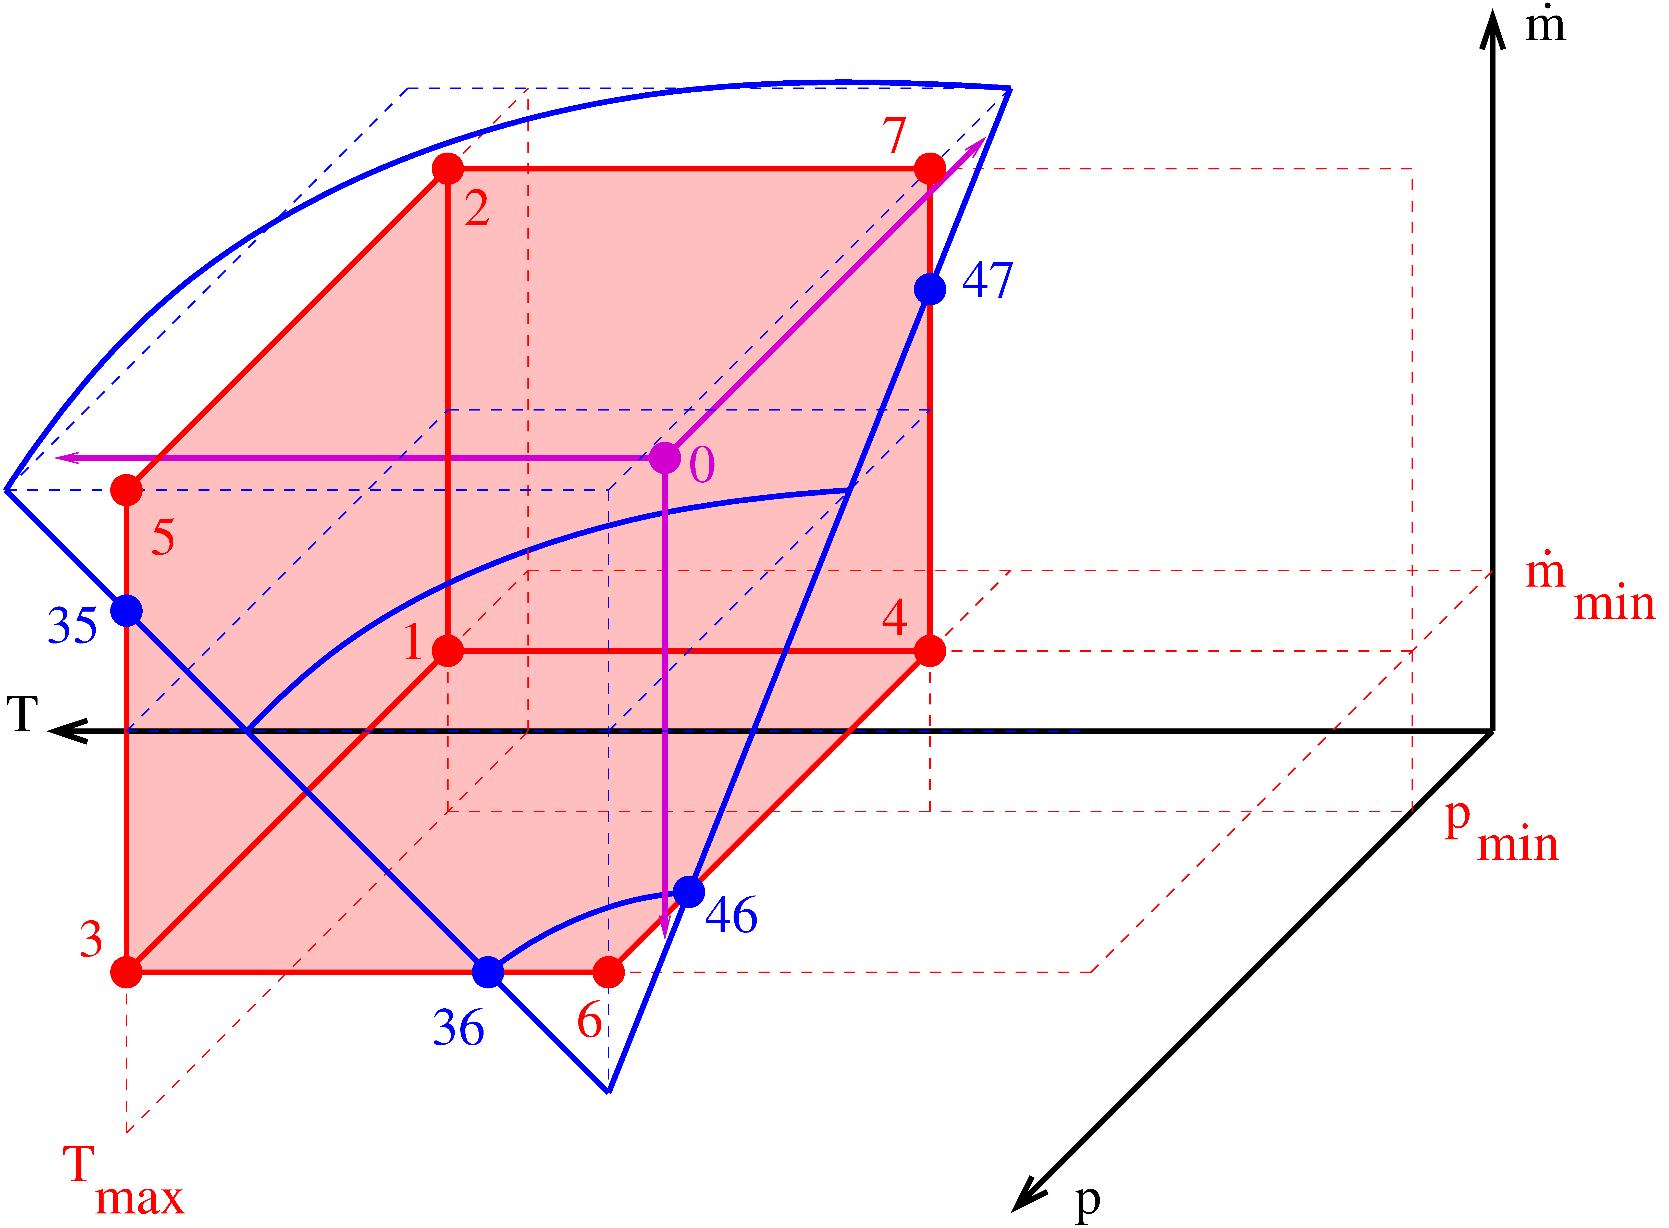
TSS limits – limits operation space
0: Normal operation
1: TSS limits
MPS should be inside
System function limits
1.75 kg/s
8 bar
70 °C
Notes:
Previous analyses -> Need to limit p,T,m
Generates a space: - normal operation, with varied parameters
- TSS limits
- MPS inside - System function limits and operation inside

Slide 8
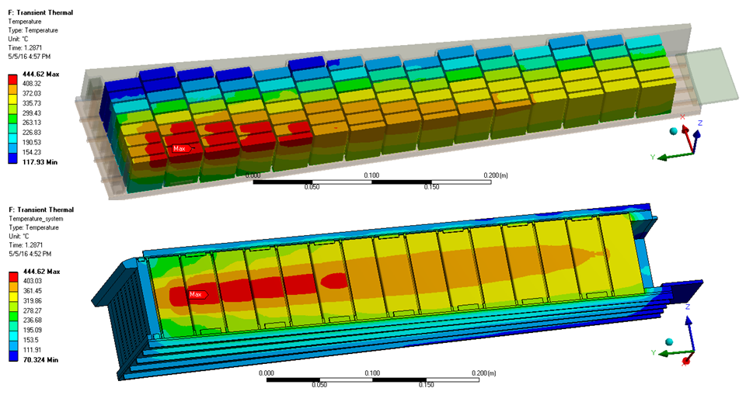
Target assessment based on CFD Assessed in accident analyses (mitigated)
Normal, ESS-Bilbao ESS-0058358 (not released)
Notes:
Basis for the limits: An analysis of when systems fails leading to unacceptable consequences
Analysis is not sufficient/approved yet

Slide 9
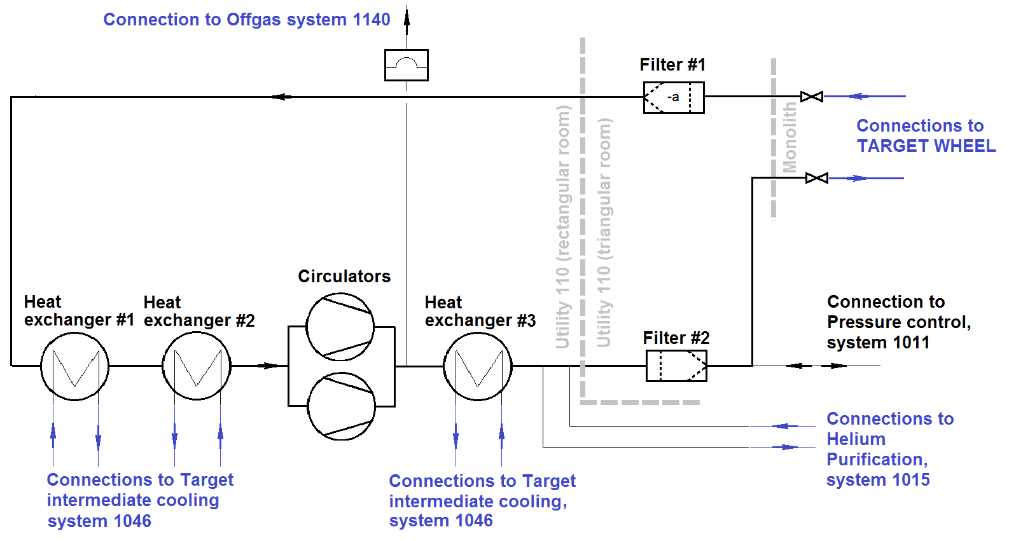
Indirect measurements in helium cooling
p
m
T
ESS-0012527 SDD-Sol
Notes:
Cannot measure the direct quantity

Slide 10
Example: Target cooling mass flow tests
Higher temperature
Could give unacceptable
Dose consequence
~ 1.65
ESS-Bilbao, ESS-0066301 not yet verified model, will be in design report
Notes:
Based on the not verified model

Slide 11
Scenario Inertia -> Margin
T_{max}
Temperature may increase after
-> Beam off in advance
t
Beam off
Notes:
Margin in terms of parameter and time

Slide 12
Trigger quantities, Margins
Temperature may increase after
-> Beam off in advance
T_{max}
T_{in}
Tolerances
Detection lag Action lag
p_{out}
m
t
Beam off
Notes:
Indirect parameters, similar margins

Slide 13
Compressor operational limits
[Emil Lundh]
Nominal, 2 compressors: m = 2.85 kg/s dp(design) = 142 kPa
dp(draft) = 158 kPa
1 of 2 parallel compressors
draft
design
1 compressor
1 compressor:
$$\frac{{1.8}^{7/4}}{{2.85}^{7/4}}∙158 kPa=71 kPa$$
System will be simulated (Modelica)
Specifications still missing
Simulation methods not yet reliable
TSS limit 1 compressor
[UJV/OFTTech]
Notes:
Operational limits

Slide 14
Operation space
Requested simulations for this points
ESS-0287373

Slide 15
Example: Timing for lost cooling stop
Stainless steel melts at about 1400 C
The normal tungsten temperature is about 400 C
The time to heat the differing 1000 C is estimated 1000 C / (100 C/pulse * 14 pulse/s / 36 ) ~ 26
Maximum time to beam off for loss of cooling -> 25 s
(the melting may finally not be the criterion)

Slide 16
Opposing interests, pushing limits together
Operation limit
MPS: Machine Protection
TSS: Safety

Slide 17
Target Wheel Rotation AA1 Problem : Insufficient cooling time

Slide 18
Target assessment based on CFD Assessed in accident analyses (mitigated)
Normal, ESS-Bilbao ESS-0058358 (not released)

Slide 19
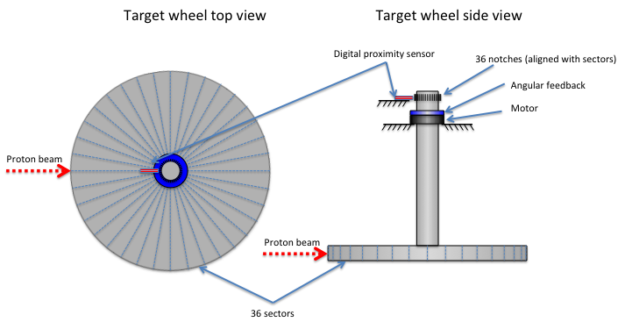
Target rotation
(WP2 Target wheel, drive and shaft description of operational limits [ESS-0060625]: LLL=7 rpm)
Unacceptable dose consequences after 3 s
Normal speed is 23.3 rpm
Footprints overlapping ½ gives 9 rpm
Notes:
Normal rotation 23 rpm Phase error relevant
Protection at half ~ 13 rpm
Safety at half ~ 7 rpm

Slide 20
Monolith Vessel Pressure AA2 Problem : Too high heat density

Slide 21
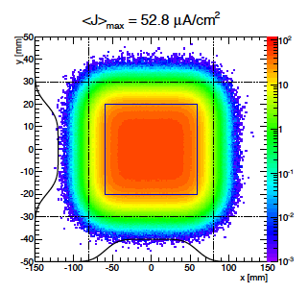
Target assessment based on CFD Assessed in accident analyses (mitigated)
No detection in tungsten
-> Indirect detection
Hole may be small
-> faster detection in monolith than in helium system
Normal, ESS-Bilbao ESS-0058358 (not released)
Notes:
Various defocussing or non-rastering -> sharp beam

Slide 22
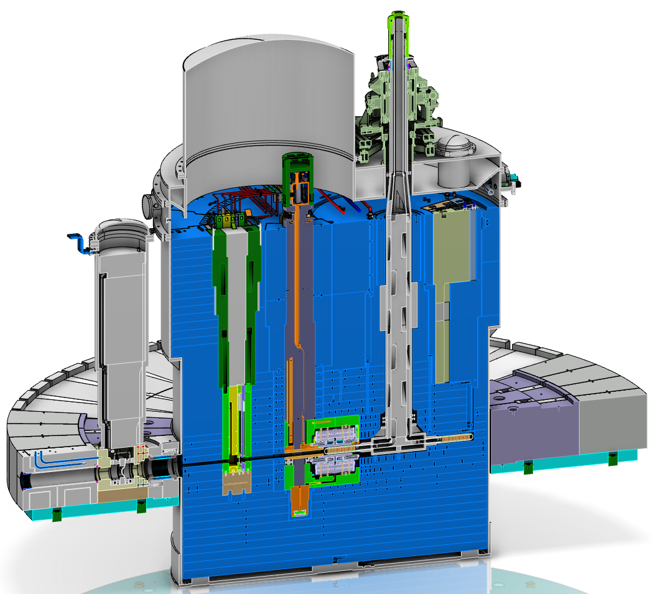
Pressure
Figure from relief document ESS-0305844
Notes:
Release into monolith, depending on hole size

Slide 23
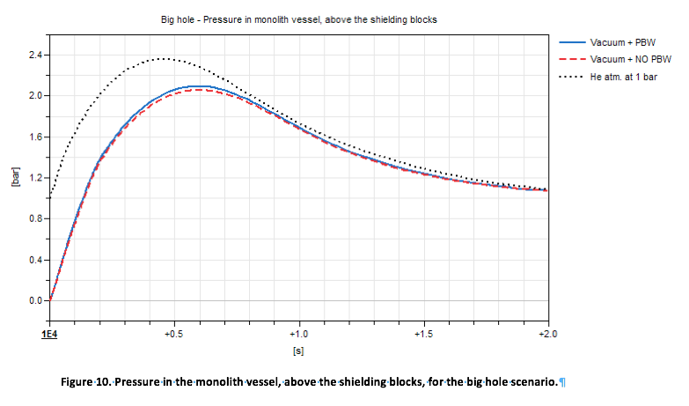
Monolith pressure
0.5
~0.07 s
Simulation AA4, ESS-0150712

Slide 24
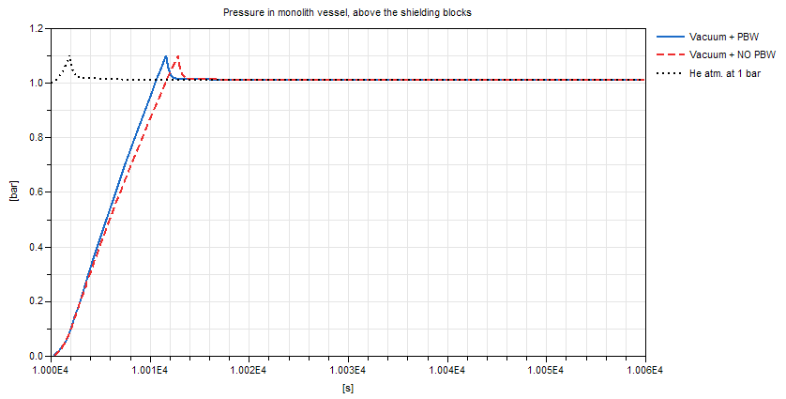
Monolith pressure
0.5
Limit may be refined calculating pressure after one rotation
=10 s
Simulation for AA2, ESS-0150710
Notes:
Simulation depends on hole

Slide 25
Timing for focused beam stop
Small holes around the perimeter, area increasing during first rotation then maybe same holes
Holes needed for pressure, earliest detection after one rotation
Latest detection after one additional rotation I.e. beam must be off at 36/14 ~ 2.5 [s] after the limit pressure is reached

Slide 26
Procedure

Slide 27
Procedure
Postulating limits now Likely to change during first years
Analyses to further confirm: - Accident mitigation - Operability
(Commissioning) Tests will decide limits finally Changes must be few and under strict control

Slide 28
Questions?

