Slide 1
TSS System Requirements - TSS CDR1
Mikael Olsson
Control Engineer
www.europeanspallationsource.se
10 December, 2018

Slide 2
TSS System Requirements - agenda
Functions
Classification
Constraints
SSM conditions
Conceptual TSS architecture
Comments from pre-CDR related to CDR1

Slide 3
TSS System Requirements
Functions

Slide 4
Functions - all functions
Radiation safety functions, identified in AAs
Functions, not identified in AAs
Achieve TSS safe state if
RSF-68: Target wheel rotational speed too slow
RSF-69: He pressure too low
RSF-70: Monolith vessel pressure too high
RSF-71: He inlet temperature too high
RSF-72: He mass flow too low
Static permit beam (bypass)
Manual operational (start/stop)
Manual safety stop
Operational monitoring
Safety monitoring

Slide 5
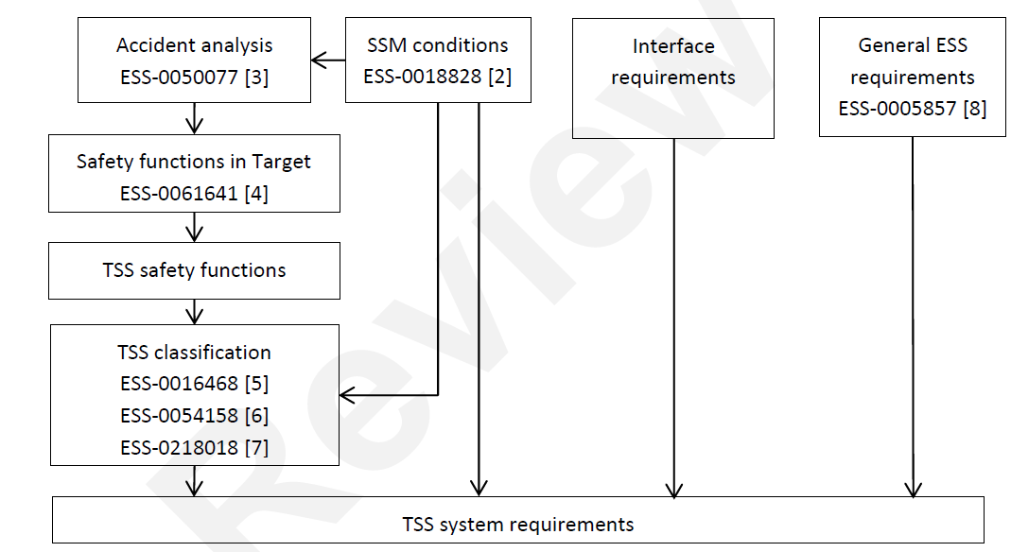
Functions - context for radiation safety functions
ESS-0002776
- TSS system requirements
ESS-0061641, Rev 1, Table 19
- Safety Functions and DID in the Target Station

Slide 6
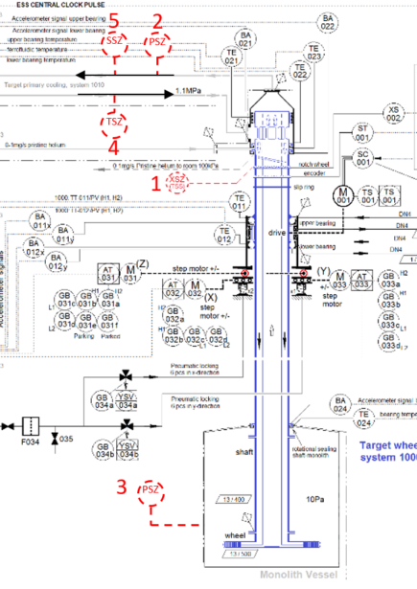
Functions - radiation safety functions
# | Function | Trip level | Trip time [s]
 | Prevent beam from hitting Target if…
1 | Target wheel rotational speed is … | < 9 rpm | 3
2 | He pressure is … | < 8 bar(a) | 25
3 | Monolith vessel pressure is … | > 0.5 bar(a) | 2.5
4 | He inlet temperature is … | > 70 $°$C | 25
5 | He mass flow is … | < 1.75 kg/s | 25
System response time <2.5 seconds - including detection, communication, logic and actuation

Slide 7
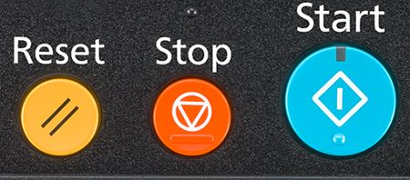
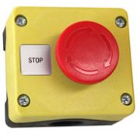
TSS system requirements - functions not identified in AAs
Static permit beam (bypass of RSF)
static permit for beam production independent of the target mode, implies that beam is direct to dump
Accelerator Division requires beam production for maintenance purposes even when the target is not ready for beam
Manual operational start/stop
Start = intentional permit of beam production
Stop = set in safe state, for maintenance of TSS, periodic testing of TSS, planned downtime, etc
It is assumed that this function is used as part of a sequence of actions defined for operation of the facility
SSM condition C25 and 29
Manual safety stop
Emergency stop, in case of antagonistic event, loss of information in main control room, etc.
SSM deems that the operators shall be able to manually shut down with a safety system
Operational monitoring
provide TSS status and status history to the operator in the main control room
SSM condition C3 and C29
Safety monitoring
Provide critical TSS status to the operator in the main control room, during defense in depth L3
Monitored data may be a subset of “Operational monitoring”
May be used to initiate manual actions in the future (not yet credited)
SSM condition C3 and C29

Slide 8
TSS system requirements
Classification

Slide 9
Classification - usage of ESS methodology
Radiation safety functions, identified in AAs
Functions, not identified in AAs
Categorization monolith events
ESS-0454232
Rules for I&C classification
ESS-0054158
General rules for categorization and classification
ESS-0054158
AAs
TSS classification report
ESS-0218018
Is there any consequence if function fails?
Categorization of TSS RSF
Classification of I&C functions at NPP
IEC 61226

Slide 10
Classification - radiation safety functions
Categorization monolith events
ESS-0454232
AAs
Cat. 1
Rules for I&C classification
ESS-0054158

Slide 11
Classification - Functions not identified in AAs, examples
Static permit beam (bypass)
Function - allows beam independent of Target mode; secures the direction of the beam towards the beam dump, and bypasses the RSFs (i.e. not manual stop)
In case of malfunction - beam incorrectly sent to Target, and RSFs denied to act
Radiation consequences - same as for AA1, AA2 and AA3
No other function exists to prevent the consequences
Categorization and classification: Cat. 1 -> EICPA
Operational monitoring
Function - provide TSS information to the operator
In case of malfunction - lack of, or wrong, information to the operator
Radiation consequences - none. TSS RSFs are not affected.
ESS general rules for categorization
Monitoring defined as a “service function”, thus important to radiation safety
No further categorization of service functions exists
Support from IEC 61226
Monitoring of important safety functions is “Cat C” (least important class) provided that periodic testing of the safety functions is performed to verify their availability
Cat C assessed to be equivalent to safety-related SSC
Categorization and classification: equivalent to Cat. 5 (safety-related) -> EIC0

Slide 12
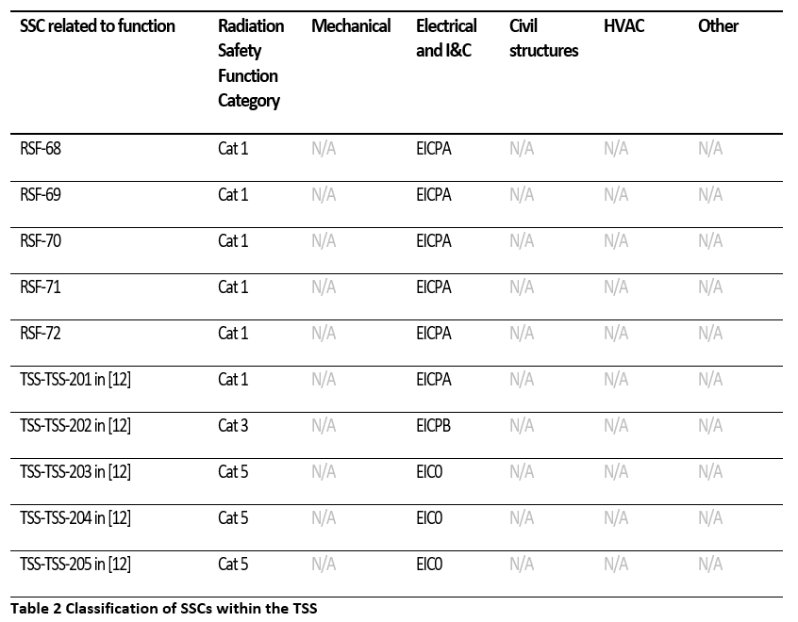
Classification - summary
Wheel rotation
He pressure
Monolith pressure
He temperature
He mass flow
Bypass
Safety stop
Operational monitor
Operational start/stop
Safety monitoring

Slide 13
TSS system requirements
Constraints

Slide 14
Constraints - general
Redundancy, diversity, physical separation, functional separation
Component quality
Qualification (ESS-0118082, ESS-0185838)
Environmental conditions resistance (ESS-0085658)
External events, for example lightning and fire
Earthquake excluded from TSS
Passive solutions, fail-safe concept
Deterministic assessment of reliability
Probabilistic assessment (Cat A ~ PFD 10⁻⁴)
IT security
Support for maintenance of the system

Slide 15
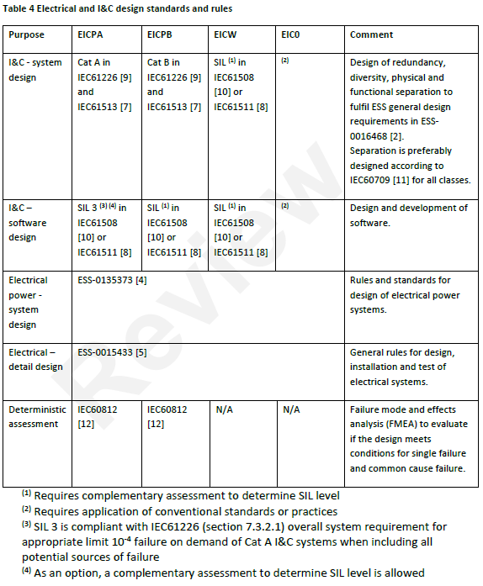
Constraints - ESS rules and standards for I&C
IEC 61226: system architecture
IEC 61511: project lifecycle, safety application software development
IEC 60709 (or IEEE 384): separation
IEC 60812: FMEA
ESS-0015433: electrical detail design

Slide 16
TSS system requirements
SSM conditions

Slide 17
SSM conditions - chapter 4, Design and Construction, and Safety Assessment - chapter 8, Information Security
Chapter 4
Chapter 8
C3, monitoring of safety functions
C6, safe state
C7, independence of safety systems
C8, classification
C10, quality and reliability
C13, proven technology
C14, consider environmental conditions, standards
C15, aging and designed lifetime
C16, lifetime, inspections, tests, monitor, calibrate, etc.
C18, separation
C19, independent single failure
C20, diversification principles
C21, independent common cause failure
C22, preferable position for safe state
C23, high class systems protected from effects in low class
C24, passive solutions
C25, shall allow manual activation if respite (sufficient time)
C29, control room with monitoring
D1, deterministic and probabilistic methods
E10, single failure
E11, common cause failure
E17, probabilistic methods
D19, vulnerability to cyber attacks
D23, not use wireless network
D28, computer for parameter settings
D30, access for authorized persons only
D31, forbid access for unauthorized persons
D32, similar to D31
D34, minimize dependency on human actions to maintain safe state
Operational functions
Single failure - redundancy
Common cause failure - diversity
Physical and function separation
Security
Safe state and fail-safe concept
Reliability evaluation
Quality

Slide 18
TSS system requirements
Conceptual TSS architecture

Slide 19
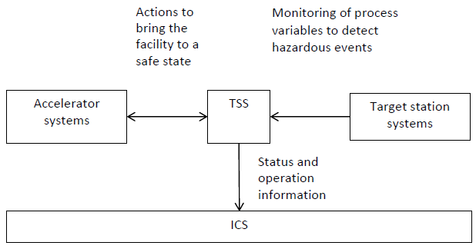
Conceptual TSS architecture - basic interfaces
ESS-0037596, TSS concept
Critical process values are monitored and evaluated continuously, from the target station systems
Actuation at the Ion source and the RFQ in the Accelerator
Control (manual) and monitoring of beam direction to bypass TSS RSFs
Information of TSS status to operator in the Main control room
Benefit ICS infrastructure
Fail-safe concept
Loss of power or communication will lead to actuation
Securing beam to dump
, Main control room

Slide 20
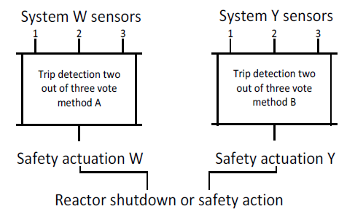
Conceptual TSS architecture - RFPD
, IEC 61226 -> IEC 61513
IEC 61226 -> IEC 62340 “NPP coping with CCF”
5.2: For I&C systems that perform category A functions the appropriate application of redundancy combined with voting mechanisms has been proven to meet the single failure criterion. This design ensures that the likelihood of a failure of such I&C systems is very low.
7.1: I&C systems perform their safety functions independently if a postulated failure of one of these I&C systems does not prevent the other systems from performing their functions as intended
He_T and He_P not diverse functions for all identified events for TSS
If failure of Relay train -> PLC train cannot solve He_T function
Share sensors between the trains
Galvanic isolation at sensor connection
If failure of Relay train -> PLC train not affected, not damaged and not prevented from performing its function -> PLC train will solve the He_T function
He_T_{A}
He_T_{B}
He_T_{C}
He_P_{A}
He_P_{B}
He_P_{C}
Electrical isolation
Relay train
PLC train
Ion source
RFQ
Stop beam

Slide 21
Conceptual architecture - IEC 62340, NPP coping with CCF
IEC 62340 – NPP coping with CCF
5.2: For I&C systems that perform category A functions the appropriate application of redundancy combined with voting mechanisms has been proven to meet the single failure criterion. This design ensures that the likelihood of a failure of such I&C systems is very low.
3.1.2: Means to achieve independence by the design are electrical isolation, physical separation, communications independence and freedom of interference from the process to be controlled
7.1: I&C systems perform their safety functions independently if a postulated failure of one of these I&C systems does not prevent the other systems from performing their functions as intended
7.1.3: The design of the architecture of I&C systems which are claimed to be independent I&C systems shall provide:
system specific processing paths from sensing the plant status to the actuation of the plant safety systems without using shared components, and
support systems (e.g. power supply or air conditioning systems), which consist of sufficiently redundant and separated sub-systems
7.2.2: Independent I&C systems shall not use shared components or services if the postulated failure of these shared components or services can cause a coincident failure of the independent I&C systems (e.g. a common power supply).
7.3.2: Independent I&C systems shall not perform identical application functions, to reduce the possibility of conditions in which a coincidental, quasi-synchronised failure of these systems may be triggered from the same input signal transient. If the implementation of identical sub-functions cannot be avoided due to the plant design, these identical subfunctions shall be fed at least with input signals from separate sensors.

Slide 22
TSS system requirements
Comments from pre-CDR

Slide 23
Comments from pre-CDR - relevant for this CDR1 and requirements
#7 “The vacuum trip point for the TSS needs to be established”.
Established according to Per’s presentation
#22 “Trip thresholds need to be agreed for both the TSS and the MPS. The headroom on some of the systems seem to be marginal? The TSS team has to investigate this in more detail”.
Thresholds established with TSS, but still to be verified and potentially adjusted.
MPS thresholds not yet defined, not within TSS scope, but within Target division scope

Slide 24
TSS system requirements
Thank you!

Slide 25
5
2
SSZ
PSZ
TSZ
4
1
trip
3
PSZ

