Slide 1
NPM Cold LINAC
CDR
Dr. Cyrille Thomas
Beam Diagnostics Engineer
European Spallation Source ERIC
11th February 2019

Slide 2
Presentation Outline
Introduction
Objectives of the CDR
Overview of the project from PDR
PDR close-out and recommendations

Slide 3
Introduction
Critical Design Review of the Cold Linac NPMs:
        Prerequisite for starting production
Charge of the review:
Does the design fulfil all requirements and respect all interfaces?
Is the design of the beamline device appropriate for its location in a particle-free region?
Is the design sufficiently mature and the level of testing/analysis appropriate to begin procurement and manufacturing of the remaining components?
Given that the CDR is also a Tollgate review for the in-kind agreement with the CEA Saclay, have the contractual obligations been met such that the CDR Milestone can be declared complete?
Is the planning appropriate and consistent with the overall ESS plans and milestones?
Is there an acquisition plan for any major or long lead time procurements, and is the lead time for procurements and contracts properly accounted for in the planning?
Has verification plan been developed? Does it cover the system features required for first protons?
Have potential safety hazards been properly identified and considered in the design choices? If required, is there a mitigation plan?
Have reliability aspects been considered in the design choices?
Have the project risks and opportunities been properly identified and their impact considered in the design? If required, is there a mitigation plan?
Were any other issues identified during the review?

Slide 4
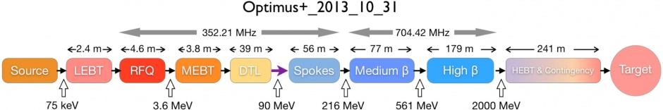
Introduction
Non-invasive Profile Monitors: 2 types:
  Fluorescence Profile Monitors (FPM): LEBT (x2), MEBT (x2), DTL (x1 de-scoped), A2T (x1)
  Ionization Profile Monitors (IPM): Spk (x1), MB (x3), HB (x1)
1
3
1
Spk:
90MeV
230 MeV
280 MeV
315 MeV
5 NPMs
MB:
= 5 (IPM_{X} + IPM_{Y})
HB:
625 MeV
Schedule 1.6
AIK 7.3

Slide 5
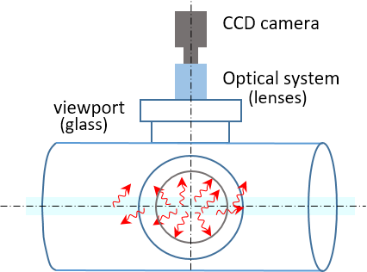
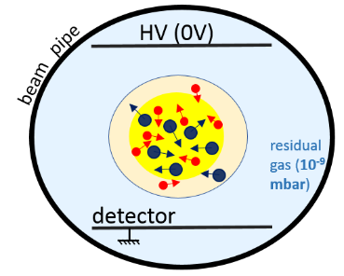
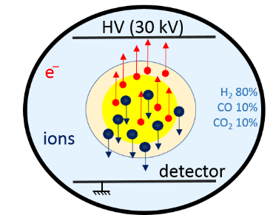




NPM types: selection criteria
IPM: Ionization PM
FPM: Fluorescence PM
$\vec{E}$ = OFF
$\vec{E}$ = ON
 | LEBT | MEBT | DTL | SPK | MB | HB | A2T
Pressure (mbar) | 10⁻⁵ | 10⁻⁷ | 10⁻⁷ | 10⁻⁹ | 10⁻⁹ | 10⁻⁹ | 10⁻⁷
Photons / cm (on CCD) | 10⁷ | 10⁵ | 10⁵ | 10² | 10¹ | 10⁰ | 10³
Ions – electrons / cm | 10⁹ | 10⁸ | 10⁸ | 10⁵ | 10⁴ | 10³ | 10⁶
 | FPM | FPM | FPM | IPM | IPM | IPM | FPM

Slide 6
Project phases
Initial design study
  Selection of the instrument principles
  Establish in-kind collaboration
Conceptual design
  Study of feasibility
  Define instrument requirements
  Define interface requirements
  Define project plan
PDR: ready for detail design
Detail design:
  Prototype design and testing
  Final Mechanical design
  Final electric and electronic design
  Acquisition and control system integration
CDR: ready for procurement and production
Delivery, Installation, integration
Commissioning
May 2016: Kick-off
2016 – Q2
2017 - Q3
2019 – Q1
2020 – Q1

Slide 7
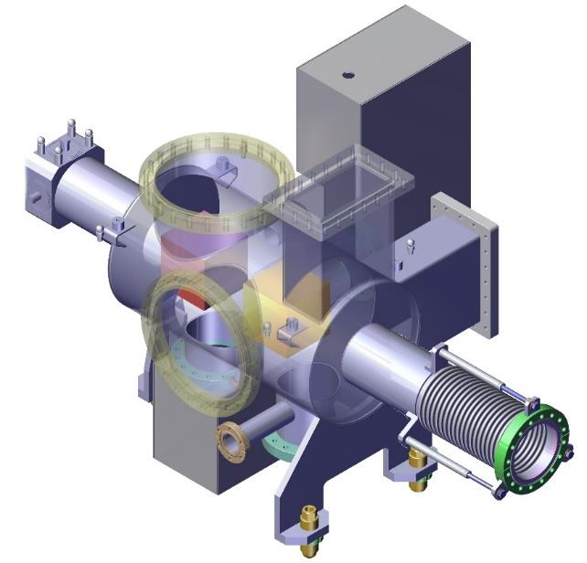
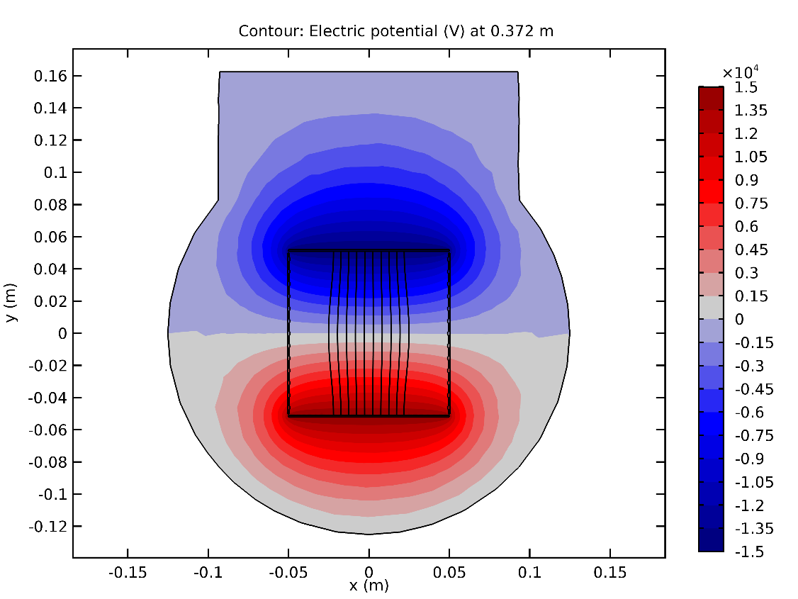
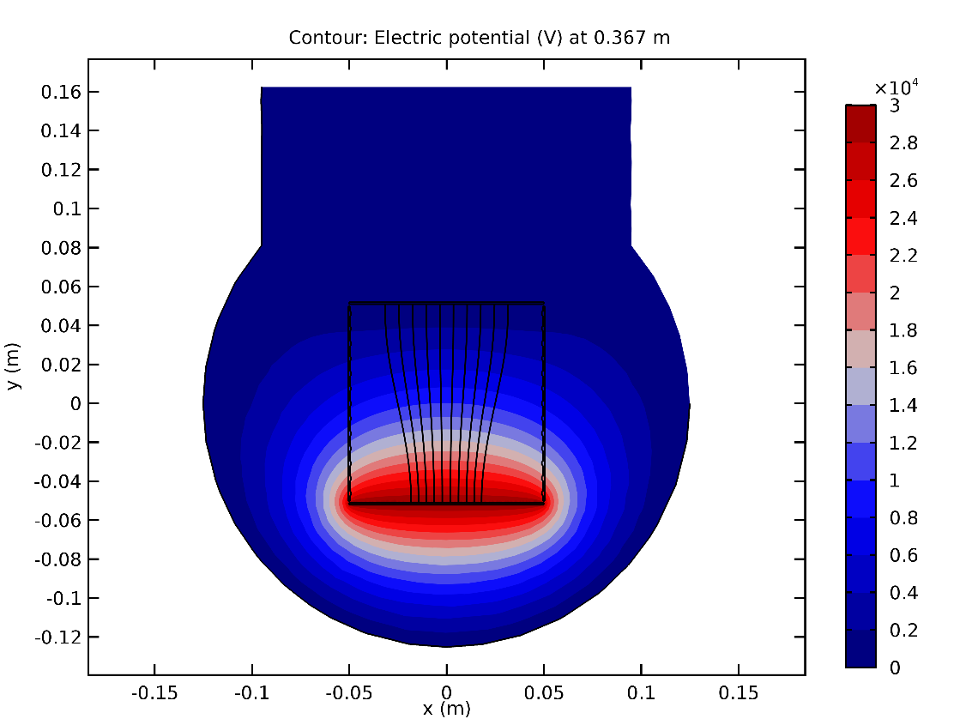
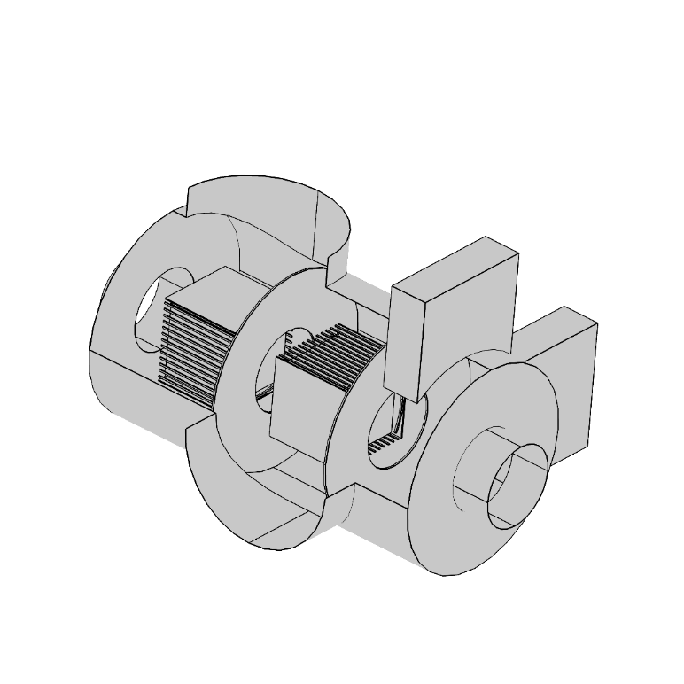
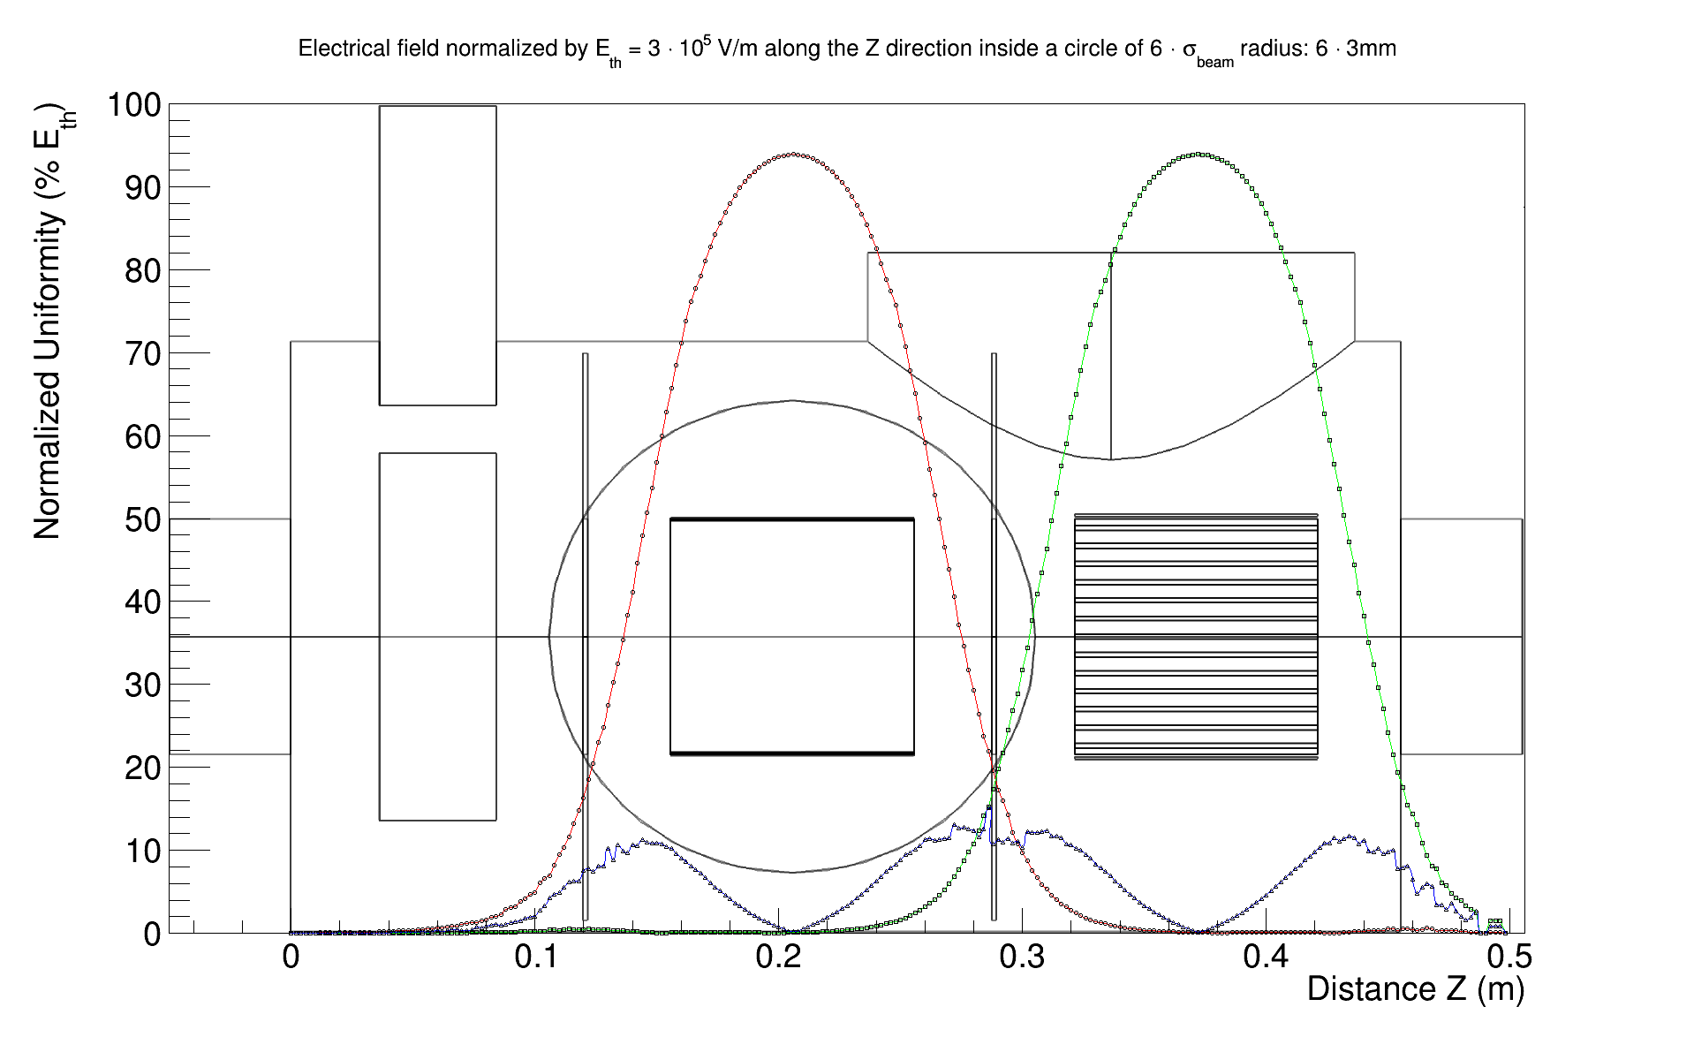
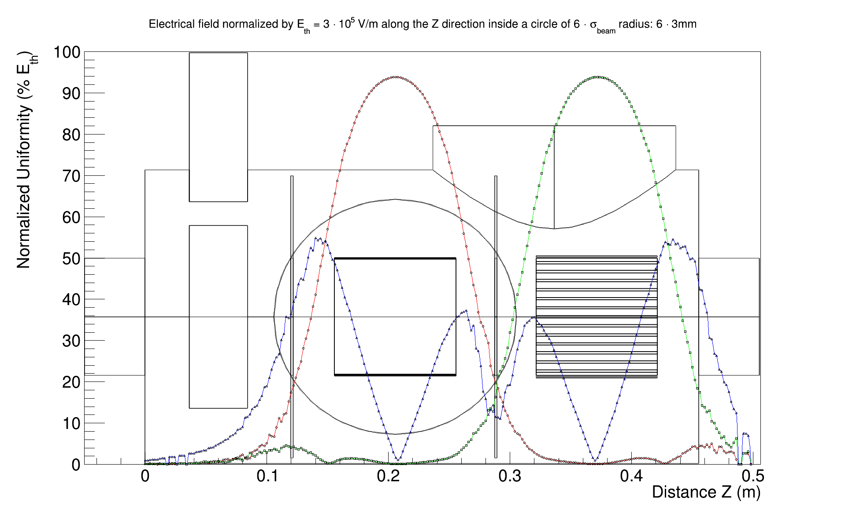
From PDR to CDR, A long journey…
Consistent and systematic studies: E-field quality
PDR recommendation
COMSOL

Slide 8
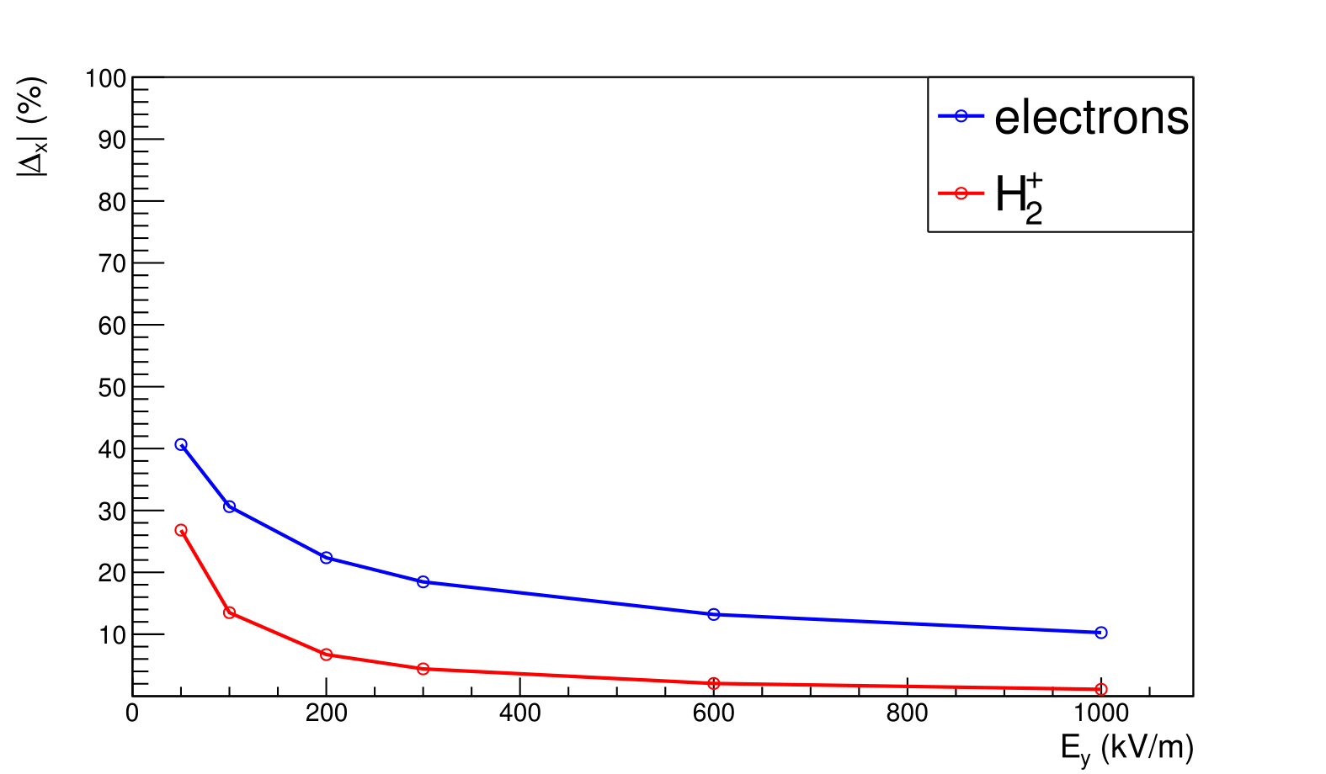
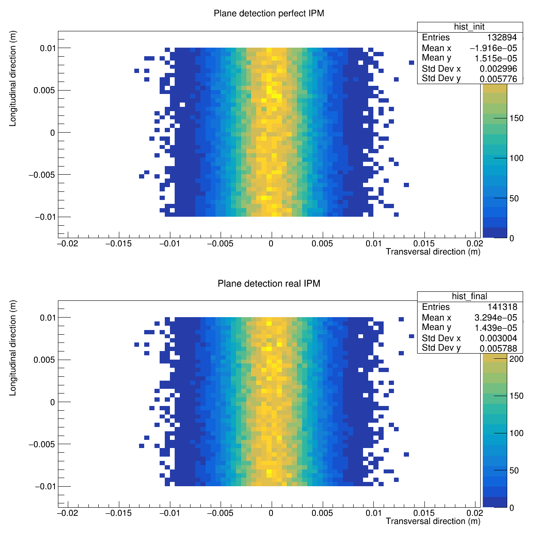
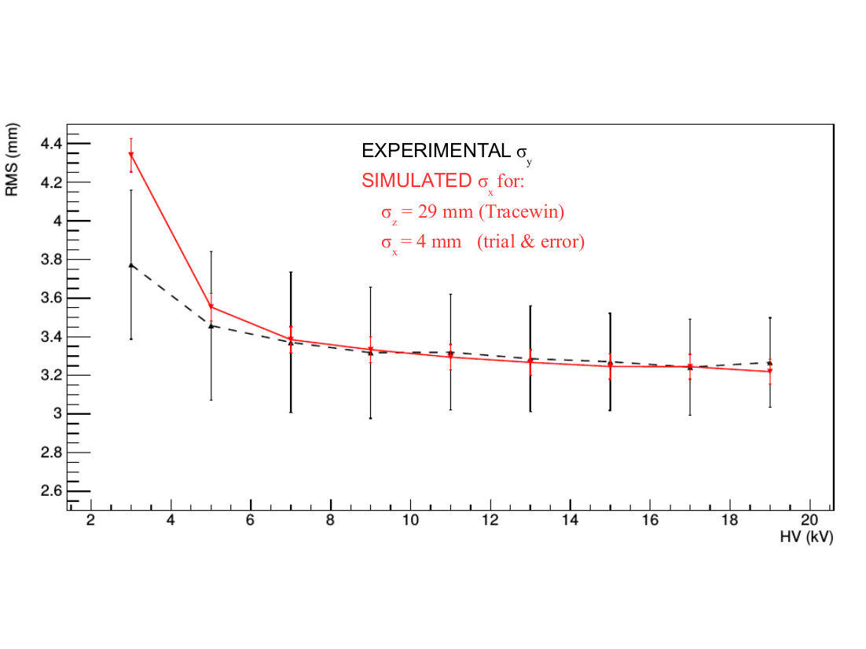
From PDR to CDR, A long journey…
Consistent and systematic studies:
3D dynamic model of the IPM: includes Space Charge
Code written in Matlab, then exported to C++
Debugging and benchmarking
ESS case study: demonstration of controlled impact of the space charge effect by the right HV field
Study impact of field uniformity (COMSOL field imported)
IPHI case study: preparation for the test of the prototypes
Beam size vs. initial size and external Field
Beam size vs. initial size and external Field
Protons
Electrons
Compare model with experiment
PDR recommendation

Slide 9
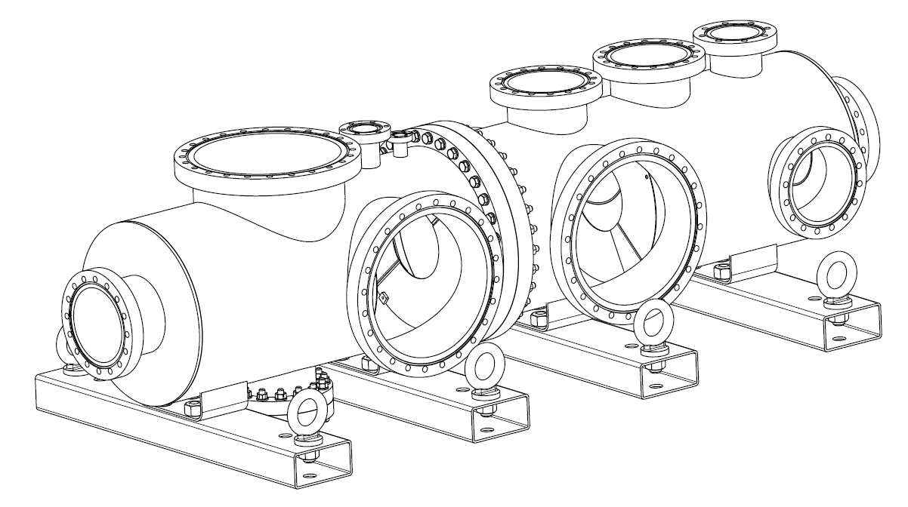
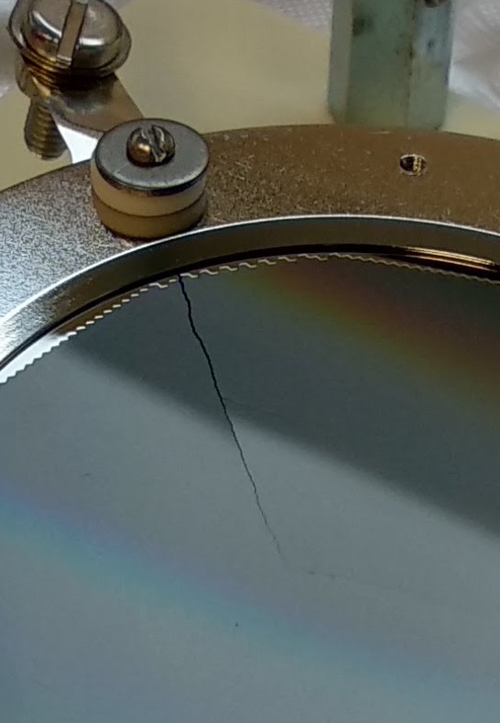
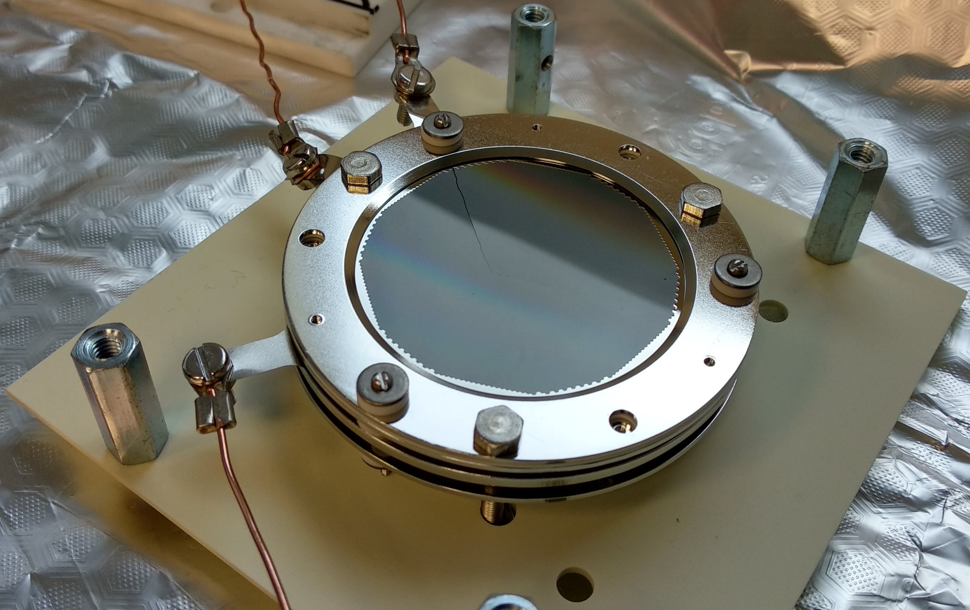
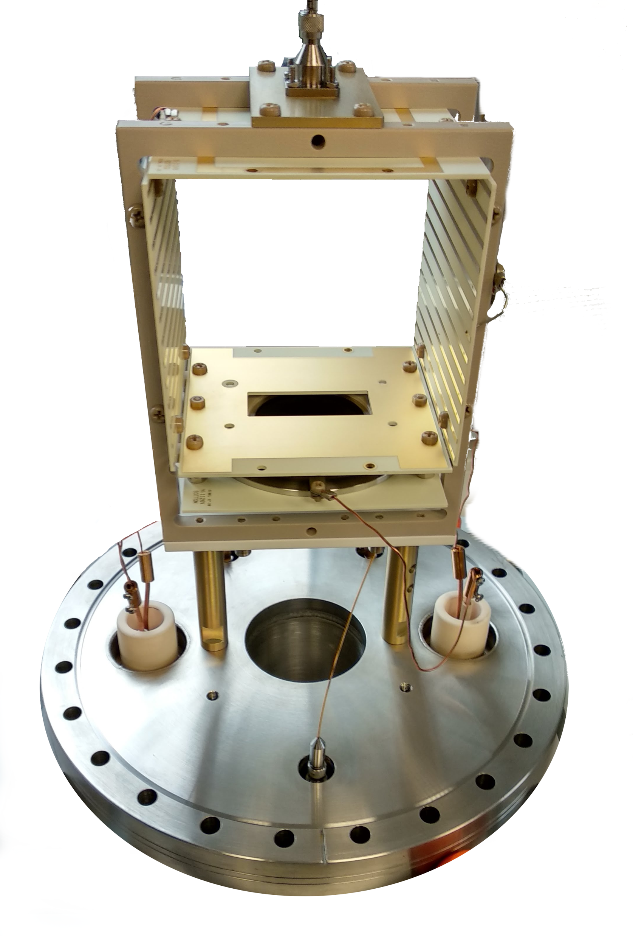
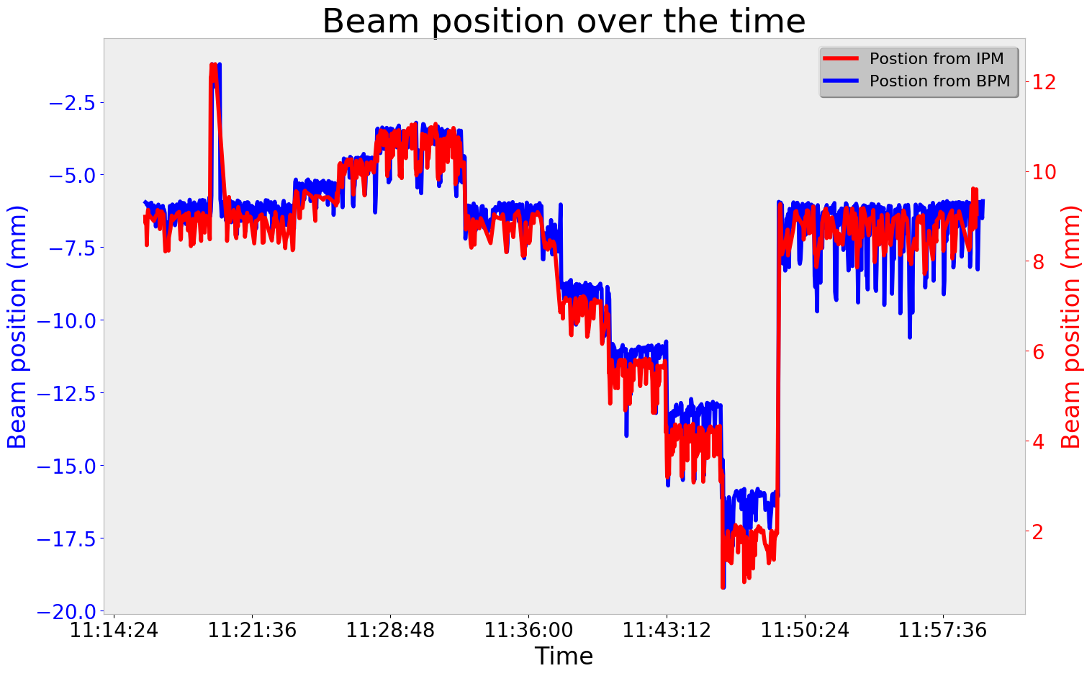
From PDR to CDR, A long journey…
Component deliveries with important delays
Chamber delivered "dirty"
Photonis MCP months late ... and broken!
Not testing during 1st period
Sparking HV cages -> solved by training procedure
Delays in starting IPHI: first beam test planned in Oct 2017
  delivered beam time in February 2018!
IPHI beam commissioning during IPM commissioning test not really ideal!
  2 weeks to establish 1st NPM image, due to beam instabilities and no BPM to assess the situation

Slide 10
From PDR to CDR, A long journey…
Deployed full EPICS control system

Slide 11
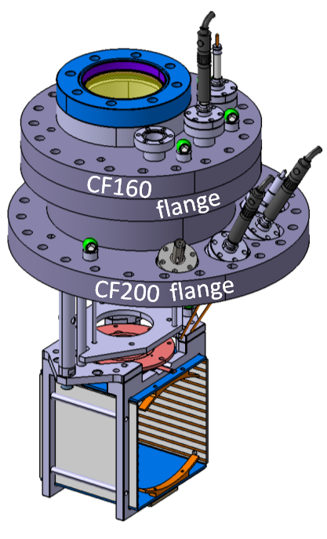

Achievements
Full model of the instrument: 3D dynamic model including space-charges
Full HV cage design, with optimisation, detail studies of field uniformity
Full prototypes design and fabrication
Manufacturing process defined
QA tests and performance measurement defined and realised on prototypes
Full series of experimental testing of the prototypes
Full EPICS control integration of the prototype
Feedback on model, construction, instrument preparation
Series of reports produced to support findings and manufacturing
Vigilant on interfaces and integration

Slide 12
Design requirements: level 4 and 5 requirements
Level 4 requirements defined in ESS-0078645 :
  All requirements apply at nominal beam peak current: 62.5mA
  Beam profile precision: 10% accuracy
  Beam size precision : 10% of the beam size
  Beam size accuracy: 0.1mm
  Operation at up to 14Hz
Level 5 requirements (ESS-0680909, ESS-0680910 and Presentations F. Benedetti, F. Belloni)
  High Voltage > 20kV and <1% non-uniform
  Sensitivity: as low as possible, and Single event detection in HB
  Calibration mandatory
  Minimum vacuum pressure 10⁻⁹ mbar
  Control interface interconnected with correctors values
  Vacuum requirement: particle free and High Vacuum

Slide 13
PDR Close-out
Recommendation | Response
Scope for profile non-destructive profile: The delivery plan should be aligned with the installation schedule. If delivery cannot be done by the time the LWU needs to be installed, additional resources in terms of time and manpower for later installation needs to be identified. | Coordination within ESS and with in-kind collaborators is established. The planning is aligned with the ESS installation plan, in agreement with Vacuum Group and with the general installation plan of the LWUs. (See Presentation 'Towards NPM Manufacturing).
General requirements for the NPM: It is recommended to document the Level 5 requirements and system performance specifications to communicate it in more details to achieve the expected performance and operating conditions. This is needed to manage expectations of the stakeholders, primarily commissioners and operators. | Level 5 document produced remains to be produced, however, performance of the instrument has been addressed and detailed in documentation ESS-0680909 and ESS-0680910

Slide 14
PDR Close-out
Recommendation | Response
Background estimation: The background must be evaluated either by simulations or by experimental investigations. One possible location might be SNS or CERN LINAC4, where such system (small vacuum vessel with the detector inside) could be placed closed to the beam line. However, such measurement requires quite some investment of manpower. | Information is still missing to compute this information. This work is in progress as some partial information on background has been recently produced and communicated by the Beam Physics section.
Space charge simulation: Only the ion detection scheme should be considered in future and the IPM should be optimized for this purpose. Electron detection is more difficult, because such slow electrons are influenced by any external magnetic field e.g. from quadrupoles, ion pumps or vacuum gauges. Moreover, the secondary electrons liberated from the residual gas ions hitting the negative HV electrode must be suppressed efficiently. | It has been shown that space charge can be under control with the HV, and the distortion of the profiles are better understood with the use of ions. See presentation from F. Belloni.

Slide 15
PDR Close-out
Recommendation | Response
Space charge simulation influence on HV: The requirement of using 60 kV for the field cage should critically reviewed and only the required value of the HV should be chosen. | Studies confirmed lower level of HV to be satisfying measurement precision required on the beam size and on the beam profile. The HV will be set to lower value, namely 20kV.
E-field cage: The evaluation of the field quality should be performed for different longitudinal positions. This should lead to the statement of an adequate longitudinal extension of the detector, i.e. the size of the MCP. The final field configuration should be verified by tracking test particles, preferably in an existing software such as COMSOL. The engineering design should be started soon taking the simulation results into account this might lead to some simplification of the cage design (e.g. in the number of degraders). Possible interference between the IPM and the Wire scanner measurements should be investigated. If the high voltage cannot remain during wire scans, the impact of this on the operation of the devices should be assessed. Preferably, the systems should be fully independent. Independently of this, the issue of trajectory correction for the e-field effect needs to be addressed. | Extended simulation of the HV cage and realistic model of the instrument has been done, showing the tolerance on the manufacturing of the HV cage to ensure required field uniformity. In addition, the prototype confirmed the design to be in agreement with the model, and helped to finalize the design. See section on E-field section on Design Study document ESS-0680909 Presentation from F. Benedetti

Slide 16
PDR Close-out
Recommendation | Response
Mechanical design: The mechanical design should be started soon to leave sufficient time for possible improvements in case of any sparking. A vacuum vessel optimized for an IPM would be an advantage (only 5 out of more than 60 vessels have to be modified). | The mechanical design is now fully achieved. See ESS-0680910. System pending to CR to be implemented by stakeholder of the LWUs design and manufacturing
Vacuum issues: A RAMI / FMEA analysis is recommended in order to categorize the designs and to select the best promising solution. A preliminary test campaign on a machine / set up with vacuum conditions closer to the ESS requirements is recommended. | A procedure has been fully established and verified by experts from ESS and cryo-engineers at CEA in charge of the cryo-modules.
Detector technology MCP saturation: This saturation effects should be discussed with the suppliers (Hamamatsu or Photonis). | No issues found during the prototype testing.

Slide 17
PDR Close-out
Recommendation | Response
Read-out detector technology general comment: We propose to take the MCP based detector as the baseline design. The phosphor readout seems to be technically simpler because commercial MCP phosphor combinations are available. A camera reading should be a standard for the ICS. Investigations with the TimePix3 technology should be performed with lower priority (but are still interesting from a scientific point-of-view). | This has been fully endorsed with the prototype development. Some investigation on TimePix3 has been done on a low energy ion beamline (12keV), showing the issues with IPM based on ions.
Detector technology MCP requirement: It is recommended to have a design with an MCP to get sufficient signal for low current or short pulse operation. Usage of a single MCP might be possible which enable better spatial resolution and less risk of false profile reproduction due to saturation. Further studies are required including a discussion with the MCP suppliers (Hamamatsu or Photonis). | Done during prototype testing. The tests results showed the necessity to use a double stage MCP. This presents the advantage of using less gain per stage, prolongating the lifetime of the MCP.

Slide 18
PDR Close-out
Recommendation | Response
Efficiency of MCP: The expected efficiency decrease of the MCP should be evaluated again taking the beam profile into account. Permanent profile monitoring should not be foreseen i.e. the MCP voltage should be lowered to prevent amplification in case the beam profile is not recorded. | None issue.
Comparison strip versus phosphor readout: The choice between both types is not easy and requires some more study; presently the phosphor readout seems to be simpler. | The choice of having a phosphor based readout has been done because using strips has been shown to work with an MCP, thus, it has been decided not to cumulate difficulties and operational issues.
Beam based tests: The tests at IPHI should have higher priority than at COSY. There may be even more suitable locations for some tests, in particular for background considerations at, e.g. at CERN LINAC4 or SNS. | Tests have been done only at IPHI.

Slide 19
PDR Close-out
Recommendation | Response
Cables: Avoid as much as possible to defer cables choices. Reducing the readout options early will help in this regard. | All cables are in cable database.
Controls: Clarifications about the final (controls) integration work should be done as soon as there is one preferred solution selected. List pros and cons of evaluated solutions, considering all relevant aspects (quality of measurements, implementation effort, future development). If the most work-intensive solution turns out to be superior to others, consider relaxing the timetable slightly (note: having said that, it should be ESS/BI and or BP to decide how soon you really need the NPMs). | The control system for the prototypes is EPICS, so most of the implementation of the control system has been done under an ESS control system. The cameras are GiGE, controlled with AreaDetector, HV units are done using controller, also integrated into EPICS. ICS proposes to use ISEG controllers with EPICS drivers and E3 EPICS interfaces.
Quality assurance: A verification plan that includes inspections and tests for production, and a plan for factory and site acceptance testing, should be presented at the CDR | See CDR document ESS-0680910

Slide 20
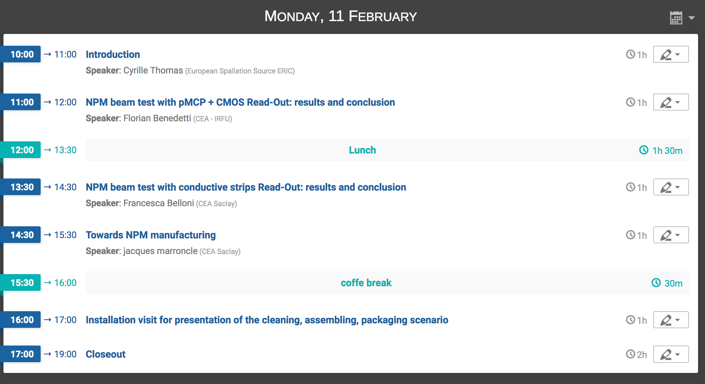
CDR Program

Slide 21
Thank you for your attention

