Slide 1
NPM beam tests with pMCP and CMOS readout:
Results and conclusions
P. Abbon, F. Belloni, F. Benedetti, M. Combet,
G. Coulloux, F. Gougnaud, C. Lahonde-Hamdoun,
P. Legou, P. Le Bourlout, A. Marcel, Y. Mariette,
J. Marroncle, J.P. Mols, V. Nadot, L. Scola, G. Tauzin
C. Thomas (ESS project leader)
ESS cNPM CDR – 2018/02/11

Slide 2
Overview
Optical IPM overview
  Readout out
  Implementation
  Control System
Electrical simulations
  Simulation setup
  Without correction
  Asymmetric
  Symmetric
IPHI setup and beam measurements
  IPHI & test campaigns
  Beam position
  Beam current
IPM characterization at IPHI
  MCPs
  Phosphorus screens
  Extrapolation to ESS
  HVs
  Field simulation checks
Conclusion

Slide 3
Optical IPM overview
  Readout out
  Implementation
  Control System

Slide 4
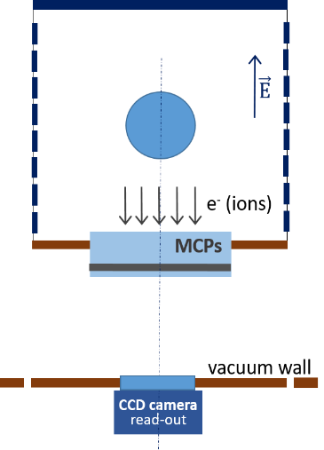


A. Readout (1/3)
How does it work ?
  MCP readout
      MCP + Phosphorus screen
          Converts and amplifies ions or e- to e-
          Amplified e- hit a phosphorus screen
      Camera
          Collect photon from phosphorus screen
  Allows multiple field configurations

Slide 5
A. Readout (1/3)
How does it work ?
  MCP readout
      MCP + Phosphorus screen
          Converts and amplifies ions or e- to e-
          Amplified e- hit a phosphorus screen
      Camera
          Collect photon from phosphorus screen
  Allows multiple field configurations

Slide 6
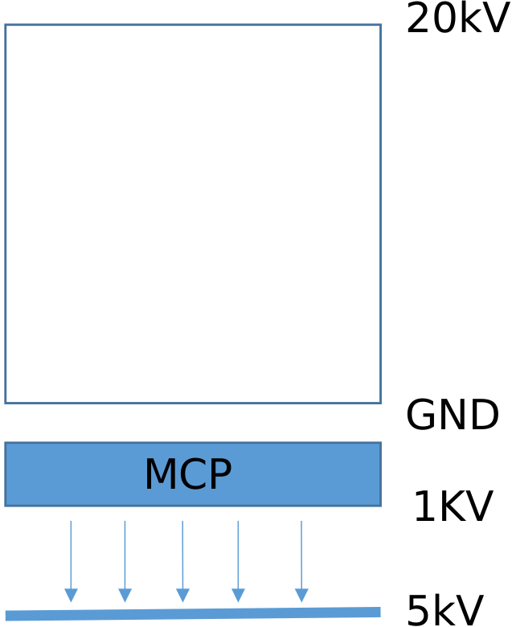
A. Readout (2/3)
Asymmetric
  HV on top electrode
  GND on bot electrode/MCP
  Independent power supplies
  Better control of gain
      Voltage
      Current
HV channel
HV channel

Slide 7
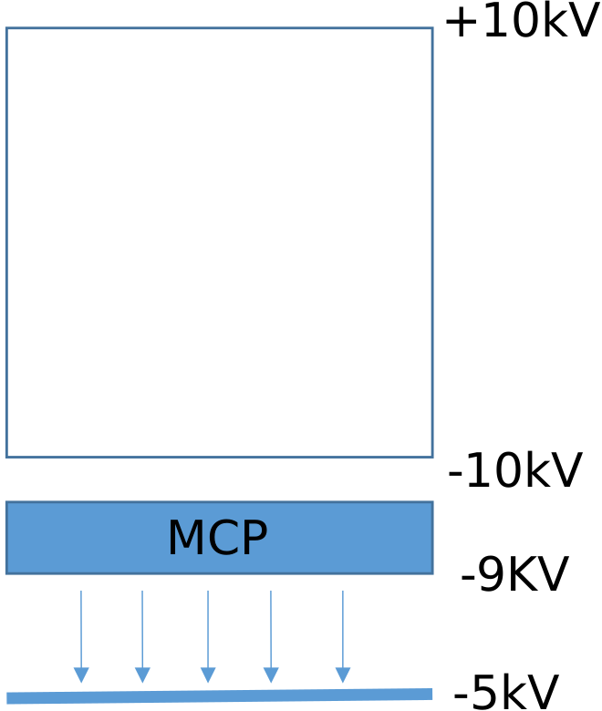
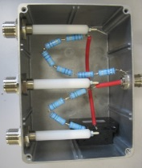
A. Readout (3/3)
Symmetric
  HT on top electrode
  Opposite HT on bot electrode/MCP
  Better field uniformity
  Use resistor bridge for MCP safety
      No information about MCP gain …
HV channel

Slide 8
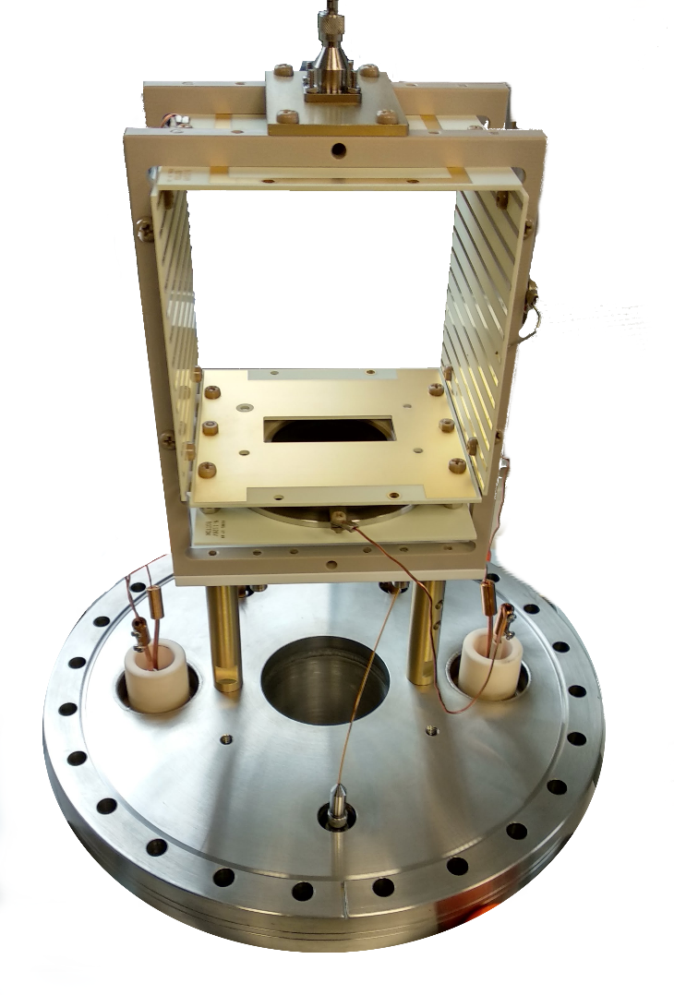
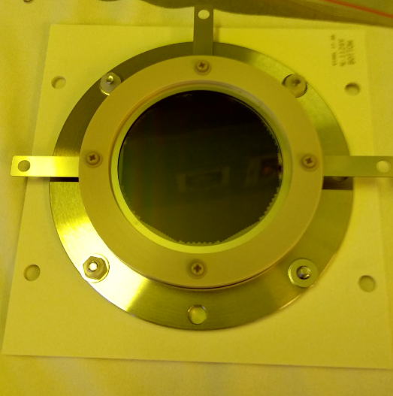
B. Implementation (1/3)
  Optical fiber for calibration
  Frame
      Previously PEEK
      Now Macor
  Degraders
      SMD resistors
      soldering
  Screw
      PEEK
      and SS
  PCB
      RO4350
  MCP
      PEEK, SS, Macor
  HV Feedthrough
  Wire
      Copper
      Kapton insulated

Slide 9
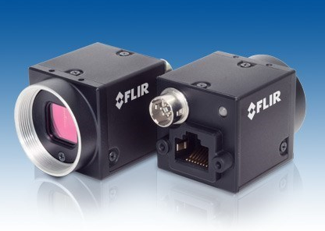
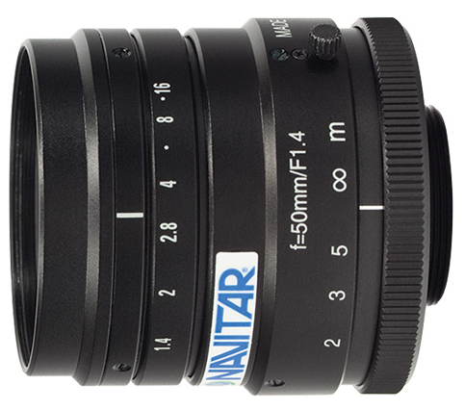
B. Implementation (2/3)
BFLY-PGE-23S6M-C
  Sony IMX249
      5.86 µm pixel size
      We use 2x2 binning ➔ 11.72µm
      80% QE @ 525nm
      2.3M pixels=1920*1200
  41 FPS
  GigE PoE
  No radiation hardness
  COTS camera (price: 379€)
MVL50M1
  50mm
  f/1.4 to f/16
  423€

Slide 10
B. Implementation (3/3)
Power supplies:
  Iseg CPS modules …
      30kV Max
      1 channel/module
      No grouped trip
  In Iseg MMC crate
      3U
      MICC controller
      SPCI protocol
We are interested in:
  Iseg EHS modules …
      20kV Max
      4 channel/module
      Grouped trip
  In a Iseg MMS crate
      3U
      MMS controller
      iCS server
Any feedback about these power supplies ?

Slide 11
C. Control system (1/2)
Almost everything run with EPICS (but not in EEE)
  Camera use AreaDetector
      PointGrey driver
          Also compatible with Aravis (tested)
          But less features
      HDF5 for file saving
          Possibility to save image + data from PV, function etc …
          Limited by the camera (HDF5 plugin can save more than 14 frame/s)
      Fit Plugin from ESS-BI
  HV and LV use asyn and StreamDevice
      HV and LV controllers use SCPI protocol ➔ StreamDevice
          1 soft IOC per controller
          1 Stream protocol file per channel type
          1 db for each channel and controller with macros ➔ same templated db file
  Archiver Appliance
      For slow control
      And some IPHI PVs

Slide 12
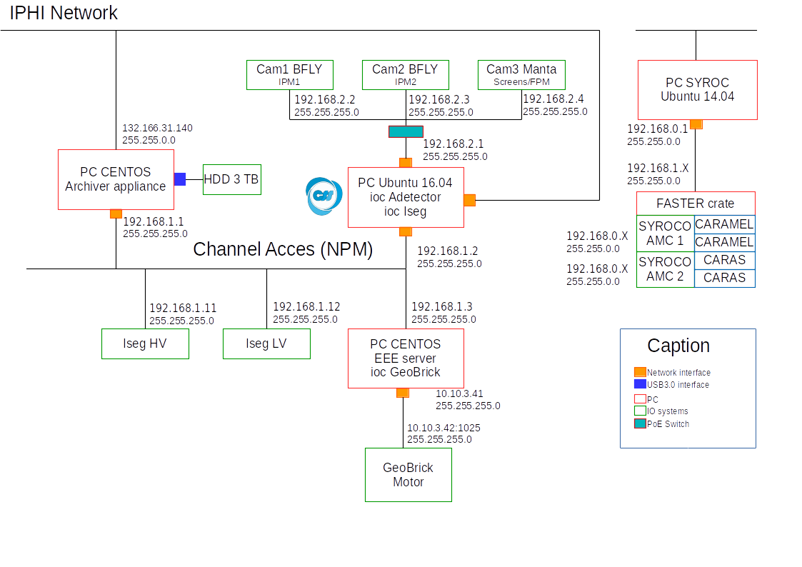
C. Control system (2/2)

Slide 13
Electrical simulations
  Simulation setup
  Without correction
  Asymmetric
  Symmetric

Slide 14
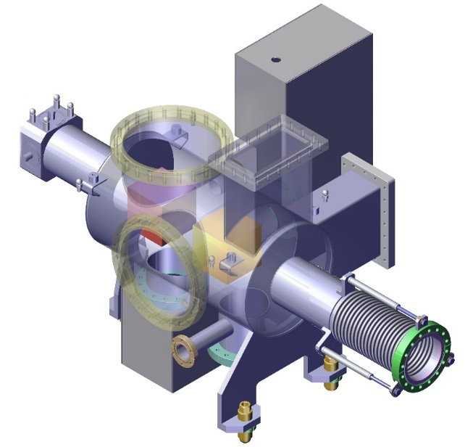
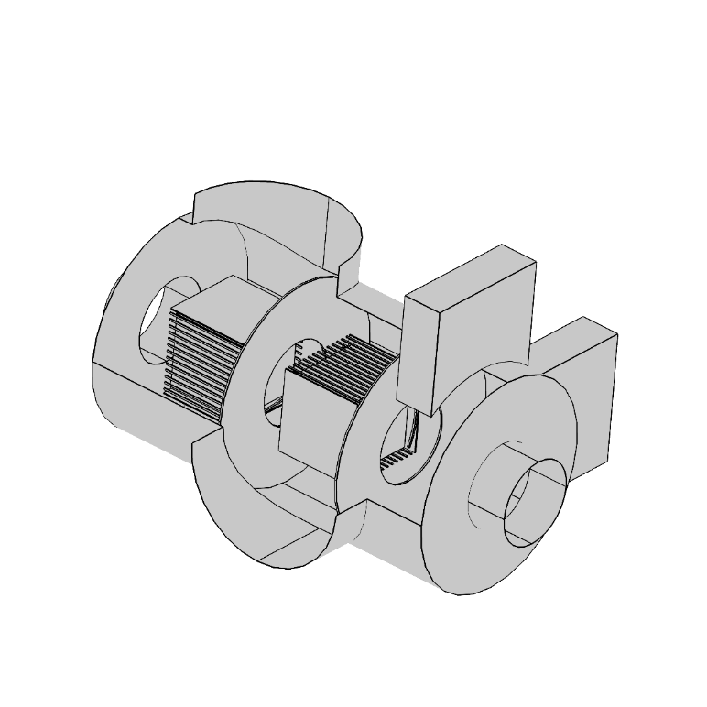
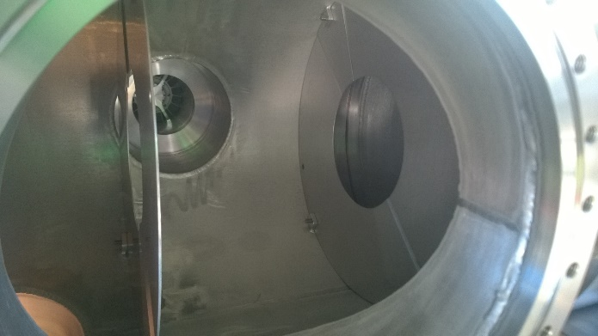
A. Simulation setup
E-Field simulations
  COMSOL
  Homemade Analysis/particle tracking
Main leverages
  Field correctors (degraders)
      Correction in transversal direction
  Disks
      Shield IPM from each other
      Independent systems

Slide 15
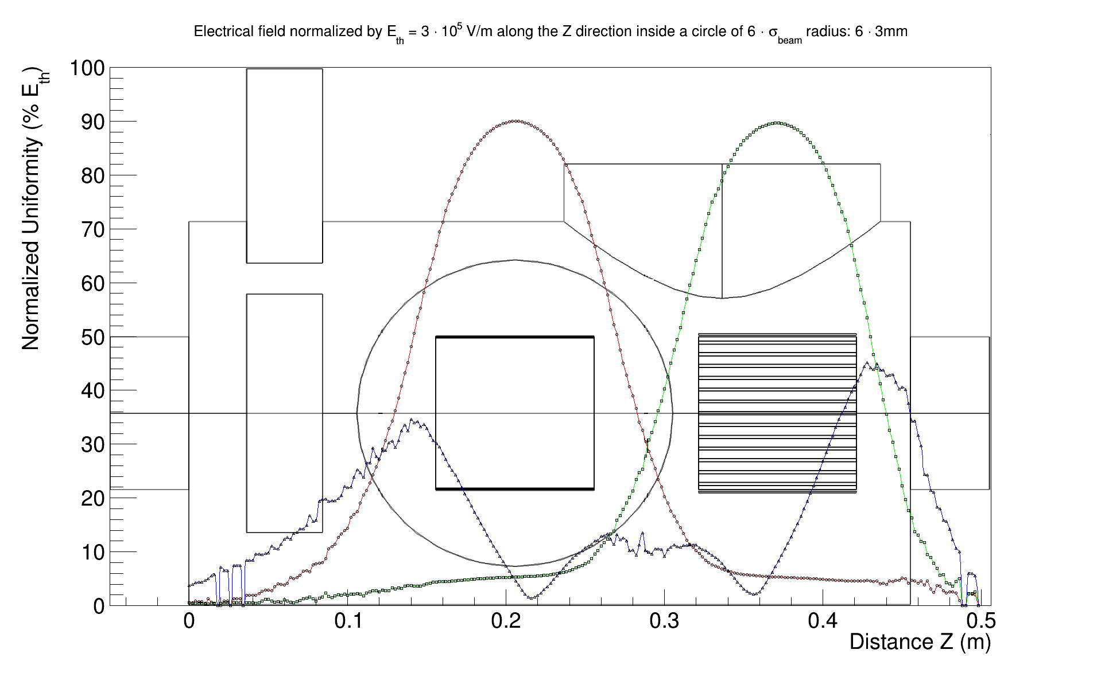

B. Field: Asymmetric without corrections (1/2)
Electrical Field normalized by $E_{Th}=3∙{10}^{5} V/m$ inside a circle of $6∙σ_{beam}=18 mm$ radius
E_{y}
E_{y}
E_{z}

Slide 16
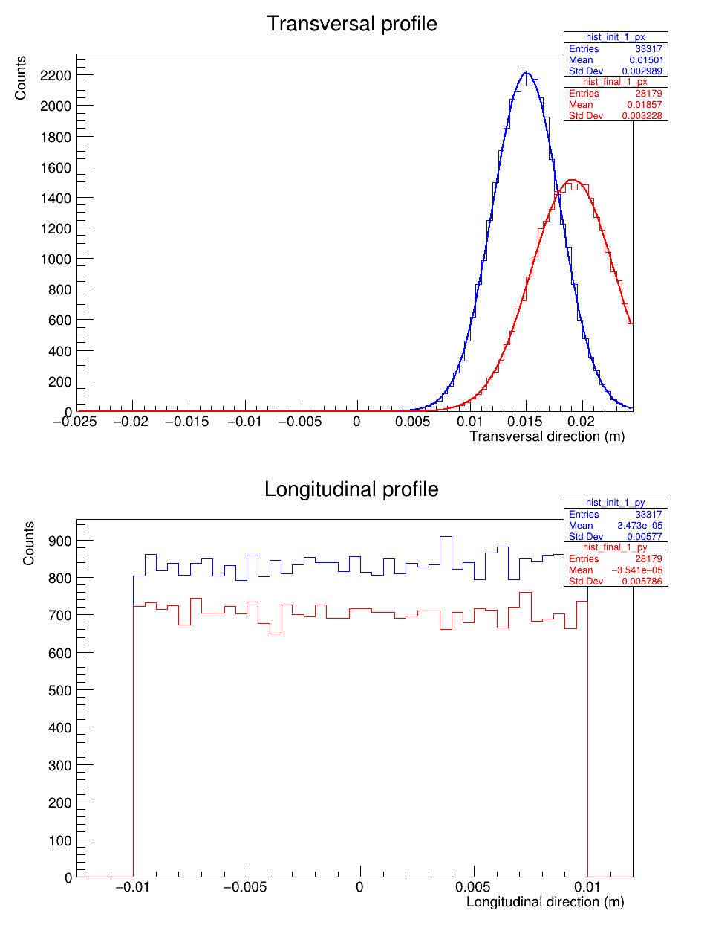
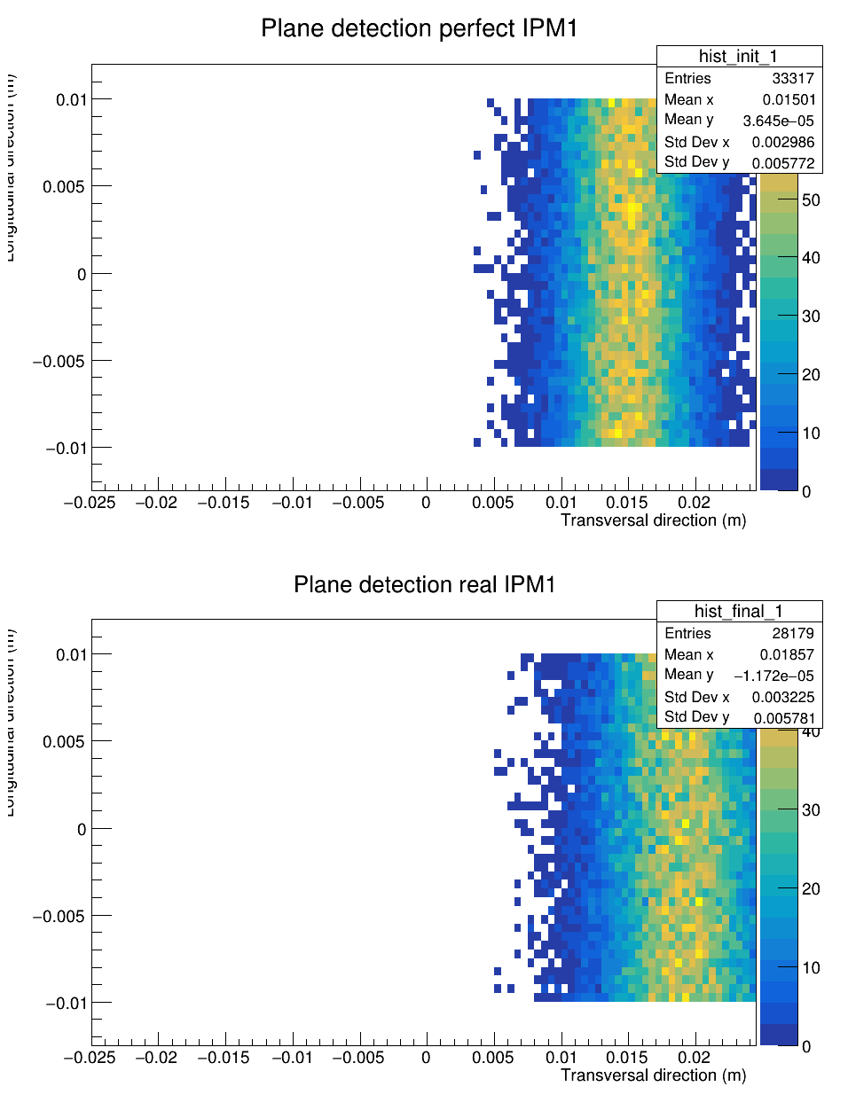
B. Tracking: Asymmetric without Hardware correction (2/2)
Error on profile: 30%

Slide 17
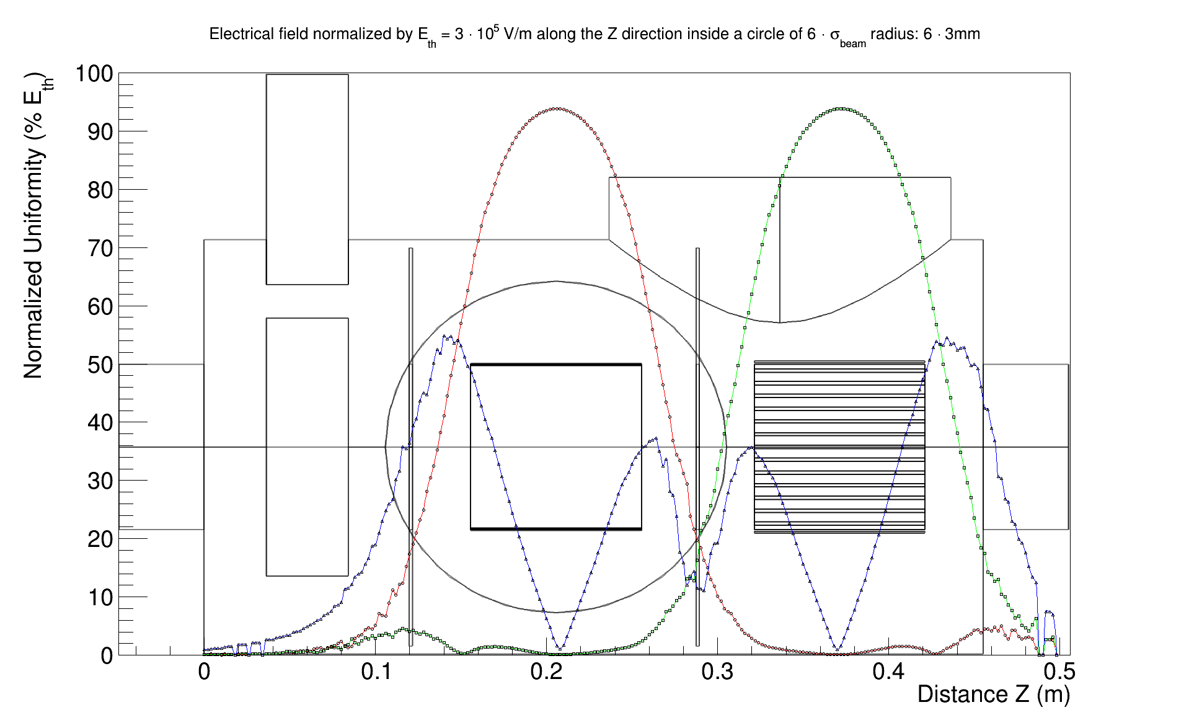
B. Field: Asymmetric + Disk + Degraders (1/2)
Electrical Field normalized by $E_{Th}=3∙{10}^{5} V/m$ inside a circle of $6∙σ_{beam}=18 mm$ radius
E_{y}
E_{y}
E_{z}

Slide 18
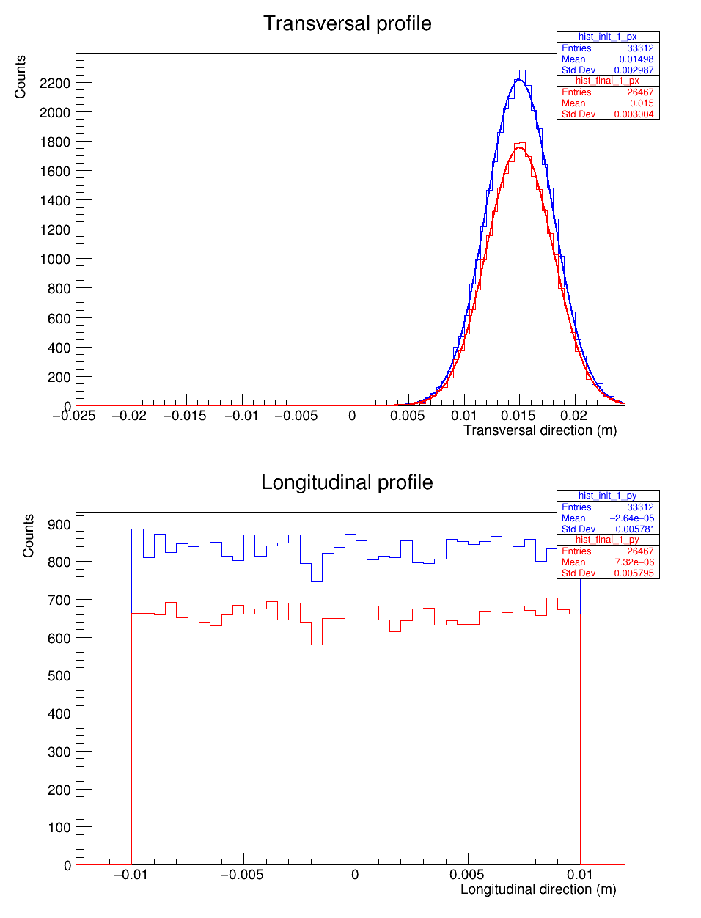
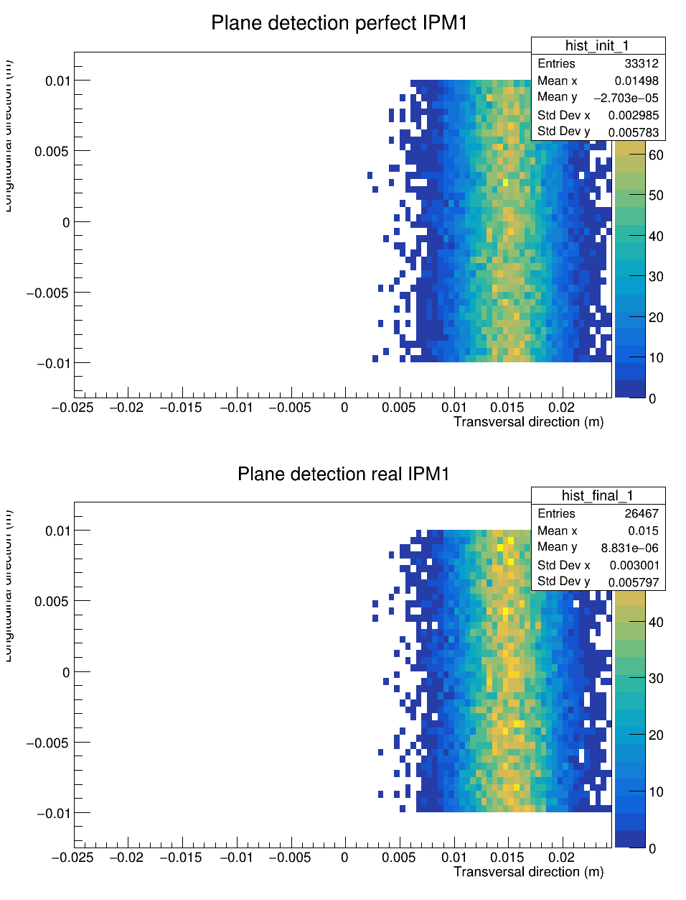
B. Tracking: Asymmetric + Disk + Degraders (2/2)
Error on profile: 1.1%
29% of particles are “lost”

Slide 19
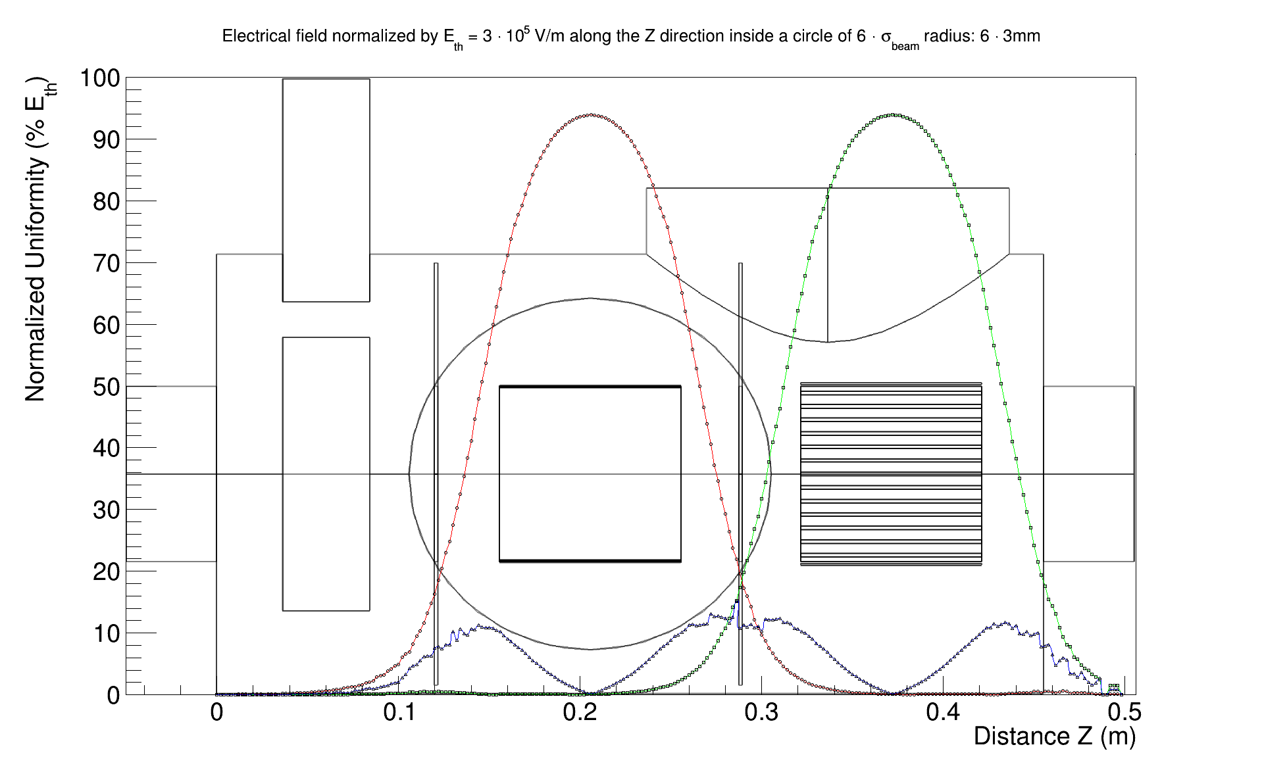
C. Field: Symmetric + Disk + Degraders (1/2)
Electrical Field normalized by $E_{Th}=3∙{10}^{5} V/m$ inside a circle of $6∙σ_{beam}=18 mm$ radius
E_{y}
E_{y}
E_{z}

Slide 20
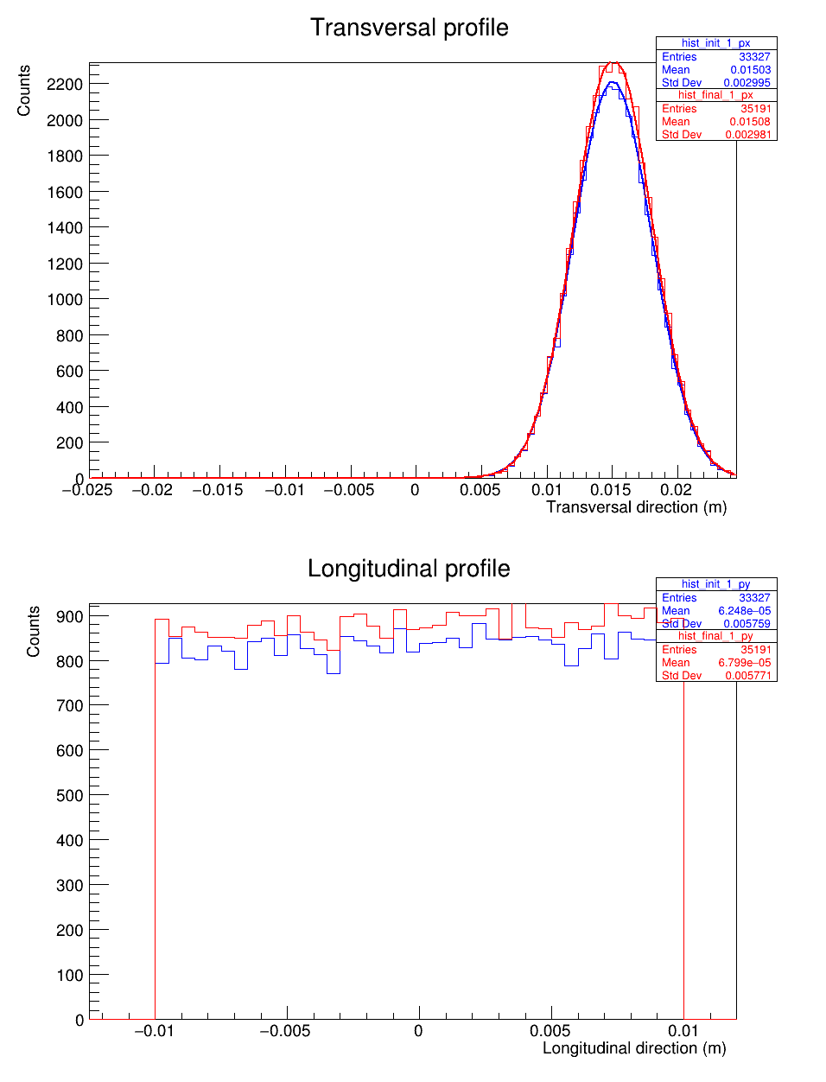
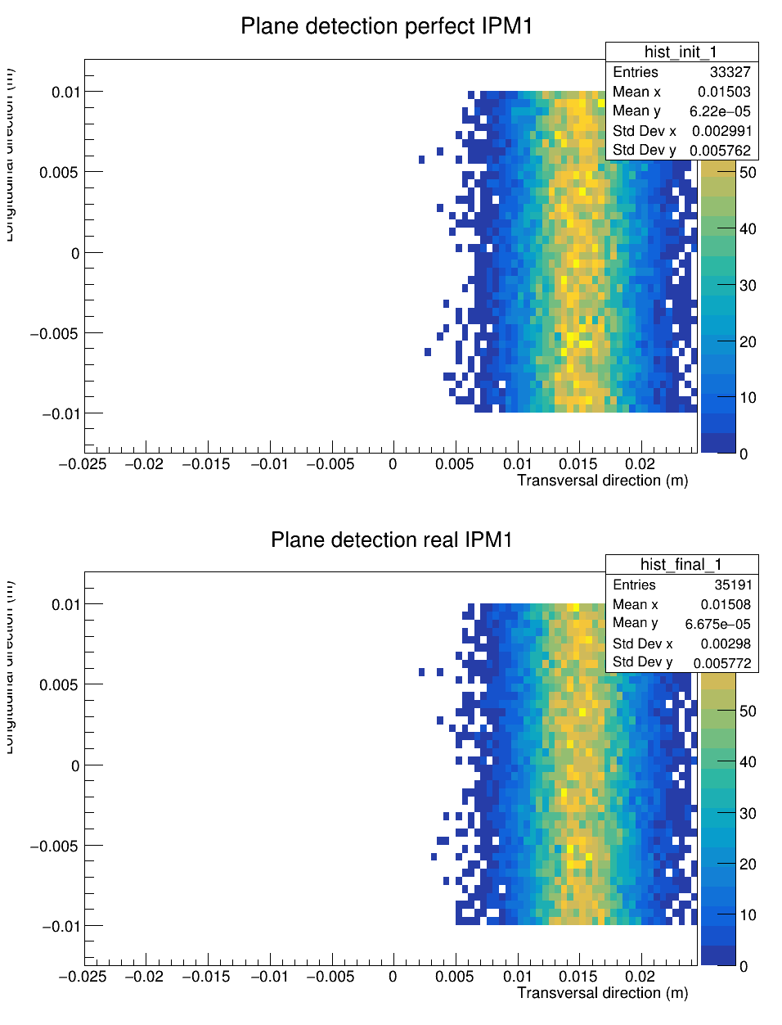
C. Tracking: Symmetric + Disk + Degraders (2/2)
Error on profile: 0.5%

Slide 21
IPHI setup and beam measurements
  IPHI & test campaigns
  Beam position
  Beam current

Slide 22
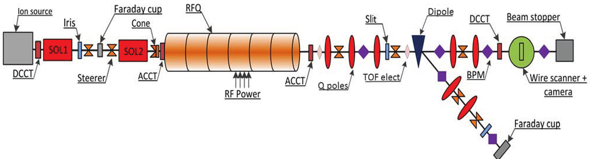
A. IPHI & test campaigns (1/4)
IPHI
  3 MeV Protons
  352 MHz RFQ
  0,5 to 100mA
  50 us to DC
  2 lines
      Main line
      Deviated line for users
Test bench
  2 parts
      Upstream: ESS LWU like vessel
      Downstream: Extension vessel
  3 IPM slots
  2 reference measurements

Slide 23
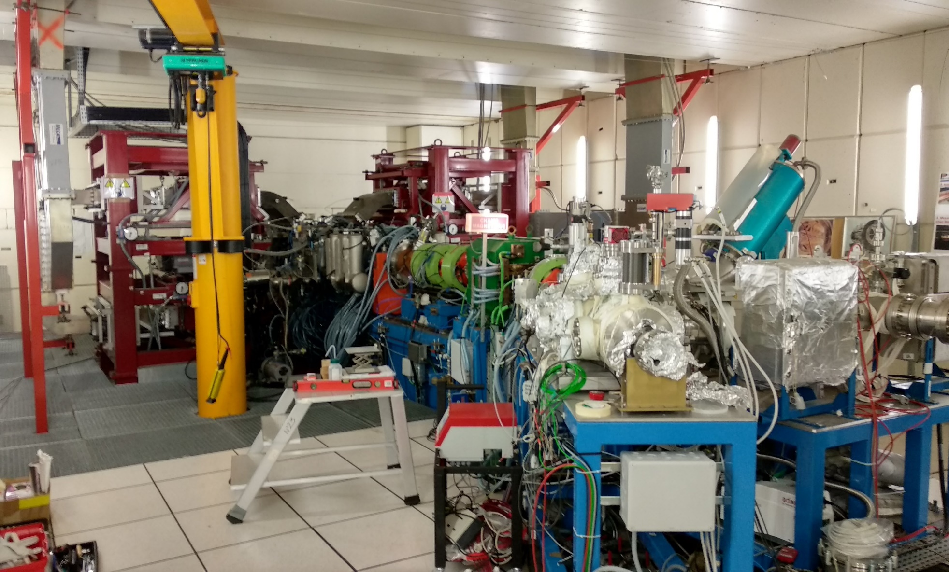
A. IPHI & test campaigns (2/4)

Slide 24
A. IPHI & test campaigns (3/4)
First campaign:
  Debug (almost 2 weeks)
      HV sparks and trips
      Readout problems
  Beam tuning (2 weeks more)
      Turn on BPM
      Fine tuning of beam
Second campaign:
  Test prototype improvements
      Higher HV
      Confirm results from first campaign
  Many external problems
      PLC failure/ CS issues
      Water leak
      Inadequate cooling system
 | First campaign | Second campaign
Starting date | 19/02/2018 | 14/09/2018
First profile | 01/03/2018 | 14/09/2018
Ending date | 13/04/2018 | 26/10/2018
IPM1 | Strips Y | Strips X
IPM2 | Optical (Hamamatsu) Y | Optical (Photonis) Y
IPM3 | Strips Y | Strips Y

Slide 25
A. IPHI & test campaigns (4/4)
Hamamatsu:
  1 MCP with Phosphor screen
      Single stage
      12 µm channel diam.
      P43 (efficient slow screen)
      Active diameter/total diameter ➔ 40%
Photonis:
  1 MCP with Phosphor screen
      Single stage
      10 µm channel diam.
      P46 (fast screen)
      Active diameter/total diameter ➔ 60%

Slide 26
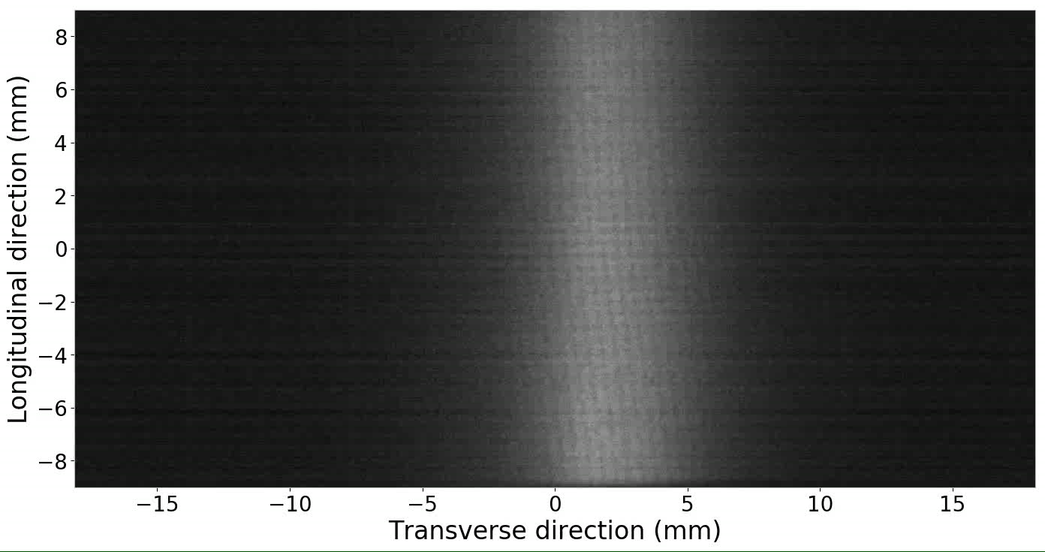
B. Beam position (1/4)

Slide 27
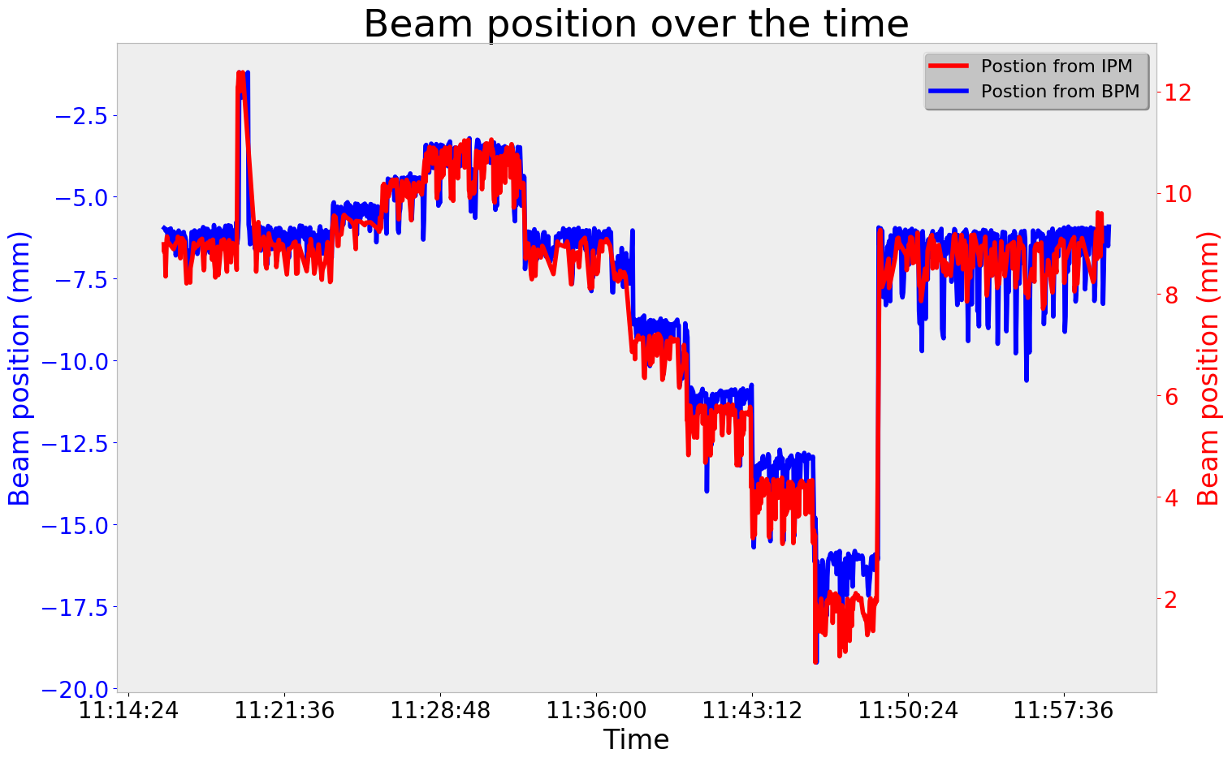
B. Beam position (2/4)

Slide 28
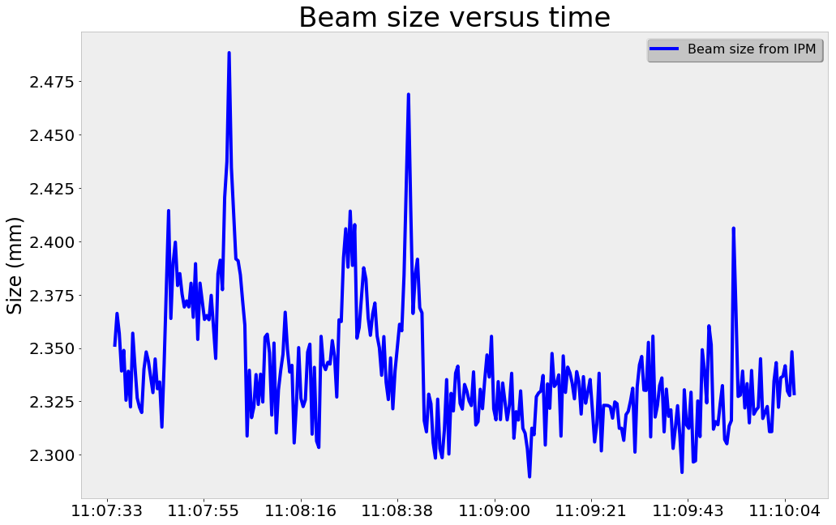
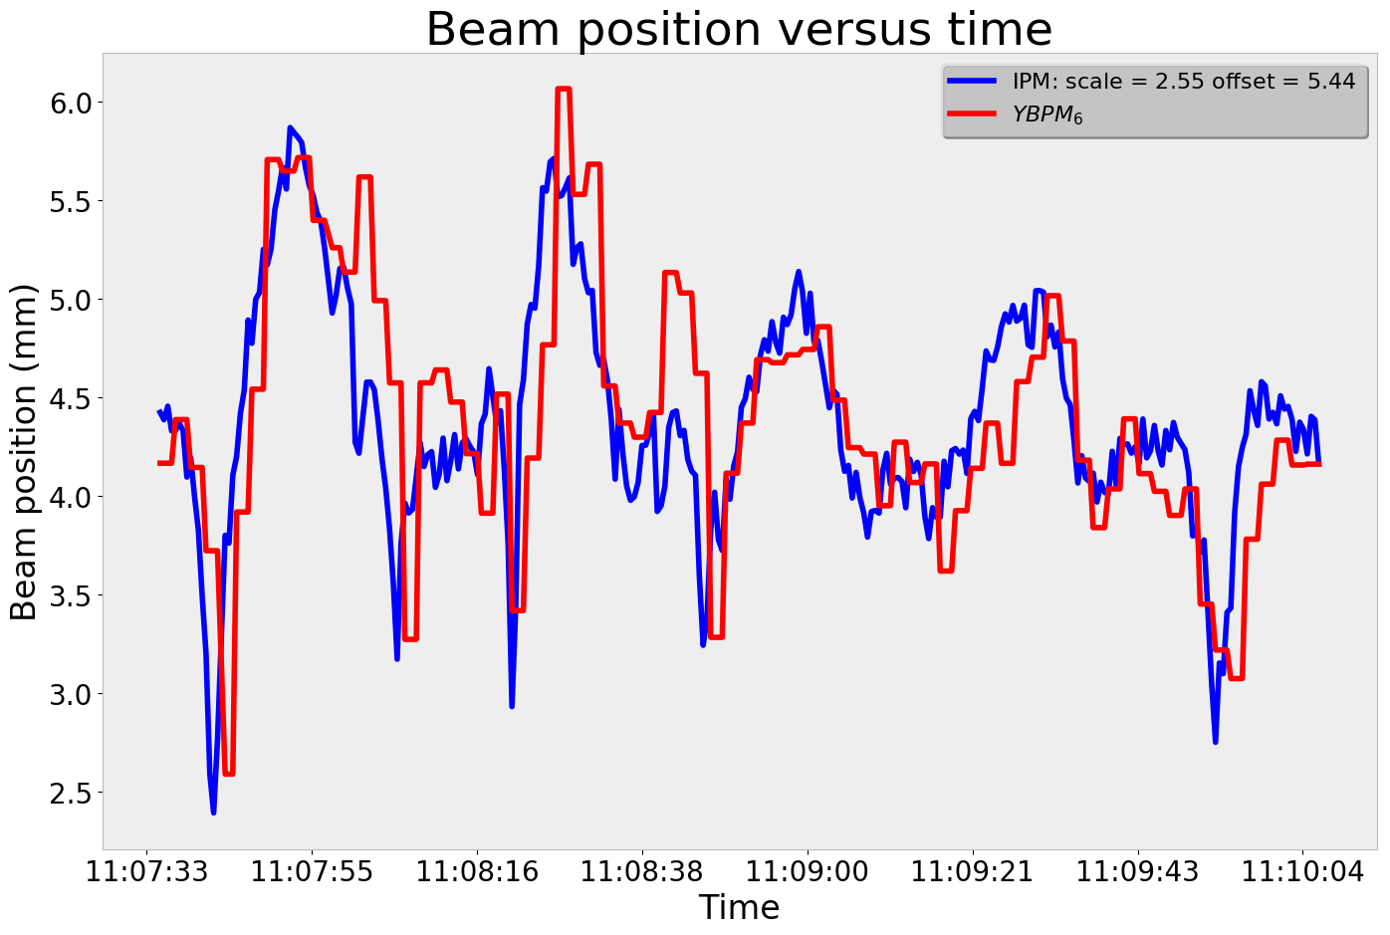
B. Beam position (3/4)
175 µm
Size:
  Variation of beam size from pulse to pulse
  May be related to beam position
Position:
  Huge variations of beam position from pulse to pulse
  Checked with BPM

Slide 29
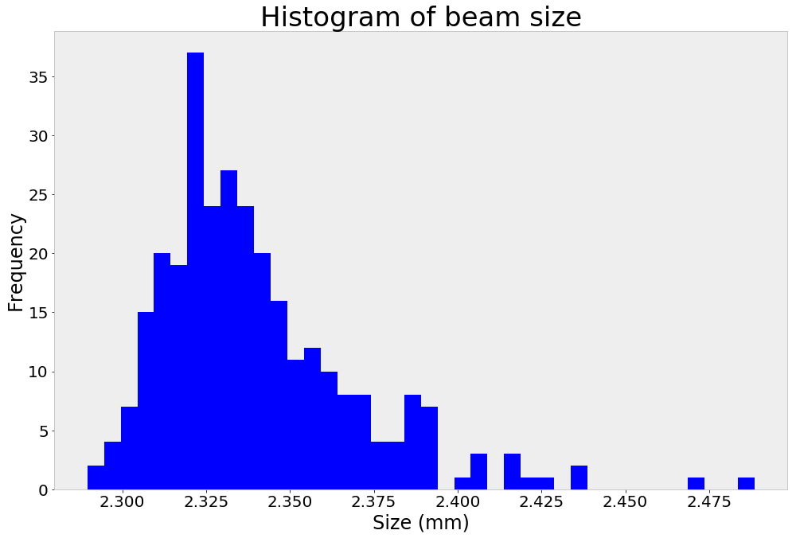
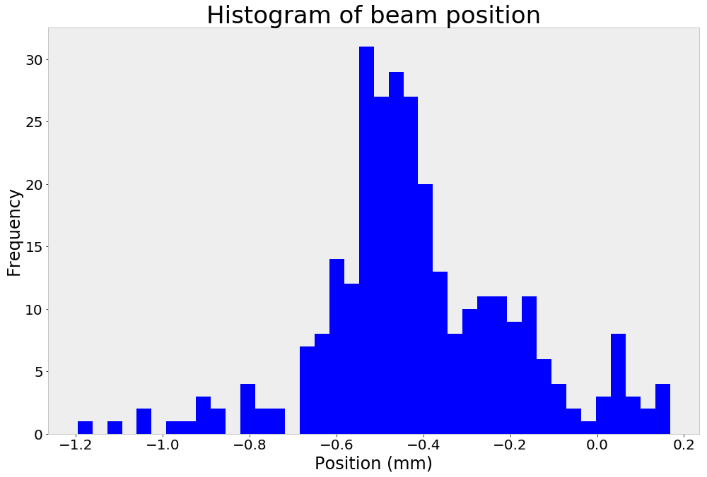
B. Beam position (4/4)
Histogram of previous run:
  Those variations afflict our measurements
      For each study we tried several time to check the reproducibility
      Error bars are given with standard mean error

Slide 30
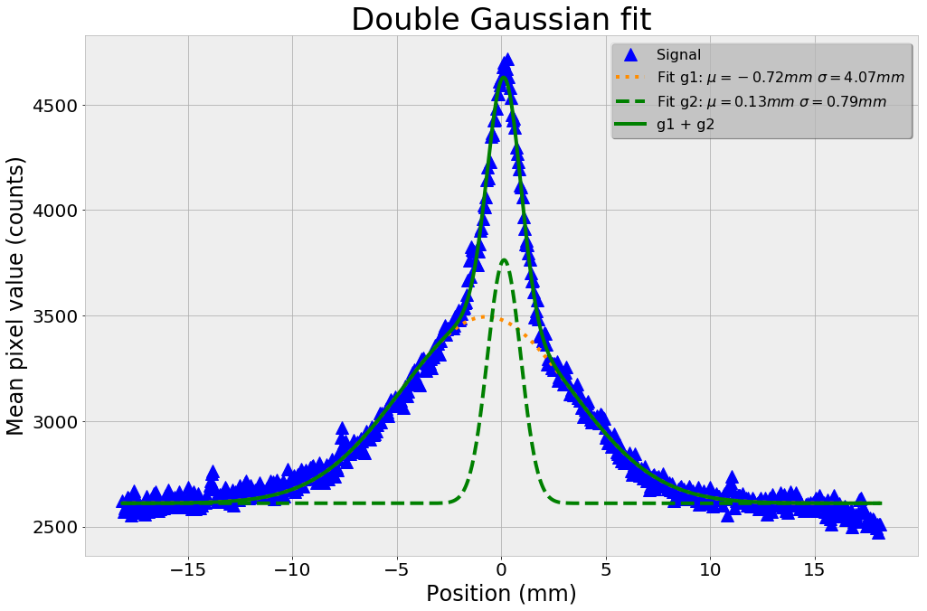
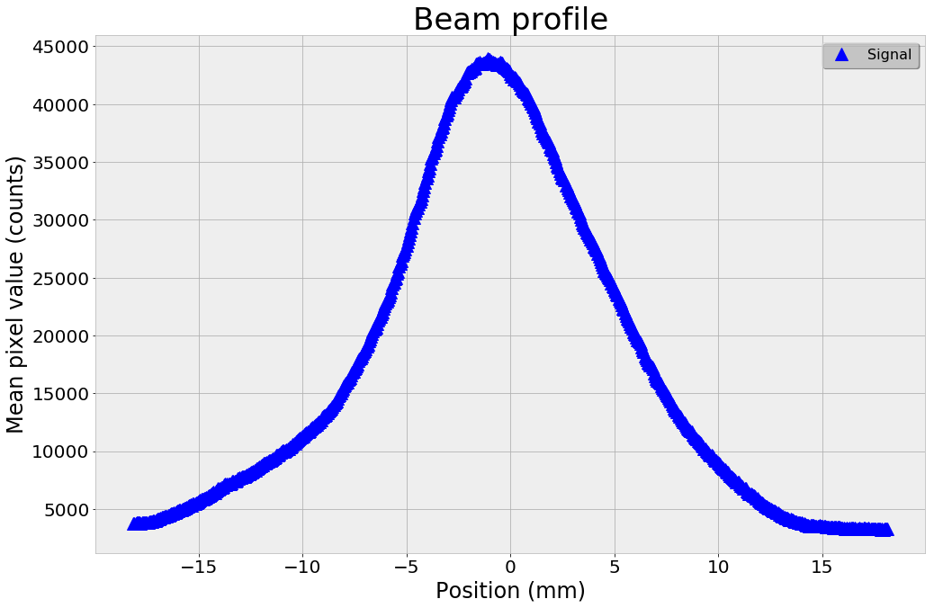
C. Beam Current (1/2)
Low current (<20mA):
  Double gaussians:
      A tight core
      A broader component
  A single Gaussian fit doesn’t work
High current (>20 mA):
  The core overlaps the halo
  More gaussian but still not perfect
  How to compare size ?

Slide 31
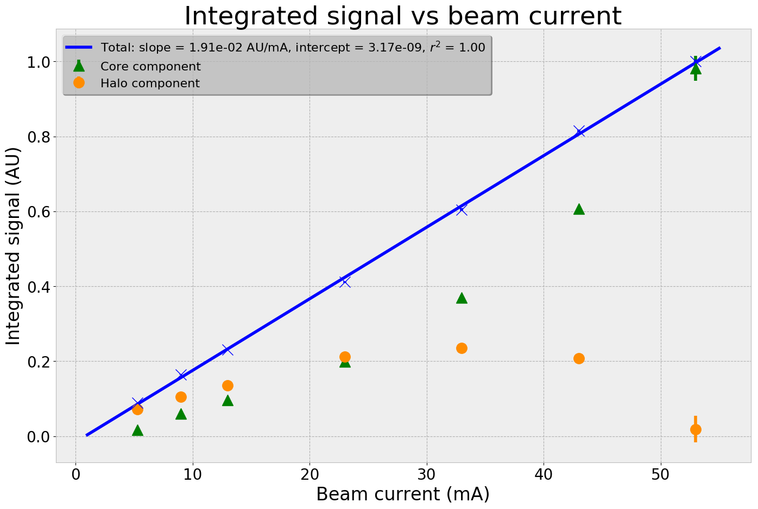
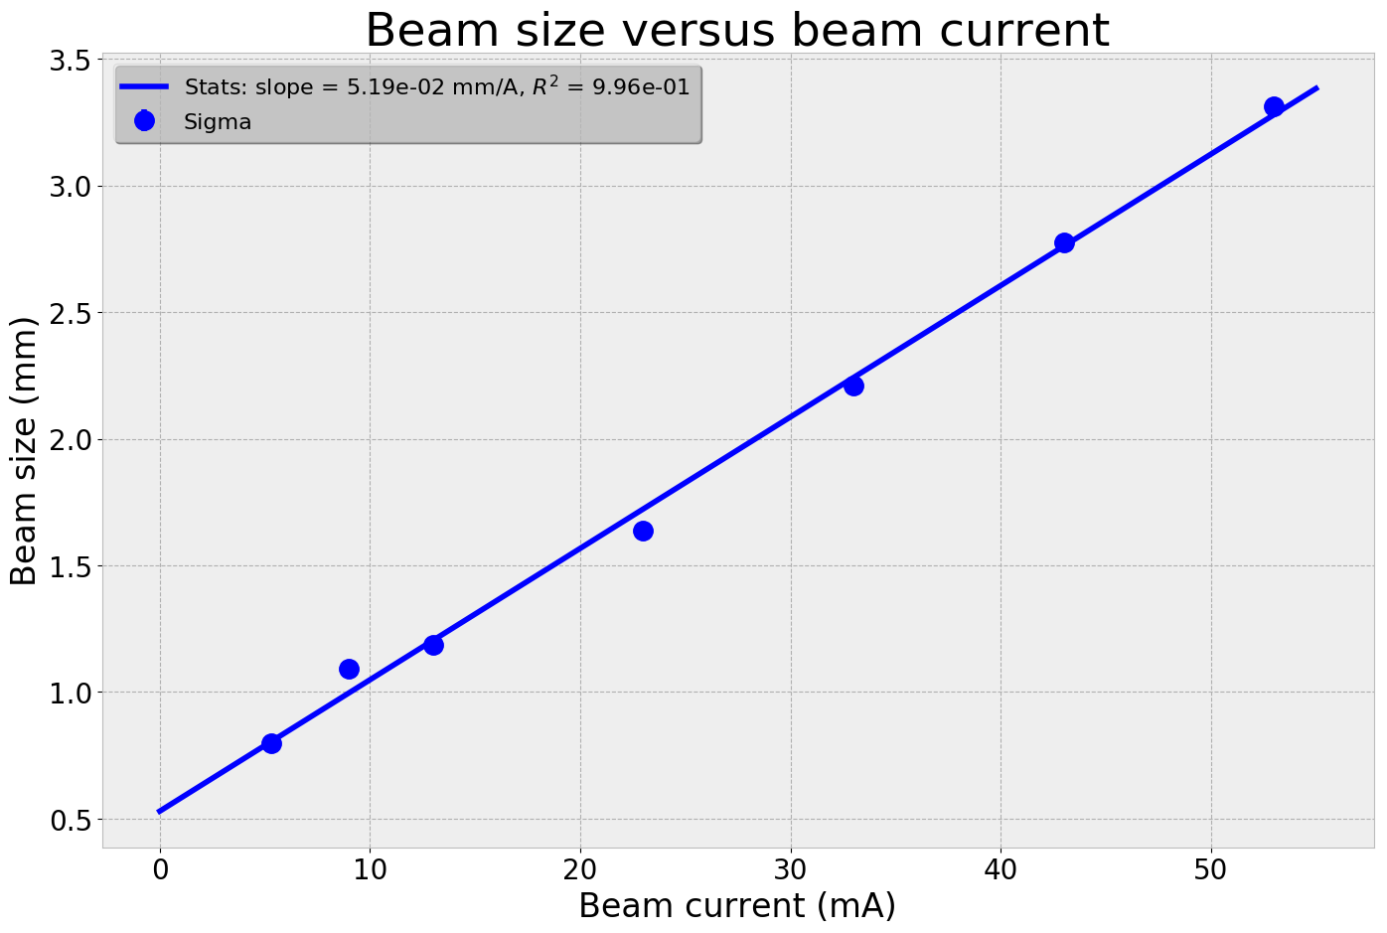
C. Beam Current (2/2)
Signal:
  At short pulse duration (150us)
  Fixed MCP gain
  Beam current sweep
  Linear response with current
Beam size:
  Linear variation of beam size with beam current

Slide 32
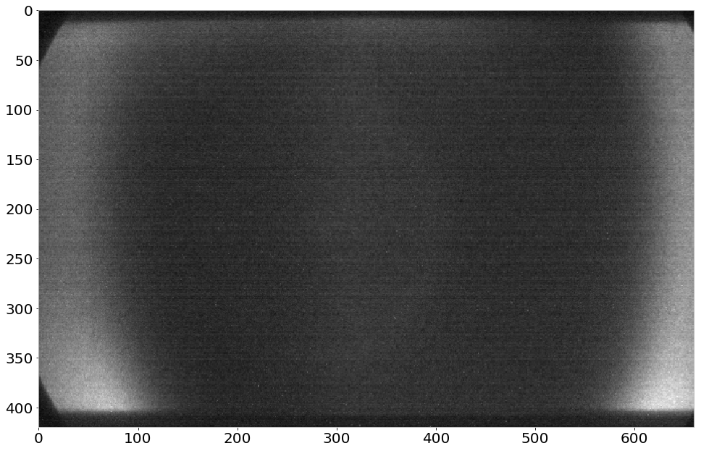
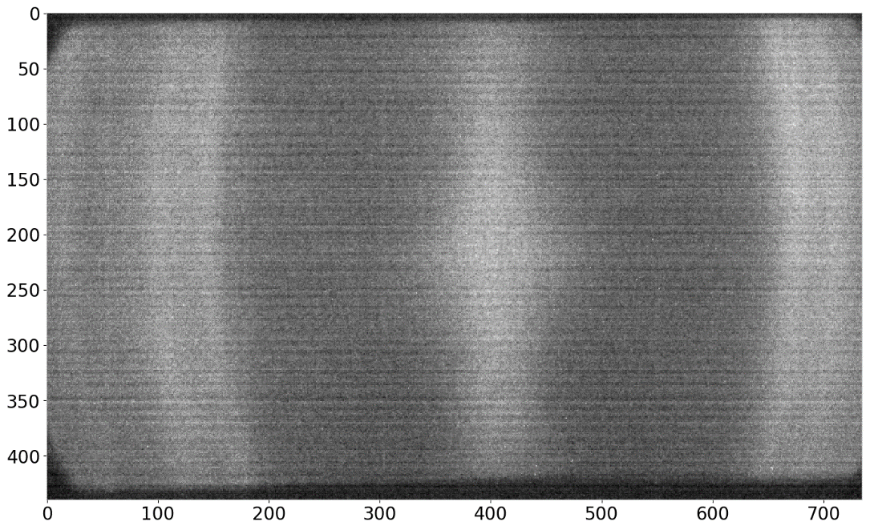
(Electron trials)
Electron profile was not possible at IPHI:
  We tried to put permanent magnet close to our chamber
      Upstream
      Downstream
  We tried also to move beam, change current, …

Slide 33
IPM characterization at IPHI
  MCPs
  Phosphorus screens
  extrapolation to ESS
  HV and fields checks

Slide 34
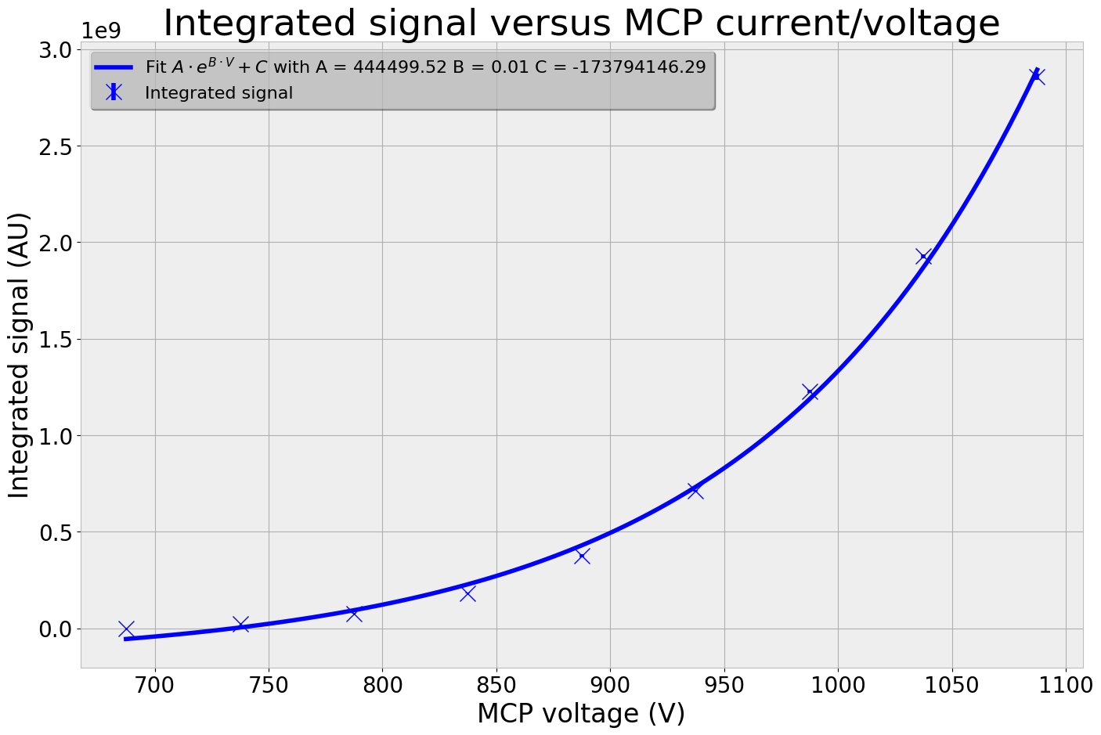
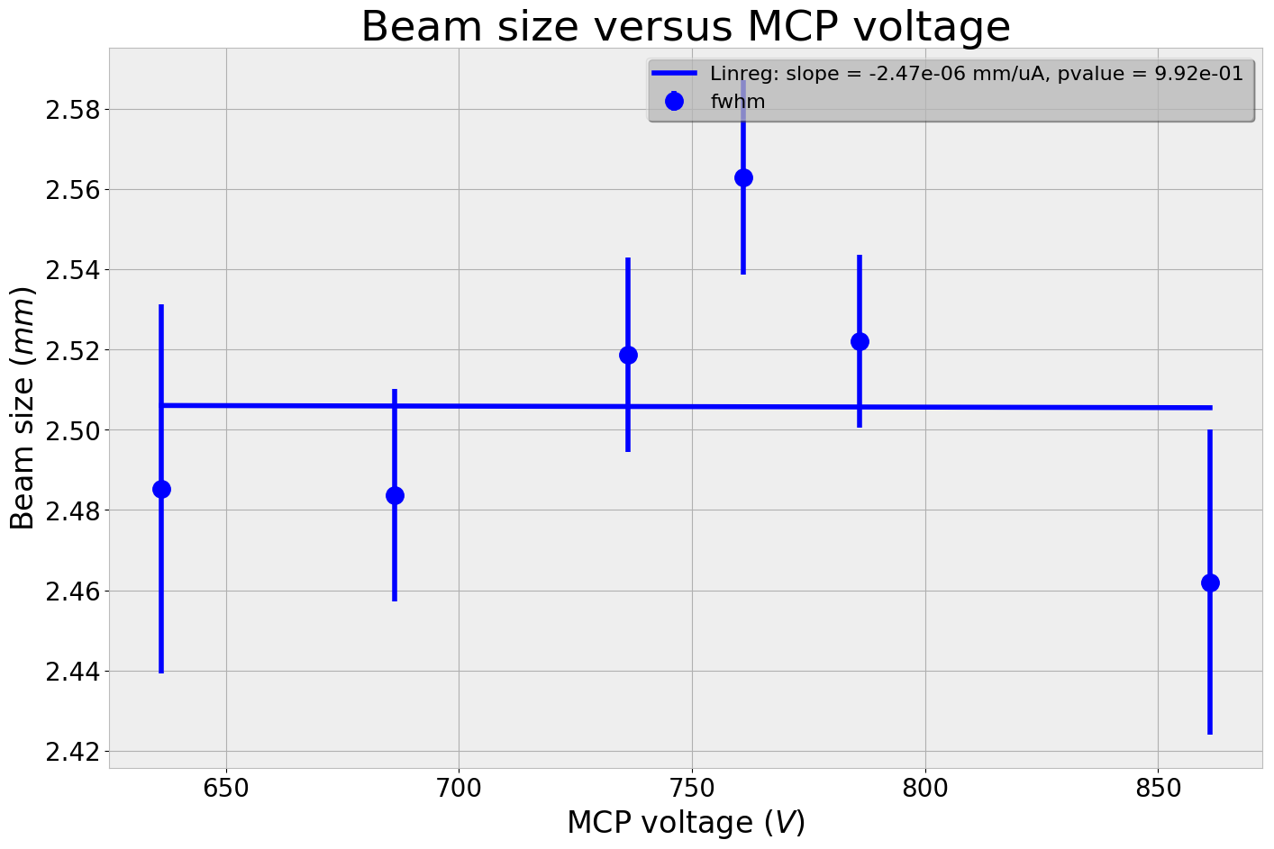
A. MCPs
180 µm
Signal:
  Relative measurement at fixed beam current (14 mA)
  Exponential gain
Size:
  Small variations of size with MCP gain

Slide 35
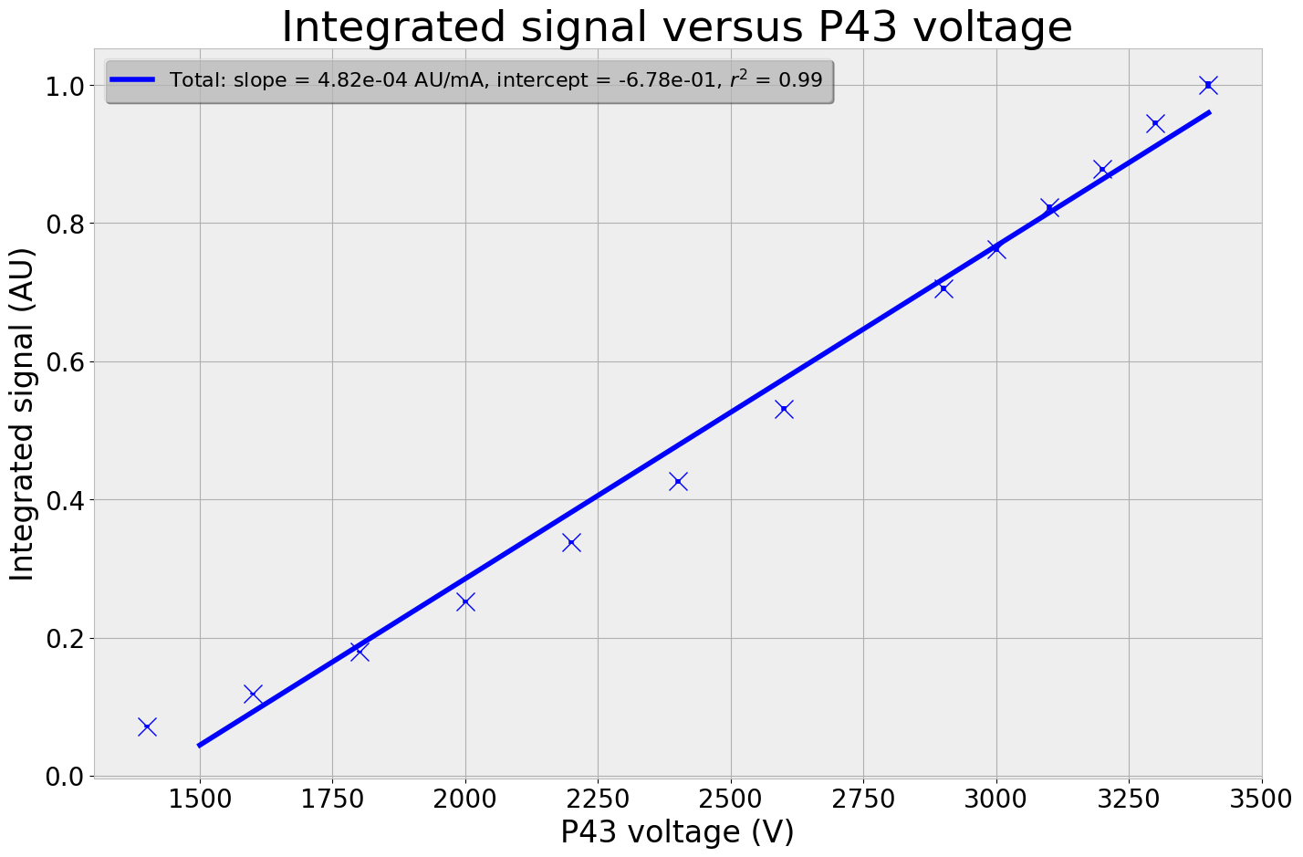
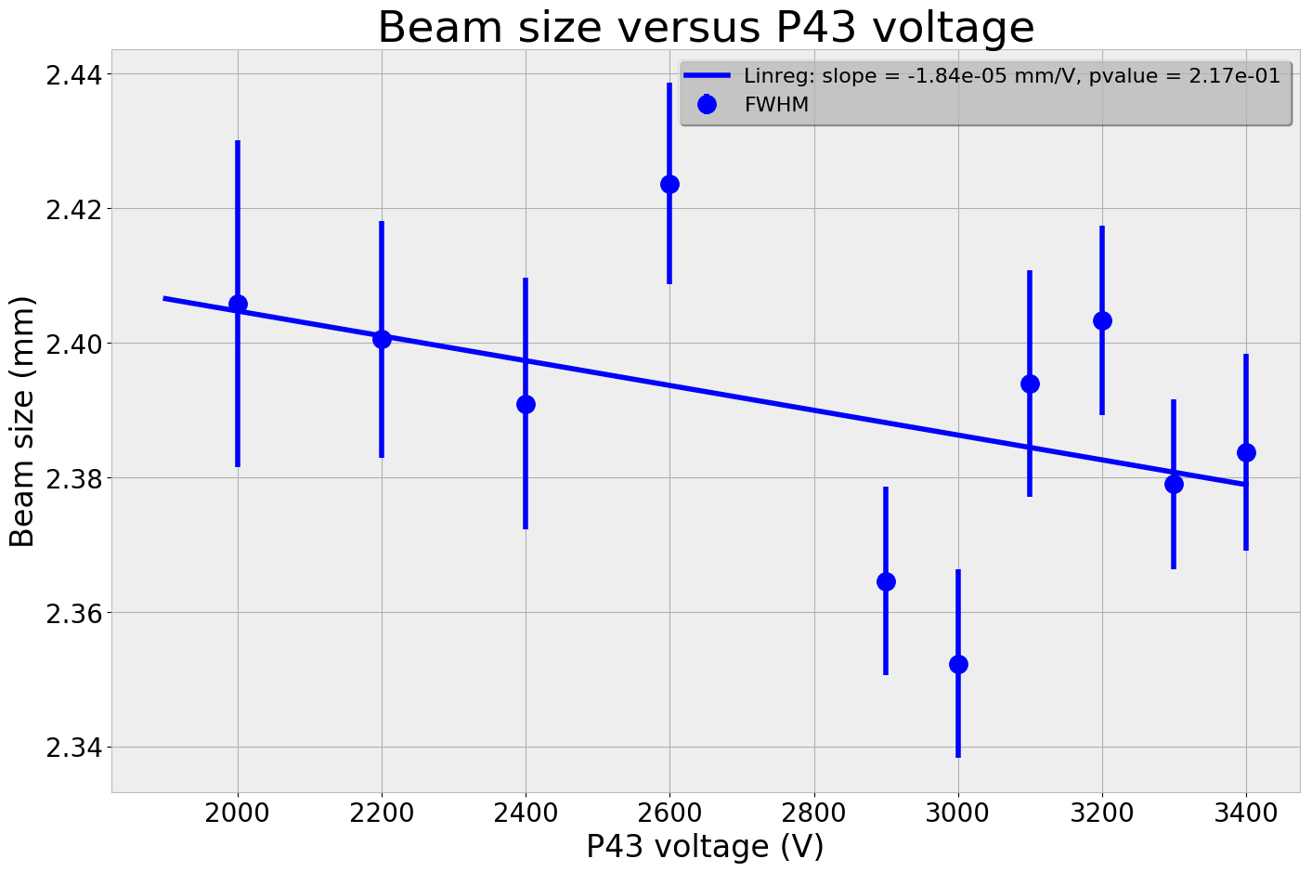
B. Phosphorus screens (1/3)
100 µm
Signal:
  Linear response
Size:
  Small variations of beam size with screen voltage

Slide 36
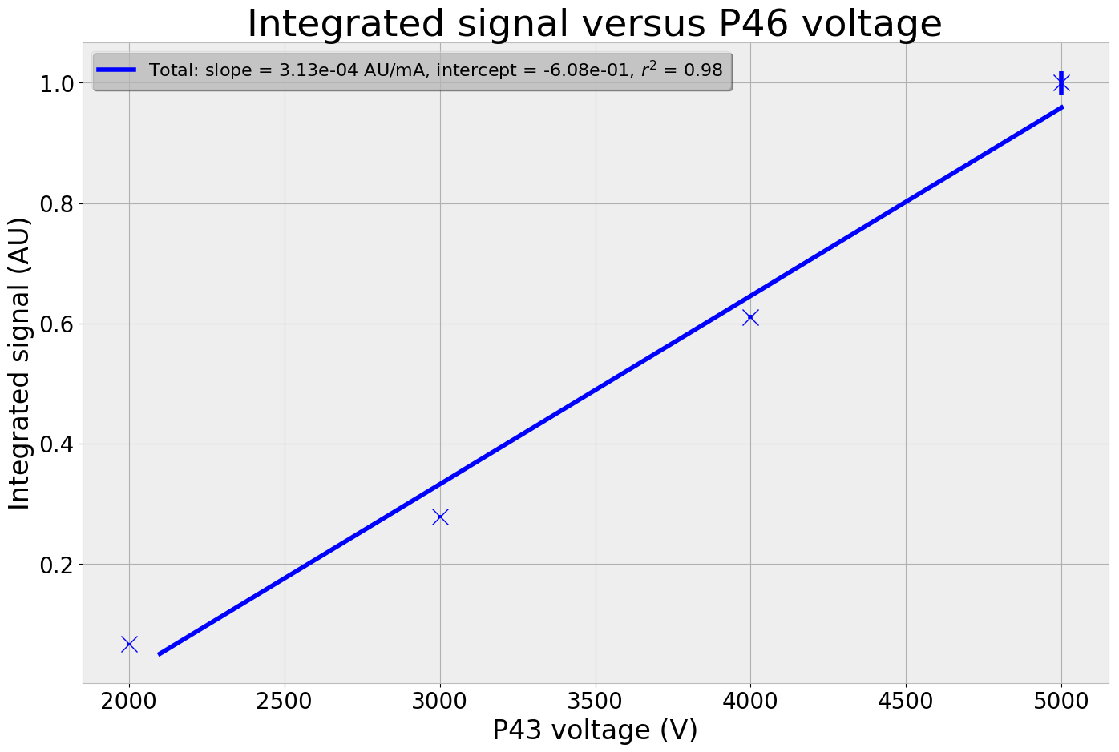
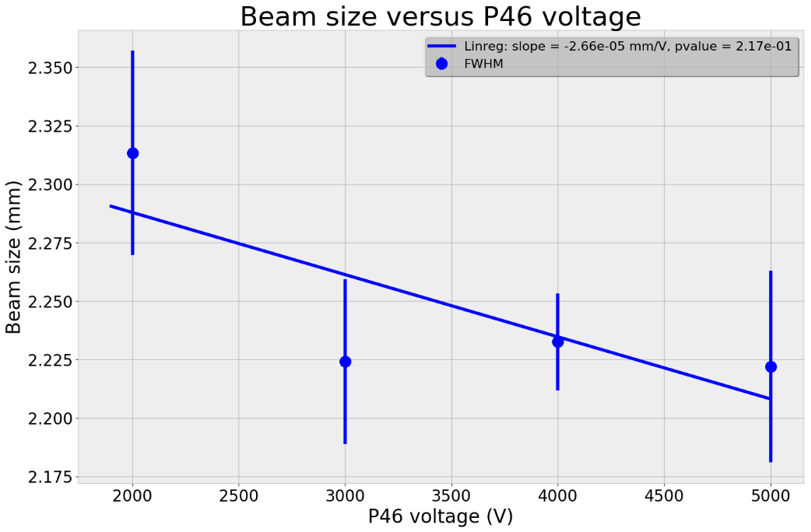
B. Phosphorus screens (2/3)
175 µm
P46:
  Linear gain
  No effect on size at high gain
Size:
  Small variations of beam size at high phosphorus gain (>3000V)

Slide 37
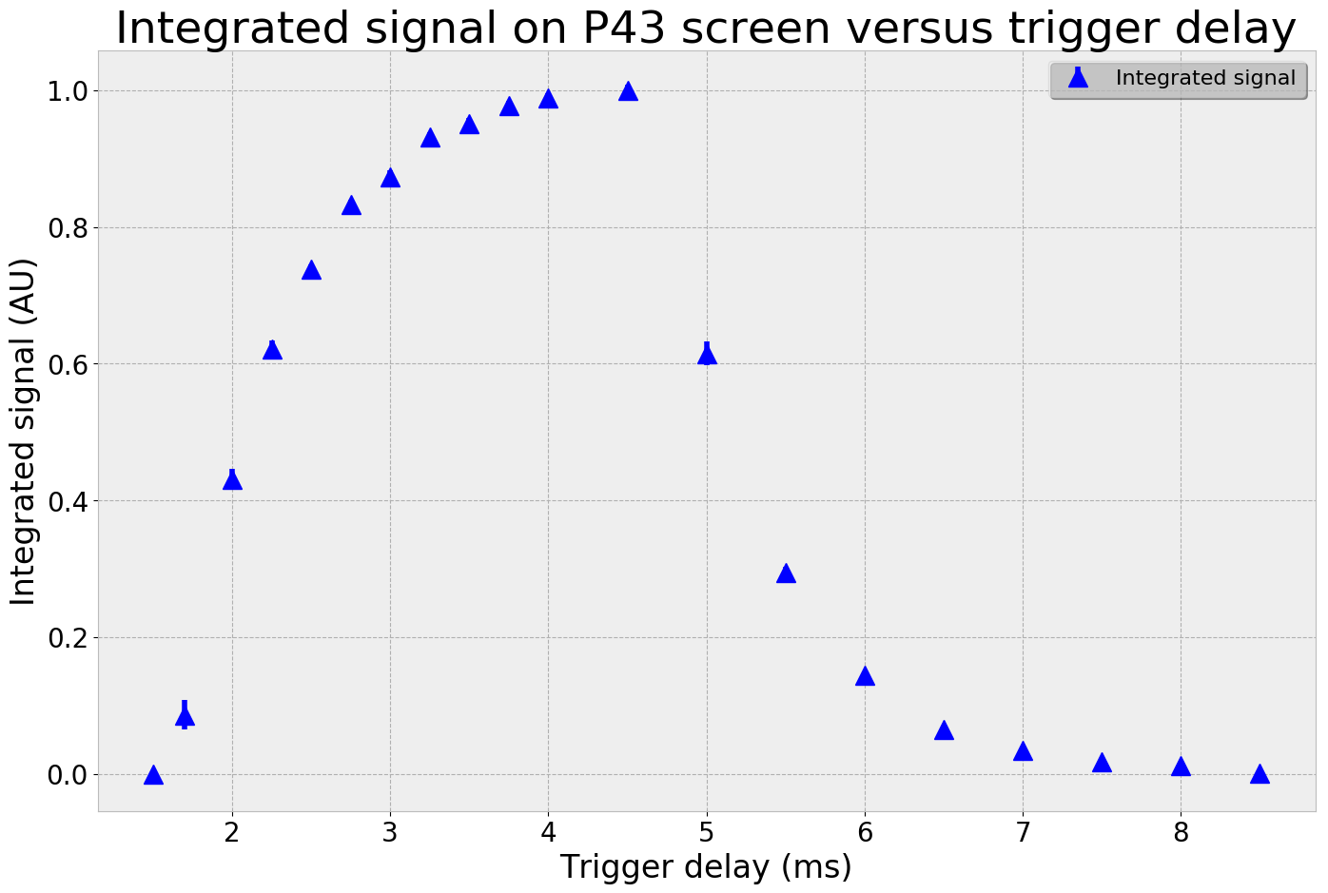
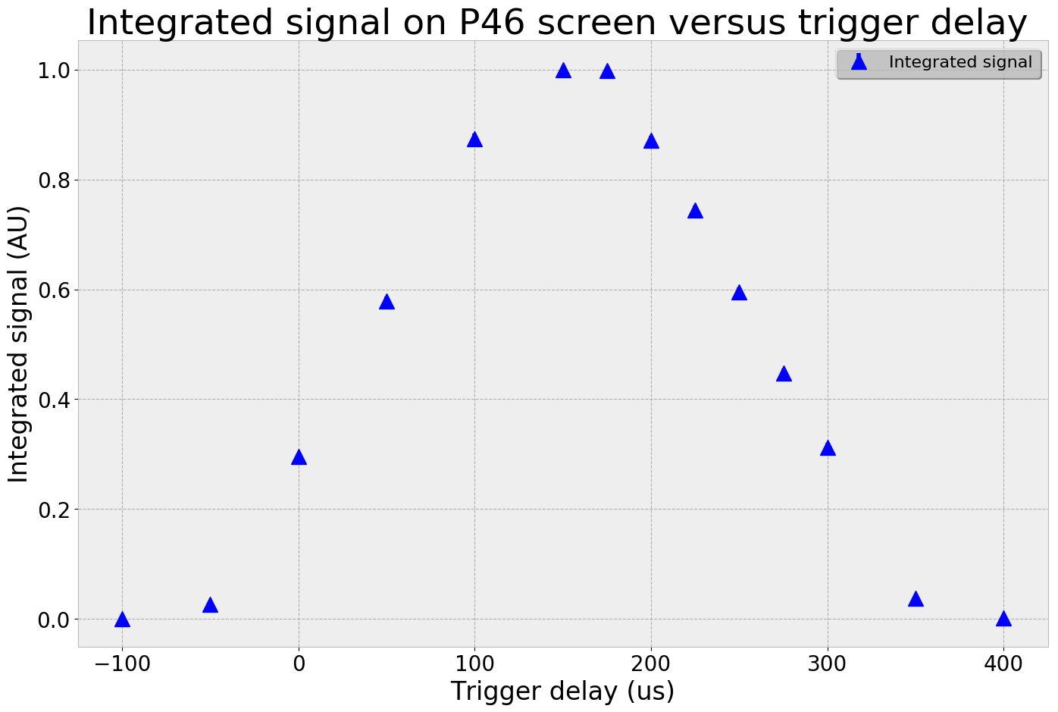
B. Phosphorus screens (3/3)
Temporal responses:
  As expected P43 is slow
  And P46 is way faster

Slide 38
C. Extrapolation to ESS (1/6)
Direct measurement of ionized particles is impossible:
  MCP gain at the maximum (1200V@Photonis)
  Go to lowest values of beam current and pulse duration
  Record pressure level and composition
  Compare with ESS nominal conditions
ESS Energy | Bethe Bloch | Pressure | Gas composition | Current | Pulse duration | Total
90 | x15 | x40 | x2.2 | /89 | /57 | 0.26
200 | x19 | x40 | x2.2 | /89 | /57 | 0.33
500 | x45 | x40 | x2.2 | /89 | /57 | 0.78
1000 | x56 | x40 | x2.2 | /89 | /57 | 0.97
2000 | x61 | x40 | x2.2 | /89 | /57 | 1.06

Slide 39
C. Extrapolation to ESS (2/6)
Bethe Bloch scaling:
  IPHI is a 3 MeV proton beam accelerator
      Cross section with residual gas is higher than ESS conditions: 90 MeV to 2 GeV
      Bethe Bloch formula
ESS Energy | Bethe Bloch | Pressure | Gas composition | Current | Pulse duration | Total
90 | x15 | x40 | x2.2 | /89 | /57 | 0.26
200 | x19 | x40 | x2.2 | /89 | /57 | 0.33
500 | x45 | x40 | x2.2 | /89 | /57 | 0.78
1000 | x56 | x40 | x2.2 | /89 | /57 | 0.97
2000 | x61 | x40 | x2.2 | /89 | /57 | 1.06

Slide 40
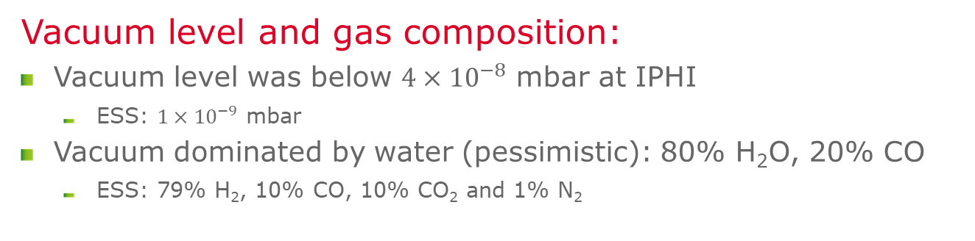
C. Extrapolation to ESS (3/6)
Vacuum level and gas composition:
  Vacuum level was below $4{×10}^{−8}$ mbar at IPHI
      ESS: $1{×10}^{−9}$ mbar
  Vacuum dominated by water (pessimistic): 80% H₂O, 20% CO
      ESS: 79% H₂, 10% CO, 10% CO₂ and 1% N₂
ESS Energy | Bethe Bloch | Pressure | Gas composition | Current | Pulse duration | Total
90 | x15 | x40 | x2.2 | /89 | /57 | 0.26
200 | x19 | x40 | x2.2 | /89 | /57 | 0.33
500 | x45 | x40 | x2.2 | /89 | /57 | 0.78
1000 | x56 | x40 | x2.2 | /89 | /57 | 0.97
2000 | x61 | x40 | x2.2 | /89 | /57 | 1.06

Slide 41
C. Extrapolation to ESS (3/6)
Beam current:
  IPHI can go to 0.7 mA current and even lower
      ESS nominal conditions : 62.5 mA
ESS Energy | Bethe Bloch | Pressure | Gas composition | Current | Pulse duration | Total
90 | x15 | x40 | x2.2 | /89 | /57 | 0.26
200 | x19 | x40 | x2.2 | /89 | /57 | 0.33
500 | x45 | x40 | x2.2 | /89 | /57 | 0.78
1000 | x56 | x40 | x2.2 | /89 | /57 | 0.97
2000 | x61 | x40 | x2.2 | /89 | /57 | 1.06

Slide 42
C. Extrapolation to ESS (4/6)
Pulse duration:
  Pulse duration can go down to 50 µs
      ESS nominal conditions: 2.86 ms
ESS Energy | Bethe Bloch | Pressure | Gas composition | Current | Pulse duration | Total
90 | x15 | x40 | x2.2 | /89 | /57 | 0.26
200 | x19 | x40 | x2.2 | /89 | /57 | 0.33
500 | x45 | x40 | x2.2 | /89 | /57 | 0.78
1000 | x56 | x40 | x2.2 | /89 | /57 | 0.97
2000 | x61 | x40 | x2.2 | /89 | /57 | 1.06

Slide 43
C. Extrapolation to ESS (5/6)
At IPHI it is possible to be close to the ESS conditions
But vacuum assumptions are subject to important uncertainties …
ESS Energy | Bethe Bloch | Pressure | Gas composition | Current | Pulse duration | Total
90 | x15 | x40 | x2.2 | /89 | /57 | 0.26
200 | x19 | x40 | x2.2 | /89 | /57 | 0.33
500 | x45 | x40 | x2.2 | /89 | /57 | 0.78
1000 | x56 | x40 | x2.2 | /89 | /57 | 0.97
2000 | x61 | x40 | x2.2 | /89 | /57 | 1.06

Slide 44
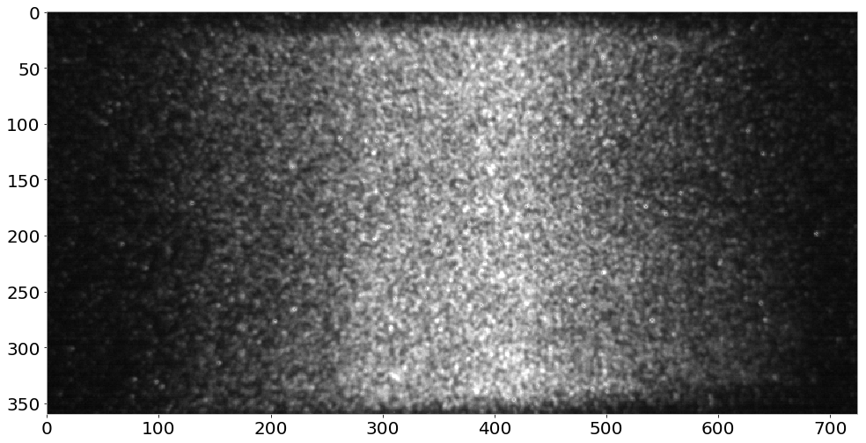
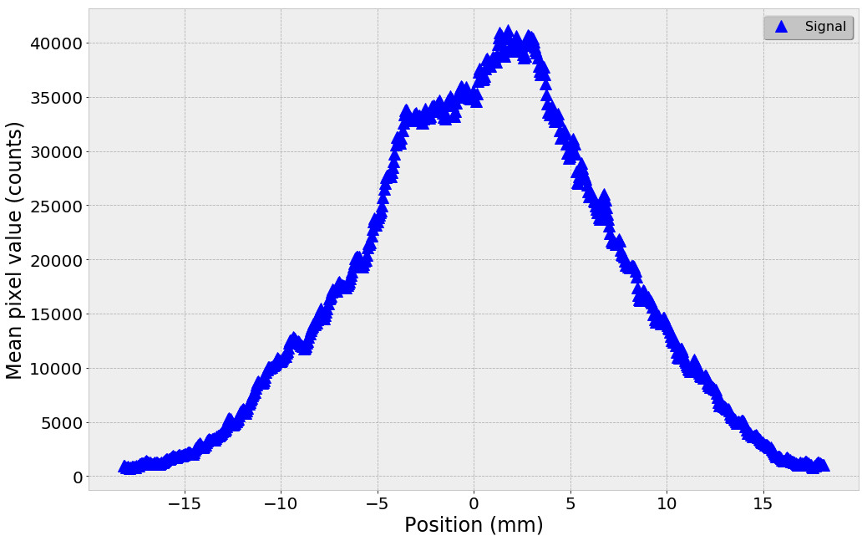

C. Extrapolation to ESS (6/6)
Example:
  Pulse duration: 50 µs
  Current: 0.7 mA
  Pressure: $3{×10}^{−8}$ mbar
  Photonis MCP
      MCP gain: 1200V
      P46: ~5000V

Slide 45
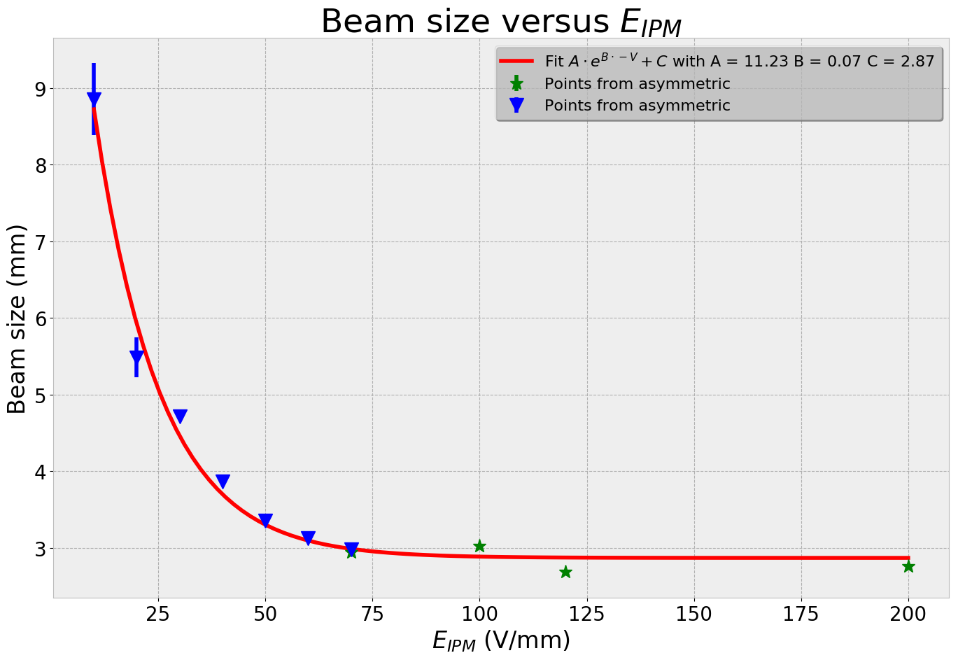
D. High voltages (1/3)
Beal size:
  Beam conditions:
      150 µs
      14 mA
  For these conditions size converges above 80V/mm
  The optimal voltage will be chosen according to SC simulations

Slide 46
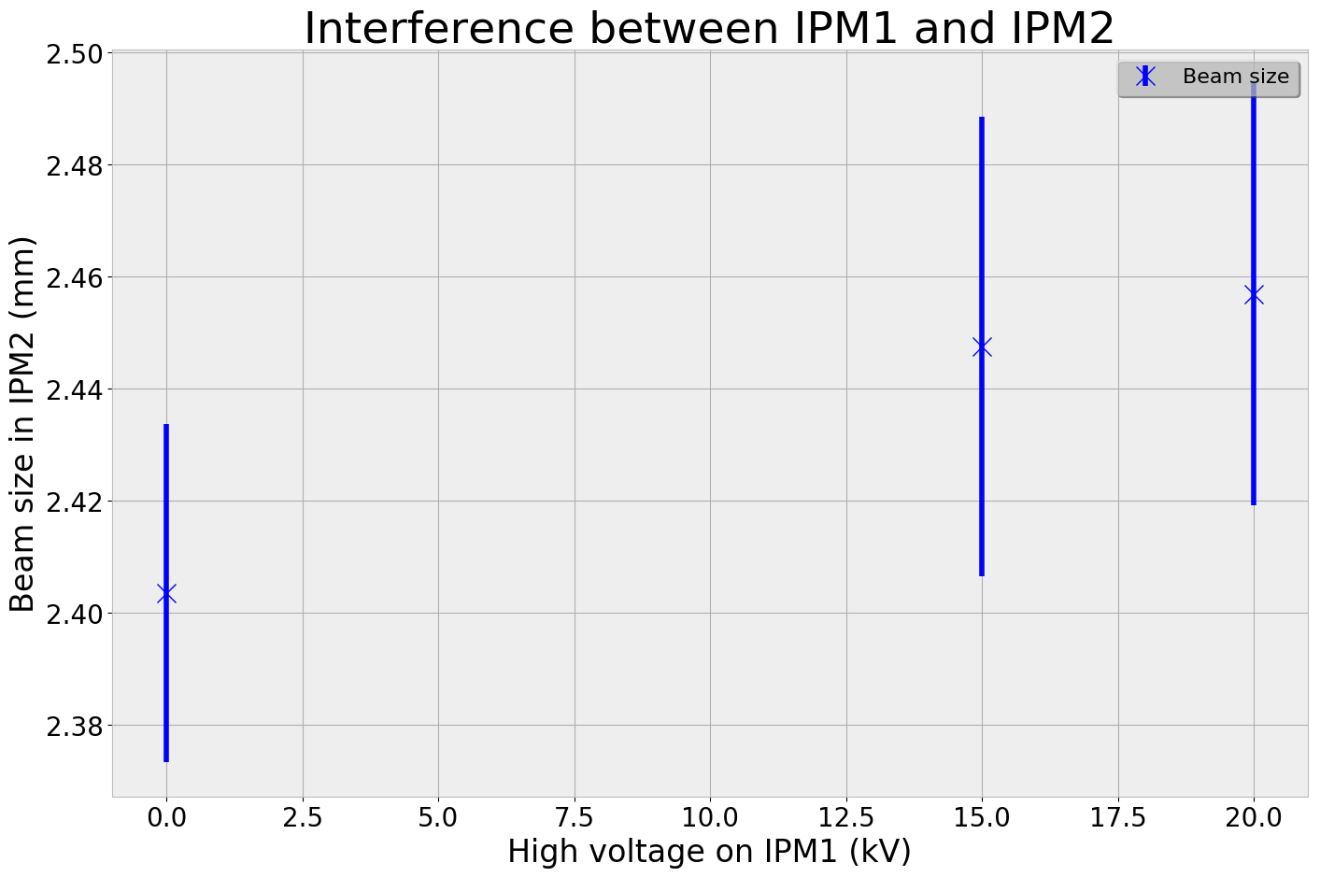
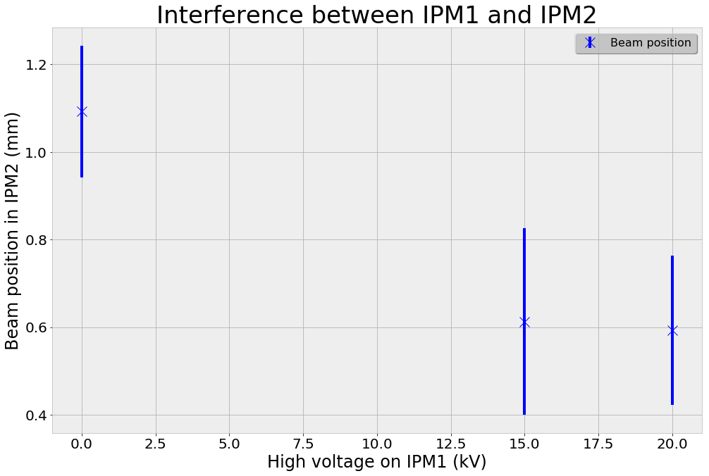
D. High voltages (2/3)
Cross interaction between IPMs
  We tested two extreme cases since we cannot be in same ESS configuration:
      IPM1: 15kV and IPM2: +/- 10kV
      IPM1: 20kV and IPM2: +/- 10kV
  Reference➔ IPM1: 0kV and IPM2: +/- 10kV

Slide 47
D. High voltages (3/3)
500 µm
60 µm
Size:
  Small influence on beam size
Position:
  Influence on beam position
  Simulations are ongoing to check this case

Slide 48
E. Field simulation checks
Field uniformity is difficult to check at IPHI
We can degrade the field by switching optical IPM from symmetric to asymmetric
  Fields correctors was optimized for symmetric usage
  If we use symmetric correctors in asymmetric mode the field will be distorted ➔ Effects on profile
  Then we suppose that symmetric gives real position size
  It is possible to measure the difference between the two cases
      Beam position
      Beam size
      Beam amplitude ➔ Not possible due to our setup

Slide 49


E. Field simulation checks

Slide 50

E. Field simulation checks

Slide 51

E. Field simulation checks

Slide 52

E. Field simulation checks

Slide 53

E. Field simulation checks

Slide 54
Conclusion

Slide 55
Conclusion (1/2)
The prototype works:
  Principle of operation has been proven at IPHI
      First campaign: Debugging issues on the protype, first results
      Second campaign: Prototype improvements, confirmation of previous results
  Single pulse measurement seems possible at ESS, even at 2 GeV
      If extrapolation is true …
  IPHI tests look like a conditioning, commissioning accelerator (only BPMs as diagnostics)
      Beam condition were peculiar, we tried to do our best …
      Now, IPHI team seems to be interested in our IPMs
However some critical questions remain open:
  MCP ageing calibration method
  Radiation hard imaging solution
  ESS Background

Slide 56
Conclusion (2/2)
Our thoughts for the final version
  MCP choice:
      Double MCP with P43 screen
          Decrease resolution
          More gain
      ALD MCPs look promising for lifetime
      Hamamatsu vs Photonis ➔ Price, availability …
  Field configuration:
      Independent to the mechanical design
      Depends on the HV power supplies
          If EHS is viable solution: symmetric
          Otherwise asymmetric
  Camera:
      Open to everything that fits to our requirements

Slide 57
IRFU/DEDIP
Thanks for your attention !
-
Questions ?

Slide 58
IRFU/DEDIP
Backup Slides

Slide 59



The tale of the photonis MCP
  2017 07 ➔ Order 2 MCPs
  2017 09 ➔ Reception
      Received: one MCP one ADP
      Photonis send correct item after
  2018 02 ➔ Crack in MCP
      We discovered it during integration
  2018 03 ➔ Sent it back to Photonis
      Fedex: Parcel damaged
  2018 04 ➔ Arrived at Photonis USA
      Almost destroyed
  2018 07 ➔ Back at CEA

Slide 60

OPI – Cameras

Slide 61

OPI – Power Supllies

Slide 62


Field uniformity analysis (1/4)
Criteria
  3D vector data are difficult to represent directly
      Go back to 2D
      Streamlines
  Find a way to quantify the uniformity
Image
  Plot an image from the solution
  Advantages
      Simple, include in COMSOL
  Drawbacks
      How to quantify/compare

Slide 63

Field uniformity analysis (2/4)
Criteria
  3D vector data are difficult to represent directly
      Go back to 2D
      Streamlines
  Find a way to quantify the uniformity
Statistical
  Make a slice in Z direction
  Calculate the quadratic mean value of E field in the area close by to the beam
  Sweep over Z
  Advantages
      Quadratic ➔ No compensation
      Error FEM solver only
  Drawbacks
      Quadratic ➔ Lost sign

Slide 64

Field uniformity analysis (3/4)
Criteria
  3D vector data are difficult to represent directly
      Go back to 2D
      Streamlines ➔ Particles tracking in our case
  Find a way to quantify the uniformity
Particle tracking
  Draw randomly (or not) particles and store the initial position
  Integrate the equation of motion w.r.t the Lorentz equation
  Store the final position
  Advantages
      That’s all we want
  Drawbacks
      Error: FEM+Interpolation+Integration
  $\vec{F}=q∙\vec{E}+q∙\vec{v}×\vec{B}$
      Non relativistic in range of a IPM
      No magnetic field in our case but possibility to add one (background)
  Interpolation on scattered data
      Radial Basis Function
      Nearest Neighbors
      Delaunay Triangulation

Slide 65
Field uniformity analysis (4/4)
Load data from COMSOL
Goals
  Load data from COMSOL and create n field objects (can be electric or magnetic)
  Different ODE solvers and interpolation methods
Third Party libs used
  Boost
      ODE integration
      Random generation
  Nanoflann for k-Nearest Neighbors search
  Intel TBB for parallelization
  VTK and ROOT for visualization
Field object
Field object
Stats
Particles
Particles
Particles
ODE
ODE
ODE
Interpolation
Interpolation
Interpolation
Integration
Integration
Integration
Track
Track
Track
Stats/Visualization

