Slide 1
Digital platform for nBLM
Fabio dos Santos Alves
CEA - Saclay
12 February, 2019

Slide 2
Agenda
IFC1410
Timing System
Fast Beam Interlock System
DDR Calibration
PCIe Link
CEA Questions

Slide 3
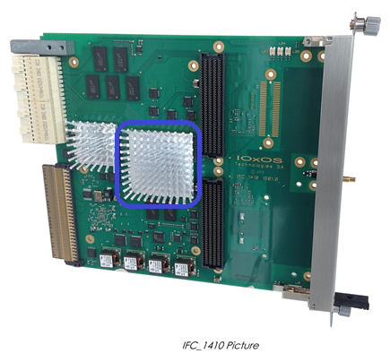
IOxOS IFC 1410 – AMC
FPGA Processing Unit
High performance Xilinx Kintex UltraScale KU040 FPGA
1024MB dual channel DDR3L-1066 SDRAM (2x 256M x 16)
Configuration from on-board SPI flash, or with remote configuration file fetched by the processor through Ethernet
Powered by IOxOS Technologies proprietary TOSCA II FPGA Design Kit

Slide 4
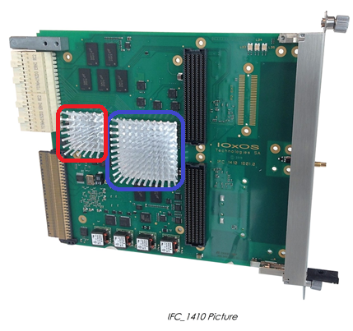
IOxOS IFC 1410 –AMC
Processor Unit
High-performance Freescale/NXP QorIQ T2081 processor, featuring the e6500 Power PC.
On-board 2GB DDR3L 1866 SDRAM
Non-volatile boot memories: dedicated 512MBit (64MB) SPI flash
Powered by U-Boot/Linux and able to run EPICS-based applications

Slide 5
TOSCA II Network on Chip (NoC) infrastructure
TOSCA Architecture:
Optimized for PCI Express Interface
Built on PCIe TLP switching
Multiple PCIe end points
IFC_1410 Eight(8) Agent_SW[]
[0] PCIe_EP Gen3x4 T2081 (CPU)
[1] PCIe_EP Gen3x4 MTCA.4 AMC (FPGA)
[7] PCIe_EP Gen2x4 MTCA.4 ADF Expansion
[3] SMEM1 Shared Memory DPRAM(128K) + DDR3L(512M)
[4] SMEM1 Shared Memory DPRAM(128K) + DDR3L(512M)
[5] XUSER#1/ [6] XUSER#2 User specific interface
[6] AXI4 64-bit Master/Slave Bridge
PCI Express
Agent_SW
PCI Express
Agent_SW
PCI Express
Agent_SW
NoC M/S
BACK-END
NoC M/S
BACK-END
NoC M/S
BACK-END
Port_0
Port_1
Port_7
REQUEST
SWITCH
RESPONSE
SWITCH
FULL MESH
FULL MESH
TOSCA NoC
Interconnect Infrastructure
Port_4
Port_2
Port_3
Port_5
NoC M/S
BACK-END
NoC M/S
BACK-END
NoC M/S
BACK-END
NoC M/S
BACK-END
XUSER
Agent_SW
SMEMIDMA
Agent_SW
SMEM-IDMA
Agent_SW
XUSER
Agent_SW
IO Specific
DDR3L x16
DDR3L x16
IO Specific

Slide 6
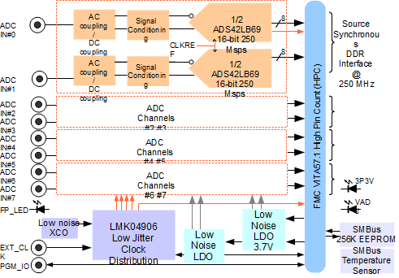
AC coupling (ADC_3110) or DC coupling (ADC_3111)
Eight channel (8) 16-bit/250Mps ADC
Single width FMC VITA 57.1-2008
ADC technology
TI ADS42LB69 dual 16-bit/250 Msps
High-speed LVDS data read-out
Clock tree distribution
TI LMK4906 (dual PLL)
On-board ultra-low noise oscillator /VCXO
External SSMC Clock reference
On board low noise power supplies generation
FMC 12P0V power supply not used

Slide 7
Timing System
Synchronize the operation of the facility
Accelerator, target, neutron instruments, CF (small extent)
Provide the base frequency of 14 Hz
Also lower (beam) repetition rates
Provide timestamping to the facility
Data correlation, EPICS archiving
Provide trigger and clock signals
With a defined position in an operation sequence
Support post-mortem analysis
What was the cause of a beam trip?

Slide 8
Structure of the system
RF Master Oscillator
88 MHz
Master Event Generator
fanout
Event
receiver
Event
receiver
fanout
Event
receiver
Event
receiver
Event
receiver
Event
receiver
Event
receiver
Event
receiver

Slide 9
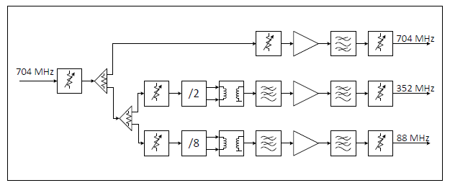
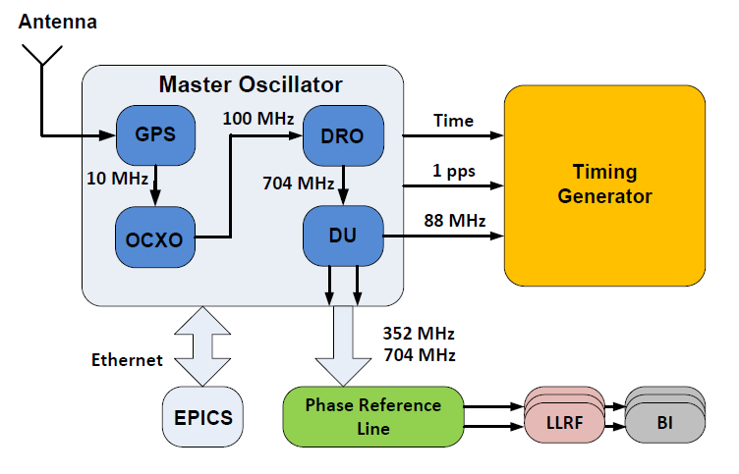
Master Oscillator Interfaces
ESS generates proton beam pulses with a frequency of 14 Hz, and a maximum length of 2.86ms.
The ESS RF master clock, running at 352.21 MHz, is used to generate the timing event clock with a frequency of 88.0525 MHz / 11.357ns period (the 4th subharmonic of the RF master clock).
All operations of the timing system are phase-synchronous to the RF master clock. The timing event clock (6289464 ticks) is used to generate the 14 Hz beam frequency.
Distribution Unit
9

Slide 10
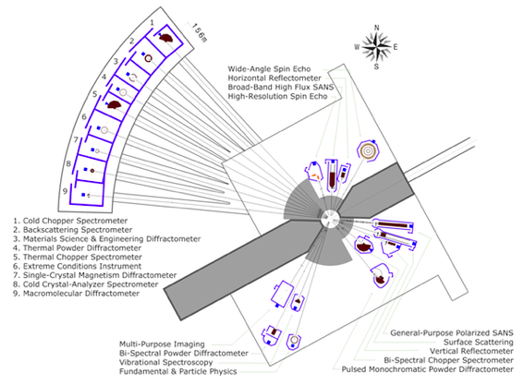
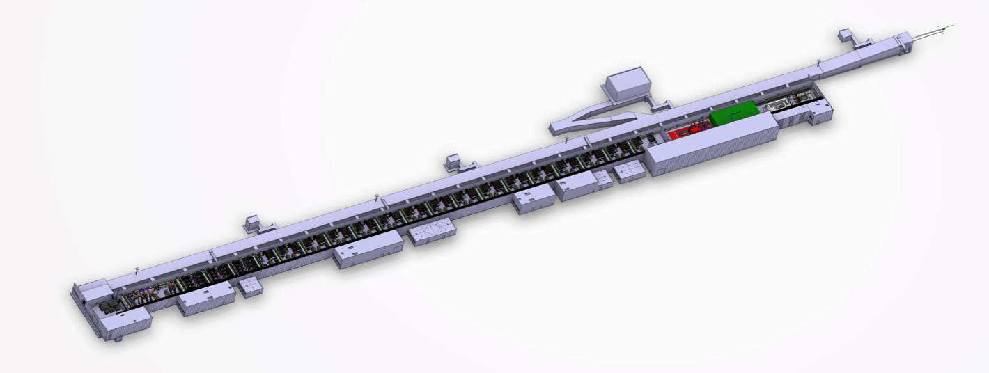
System layout principle
fan-out
EVR
fan-out
EVR
EVR
EVR
EVG
EVR
fan-out
EVR
fan-out
Long-haul fan-outs single mode optical fiber, short haul to EVRs multimode
10

Slide 11
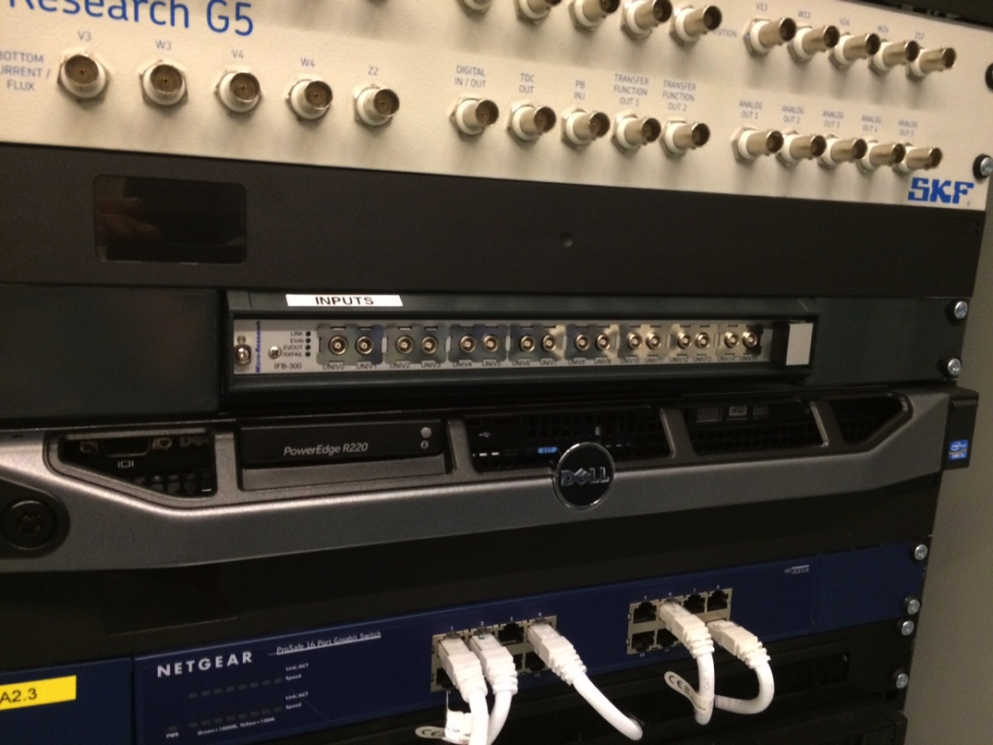
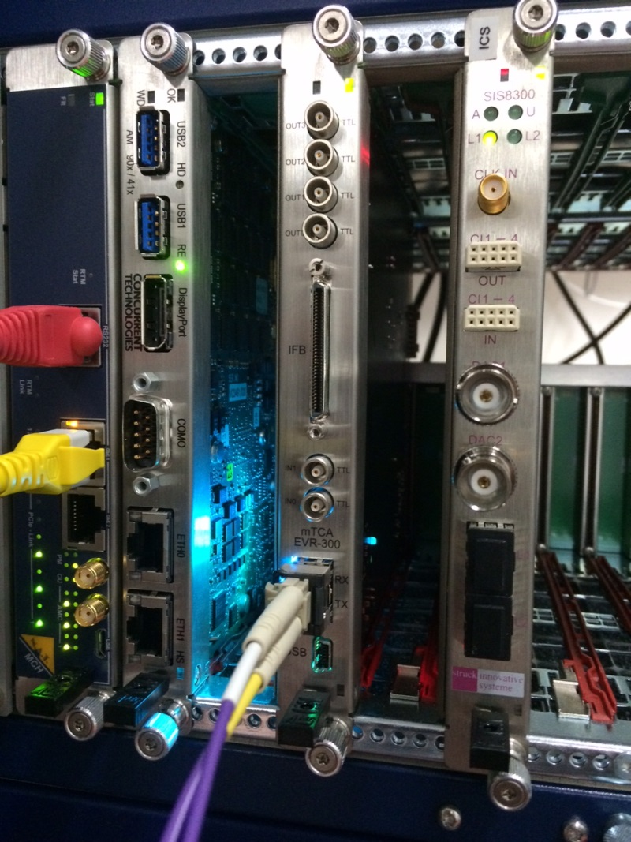
Event Receivers
PCIe (for industrial PCs, etc.)
MTCA.4
11

Slide 12
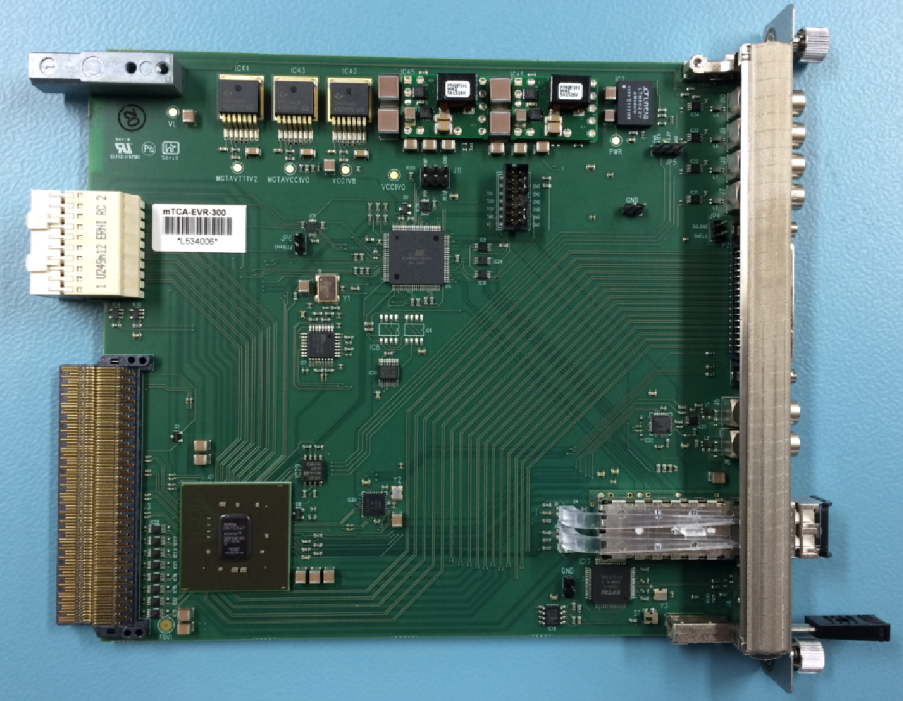
MTCA EVR
Integrated in mrfioc2
Can send triggers on the backplane
Can be set to generate events
Tests waiting new Lodz firmware.
12

Slide 13
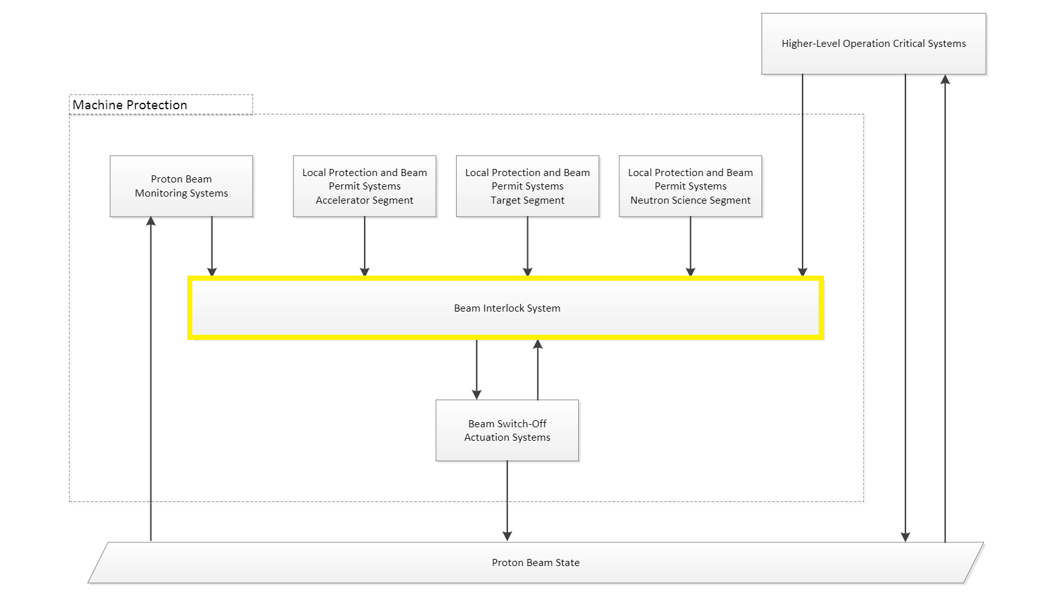
Fast Beam Interlock System
Protect the whole machine (the Accelerator Linac, Target and Neutron lines) against Beam induced damages and activation, reaching the PIL2 (Protection Integrity Level 2).

Slide 14
FBIS Interface
RTM under development:
REQ 3-7-8: The RTM shall provide 1 network interface connected to the IFC1410 PPC CPU with speed of at least 1Gbps (1000BASE-T)
REQ 3-7-9: The RTM card shall provide 1 SFP+ interface connected and controlled by the PPC CPU, and connected to the main I2C network.
REQ 3-7-10: The RTM card shall provide 2 SFP+ interface connected to the FPGA.
REQ 3-7-12: The RTM shall provide an MDIO/I2C switch connecting the FPGA to the piggyback connector (using 2 pins among the 22 available) and to the 2 SFP+ connected to the FPGA.

Slide 15
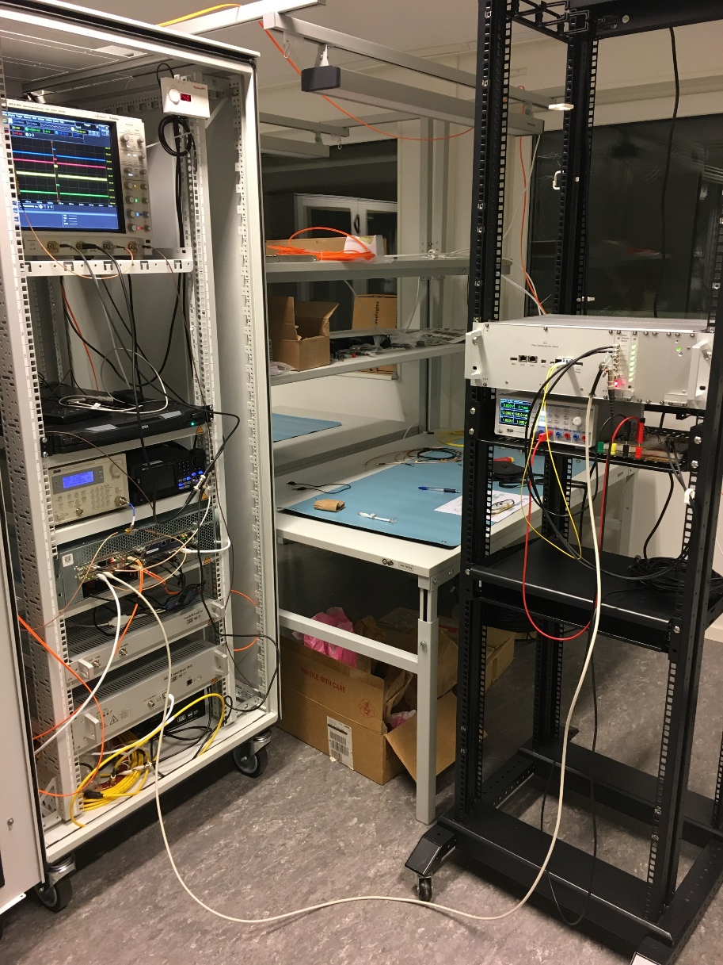
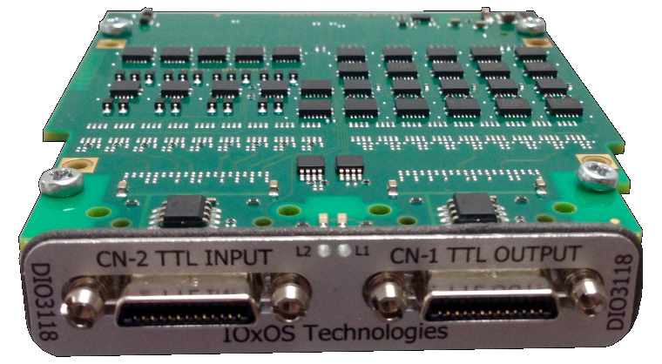
FBIS Interface
Use of solution based on a IOxOS DIO3118 DIO FMC has been foreseen as an intermediate solution for test purposes.

Slide 16
FBIS Test site

Slide 17
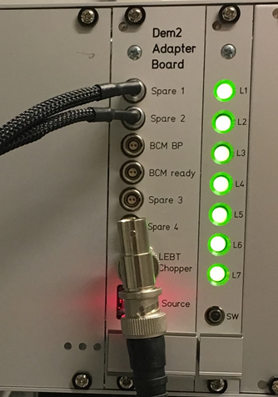
FBIS Test site
Spare 1 and 2 are TTL inputs, BCM BP and BCM ready are LVDS inputs, spare 3 and 4 are RS485 inputs. Monitoring LEDs L1 to L6 show the input status (TRUE or FALSE).
Then inside the Demonstrator is programmed 1 SCU (Signal Conversion Unit) firmware which serializes the input signals and send them to the DLN through a fast link (with Aurora64) on the fiber.
This fiber is plugged back on the Demonstrator as the DLN firmware is also programmed inside. This one take the decision to keep or remove the Global Beam Permit on 2 outputs: a BNC TTL connector (to the Actuator LEBT chopper) and a fiber (to the Actuator FSU=Fast Shutdown Unit inside the High Voltage platform).
So the BLM electronic could be plugged directly to the inputs spare 1 and/or spare 2 (for Beam Permit and or Ready, the behaviour is the same for both signals).

Slide 18
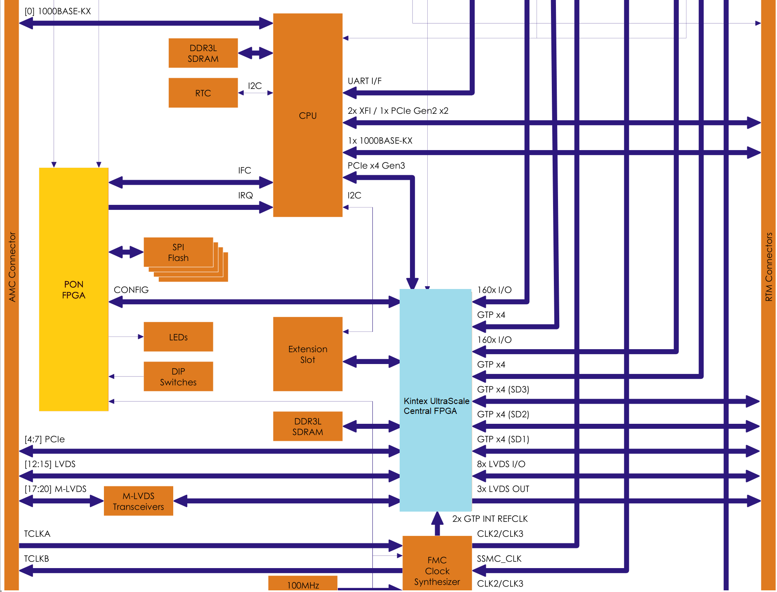
IFC1410 – DDR calibration issues

Slide 19
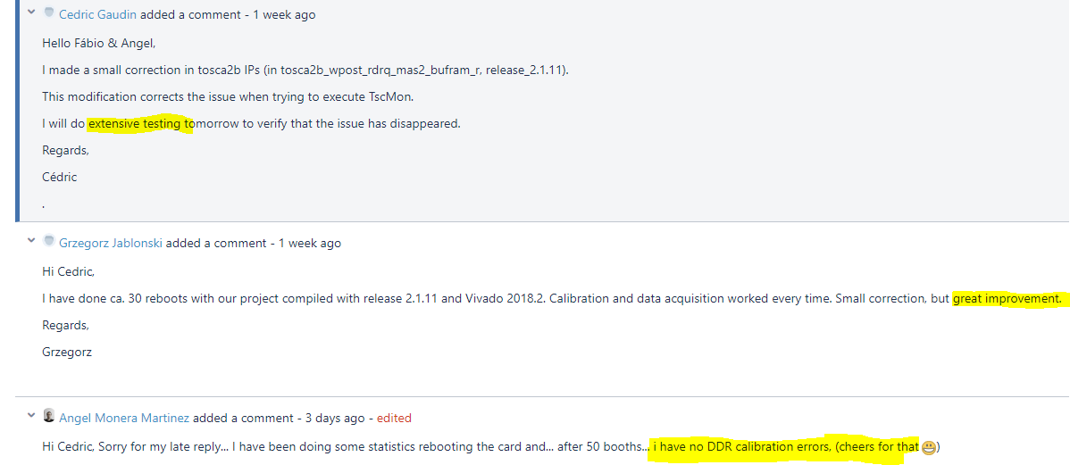
IFC1410- DDR Debugging
Work with IOxOS to report and identify board issues.

Slide 20
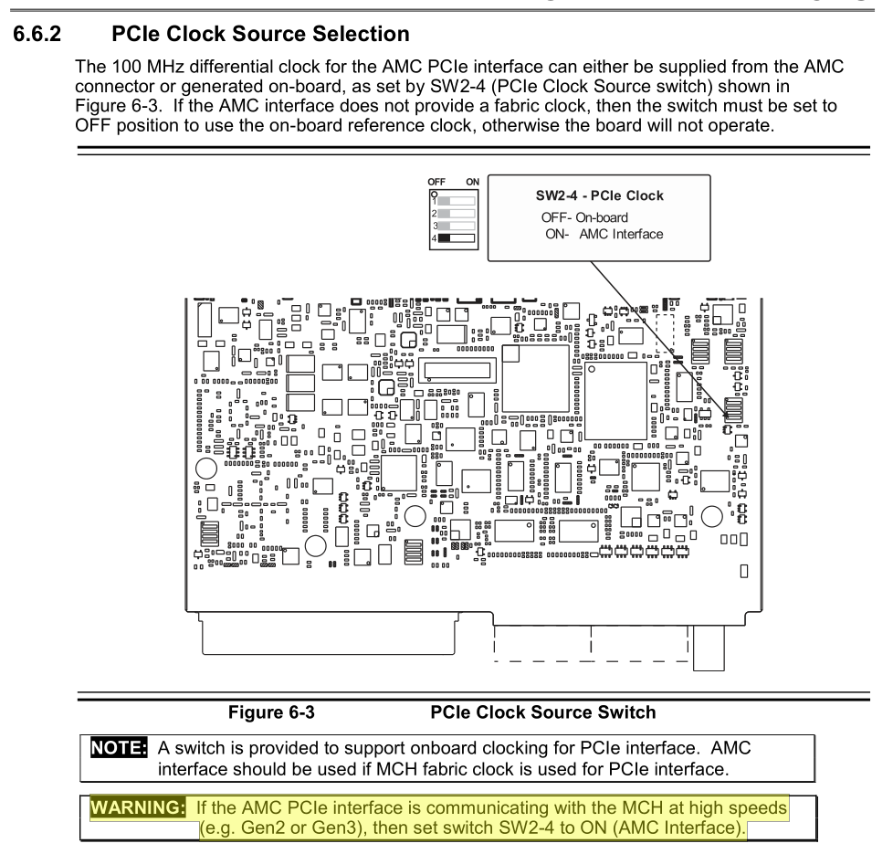
IFC1410 – PCIe with Concurrent CPU
Need a proper boot procedure when NAT-MCH is configured to Gen3 speed: for unknow reason IFC1410 can’t get Gen3 when CT-CPU is powered on.
CPU should use backplane clock.
IFC1410 should use backplane clock.
@Gen2 works fine.
FMC should be activated via Power PC (QorIQ) or PON firmware upgrade

Slide 21
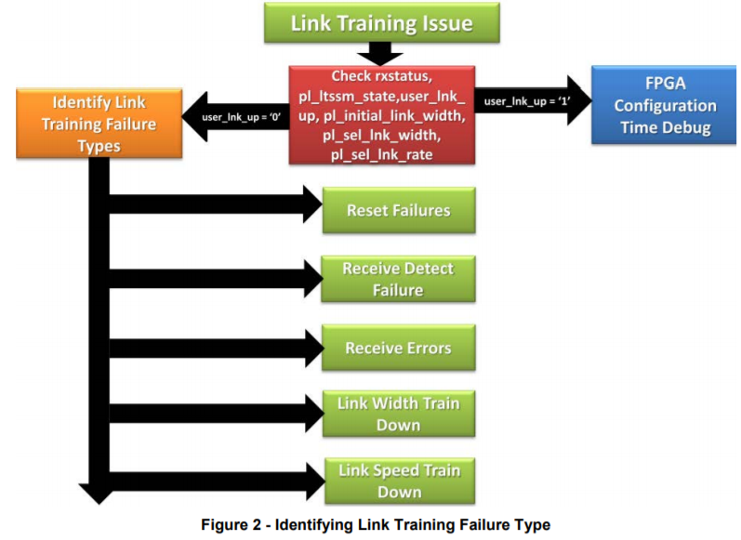
CT CPU - PCIe Action Plan
CT CPU sent to IOxOS for debugging.
Discussion with NAT-MCH and Recab (CT-CPU supplier) .

Slide 22
CEA Slides
ICS has plans to drop nds3.

Slide 23
CEA Answers
One CT CPU per IFC1410? or several ? One per crate.
Who is doing bandwidth calculation? The bandwidth depends on simultaneous operations on PCIe link. It’s a complex test scenario. ICS will start deploying XEON E3-1505M CPU’s instead Core i7.
Is it a temporary or long term solution for the nBLM ? Long Term.
Do you plan to use the CPU IFC1410 in any of your system ? Yes, because PON registers are only available for this CPU.

Slide 24
CEA Answers
Only one IOC for nBLM on CT or one per IFC1410? ICS and In-Kinds should decide which solution is best.
We have received the EVR board. EVR IOC tested on CT ? Tutorial? We will send all information as soon we test Lodz implementation.
Polish team has tested with EVR (timing trigger) ? Yes.
DOD storage: PV ? ○ file ? / file format / protocol / … DOD storage is a premature question, should not be in the scope of this CDR. But DOD storage will be remote, not on the IOC.
EEE vs E3? E3
ADC3111 overheating: Not reported @ESS. I've brought one more ADC3111 for CEA testing.

Slide 25
More questions?

