Slide 1
CDR 2019 icBLM
Cabling/connector/PP/EMC
Saclay CEA
Edvard Bergman
BD Laboratory manager
ESS ERIC
www.europeanspallationsource.se
6 February, 2019

Slide 2
icBLM signal EMI/EMC
Magnitude of EMI.
How to “regard” the signal from the icBLM.
Choosing signal cables.
icBLM end to end connection.
Uppsala measurement test.
Remaining planning/issues?

Slide 3
Example from telecom industry EMI magnitude.
“Worst case” low level CW impact as EMI.
“Stray capacitance”

Slide 4
icBLM, its signal complexity
Design principle.
Single mode & differential mode connection……….

Slide 5
How to “regard” the signal from the icBLM.
The signal output from the icBLM is an “mixed current” from DC to several of hundreds of kHz (up to some MHz) as CW. The signal is similar to audio signals.
Its complexity make it considerable to choose one kind of cable type, as coax/triax or shielded twisted pair. Considering single mode or differential mode “signal behavior”.
Twisted pair is a particularly effective way of reducing both magnetic and capacitive interference pick-up. Reducing low frequency magnetic pickup because it reduces the effective magnetic loop area to almost zero.
The signal interface is through an triaxle Lemo connector as small as it can be. Require low capacitance matching cable for the input interface.

Slide 6
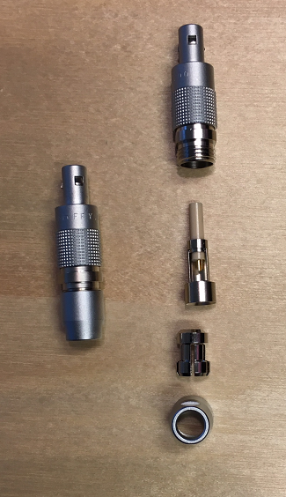
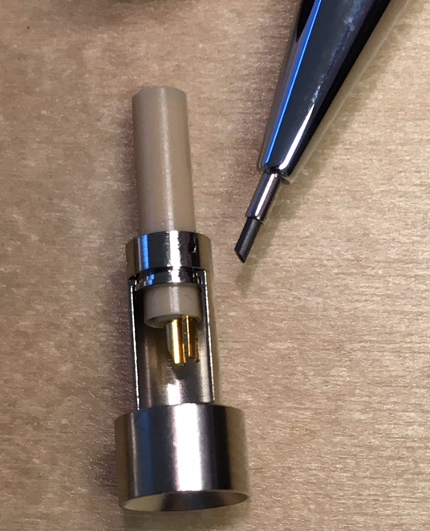
Delicate small connector. Risk for coupling effect. Interface to FMC input require low capacitance.

Slide 7
icBLM cable connection & possible EMI solutions.

Slide 8
Uppsla test.

Slide 9
icBLM end to end connection. Patch Panel (Box converter).

Slide 10
Mesurement results from Uppsala test facility.
Belden 9182 Twisted pair. 100m
AMGAB Twisted pair, custom made. 100m
COAXIAL RG58 (CERN). 10m with and without CONDUIT

Slide 11
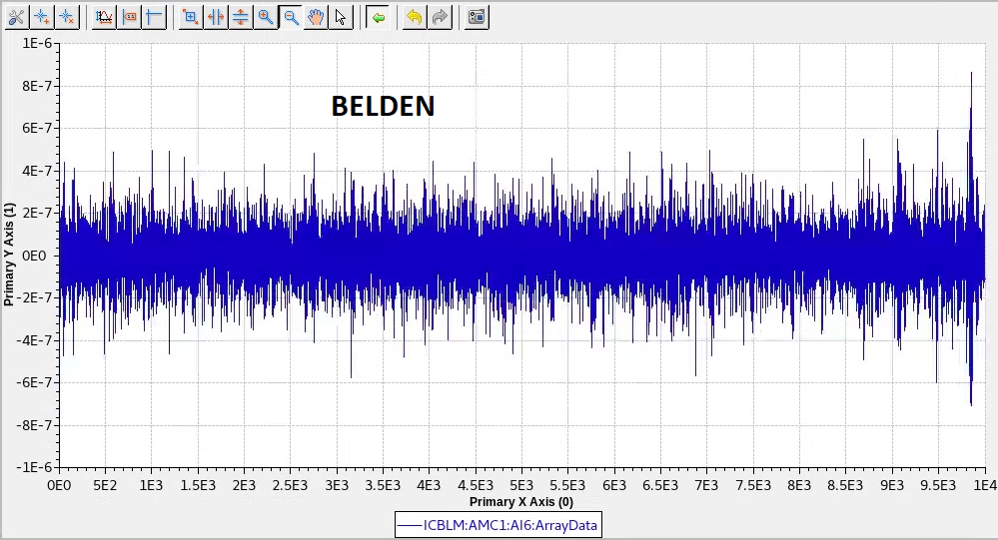
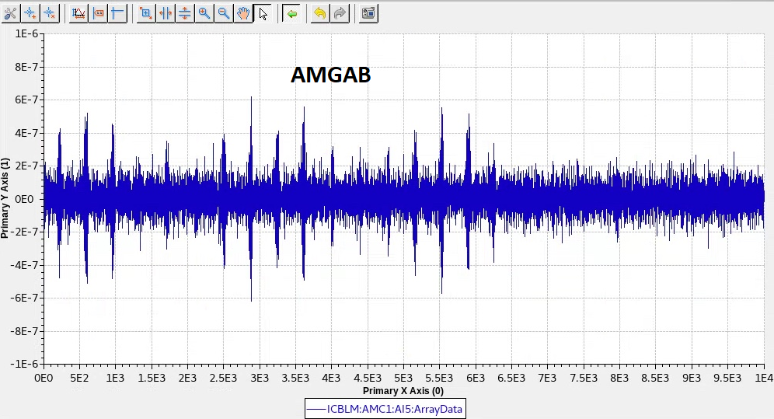
Uppsala test. Belden/AMGAB Twisted pair. 100m. Without conduit. Performance visa verce cost

Slide 12
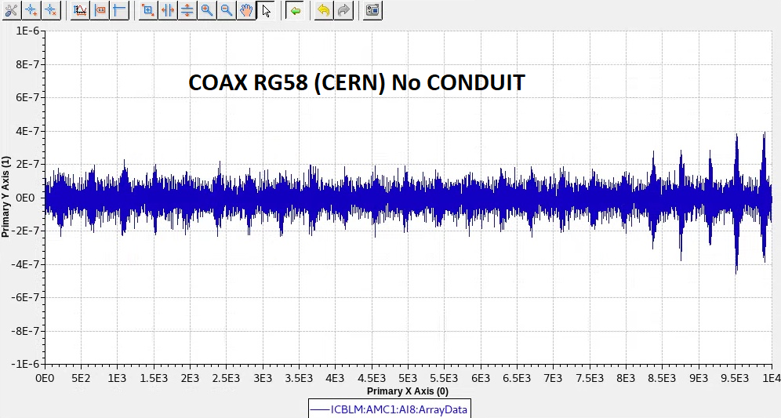
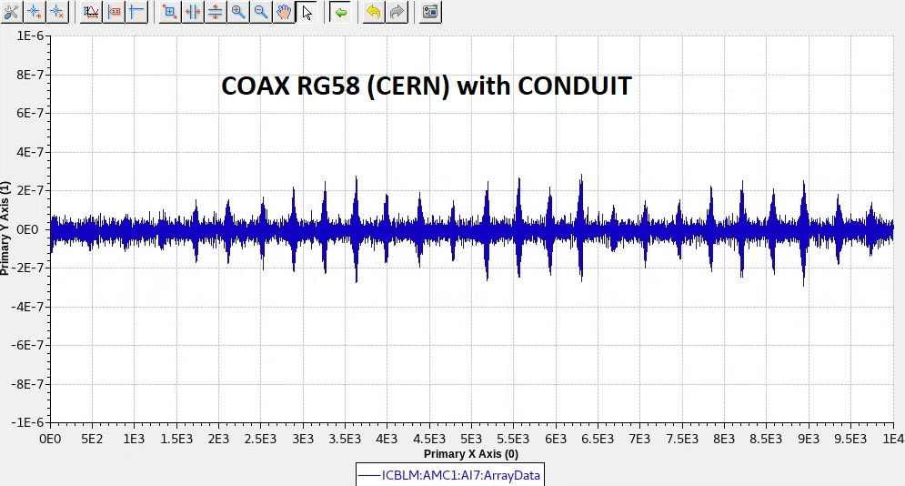
Conduit shielding impact on noise. COAXIAL RG58 (CERN)

Slide 13
Remaining and planning tasks/issues end to end termination.
Ordering/manufactory patch-panel cables, connectors and boxes.
Mounting/placing the detectors on accelerato/tunnel
Drilling holes for fixing pole–holders in tunnel.
Installation/planning of conduits in tunnel and gallery. Ongoing.
Test of icBLM

Slide 14
icBLM & EMC
Thank you!

