Slide 1
Digital platform for icBLM
Fabio dos Santos Alves
CEA - Saclay
13 February, 2019

Slide 2
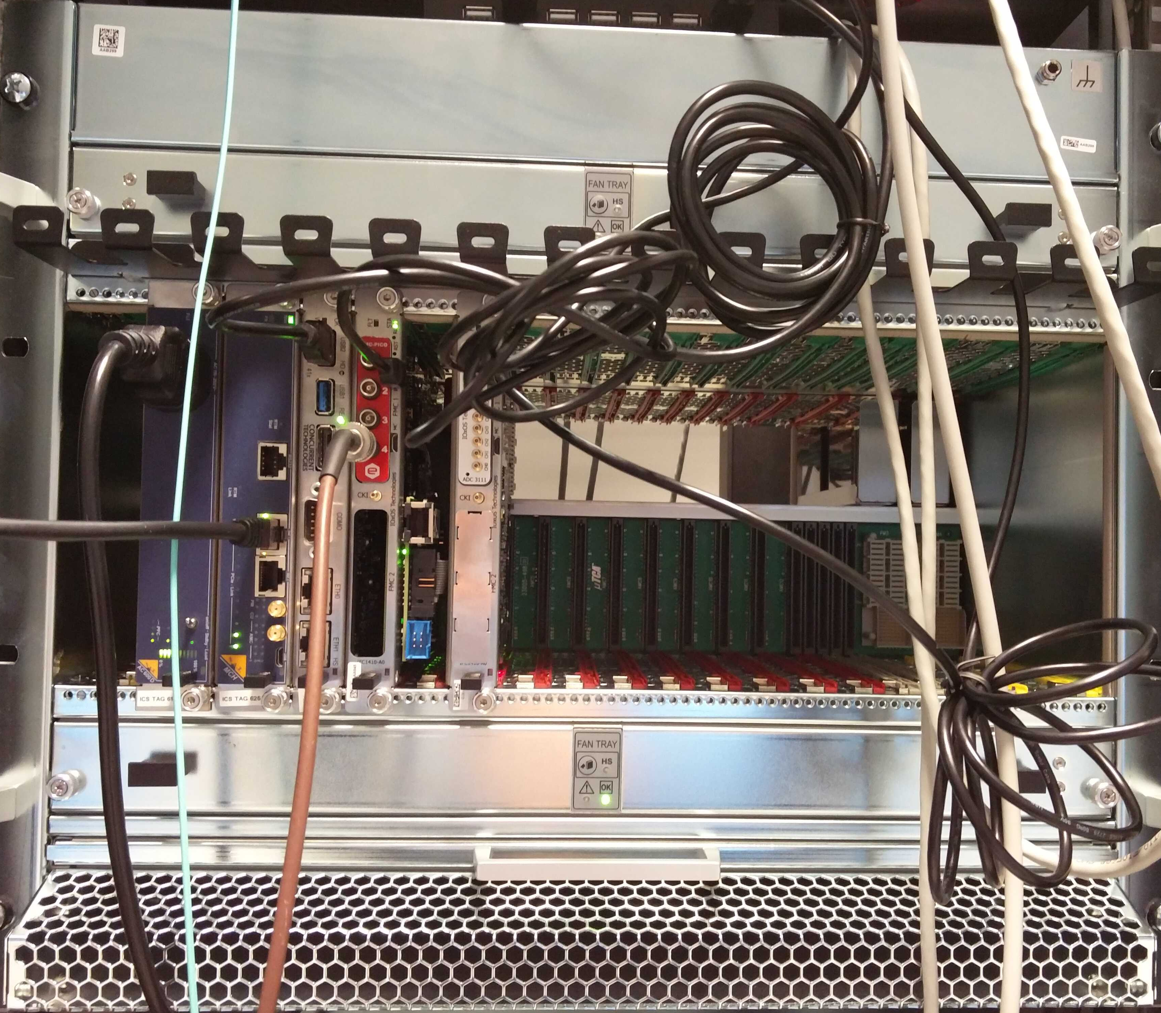
Fmc-pico-1m4 – Testbed
Tests were realized using latest Lodz firmware and software.

Slide 3
Initial tests on acquiring data from Pico4…

Slide 4
Initial tests on acquiring data from Pico4…

Slide 5
Łódź Environment vs ICS Environment
Łódź
New GCC compiler: 7.3 or superior
Use of HDF5
ICS:
GCC: 4.8
No support

Slide 6
ICS software standard
ICS will provide the "standard way" to build the application in host and target.
Include new GCC and HDF5 on CentOS distribution
Cross compiler and root file system
3rd party library should be discussed with ICS and so on.

Slide 7
ICS actions
A ICS standard for:
MTCA system
Timing System
Firmware
User application
Epics layer
Jira:
https://jira.esss.lu.se/browse/ICSHWI-1775
https://jira.esss.lu.se/browse/ICSHWI-1693

Slide 8
More questions?

