Slide 1
Risk, Schedule, Deliveries
January 15, 2019, ESS, Lund
Pedro J. González
RF Group
www.essbilbao.org

Slide 2
Outline
Schedule
Deliveries
Risk

Slide 3
Schedule
Main goal:
LLRF systems available and ready for RF conditioning of cavities as soon they are installed in the tunnel.
  RFQ, DTL#1, Bunchers, DTL#2..5
  Spokes
Back-up plan: use of prototype/development systems for RF conditioning

Slide 4
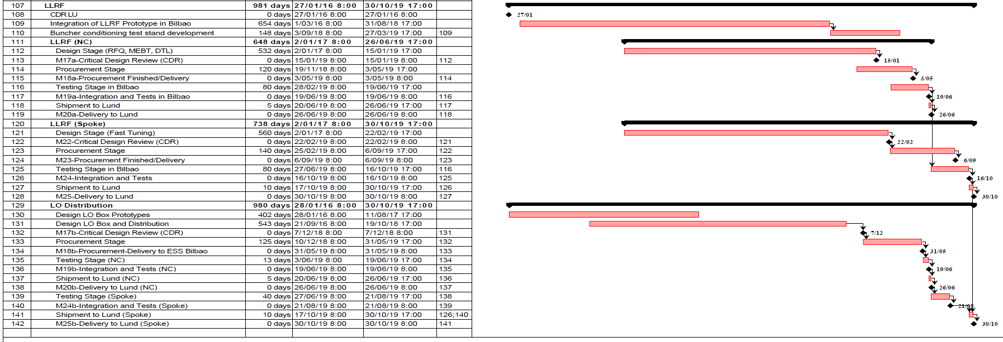
Schedule

Slide 5
Deliverables
*According to AIK 3.1 MEBT and IIK 14.10.4 MEBT Control: Procurement by ICS, installation by ESS Bilbao (Pos. 1, 2, 3, 4, 10, 11)
 | LLRF Deliveries |  | AIK 8.1 | AIK 3.1 | AIK 8.1 | AIK 8.1 | AIK8.2 | AIK8.2
Pos |  | Supplier | RFQ | Buncher | DTL | Spoke | MB | HB | Details
 | MTCA modules |  | 1 | 3 | 5 | 26 | 36 | 84
1 | MTCA crate | Schroff | Bilbao | Bilbao* | Bilbao | Bilbao |  |  | Procurement and installation
2 | PSU | Wiener | Bilbao | Bilbao* | Bilbao | Bilbao |  |  | Procurement and installation
3 | MCH | N.A.T | Bilbao | Bilbao* | Bilbao | Bilbao |  |  | Procurement and installation
4 | Timing Rx | MRF | Bilbao | Bilbao* | Bilbao | Bilbao |  |  | Procurement and installation
5 | Digitizer AMC | Struck | Bilbao | Bilbao | Bilbao | Bilbao |  |  | Procurement and installation
6 | RF RTM 352 | Struck | Bilbao | Bilbao | Bilbao | Bilbao |  |  | Procurement and installation
7 | Pz controller | PEG | na | Na | na | Bilbao |  |  | Procurement and installation
8 | Pz supply | PEG | na | Na | na | Bilbao |  |  | Procurement and installation
9 | RTM carrier | PEG | na | Na | na | Bilbao |  |  | Procurement and installation
10 | Gap filler plates |  | Bilbao | Bilbao* | Bilbao | Bilbao |  |  | Procurement and installation
11 | RTM coax whip | Elspec (TBA) | Bilbao | Bilbao* | Bilbao | Bilbao |  |  | Procurement and installation
12 | Digitizer FW | ESS | Bilbao | Bilbao | Bilbao | Bilbao |  |  | Design, implementation and verification
13 | IOC | ICS | Bilbao | Bilbao | Bilbao | Bilbao |  |  | Implementation and verification
14 | Installation | - | Bilbao | Bilbao | Bilbao | Bilbao |  |  | Installation of LLRF MTCA
15 | Functional testing @ESS | - | Bilbao | Bilbao | Bilbao | Bilbao |  |  | Functional test of complete MTCA system

Slide 6
Deliverables
Changes in red (Pos. 20, 28, 32, 33)
Main Cavity Field RF cables (Pos. 26): scope swap proposed
 | LLRF Deliveries |  | AIK 8.1 | AIK 3.1 | AIK 8.1 | AIK 8.1 | AIK8.2 | AIK8.2
Pos |  | Supplier | RFQ | Buncher | DTL | Spoke | MB | HB | Details
 | LLRF rack modules
16 | Slow motion controller HW | Beckhoff | na | Bilbao | Bilbao | Bilbao |  |  | Procurement and installation
17 | Slow ctrl tuning algorithm | ICS | CEA/Saclay | Bilbao | INFN | ?? |  |  | Design and Integration
18 | Pz ctrl tuning algorithm |  | na | na | na | LU? |  |  | Design and integration
19 | LO & Clk generation unit | Bilbao | Bilbao | Bilbao | Bilbao | Bilbao |  |  | Design, procurement and installation
20 | LO & Clk distribution unit | Bilbao | na | na | Bilbao | na |  |  | Design, procurement and installation
21 | RF split box | PEG | PEG | PEG | PEG | PEG |  |  | Procurement
22 | RF Patch Panel | PEG | PEG | PEG | PEG | PEG |  |  | Procurement
23 | Rack cables | ?? | Bilbao | Bilbao | Bilbao | Bilbao |  |  | Specification and Procurement
24 | Pz ctrl distribution box |  | WP8 | WP8 | WP8 | WP8 |  |  | Procurement and installation
25 | Rack installation |  | WP8 | WP8 | WP8 | WP8 |  |  | Installation of LLRF rack and cabling
 | LLRF system
26 | RF cables main field ctrl | RFS (TBA) | Bilbao? | Bilbao | Bilbao? | Bilbao? |  |  | Procurement
27 | RF cables field monitoring | RFS (TBA) | ESS | na | ESS | ESS |  |  | Procurement
28 | non-coax cables |  | Bilbao | Bilbao | Bilbao | Bilbao |  |  | Procurement
29 | Installation |  | WP8 | WP8 | WP8 | WP8 |  |  | Complete LLRF system incl all external cables
30 | Expert Screens | ICS |  |  |  |  |  |  | LLRF OPI
31 | RF conditioning wo cavity |  | WP8 | WP8 | WP8 | WP8
32 | Start up procedures |  | CEA/WP3 | Bilbao | INFN |  |  |  | freq tracking and slow tuning
33 | RF conditioning w cavity |  | CEA/WP3 | Bilbao/WP3 | INFN
34 | Beam comissioning |  | WP3/CEA | WP3/Bilbao | WP3/INFN

Slide 7
Risks
Potential impact on Schedule, Performance, Cost
Insufficient manpower at ESS Bilbao
  Small team, limited experience in accelerators
  Action: 2 engineers are joining the RF team in Feb 2019
Lack of coordination-collaboration between partners (LU, WP8, WP3, ICS, Bilbao, PEG)
  Several components (HW, FW, SW, Scripts, IOC,…) being developed in parallel by different teams (also RF transmitters and Cavities)
  Installation and Commissioning in Lund by many parties
  Action: Participate regularly in coordination meetings
Compatibility/interoperatibility of COTS and custom components
  Main components are single source, some are still under development
  Action: Follow-up of new revisions/obsolescence and inform the stakeholders
Specifications not met/Insufficient performance
  LO Box and Distribution, RFQ, DTL, Timing&Sync
  Action: Carry out extensive tests before delivery
Delay in delivery of HW modules
  Delays in contracting suppliers, electronic components’ availability
  Action: Launch call for tenders ASAP, then follow-up of suppliers

Slide 8
Thank you

