Slide 1


Experimenting with extreme cold: from fundamental science to innovative technology
ECD Oct 2019
Rich Haley

Slide 2
Outline
Lancaster University
& Physics Department
Facilities for ULT Quantum
Science & Technology
  Clean room and nanofabrication
  Ultra low temperatures
  IsoLab
European Microkelvin Platform (EMP)
Superfluid helium-3
ULT nanoelectronics & electron thermometry
Cryofree quantum sensors & the G-SQUID

Slide 3
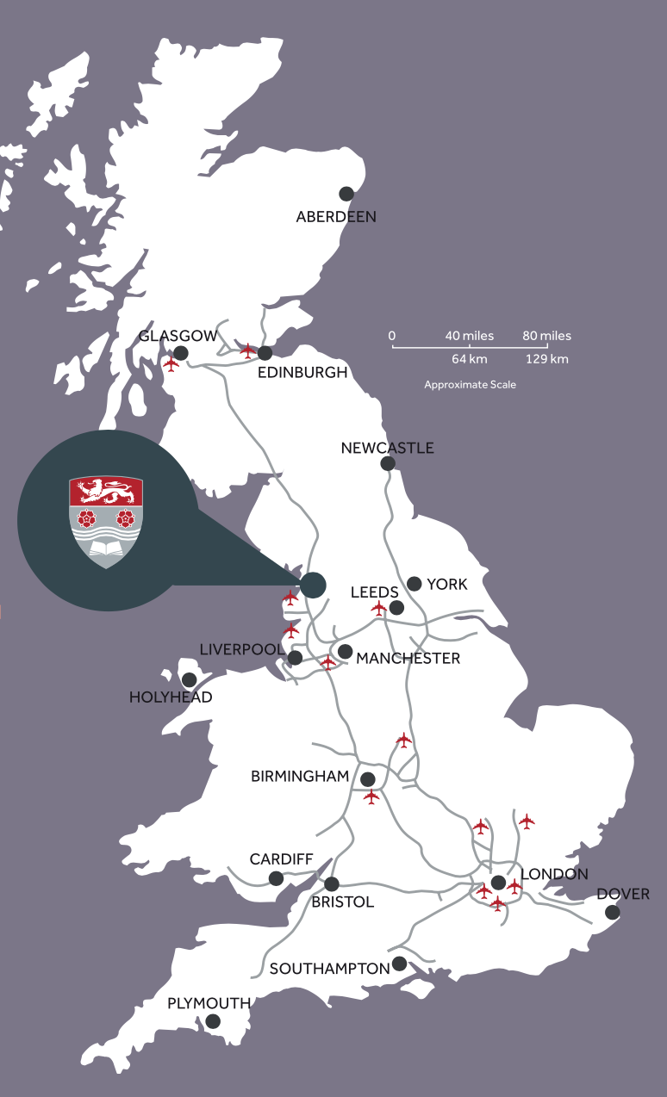
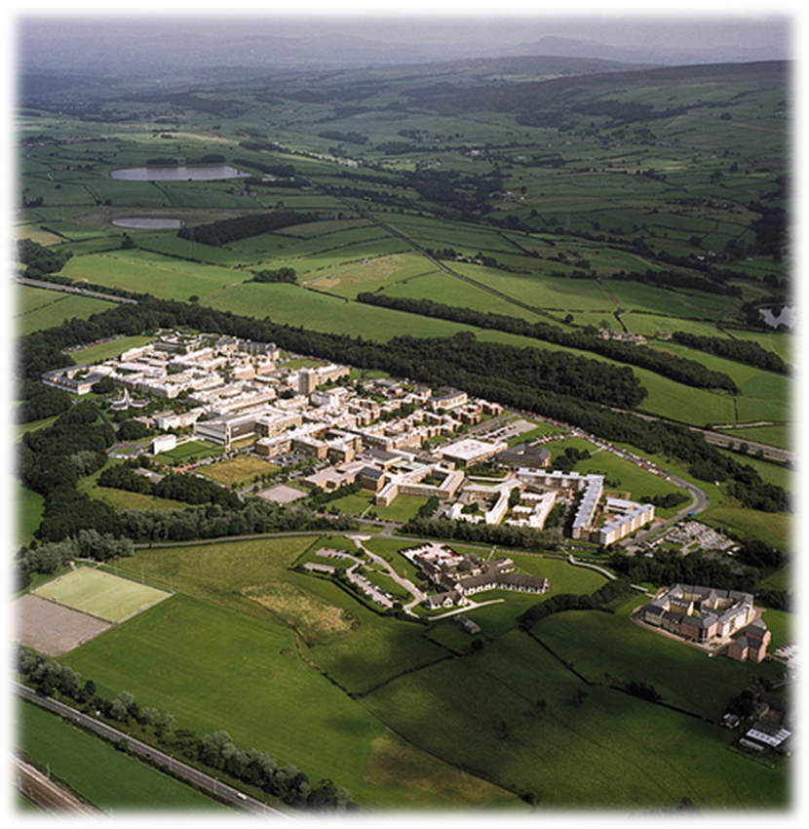
Department of Physics
Founded 1964
~ 50 academics
~ 50 postdocs
~ 100 grad students
~ 500 undergraduates
Recently undergone
major refurbishment

Slide 4
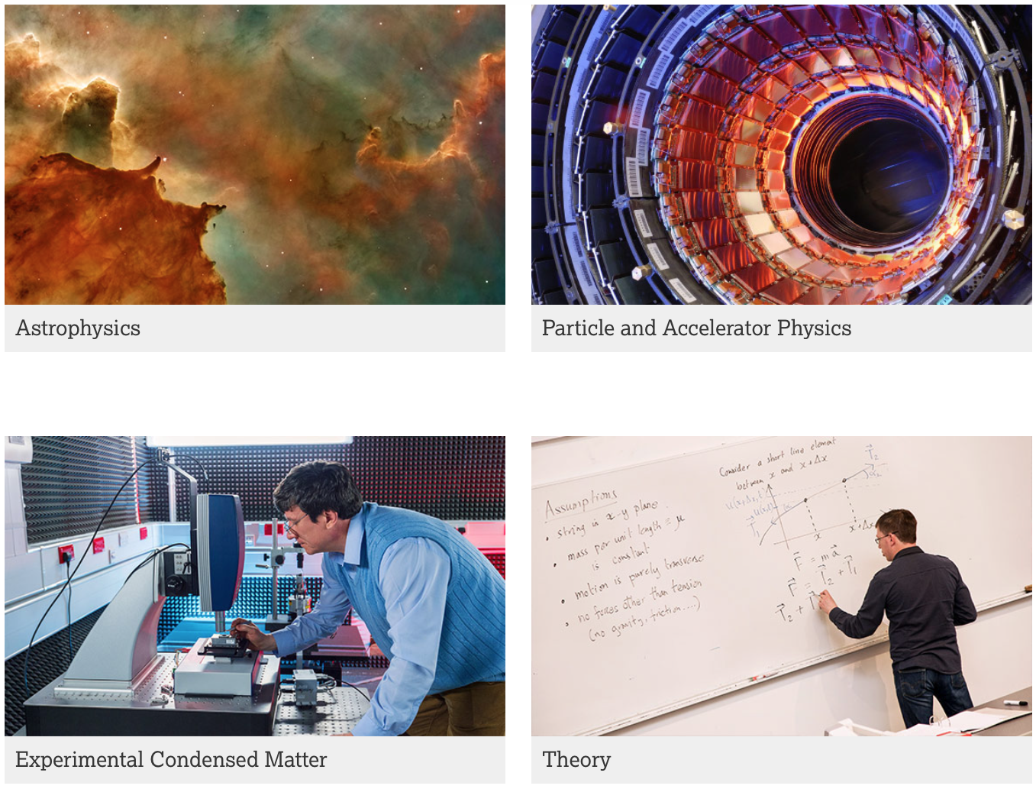

Research
- major groups

Slide 5
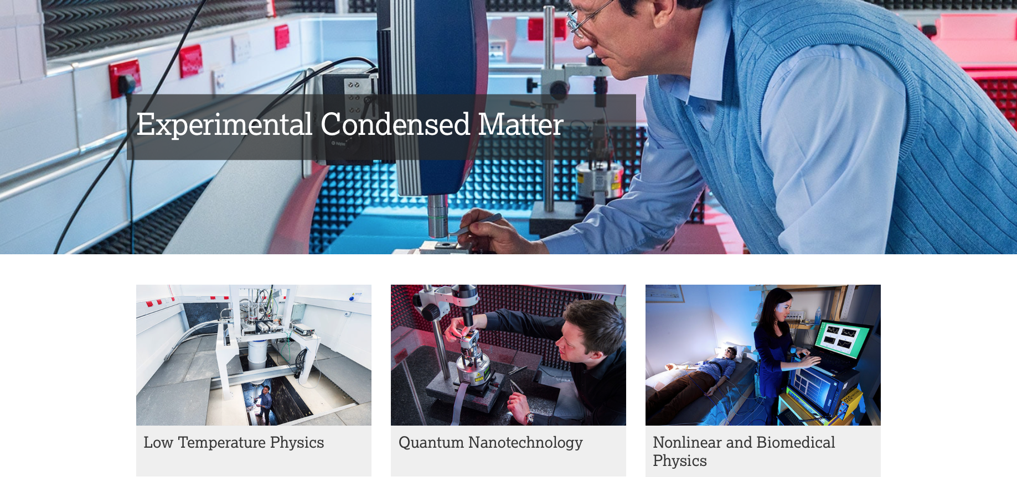
Research
- activities

Slide 6
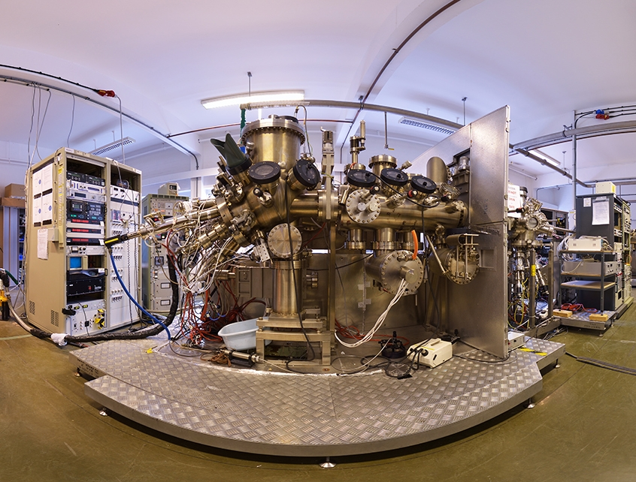
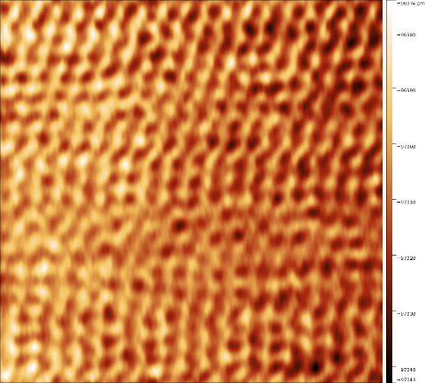
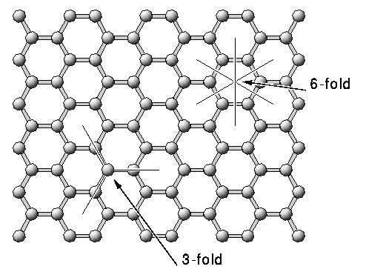
Quantum Technology Centre
www.lancaster.ac.uk/quantum-technology
Superconducting quantum circuits
Semiconductor nanostructures and devices
Quantum information & cryptography
NanoElectroMechanics
2D materials
Low & ultra low T characterisation
Scanning probe microscopy
Atomic resolution on graphite in IsoLab

Slide 7
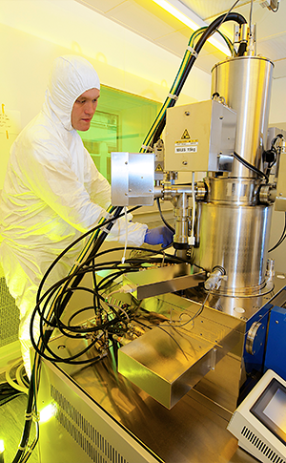
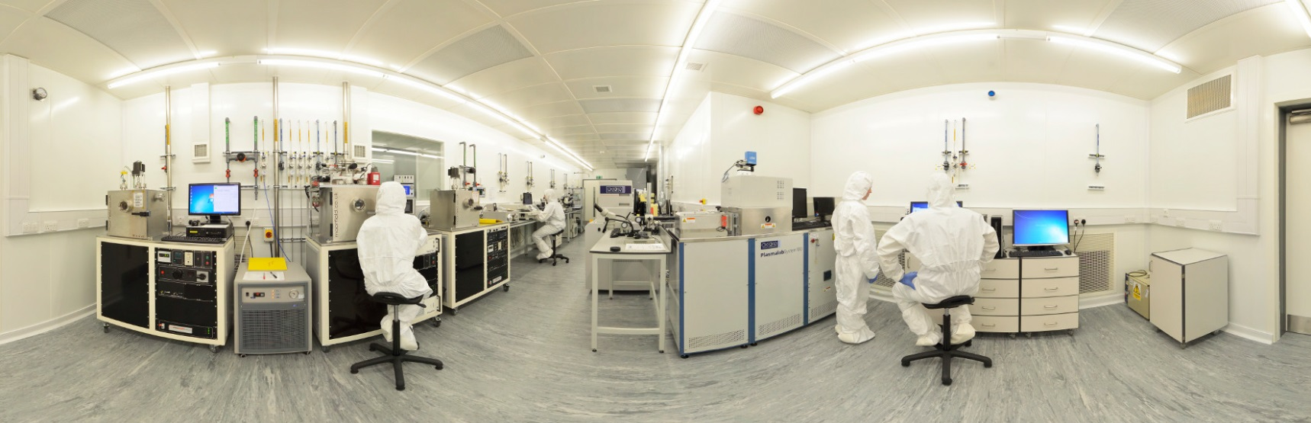
Clean Room Nanofabrication
Class 1000 and class 100 cleanrooms
Dedicated electron-beam writer
Plasma processing
Thin-film deposition

Slide 8
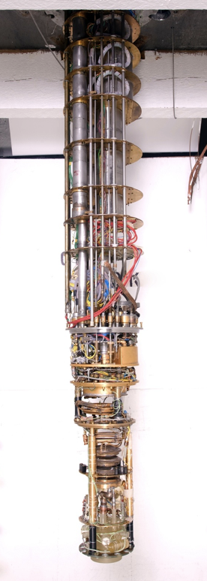
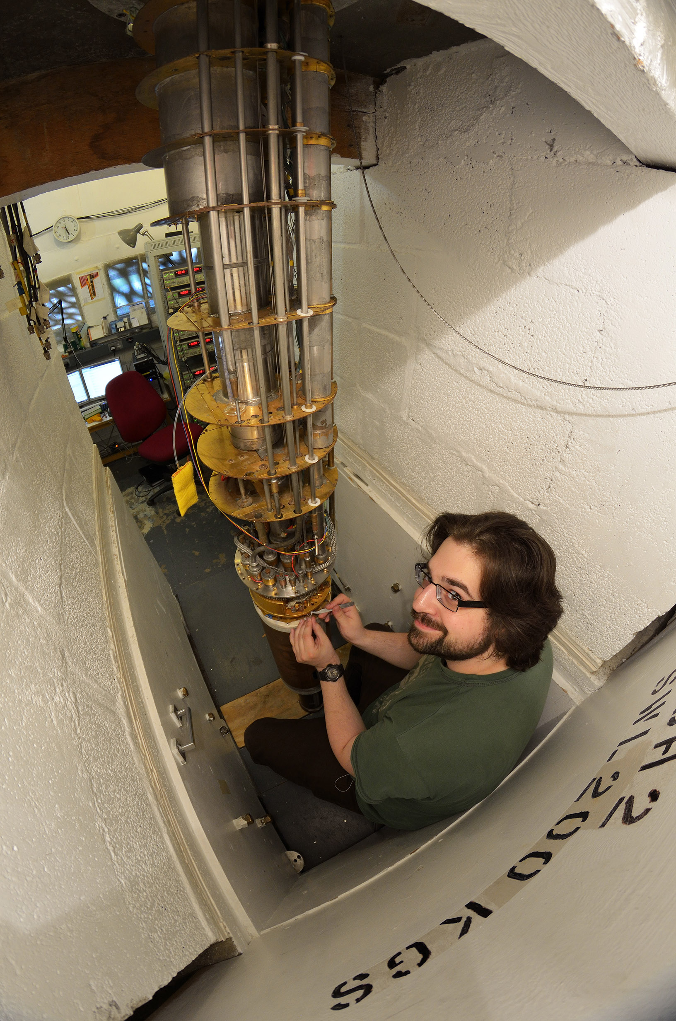
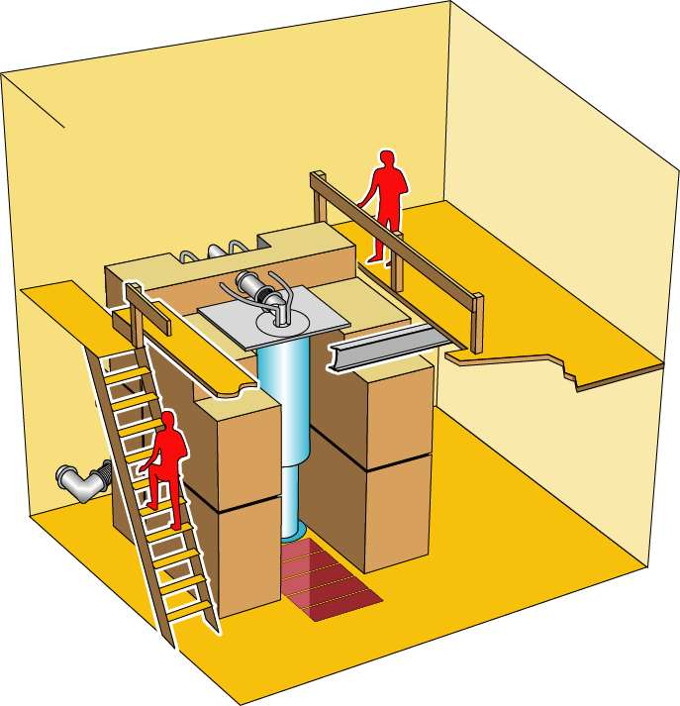
Ultra Low Temperatures
Custom microkelvin “wet” refrigerators
Condensates/superfluidity
Fundamental phase transitions
Quantum fluid analogues
Nano-scale devices at ULT
Novel instrumentation
Cooling technology

Slide 9
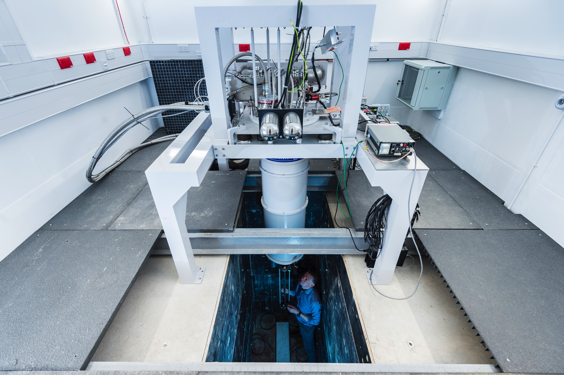
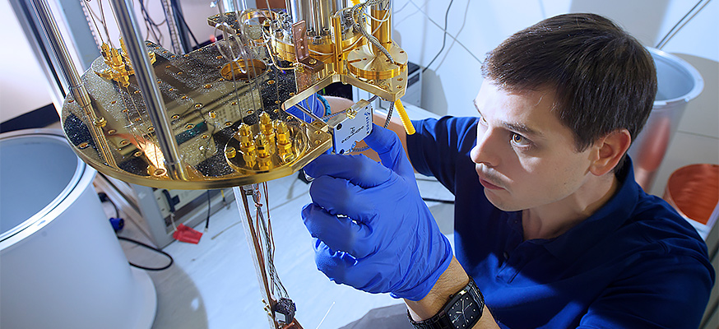


Ultra Low Temperatures
Commercial cryo-free “dry” refrigerators

Slide 10
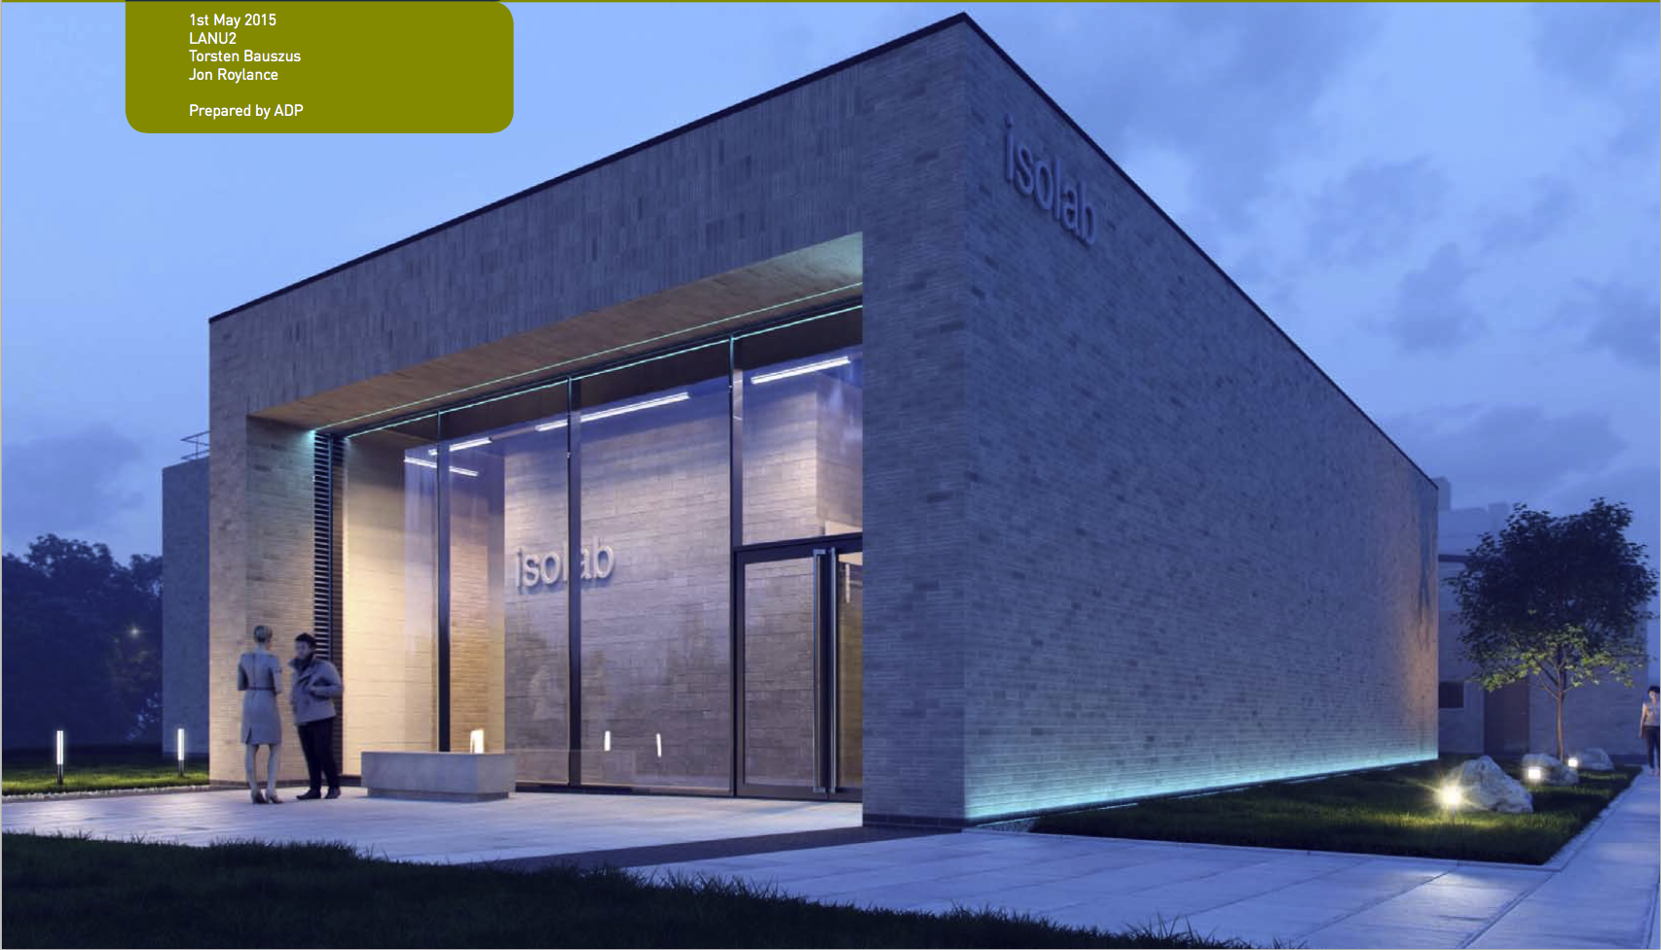
IsoLab ultra-isolated lab environments
Wolfson Foundation
Garfield Weston
JP Moulton
EPSRC
LU

Slide 11
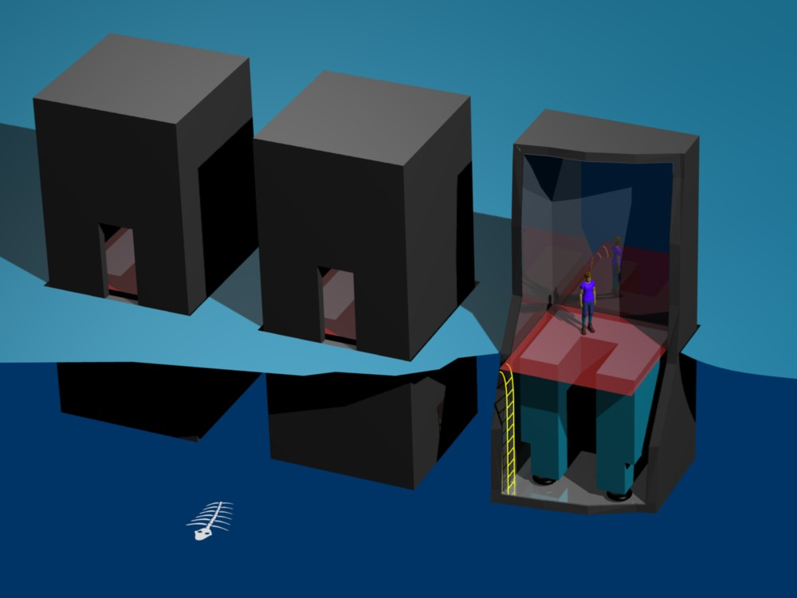
IsoLab ultra-isolated lab environments
1. Three concrete “bunkers” sit inside a concrete “tank” (not shown) sunk into the ground.
2. The inner surfaces of the “bunkers” are covered with electrical/anechoic shielding to minimise E-M fields and air-borne vibrations.
3. 50 tonne concrete block added to each volume supported by air springs to give further vibration isolation.
4. Modular experimental floor gives access to block, but does not touch.
Unprecedented isolation from external influence
Ideal for characterising quantum-enhanced and nanoscale materials & systems
Open access for collaboration with academic and industrial partners

Slide 12


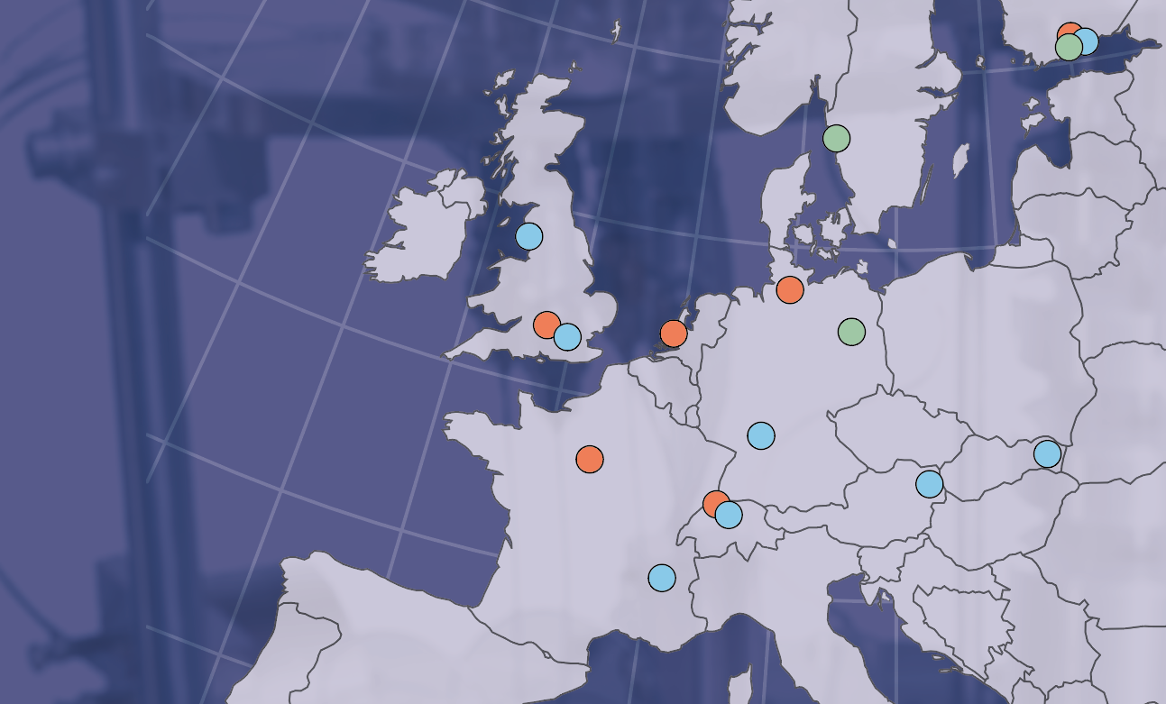

8 EMP Institutions
3 Technology Partners
6 Industrial Partners
Facilities available at
Aalto University
Basel University
CNRS Grenoble
Heidelberg University
Lancaster University
Royal Holloway UL
SAS Košice
TU Vienna

Slide 13















EMP Institutions
Industrial Partners
Technology Partners
Aalto University
Lancaster University
Physicalisch Technische
Bundesanstalt
Basel
University
Royal
Holloway
Technical Research Centre of Finland
CNRS Genoble
Technical
University
Vienna
Chalmers Technical University
Slovak Academy
of Sciences
Heidelberg
University

Slide 14
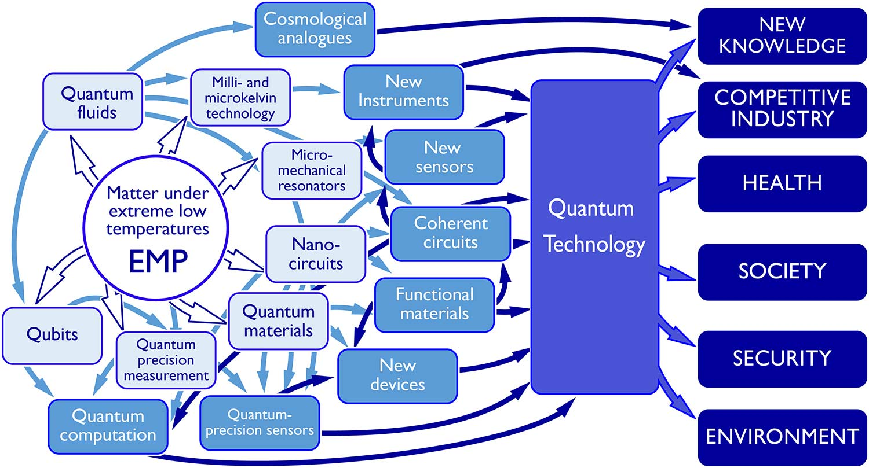
Research Overview

Slide 15
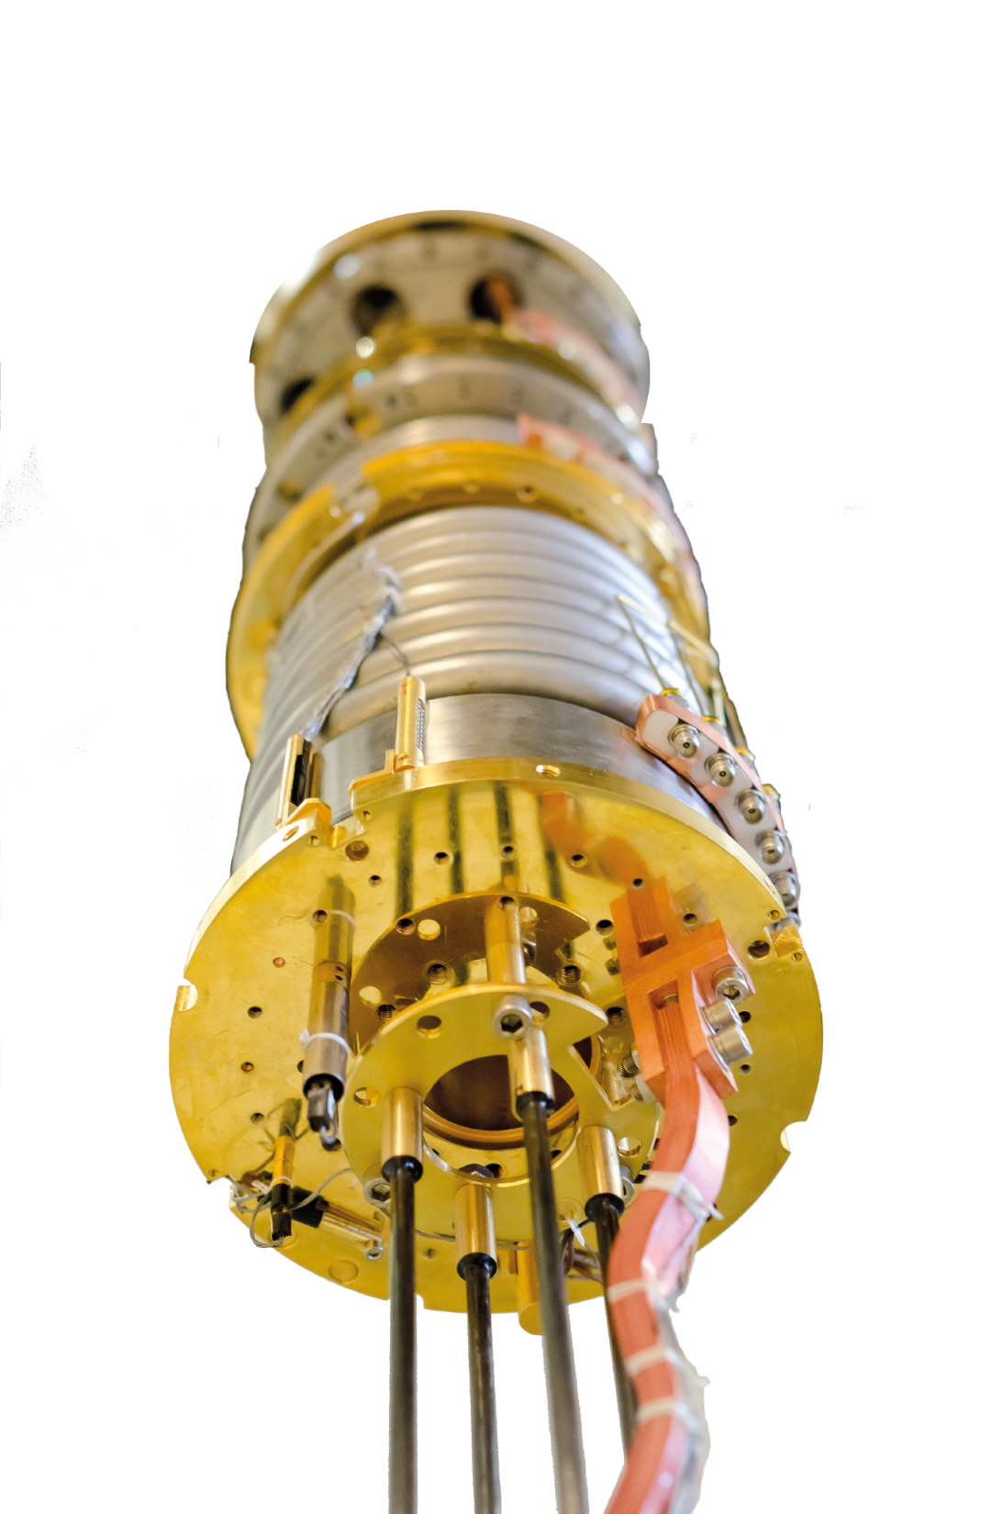
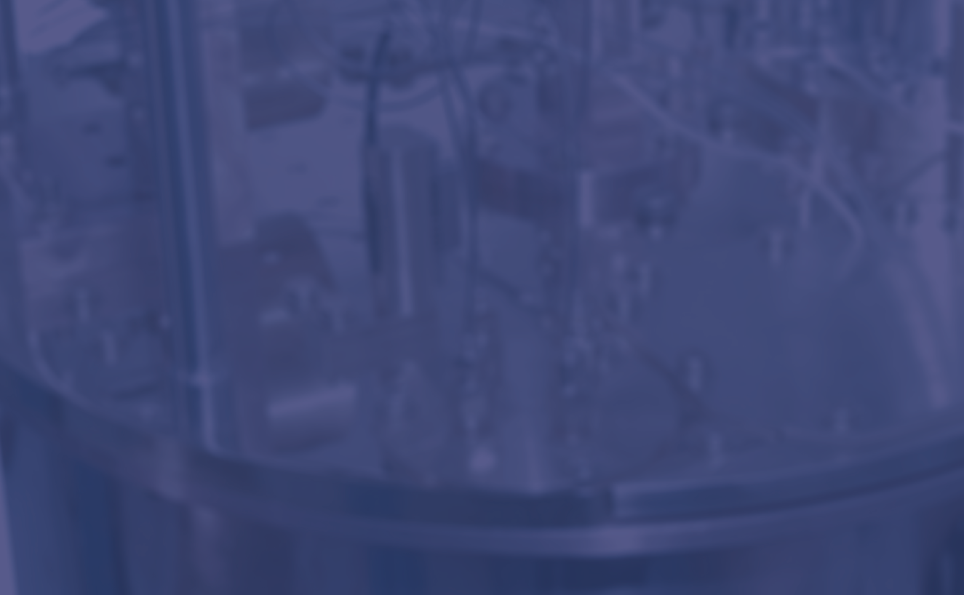
Available Cryostats / Sample Environment:
15 Microkelvin demagnetisation refrigerators
30 dilution refrigerators (dry & wet)
Rotating cryostats, high frequencies,
strong magnetic fields, clean rooms, …
Become a User:
www.emplatform.eu
User Access to EMP
Access to EMP facilities free of charge
Travel and local expenses are covered
Logistical and technical support
About EMP
Provide access to low temperatures
across communities
Drive forward inter-related areas of quantum materials, nanoscience, and quantum technology
Generate knowledge, applications, and commercial opportunities

Slide 16
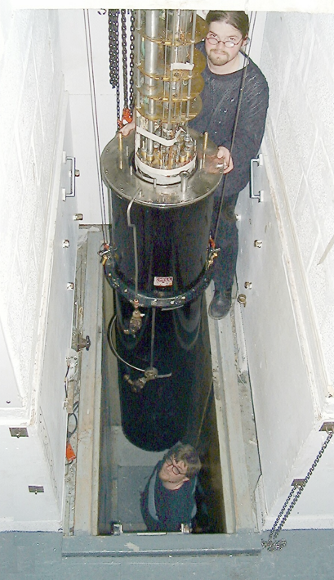
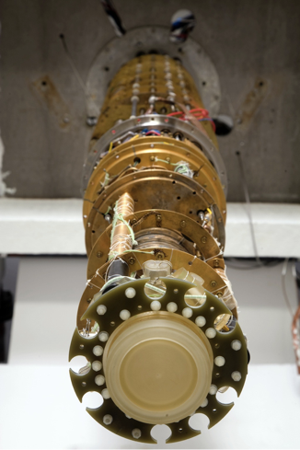
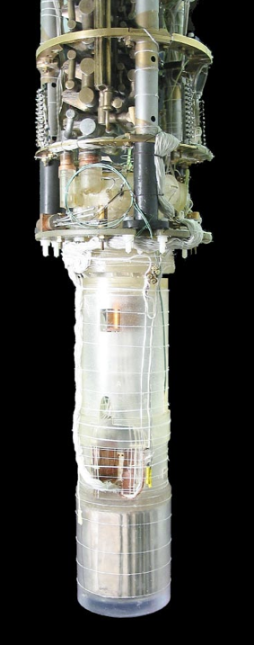
Superfluid helium-3 below 1 mK
- fridges & demag stages

Slide 17
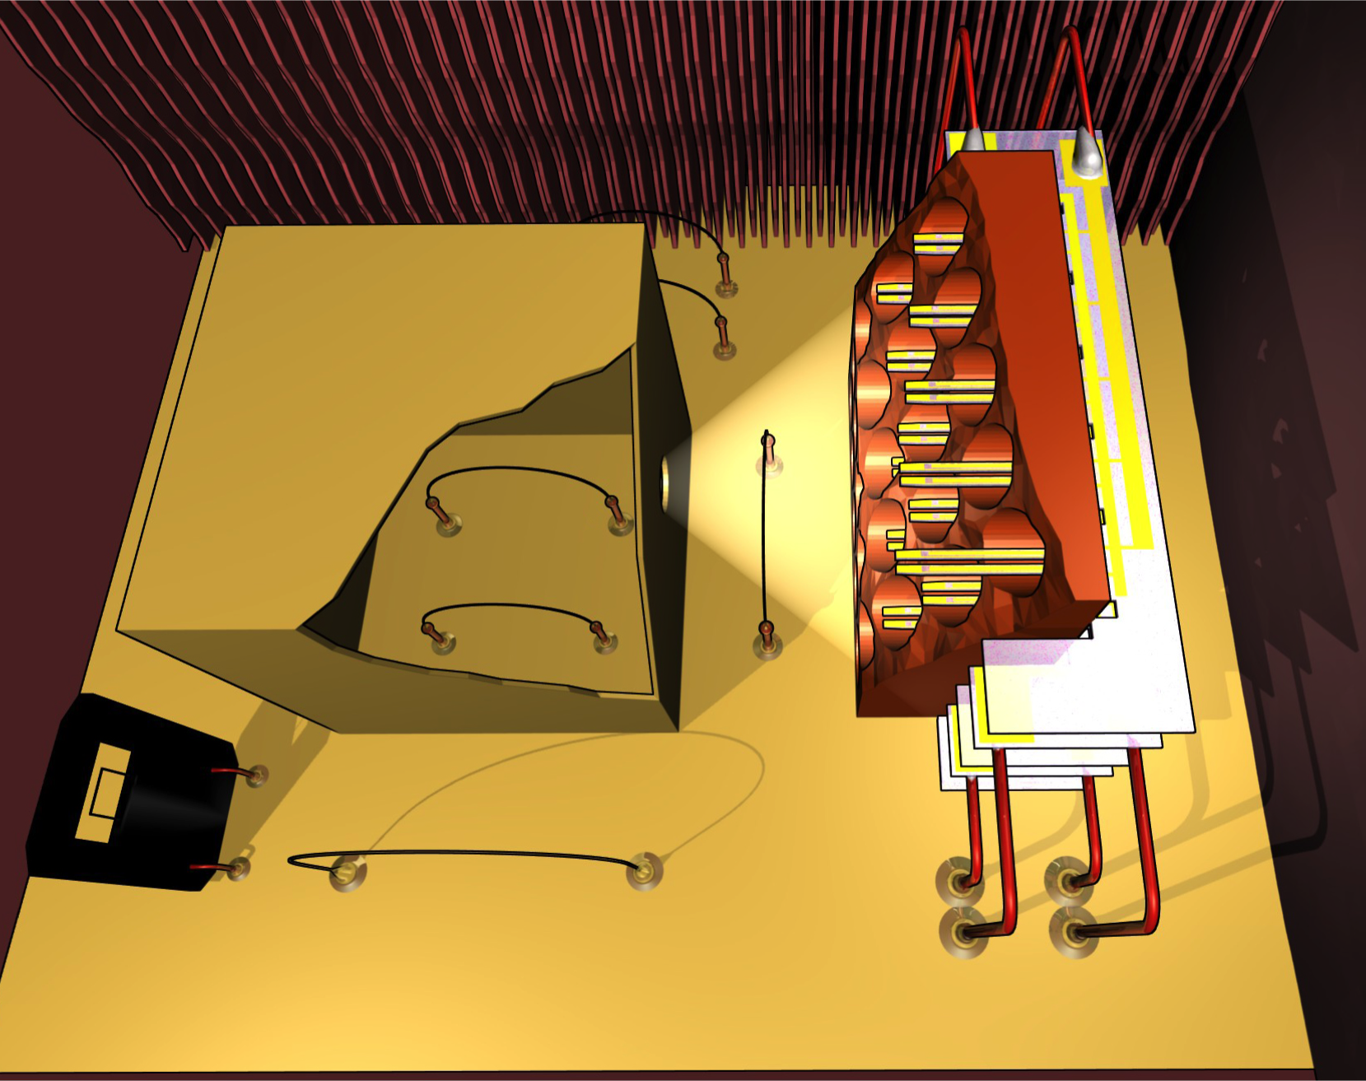
Superfluid helium-3 below 1 mK
- properties and probes
Fermionic BCS condensate
Frictionless, extremely pure, “perfect liquid”
Exotic multi-phased magnetic liquid crystal
Well-understood single quantum state
Quantized superfluid circulation
Quantum phase transitions
Cosmic simulations, Kibble-Zurek, branes…
1 cm

Slide 18
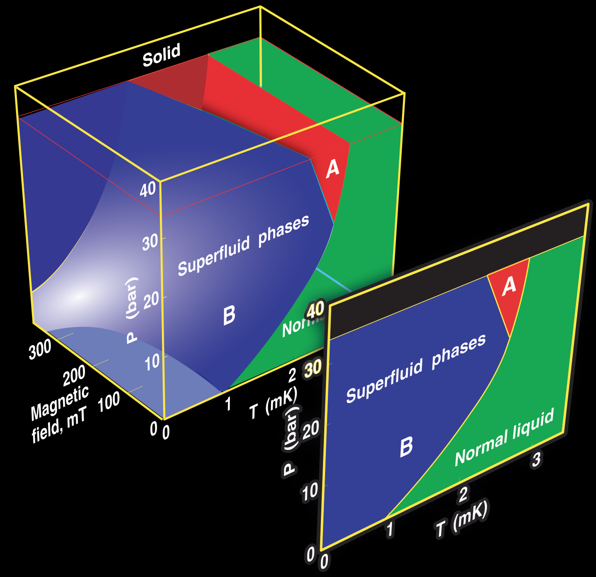
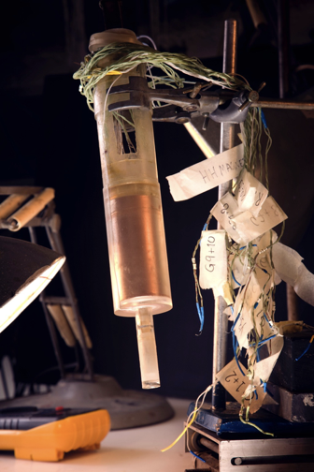
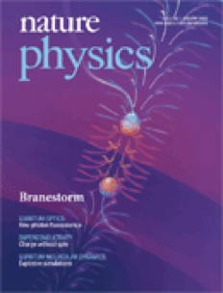
Superfluid helium-3 below 1 mK
- phase transitions & cosmology

Slide 19
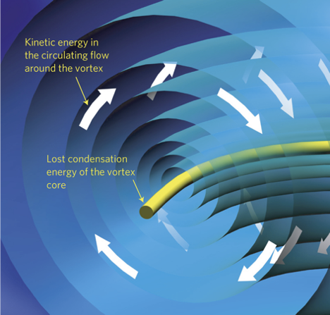
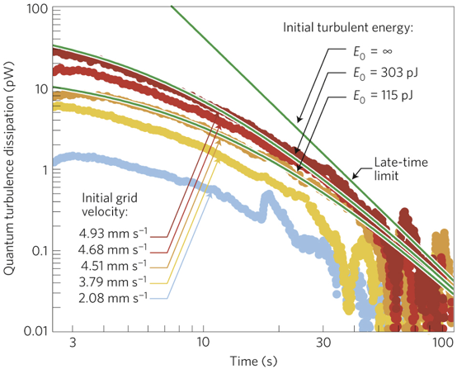
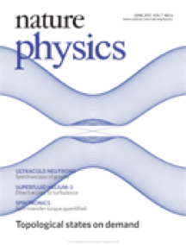
Superfluid helium-3 below 1 mK
- quantum turbulence

Slide 20
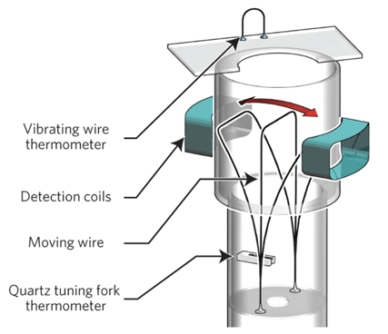
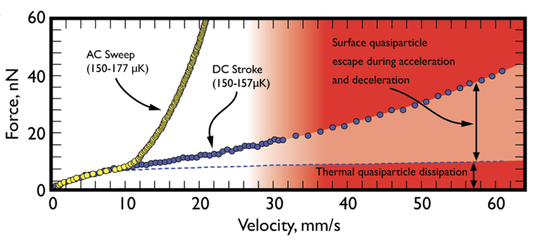
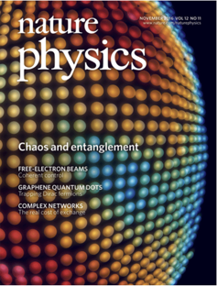
Superfluid helium-3 below 1 mK
- supercritical flow
?
Flow speeds exceeding the Landau critical velocity
AC vs DC flow
DC flow breaks the “superfluid speed limit”!?
Implications for superconductors?

Slide 21


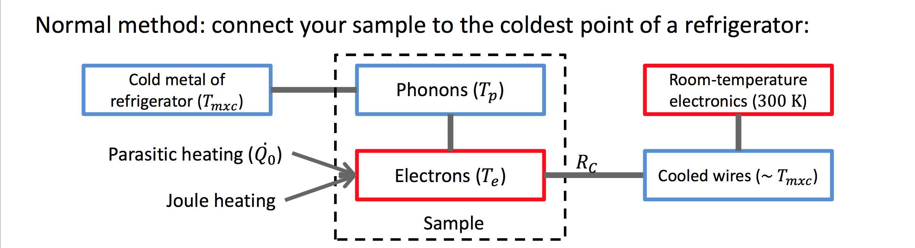
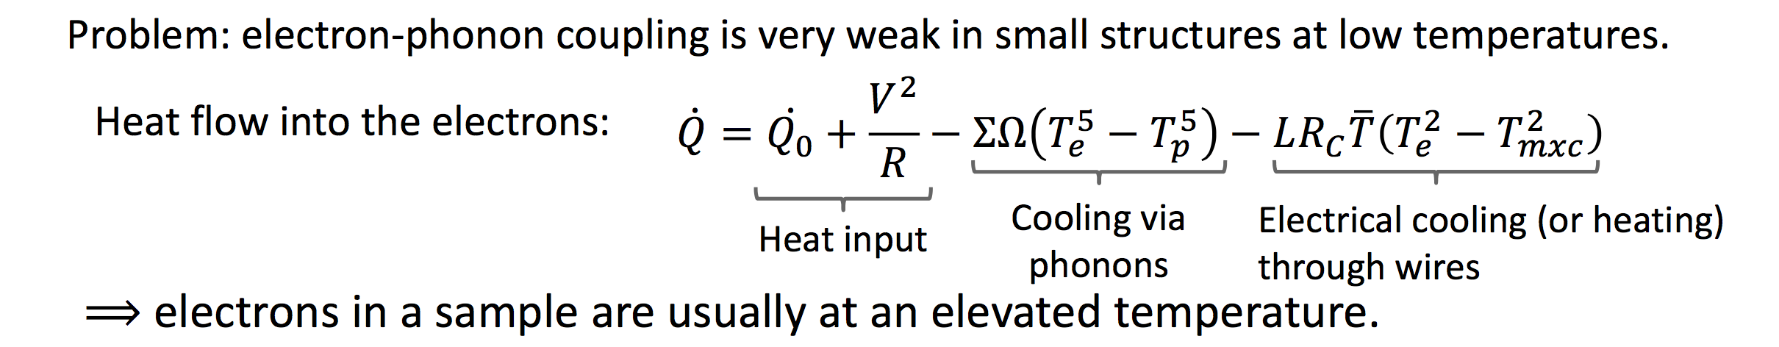
Primary thermometry of nanoelectronic devices
How does one cool a nanoelectronic sample and measure T_{e}?

Slide 22
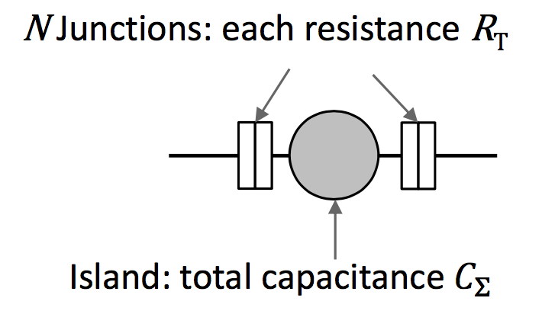
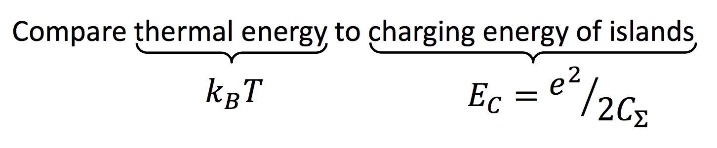
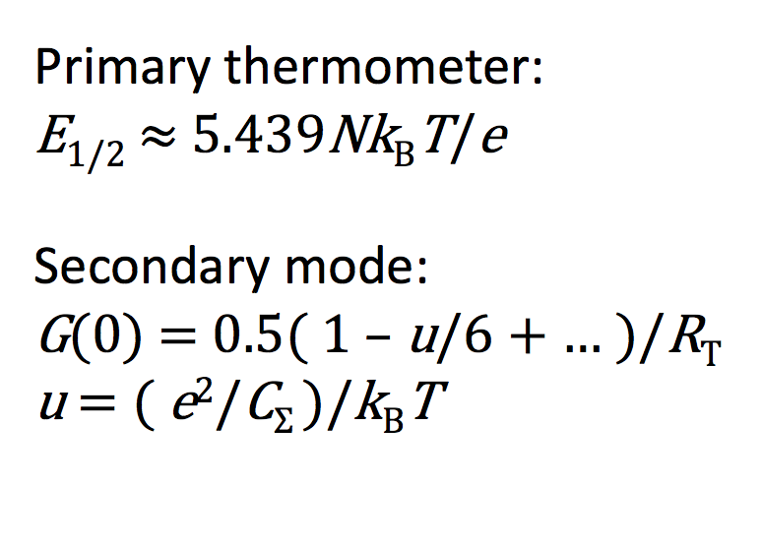
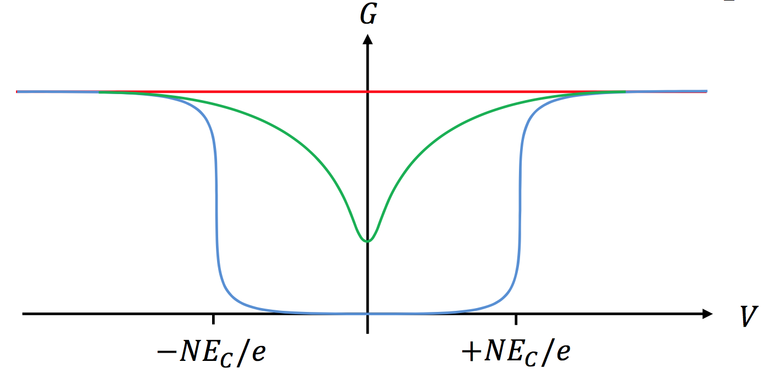
Primary thermometry of nanoelectronic devices
The Coulomb Blockade Thermometer (CBT)
Current through island blocked at low T by finite charging energy.
For current to flow, either T or bias voltage V must increase.

Slide 23
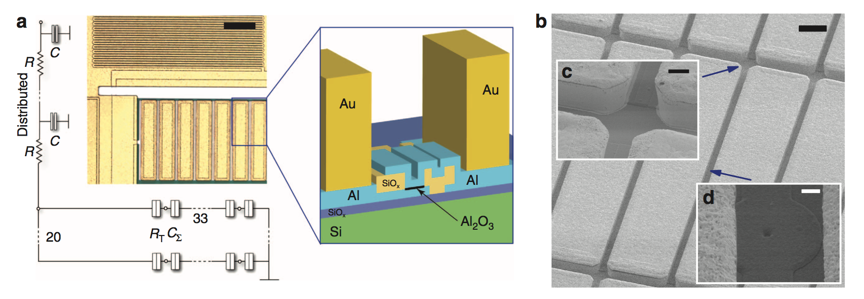
Primary thermometry of nanoelectronic devices
The Coulomb Blockade Thermometer (CBT)

Slide 24
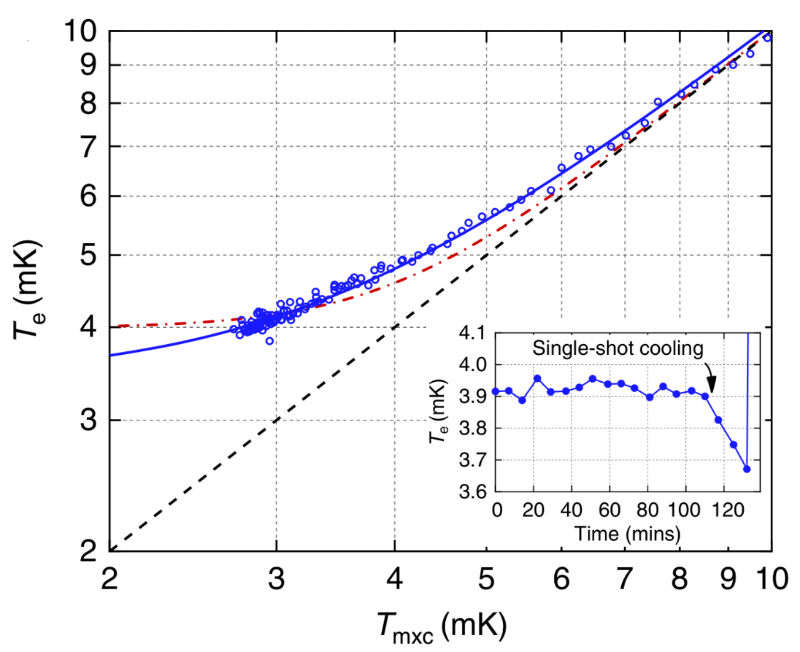
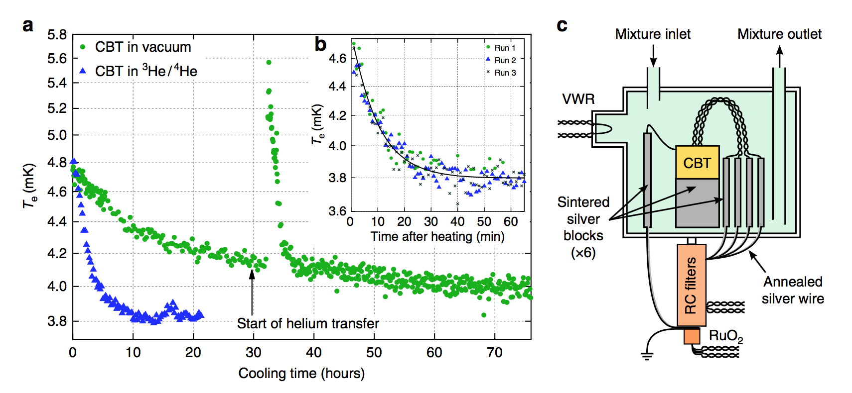

Primary thermometry of nanoelectronic devices
Breaking the “4 mK barrier”

Slide 25
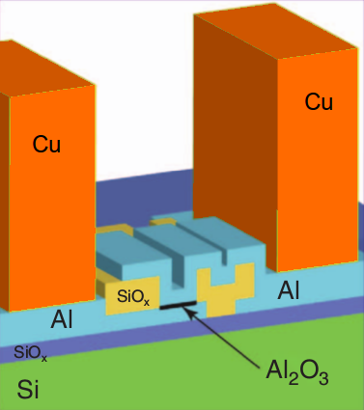

Primary thermometry of nanoelectronic devices
Can we get colder?
Yes! Exploit adiabatic demagnetisation of copper…

Slide 26
Primary thermometry of nanoelectronic devices
Below 1.3mK for almost 1,000 seconds

Slide 27


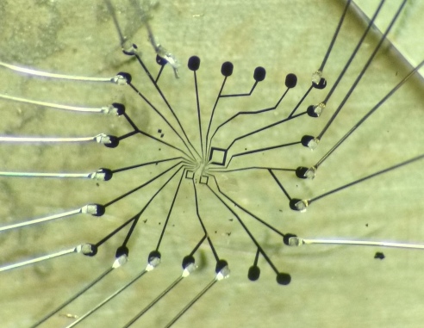
CUEQS
Cryofree Ultra low temperature Environment for Quantum Sensors
Platform
  User-friendly, adjustable, portable instrument for QT sensors
  Use new Cryofree “dry” dilution fridge push-button technology
  New materials and devices to exploit colder environment
Sensors
  Low temperature QT-enhanced devices, eg. qubits, sensors
  Sensors for medical diagnostics, eg. MEG, low field MRI
  Sensors for geo-imaging, eg. oil/gas exploration, utility location
  Superconductor-based quantum information processing
G-SQUID

Slide 28
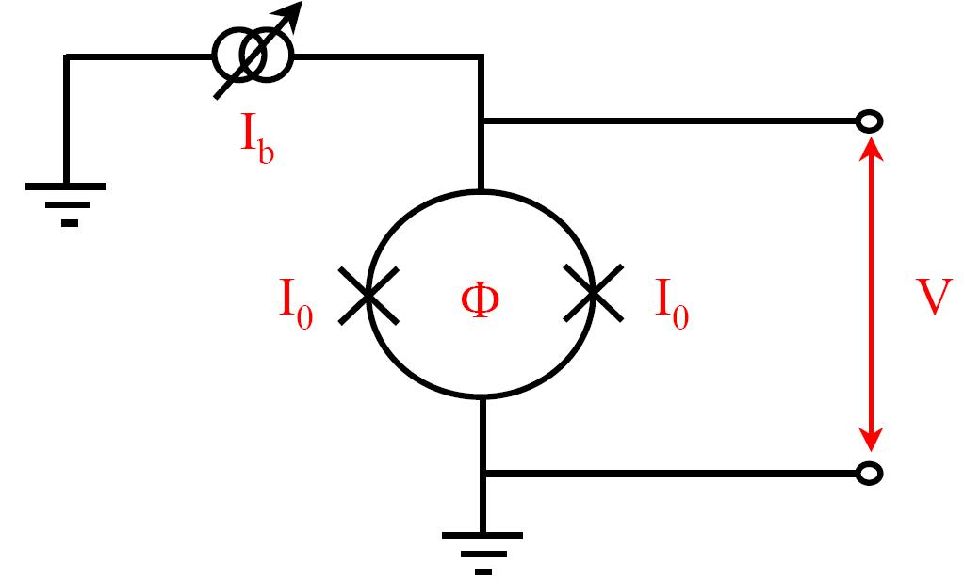
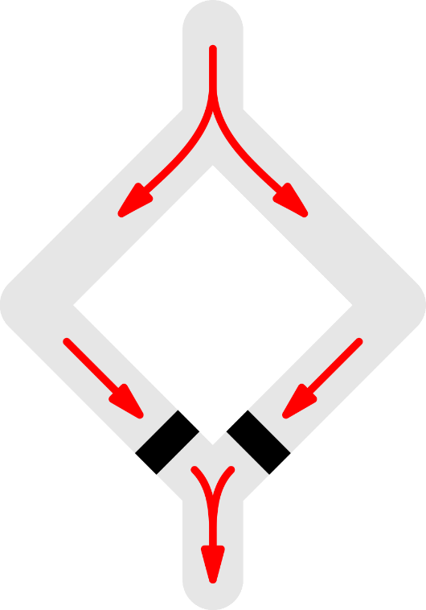
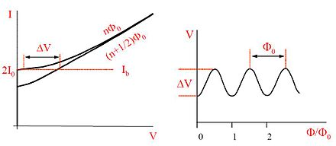
CUEQS
Cryofree Ultra low temperature Environment for Quantum Sensors
Sensor challenge: exploit new platform to outperform traditional magnetometers
SQUID

Slide 29
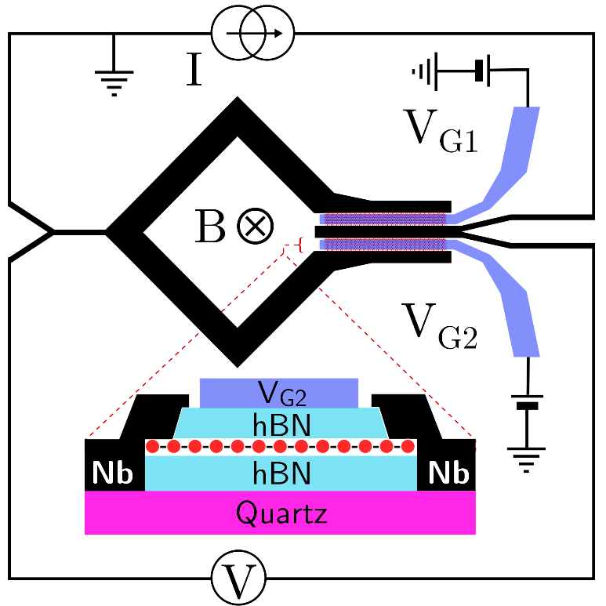
CUEQS
Cryofree Ultra low temperature Environment for Quantum Sensors
Sensor challenge: exploit new platform to outperform traditional magnetometers
Graphene SQUID (DC) - magnetometry
Square loop ~ 12.5 μm x 12.5 μm
Gated SGS Josephson junctions
Monolayer graphene encapsulated by boron nitride
Nb for superconducting leads
Quartz substrate
SQUID
G-SQUID

Slide 30
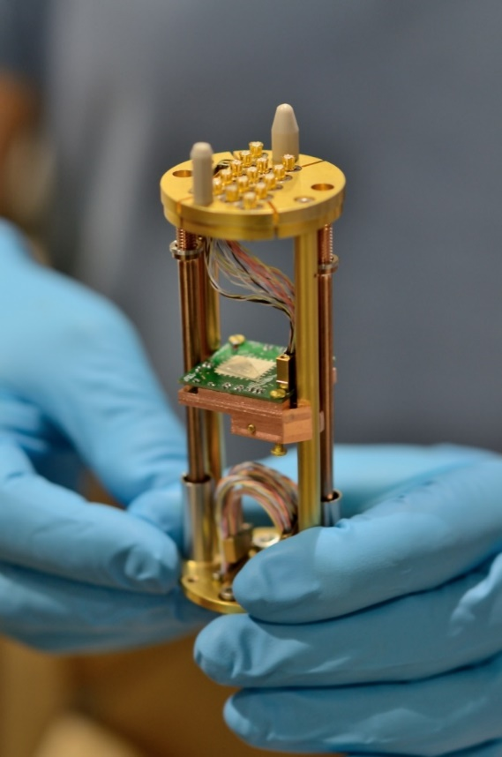
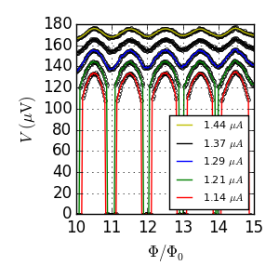


CUEQS
Cryofree Ultra low temperature Environment for Quantum Sensors
I_{c} flux modulation
9 μT ~ 230 μm² , actual 212 μm²
Flux modulation of voltage
620 μT ~ 3.3 μm²
Junction Fraunhofer pattern

Slide 31



CUEQS
Cryofree Ultra low temperature Environment for Quantum Sensors
Changing asymmetry in I_{c}
Square loop ~ 50 μm x 50 μm
Asymmetric arm lengths
Gates alter I_{c} – can create asymmetry in I_{c} to counteract asymmetry in L
Change device from asymmetric to symmetric
Graphene-based tunable SQUIDs
APL: 10.1063/1.4981904

Slide 32


CUEQS
Cryofree Ultra low temperature Environment for Quantum Sensors
Cold electronics for enhanced low noise measurements
Noise problem in measurement chain
Demand for commercial cryogenic low noise electronics
 | Target | Current status
Bandwidth | DC – MHz | DC – MHz
Gain | 40 dB | ≈ 38 dB
Broadband noise (above ≈ 1 kHz) | $\sim$1 nV/√Hz | $\sim$10 nV/√Hz
1/f noise | $<$ 100 nV/√Hz @ 1 Hz | $\sim$1 µV/√Hz @ 1 Hz
Low-frequency performance dominated by 1/f noise of amplifier second stage
Long-term plan to optimise input noise using custom fabricated FETs

Slide 33








Thank you!
Rich Haley ECD Oct 2019

Slide 34
Available Cryostats / Sample Environment:
15 Microkelvin demagnetisation refrigerators
30 dilution refrigerators (dry & wet)
Rotating cryostats, high frequencies,
strong magnetic fields, clean rooms, …
Become a User:
www.emplatform.eu
User Access to EMP
Access to EMP facilities free of charge
Travel and local expenses are covered
Logistical and technical support
About EMP
Provide access to low temperatures
across communities
Drive forward inter-related areas of quantum materials, nanoscience, and quantum technology
Generate knowledge, applications, and commercial opportunities

