Slide 1

Cryogenics for the ESS Superconducting Linac
Jaroslaw Fydrych and Xilong Wang
European Spallation Source ERIC
ECD, Lund, Sweden, 07th Oct, 2019

Slide 2
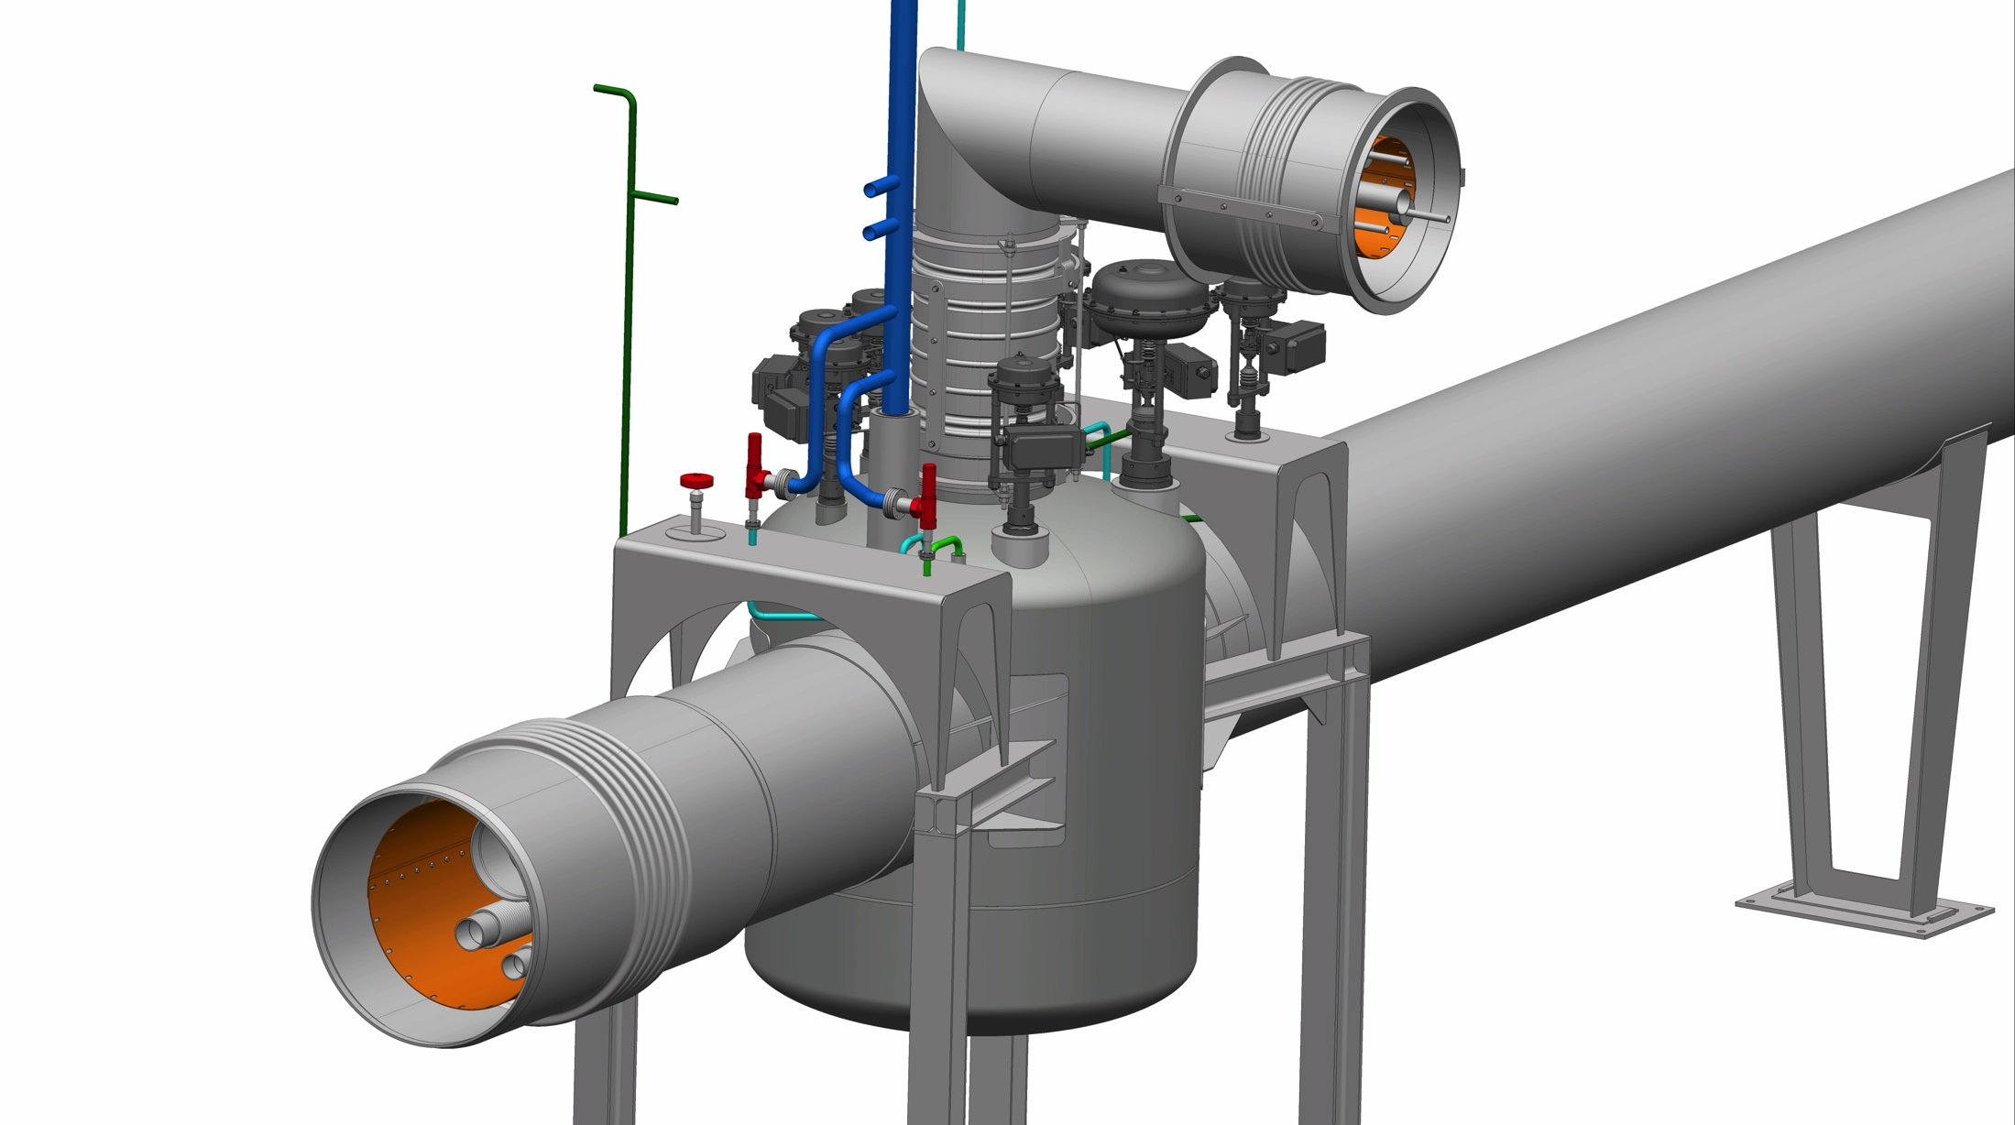
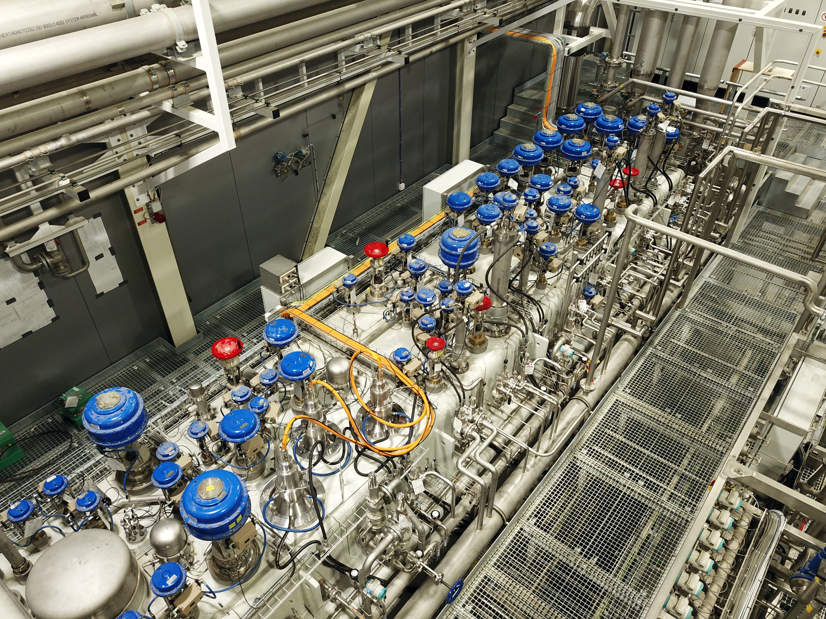
Outline
Introduction to the Linac cryogenic system
Cryogenic Distribution System
    2.1. Specification and design
    2.2. Collaboration with in-kind partners
    2.3. Current status and next actions
Accelerator Cryogenic Plant
    3.1. Specification
    3.2. Current status
    3.3. Selected issues

Slide 3
ESS Cryogenic System Block Diagram
Pure Helium
Gas Storage
Standalone Helium Purifier
Helium Recovery System
Cryogenic System for Linac
Target Moderator
Cryoplant
Accelerator
Cryoplant
20 m³ LHe Tank
5 m³
LHe Tank
Test & Instrument Cryoplant
Target Cryodistribution System
Test Stand Cryodistribution System
LHe Mobile Dewars
Cryodistribution System for Elliptical Linac
Cryodistribution System for
Spoke Linac
Hydrogen Circulation Box
LN2 Storage Tanks
Elliptical
Cryomodules
Spoke
Cryomodules
LN2 Mobile Dewars
Instruments & Experiments
Lund Test
Stand 2
Hydrogen Moderator

Slide 4
Layout of the ESS Linac Cryogenic System
ACCP
Cryogenic
Transfer
Line (65 m)
Cryogenic Distribution Line (310 m)
comprising 43 valve boxes
Auxiliary process lines
Splitting
box
Endbox
21 High-Beta
Cryomodules
(174 m)
9 Medium-Beta
Cryomodules
(75 m)
13 Spoke
Cryomodules
(54 m)
Cryogenic Distribution System for the ESS linac is intended for delivering the cooling power from the Accelerator Cryogenic Plant (ACCP) to the cryomodules by means of the constant flows of supercritical helium at 4.5 K and 3 bar(a) and cold gaseous helium at 40 K and 19.5 bar(a).

Slide 5
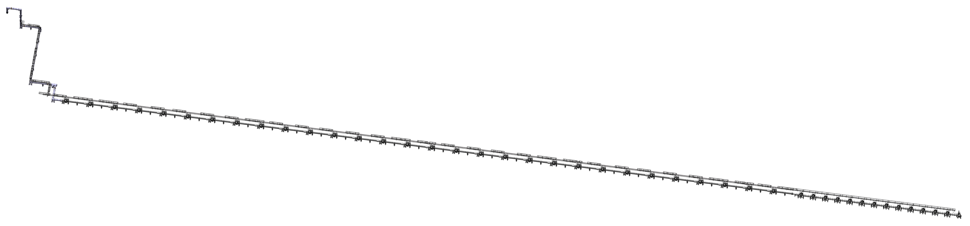
Layout of the ESS Linac Cryogenic System
ACCP
CDS-EL
CDS-SPK
Cryogenic
Transfer
Line (65 m)
CDS-EL CDL (250 m)
comprising 30 valve boxes
CDS-SPK CDL (60 m)
comprising 13 valve boxes
Auxiliary process lines
Splitting
box
Endbox
Interface
with ACCP
30 Elliptical
Cryomodules
13 Spoke
Cryomodules
Interface
with vacuum pumps
Interfaces
with control system
Interface
between CDS-EL
and CDS-SL
Interfaces with
21 HB CMs
Interfaces
with Linac tunnel flour and ceiling
Interface with
CDS Vent Line
Interfaces
with 9 MB CMs
Interface
to 13 SPK CMs

Slide 6
Linac CDS - General flow scheme
Elliptical cryomodules
Spoke cryomodules
Two main cryogenic circuits:
- thermal shield circuit (TS supply and TS return lines)
- cold helium circuit (Helium supply and VLP lines)

Slide 7
Valve Box flow scheme diagram
Valve box
for the elliptical cryomodule
The heat exchanger,
JT and filling valves are
in the cryomodule!

Slide 8
Valve Box flow scheme diagram
Valve box
for the spoke cryomodule
The heat exchanger,
JT and filling valves are
in the valve box!

Slide 9




Partners
ESS Cryodistribution is being provided
as two separated in-kind contributions.
WUST from Poland provides the design, procurement, manufacturing, transport and installation of the CDS for Elliptical Linac (and the CDS for Lund Test Stand 2).
CNRS/IPNO from France provides
the design, manufacturing, transport and installation of the CDS for Spoke Linac.

Slide 10
Technical documentation developed at ESS
- Lists of requirements
Main general requirements
adequate to ensure smooth operation throughout the expected lifetime of 45 years,
suitable for continuous operation (with limited scheduled interruptions only) to meet top-level requirement of 95 % availability of the linac itself,
ensure no deterioration of thermal and mechanical properties within the operation lifetime,
must allow for the separation of a single cryomodule from the cryodistribution line,
must allow for the warm-ups and cool-downs of a single cryomodule, while keeping the rest of the system at cryogenic temperatures,
must comply with Swedish and European legislation concerning occupational health, safety and environmental protection,
Main technical requirements
heat loads not higher than 420 W and 3.66 kW to the cold helium circuit and thermal shield, respectively,
supercritical helium temperature below 5.2 K in the interfaces to the cryomodules at nominal operation conditions,
vacuum insulation below 10⁻⁶ mbar at nominal working condition (below 5·10⁻³ mbar at ambient temperature with active vacuum pumping),
integral helium leak rate below 1⋅10⁻⁷ mbar⋅l/sec from the helium circuit to the vacuum,
tightness of the valve seats ≤ 1⋅10⁻⁴ mbar⋅l/sec,
200 full thermal cycles,
all materials and components must tolerate the radiation dose of 5⋅10⁵ Gy,
Total number of
technical requirements: 228!

Slide 11
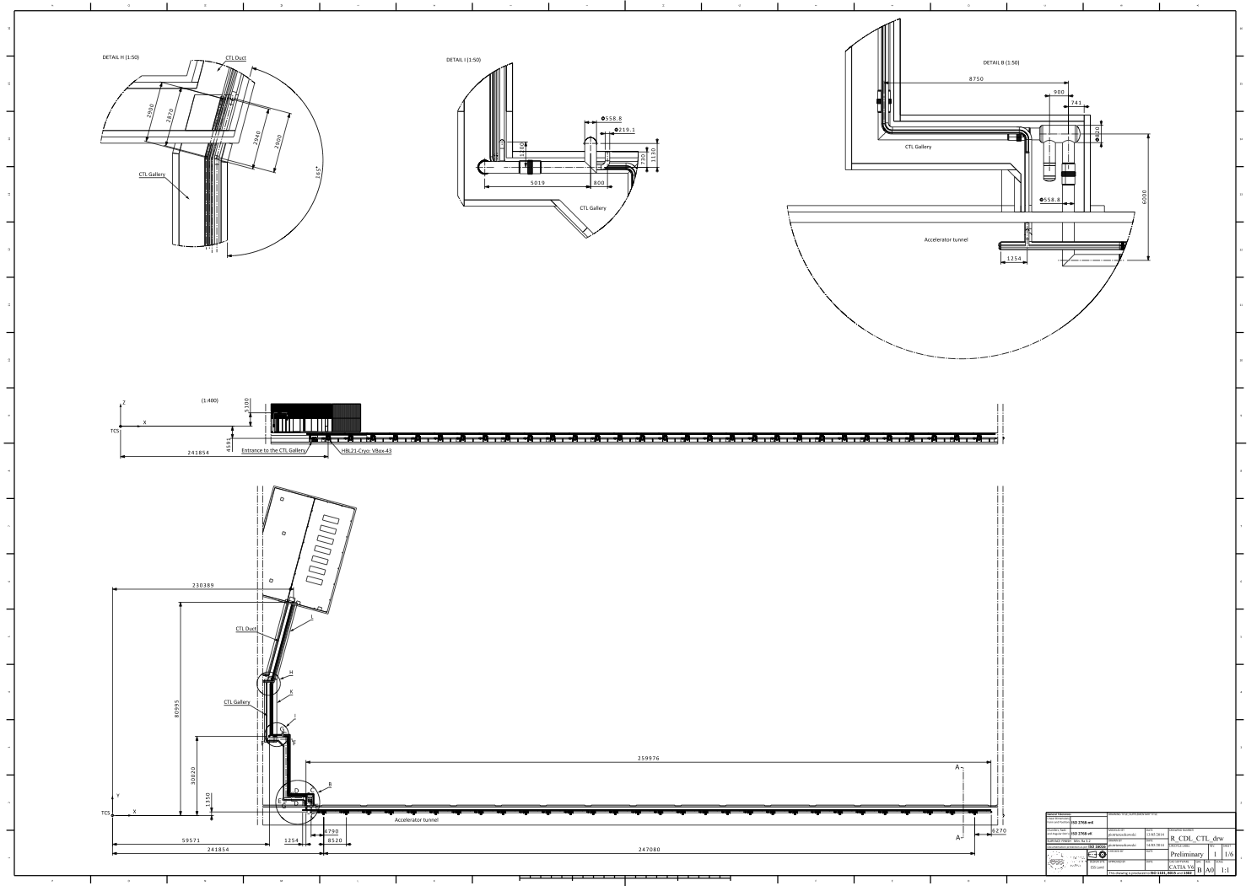
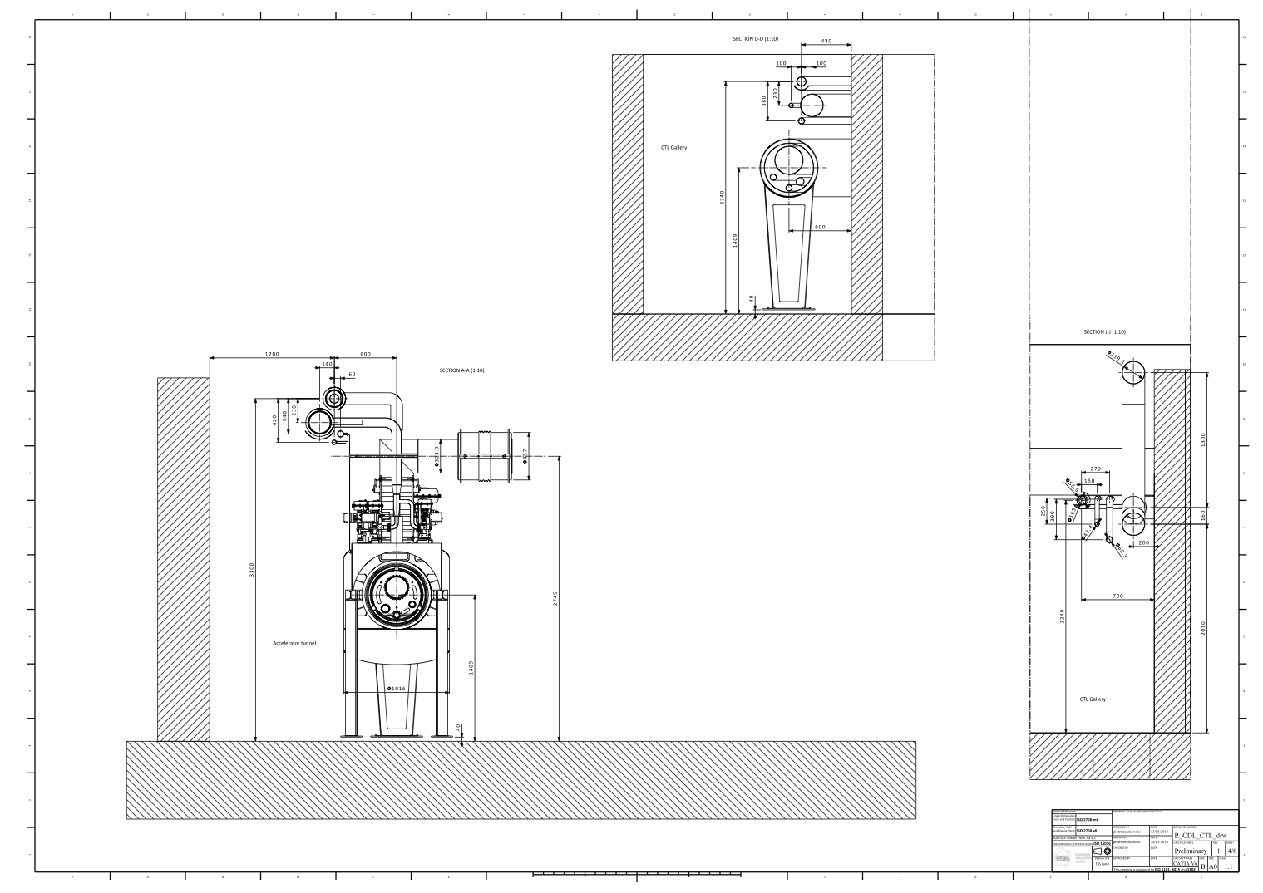
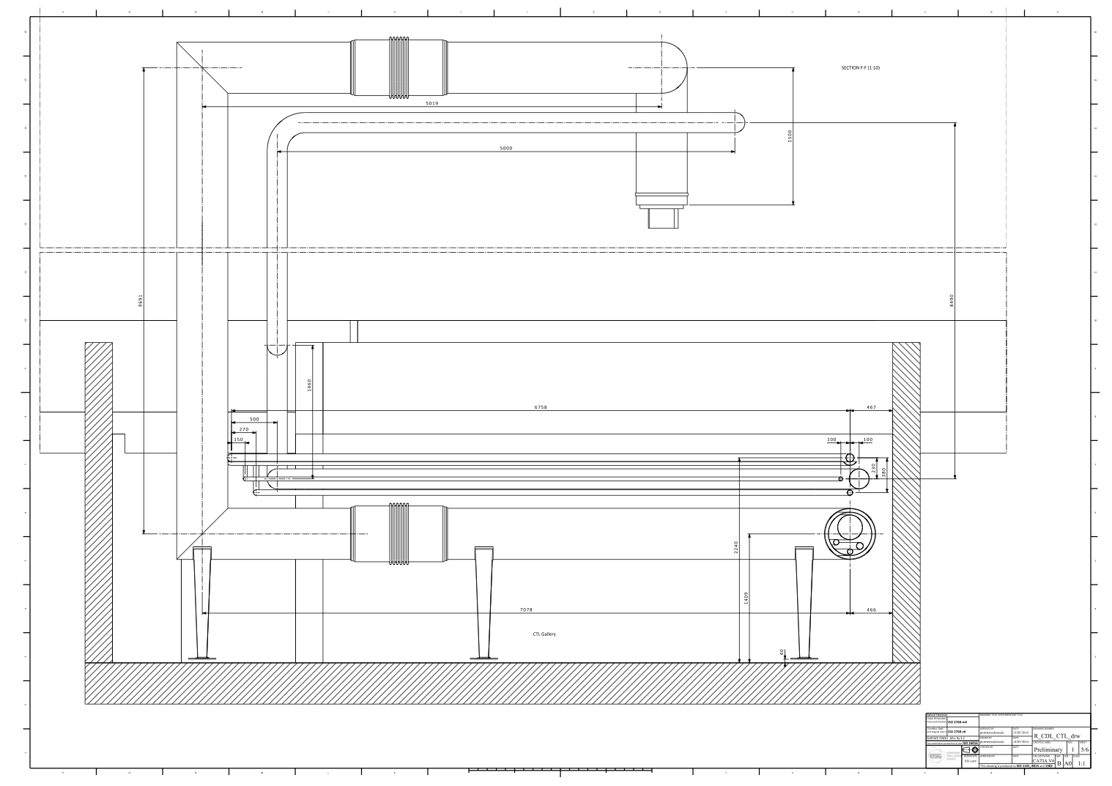
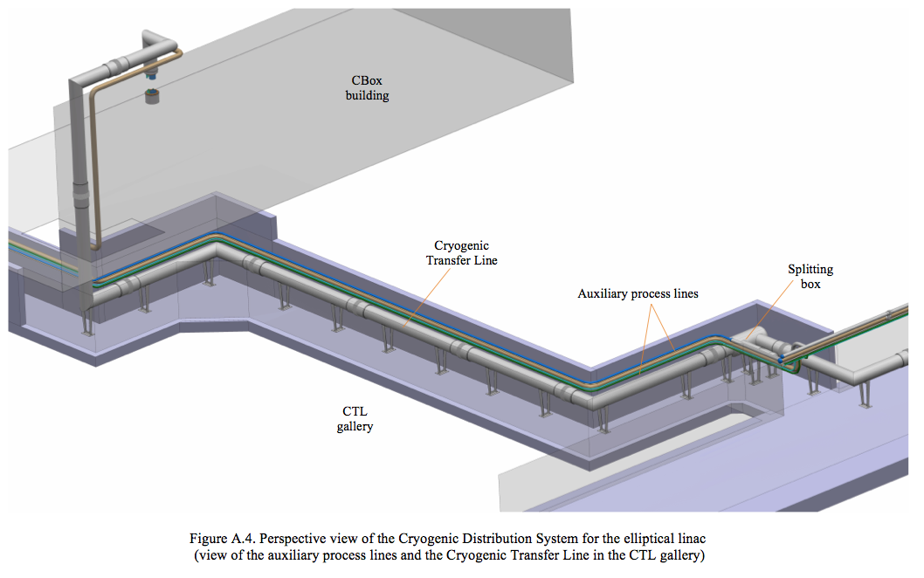
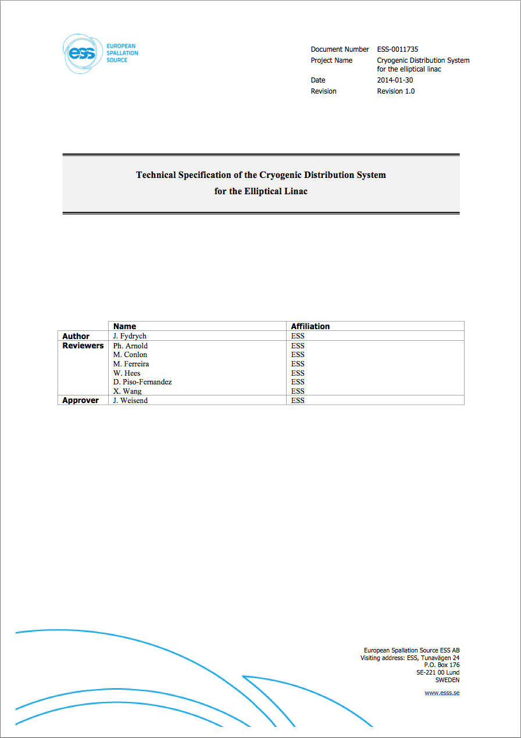
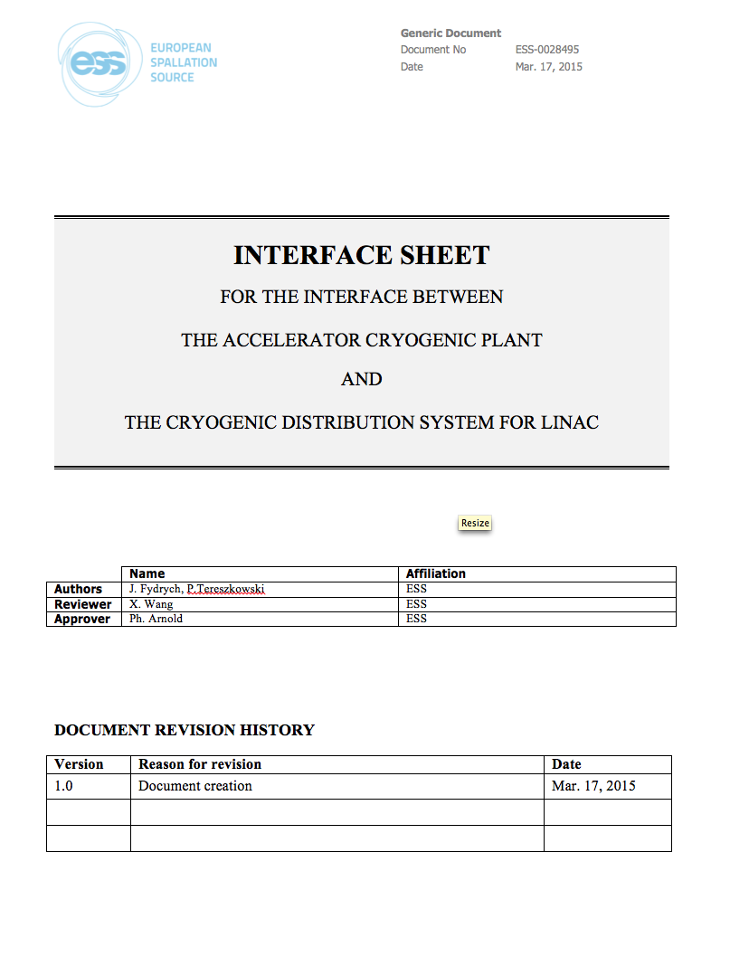
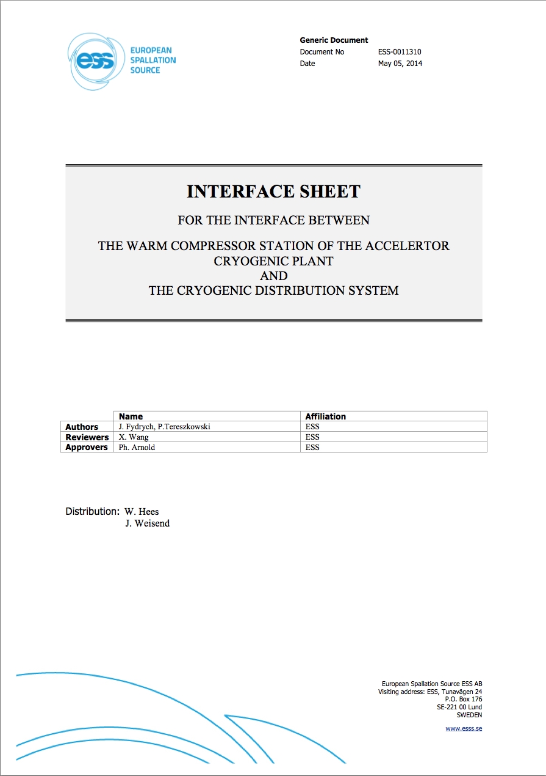
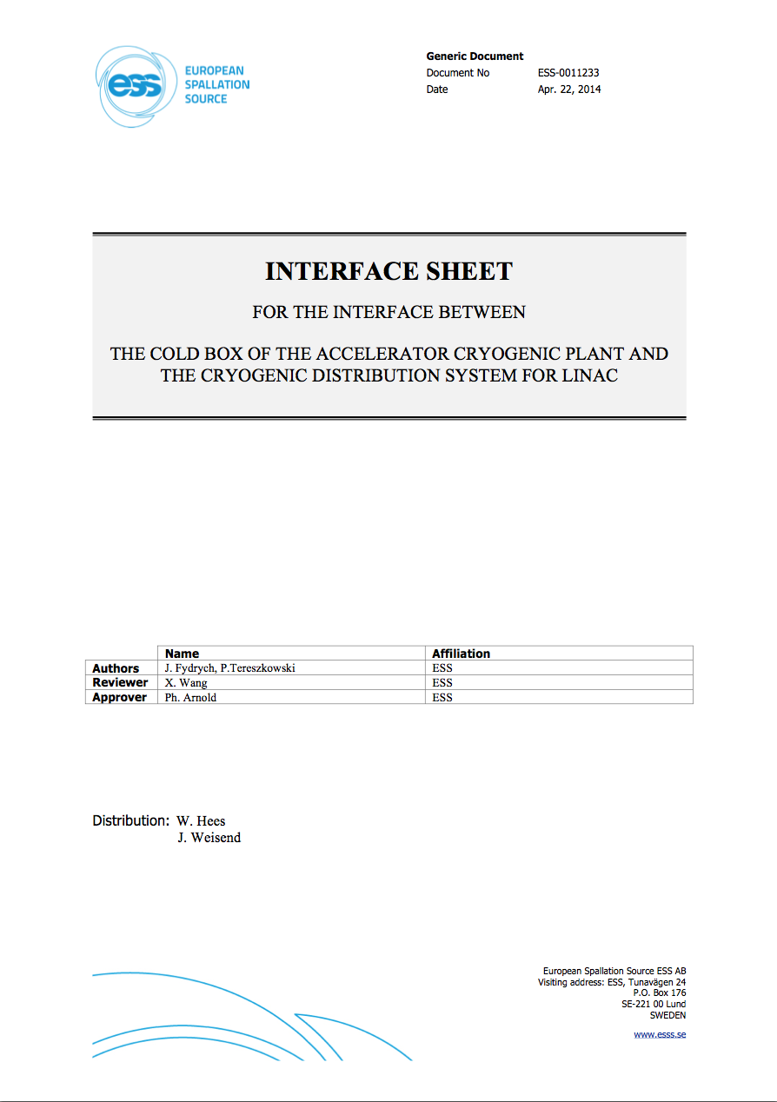
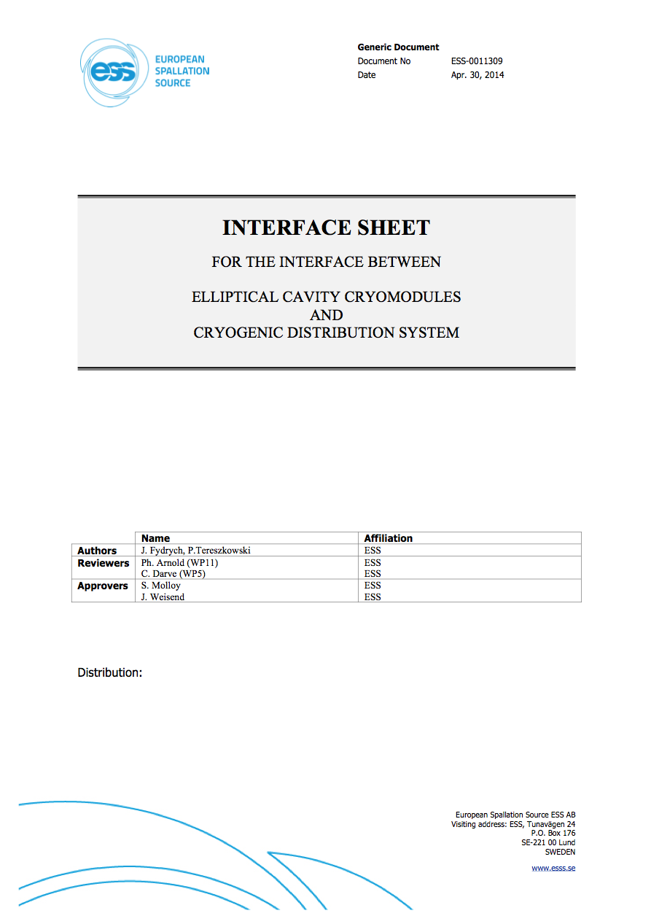
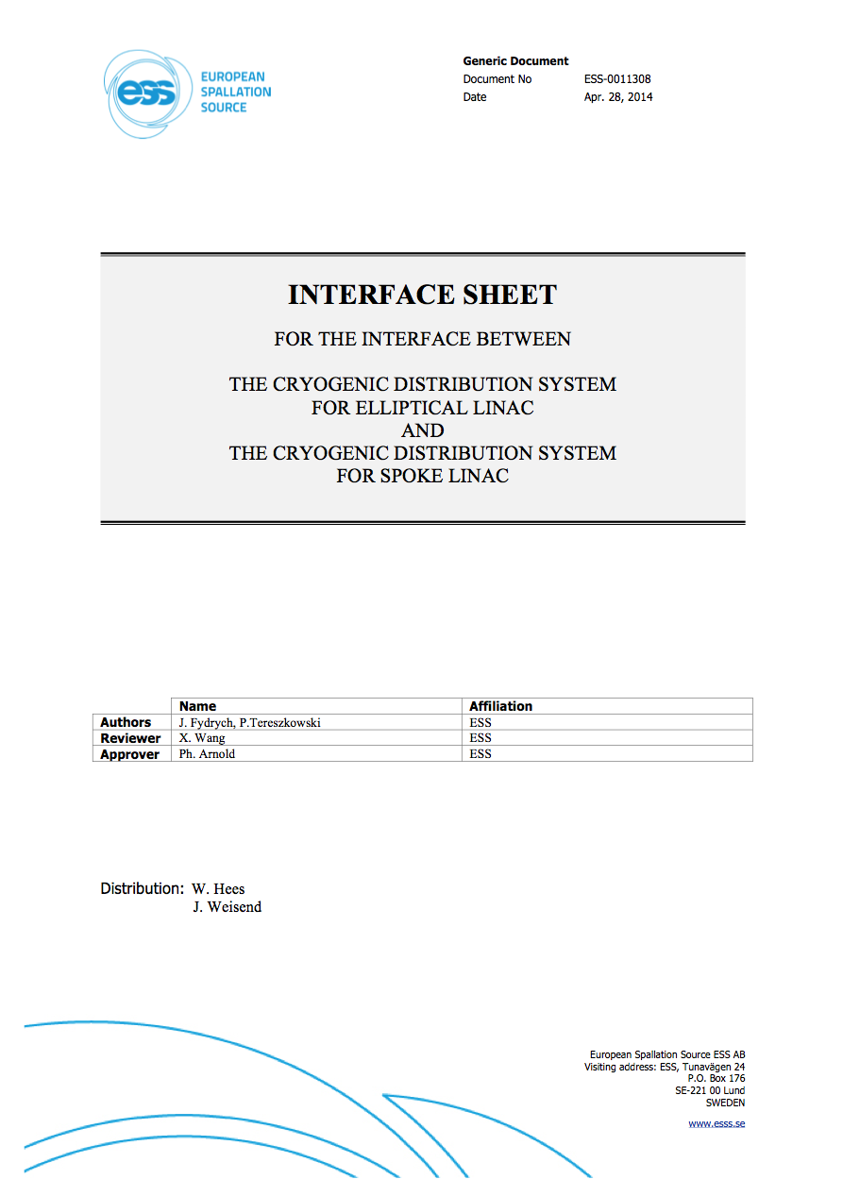
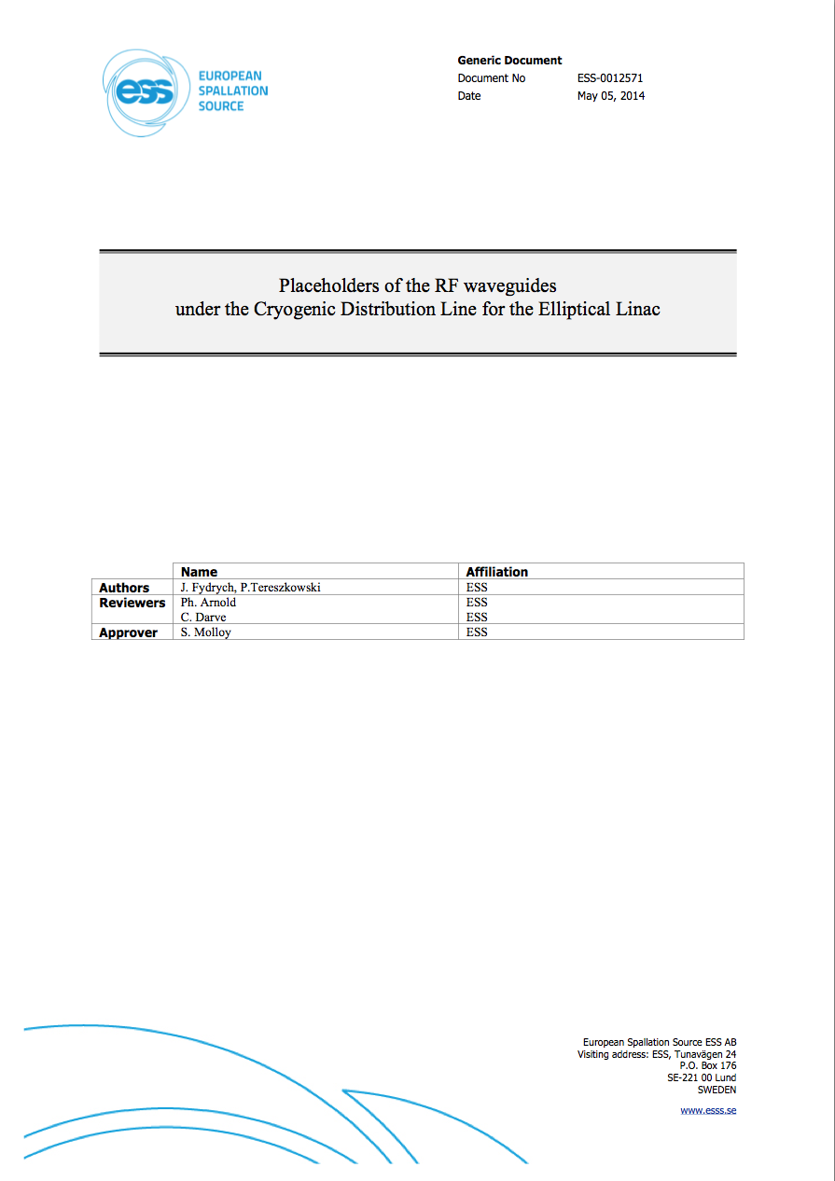
Technical documentation developed at ESS
- Specifications
ESS-0011735: Technical Specification of the Cryogenic Distribution System for the Elliptical Linac
ESS-0028495: Interface between the ACCP and the CDS
ESS-0011309: Interface between the CDS and the elliptical cavity cryomodules
ESS-0011308: Interface between the CDS for the elliptical linac and for the CDS for the spoke linac
ESS-0012571: Location of the wave guides under the Cryogenic Distribution Line for the elliptical linac
Appendix A. Perspective view of the CDS for the elliptical linac
Appendix B. Routing and overall dimensions of the CDS for the elliptical linac

Slide 12
Technical documentation developed at ESS
- Conceptual design

Slide 13
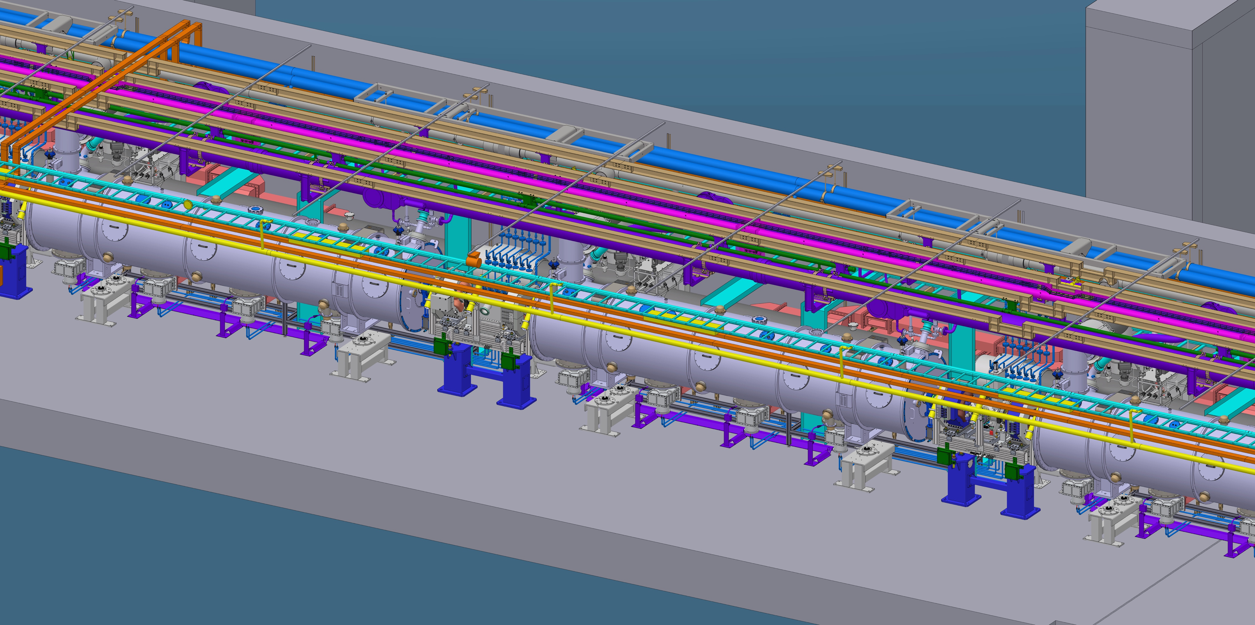
3D model of the Elliptical Linac section
transportation pathway

Slide 14
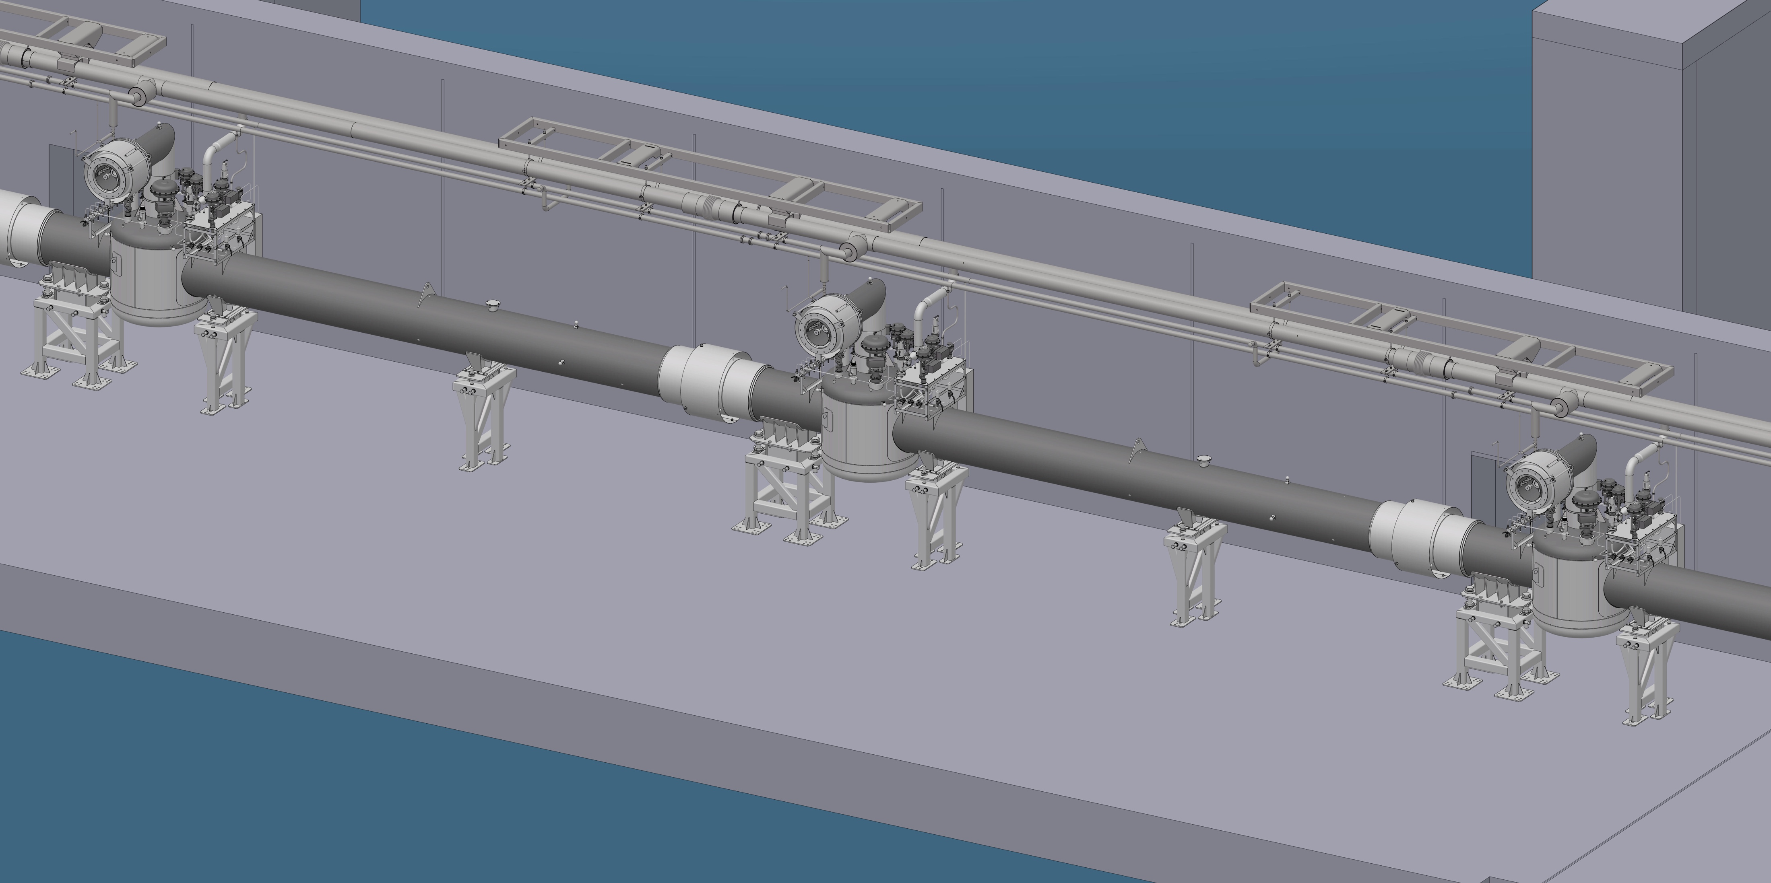
3D model of the CDS-EL
CDS-EL detailed design developed by WUST,
in the scope of Polish in-kind contribution
to the ESS Accelerator Project.

Slide 15
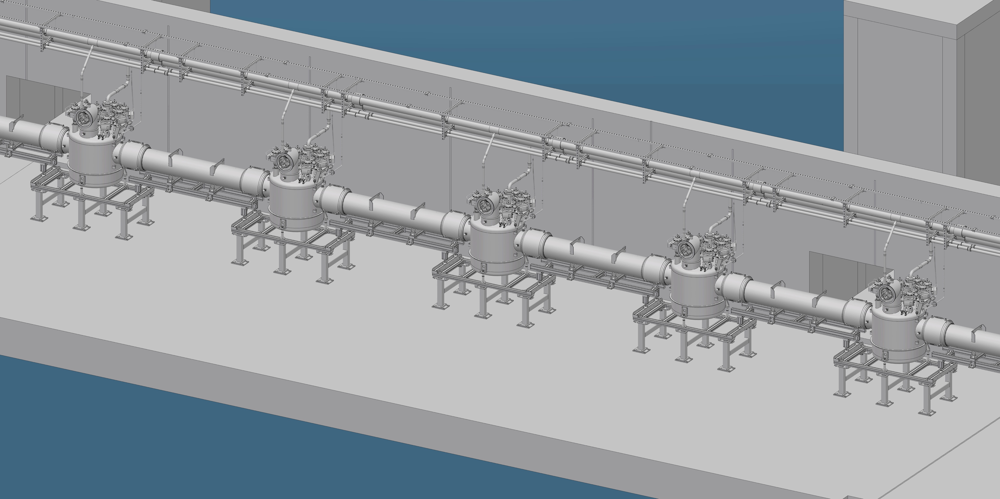
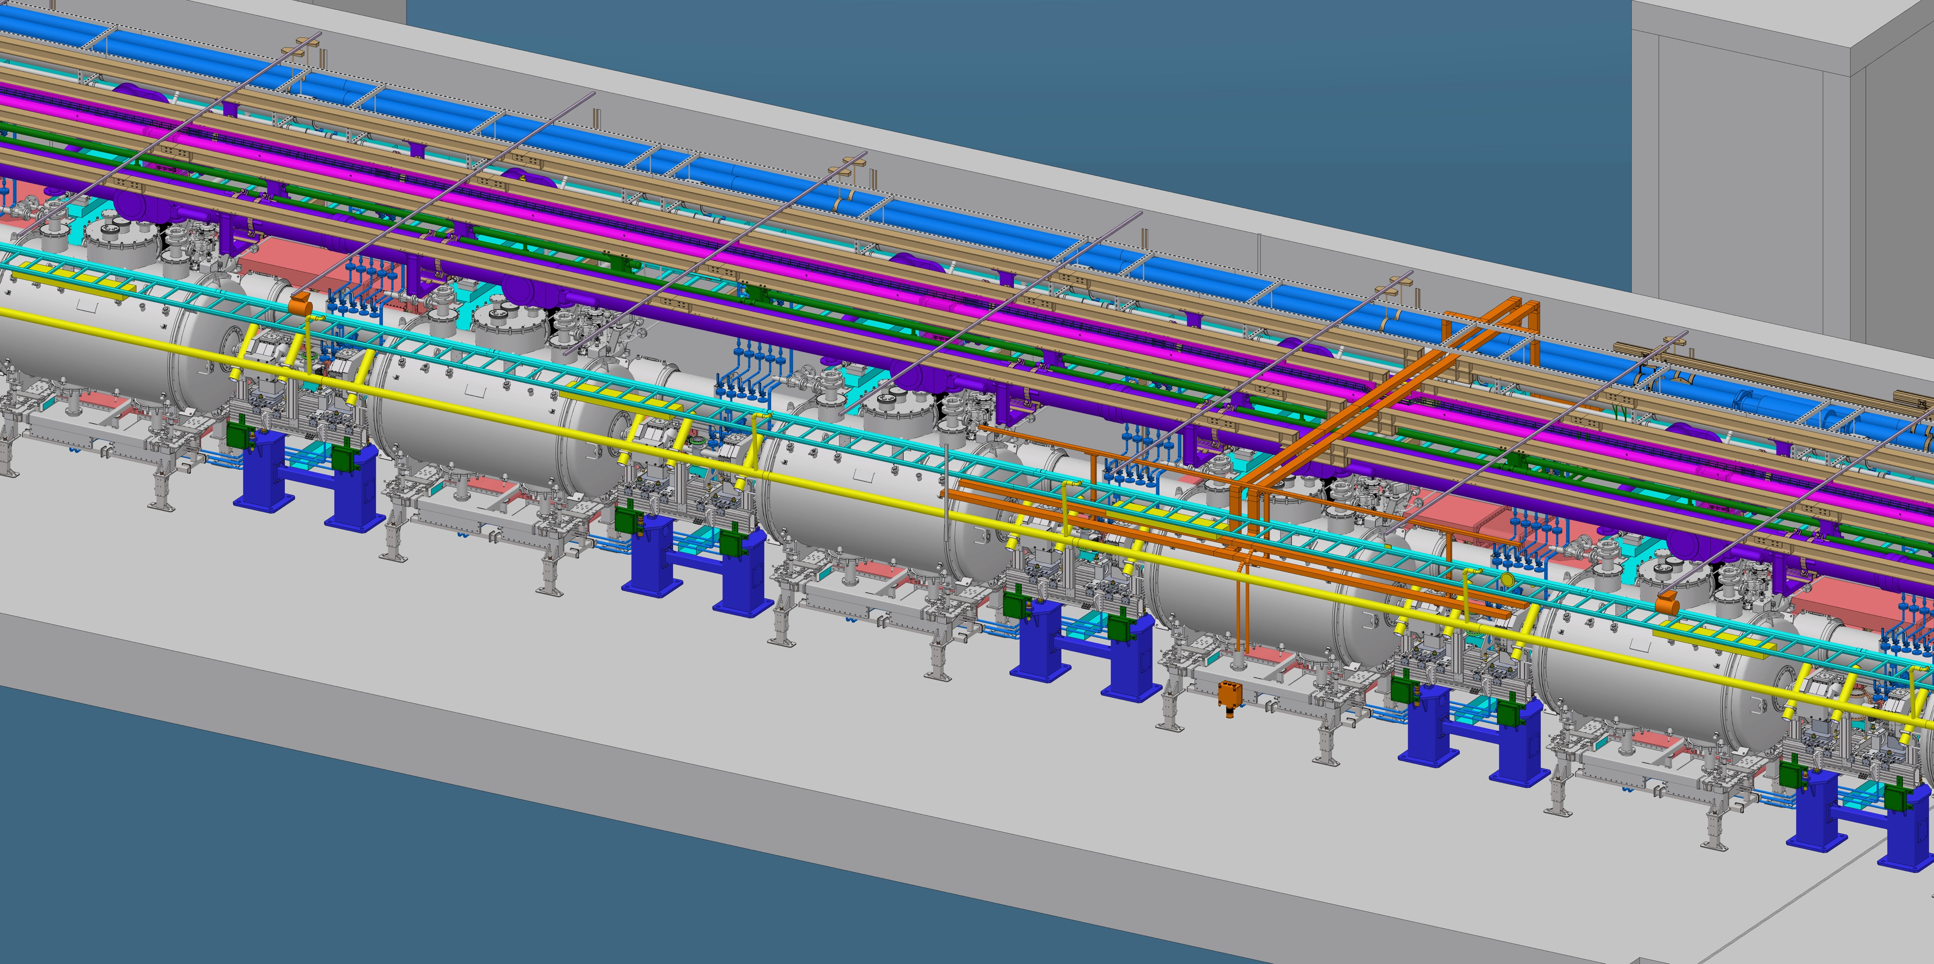
3D model of the Spoke Linac section
transportation pathway

Slide 16
3D model of the CDS-SPK
CDS-SPK detailed design developed by IPNO,
in the scope of French in-kind contribution
to the ESS Accelerator Project.

Slide 17
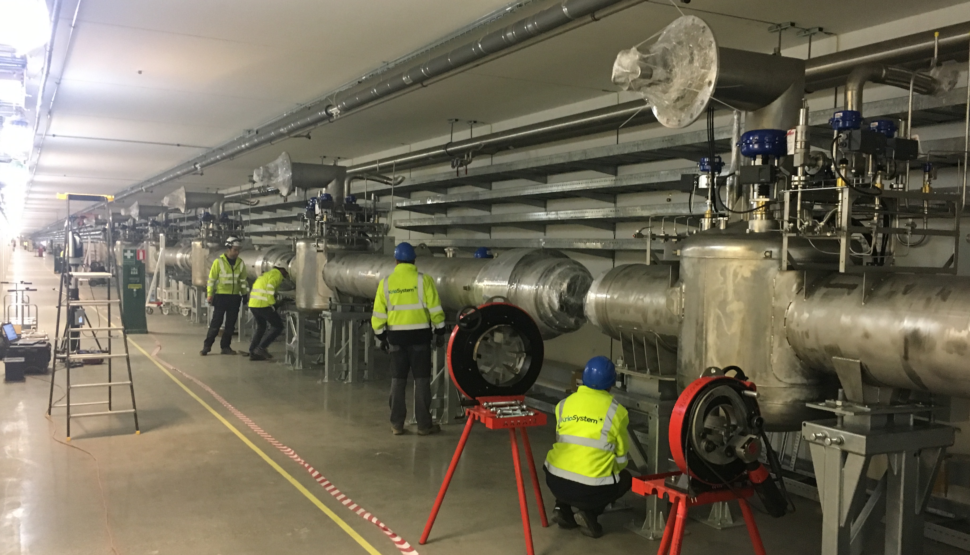
Current status of the CDS project
CDS-EL CTL
11 CTL sections manufactured (92%)
5 CTL sections ready to be installed
in Week 42
CDS-EL VBoxes
28 Vboxes manufactured (93%)
27 VBoxes installed and positioned (90%)
24 interconnections welded (80%)
17 auxiliary line sections installed (57%)
CDS-SPK
VBoxes under manufacturing
End Box under manufacturing
Auxiliary Lines manufacturing contracted
CDS-SPK installation activities contracted
Installation of the CDS-EL VBoxes carried out
by the WUST’s contractor, KRIOSYSTEM, Poland

Slide 18
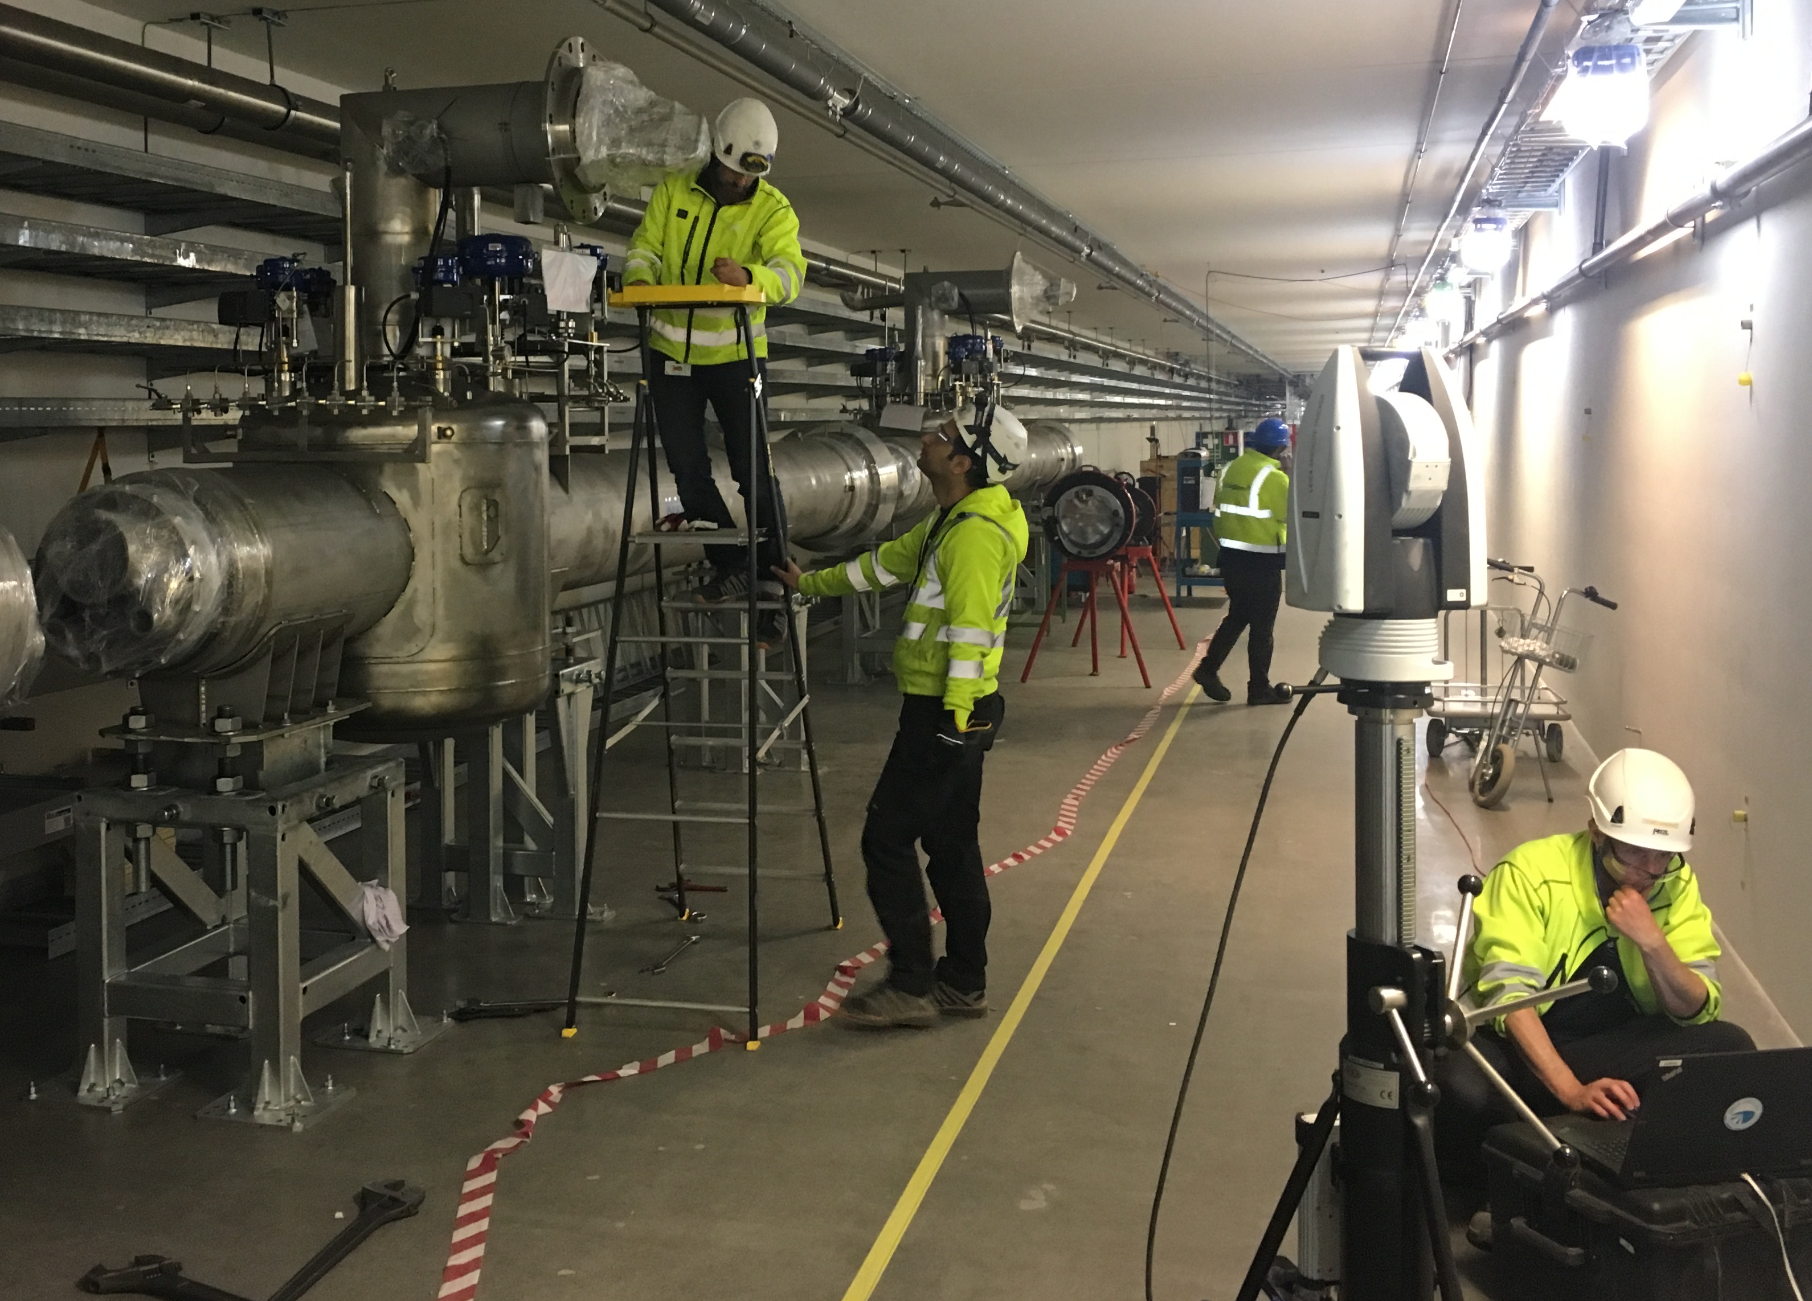
Current status of the CDS project
CDS-EL CTL
11 CTL sections manufactured (92%)
5 CTL sections ready to be installed
in Week 42
CDS-EL VBoxes
28 Vboxes manufactured (93%)
27 VBoxes installed and positioned (90%)
24 interconnections welded (80%)
17 auxiliary line sections installed (57%)
CDS-SPK
VBoxes under manufacturing
End Box under manufacturing
Auxiliary Lines manufacturing contracted
CDS-SPK installation activities contracted
Positioning of the CDS-EL VBoxes carried out
by the ESS Survey and Alignment team

Slide 19
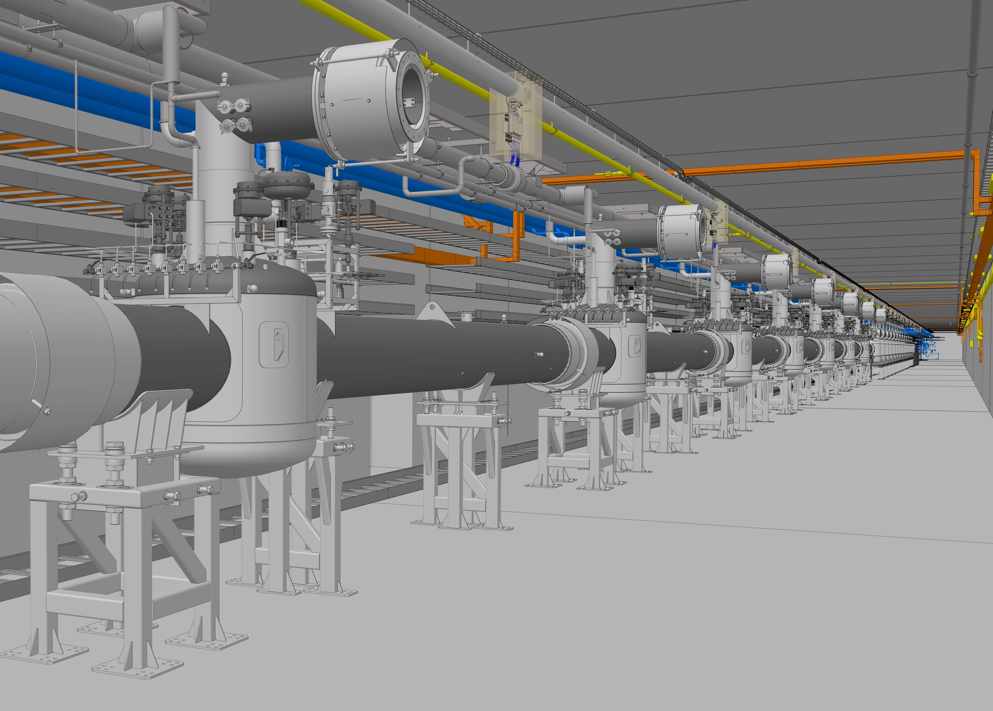
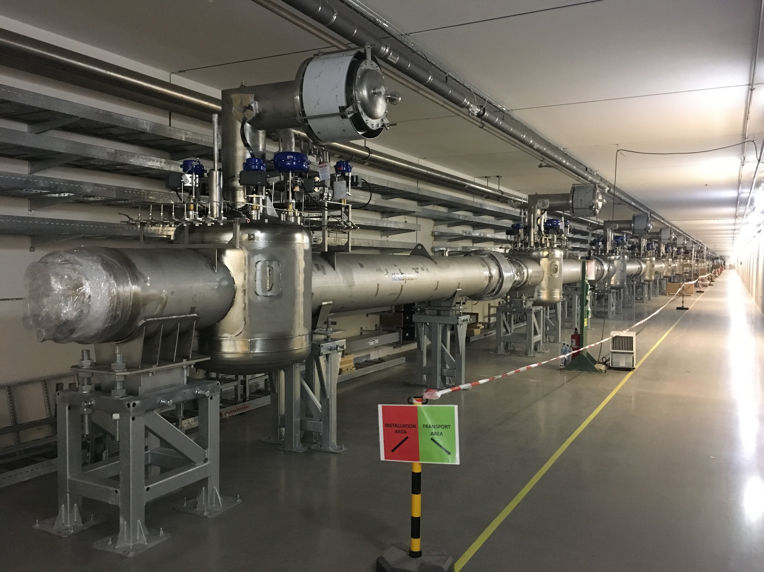
Current status of the CDS project
MBL section of the CDS-EL – in the detailed 3D model…
… and in real life!
27 of the 30 CDS-EL Valve Boxes installed and positioned in the tunnel,
in accordance to the ESS Linac Installation Plan!

Slide 20
Towards completion of the CDS project
CDS-EL
Finish of the CDS-EL installation
in Dec 2019
CDS-SPK installation
from Dec 2019 to Feb 2020
Commissioning of both CDS-EL and CDS-SPK in March 2020
CDS-SPK

Slide 21
ESS Cryogenic System Block Diagram
Pure Helium
Gas Storage
Standalone Helium Purifier
Helium Recovery System
  ACCP
Target Moderator
Cryoplant
Accelerator
Cryoplant
20 m³ LHe Tank
5 m³
LHe Tank
Test & Instrument Cryoplant
Target Cryodistribution System
Test Stand Cryodistribution System
LHe Mobile Dewars
Cryodistribution System for Elliptical Linac
Cryodistribution System for
Spoke Linac
Hydrogen Circulation Box
LN2 Storage Tanks
Elliptical
Cryomodules
Spoke
Cryomodules
LN2 Mobile Dewars
Instruments & Experiments
Lund Test
Stand 2
Hydrogen Moderator

Slide 22
ACCP - Specification
Heat loads:
  3 kW @ 2 K, 9 g/s @ 4.5 K and 11380 W @ 40 -50 K
Continuous operation:
  24 h per day / 7 days per week
  2 years without scheduled shut-down
Availability: > 99 % not count utilities & process control
Two stages and four main operation modes each stage
  ND, NTD, TS SB, 4.5 K SB, Max. Liquefaction mode

Slide 23
ACCP – System Features
Three warm compressors, six turbines, three cold compressors and several bunches of plate fin heat exchangers
Mixed compression cycle at 2 K plus helium guard system for SP compressor
Capacity control
  Floating pressure cycle for HP compressor
  VFD for SP, LP compressors and CCs
  Exchange of CCs flow parts
All built-in acceptance test equipment
Energy recovery

Slide 24
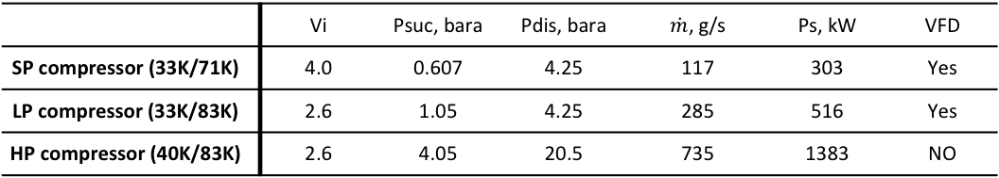
ACCP – System Parameters
Main electrical power | 2.37 MW
Power at 4.5 K equivalent | ~9 kW with exergy efficiency 25.9%
 | Vi | Psuc, bara | Pdis, bara | $\dot{m}$, g/s | Ps, kW | VFD
SP compressor (33K/71K) | 4.0 | 0.607 | 4.25 | 117 | 303 | Yes
LP compressor (33K/83K) | 2.6 | 1.05 | 4.25 | 285 | 516 | Yes
HP compressor (40K/83K) | 2.6 | 4.05 | 20.5 | 735 | 1383 | NO
Impurity removal (ORS/dryer/cryogenic adsorbers) | Oil | BOR (1000 ppm) - Coalscer in skid (10 ppm) - FOR (0.5 ppm Aerosols and 10 ppb Vapour)
 | Water | One bed on line dryer (0.1 ppmv)
 | Air | Two 80 K Adsorbers (73 K, 20 bar) and one 20 K adsorber (24 K, 20 bar)
Liquid He storage | 20’000 Dewar (2.2 tons) + Subcooler in cold box (1500 liter)
Warm He storage tank | 14 X 70 m³ at 20 bar (2.7 tons) (CMs + CDS + ACCP in total)

Slide 25
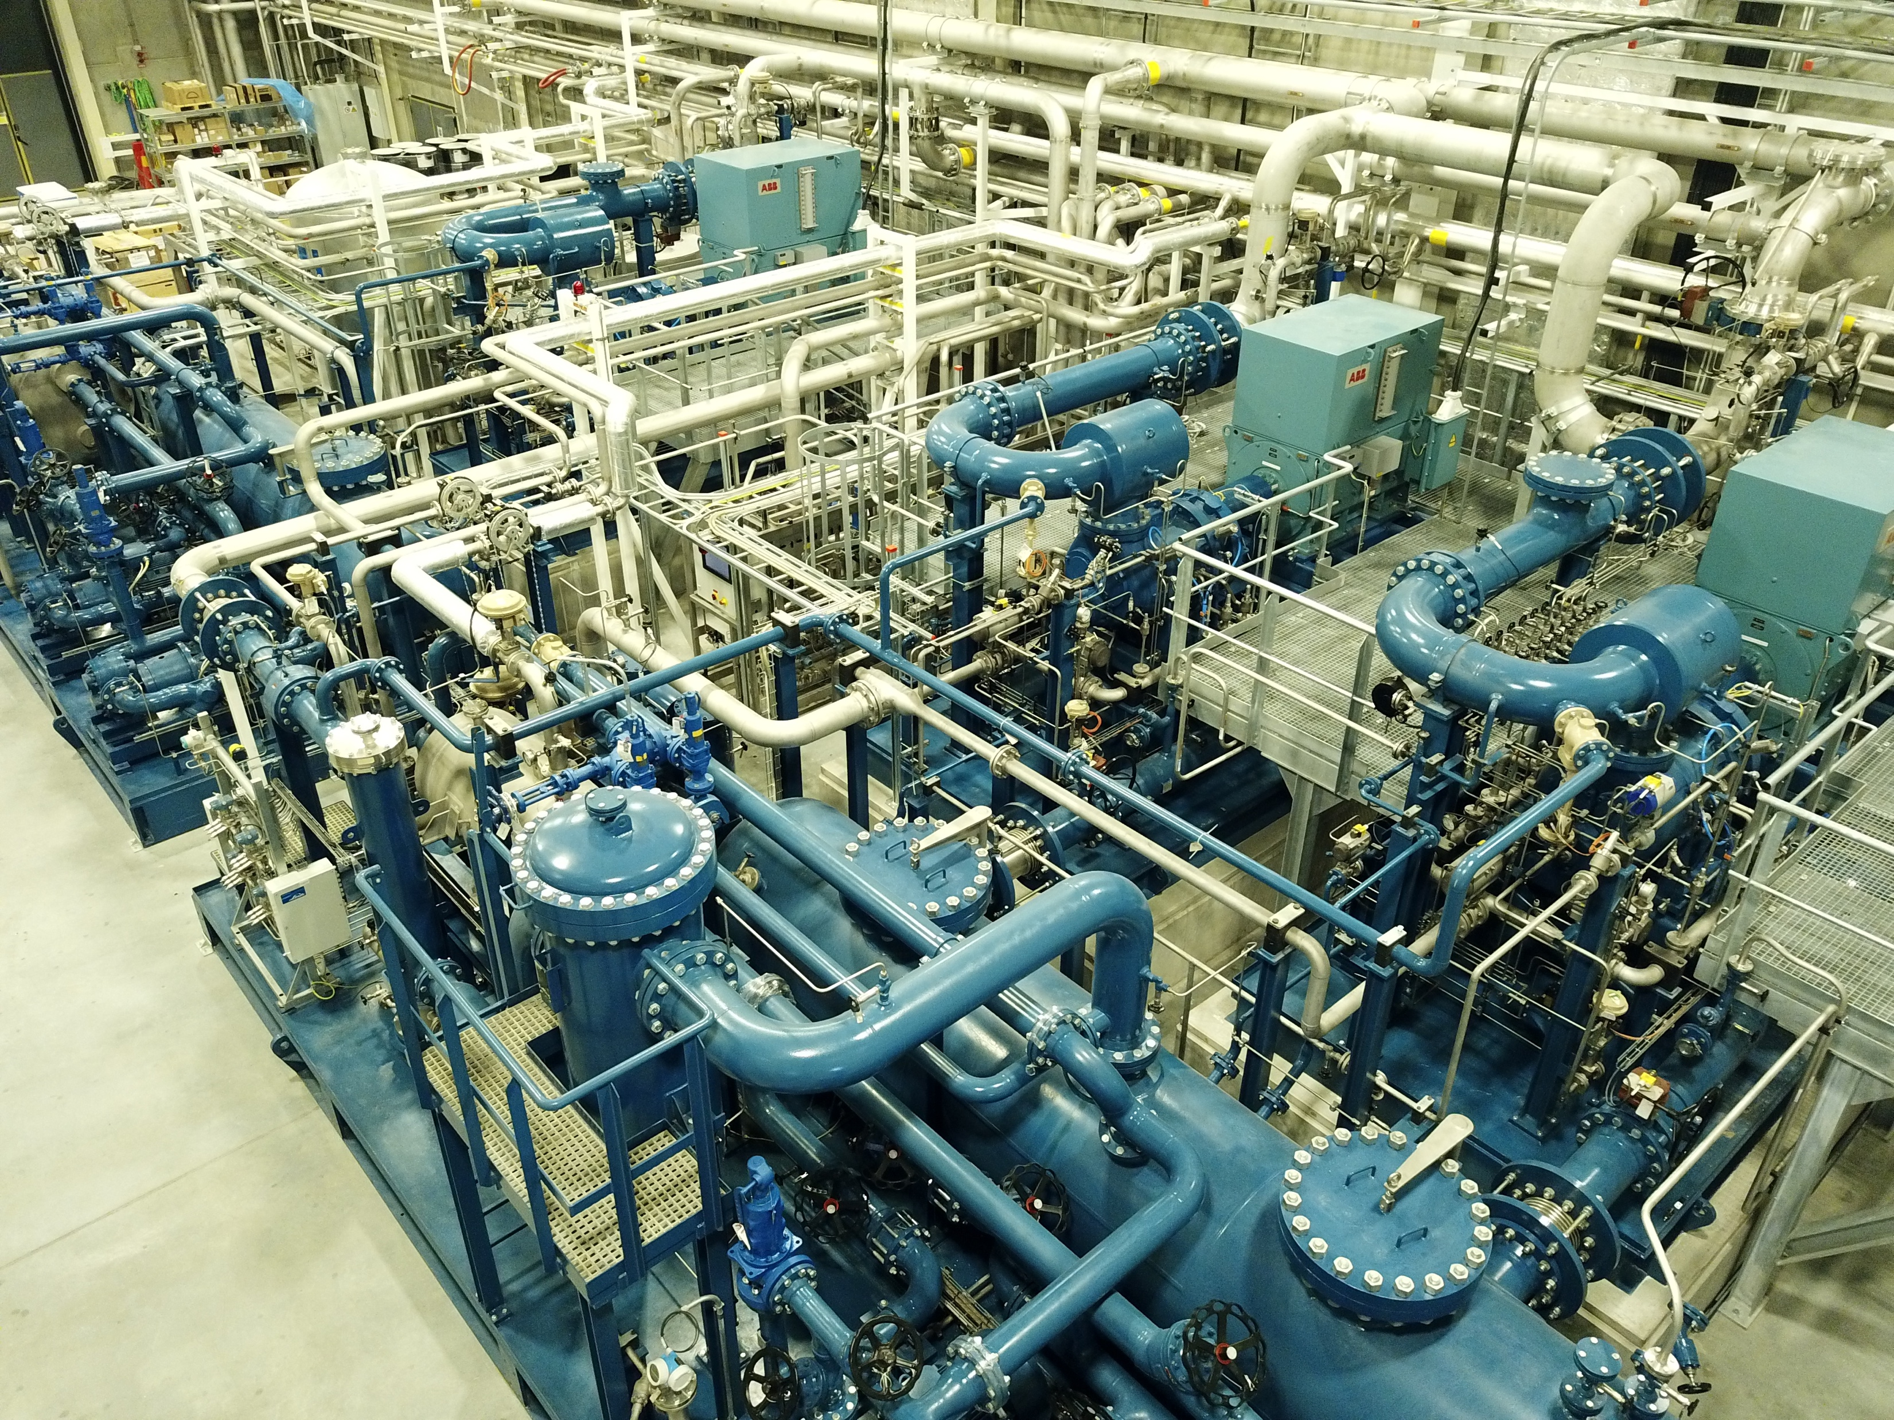
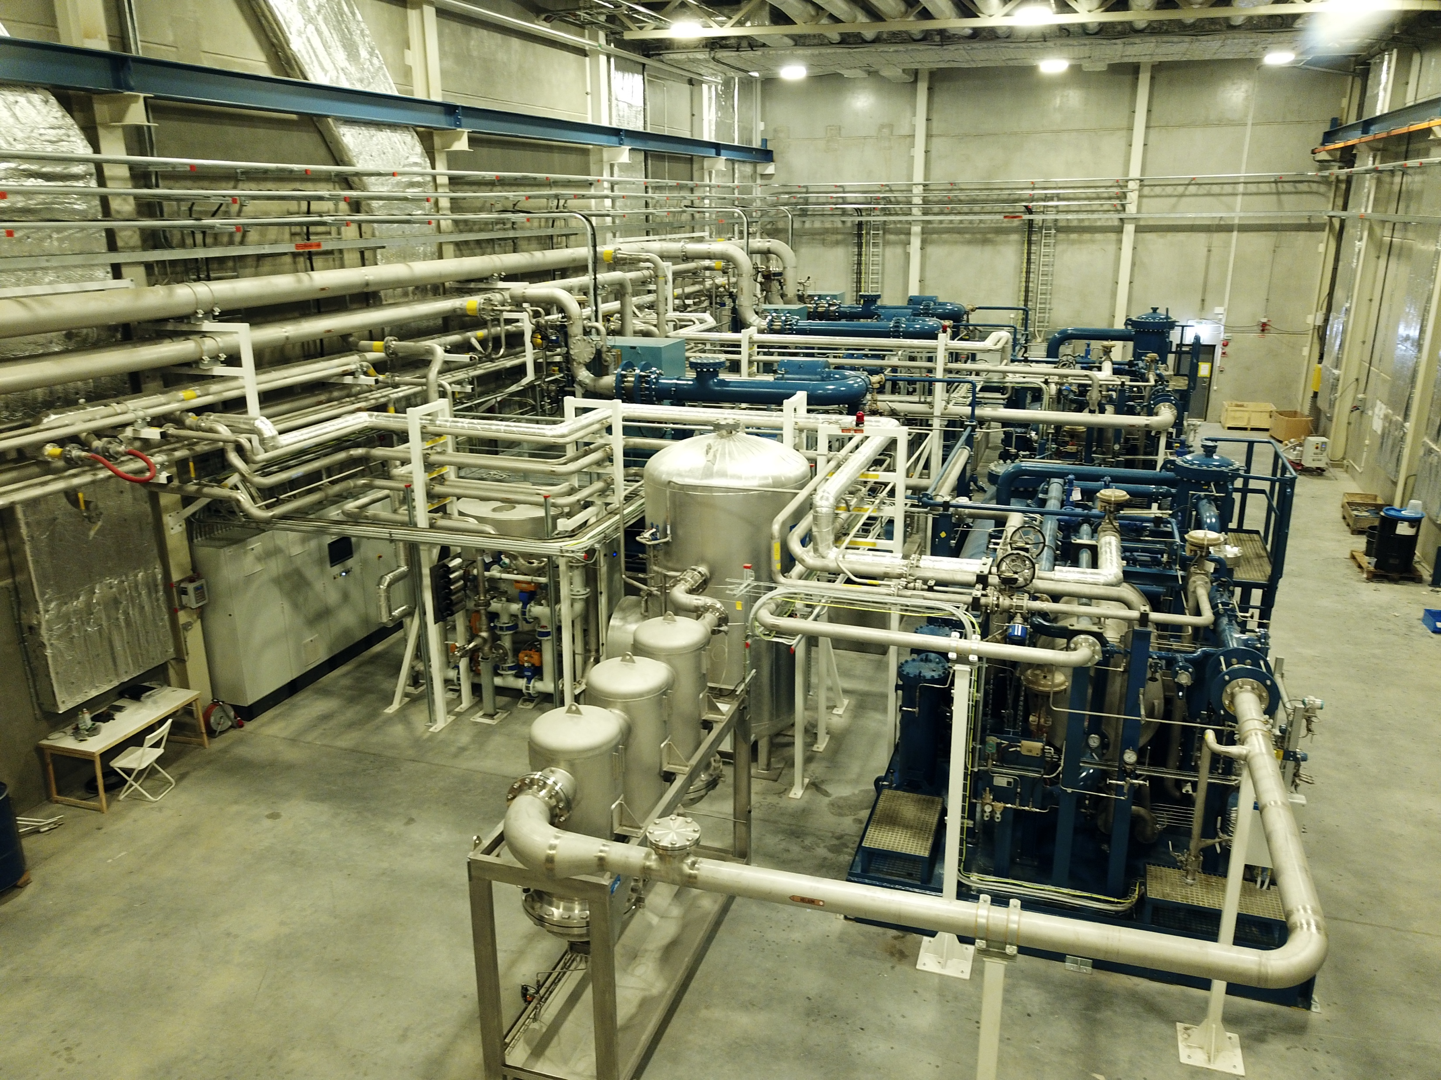
ACCP - WCS

Slide 26
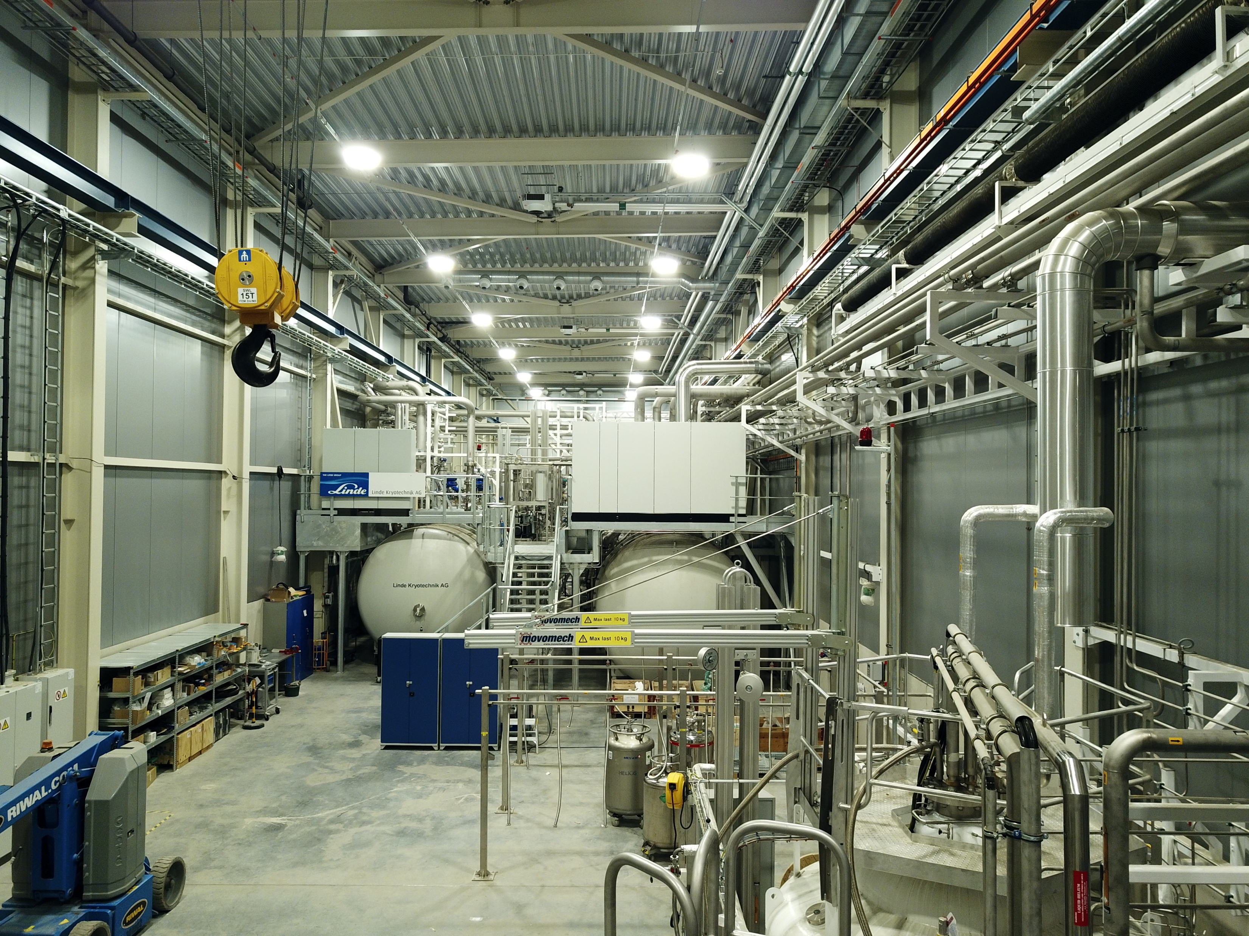
ACCP – Cold Box

Slide 27
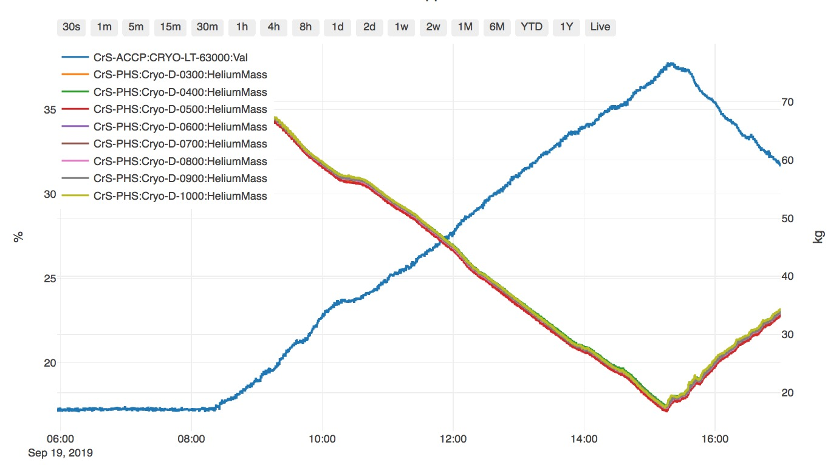
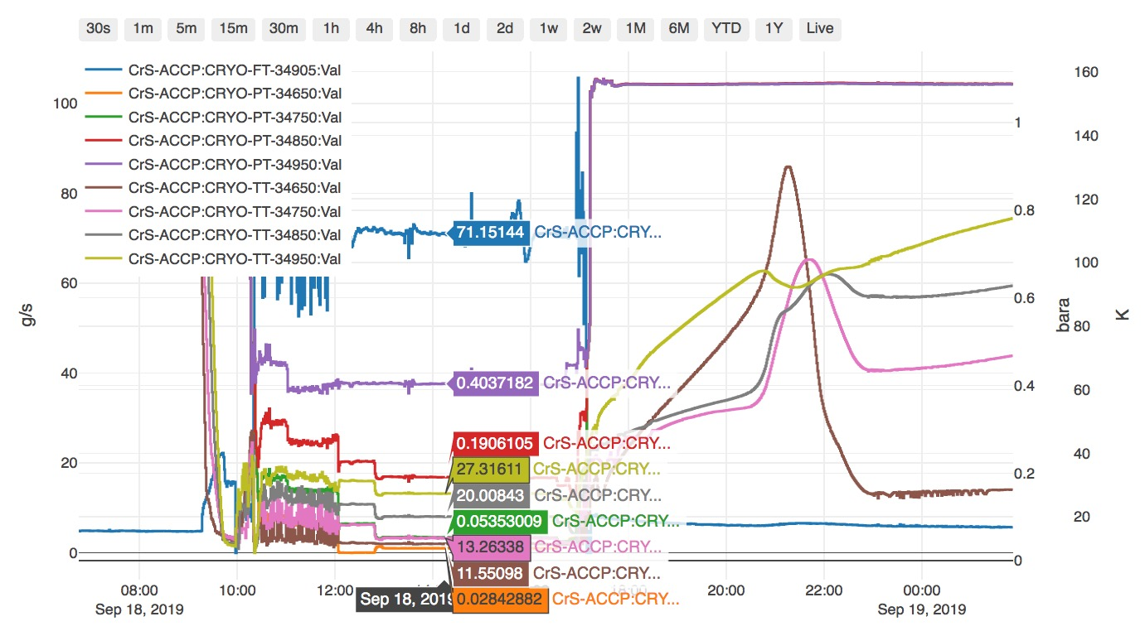
Current Status
Successful 100 hours acceptance tests of ACCP-WCS (Partially)
Plant automatic CD/WU
Some operation modes preliminary tested
Max. Liquefaction rate – to be improved
Cold compressors started up

Slide 28
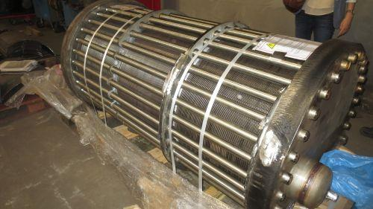
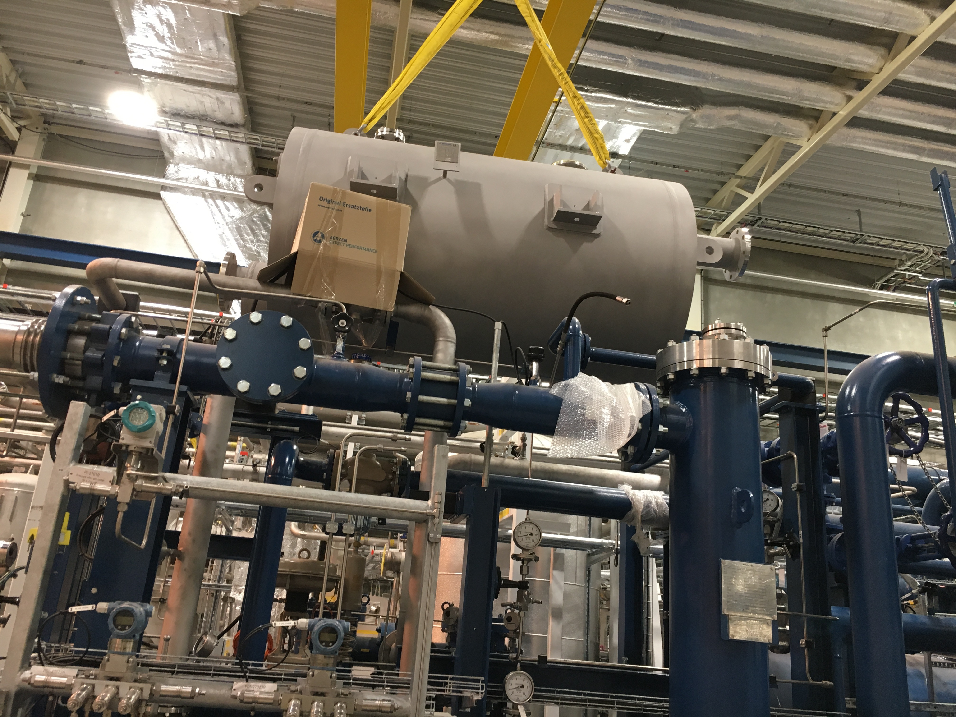
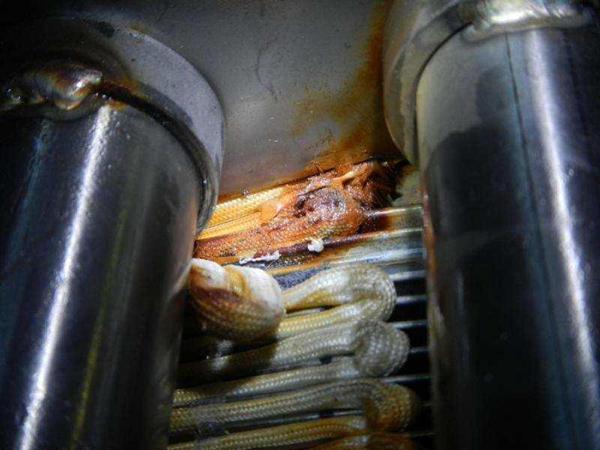
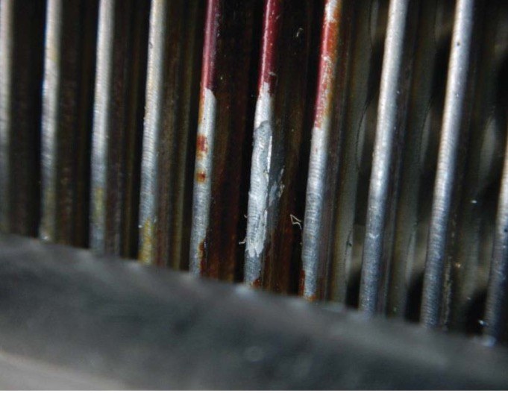
Selected Issues
Two oil coolers corrosions and replacement

Slide 29
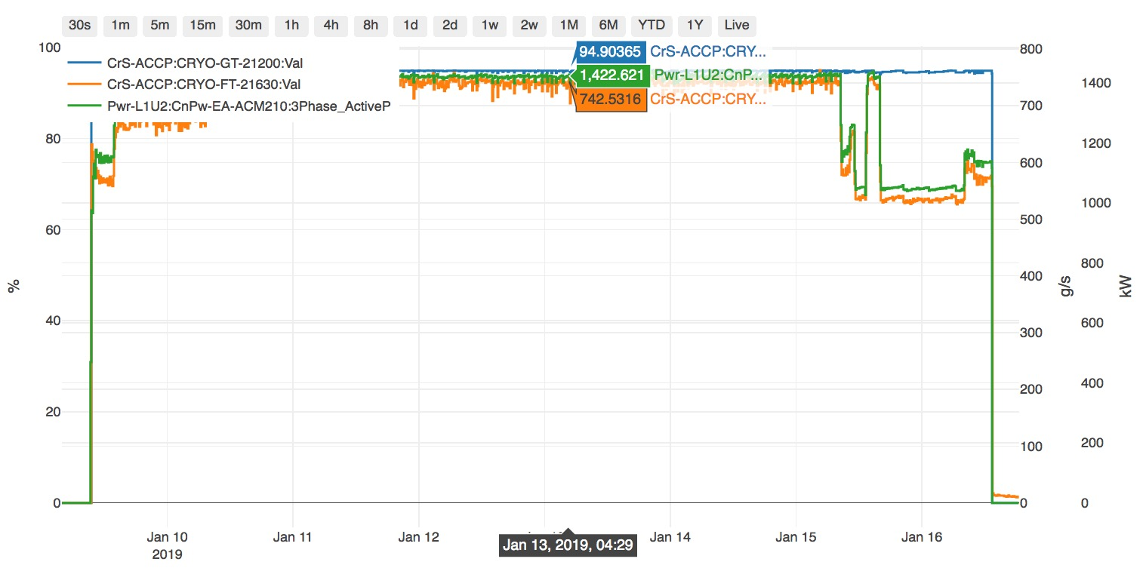
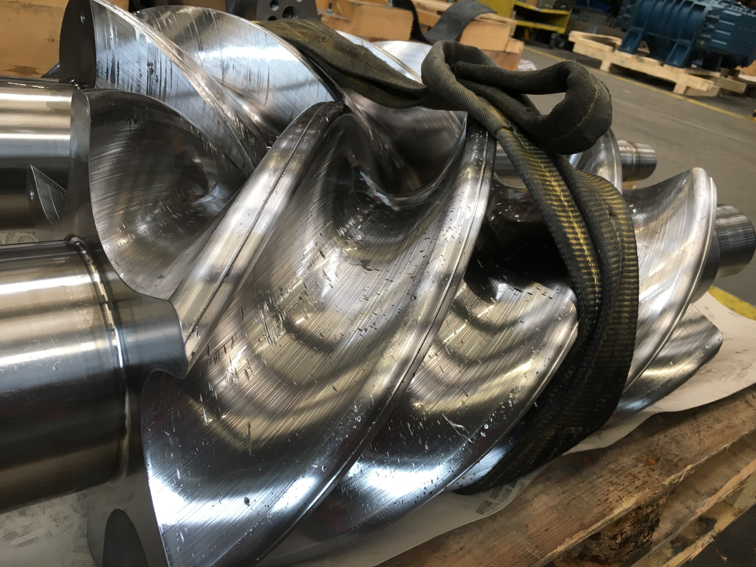
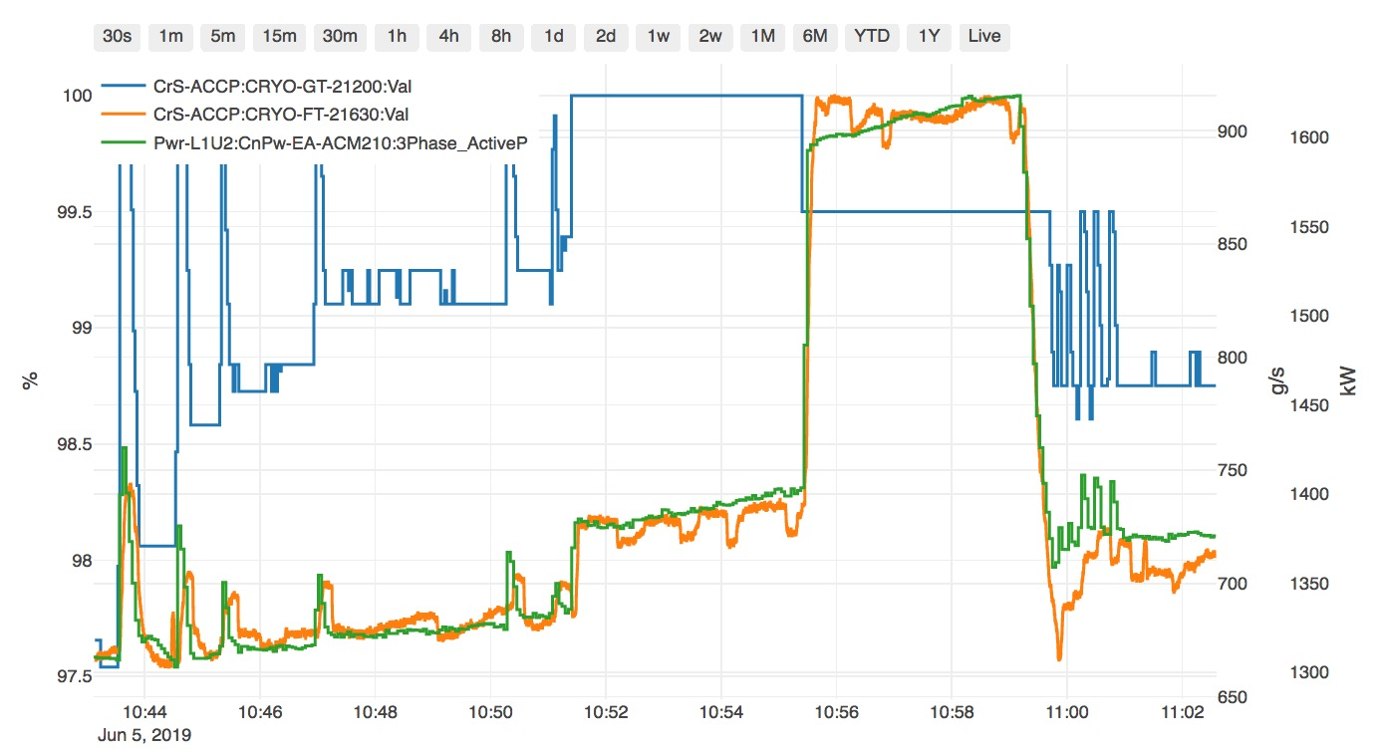
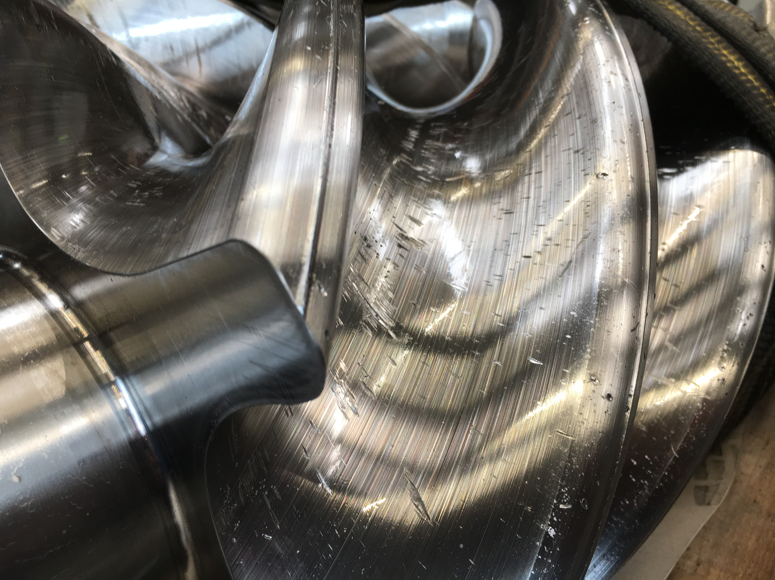
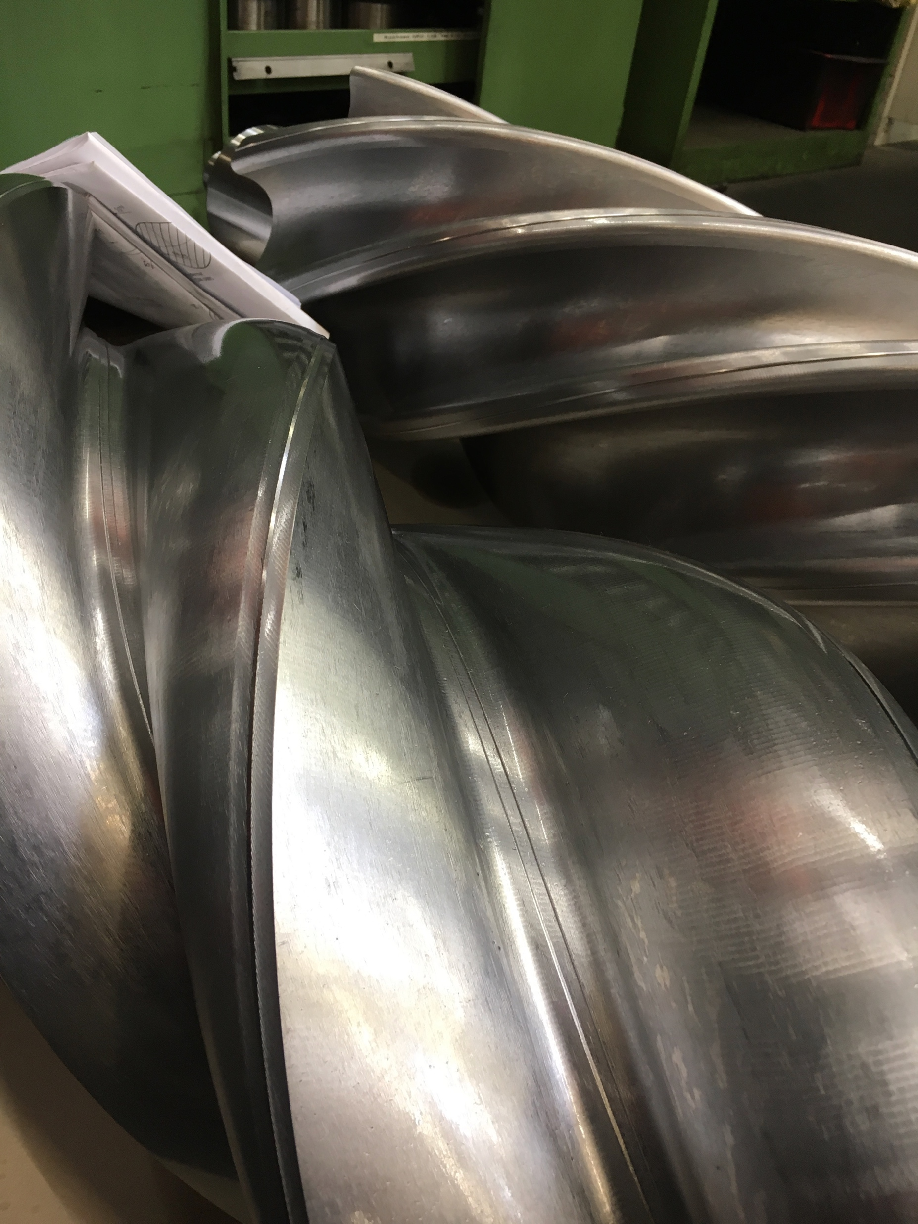
Selected Issues
HP compressor damage and spare compressor slide valve control
  Old: 95 %
HP flow
Power
  Spare: 99.8 %
Slide valve position
  Damaged
  New

Slide 30
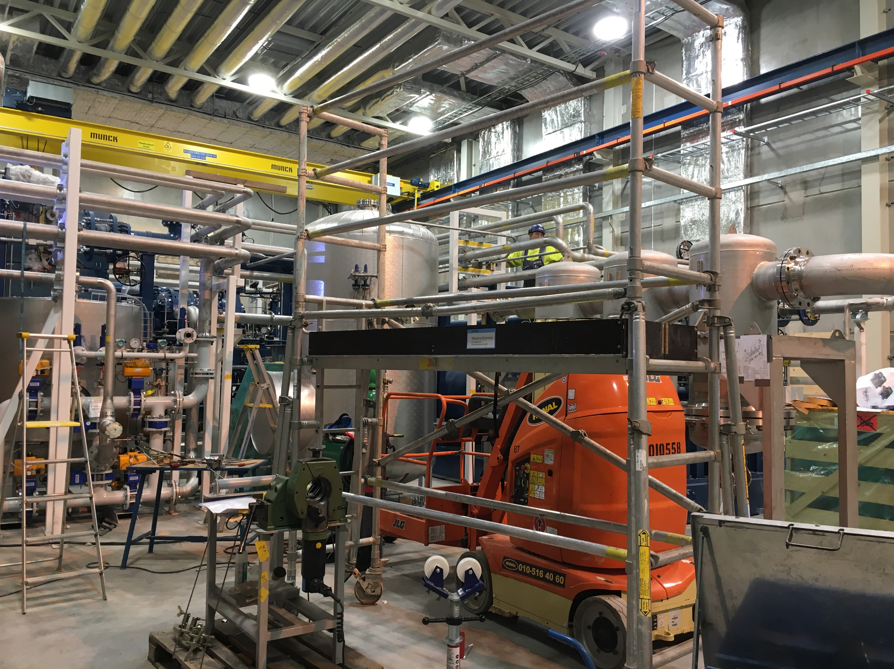
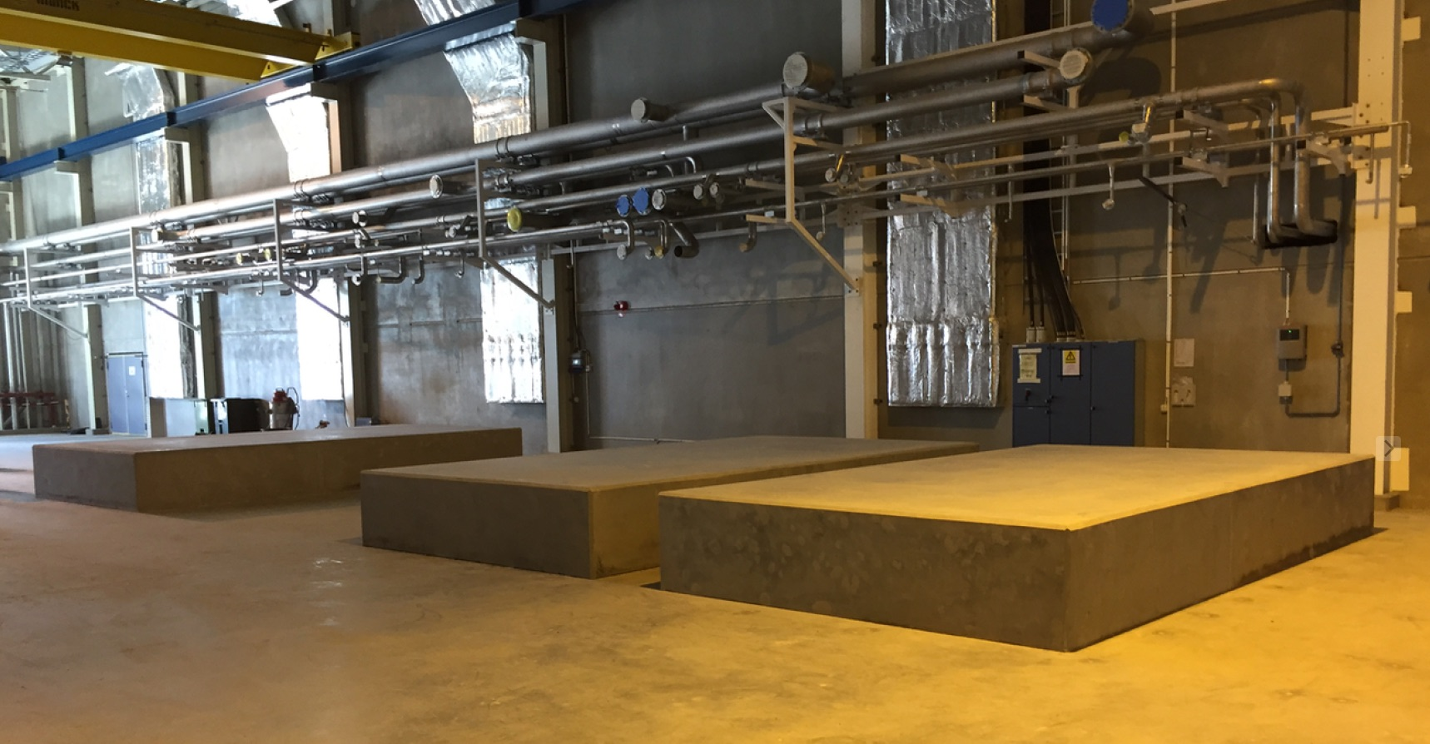
Selected Issues
Under estimation of ESS CF work and ESS site work coordination
  Concrete foundation of compressor skids
  Site work coordination and conflicting

Slide 31
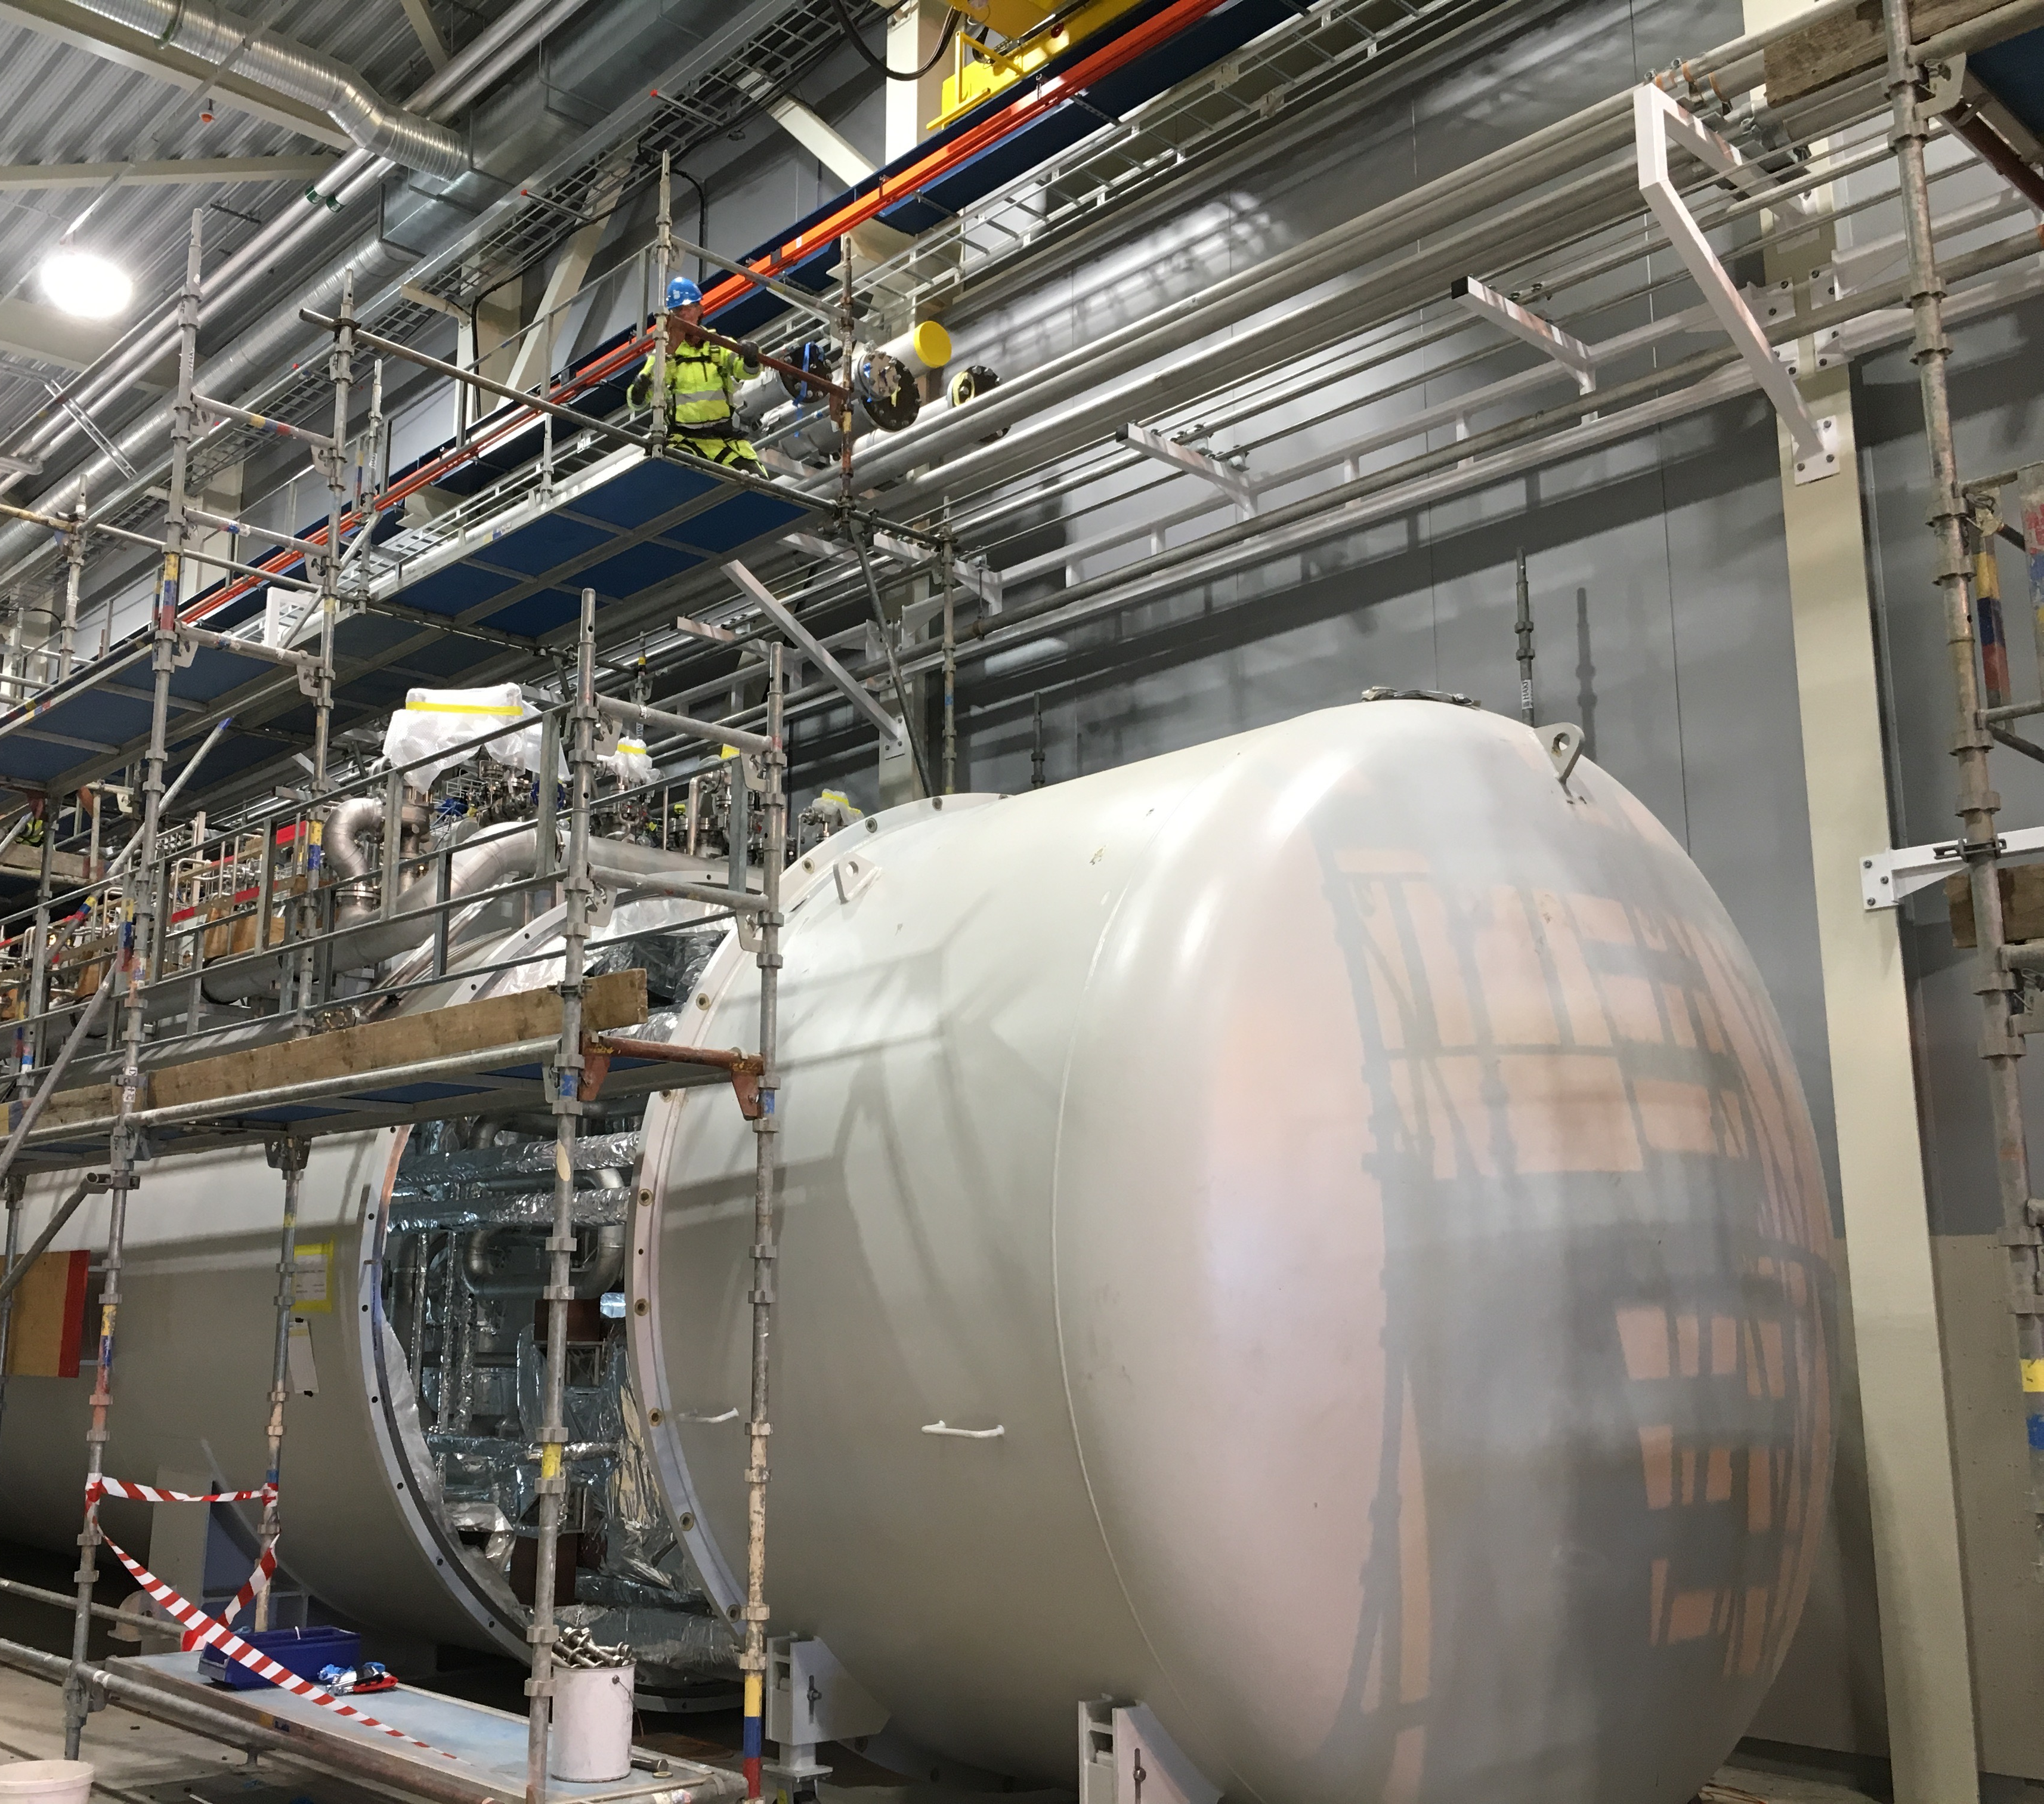
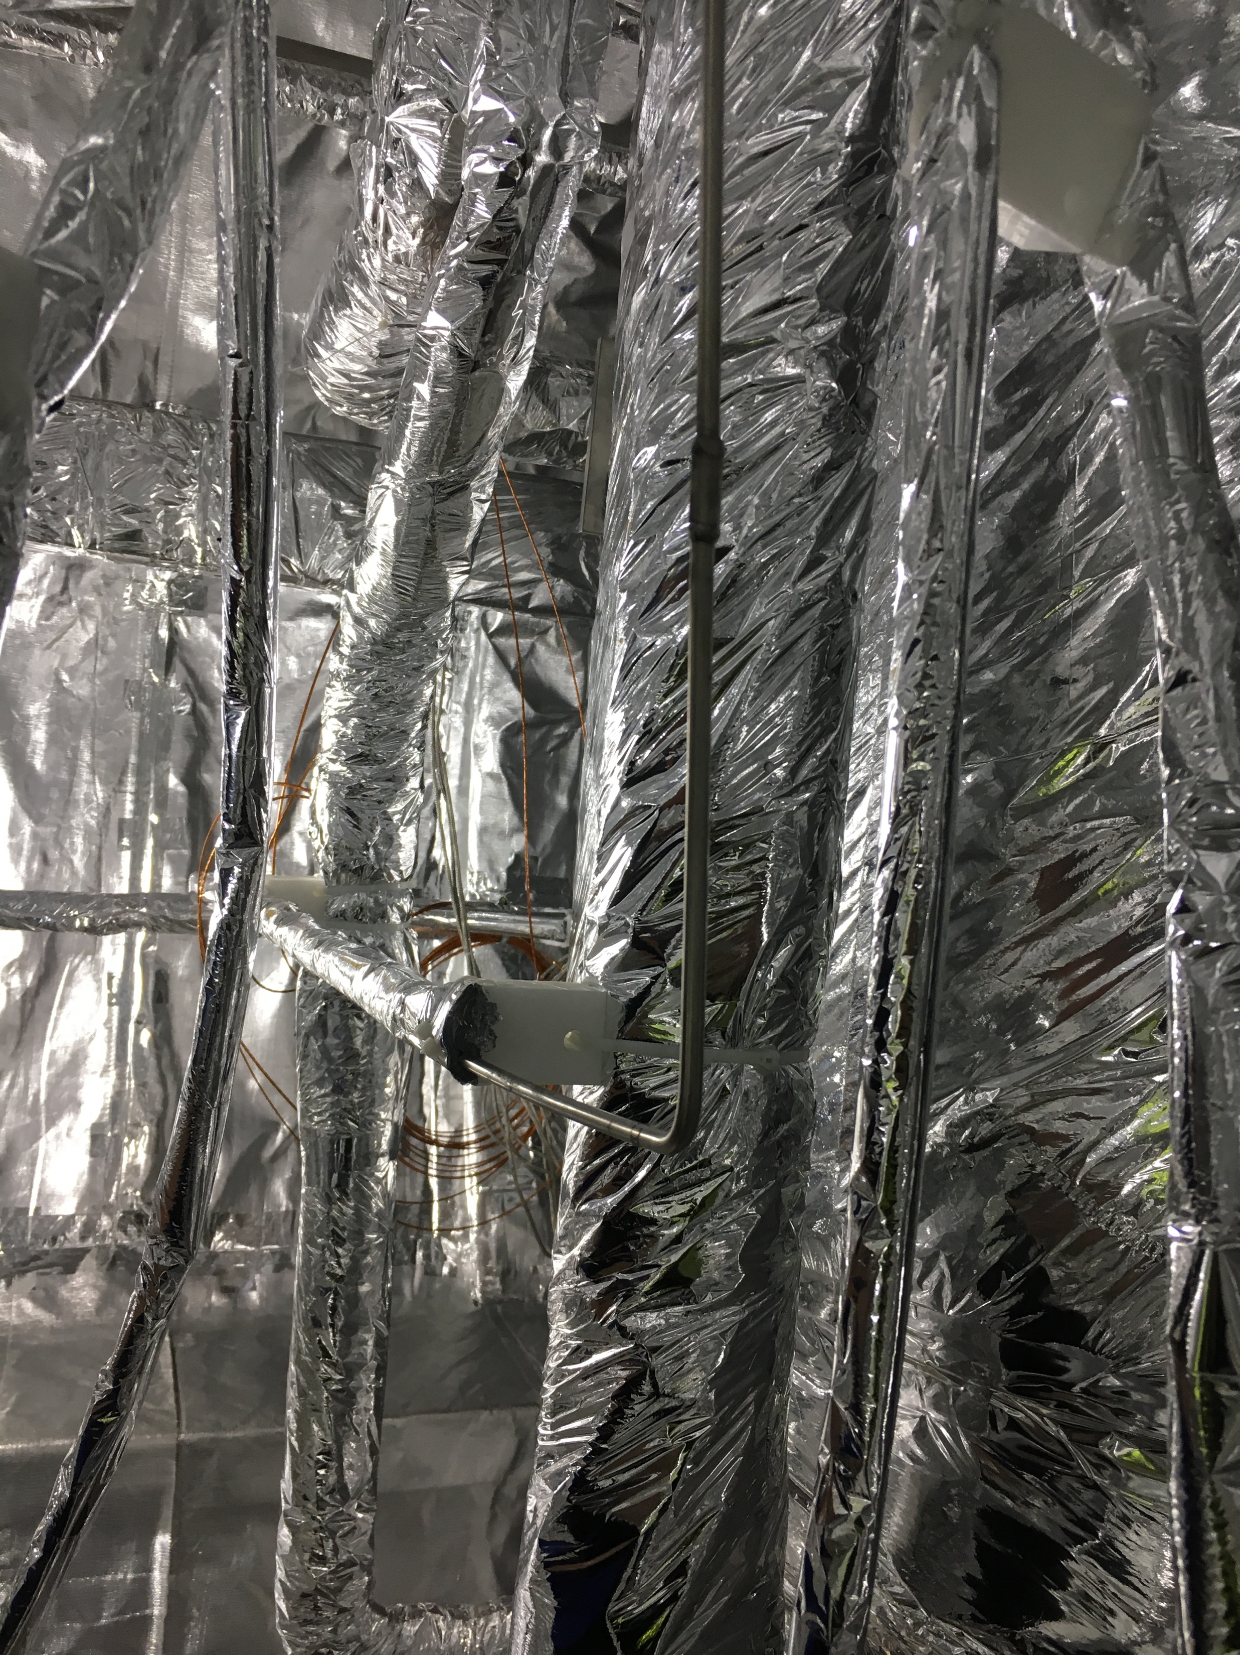
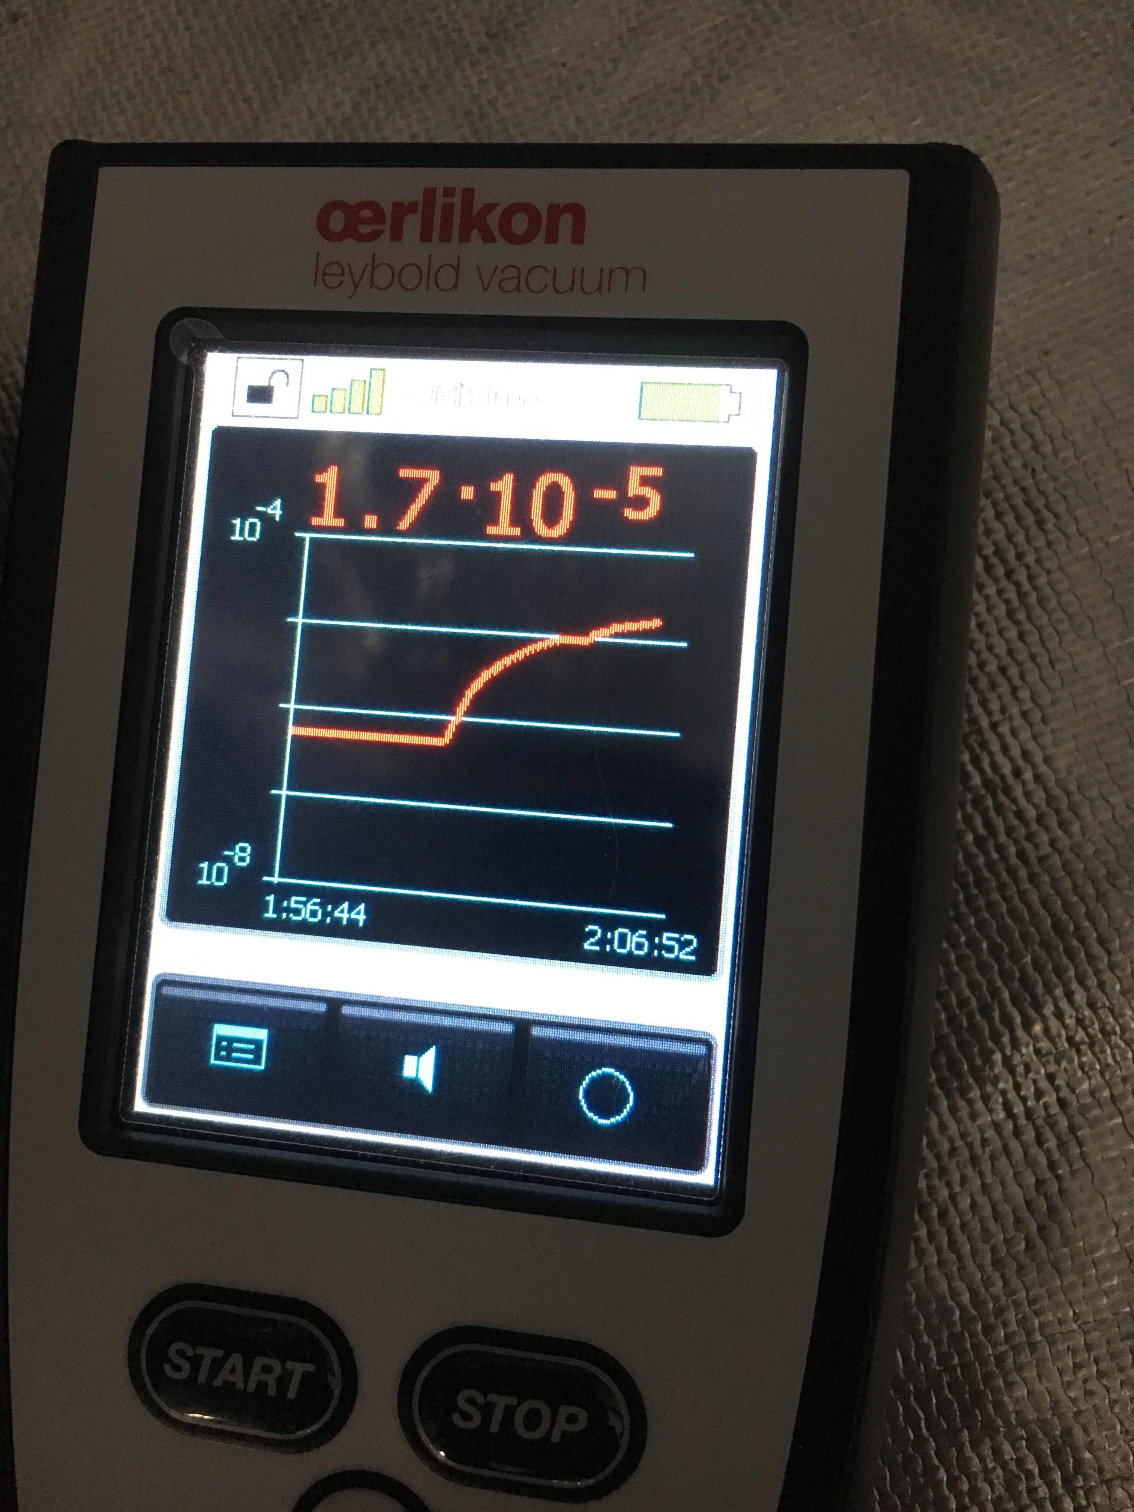
Selected Issues
Leak searching and repair
Leak here!

Slide 32
Acknowledgements
Excellent Team works by LKT/ESS
Prof. Hans Quack
Guy Gistau Baguer
DESY
CERN
FERMILAB
Uppsala university
KSTAR-NFRI
Thank you

