Slide 1
Design of the ESS Cryogenic Moderator System (CMS) and Target Moderator Cryoplant (TMCP)
Hideki Tatsumoto, Philipp Arnold
European Spallation Source ERIC
07. October, 2019

Slide 2
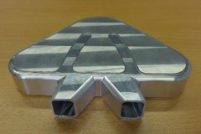
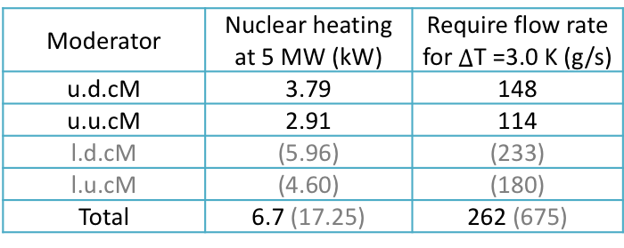
Introduction
ESS Spallation neutron source
ESS hydrogen moderator requirements
ESS moderator is optimized for a maximum neutron brightness under the condition of a para-H2 > 99.5%
- Equilibrium p-H2 fraction
99,5% @22.5 K and 99,95% @17K
- Ortho-para-H2 converter (IONEX)
(2) Average temperature rise through moderator < 3 K.
Upper Downstream Cold Moderator
u.u.c.M
Proton beam
l.d.c.M
l.u.c.M
Moderator | Nuclear heating at 5 MW (kW) | Require flow rate for $∆$T =3.0 K (g/s)
u.d.cM | 3.79 | 148
u.u.cM | 2.91 | 114
l.d.cM | (5.96) | (233)
l.u.cM | (4.60) | (180)
Total | 6.7 (17.25) | 262 (675)
5 MW proton beam
(at repitation rate
of 14 Hz)
Proton beam window
Cryogenic Moderator System (CMS) has been designed to ciculate subcooled LH2 (T=17 K, P=10 bar and pH2=99.5%) at 1 kg/s.
Rotating Tungsten
target wheel

Slide 3

Cryogenic Moderator System (CMS) Overview
Subcooled liquid hydrogen (17 K and 10 bar)
Design pressure: 17 bar.
Hydrogen pump | Two pumps in series
O-p-H₂ converter | IONEX
p-H₂ measurement | In-situ Raman spectroscopy
Pressure mitigation | PCB (65 L)
Thermal compensation | TMCP through HX
He Refrigerator:30.3 kW
(Target Moderator
CryoPlant)
17 K
 | Number of moderators
 | 2 | 4
LH₂ inventory (L) | 321.8 | 375.8
GH₂ inventory (L) | 65.8
Circulation flow rate (kg/s) | 0.5 | 1.0
1 kg/s (0.5 kg/s)
$\sim$35 m

Slide 4
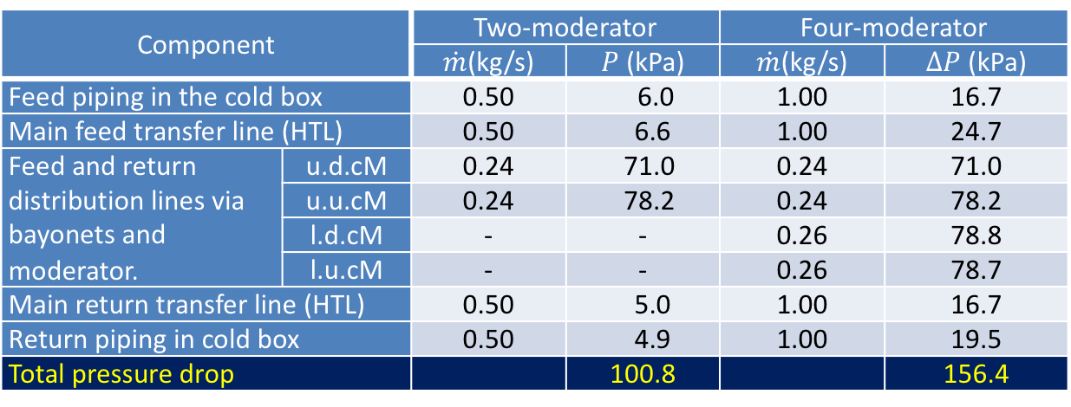
Pressure Drop
Fluid properties of pH2 at 17 K and 1.0 MPa given by GASPAK.
Friction factor : Colebrook equation
(surface roughness = 0.05 mm)
Pressure drops of the moderators are calculated by a CFD simulation.
Component |  | Two-moderator |  | Four-moderator
 |  | $\dot{m}$(kg/s) | $P$ (kPa) | $\dot{m}$(kg/s) | $∆P$ (kPa)
Feed piping in the cold box |  | 0.50 | 6.0 | 1.00 | 16.7
Main feed transfer line (HTL) |  | 0.50 | 6.6 | 1.00 | 24.7
Feed and return distribution lines via bayonets and moderator. | u.d.cM | 0.24 | 71.0 | 0.24 | 71.0
 | u.u.cM | 0.24 | 78.2 | 0.24 | 78.2
 | l.d.cM | - | - | 0.26 | 78.8
 | l.u.cM | - | - | 0.26 | 78.7
Main return transfer line (HTL) |  | 0.50 | 5.0 | 1.00 | 16.7
Return piping in cold box |  | 0.50 | 4.9 | 1.00 | 19.5
Total pressure drop |  |  | 100.8 |  | 156.4
Required LH2 pump head > 156.4 kPa.

Slide 5
Hydrogen Pump
A ball-bearing type hydrogen pump
Required pump heads are 156.3 kPa for 1 kg/s and 100.8 kPa for 0.5 kg/s.
If one pump fails, the other is ramped up to get the required flow rate.
Two-pump operation in series
Single pump operation
17K and 1.0 MPa
17K and 1.0 MPa
For the two-pump operation, the required rotation speeds are 7,500 rpm and 10,000 rpm for the two- and four-moderator arrangements.
It turns out that, even if one pump fails, the revolution speed required for the remaining pump is lower than the maximum speed of 14,000 rpm.

Slide 6
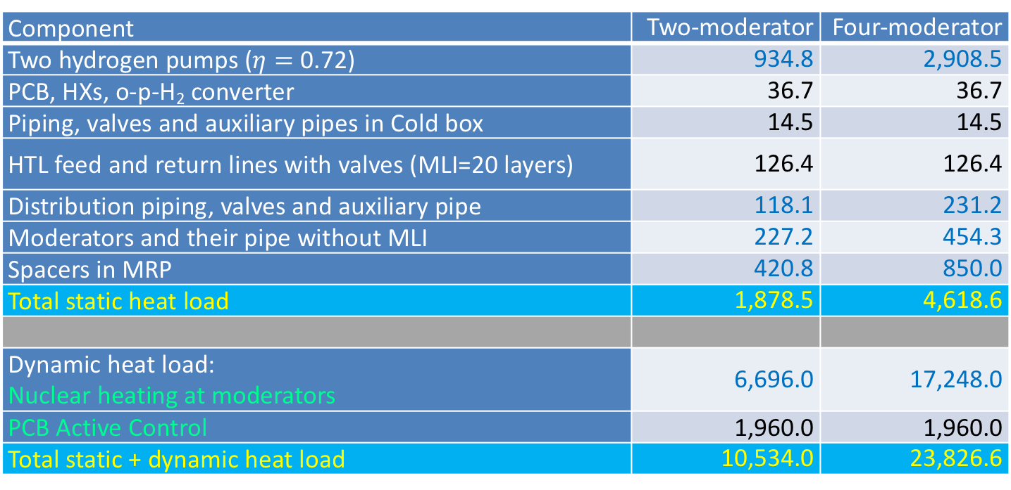
Heat Load
Component | Two-moderator | Four-moderator
Two hydrogen pumps ($η=$ 0.72) | 934.8 | 2,908.5
PCB, HXs, o-p-H₂ converter | 36.7 | 36.7
Piping, valves and auxiliary pipes in Cold box | 14.5 | 14.5
HTL feed and return lines with valves (MLI=20 layers) | 126.4 | 126.4
Distribution piping, valves and auxiliary pipe | 118.1 | 231.2
Moderators and their pipe without MLI | 227.2 | 454.3
Spacers in MRP | 420.8 | 850.0
Total static heat load | 1,878.5 | 4,618.6
Dynamic heat load: Nuclear heating at moderators | 6,696.0 | 17,248.0
PCB Active Control | 1,960.0 | 1,960.0
Total static + dynamic heat load | 10,534.0 | 23,826.6
Total heat loads are lower than the maximum TMCP cooling power of 30.3 kW.

Slide 7

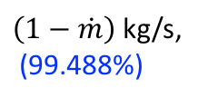
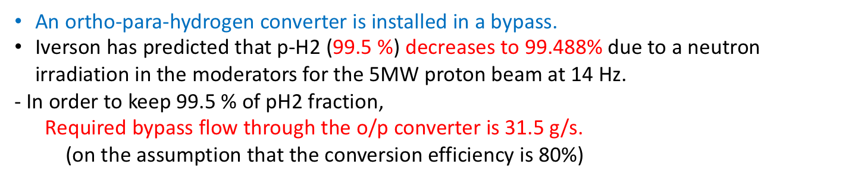

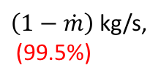

Ortho-para-hydrogen Converter
An ortho-para-hydrogen converter is installed in a bypass.
Iverson has predicted that p-H2 (99.5 %) decreases to 99.488% due to a neutron irradiation in the moderators for the 5MW proton beam at 14 Hz.
- In order to keep 99.5 % of pH2 fraction,
Required bypass flow through the o/p converter is 31.5 g/s.
(on the assumption that the conversion efficiency is 80%)
1 kg/s,
(99.5%)
$\left(1−\dot{m}\right)$ kg/s,
(99.488%)
Catalyst | IONEX® Type OP (Ferric oxide)
Catalyst particle size (mm) | 0.5
Catalyst bed size (L) | 35 (9.6:calculated value)
Porosity (-) | 0.4
Flow rate (g/s) | 31.5
Pressure drop (kPa) | 24.6
Space Velocity (min⁻¹) | 2170
Conversion efficiency (%) | 80
$\dot{m}$kg/s
0.8 x 99.96+0.2 x 99.5%
Moderators
O-p-H₂ converter
$η$=0.8
17.3 K
99.488%
99.5%
$\dot{m}$kg/s (99.5%)
Dia.=273 mm
1 kg/s,
(99.5%)
$\left(1−\dot{m}\right)$ kg/s,
(99.5%)

Slide 8

In-situ Ortho-para-hydrogen Fraction Measurement System
ESS plan is to measure the para-hydrogen concentration in situ, using Raman spectroscopy through a small sapphire glass window to ensure the 99.5% of para-hydrogen requirement.
Sapphire glass windows (dia.< 20mm) are placed in a bypass and are isolated from the main loop by feed and return valves.
-> If a hydrogen leak occurs due to a failure of the glass window, it is completely isolated from the main CMS loop.
-> The remaining LH2 is released and depressurized, while the leaked hydrogen leaked in the vacuum space is released through a vacuum safety device.
Sapphire glass windows
(dia.< 20mm)
Design result
Design pressure (MPa) | 1.7
Volume (L) | 0.6
Flow rate (g/s) | 1.0
Pressure drop (kPa) | 1.47
Heat load (W) | 10
Temperature rise (K) | 1.0
Piping size:
½” tubing
$∆P$=3.94 kPa
Now high reliable sapphire glass window is being developed.

Slide 9
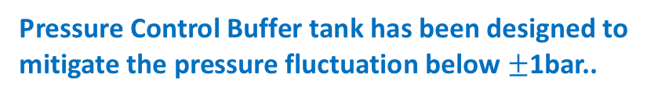
Pressure Control Buffer (PCB)
LH2 density change due to the nuclear heating (ΔT=2.1 K for 5 MW beam) would result in a pressure rise.
Unlike SNS and J-PARC, ESS plans to use ”Subcooled LH2” (17K and 10 bar).
It is expected that GH2 phase (behaving as a compressible fluid) would mitigate the sudden large pressure fluction.
Pressure Control Buffer tank has been designed to mitigate the pressure fluctuation below $±$1bar..
PCB (65 L) is placed in the pump discharge.
Evaporated gas is liquified passing through HX-61200 and then come back to the LH2 pump suction.
Pressure in the CMS is controlled by the bypass valve .
For the nominal operation, the bypass flow is estimated to be 0.33 g/s and 200 W is removed by HX-61200.
ΔP
For the case of a large pressure rise, it would be mitigated by increasing the bypass flow and liquefying it. -> ”Active control”

Slide 10
Mitigation of the Pressure Fluctuation Caused by the Nuckear Heating by Using the PCB
Simple calculation model
Before a proton beam injection
After a 5MW proton beam injection
Travel time from moderator to HX = 11.5 s
P₁=10 bar
T₂=17.5 K
T₂=17.5 +ΔT(=2.1K)
V₂=179 L
V₂=179 L
HX
GH₂:V₄=65-V₃,
T₄=45 K
17.2 kW
for 4 moderators
4 Moderators
T₁=17 K
ΔV
T₁=17 K
LH₂:V₃, T₃=T₁
1 kg/s
V₁=162 L
V₁=162 L
Calculation of the mass balannce on the assumption that
all the heat load applied at the moderators is completely removed through the HX.

Slide 11
Simulation Results
Effect of proton beam power
Effect of liquid H2 volume in PCB
V3=20 L
For 5 MW proton beam opeation
Four moderators
Four moderators
Two moderators
Two moderators
Pressure rise (bar)
Pressure rise (bar)
Proton beam power (MW)
Liquid hydrogen volume in PCB,V3 (L)
It is predicted that the pressure rise would be below 1 bar for V₃=20 L, if the thermal compensation by the TMCP works well.

Slide 12
CMS Schedule
Manufacturing CMS cold box (until January, 2020)
TUV inspection and preparation for FAT (January to March, 2020: )
FAT for the CMS cold box at Forschungszentrum Jülich (March and April, 2020 )
Manufacturing HTL
Installation at ESS site (October, 2020 to March, 2021 ).
Commissioning (August, 2021 to April, 2022)

Slide 13
Summary
ESS cryogenic moderator system (CMS) where subcooled liquid hydrogen (17 K and 10 bar) has been designed and is being manufactured.
- Two pumps in series
- Two kinds of heat exchangers
- Ortho-para hydrogen converter
- Pressure control buffer (PCB) for passive and active pressure control.
- In-situ para-hydrogen measurement system
- Hydrogen transfer line (HTL)
- Hydrogen vent line
It is confirmed that the pressure drop and the heat load meet the design requirement.
The simple simulation result says that the PCB can mitigate the pressure fluctuation caused by the nuclear heating below 1 bar if the nuclear heating can be completely removed through the HX by TMCP.

Slide 14
ESS Cryogenic System Block Diagram
Pure Helium
Gas Storage
Standalone Helium Purifier
Helium Recovery System
Target Moderator
Cryoplant
Accelerator
Cryoplant
20 m³ LHe Tank
5 m³
LHe Tank
Test & Instrument Cryoplant
Target Cryodistribution System
LHe Mobile Dewars
Test Stand Cryodistribution System
Cryodistribution System for Elliptical Linac
Cryodistribution System for
Spoke Linac
LN2 Storage Tanks
Hydrogen Circulation Box
Elliptical
Cryomodules
Spoke
Cryomodules
LN2 Mobile Dewars
Instruments & Experiments
Test Stand Lund 2
Hydrogen Moderator

Slide 15
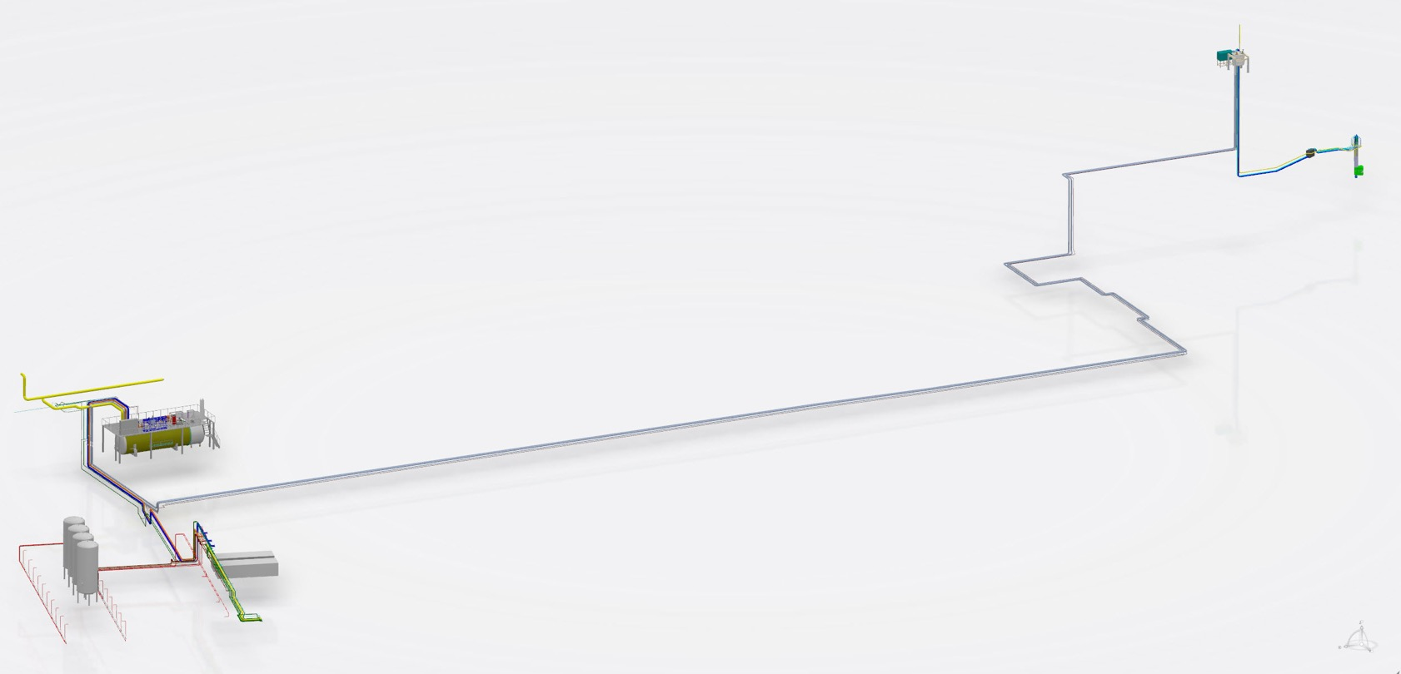
The Target Moderator Cryoplant (TMCP)
Duty Specification Helium Refrigeration System
Heat load: 30.3 kW @ >15 K feed and < 20 K return temperature
Large turndown-ability: static heat load ~ 5 kW with max energy efficiency
Handle beam trips, long term and short term
Cool down and warm up TMCP, CTL, CMS
Acceptance testing TMCP alone
Acceptance testing integrated TMCP-CTL-Jumper Spool Box
Target Moderator
Cryoplant
Target Cryodistribution System
Hydrogen Circulation Box
Hydrogen Moderator

Slide 16
TMCP simpliefied flow scheme
PCB
(65 L)
Filter
U-shaped
Bayonet
MRP
NV-82016
NV-62016
O-p-H2
converter
CMS cold box
HTL
Feed valve
Distribution lines
Distribution box
u.d.cM
u.u.cM
l.d.cM
l.u.cM
Moderators

Slide 17
TMCP simpliefied flow scheme
Ambient heater: central equipment
Heat load for Coldbox acceptance test
Warm-up of Coldbox
Heat load for integrated system
Heat load during beam trip
Temperature control during hydrogen circuit warm-up / cool-down
Mitigation of pressure increase during power shut-down
Switching compressor operation while keeping CTL inventory stable

Slide 18
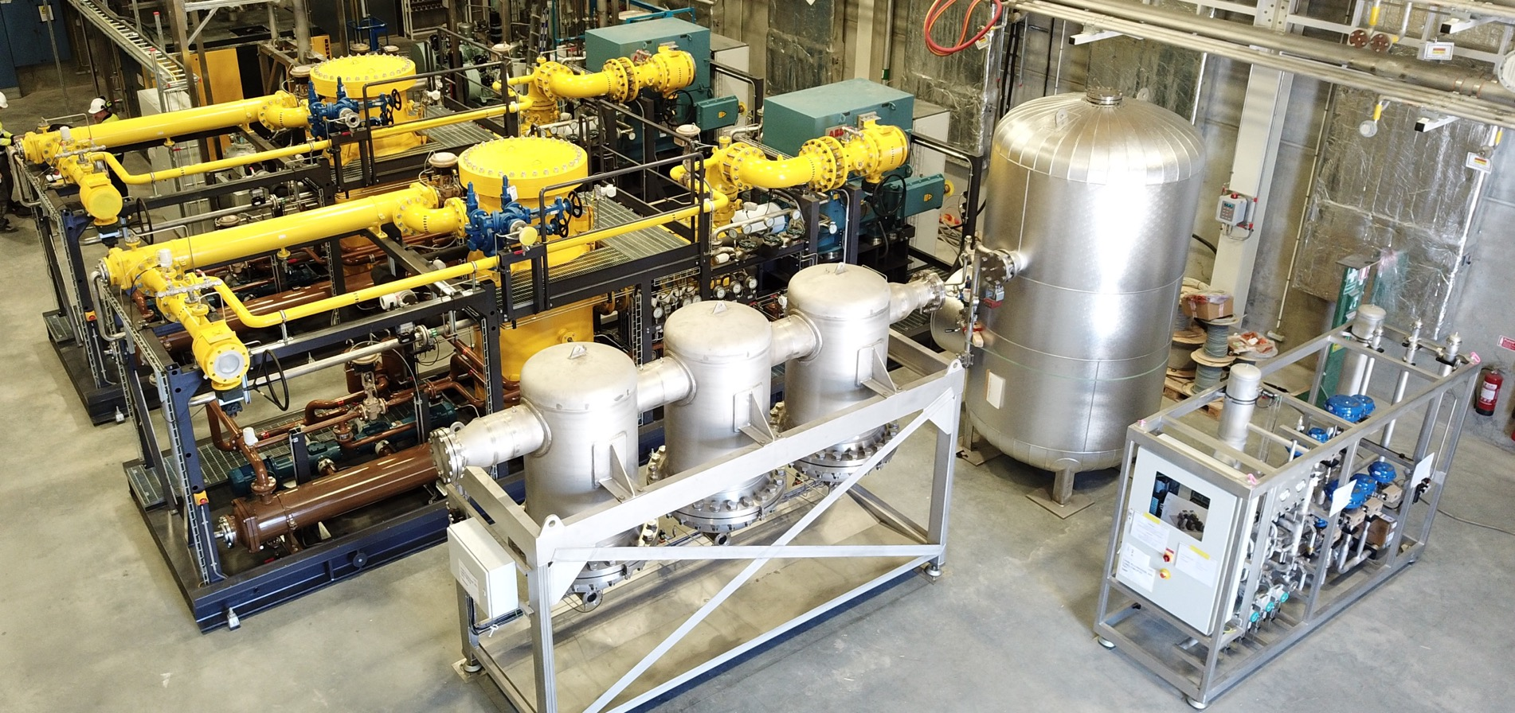
TMCP Compressor system

Slide 19
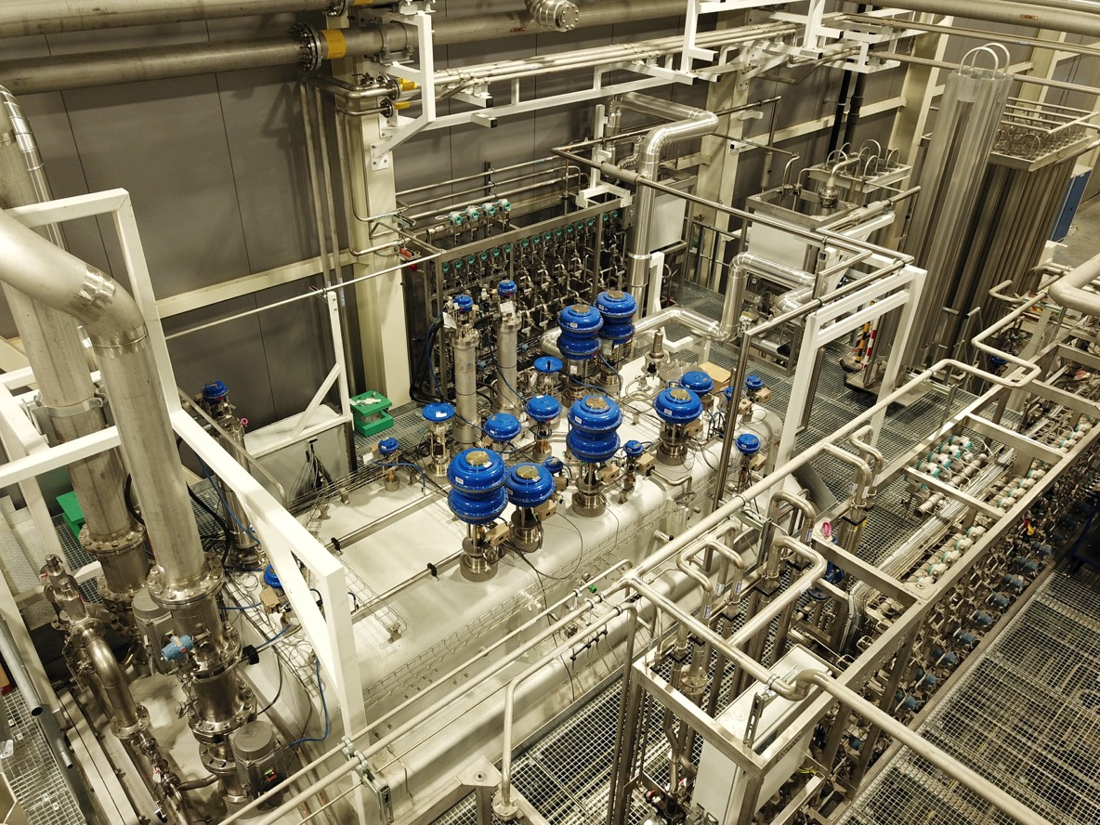
TMCP Coldbox
TMCP consist of
Coldbox 3.5m diameter, 10m long, 5.7m high inc. 3 expansion turbines
Combined ACCP and TMCP Coldbox platform
Jumper Spool valve box in target building
2 identical GEA compressors in Enerproject skids, 1200 kW power
Bulk oil removal, final oil removal, gas management, analysers
Long single helium VJ transfer lines being procured now

Slide 20
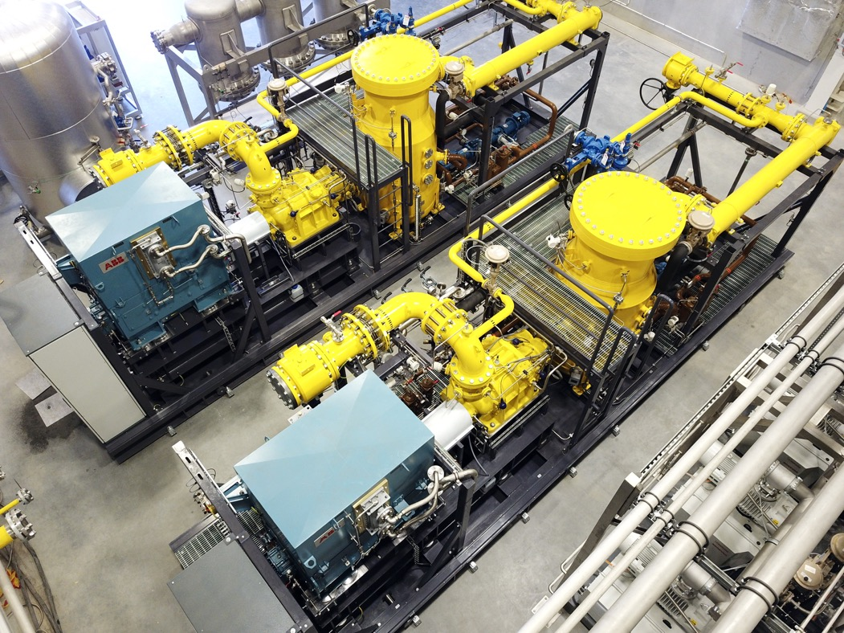
Current status
Successful completion of TMCP alone acceptance testing
Excellent compressor performance (efficiency, cooling water control, slide valve control, documentation)
Acceptable coldbox and overall performance, few punch points
Cryoline project to start soon
Integrated testing in 2021 / 2022
Questions?

