Slide 1
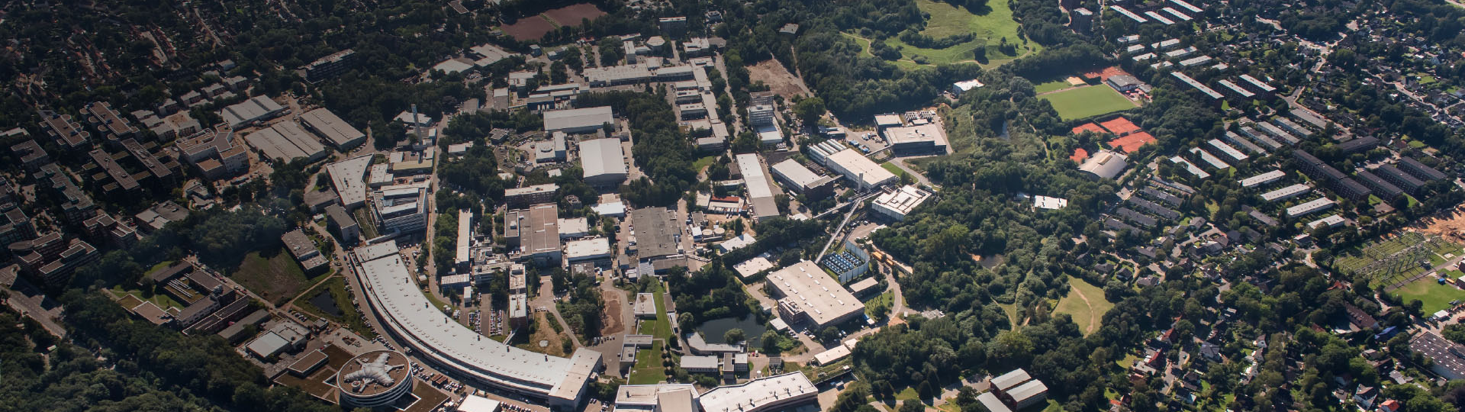
Present status and possible upgrade of the XFEL cryomodules
From TTF to CW-EuXFEL
Kay Jensch
European Cryogenic Days, 07/10/2019 Lund

Slide 2
Outlook
01 The cryogenic of the EuXFEL accelerator
General layout of the accelerator
Components: modules and more
02 The EuXFEL cryomodule
Short history
Main components
03 EuXFEL-CW
Scope and requirements
Main challenges for the cryogenic

Slide 3
The cryogenic of the
European XFEL accelerator

Slide 4
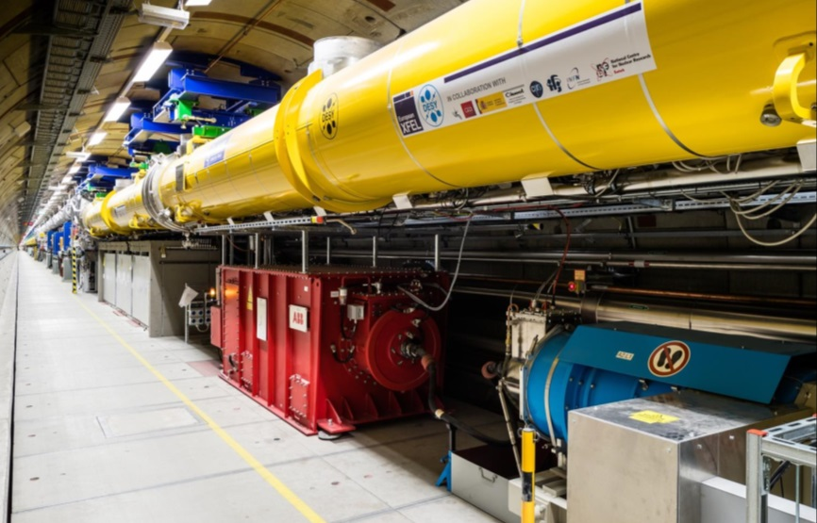
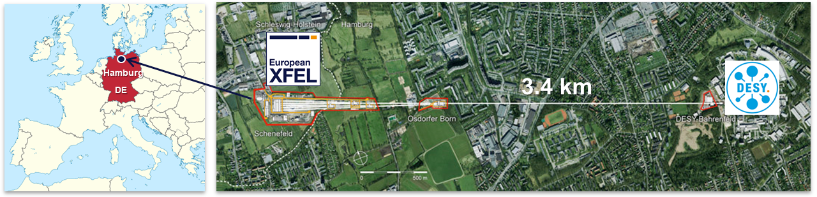
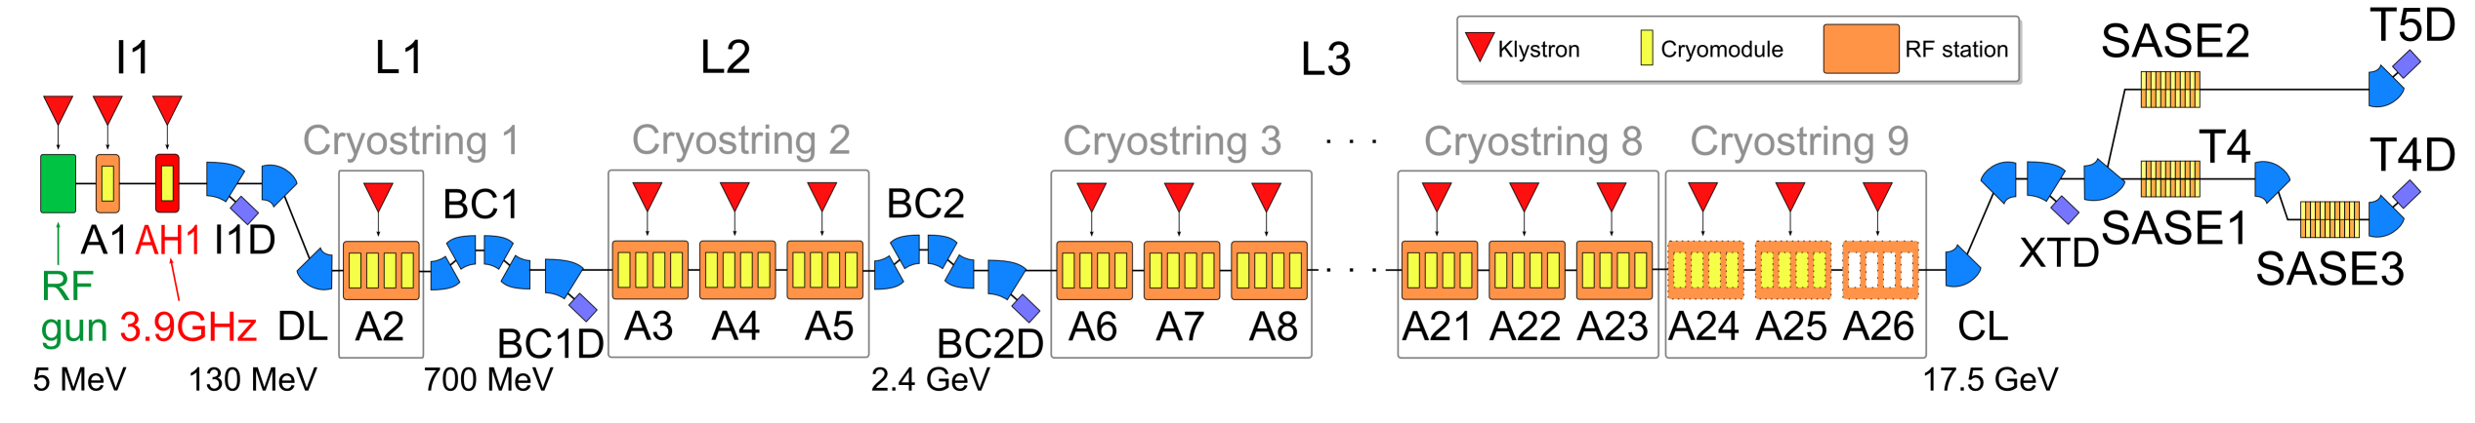
The European X-ray Free Electron Laser (EuXFEL)
Courtesy J. Branlard
The complete facility
Soft and hard X-ray light experiments
Design energy 17.5 GeV, typical SASE user runs at 14 -14.5 GeV
Pulsed operation at 10 Hz
~800 TESLA-type cavities
Resonance frequency 1.3 GHz
32 cavities per XTL RF station
Typical 3 RF stations for a cryogenic string

Slide 5
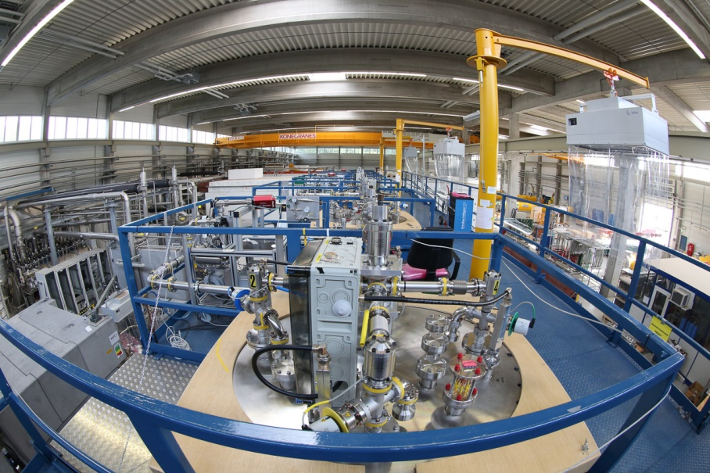
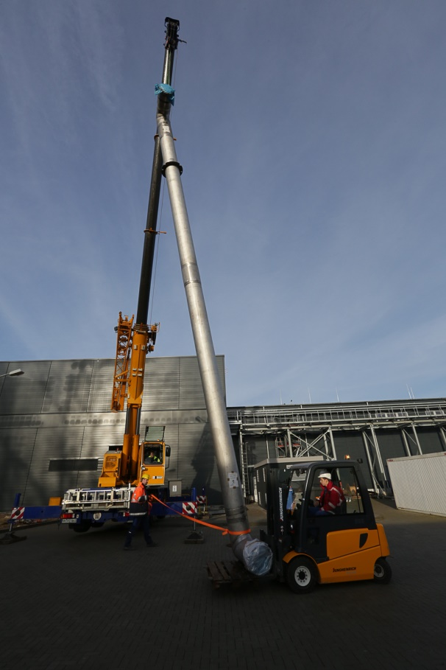
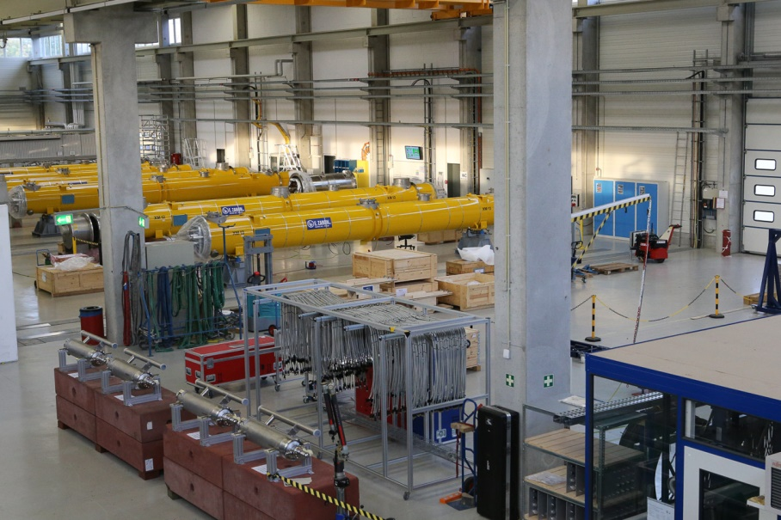
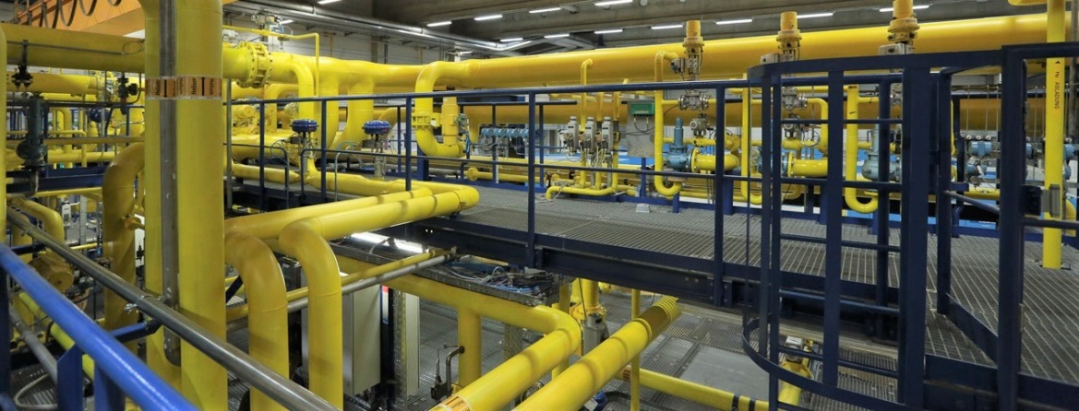
The European X-ray Free Electron Laser (EuXFEL)
The cryogenic facility
2 cryoplants (2 refurbished of 3 former HERA plants)
1 new 2K Coldbox with 4 stage cold compressors
1 distribution system (4 main boxes, >300 m of transfer lines, …)
14 cryogenic caps/boxes for cryomodule connections
98 cryomodules
Test facility (AMTF) :
  3 cryomodule test benches @ 2K (1.8K)
  2 cavity vertical test cryostat @ 2K (1.8K)

Slide 6
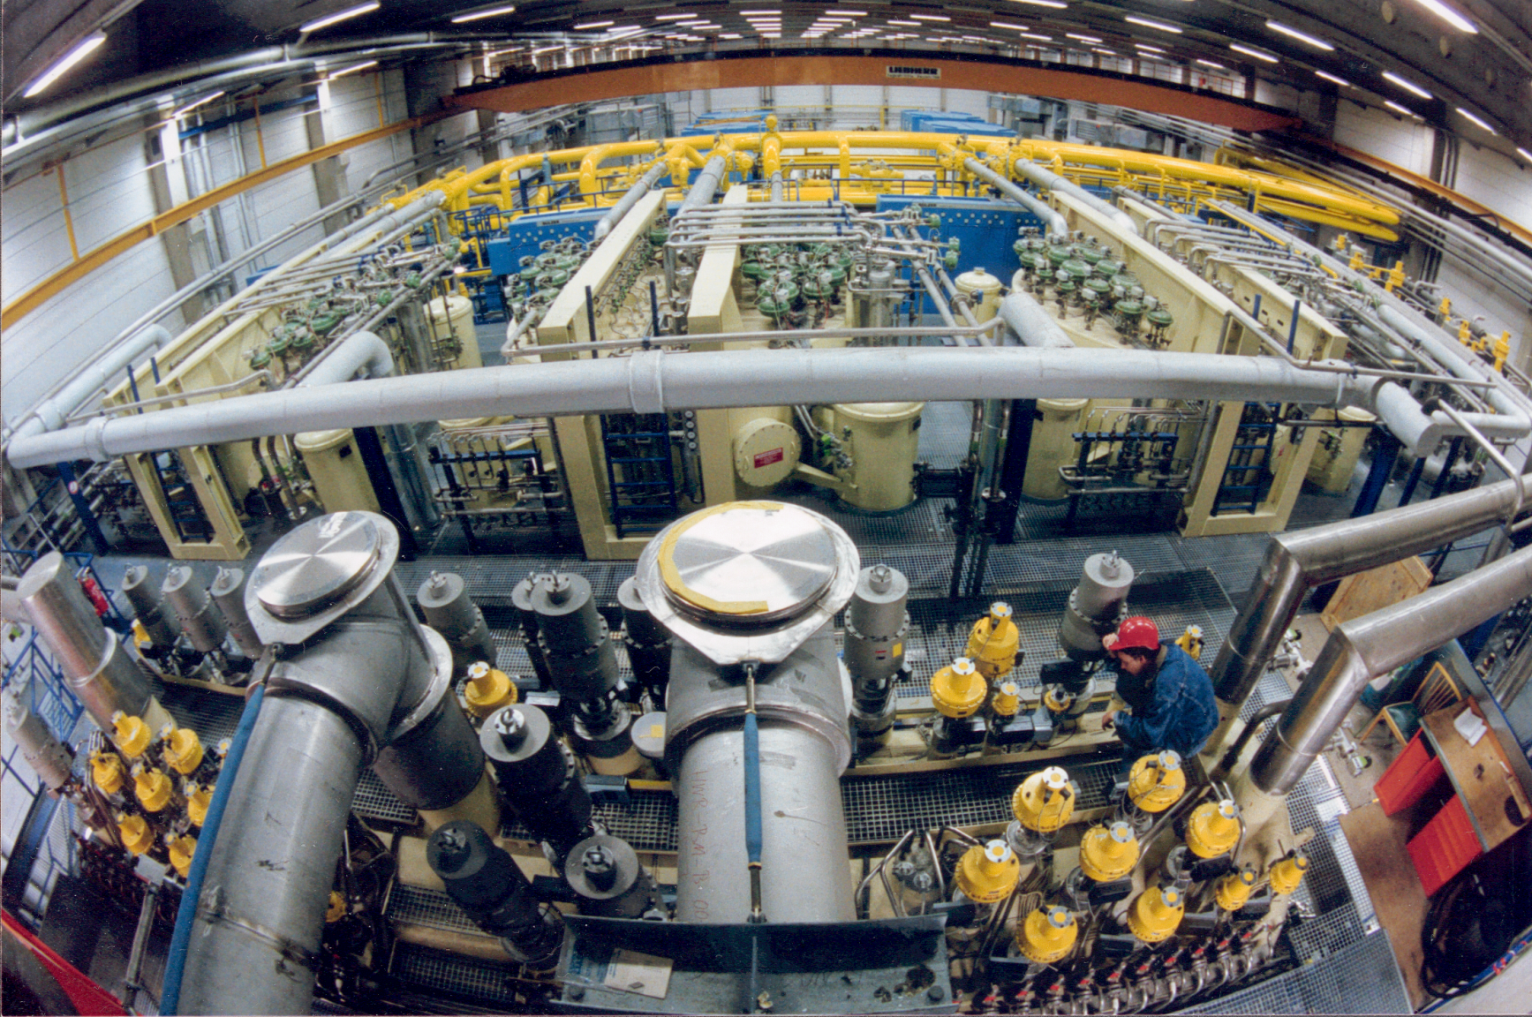
Cryo plant
2 cold boxes for the XFEL-Linac and 1 for FLASH, AMTF and CMTB operation
Former HERA
FLASH
XFEL

Slide 7
The EuXFEL cryogenic system
At 2K since December 2016
AMTF
Shaft
Cryo Plant
SC
SC
SC
SC
SC
SC
Warm
He-Pumps
Cold Compressors
CB44
XRTL
SC
SC
Distribution Box
XLVB
Distribution Box
DB54
Distribution Box
XLVB
Distribution Box
XLVB
Purifier XLTP
Coldbox 41
Coldbox 43
Injector
FB
Distribution Box
XIVB
EC
CM
3.9 GHz
FC
XLTL1
XLTL2
XLTL3
Main Linac
connection foreseen
for a second injector
L1
L2
L3
FC
4 CMs
EC
FC
12 CMs
EC
FC
12 CMs
SCB
SCB
8 CMs
EC

Slide 8
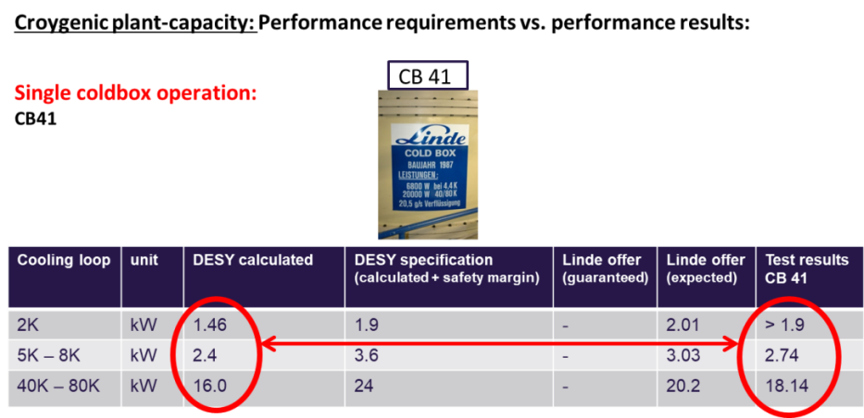
EuXFEL 2K philosophy
Cold and warm compressors
Up to 17,5 GeV operation - only one cryo-plant necessary
Coldbox and Cold Compressors for standard 2K operation
Warm compressors only as backup -> can cover only static losses
    AMTF Test Benches and FLASH operated only with the warm compressors
Warm
Compressors
1000 mbar
31mbar
(2K return flow)
Coldbox 41
1000 mbar
Cold Compressors
CB44
XLTL1
XLTL2
XLTL3
Main Linac
L1
L2
L3
FC
4 CMs
EC
FC
12 CMs
EC
FC
12 CMs
SCB
SCB
8 CMs
EC
EC
CM
3.9 GHz
FC
Injector

Slide 9
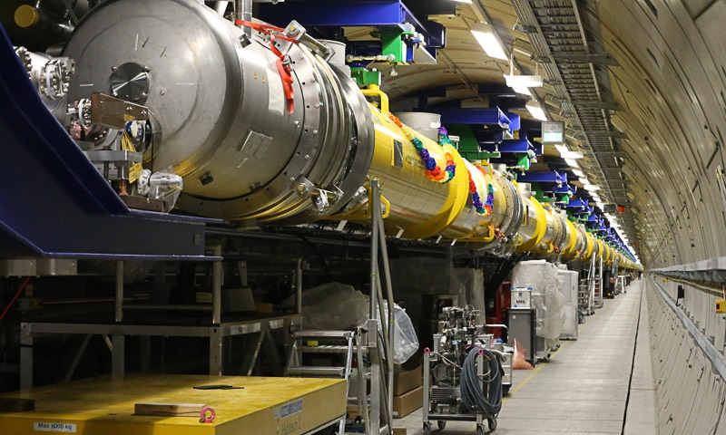
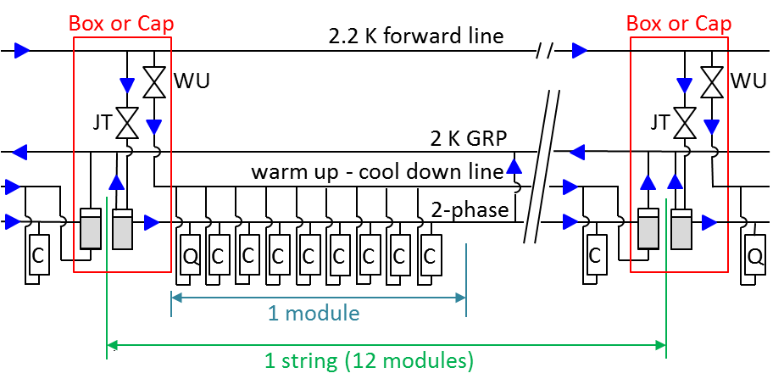
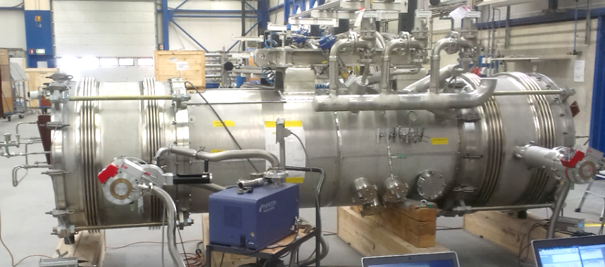
Helium distribution in the linac
Flow scheme for one cold string
2 indipendent sections: injector and main linac
Main linac divided in 3 parts L1, L2, L3, but one big cryosection
(cool down as one)
2K helium divided in smaller strings (CS1 to CS9)
→ end, feed and string connection boxes
JT-valves only in the boxes
Boxes directly attached to the modules
Cryomodules

Slide 10
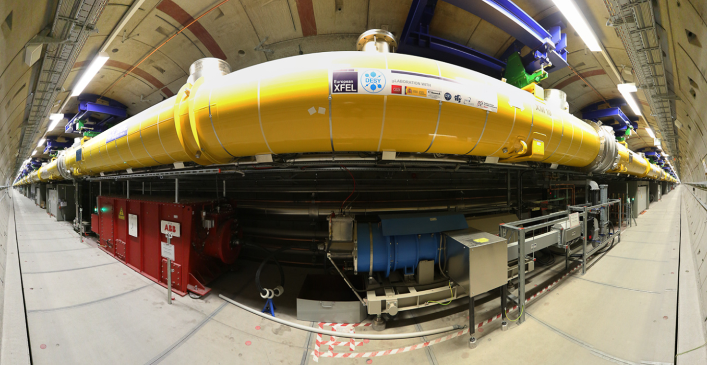
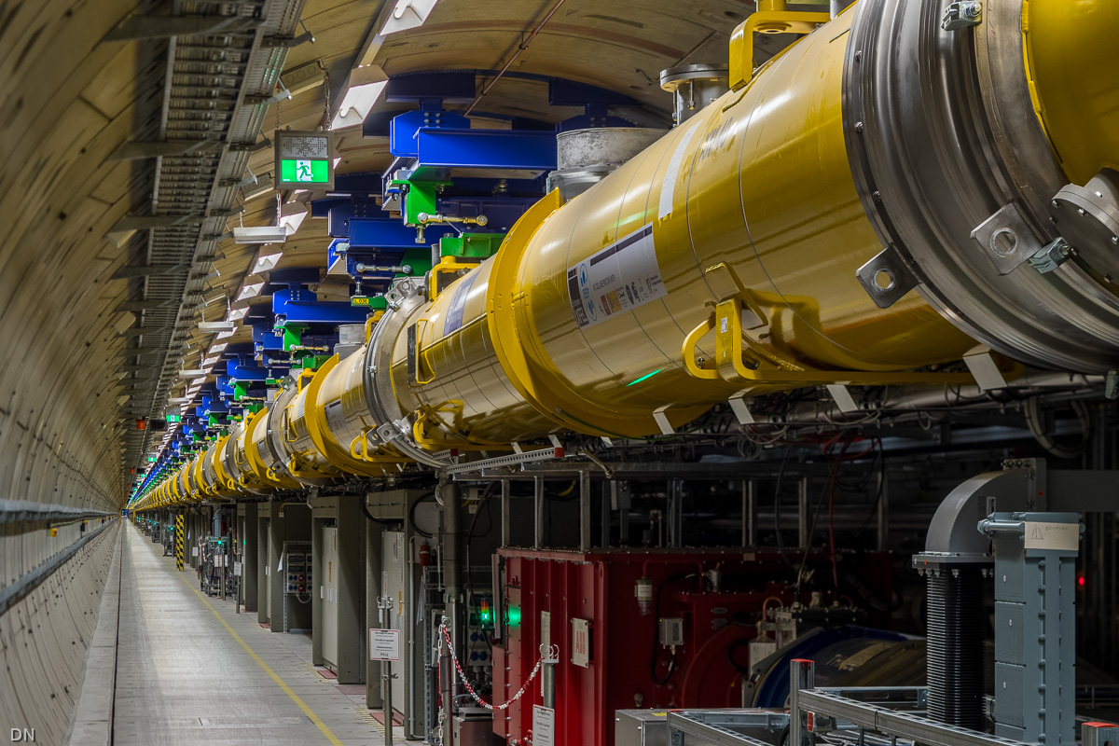
It means “roughly one Kilometer of Cold Linac”
Linear Accelerator (XTL)

Slide 11
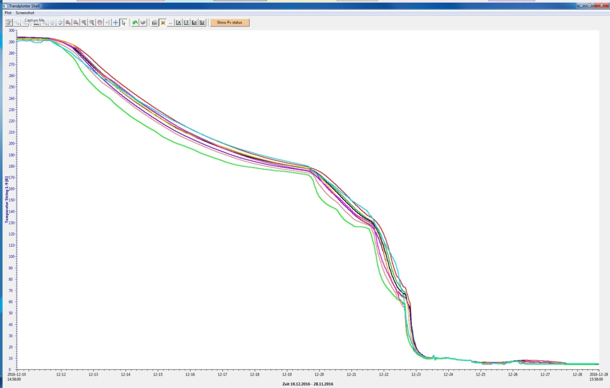
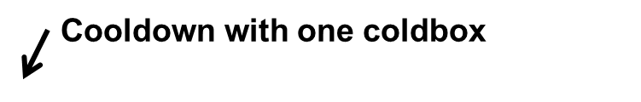
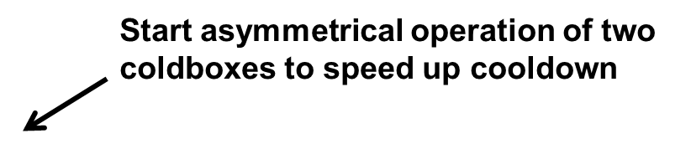
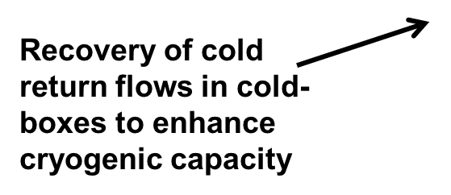
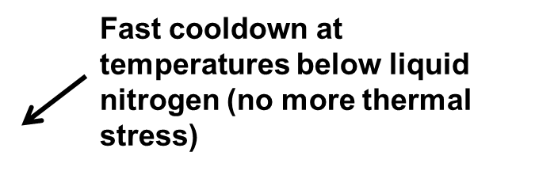
Cool Down curve EuXFEL
First EuXFEL Linac cool down 10.12. – 27.12.2016 -> since then continuously cold

Slide 12
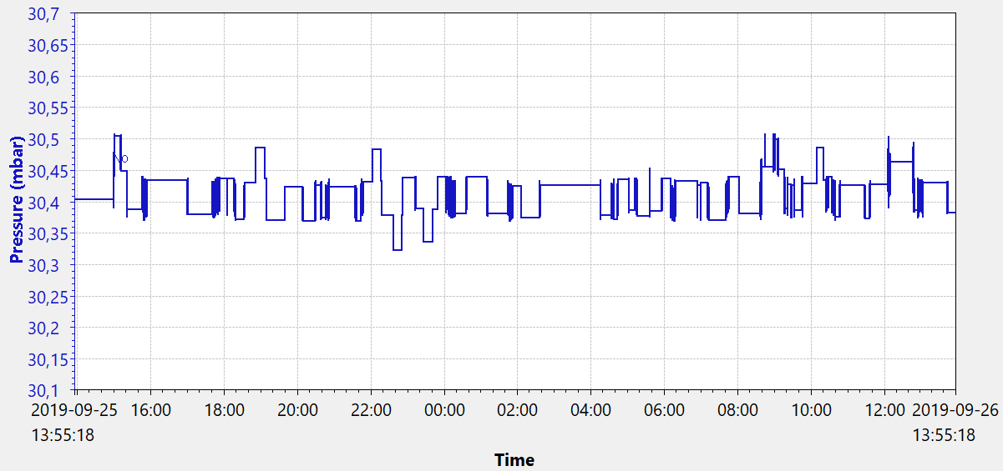
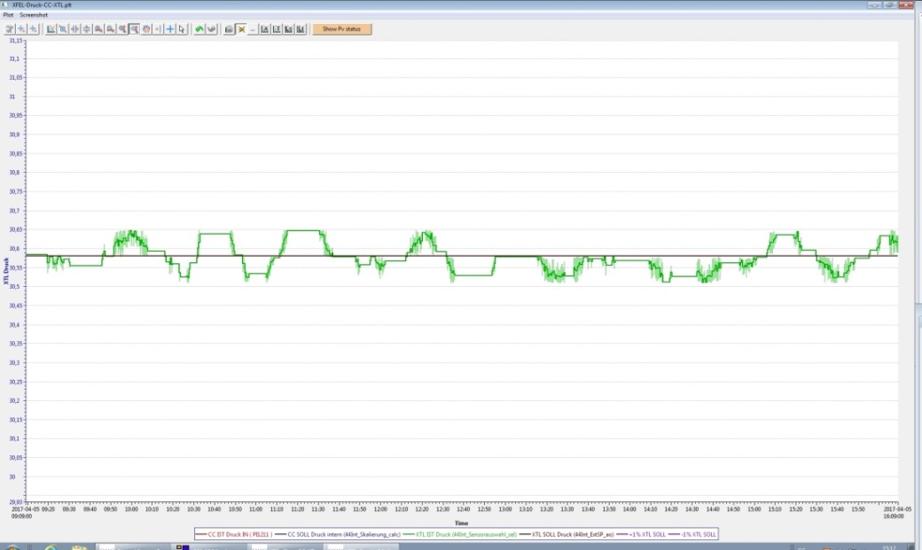
2K Helium pressure stability
Required: +- 1% (0.3 mbar), typically achieved better than +-0.5% (0.15 mbar)
Typical 24h pressure values at the L3 feed cap
  30.9 mbar
2K pressure
  30.6 mbar
1% - pressure stability
  30.3 mbar
05.04.2017 (09:00)
05.04.2017 (16:00)

Slide 13
The EuXFEL cryomodule

Slide 14
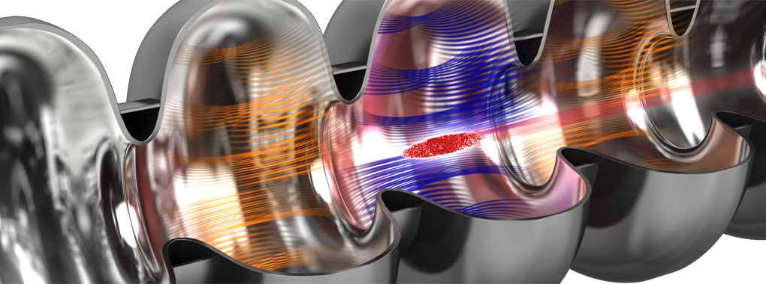
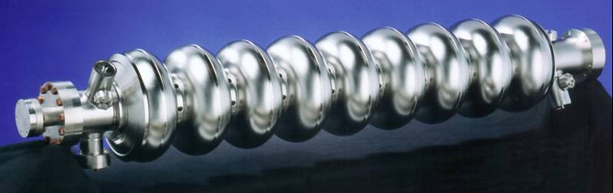
The accelerating cavity
How does it work
The 1.7 km-long particle accelerator brings bunches of electrons to high energies at nearly the speed of light.
The electrons are accelerated in special cavities,
the so-called resonators, where an oscillating
microwave transfers its energy to the electrons.
The resonators are made of the niobium and are superconducting, i.e. nearly the entire electrical power is transferred to the particles.
The electron bunches are generated by knocking the particles out of a piece of metal using a conventional laser.
Source (text and upper picture): https://www.xfel.eu/facility/overview/how_it_works/index_eng.html

Slide 15
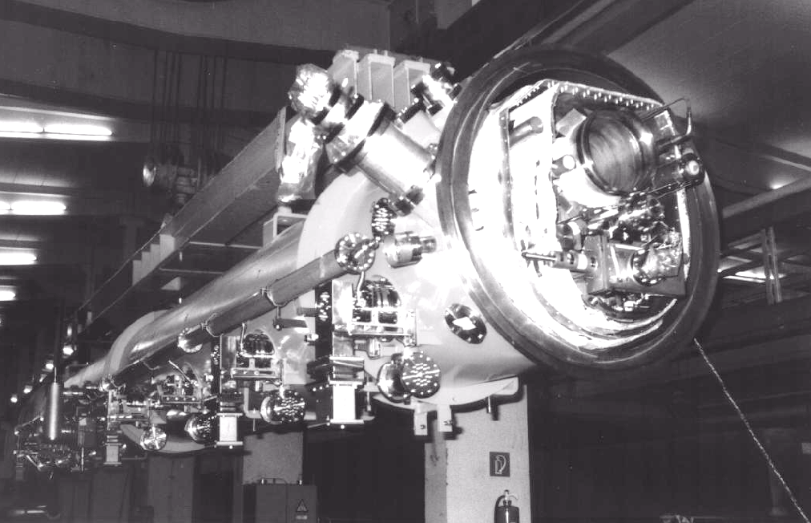
Cryomodules: a short history
Where do we come from
Design based on the TTF cryomodule
  Components developed in a wide international collaboration (DESY, Saclay, Fermilab, INFN-LASA, …)
    “Construction, Commissioning and Cryogenic Performances of the first Tesla Test Facility (TTF) Cryomodule”, C. Pagani, J.G. Weisend et al., 1998”
  3 generations of cryomodules (simplification and optimization for mass production)
  Different stages of the design are installed in FLASH (the Free-Electron LASer in Hamburg)
3 prototypes and 3 pre-series finalized the design for the XFEL
Production and assembly of the different XFEL components
around the world:
  Cavities (IT, DE), Cold Mass and Vacuum Vessel (IT, China),
  Magnet (Spain), Vacuum components (Poland, DE, Russia),
  Couplers (DE, FR, USA), …
  Assembly in France (CEA Saclay)
  Test and installation in Germany (DESY)
1998 design

Slide 16
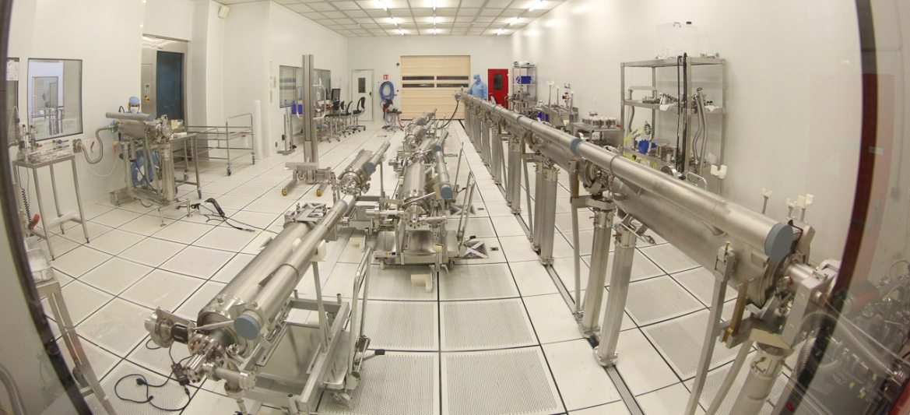
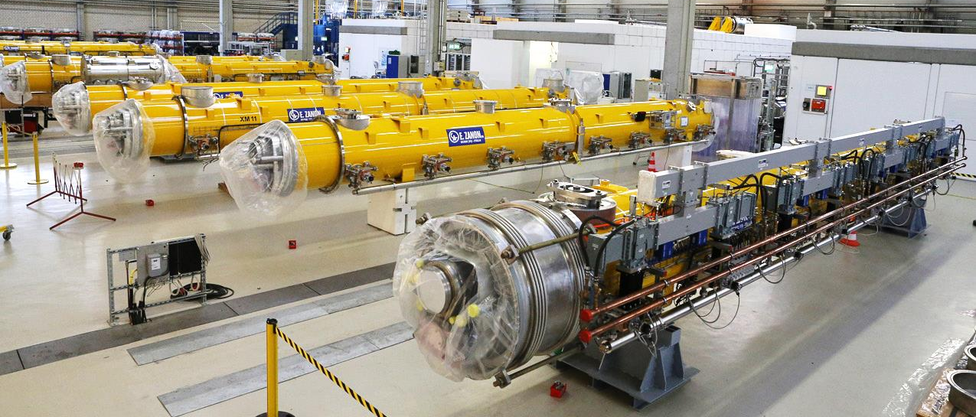
Main features of a cryomodule
What are they for?
Supply the cavity string with 2 K liquid helium
Multi-transfer line for the 2.2 – 80K circuits -> no separate transferlines in the Linac
Mechanically support the cavity string, allowing thermal shrinkage of parts from 300 K to 2 K without introducing
stresses during cool down and warm up
Guarantee the cavity string alignment with a precision
better than 0.5 mm
Thermally isolate the cavity string at 2K from
the 300 K environment
Bring high power RF to the cavity string (coupler)

Slide 17
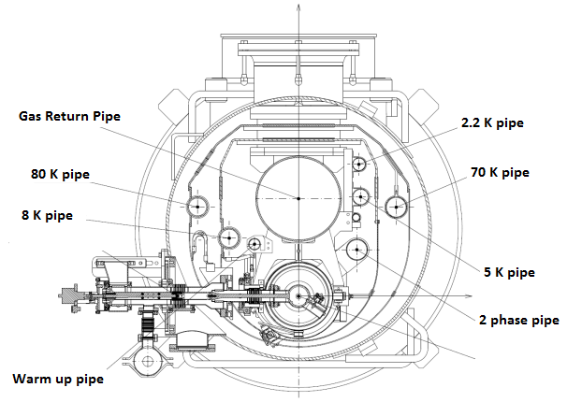
Supply helium
Cryo module cross section
3 main circuits:
  40-80 K thermal shield
  5-8 K thermal shield
  2 K circuit
    Warm up / cool down
    2.2K supply
    2 phase pipe - LHe/GHe supply/return
    GRP GHe return
Cavity-String
  8x 1.3 GHz cavities @2K
  8x main RF-coupler (FPC)
  1x Q-pole magnet @2K
  1x Beam Position Monitor (BPM)

Slide 18
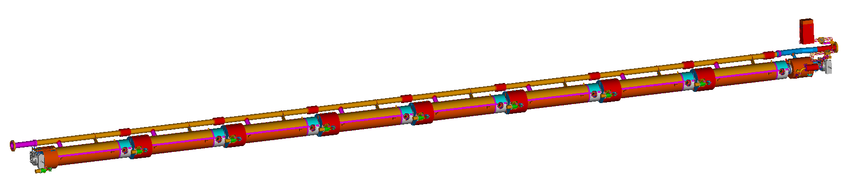
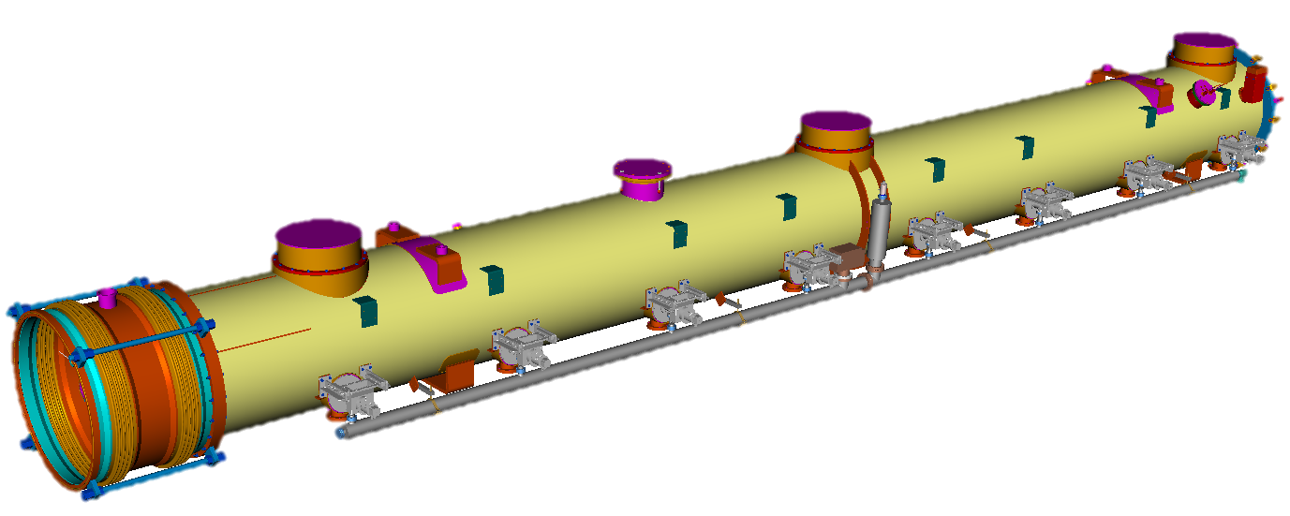
Support of the cavity string 1/2
Cold Mass: includes all service pipes and the cavity string support structures
Cavity-String: 8 SCRF cavities (with helium tank, 2 phase line, tuner with piezos,…, 1 quadrupole and 8 RF-cold couplers
Vacuum Vessel: Cold Mass with Cavity-String and on the outside 8 RF-warm couplers and the whole wave guide system

Slide 19
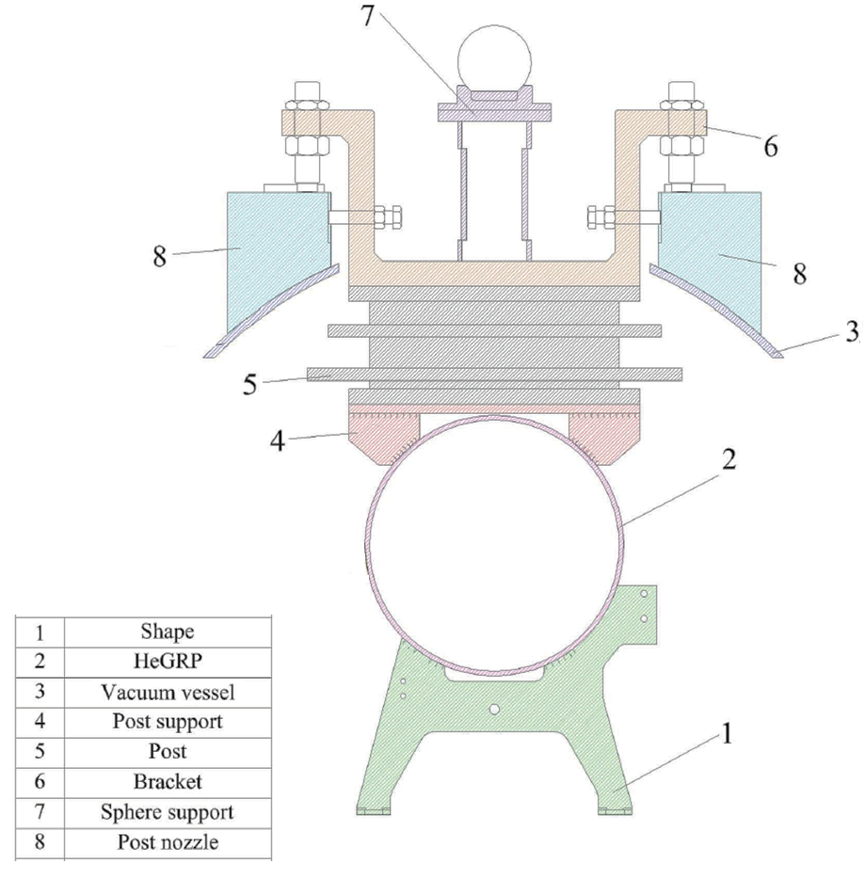
Support of the cavity string 2/2
The vacuum vessel is either hanging from the ceiling of the XFEL tunnel or supported on the floor in the AMTF, CMTB and FLASH
The cold mass is supported via the bracket + post assembly to the vacuum vessel. The center bracket is fixed to the vacuum vessel, while the 2 lateral ones are free to slide longitudinally, to allow the thermal shrinkage of the cold mass without introducing stresses.
Thermal sections:
300K
300 – 2K
2K

Slide 20
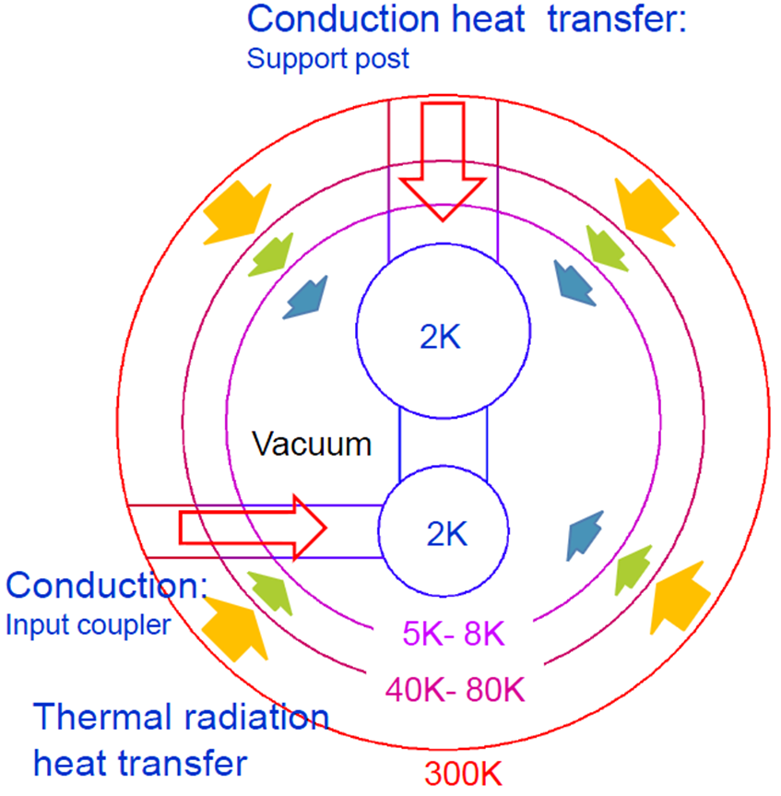
Thermally isolate the cavity string
Image courtesy N. Ohuchi
From 300 k to 2K
Design of the support post:
thin pipe of G10 material to reduce conduction; shirink-fit assembly tecnique to guarantee strength
Thermal shields at 5-8 K and 40-80 K
Thermal intercepts at 4K and 80K to readuce direct conduction 2 K -> 300 K
Isolation vacuum with Multi Layer Insulation (MLI)

Slide 21

Guarantee string alignment (1/2)
Only one fixed point: the middle post (no stresses due to shrinkage)
Coupler longitudinal flexibility (in the mm range)
Cavity string fixed to an invar bar
(integral shrinking coefficient 300 K – 2 K = 0.04 mm/m)
Cavity string support system with rollers: very low friction
Pins between GRP and post and post and brackets,
to reproduce exact position after multiple assemblies

Slide 22
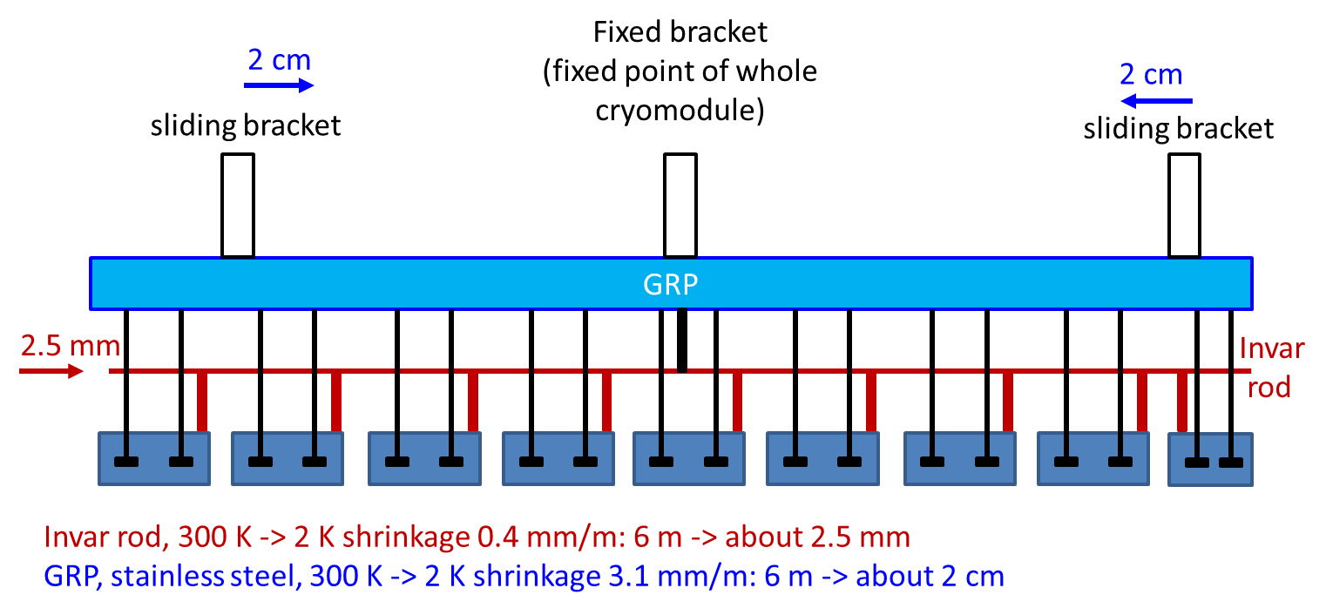
Guarantee string alignment (2/2)

Slide 23
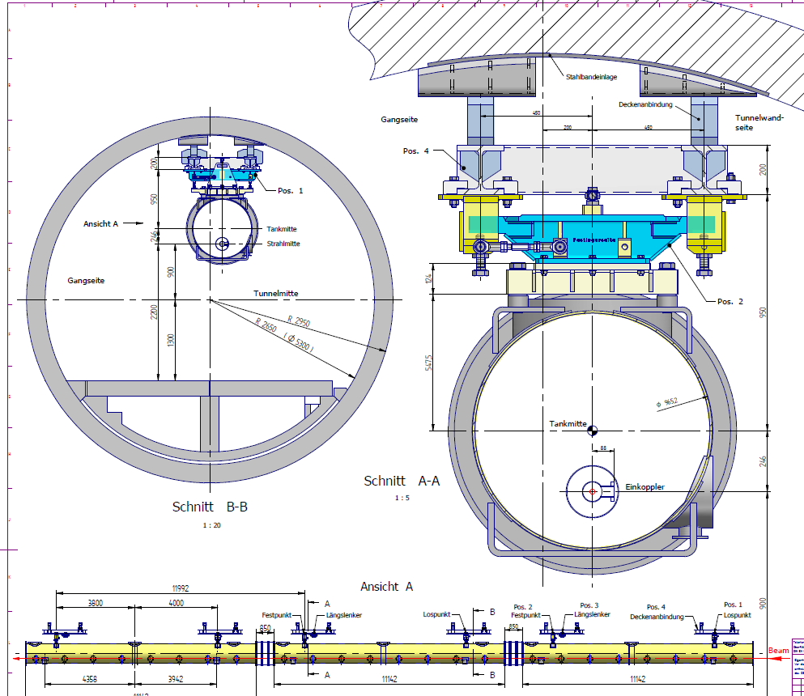
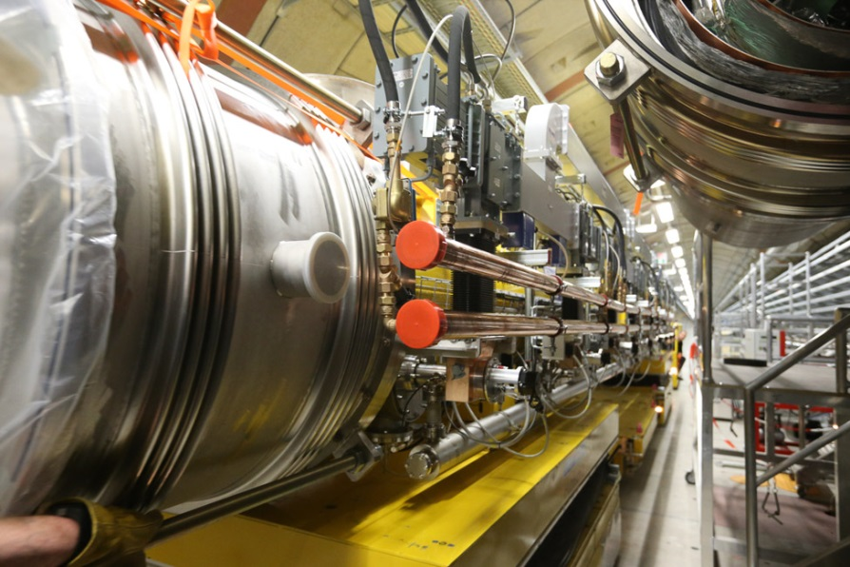
Modules supports @ XFEL
Welded roof frame
Alignment frame (adjustable)
Klystron,
Racks,
etc.
Transport
Line

Slide 24
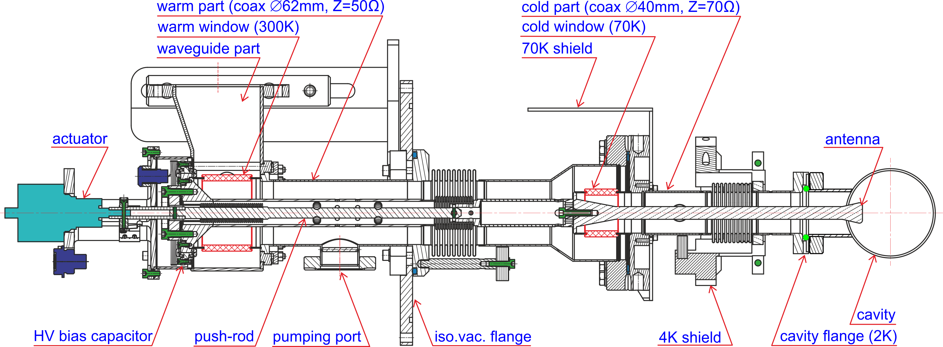
Bring RF to the cavities
Courtesy D. Kostin
The XFEL input RF power coupler
The XFEL coupler consists of warm, cold and waveguide main parts. Coaxial coupler is made of copper and copper plated (10/30µm) stainless steel with 2 alumina TiN coated ceramic windows.
Motorized antenna tuning (±10mm) allows for Qext adjustment (10⁶..10⁷).
All FPCs are pre-conditioned up to 1 MW pulsed RF power up to 400 µs, repetition rate is 10Hz

Slide 25
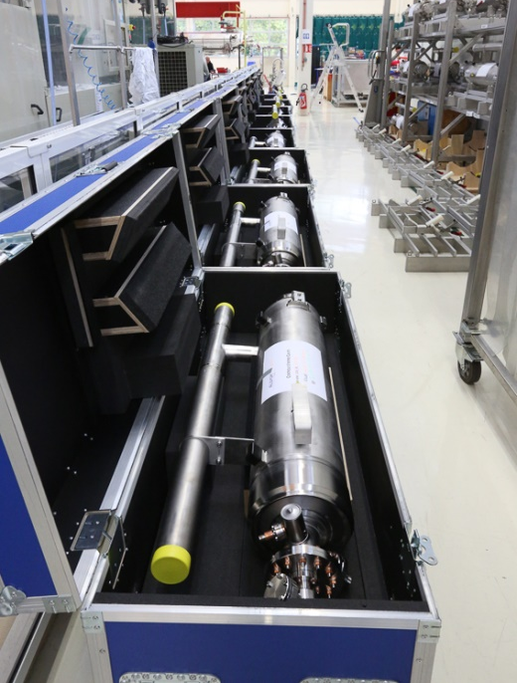
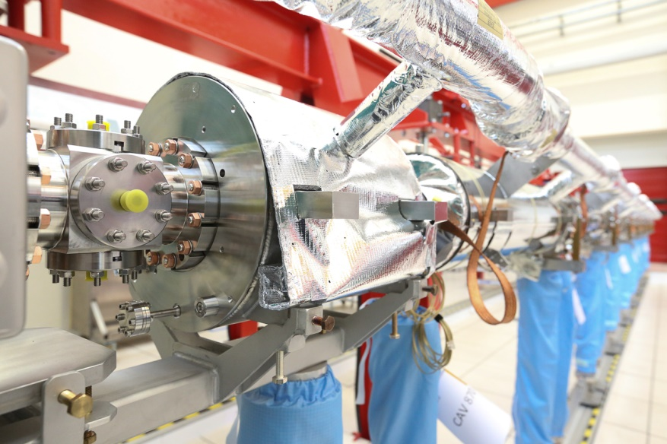
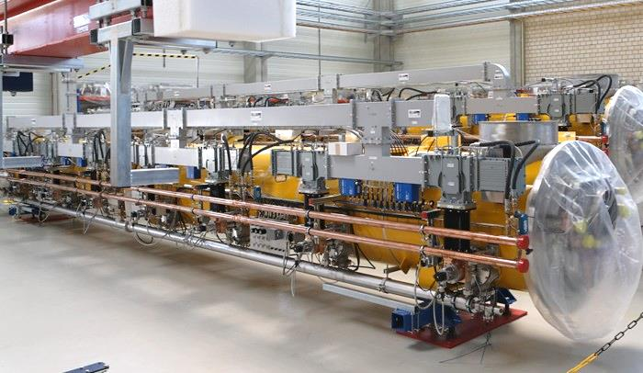
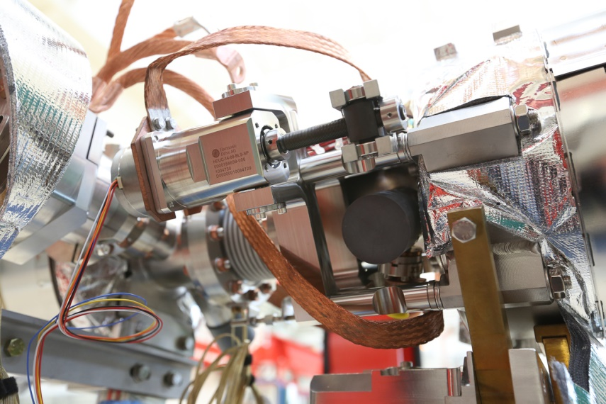
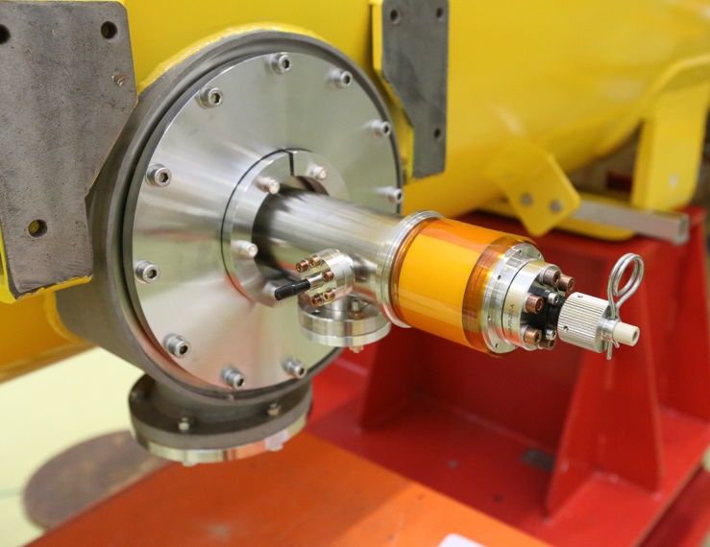
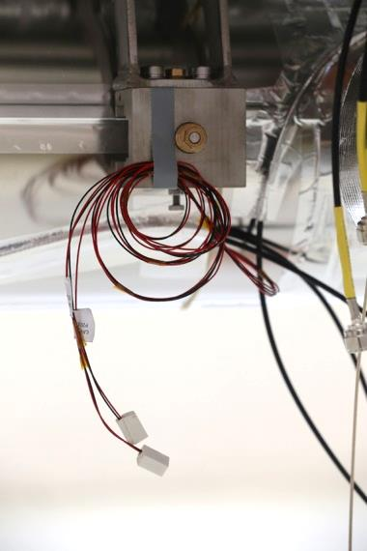
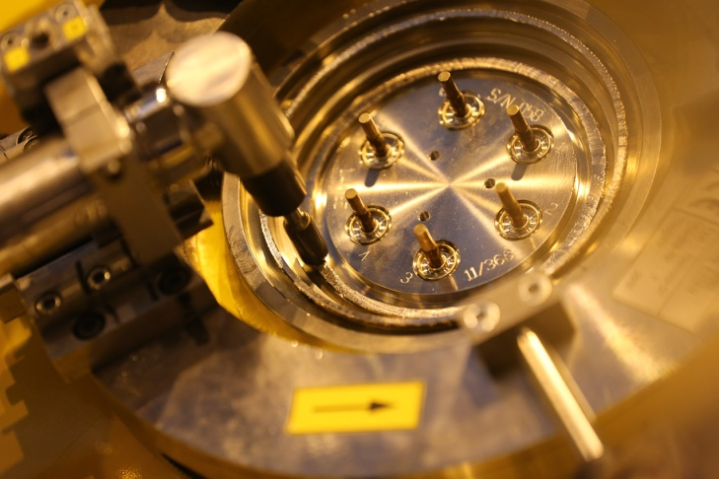
Some cryomodule components
Cavity, magnet and CL, coupler, tuner, HOM, WG, magnetic shielding … only to mention a few
Fully dressed EuXFEL cryomodule

Slide 26
Some additional remarks
Related to cryomodules
  Tunnel “inclination”
  The tunnel itself is laser straight
    -> therefore all components inside the tunnel (modules) have a slight slope (gravity), i.e. the liquid helium level is different at the beginning and at the end of a string of 12 modules
    -> after ~two-thirds of the main accelerator the He supply (JT-valves) is shifted to end of the cryo-string to keep the liquid Helium level lower at the JT-valve than at the end-cap
TÜV / PED, manufacturing
  The accelerator was constructed by DESY but handed over for operation to the XFEL-company (i.e. marketing)
    -> all components has to be build according to the PED and be CE-certified
Transport
  The modules were assembled about 1000 km from Hamburg at CEA-Saclay -> therefore a “closed and tested transport scenario” was necessary
  No transported XFEL module showed transport damages or performance degradations related to the transport.

Slide 27
The EuXFEL CW upgrade

Slide 28
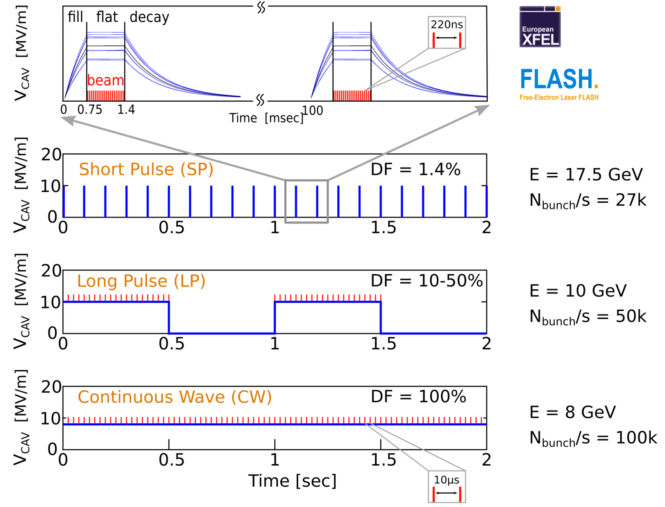
Motivation for Continuous Wave (CW) Operation
Courtesy J. Branlard
Benefits of Continuous Wave (CW) operation
Flexible beam patterns for detectors
Almost any macro pulse structure can be offered
Slower repetition rate lasers
Fill-transients no longer an issue
Benefits of Long Pulse (LP) operation
Still high duty factor (DF = 10-50%)
Higher gradients than CW with same heat load
*
*up to 500 kHz
for 20pC
*
*up to 1 MHz for 20pC

Slide 29
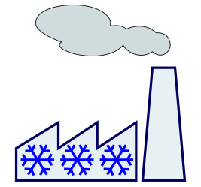
Operating the XFEL in CW (possible upgrade)
Courtesy J. Branlard
Injector
1.3 GHz module
3.9 GHz 3rd harm.
L1
4 modules
(1 RF station)
L2
12 modules
(3 RF stations)
L3
80 modules
(20 RF stations)
SASE2
A2
A3
A4
A5
A2
A3
A4
A5
A6
A25
A6
A29
A1
AH1
A1
AH1
SASE1
1 Module
SASE3
cw optimized modules
Linac section L3
operated at moderate CW gradients
lengthened by former A2 … A5
80 + 12 modules
24 RF stations
Expected energy 8 GeV !
1 – Replace the front-end cryomodules (17x)
  CW cavities higher Q0 / lower cryo-losses
2 – Install CW capable RF sources
  1x IOT per RF station
3 – Double the cryo plant (cost driver)
  2.5 → 5kW
4 – Install CW capable gun:
  RF gun upgrade
The former front-end cryomodules can be installed at the end of the linac to lengthen L3 (+4 RF stations)
No further action required in L3 (>1km)
The upgraded XFEL would be capable of short pulse long pulse AND continuous wave operation

Slide 30
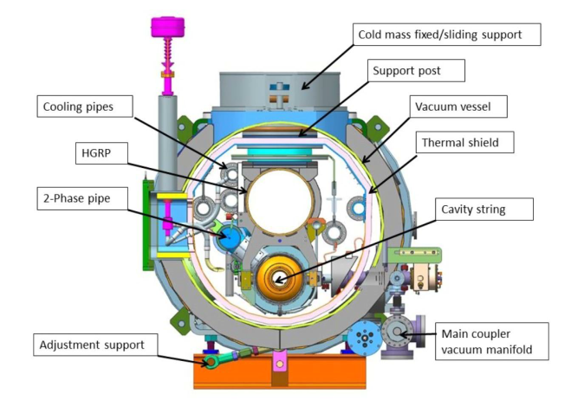
What does it mean for cryogenic and cryomodules
Our first thoughts…
Much higher Heat loads!
  New cryoplant needed
  New cryo-distribution needed
New modules for high gradient CW (e.g. LCLSII)
  Bigger 2-phase pipe
  JT and LHe level control in the module?
  Modifications at the RF Power Coupler possible
  Design changes of the tuner system inc. piezos
  Microphonics vs Lorentz Force Detuning compensation
  Better thermalisation
  Fast cool down capabilities
Thermoacoustic oscillations in modules and cryo system
Test stand upgrade / modifications
  Different He distribution
  Fast cool down capabilities
  Inductive Output Tube (IOT) in AMTF
  New test environment for SC GUN in AMTF
Injector: NC vs SC gun -> R&D ongoing @DESY
LCLSII cryomodule

Slide 31
Thank you

Slide 32
Abstract
Title: “Present status and possible upgrade of the XFEL cryomodules”
The European X-Ray Free-Electron Laser Facility (European XFEL) is an X-ray research laser facility located in Germany. The European XFEL superconducting accelerator is now running at 2K since almost 2 years. The cold linac consists of 96 assembled cryomodules, 6 feed/end boxes and 6 string connection boxes fixed to the ceiling of the accelerator tunnel; the injector consists of a radio frequency gun, one 1.3 GHz and one 3.9 GHz cryomodule, one feed and one end cap lying on ground supports.
We give in this talk a brief introduction on the cryogenic structure of the European XFEL cold linac, followed by a deeper description of the cryomodules and their main components and we conclude presenting the challenges in the cryomodule design to allow a future CW operation of the machine.

