Slide 1
Analytics for Cold Hydrogen Isotopologues at the Tritium Laboratory Karlsruhe
Robin Größle, Bennet Krasch, Alexander Kraus, Sebastian Mirz,
Florian Priester, Marco Röllig, Stefan Welte
robin.groessle@kit.edu
Spectrum taken with a DVD spectrometer
and mobile phone camera
Photo from a multiphase mixture of Neon and D2

Slide 2
Outline
The Tritium Laboratory Karlsruhe
Cryogenic distillation for isotope separation
Direct ortho-para measurement for distillation and catalyst investigation
IR absorption spectroscopy of liquid Hydrogen isotopologues
New challenges at UCN Sources
Tritium trace detection and monitoring

Slide 3
The Tritium Laboratory Karlsruhe

Slide 4
Three isotopes of hydrogen
ortho/para
Hydrogen (H)
p⁺
stable
H₂
D₂
n
stable
Deuterium (D)
p⁺
T₂
ortho/para
p⁺
HD
Tritium (T)
n
unstable
(radioactive)
n
HT
DT

Slide 5
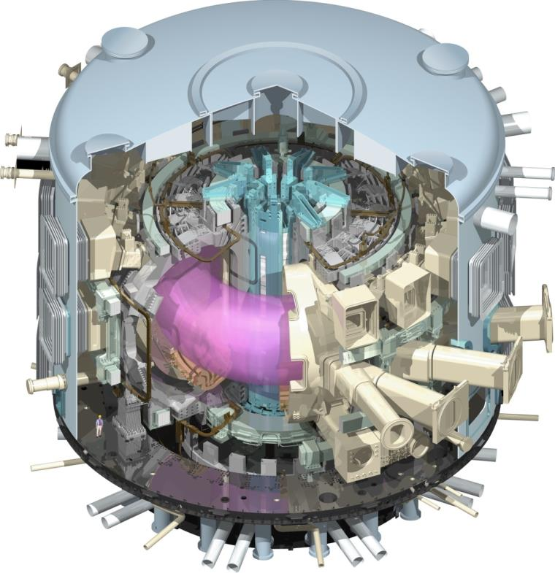
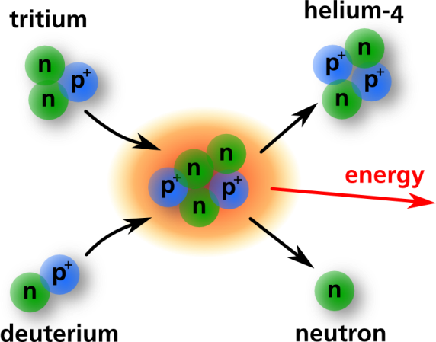
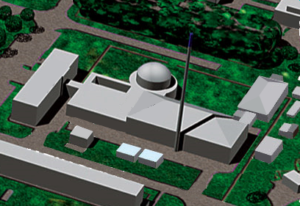
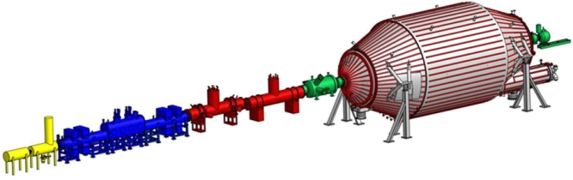
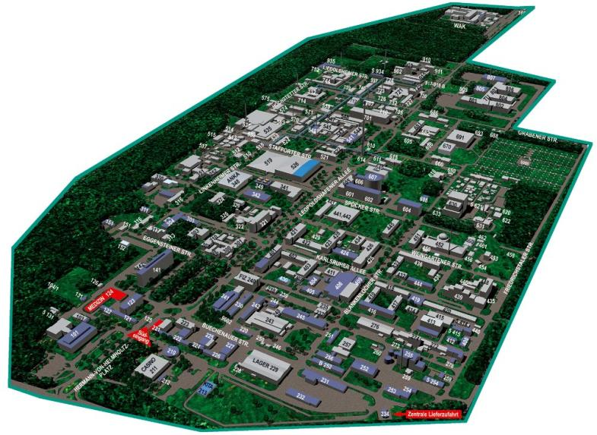
Tritium Laboratory Karlsruhe
Tritium Laboratory Karlsruhe (TLK)
Commissioning 1993
~50 persons
Licensed for 40 g of tritium
Actual R&D focus on:
  Tritium fuel cycle for fusion reactors
  KATRIN Experiment
Karlsruhe Institute of Technology Campus North

Slide 6
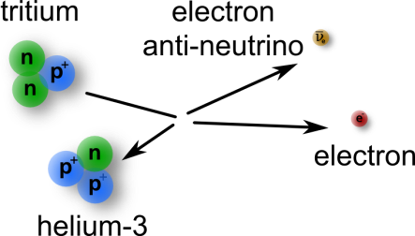
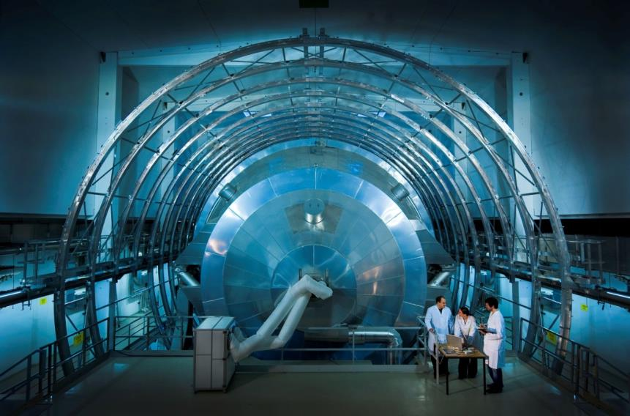
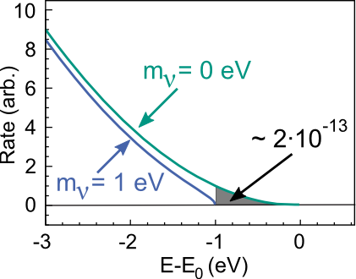
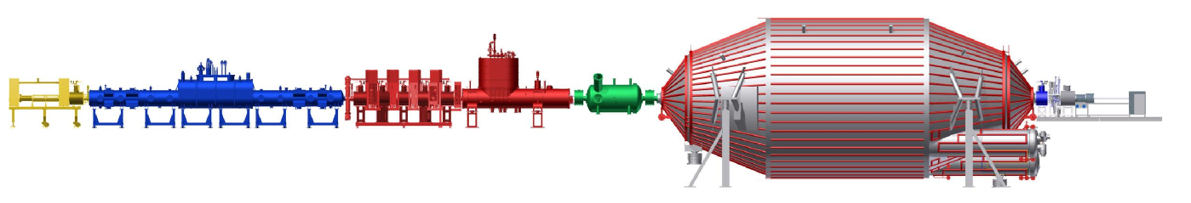
The KATRIN Experiment
Tritium throughput 40g /day

Slide 7
Fusion power using tritium
Fusion reactor ITER
T ~ 100 Mio. °C
Tritium throughput in a power plant >10 kg /day
Iter.org

Slide 8
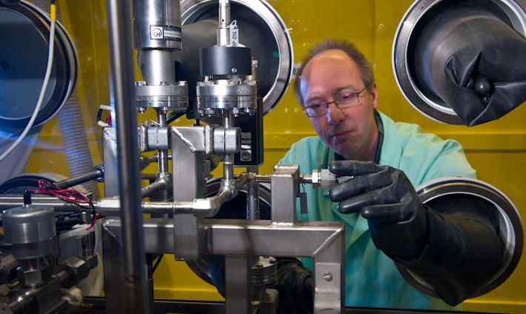
Tritium Handling Basics
Tritium is:
“highly reactive”,
radio active and
expensive.
→closed tritium cycle
This means:
high vacuum leak tight,
full metal,
tritium recovery and
isotope separation
systems.
And everything in a second barrier.

Slide 9
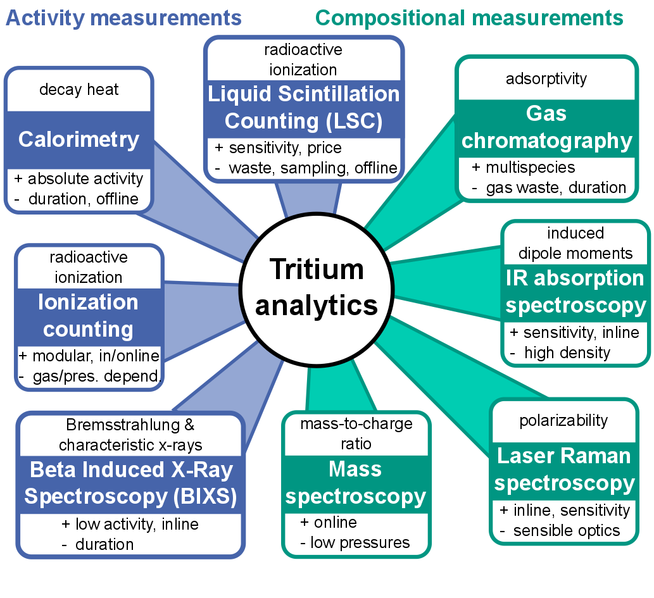

R&D topics at the TLK
Interaction of Tritium with other materials:
  Ad-, physi- and chemisorption on the surface
  Diffusion through the material
  De-solving in the bulk
  Chemical and ortho para catalysis
Tritium cycle systems
  Water detritiation by liquid phase catalytic exchange
  Isotope separation by gaschromatography or cryogenic distillation
  Tritium extraction from Lithium Lead (basics and technology)
  Tritium and Hydrogen traps and storage (metal hydrides,…)
  Tritium diffusion through first barriers (heat exchanger,…)
Tritium and Hydrogen analytics

Slide 10
cryogenic distillation for isotope separtion

Slide 11
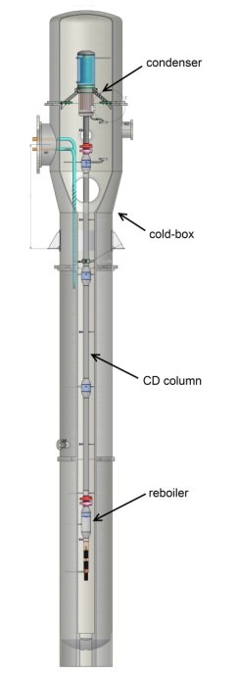
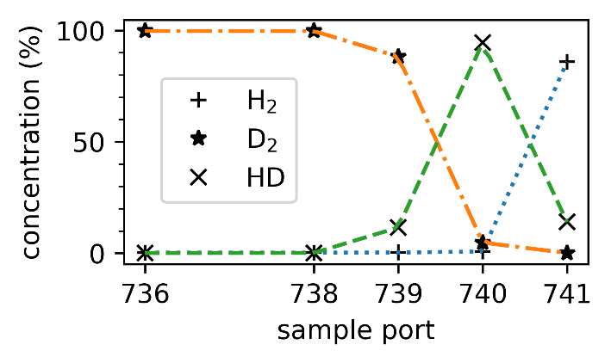
Isotope separtion by cryogenic distillation
~20 K
condenser
molecular composition measured with QMS
cold box
column
reboiler
4
3
2
condenser
reboiler
R&D activities include test of different column geometries, packing materials and analytic systems.
~25 K

Slide 12
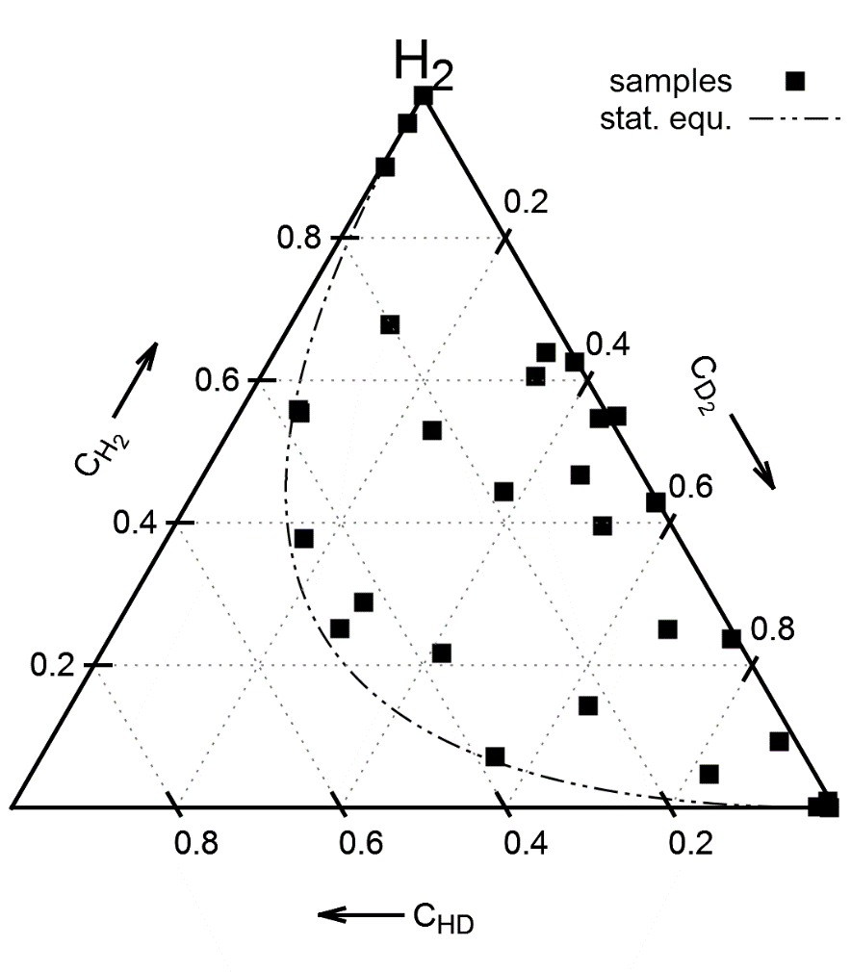
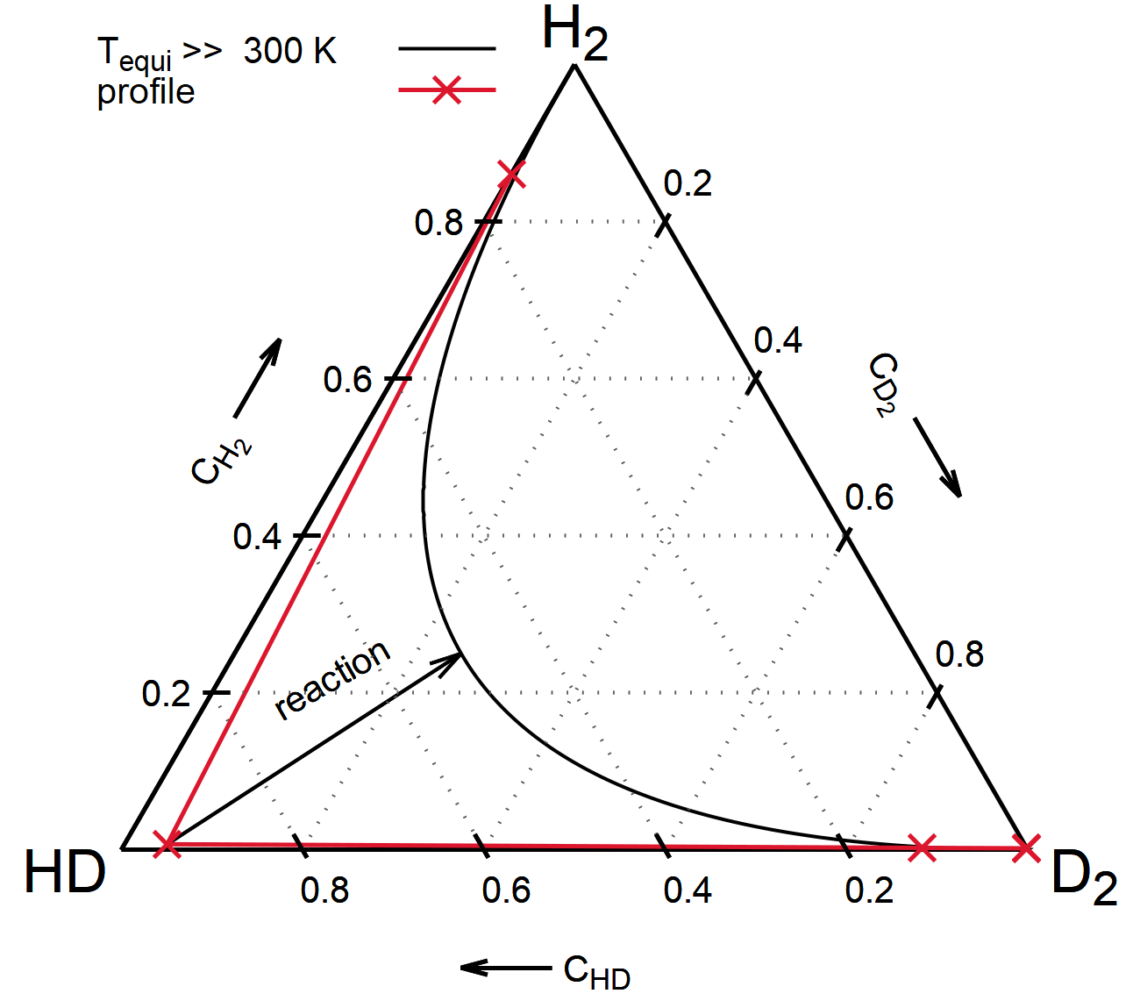
Producing HD samples above the thermal equilibrium
HD distillation (example)
  80% H and 20% D
  Maximum HD concentration by catalysis: 32 %
  Maximum HD concentration in CD column: >94 %
  HD concentration in 10 mol sample: 82 %
Samples used for cross calibration of
  QMS
  IR on liquid phase (~20 K)
  Raman in gas phase (~293 K)

Slide 13
Direct ortho-para measurement for distillation and catalyst Investigation

Slide 14
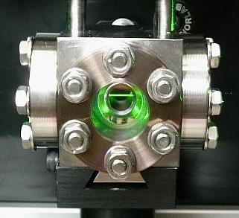
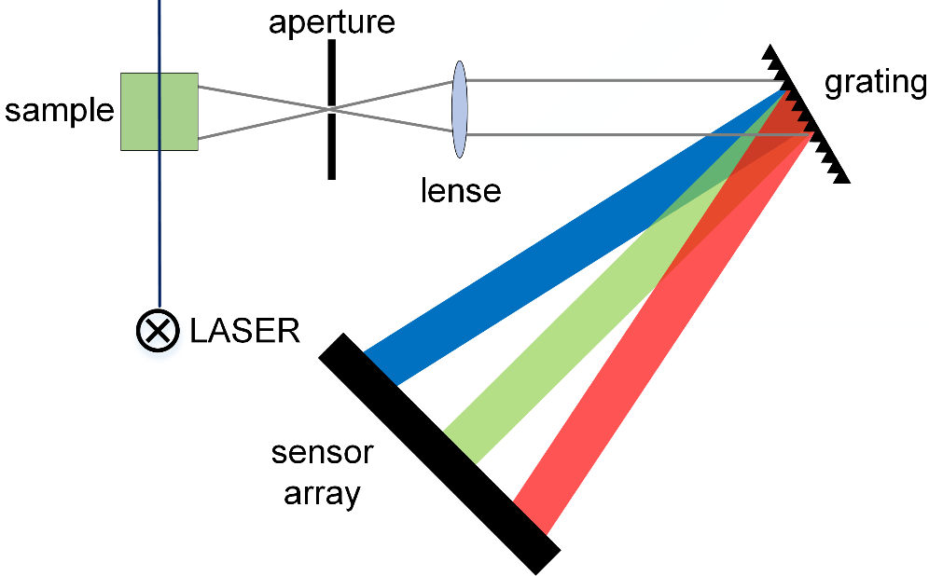
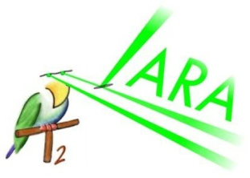
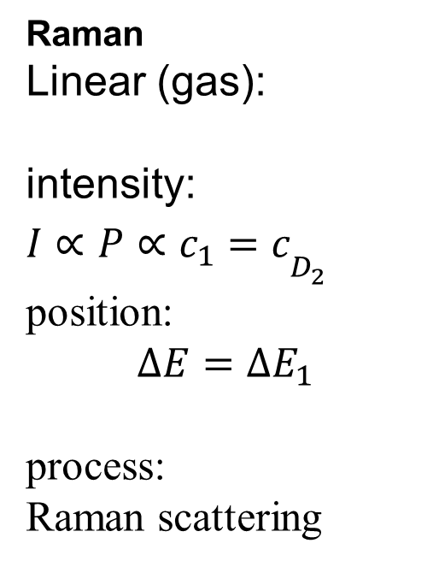
Raman spectroscopy on hydrogen isotopologues
Raman
Linear (gas):
intensity:
$I∝P∝c_{1}=c_{D_{2}^{}}^{}$
position:
$$ΔE=ΔE_{1}$$
process:
Raman scattering

Slide 15
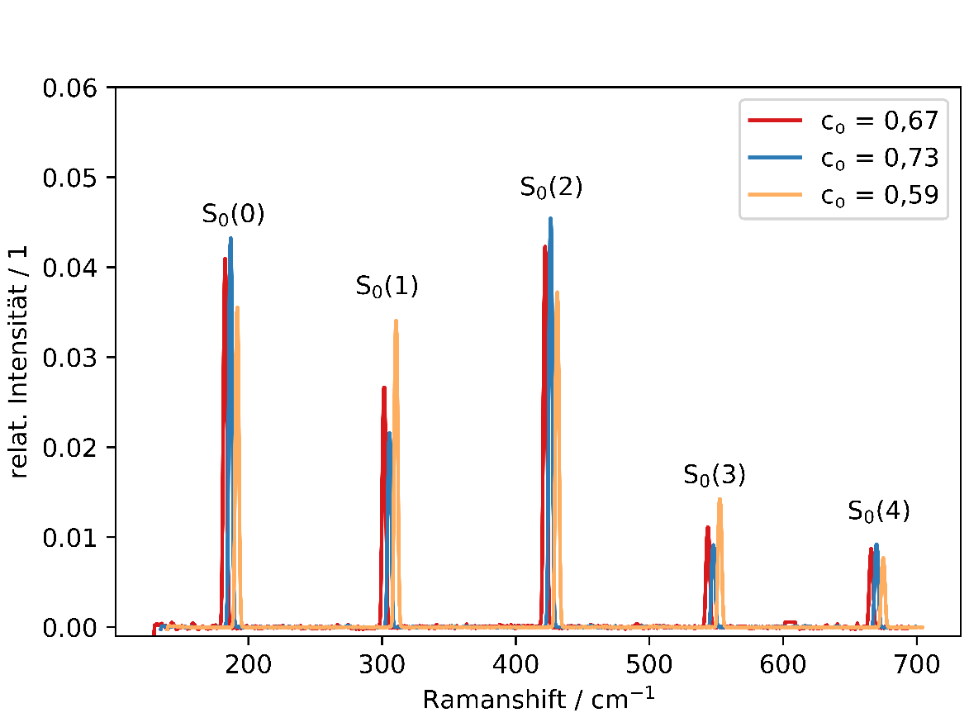
Producing D₂ para samples above the thermal equilibrium by distillation
Recent measurements:
First test measurements of D₂ distillation (example):
Feed n-D2 with 33% para
Para concentration:
  Feed: 33%
  Top: 27%
  Bottom: 41%
Highest para concentration yet 49.9%
spectra shifted for visualization
Preliminary
BA Daniel Kurz
Raman spectroscopy ideal for molecular composition and direct ortho para measurement.
Four systems in operation, two of them in 24/7 operation
Main molecular composition diagnostic tool for KATRIN
Ortho para catalyst kinetics under investigation

Slide 16
Efficient hydrogen liquefaction
Ortho-para catalyst
Heat exchanger
Cooling agent
n-H2
e-H2
He, Ne…
temperature
[Wilhelmson2018]

Slide 17
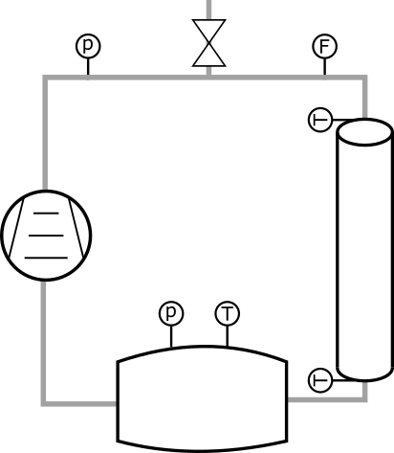
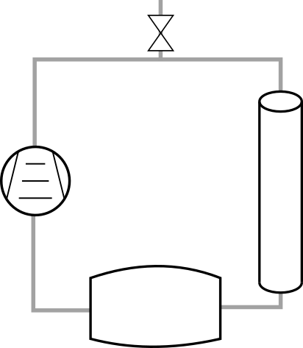


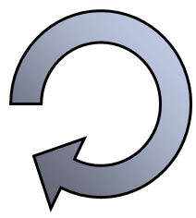


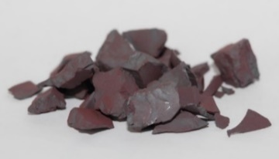
Experimental characterisation of o-p-catalysts
pressure
temperature
flow
material
Notes:
KLÄREN: Was können wir messen, was macht die Simulation
Am besten hier schon anbringen

Slide 18
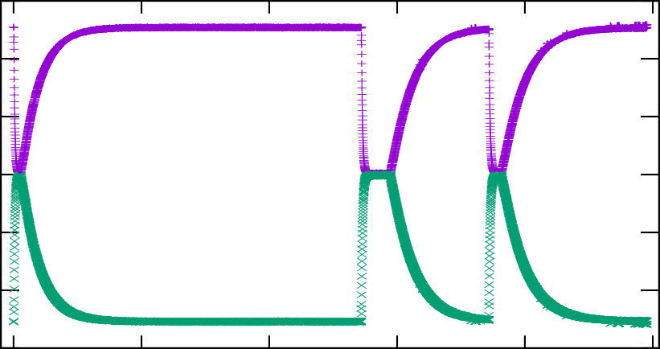
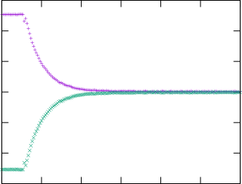





Ortho-para-conversion kinetics of H₂ on Fe₂O₃ (77K and 300K)
0.7
0.7
ortho
0.6
0.6
$k=4.8 h^{−1}$
0.5
Ortho-para fraction (1)
0.5
0.4
0.4
0.3
para
0.3
65
65.5
66
66.5
67
0
25
50
75
100
125
time (h)
Notes:
GG adsoprtion desorption (T, p_part)
Sorption and conversion not visible
Reaktion 1. Ordnung für Fe2O3

Slide 19
IR absorption spectroscopy of liquid Hydrogen isotopologues

Slide 20
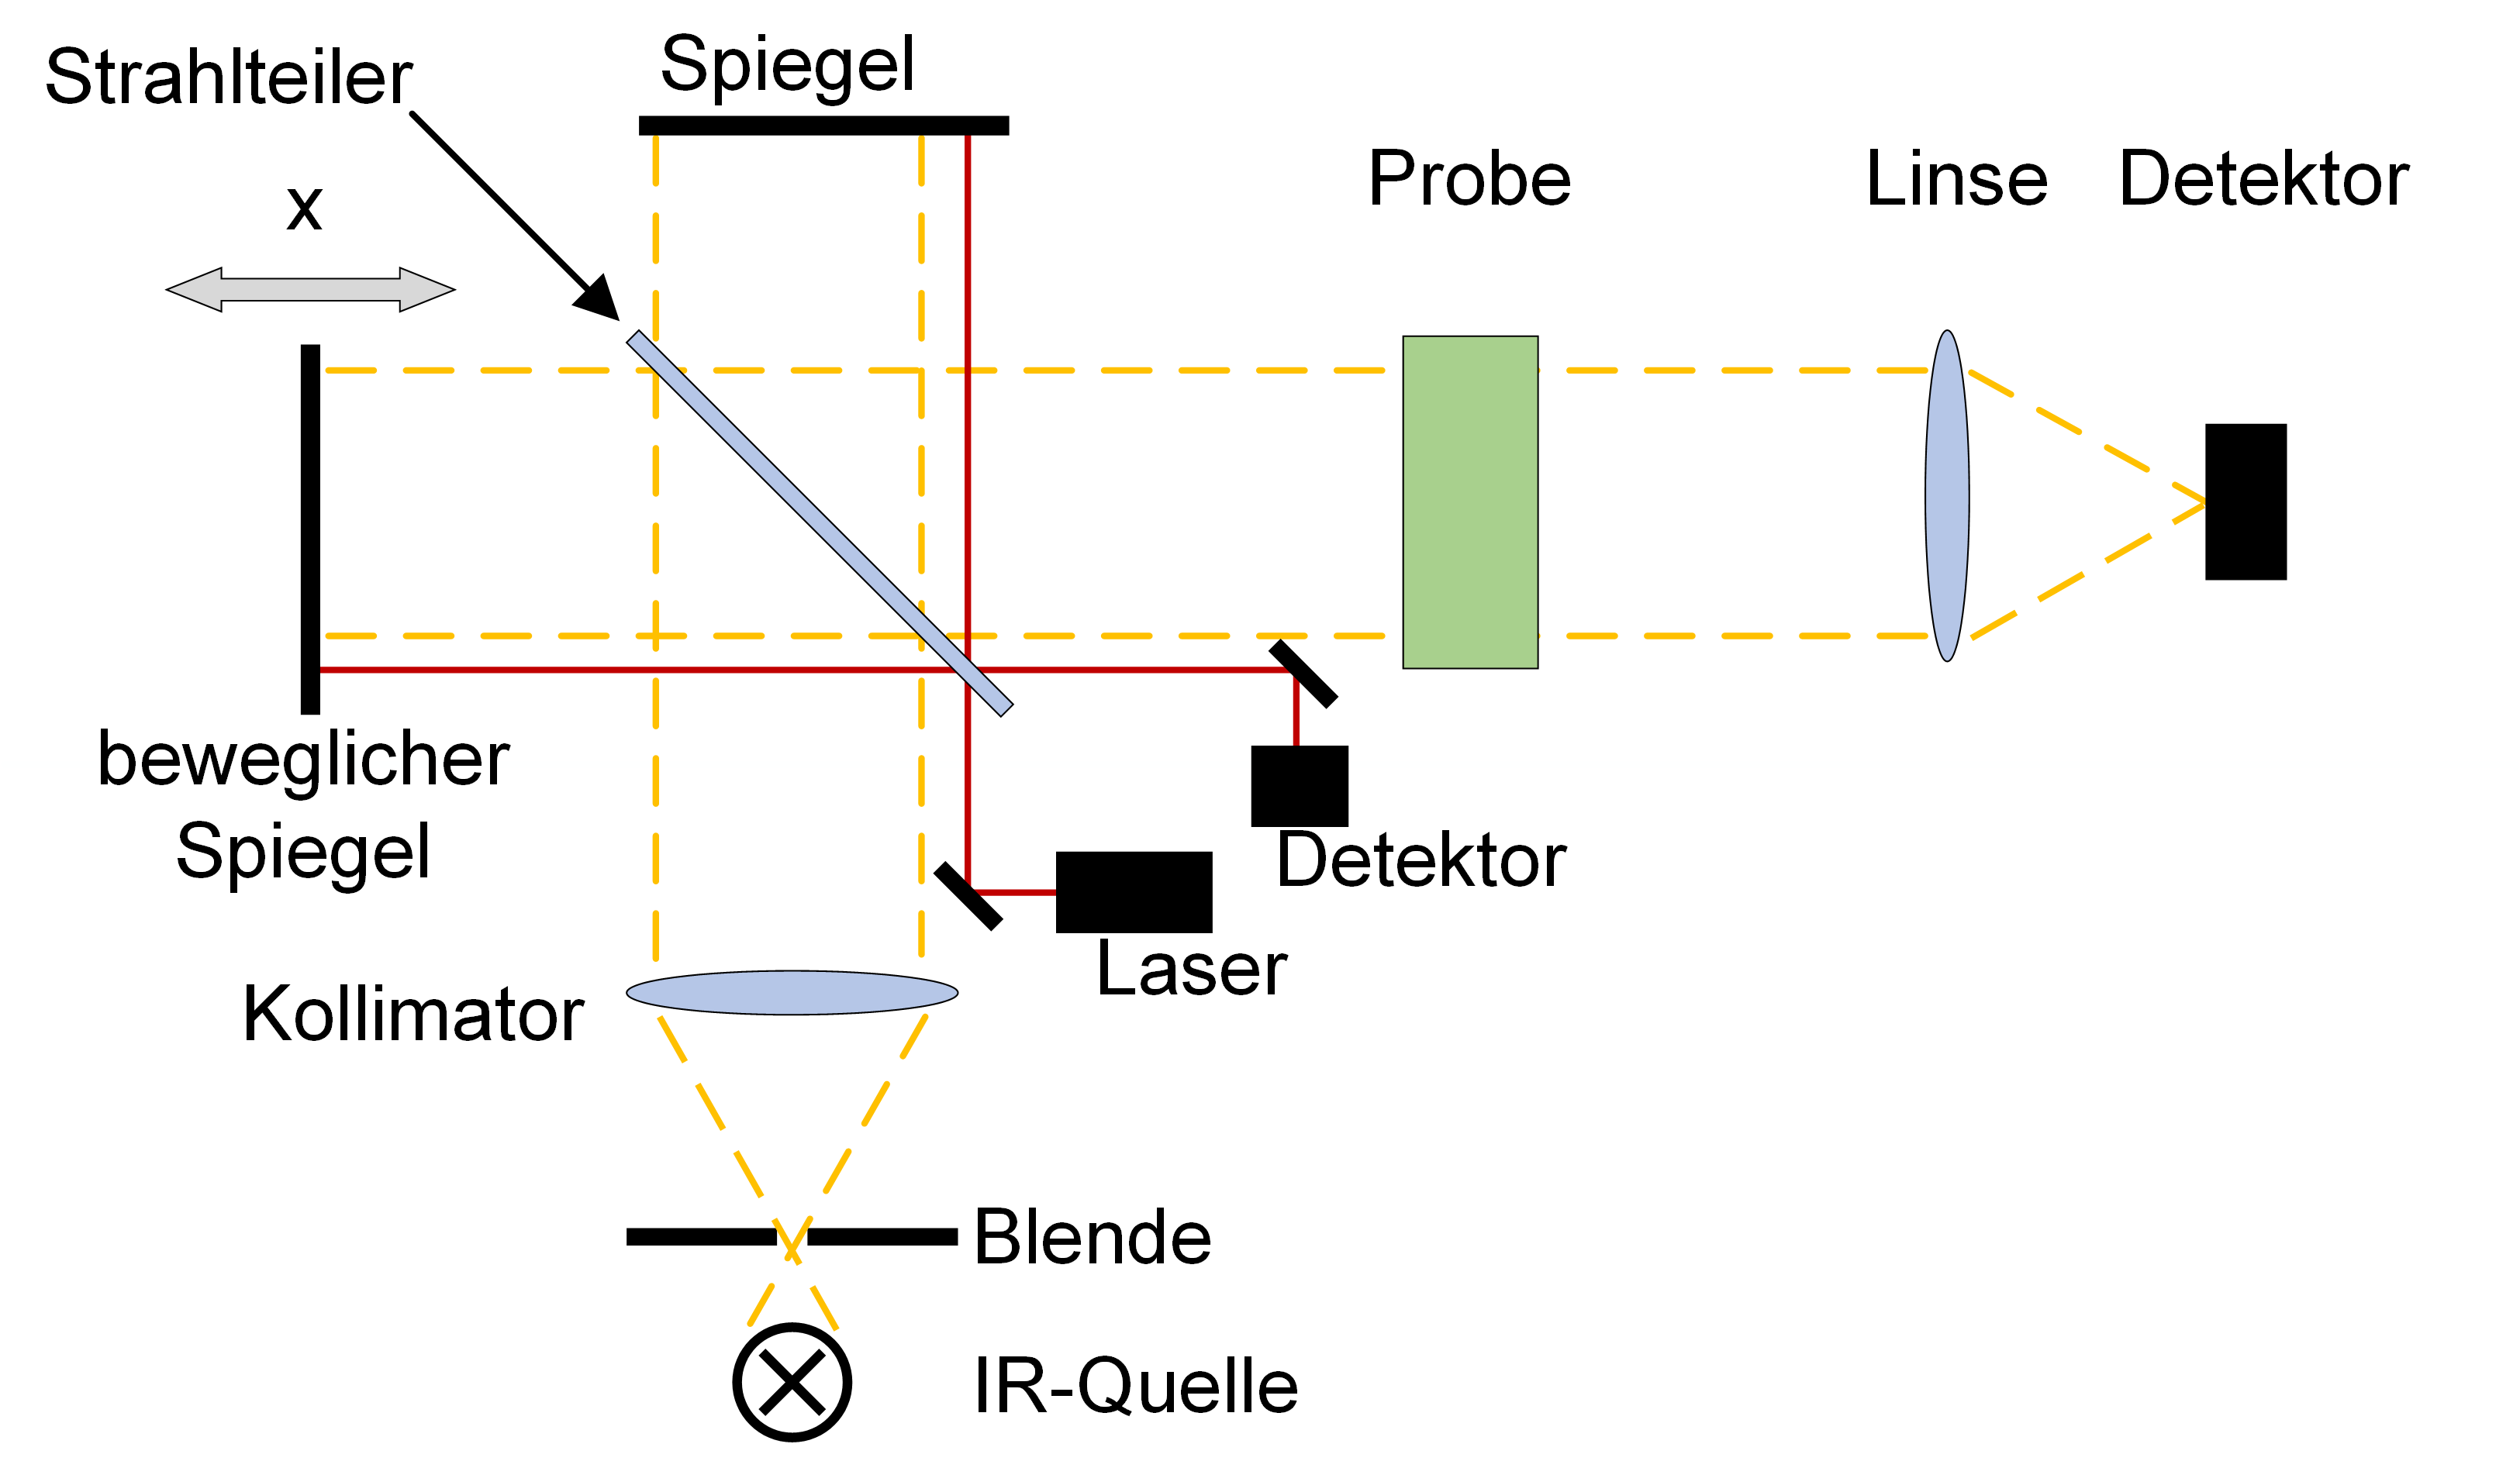

FTIR-absorption spectroscopy on liquid hydrogen isotpologues
precision: 0.01 cm⁻¹
resolution: 0.4 cm⁻¹
spectral range:
~2000 to ~10000 cm⁻¹
TApIR

Slide 21
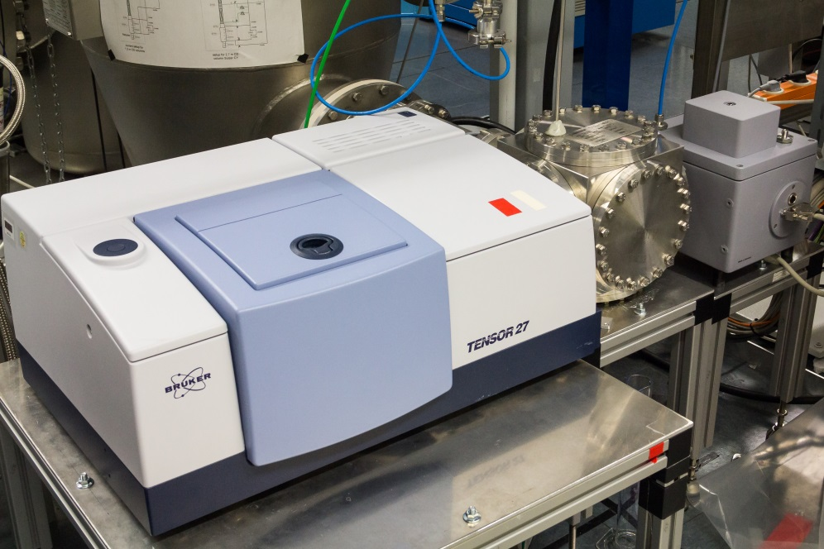
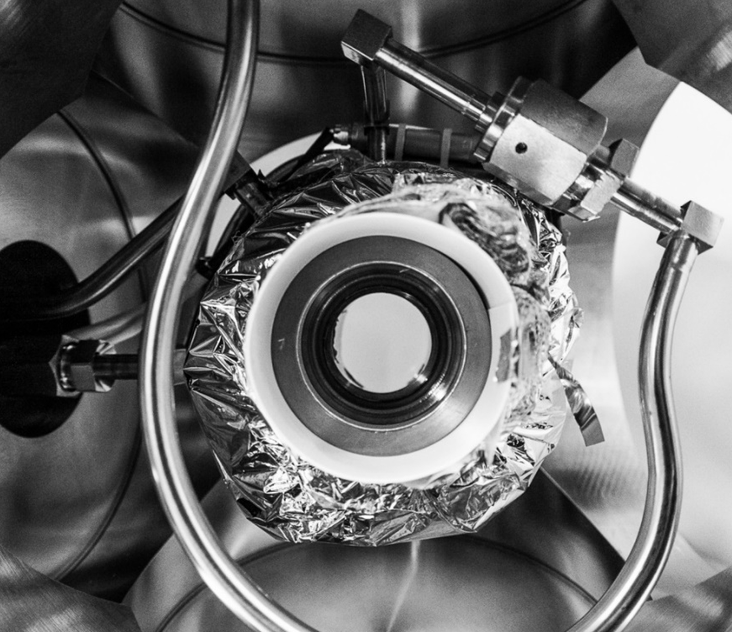
IR-spectroscopy for o-p-conversion investigation in liquid hydrogen
detector
He
Q₂
cryo cell
IR-spectrometer
Saphire windows
cryo cell

Slide 22
IR Absorption on dense Hydrogen isotopologues
Single molecule:
Due to symmetry
very weak transitional matrix elements
and no IR absorption
ortho para H₂, T₂ (D₂ quite similar):
symmetric | antisymmetric
odd J even J
|↓↓⟩
|↑↓⟩ + |↓↑⟩
|↑↓⟩ − |↓↑⟩
|↑↑⟩
Collision induced excitation:
rotational (J) and vibrational (v)
excitation
due to symmetry constrain
nuclear spin is coupled
to rotation
-> excludes ∆J = ±1
Dimer formation:
rotational (J_{A}, J_{B}), vibrational (v_{A}, v_{B})
and dimer rotation (L) excitation
IR absorption spectra of dense hydrogen is dominated by molecular interactions.
Chrystal lattice (hcp):
Phonon excitation (v:P)

Slide 23
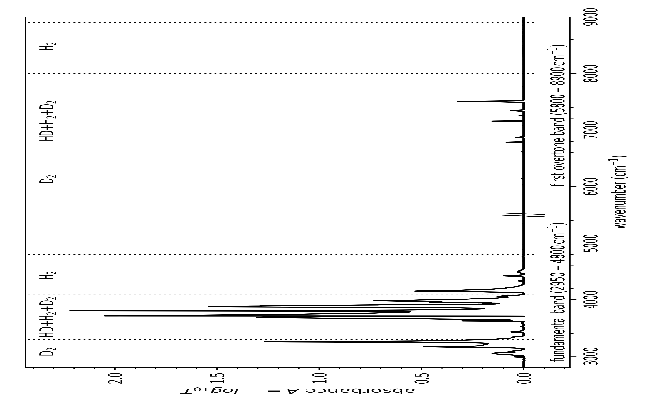
IR absorption spectrum
82 % HD (liquid, ~20 K)

Slide 24
IR absorbance spectrum of a D2-HD-H2 mixture

Slide 25
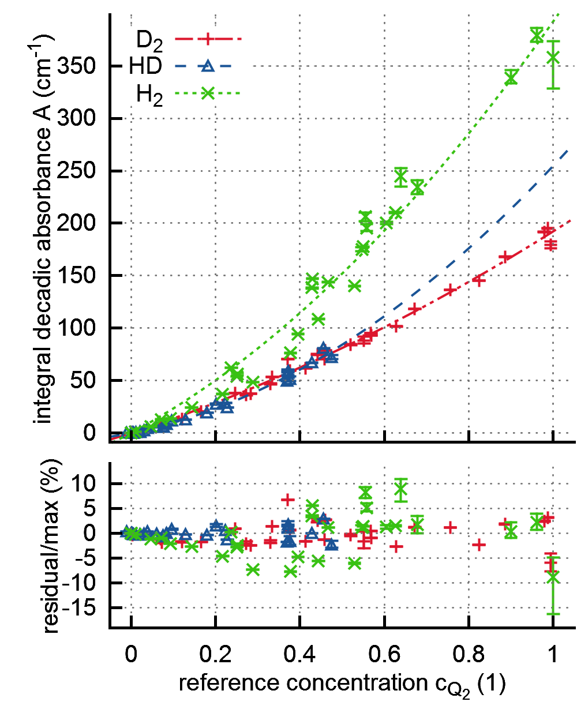
Calibration for H₂, D₂ and HD concentration
absolute calibration better than 5%
limited due to natural ortho-para-conversion
HD calibration limited at 50% of HD (equilibrium)
Goal: calibration against all six isotopologues and three ortho para ratios
 | $${\tilde{ν}}_{a}$$ | $${\tilde{ν}}_{b}$$ | a_{2,Q2} | a_{1,Q2}
 | (cm⁻¹) | (cm⁻¹) | (cm⁻¹) | (cm⁻¹)
D₂ | 3006 | 3120 | 61.+/-7 | 131.+/-6
HD | 3964 | 4050 | 172.+/-24 | 82.+/-10
H₂ | 4654 | 5037 | 177.+/-29 | 215.+/-21

Slide 26
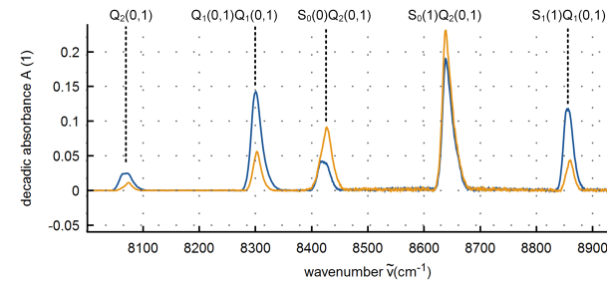
IR-spectroscopy for o-p-conversion investigation in liquid hydrogen
Natural ortho-para-conversion in liquid H₂: t_{1/2} ~days
He

Slide 27
IR-spectroscopy
IR spectroscopy of liquid, solid and gaseous hydrogen isotopologues has a high potential for very different applications
The challenge is the complex calibration since IR spectroscopy is sensitive on al kind of interactions
Our goal is a full calibration against all six hydrogen isotopologues and ortho para ratios

Slide 28
New challenges at UCN Sources

Slide 29
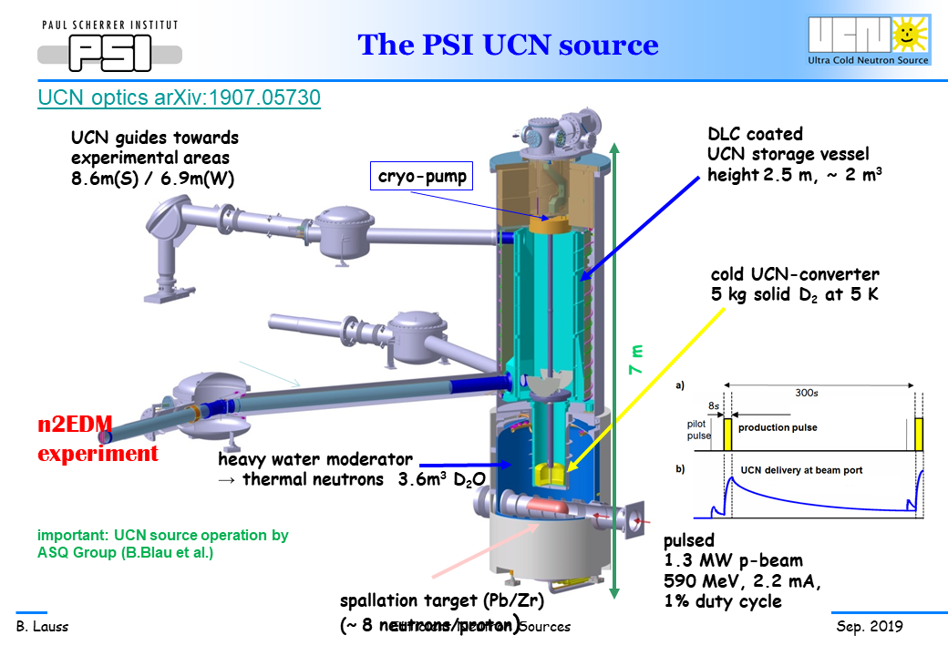
Bulk and surface properties of the D2 crystal
Accurate measurement of impurities (mainly HD and DT)
Crosscheck total cold neutron flux models by tritium production rate
Further isotopic purification?

Slide 30
Tritium trace detection and monitoring

Slide 31
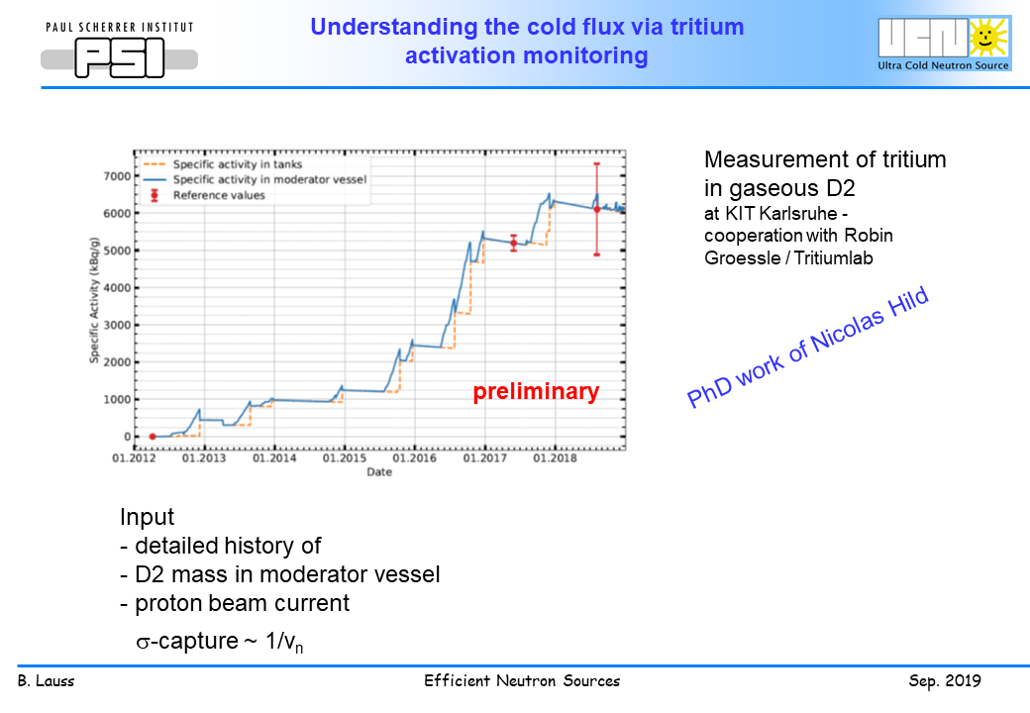

Slide 32
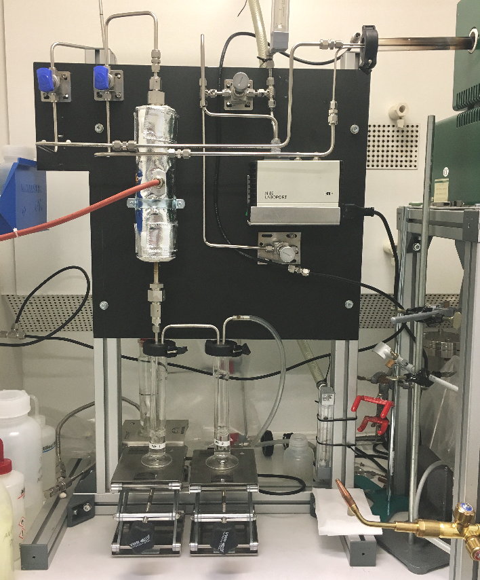
Oxidation and Liquid Scintillation Counting
stack
reactor
Oven for bake out
T₂
T₂
T₂
T₂
T₂
sample
A
B
T₂
T₂
H₂O
H₂O
H₂O
“air”
H₂O
HTO
H₂O
A: sample with tritium
B: break through control
A
B
Sample A and B transferred to the LSC-system
Pro: Very low level of detection
Con: high effort for each measurement
Main challenge: building up a reproduce able process from oxidation to extraction

Slide 33
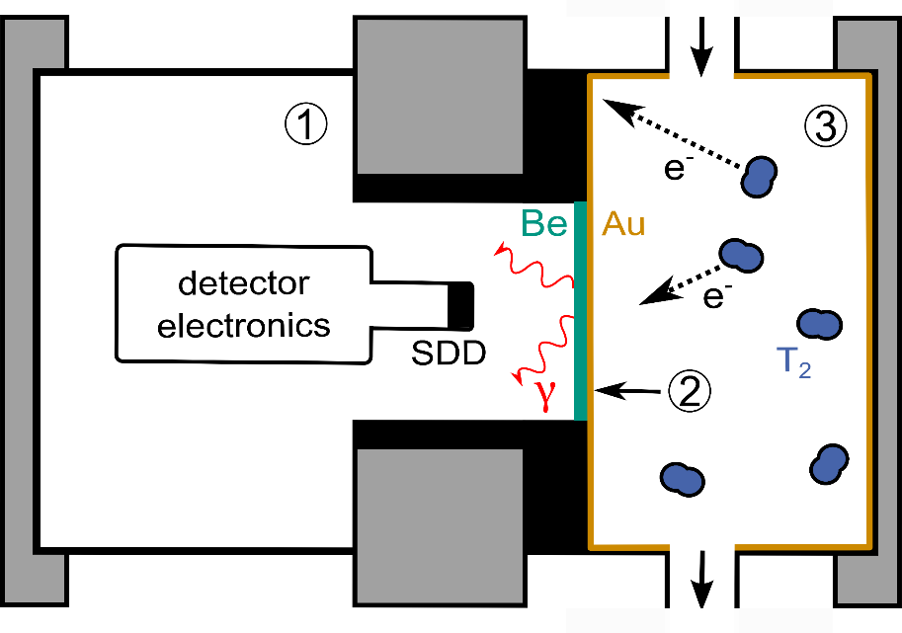
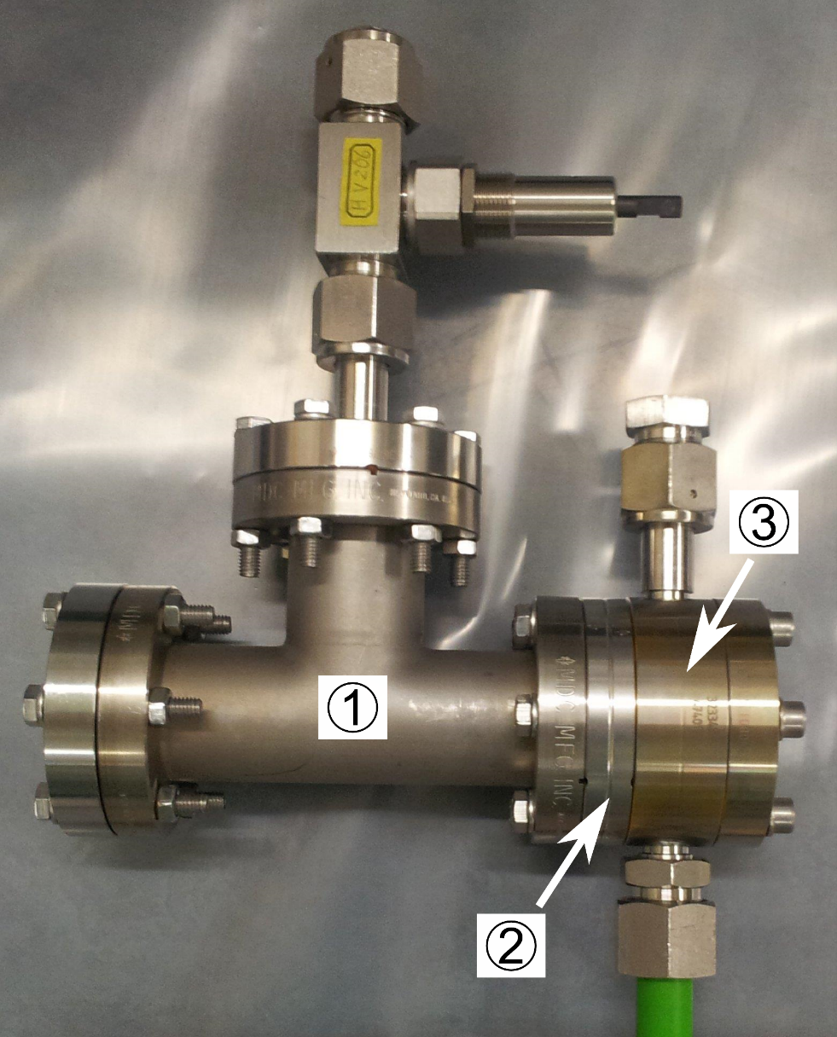
BIXS Beta Induced Xray Spectroscopy
Detector volume
Au-coated be-window
Sample volume
Benefits:
In-line measurement
No waste production
Low noise silicion drift detector (SDD)

Slide 34
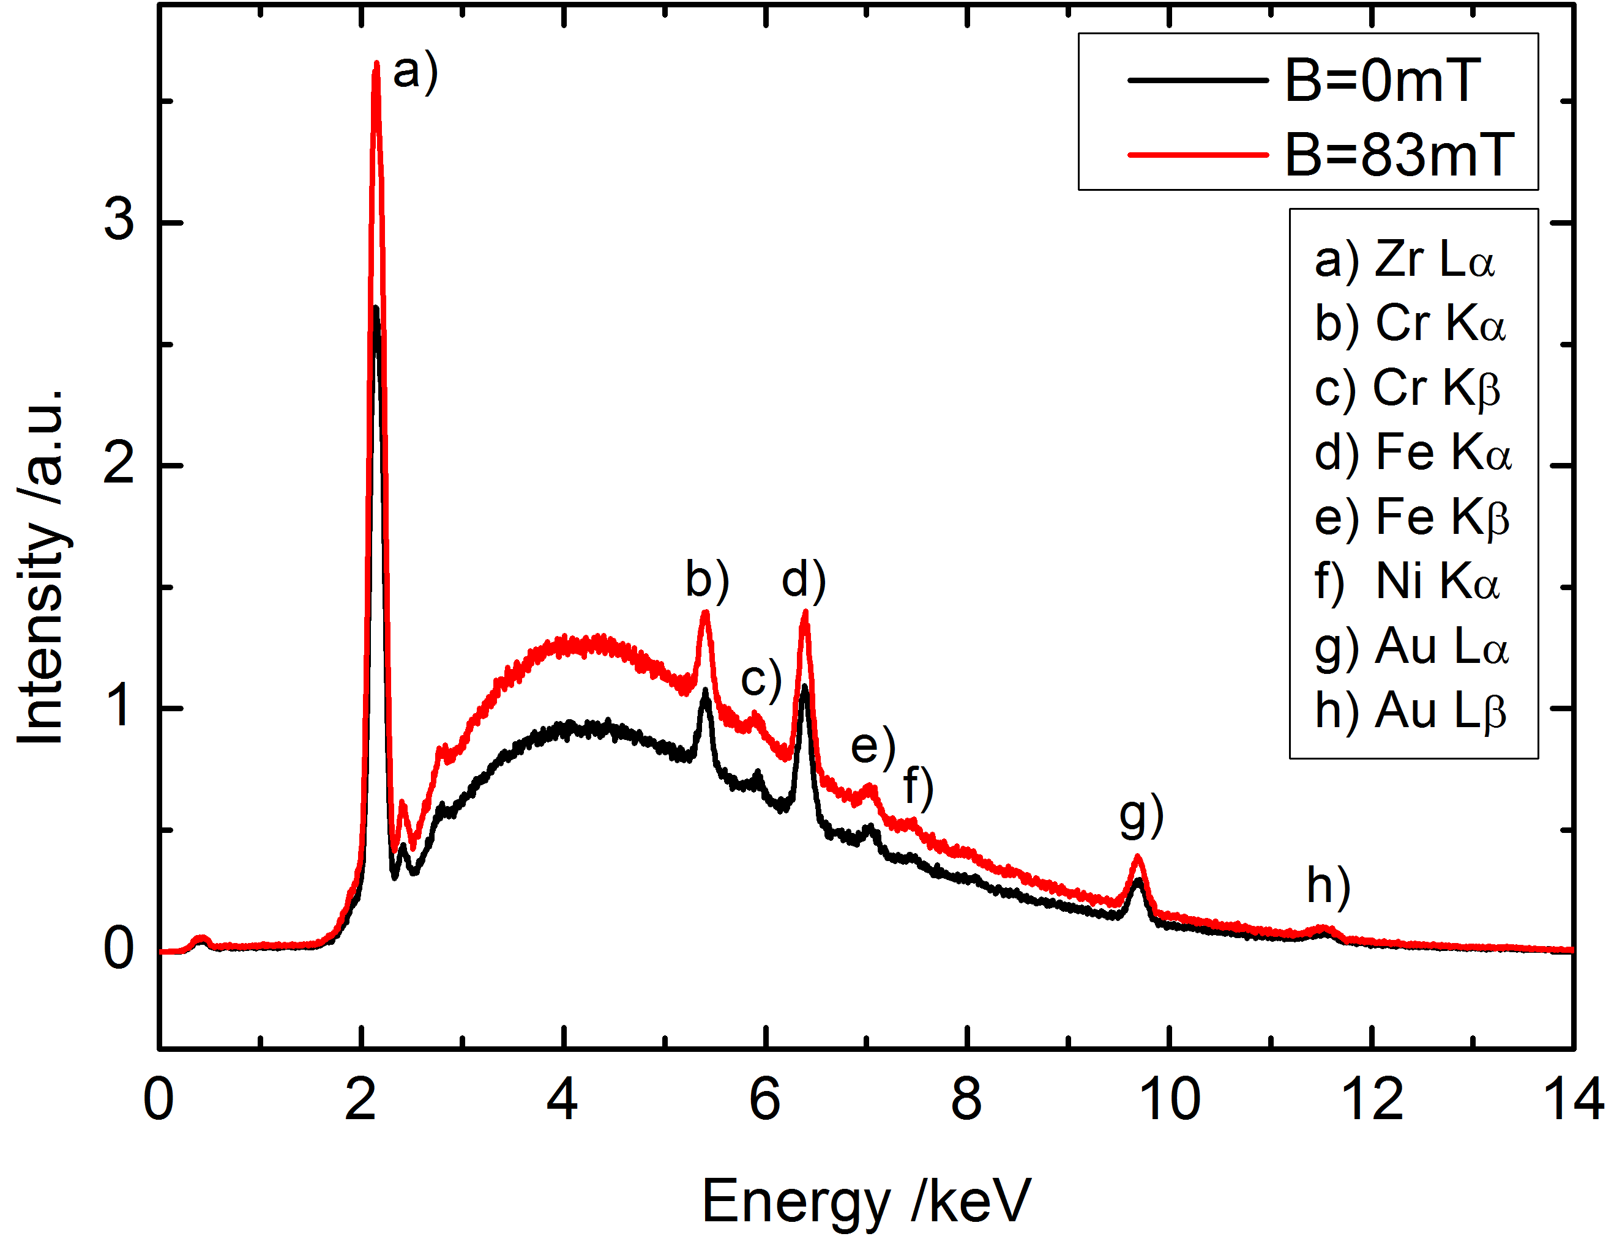
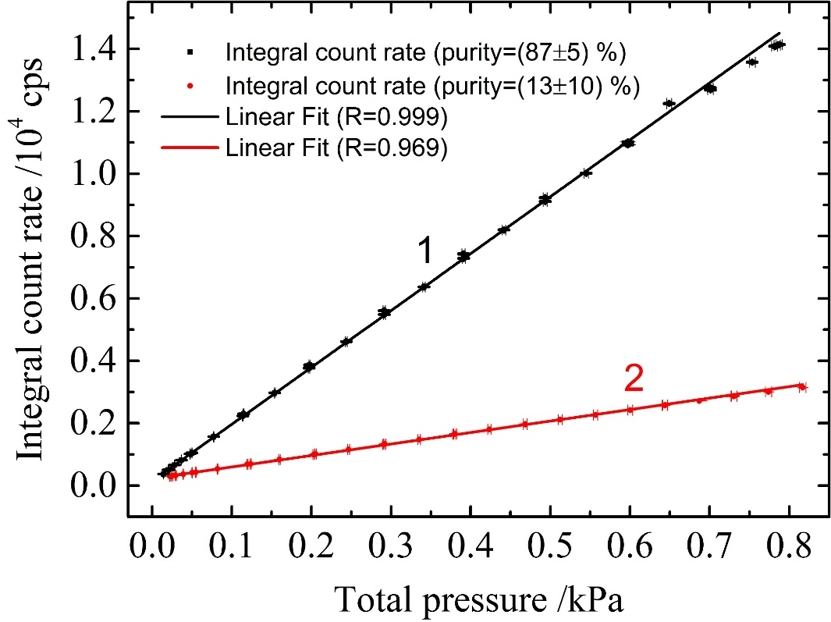
BIXS Beta Induced Xray Spectroscopy
characteristic peaks in spectrum
Integral count rate is linear over total pressure
Several systems in operation: TRACE, Triade, KATRIN WGTS monitoring
New development:
optimization for tritium traces in D2

Slide 35


Conclusion
Ox and LSC: offline system to measure traces of tritium in gas, solid and liquid sample
Raman:
monitoring of molecular composition and ortho para ratio
IR:
samples with high density, sample composition and studies beyond the sample composition
BIXS:
inline monitoring of absolut Tritium content in gas or on/in surfaces

Slide 36
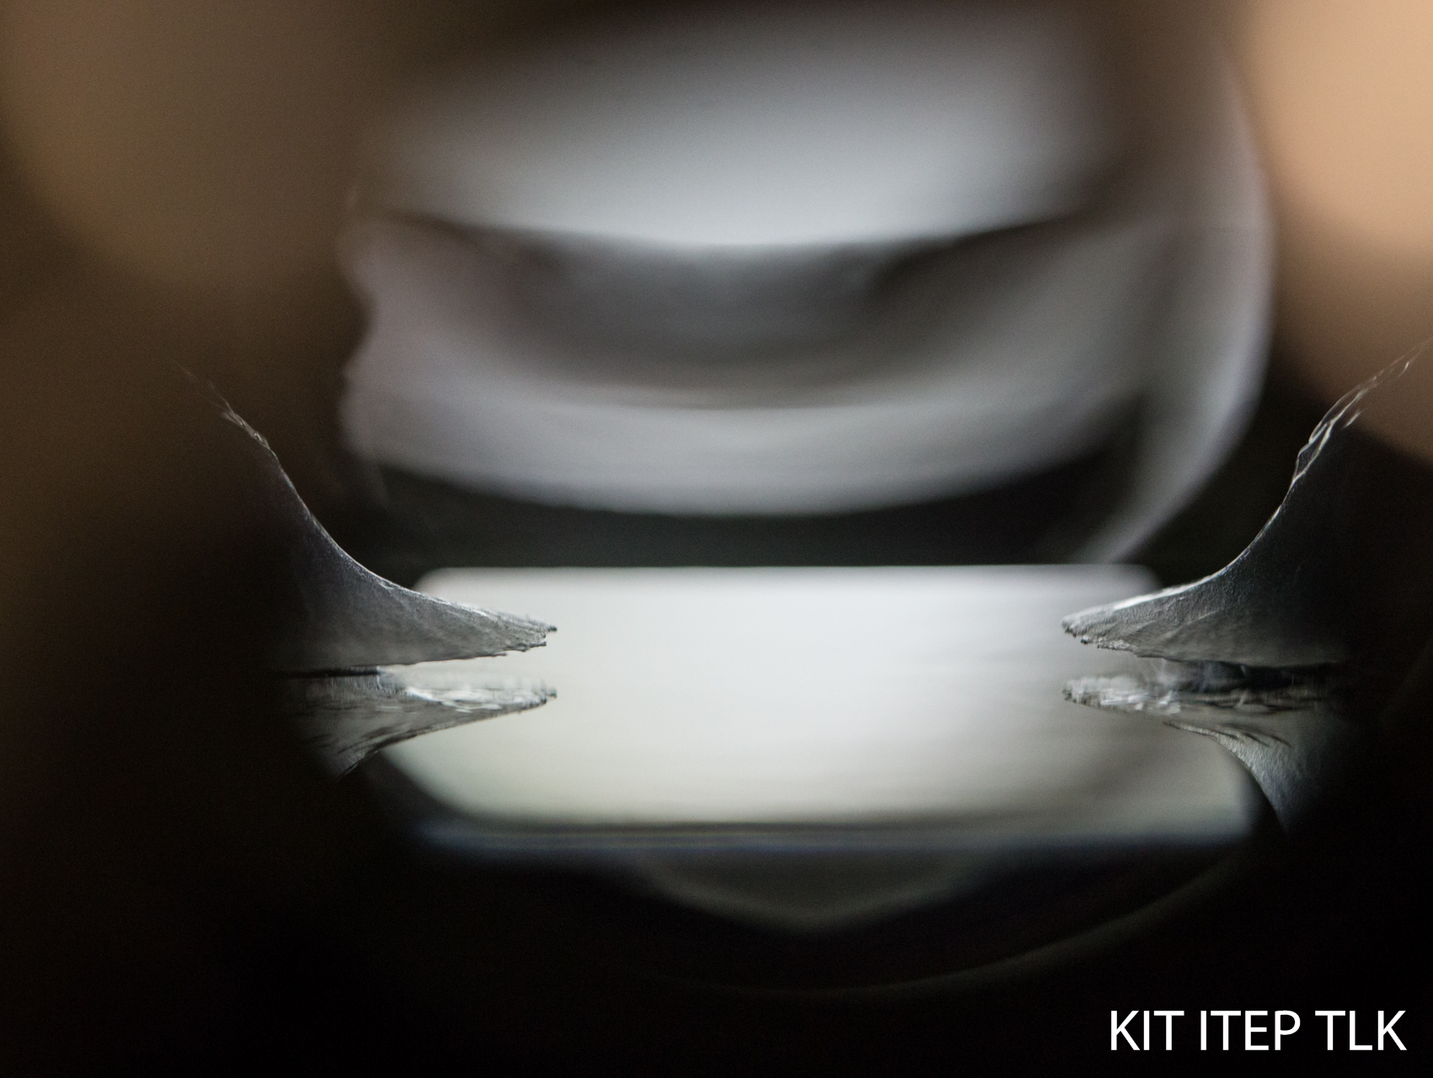
Thank You for Your
Attention!
Acknowledgements to the whole TLK team
KIT IKP-TLK

Slide 37
Raman Spectroscopy
Fischer, S. Commissioning of the KATRIN Raman system and durability studies of optical coatings in glove box and tritium atmospheres. PhD thesis: Karlsruhe Institute of Technology, 2014.
M. Schlösser et al. Fusion Science and Technology. 67:3 (2015).
Rupp, S. Development of a highly sensitive hollow waveguide based Raman system for the compositional analysis of the KATRIN tritium source gas. PhD thesis: Karlsruhe Institute of Technology, 2016.
T. M. James et al. Applied Spectroscopy. 67:8 (2013).
IR Spectroscopy
Mirz, S. et al. Fusion Science and Technology, 71(3):375–380, 2017.
BIXS
M. Röllig, F. Priester, M. Babutzka, J. Bonn, B. Bornschein, G. Drexlin, S. Ebenhöch, E.W. Otten, M. Steidl, M. Sturm, Activity monitoring of a gaseous tritium source by beta induced X-ray spectrometry, Proceedings of the 27th Symposium On Fusion Technology (SOFT-27); Liège, Belgium, September 24-28, 2012, Fusion Engineering and Design, Vol. 88, Issue 6-8, Pages 1263-1266 (2013), available online (in press), http://dx.doi.org/10.1016/j.fusengdes.2012.11.001
S. Ebenhöch, S. Niemes, F. Priester, M. Röllig, Investigations of the applicability of a new accountancy tool in a closed tritium loop, ISFNT 2015, Fusion Engineering and Design
M. Röllig, S. Ebenhöch, S. Niemes, F. Priester, M. Sturm, Development of a compact tritium activity monitor and first tritium measurements, Fusion Engineering and Design
M. Röllig, F. Priester, Galet - Benchmark of a Geant4 based application for the simulation and design of Beta Induced X-ray Spectrometry Systems, Fusion Engineering and Design, 109–111 (2016) 684–687
Mirz, S. Investigation of Van-der-Waals Clusters of Liquid and Gaseous Hydrogen Isotopologues via Infrared Absorption Spectroscopy, Disstertation, Karlsruhe, 2019,
DOI: 10.5445/IR/1000097484
Mirz, S., Größle, R ., Kraus, A., Analyst, 144:4281-4287, 2019.
First Calibration of an IR Absorption Spectroscopy System for the Measurement of H₂, D₂, and HD Concentration in the Liquid PhaseR Größle, A Kraus, S Mirz, S Wozniewski
Fusion Science and Technology 71 (3), 369-374
Cryogenic Distillation
Review of the TLK Activities Related to Water Detritiation, Isotope Separation Based on Cryogenic Distillation and Development of Barriers Against Tritium PermeationI Cristescu, A Bükki-Deme, R Carr, N Gramlich, R Groessle, C Melzer, ...
Fusion Science and Technology 71 (3), 225-230

