Slide 1
Cryogenic Supply for the Series Test Facility (STF) for SIS100 Magnet Testing
Claus Schroeder and Holger Kollmus
for the CRY Department at GSI
Lund, 07.-08.10.2019

Slide 2
Outline
Overview
  FAIR Project
  Cryogenic Infrastructure @ GSI
      HeSu
      R³B and FoPi plant
  Cryo Testing
    PTF
    STF
STF
  Mechanical concept
  Status
  Additional tasks
  Modifications
Quadrupole testing
String planning
Lund, 07.-08.10.2019
Notes:
1

Slide 3
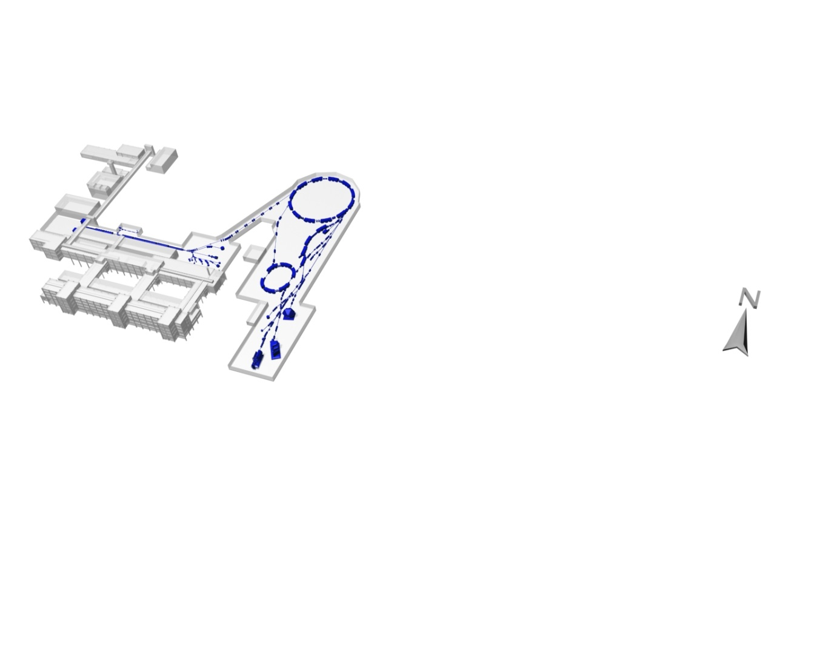
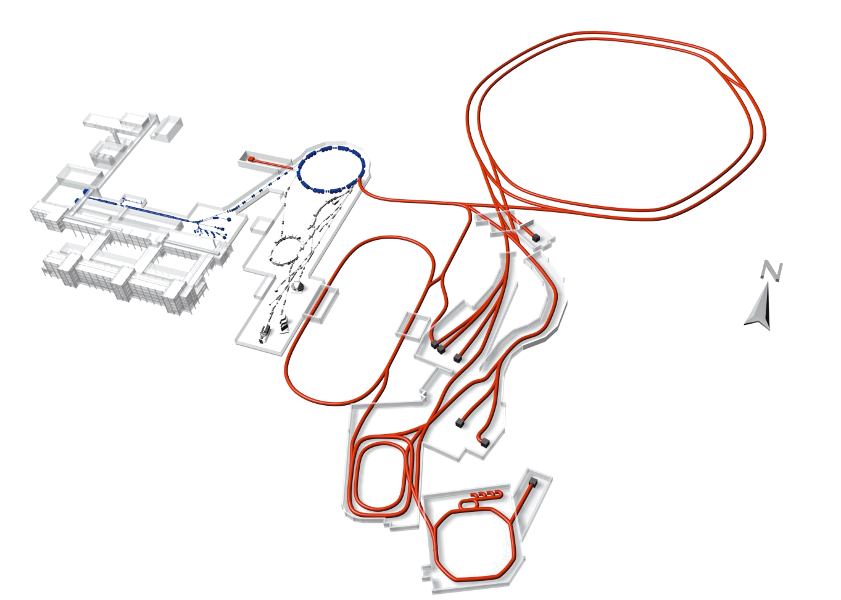
Facility for Antiproton and Ion Research
GSI-Today
Protons to Uran
max 1 GeV/u Uran and
2 Gev/u for Neon
SIS 100/300
UNILAC
SIS
ESR
HESR
GSI in futue / FAIR
Rare isotopic beams
Anti protons
Higher Beam Current
At higher energies
Super
FRS
RESR
CR
NESR
100 m

Slide 4
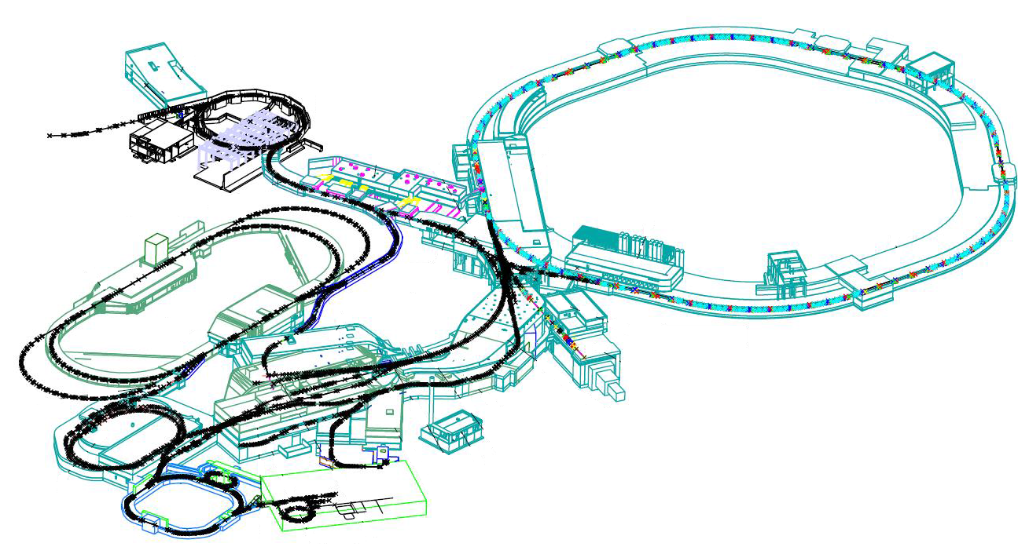
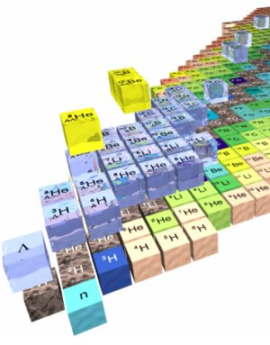
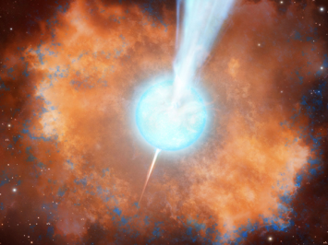
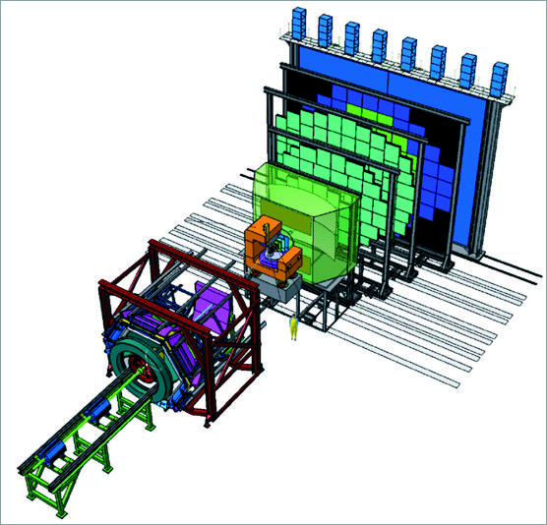
SIS100 with SuperFRS and CBM
SIS18
SIS 100
NuSTAR
CBM
SuperFRS
CBM
SIS100, SuperFRS and CBM are using SV magnets supplied by one central plant

Slide 5
Cryogenic Supply for FAIR
SIS 100
(SIS 300)
CBM
SuperFRS
Panda
APPA
R3B

Slide 6
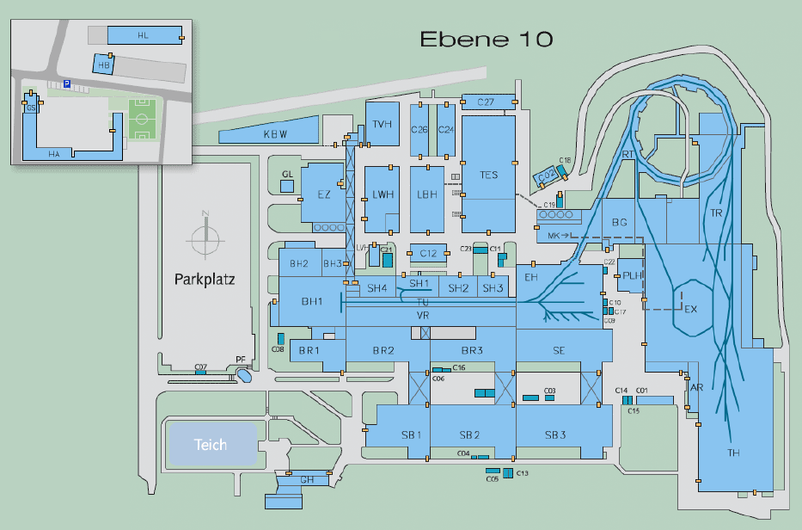
Overview of FAIR cryogenic Infrastructure
at GSI-campus
Overview of GSI-campus, with the location of the existing PTF and the
STF-area.
HeSu (Helium Supply plant)
central liquefier for Helium-Dewar
filling
existing PTF with annex,
housing compressor and
transformers
new annex building, housing
compressor, cold box, distribution
box and electrical infrastructure
given area for STF in
existing hall
GSI campus

Slide 7

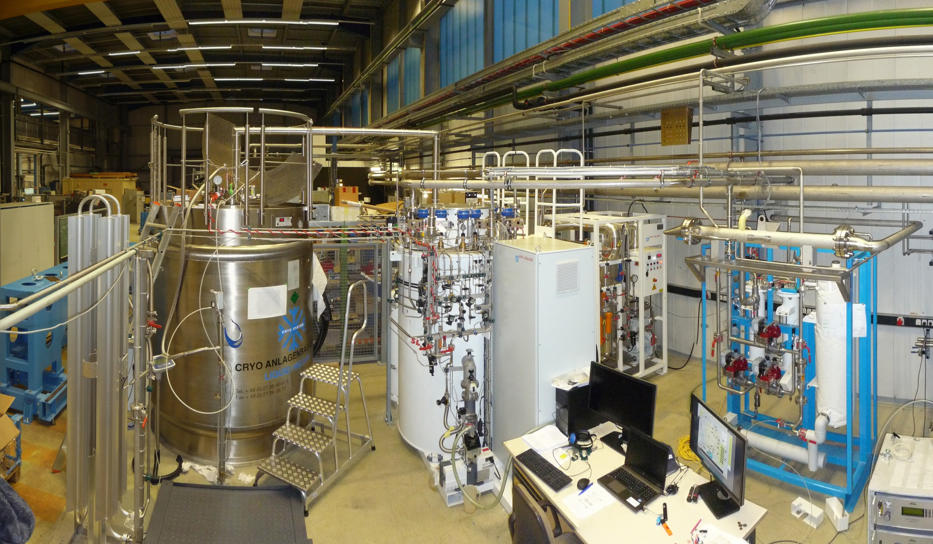
Helium Liquefier (HeSu)
Operation since 2015
Liquefaction rate ~ 20+ l/h
3000 l LHe storage, 8000 l delivered so far
Decant Station and campus wide recovery system

Slide 8
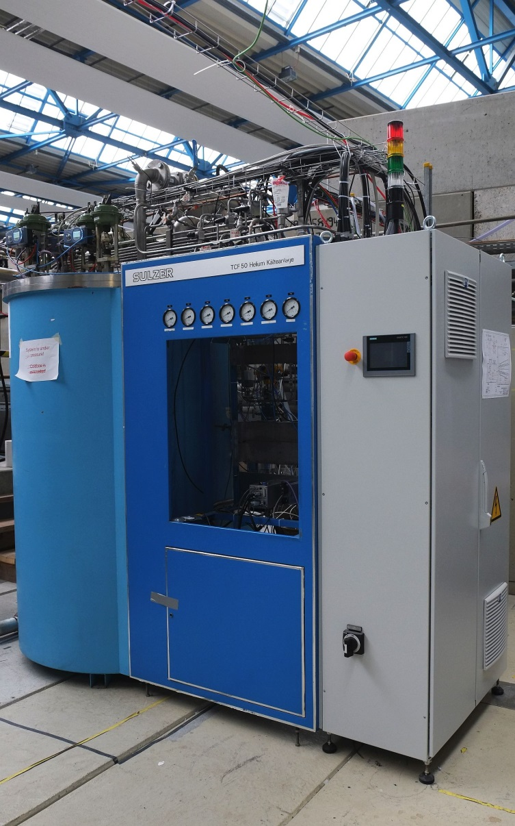
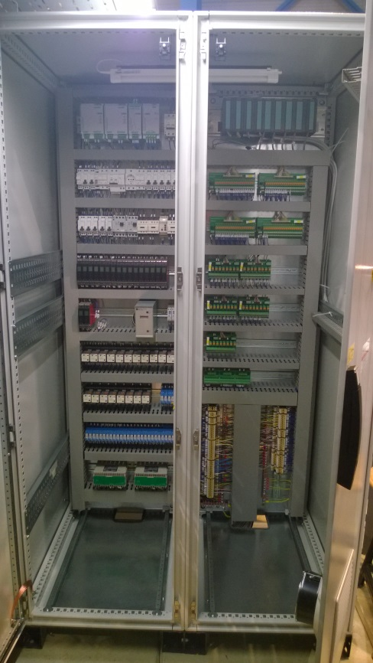
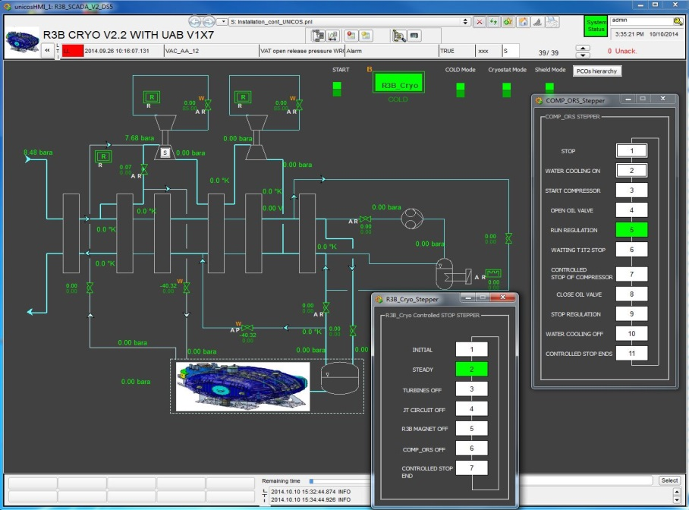
R³B Cryo Plant and FoPi Cryo Plant
Refurbished and Migrated to UNICOS
TCF50 including new cabinet
Cabinet
UNICOS + WinCC OA
Supported by CERN and INFN:
M. Pezzetti, Ph. Gayet, R. Pengo and B. Gallese

Slide 9
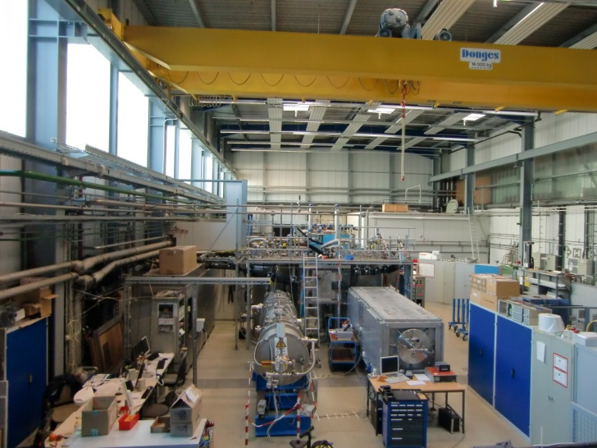
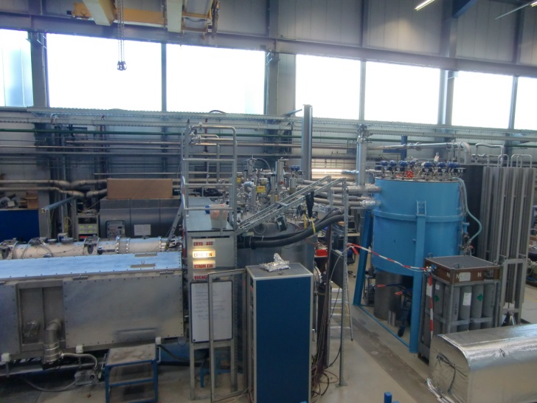
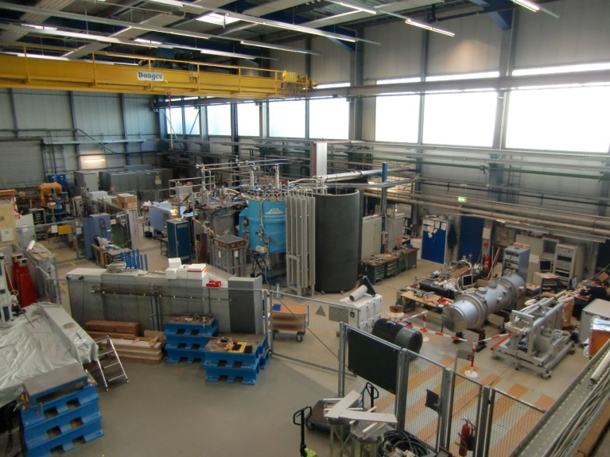
PTF Infrastructure
Cryogenic infrastructure at PTF:
70.000 h operation of the PTF
in operation at GSI since 2005
2.200 h with 60 g/s
90.500 h total operation of the cryo plant
only 300 m³ Helium inventory
40-80% Helium losses/year
Cryo plant: | PTF
Cooling power @ 4,5 K | 300 W
Helium circulation pump | 60 g/s- 200 g/s
Helium liquefaction rate | 2 g/s
Max. power consumption | 250 kW
Preparation area,
Cryogenic
infrastructure is
located in the
middle of the
hall
Distribution box (blue)
Feed boxes and
universal cryostat

Slide 10
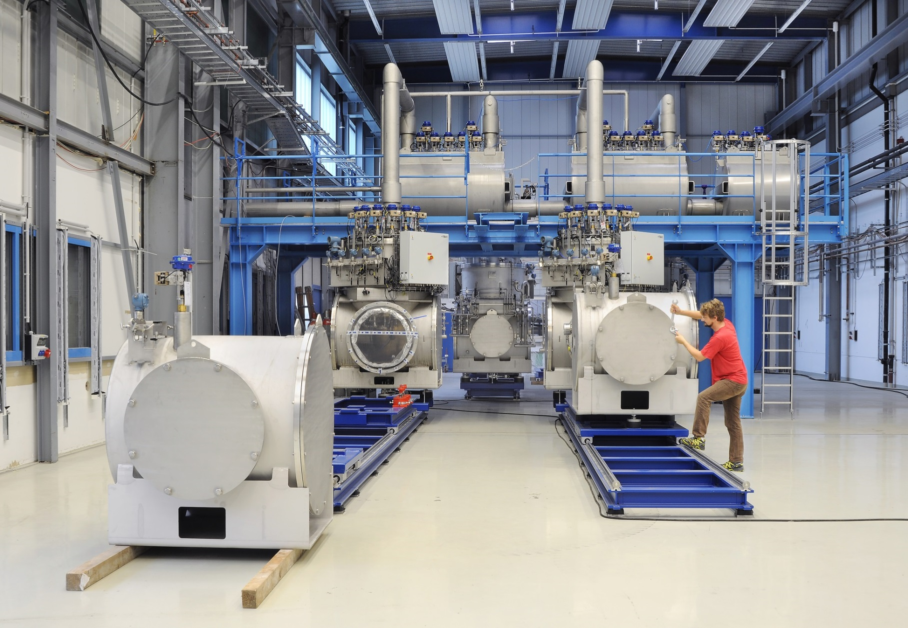

The Series Test Facility
Operating since 2015
1.5 kW 4 K equivalent, 6 g/s liquefaction, four test benches
SIS 100 dipoles, quadrupoles and SuperFRS Magnets can be tested
Testing of SIS100 and SuperFRS local cryogenics

Slide 11

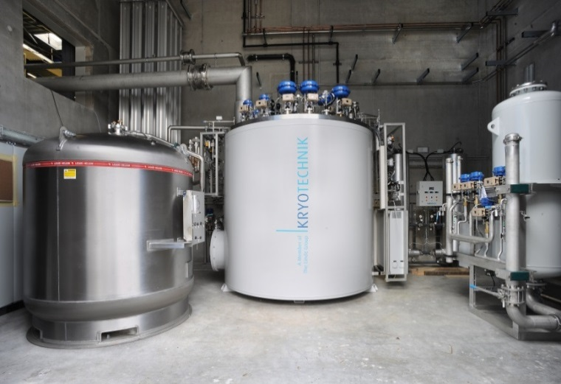
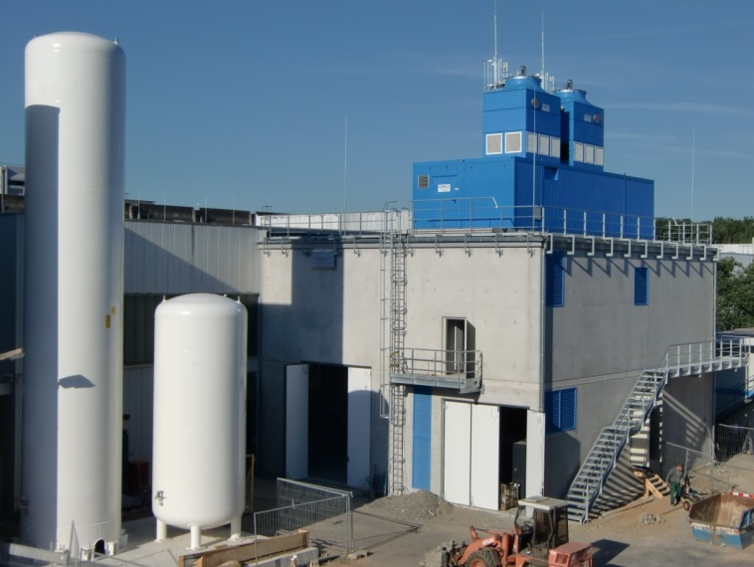
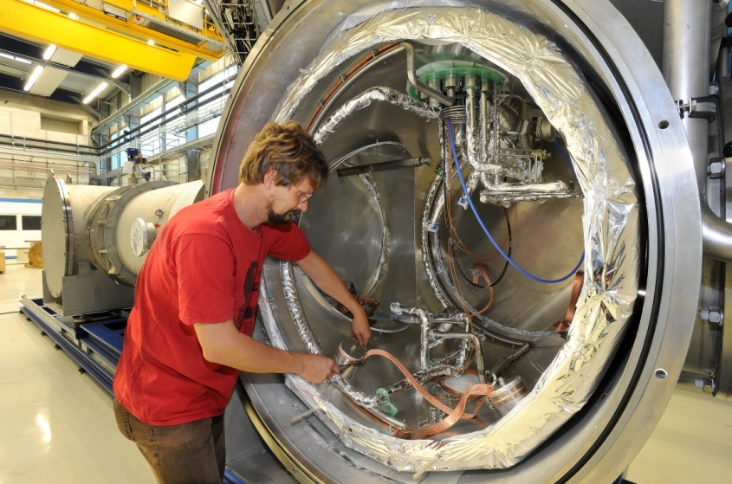
STF: Overview and Key Paramenters
Cryogenic infrastructure at STF:
25.000 h operation of the STF
sub-cooling in the Feedboxes
in operation since 2015
1.000 m³ Helium inventory @
warm
up to 3.000 l Helium at cold
Coldbox in the cryo room (1.5 kW@4.5K eq.)
Cryo plant: | STF
Cooling power @ 4,5 K | 700 W
Cooling power @ 50 K – 80 K | 2000W
Helium liquefaction rate | 6 g/s
Max. power consumption | 434 kW
„Cold End“ in the STF testing hall
Helium tanks and annex building with 1,1 MW water cooling
Easy excess to the connection area
Notes:
1

Slide 12
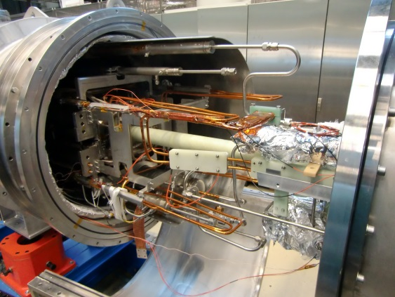
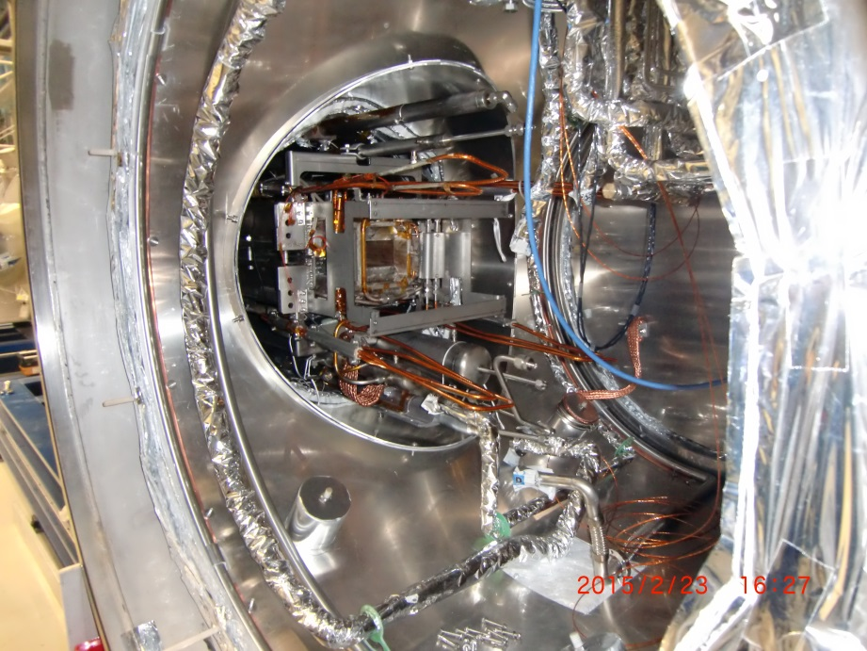
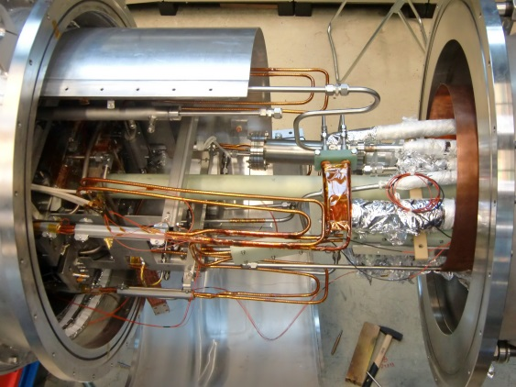
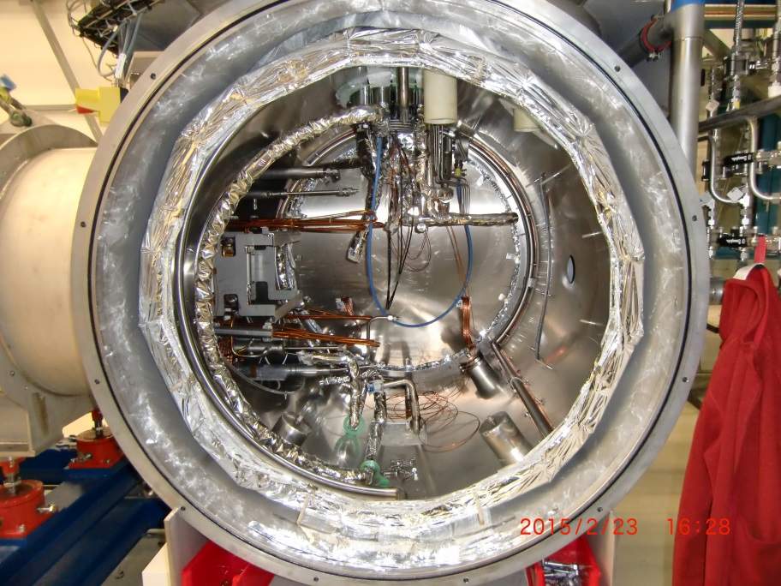
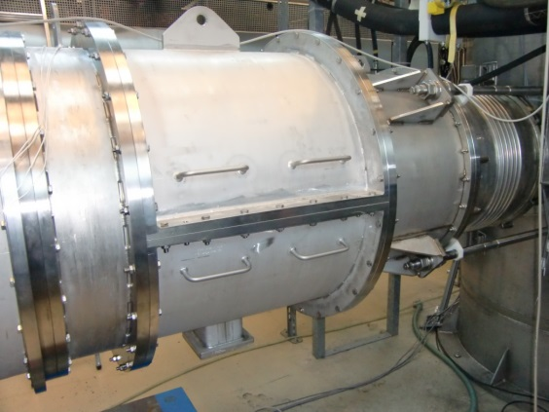
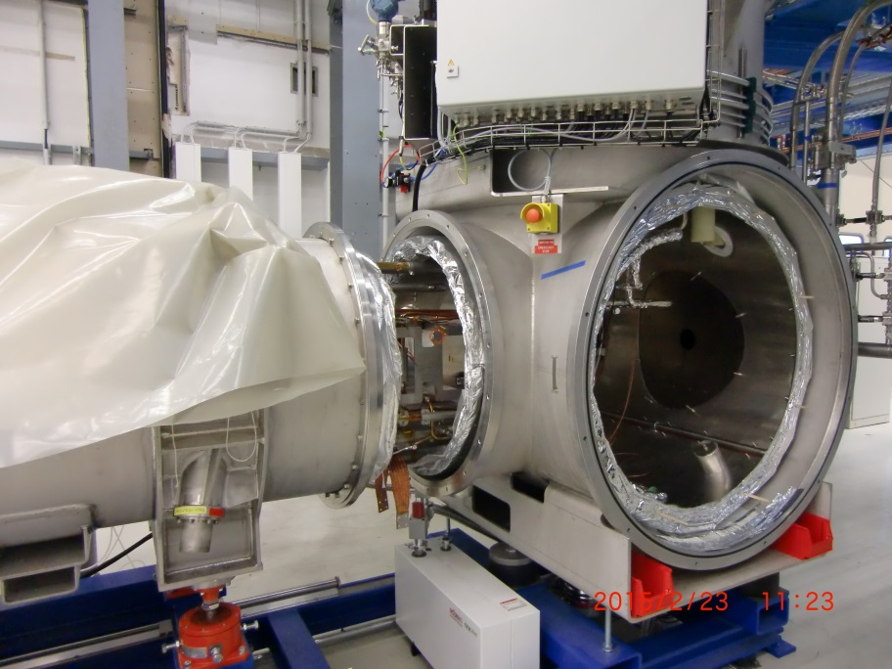
Mechanical concept I: PTF versus STF
Evolution from prototype- to serial-facility
Magnet connection at PTF:
2 meters extra length
lot of flange connections
hard to install
needs strut sections at the bellow
needs additional bus bar
Endbox (Endcap) is:
direct mounted to the magnets
needs a crane
Magnet connection at STF:
magnet penetrates FBx and EBx
easy flange connections
easy to install
no bellows needed
direct connection to the main current leads (MCLs)
Endbox (Endcap) is:
movable on the rail system
no crane needed
Connection area at PTF
Connection at STF

Slide 13
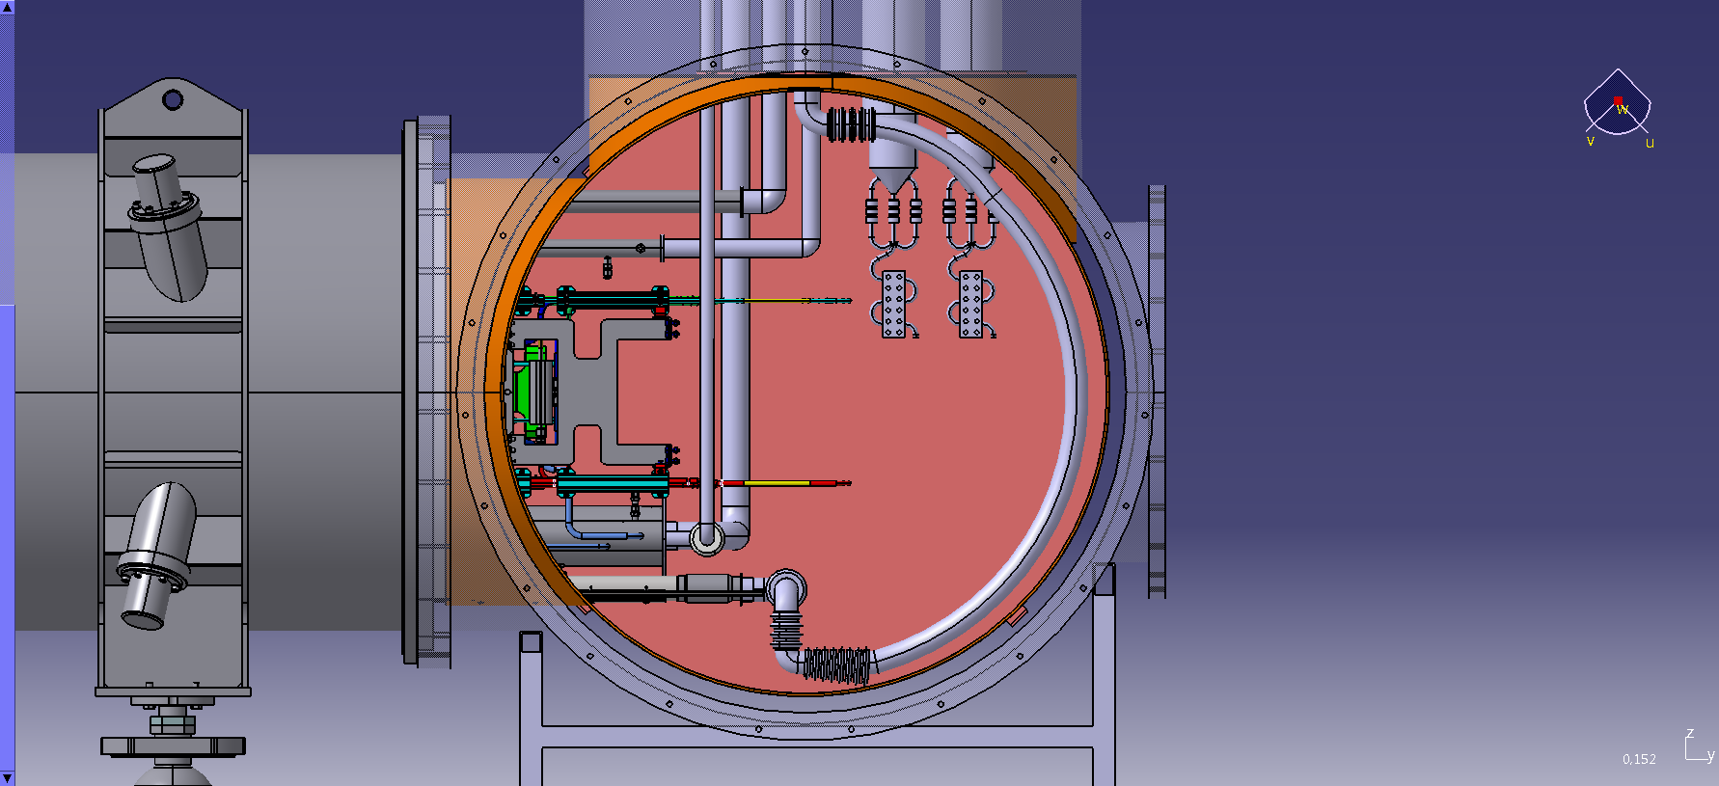
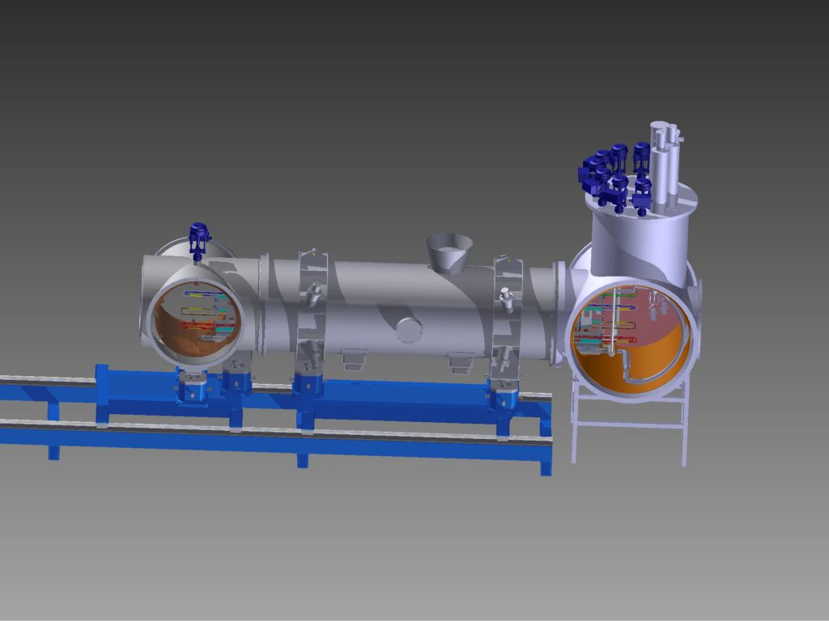
Mechanical concept II
Feedbox connection at STF:
save space
easy excess to the connecting zone
as less as possible crane action
less flanges
no bellows, no additional bus bar
From first ideas…
…to final concept

Slide 14
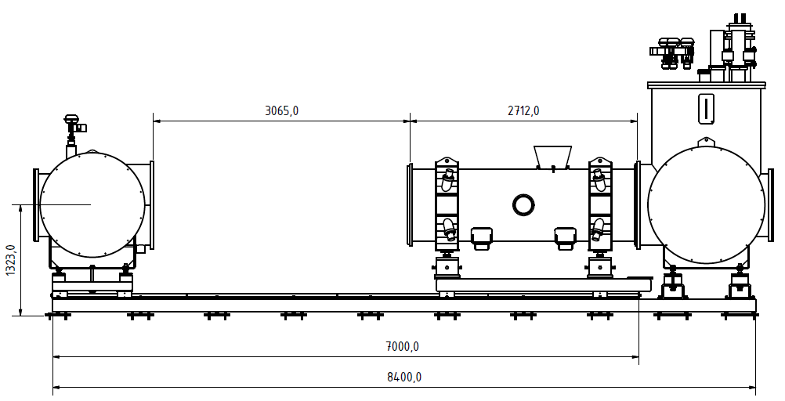
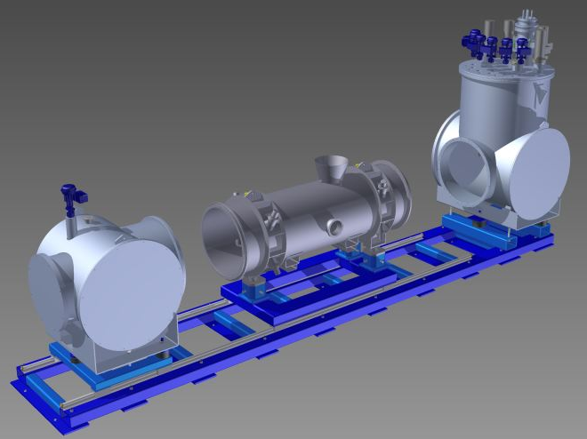
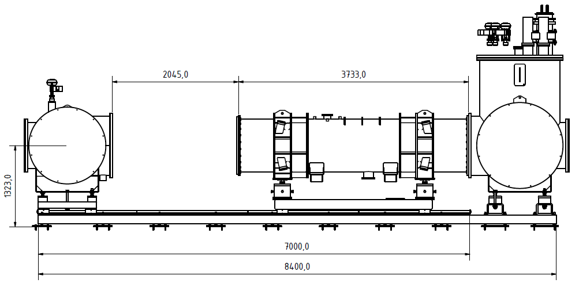
Mechanical concept III
Rail system enables dipole and quadrupole installations;
high precision was
requested:
± 0,1 mm horizontal
± 1 mrad
1305+/- 5
1305+/- 5
Rail system is prepared to also test SIS100-quadrupols

Slide 15
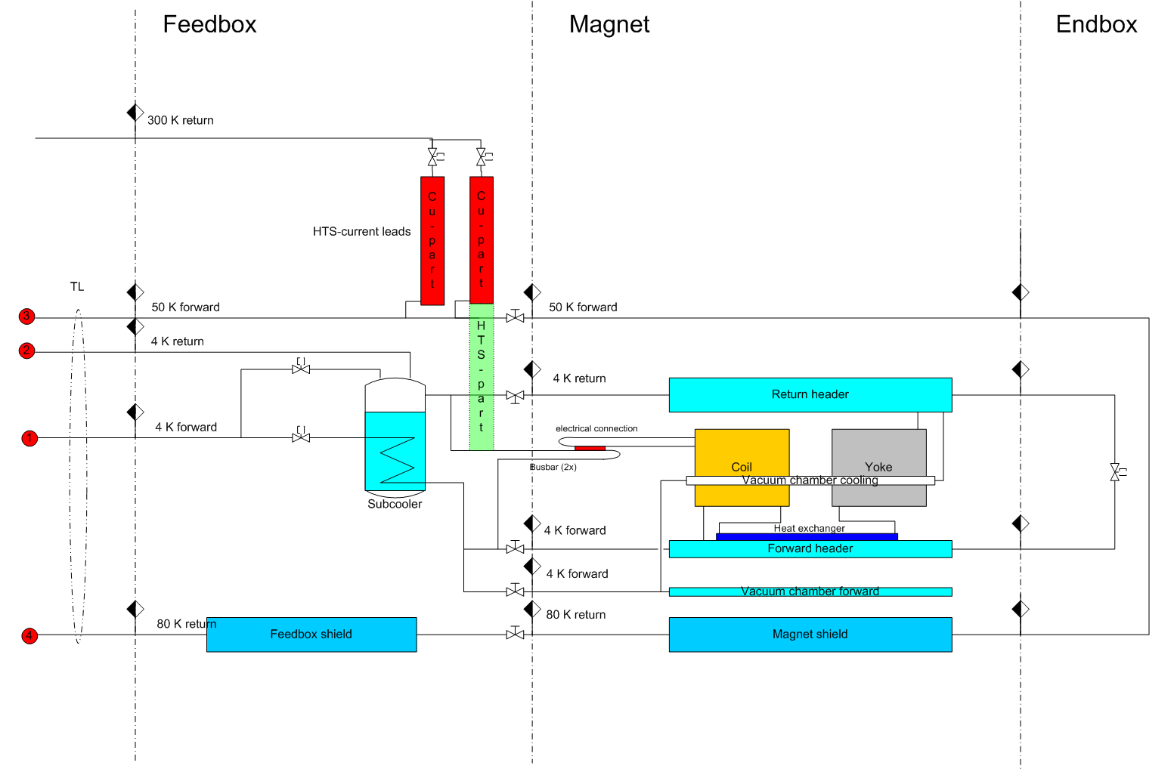
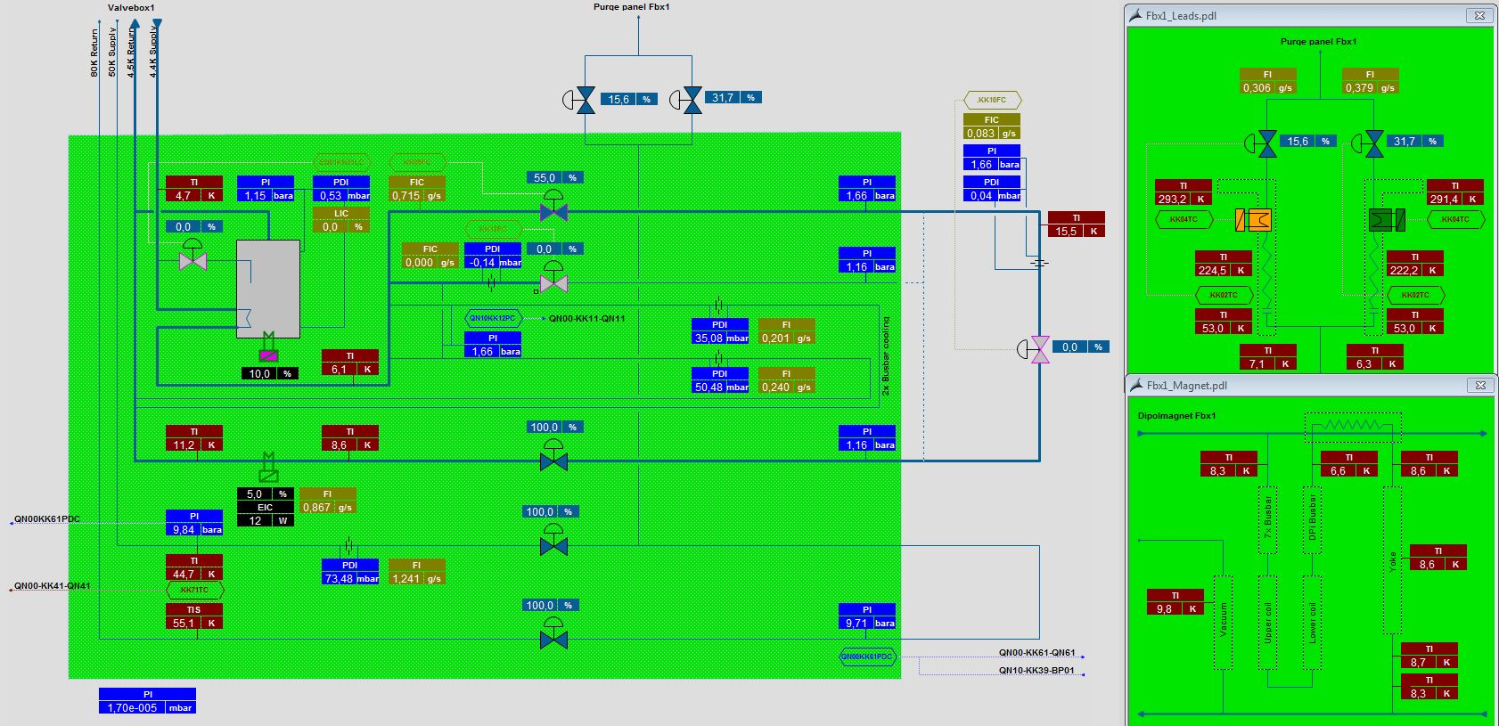
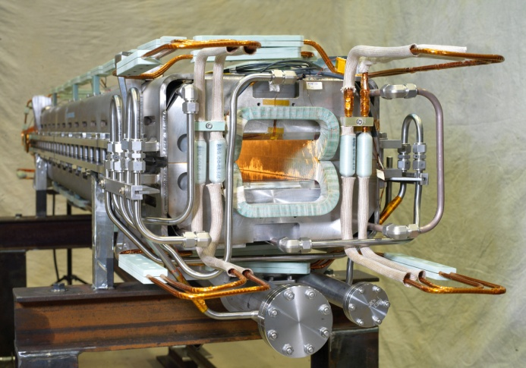
Serial Testing Status
Sketch of process lines
HMI for the operation of one Feedbox during magnet test
SIS 100 Dipole:
cooling by forced-two-phase-Helium-flow
at entrance subcooled
108 pieces
aperture: 130x60 mm²
ramp rate. 4T/s
max. field: 1,9 T
cold mass length: 3060 mm
over all length: 3700 mm
Notes:
<Foliennummer>

Slide 16
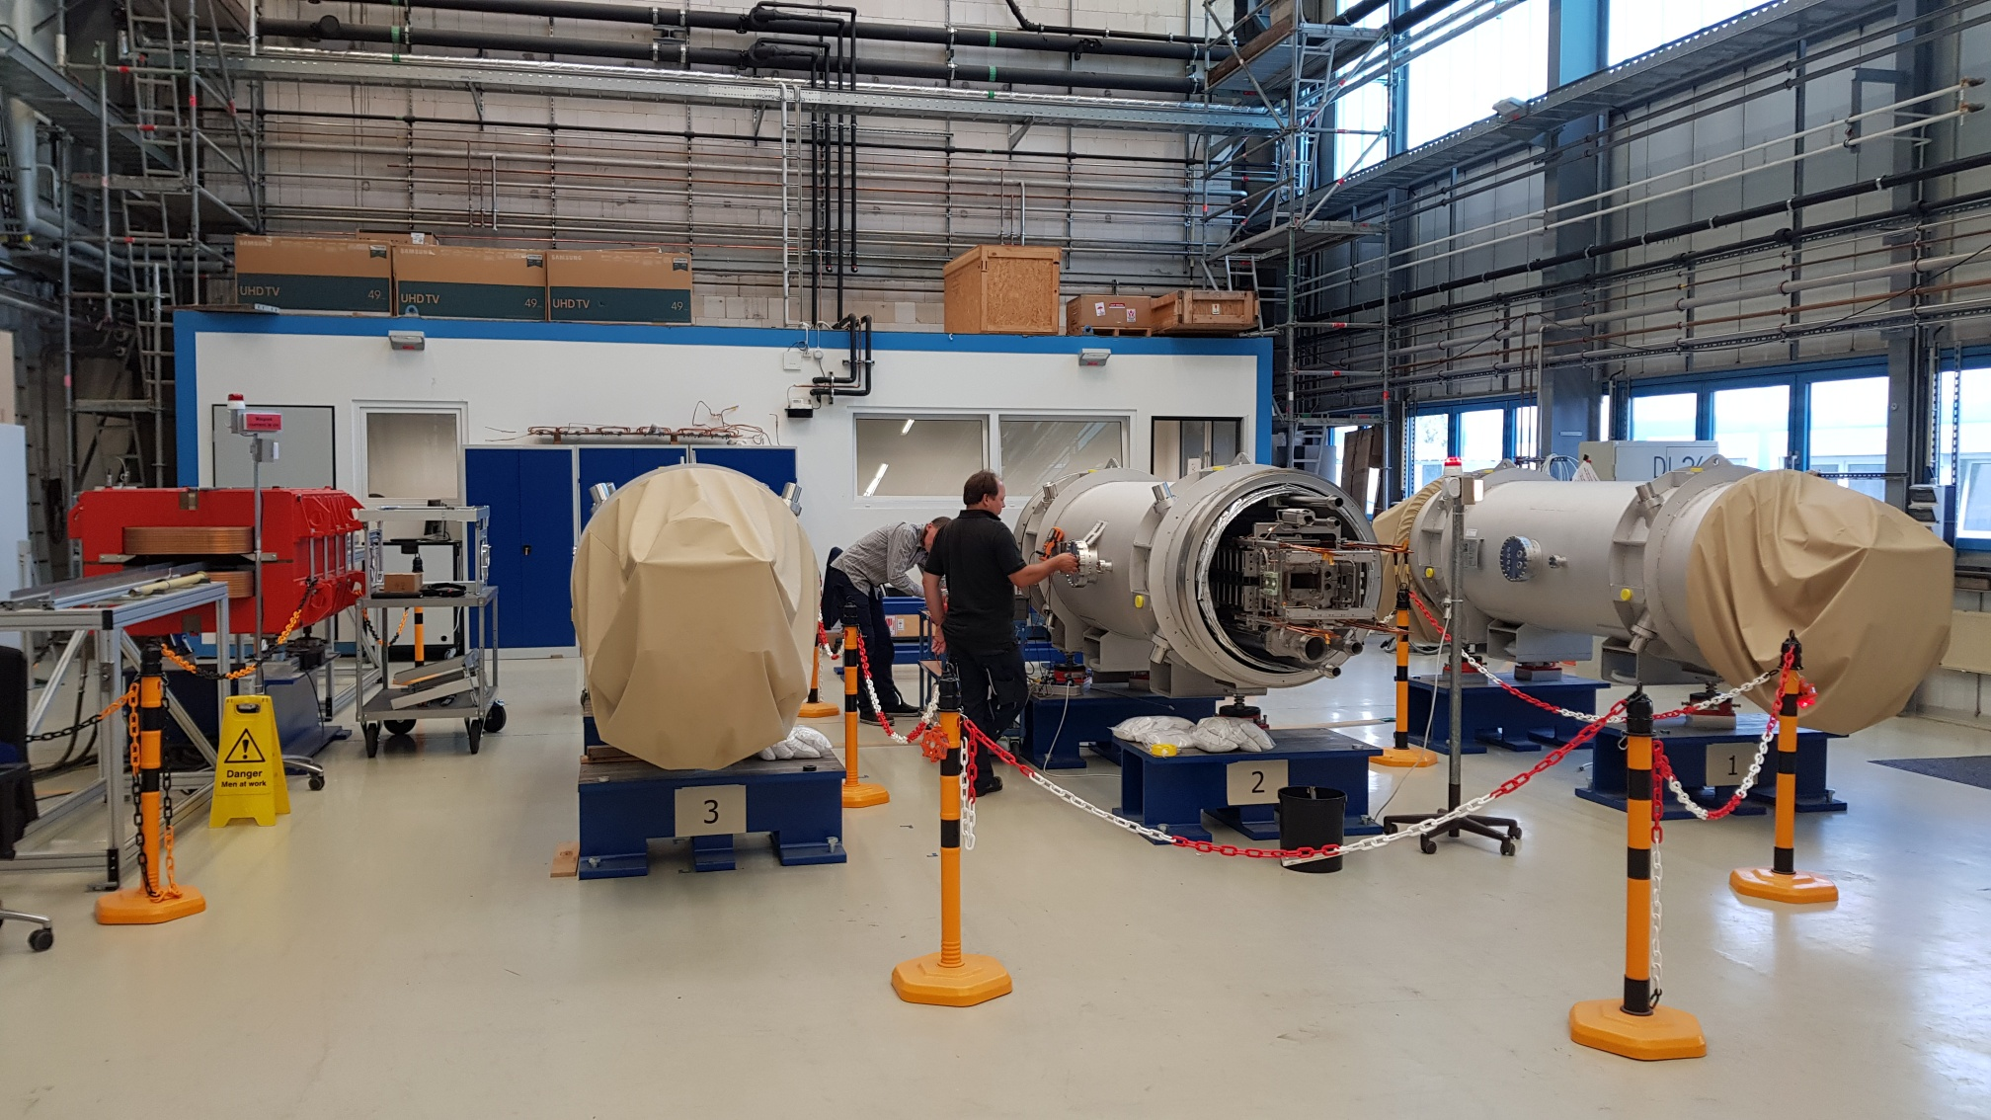
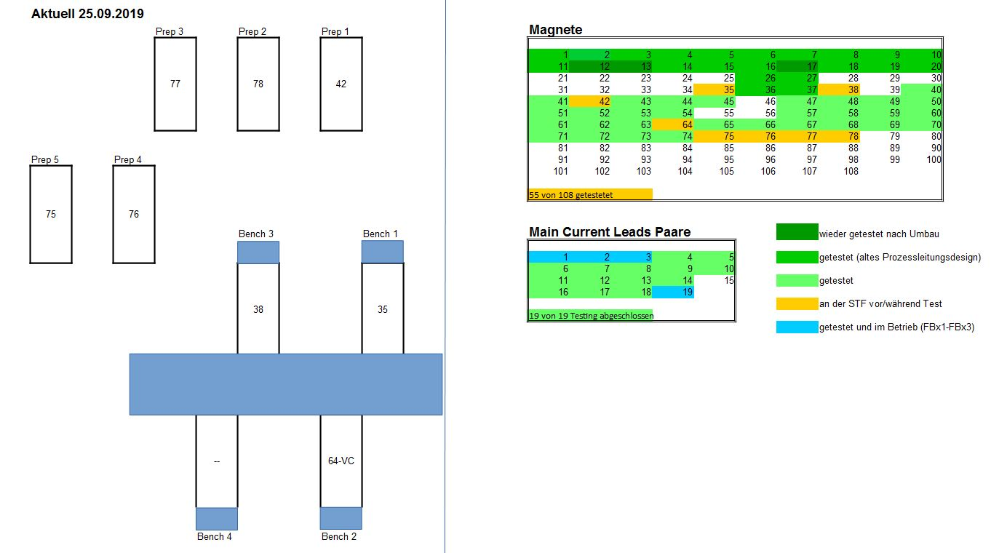
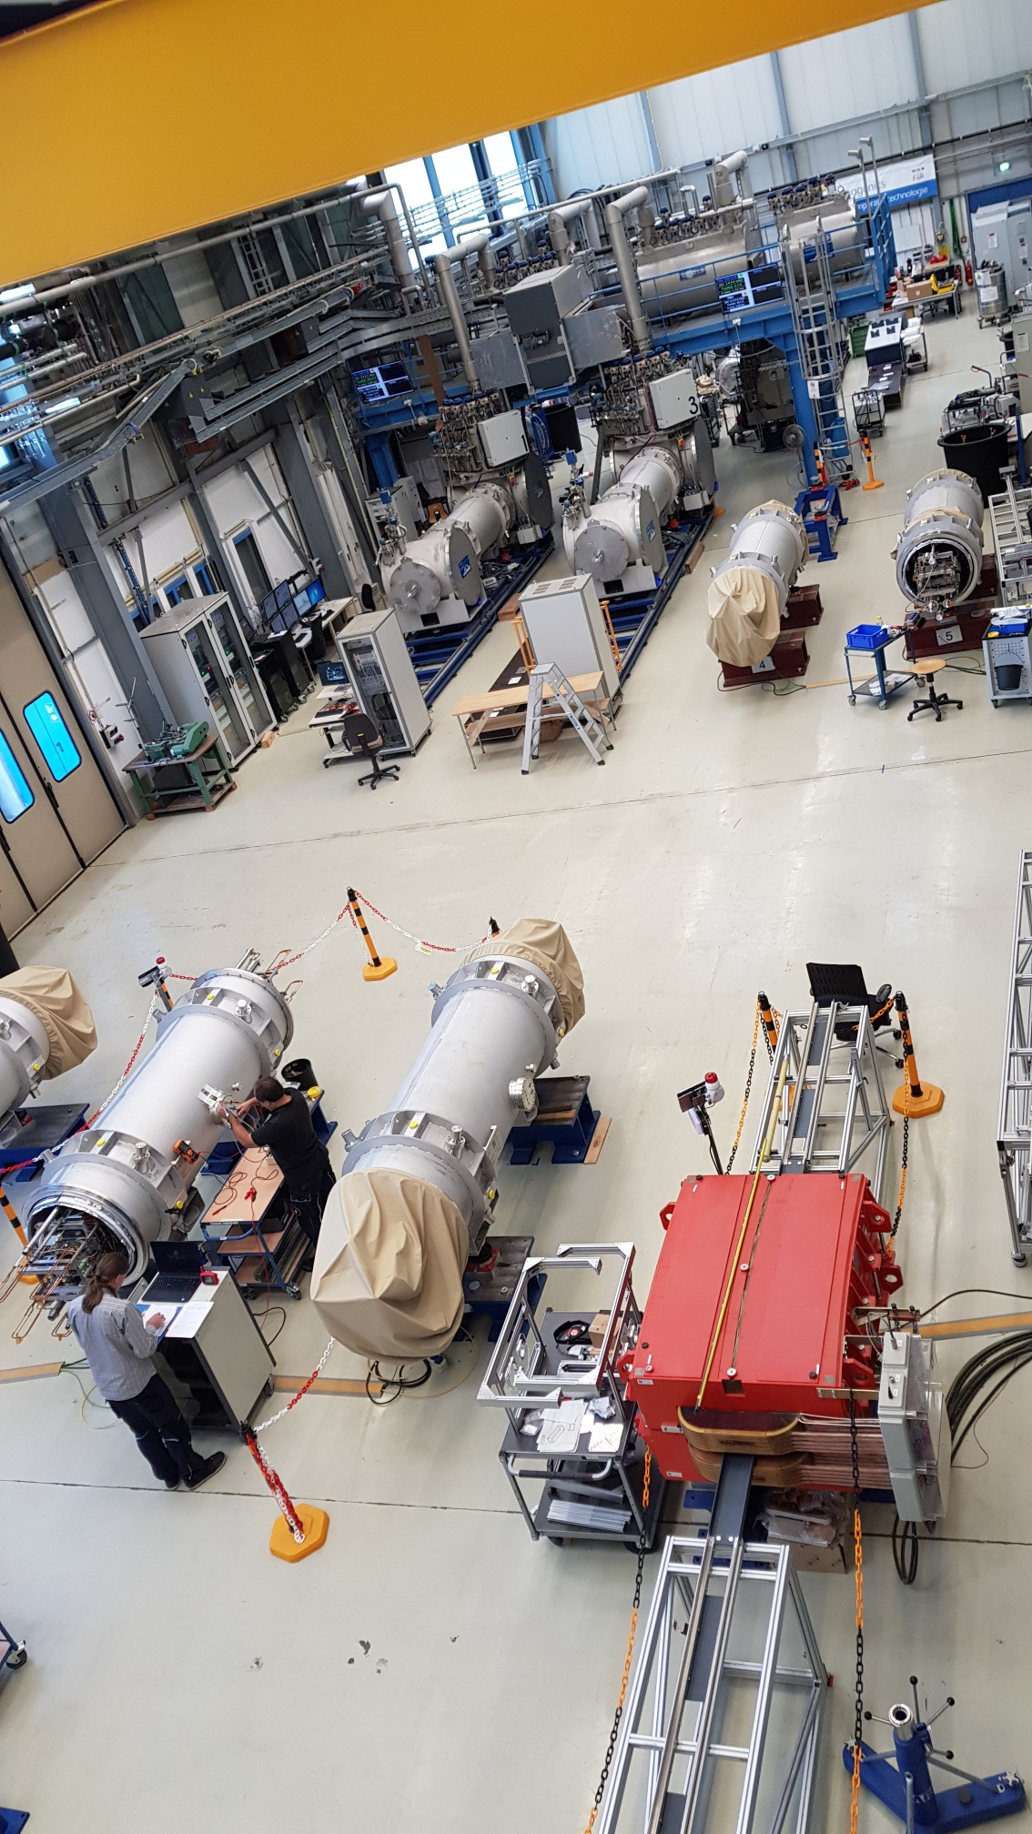
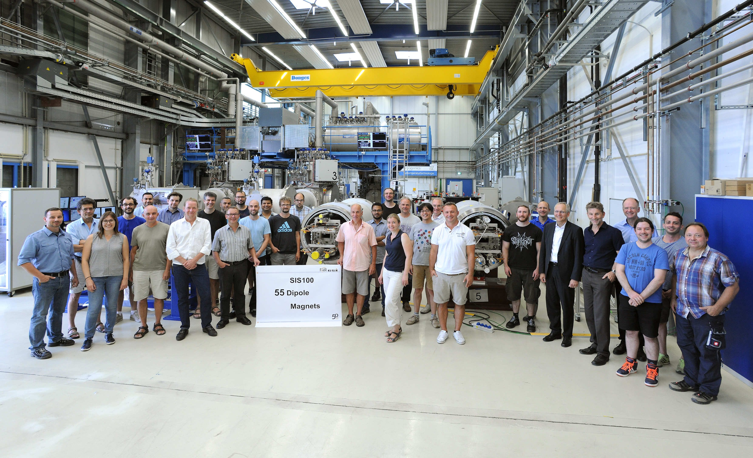
Serial Testing Status
Preparation area; incoming and outgoing tests
Scatch of test area
100 % of MCLs
50 % of SIS100-Dipols
one bypass-line
one Beam-vacuum-chamber
2 cryo-pump-prototyps
View in the testing hall with warm calibration magnet in front
Half of the SIS100 Dipole magnets are successfully testet

Slide 17
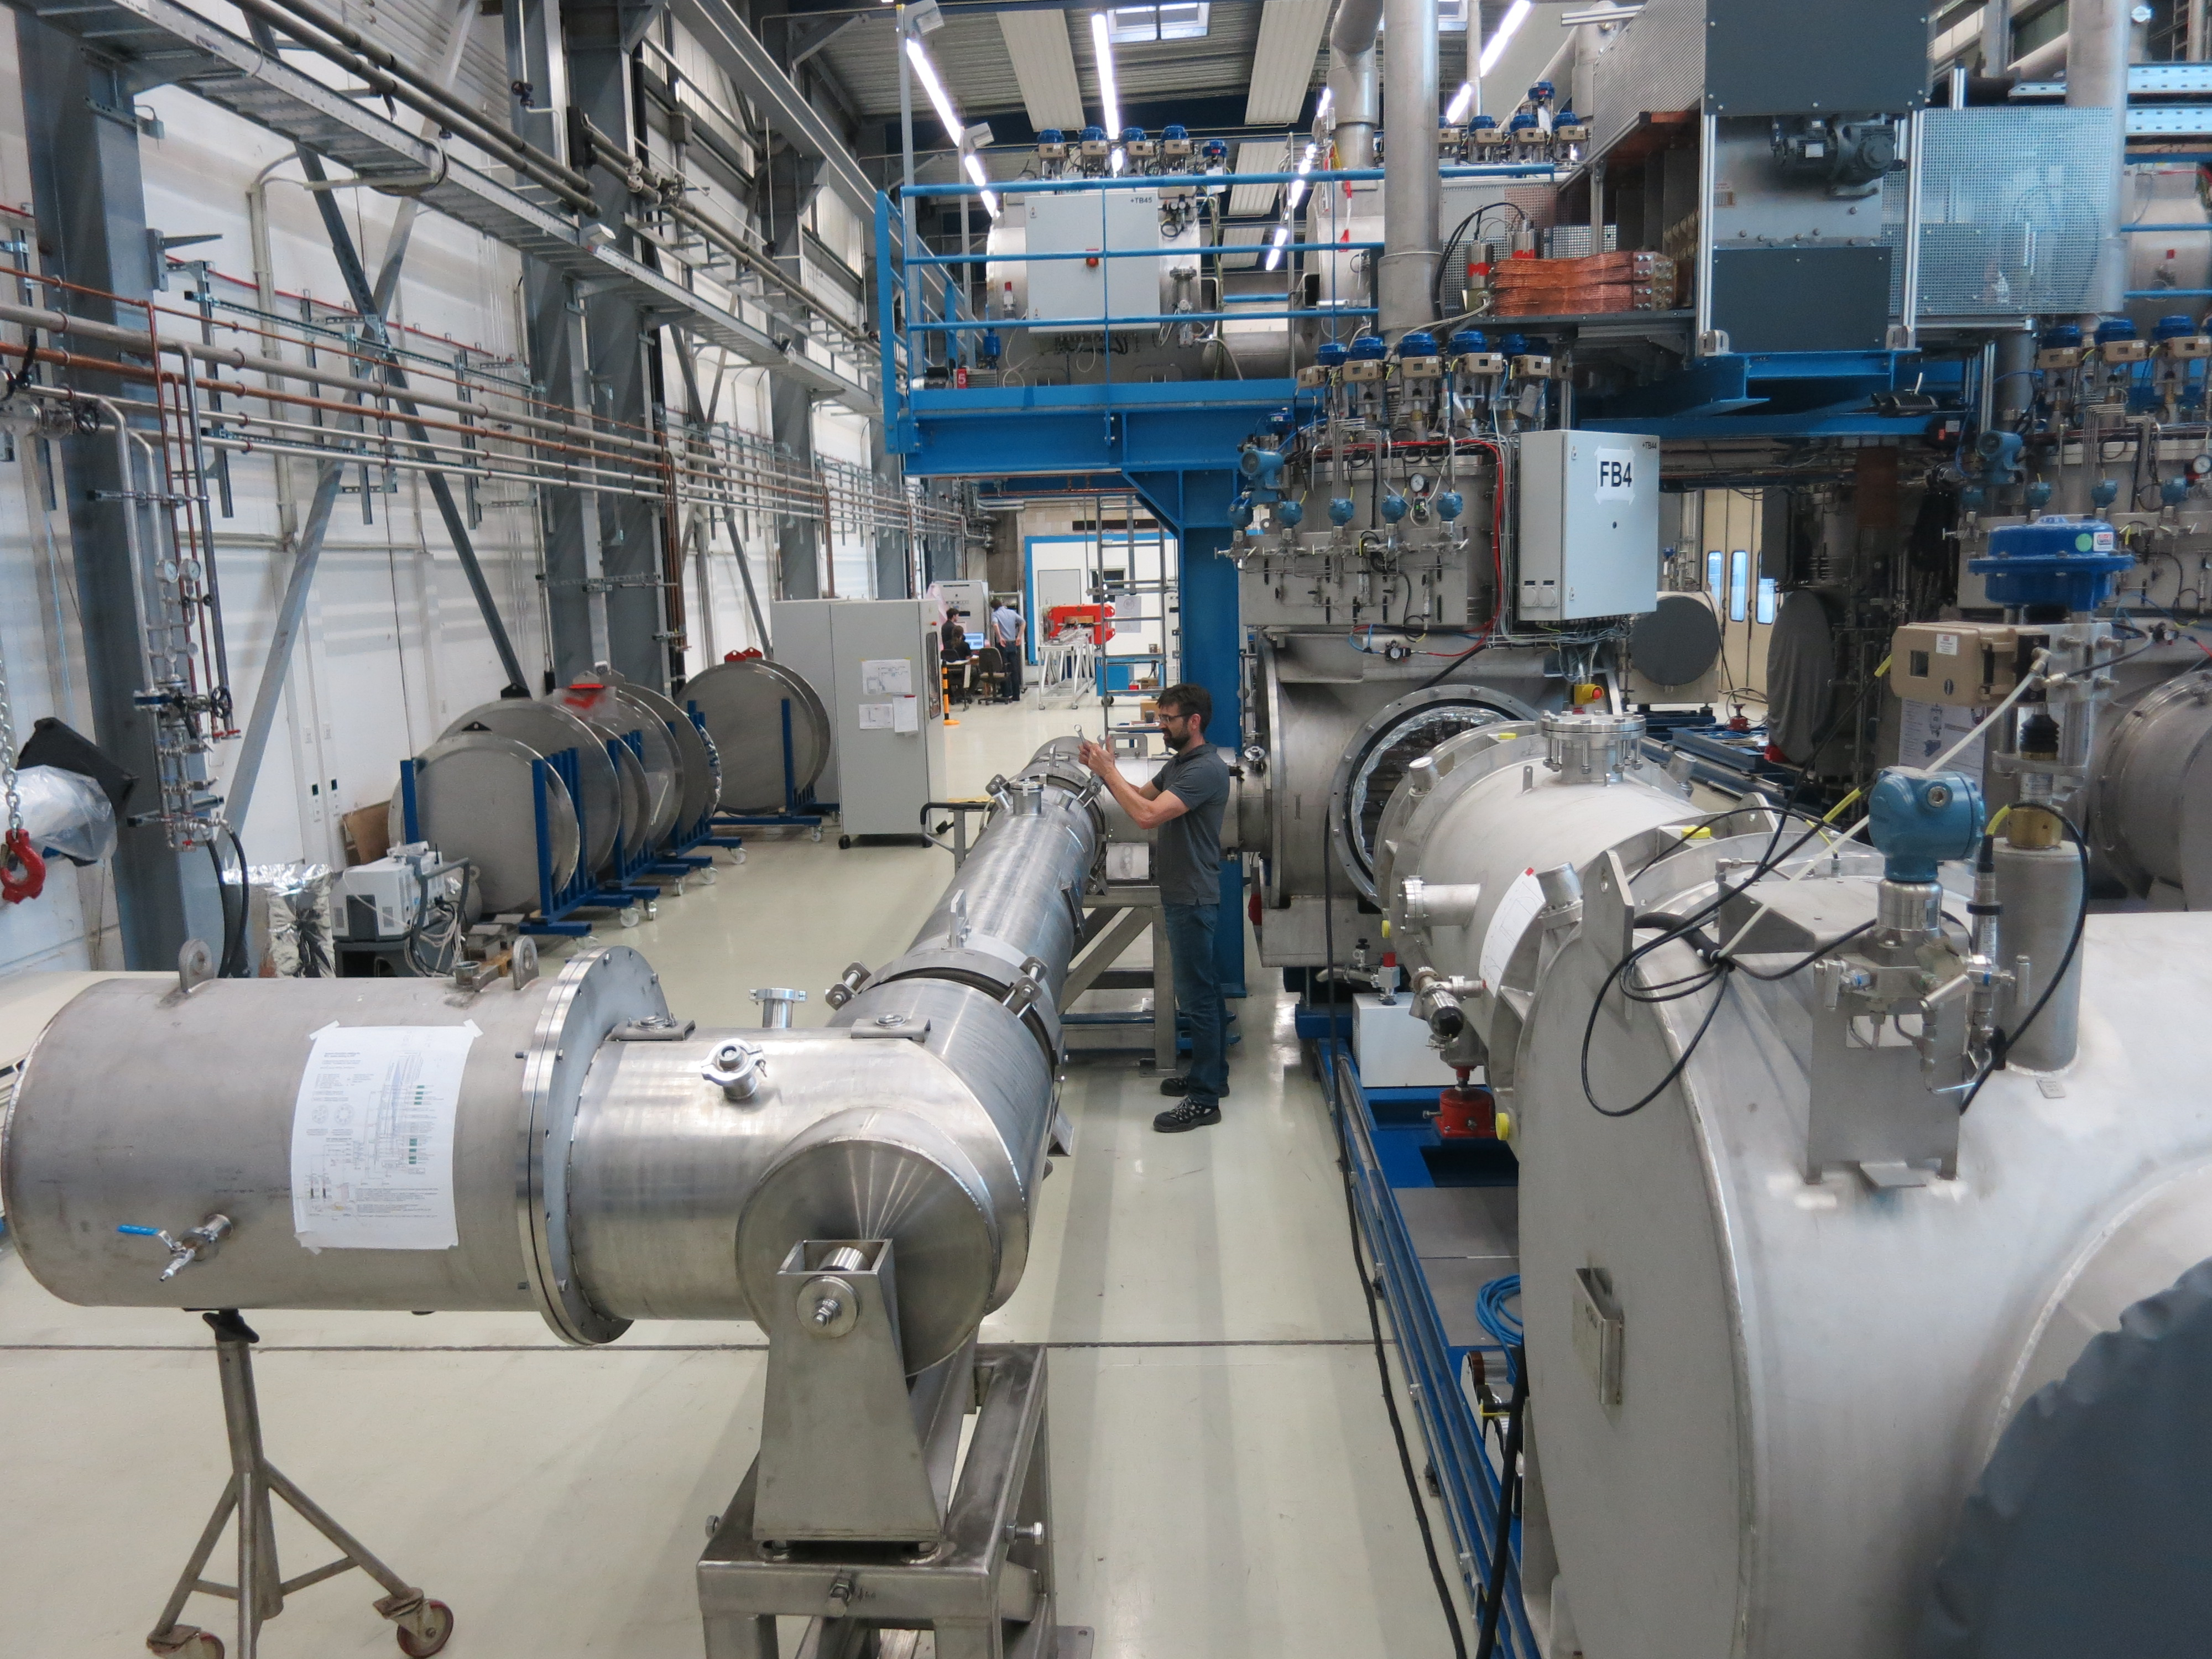
Additional Testing:
SIS100 By-Pass Line (Polish In-Kind)
Successfully tested at GSI STF
Series production in started
Production time until 2022

Slide 18
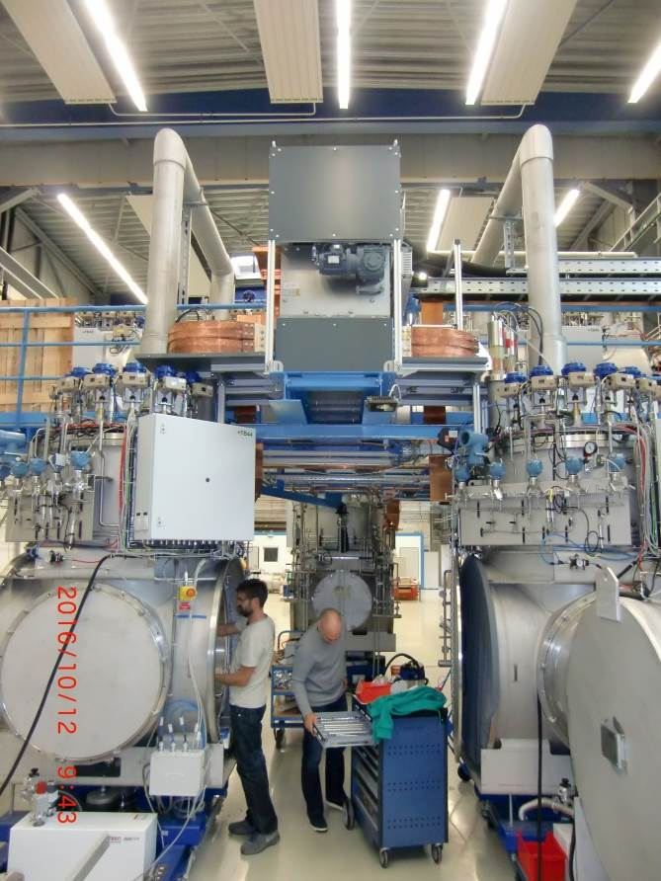
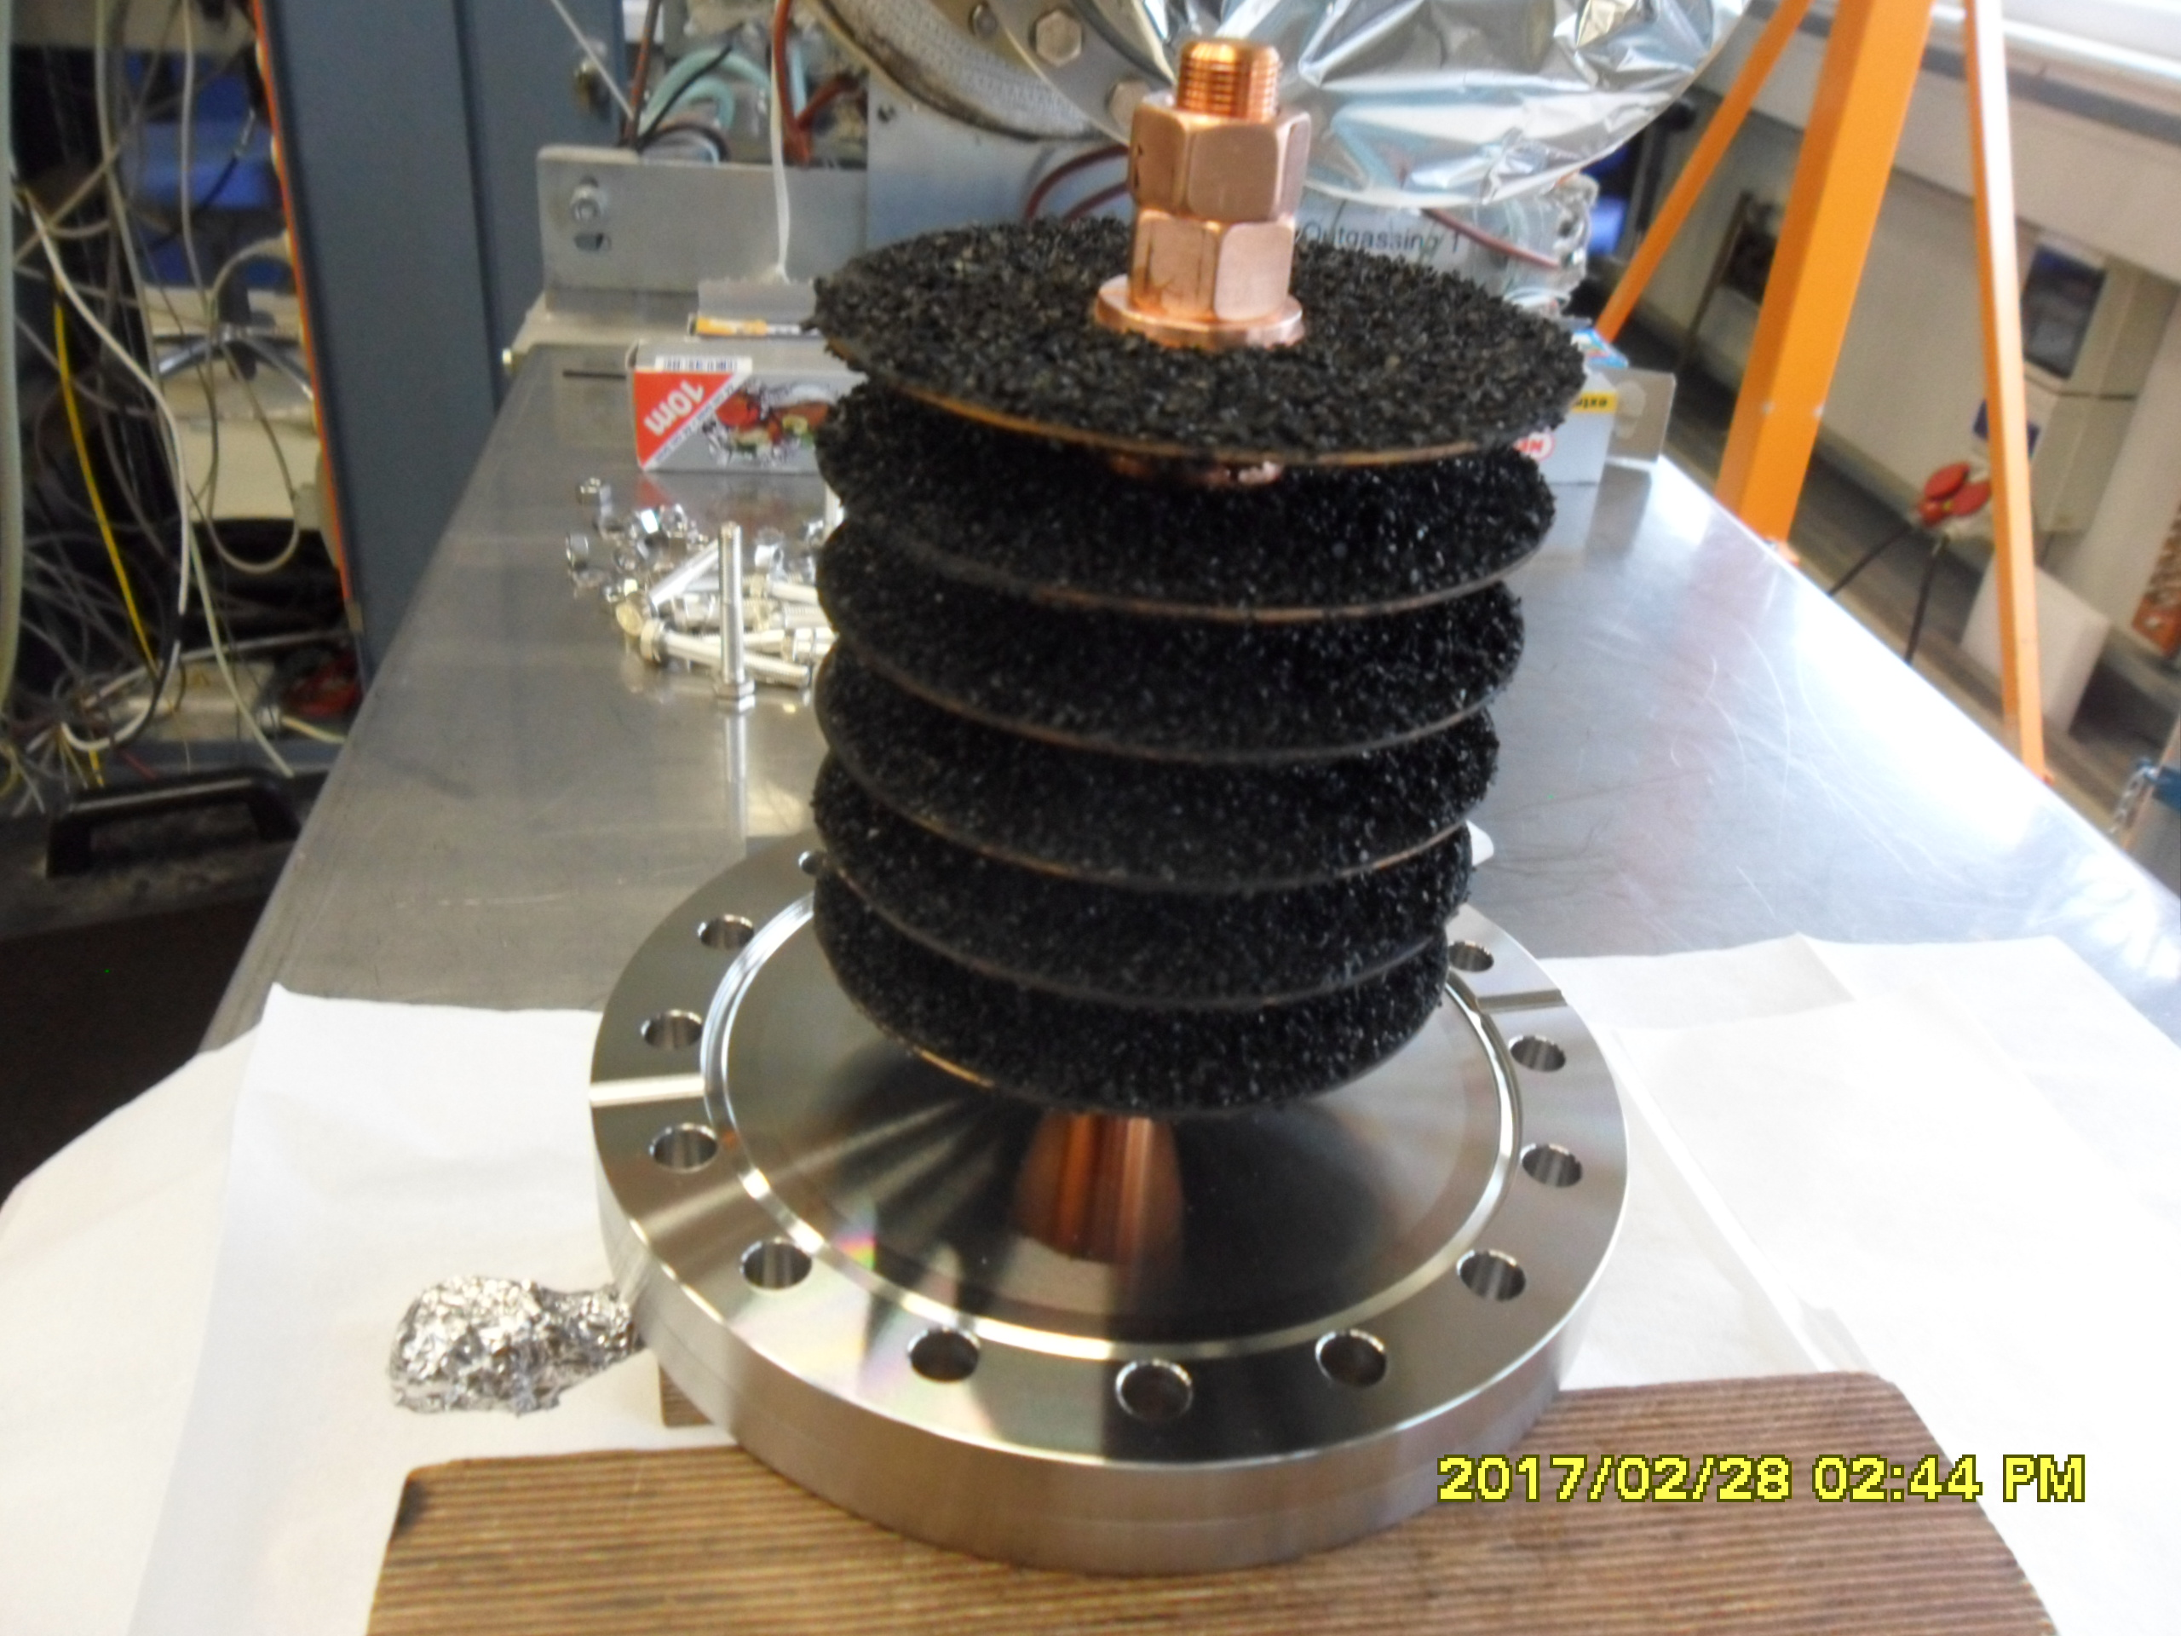
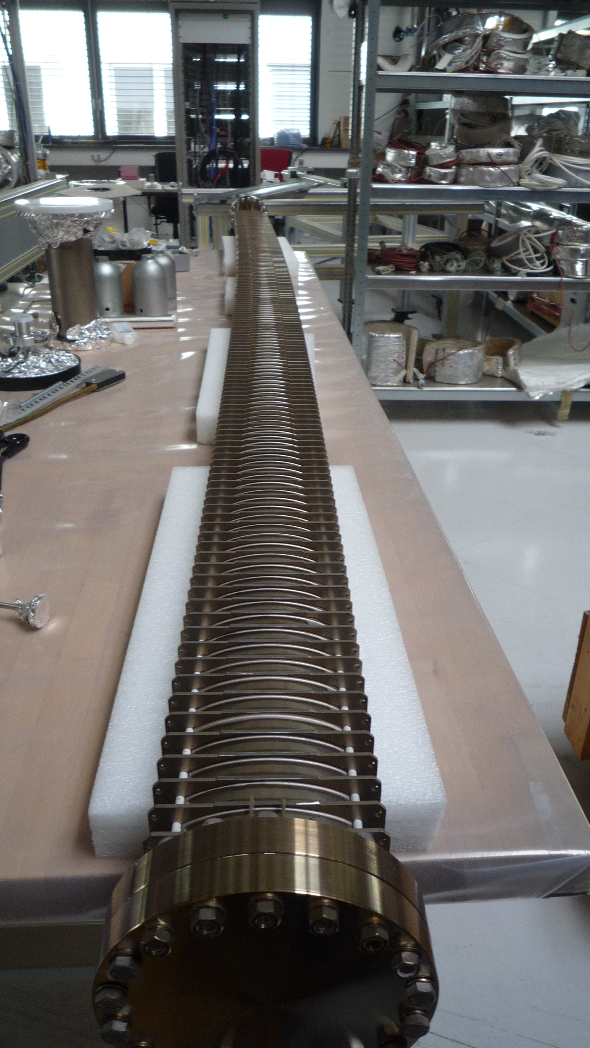
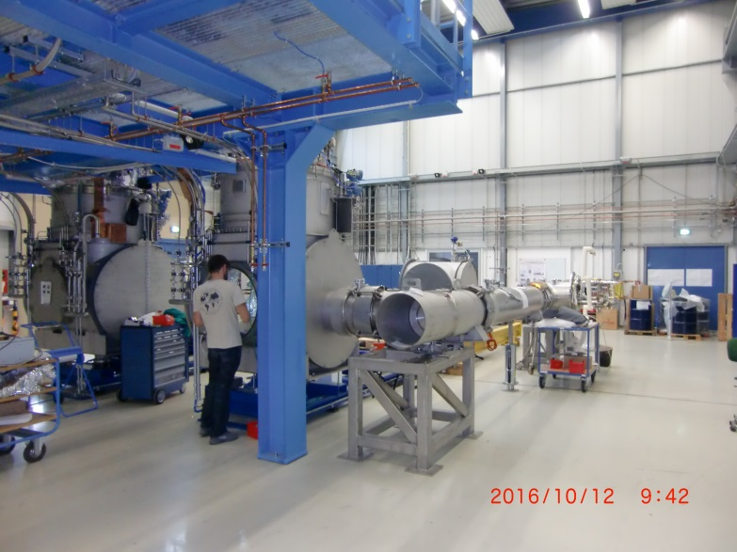
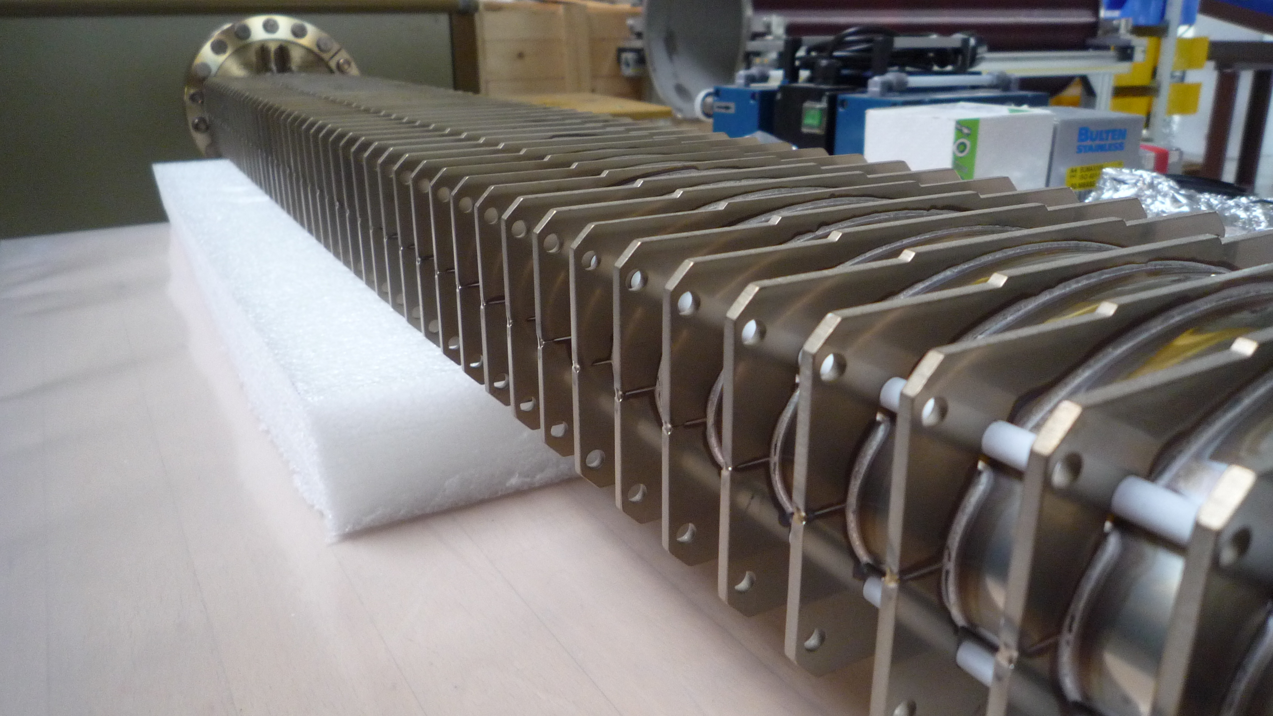
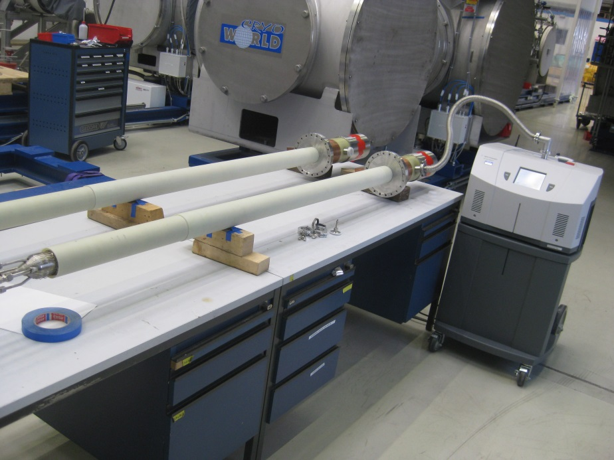
Additional Testing II:
MCL SIS100, Cryo-Adsroption Pump, Beam Pipe Chamner
One key item of SIS100 are the cryo-cooled, bended beam-vacuum-cambers
Cryogenic pump
Electrical switch for 14 kA between 2 benches
The 4. bench operated mainly for the serial testing of main current leads (MCLs)
Jumper-line during installation on the side of one Feedbox

Slide 19
SIS100-quadrupol at STF
4 different configurations
Arc section modules
types 2.5 to 2.9D
  54 modules
  Arc section module type
  incline of the arc-section
  Cryogenic supply in
  line of the arc section
Straight section modules
types 2.123 and 2.13s
  17 modules
  Stand-alone module
  types are in between two
  warm sections
  Cryogenic supply through
  attached by-pass line
Arc termination modules
types 2.4 and 1.E
  10 modules
  US- and DS-termination of
  the arc section of SIS100
  Cryogenic supply by
  attached by-pass line
  Additional support for vacuum forces
Special modules
types 2.4x and 1.Ei
  2 modules
  US- and DS-terminations of
  sector 5 in SIS100
  Additional Injection-
  and extraction QP-doublets
  separately supported
  Cryogenic supply by
  attached by-pass line

Slide 20
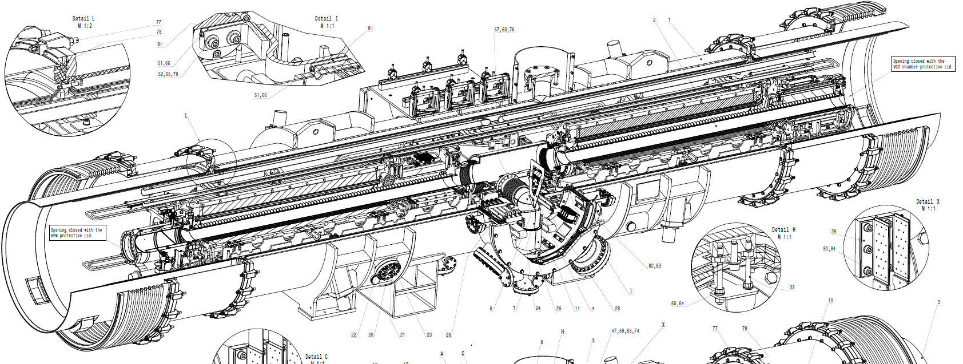
SIS100-quadrupol at STF
Cryocatcher
Defocusing QD
Beam direction
Beam Position Monitor
Vacuum Chamber
Focusing quadrupole F2
Steering
Magnet - ST
Downstream unit SF2B (F2 + steerer)
Upstream unit VQD (QD + sextupole)
SIS100 Quadrupole-module is a highly complex system of two quadrupole magnets and various additional components

Slide 21
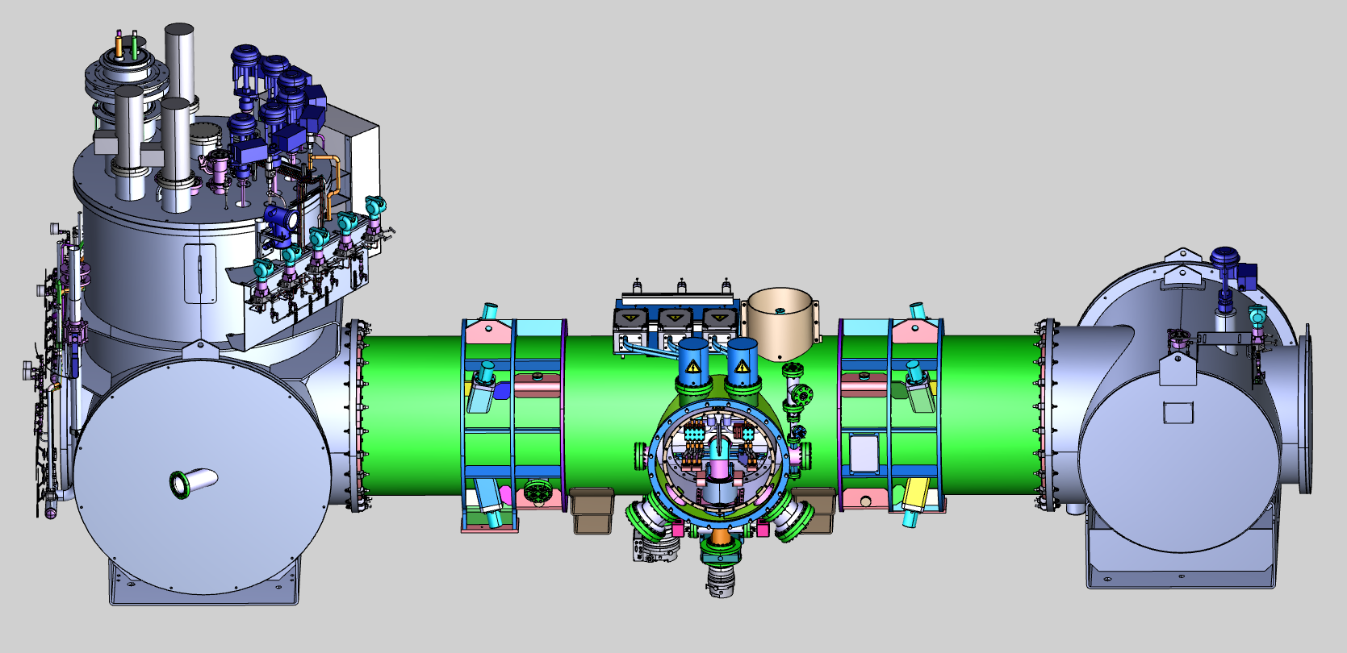
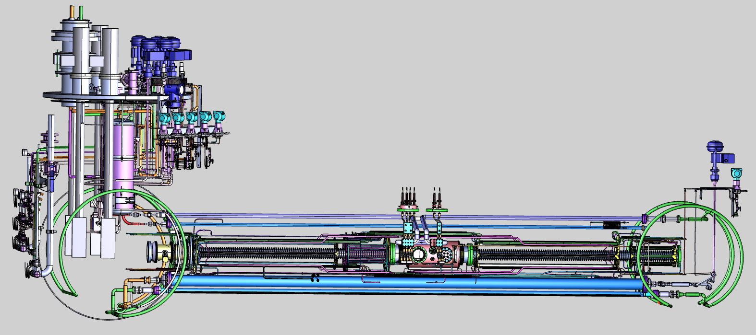
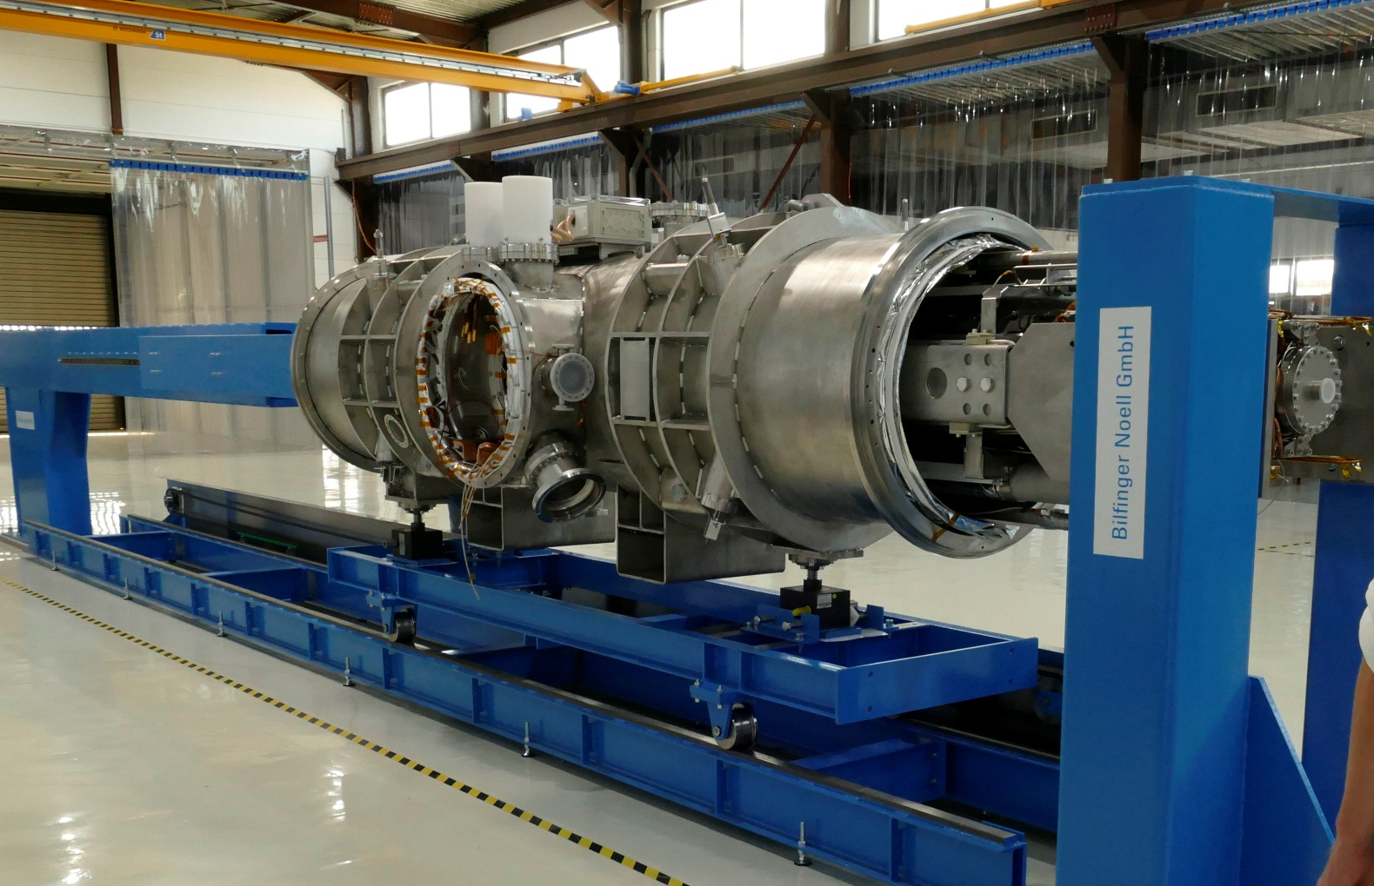
SIS100-quadrupol at STF
1. Magnet units, vacuum chambers, beam diagnostic and other
module components available at Bilfinger Noell for prototype
assembly.
2. Integration of QDM prototype advanced, module will be delivered
in October 2019 to GSI.
3. Testing campaign of the magnet module is planned and will start
in November 2019 at GSI series test facility.
Mounting scheme at Series Test Facility station
Assembly of prototype at Bilfinger-Noell

Slide 22
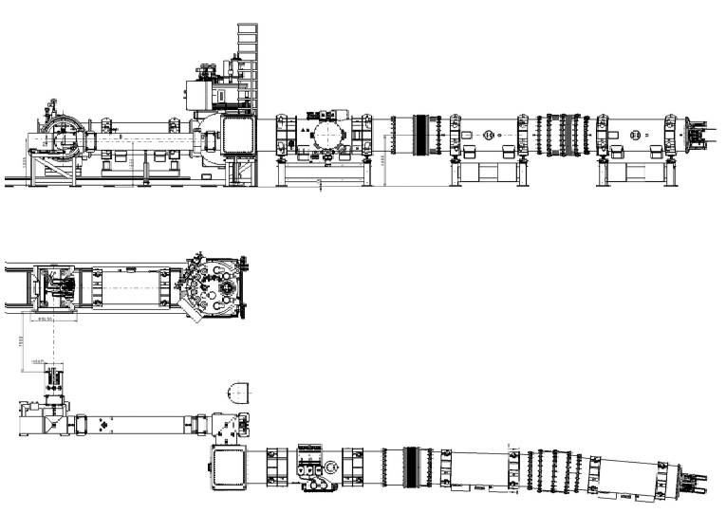
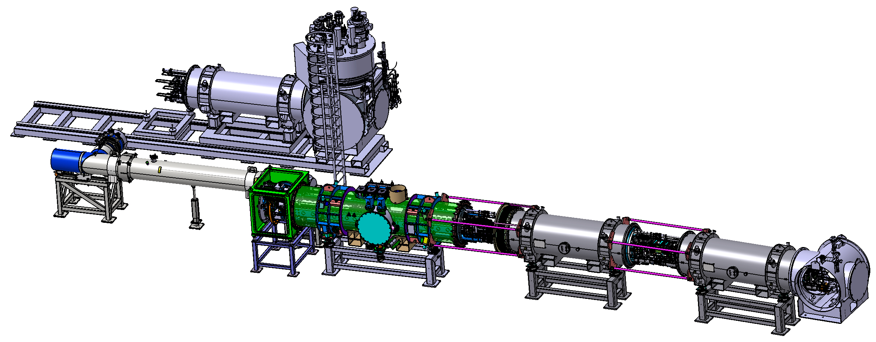
String plannings
Next big step in preparation is the installation of a string at STF.
After testing the first quadrupole-module we will immediately start building up a string with one quadrupole-module and two dipoles using also existing ring parts as feed-in-line and feed-in-cryostat.
Missing parts (red) as special end-box and connecting part are in design phase.
After first tests with electrical dipole- and quadrupole circles in series, we will be also able to operate the dipole circles and quadrupole circles independently.
During installation we will test all possible installation processes we will also have later during ring installation.
Side view of string
Top view of string
3-D-model of planned string

Slide 23
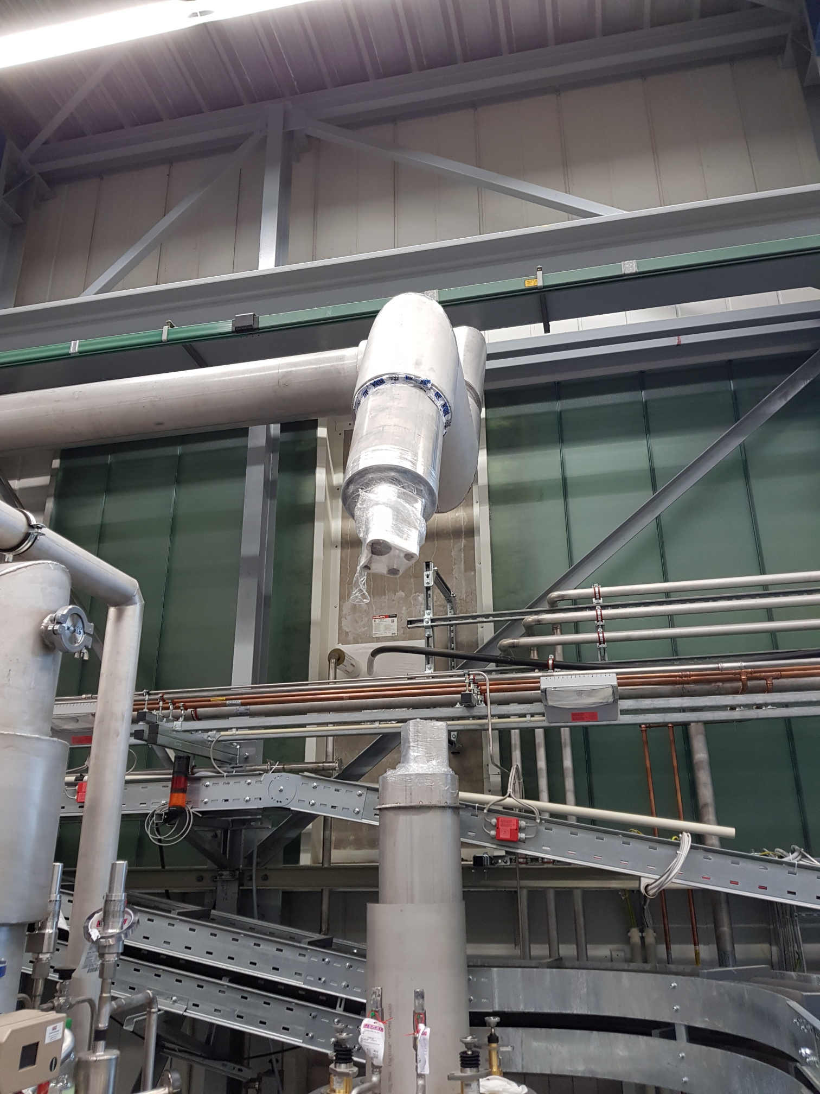









Modifications of the STF
Cryoplant was planned from very beginning to serve in a later stage superconducting cw-linac via the String-End-box.
By installing new distribution-box between Cold-box and test-area we will enable cw-linac-tests from the very beginning.
As a first step the new box and 20m transfer line was installed during shutdown-phase beginning 2019.
In 2. step we will install the residual transferlines and needed cryogenic infrastructure in the cw-linac-testbulding beginning October 2019 by DeMaCo.
This infrastructure will be later used to serve also the real cw-linac without any additional modifications.
We used some space between cold-box and first distribution box to cut the fourfold- and singelfold-transferline and installed additional distribution box for cw-linac supply.
New box is already implemented to the HMI of the cryoplant.
Cw-linac superconducting accelerator cell

Slide 24

CW-Linac at GSI
Layout of demonstrator cryomodule
Layout properties
Multigap CH cavities
Cavities with short lengths (<1 m) and small transverse dimensions (<0.5 m)
Modular construction with 4 cryomodules
Each containing 3 CH cavities, 1 buncher, 2 solenoids
E_{a}= 7.1 MV/m enables compact linac design
First step → Demonstrator project
Superconducting
9.3 T solenoids
2.2 m
Superconducting
217 MHz CH cavity
Support frame

Slide 25

Thank you for your interest
Magnet side of jumper-line; all bus bars are shorted

