Slide 2


First operational results of large liquid argon volume membrane cryostats and their cryogenic systems at CERN
Johan Bremer on behalf of the
CERN Neutrino Platform Collaboration

Slide 3
Content
Introduction to DUNE
Prototyping
  One of the possible detection principles
  The Membrane cryostat principle
  Detector integration
  Liquid argon purity
  Cryogenics
Purging, cool-down and filling
Stable operation results (pressure and temperature stability, purity level)
Conclusions

Slide 4
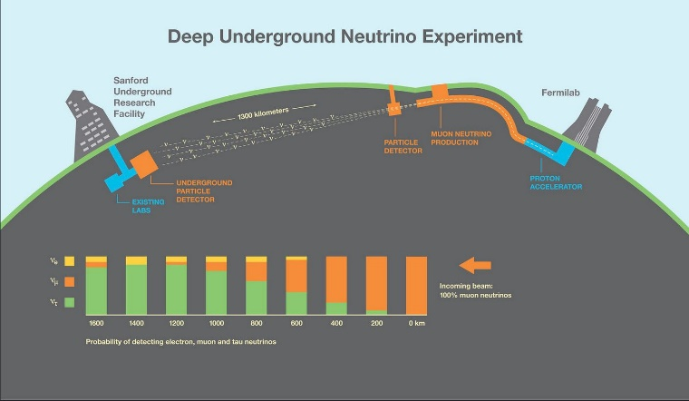
Introduction to DUNE
An international collaboration of more than 1000 scientists is working on the next large neutrino experiment, containing the creation as well as the detection of neutrino’s:
New PIP-II at Fermilab: 250 meter long superconducting Linac. Proton beam then passes the existing Booster and Main Injector-Recycler, creating a proton beam with an energy of 120 billion electronvolt (120 GeV).
  These proton will hit a graphite target generating particles which will decay in muon neutrino’s;
DUNE (Deep Underground Neutrino Experiment) near detector at the Fermilab site
DUNE far detector at 1300 km from Fermilab
LBNF (Long-Baseline Neutrino Facility) supplying the experimental infrastructure (caverns, cryogenic infrastructure, electrical power,…)

Slide 5
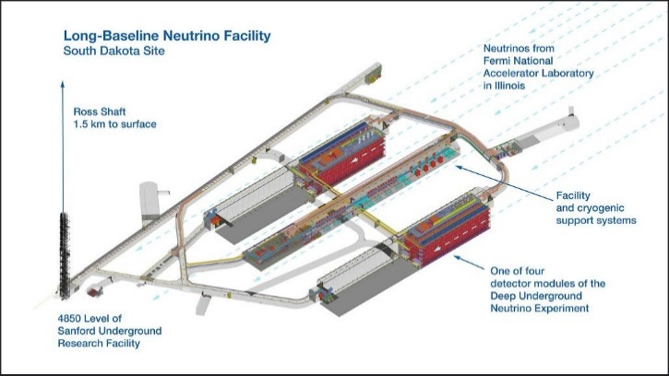
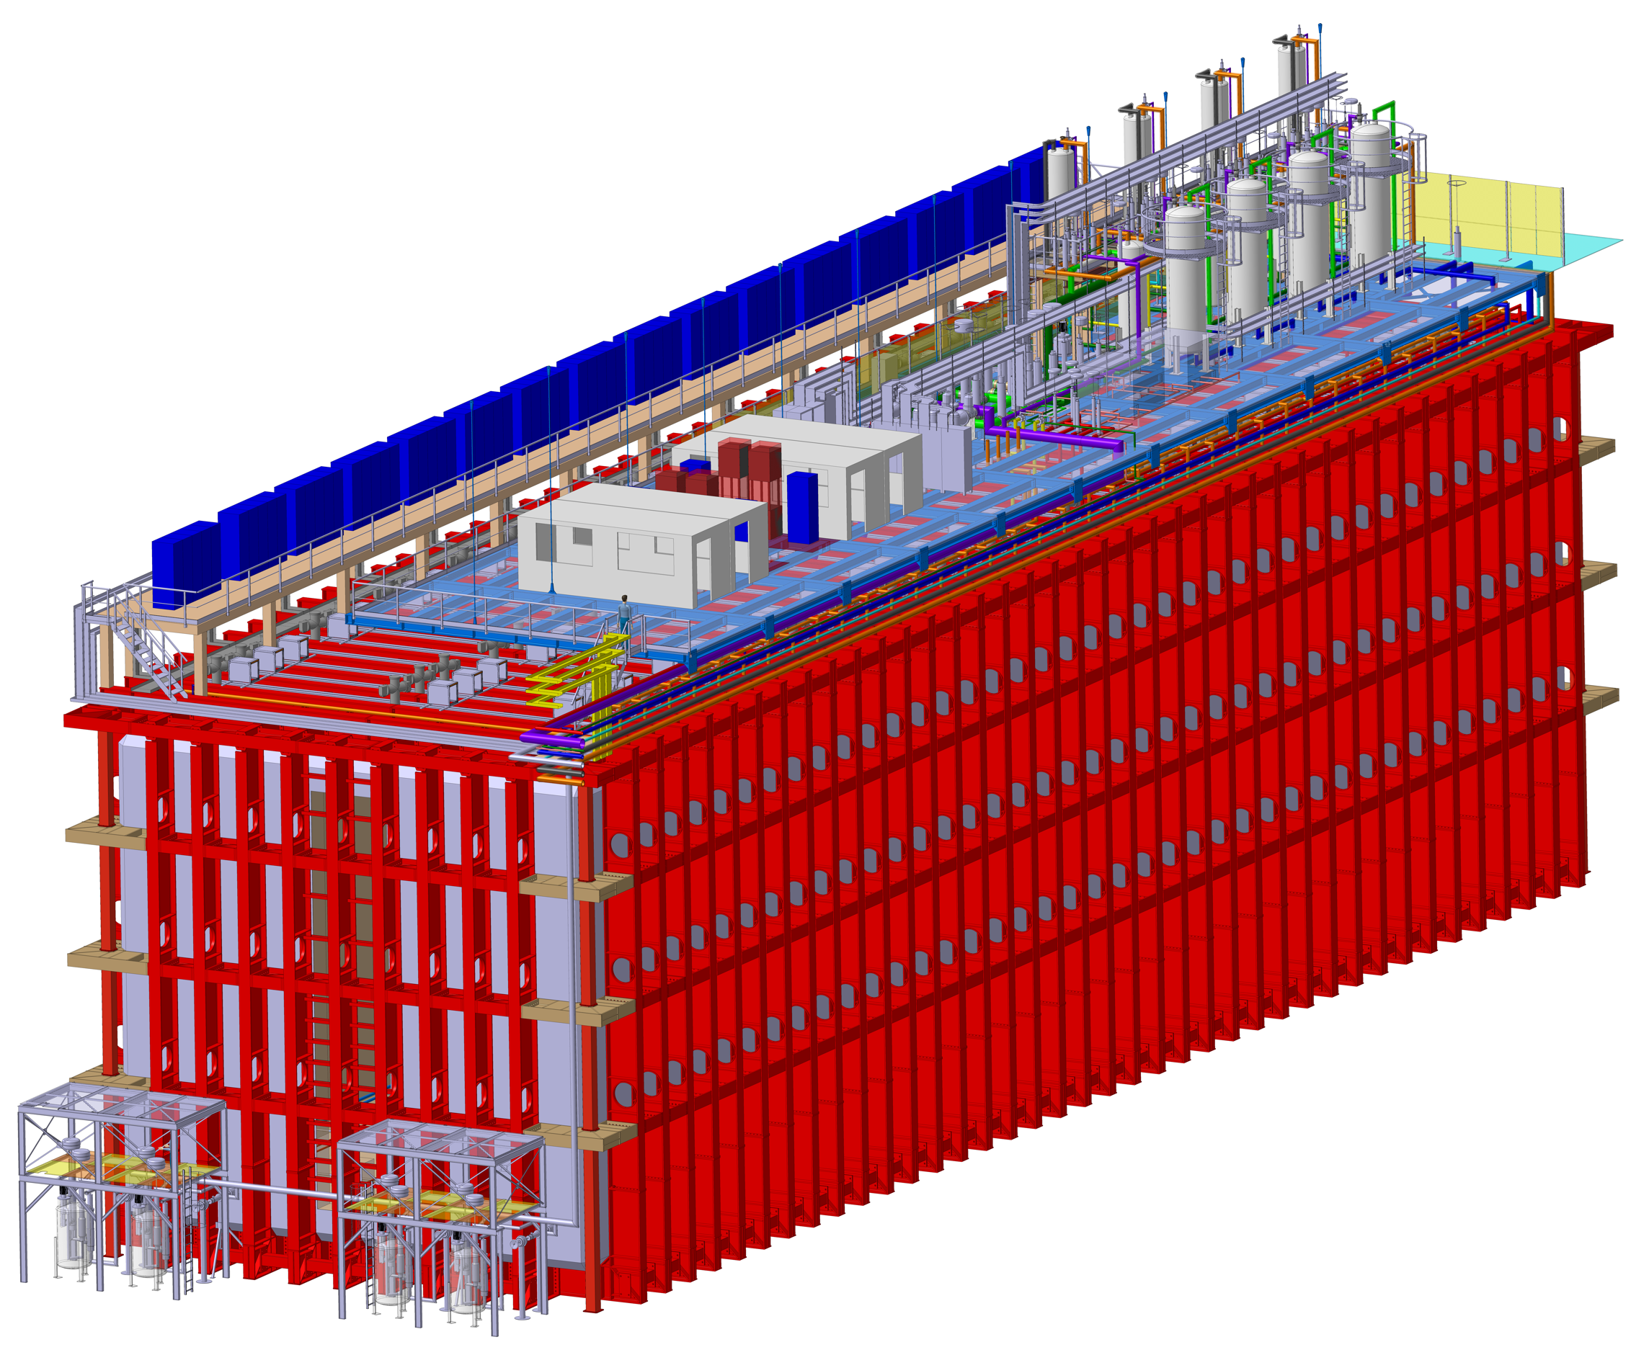
Introduction to DUNE FD
Interesting from the cryogenics point of view:
The Far Detector
1300 km from Fermilab;
1,5 km underground;
Detector housed in four cryostats holding a total volume of 70.000 tons of liquid argon;
Use of membrane cryostat principle;
Argon purity needed in ppt O₂ equivalent;
Uninterrupted cooling power based on evaporation of LN2.
From no experience to 17.500 tons cryostat: Proto-typing needed

Slide 6
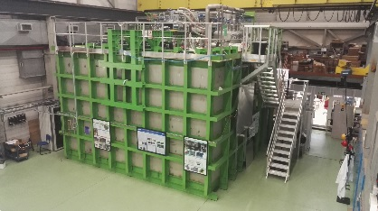
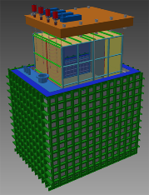
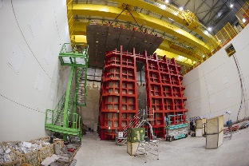
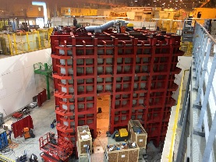
Prototyping
1 x 1 x 3
17 m³
Proto Dune SP
Proto Dune DP
35 T
SBNND
35 T
Program finished
(2016/17)
(Fermilab)
26 T
Program finished
(2016/17)
(CERN)
263 T
2020
(Fermilab)
840 T
Cool-down in August 2018
(NP04, CERN)
840 T
Cool-down in August 2019
(NP02, CERN)

Slide 7
Prototype cryostats (NP02 and NP04) at CERN
At CERN a test station has been build containing two detectors, each housed in a cryostat with a volume of about 600 m³ and equipped with its complete infra-structure (including cryogenic system, purification system, electrical power supply etc.). These systems were conceived to test:
two detection principles (single phase, and double phase);
the membrane cryostat principle;
the experimental set-up (how to build and insert the detector);
the high purity principle;
the cryogenic system;
Foreseen to be tested wit SPS beam

Slide 8
Single phase detection principle
Drift time
Wire number

Slide 9
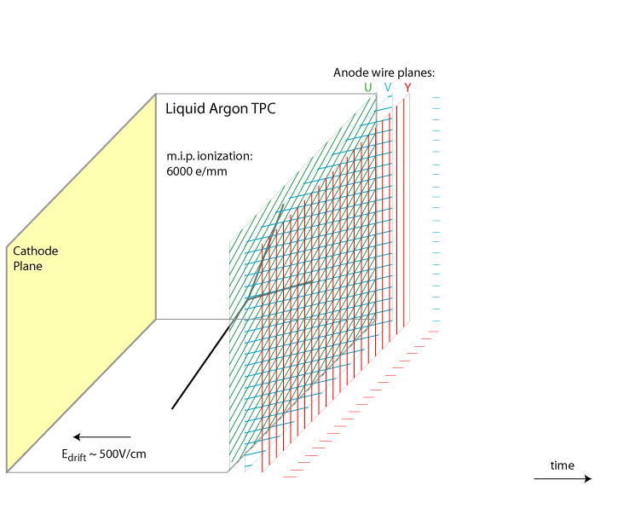
Single phase detection principle
175 kV over detector volume

Slide 10
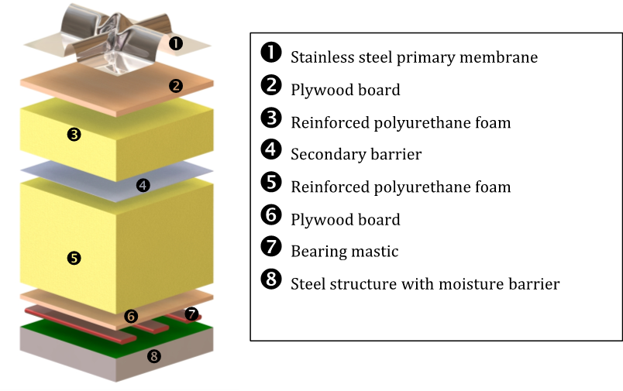
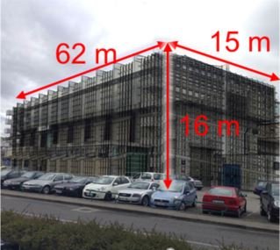
The membrane cryostat principle
Advantages:
No insulation vacuum: cannot break the vacuum;
Rectangular constructions can be build, gaining space;
Several tenths of year experience with the storage transport of large volumes of natural gas (111 K);
LAR only in contact with stainless steel membrane (cleanness);
Dis-advantages:
High heat load through walls (5 W/m²);
Membrane cannot support forces, which have to be transferred to a heavy outer structure;
System supports only very low over pressure (forces on outer structure) and under pressure (forces on membrane);
System has never been used to support experiments nor to be equipped with connection at the bottom and signal feed throughs

Slide 11
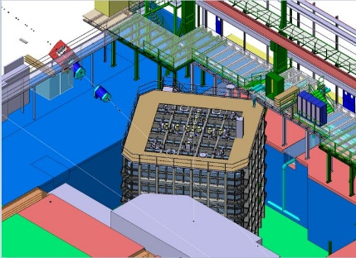
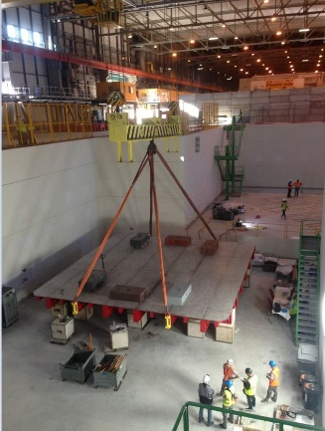
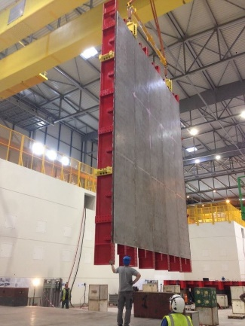
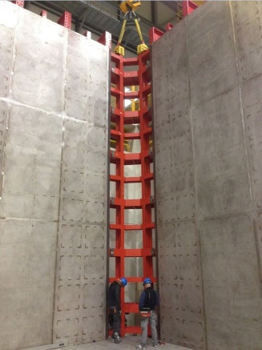
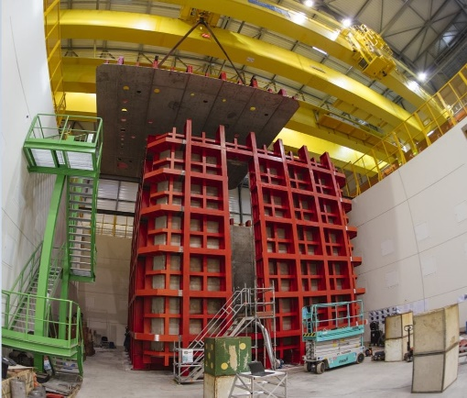
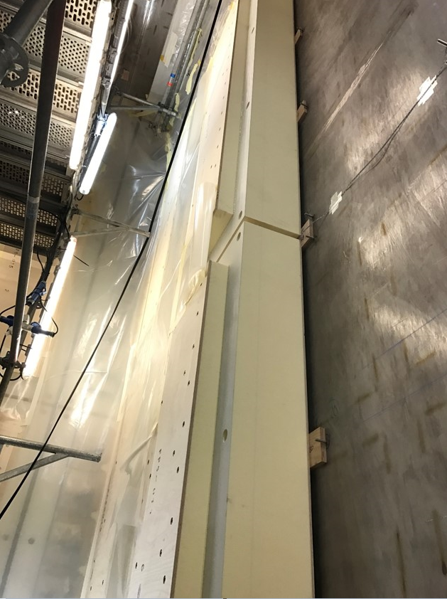
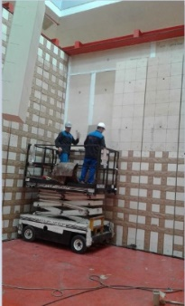
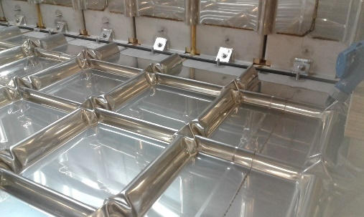
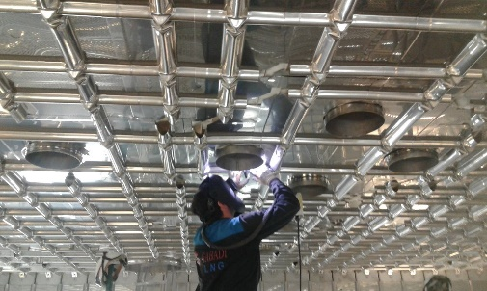
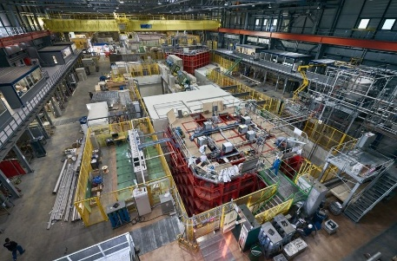
The membrane cryostat construction

Slide 12
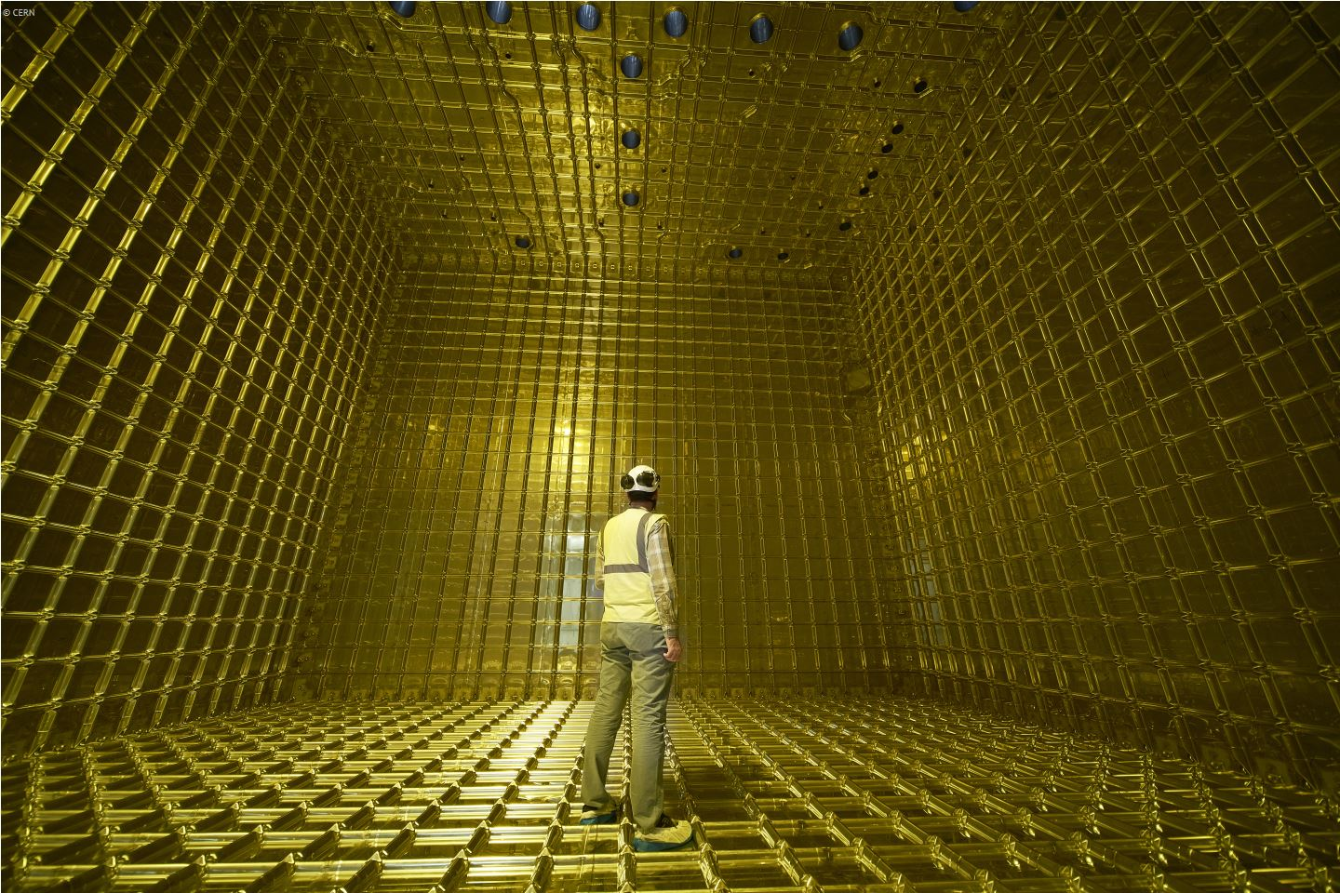
The membrane cryostat

Slide 13
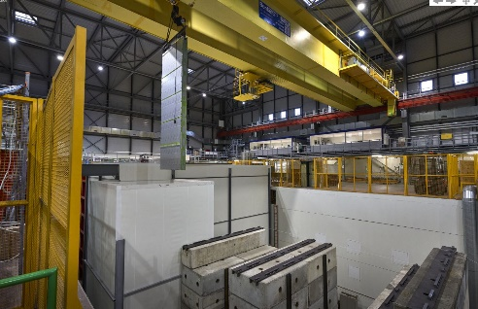
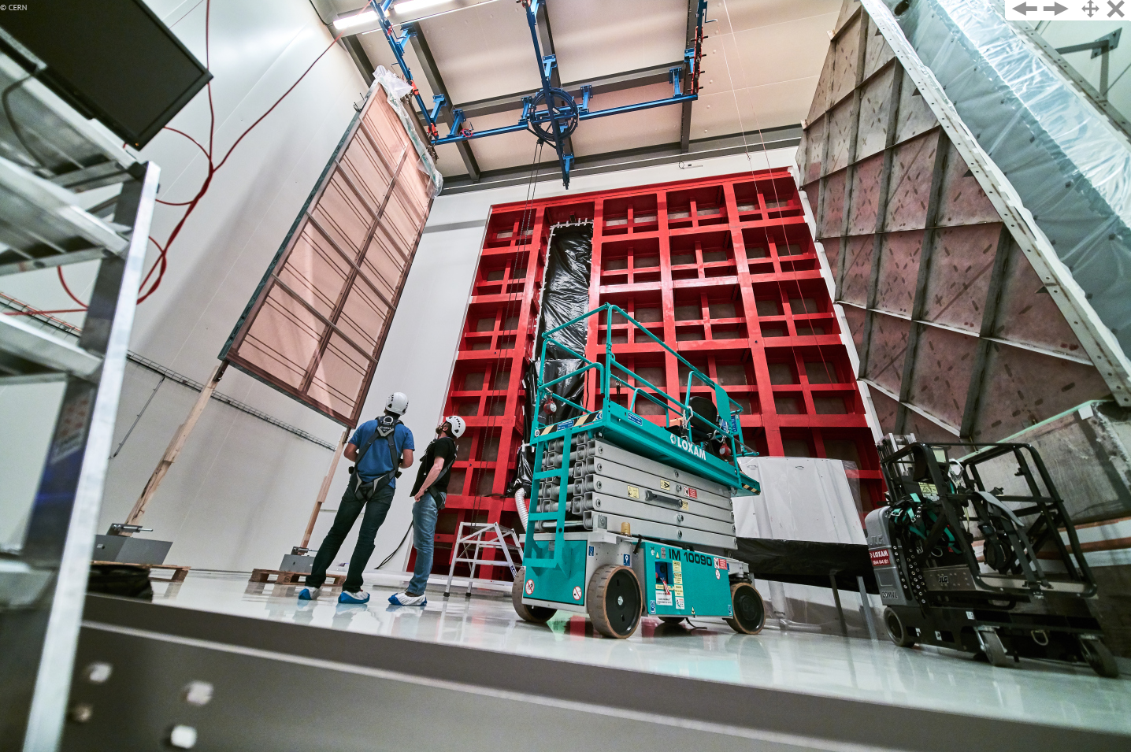
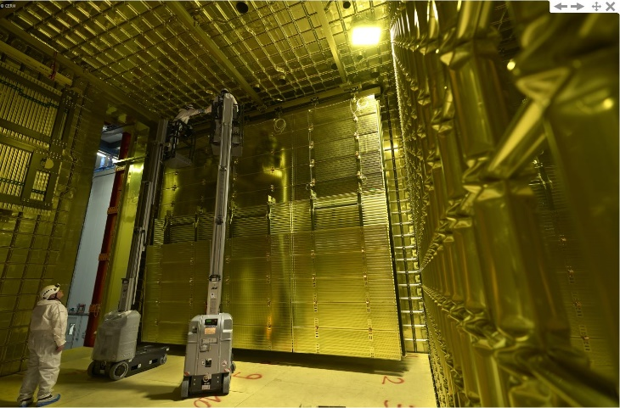
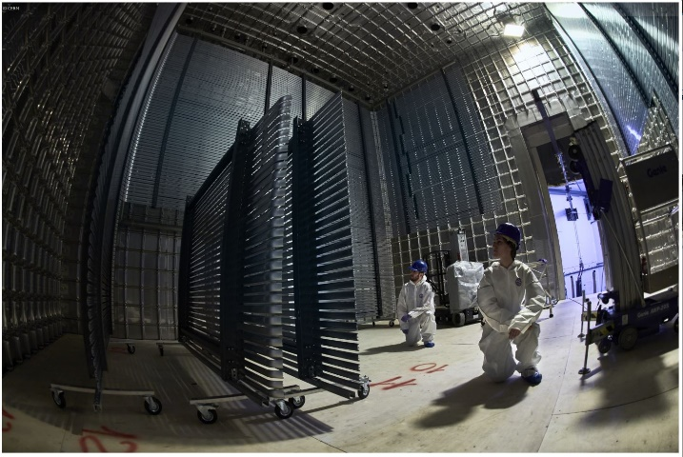
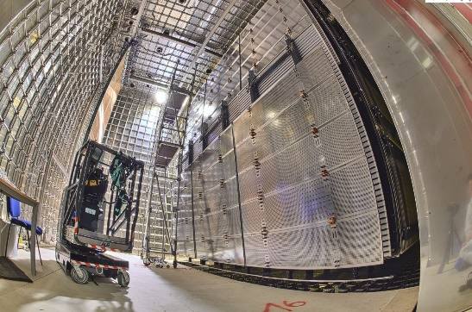
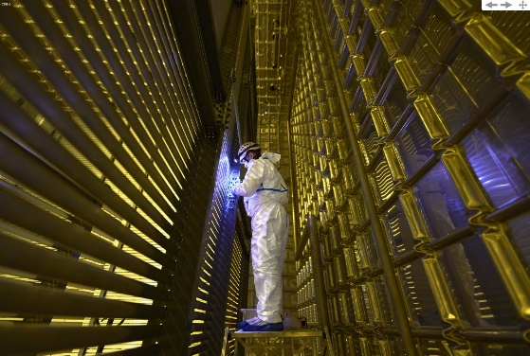
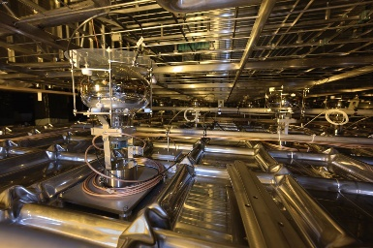
Detector integration (no support from membrane)

Slide 14
Cryogenic principles
Demands:
The cryogenic system needs to be able to adsorb the heat-load into the cryostat and cryogenic system;
Temperature gradient over the detector volume shall be within one Kelvin;
The cryogenic system has to guarantee a cryostat gas pressure staying well within the -30 mabrg and 350 mbarg limits (set pressure of safety valves);
Cryogenic system needs to assure an operational availability over a long period;
Molecular Sieve
Moisture adsorption
Cryogenic system needs to assure an oxygen equivalent impurity of the liquid argon in the detector within the low ppb O₂ eq (10⁻⁹) level;

Slide 15
Cryogenic principles
Solutions:
The cryostat is protected by two pre-safety valves: venting argon or entering argon gas when system comes close to safety valve opening pressure;
Cooling is supplied by evaporation of liquid nitrogen;
All supply systems are backed-up (electrical, compressed air, …), and cryostat system will “survive” without attendance (= without control/supply systems)
All detector wiring will leave the cryostat via the top: push the gas, created by the heat load into the argon bath, out of the cryostat via these cable feed-throughs. This gas is re-liquefied, and passed through a purifier system before being returned to the cryostat volume;
Molecular Sieve
Moisture adsorption
A circulation pumps takes continuously liquid argon from the bottom of the cryostat, passes it through a purifier, and returns it to the bottom of the cryostat;

Slide 16
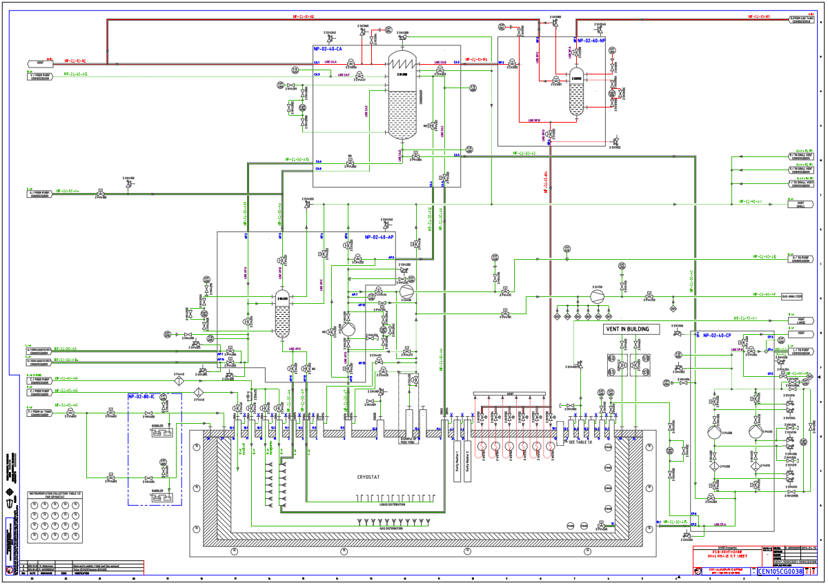
Cryogenic principles
to purifier
from purifier
Molecular Sieve
Moisture adsorption
1.9 kg/s
720 Tons of Liquid Argon

Slide 17
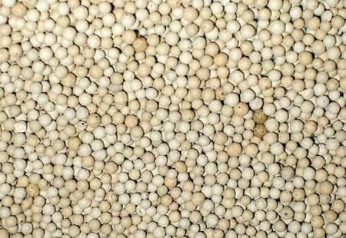
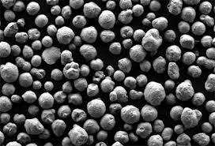

Liquid argon purity
Demanded liquid argon purity: < 1 ppb O₂ equivalent
Cryostats can not be vacuum pumped. Open loop purge: enter clean argon over the cryostat bottom surface and push air out at the top. At the correct speed (about 1 m/s) arrived at a gas purity of < 1 ppm O2 eq. after having passed 15 cryostat volumes;
Closed loop purge: cycle gas volume through warm purifier with help of warm circulator;
Purifier (warm and cold): Molecular Sieve (H₂O) and active Cu pellets (replacement of Oxysorb). These systems can be regenerated on-line.
Cu-226 (Cu coated Al₂O₃)
Oxydation (RT and -87 K):
$$Cu^{2+}+{\frac{1}{2}O}_{2}→CuO$$
Reduction (420 K)
$$CuO+H_{2}→H_{2}O+Cu^{2+}$$
Molecular Sieve
Moisture adsorption

Slide 18
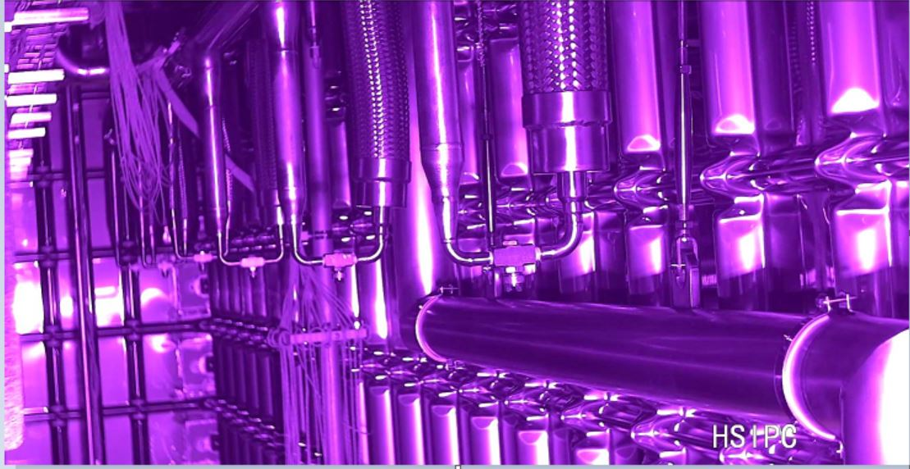
Purging, cool-down and filling
At the start of operation, each cryostat has been purged: enter clean argon gas (< 2 ppm O₂ eq.) at the bottom of the cryostat via a distributed system. Keep the vertical gas flow speed at about 1 m/s. In this way no turbulences and no back diffusion (open loop purge);
Closed loop purge: push cryostat gas in close loop through a purifier: O₂ level will drop (<100 ppb), but what is N₂ percentage doing: leak / no leak?
Start liquid argon delivery: specified < 2 ppm O₂ eq., at delivery measured: < 0.7 ppm;
Distribute argon via liquid purifier to bottom lines and top sprayers. Within two days coldest point cryostat < 100 K and during this cool-down temperature gradient over detector < 70 K.
Then: start liquid argon filling

Slide 19
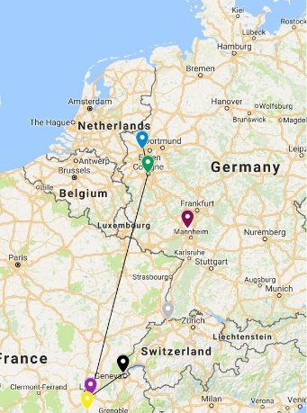
Purging, cool-down and filling
About 950 tons of LAr to be delivered at a rate of 40 tons per day (5 days/week): a logistic nightmare!

Slide 20
Purging, cool-down and filling

Slide 21

Purging, cool-down and filling

Slide 22
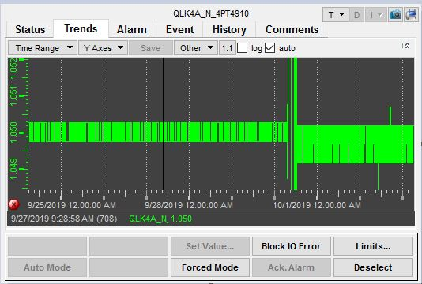
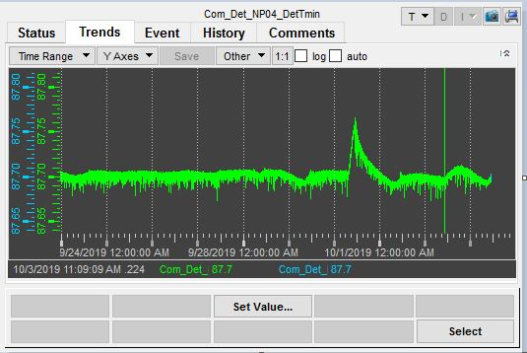
Stable operation results
Once the cryostat is filled, the liquid argon pumps are started to push the liquid through the purifier system. The liquid is then returned to the bottom of the cryostat, introducing thermal movement in the bath (breaking the stratification). The re-condensation loop is constantly active (compensation of heat loads).
Stability of argon bath pressure
Stability of argon bath temperature

Slide 23
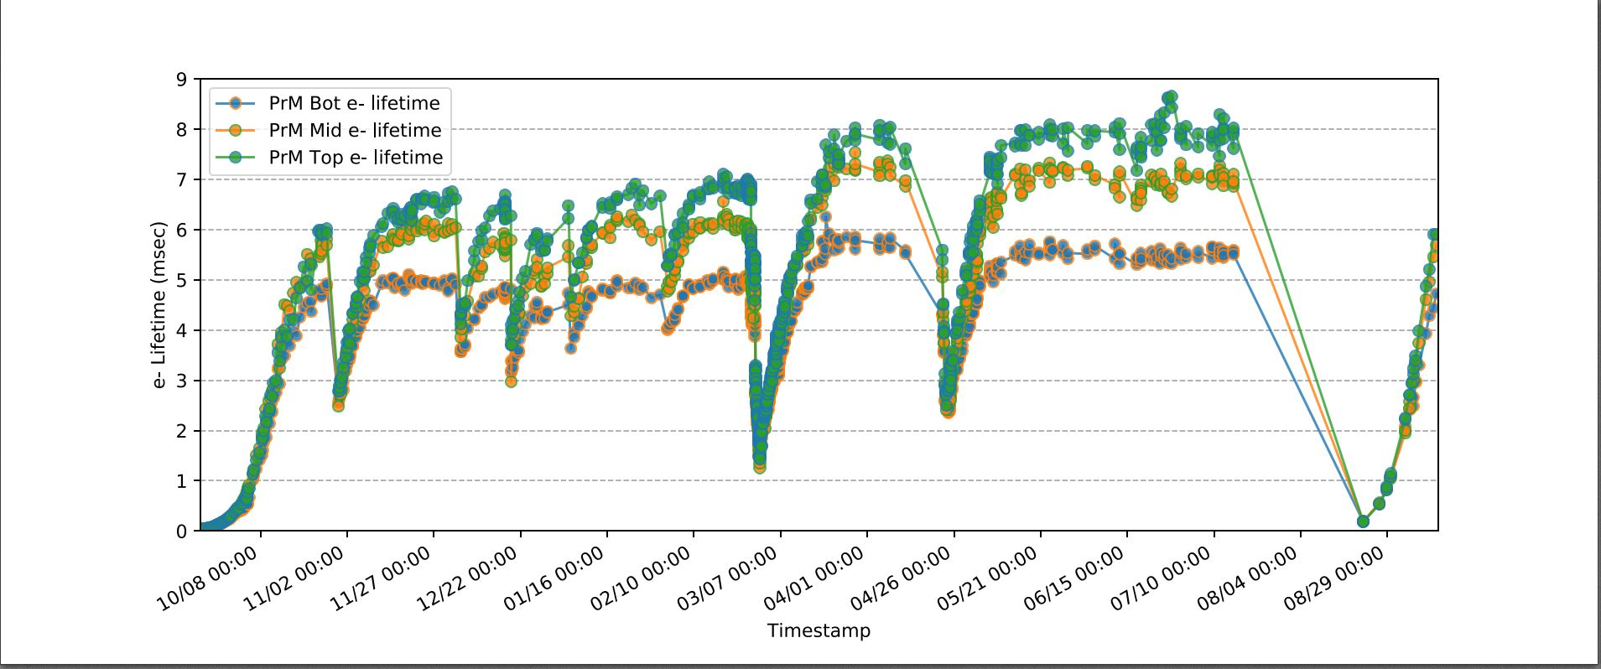

Stable operation results
The passing of the liquid through the purifier system lowers the oxygen content in the detector. After one month of circulation level from about 50 ppt!
purity (ppb)= $\frac{300}{t\left(usec\right)}$ = 35 ppt
HV over detector volume operational at 175 kV!

Slide 24
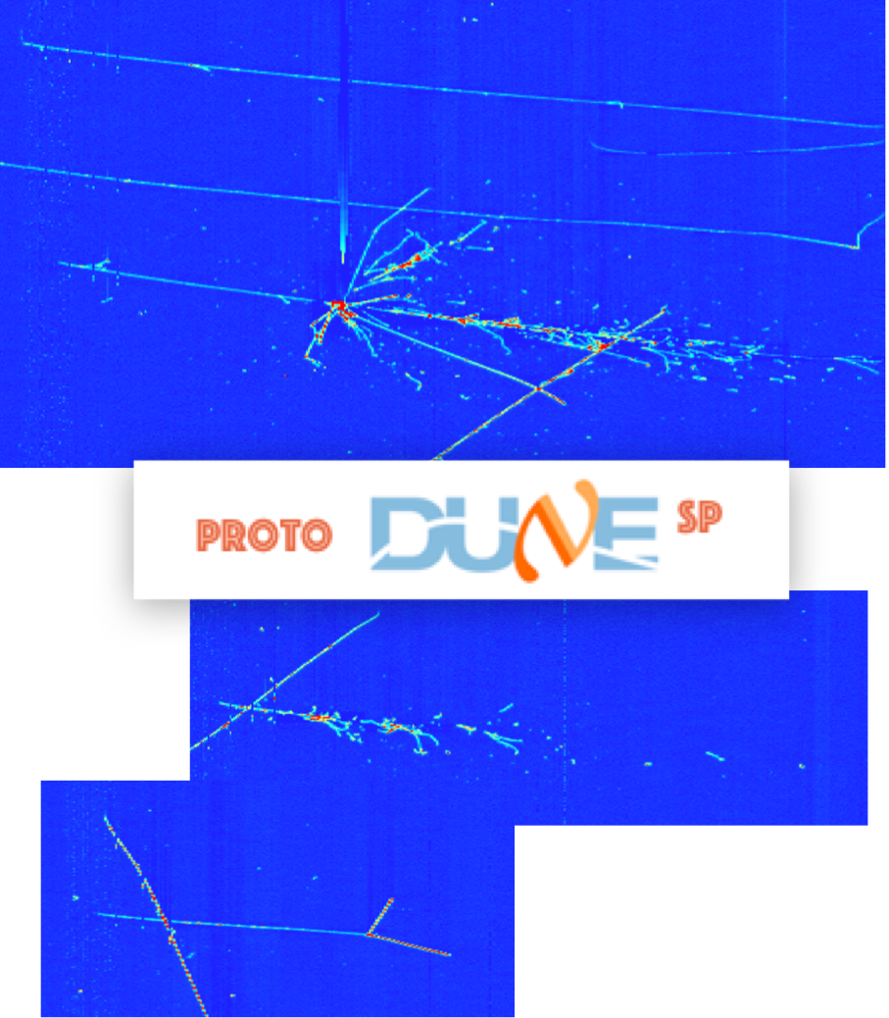
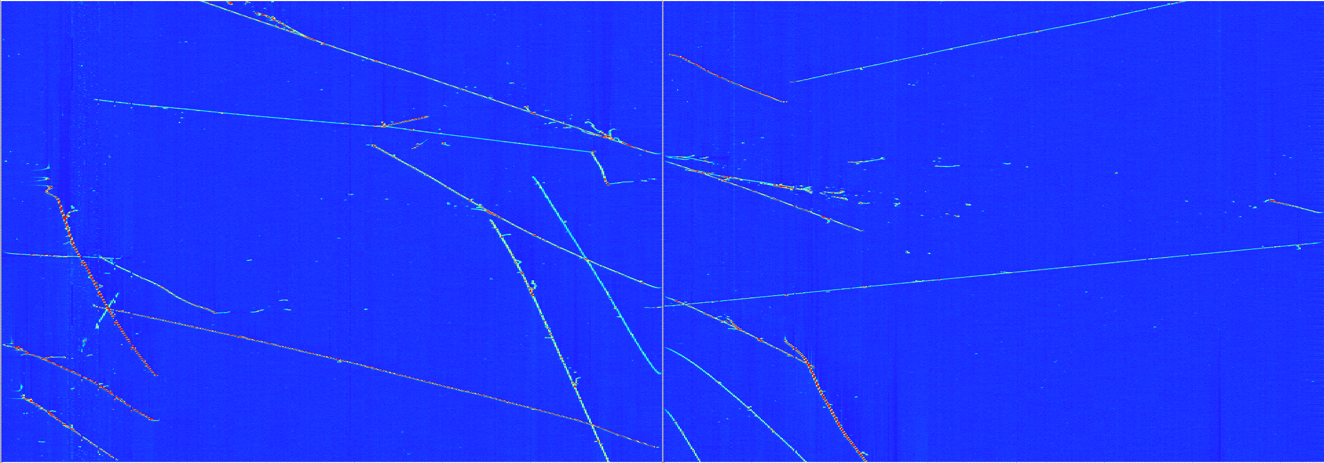
tracks
LArTPC data of unprecedented quality
7 GeV - Pion Interaction
3 GeV - Pion Interaction(s)
(and decay)
2 GeV - Electron shower
1 GeV - Pion Interaction (Absorption —> 2 p)
24
7/29/19

Slide 25
Conclusions
CERN is via the Neutrino Platform participating in the proto-typing for the DUNE experiment;
DUNE asks for large volume liquid argon based detectors;
Recently two DUNE prototype detectors, each housed in a 600 m3 membrane cryostat, have been brought to operation conditions;
The cryogenic system full-fills largely the requirements (temperature gradients, pressure stability, impurity level,..) demanded by the DUNE experiment;
……. First DUNE detector cryostat foreseen to be filled by end 2028!

