Slide 1




The cryogenic needs of the FCC
2019 European Cryogenics Days
08.10.2019 in Lund, Sweden
Claudio Kotnig on behalf of the CERN Cryogenics Group

Slide 2
Gentle Reminder: Particle Colliders
  Particle beams are accelerated to close to the speed of light
  Two opposing particle beams are brought to collision
  E = m · c²
  ... in linear colliders only one attempt
  ... in circular colliders non-collided particles are collected, returned and used for several attempts
  → Particle trajectories deflected by superconducting magnets (cryogenic temperatures necessary)

Slide 3
LEP & LHC
  Geneva Basin
  LEP Operation
  1990 - 1995 (z⁰ - Bosons)
  1996 - 2000 (w± - Bosons)
  LHC Operation
  2009 - 2023
  2026 - 2038 (HiLumi)
5
5
4
4
6
6
3
3
  Cryoplant
7
7
  RF Cavities
2
  Experiment
2
8
1.8
8
1
  Cryogenic Distribution Line
1
  LEP Cryo
  LHC Cryo
  10 x 18 kW @ 4.5 K cryoplants
  8 x 3.3 km of Cryogenic Distribution line
  4 x 12 kW @ 4.5 K cryoplants

Slide 4
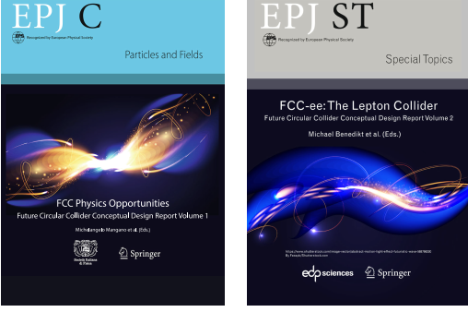

European Strategy for Particle Physics
What next?
  In 2013 the European Strategy for Particle Physics decided to launch studies to investigate different machines and concepts for future research in particle physics
  Circular Collider Study:
  Future Circular Collider
  Integration into existing Accelerator Complex at CERN
  LHC
  SPS
  PS
  LEIR
  FCC Conceptual Design Report
  (issued 15.01.2019)
  https://fcc-cdr.web.cern.ch/
  FCC

Slide 5


Some FCC superlatives in vivid comparisons
Timeline
  LHC
  FCC
  2014 Start FCC conceptual design phase
  2019 CDR released 15.01.2019
  2020 - 2028 Preparation
  2029 - 2037 Tunneling & installation FCC-ee
  2038 - 2053 FCC-ee operation in 4 stages
  2054 - 2063 FCC-hh preparation & installation
  2064 - 2090 FCC-hh operation
  FCC
  Cheops
  Cheops
  LHC
  ZU
  GE
  LA
  GE
Some data
 | LEP/(HL-)LHC | FCC
Circumference | 27 km | 100 km
Excavated soil volume tunnel
Electrical power consumption
Max. stored beam energy
  Saab 200
  A350
  0.42 · 10⁶ m³
3.25 · 10⁶ m³
  200 MW
580 MW
  0.33 GJ
8.4 GJ

Slide 6
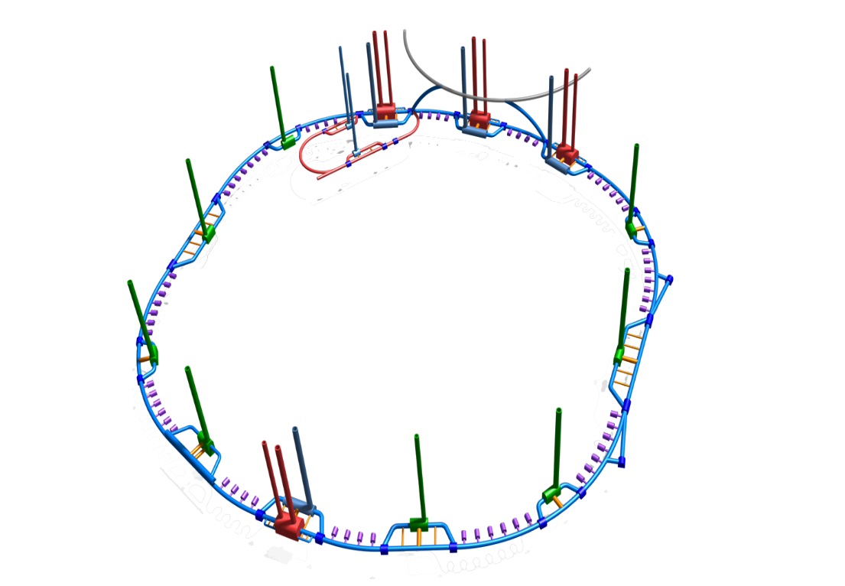
FCC tunnel
A
B
C
L
D
K
  ≈ 600 m
E
J
F
I
G
H
  Courtesy of J.Osborne

Slide 7
FCC machines
FCC-ee machine
FCC-hh machine
  Precise measurements: Beam energy tuned to create certain particles
  Discovery machine: Beam energy maximized to create new particles

Slide 8
Benefits for particle physics research
  Same Energy
  Luminosity increase by 10² ÷ 10⁵
  Energy increase by factor 7
  Luminosity increase by factor 1 ÷ 2
  Courtesy of L.Tavian

Slide 9
FCC-ee Cryogenics: Research Goal in 4 Stages
Research goal
In-depth exploration to find
Optimized to study 4 particles at highest luminosity
confirmation of or
deviations from the Standard Model
The 4 Stages Plan
1. Stage (2038 - 2041): z⁰-Bosons (E_{Beam} = 45.6 GeV)
2. Stage (2042 - 2044): w±-Bosons (E_{Beam} = 80 GeV)
Increasing
cryogenic
requirements
3. Stage (2045 - 2047): Higgs Bosons (E_{Beam} = 120 GeV)
2048 – 2049: 1 year installation, upgrade & rearrangement
4. Stage (2049 - 2053): Top Quarks (E_{Beam} = 175 | 182.5 GeV)

Slide 10
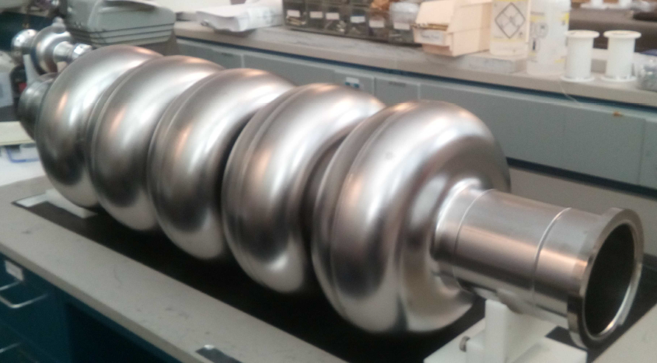
FCC-ee Cryogenics: Applications
Cryogenic Applications
RF Cavities
Accelerating the lepton bunches
Compensate for the energy losses due synchrotron radiation P_{SR}
  Energy losses per turn:
Stage 1 (z⁰) | 0.036 GeV
Stage 2 (w±) | 0.34 GeV
Stage 3 (Higgs) | 1.72 GeV
Stage 4 (Top Quark) | 7.8 / 9.2 GeV
  Courtesy of JLAB

Slide 11
FCC-ee Cryogenics: Stage 1/4 (z-Boson)
1. Stage: z⁰-Bosons (E_{Beam} = 45.6 GeV)
2. Stage: w±-Bosons (E_{Beam} = 80 GeV)
B
A
3. Stage: Higgs Bosons (E_{Beam} = 125 GeV)
C
L
4. Stage: Top Quarks (E_{Beam} ≥ 173 GeV)
D
K
E
J
F
I
H
G
Header C: 400 MHz RF Cavities Supply (4.6 K / 3 bar)
Header D: 400 MHz RF Cavities Return (4.5 K / 1.3 bar)
Header E: Thermal Shields Supply (50 K / 20 bar)
Header F: Thermal Shields Return (75 K / 18 bar)
QRL
Beam 1
Beam 2
Booster
Newly installed 400 MHz RF Module @ 4.5 K
Formerly installed 400 MHz RF Module @ 4.5 K
Newly installed 800 MHz RF Module @ 2.0 K

Slide 12
FCC-ee Cryogenics: Stage 2/4 (w-Boson)
1. Stage: z⁰-Bosons (E_{Beam} = 45.6 GeV)
2. Stage: w±-Bosons (E_{Beam} = 80 GeV)
B
A
3. Stage: Higgs Bosons (E_{Beam} = 125 GeV)
C
L
4. Stage: Top Quarks (E_{Beam} ≥ 173 GeV)
D
K
E
J
F
I
H
G
Header C: 400 MHz RF Cavities Supply (4.6 K / 3 bar)
Header D: 400 MHz RF Cavities Return (4.5 K / 1.3 bar)
Header E: Thermal Shields Supply (50 K / 20 bar)
Header F: Thermal Shields Return (75 K / 18 bar)
QRL
Beam 1
Beam 2
Booster
Newly installed 400 MHz RF Module @ 4.5 K
Formerly installed 400 MHz RF Module @ 4.5 K
Newly installed 800 MHz RF Module @ 2.0 K

Slide 13
FCC-ee Cryogenics: Stage 3/4 (Higgs Boson)
1. Stage: z⁰-Bosons (E_{Beam} = 45.6 GeV)
2. Stage: w±-Bosons (E_{Beam} = 80 GeV)
B
A
3. Stage: Higgs Bosons (E_{Beam} = 125 GeV)
C
L
4. Stage: Top Quarks (E_{Beam} ≥ 173 GeV)
D
K
E
J
F
I
H
G
Header C: 400 MHz RF Cavities Supply (4.6 K / 3 bar)
Header D: 400 MHz RF Cavities Return (4.5 K / 1.3 bar)
Header E: Thermal Shields Supply (50 K / 20 bar)
Header F: Thermal Shields Return (75 K / 18 bar)
QRL
Beam 1
Beam 2
Booster
Newly installed 400 MHz RF Module @ 4.5 K
Formerly installed 400 MHz RF Module @ 4.5 K
Newly installed 800 MHz RF Module @ 2.0 K

Slide 14
FCC-ee Cryogenics: Stage 4/4 (Top Quark)
1. Stage: z⁰-Bosons (E_{Beam} = 45.6 GeV)
2. Stage: w±-Bosons (E_{Beam} = 80 GeV)
B
A
3. Stage: Higgs Bosons (E_{Beam} = 125 GeV)
C
L
4. Stage: Top Quarks (E_{Beam} ≥ 173 GeV)
D
K
E
J
F
Header A: 800 MHz RF Cavities Supply (2.2 K / 1.3 bar)
Header B: 800 MHz RF Cavities Supply (2.0 K / 30 mbar)
Header C: 400 MHz RF Cavities Supply (4.6 K / 3 bar)
Header D: 400 MHz RF Cavities Return (4.5 K / 1.3 bar)
Header E: Thermal Shields Supply (50 K / 20 bar)
Header F: Thermal Shields Return (75 K / 18 bar)
Header C: 400 MHz RF Cavities Supply (4.6 K / 3 bar)
Header D: 400 MHz RF Cavities Return (4.5 K / 1.3 bar)
Header E: Thermal Shields Supply (50 K / 20 bar)
Header F: Thermal Shields Return (75 K / 18 bar)
QRL
Beam 1&2
Booster
Newly installed 400 MHz RF Module @ 4.5 K
Formerly installed 400 MHz RF Module @ 4.5 K
Newly installed 800 MHz RF Module @ 2.0 K

Slide 15
FCC-ee Cryogenics: Cryo Staging Overview
FCC-ee Cryo Summary
 | Stage 1 (z⁰) |  | Stage 2 (w±) |  | Stage 3 (Higgs) |  | Stage 4 (Top Quark)
Time | 2038 - 2041 |  | 2042 - 2044 |  | 2045 - 2047 |  | 2049 - 2053
Frequency | 400 MHz | 800 MHz | 400 MHz | 800 MHz | 400 MHz | 800 MHz | 400 MHz | 800 MHz
T_{sat} (p_{Sat}) | 4.5 K (1.3 bar) | 2.0 K (30 mbar) | 4.5 K (1.3 bar) | 2.0 K (30 mbar) | 4.5 K (1.3 bar) | 2.0 K (30 mbar) | 4.5 K (1.3 bar) | 2.0 K (30 mbar)
Number Cryoplants | 1 CP @ Point J | - | 1 CP @ Point J | - | 1 CP @ Points D & J | - | 2 CPs @ Points D & J | 2 CPs @ Points D & J
RF voltage | 0.1 GV | - | 0.75 GV | - | 2 GV | - | 4 GV | 5.4 / 6.9 GV
Cryopower | 1 x 4 kW @ 4.5 K |  | 1 x 41 kW @ 4.5 K |  | 2 x 41 kW @ 4.5 K |  | 4 x 41 kW @ 4.5 K 4 x 12 kW @ 2.0 K
Cryopower @ 4.5 K | 4 kW @ 4.5 K |  | 41 kW @ 4.5 K |  | 82 kW @ 4.5 K |  | 252 kW @ 4.5 K
Electrical Power Consumption | 0.9 MW |  | 9.5 MW |  | 19 MW |  | 58 MW
Helium Inventory
Cryomodule | 1.2 t |  | 1.6 t |  | 4.1 t |  | 11.0 t ÷ 12.6 t
Distribution | 7.9 t |  | 7.9 t |  | 7.9 t |  | 8.9 t
Cryoplant | 1.0 t |  | 1.0 t |  | 2.0 t |  | 4.0 t
Total | 10 t |  | 10 t |  | 14 t |  | 24 t ÷ 26 t

Slide 16
FCC-hh Cryogenics: Research Goal
Research goal
Production of new particles
Precise measurement of the Higgs self-coupling
Exploration of the electroweak symmetry breaking
WIMPs (warm interacting massive particles) as candidates for dark matter can be discovered or ruled out
4 collision modes
Hadron – Hadron
Hadron – Lepton
Ion – Ion
Ion – Proton

Slide 17
FCC-hh Cryogenics Challenges
  Challenge # 1: Cryogenics is an ancillary application
  Main purpose of the FCC is particle physics Cryogenics has to be adapted to enable it

Slide 18
Challenge #1: Physics is the boss
Why superconductivity?
m = 0.51 MeV/c²
e⁻
  1.5·10⁵ A/cm²
m = 938.27 MeV/c²
p⁺
  16 T
  2 K
  Heat sink: Saturated two-phase helium flow
  p_{min} = 16 mbar
  → T_{sat} ≈ 1.8 K
  ΔT < 0.3 K
  → P_{min} = 750 MW
  (Must be intercepted)
  P_{SR} ≈ 30 W/m
  T_{Coil} < 2.15 K
  ΔT ≈ 300 K

Slide 19
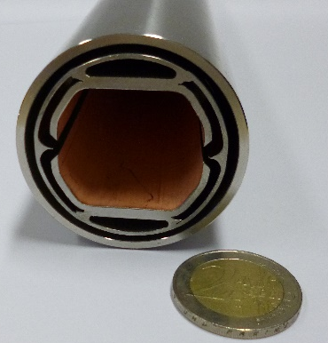
Challenge #1: Physics is the boss
  Temperature range (40 ÷ 60 K) chosen to
  Preserve vacuum quality
  Keep image current impedance low
  Decrease exergetic costs
  High pressure level (50 bar) chosen to
  Decrease pressure losses
  Decrease compression ratio
  Cooling Channel
  Courtesy of Cedric Garion
  300 K
  60 K
  2 K
  T_{BS} = 40 ÷ 60 K
  p_{BS} = 50 bar
  Thermal shields: Operated in series after cooling the beam screens

Slide 20
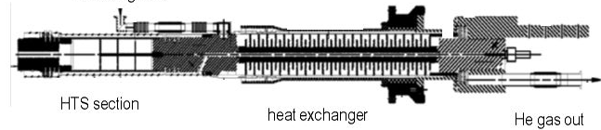
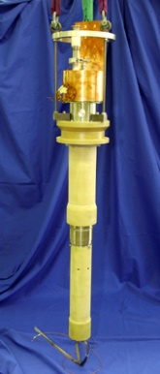
Challenge #1: Physics is the boss
  Current Leads
  Electrical power to feed electromagnets is delivered by transmission lines at ambient temperature level
  The conductors transmitting the current to the Nb₃Sn cables have to cooled down from 300 K to 2 K
  Wiedemann-Franz law: Good electrical conductors are good thermal conductors → sophisticated design needed to reduce heat leaks
  Transmission Line @ 300 K
  I_{tot} ≈ 20 MA
  Courtesy of Amalia Ballarino
  Nb₃Sn Cables @ 2 K
  Δl ≈ 1.5 m
  ΔT ≈ 300 K
  Courtesy of CERN

Slide 21
FCC-hh Cryogenics Challenges
  Challenge # 1: Cryogenics is an ancillary application
  Challenge # 2: Much power for low temperature
  A second Geneva– electrically spoken

Slide 22
Challenge #2: Get the power
Cycle | Q_{Load} in kW | P_{min} in MW | P_{real} in MW
CMC+B | 140 | 18 | 130
BS+TS | 5800 | 29 | 81
CL | 1170 | 2 | 7
  220 MW (38 %)
  Electrical Power Consumption of CERN during FCC-hh operation
  Cold Mass Cooling & Header B heat leaks
  580 MW
140 kW @ 1.8 K
P_{max} = 220 MW
A
B
C
L
D
P_{max} = 220 MW
K
E
P_{max} = 220 MW
1170 kW @ 4.5 ÷ 300 K
J
5800 kW @ 40 ÷ 60 K
  Current Lead Cooling
  Beam Screen Cooling & Thermal Shields
F
I
G
H

Slide 23
FCC-hh Cryogenics Challenges
  Challenge # 1: Cryogenics is an ancillary application
  Challenge # 2: Much power for low temperature
  Challenge # 3: Efficiency vs. Simplicity
  CAPEX vs. OPEX
  Economics vs. Availability
  Ingenuity vs. Beauty

Slide 24
Challenge #3: Compromises
  To keep the efficiency high, the separated cooling loops have to be short!
  For 5500 arc magnets (dipoles and quadrupoles)
  Minimal 16500 Valves, 5500 heat exchangers, 5500 separators, ...
  → Large controlling effort
  → High CAPEX
  → Decreased availibilty
  → Error-prone installations
  Same question/consideration for the level above:
  How many magnets are supplied by the same Cryoplant?
  Shortest possible cooling loop: 1 Magnet (15 m)
24

Slide 25
Challenge #3: Compromises
  Cryogenic distribution line
  Short arc (4.4 km)
  Long arc (8.4 km)
  Lattice Half-Cell
  QRL
  Cold Mass
25

Slide 26
FCC-hh Cryogenics Challenges
  Challenge # 1: Cryogenics is an ancillary application
  Challenge # 2: Much power for low temperature
  Challenge # 3: Efficiency vs. Simplicity
  Challenge # 4: As big as possible
  Compromise between the largest available and the smallest acceptable

Slide 27

Challenge #4: Size matters
100 kW @ 4.5 K
Surface
Cavern
FCC tunnel
  ITER: 25 kW @ 4.5 K
  x 4
  FCC: 100 kW @ 4.5 K

Slide 28
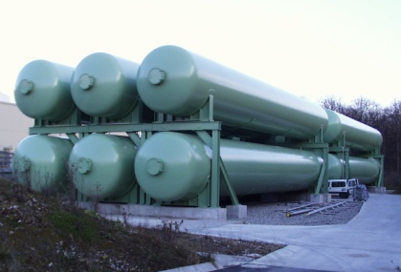
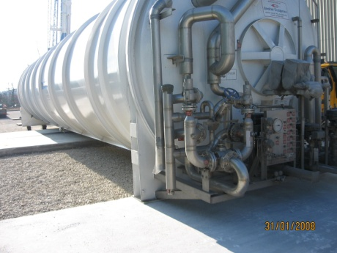
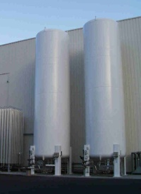
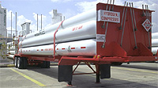
Challenge #4: Size matters
  Courtesy of CERN
  Courtesy of CERN
  60 x Gaseous He (250 m³, 20 bar)
  156 x Quench Buffer (250 m³, 20 bar)
  10 x Gaseous He (250 m³, 50 bar)
  10 x Nelium (250 m³, 50 bar)
  50 x Liquid He (120 m³)
  10 x Gaseous Ne (10 m³, 200 bar)
  6 x Liquid N (50 m³)
  Courtesy of CERN
  6 x He Boil-off liquefier (150 ÷ 300 l/h)
  Courtesy of CERN
28

Slide 29
FCC-hh Cryogenics Challenges
  Challenge # 1: Cryogenics is an ancillary application
  Challenge # 2: Much power for low temperature
  Challenge # 3: Efficiency vs. Simplicity
  Challenge # 4: As big as possible
  Challenge # 5: Attempt for new technology
  New solutions for old problems

Slide 30

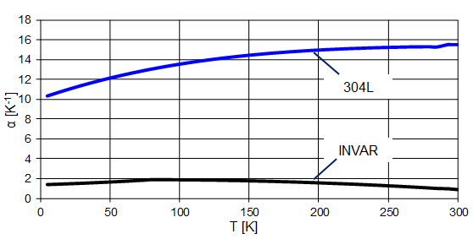

Challenge #5: Sometimes change a winning team
Invar technology for the QRL
Nelium Brayton Cycle
  Courtesy of MAN
Efficiencies of centrifugal compressors higher than for screw compressors
  Long arc (8.4 km)
  → Helium compressors need to be very large due to low density
  Nelium is a blend of helium (75 %) and neon (25 %)
Cooling Capacity (@ 40 ÷ 300 K):
  0.64 Fe
  0.36 Ni
270 kW @ 40 ÷ 300 K (Cold Mass & Current Leads)
700 kW @ 40 ÷ 63 K (Beam Screen & Thermal Shield)
  Courtesy of Pawel Duda
Assumed Carnot efficiency 0.42 →
Electrical Power P_{el} ≈ 9 MW
  Cool down: 300 K → 60 K
  304L: ΔL ≈ 28 m
  Invar: ΔL ≈ 3.5 m
30

Slide 31
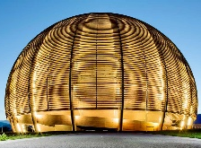
Challenge #5: Sometimes change a winning team
  Courtesy of MAN
Cool Down with N₂ (80 K)
For the same CD timescale (≈ 10 d):
10 trucks per hour (nonstop)
Nitrogen Storage (60000 m³)
6 x
  Courtesy of CERN
Cool Down with Nelium Cycle (40 K)
Cool Down and Warm Up operations with the Beam Screen Cooling Warm Compressor and the Nelium Cycle
  p_{max} = 50 bar
  p_{max} = 20 bar
  Courtesy of Hugo Correia Rodrigues

Slide 32
FCC-hh Cryogenics Challenges
  Challenge # 1: Cryogenics is an ancillary application
  Challenge # 2: Much power for low temperature
  Challenge # 3: Efficiency vs. Simplicity
  Challenge # 4: As big as possible
  Challenge # 5: Attempt for new technology
  Challenge # 6: Little big problems
  Find a solution for 99 % of the machine doesn‘t mean to have solved 99 % of the problems

Slide 33
Challenge #6: Technodiversity
  Example # 1: Inner Triplet Cooling
  Example # 2: Quenching
  Example # 3: BSC-Cycle Transient for HiLumi-FCC
35 MJ / Magnet
  Max. allowed pressure 20 bar
  Capacity of header D
  Capacity of quench buffers
  ...
  HiLumi-Beam Life Cycle: 4.5 hours
  → Beam Screen Cooling system never reaches steady-state operation
33

Slide 34
FCC-hh Cryogenics: Overview
FCC-hh Cryo Summary
 | Cold Mass Cooling | Current Lead Cooling |  | Beam Screen Cooling & Thermal Shiedling
Heat Load | 155 kW | 1.7 kW | 1165 kW | 5980 kW
Temperature level | 2.05 K | 4.5 K | 36 ÷ 300 K | 40 ÷ 62 K
Minimal electrical power (Carnot) | 17500 kW | 112 kW | 1641 kW | 29100 kW
Electrical Power Consumption | 131.5 MW | 6.8 MW |  | 80.3 MW
Overall exergetic efficiency | 0.13 | 0.26 |  | 0.36
Cryopower @ 4.5 K / Cryoplant | 103 kW @ 4.5 K (x 10 Cryoplants)
Cryogen Inventory during nominal operation
 | Helium | Neon | Nelium | Nitrogen
Cold Mass | 400 t | - | - | -
Distribution System | 350 t | - | - | -
Cryoplants (+ Shafts) | 8 t | 5 t | 39 t | -
Storage | 88 t | 10 t | 1 t | 242 t
Sum | 846 t | 15 t | 40 t | 242 t

Slide 35
FCC Cryogenic Challenges: LEP/LHC vs FCC
LEP vs. FCC-ee
 | LEP |  | FCC-ee
Research object | z⁰ | w± | z⁰ | w± | h | t₁ & t₂
Number Cryoplants | - | 4 | 1 | 2 | 2 | 4
Total Cryopower [kW @ 4.5 K] | - | 48 | 4 | 41 | 82 | 126
Total Cryopower per cryoplant [kW @ 4.5 K] | - | 12 | 4 | 41 | 41 | 63
Factor 5 ÷ 6
HL-LHC vs. FCC-hh
= 4 x state-of-the-art capacity
 | HL-LHC | FCC-hh
Number Cryoplants | 10 | 10
Total Cryopower per cryoplant [kW @ 4.5 K] | 18 | 103
Total electric power consumption (w/o IPs) [MW] | 42 | 220
Max. Distribution Distance (long sector) [m] | 3300 | 8400
Overall storage capacity [m³] | 16400 | 65400
Helium inventory [t] | 145 | 846
Neon inventory [t] | 0 | 25
Nitrogen inventory [t] | 40.5 | 242
Factor 5 ÷ 6
Factor 5 ÷ 6
Factor 2 ÷ 3
Factor 4
Factor 6 ÷ 7
Factor 6

Slide 36

The FCC cryogenic needs
Cold-bloodedly calculating Engineers
  LHC
  SPS
  Keep chilled in hot discussions
  PS
  LEIR
  Reliability
  Efficiency
Icy determination to make decisions
  Keep cool heads upon the challenges
  FCC
… and who shall deliver that if not Cryogenics?

Slide 37
"What starts out as science fiction today may wind up being finished tomorrow as a report.“
Norman Mailer
The cryogenic needs of the FCC
2019 European Cryogenics Days
08.10.2019 in Lund, Sweden

Slide 38
A brief overview: The FCC
B
  ?
A
C
L
D
K
  ?
  ≈ 600 m
E
  ?
J
F
I
  ?
  Limestone (5 %)
G
H
  Courtesy of J.Osborne

Slide 39
A brief overview: The FCC-ee (2038 - 2053)
  Lepton Collider to study 4 particles: z⁰-Boson, w±-Boson, Higgs Boson, Top Quark
  Two experiments (interaction points) with small cryogenic needs in the Points A & G
  Large cryogenic consumers are the RF Cavities located in the Points D & J (+ distribution)
A
B
C
L
D
K
E
J
F
I
G
H

Slide 40
A brief overview: The FCC-hh (2064 - 2090)
  Hadron Collider to study massive particles and eventually discover new physics (e.g. SUSY)
  Four experiments (interaction points) and superconducting RF Cavities with small cryogenic needs in the Points A, B, G, H & L
  Large cryogenic consumers are the magnets to bend and focus the hadron beams (+distribution)
A
B
C
L
D
K
E
J
F
I
G
H

Slide 41
Benefits for the research
Lepton Colliders
 | LEP |  | FCC-ee
Research object | z⁰ | w± | z⁰ | w± | h | t₁ | t₂
Particle Energy [GeV] | 60 (max.) | 105 (max.) | 45.6 | 80 | 120 | 175 | 182.5
Beam Current [mA] | 8.4 | 6.2 | 1390 | 147 | 29 | 6.4 | 5.4
Luminosity / IP [nb·s⁻¹] | 0.0085 | 0.025 | 230 | 28 | 8.5 | 1.8 | 1.55
RF voltage [GV] | 0.4 | 4.1 | 0.1 | 0.75 | 2.0 | 4.0 / 5.4 | 4.0 / 6.9
RF frequency [MHz] | 352.2 |  | 400 |  |  | 400 / 800
Hadron Colliders
 | LHC |  | HL-LHC |  | FCC-hh
Research object | p⁺ | Pb | p⁺ | Pb | p⁺ | Pb
Nucleon Energy [TeV] | 7 | 1.38 | 7 | 1.38 | 50 | 19.7
Total Beam Energy [MJ] | 392 | 1.9 | 694 | 3.4 | 8300 | 362 ÷ 709
Beam Current [mA] | 584 | < 1 | 1120 | < 1 | 500 | < 1
Luminosity / IP [nb·s⁻¹] | 2.5 | 0.5 · 10⁻⁶ | 12.5 | 6 · 10⁻⁶ | 12.5 ÷ 75 | 80 · 10⁻⁶ ÷ 320 · 10⁻⁶
Dipole Field [T] | 8.33 |  |  |  | 16

Slide 42
FCC-ee Cryogenics: Stage 1/4 (z-Boson)
Frequency | 400 MHz | 800 MHz
T_{sat} (p_{Sat}) | 4.5 K (1.3 bar) | 2.0 K (30 mbar)
Number Cryoplants | 1 CP @ Point J | -
RF voltage | 100 MV | -
Cryopower / Cryoplant | 4 kW @ 4.5 K
Total Cryopower @ 4.5 K | 4 kW @ 4.5 K
Electrical Power | 0.9 MW
A
B
C
L
D
K
E
J
F
I
H
G
Header C: 400 MHz RF Cavities Supply (4.6 K / 3 bar)
Header D: 400 MHz RF Cavities Return (4.5 K / 1.3 bar)
Header E: Thermal Shields Supply (50 K / 20 bar)
Header F: Thermal Shields Return (75 K / 18 bar)
QRL
Beam 1
Beam 2
Booster
Newly installed 400 MHz RF Module @ 4.5 K
Formerly installed 400 MHz RF Module @ 4.5 K
Newly installed 800 MHz RF Module @ 2.0 K

Slide 43
FCC-ee Cryogenics: Stage 2/4 (w-Boson)
Frequency | 400 MHz | 800 MHz
T_{sat} (p_{Sat}) | 4.5 K (1.3 bar) | 2.0 K (30 mbar)
Number Cryoplants | 1 CP @ Point J | -
RF voltage | 750 MV | -
Cryopower / Cryoplant | 41 kW @ 4.5 K
Total Cryopower @ 4.5 K | 41 kW @ 4.5 K
Electrical Power | 9.5 MW
A
B
C
L
D
K
E
J
F
I
H
G
Header C: 400 MHz RF Cavities Supply (4.6 K / 3 bar)
Header D: 400 MHz RF Cavities Return (4.5 K / 1.3 bar)
Header E: Thermal Shields Supply (50 K / 20 bar)
Header F: Thermal Shields Return (75 K / 18 bar)
QRL
Beam 1
Beam 2
Booster
Newly installed 400 MHz RF Module @ 4.5 K
Formerly installed 400 MHz RF Module @ 4.5 K
Newly installed 800 MHz RF Module @ 2.0 K

Slide 44
FCC-ee Cryogenics: Stage 3/4 (Higgs Boson)
Frequency | 400 MHz | 800 MHz
T_{sat} (p_{Sat}) | 4.5 K (1.3 bar) | 2.0 K (30 mbar)
Number Cryoplants | 1 CP @ Point J & D | -
RF voltage | 2000 MV | -
Cryopower / Cryoplant | 41 kW @ 4.5 K
Total Cryopower @ 4.5 K | 82 kW @ 4.5 K
Electrical Power | 19 MW
A
B
C
L
D
K
E
J
F
I
H
G
Header C: 400 MHz RF Cavities Supply (4.6 K / 3 bar)
Header D: 400 MHz RF Cavities Return (4.5 K / 1.3 bar)
Header E: Thermal Shields Supply (50 K / 20 bar)
Header F: Thermal Shields Return (75 K / 18 bar)
QRL
Beam 1
Beam 2
Booster
Newly installed 400 MHz RF Module @ 4.5 K
Formerly installed 400 MHz RF Module @ 4.5 K
Newly installed 800 MHz RF Module @ 2.0 K

Slide 45
FCC-ee Cryogenics: Stage 4/4 (Top Quark)
Frequency | 400 MHz | 800 MHz
T_{sat} (p_{Sat}) | 4.5 K (1.3 bar) | 2.0 K (30 mbar)
Number Cryoplants | 2 CPs @ Point J & D | 2 CPs @ Point J & D
RF voltage | 4000 MV | 5400 / 6900 MV
Cryopower / Cryoplant | 41 kW @ 4.5 K & 12 kW @ 2.0 K
Total Cryopower @ 4.5 K | 252 kW @ 4.5 K
Electrical Power | 58 MW
A
B
C
L
D
K
E
J
F
Header A: 800 MHz RF Cavities Supply (2.2 K / 1.3 bar)
Header B: 800 MHz RF Cavities Supply (2.0 K / 30 mbar)
Header C: 400 MHz RF Cavities Supply (4.6 K / 3 bar)
Header D: 400 MHz RF Cavities Return (4.5 K / 1.3 bar)
Header E: Thermal Shields Supply (50 K / 20 bar)
Header F: Thermal Shields Return (75 K / 18 bar)
QRL
Beam 1&2
Booster
Newly installed 400 MHz RF Module @ 4.5 K
Formerly installed 400 MHz RF Module @ 4.5 K
Newly installed 800 MHz RF Module @ 2.0 K

Slide 46
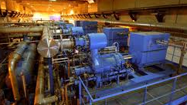
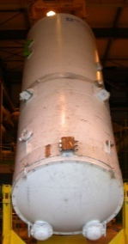
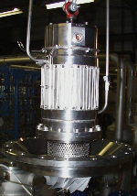
FCC-hh Cryogenics: Cold Mass
Cold Mass Cooling
  Values for one long sector:
12.1 kW
Q_{CM}
Q_{B}
@ 1.8 K
2 kW
  Courtesy of CERN
1.8 MW
P_{min}
P_{real}
  T_{max} = 2.05 K
13 MW
  Bayonet heat exchanger
  Coils
  Collar
  Iron Yoke
  Courtesy of CERN
  Cold Mass
  1.44 W/m
  Superfluid helium bath
  0.24 W/m

Slide 47
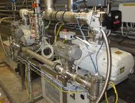
FCC-hh Cryogenics: Beam Screen & Thermal Shields
Beam Screens and Thermal Shields (Baseline)
  Values for one long sector:
520 kW
Q_{BS}
Q_{TS}
P_{Circ}
  Courtesy of CERN
80 kW
@ 40 ÷ 62 K
100 kW
2.9 MW
P_{min}
P_{real}
8.1 MW
  Beam Screen Cooling Channel (40 ÷ 60 K)
  31.1 W/(m·Aperture)
  4 W/m
  5.3 W/m

Slide 48
FCC-hh Cryogenics: Beam Screen & Thermal Shields
Beam Screens and Thermal Shields (Option)
  Values for one long sector:
520 kW
Q_{BS}
Q_{TS}
P_{Circ}
@ 40 ÷ 62 K
  Courtesy of CERN
80 kW
370 kW
@ 40 ÷ 300 K
2.9 MW
P_{min}
P_{real}
8.7 MW
  Beam Screen Cooling Channel (40 ÷ 60 K)
  31.1 W/(m·Aperture)
  4 W/m
  5.3 W/m

Slide 49
Beam screen cooling and thermal shielding
  Cryogenic distribution line
  FCC dipole
  Beam screens works as thermal barriers to shield the cold mass (T < 2 K) against beam induced heat loads
  Beam Screens
  60 K
  300 K
  The branched flow is divided and passes 4 cooling channels in 2 beam screens (40 K – 60 K)
  Heat sources generate a heat load of about 60 W/m on the beam screens in total
  ≈ 2 K
  p = 50 bar
  T = 40 K
  2 operation temperatures investigated

Slide 50
FCC-hh Cryogenics: Current Leads
Current Leads
  Values for one long sector:
117 kW
@ 4.5 ÷ 300 K
Q_{CL}
175 kW
P_{min}
P_{real}
680 kW
  Courtesy of CERN
  117 kW
  170 W

Slide 51
FCC-hh Cryogenics: Nelium Cycle
Nelium Brayton Cycle
Uses a blend of helium (75 %) and neon (25 %)
  → Increased density:
  Higher pressure ratios per stage
  Centrifugal instead of volumetric machine
Cooling Capacity (@ 40 ÷ 300 K):
700 kW @ 40 ÷ 63 K (Beam Screen & Thermal Shield)
270 kW @ 40 ÷ 300 K (Cold Mass & Current Leads)
Cool-Down and Warm-Up Operations
Baseline: Cool Down and Warm Up operations with the Beam Screen Cooling flow scheme, a Warm Compressor and the Nelium Cycle

Slide 52
FCC-hh Cryogenics: Nelium Cycle
Nelium Brayton Cycle
Blend of helium (75 %) and neon (25 %)
Courtesy of Steffen Klöppel
  p
  p
  in
  in
Steady-State
  p
  p
  out
  out
  Courtesy of MAN
Steady-State
Cool-Down

