Slide 1
Cryogenics for the ESS Instrument Sample Environment
Alex Holmes, Philipp Arnold
European Spallation Source ERIC
07/09/2019

Slide 2
ESS Cryogenic System Block Diagram
Pure Helium
Gas Storage
Standalone Helium Purifier
Helium Recovery System
Target Moderator
Cryoplant
Accelerator
Cryoplant
20 m³ LHe Tank
5 m³
LHe Tank
Test & Instrument Cryoplant
Target Cryodistribution System
LHe Mobile Dewars
Test Stand Cryodistribution System
Cryodistribution System for Elliptical Linac
Cryodistribution System for
Spoke Linac
LN2 Storage Tanks
Hydrogen Circulation Box
Elliptical
Cryomodules
Spoke
Cryomodules
LN2 Mobile Dewars
Instruments & Experiments
Test Stand Lund 2
Hydrogen Moderator

Slide 3
The Test & Instruments Cryoplant
Duty Specification
Liquefier Coldbox
  Cooling for CM Teststand: 76W @ 2K, 420W @ 40K, 6 l/h Liquefaction
  Liquefaction for NSS: 7500 l/month
  Recovery of evaporating helium in linac when ACCP stops
  Provide liquid helium to Lund University and MAX IV: 1000 l/month
Recovery System
  Helium returning from instruments
  Flash gas from mobile dewar filling, helium transfer operations
  Dewar boil off, purifier regeneration, purge operations
  Cryomodule safety valves discharge
  Compression, storage, distribution of impure helium
External Purifier
  Emptying HP buffer when internal purifier not available
  Make-up and back-up
Standalone Helium Purifier
Helium Recovery System
5 m³
LHe Tank
Test & Instrument Cryoplant
LHe Mobile Dewars
Test Stand Cryodistribution System
LN2 Storage Tanks
LN2 Mobile Dewars
Instruments & Experiments
Test Stand Lund 2
3

Slide 4
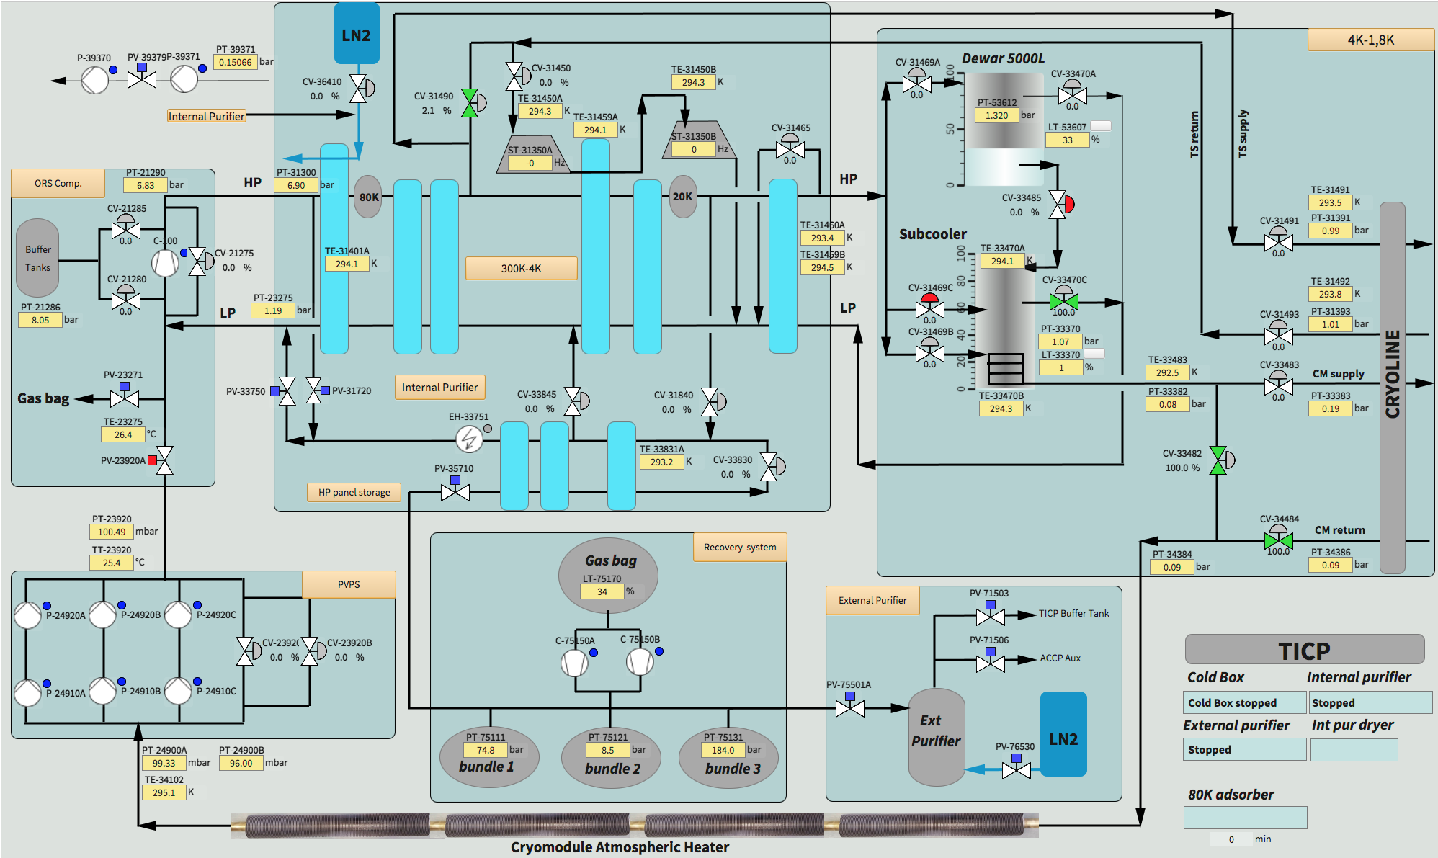
TICP Process Overview
TICP consist of
HELIAL ML ™
Process Vacuum Pumps
5’500 l Dewar, 3 mobile Dewars
Filling and mobile Dewar boil-off station
100 m³ gasbag
2 recovery compressors
12 m³ HP impure storage bundles
Stand-alone purifier
HELIAL ML including
LHe sub-cooler vessel and coil
Thermal shield circuit
4-fold CTL interface
Special GMP

Slide 5
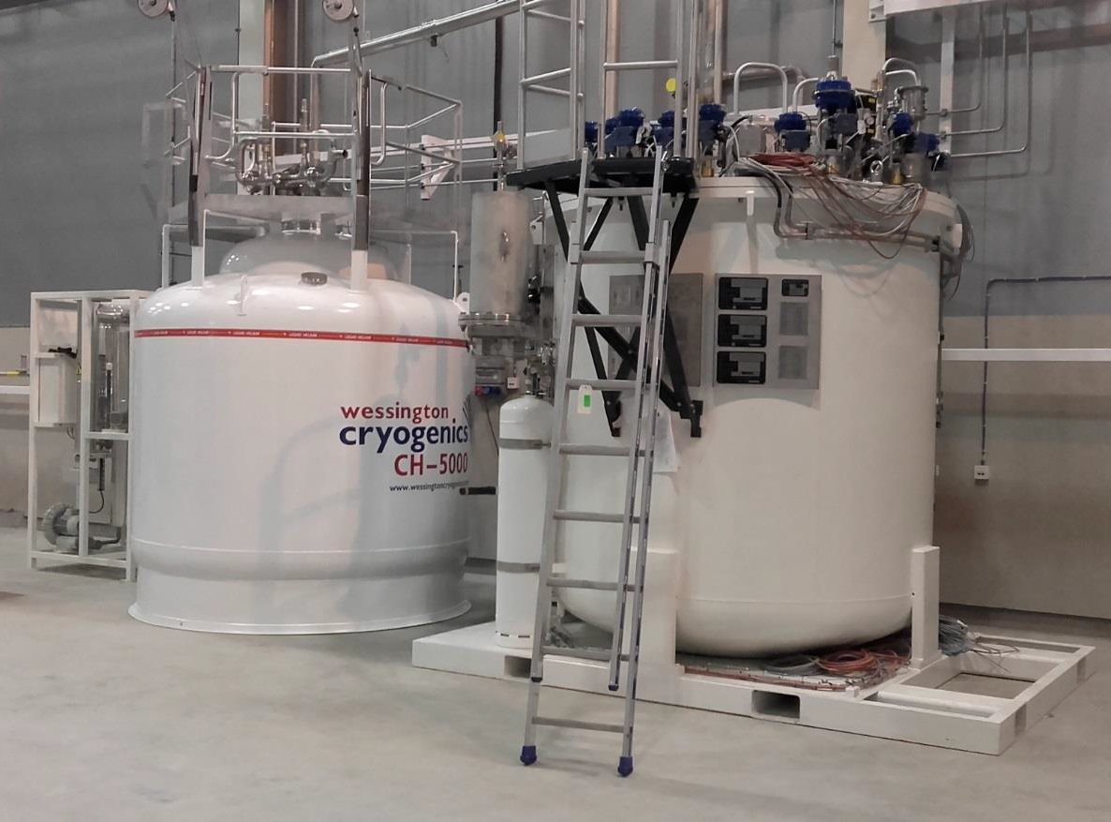
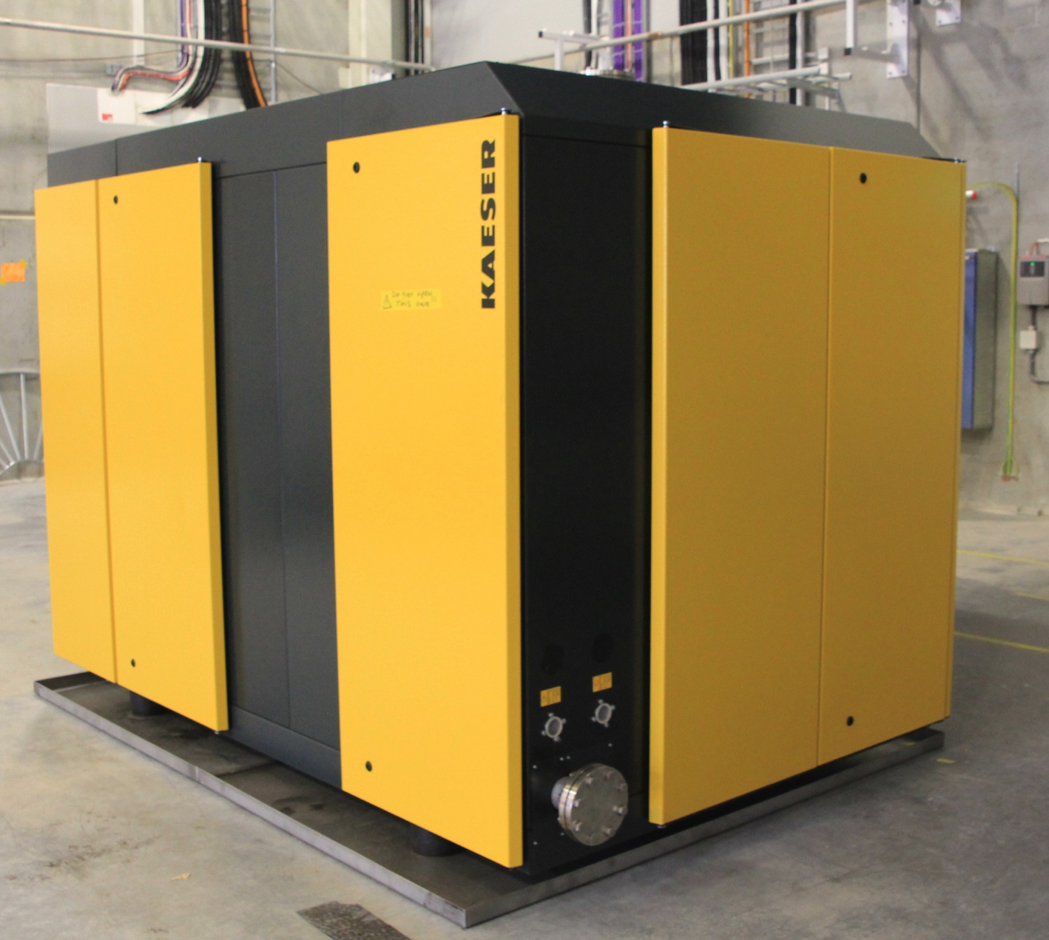
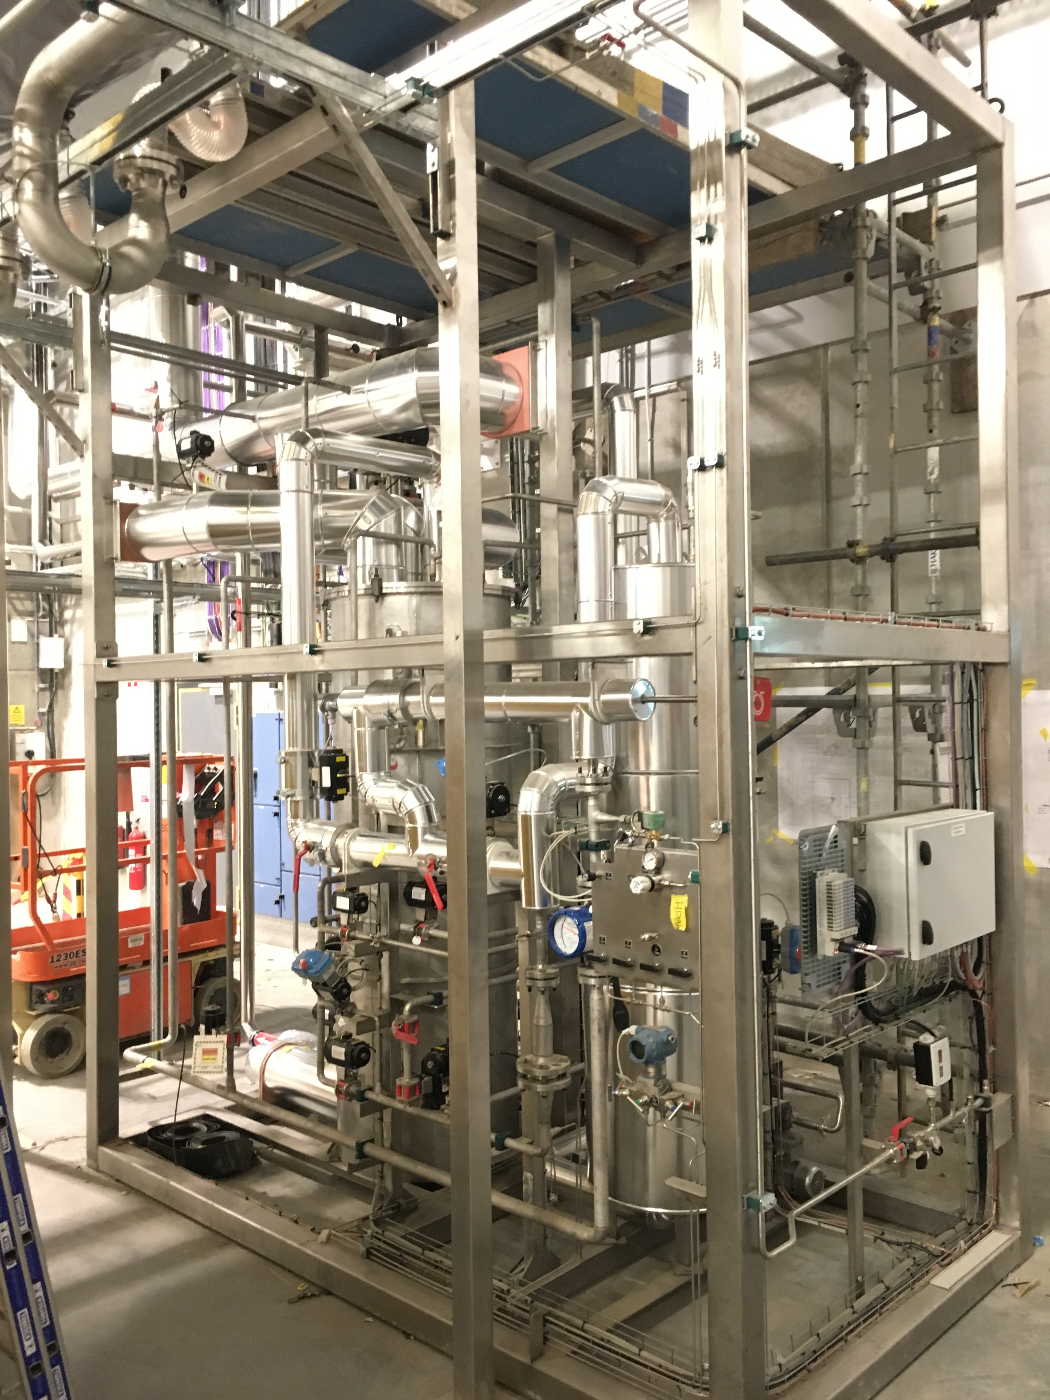
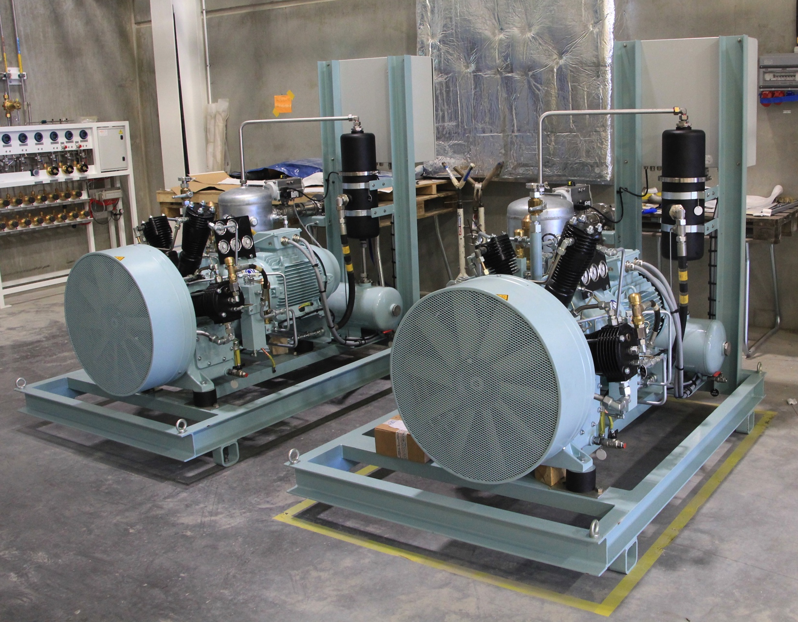
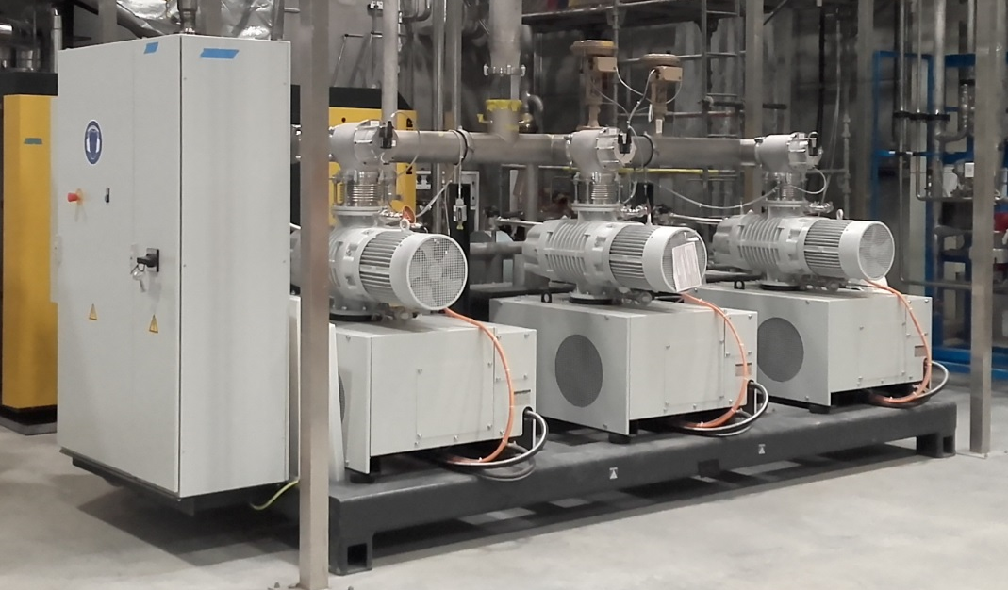
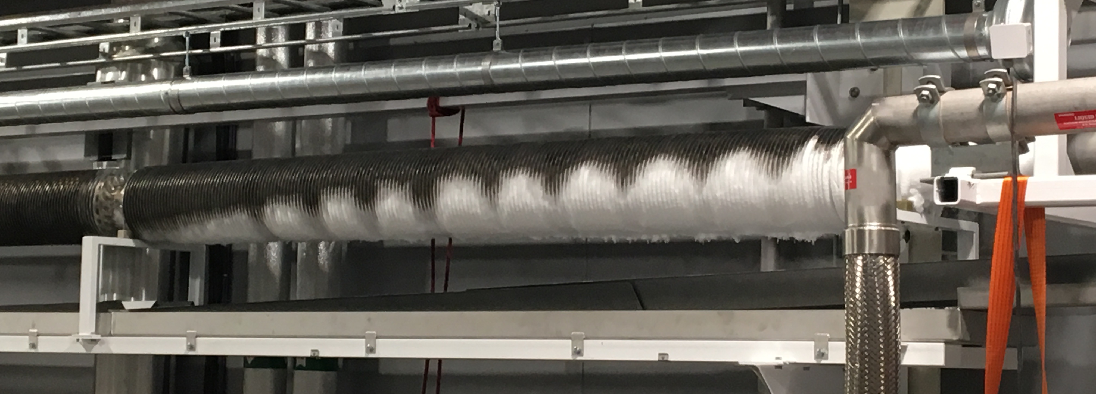
Acceptance testing
Acceptance testing of everything that can be tested
Recycle compressor
Coldbox as liquefier with internal purifier: 137 l/h, 1% N2
Coldbox in CM test mode
Process Vacuum Pumps: 5.4 g/s
Ambient heater for VLP return
External purifier: 3.1 g/s, 1% N2
HP compressors: 2 x 60 m³/h
Gasbag and HP panel
Semi-automatic filling station
Adsorber regeneration

Slide 6
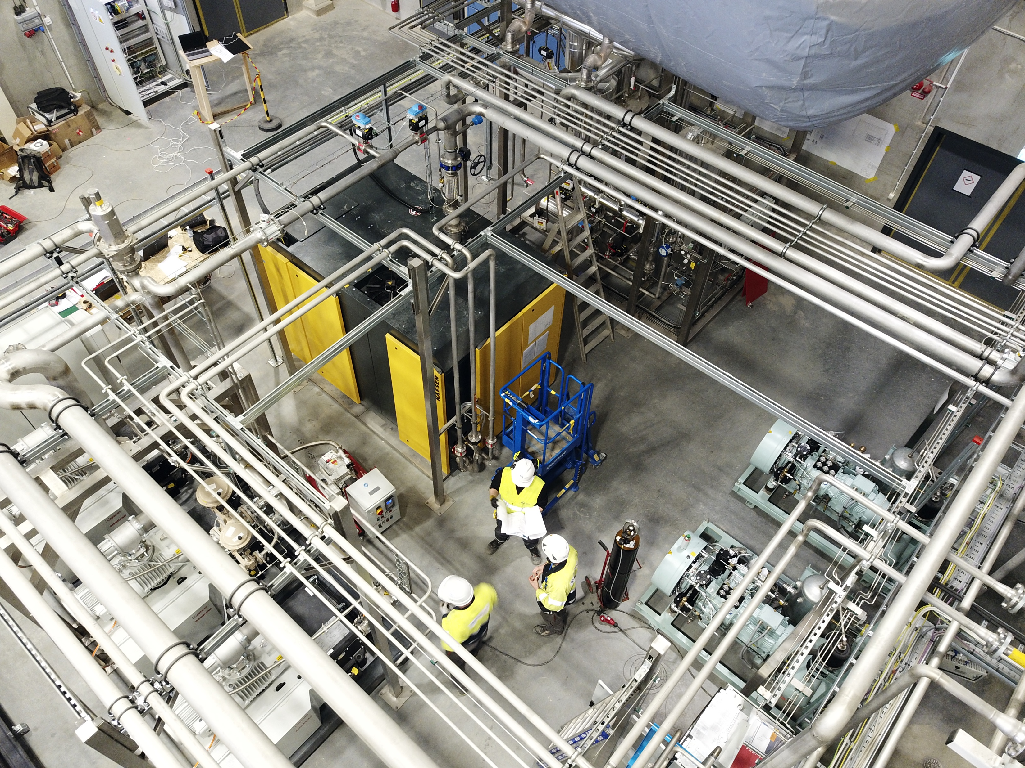
Current status
Recovery system and external purifier operational since summer 2018
TICP entirely operational since December 2018
Documentation completed in summer 2019
Several improvements by ESS, particularly controls
More than 3600 l liquefied (and partly recovered) from Lund University and MAX IV
Cryodistribution for CM teststand tested
Questions?

Slide 7
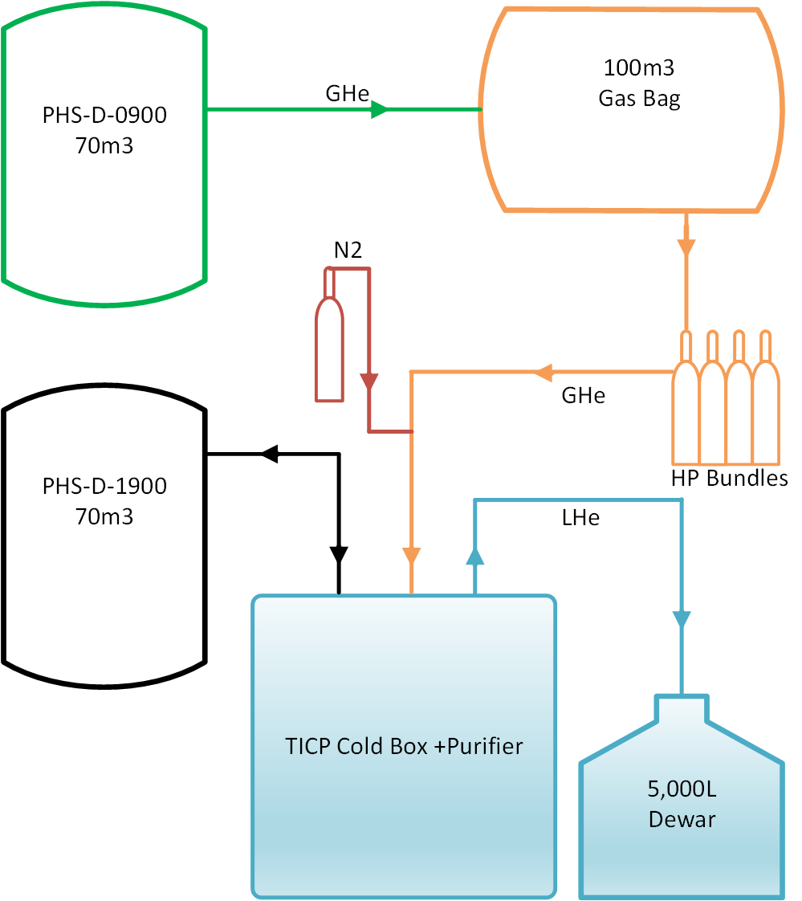
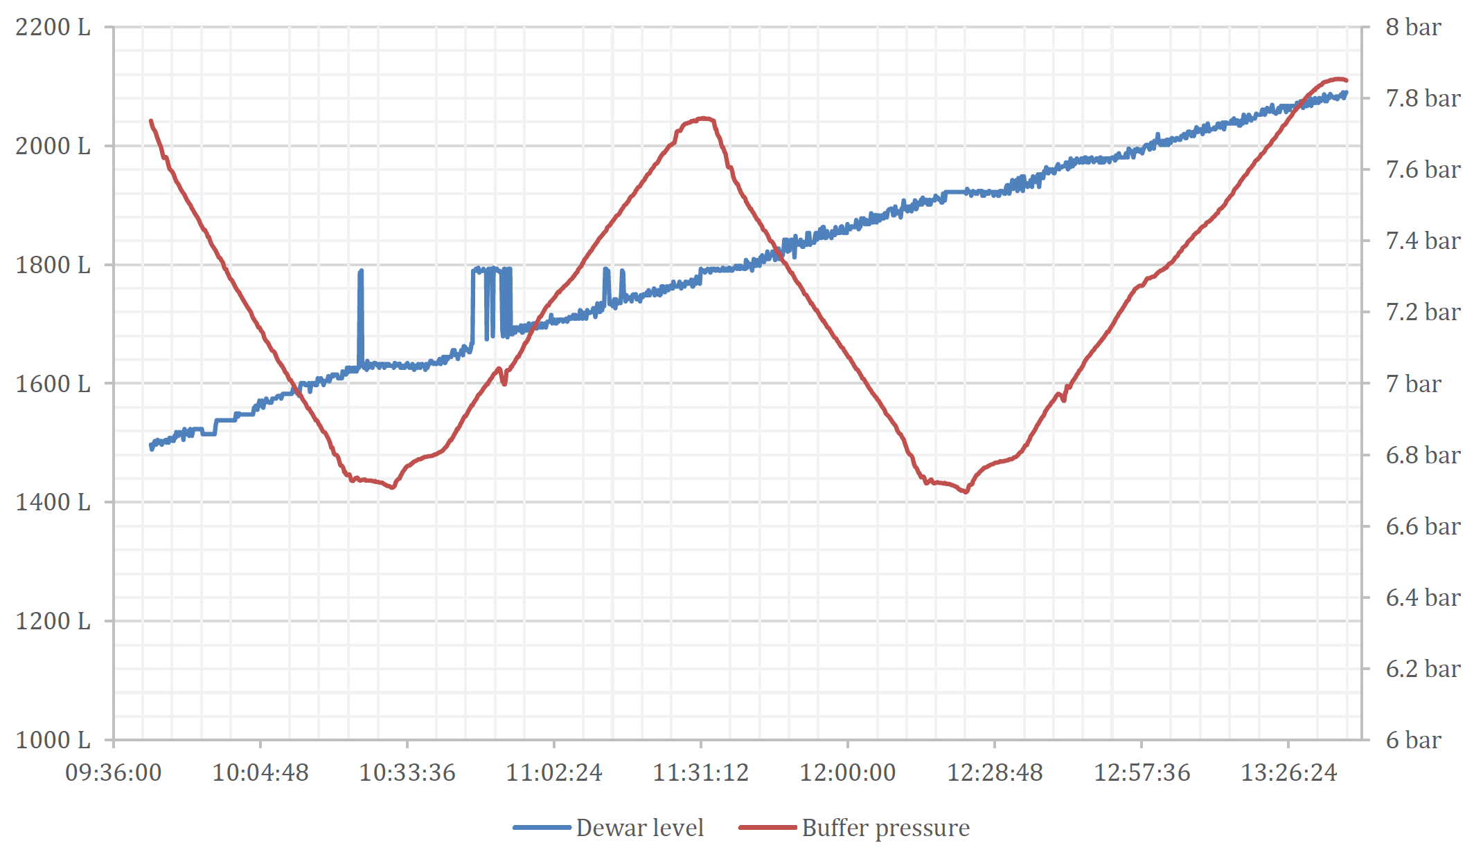
Coldbox liquefaction and internal purification
Test set-up
Test set-up
Manually controlled flow of nitrogen from HP nitrogen bottle into HP helium from impure helium HP storage
Best mixing point: upstream line dryer before coldbox purifier inlet in function of online impurity measurement
MP pure helium buffer pressure to be constant over time
Mass balance for gas side and liquid side to double-check liquefaction rate
Don’t forget rising level in Dewar (push back of cold vapour) and level change in internal sub-cooler

Slide 8
Coldbox liquefaction and internal purification
Results
Supplier guarantees or statements in proposal
  137 l/h liquefaction w/ LN2 pre-cooling (18 g/s), rising dewar level, constant PHS, 2% impurities
  40.7 l/h liquefaction w/o LN2 pre-cooling, rising dewar level, constant PHS, 2% impurities
  Coldbox Cooldown in <3.5 hours w/ LN2 pre-cooling, warm-up Coldbox in <8 hours
Results
  Several control logic adjustments and substantial controller finetuning necessary
  138.7 l/h w/ LN2 pre-cooling @ 1% N2 impurity
  54.5 l/h w/o LN2 pre-cooling @ 1% N2 impurity
  Coldbox Cooldown in ~8 hours, warm-up ~24 hours

Slide 9
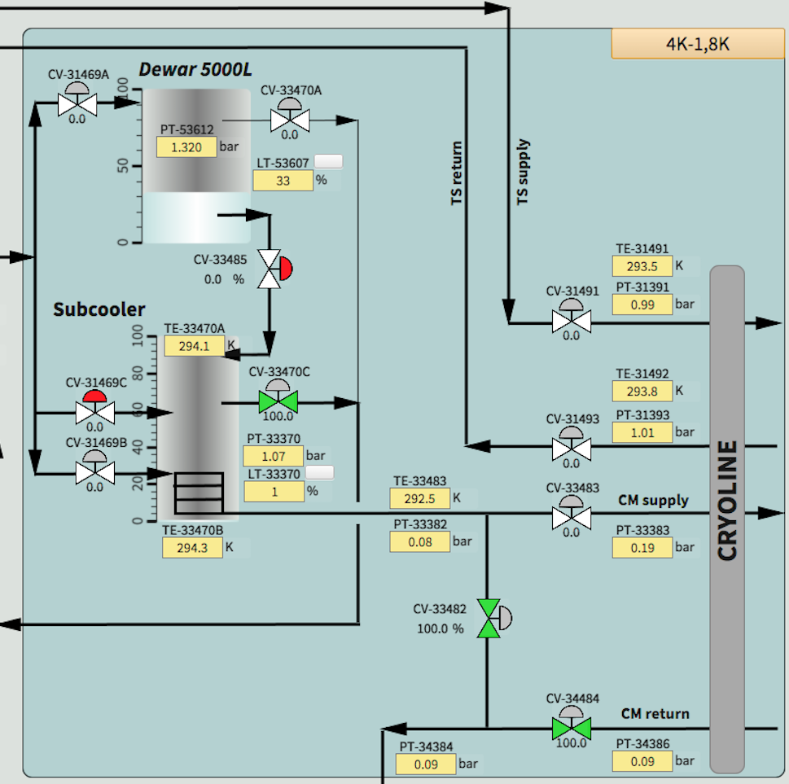
Cryomodule test mode
Test set-up and results, cold part
TICP Coldbox System
Test set-up
  De-coupling of PVPS and liquefier performance (no phase separation @2K, different performance margins)
  Approach of stable Dewar level control for maximum 2K flow not feasible, instead
  Setting of 4.1 g/s 2K flow at flow counter downstream PVPS and allow slight Dewar level rise
Supplier guarantees or statements in proposal
  4 g/s ”constant level liquefaction” w/ LN2 pre-cooling (14 g/s) + 387 W@ <40K supply
Results
  Successful test of liquefier: 4.1 g/s + 387 W @ 37K (inlet) – 41K (outlet) and 500 mbar dp
  Acceptable ambient heater performance
TICP Compr System

Slide 10
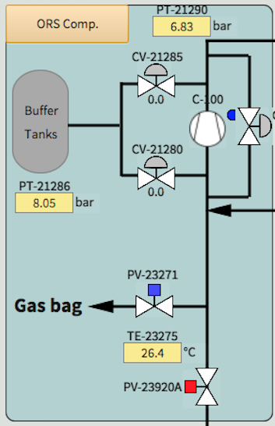

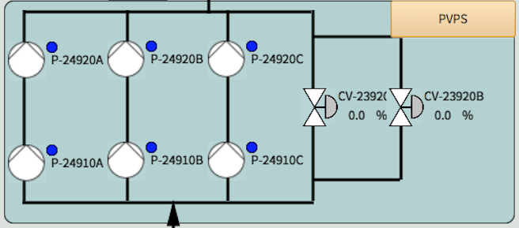
Cryomodule test mode
Test set-up and results, warm part
Test set-up
  Separate test of PVPS together with recycle compressor with bypass valve from downstream ORS to PVPS suction
  On-line impurity measurement to detect impurity intake over time into the closed loop
Supplier guarantees or statements in proposal
  Sub-atmospheric vapour return 3.99 g/s @ <27 mbar
Results
  5.4 g/s PVPS flow @ 25 mbar (±0.1 mbar) and excellent control response
  very smooth switching ON and OFF one pump train

Slide 11

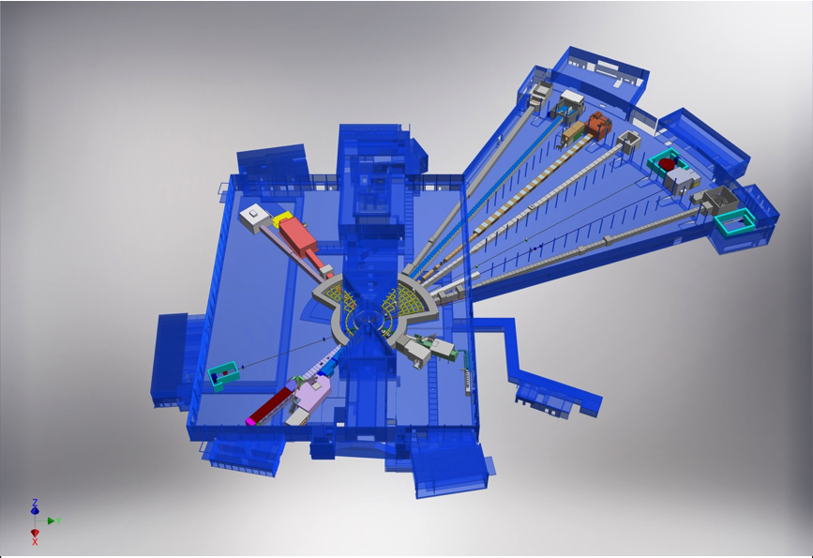











The ESS Instrument suite
+
Nuclear Physics Institute
NMX
BEER
+
C-SPEC
BIFROST
MIRACLES
MAGIC
ODIN
T-REX
DREAM
HEIMDAL
LoKI
VESPA
FREIA
SKADI
ESTIA
+
ESS In-Kind Partners also collaborate on sample environment, data management systems etc.
ESS Instrument Layout (December 2016)

Slide 12
ESS instruments cater to many science topics
Version 2/11/2017
ODIN Imaging Instrument
SKADI General Purpose SANS
LOKI Broadband SANS
Surface Scattering
FREIA Horizontal Reflectom.
ESTIA Vertical Reflectom.
HEIMDAL Powder Diffract.
DREAM Powder Diffract.
Monochromatic Powder Diffract.
BEER Engineering Diffract.
Extreme Conditions Diffract.
MAGIC Magnetism Diffract.
NMX Macromolecular Diffract.
CSPEC Cold Chopper Spec.
Broadband Spectrometer
T-REX Thermal Chopper Spec.
BIFROST Xtal Analyser Spec.
VESPA Vibrational Spec.
MIRACLES Backscatt. Spec.
High-Resolution Spin-Echo
Wide-Angle Spin-Echo
Particle Physics Instrument
Large-Scale Structures
Spectroscopy
Diffraction
life sciences | magnetism & superconductivity
soft condensed matter | engineering & geo-sciences
chemistry of materials | archeology & heritage conservation
energy research | particle physics

Slide 13
Instrument installation schedule
(V4.1, 29th November 2018)

Slide 14
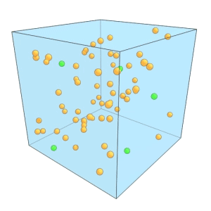
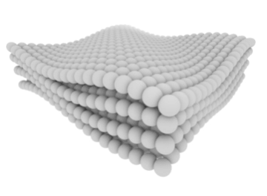
Why do we want to cool things?
Temperature ⇔ kinetic energy
Translation, vibrations, rotations etc. of
atoms, molecules, electrons…
Lower temperature allows other
interactions to take over ⇒
Phase transitions:
Classical (e.g.crystallisation)
or
Quantum (magnetism, superconductivity)
Collective motions (phonons).
Credit: Sean Kelley/NIST
Translational motion
Credit: Sean Kelley/NIST
Neutron energies match well with phonons and other excitations

Slide 15



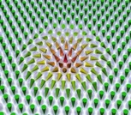
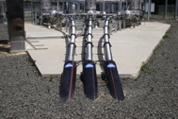
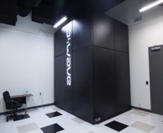
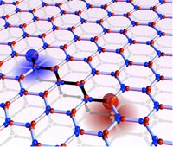
Neutrons for magnetic and electronic phenomena
Hunting for materials that make our technology smarter
Understanding quantum phenomena and novel states of matter in detail
Improving electronic properties and exploiting quantum phenomena
The sensitivity of neutrons to magnetism and the unique ESS neutron flux makes it possible to study quantum materials ‘in-operandi’ to understand them at a microscopic level.
Cryogenics is crucial for this!
Notes:
Part 1: Scientists have since centuries been fascinated by electronic phenomena observed in many materials.
The most prominent examples are probably (ferro)magnetism of iron and static electricity of amber.
Since about 200 years using electricity has changed our lives and it continues to do.
Though we exploit the fascinating electronic properties already we are hunting for even better materials for our future technology improving our lives.
There are uncovered secrets to look for in this field that can help us develop sophisticated new technology to make our lives easier.
We have realised that we know very little about these electronic properties at a microscopic level.
The world today is for example highly dependent on cheap energy. There is a lot of lost energy in the cables that carry electricity from the power source to your lamp. We know that there is material, superconducting material, that has zero resistance for the electricity passing through. This type of material is highly enigmatic and would revolutionize the world and the technology if we could use it in an easy way. Though even the best materials need cooling to below -200degC and they are very brittle. This makes them very expensive and difficult to use. Understanding more about its properties would help a lot. The images shows the regular sort of cables that we use now, and superconducting cables that are tried out as a concept for 600 meters in Long Island, USA.
The properties of superconducting material is so enigmatic, because it leads us into quantum phenomena.
Part 2:
To study quantum phenomena, physicists work with exotic material and manipulate this matter into quantum states. Though quantum phenomena are so difficult for us to grasp they have been predicted and described mathematically. The top image shows a skyrmion, a sort of magnetic vortex, which is amazingly robust inside the material for a long time. It almost behaves like a (pseudo-) particle. The lower image is two monopoles. If you cut a magnet in half, the two new magnets will have a south pole and a north pole. Now physicists have found monopoles, a south pole, red, and a north pole, blue, that are independent of each other. They exist for a short while in spin ice and is certainly quantum phenomena.
Part 3: Computers use ones and zeros to produce and remember data. Based on this idea from the 1950’s, Moore´s law predicts that semiconductors in computers will become half their size smaller and twice as fast every 18 months – which has been accurate so far. However, researchers anticipate a decline in Moore´s law by 2030, due to the fact that semiconductors by then will have reached atom-size and quantum laws dictate their behaviour. Encoding information in quantum states instead of ’bits’ (of ones and zeros) make it much faster, smaller and safer.

Slide 16
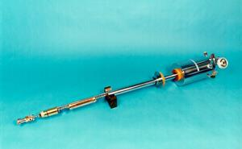
Typical cryogenic sample environment planned for ESS
Wet, dry, dilution, He3,
Flow cryostats (not shown)
Typically Variable Temperature Insert into outer cryostat/cryomagnet
To allow rapid sample changeover
Pictures: ILL, HZB, STFC, other manufacturers are available…

Slide 17
Special requirements for neutron facilities
Fast turnaround time needed (50k€/day running cost for a single beamline, every minute counts!)
Reliability very important.
Choice of materials to minimise activation and background (e.g. neutron absorbing materials inside cryostat/magnet).
Choice of wet/dry/recondensing not completely obvious, though helped by having liquefier on-site.

Slide 18
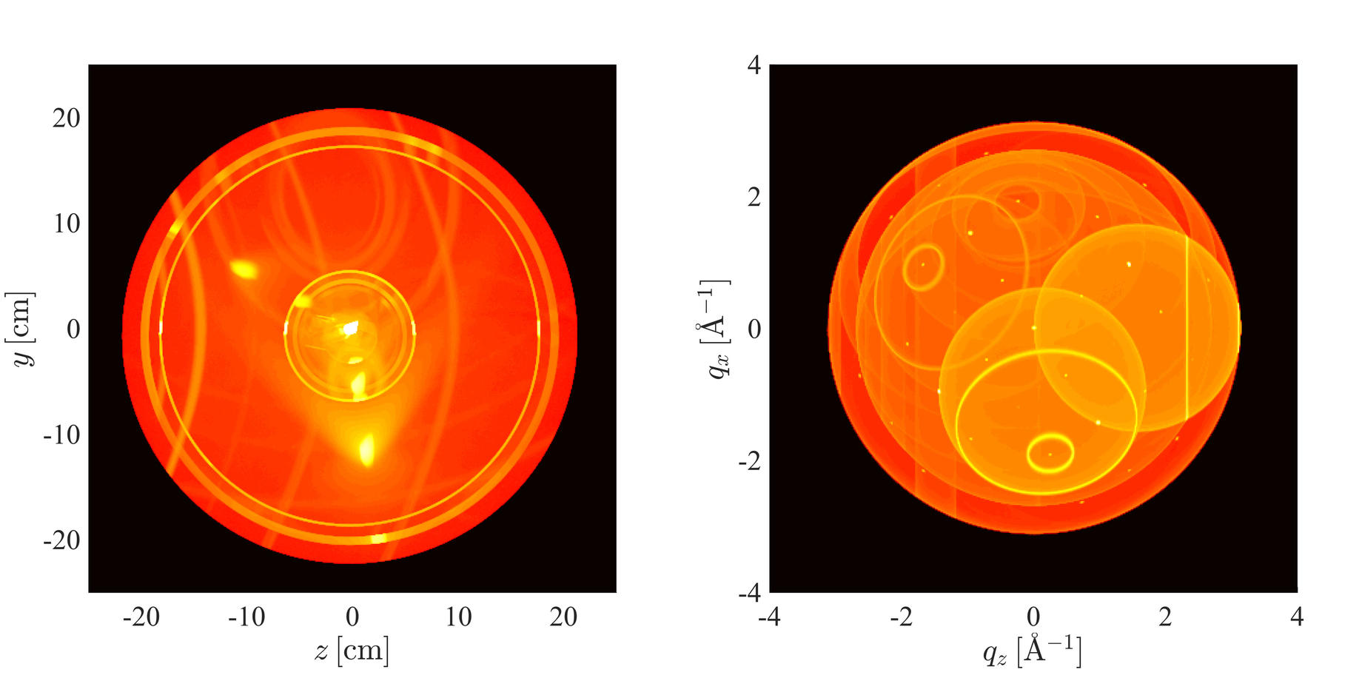
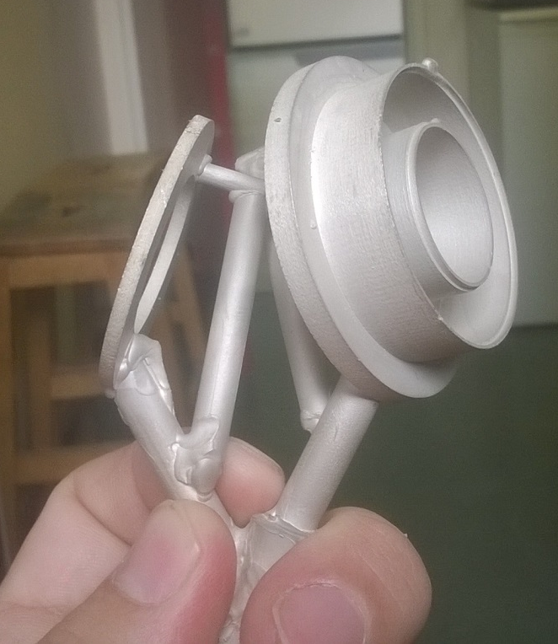
Future developments
Peltier-based fast temperature control
Background optimisation (picture: Mads Bertelsen)
3D printing
DOI: 10.3233/JNR-180093

Slide 20
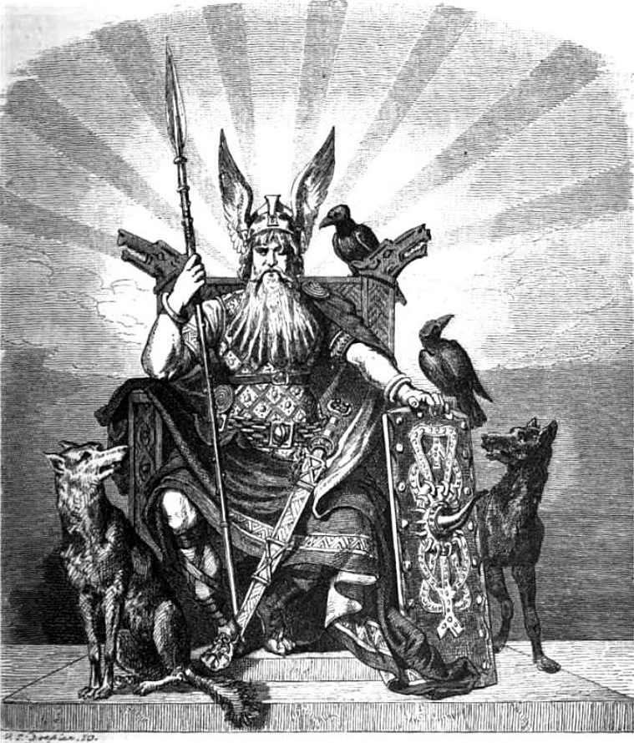
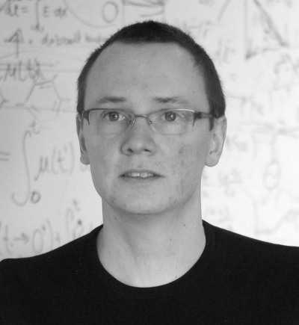

Huginn: RUC - ESS collaboration
RUC
Bo Jakobsen
Torben S. Rasmussen
Kristine Niss
ESS
Alex Holmes
Harald Schneider
Anders Pettersson
Arno Hiess

Slide 21
The Huginn project
Aim of the project is to utilize Peltier elements for temperaturecontrol
  Providing a sample environment with excellent temperature stability
  Allowing for fast change of temperature
Two different devices have been designed and constructed
  A sub-cryostat insert for use with general purpose sample cells and different outer cryostats
  A SANS multi-temperature cuvette holder

Slide 22
Final Design

Slide 23
Performance I
20%–50% gain in measuring time

Slide 24
Performance I
20%–50% gain in measuring time

Slide 25
Performance II
Temperature on Al dummy sample stable within 1mK

Slide 26
Performance II
Temperature on sample while changing main cryostat
  Main cryostat changing from 250K to 300K

Slide 27
Performance III
Fast temperature jumps – main cryostat at 200K

Slide 28
Performance III
Fast temperature jumps at low base temperature (100K)

Slide 29
Performance summary
Working temperature: 100K to 370K
5K changes in equilibrium within minutes
Difference from outer cryostat: approximate 15K
Improves stability over bare cryostat performance by at least an order of magnitude
https://doi.org/10.3233/JNR-180093

