Slide 1
Rack Placement
Chopper Workshop
Gabor Laszlo
NSS Lead Instrument Engineer
www.europeanspallationsource.se
14.02.2019

Slide 2
Rack properties
(PSS Rack Size : 1000mmx600mm)
Power distribution: 1200mmx800mm (?)
Motion Control Rack Size: 800mmx600mm (?)
Detector (beam monitor) Rack Size: 800mmx600mm (?)
Chopper Rack Size: 800mmx800mm
Turbo Pump: 800mmx800mm
Backing Pump:?
Cooling Skid: 1000mmx1000mm
(Access to PSS Rack : 1000mm both sides)
Access to Power distribution Rack : 600mm both sides (?)
Access to Motion Control Rack: 800mm front side(?)
Access to Detector Rack: 800mm front side(?)
Access to Chopper Rack: 800mm both sides
Minimum path width for traffic: 900mm

Slide 3
Constrains
Constrains on rack placement:
Cable length limitations (?)
Floorspace
Distance from sensitive components
Blocking of trafic routes including cranes
The cabinets should be outide of the shielding
(If the racks are on the top of the shielding, we need safety features (rails, stairs). If the shielding has to be removed, we shall avoid the re-connection of all the cables.)

Slide 4
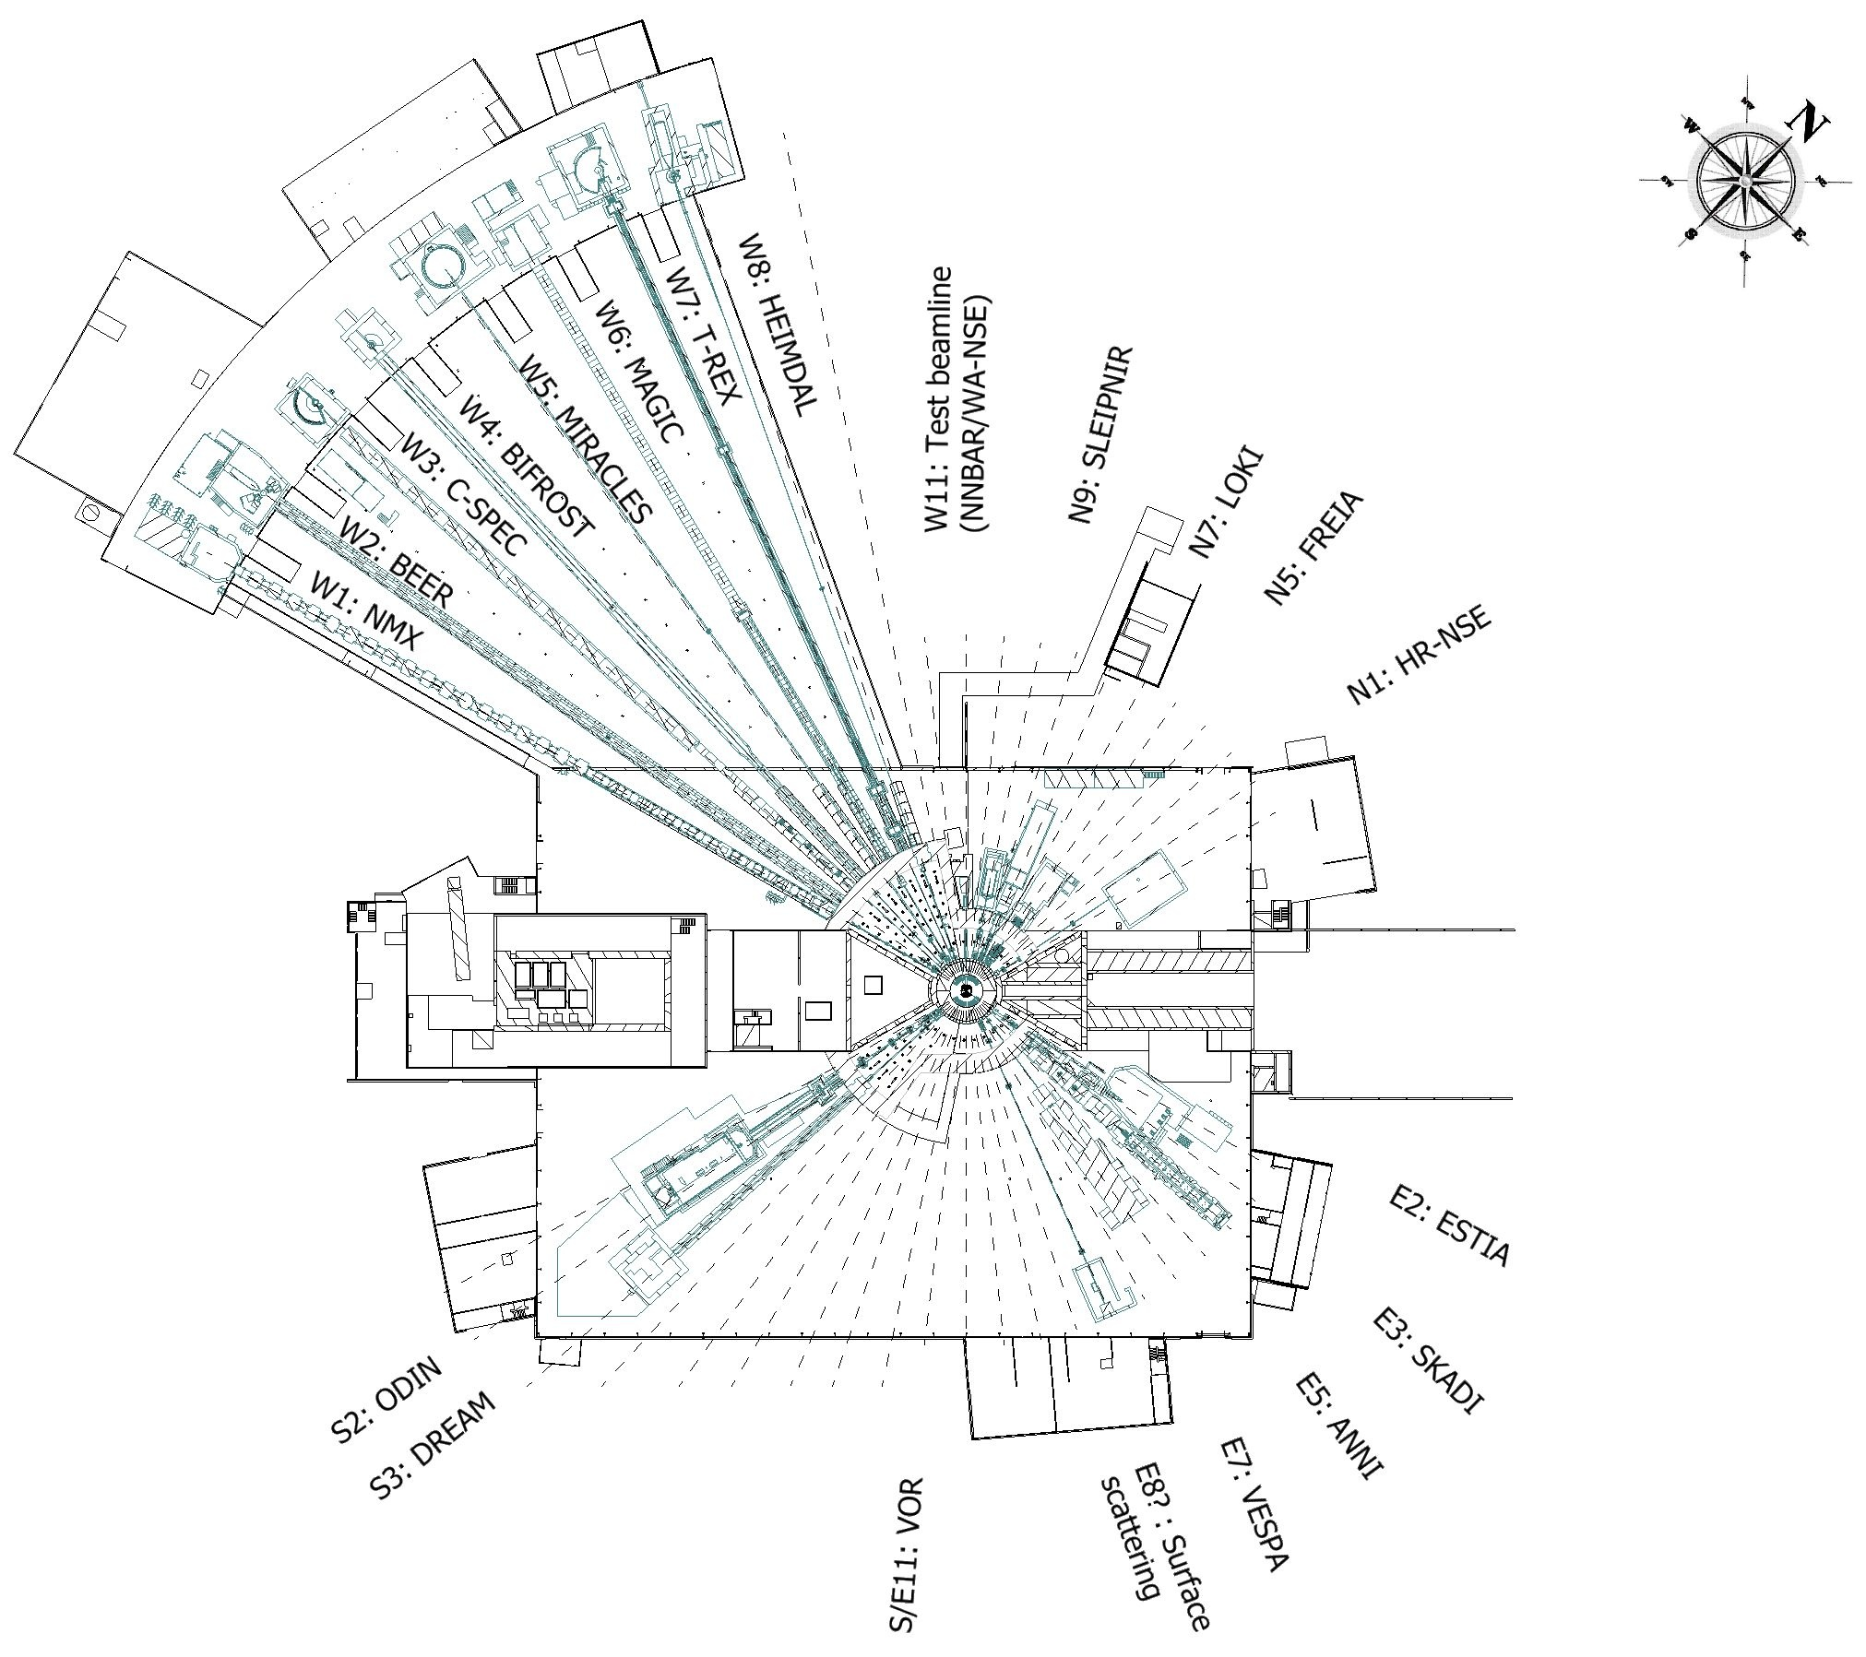

Slide 5
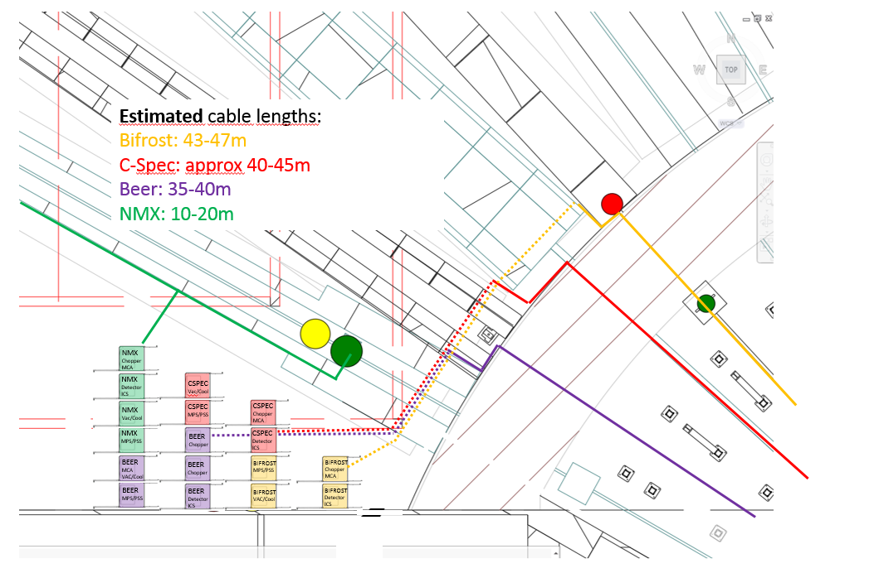
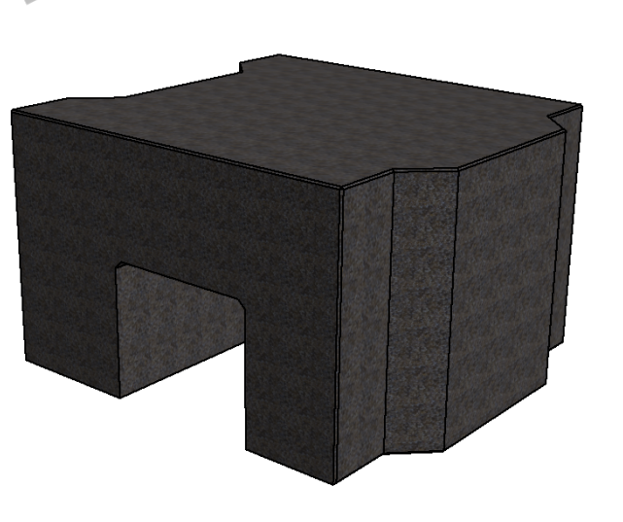
West Sector
From: Markus Olsson

Slide 6
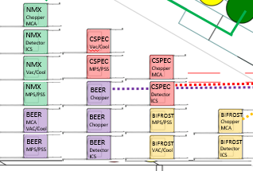
West Sector

Slide 7
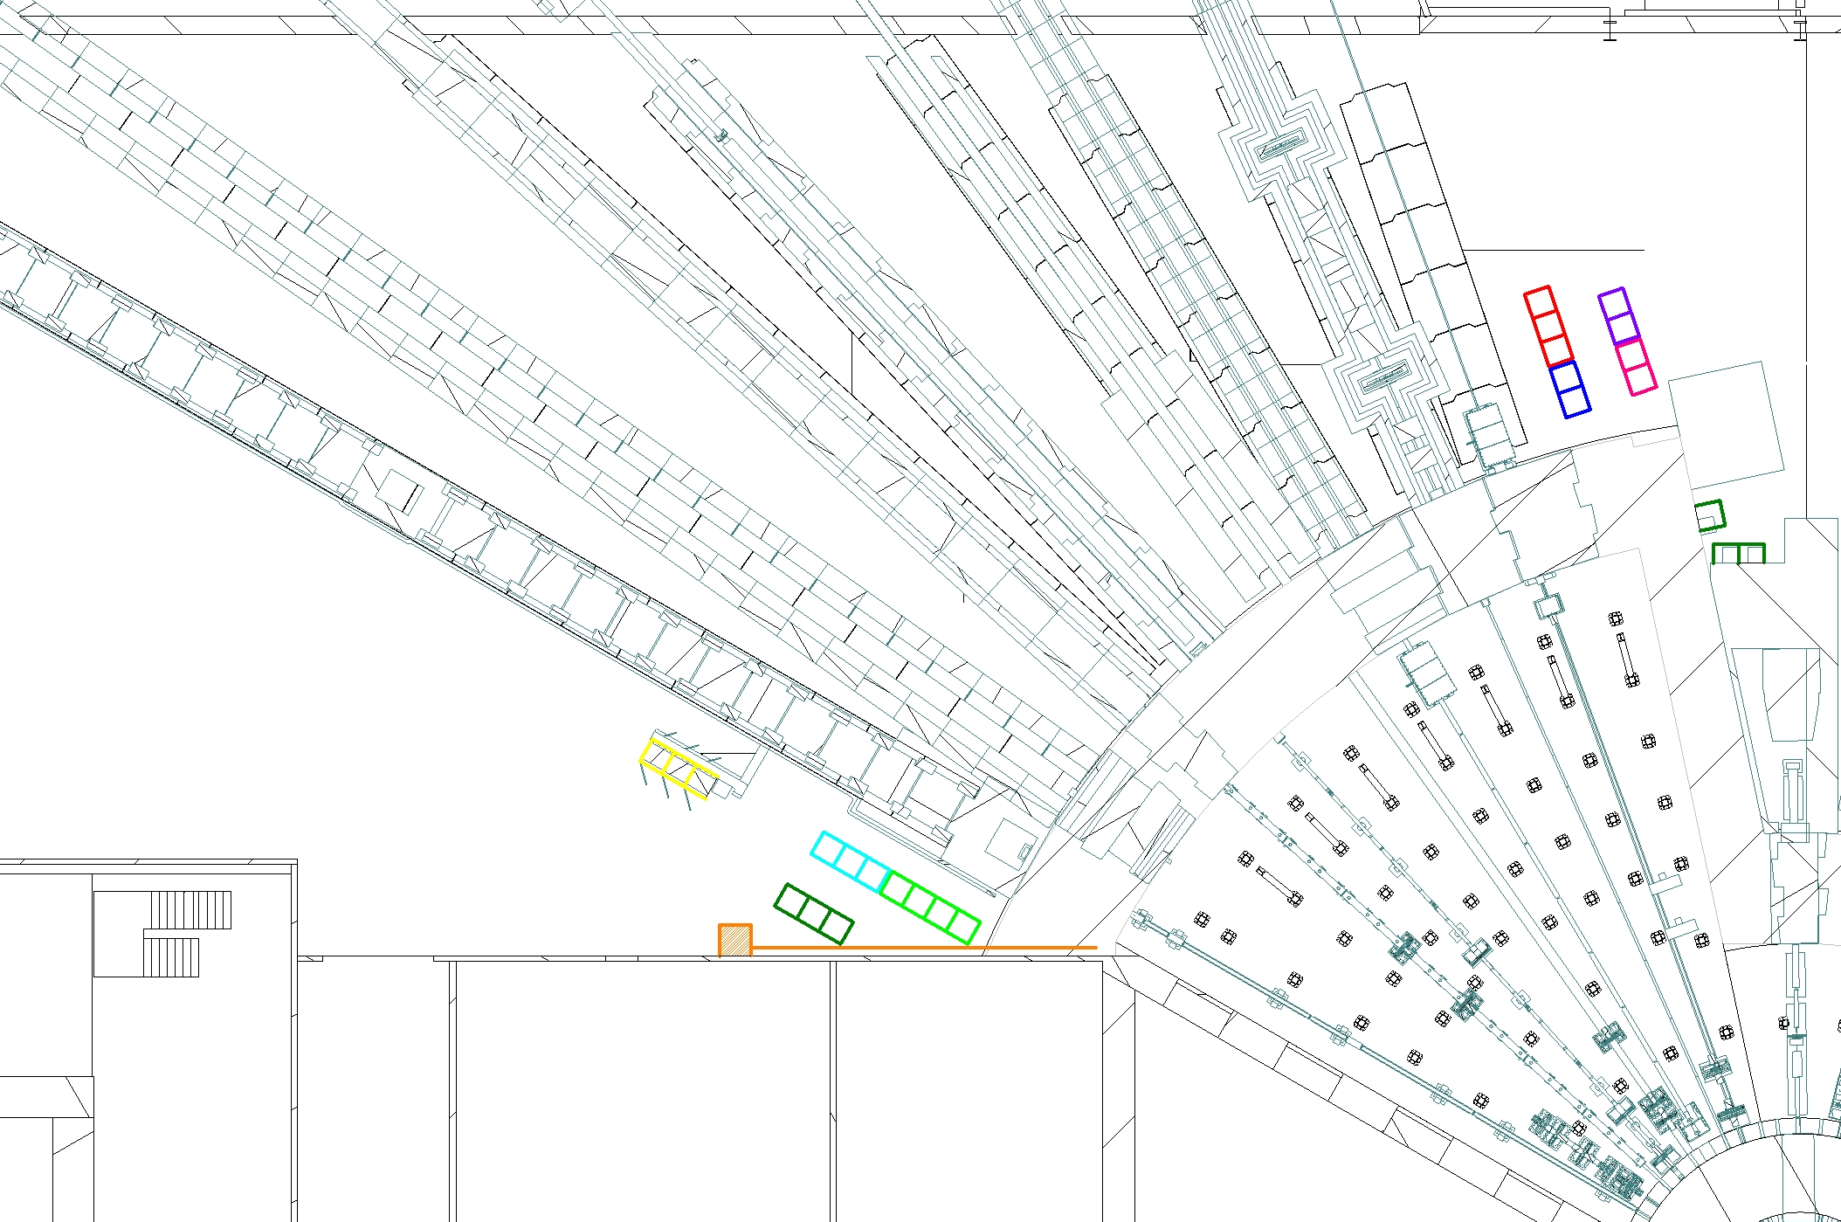
West Sector

Slide 8
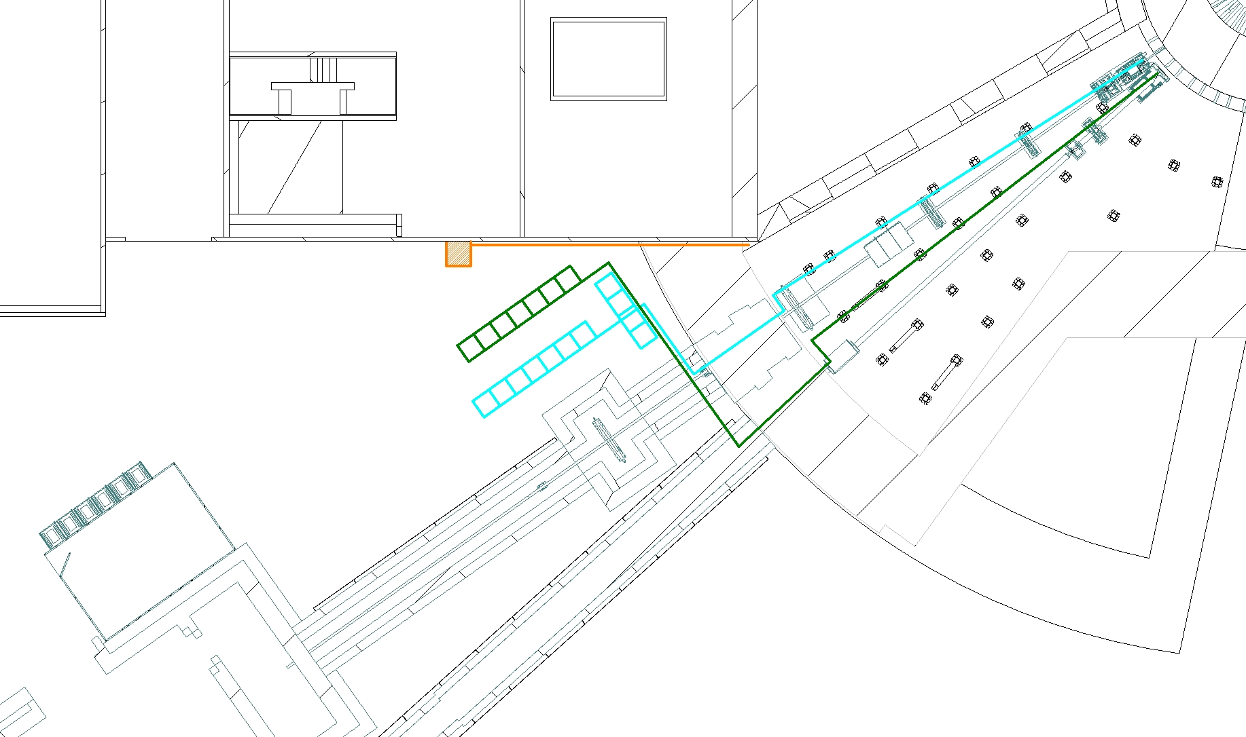
South Sector

Slide 9
South Sector

Slide 10
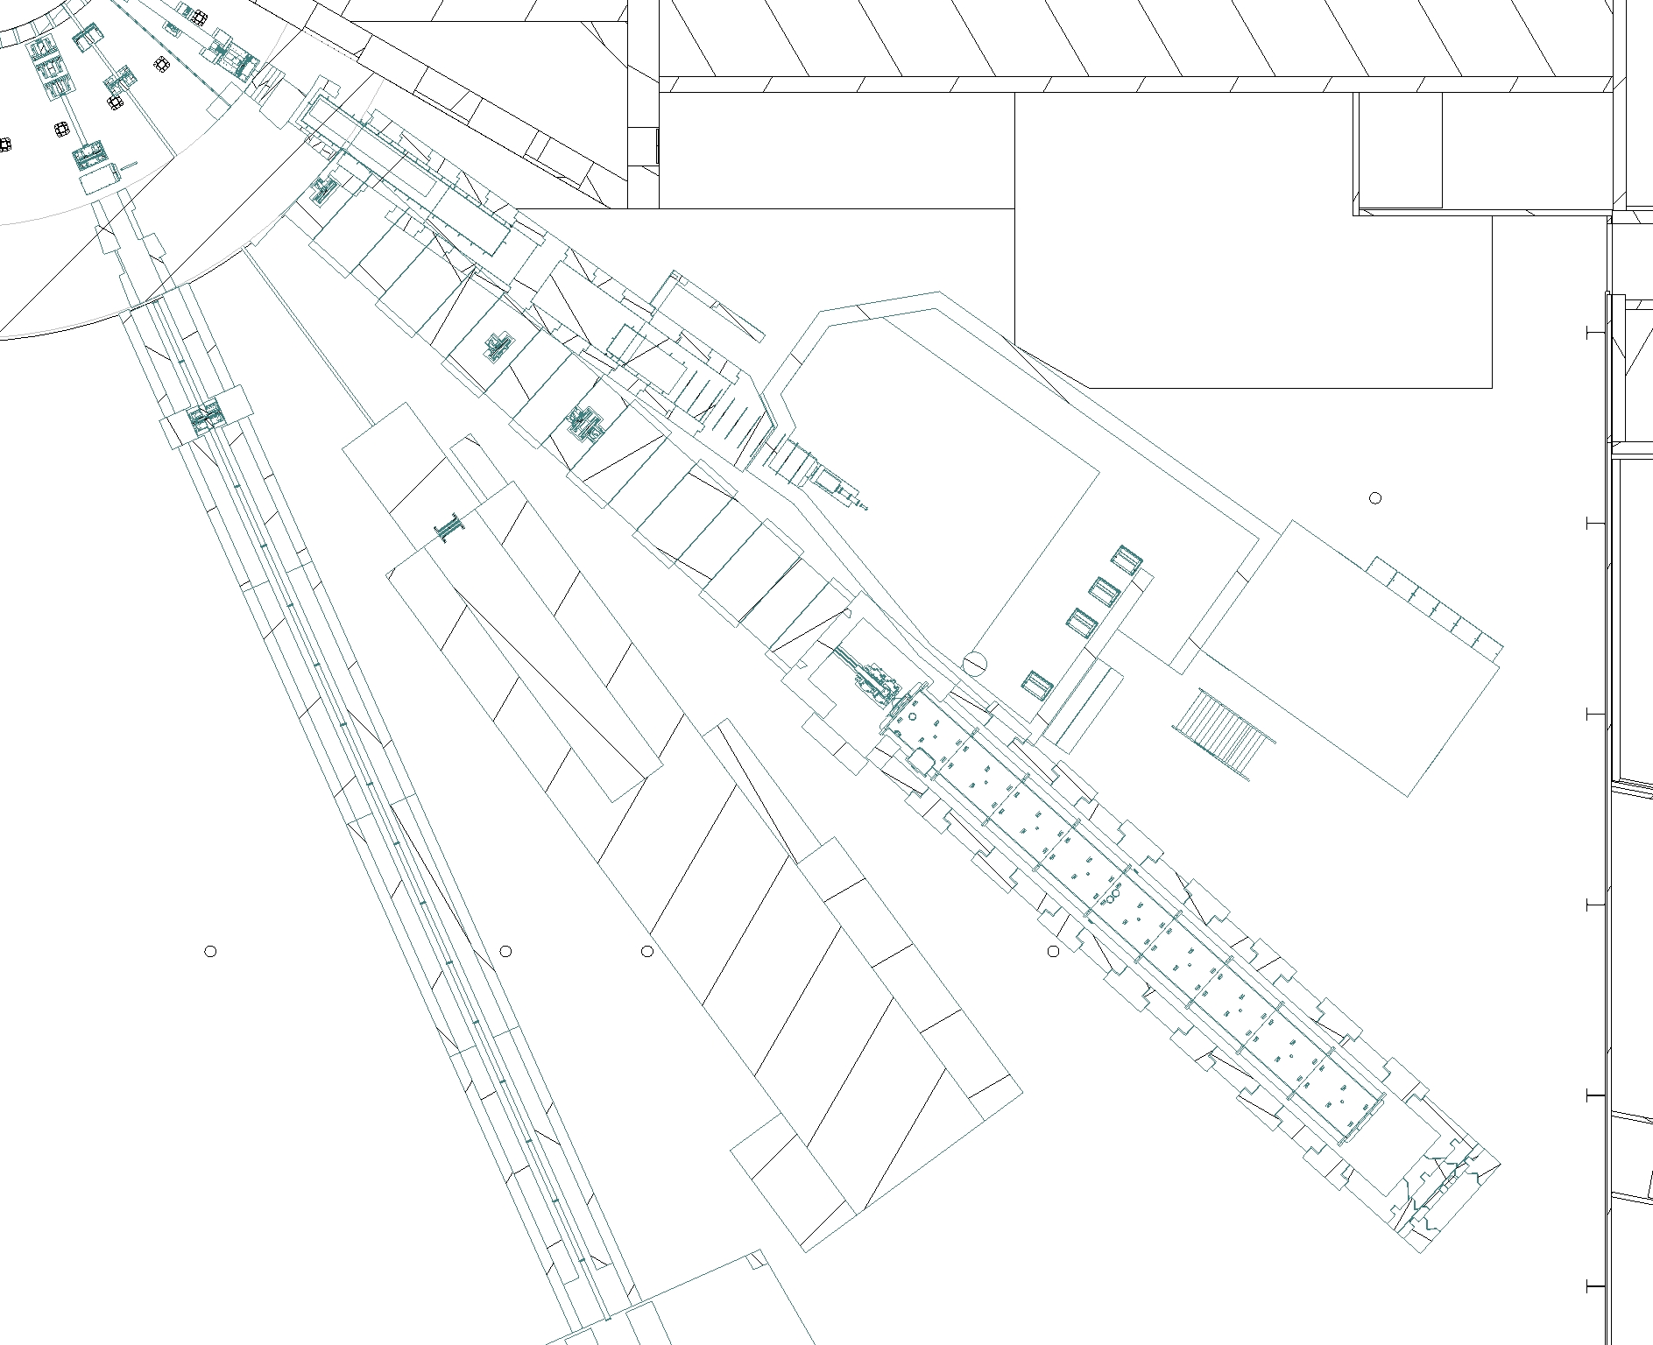
East Sector

Slide 11
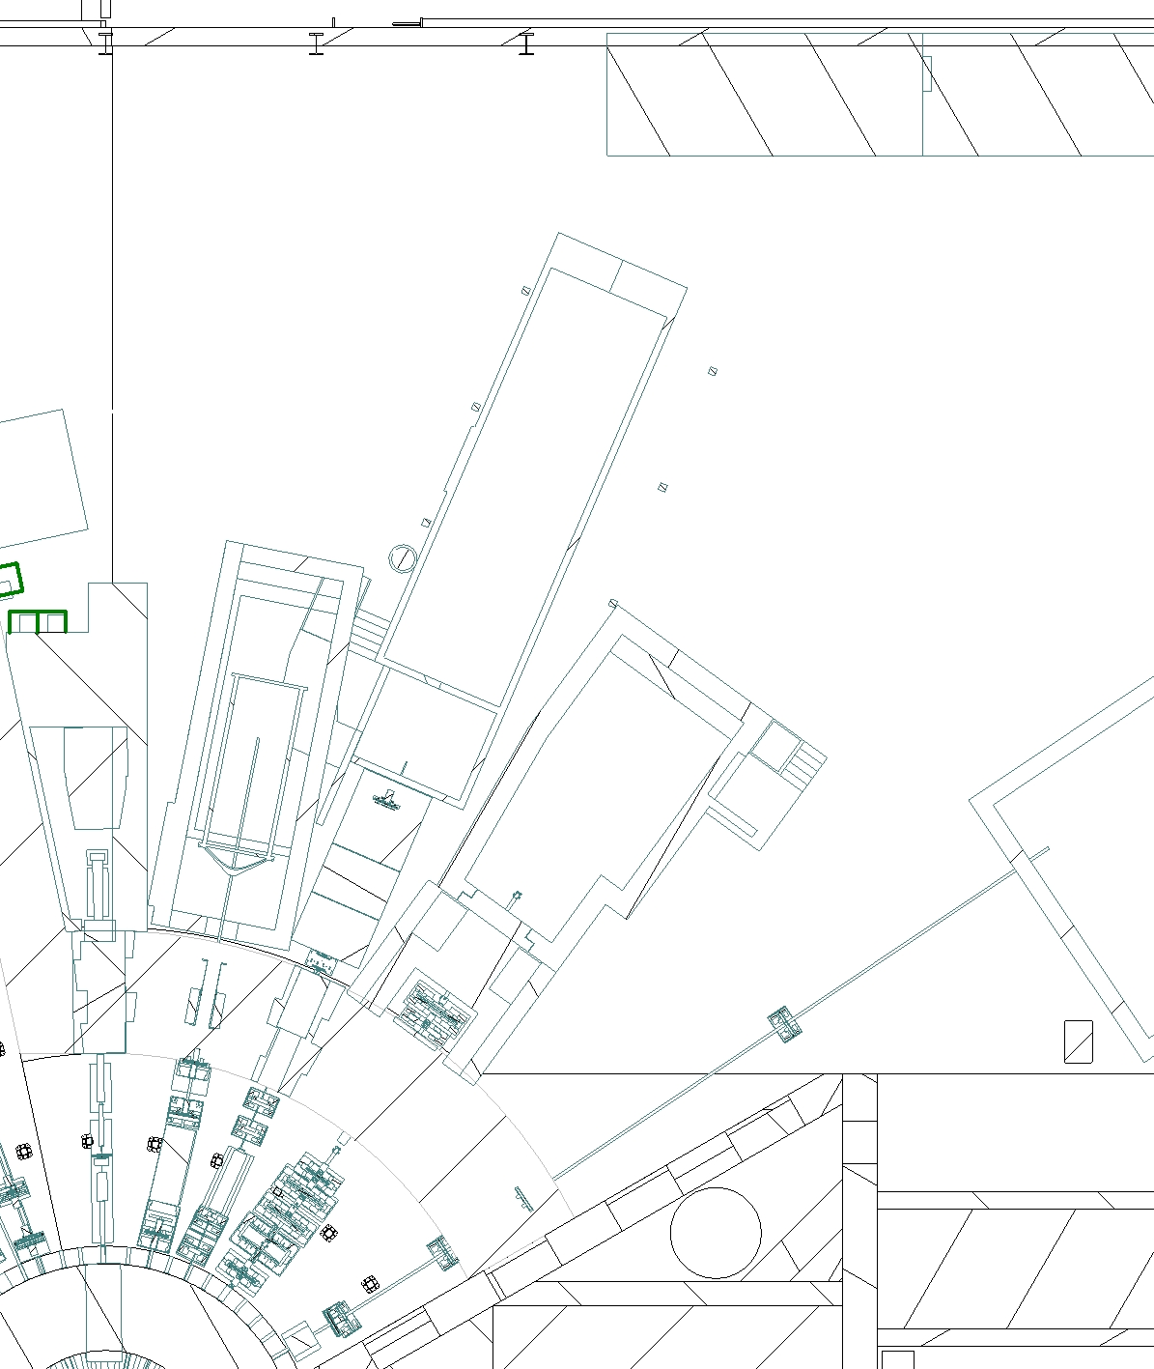
North Sector

Slide 12
Thank you!

