Slide 1
Chopper control software
Andrés Quintanilla
Mechatronics engineer
Neutron Chopper Group
European Spallation Source ERIC
14 February, 2019

Slide 2
Overview
Goals
Controls architecture
Architecture for large scale integration of components.
Flow of communication.
Integration process
Standard variable list
EPICS integration
Discussion subjects
GUI, handling control from different points
Emergency routines
Open subjects

Slide 3
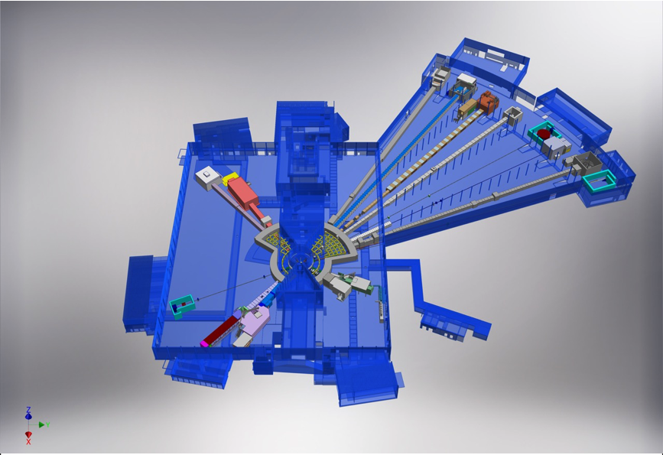
Goals
BEER
NMX
C-SPEC
BIFROST
Standardise:
Hardware
Timing
Controls and monitoring
Integration process
Software maintenance
MIRACLES
✓
MAGIC
T-REX
✓
HEIMDAL
ODIN
DREAM
VESPA
LOKI
FREIA
SKADI
ESTIA
(1:800)

Slide 4
Controls architecture
For large scale integration
DMSC
CHIC- Chopper Integration Controller
Allows the implementation of all the standarisation needed by acting as a "transducer" between EPICS and the chopper drives.
It is a monitoring system (predictive maintenance) for external measurements such as vibration, cooling, vacuum and disk temp.
User interface
Data analysis
EPICS
Timing System
Engineering
HMI
(CS-Studio)
Time stamping
(TDC pulse)
Data archive
Timing IOC
CHIC IOC
Synchronization signal (7-406Hz)
SKF
Jülich
CHIC
Kollmorgen
Other DCU
Control Interface
Diagnostics
Chopper MPS
Monitoring
Chopper Axis _{(1..N)}
Motor & Bearing Control
Ref input
Sensors
TDC output

Slide 5
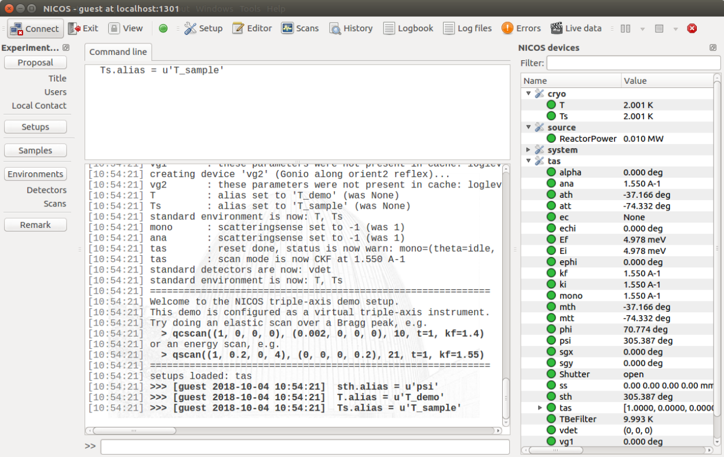
Controls architecture
For large scale integration
DMSC
In terms of hardware:
”DMSC” (Data Managment and Software Centre) refers to Data analysis system and science users interface.
User interface
Data analysis
EPICS
Timing System
Engineering
HMI
(CS-Studio)
Time stamping
(TDC pulse)
Data archive
Timing IOC
CHIC IOC
Synchronization signal (7-406Hz)
CHIC
Control Interface
Diagnostics
Chopper MPS
Monitoring
Chopper Axis _{(1..N)}
Motor & Bearing Control
Ref input
Sensors
TDC output

Slide 6
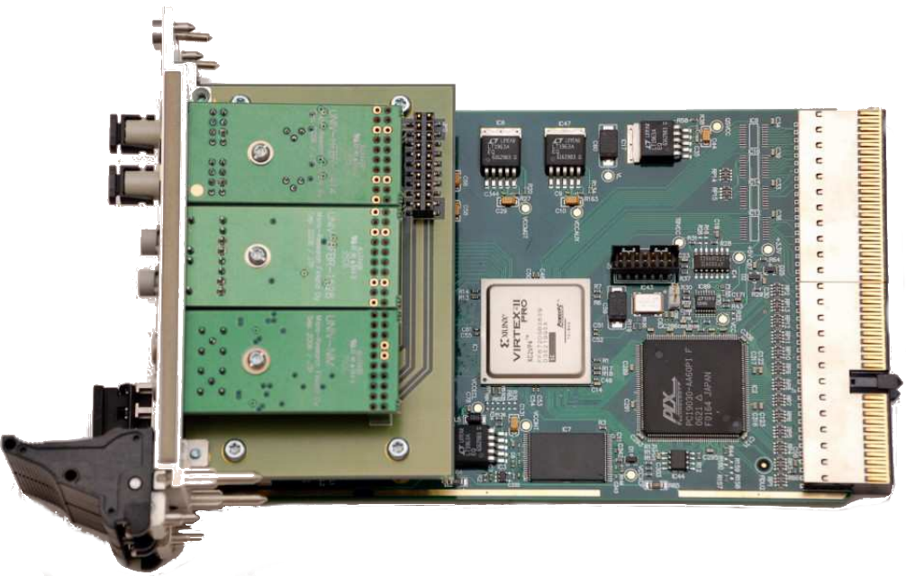
Controls architecture
For large scale integration
DMSC
In terms of hardware:
”EPICS” (Experimental Physics and Industrial Control System) refers to the industrial PC and the timing card.
User interface
Data analysis
EPICS
Timing System
Engineering
HMI
(CS-Studio)
Time stamping
(TDC pulse)
Data archive
Timing IOC
CHIC IOC
Synchronization signal (7-406Hz)
CHIC
Control Interface
Diagnostics
Chopper MPS
Monitoring
Chopper Axis _{(1..N)}
Motor & Bearing Control
Ref input
Sensors
TDC output

Slide 7
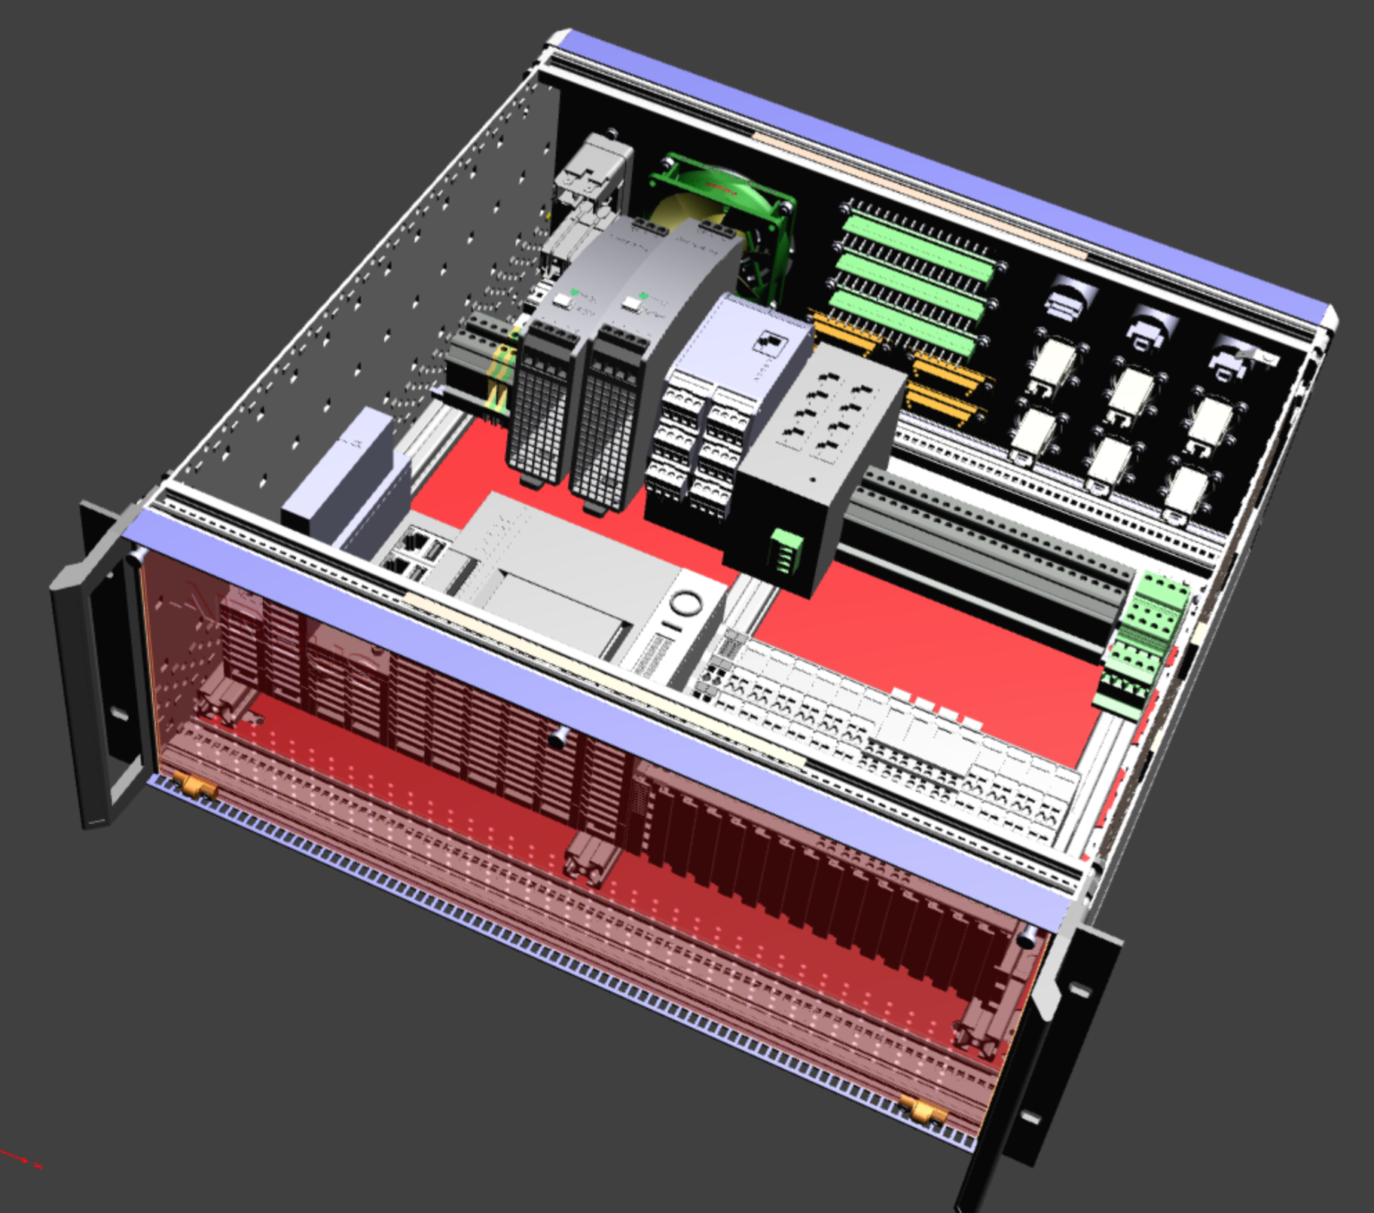
Controls architecture
For large scale integration
DMSC
In terms of hardware:
”CHIC” (Chopper Integration Controller)
refers to the subrack developed by Airbus.
User interface
Data analysis
EPICS
Timing System
Engineering
HMI
(CS-Studio)
Time stamping
(TDC pulse)
Data archive
Timing IOC
CHIC IOC
Synchronization signal (7-406Hz)
SKF
Jülich
CHIC
Kollmorgen
Other DCU
Control Interface
Diagnostics
Chopper MPS
Monitoring
Chopper Axis _{(1..N)}
Motor & Bearing Control
Ref input
Image and design by Airbus
Sensors
TDC output

Slide 8
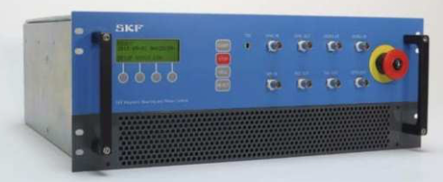
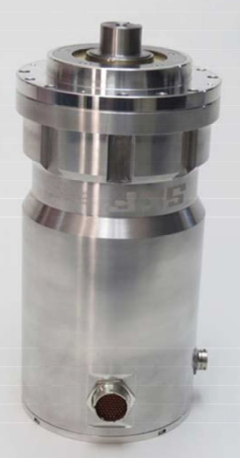
Controls architecture
For large scale integration
DMSC
In terms of hardware:
”Chopper Axis” refers to the spindle, the controller and sensors.
User interface
Data analysis
EPICS
Timing System
Engineering
HMI
(CS-Studio)
Time stamping
(TDC pulse)
Data archive
Timing IOC
CHIC IOC
Synchronization signal (7-406Hz)
CHIC
Control Interface
Diagnostics
Chopper MPS
Monitoring
Chopper Axis _{(1..N)}
Motor & Bearing Control
Ref input
Sensors
TDC output

Slide 9
Controls architecture
For large scale integration
DMSC
Interaction between the CHIC and the different chopper axis.
User interface
Data analysis
EPICS
Timing System
Engineering
HMI
(CS-Studio)
Time stamping
(TDC pulse)
Data archive
Timing IOC
CHIC IOC
Synchronization signal (7-406Hz)
CHIC
Control Interface
Diagnostics
Chopper MPS
Monitoring
Chopper Axis _{(1..N)}
Motor & Bearing Control
Ref input
Sensors
TDC output

Slide 10
Controls architecture
Flow of communication
Message layers (ESS+Airbus)
Control interface
Monitoring
Interlocks
GUI
Data logging
CHIC Layer
Supplier 1
Supplier 2
Supplier n
Supplier 1
Supplier2
Supplier n
Chopper Controller 1
External Sensors 1
Chopper Layer
Chopper Controller 2
External Sensors 2
Chopper Controller n
External Sensors n

Slide 11
Controls architecture
Flow of communication – New command sent from GUI or EPICS
Message layers (ESS+Airbus)
Control interface
Monitoring
Interlocks
GUI
Data logging
CHIC Layer
Supplier 1
Supplier 2
Supplier n
Supplier 1
Supplier2
Supplier n
Chopper Controller 1
External Sensors 1
Chopper Layer
Chopper Controller 2
External Sensors 2
Chopper Controller n
External Sensors n

Slide 12
Controls architecture
Flow of communication – Command is analysed for limits
Message layers (ESS+Airbus)
Control interface
Monitoring
Interlocks
GUI
Data logging
CHIC Layer
Supplier 1
Supplier 2
Supplier n
Supplier 1
Supplier2
Supplier n
Chopper Controller 1
External Sensors 1
Chopper Layer
Chopper Controller 2
External Sensors 2
Chopper Controller n
External Sensors n

Slide 13
Controls architecture
Flow of communication – Adapts the command to different suppliers
Message layers (ESS+Airbus)
Control interface
Monitoring
Interlocks
GUI
Data logging
CHIC Layer
Supplier 1
Supplier 2
Supplier n
Supplier 1
Supplier2
Supplier n
Chopper Controller 1
External Sensors 1
Chopper Layer
Chopper Controller 2
External Sensors 2
Chopper Controller n
External Sensors n

Slide 14
Controls architecture
Flow of communication – Adapted command arrives to each chopper
Message layers (ESS+Airbus)
Control interface
Monitoring
Interlocks
GUI
Data logging
CHIC Layer
Supplier 1
Supplier 2
Supplier n
Supplier 1
Supplier2
Supplier n
Chopper Controller 1
External Sensors 1
Chopper Layer
Chopper Controller 2
External Sensors 2
Chopper Controller n
External Sensors n

Slide 15
Controls architecture
Flow of communication – Feedback that command was executed
Message layers (ESS+Airbus)
Control interface
Monitoring
Interlocks
GUI
Data logging
CHIC Layer
Supplier 1
Supplier 2
Supplier n
Supplier 1
Supplier2
Supplier n
Chopper Controller 1
External Sensors 1
Chopper Layer
Chopper Controller 2
External Sensors 2
Chopper Controller n
External Sensors n

Slide 16
Controls architecture
Flow of communication – Constantly monitors feedback for MPS
Message layers (ESS+Airbus)
Control interface
Monitoring
Interlocks
GUI
Data logging
CHIC Layer
Supplier 1
Supplier 2
Supplier n
Supplier 1
Supplier2
Supplier n
Chopper Controller 1
External Sensors 1
Chopper Layer
Chopper Controller 2
External Sensors 2
Chopper Controller n
External Sensors n

Slide 17
Controls architecture
Flow of communication – Stores feedback for Diagnostics
Message layers (ESS+Airbus)
Control interface
Monitoring
Interlocks
GUI
Data logging
CHIC Layer
Supplier 1
Supplier 2
Supplier n
Supplier 1
Supplier2
Supplier n
Chopper Controller 1
External Sensors 1
Chopper Layer
Chopper Controller 2
External Sensors 2
Chopper Controller n
External Sensors n

Slide 18
Controls architecture
Flow of communication – Something is not normal.
Message layers (ESS+Airbus)
Control interface
Monitoring
Interlocks
GUI
Data logging
CHIC Layer
Supplier 1
Supplier 2
Supplier n
Supplier 1
Supplier2
Supplier n
Chopper Controller 1
External Sensors 1
Chopper Layer
Chopper Controller 2
External Sensors 2
Chopper Controller n
External Sensors n

Slide 19
Controls architecture
Flow of communication – Interlocks and control interface act accordingly.
Message layers (ESS+Airbus)
Control interface
Monitoring
Interlocks
GUI
Data logging
CHIC Layer
Supplier 1
Supplier 2
Supplier n
Supplier 1
Supplier2
Supplier n
Chopper Controller 1
External Sensors 1
Chopper Layer
Chopper Controller 2
External Sensors 2
Chopper Controller n
External Sensors n

Slide 20
Controls architecture
Flow of communication – Interlocks and control interface act accordingly.
Message layers (ESS+Airbus)
Control interface
Monitoring
Interlocks
GUI
Data logging
CHIC Layer
Supplier 1
Supplier 2
Supplier n
Supplier 1
Supplier2
Supplier n
Chopper Controller 1
External Sensors 1
Chopper Layer
Chopper Controller 2
External Sensors 2
Chopper Controller n
External Sensors n

Slide 21
Goals
BEER
NMX
C-SPEC
BIFROST
Standardise:
Hardware
Timing
Controls and monitoring
Integration process
Software maintenance
✓
MIRACLES
MAGIC
✓
T-REX
HEIMDAL
✓
ODIN
DREAM
VESPA
LOKI
FREIA
SKADI
ESTIA
(1:800)

Slide 22
Integration Process
Standard variable list
DMSC
Chopper Axis to be installed across the instruments, will be from different suppliers.
What different suppliers means in terms of software:
→ Different variables, types, amount
→ Different machine state
→ Different comm. protocols
→ Different alarms, limits
→ Different GUI
User interface
Data analysis
EPICS
Timing System
Engineering
HMI
(CS-Studio)
Time stamping
(TDC pulse)
Data archive
Timing IOC
CHIC IOC
Synchronization signal (7-406Hz)
CHIC
Control Interface
Diagnostics
Chopper MPS
Monitoring
Chopper Axis _{(1..N)}
Motor & Bearing Control
Ref input
Sensors
TDC output

Slide 23
Integration Process
Standard variable list
DMSC
For example:
SKF Chopper Axis:
242 variables
7 different data types
16 states
88 alarms
User interface
Data analysis
EPICS
Timing System
Engineering
HMI
(CS-Studio)
Time stamping
(TDC pulse)
Data archive
Timing IOC
CHIC IOC
Synchronization signal (7-406Hz)
CHIC
Control Interface
Diagnostics
Chopper MPS
Monitoring
SKF
Chopper Axis _{(1..N)}
Motor & Bearing Control
Ref input
Sensors
TDC output

Slide 24
Integration Process
Standard variable list
Command - Store to Flash SPV
Command - Store to Flash DSP
Command - Store to Flash AMP
Command - Store to Flash MCP
Status - Store to Flash SPV
Status - Store to Flash DSP
Status - Store to Flash AMP
Status - Store to Flash MCP
Alarm – DSP HW Watchdog
Alarm – AMP HW Watchdog
Alarm – MCP HW Watchdog
Alarm - SPV SW Watchdog
Alarm - DSP SW Watchdog
Alarm - AMP SW Watchdog
Alarm - MCP SW Watchdog
Alarm - Radial Oscillator Over Voltage
Alarm - Radial Oscillator Under Voltage
Alarm - Axial Oscillator Over Voltage
Alarm - Axial Oscillator Under Voltage
Alarm - Position V13
Alarm - Position W13
Alarm - Position V24
Alarm - Position W24
Alarm - Position Z12
Alarm - External Fault
Alarm - Controller Over - Temp
Alarm - Motor Over - Temp
Alarm - Numeric Bus Over Voltage
Alarm - Numeric Bus Under Voltage
Alarm - Analog Bus Over Voltage
Alarm - Analog Bus Under Voltage
Alarm - Power Bus Over Voltage
Alarm - Power Bus Under Voltage
Alarm - Motor Bus Over Voltage
Alarm - Motor Bus Under Voltage
Alarm - Motor Bus Over Current
Alarm - Overspeed
Alarm - Speed Sensor
Alarm - Brake Failure
Alarm - Rotation without Levitation - DSP
Alarm - Rotation without Levitation - SPV
Alarm - Rotation Lockout
Alarm - Interlock: PSU
Alarm - Interlock: UPS
Alarm - Interlock: Vacuum
Alarm - Interlock: Cooling
Alarm - Interlock: Analog
Alarm - Hard Overcurrent V13
Alarm - Hard Overcurrent W13
Alarm - Hard Overcurrent V24
Alarm - Hard Overcurrent W24
Alarm - Hard Overcurrent Z12
Alarm - Command Limit V1
Alarm - Command Limit V2
Alarm - Command Limit V3
Alarm - Command Limit V4
Alarm - Command Limit W1
Alarm - Command Limit W2
Alarm - Command Limit W3
Alarm - Command Limit W4
Alarm - Command Limit Z1
Alarm - Command Limit Z2
Alarm - Energy Limit V1
Alarm - Energy Limit V2
Alarm - Energy Limit V3
Alarm - Energy Limit V4
Alarm - Energy Limit W1
Alarm - Energy Limit W2
Alarm - Energy Limit W3
Alarm - Energy Limit W4
Alarm - Energy Limit Z1
Alarm - Energy Limit Z2
Alarm - Current Limit V1
Alarm - Current Limit V2
Alarm - Current Limit V3
Alarm - Current Limit V4
Alarm - Current Limit W1
Alarm - Current Limit W2
Alarm - Current Limit W3
Alarm - Current Limit W4
Alarm - Current Limit Z1
Alarm - Current Limit Z2
Alarm - Communication DSP
Alarm - Communication AMP
Alarm - Communication MCP
Alarm - Checksum SPV
Alarm - Checksum DSP
Alarm - Checksum AMP
Alarm - Checksum MCP
Alarm - Ref Loss
Alarm - Timebase DSP
Alarm - Timebase MCP
Alarm - Timebase AMP
Alarm - Level
Real time Clock - Year
Real time Clock - Month
Real time Clock - Day
Real time Clock - Time
Motor Status - State
Motor Status - External Input/Output register
Motor Temperature
TDC Delay
Disk Angular Alignment
Max Speed
Min Speed
Run Speed Setpoint
Rotation Direction
Motor Control Mode
Motor Kp
Motor Ki
Run Speed
Reference In Period
Reference Out Period
Veto Window
Reference Delay
Motor Kphase
Stats - Phase OK
Stats - Phase Efficiency
Stats - Phase Accuracy
Stats - Phase Repeatability
Stats - Veto Counts
Stats - Non - Veto Counts
Home Angle Setpoint
Home Kp
Home Ki
Home Kd
Home Angle
Command - Modbus Run On
Command - Modbus Run Off
Command - Coast On Command
Command - Coast Off Command
Command - Modbus Clear Alarms
Command - Clear Veto Counts
Command - Modbus Control Request
Command Processing Status - Modbus Run On
Command Processing Status - Modbus Run Off
Command Processing Status - Hardwire Run On
Command Processing Status - Hardwire Run Off
Command Processing Status - MBScope Run On
Command Processing Status - MBScope Run Off
Command Processing Status - Local Run On
Command Processing Status - Local Run Off
Command Processing Status - Test Mode On
Command Processing Status - Test Mode Off
Command Processing Status - Coast On
Command Processing Status - Coast Off
Command Processing Status - Modbus Clear Alarms
Command Processing Status - Hardwire Clear Alarms
Command Processing Status - MBScope Clear Alarms
Command Processing Status - Local Clear Alarms
Command Processing Status - Reset Veto Counter
Command Processing Status - Store to Flash SPV
Command Processing Status - Store to Flash DSP
Command Processing Status - Store to Flash AMP
Command Processing Status - Store to Flash MCP
Command Processing Status - Modbus Request Control
Command Processing Status - MBScope Request Control
Command Processing Status - Hardwire Request Control
Command Processing Status - Local Request Control
Status - Modbus Run
Status - Hardwire Run
Status - MBScope Run
Status - Local Run
Status - Test Mode
Status - Coast
Status - Modbus Clear Alarms
Status - Hardwire Clear Alarms
Status - MBScope Clear Alarms
Status - Local Clear Alarms
Status - Clear Veto Counts
Status - Modbus Request Control
Status - MBScope Request Control
Status - Hardwire Request Control
Status - Local Request Control
Time Controller Powered On
Time System Levitated
Time System Rotated
System State
Alarm - Motor Inhibit
Alarm - Remote Motor Inhibit
Alarm - Brake Resistor Failure
Alarm - MBResearch Communication
Consolidated Status - Veto Counts
Consolidated Status - Phase Accuracy
Consolidated Status - Phase Repeatability
Consolidated Status - Speed
Consolidated Status - Status Register
Veto Window
Reference Delay
Alarm - Motor Inhibit Warning
Alarm - Motor Amplifier
Command - Home Open
Command Processing Status - Home Open
Home Open Angle Set Point
Command – Home Closed
Command Processing Status – Home Closed
Home Closed Angle Set Point
Status – Parked at Home Angle Setpoint
Status – Parked at Home Open Angle Setpoint
Status – Parked at Home Closed Angle Setpoint
Home Enable
Actual Phase Error
Speed Look-up Table – Speed 1
Speed Look-up Table – Motor Kp 1
Speed Look-up Table – Motor Ki 1
Speed Look-up Table – Motor Kphase 1
Speed Look-up Table – Speed 2
Speed Look-up Table – Motor Kp 2
Speed Look-up Table – Motor Ki 2
Speed Look-up Table – Motor Kphase 2
Speed Look-up Table – Speed 3
Speed Look-up Table – Motor Kp 3
Speed Look-up Table – Motor Ki 3
Speed Look-up Table – Motor Kphase 3
Speed Look-up Table – Speed 4
Speed Look-up Table – Motor Kp 4
Speed Look-up Table – Motor Ki 4
Speed Look-up Table – Motor Kphase 4
Speed Look-up Table – Speed 5
Speed Look-up Table – Motor Kp 5
Speed Look-up Table – Motor Ki 5
Speed Look-up Table – Motor Kphase 5
Alarm - Motor Power
System Asset ID
System Customer ID
System Payload ID
System Facility
System Installation Location
Last Loaded PVF
Normalized Controller Temperature
Controller Temperature FSV Min
Controller Temperature FSV Max
Normalized Peak Position V13
Normalized Peak Position W13
Normalized Peak Position V24
Normalized Peak Position W24
Normalized Peak Position Z12
Peak Position FSV V13
Peak Position FSV W13
Peak Position FSV V24
Peak Position FSV W24
Peak Position FSV Z12
For example:
SKF Chopper Axis:
242 variables
7 different data types
16 states
88 alarms

Slide 25
Integration Process
Standard variable list
DMSC
For example:
Standard variable list:
47 variables
3 different data types
10 states
11 alarms
User interface
Data analysis
EPICS
Timing System
Engineering
HMI
(CS-Studio)
Time stamping
(TDC pulse)
Data archive
Timing IOC
CHIC IOC
Synchronization signal (7-406Hz)
SKF
CHIC
Control Interface
Diagnostics
Chopper MPS
Monitoring
Chopper Axis _{(1..N)}
Motor & Bearing Control
Ref input
Sensors
TDC output

Slide 26
Integration Process
Standard variable list
Alarm | Hardware Alarm | HW_Alrm
 | Software Alarm | SW_Alrm
 | Voltage Alarm | V_Alrm
 | Position Alarm | Pos_Alrm
 | Temperature Alarm | Tmp_Alrm
 | Interlock Alarm | ILck_Alrm
 | Current Alarm | I_Alrm
 | Energy Alarm | P_Alrm
 | Communications Alarm | Comm_Alrm
 | Reference signal Alarm | Ref_Alrm
 | Level of Alarms by enumeration | Lvl_Alrm
Status | Chopper State by enumeration | Chop_Stat
 | Levitation status | Lev_Stat
 | Parking status | Park_Stat
 | Phase status | Phs_Stat
 | Vacuum status | Vac_Stat
 | Rotation | RotSP_Stat
 | Rot Speed setpoint | SpdSP_Stat
 | Rotational speed | Spd_Stat
 | Motor temperature | MtrTmp_Stat
 | Drive temperature | DrvTmp_Stat
 | Rotor Position | Pos_Stat
 | Time on | TimOn_Stat
 | Time levitated | TimLevi_Stat
 | Time rotating | TimRot_Stat
 | Park Position | ParkPosSP_Stat
 | Park Setpoint | ParkSP_Stat
 | Peak Position V13 | PosV13_Stat
 | Peak Position W13 | PosW13_Stat
 | Peak Position V24 | PosV24_Stat
 | Peak Position W24 | PosW24_Stat
 | Peak Position Z12 | PosZ12_Stat
 | Maximun speed | MaxSpd_Stat
 | Minimun speed | MinSpd_Stat
 | Control Mode | CtrlMd_Stat
Command | Commands by enumeration. To be set back to idle after confirmation that command was sent and received. | Cmd idle
 |  | Cmd Start
 |  | Cmd Stop
 |  | Cmd Estop
 |  | Cmd ClrAlrm
 |  | Cmd Park
 |  | Cmd Cali
Setpoint | Rotation | Rot_SP
 | Park Position | ParkPos_SP
 | Park setpoint | Park_SP
 | Rot speed setpoint | Spd_SP
 | Control Mode | CtrlMd_SP
For example:
Standard variable list:
47 variables
3 different data types
10 states
11 alarms

Slide 27
Integration Process
Standard variable list
Standard variable list:
47 variables
3 different data types
10 states
11 alarms
SKF Chopper Axis:
242 variables
7 different data types
16 states
88 alarms
Merge different axis variables into the standard list.
Source file
Implementation demo
Notes:
What about Julich, Mirrotron etc ?

Slide 28
Integration Process
Standard variable list
DMSC
With a standard variable list, the integration of different chopper axis towards EPICS is simplified.
User interface
Data analysis
EPICS
Timing System
Engineering
HMI
(CS-Studio)
Time stamping
(TDC pulse)
Data archive
Timing IOC
CHIC IOC
Synchronization signal (7-406Hz)
SKF
CHIC
✓
Control Interface
Diagnostics
Chopper MPS
Monitoring
SKF
Chopper Axis _{(1..N)}
Motor & Bearing Control
Ref input
Sensors
TDC output

Slide 29
Integration Process
EPICS integration
DMSC
Next step is to integrate towards EPICS.
The selected method uses a framework that ICS has already in place and using to integrate Accelerator components.
Modbus and TCP/IP as comm. protocols
Auto generation of PLC and EPICS code
Auto link variables between PLC-EPICS
Auto connect after start-up or disconnection.
User interface
Data analysis
EPICS
Timing System
Engineering
HMI
(CS-Studio)
Time stamping
(TDC pulse)
Data archive
Timing IOC
CHIC IOC
Synchronization signal (7-406Hz)
CHIC
Control Interface
Diagnostics
Chopper MPS
Monitoring
Chopper Axis _{(1..N)}
Motor & Bearing Control
Ref input
Sensors
TDC output

Slide 30
Integration Process
EPICS integration
EPICS
CHIC IOC
standard variable list
TCP/IP Client
Modbus Client
TCP/IP Server
Modbus Server
Variables are auto-linked.
1.Close all connections
Creates memory locations accessible via Modbus
Auto connect after start-up
or disconnection.
2.Initialize “Listener”
3.Accept connection
4.Push data to EPICS
CHIC
standard variable list

Slide 31
Integration Process
EPICS integration
EPICS
CHIC IOC
standard variable list
TCP/IP Client
Modbus Client
Some code for every integration
TCP/IP Server
Modbus Server
Variables are auto-linked.
1.Close all connections
Creates memory locations accessible via Modbus
2.Initialize “Listener”
3.Accept connection
4.Push data to EPICS
CHIC
standard variable list

Slide 32
Integration Process
EPICS integration
How is it done:
Configuration file with process variables for control and monitoring.
The script creates two equivalent sets of code. PLC and EPICS code.
Generated codes are with all variables linked.
Facilitates software maintenance/upgrade
Configuration file
Python script
PVs to integrate
IOC Factory
IP addresses
PLC Factory

Slide 33
Integration Process
EPICS integration
EPICS
CHIC IOC
standard variable list
TCP/IP Client
Modbus Client
TCP/IP Server
Modbus Server
1.Close all connections
Creates memory locations accessible via Modbus
2.Initialize “Listener”
3.Accept connection
4.Push data to EPICS
CHIC
standard variable list
Link to demo

Slide 34
Goals
BEER
NMX
C-SPEC
BIFROST
Standardise:
Hardware
Timing
Controls and monitoring
Integration process
Software maintenance
✓
MIRACLES
MAGIC
✓
T-REX
HEIMDAL
✓
ODIN
✓
DREAM
✓
VESPA
LOKI
FREIA
SKADI
ESTIA
(1:800)

Slide 35
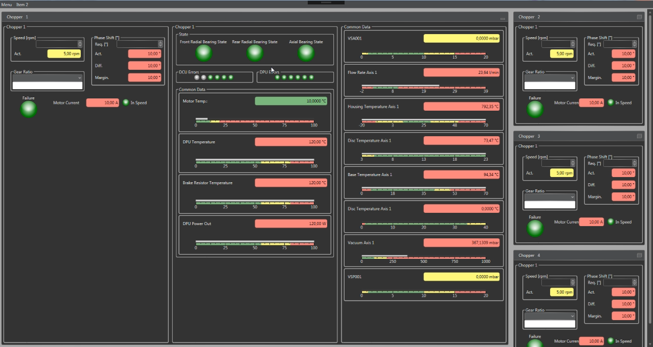
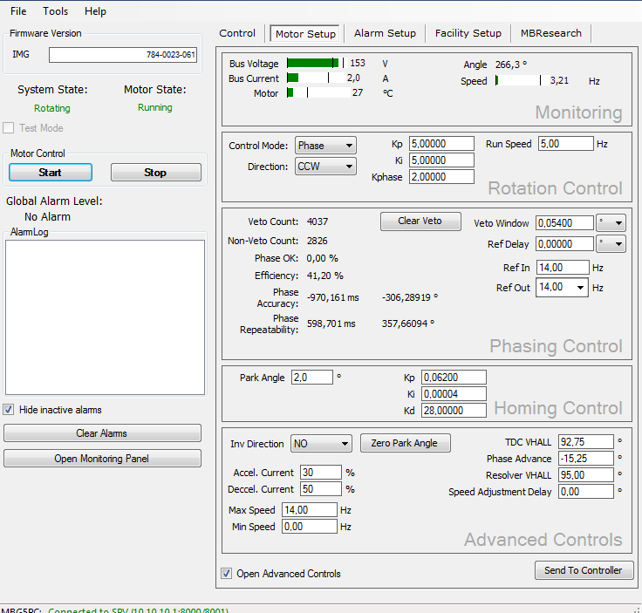
Discussion items
Graphical User interfaces
Users
DMSC
User interface
Data analysis
EPICS
Timing System
Engineering
Engineering
HMI
(CS-Studio)
Time stamping
(TDC pulse)
Data archive
Timing IOC
CHIC IOC
Synchronization signal (7-406Hz)
Engineering
CHIC
Control Interface
Diagnostics
Chopper MPS
Monitoring
Suppliers and
commissioning
Chopper Axis _{(1..N)}
Motor & Bearing Control
Ref input
Sensors
TDC output
Notes:
Handling control from different GUIs

Slide 36
Discussion items
Graphical User interfaces
DMSC
Control modes:
EPICS: control is only from EPICS variables. How will Nicos be handled?
CHIC: control is only from CHIC GUI.
Local: control is only from suppliers GUI or motor drive front panel.
Each system must synch their commands/setpoints to the actuals and ignore new ones, when the control mode is assigned to a different system.
In which level(s), should the control mode be allowed to change?
User interface
Data analysis
EPICS
Timing System
Engineering
HMI
(CS-Studio)
Time stamping
(TDC pulse)
Data archive
Timing IOC
CHIC IOC
Synchronization signal (7-406Hz)
CHIC
Control Interface
Diagnostics
Chopper MPS
Monitoring
Chopper Axis _{(1..N)}
Motor & Bearing Control
Ref input
Sensors
TDC output
Notes:
Handling control from different GUIs

Slide 37
Discussion items
Emergency routines
2 different routines suggested:
Human generated emergency:
Stop as fast as possible.
After stop: Park open or in close position? Or not park at all?
Machine generated emergency:
Coast rotation by disconnecting electric power of motor.
What about magnetic bearings?
After then emergency situation is not present anymore:
Allow/Resume rotation immediately.
OR
Wait for acknowledgement that an emergency occurred from users.

Slide 38
Discussion items
Open subject?
CHIC GUI

Slide 39
Aknowledgments
Markus Olsson
Nikolaos Tsapatsaris
Nicklas Holmberg
John Sparger
Kristian Löki
Miklos Bóros
David Brodrick
Javier García
Thomas Gahl
Airbus Space and Defense
We hope to say in the future:
Any neutron chopper system in the world is compatible with ESS control system.
ESS does not have drifting choppers.

