Slide 1
BEAST Alarm Tool
Banafsheh Hajinasab
Based on presentation by K. Strnisa, Cosylab
www.europeanspallationsource.se
February 14, 2019

Slide 2
Outline
Purpose of alarms
General alarm principles
BEAST architecture
BEAST graphical interface
Alarm system configuration

Slide 3
Purpose of Alarms
ALARMS ARE NOT AN INTERLOCK SYSTEM
Meant for problems that require thinking
Notify the operator about a problem
Help the operator
Must not confuse

Slide 4
Purpose of the Alarm Tool - BEAST
Help the operators handle alarms correctly
Display
Reason for alarm
Offer guidance
Alarm details
Graphical view of hierarchical alarm structure
Connect to with tools related to the solution
Log alarms and operator actions

Slide 5
Cause For Alarm
Deviation from tolerance band for PV
Hardware or software error
LOSS OF COMMUNICATION
Triggered by PVs in the database

Slide 6
Severity And Status
There are two parts to an alarm:
alarm status
severity of that alarm status
Status and severity are determined in the database
Alarm status and severity are set and checked whenever a record is processed.

Slide 7
Alarm Severity
SEVR field of a record – the severity of alarm condition
The alarm severity can take one of four values
OK: The record is not in alarm.
MINOR: Lowest alarm severity.
MAJOR: Highest severity condition.
INVALID: Invalid data or no communication. This is the highest severity condition.

Slide 8
Alarm Status
STAT field holds alarm state of the record, what caused the record to go into alarm
STAT field can have one of more than 20 values
HIHI
HIGH
LOW
LOLO
READ
WRITE
LINK
...

Slide 9
Alarm States (not status)
Three alarm states
OK
ALARM
ACKNWLEDGED
Different ways of handling transitions
Latching
Non-Latching

Slide 10
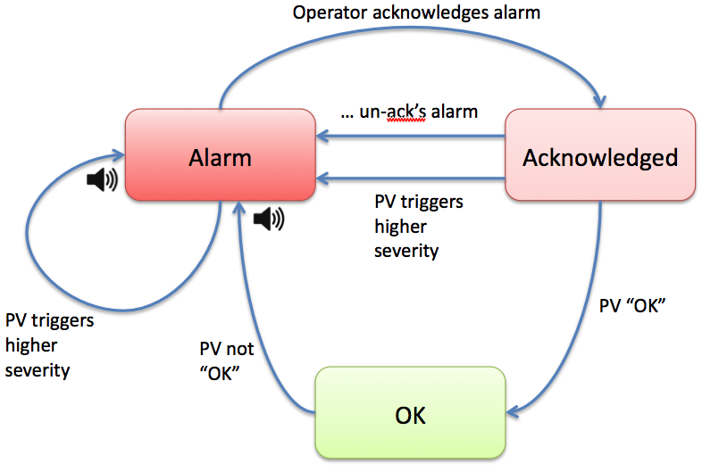
Latched Alarms
Notes:
Alarm are typically configured to "latch" and behave as shown in the first state diagram. Assume that the alarm is initially OK. As soon as an alarm trigger PV sends for example a MINOR alarm severity, the alarm system will latch the time and value of that occurrence and display the alarm in the user interface. If the alarm was configured for annunciation, the alarm description will be annunciated.
Ideally, an operator investigates the alarm, fixes the underlying reason, acknowledges the alarm, the PV returns to OK and the alarm clears. In reality, other things can happen.
The PV might only cause a brief nuisance trip, then quickly return to OK on its own. Or the PV might goes in and out of alarm. Either case really indicates a problem in the alarm trigger PV.
Still, the alarm system latches the alarm at the original occurrence and annunciates only once to reduce 'chatter’.
If the alarm re-occurs while the original alarm is still not acknowledged, it is not annunciated again because we assume that operators are still investigating the initial alarm, or just too busy to look at any alarms right now. In either case, another annunciation would only cause noise. The alarm system can also be configured with delays to only alarm if the trigger PV persists for a certain time, which can be used as a workaround for less than perfect alarm trigger PVs.
When a MINOR alarm is followed by a MAJOR alarm, or generally a higher level alarm, that causes another annunciation because it is considered a different, more important situation. On the other hand, if an INVALID alarm relaxes to MAJOR or generally a lower severity, the display will update to reflect the 'current' severity but the alarm severity remains latched to the highest alarm level.
Acknowledging an alarm means to acknowledge the current alarm severity.
Acknowledge Example 1:
A trigger PV goes MAJOR, alarm system goes into MAJOR alarm. When acknowledged, the alarm is MAJOR-acknowledged. Should the PV relax to MINOR, the current state of the alarm will be MINOR, but the overall alarm state stays at MAJOR-acknowledged. If the PV actually cycles between MINOR and MAJOR, there will be no new annuncuations because the operator already acknowledged the MAJOR alarm. Finally, once the PV clears to OK, all will be OK.
Acknowledge Example 2:
A trigger PV goes MAJOR, alarm system goes into MAJOR alarm. Operator looks at the problem, improves the situation but can't fully fix it, yet, so the PV stays in MINOR alarm. The alarm system will show that there was a MAJOR alarm, and right now the PV is still in MINOR alarm. When acknowledged, the alarm system state changes to MINOR-acknowledged. If the PV clears to OK, all will be OK. On the other hand, should the PV go back into MAJOR alarm, this would cause a new annunciation because we only acknowledged when the PV was at a MINOR severity level.
Acknowledged alarms are less visible in the alarm system user interface so that new, not-yet-acknowledged alarms are more obvious. Operators can manually un-acknowledged alarms, which might be useful to make them more visible again when trying to decide how to handle several alarms.
In summary, acknowledging an alarm means to acknowledge the current severity of the PV, and an alarm will fully 'clear', i.e. disappear from the alarm table when the alarm trigger PV returns to OK and the alarm is acknowledged. However the whole process is always logged.

Slide 11
Non-Latched Alarms
Notes:
The second diagram shows the behavior of alarms that are not configured to latch. You will notice that it is very similar to the latched alarm behavior except that
non-latching alarms do not require acknowledgement. They may be acknowledged to remove them from the list of 'active' alarms, but they clear automatically once the trigger PV relaxes to "OK" without requiring a manual alarm acknowledgement. The difference is actually only one extra automatic state transition, noted in the diagram.
Typical use cases for non-latching alarms:
*Something else in the control system already latches the alarm trigger PV. For example, the alarm trigger PV could be an "overtemperature" indicator of a power supply where the power supply already latches this indicator until it is reset at the power supply.
*A trigger PV is known to cause frequent brief alarms, and it would be too much work for operators to acknowledge each occurrence. In this case, configuring the alarm not to latch is a workaround, but in an ideal world you would fix the root cause: Remove noise from the alarm trigger PV, or configure the alarm system with a delay.

Slide 12
Maintenance Mode
Sometimes parts of the machine have to be turned off
This will produce A LOT of alarms – mostly INVALID
Implement automatic disabling in the database
turn off every alarm manually
Time consuming
The alarm system has a special maintenance mode
INVALID alarms are not annunciated
INVALID alarms are automatically acknowledged
If PV leaves the INVALID state it is considered a new alarm

Slide 13
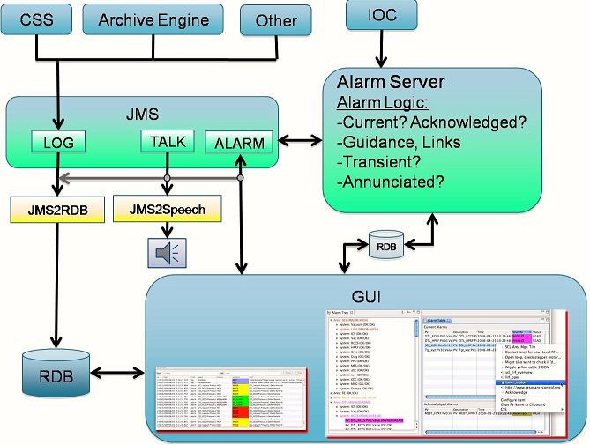
Architecture
Notes:
Technically, the alarm system consists of several elements:
IOC:
Control System IOCs provide the Alarm Trigger PVs which indicate alarm conditions.
Alarm Server
The Alarm Server receives alarms from IOCs via Channel Access and sends alarm messages to a JMS Server. It also receives the acknowledgements from Alarm System GUIs. Most of the alarm logic is performed by the alarm server.
It includes a Relational Database. It stores the alarm configuration as well as the current state of all alarms.
The configuration includes information for the Alarm Server (what PVs to monitor, whether to latch or annunciate alarms) as well as the Alarm Client GUI (user guidance on an alarm, related display links). The Alarm Server also updates the current alarm state of each PV in the RDB.
While the RDB is good for storing this type of information, it is technically unsuited for triggering GUI updates in response to alarm changes. The GUI would have to poll the RDB at a high rate to learn about alarm state changes. Instead, a more suitable Java Message System (JMS) is used to communicate alarm system changes.
JMS Server:
The JMS Server is the message bus that allows the Alarm Server, GUI, JMS2Speech to communicate.
Alarm System GUI:
The Alarm System GUI, basically a table and tree view of current alarms in CSS, allows users to view current alarms, acknowledge them, invoke operator displays related to the alarm, browse the alarm history, or change the alarm configuration.
Annunciator - JMS2Speech:
The Annunciator included in the CSS alarm GUI or an alternate stand-alone JMS2Speech tool is used to annunciate new alarms. Whenever a PV's severity changed to a higher severity, the PV's description will be annunciated once.
JMS2RDB:
This tool can write all JMS traffic to a Relational Database (RDB), allowing analysis of the most frequent alarms, reconstruction of the time line of a specific alarm, and more.

Slide 14
The Alarm Perspective
A set of views related to alarm management
Alarm tree
Alarm table
Message history
Alarm related preferences

Slide 15
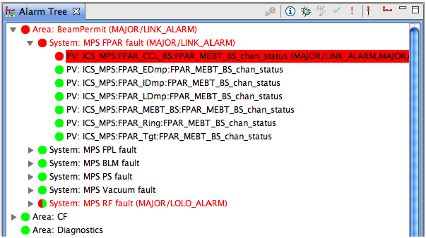
Alarm Tree
Hierarchical view
Sync with RDB configuration on the Alarm Server

Slide 16
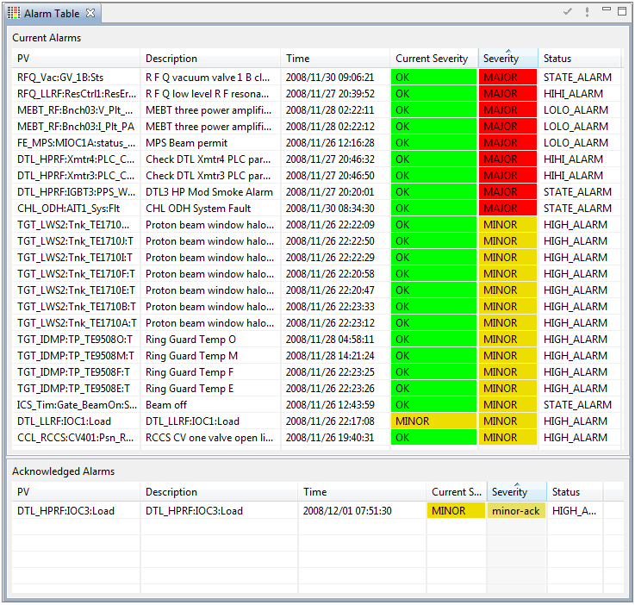
Alarm Table

Slide 17
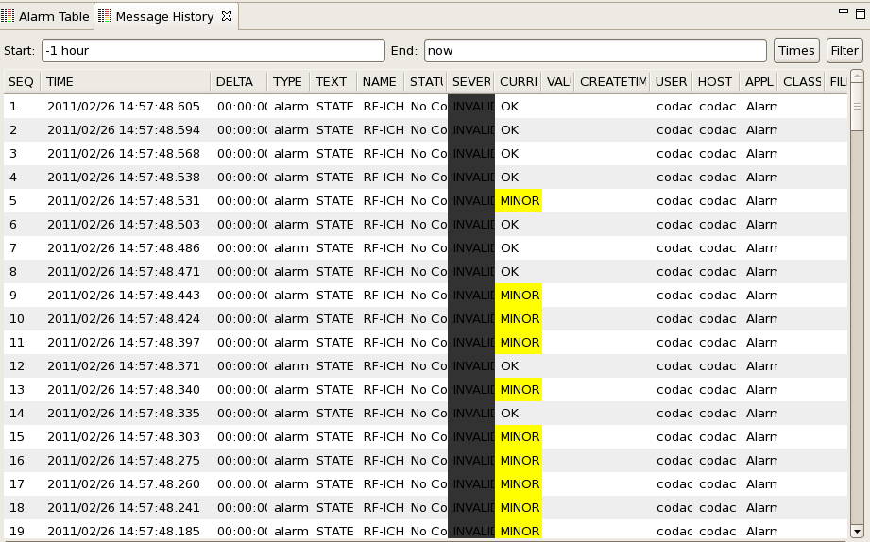
Message history

Slide 18
Conclusion
Alarms are meant for situations that require the operator
Conditions and severities configured in EPICS database
Two basic types of alarms – Latching and Non-Latching
BEAST tool is more than just a GUI

