Slide 1
European Spallation Source
Archiving Service
Ricardo Fernandes
European Spallation Source ERIC
2019/02/14

Slide 2
Archiving Service
Outline
Context
Archiver Appliance
How to archive PVs (and who does what)
Ways to retrieve archived data
Next steps (future)

Slide 3
Archiving Service
Context
Thousands of devices (e.g. PLCs, detectors) performing specific functions and deployed all over the place at ESS (i.e. machine and end-station instruments)
Around 1 000 EPICS input/output controllers (IOCs) to control devices
Around 1.5 millions of process variables (PVs) generated by IOCs
Many aspects of controls (e.g. calibration, diagnostics) rely on historical values of PVs
We need a service to store (i.e. archive) historical values of PVs!

Slide 4
Archiving Service
Available technologies (or the zoo :)
Channel Archiver by LANL (https://epics.anl.gov/docs/GSWE/starttools/channelarchiver.htm)
BEAUTY by ORNL (http://cs-studio.sourceforge.net/docbook/ch11.html)
EPICS Data Archiver by the University of Chicago (https://github.com/newville/epicsarchiver)
Archiver Appliance by SLAC, BNL and MSU (https://slacmshankar.github.io/epicsarchiver_docs)
…
Archiver Appliance as the chosen technology to implement a proper archiving service at ESS!

Slide 5
Archiving Service
(Some) reasons for choosing Archiver Appliance
Open-source and actively used/maintained by several major organizations
Able to archive around 25% of PVs at ESS (i.e. ~ 375 000 PVs) at different rates/sizes
Able to scale storage capacity according to the needs
Able to retrieve stored data in a performant way using a multitude of programming languages/software packages
Able to implement different storage policies based on the “age” of data

Slide 6
Archiving Service
What is the Archiver Appliance (technically) and how it works (in a high-level)
Consumer layer
…
Java application (runs on a Tomcat server)
Has a web-based graphical interface
Uses Google Protocol Buffers for persistency
Exposes stored data through web services
Returns stored data in multiple formats (e.g. CSV)
Client #1
Client #2
Client #3
Client #X
Web services
(i.e. HTTP protocol)
Archiving
Service
Workload balancer/dispatcher
Archiver Appliance #1
Archiver Appliance #2
…
Archiver Appliance #X
Channel Access protocol
(i.e. TCP/IP connection)
Control layer
…
IOC #1
IOC #2
IOC #3
IOC #X

Slide 7
Archiving Service
(Possible) storage policies
Short term storage (STS): 10 days (~ 8.4 GB/day)
Medium term storage (MTS): 100 days (20% of short term storage = 1.68 GB/day)
Long term storage (LTS): “forever” (20% of medium term storage = 0.34 GB/day)

Slide 8
Archiving Service
Current landscape (or where it is being used)
Four Archiver Appliances currently deployed (two for production and two for testing purposes)
Around 16 500 PVs being archived in production:
  Cryogenics: 15 500 PVs
  Cooling & Water system: 411 PVs
  ODH Detection: 365 PVs
  Vacuum: 169 PVs

Slide 9
Archiving Service
How to archive PVs (and who does what)
Integrated Control System (ICS) Division
Integration
Group
Software
Group
Infrastructure Group
Chopper
Group
PVs list
PVs list
Vacuum
Group
Pushes PVs list
Maintains AA code-base
PVs list
Manages AA
network and servers
…
Configures AA to archive PVs list
Archiver Appliance
Git
Diagnostics
Group

Slide 10
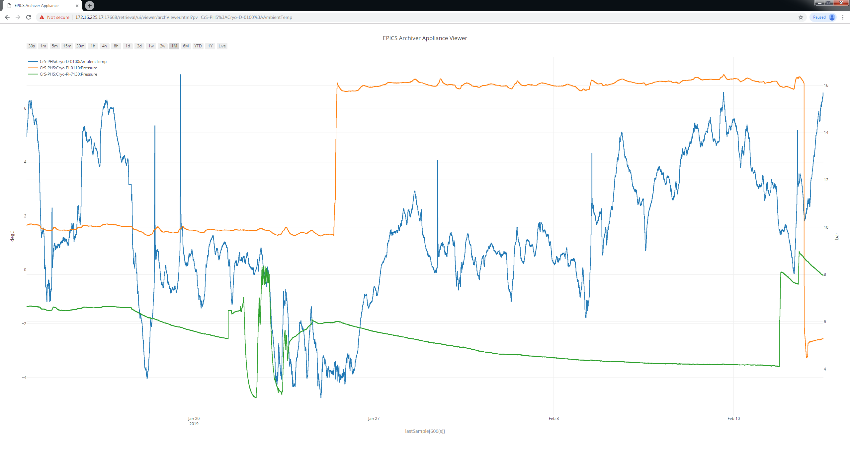
Archiving Service
Ways to retrieve data (graphically through Archiver Appliance web interface)

Slide 11
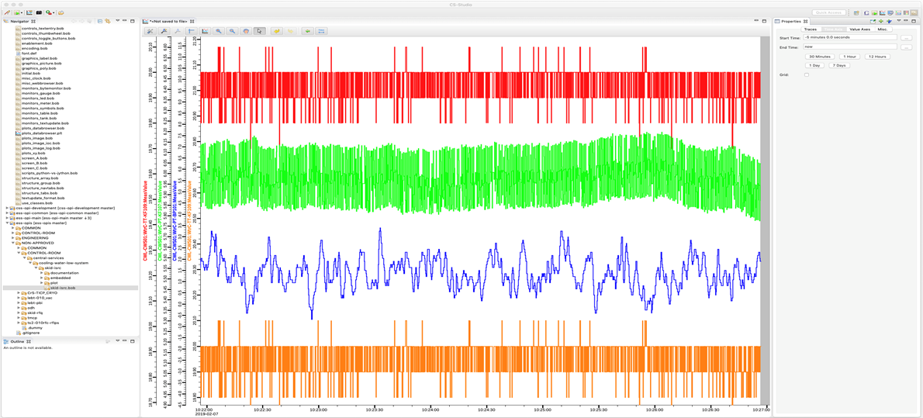
Archiving Service
Ways to retrieve data (graphically through CS-Studio Data Browser)

Slide 12








Archiving Service
Ways to retrieve data (programmatically)
Using popular programming languages such as C, C++, Python, Java and R
Jupiter Notebook
MATLAB
EXCEL

Slide 13
Archiving Service
Next steps (future)
Define archiving template EXCEL files per device type (to ease configuration of AA to archive PVs)
Understand how the Archiver Appliance scales
Clarify storages policies (i.e. STS, MTS and LTS) at ESS
Implement proper infrastructure to support the Archiving Service (based on clear storage policies)

Slide 14
Archiving Service
QUESTIONS?

