Slide 1
NICOS, Kafka and the DMSC
Matt Clarke
ESS DMSC

Slide 2
Introduction
DMSC
Beamline Controls Group
Apache Kafka
Streaming architecture
NICOS
Progress

Slide 3
BCG
?

Slide 4
Introduction
DMSC
Beamline Controls Group
Apache Kafka
Streaming architecture
NICOS
Progress

Slide 5
Data Management And Software Centre
Data reduction analysis and modelling
Data systems and technologies
Experiment Control and Data Curation

Slide 6
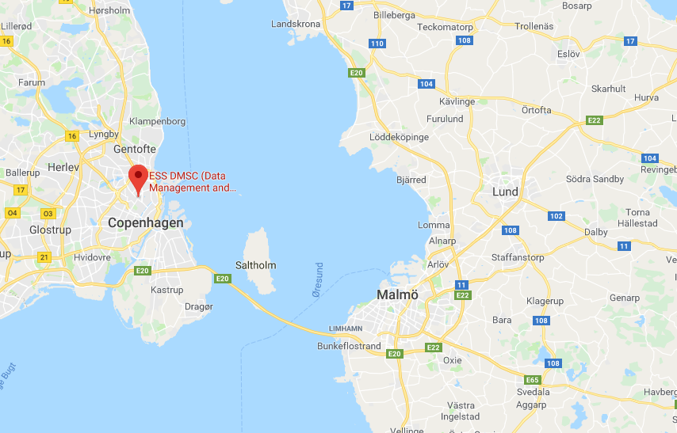
Where we are

Slide 7
Introduction
DMSC
Beamline Controls Group Team
Apache Kafka
Streaming architecture
NICOS
Progress

Slide 8
The BCT
“A team/project across the science directorate to deliver controls scope to instruments in collaboration with the integrated control systems division”
https://confluence.esss.lu.se/display/BCG
https://jira.esss.lu.se/secure/RapidBoard.jspa?projectKey=BCG

Slide 9
At the instrument level
DMSC
EPICS
ICS
Choppers
Motion Control
Sample Environment
Detectors

Slide 10
Introduction
DMSC
Beamline Controls Team
Apache Kafka
Streaming architecture
NICOS
Progress

Slide 11
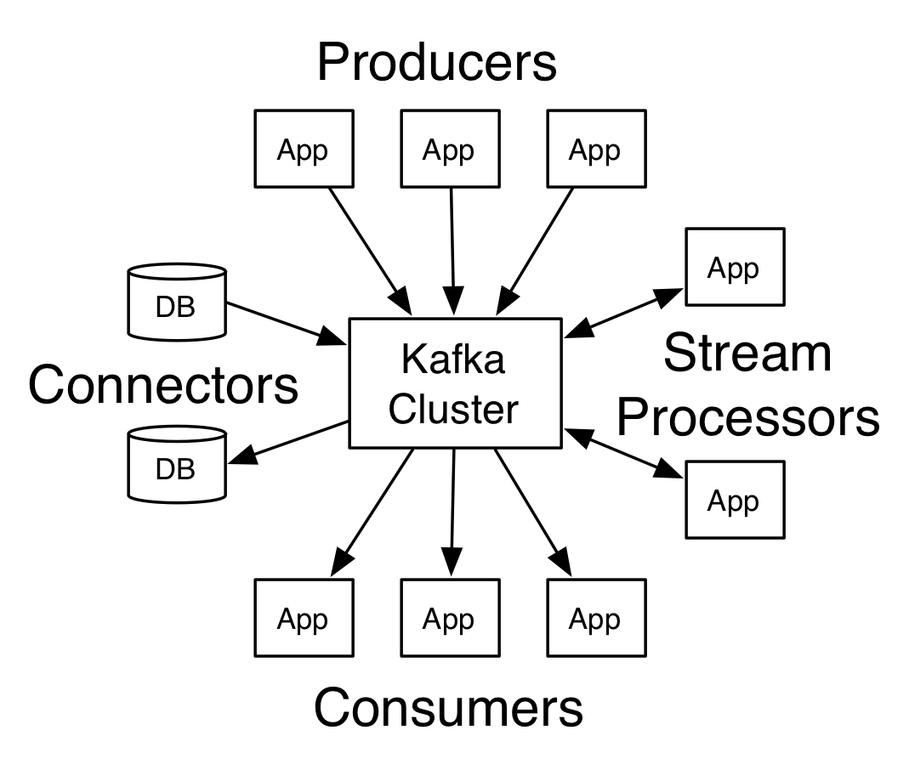
Apache Kafka
“used for building real-time data pipelines and streaming apps.
It is horizontally scalable, fault-tolerant and wicked fast”

Slide 12
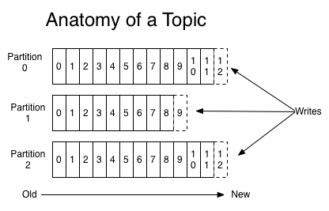
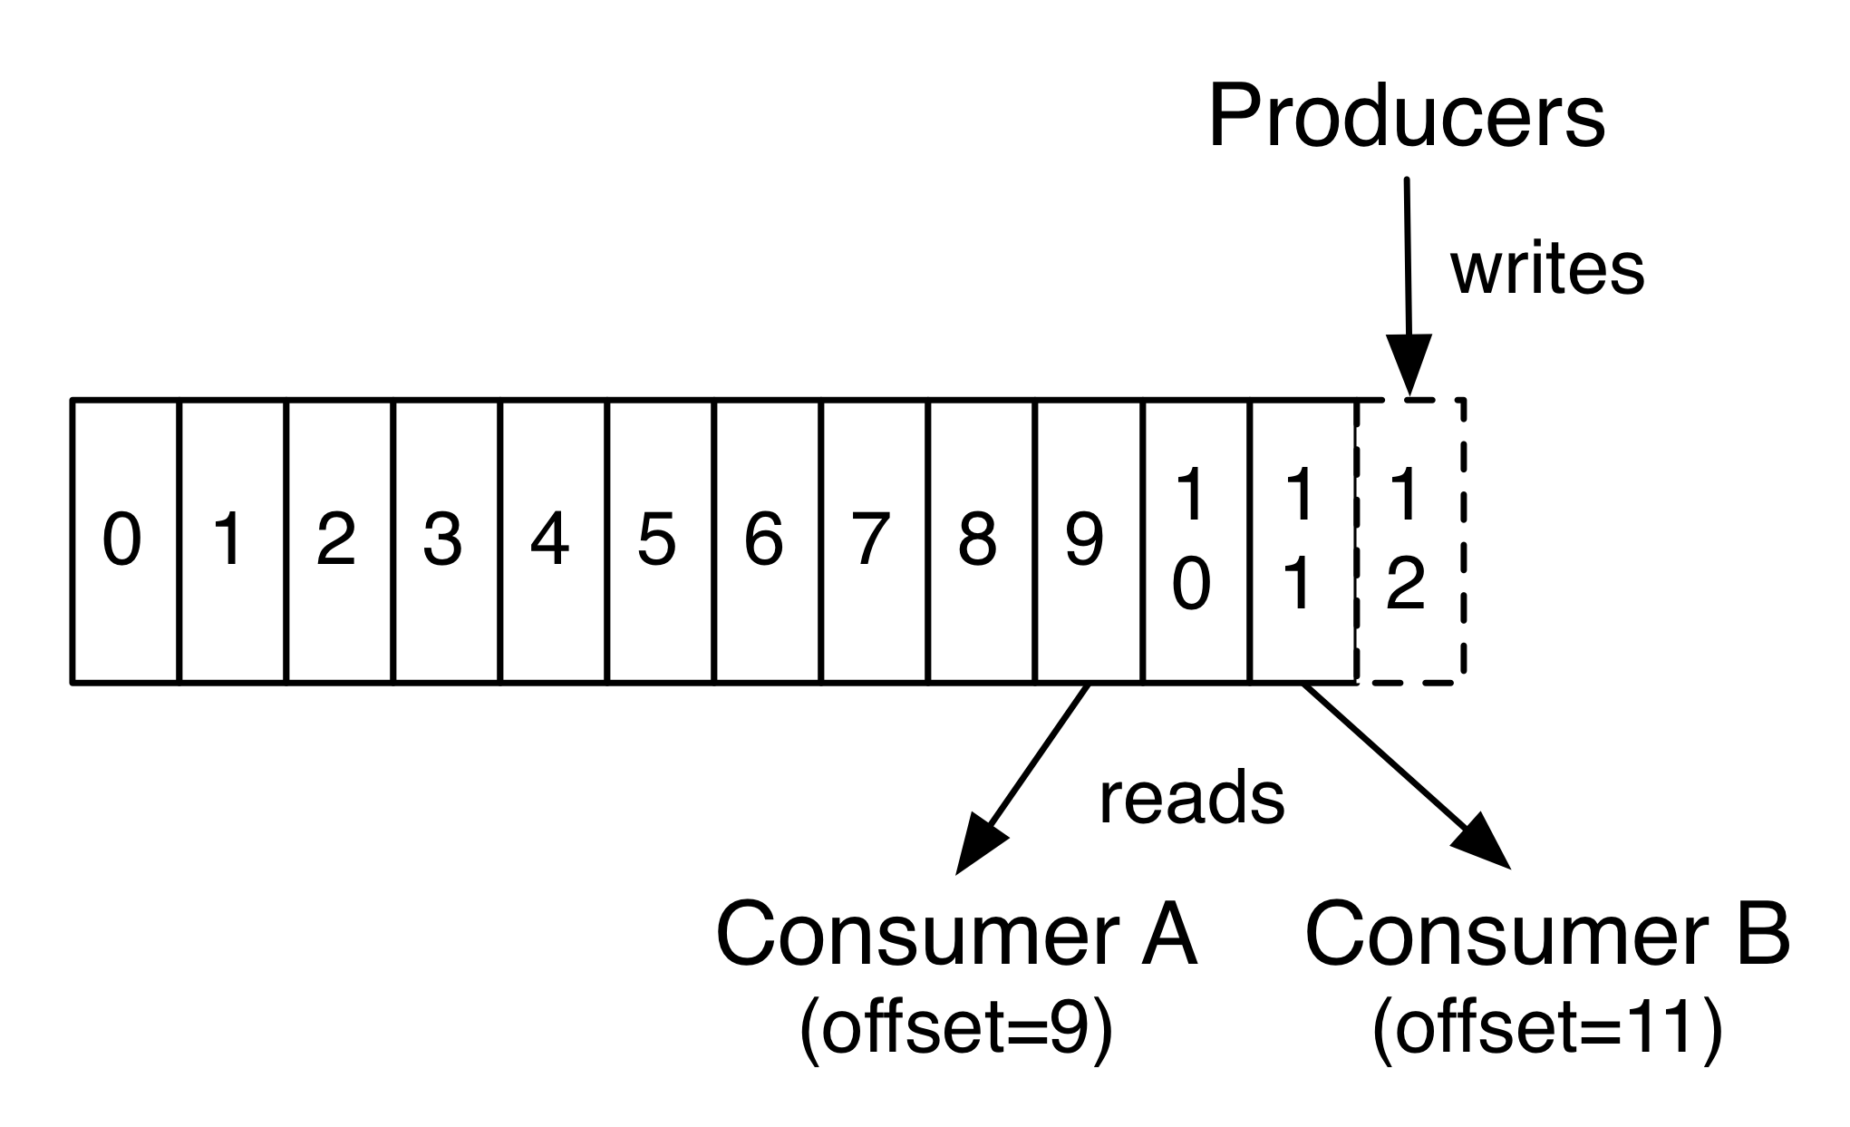
Apache Kafka
Topics
Uniquely named
Offset controlled by the consumer
Divided into partitions

Slide 13
Introduction
DMSC
Beamline Controls Team
Apache Kafka
Streaming architecture
NICOS
Progress

Slide 14
Streaming architecture

Slide 15
Streaming architecture

Slide 16
Introduction
DMSC
Beamline Controls Team
Apache Kafka
Streaming architecture
NICOS
Progress

Slide 17
NICOS
Developed by FRM II in Munich
Written in Python
Client server architecture
Consists of a number of services:
Poller
Cache
Daemon
…

Slide 18
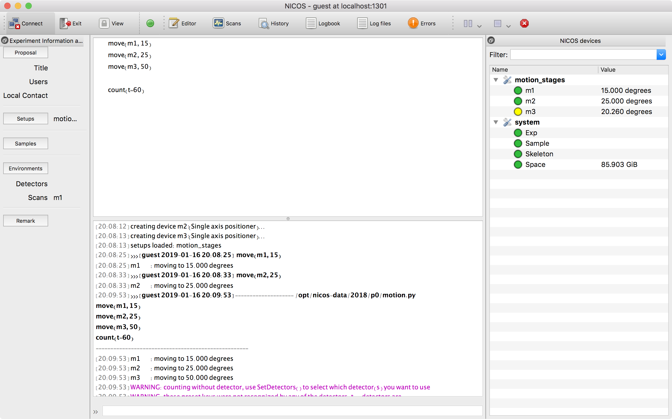
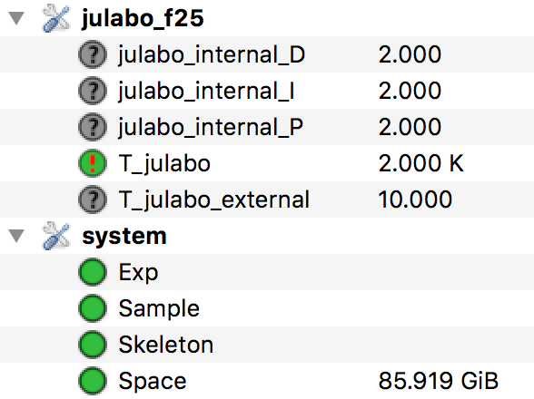
NICOS user interface

Slide 19
NICOS
Changes for the ESS:
EPICS support added ✓
Forwarder and Filewriter Kafka support ✓
Kafka-based cache [in progress]
User experience review [planned]
Equipment integrated
Motion controllers
Temperature controllers
Event receivers
Choppers (partial)
…

Slide 20
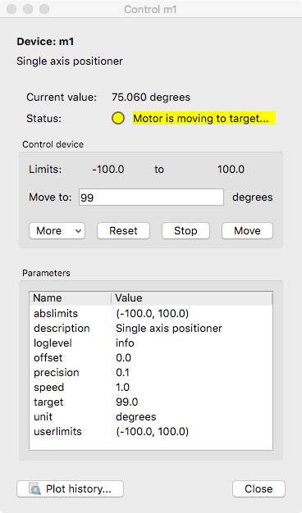
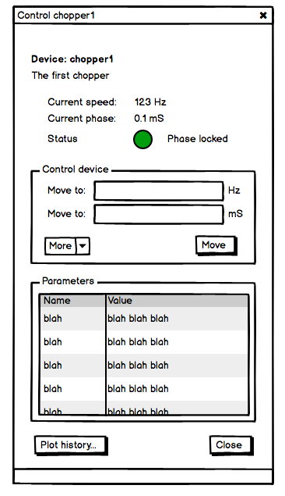
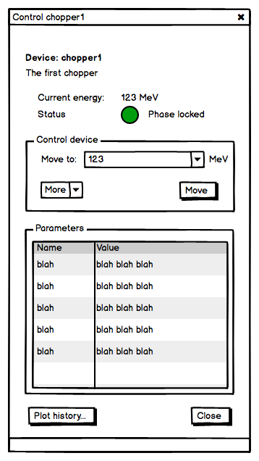
What might the user see?

Slide 21
What might the user see?

Slide 22
Introduction
DMSC
Beamline Controls Team
Apache Kafka
Streaming architecture
NICOS
Progress

Slide 23
Proof of concept

Slide 24
For real

Slide 25
AMOR @ SINQ
AMOR are running the full system for a few days each cycle
SINQ see NICOS as a possible replacement for SICS
Mostly positive
Successfully created NeXus files
Some empty files produced
Misconfigured Kafka
Incompatible NeXus files
Scientist likes NICOS
Some UI dislikes

Slide 26
An early Xmas present from HZB
ESS Timing System
SAMPLE
DELAY LINE
DETECTOR
Forwarder
Kafka
EFU
Filewriter

Slide 27
Conclusions
Kafka was chosen as the basis of our data streaming architecture
NICOS was chosen for our top-level control system
Aimed at the ESS, but ISIS and SINQ are also benefitting
Both successfully used on real beamlines
Still work to be done!

