Slide 1
Instruments Shielding Project Installation
Antonio Bianchi
NSS Installation Coordinator
NSS Project Division
www.europeanspallationsource.se
24th January 2019

Slide 2
General view
Neutron Shielding installation starts: June 2020 (E02.1)
Skanska handover - end of June 2020 (green area)
E02.2 access Q2 2021
D03 access Q1 2021
D01 access Q2 2021

Slide 3
External storage area (E buildings)
E01
E02
(The area might be useful for temporary storage of shielding blocks)
NSS storage area from Q4 2019
1000 m2 (on-going discussion with Skanska)

Slide 4
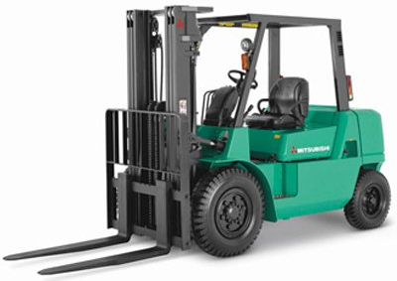
Site route (E02 access)
Site road under construction and suitable vehicles
Unloading zone
Final road - 8% steep up to the E02 gate
E02 gate
3.6 x 3.8 m
E02

Slide 5
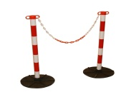
Logistic and storage area into E01 and E02.1
Reference time
September 2019 – April 2021
Guide Shielding length 44.000 mm
Any of the represented areas will require a physical delimitation
Entrance for shielding blocks (during construction)
E02 gate
Storage areas will be allocated to minimize dependencies between different installation teams
Note: beamline piles can reduce the available area

Slide 6
E01- E02 logistic details
E01
Heimdal side
E01
NMX side
5 m
Pedestrian way
Ladder
2.7 m
6 m
Office
BIFROST
44 m
E02.1
E01 - Heimdal side
Building pillars
Temp separ.
wall
Magic
C SPEC
E02.2
E02.1/E02.2
Free corridor 5 m

Slide 7
Logistic alternatives to manage heavy components
A) Ramp slope reduction by ramp’s extension
A
Temporary steel structure to reduce the ramp-slope up to 16.5 % (3 m extension), to be suitable with electric forklift
B
B) E02 slab extension
Temporary steel platform in order to extend the E02 slab under the E01 crane hook-print

Slide 8
Transport and lift neutron shielding in the hall (E01/E02)
Mitsubishi FD 80N
Load capacity | 8 tonne
Overall width | 2.390 mm
Gradeability | 31%
Power source | Diesel
Linde E80
Load capacity | 8 tonne
Overall width | 2.180 mm
Gradeability | 16%
Power source | Battery
Steel gantry crane (E02 building)
Load capacity | 10 tonne
Overall width | 6.300 mm
Overall high | 6.500 mm

Slide 9
ESS Installation Support functions
ESS RESPONSIBLE
CONTACT PERSON
MANDATORY/OPTIONAL
FREE/COST
PROVIDER NAME
NSS PROJECT ORGANIZATION
(NSS INSTALLATION COORDINATOR)
Construction site
Ladders/Temporary steel structure
Laydown Areas
Crane drivers
Logistics/Transport
Heavy lifting
Concrete drilling
Survey/Alignment
General support (washing/cleaning)
PPE and general consumables
Safety fencing
Workers cabin
Waste management

Slide 10
Shielding installation-sequence in E02.1 (and ESS/In Kind resources)
E02 - Step 1
E02- Step 2
Forklift
Concrete shielding block (roof)
3,00 x 1,00 x 0,30 m
(2.5 tons)
1(ESS)
2 (In-Kind)
3 (In-Kind)
4 (ESS)
Shielding wall
Gantry crane
Ramps between E01 and E02
Installation in the beamline gallery requires specific caution, due to there are not permanent cranes available
22 %

Slide 11
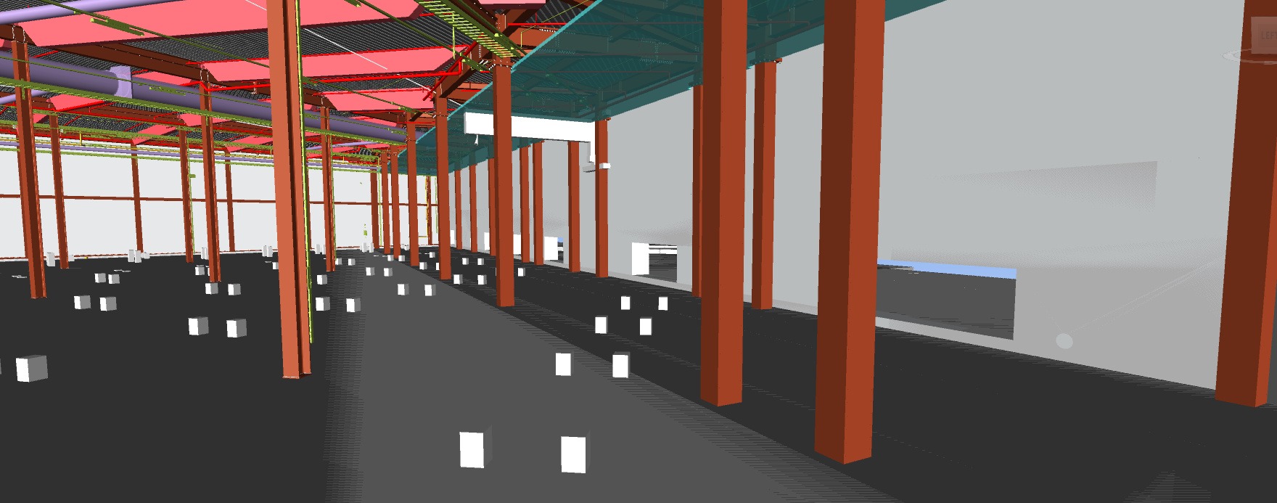
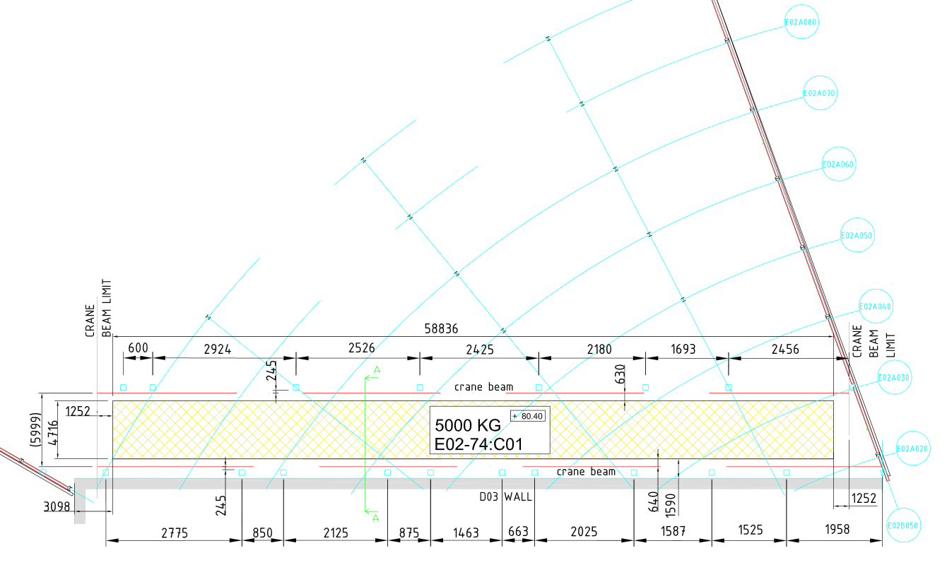
E02.2 building crane (5 tonne capacity)
D03/E02 separation wall
Crane hook-print 5 tonne
Delivered from CF in the E02.2 hall (May 2021)
View n. 1
3D View n. 1
E02.2
Crane hook-print
D03/E02 separation wall
D03

Slide 12
Installation – resource estimation (labour)
 | Installation of neutron shielding resource estimation (labour) |  | C Spec, Bifrost, Magic, Heimdal |  | Dream, Vespa |  | Odin
 |  | N. | Work Hours | Total W.H. | Work Hours | Total W.H. | Work Hours | Total W.H.
 | Description |  | h | h | h | h | h | h
a | Skilled Technical personnel (Mech. Tech.) | 2 | 360 | 720 | 320 | 640 | 240 | 480
b | Crane Operator, incl. tempor. cranes | 1 | 360 | 360 | 320 | 320 | 240 | 240
c | Rigger | 1 | 360 | 360 | 320 | 320 | 240 | 240
d | Surveyor | 2 | 64 | 128 | 48 | 96 | 32 | 64
e | Handling/Forklift Operator | 1 | 360 | 360 | 320 | 320 | 240 | 240
f | Support Technical staff | 1 | 64 | 64 | 48 | 48 | 32 | 32
 |  |  |  | 1992 |  | 1744 |  | 1296
 | FTE (per instrument) |  |  | 1.11 |  | 0.97 |  | 0.72
 | Total amount (labour) |  |  | 4.43 |  | 1.94 |  | 0.72
 | Assumptions
1 | Beamline shielding 15m /week (9 weeks in total) - C Spec, Bifrost, Magic, Heimdal
2 | Beamline shielding 15m /week (4 weeks in total) - Dream, Vespa
3 | Beamline shielding 15m /week (2 weeks in total) - Odin
4 | Surveying - 2 technicians plus tracker marking limit of shielding and cave footprint - marking before drilling - 64 hours in total west sector
5 | Experimental cave not included
6 | Management/supervisor

Slide 13
Questions

