Slide 1
Operations, Risks & Hazards
Preliminary Design Review of the Common Shielding Project
Lund, 24th of January 2019
Ken Andersen, Neutron Instruments Division, European Spallation Source ERIC

Slide 2
Operational aspects
Guide interface
  Pre-align sections on 4m girders
  Alignment access only needed at ends
Utilities routing
  Feed out of shielding as close to source as possible
  Pumps, control racks, etc. are all outside shielding
Realignment access with single lift
  Provides visual and mechanical access from sides
  Maintenance access requires more lifts
Personnel Safety Systems
  Allow access when proton beam is off
  Access with proton beam on & with shutter closed needs update to requirement #12
  Interlocked doors may be possible, but needs discussion and will cost
Cranes needed for access inside shielding
  Fixed cranes in D01/D03
  Gantry cranes in E02: requires dismantling and reassembly to move

Slide 3
Risk Analysis
Performance Risk | P | I | Mitigation
Shielding is insufficient | 4 | 1 | Install additional shielding on outside, or create unrestricted controlled areas
Shielding is incompatible with guide design | 2 | 4 | Effective communication with instrument teams
Cost Risk | P | I | Mitigation
Cost estimates are insufficient | 2 | 3 | Maximise standardisation Modular design which is well-adapted to serial production Ensure quick buy-in from instrument teams Effective competitive tendering
Shielding is insufficient | 4 | 3 | Neutronics calculations during detailed design phase, allowing some re-design if required
PSS turns out to be complex and expensive | 2 | 3 | Effective communication with PSS team

Slide 4
Risk Analysis
Schedule Risk | P | I | Mitigation
Shielding may not be installed in time | 1 | 4 | Ensure quick buy-in from instruments Apply lessons learnt from bunker procurement
Operability Risk | P | I | Mitigation
Shielding is insufficient | 4 | 2 | Neutronics calculations during detailed design phase, allowing some re-design if required
PSS is inconveniently slow and cumbersome | 2 | 3 | Effective communication with PSS team
Frequent access is needed to chopper pits | 2 | 3 | Allocate gantry cranes to particular chopper pits
Shielding is incompatible with guide design | 2 | 3 | Effective communication with instrument teams

Slide 5
Preliminary Hazard Analysis
Event | P | I | Mitigation
Fire inside shielding | H3 | 2 | Avoid use of flammable material for shielding
Personnel hit by falling blocks during transport | H3 | 5 | Effective design of lifting points Safe use of cranes
Personnel hit by falling blocks during earthquake | H4 | 5 | If necessary, fix blocks to floor
Personnel falling off shielding | H3 | 3 | Install safety barriers where necessary
Personnel falling into chopper pit | H3 | 3 | Use safety harness when working at height
Personnel receiving dose > 3 uSv/hour outside shielding | H2 | 2 | Radiation survey after maintenance work
Personnel receiving dose > 3 uSv/hour inside shielding | H2 | 2 | Radiation survey before maintenance work
Personnel contaminated by activated dust | H2 | 3 | Seal all exposed concrete surfaces Internal surfaces covered by steel and/or borated cement

Slide 6
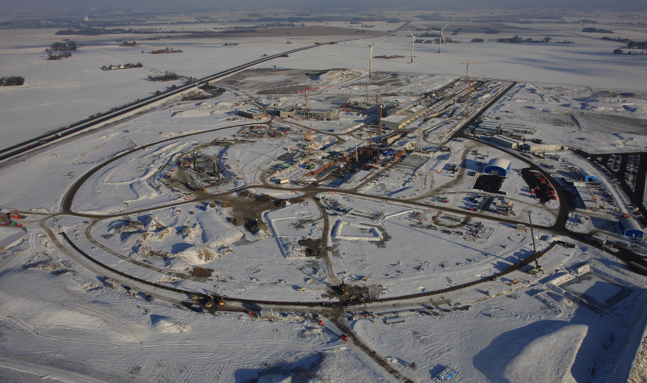
Thank you!
ESS site 2016
5th June 2015

