Slide 1
ESS Project Status
Roland Garoby
ESS Technical Director
11 February 2019

Slide 2
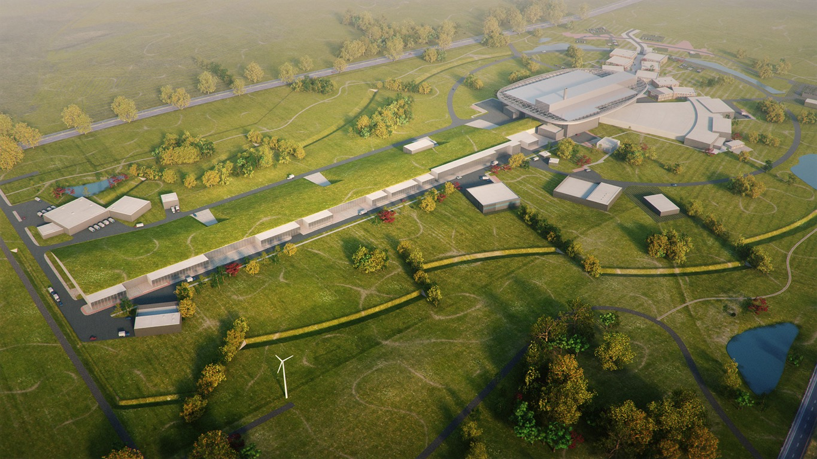
ESS basic design principle
Target Station:
- He-gas cooled rotating W-target (5MW ultimate beam power)
- 42 beam ports
High Power Accelerator:
Ultimate energy: 2 GeV
Rep. Rate: 14 Hz
Current: 62.5 mA
15 Instruments in Construction budget
>30 times higher performance than at ILL
Ion Source

Slide 3
Some numbers
1843 M€ construction cost
5 MW world’s most powerful particle accelerator
15 experimental stations
20 ⨉ more sensitive on average than today’s best
800 experiments per year
2023 first science for users
15 European member and observer nations

Slide 4
ESS in-kind partners make ESS possible
Aarhus University
Atomki - Institute for Nuclear Research
Agder University
Bergen University
CEA Saclay, Paris
Centre for Energy Research, Budapest
Centre for Nuclear Research, Poland, (NCBJ)
CERN, Geneva
CNR, Rome
CNRS Orsay, Paris
Cockcroft Institute, Daresbury
DESY, Hamburg
Delft University of Technology
Edinburgh University
Elettra – Sincrotrone Trieste
ESS Bilbao
Forschungszentrum Jülich
Helmholtz-Zentrum Geesthacht
Huddersfield Univesrity
IFJ PAN, Krakow
INFN, Catania
INFN, Legnaro
INFN, Milan
Institute for Energy Research (IFE)
Institut Laue-Langevin (ILL)
Rutherford-Appleton Laboratory, Oxford (ISIS)
Kopenhagen University
Laboratoire Léon Brilouin (LLB)
Lodz University of Technology
Lund University
Nuclear Physics Institute of the ASCR
Oslo University
Paul Sherrer Institute
Roskilde University
Tallinn Technical Univesrsity
Technical University of Chemnitz
Technical University of Denmark
Technical University Munich
Science and Technology Facilities Council
(STFC)
University of Tartu
Uppsala University
WIGNER Research Centre for Physics
Wroclaw Univesrity of technology
Warsaw University of Technology
Zurich University of Applied Sciences
(ZHAW)

Slide 5
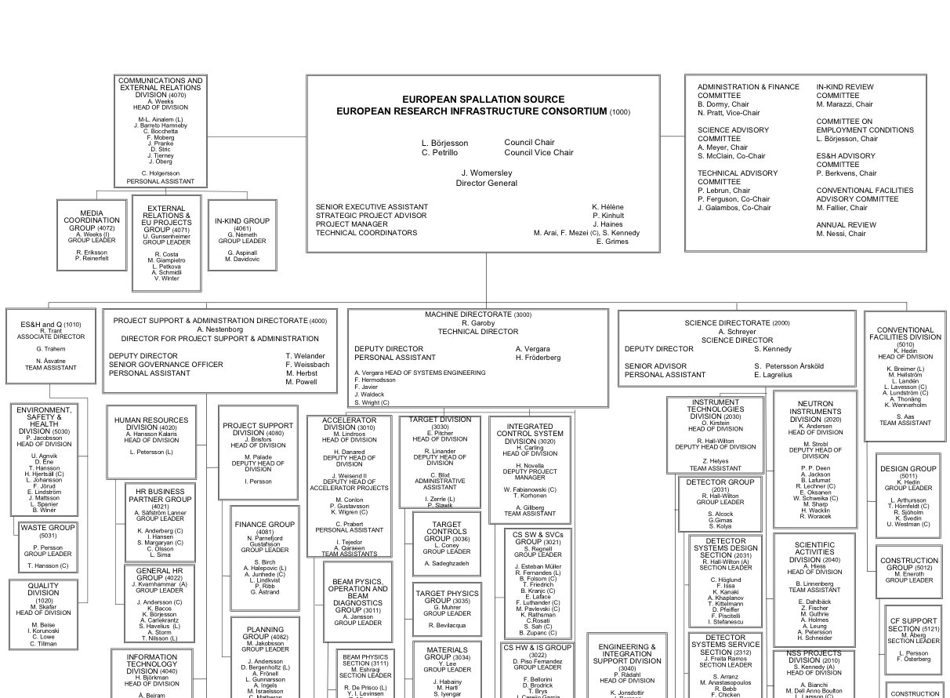


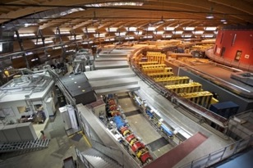
Organisation and People
471
Employees
48
Citizenships
~ 100
Collaborating Institutions
Notes:
Updated September 2017

Slide 6
Baseline schedule has been revised in 2018
2018
2019
2020
2021
2022
2023
2024
2025
BOT
ES
SOUP
EOC
Warm LINAC Commissioning Steps
1.3 GeV Capability Installed
Accelerator + ICS
Hi-Beta Install
Beam on Dump
(570 MeV)
Accel RBOT
Start of Neutron Source
Accelerator Schedule Float
CF + Target + NSS (Bunker+TBL) + ICS
Bunker and Test Beam Line RBOT
Access for Monolith Installation
Target RBOT
15th Instrument Complete (Ready for hot commissioning)
NSS Instruments + ICS
BOT - Beam on Target
ES - Early Science
SOUP - Start of User Programme
EOC - End of Construction project
RXXX - Ready for XXX
Instrument Hall Access for Start of Installation
Start beam commissioning for 1st Instruments

Slide 7
Transition to Operations for Early Science is outlined
Updated description of “Early Operations of the ESS Neutron Instruments and first scientific results” (ESS-0420218) distinguishing successive stages.
(NSS requirement: 2.86 ms beam pulses on a 14 Hz time grid)
Up to Beam on Target (-July 2022)
  570 MeV Beam on Dump after “Accelerator Ready for Beam On Target” (mid-2021)
  Beam commissioning at increasing energy interlaced with installation of High Beta cryomodules
ESS initial stages (July 2022-December 2023)
  Early Days: BOT to (BOT + 3 months) (July – September 2022). Req.: 1x8 h /week with > 100 kW
  Consolidation Days: The next 3 months: (BOT + 3 months) to (BOT + 6 months) (October – December 2022). Req.: 6x8 h/week with >100 kW.
  Performance Assessment days: (BOT + 6 months) to (BOT + 9 months) (January – March 2023). Req.: 12x8 h/week with >100 kW.
  First Performance Demonstration Days: (BOT + 9 months) to (BOT + 12 months) (April – June 2023). Req.: 33x8 h/2 weeks with >300 kW.
  Ramp up and Early Science: (BOT + 12 months) to (BOT + 18 months) (July – December 2023). Req.: 33x8 h/2 weeks with up to 500 kW.
Start of the ESS User programme SOUP (2024-2027)
500 kW beam power with 80 % availability.

Slide 8
ESS Project 57% complete
Project execution is on track with new schedule
  Based on “Early Finish” dates
  Beam on Target (BOT) in mid-2022, Start of User Programme (SOUP) at end of 2023
Ramping down building design work, ramping up installation
Ion source/LEBT and helium cryo-plants are being brought on-line
Safety readiness review SRR1 completed - permission to start trial operation of ion source granted
Staff moved to ESS site, work started on permanent laboratory and office complex
Collaboration Agreement finally signed with Germany
Full 2019 budget request approved by Council

Slide 9
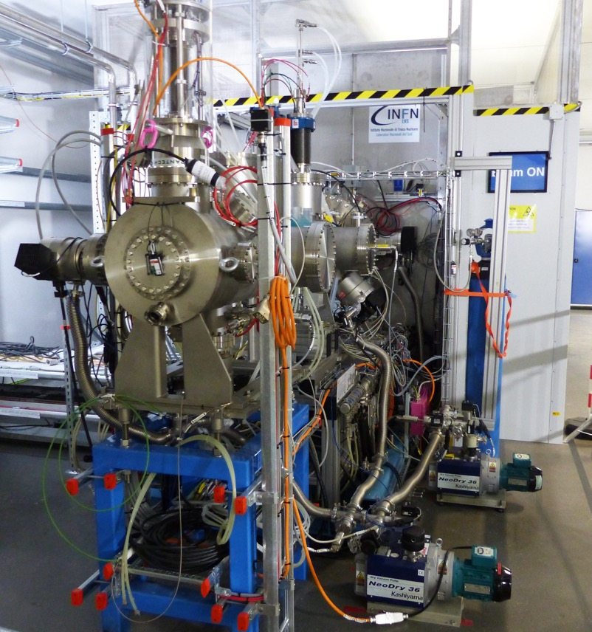
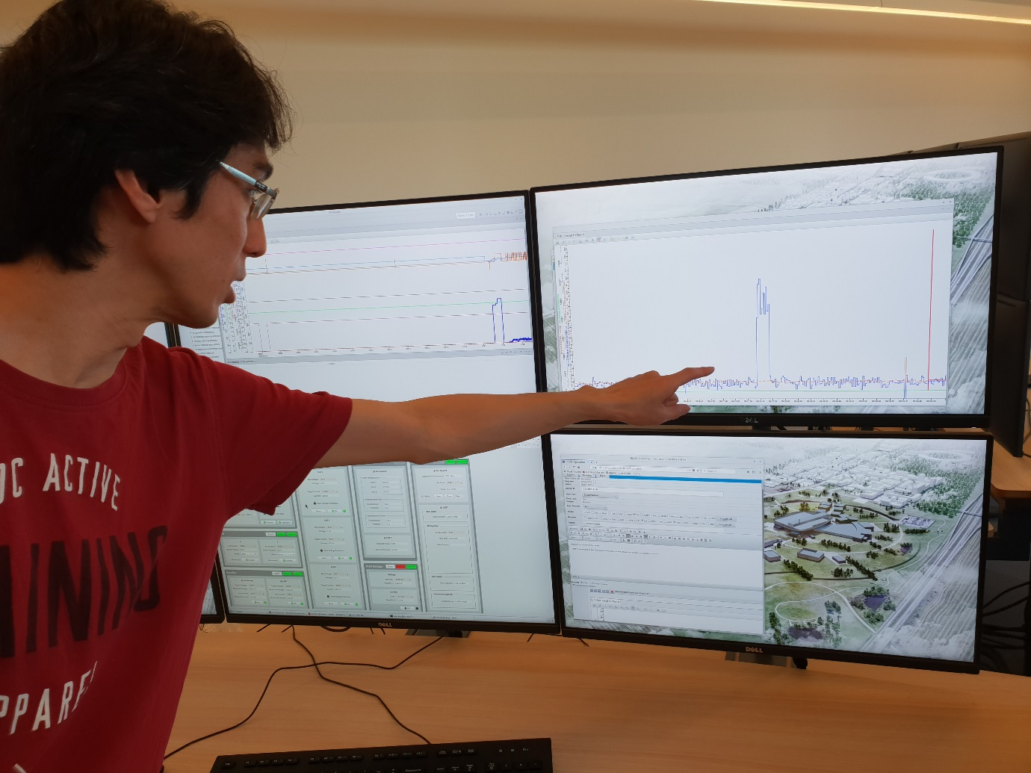
Ion source & LEBT are being commissioned
First beam: 19 Sept. 2018

Slide 10
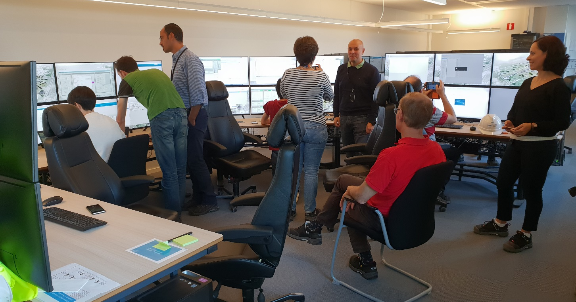
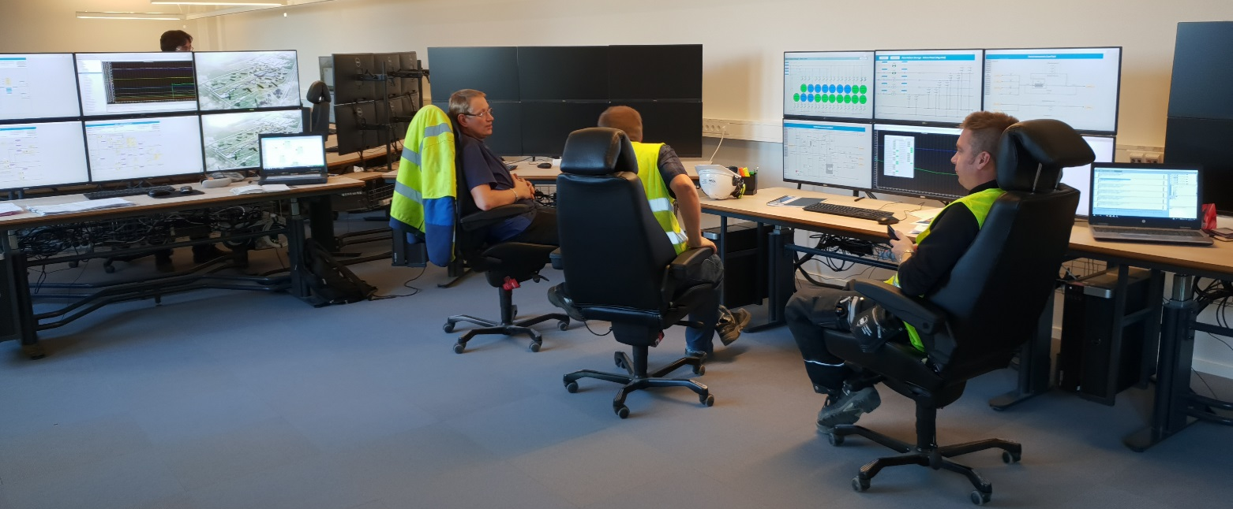
The temporary control room is operational
For commissioning the ion source…
…and the cryoplants.

Slide 11
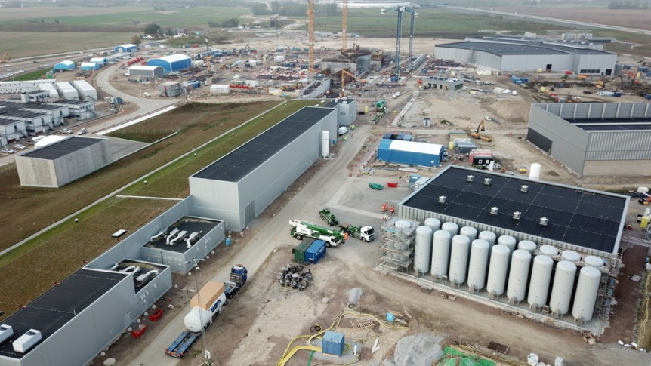
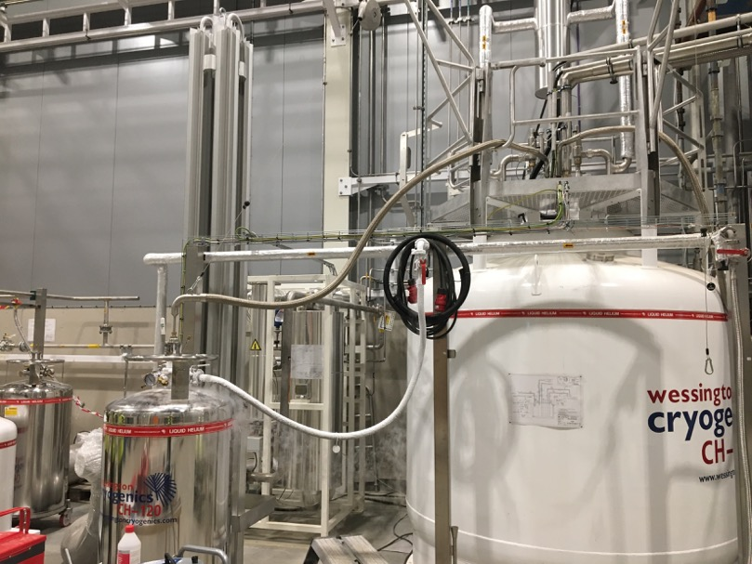
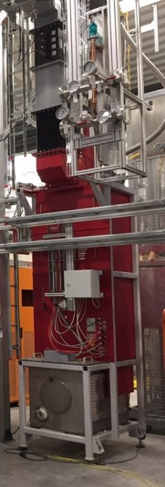
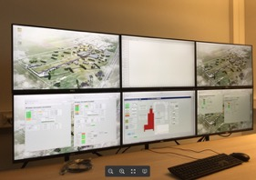
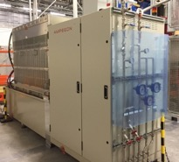
Infrastructure installation is in progress
Cryogenics plants installed and partly operational:
All large components of all cryoplants are on site.
Successful acceptance tests of liquefaction, refrigeration, internal purifier and Process Vacuum Pumps System. Final acceptance of plant completed.
Filling of liquid helium into mobile Dewars
TMCP cold box
delivered
All 19 PHS tanks ready and filled with helium
High power RF available in Test stand 2 (elliptical cavities cryomodule):
Modulator and klystron running
Bunker built
Licensing in preparation for cryomodule test
Accelerator Infrastructure project in progress:
10 496 meters of pipes, ~6000 welds, ~5000 valves
3000 m cable trays, > 700 km cables, 24 902 cables
6 central UPS-units
~800 control racks and 100-120 cooling units.

Slide 12
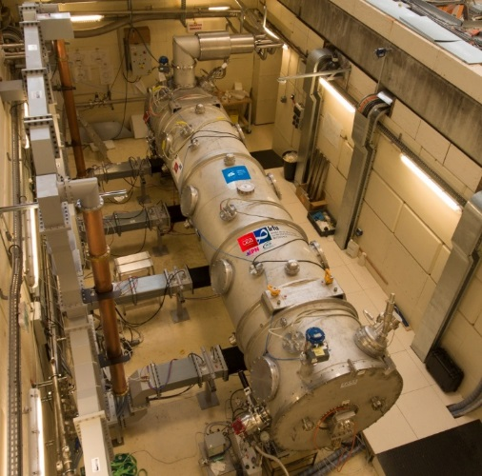
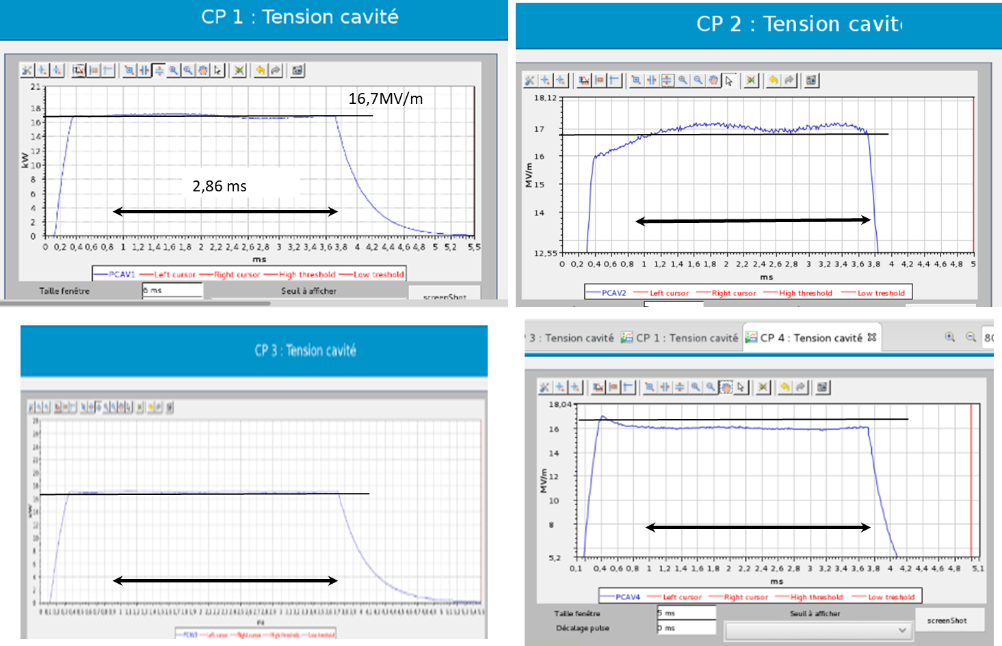
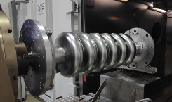
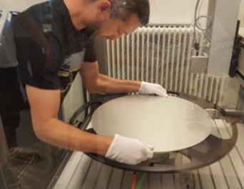
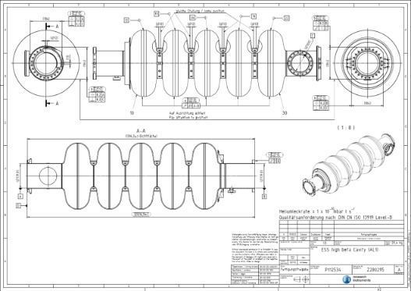
Work progresses actively at in-kind partners (1/2)
Cryomodules and elliptical cavities
  Development phase : Medium-β Cryomodules demonstrator tested, nominal gradient obtained in cavities (CEA-Saclay)
  Medium Beta cavities production (INFN- LASA)
    3 cavities welded
    2 cavities bulk BCP surface treatment done and annealing
RF voltage in
cavities 1-4
(Open loop &
Trapezoid pulse
on piezo tuner)
Performance of
reprocessed cavities
after coupler accident
in 2017
- High Beta cavities production (STFC – Daresbury)
  Niobium Material - Contract awarded in Oct17
  Final Nb batch delivery expected in Dec18
  Cavity Manufacture - Contract awarded in Jul18
Mail from P. Michelato (INFN) on 21/12/2018:
“…The first INFN-LASA medium beta cavity… reached
23.7 MV/m with a Q₀ of 7.9e9. At the ESS field of 16.7 MV/m,
the Q₀ is 1.7e10, well over the ESS requirements of 5e9.
The frequency at cold is 704.221 MHz with a Q_{t} of 3.6e11…”

Slide 13
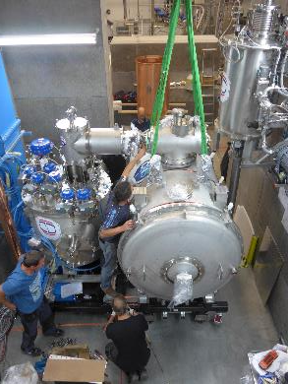
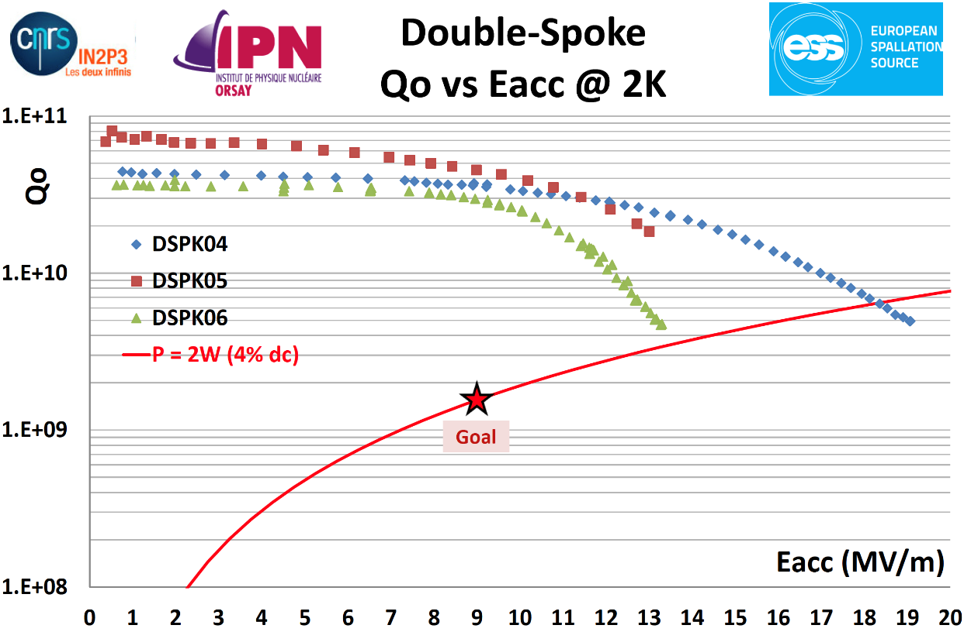
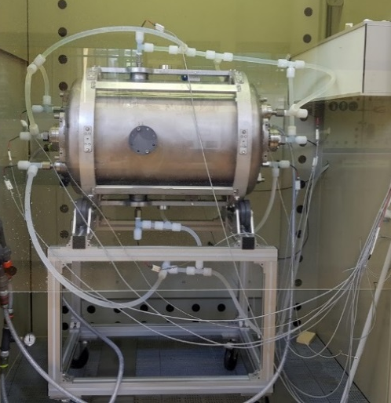
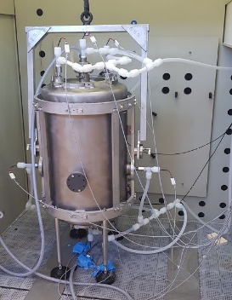
Work progresses actively at in-kind partners (2/2)
Cryomodules and spoke cavities
Prototype cryomodule delivered
at FREIA (Uppsala)
Start of test in February 2019
Assembly of the 1st series cryomodule will begin mid –March
Delivery at FREIA mid-May
3 series spoke cavities have been tested and exceed requirements

Slide 14
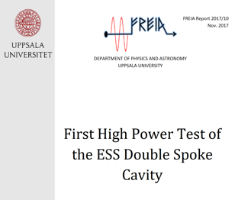
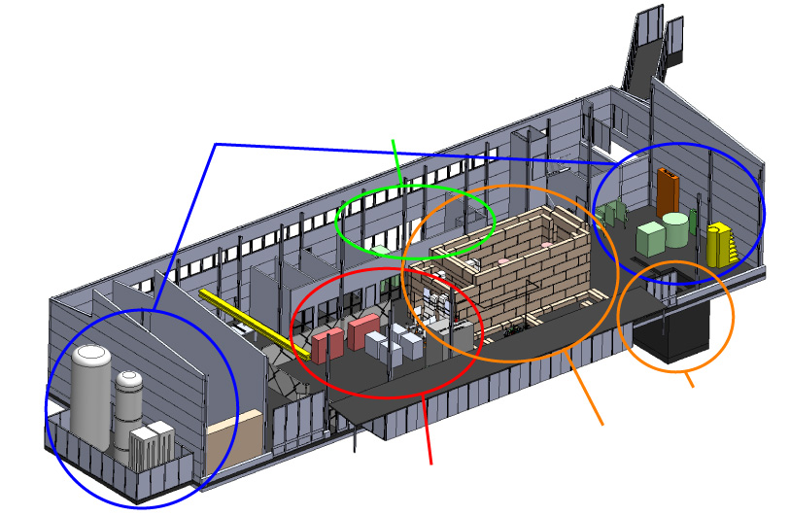
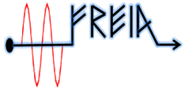
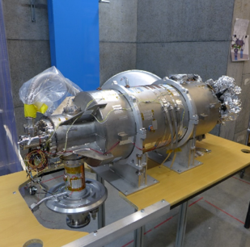
Test infrastructure is operational at partners’ premises
(e.g. FREIA in Uppsala)
Several Spoke prototypes tested in HNOSS
Successful validation test of high beta cavity assembly
Spoke prototype cryomodule received and being connected.
State-of-the-art Equipment
cryogenics
- liquid helium
- liquid nitrogen
control room
- equipment controls
- data acquisition
Romea in HNOSS
HB package at FREIA
vertical cryostat
3 bunkers
with test stands
horizontal cryostat
radio-frequency (RF) power sources

Slide 15
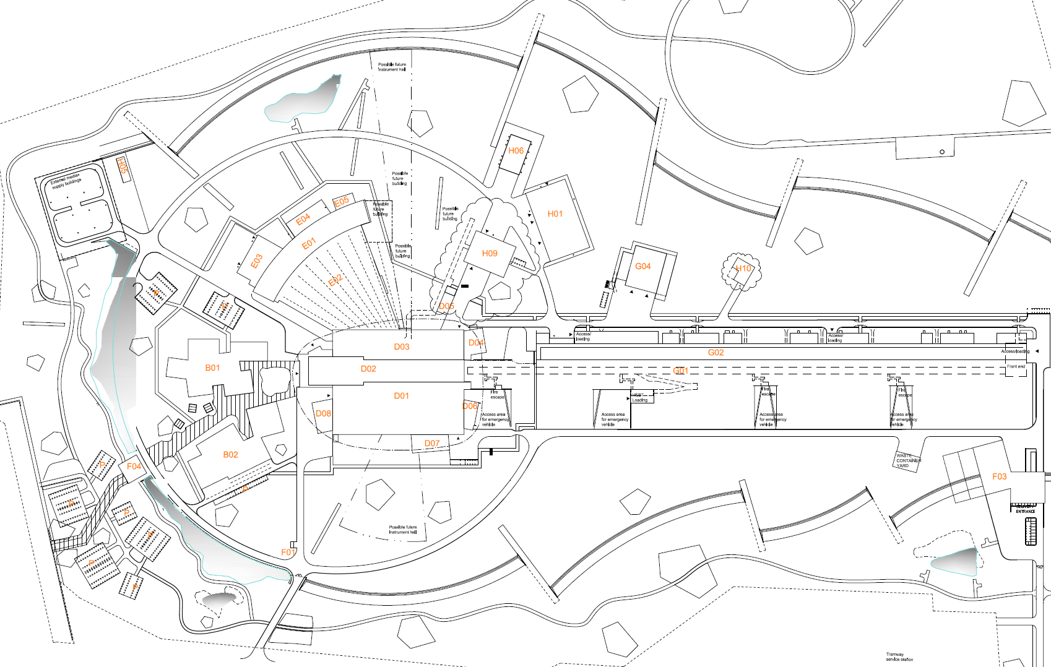
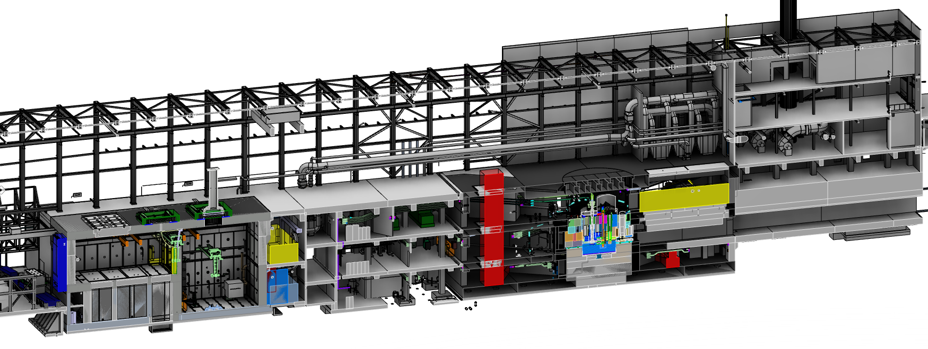
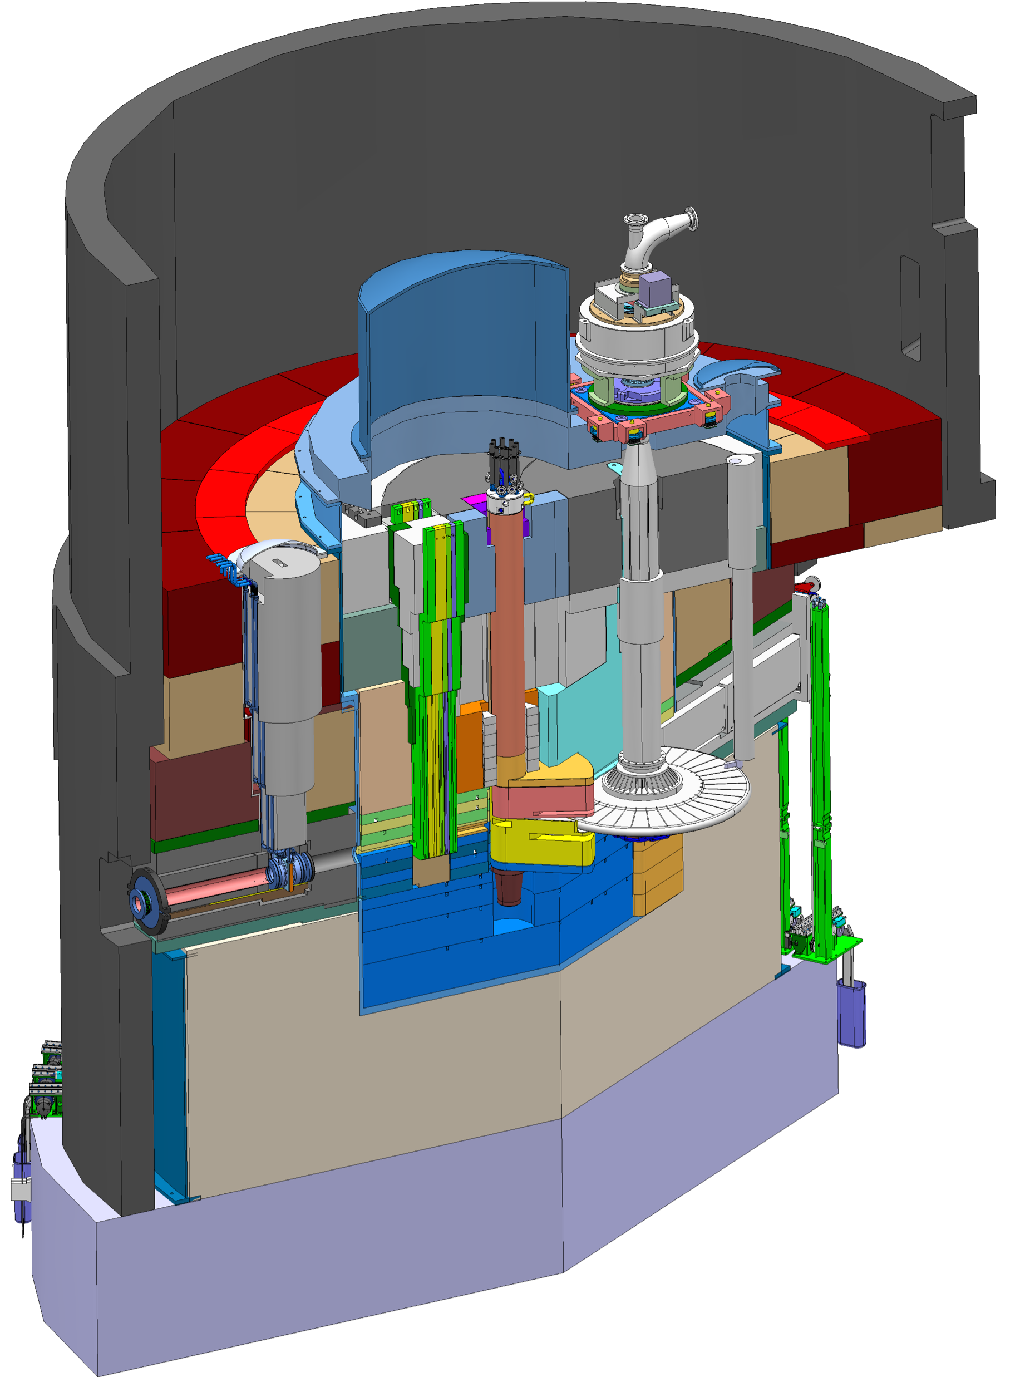
ESS Target and Target building
(41% complete)
Target Building
Utilities and cooling plant
Remote handling systems
High bay
22 m
130 m
Transport hall
37 m
Target Building
Moderator and reflector
proton beam instrumentation plug
monolith vessel
neutron beam extraction port
Target
monolith
Active cells
Utilities block
Beam expander hall
proton
beam
target wheel
target monitoring plug
Target Monolith
Rotating solid tungsten target (11 t, 23.3 rpm)
Moderators (LH₂ – 17 K and H₂O – 300 K)
Helium gas cooling of target (11 bar, 3 Kg/s)
Target Safety System
Diagnostics and instrumentation
proton
beam window

Slide 16

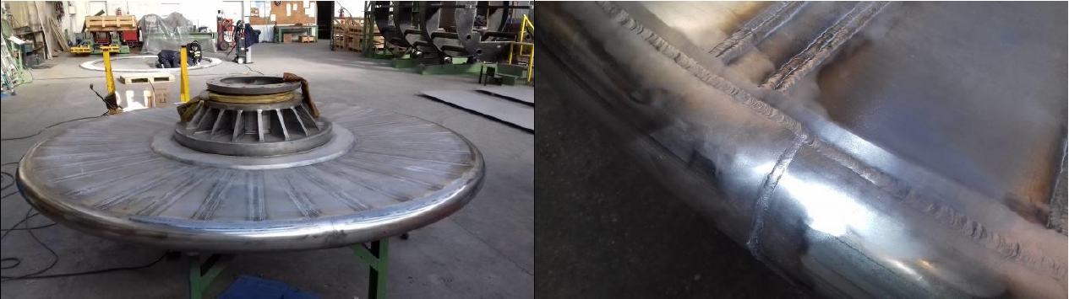
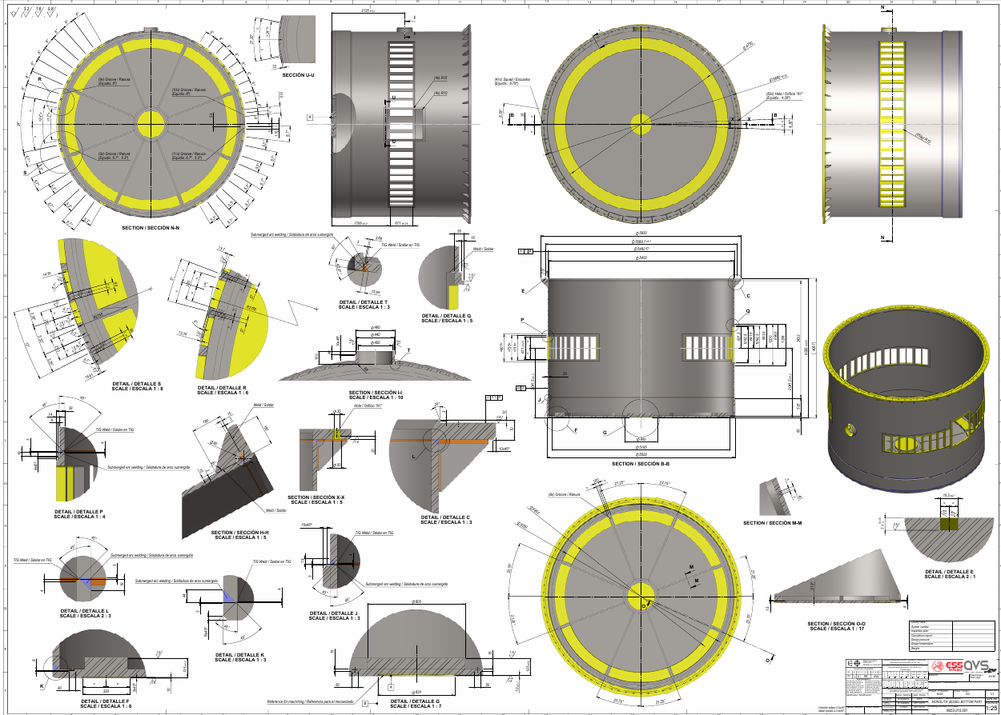
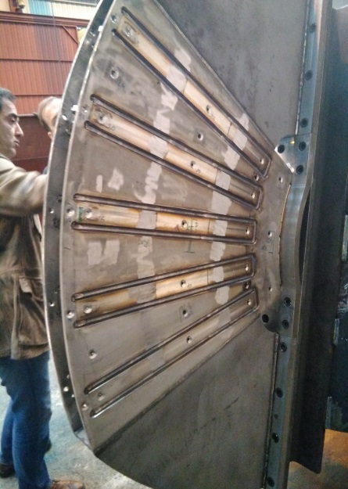
Work progresses actively at in-kind partners (1/2)
Target and its monolith vessel
1st prototype of target wheel suffered from deformation after welding
Contract for manufacturing of Target Monolith vessel awarded in June 2018
Problem solved on 3rd prototype last week

Slide 17
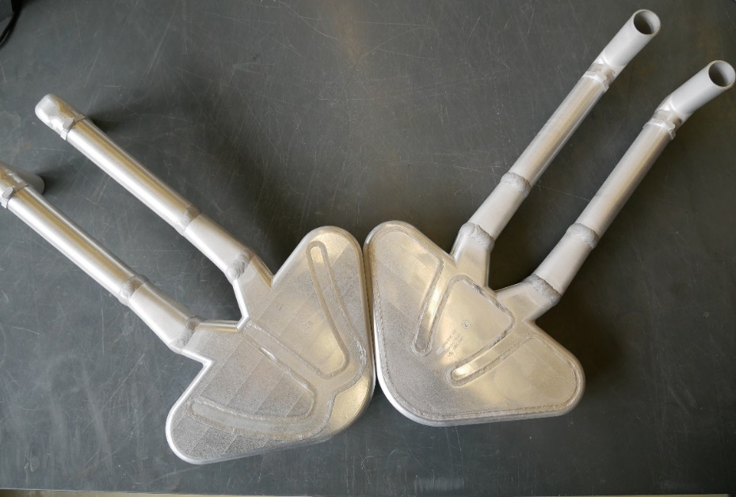
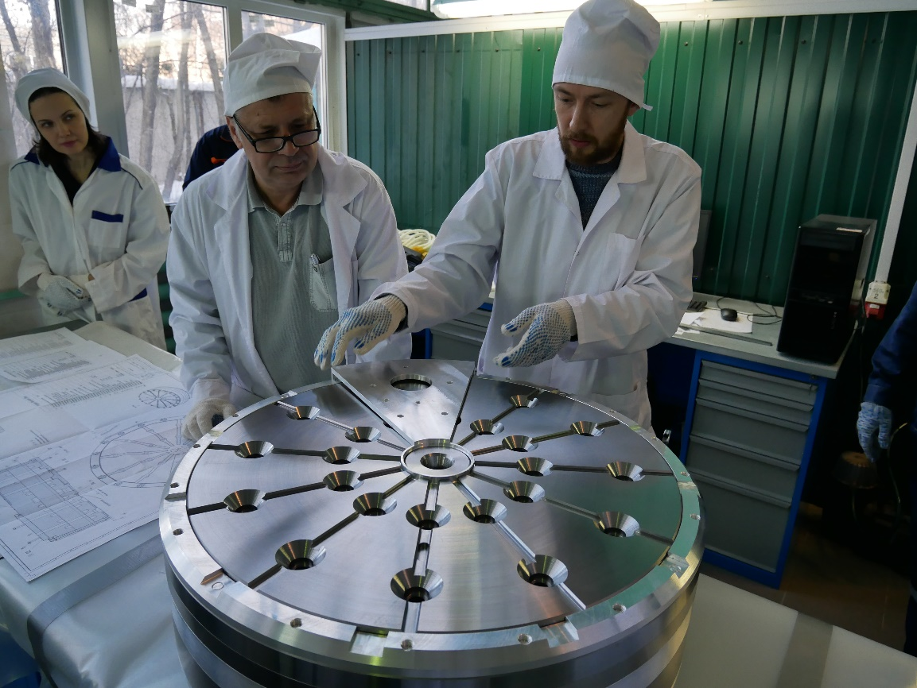
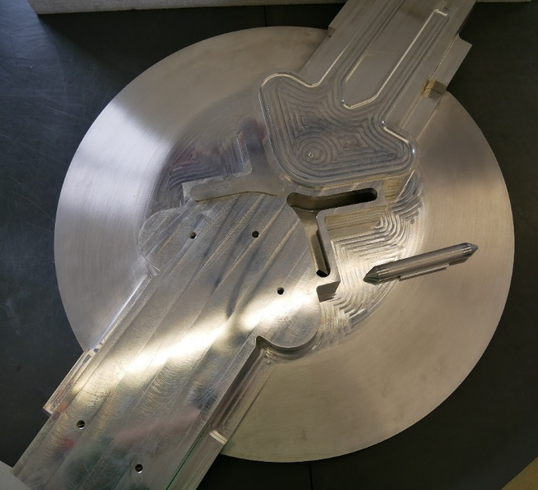
Work progresses actively at in-kind partners (2/2)
Moderators and reflectors
Cold moderators are built and tested (FAT).
Beryllium reflector built and tested (Acceptance test in Moscow)
Thermal moderators are being manufactured.

Slide 18
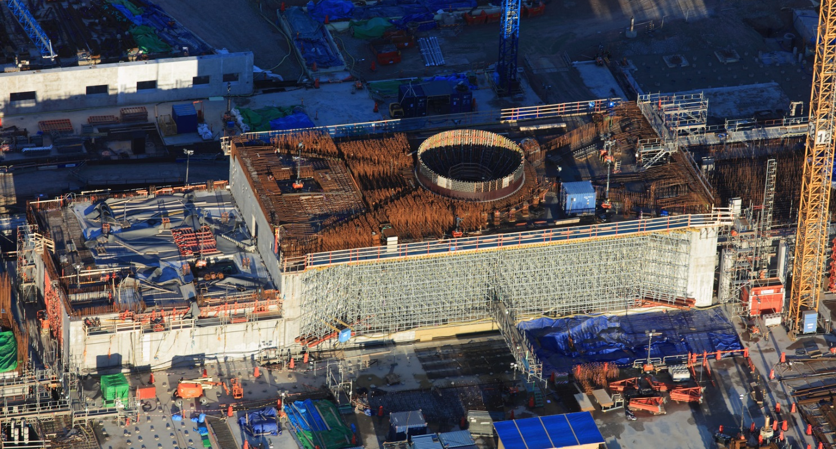
High bay slab will soon be cast

Slide 19
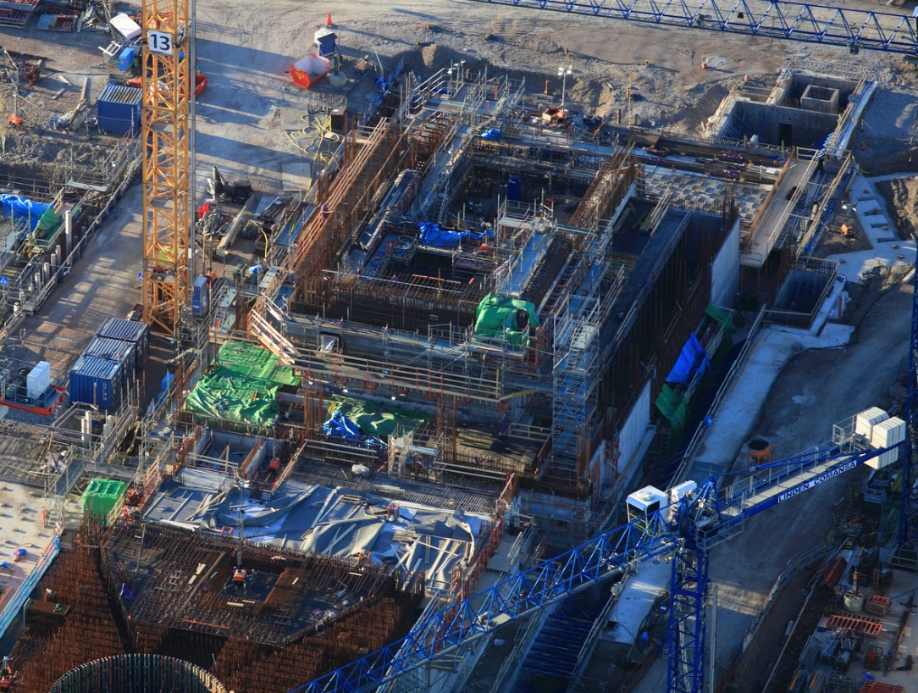
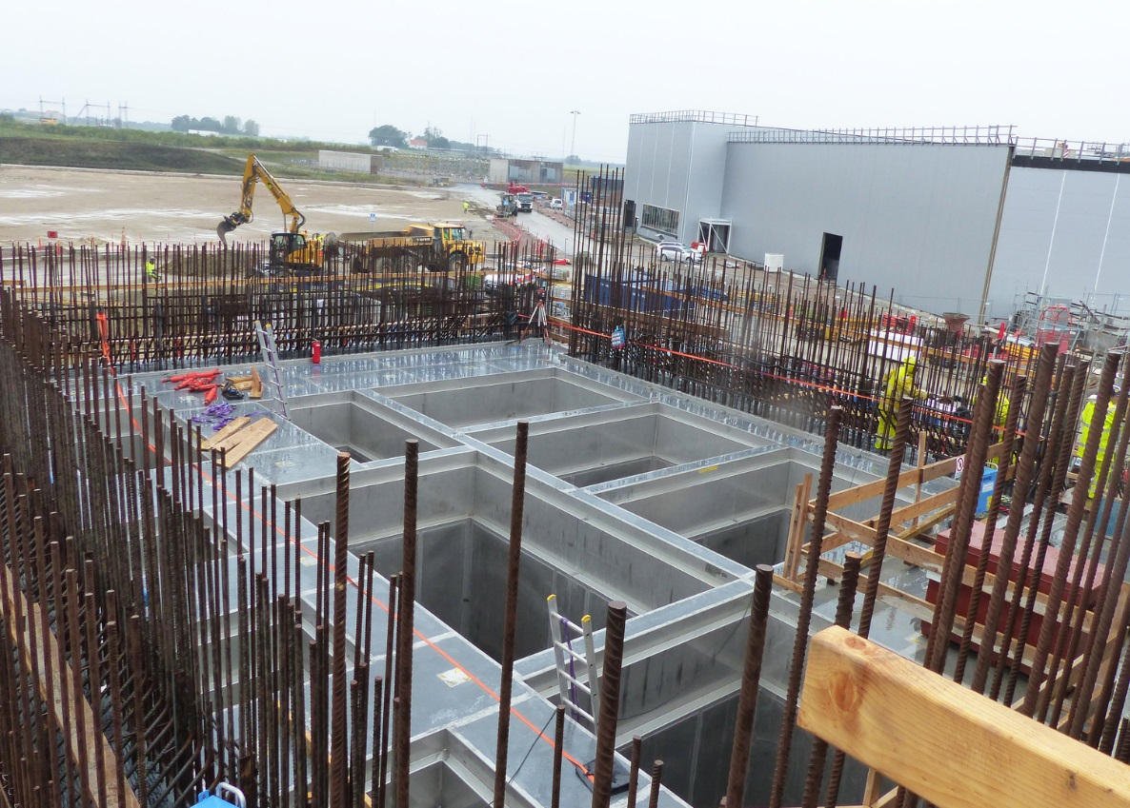
Construction of Active Cells is advancing
Aerial view of Active Cells
Storage pits in Active Cells

Slide 20
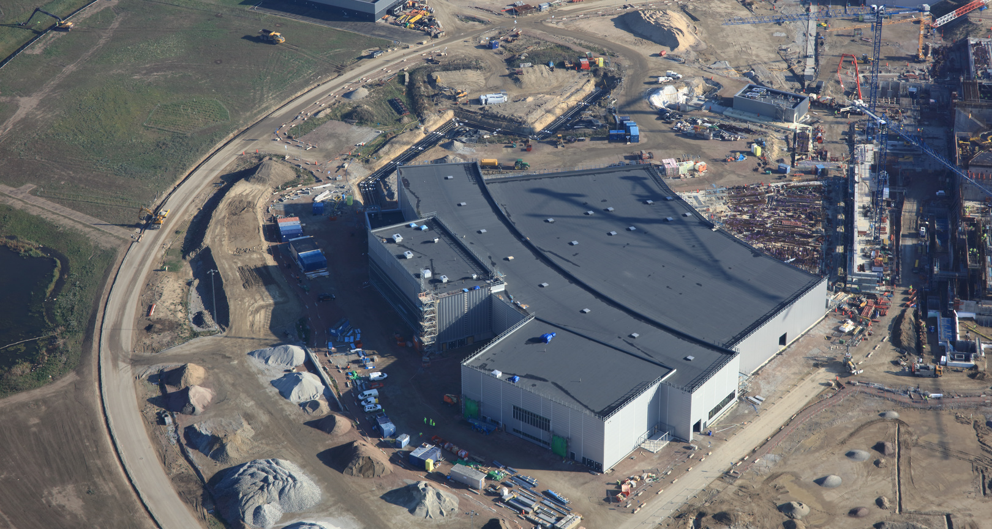
Construction of experimental hall E01 is well advanced

Slide 21
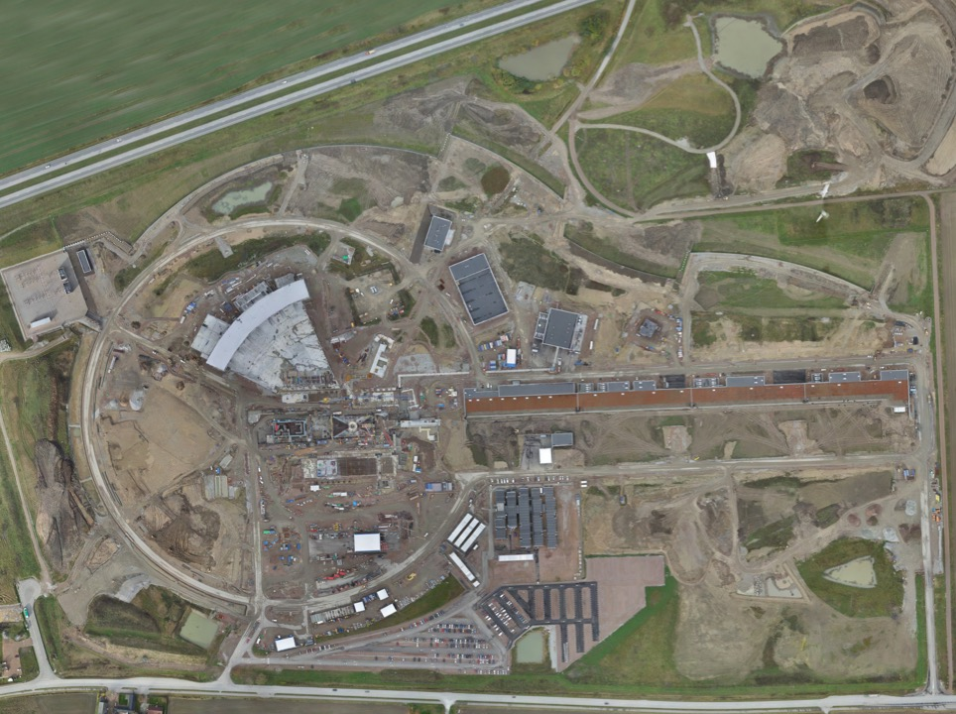
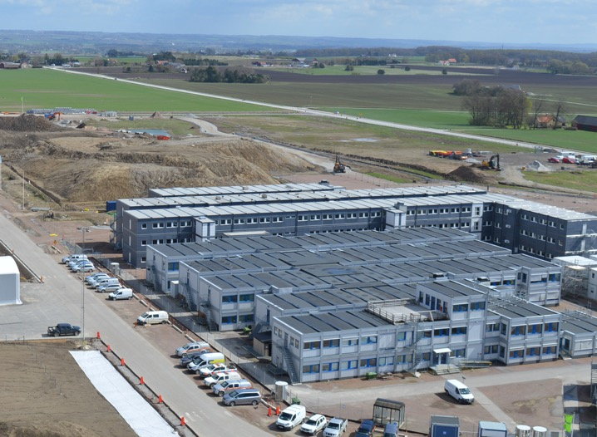
Moved to site in summer 2018 -
Moving to permanent office and lab buildings in 2021
Permanent
Office Campus
2021
New 2018 ESS offices for all staff
PermanentEntrance
Bus 20
Lund Tramway Depot

Slide 22
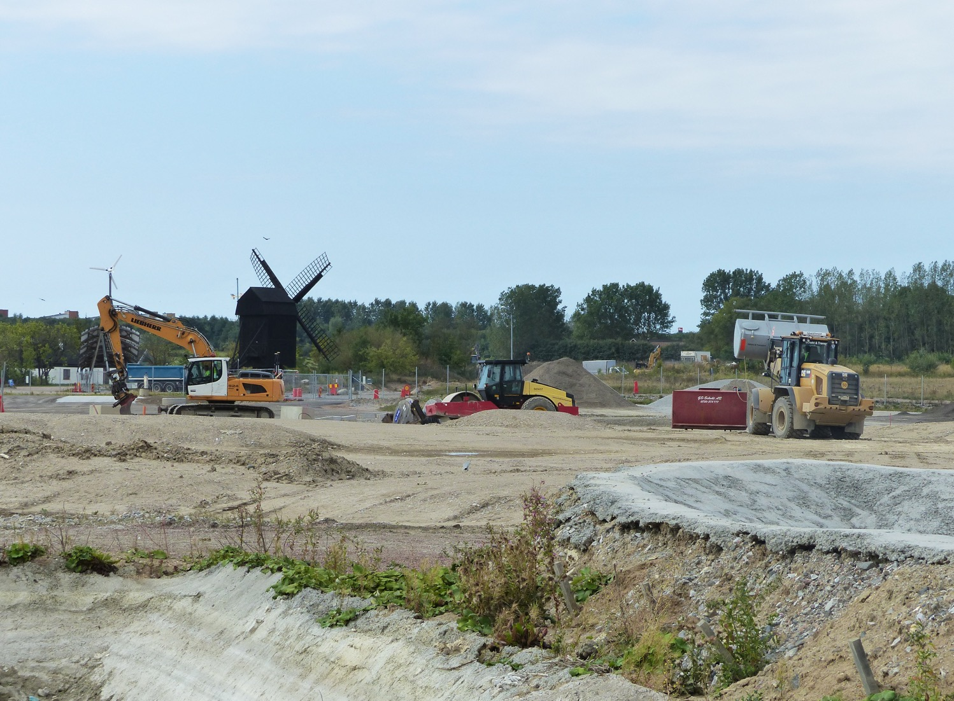
Office and Laboratory Campus
Ground breaking for the ESS Offices and Laboratories
December 2018
Campus will consist of 3 buildings, 450 workspaces, 16 labs and workshops

Slide 23
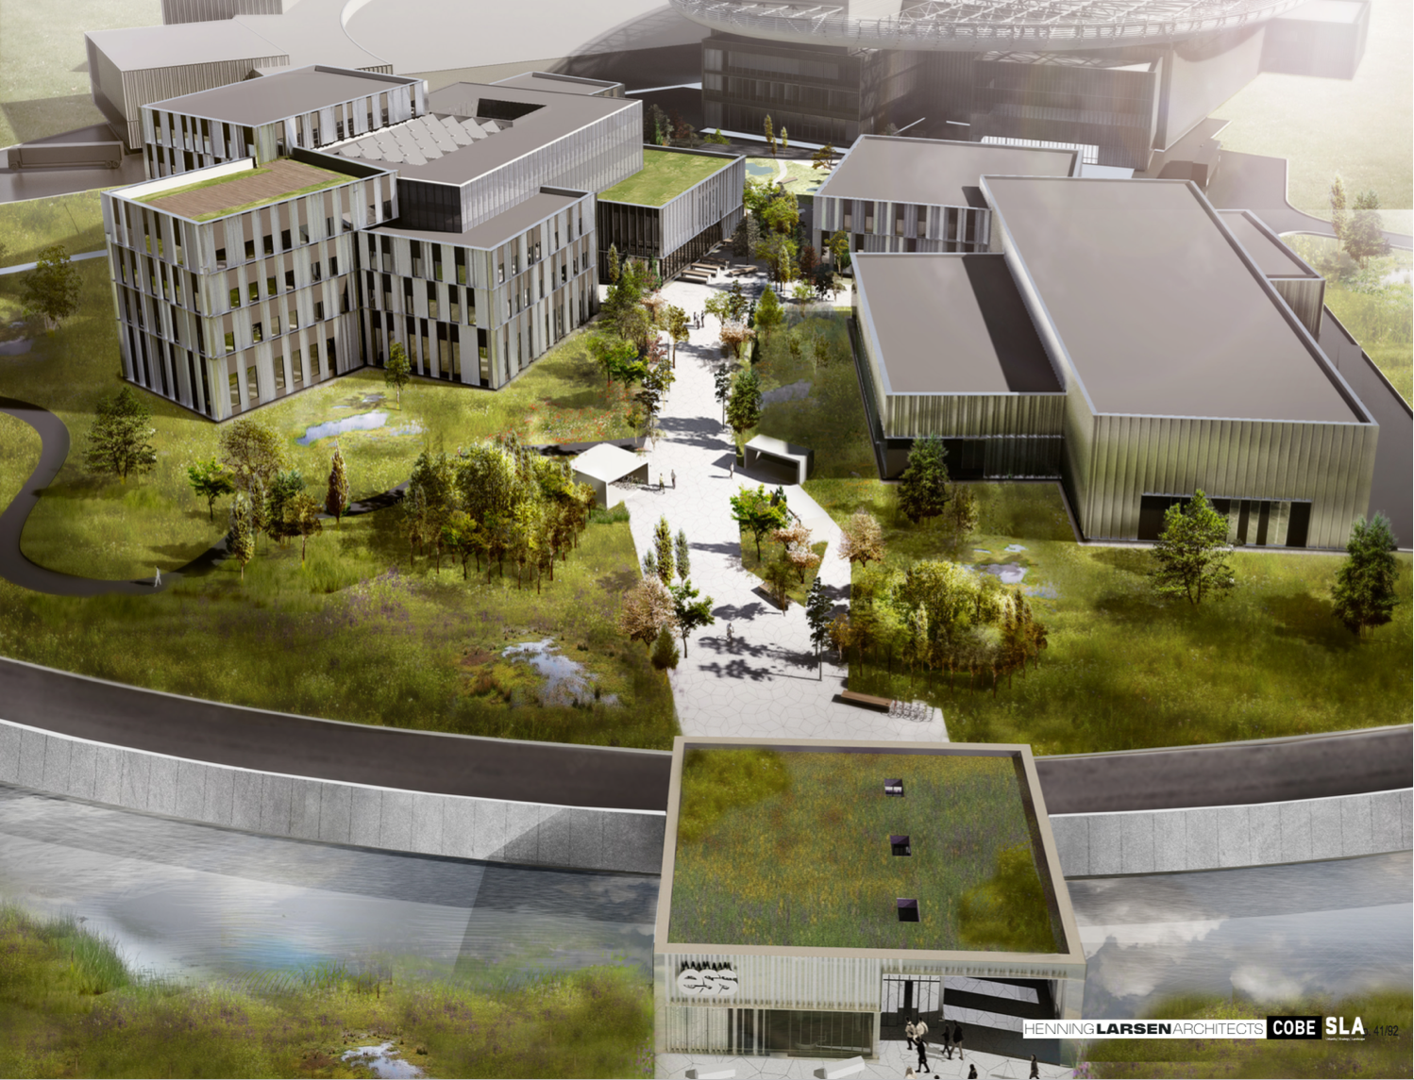
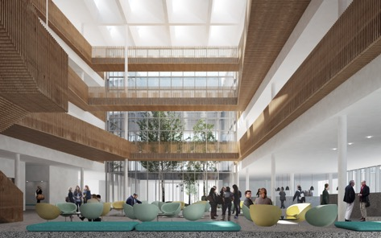
Campus
Labs and Workshops
Offices, auditorium canteen
Plan to move in early 2021
Entrance Building

Slide 24
Key activities in 2019
Install and start commissioning next stage of the linac
Target Building access granted for start of technical (Target) equipment installation
Start instrument installation in long beamline Experimental Hall
Begin construction of Campus and Lab Buildings

Slide 25
Thank you!

