Slide 1
ectogrid™ in Brunnshög for efficient recovery of ESS low temp surplus heat

Slide 2
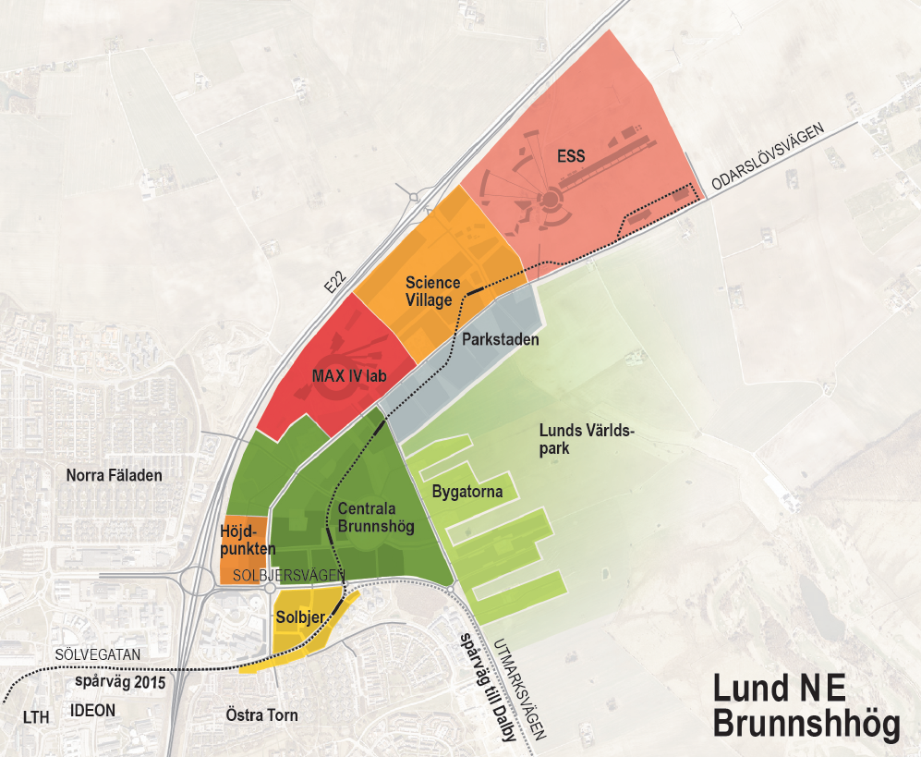
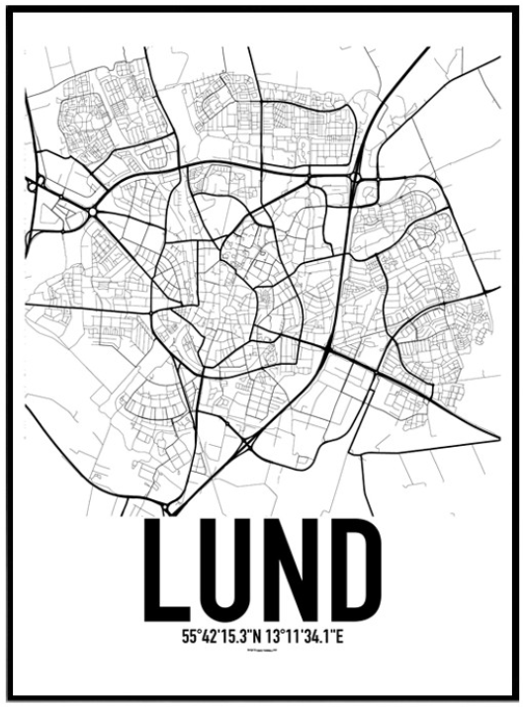
Back-up´s
City area Brunnshög in Lund, Sweden

Slide 3
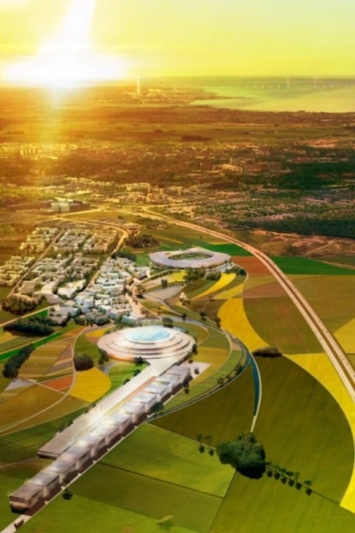
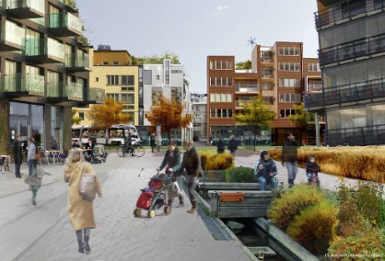
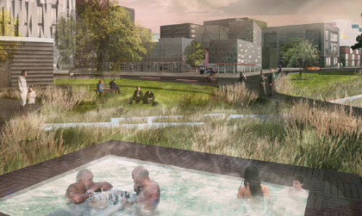
Lund municipality with high ambitions for Brunnshög area
40 000 people to live and work in the area
World's best research and innovation environment
International destination for science, culture & recreation
European model for sustainable city development
Local energy production 50% higher than consumed (”city as power plant")
Transportation: Max 1/3 car, Min 2/3 public or bike

Slide 4
E.ON’s concept enables sustainable and economically feasible heat recovery regardless temperature levels
Illustrative
High temp
Medium temp
Medium/low temp
Low temp
District heating
Full flexibility and redundancy

Slide 5
Conventional cooling
Infrared spectrum
Visual spectrum

Slide 6
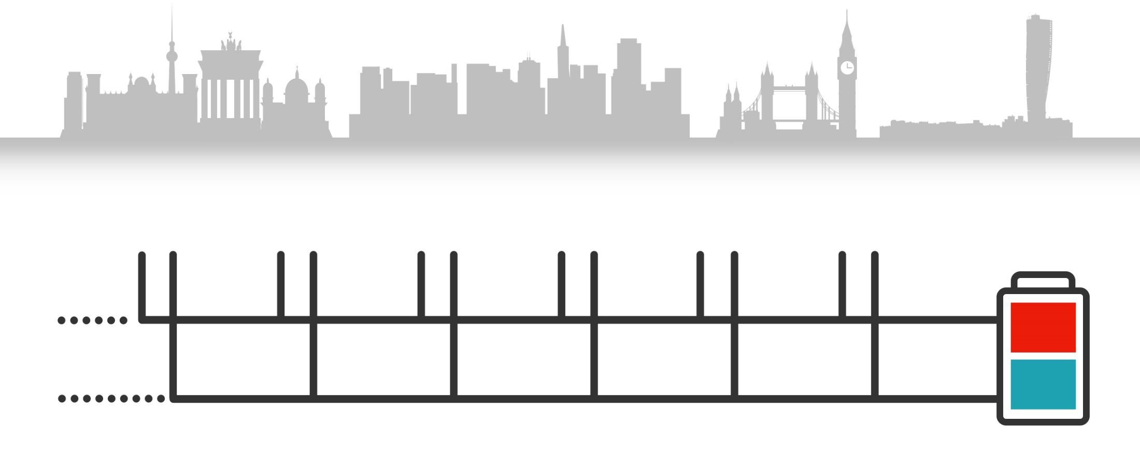
The most energy efficient heating and cooling solution
Cheaper to build - one grid serves 2 utilitites
Cheaper to operate
How ectogrid™ works
Buildings connected to the same system provide each other with heating and cooling.
~15-40 ^{O}C
~5-30 ^{O}C

Slide 7
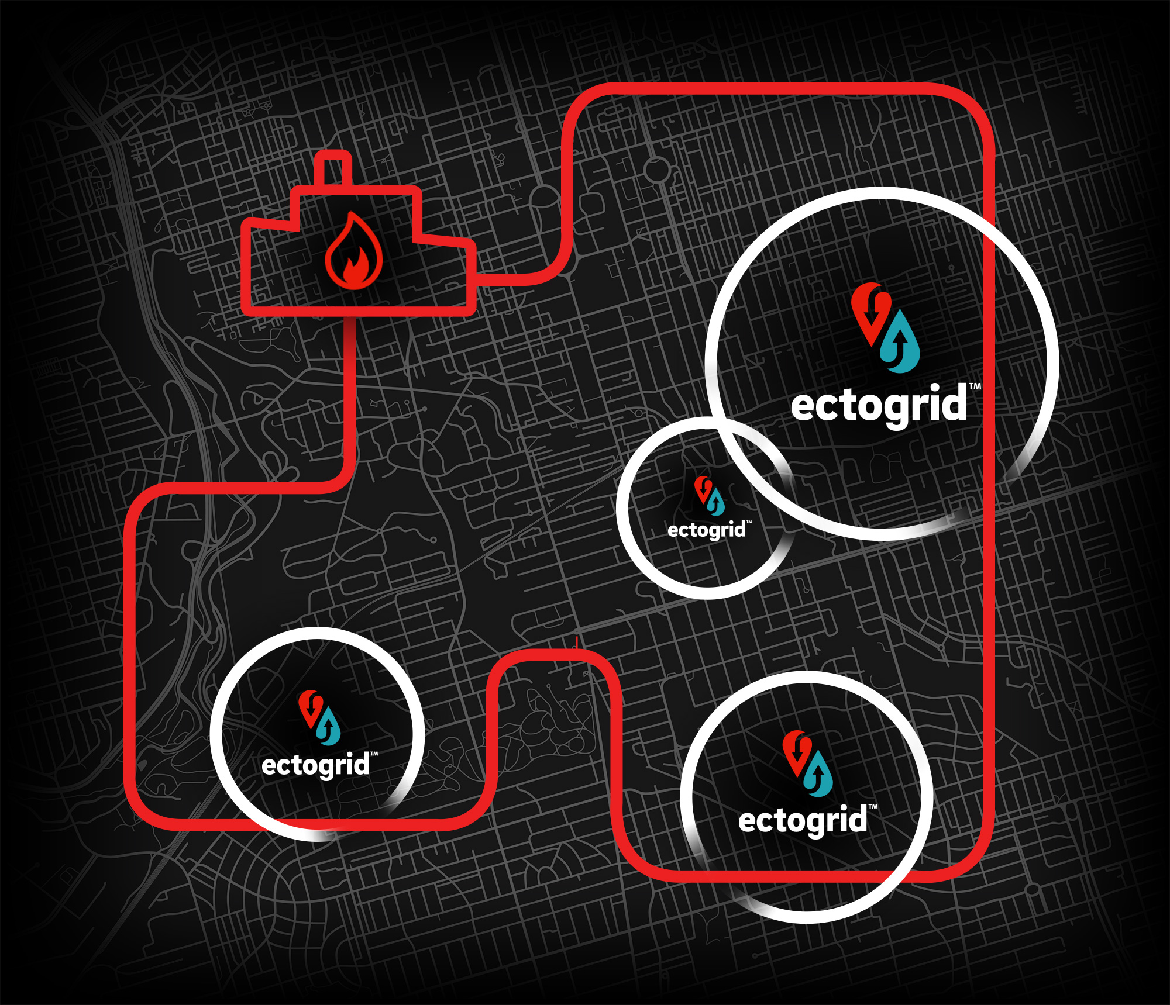

Slide 8
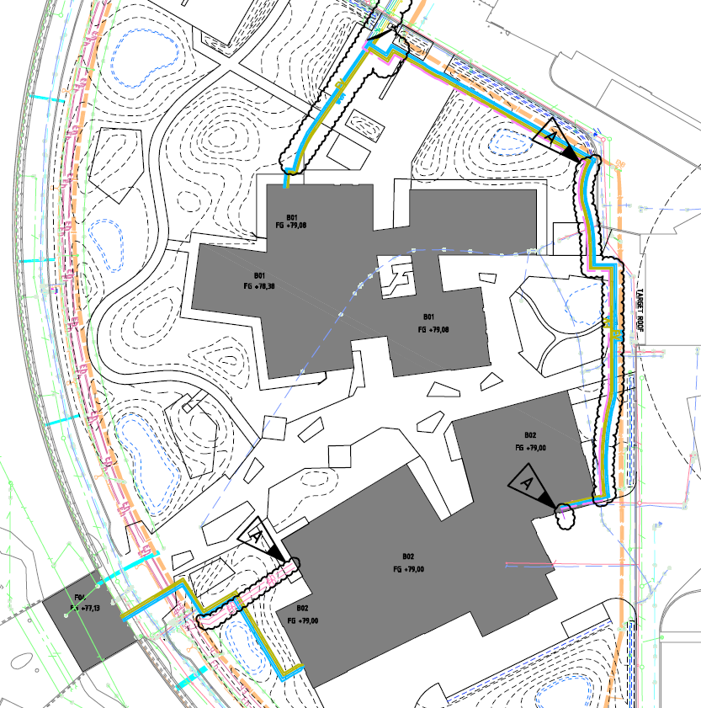
ectogrid™ to ESS Campus
B01
B02
F04

Slide 9
Science Village Scandinavia

Slide 10
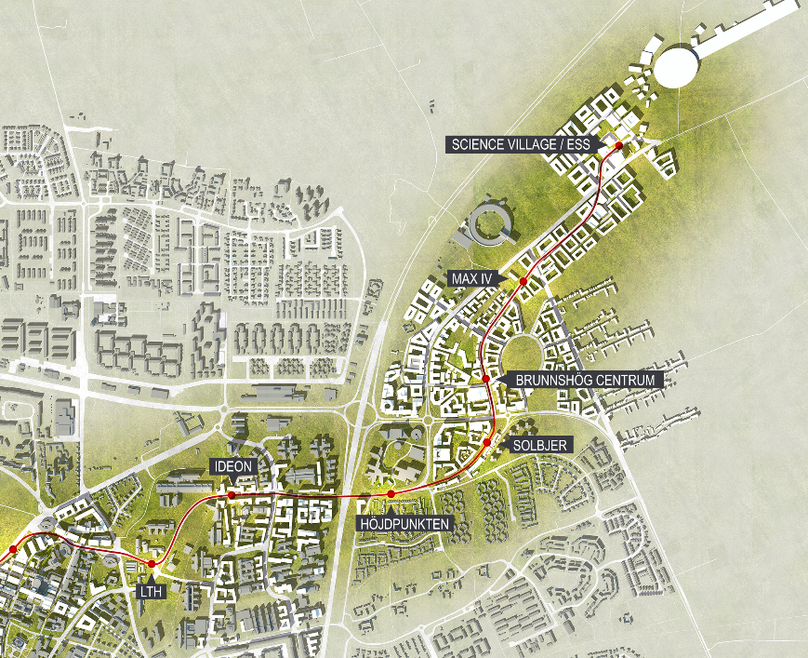
Ongoing/initiated ectogrid™ cases in Lund NE
1
2
3
4
8
5
6
7

Slide 11
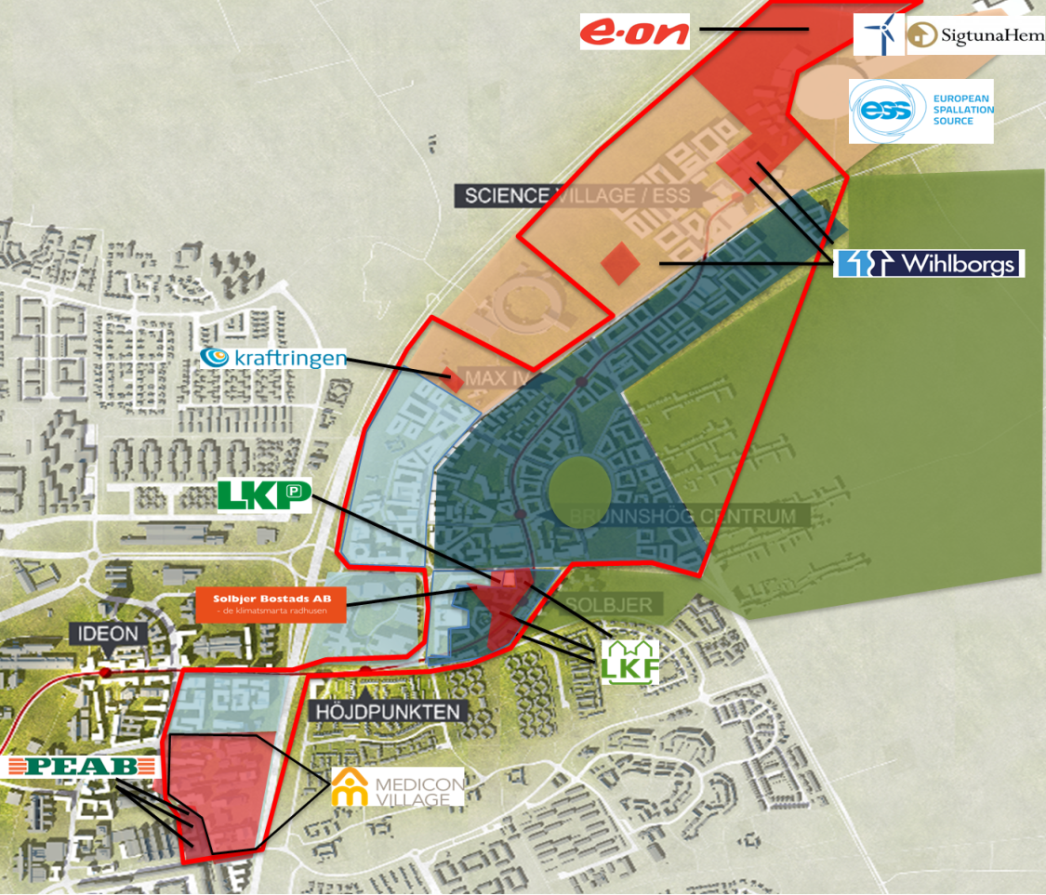
EU H2020 application regarding surplus energy utilization
ESS and E.ON sub-project in EU H2020-funding application. Countries involved Sweden, Italy, Denmark, Romania, Moldavia, Greece, Cyprus, Ukraine, Hungary, Belgium, Netherlands, Austria
Positive Energy District
ectogrid™ in district using ESS low temp surplus heat as balancing energy
Maximizing energy recovery and minimizing energy need
Response in May

