Slide 1
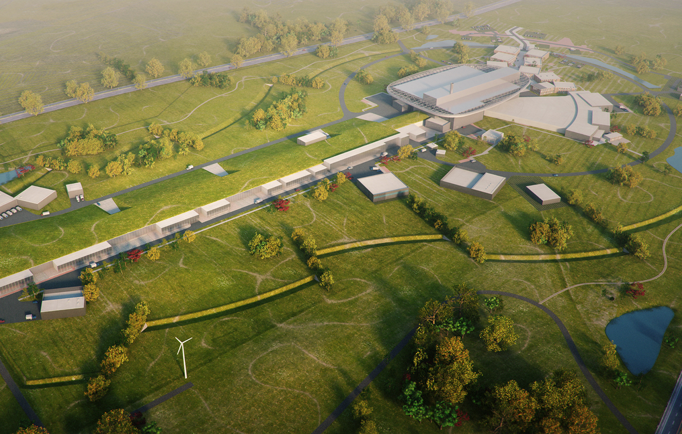
Central Process System, CPS

Slide 2
CPS Energy Balance 2025 and ahead
DH to Kraftringen
175 GWh
CPS
Recycling
> 95 %
CWL 35 GWh
CWM 35 GWh
CWH 60 GWh
HVAC to air 6 GWh
Electricity 34 GWh
DHL 17 GWh

Slide 3
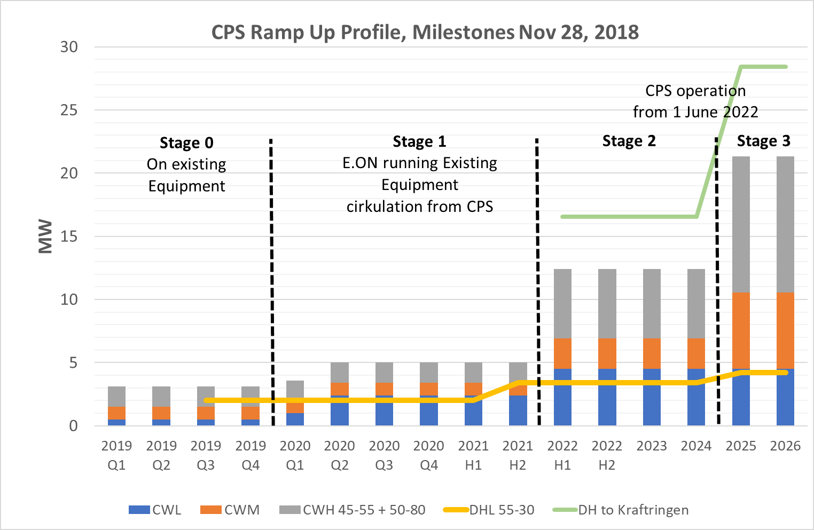
CPS Ramp Up
Flexible
DHL from October -19

Slide 4
Timeplan 2019 – Stage 1
Meeting ESS
Projekt meeting
Construction meeting
Construction meeting
PD Review
Piping PD design
Piping DD design
Piping Procurement
Installation
Electric design
Cirkulation
Electric Procurement
Installations
Power up
IAR Procurement
Installations
IAR ??
DIW Procurement
Installations
HVAC Design
DIW ??
HVAC Procurement
Installations
Jan
Feb
Mars
April
Maj
Juni
Juli
Aug
Sep
Okt
Nov
Dec

Slide 5
Timeplan 2020/2022 – Stage 2
PD Review update
DD Review update
Design update
Piping DD
Heatpump Procure
Heatpump Installation
Piping Procure
Installation
Electric DD
Electric Procure
Installation
CPS in operation
Control System
Commissioning
Q3 2020
Q4 2020
Q1 2021
Q2 2021
Q3 2021
Q4 2021
Q1 2022
Q2 2022
Q3 2022

Slide 6
Timeplan 2023/2025 – Stage 3
PD Review update
DD Review update
Design update
Piping DD
Heatpump
Procure
Heatpump
Installation
Piping Procure
Installation
Electric DD
Electric
Procure
Installation
CPS in updated operation
Control System update
Commissioning
Q3 2023
Q4 2023
Q1 2024
Q2 2024
Q3 2024
Q4 2024
Q1 2025

Slide 7
3D modulation

