Slide 1
ESS
Björn Eldvall
P&ID

Slide 2
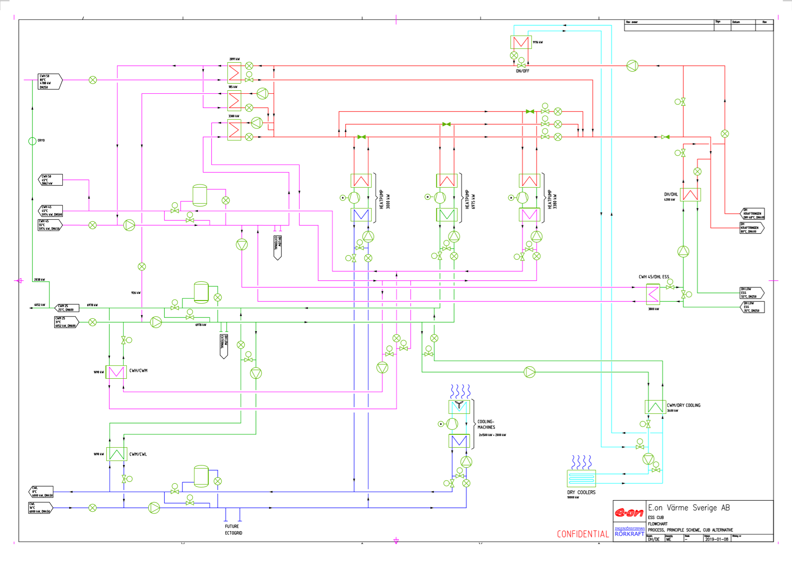

Slide 3
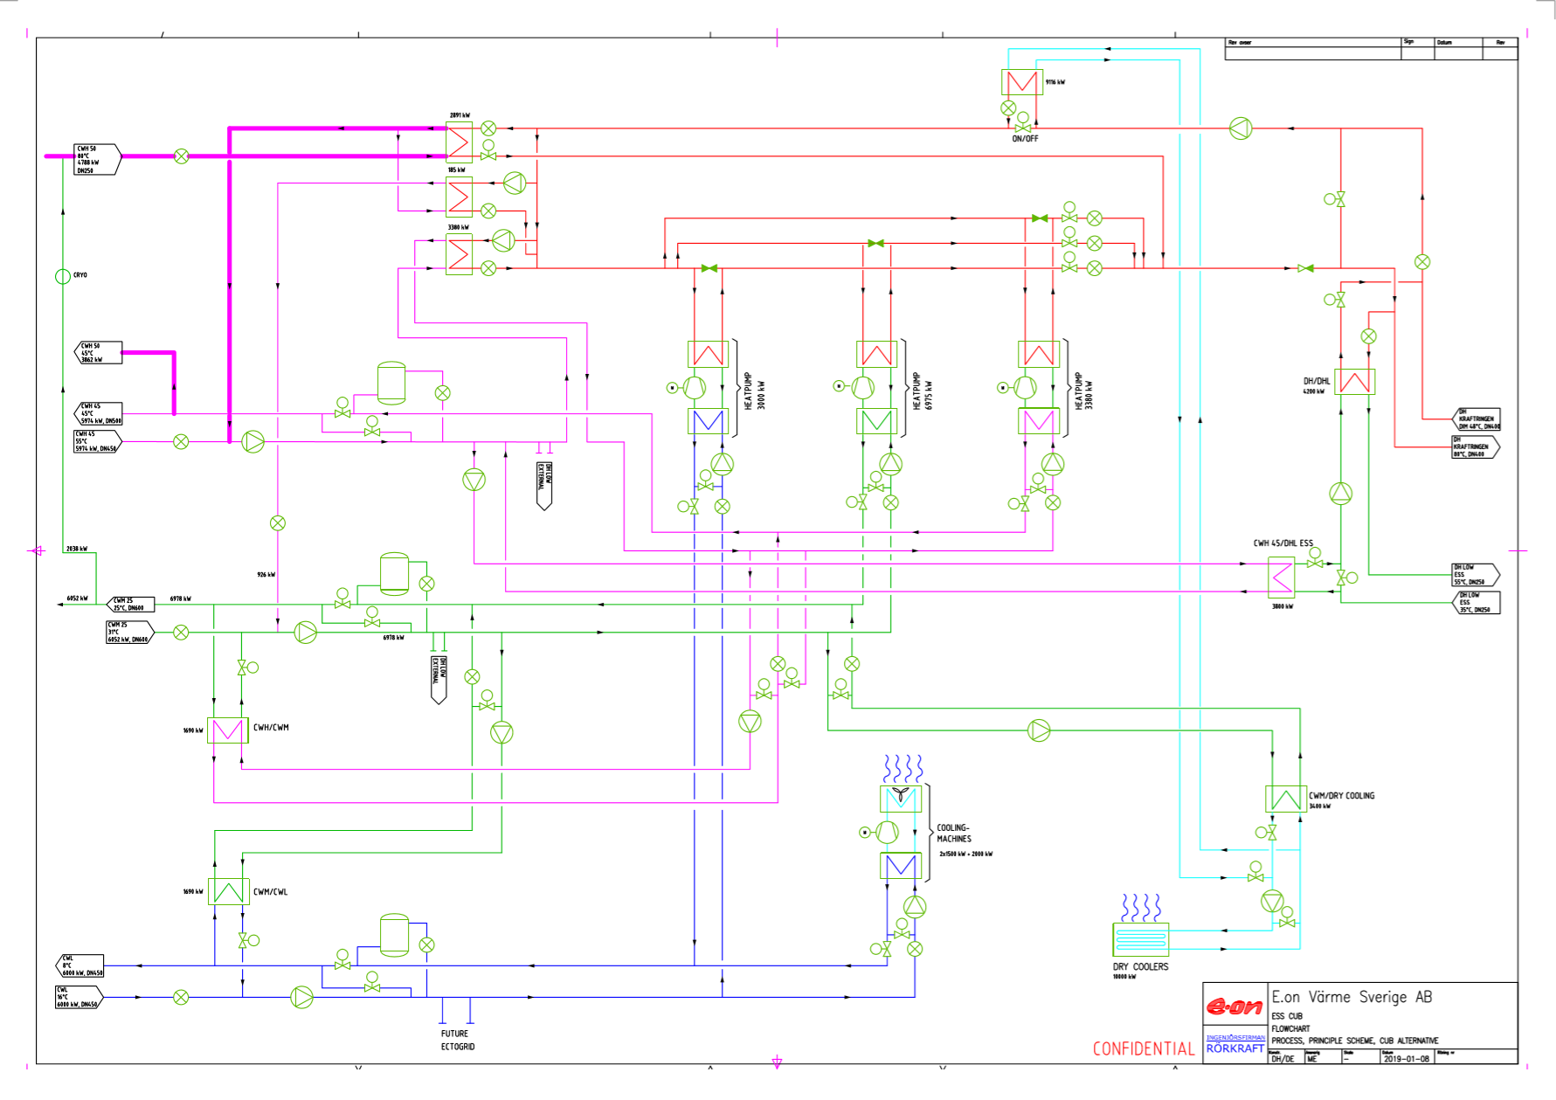

Slide 4
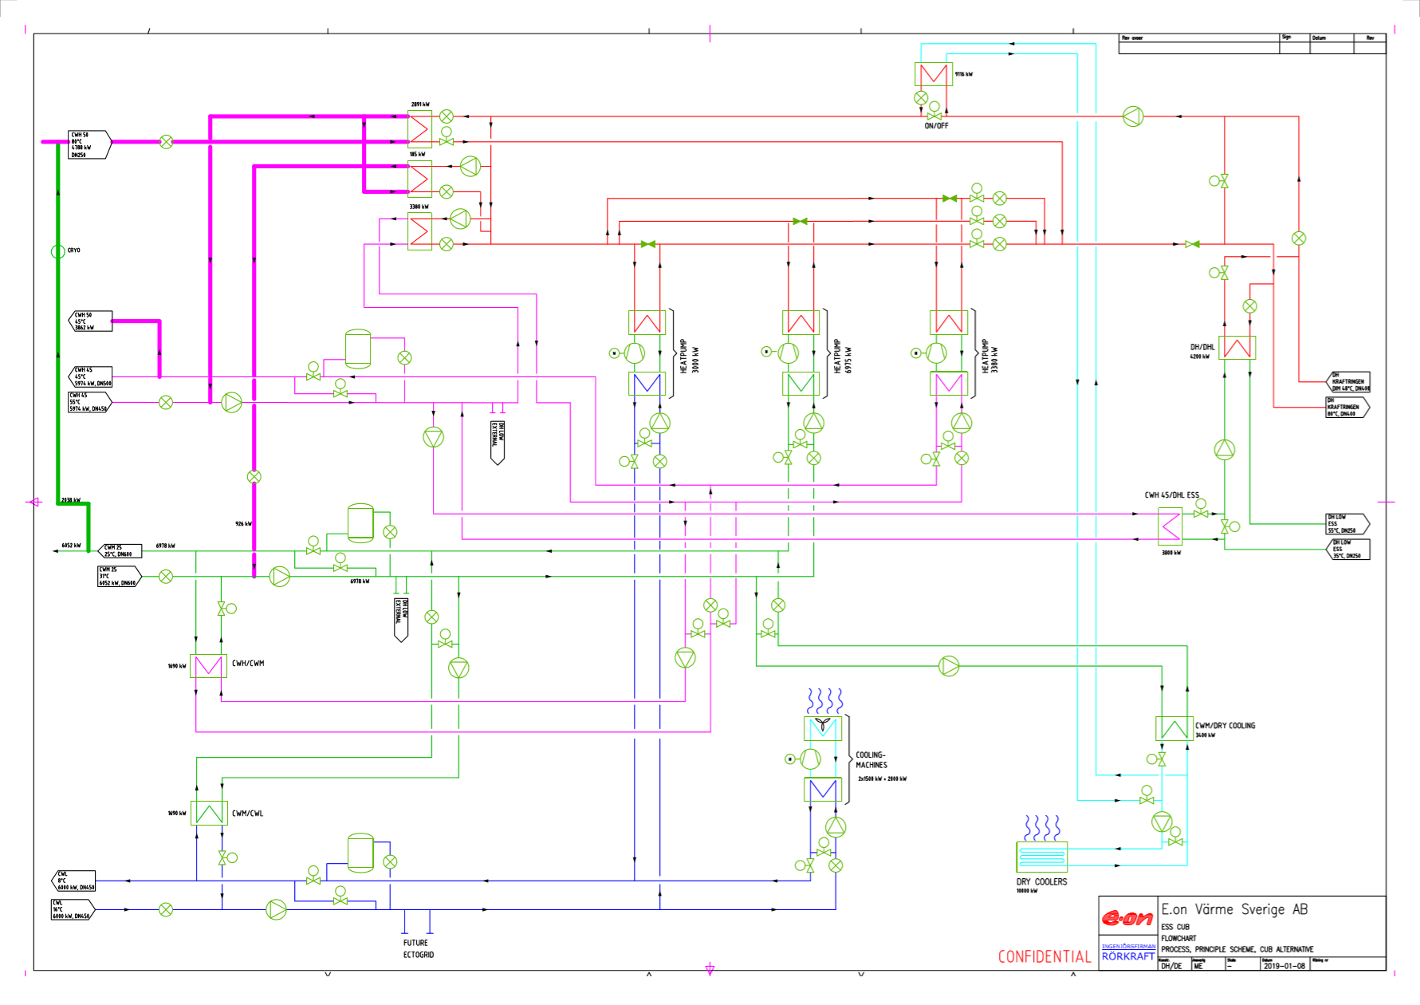

Slide 5
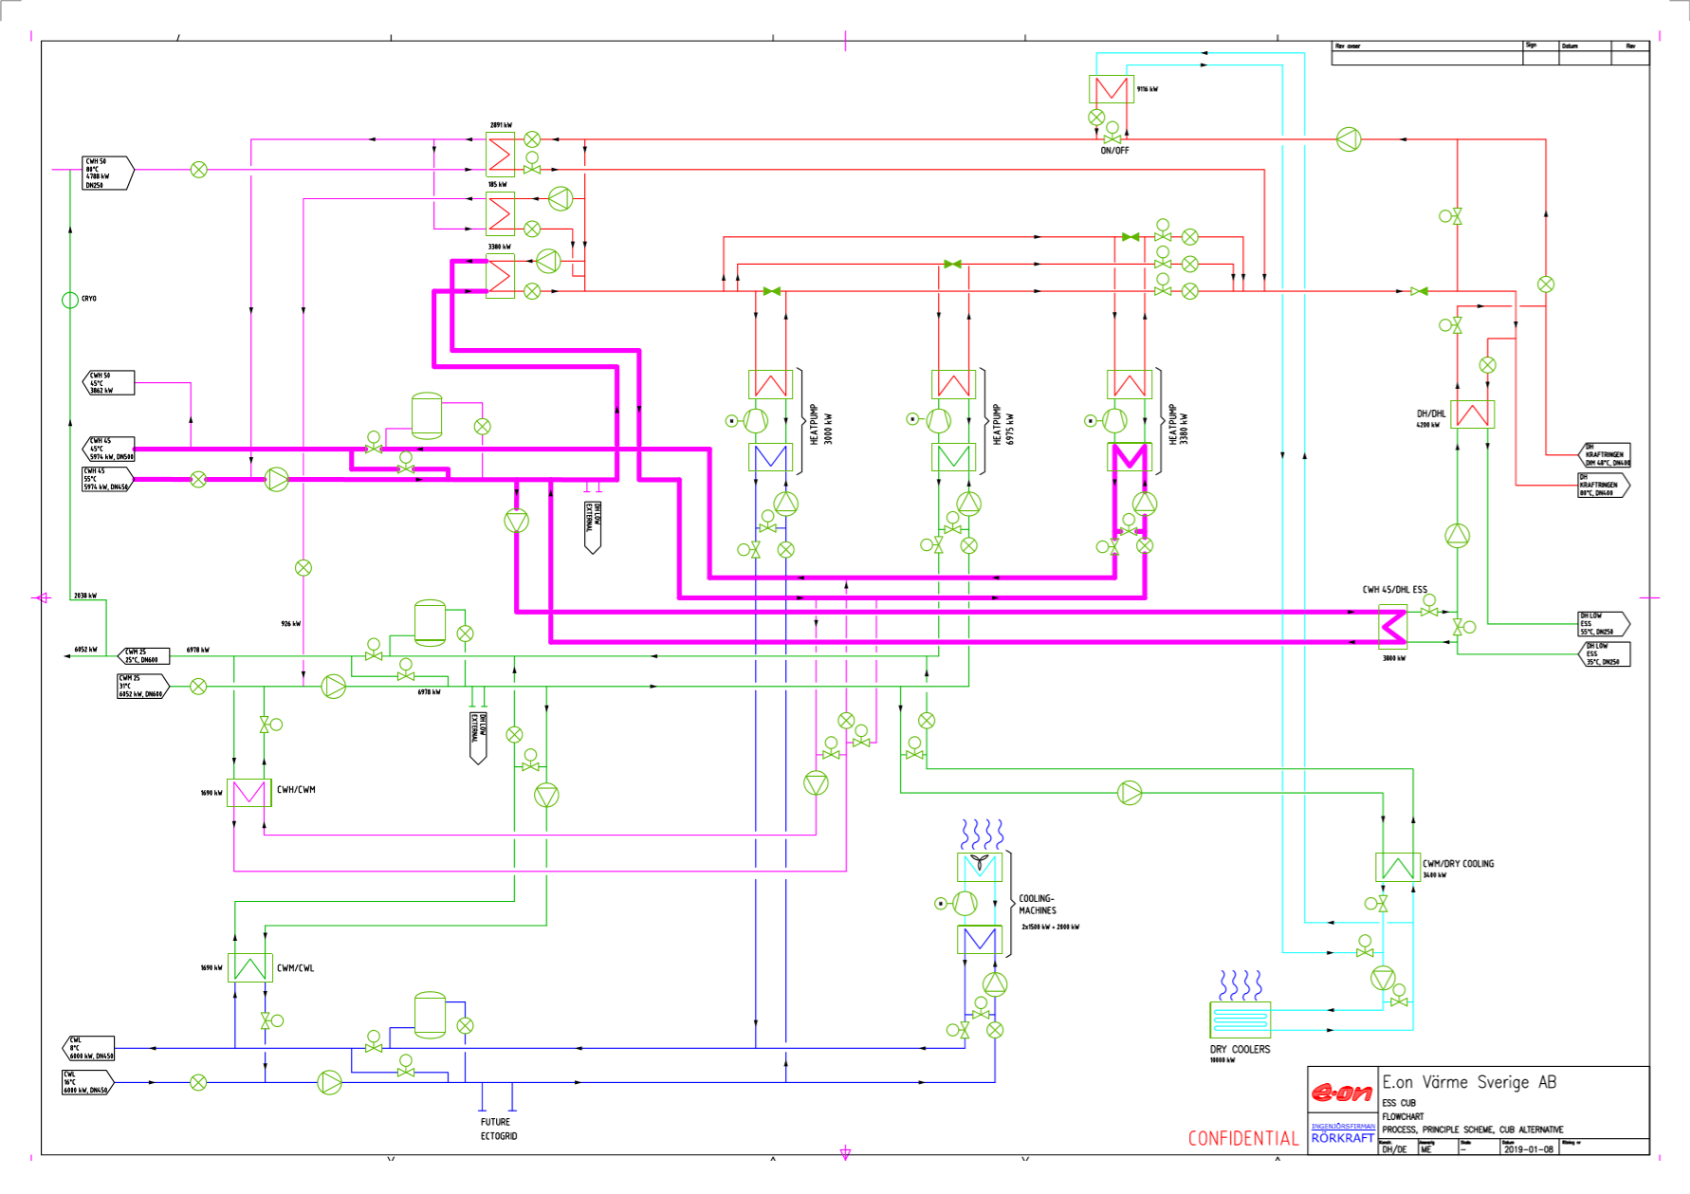

Slide 6
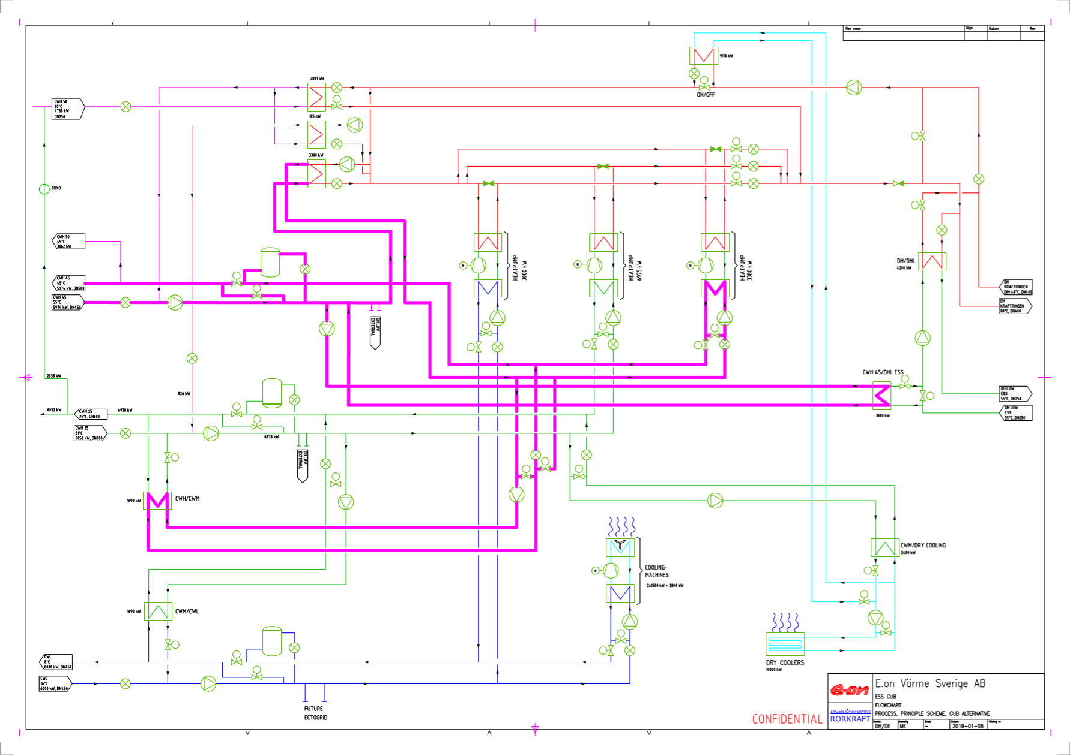

Slide 7
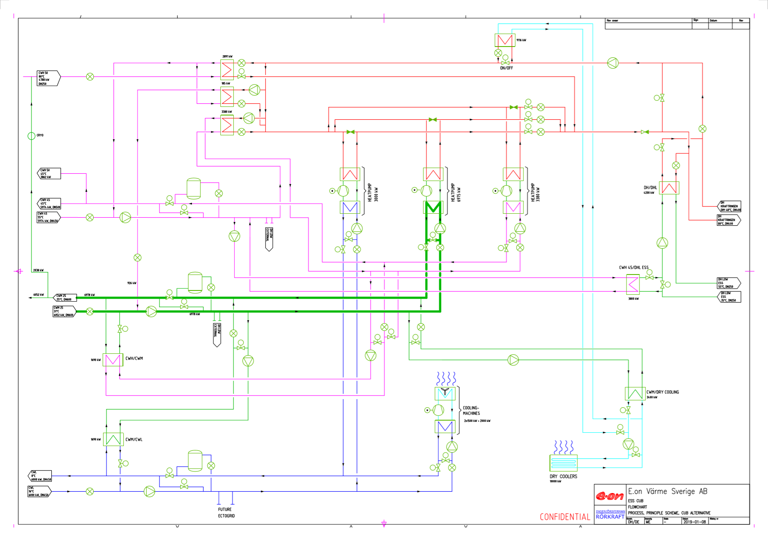

Slide 8
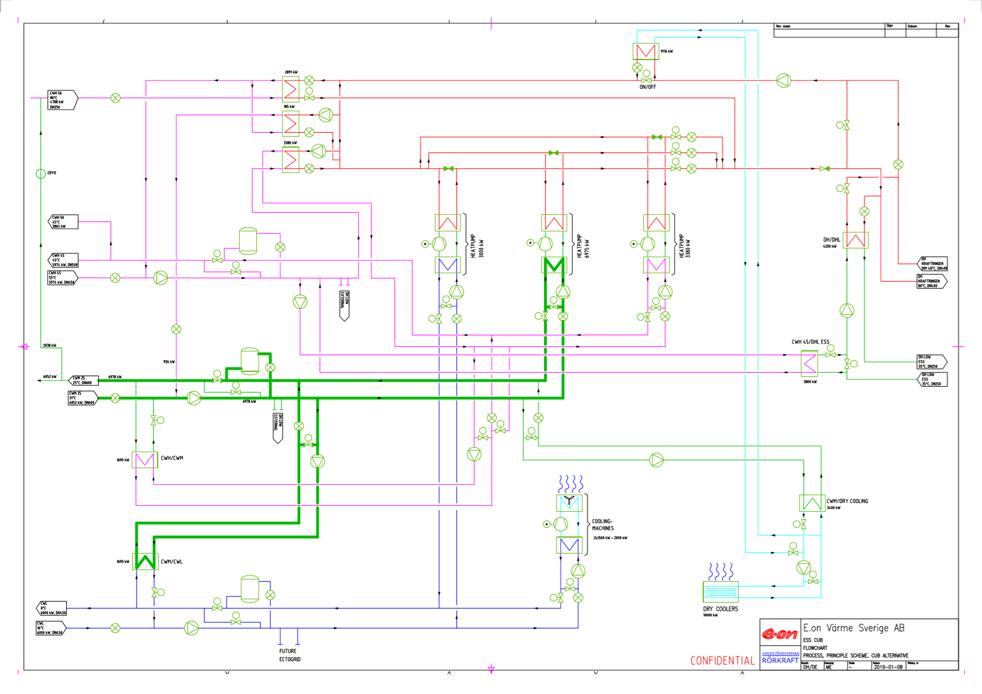

Slide 9
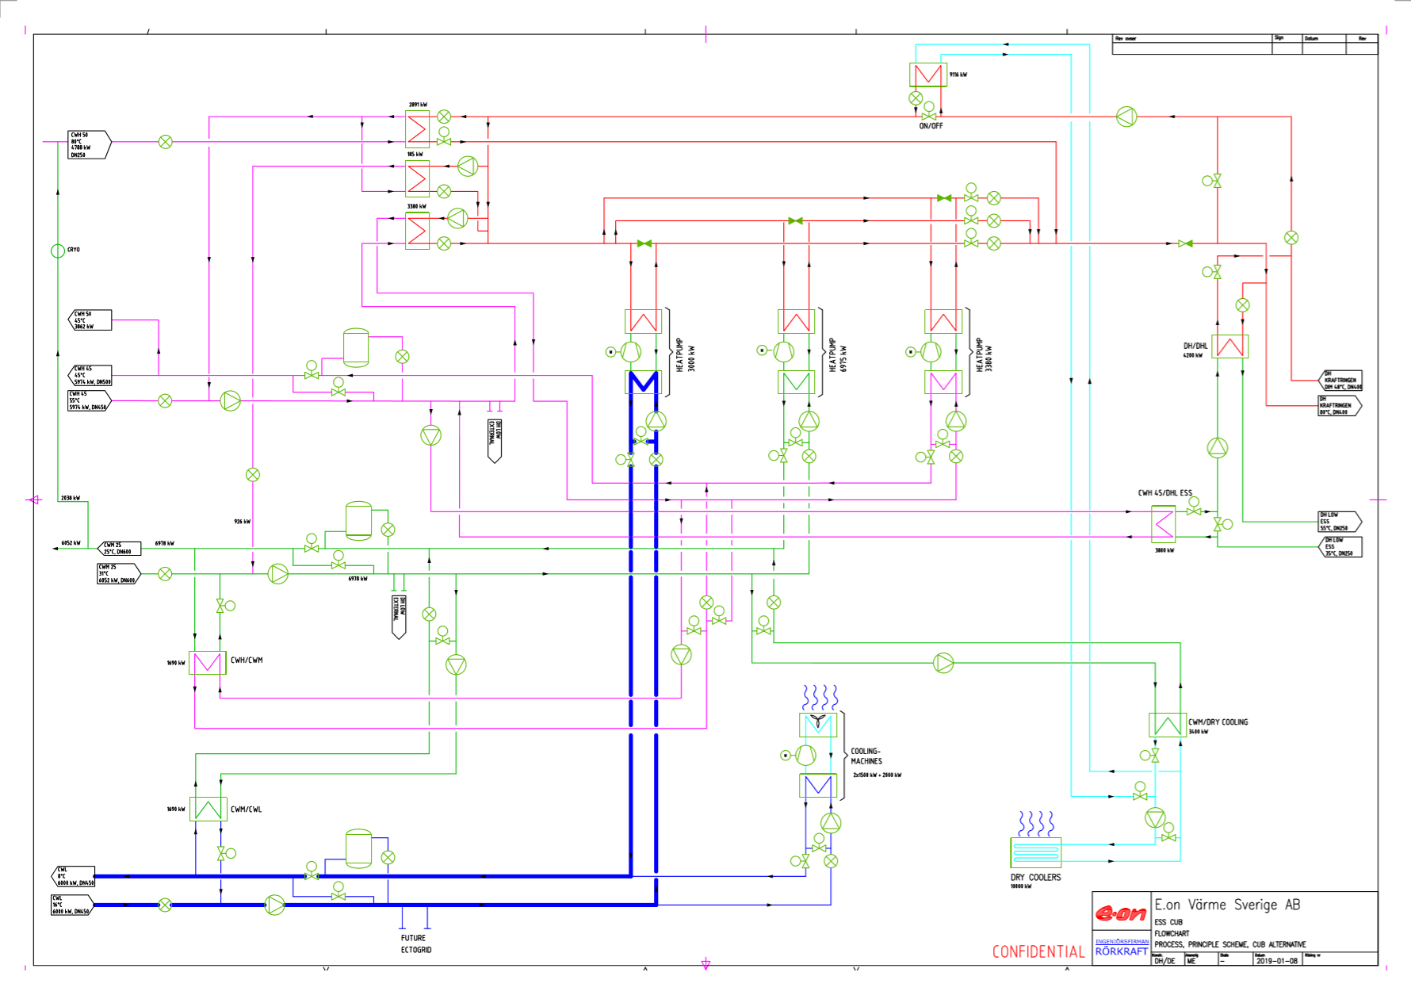

Slide 10
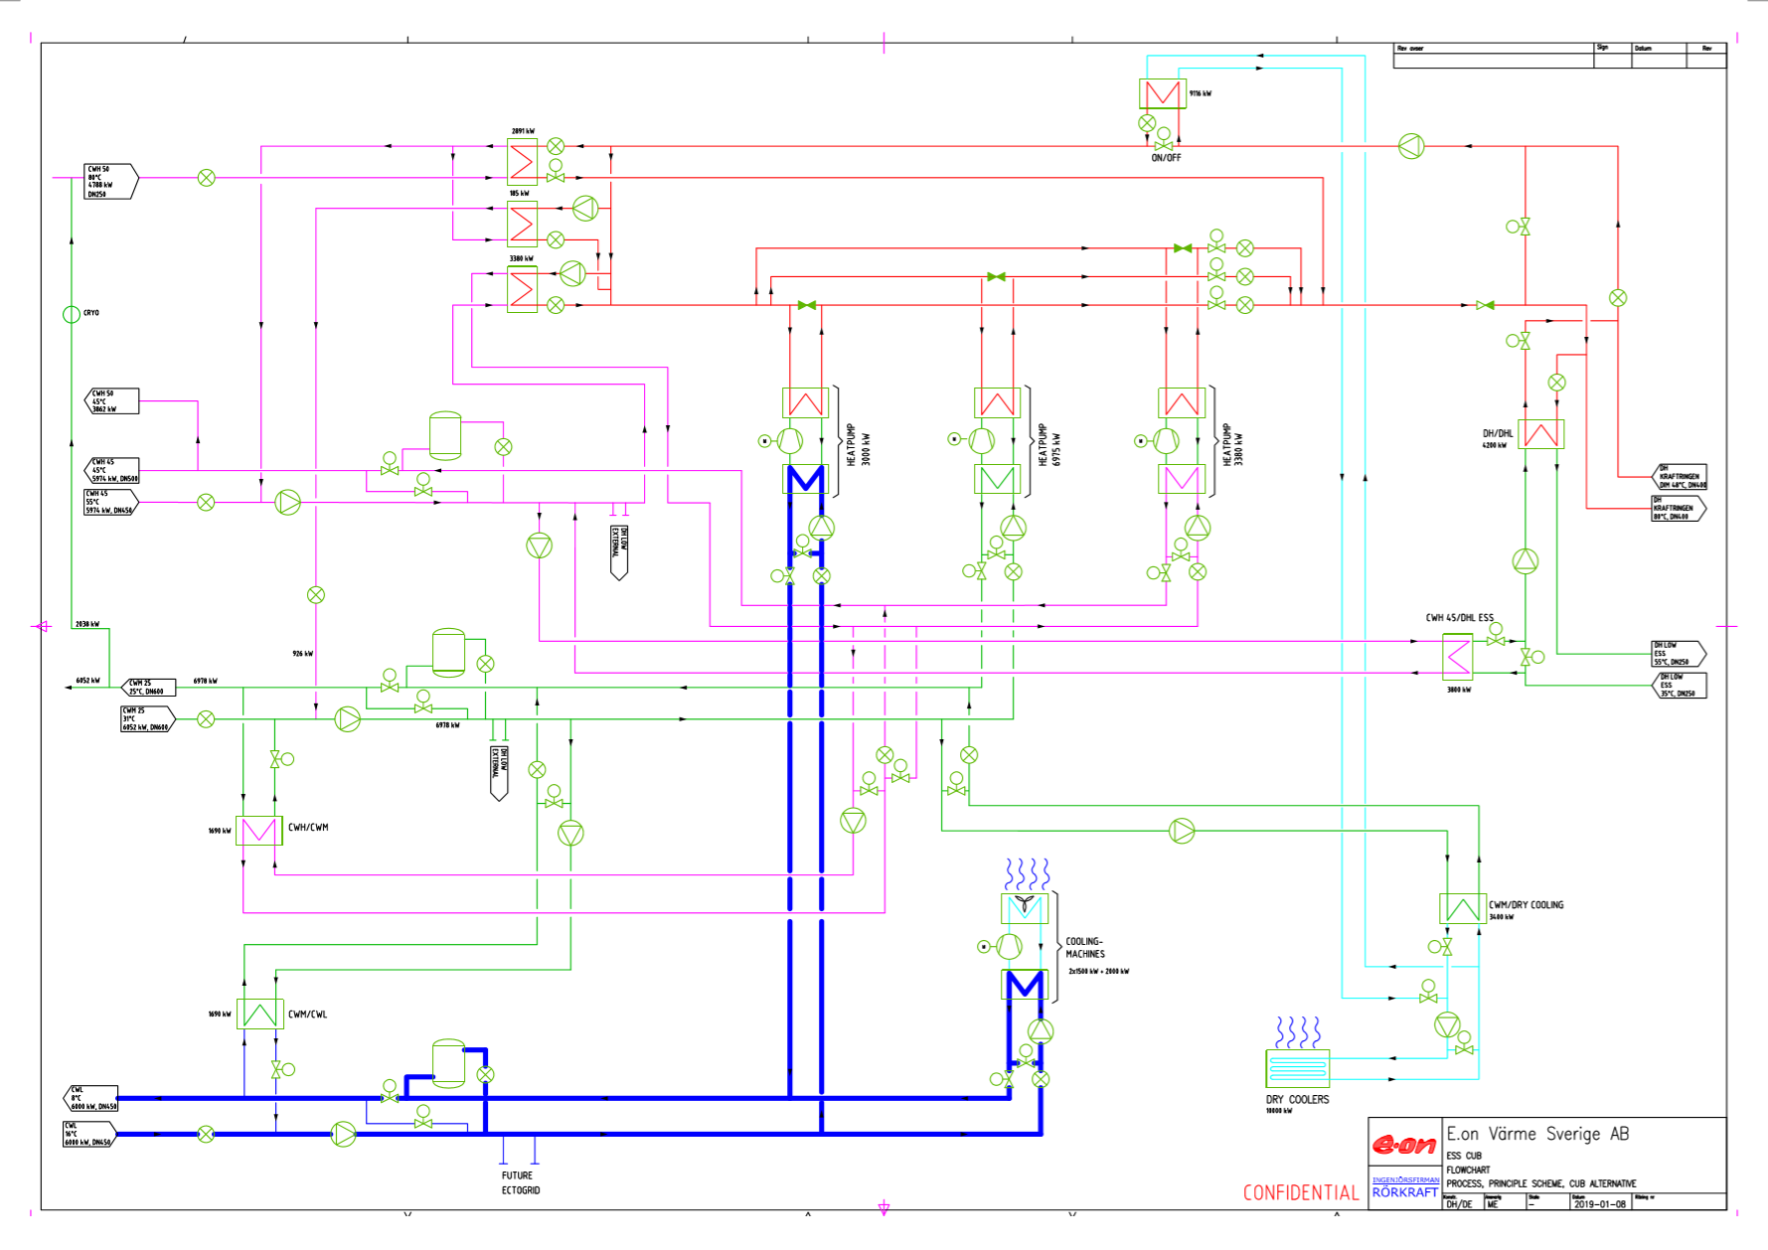

Slide 11
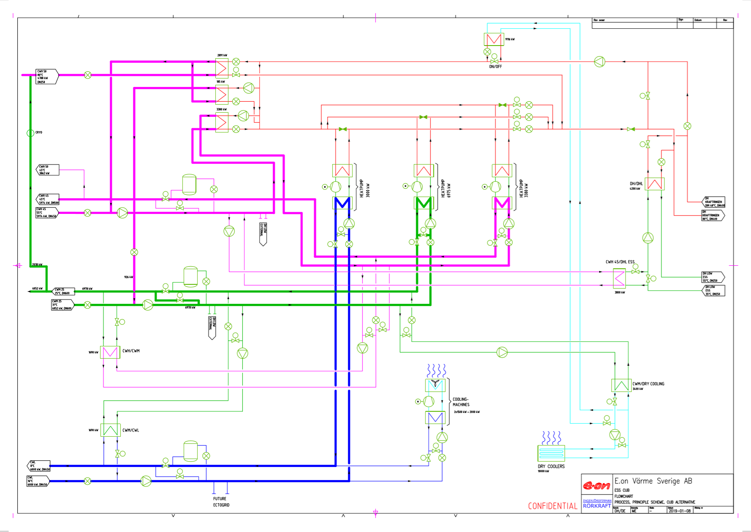

Slide 12
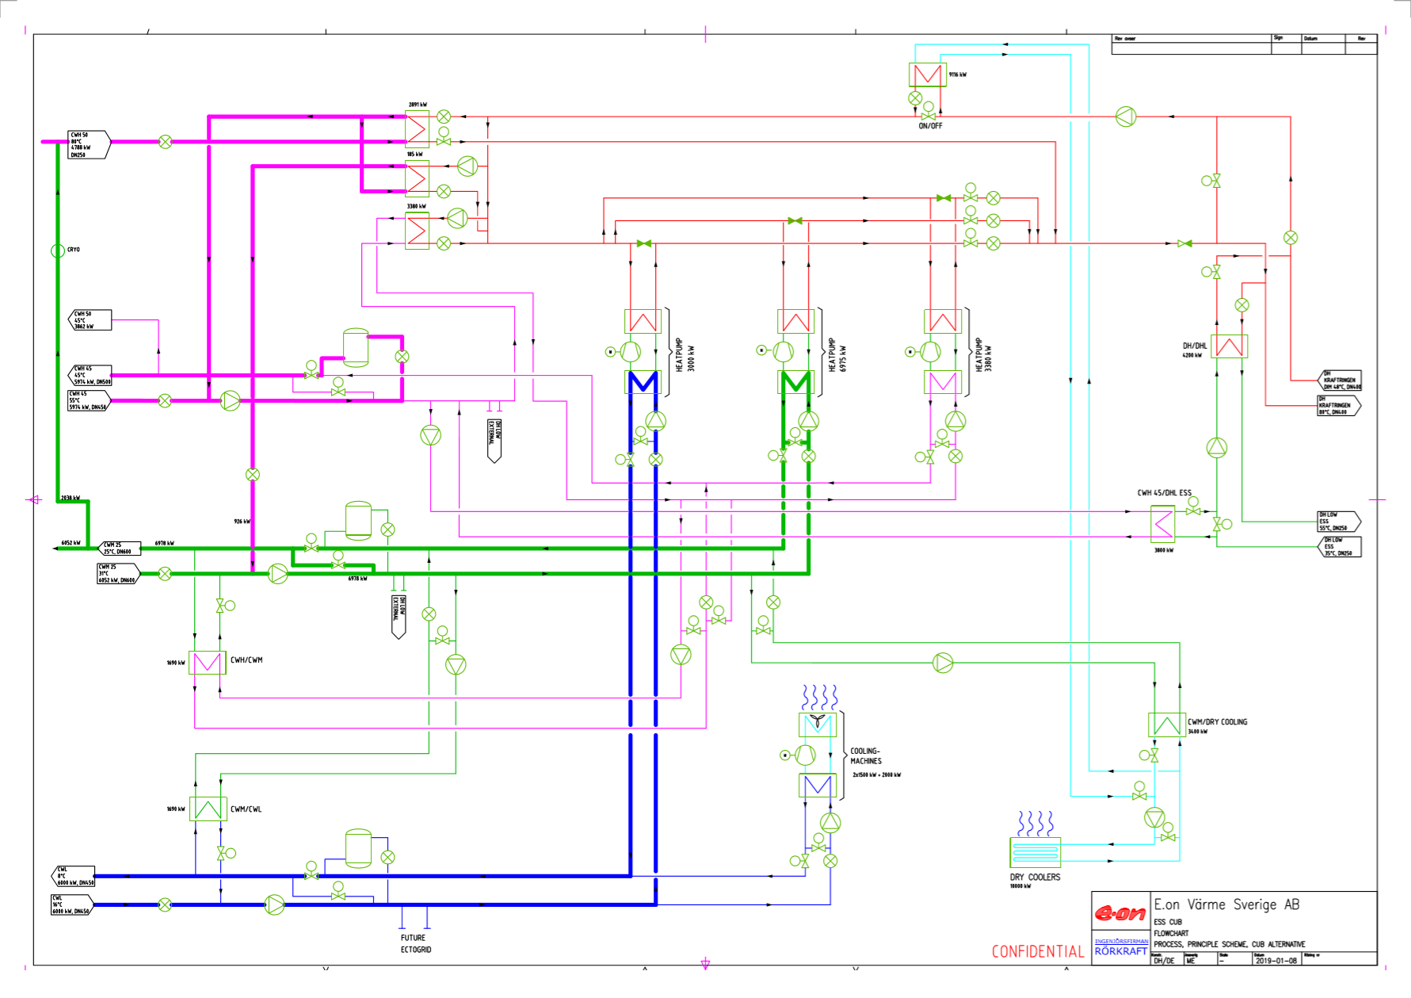

Slide 13
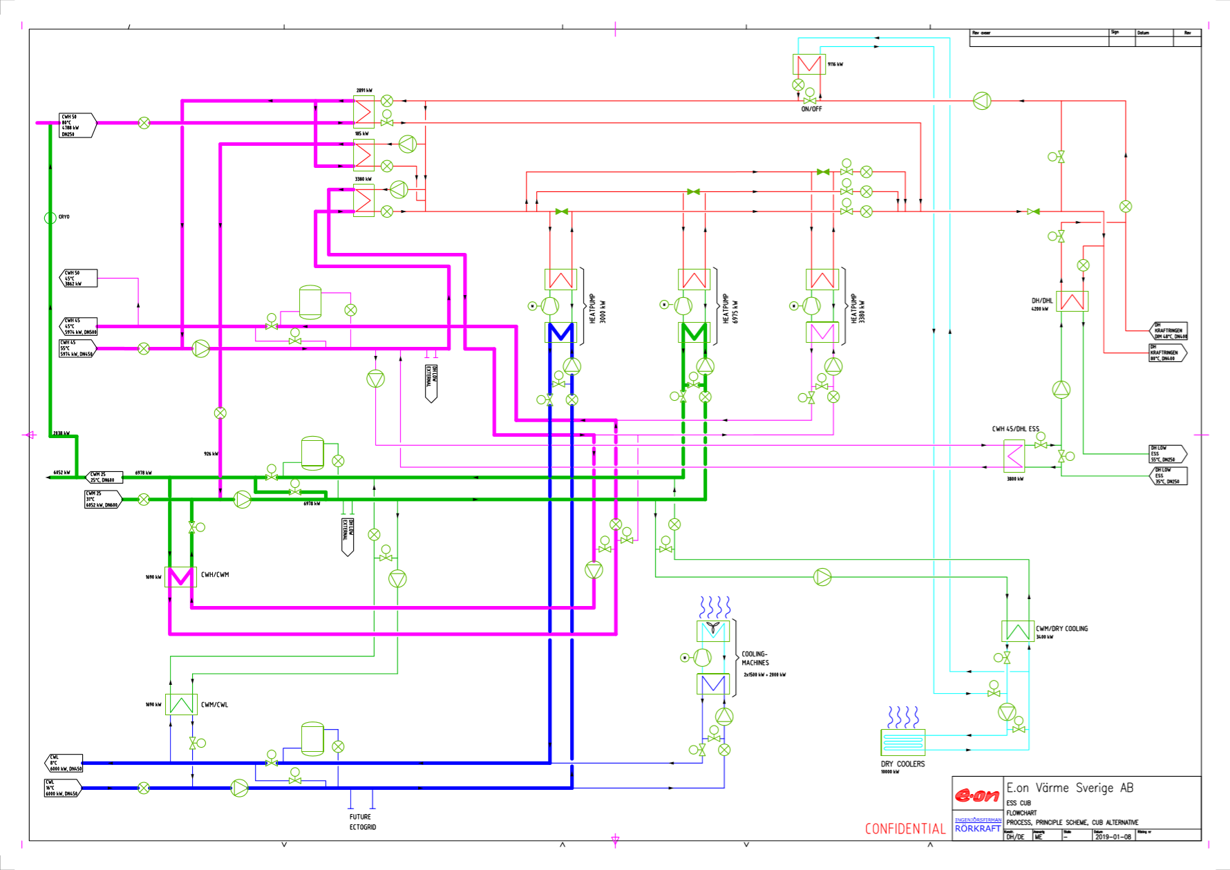

Slide 14


Slide 15
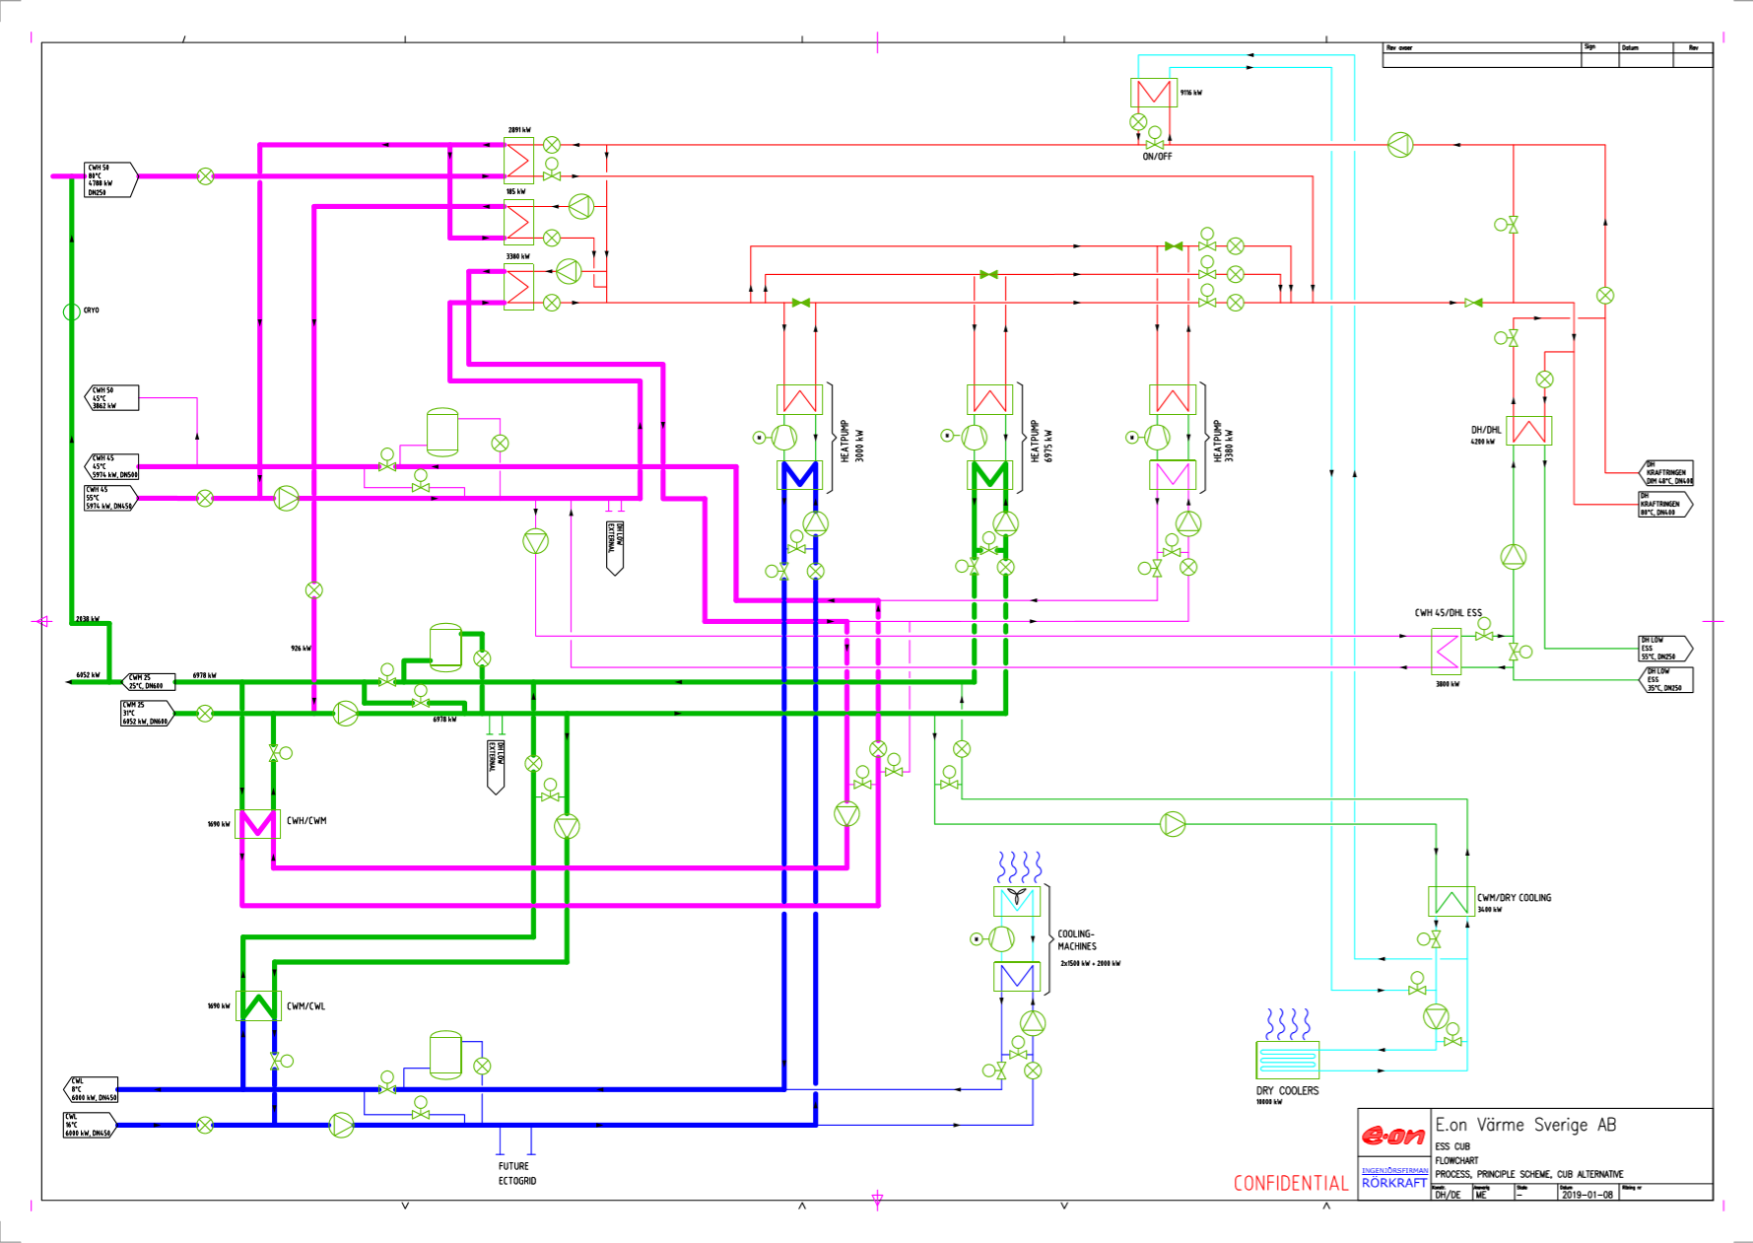
Bort, CWH

Slide 16
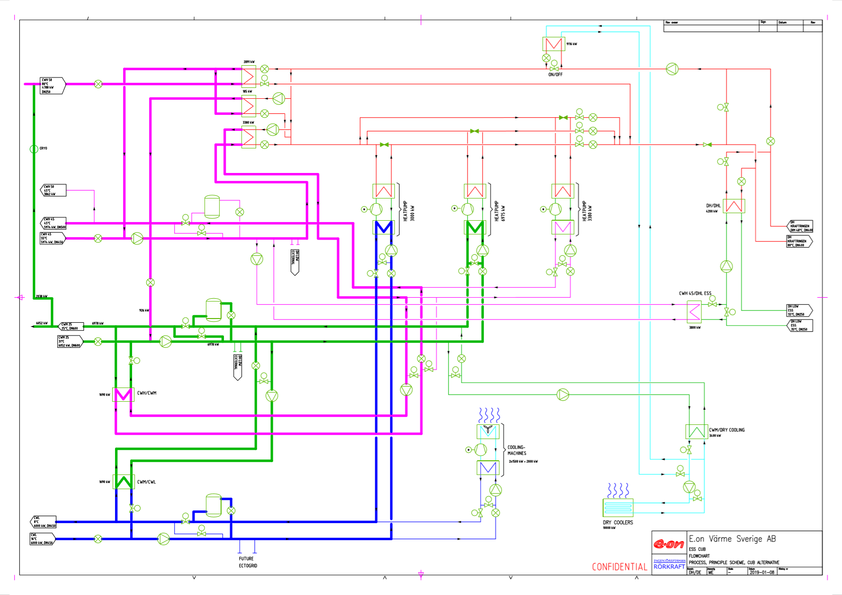

Slide 17
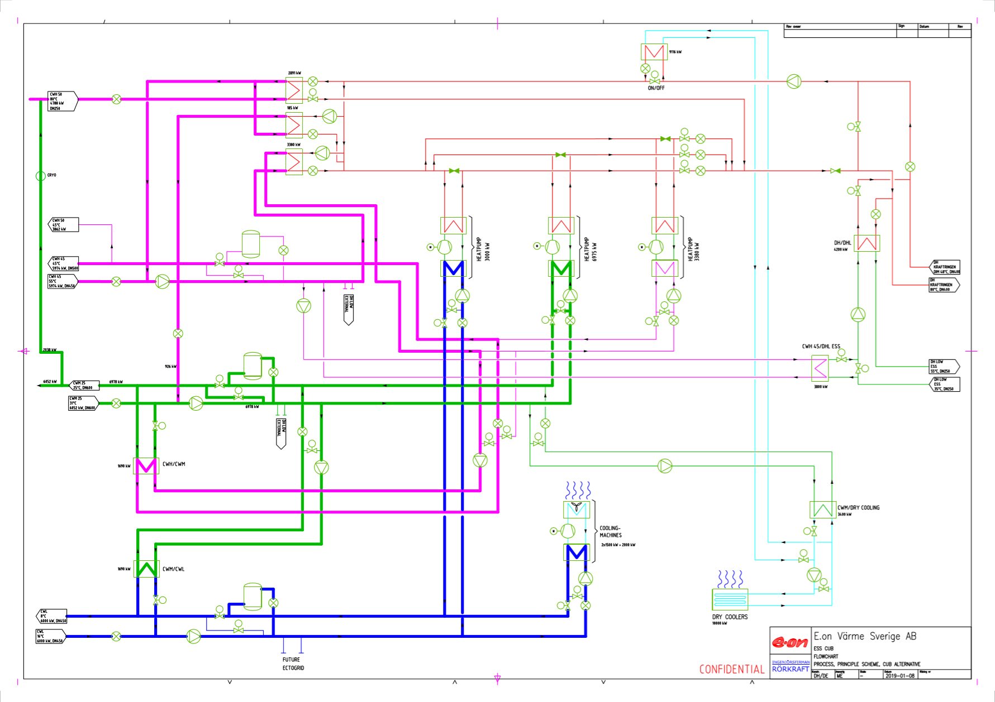

Slide 18
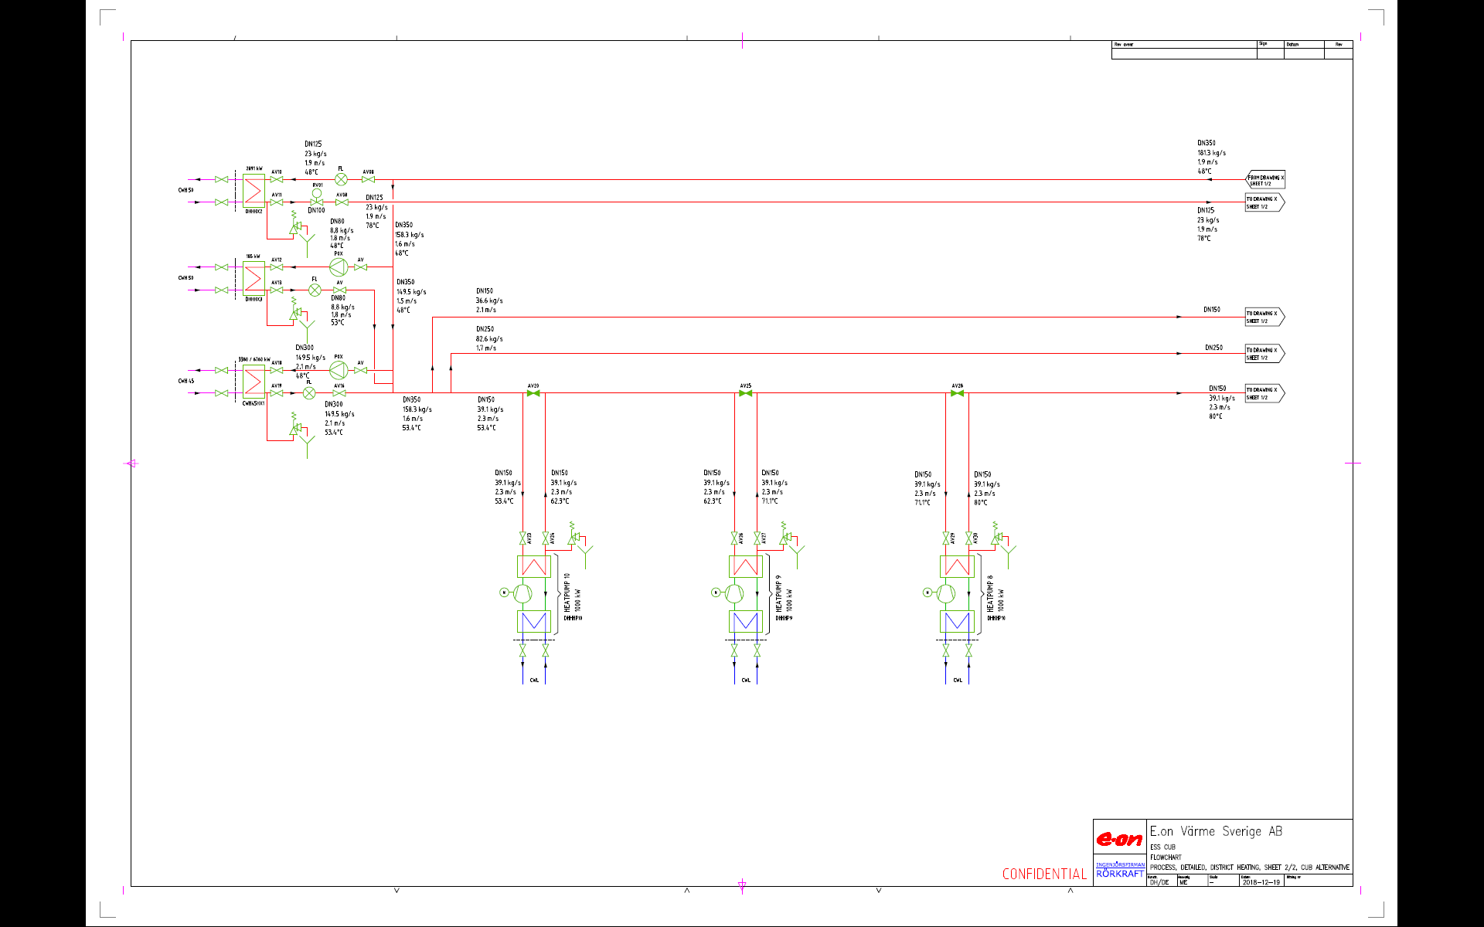
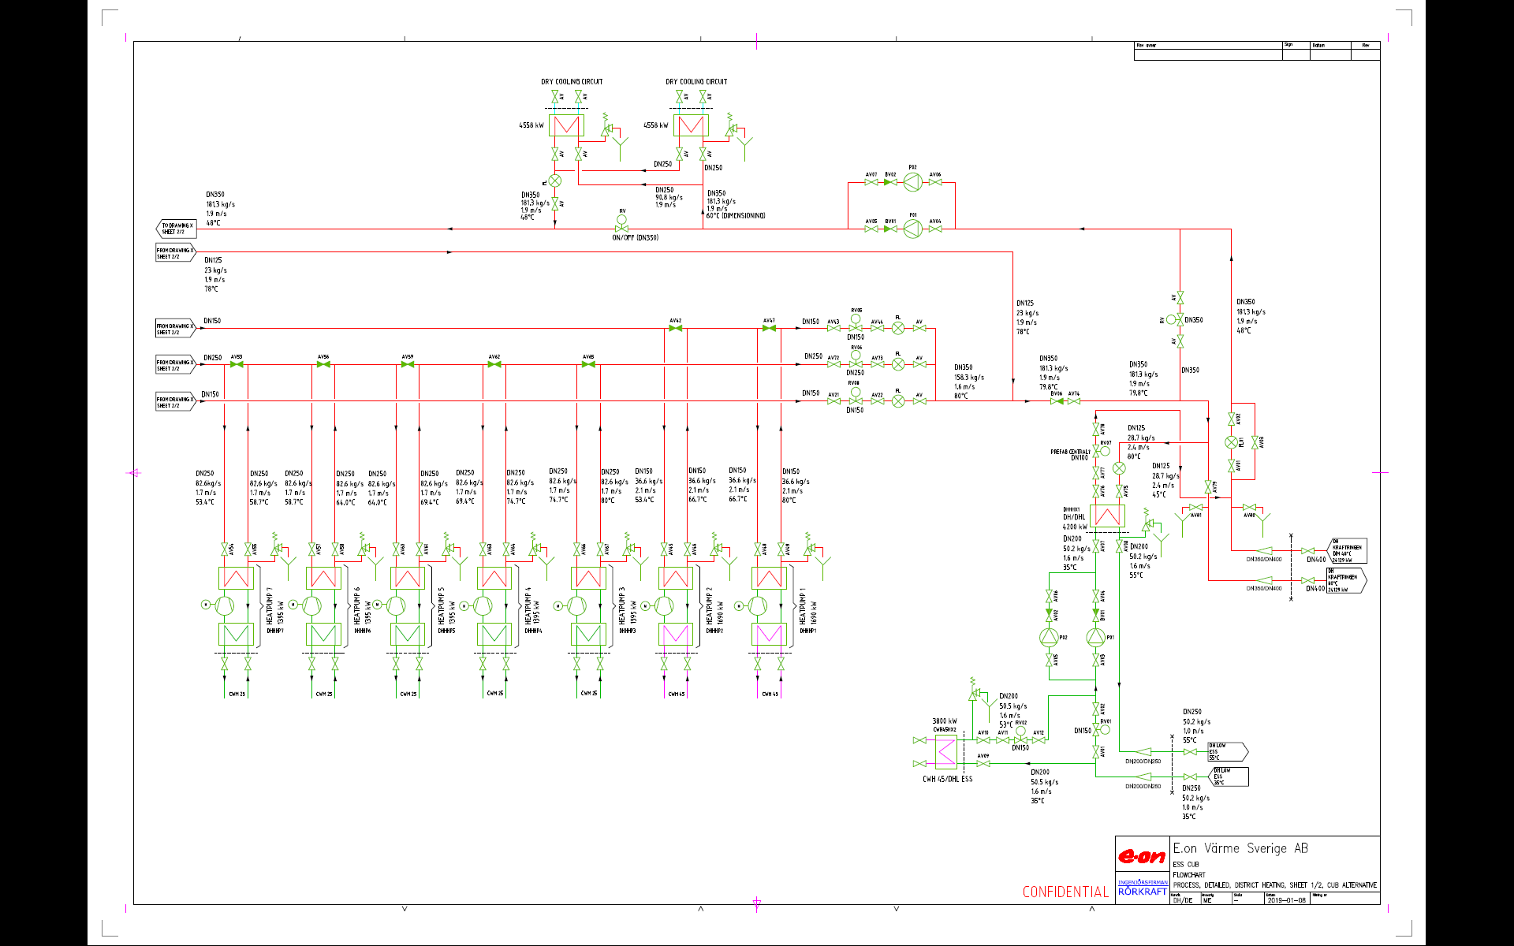

Slide 22
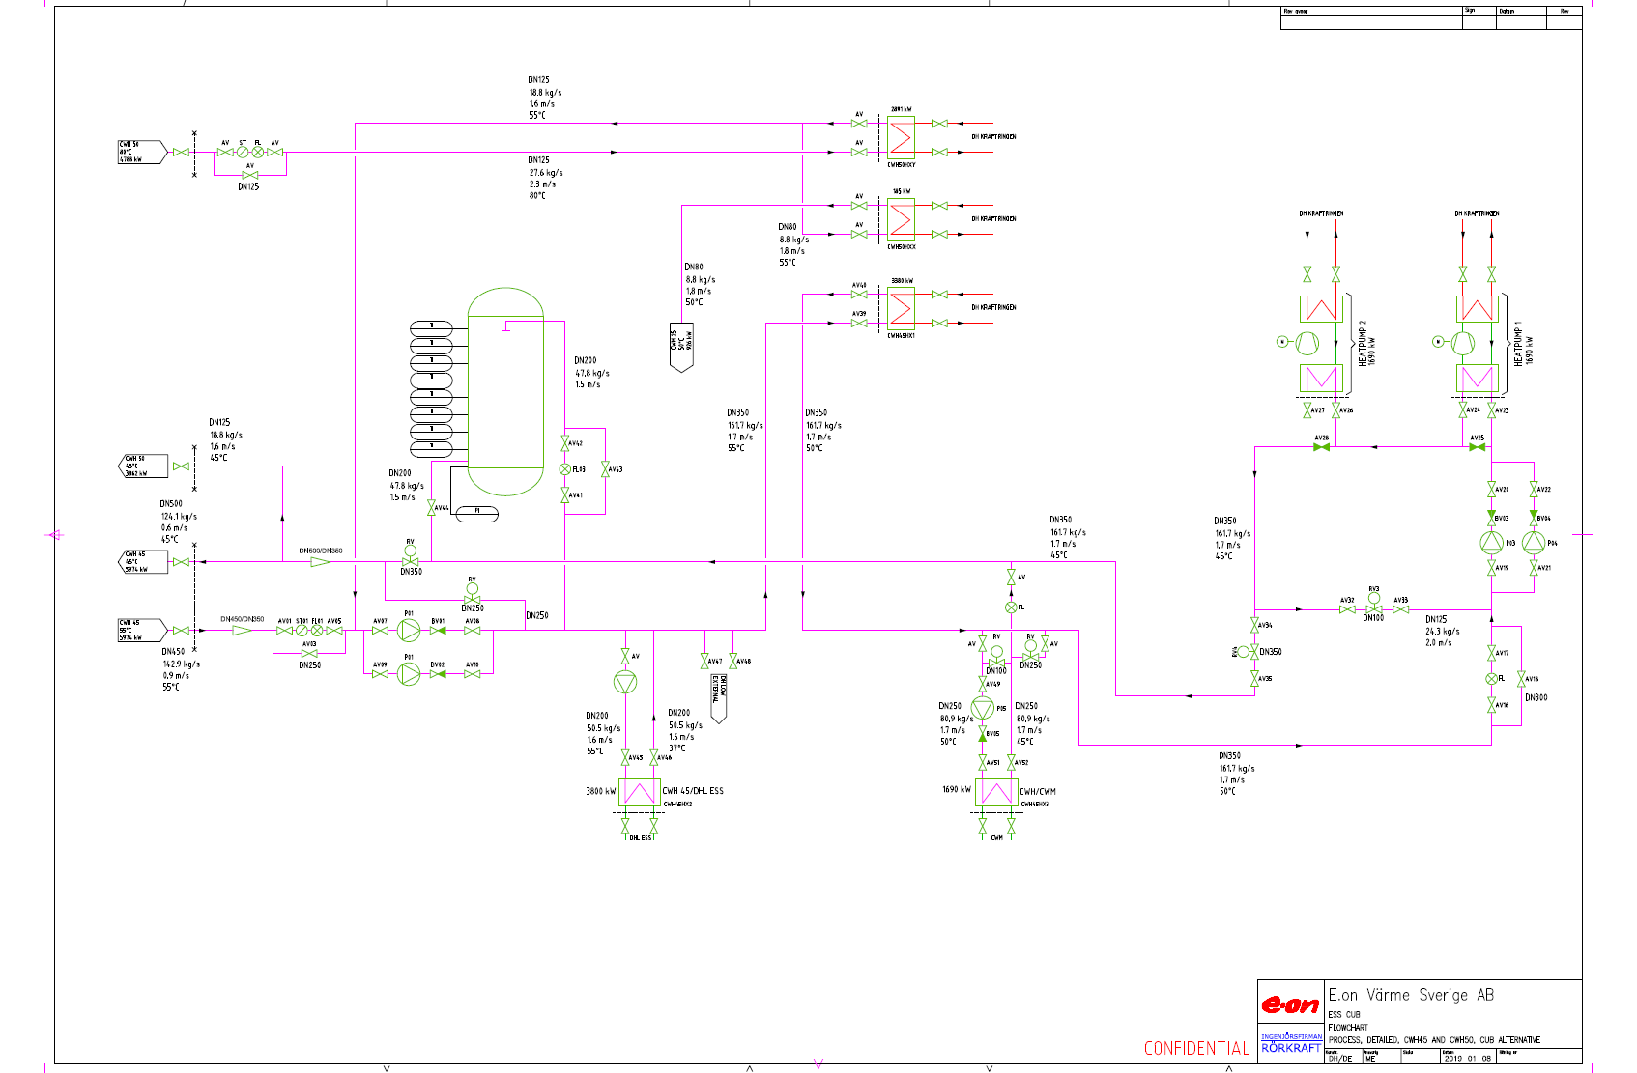

Slide 23
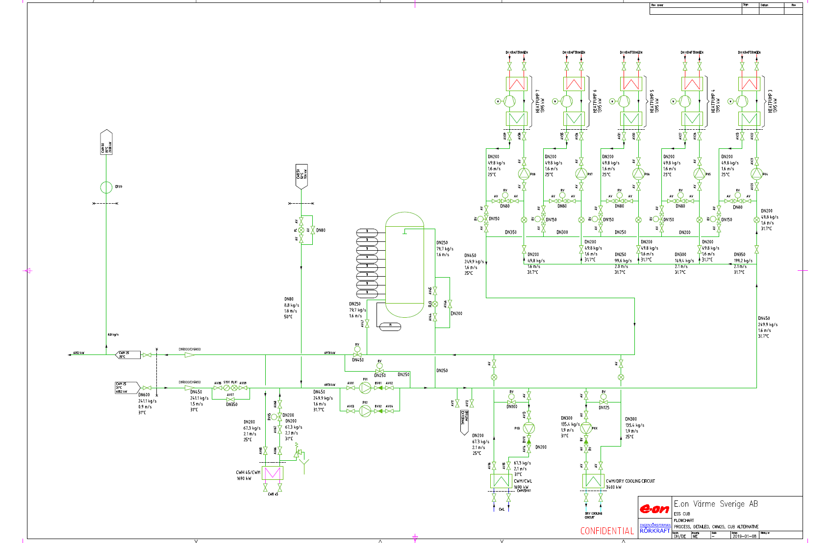

Slide 24
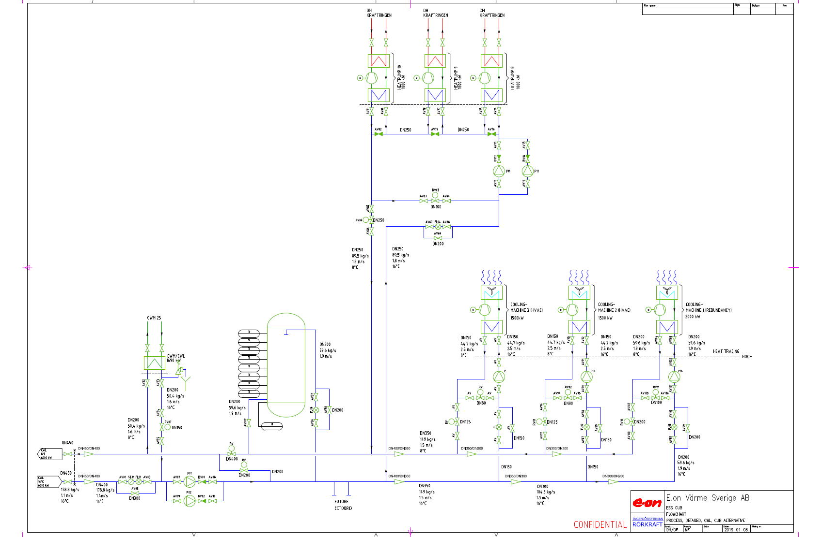

Slide 25
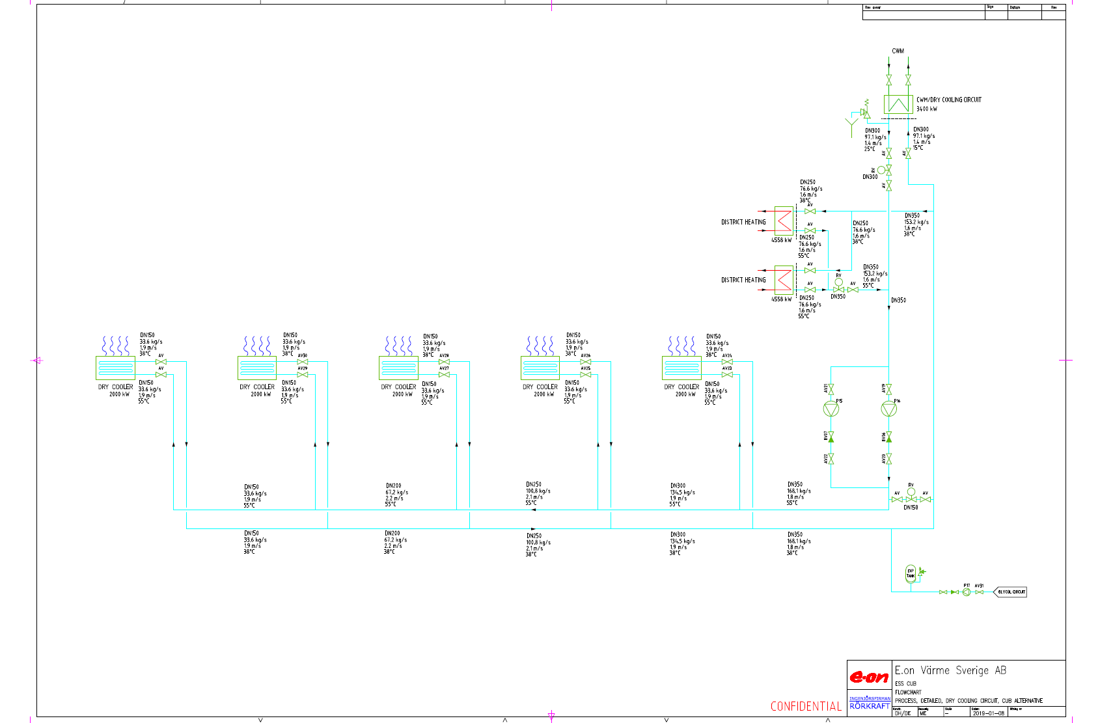

Slide 26
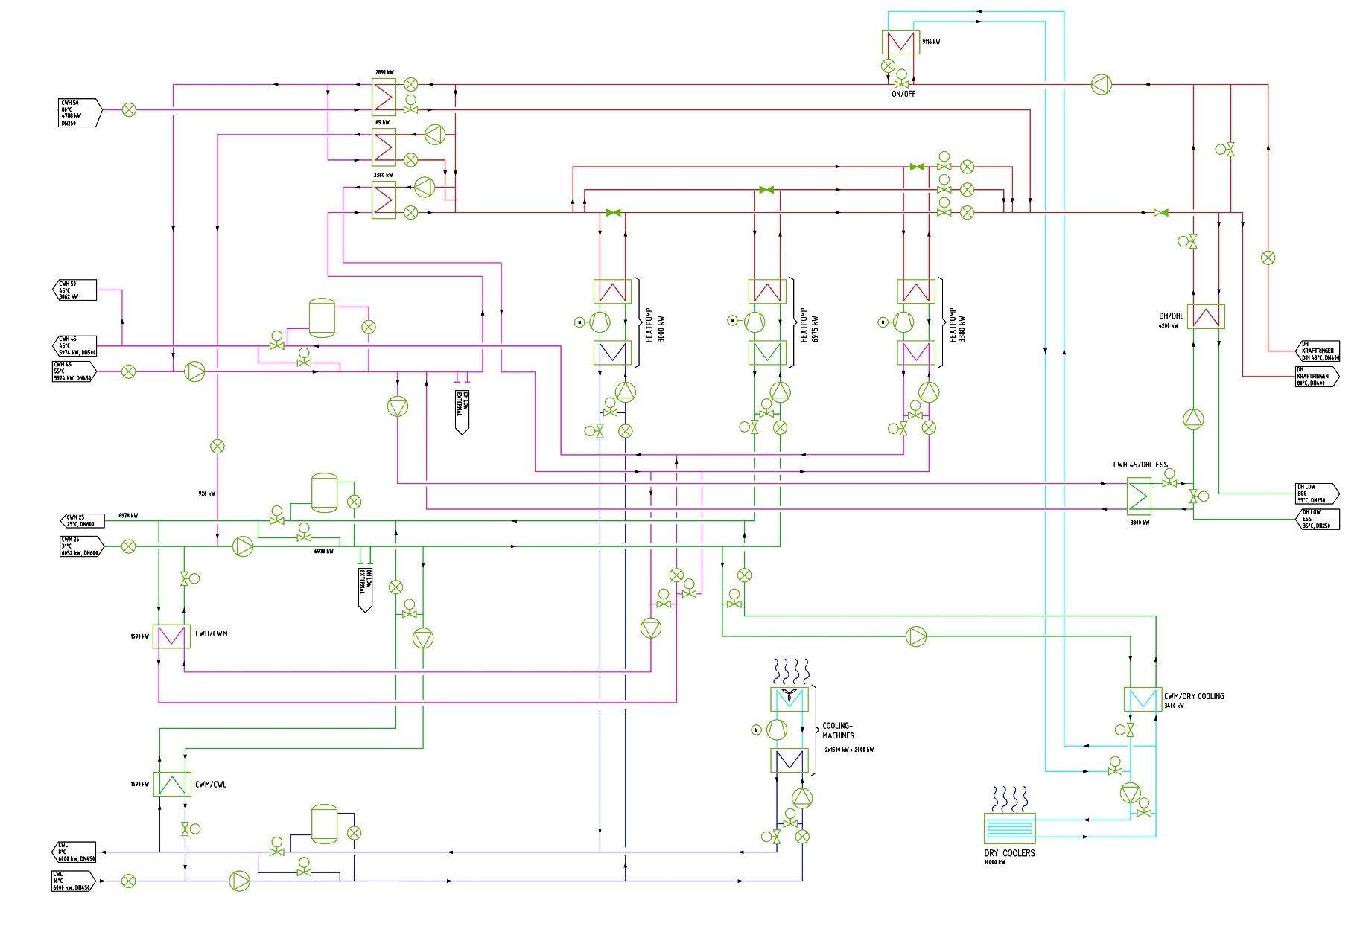
Start-up procedure

Slide 27
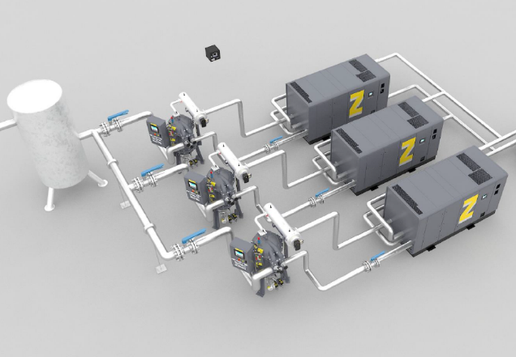
Compressed air
Extent:
Water cooled compressors, VSD, 50%, (2*1500 Nm3/h)
ND dryer, VSD, (Dp -40 C)
After cooler
Compressed air vessel, 4 m3
-Heat recovery system, connected to CWM, CWH
-Emergency cooling system
-Connection point external compressor
Notes:
So, I was asked to talk about the compressed air equipment that we plan to install in the CUB.
The air demand at ESS is aspected to be 3000 Nm3/h, and in the original scope we were aspected to deliver that and also equipment for redundancy based upon failure of biggest machine.
But since the need for compressed air came earlier than aspected ESS has alraedy installed some air compressors that replaces the need for redundancy equipment.
The main components in the compressed air solution are the….
Variable speed controlled & Water cooled compressor
After coolers
ND dryers
Air vessel
The Facility is connected to a heat recovery system that provide cooling to the equipment but also recover the surplus heat to both the CWM & CWH curcuit
There´s also an emergency cooling system
and a possibility to connect an external compressor if needed

Slide 28
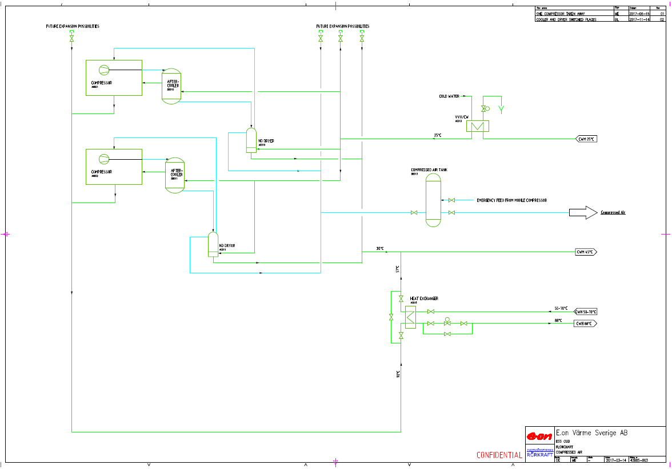
Compressed air solution
4 m3 Air vessel to reduce pressure fluctuations
and demand changes
compressors with 50% capacity each,
1500 Nm3/min
Connection of external compressors
Heat recovery, both circuits
Prepared for uninterrupted expansion
Emergency cooling
ND dryers
Notes:
Here´s the flowchart that shows our design wich are based up on the ESS specifications.
We have chosen to design the compressed air system with two compressors that have 50% capacity each. There are also one compressed air facility in the other end of the compressed air grid owned by ESS, with a capacity of a bit more than 50%, that functions as a redundancy in case of failure.
Both of our compressors are speed regulated and the plant is pressure controlled, based on a reference sensor located in the worst point of the grid.
In order to meet the dewpoint requirement, each compressor has an ND dryer, which differs slightly from the more traditional MD dryer through an extra cooling stage. By using the ND dryer it allows us to optimize energy usage and also reach the tough dewpoint of -40 degrees.
The speed ​​control in combination with the accumulation in the grid and management system, we will be able to keep the pressure requirement, but as an extra security, due to that the outlet pattern is not fully known, we have also chosen to install a 4m3 accumulation.
Most of the energy supplied to the facility are converted into high-quality heat which allows us to recovery surplus heat and also provide urgent cooling for the compressors. The heat recovery system are connected to both CWM and CWH cooling circuits, where we recycle as much as possible into the high-temperature circuit and the remaining heat is taken care of and recycled in the CWM curicuit.
By using both circuits it also gives us higher reliability, but if, for some reason, the cooling curcuits failures and we need to cool off the compressors anyway we are considering to install a completely independent emergency cooling equipment connected to the cold water that automatically starts.
There´s always a compressor as a permanent backup, and if for some reason it is necessary to have additional capacity, the system is prepared to connect a rental compressor, and, in the event of a major brake down, we can section off all or part of existing compressors.
The supplier we´ve been talking to has a well-developed rental store both in Copenhagen and Gothenburg where these sizes of compressors are usually available and can be installed and operated within 24 hours.
The plant is also prepared for further expansion during operation through the possibility of connecting to the valve-mounted expansion hub. This allows us to take a new compressor in operation without affecting the availability.
The entire plant including the ESS compressors, is also equipped with a control system adapted for compressed air and that are fully communicable both down and upstream, for making it easy to monitor and easy to optimize.

Slide 29
Redundancy
The facility is designed for high reliability and performance
At least 50% of the air demand as a back up (failure of the largest machine)
Scheduled maintenance program in cooperation with ESS during low demand periods, (the service demands are roughly 3 h every 6th month and 3 days after 24000 h running time), each service are done with uninterrupted delivery.
Speed control reduces pressure changes and also minimizes the wear and energy demand
Prepared for connection of external compressor
    Tubes and electrical connection
    Reserved location & Emergency Planning
    Established rented centrals (CPH & GBG)
Dual cooling circuits and emergency cooling if everything else falls
Standard machines, well-known supplier with spare parts on the shelf or in the line
Superior control, adapted for compressed air systems
Prepared for expansion under continues operation
Notes:
There´s a desire of redundancy and we have designed the system for high reliability and performance
We have always at least 50% of the air demand as a back up which means that we can always handle a brake down of the largest machine without any interruption.
We have prepared for connection of an external compressor. There´s a reserved location and connection point outside the CUB with prepared piping and power.

Slide 30
Energy efficiency
Energy efficient design and construction
Speed-controlled compressors, low pressure differentials
Possibility of different setpoints to suit true demand requirements
Dedicated control system with full communication both upstream and downstream, as well as logging functions for operating efficiency.
Heat recovery from compressors (90 C), primarily by direct cooling towards (CWH) and then final cooling through the CWM circuit.
ND dries, meets the quality requirements and are energy efficient, revised Dp requirements can be adapted for further energy optimization.
The air inlet of the compressed air compressors is connected to outside air to utilise density gains.
Notes:
We have also done an energy efficient design and construction.

Slide 31
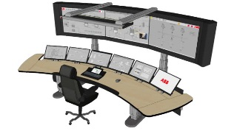


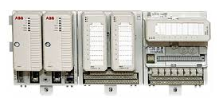
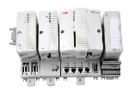
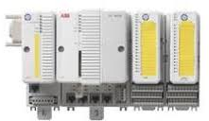
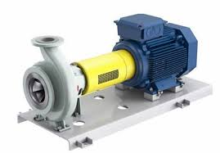
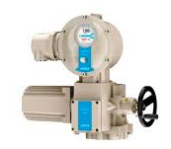
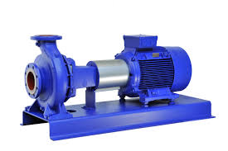
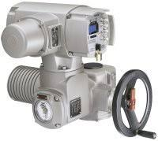
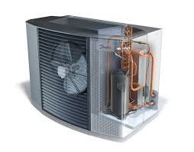
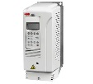
E.ON Control system architecture in Malmö
Why control system ABB 800xA
ABB 800xA Operator Workplace
Business systems
Client/server network server
GPS clocksync
Primary server
Secondary server
800xA Historian
Control Network
AC800M
I/O Cabinet
AC900F
AC800M
ESS H01
SHP
SPK
Other sites

Slide 32
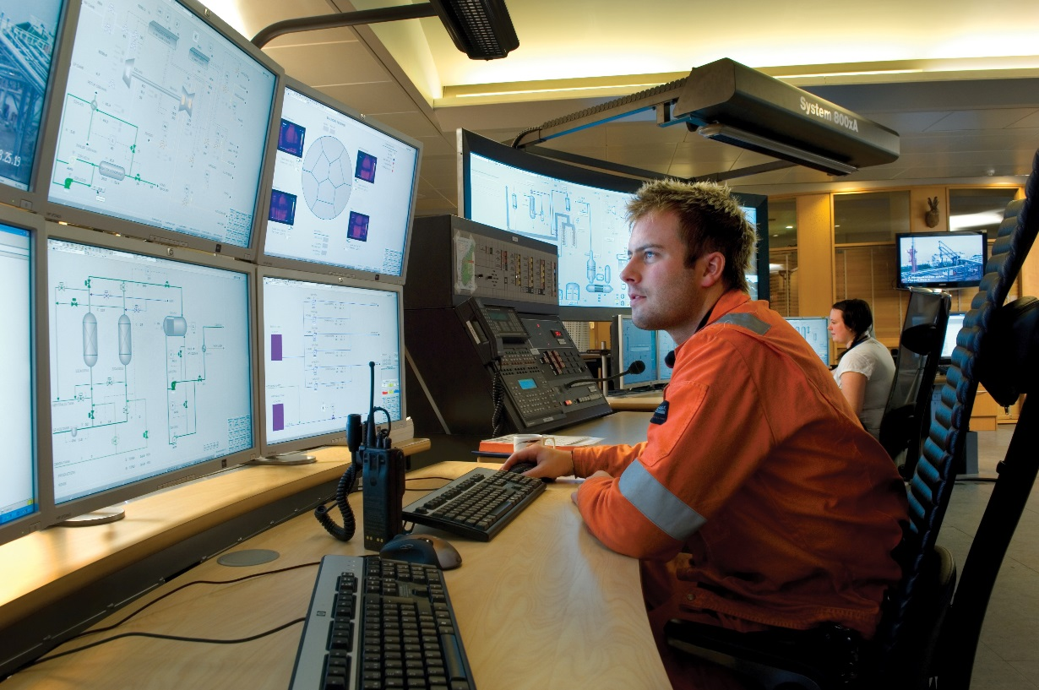
H01 will be controlled and monitored from Heleneholmsverket in Malmö
Why control system ABB 800xA

Slide 33

Time for discussion
Time for discusion?

