Slide 1
Review of the
Conceptual Design of the
Central Process Systems
- Charge and planning -
12 February 2019, Lund
Roland Garoby
https://indico.esss.lu.se/event/934/

Slide 2
Review purpose
The main purpose of the review is to scrutinize and optimize the design of the “Central Process System” (CPS) that is proposed by the selected contractor.
The CPS design has to allow ESS facility to operate reliability and to fulfil its commitments to the authorities, especially in terms of sustainability and heat recovery.
Optimization is concerning:
Costs of construction and operation*,
Design principles in view of sustainability,
Practical implementation in view of maximizing reliability and minimizing complexity and maintenance efforts.
* Qualitatively, on the basis of the technical design

Slide 3
Planning
1st Review on November 14-15, 2017. Presentation of ESS needs and required cooling systems. Explanation of E.ON energy strategy (“Ectogrid”) and preliminary plans for the Central Processing System (CPS) at ESS.
2018:
Re-baselining of the whole ESS project.
Revisiting the cooling systems for simplifying and optimizing the CPS. New version summarized in ESS-0508287.
2nd Review on February 12-13, 2019 to analyze the Preliminary Design submitted by the contractor.
Overview schedule of implementation to be presented by E.ON on February 12, 2019.

Slide 4
Review charge
Are the Contractor’s responses to the questions from the first review satisfying?
Are the ESS revised requirements meeting ESS needs and likely to simplify the CPS design and its construction and operations costs?
Analyze the CPS design proposed by the Contractor:
Is the information communicated sufficiently complete to allow judging the proposal?
Is the design in-line with ESS requirements?
Is it addressing ESS need for reliability and availability?
Is it correctly sized and cost effective (construction)*?
Is it properly minimizing cost of operation and maintenance*?
More generally, the Committee is encouraged to provide comments and suggestions for improvement on all matters it judges relevant.
* Qualitatively, on the basis of the technical design

Slide 5
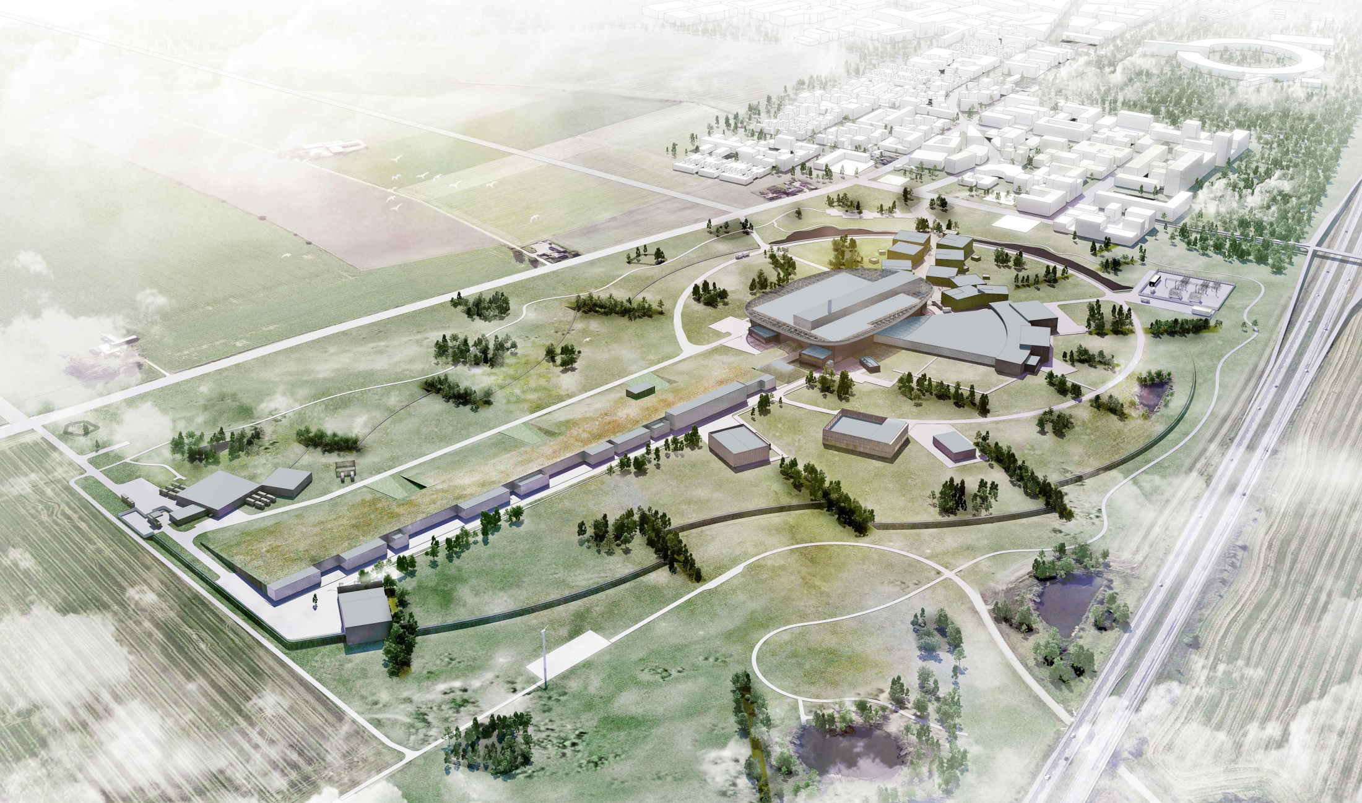
Thank you for being here.
We look forward to your advice!

Slide 6
Reminder from first review (1/2) - Requests
Present a Failure Analysis that explicitly demonstrates the redundancy of all systems including cooling, water treatment and compressed air. (No single point of failure within the CUB systems should disturb the ESS operation.)
Show explicitly how the quality of the water is monitored, what happens if the quality requirements aren’t met and how redundancy is met.
The subcontracting engineers responsible for the water quality system design should attend.
E.ON should make a decision on the possible implementation of the “ectogrid”.
Determine which part of the Central Process Systems needs to be attached to the backup generator. A restart strategy should also be developed.
Provide the characteristics of the rejected water and inform ESS of the needs for draining.
Describe the noise environment.
Provide details on the optimization of electricity consumption.
Describe a preliminary plan for operation, maintenance and troubleshooting.
Exploit the ESS replies to the questions listed in the section below (“Questions to ESS”).

Slide 7
Reminder from first review (2/2) - Recommendations
E.ON should take note of the ESS PLC and EPICS standards and is encouraged to apply them.
ESS and E.ON should work together to optimize any interlocks. Interlocks should be minimized if possible.
Examine the possibly of using the 80 C heat to produce the chilled water.
Examine decoupling the production of temperature from the distribution of the water.
Consider the use of double walled heat exchangers between the ESS and the external circuits.

