Slide 1
Status of Beam Instrumentation
Tom Shea
European Spallation Source ERIC
April 11, 2019

Slide 2
Outline
Intro
  Beam Diagnostics Organization
  Instrumentation Suite
Status by Example
  Systems initially deployed in LEBT
  Systems for NC linac commissioning
  Systems for beam on target
Plans
  Installation Schedule
  Changes over the past year
  Plan with ICS

Slide 3
Organization
>20 Partners and Collaborators
Aarhus University
CEA Saclay, Paris
CERN, Geneva
Cockcroft Institute, Daresbury
DESY, Hamburg
Elettra – Sincrotrone Trieste
ESS Bilbao
INFN, Catania
INFN, Legnaro
Lund University
University of Oslo
DTU, Denmark
STFC, Daresbury
WUT, Warsaw
Chinese ADS
J-PARC, Japan
ORNL, USA
LANL, USA
INR, Moscow
Högskola Väst, Trollhättan
Stony Brook U., New York
BNL, New York
At ESS Lund, the team consists of staff, consultants, students, and matrixed staff
Lead system design and deployment
Cover all technical disciplines
Thomas Shea
System Leads
Rafael Baron
Clement Derrez
Elena Donegani
Hooman Hassanzedagen
Irena Dolenc Kittelmann
Roxana Tarkeshian
Cyrille Thomas
Technical Team
All system leads contribute technical expertise
In addition:
Edvard Bergman
Thomas Grandsaert
Slava Grishin
Maria Hoflund
Hinko Kocevar
Mehdi Mohammednezhad
Johan Norin
Kaj Rosengren

Slide 4
Proton Beam Instrumentation Suite
Assets
Variant | System | ISrc | LEBT | RFQ | MEBT | DTL | Spk | MBL | HBL | HEBT | DMPL | A2T | Target | Sum | Tunnel | Gallery
APTMM | APTM |  |  |  |  |  |  |  |  |  | 1 | 1 | 2 | 4 | 9 | 10
BCM | BCM | 1 | 1 | 1 | 2 | 5 |  | 1 | 1 | 2 | 2 | 3 |  | 19 | 57 | 79
FBCM | BCM |  |  |  | 1 |  |  |  |  |  |  |  |  | 1 | 1 | 6
ICBLM | BLM |  |  |  |  | 5 | 52 | 36 | 84 | 49 | 6 | 34 |  | 266 | 266 | 335
nBLM | BLM |  |  |  | 4 | 42 | 26 | 2 | 2 | 2 |  | 4 |  | 82 | 107 | 201
BPM | BPM |  |  |  | 7 | 15 | 14 | 9 | 21 | 16 | 4 | 12 |  | 98 | 196 | 280
FBPM | BPM |  |  |  | 1 |  |  |  |  |  |  |  |  | 1 | 2 | 8
COLL | COLL |  |  |  | 3 |  |  |  |  |  |  |  |  | 3 | 24 | 17
DPL | DPL |  | 1 |  |  |  |  |  |  |  |  |  |  | 1 | 4 | 11
EMUAS, EMUSG | EMU |  | 1 |  | 1 |  |  |  |  |  |  |  |  | 2 | 28 | 37
FC | FC |  | 1 |  | 1 | 2 |  |  |  |  |  |  |  | 4 | 33 | 18
GRD | GRD |  |  |  |  |  |  |  |  |  |  |  | 1 | 1 | 1 | 20
IBS | IBS |  |  |  |  |  | 1 | 1 |  |  |  |  |  | 2 | 8 | 18
IMG | IMG |  |  |  |  |  |  |  |  |  | 1 |  | 2 | 3 | 3 | 31
LBM | LBM |  |  |  | 1 |  | 1 | 1 |  |  |  |  |  | 3 | 6 | 15
BIF | NPM |  | 2 |  | 2 |  |  |  |  |  |  | 1 |  | 5 | 102 | 26
IPM | NPM |  |  |  |  |  | 1 | 3 | 1 |  |  |  |  | 5 | 10 | 23
FWS | WS |  |  |  |  |  |  |  |  | 3 |  |  |  | 3 | 27 | 26
WS | WS |  |  |  | 3 |  | 3 | 3 | 1 |  |  | 1 |  | 11 | 74 | 93
XRS | XRS |  |  |  |  |  |  | 1 |  |  |  |  |  | 1 | 1
totals |  | 1 | 6 | 1 | 26 | 69 | 98 | 57 | 110 | 72 | 14 | 56 | 5 | 515 | 959 | 1254

Slide 5
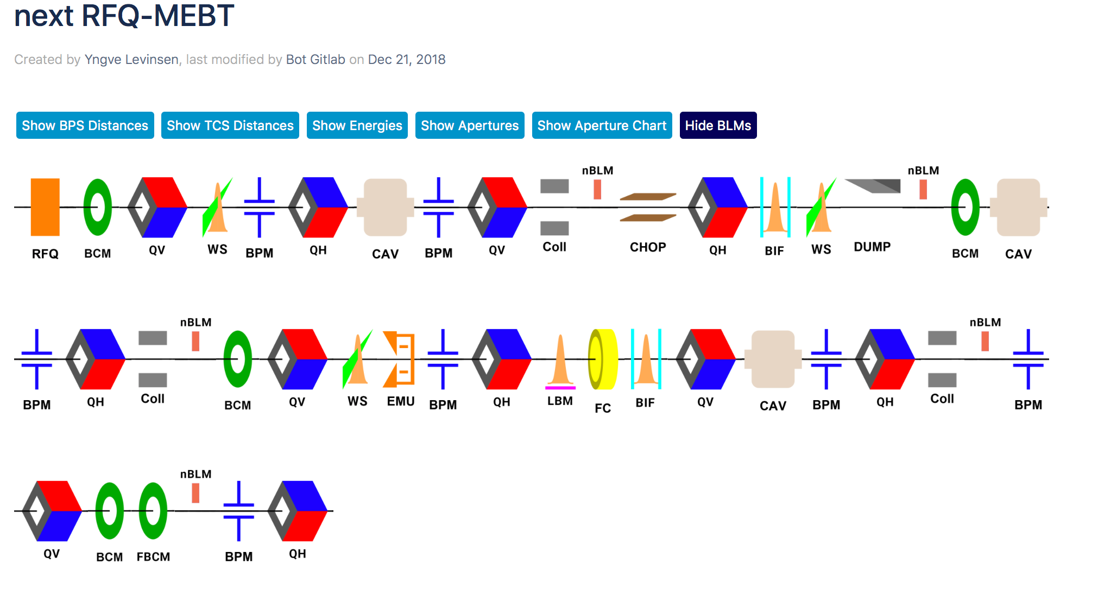
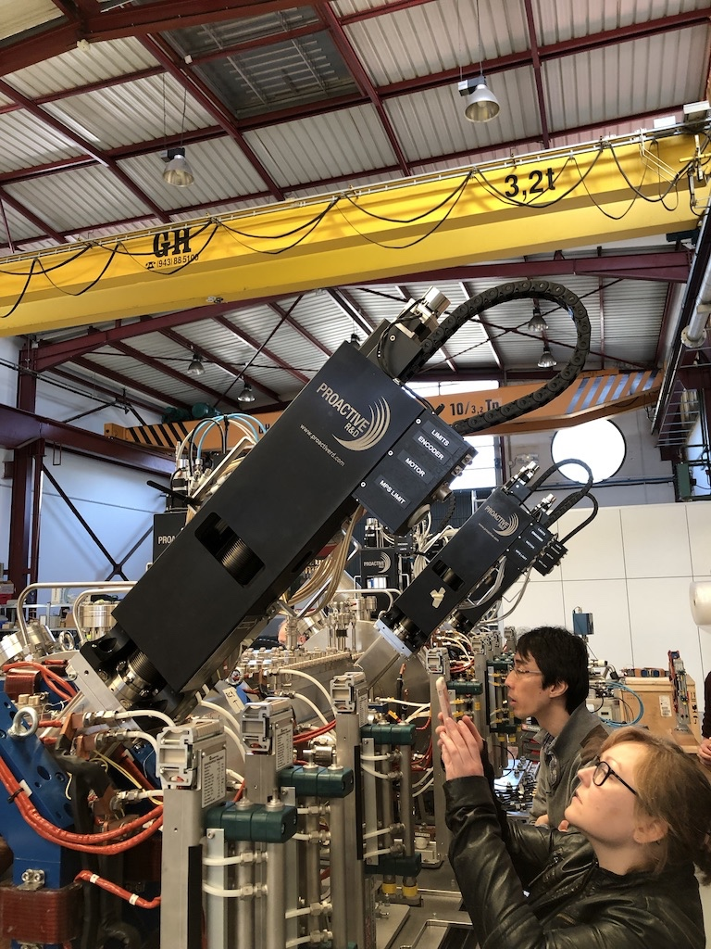
MEBT Beam Instrumentation
From concept to reality

Slide 6
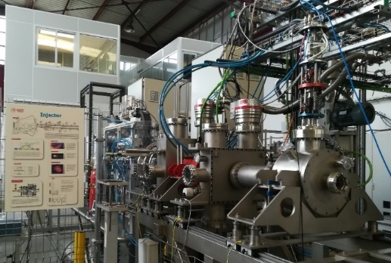
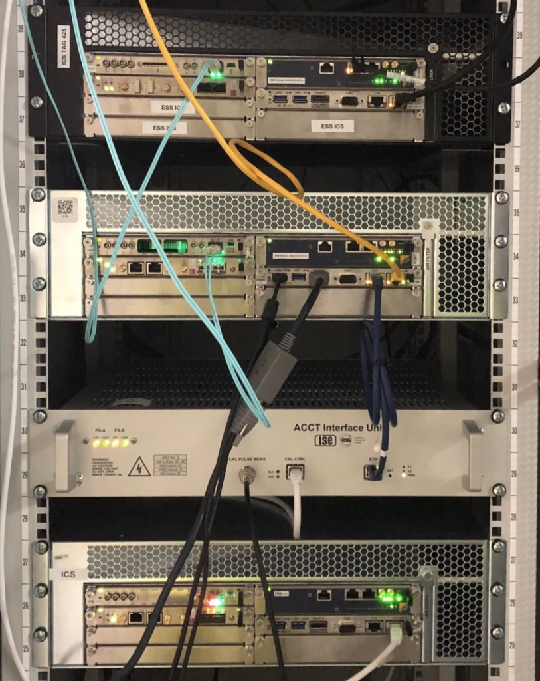
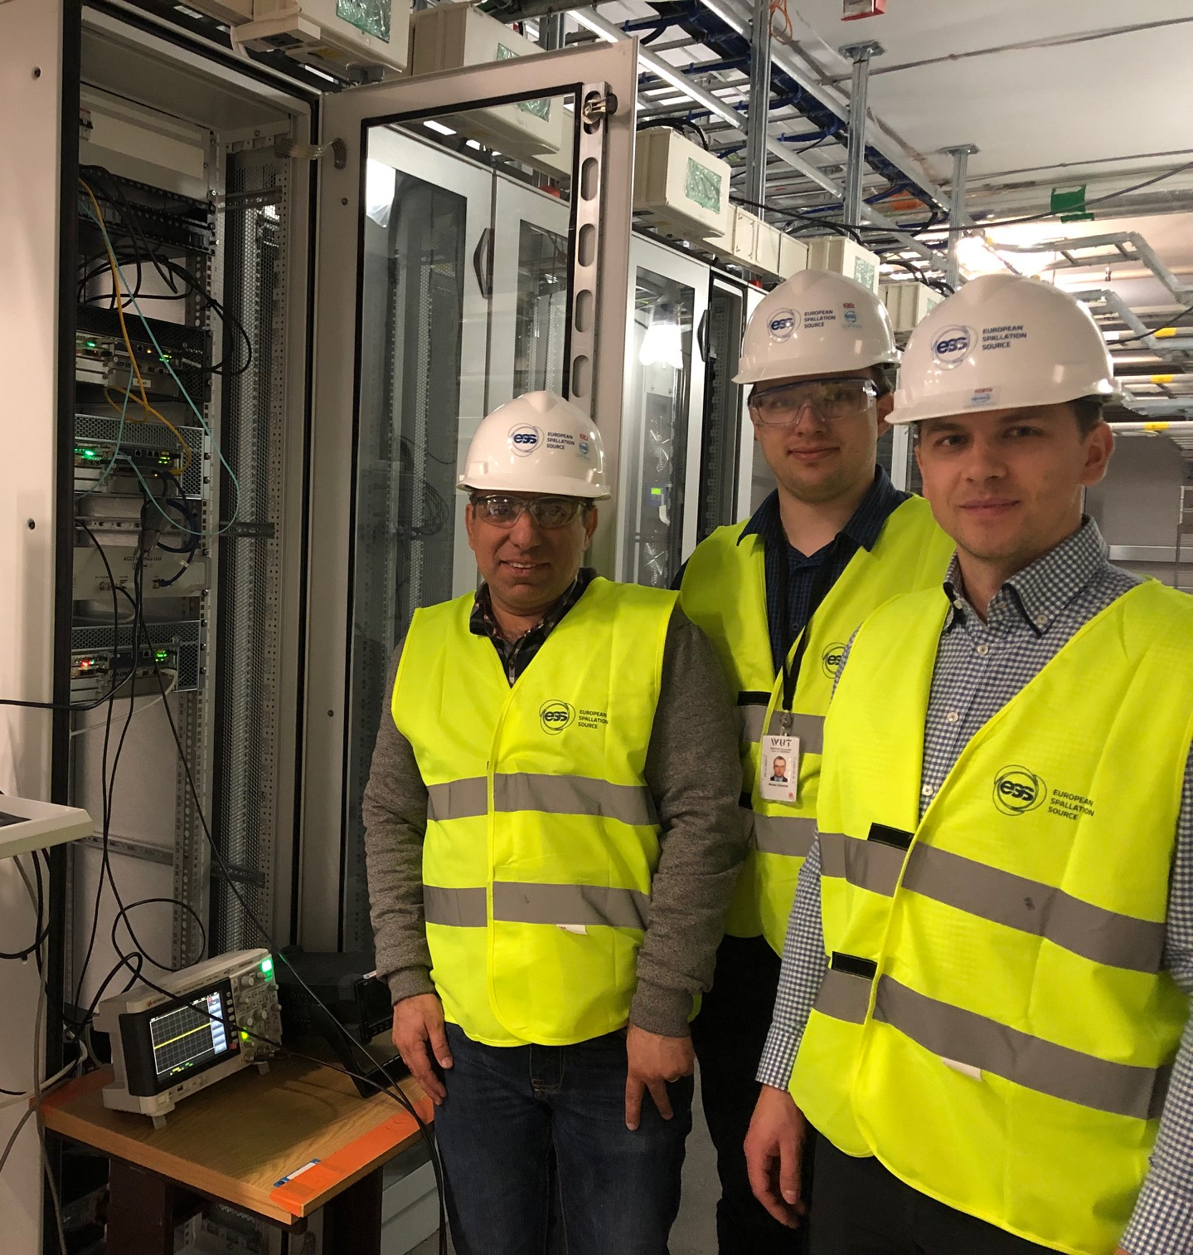
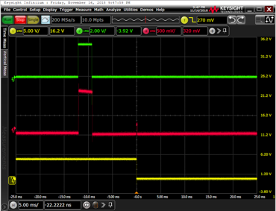
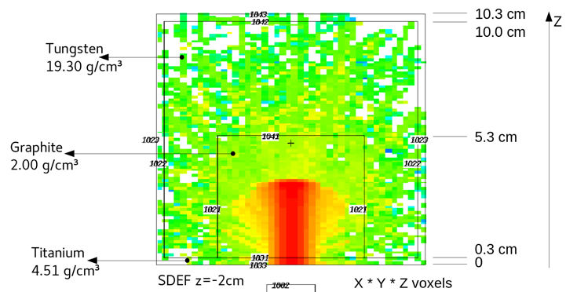
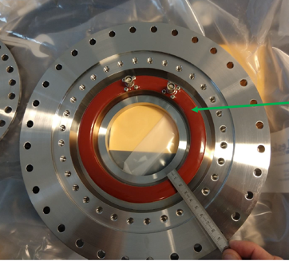
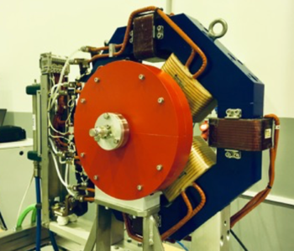
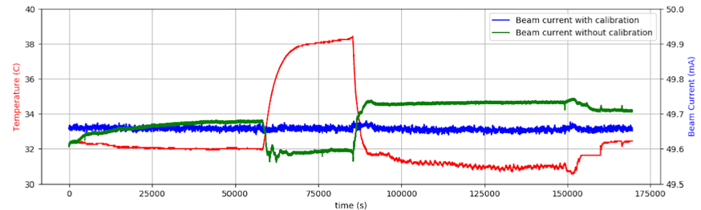
Beam Current Monitor (BCM) and Faraday Cup (FC)
MEBT FC tested with injector beam in Bilbao
LEBT BCMs and Faraday cup in operation at ESS.
Performance requirements have been achieved.
All BCM chassis received from WUT
Warsaw team is at ESS this week for acceptance testing and installation:
MEBT FC system tested in beam in Bilbao
DTL FC simulated (supporting licensing)
Bids received for all DTL devices (most critical procurement for NC Linac)
BCM auto calibration feature and machine protection successfully tested in the lab.
RFQ and MEBT BCM assemblies
Spoke beam stop simulation

Slide 7
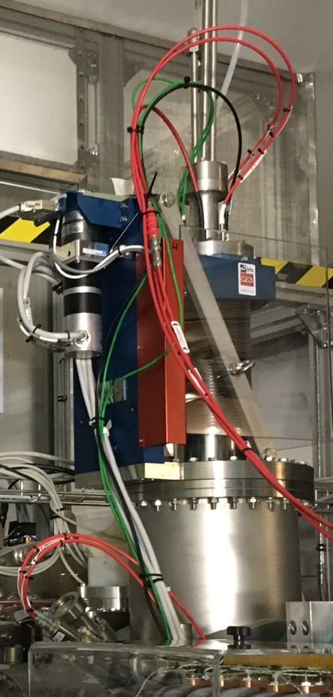
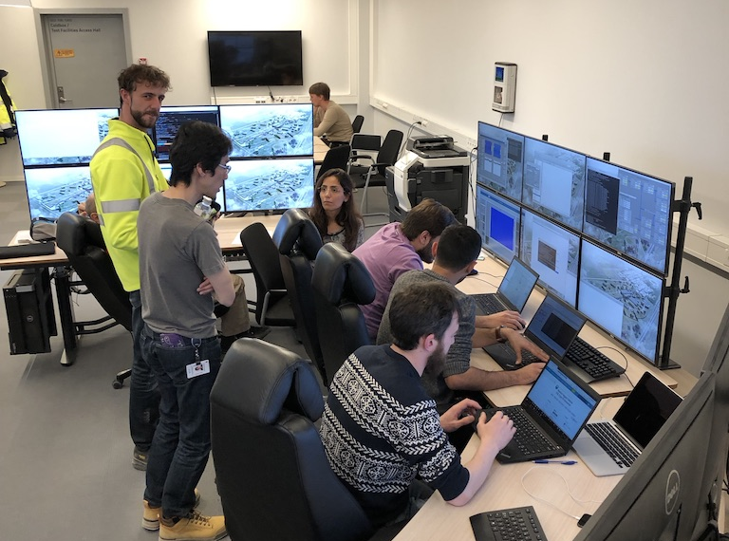
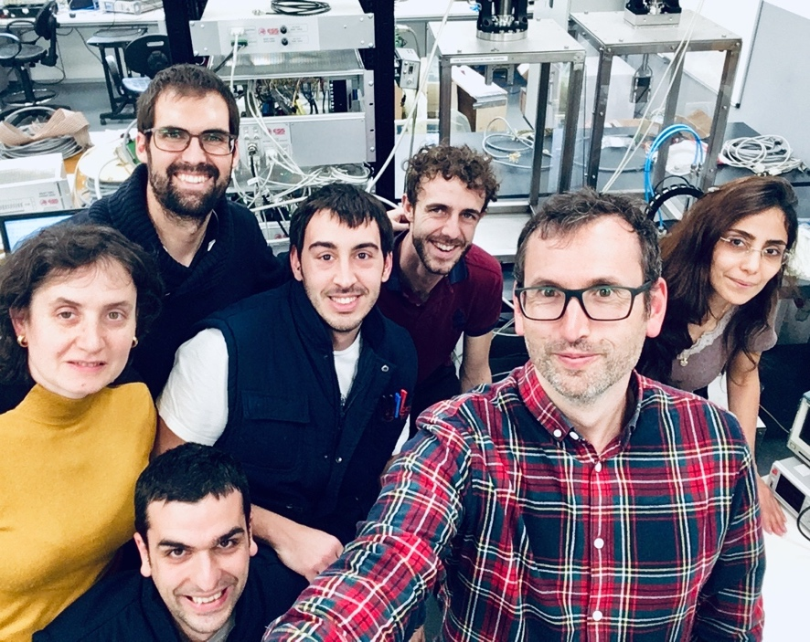
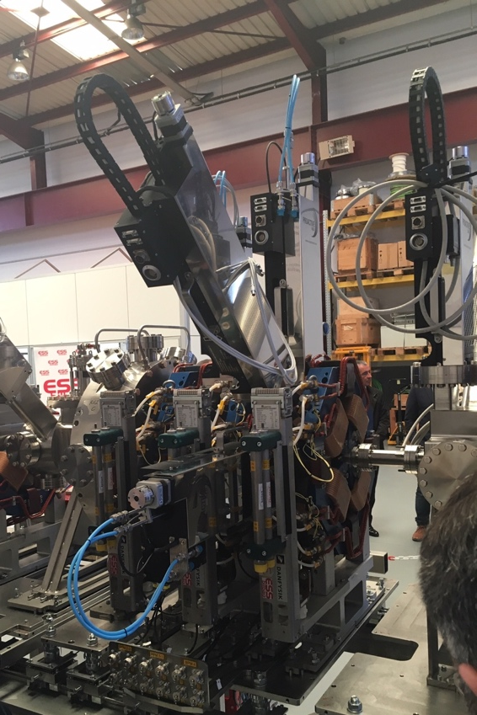
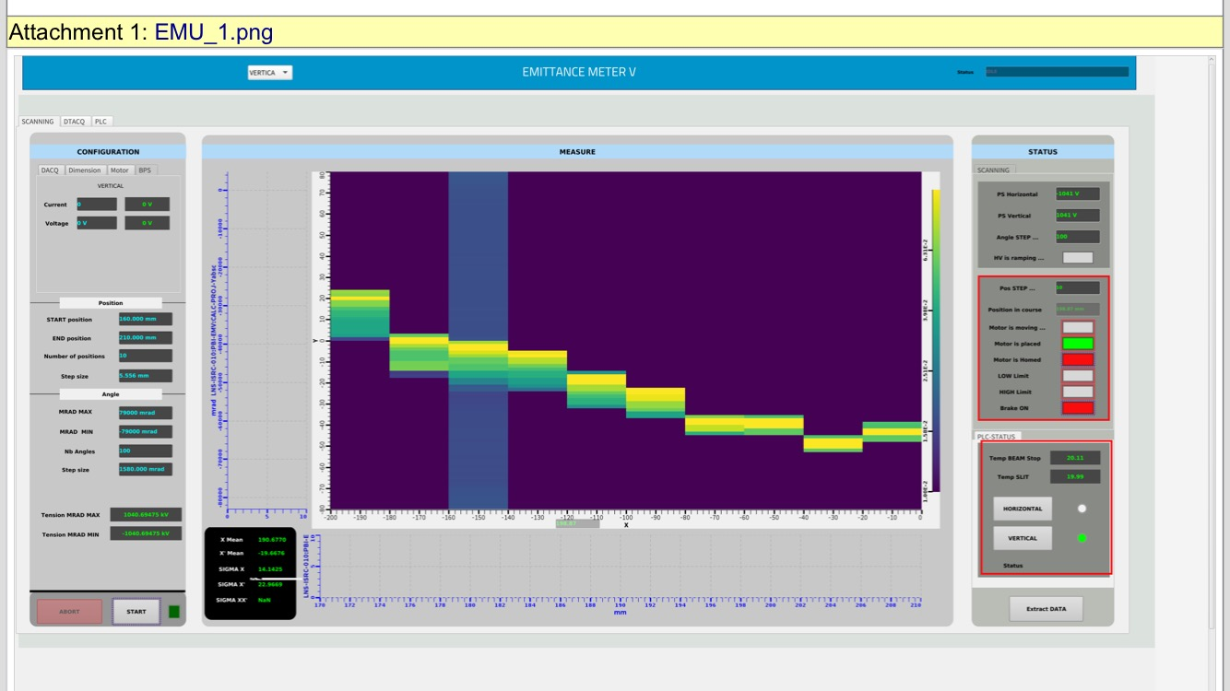
Emittance Measurement Units (EMU)
LEBT EMU installed in Lund in August 2018; commissioning with beam began last night.
MEBT EMU vertical test performed at ESS Bilbao. Slit and grid installed in MEBT.
Lund last night
Bilbao in February

Slide 8
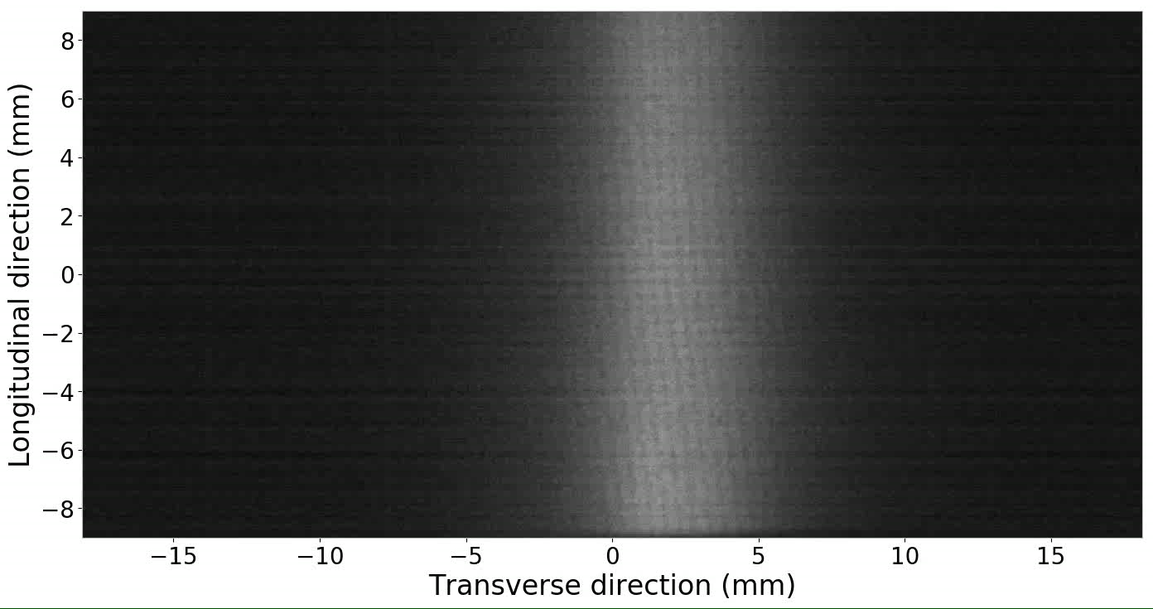
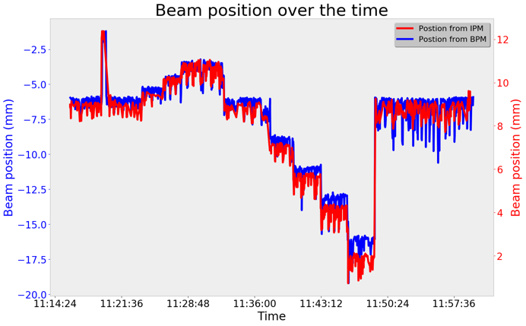
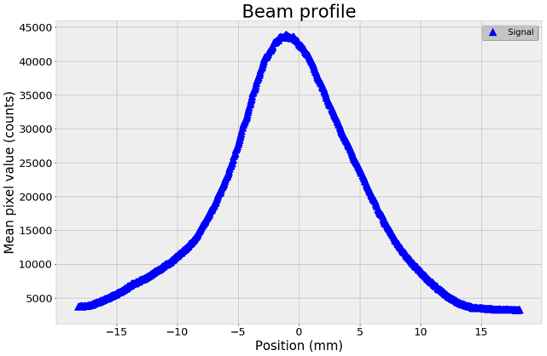
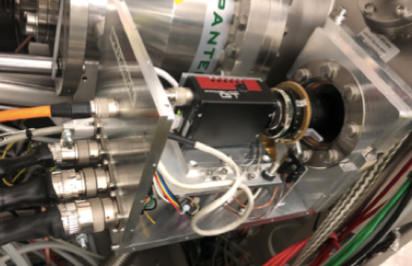
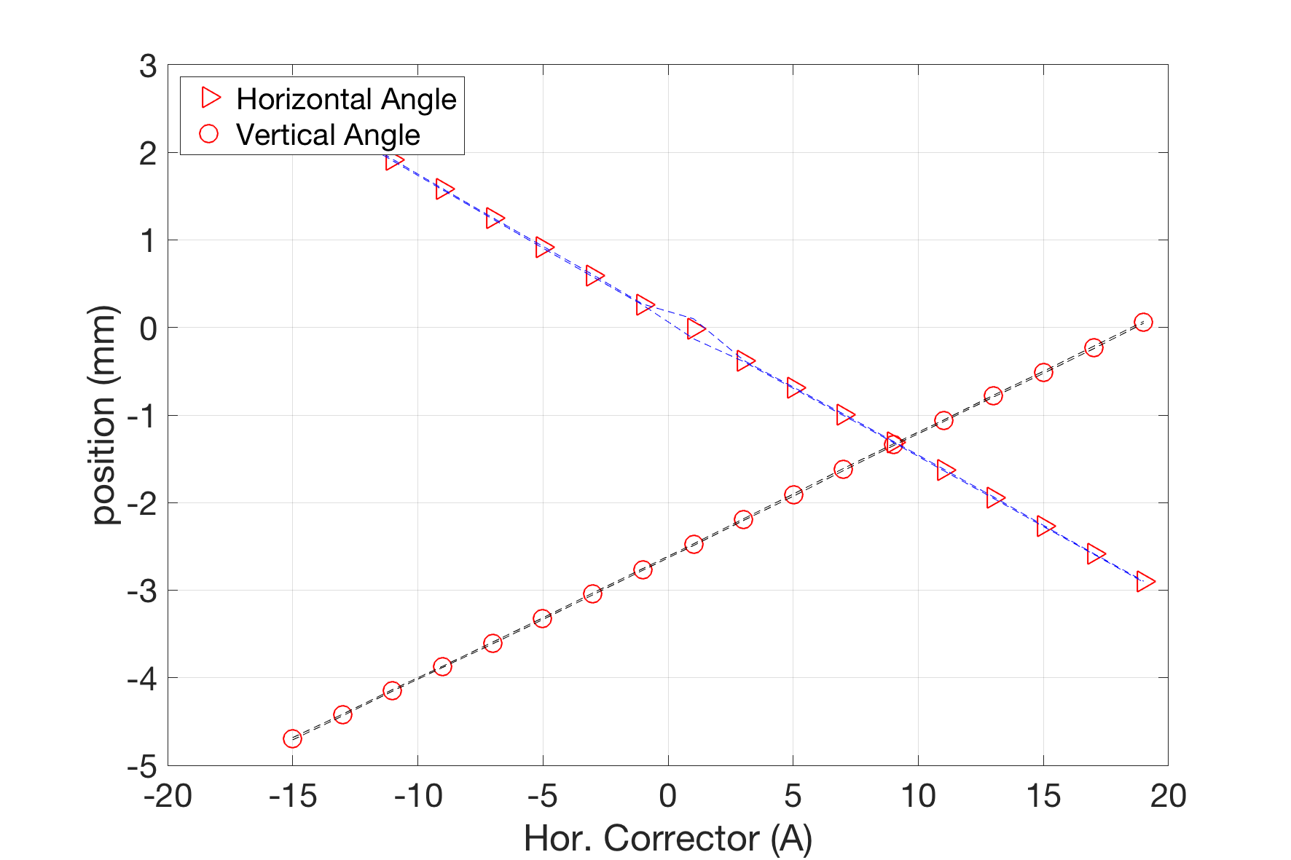
Non-Invasive Profile (NPM)
Beam induced fluorescence (BIF) and Ionization profile monitor (IPM)
IPM tested in beam at CEA Saclay
CDR passed – camera system with intensifier selected
*Ryoichi

Slide 9
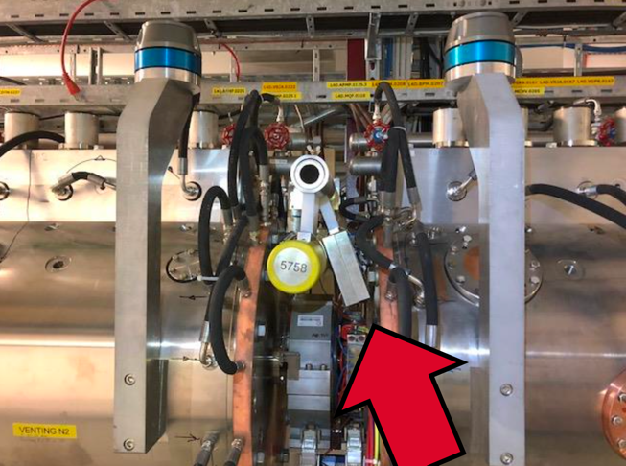
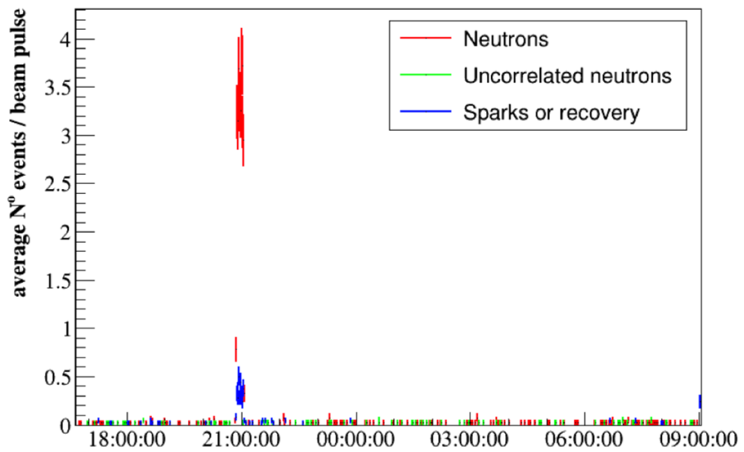
Neutron Beam Loss Monitor (nBLM)
Fast nBLM tested in Linac4
Detector installed at DTL1-2 intertank region (~12MeV H⁻)
Neutrons discrimination demonstrated during normal operation and controlled beam spill
Detectors are in production at CEA Saclay
First full batch due this month
In Lund and Łodz, work continues to address issues with digital platform
noise
gammas from RF
neutrons
Neutrons
(~200 µs)
Neutrons during time of beam spill
gammas from RF
(~880 µs)
Notes:
Distribution of events over amplitude
reconstructed events – blue histo
“Raw” processed data (as collected) – black histo
Neutrons above ~ 30mV – consistent with scope results (CEA)
Distribution of events over amplitude and time inside the Linac4 pulse period (1.2s) for a 2h long run:
Plots consistent with the data collected with scope
Measured RF pulse period ~880us consistent with expected value of 850us
Clear separation of neutrons from RF induced photons and noise – proof of basic nBLM neutron detection algo idea with final platform (IFC1410)
Plots below: time measured from end of pulse period
Test at linac4 in Dec. 2018
nBLM-F detector installed at DTL1-2 intertank region (~12MeV H⁻)
Processed data collected with scope and with IFC1410 based prototype (FW & command line SW provided by Lodz).
Online: event detection and amplitude, TOT, timestamp, rise time, etc extraction: framing & splitting events to provide neutrons/us
Offline analysis: event reconstruction

Slide 10
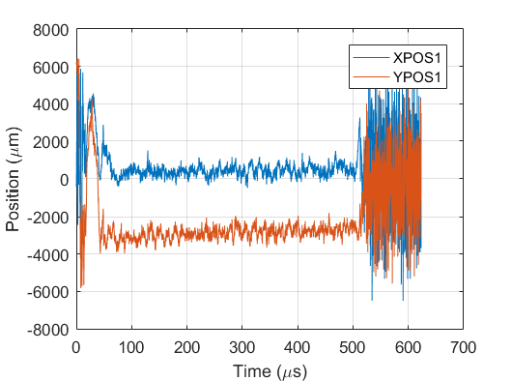
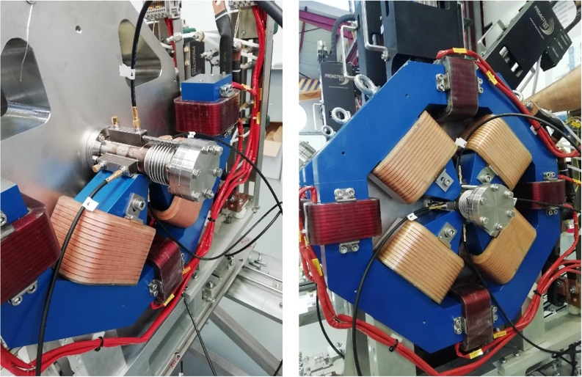
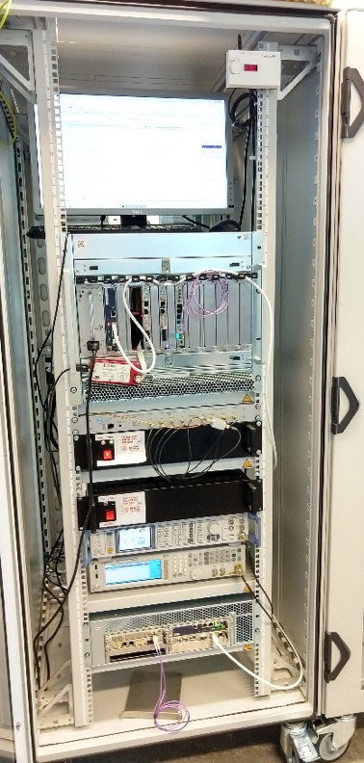
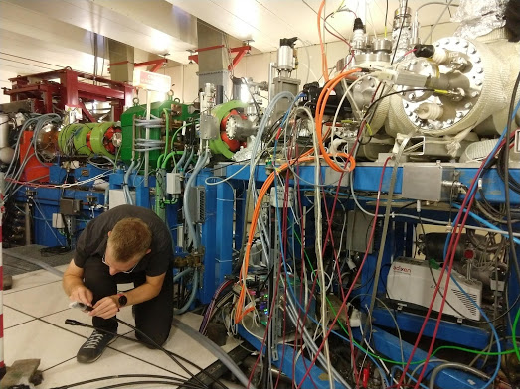
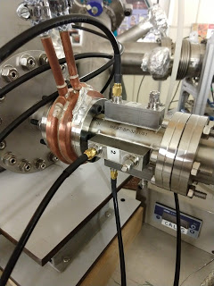
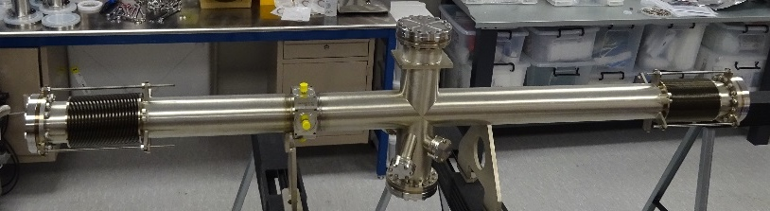
Beam Position Monitors (BPM)
MEBT BPM sensors and BPM electronics verified with beam tests at CEA Saclay IPHI accelerator: 3 MeV, 0.4 mA to 50 mA, proton beam, 352.2 MHz RF.
All MEBT BPMs accepted. LWU BPM production is 93% complete. In Daresbury, BPMs are being installed in the LWUs.
Analog Front End is designed and tested. Taking advantage of ESS schedule change by adding embedded functions to improve cost/performance.

Slide 11
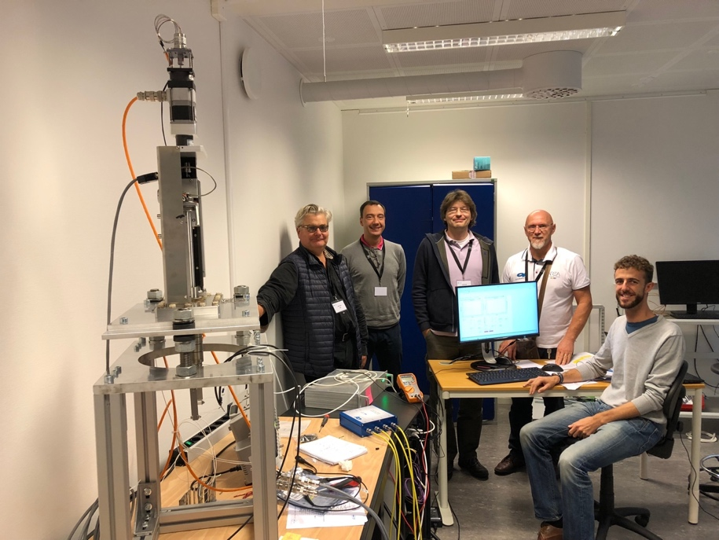
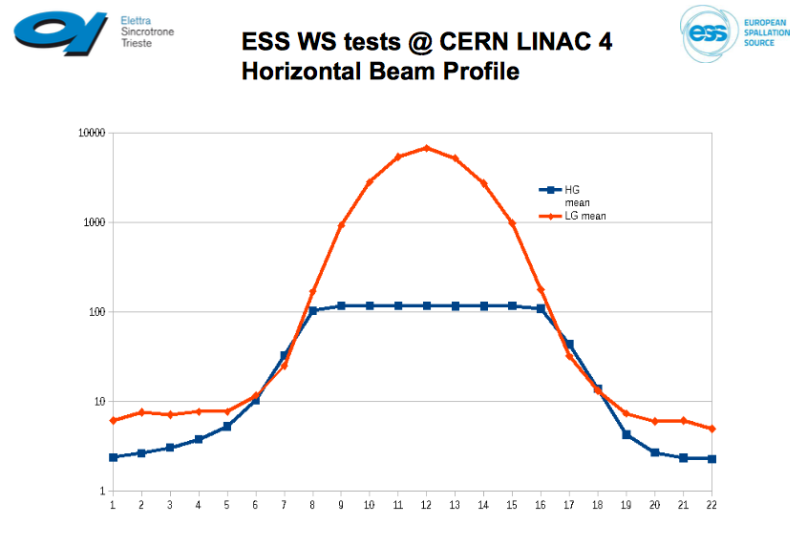
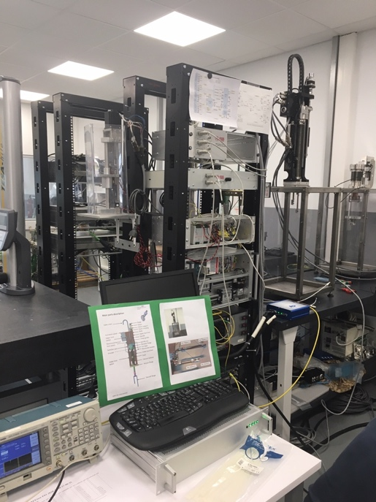
Wire Scanners
Electronics verified during beam tests at CERN LINAC4
Complete acquisition chain verified during vertical integration tests with team from Elettra using MEBT and High Energy actuators.
Analog Front Ends and Back Ends received in Lund. All Normal-Conducting Linac equipment ready for installation.
Initial EPICS integration done by Elettra, updates needed before linac commissioning
Vertical test in Lund
Vertical test in Bilbao
Beam Tests at LINAC4

Slide 12
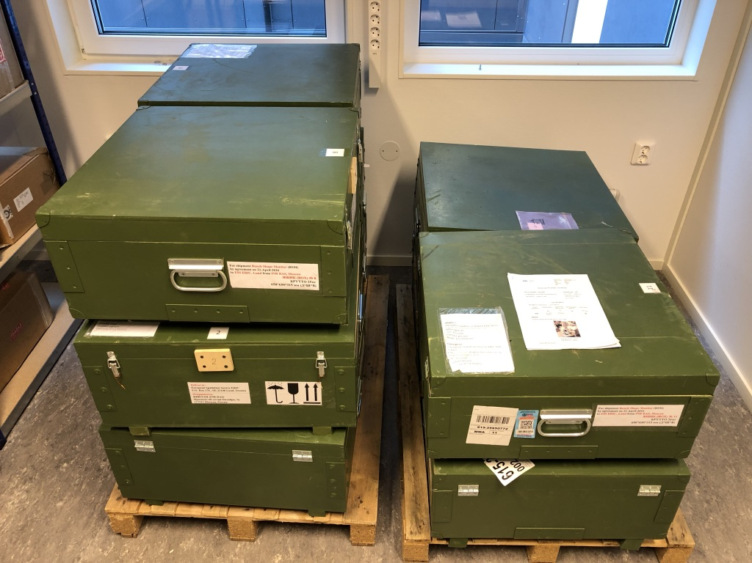
Longitudinal Bunch Monitor (Bunch Shape Monitor)
3D model vs Reality
Model
Chamber installed in MEBT
Units for MEBT and Spokes received
Vacuum test report

Slide 13
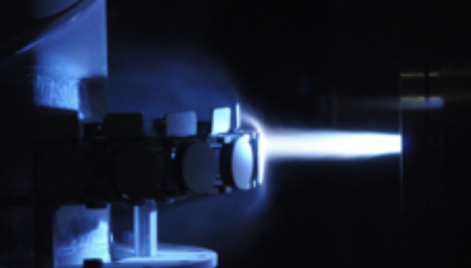
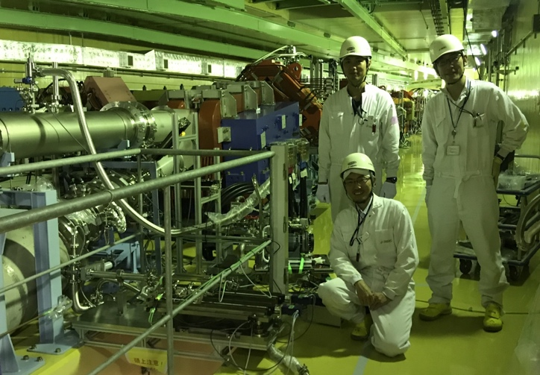
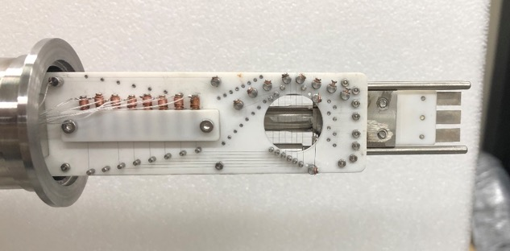
Beam on Target Diagnostics:
Aperture Monitor, Grid, Imaging
Aperture monitor and grid tested in beam at J-PARC
MLF Experiment 2018AU990:
ESS, LTH, J-PARC, IMP/CAS collaboration
In Trollhätten, industrialization of luminescent coating for target
In Lund, acceptance testing of target and dump optical systems and screens

Slide 14
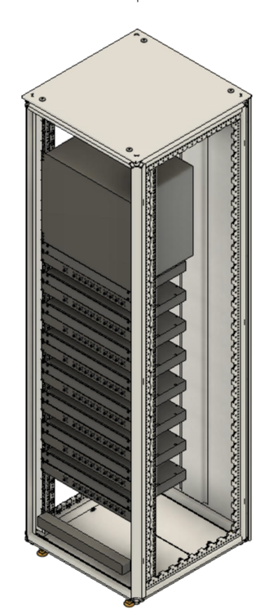
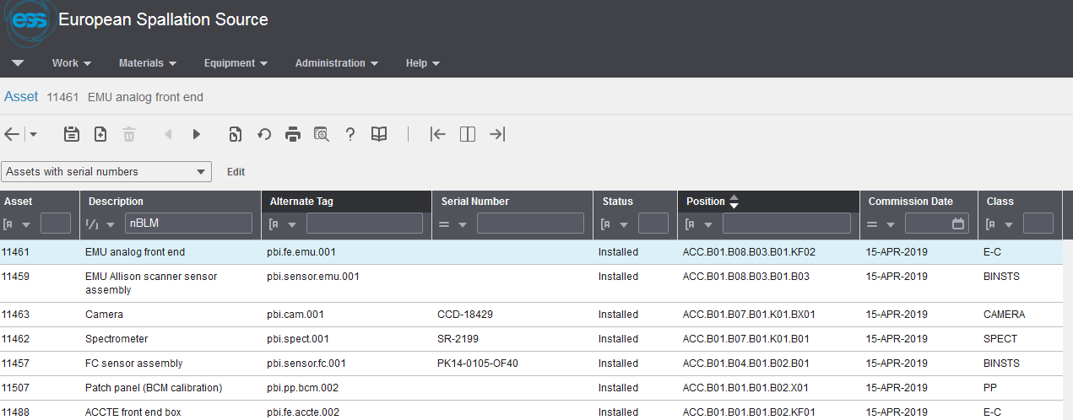
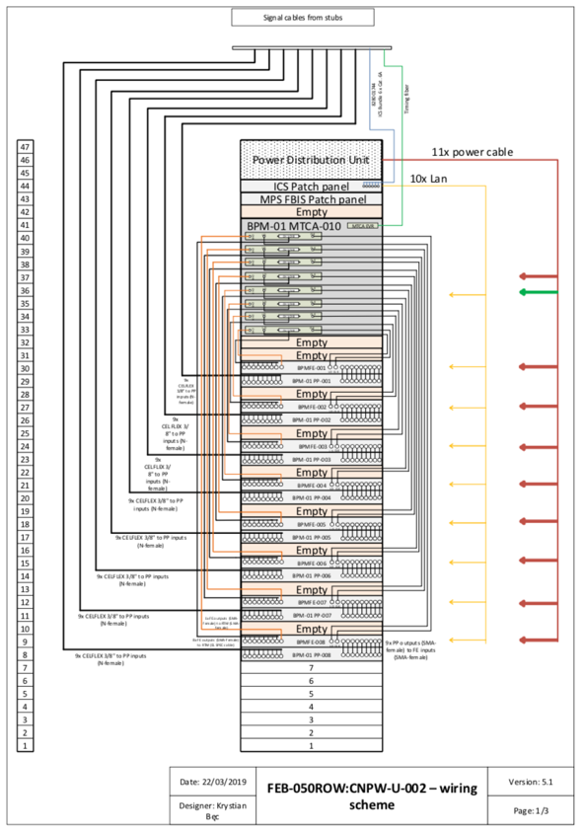
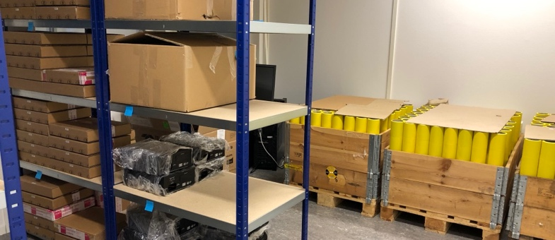
Data and Documentation for Installation
Data migration to ESS Asset Management System is ongoing.
As of today:
All operational beamline devices (LEBT)
All loss monitors for entire facility (ICBLM and nBLM)
Verification data is in HDF5 datasets – will be linked.
Interconnect documentation is ongoing
ePLAN 3D data/documentation
(Warsaw partners)

Slide 15
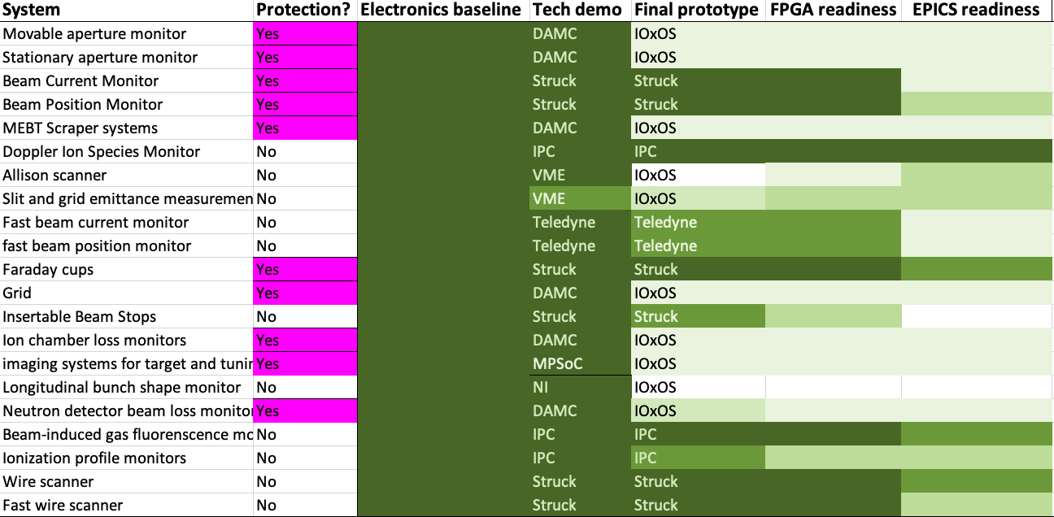

Status of Controls Integration
99% integrated = 100% failure
Most
Complete
Least
Complete

Slide 16
Installation and Integration Schedule
85% of non-labor is committed
Remaining flexibility is in integration
ISrc to DTL1
ISrc to DTL4
ISrc to Beam Dump (BOD)
Today
RBOT
2019
2020
2021
2022
ISrc and LEBT
7 Systems
5 Variants
114 Assets
62 Cables
RFQ to DTL1
43 Systems
12 Variants
321 Assets
388 Cables*
DTL2 to DTL4
39 Systems
5 Variants
157 Assets
179 Cables
DTL5 to Dump
366 Systems
12 Variants
1220 Assets
1625 Cables
A2T
61 Systems
10 Variants
271 Assets
318 Cables
*Infrastructure (cables) installation schedule is tight for NC Linac testing

Slide 17
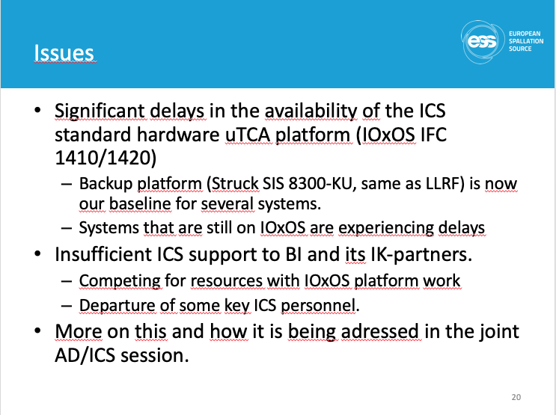
Since TAC one year ago
Adapted the plan to new installation schedule
Added Warsaw to support installation labor peak
Transferred tech labor (4 FTE-years) to support SRF work
  Defer integration of about two thirds of BLMs, one third of BPMs, all fast WS
Self-performing some integration activities while ICS ramps up resources and solves digital platform issues
ICS and Diagnostics are co-sponsoring an FPGA forum to increase productivity on digital platforms
Still working with ICS to address issues reported at TAC 17:
Proposals being evaluated
Defer third longitudinal monitor
Defer platform migration and deploy engineering operator interfaces for commissioning
Take advantage of remaining flexibility to prioritize features for first protons
How? Next slide

Slide 18
Proposal developed with ICS
Manage objectives across teams
  We have a plan in P6. We manage execution
  with team boards containing detailed tasks.
  Focus on first proton functionality: Features, not systems - Avoid a priori rejection of entire measurement systems
Tighten communications
  The most successful diagnostics projects have been executed by multidisciplinary teams that integrate early: (Examples: J-PARC experiment, BPM, …)
  Take a more lean approach to documentation and procedures. Rely on data and intra-team communications.
P6 Plan (Milestones, Earned Value)
~2 months
One Program Board
Add a program board that contains the objectives
~2 weeks
Many Team Boards
Add a program forum that periodically prioritizes and agrees on objectives. Includes ICS, Diagnostics, Ops, Linac group, and other key stakeholders.*
Probability of effective communication
On same project team
  *see Henrik’s presentation this afternoon
Physical separation

Slide 19
Summary
Technical choices for virtually all instrumentation systems have been validated
Performance has been demonstrated with beam in accelerator environments
Delivery of beamline devices and electronic hardware supports the installation schedule
Delivery of infrastructure and of controls integration pushes diagnostics toward the critical path
  With infrastructure, we can manage installation on schedule
  With ICS, we have developed a proposal to prioritize system features, and deliver integrated systems suitable for first protons

