Slide 1
Operations Planning at ESS Accelerator
Lali Tchelidze
Operations Section Leader
April, 2019

Slide 2
ESS Initial operations - overview
ESS has formally started the initial operations in the beginning of the 2019 and is gradually transitioning towards the operations.
Current, major operational activities include:
Ion Source and LEBT commissioning
Commissioning of cryogenic systems
Operation of test stands
Operations section is established, to support ramping up operational activities in the main control room (currently local control room), and eventually to provide control room staffing for 24/7 operation of the neutron source and technical infrastructure.

Slide 3
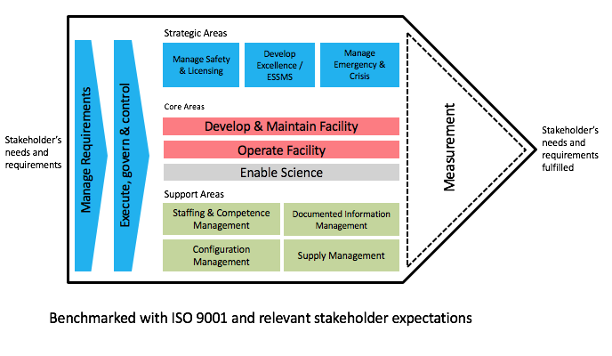
ESS Management System

Slide 4
ESS Management System 1.0
ESS Management System 1.0 – for Ion Source and LEBT commissioning stage.
ESSMS 2.0 – currently under developed for the NC linac commissioning stage.
ESS Management System 1.0
Focus on the beam commissioning, however all other operational activities should benefit from it.

Slide 5
Operations section – organization
A section leader and one senior scientist
Most shift leaders are currently from beam physics section
Two shift leader recruitments ongoing
Two operator recruitments soon to be launched
We have budgeted for one additional operator in 2019, then four more in 2020-2021, and 12 total (plus a section leader) from 2022 onwards.

Slide 6
Operations section – organization
Daily meetings in the (local) control room
Shift leader, study/test leader, additional support
Work is typically organized during normal working hours, however between March 18 – April 26, work is scheduled between 08:00 am and 21:00 pm (as required).

Slide 7
Operations – organization
Bi-weekly meetings of Operational Coordination Team (OCT).
The primary purpose of OCT is to assure operation of the neutron source and technical infrastructure for science. The team consists of representatives from the ESS operations organization, from the baseline activities and from the systems and services. It is chaired by the ESS Operations Manager and includes the deputy science director. OCT reports and recommends directly to the ESS Management Team [ESS-02670027].

Slide 8
Some Related Roles
The (Machine) Section Coordinator is responsible for the coordination of all activities within the (machine) section. This includes coordination with all relevant stakeholders (including the area coordinator and system owners) to ensure adequate planning and documentation to support installation work, followed by a testing and commissioning activities.
The (Machine) Section Coordinator is also responsible for ensuring that the (machine) section is adequately tested and handed over to operations (section leader) at predetermined times. To this end, the machine section coordinator is empowered to make decisions on priorities and sequence of activities internal to the (machine section). System owners are responsible to provide required information for their system to support such decisions.
The (machine) section coordinators own installation and testing plans. He/she reports to the AD installation manager for installation issues and to the testing and commissioning manager for testing and commissioning issues. Additionally, this person is responsible for continuously providing coordinated support during operations, as required (when and if problems are observed with the (machine) section). For these issues, the (machine) section coordinator reports to the operations section leader.

Slide 9
Some Related Roles
The Beam Commissioning Coordinator is in charge of the beam commissioning plan, and schedules, as well as coordinates the beam commissioning activities in the control room.
He/she is responsible for, and has the authority to restrict the beam configuration (e.g. pulse length, current, rep-rate, focusing and destination) for each step of the commissioning, within the boundaries set out in the ESS Operational Limits and Conditions and the approved operational envelope, in order to avoid beam related damage to the machine. He/she also decides when to move from one step of beam commissioning to the next.
The beam commissioning coordinator reports to the testing and commissioning manager for the commissioning issues.

Slide 10
Some Related Roles
The Testing and Commissioning Manager is the person responsible for continuously optimizing the testing and commissioning activities of the ICS and the accelerator sub-projects in view of meeting the main project milestones.
He/she sets priorities for the use of allocated accelerator and ICS testing and commissioning resources (people and equipment) and makes requests for additional resources to heads of sub-projects when needed.
He/she supports with execution of the testing and commissioning plans. He/she also leads the preparations for the safety readiness reviews, participates in the SRR and leads the follow-up of it.
He/she leads the follow-up of handover forms for beam permit to operations.
He/she decides on start and stop of scheduled testing and commissioning activities, with the view to assure safety at ESS, given that installation, testing and commissioning at ESS largely are done in parallel.
He/she decides on the test and commissioning schedule. If it requires changing higher-level milestones for the sub-projects, this is handled through a CR via the sub-project leaders.

Slide 11
Handover and Beam Permit process What was done for ion source and LEBT
Operation
Testing and Commissioning
Beam on
Concept for handover process – NO modification are made without a notification/request.
Handover of individual systems (e.g. vacuum, water cooling, PSS0, Beam instrumentation, etc.) to the Operations Section, followed by a Beam Permit, before the first beam.

Slide 12
Handover and Beam Permit process What is being discussed for the next stages
Operation
Testing and Commissioning
Beam on
Concept for handover process – NO modification are made without a notification/request.
Initial handover/transition of systems (e.g. vacuum, water cooling, RF, etc.), followed by a Beam Permit, before the first beam.
Handover to operations – at the end of commissioning stage(s).
Systems that won’t require changes (e.g. PSS) are handed over to operations before the beam permit is issued.

Slide 13
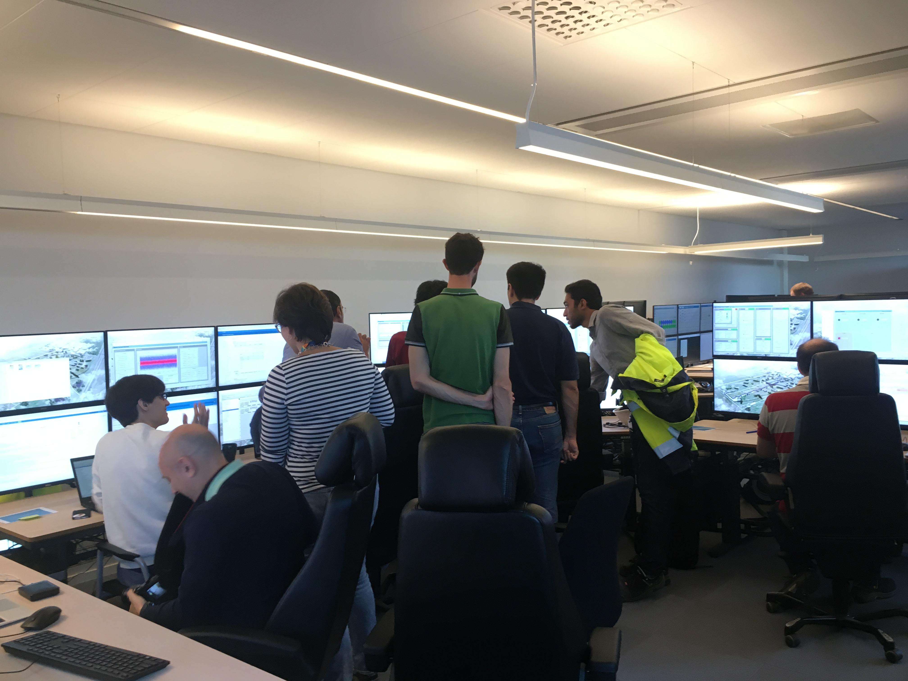
Campus
Thank you!

Slide 14
TAC comments from 2018
TAC comment: during commissioning there has to be enough staff to operate and write instructions for operation. One 8 hour shift per day may prove inadequate. 2 shifts can provide an opportunity for catch up on the AD schedule. Means must be provided to facilitate conditioning of RF components for long periods when beam is not present.
ESS response:
We didn’t get to hire control room staff for this stage of beam commissioning, so we need to catch up with the operating instructions at a later stage.
Between March 18 and April 26, 2019, we are working between 8 am and 9 pm (as required by a schedule).
We are currently hiring 2 shift leaders, 2 operator positions will be opening soon.

Slide 15
TAC comments from 2018
TAC comment: finalize use cases and probable fault modes. Work with the science/instrument specialists and those knowledgeable of target damage scenarios.
ESS response:
The operation of the neutron source and technical infrastructure will occur from the main control room. Integrated approach is taken, and the control room team will be trained and responsible for operating the neutron source.
Close collaboration with the science floor coordinators will be established for the mutual benefit for operations.
Reliability availability note from Enric.

