Slide 1
TAC 19 - ICS breakout session
Welcome and introduction
Henrik Carling
Head of integrated control systems, ESS
ESS/ICS
Date: 2019-04-11

Slide 2
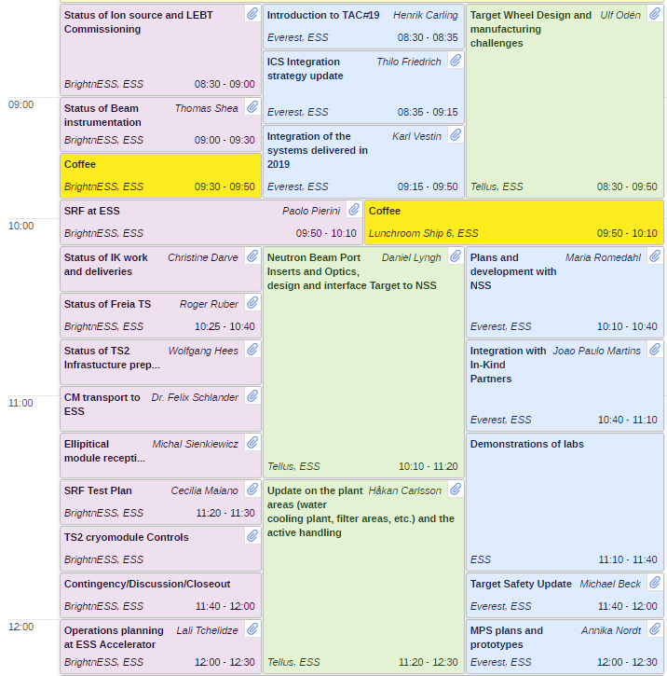
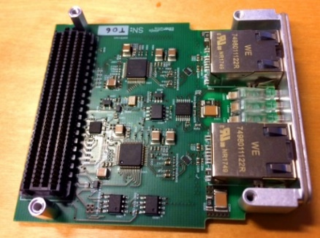
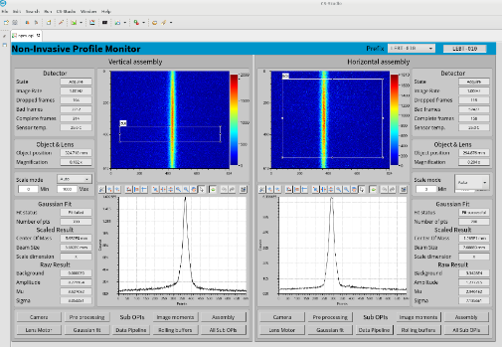
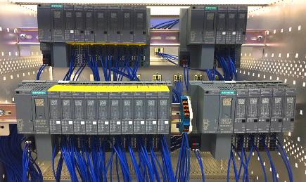
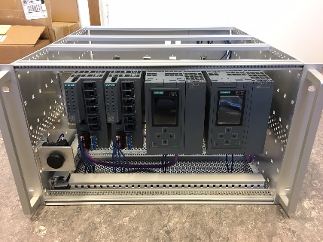
TAC 19 ICS breakout session
Welcome to the ICS breakout session of TAC 19
Report on the Control System plans and development of the NSS
Report on Integration Activities for system to be delivered in the coming 12 months from the TAC meeting
Update on Target Safety
Report on the MPS management interface: the plans, functionalities, prototypes and implementation status
Report on how integration work is organised and managed with in-kind partners
Joint session Accelerator, Target and ICS
Joint session on Accelerator/ICS collaboration
Presentation of interest

Slide 3
Changes
Minor changes to the agenda
Charge questions
Is the updated control system integration strategy appropriate and adequate? Suggestions for improvement are welcome.
Do you see any improvements that can be made using recent learnt lessons?
Is the way forward for controls development and integration of instruments feasible?
Is the safety classification work for basic process control systems appropriate and adequate?
Is the work on basic process control systems for target appropriate and adequate?
Is the integration of machine protection strategies into operations likely to be successful?

Slide 4
Recommendations from TAC 18
ICS Management should give greater emphasis on the coordination with stakeholders beyond the accelerator to target and Neutron Scattering System (NSS). The role of an embedded ICS person in these Divisions could help improve understanding and trust
  The interaction with stakeholders beyond accelerator is currently managed by work package managers that are dedicated to supporting the stakeholder (NSS and target). The current set-up makes the work package managers "embedded" into the stakeholder to the extent needed for the situation and it provides the advantage of internal coordination in ICS.
  Also, external initiatives, such as the beamline controls group for NSS/ICS interaction, further clarifies the interface and roles between ICS and stakeholders.
The ESS TSS is a critical system for the facility. Given its importance, a dedicated review of the TSS with experts who have built and operated such systems would seem appropriate
  Target division is responsible for the target safety system - a series of critical design reviews have been arranged by the target division.
  The target safety system design, starting in 2013, passed the Preliminary Design Review (PDR) in 2016-02, with a review committee that included two external subject matter experts, one on safety system design and implementation and the other on facility radiation safety and analysis.
  Currently, the target safety system is undergoing a critical design review process, divided in three parts.
  The review committee has both members internal to the ESS organisation and several from other existing and similar facilities.
  The first part took place 2018-12-10, the second part in conjunction with TAC 19 (including a cTAC member) on 2019-04-08 - 2019-04-09, and the third part is scheduled in 2019-05
  Also, there will be an independent review of the TSS design, performed by a Swedish subject matter expert company, Safetech Engineering. This external review will also be finalised during 2019-05
Ensure each staff member and partner understands the intermediate activities needed to meet milestone and their role in the overall project success
  Since TAC 18, ICS has put increased focus on refining the project plan and work with the control system integration process.
  This development has resulted in a significant improvement in the documented ICS integration processes (as will be elaborated during TAC 19), which has or will help stakeholders and internal ICS staff better understand the flow of activities and intermediate steps needed to meet milestones.
  The integrated project plan has also been refined with various degrees of success - mainly depending on the clarity of plans from the stakeholders. Some work packages remain a worry.

Slide 5
Recommendations from TAC 18
ICS should maintain sufficient stock of standard PLC, EtherCat and MTCA components above and beyond what is scheduled such that they are available to issue to their customers when they need them. Even when not expected
  From experience, we have started being more proactive when it comes to standard hardware equipment.
  For MicroTCA infrastructure components (Crates, Power supplies, MCH:s) we have a level of stock that will be sufficient to cover "spontaneous needs" as well as the foreseen needs for installation.
  For MicroTCA specific equipment (processing boards, timing system components and CPU:s) we also have a sufficient stock to cover all spontaneous and installation needs.
  We are working on improve the availability of standard FMC modules - these often have long lead times and tend to be problematic if a sudden need arises.
  For PLC equipment we do not keep a stock but we have a well worked-in routine within our framework agreement with our standard PLC supplier that has a short turnaround time from request to supply (< 1 week)
  For EtherCAT equipment we also have a good relationship with the supplier and we are working on creating a framework to ensure continuous, short lead time supply.
  ICS is procuring in batches to get a price advantage, in the cases when framework agreements are not yet available
  Storage of these spares is done in our own lab-storage area, without incurring any logistics extra-cost
Bring more focus to the near term integration of the MPS with the linac. Less immediate emphasis on the reliability studies. Management should provide a compromise on the overly demanding documentation requirements
  The presentation during the last TAC indeed focussed on reliability analyses for the FBIS. However this does not mean that near term integration of machine protection systems are not being focussed on as well.In total 4 machine protection systems are needed for the nc linac:
    MPS-Vac (for vacuum)
    MPS-ID (for insertable devices, like wire scanners, Faraday Cups, etc)
    MPS-Mag (for quadrupole magnets)
    FBIS (to allow beam only when all relevant systems are ready and to stop beam upon detecting an issue, like beam losses)
  The following prototypes are ready and heavily tested in the different labs at ESS and ZHAW: MPS-ID, MPS-Vac, MPS-Mag, FBIS.
  The interface FBIS-BCMs-Timing System has been tested. Currently there is a lot of work done on removing the dependencies of BCM measurement from/to timing system, as this is an issue for protection.
  FBIS HW commissioning for the NCL is described here: ESS-0880176
  Interfaces FBIS-Ion Source have been tested on Ion Source, LEBT test stand
  Interfaces LEBT chopper-FBIS cannot yet be tested since LEBT chopper is not ready, but these tests are planned together with the operations team
  Detailed installation, testing and verification plan for all MP systems for NC linac are coordinated together with accelerator teams and integrated into AD plans and the plan can be found here: https://jira.esss.lu.se/plugins/servlet/softwareplant-bigpicture/gantt
  Electrical drawings for NCL MPS can be found here: ESS-0308178
  Installation of MPS will start on 2019-04-01.
  FAT, SAT, SIT and FIT templates and plans and protocols will be presented during TAC19.
  Conclusion: presentation during previous TAC was biased and requested integration and testing details will be presented in the upcoming TAC (April)

Slide 6
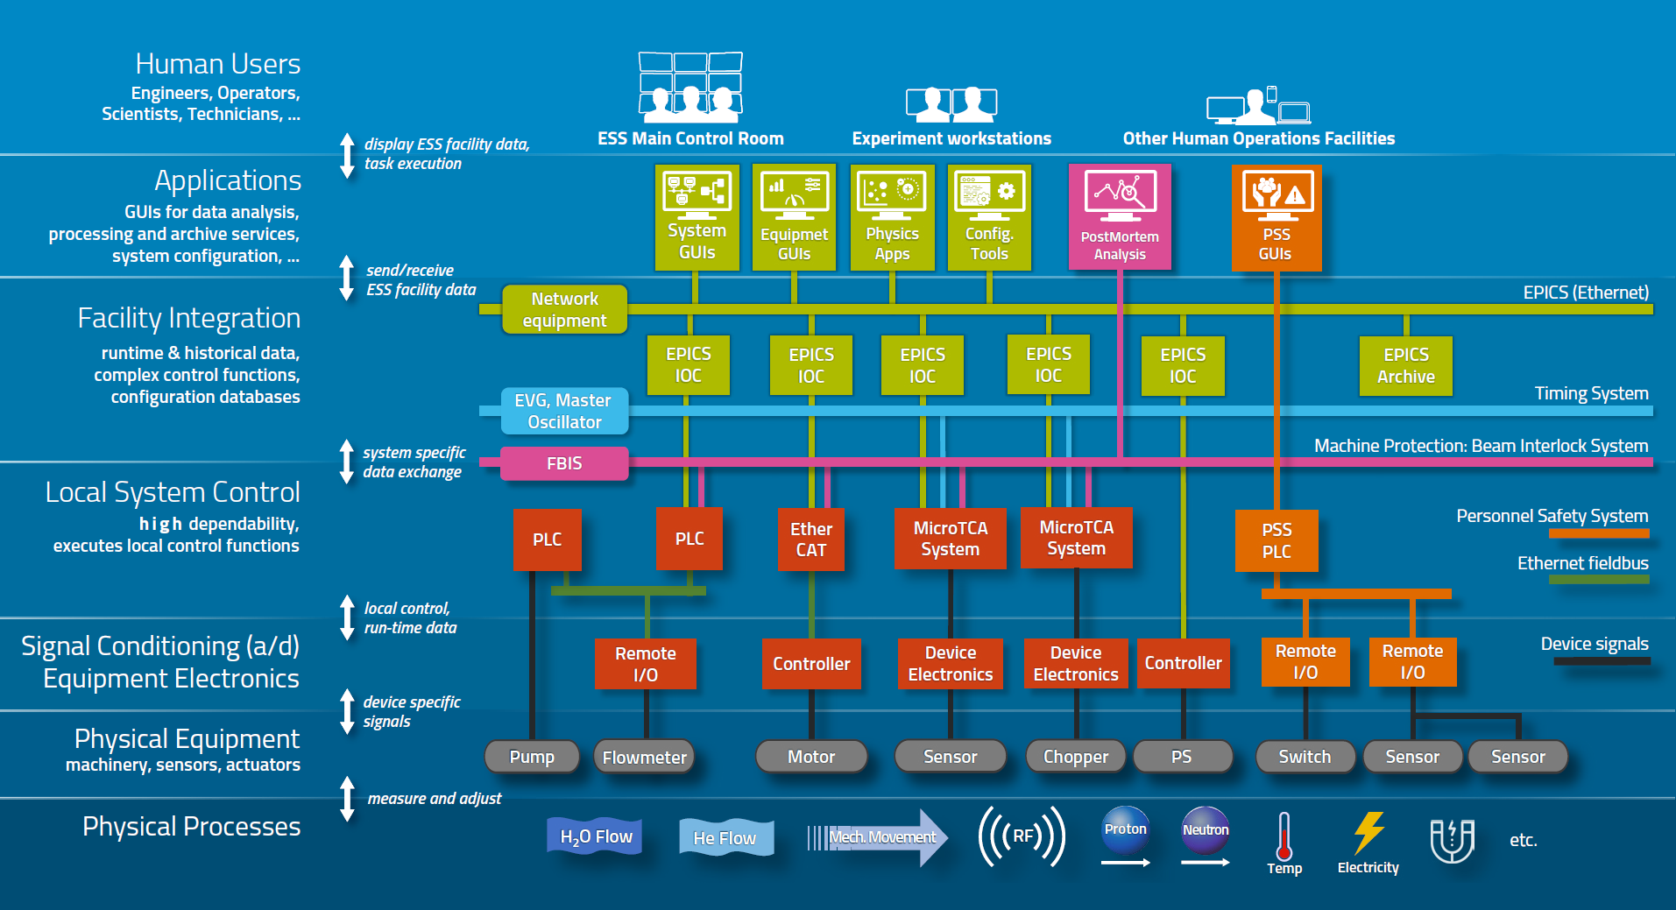
Control system overview
ICS overview document available [link]
ICS weekly reports (130+ recipients)

Slide 7
ICS vision and mission statements
ICS vision statement
ESS operated efficiently, reliably and safely, with a control system that everyone loves
ICS mission
The ICS division shall provide and maintain world-class and cost-efficient control, protection and safety systems and services for the ESS facility.
The division shall develop competence and innovative solutions that can be shared in the community through open processes

