Slide 1
ICS Integration Strategy Update
Thilo Friedrich
ICS Systems Engineering and Engineering Process Coordinator
European Spallation Source ERIC
2019-04-11

Slide 2
Table of content
Engineering Management for ICS / ESS control systems
ESS Handbook for Engineering Management for Control Systems
Goals of the Handbook
Content outline
Control system life cycles
Applying the Handbook
Use by work package managers
Use by engineers
How is the Handbook content validated?
To what extent is it used today?
Roadmap

Slide 3
Engineering management at ICS Systems Engineering, system life cycles
Engineering Management for ICS control systems
ESS-0054678 ICS Integration Strategy
major update
ESS Handbook
for Engineering Management
of Control Systems
ESS-0054678
Engineering Management for PSS
ESS-0469185 Safety plan for
Personnel Safety Systems
Engineering Management for MP
ESS-0057245 Machine Protection -
Systems Engineering Management Plan
ESS-wide guideline
for common “engineering management”
of the control systems.
Engineering Management for
Control system software
(draft in work)
Engineering Management for
Control system infrastructure
(workflow descriptions)

Slide 4
Note: Two Handboooks for controls now ...
ESS Handbook
for Engineering Management
of Control Systems
ESS-0054678
ICS Handbook
ESS-0067637
next major
update soon
Control system’s engineering management,
life cycle management,
system reviews,
technical documentation.
Technical architecture for ESS control systems, e.g.
Process/device control systems,
Timing system,
Personnel safety systems,
Machine Protection,
Technical network,
Technical standards and technologies
hardware platforms (MTCA, etc)
EPICS, related software services
programming languages, software tech’s, etc.

Slide 5
Goals for the ESS Handbook for Engineering Management of Control Systems
Provide a practically meaningful method for structuring the development and life cycle of control systems, useful for
work package managers for defining development stages and outputs (systems and information),
chairs of system reviews (PDR, CDR, etc.),
control system engineers for creating documentation,
contributors to the development of ESS control systems, (incl. IKC’s, suppliers, partners, ...)
parent system (equipment) owners, for understanding the relation of the development activities.
ESS Handbook
for Engineering Management
of Control Systems
ESS-0054678
The method shall be flexible, scalable and adaptable to individual developments in a controlled way.
Control system developments differ vastly in complexity and stakeholder characteristics.
The method shall have a defined degree of maturity by demonstrating conformance with relevant ESS quality criteria and relevant industrial standards. (Annexes)
ESS control system developments face noteworthy expectations (SSM etc. related) on demonstrating quality assurance.

Slide 6
ESS Handbook for Engineering Management of Control Systems Table of content outline
1. Introduction
2. Relevant concepts and tools
3. System life cycle for ESS facility control systems
4. System life cycle for generic control systems
and technology developments
5. System reviews of control systems
6. System documentation
7. Applicable standards and workflows
Annexes A, B, C on Conformance
how to understand and apply the Handbook
what are “life cycles” and how to use them
what is a PDR, CDR, etc. for a control system
how to write system descriptions and plans
where to start...
Only for quality assurance demonstration.

Slide 7
Default system life cycle model for control systems
System reviews define different life cycle periods.
Pass/fail results gate the progress to the next stage.
Default life cycle means, individual system life cycle can be adjusted to particular circumstances,
e.g. by adding or merging reviews.

Slide 8
Life cycle and documentation
What information shall be available in what period?

Slide 9
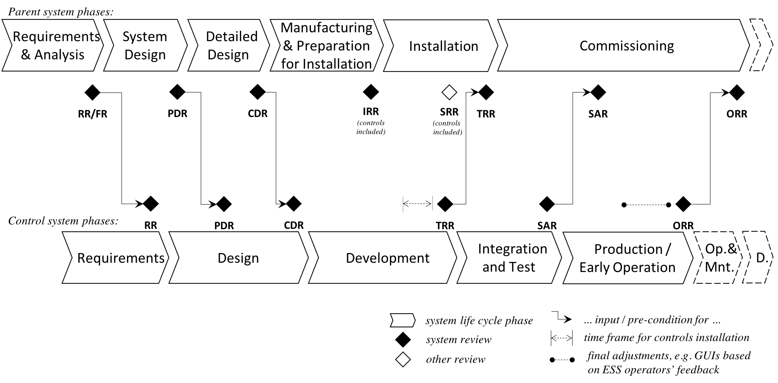
Parent system life cycle and control system life cycle
This clarifies relations to the life cycle of the ESS parent system.

Slide 10
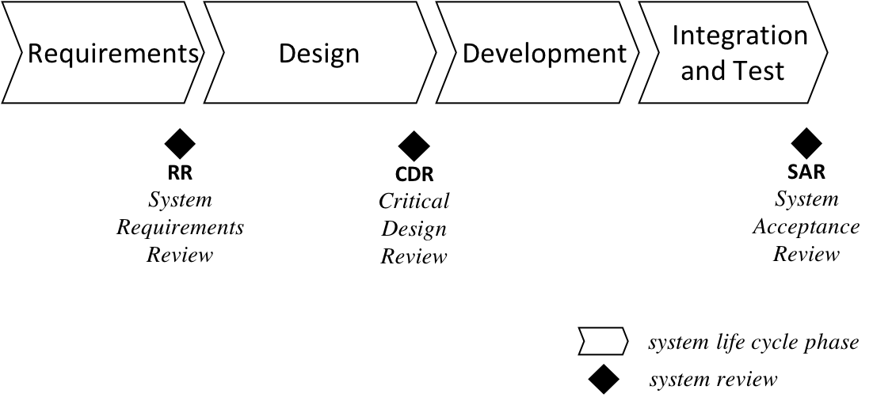
Generic system life cycle
As new generic system designs are by definition abstracted from a concrete context, this life cycle does not include installation, etc.
Still, tailoring can be done. Reviews and documentation outputs can be removed or added as reasonable, such as e.g.
an additional design review or test readiness review,
reduction to only CDR and SAR.
A generic system, before becoming an ESS in-house standard, should typically have at least some kind of system acceptance review.

Slide 11
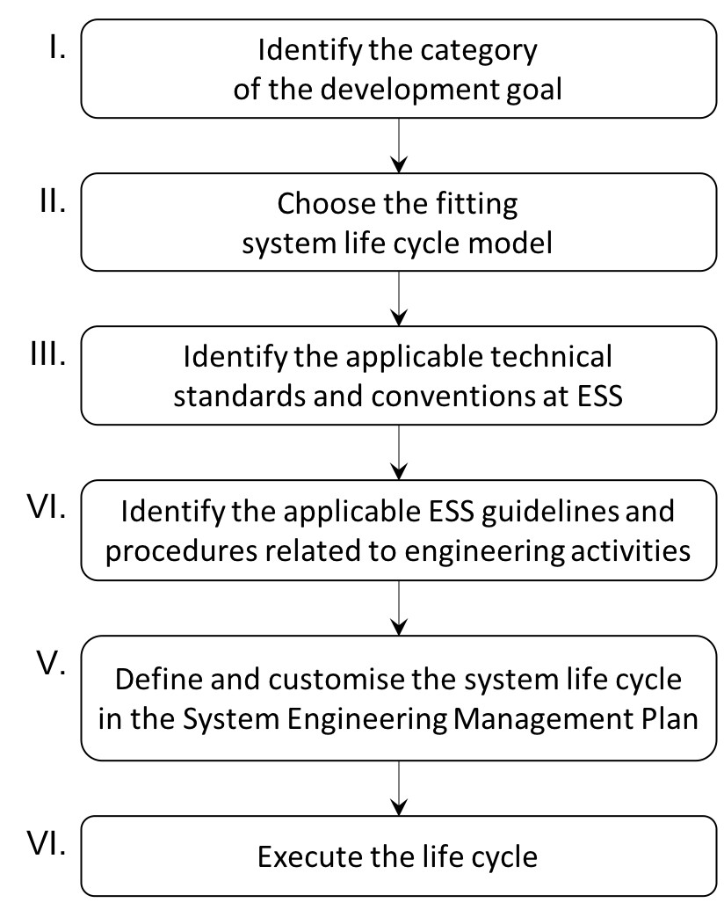
Using the Handbook as work package manager
Starting the system life cycle management
unique within ESS facility?
multiple-instance technology?
generic, transferable component?
life cycle for a ESS facility control system
life cycle for a technology development
“one-go” component development (not in this release)
hardware platforms, OS, programming language, EPICS version, data conventions, code management, etc.→ ICS Handbook
procurement rules, safety rules, access to workplaces, applicable design tools, etc.
SEMP
for
“control
system XY”
define the engineering plan for the development goal
+ tailoring

Slide 12
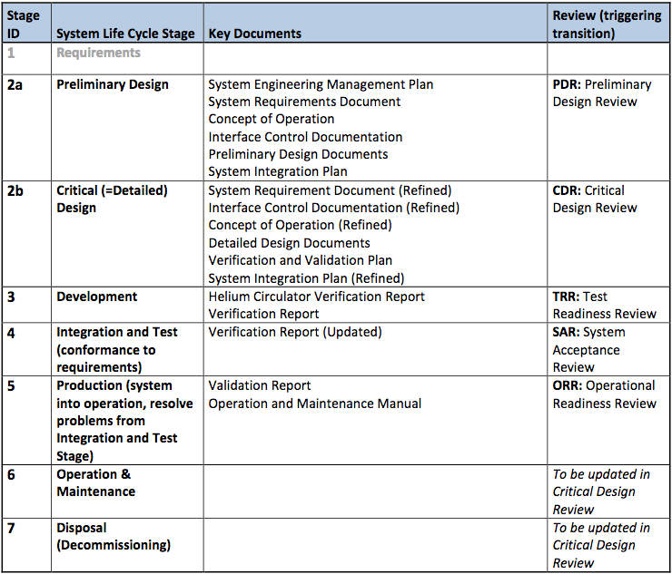
Using the Handbook as work package manager
information
inputs
One control system’s life cycle,
in its simplest table form.
Tailoring example:
Due to factual progress at the time of writing, the RR is merged into the PDR.
The tailoring is traceable in the Systems Engineering Management Plan (SEMP).
screenshot from
He circulator control system SEMP

Slide 13
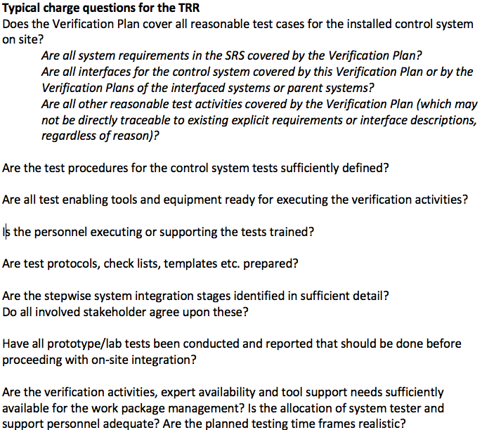
Using the Handbook as chair of control system reviews
Section 5. explains ”Control System Review” types (RR, PDR, CDR, TRR, SAR, ORR).
For each review type, there is an explanation of its purpose, and a set of typically useful, controls-related charge questions for this review type. These address
what has been achieved / produced / described so far, and
how good is the planning and preparation for the next development stage.
The charge questions indicate suitable pass/fail criteria,
which the chair can refine for the particular
control system development under scrutiny.

Slide 14
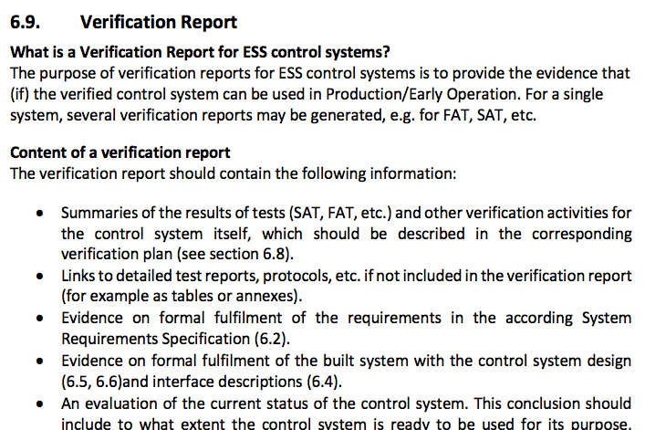
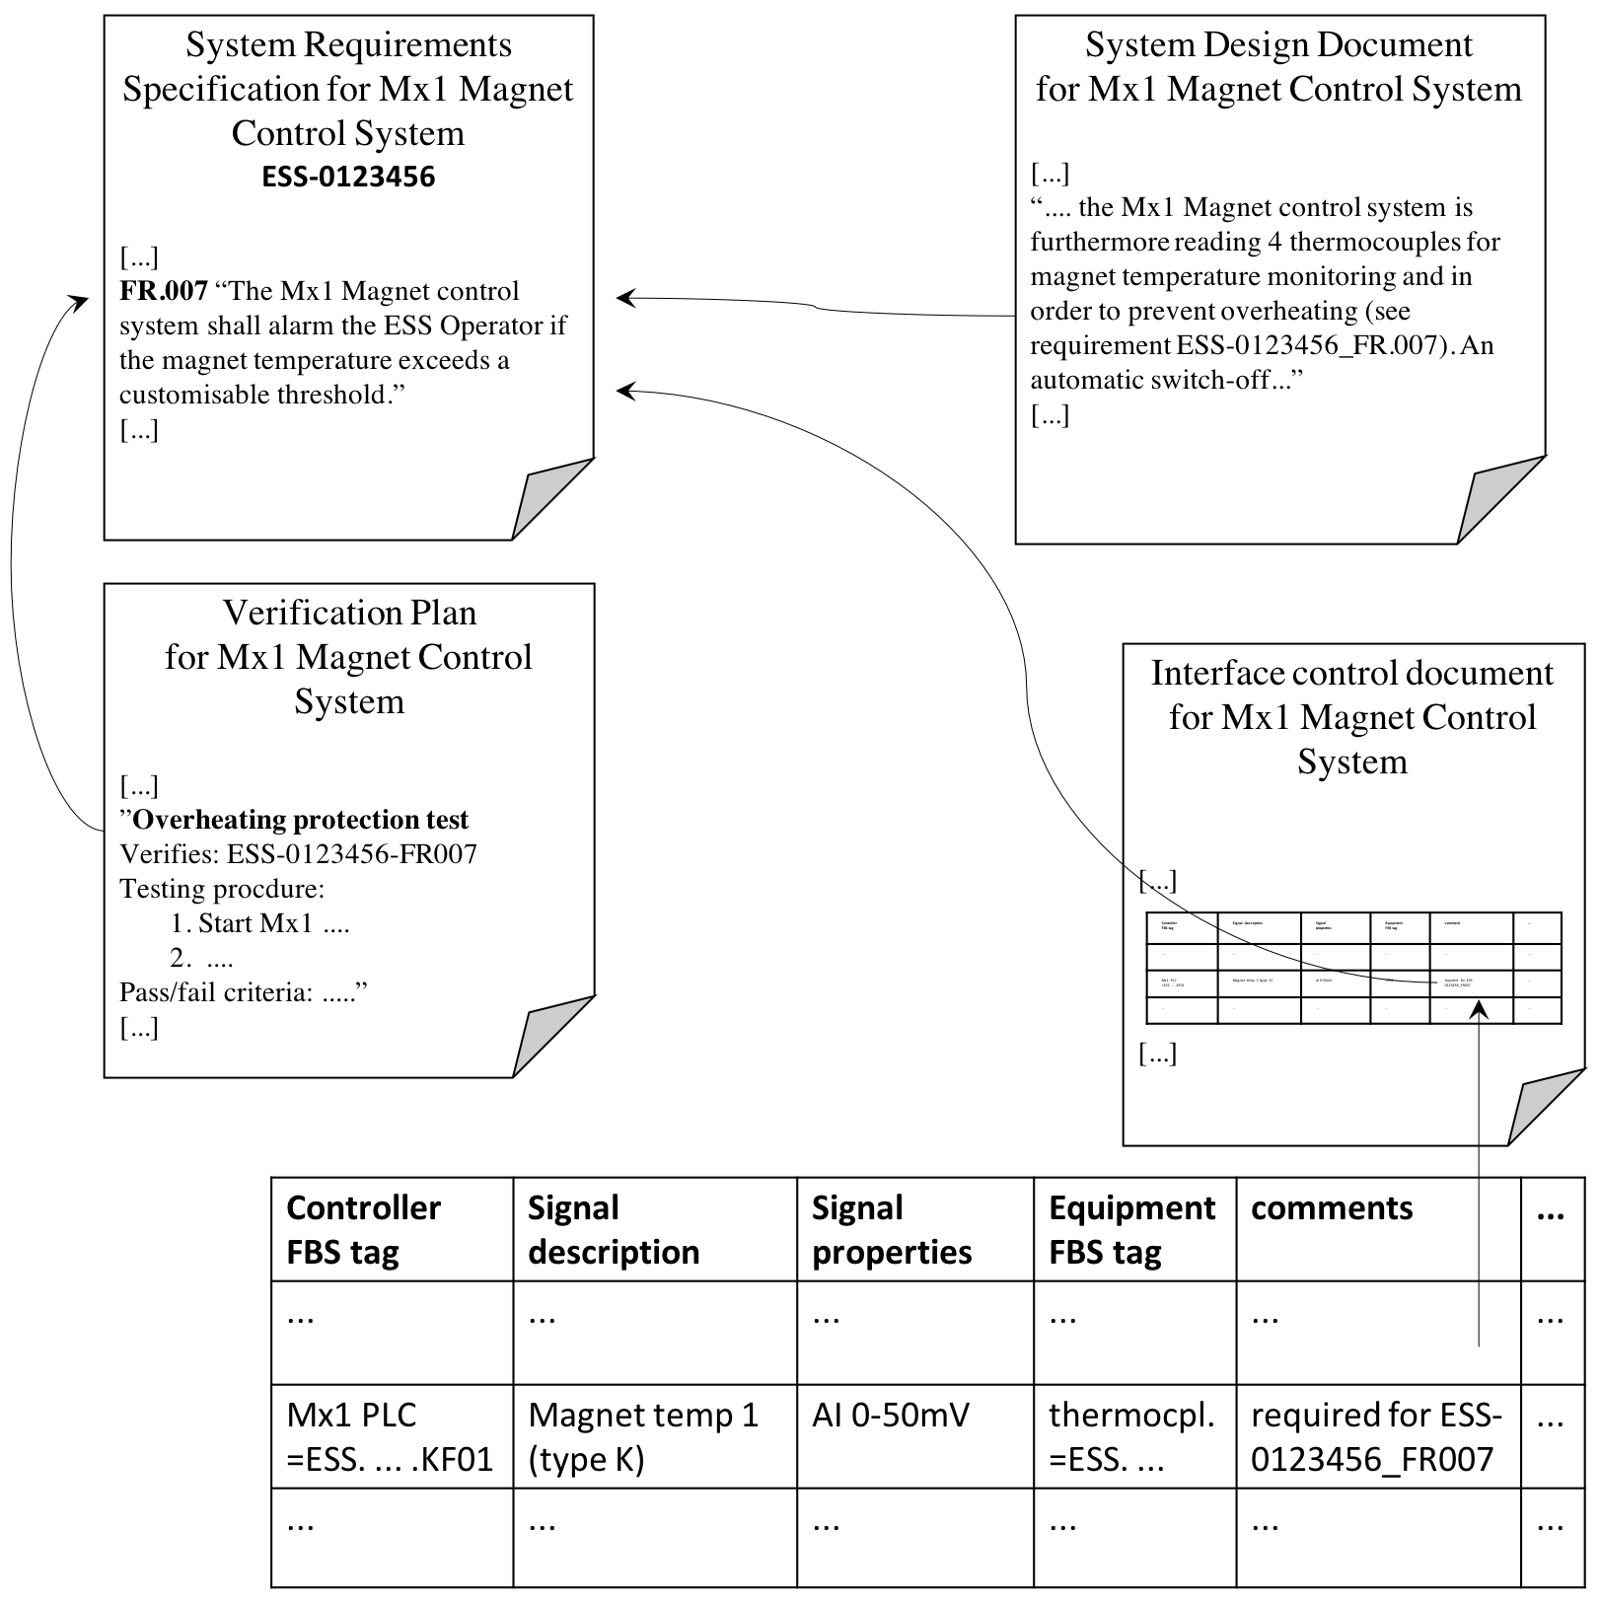
Use the Handbook as control system engineer
Writing documentation
ESS control system engineers have a wide range of experience of documentation styles before ESS. None are 100% transferable to ESS. Support for authors of technical documentation is in ”6. System Documentation”.
For each document type, there is
an explanation of its purpose and the expected, useful content (and the limitations!),
practical advise for the author on typical questions, problems, uncertainties, etc. which often emerge when this type of document is written.
about 40% of
the Handbook
This is ESS-specific and control-system-domain specific support text. Final level of support is in-person, per-document.
“Notes for authors” -
how to make life easier.
illustration explaining
“Requirements traceability across documents.”

Slide 15
ESS Handbook for Engineering Management of Control Systems - How is it validated?
Status: in review, responding to comments
reviewed by approximately 15 ICS staff members
in detailed review by central ESS functions
ESS engineering management, ESS information systems, ESS Operations
in review coordination: NSS, AD, TD, quality assurance
ESS Handbook
for Engineering Management
of Control Systems
ESS-0054678
The high number of reviewers is motivated by
wish for feedback by all ESS stakeholders,
need to develop some degree of buy-in and spreading. The content discussions are unavoidable anyway.
Review is conducted with a systematic comment tracking, so it stays feasible both for editing and for keeping up with changes (among reviewers).

Slide 16
ESS Handbook for Engineering Management of Control Systems - To what extent is it used today?
Review version available to all engineers, WP managers, as reference material.
preliminary feedback: Handbook is understandable and practically applicable.
SEMPs have become a default step in system development.
ICDs, design documents, system integration plans, verification plans for control systems are increasingly aligned with the spirit and intention of the Handbook.
Documentation quality incl. alignment across the different integration teams increases.
Legacy isn’t forcefully transferred onto the current guideline track. This can happen over time, with focus on the more challenging or problematic control system developments.

Slide 17
Roadmap
2019-04: content reviews of ESS central functions
2019-06: content reviews of technical divisions, release
2020 - Update
adjustments to evolving ESS rules and toolsets (PLM, inventory, etc.),
describe/define the management of technical standards for control systems,
references to new development guidelines, conventions, etc.
e.g. method for reliability & availability analysis for control system hardware
improved examples and guidance text on further feedback

Slide 18
ESS Handbook for Engineering Management of Control Systems
ESS Handbook
for Engineering Management
of Control Systems
ESS-0054678
major update
Table of Content
Goals
1. Introduction
2. Relevant concepts and tools
3. System life cycle for ESS facility control systems
4. System life cycle for generic control systems and technology developments
5. System reviews of control systems
6. System documentation
7. Applicable standards and workflows
10.-12. Annexes on conformance
... a practically meaningful method for structuring the development and life cycle of control systems, useful
... for WP managers, review chairs,
... for control system engineers.
... flexible, scalable and adaptable to individual developments in a controlled way.

Slide 19
Back-up slides

Slide 20
Annexes: Conformance
ESS defines “Quality assurance activities” which apply to normal (non-safety-critical) control systems.
ESS-0016468 “ESS rule for identification and classification of safety important components”
Annex A demonstrates that control systems developed using this Handbook perform the required “Quality assurance activities”.
ESS rules define “EIC0” systems, some of which are normal control systems. Any ESS “EIC0” system “Requires application of conventional standards or practices” .
”ESS Rules for Radiation Safety Classification of Electrical and Instrumentation & Control Equipment including Design and Quality Requirements”
Annex B demonstrates that control systems developed using this Handbook fulfil the conformance requirements of the international standard “ISO/IEC/IEEE 15288:2015 Systems and software engineering – System life cycle processes” using the standard’s method “Full conformance to outcomes”.
Annex C indicates conformance with requirements for common technical processes as described in the NPR 7123.1 “NASA Systems Engineering Processes and Requirements” [29], chapter 3.

