Slide 1
ICS plans and development with NSS
Maria Romedahl
Technical Coordinator for ICS work package 12
ESS/ICS, TAC#19, ESS-1090045
Date: 2019-04-11

Slide 2
Charge Questions and Presentation Description
Charge for TAC19 review:
Report on the control system plans and development of the NSS
Is the way forward for controls development and integration of instruments feasible?
Presentation Description:
Report on current status for collaboration with NSS

Slide 3
Presentation Goal
To report oh how ICS and NSS collaborates today
To share, with the TAC19, a proposal for an improved and extended collaboration with NSS
Get feedback and recommendations from the TAC19 on this proposal
Note:
Parts of this proposal is based on the proposal on how to manage complex interaction as presented in the TAC19 joint session in collaboration with the accelerator division
This ICS/NSS proposal is not based on any workflow descriptions from the current proposal for a beamline controls team (BCT) as currently discussed between ICS and NSS

Slide 4
Current status of plans and development with NSS
Both NSS and ICS maintain high level milestone planning in Primavera P6
The two plans are linked using “level 1b milestones”
Level 1b milestones between NSS and ICS work package 12 (neutron instruments integration) have been hard to define, thus there are only a few of them.
Too few long-, mid- and short-term milestones or goals constitutes a risk that we (NSS and ICS) do not meet our common objectives.

Slide 5
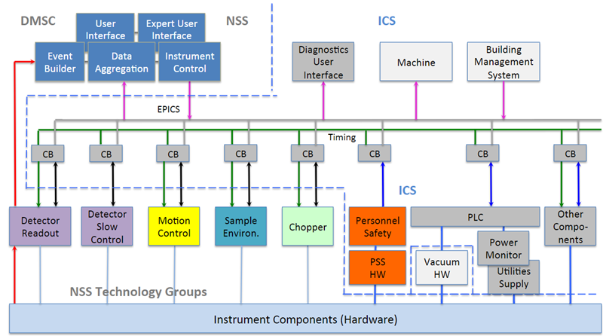
Technical model for integration
A technical model for integration interfaces between ICS and NSS has been established since a long time
This was presented at TAC17

Slide 6
Project interfaces
NSS project management
ICS project management
Neutron choppers
ICS has many internal stakeholders within NSS and thus many interfaces towards NSS
Prioritization, planning and coordination becomes complicated from ICS’ point of view
Motion control and automation
Sample environment
Detector group
ICS work package 12
ICS hardware and integration group
Data management and software centre
Other groups in NSS
NMX
BEER
C-SPEC
HEIMDAL
…

Slide 7
Beamline controls team today (p. 1 of 3)
NSS project management
ICS project management
Neutron choppers
Motion control and automation
Sample environment
Detector group
ICS work package 12
Beamline controls team
ICS hardware and integration group
Data management and software centre
Other groups in NSS
The beamline controls team concentrates these interfaces towards ICS and creates a collaboration environment designed to promote planning coordination and prioritization
NMX
BEER
C-SPEC
HEIMDAL
…

Slide 8
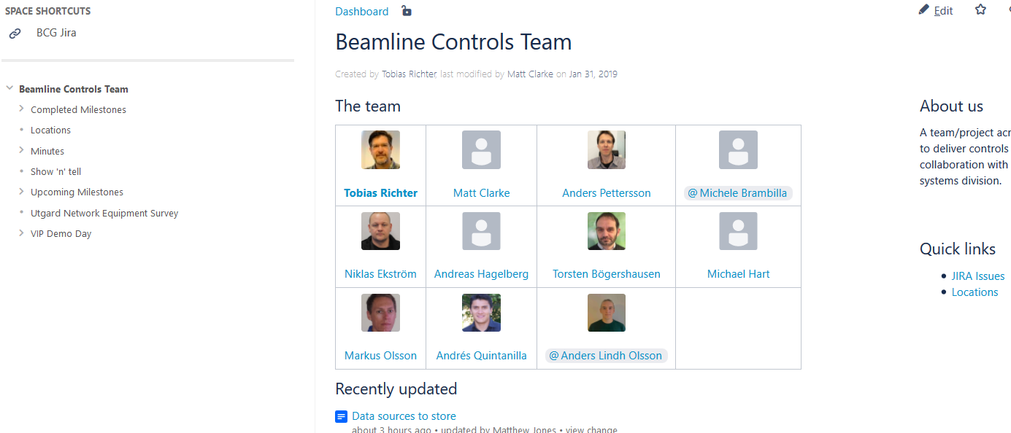
Beamline controls team today (p. 2 of 3)
https://confluence.esss.lu.se/display/BCG

Slide 9
Beamline controls team today (p. 3 of 3)
BCT is “a team/project across the science directorate to deliver controls scope to instruments in collaboration with the integrated control systems division”.
ICS work package 12 is not an active part of the BCT meeting, but ICS work package 12 aligns with BCT about once a month.

Slide 10
BCT improvement proposal (under discussion) p. 1 of 6
BCT is “a team across the science directorate and ICS, to collaborate, plan, prioritize, and deliver the controls functionality for the neutron instruments”.
BCT is not a project and it is not a line organization.
Controls deliveries formally come from either ICS or the NSS project. This means that ICS will still have an EVM* separated from the NSS project.
* Earned Value Management

Slide 11
BCT improvement proposal (under discussion) p. 2 of 6
Scope Proposal
In Scope
NICOS (Scientific User Interface)
Engineering Interfaces
Timing system integration
EPICS IOCs for NSS devices
Detector slow controls
Area detector controls interfaces
Chopper controls
Sample environment
Motion control inc. robotic systems
Archiver integration
Alarms, logging
Not in scope
Design of hardware systems and sub systems.
Standardisation of sub-system devices.
Development and design of timing system
Development and design of ICS standard EPICS environment and software stack

Slide 12
BCT improvement proposal (under discussion) p. 3 of 6
BCT is formed across the science directorate and the ICS division (mainly work package 12).
NSS Project
BCT
ICS Project
Other
Staff1
Staff2
MCA
Staff1
Staff2
SE
Staff1
Staff2
Staff n
Staff n
Staff n
DG
DMSC
Staff1
Staff2
Staff n
Staff1
Staff2
Staff n
Staff 1 - n
NCG
ICS work package 12
Staff 1 - n
Staff1
Staff2
Staff n
Hardware and Integration and other groups
NSS Management
ICS Management
12

Slide 13
BCT improvement proposal (under discussion) p. 4 of 6
NSS project management
ICS project management
Neutron choppers
Motion control and automation
Sample environment
Detector group
ICS work package 12
Beamline controls team
ICS hardware and integration group
Data management and software centre
Other groups in NSS
Interactions regarding beamline controls between
ESS and the neutron instrument in-kind projects (including the ESS test beamline)
The NSS core technology groups
is managed through the BCT.
NMX
BEER
C-SPEC
HEIMDAL
…

Slide 14
BCT improvement proposal (under discussion) p. 5 of 6
The BCT leader is appointed by NSS
From start up until now it has been Tobias Richter from DMSC
All representatives within the BCT shall be aligned with their line manager, core tech group or work package so agreed decisions within the BCT will be accepted and official for both NSS and ICS
The BCT shall be present at all IKON:s and actively interact with the neutron instruments

Slide 15
BCT improvement proposal (under discussion) p. 6 of 6
BCT will have a stake in long term (years) milestones between the NSS project and the ICS project
BCT will define mid term (2-3 months) goals and plans for the common objectives between NSS and ICS
BCT has a Jira board with prioritized milestones and tasks from the NSS project
ICS work package 12 has a Jira board with a backlog of user stories

Slide 16
Example: BCT mid-term planning
Proposed way of working for the BCT mid-term planning:
Each BCT stakeholder presents prioritized tasks and available resources
Open discussion and questions about the presentations
Agreement on a commonly agreed list of goals (1-3) for the next increment (2-3 months).
Break-down into tasks, procurements and issues that need to be addressed for the next increment.
Request for resources from each BCT stakeholder, for mid-term view
Iteration of step 4 and 5 until everyone can commit to the plan

Slide 17
Illustration of the BCT mid-term planning
Level 1b milestones
NSS P6 waterfall plan
ICS P6 waterfall plan
Can be input to
Can be input to
1-3 BCT goals
1-3 BCT goals
BCT mid-term plan
BCT mid-term plan
2-3 months
4-6 months
8 -12 sprints
by work package 12
8 -12 sprints
by work package 12

Slide 18
Summary
Current status for collaboration with NSS
Today ICS and NSS already collaborate through a team called Beamline Controls Team, BCT.
Proposed update of the BCT
BCT is formed across the science directorate and the ICS division.
An updated scope of the BCT was presented
ICS will be part of the BCT meetings
Once every 2-3 month the BCT will update the mid-term plan and define 1-3 goals.
Jira and Confluence are identified tools for the BCT work

Slide 19
Thank You for listening
Questions?
Maria Romedahl
maria.romedahl@esss.se

