Slide 1
ICS work package 11 – Target Update Integrated Control Systems
Michael Beck
Work package manager
ESS/ICS
Date: 2019-04-11

Slide 2
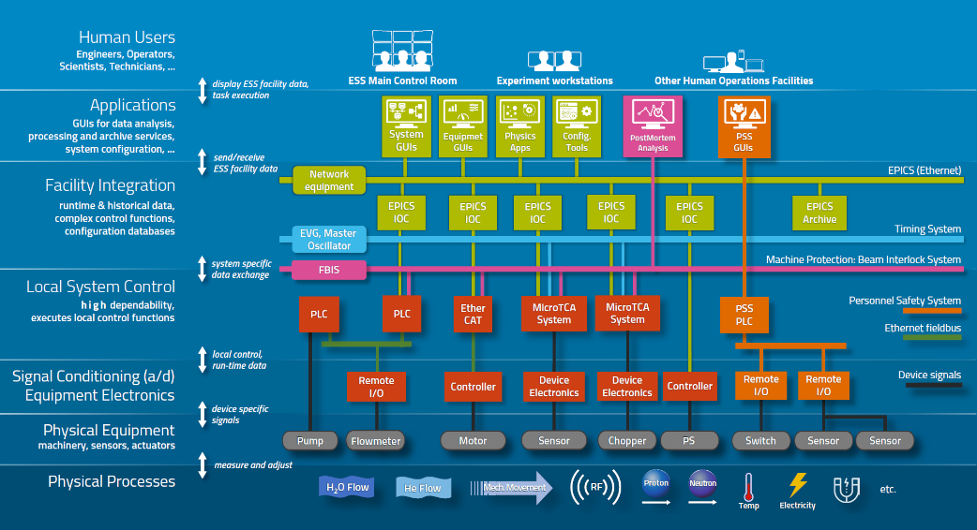
Background
Work Package 11’s scope is a part of the overall ICS strategy to design and integrate control systems into EPICS, in this case Target Station’s Basic Process Control (BPCS), using standard hardware, software and processes.
Notes:
System Engineering Management Plan, Control System Requirements, Interface Control Document, System Design Document, System Integration Plan, Verification Plan through
PDR, CDR, TRR and SAR

Slide 3
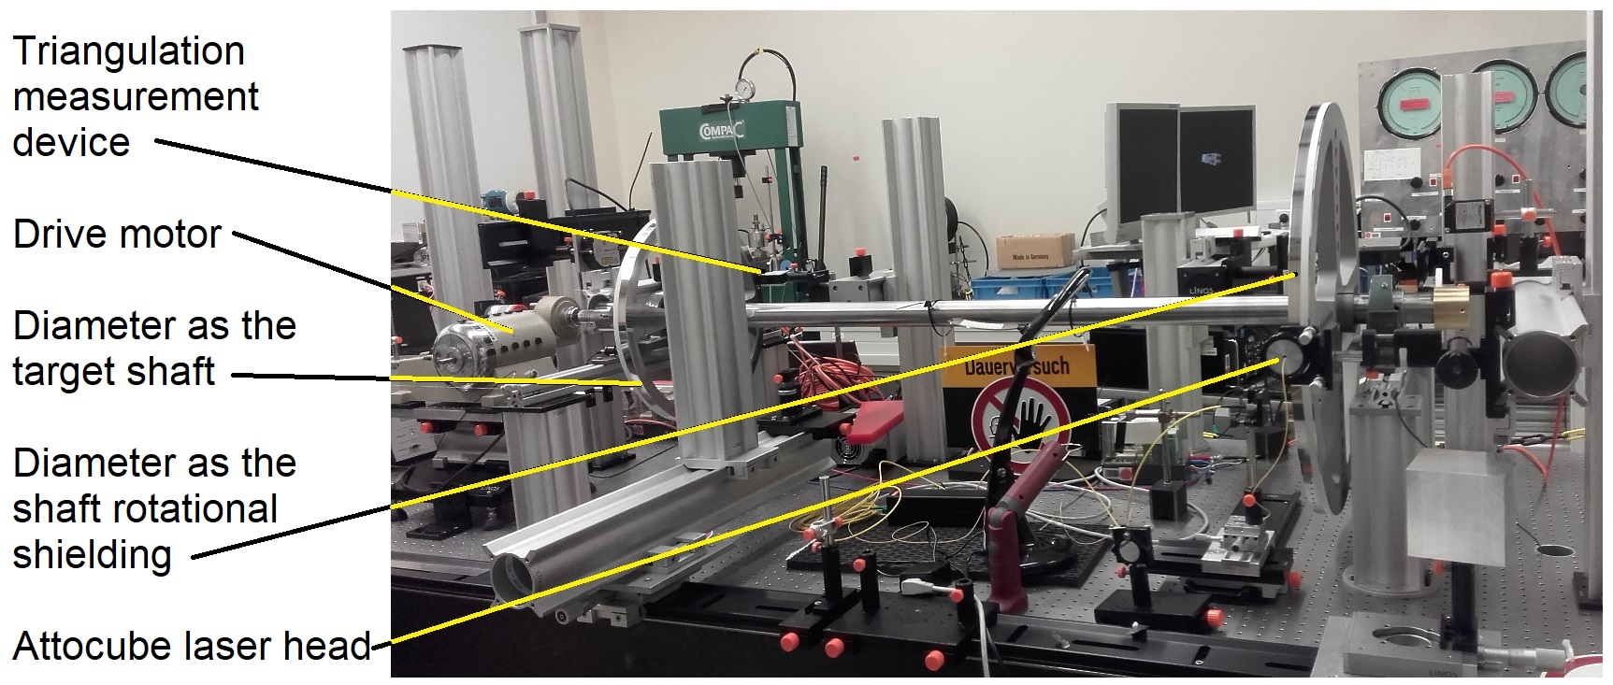
Target Wheel and Monitoring System
PDR
CDR
TRR
SAR
2019-08
2019-12
2020-05
2021-12
2018
2018
2019
2020
2021
2021
Today
Design
2018-01 - 2019-09
Stakeholders
Bilbao
AVS
Julich
Target Division
Motion Control Group
Scope of Work
Motion control of the Target Wheel (TW-PLC)
Vibrations, Synchronization and Lubrication
Timing Application
Target Monitoring System (TMS-PLC)
IR Camera, Gamma Imaging of Bricks, He Acoustic Measurement
X/Y Laser Measurement
Z calculation
Timing System Application
Status
Motion Control Testing on Rig in RATS
Control System PDR in the Summer
Notes:
TMS Julich CDR – 2019-05
TW AVS Drive FAT – 2019-09
TW Bilbo FAT – Q120
TS Julich FAT – 2020-02

Slide 4
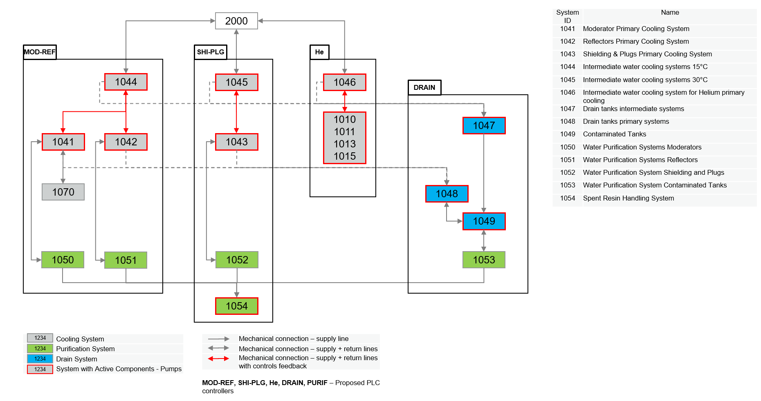
Water Cooling Control System
PDR
CDR
TRR
SAR
2019-03
2019-12
2020-07
2021-12
2018
2018
2019
2020
2021
2021
Today
Design
2018-01 - 2019-12
Stakeholder
Target Division
Scope of Work
Primary Water Cooling Systems (MR/SP/THCS-PLC)
Intermediate Cooling Systems (MR/SP-PLC)
Drain Tanks (DR-PLC)
Water Purification System (MR/SP-PLC)
Neutron Beam Instrument Plugs Cooling
(DR-PLC)
Proton Beam Window Cooling (MR-PLC)
Status
Preliminary Design Review held in 2019-03, follow up
Require further Functional Specification
OPI development continuing

Slide 5
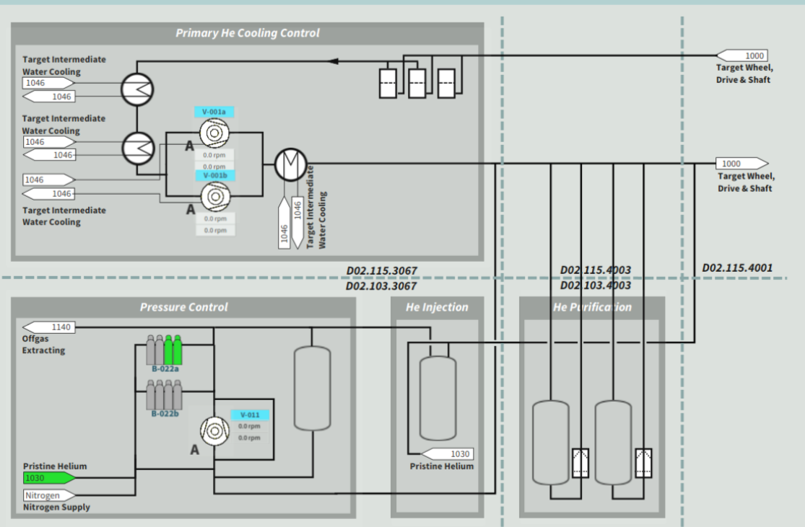
Helium Cooling Control System
PDR
CDR
TRR
SAR
2019-01
2019-09
2020-07
2021-12
2018
2018
2019
2020
2021
2021
Today
Design
2018-01 - 2019-09
Stakeholders
OFTTech
Target Division
Scope of Work
Purification (THCS-PLC)
Target Cooling (THCS-PLC)
Pressure Control (THCS-PLC)
Injection System (THCS-PLC)
Status
PDR Held in 2019-01
CDR has been delayed till the fall
Purification and Circulator Details
Testing Tool development

Slide 6
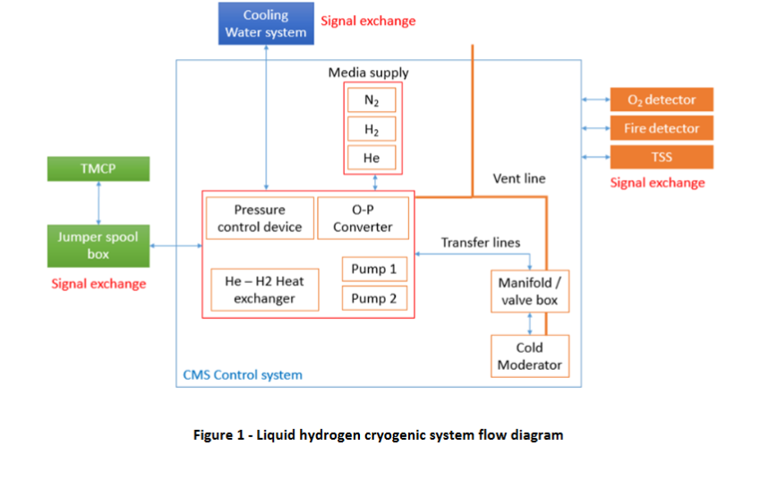
Cryogenic Moderator Control System
PDR
CDR
TRR
SAR
2018-03
2019-10
2021-03
2021-12
2017
2017
2018
2019
2020
2021
2021
Today
Design
2017-01 - 2019-09
Stakeholders
Julich
Target Division
Elteba
Scope of Work
Cryogenic Mod (CMS-PLC)
Associated Vacuum Pumps (CMS-PLC)
Filling Station (CMS-PLC)
Cold Box (CMS-PLC)
Status
Control cabinet being built at Elteba
Cabinet FAT in 2019-06
Initial controls testing to start at Julich in 2019-08
Manual control of devices implemented in PLC/OPIs

Slide 7
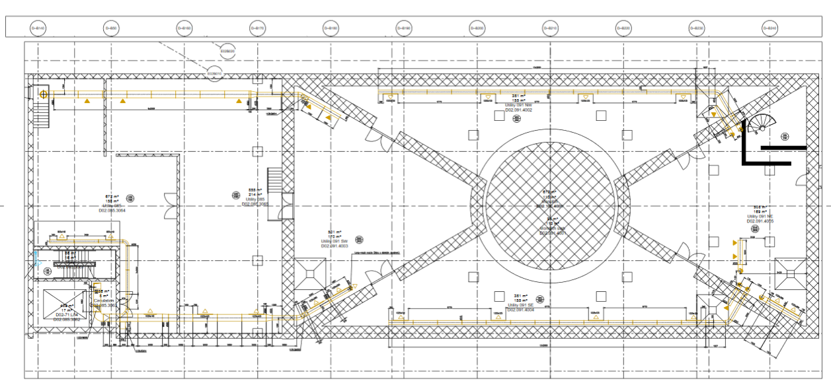
HVAC
PDR
CDR
TRR
SAR
2018-02
2020-03
2020-12
2021-12
2017
2017
2018
2019
2020
2021
2021
Today
Design
2017-09 - 2020-03
Stakeholder
Target Division
Scope of Work
Monitoring of Turn-key Solution (HVAC-PLC1/2)
Critical Alarms, Archiving, OPI
Status
Functional specifications starting to develop
PDR held in early 2018

Slide 8
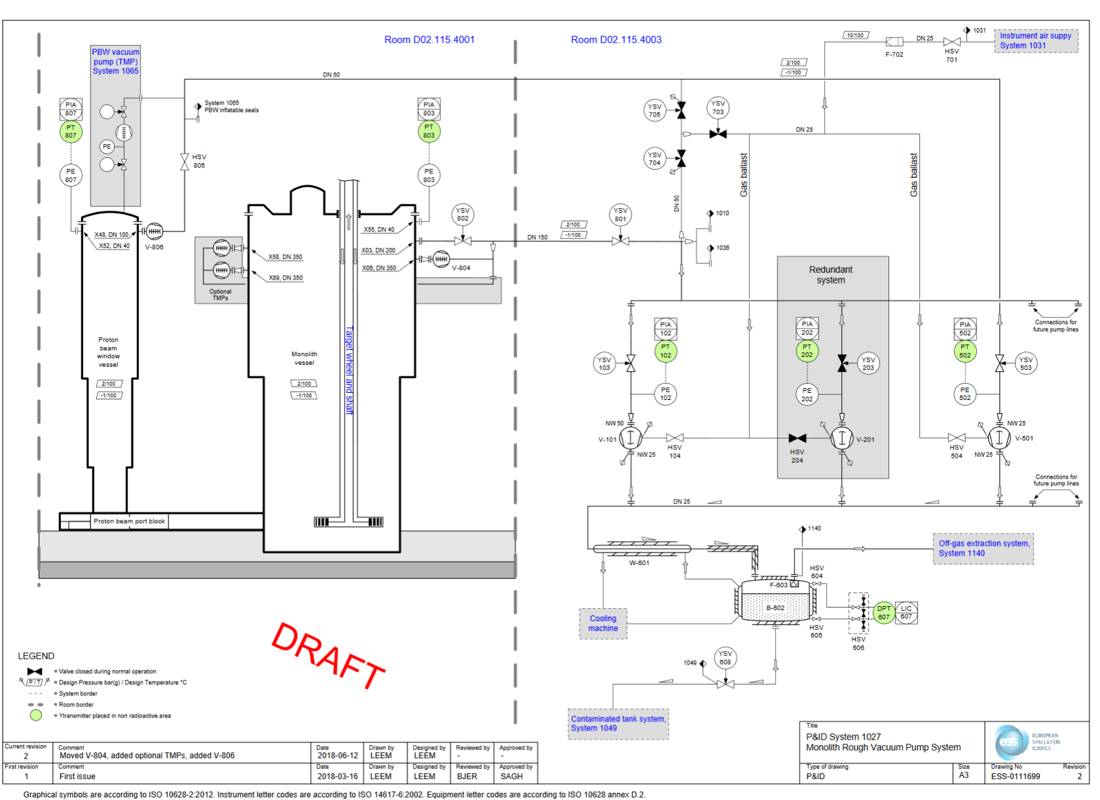
Vacuum System
PDR
CDR
TRR
SAR
2019-09
2020-04
2021-03
2021-12
2019
Jan
Apr
Jul
Oct
2020
Apr
Jul
Oct
2021
Apr
Jul
Oct
2021
Today
Stakeholders
Target Division
Vacuum Group
ICS work package 10
Design
2019-01 - 2020-04
Scope of Work
Monolith Rough Vacuum System (VAC-PLC)
Proton Beam Window (VAC-PLC)
Status
Target’s Vacuum CDR scheduled in next couple months
Control Development to be coordinated with Accelerator work, current plan may change

Slide 9
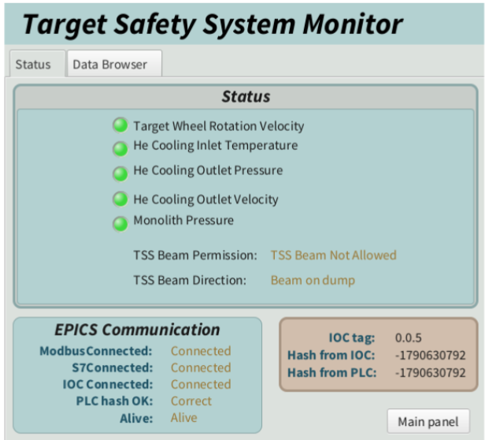
Special Modules: Monitoring Systems
PDR
CDR
TRR
SAR
2019-12
2020-05
2020-12
2021-12
2019
Jun
Oct
Feb
Jun
Oct
Feb
Jun
Oct
2022
Design
2019-06 - 2020-06
Stakeholder
Target Division
Scope of Work
Active Cell Monitoring System (IOC on TN)
TSS Monitoring System (IOC on TN)
Tuning Beam Dump (TBD-PLC)
Light Shutter System (LSS-PLC1/2)
Utilities (UTL-PLC)
Radiolysis (SP-PLC)
NBOA (DR-PLC)
Status
Currently Radiolysis, NBOA is in water cooling control system
Requirements are still coming in

Slide 10
Global Target Integration
PDR
CDR
TRR
SAR
2019-12
2020-06
2020-12
2021-12
2019
Mar
Aug
2020
Jun
Nov
Apr
Sep
2022
Today
Design
2019-03 - 2020-06
Stakeholders
All Target System Owners
Target Operations and Maintenance Group
ESH
Scope of Work
Target PLC Network
Control Logic for Target Station (TS-PLC)
Global OPIs for Target Station
Target MPS/PSS integration into EPICS
Status
Function Requirements still coming in

Slide 11
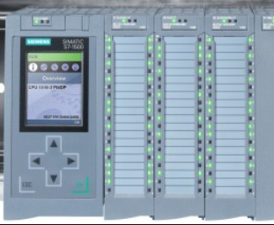
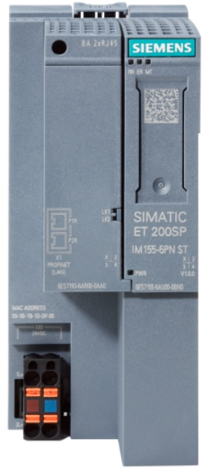
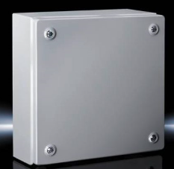
Target Station: Network/BPCS Architecture (Part 1)
Technical Network
Target PLC Network
D02.125.3024
D02.125.3024
Highbay
D02.115.3064
D02.115.3067
D02.115.400
D02.115.4005
TWCS
MR-PLC
TWCS
SP-PLC
VAC-PLC
THCS-PLC
TS/UTL-PLC
D02.103.3064
D02.103.3067
D02.103.4003
+
Proton Beam
D02.085.3064
D02.085.3067
D02.091.4003
TWCS:
NBIP/NBOA/DR-PLC
LSS-PLC 1
LSS-PLC 2
Utility
Utility
Triangular room
Target Wheel
Notes:
TMS Julich CDR – 2019-05
TW AVS Drive FAT – 2019-09
TW Bilbao FAT – Q120
TS Julich FAT – 2020-02

Slide 12
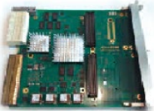
Target Station: Network/BPCS Architecture (Part 2)
Technical Network
Target PLC Network
D02.125.3024
D02.150.4015
D02.125.3024
Highbay
CMS-PLC
HVAC-PLC1
HVAC-PLC2
D02.125.4014
D02.115.3064
D02.115.4005
TWCS
MR-PLC
TIME-SYS
TW-PLC
TMS-PLC
TBD-PLC
D02.103.3064
D02.100.4015
+
Proton Beam
D02.085.3064
Outside
accelerator
Triangular room
A2T

Slide 13
Questions?
Thank you for your attention
Contact: Michael.Beck@esss.se

