Slide 1
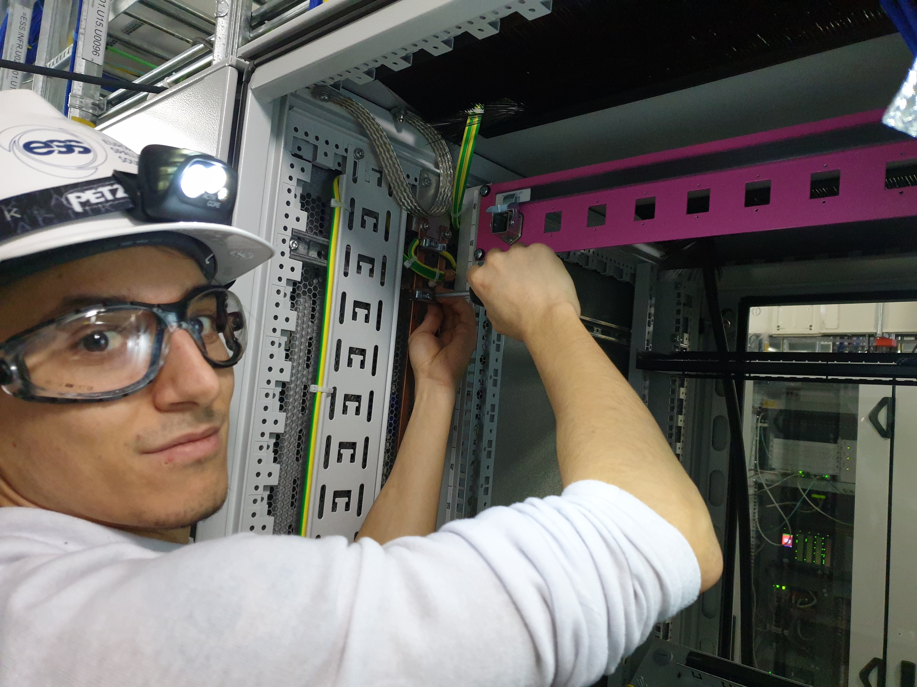
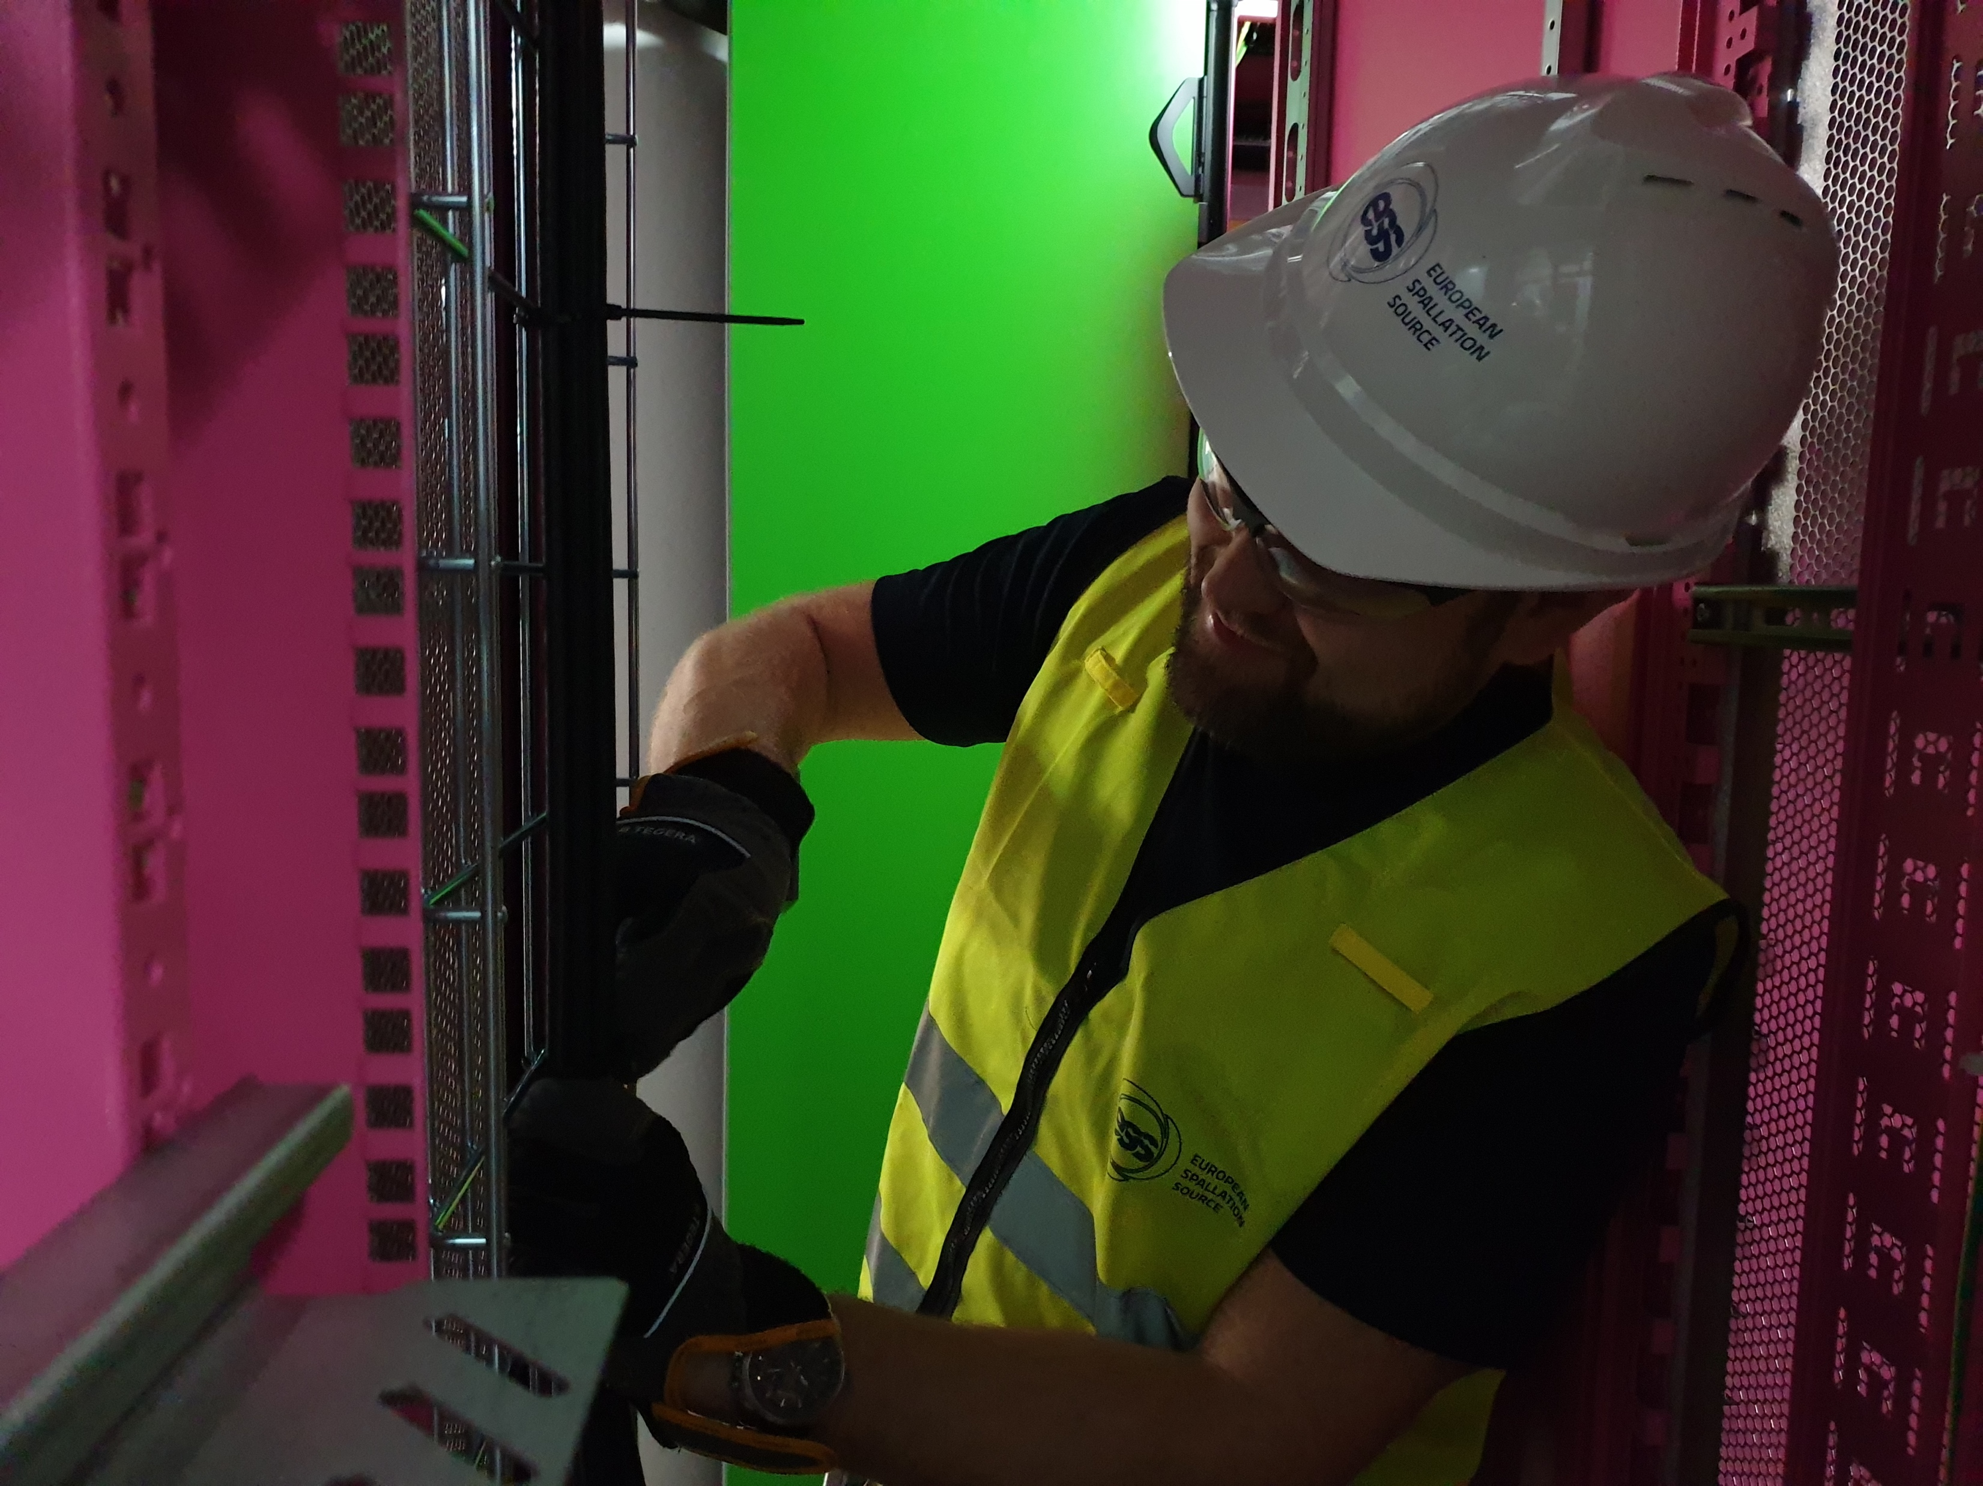
Status on ESS Machine Protection Technical Advisory Committee (TAC) ICS/ Protection Systems Group/ MP Team Annika Nordt, David Sanchez-Valdepenas, Enric Bargalló, Fernando Carrasco Martin, Joakim Söder, Johannes Gustafsson, Manuel Zaera-Sanz, Martin Carroll, Stephane Gabourin, Szandra Kövecses, Viktor Fred
European Spallation Source ERIC
2019-04-11

Slide 2
TAC Charge
Report on the plans, functionalities, prototypes and
implementation status for Machine Protection

Slide 3
Outline
Glossary
FBIS Commissioning Plan: Focus on Normal Conducting LINAC
How to Stop Beam
Overview on Interface Documentation
Prototypes and Hardware In the Loop: Scope, Status, Results
BCM-FBIS-Timing System Test Stand: Scope and Results
From Prototyping Towards Production: System Deployment
Installation: Schedule, Strategy, Documentation, Status
Summary

Slide 4
Glossary
BCM – Beam Current Monitor
BLM – Beam Loss Monitor
BPM – Beam Position Monitor
DLN – Decision Logic Node
FAT – Factory Acceptance Test
FBIS – Fast Beam Interlock System
FEB – Front End Building
FIT – Final Integration Test
FSU – Fast Shutdown Unit
HIL – Hardware in the Loop/ Testbench for FBIS
MPS-ID – Machine Protection System for Insertable Devices (wire scanners, faraday cups, emittance measurement unit, etc)
MPS-Mag – Machine Protection System for LINAC Magnets (quadrupoles)
MPS-Vac – Machine Protection System for Vacuum (sector gate valves)
NCL – Normal Conducting LINAC
PSS – Personnel Safety System
RF-LPS – Local Protection System (LPS) for RF
SAT – Site Acceptance Test
SCU – Signal Conditioning Unit
SIT – Site Integration Test
SST – Software Simulation Test
ZHAW – Zurich University of Applied Sciences/In Kind Partner for FBIS Development

Slide 5
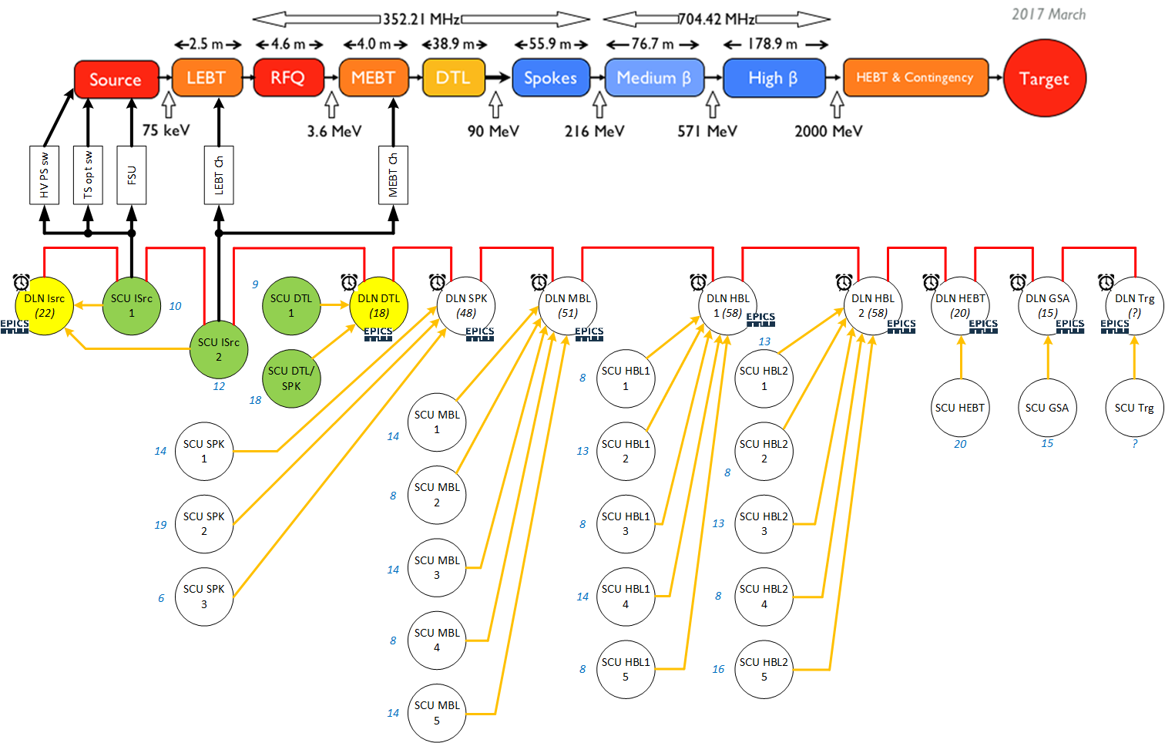
FBIS Commissioning Plan: ESS-0880176
FBIS Plan for NCL
Signal Conditioning Unit Mezzanine Cards (Types and Numbers per SCU)
Name | PLC | Struck | IFC1410 | FBIS OPL | ISrc | HV PS | LEBT Ch | MEBT Ch
ISRC-010Row:MPS-SCU-0501 | 5 | 1 | 2 | 2 | 1 | 1 | 0 | 0
ISRC-010Row:MPS-SCU-0502 | 1 | 3 | 2 | 2 | 0 | 0 | 1 | 1
DTL-010Row:MPS-SCU-0501 | 0 | 0 | 4 | 0 | 0 | 0 | 0 | 0
DTL-030Row:MPS-SCU-1001 | 0 | 2 | 3 | 0 | 0 | 0 | 0 | 0
TOTAL | 6 | 6 | 11 | 4 | 1 | 1 | 1 | 1
NCL-MP-Systems:
1) MPS-Vac: allow beam operation only if all valves upstream beam destination are open and vacuum is OK
2) MPS-ID: allow ID operation only if beam power permits & ID is OK
3) MPS-Mag: allow beam operation only if power supplies send an OK
4) FBIS: Collect all signals and allow beam only if they are ready & OK
The FBIS is connecting to the following systems as part of the normal conducting LINAC:
Sensor systems: BCMs, BLMs, BPMs, Scrapers, MPS-ID, MPS-Vac, MPS-Mag, Ion Source-PLC, PSS-PLC, RF-LPS (1 per cavity)
Actuator systems: Ion Source, Timing System, LEBT chopper, MEBT chopper (details on next slide)

Slide 6
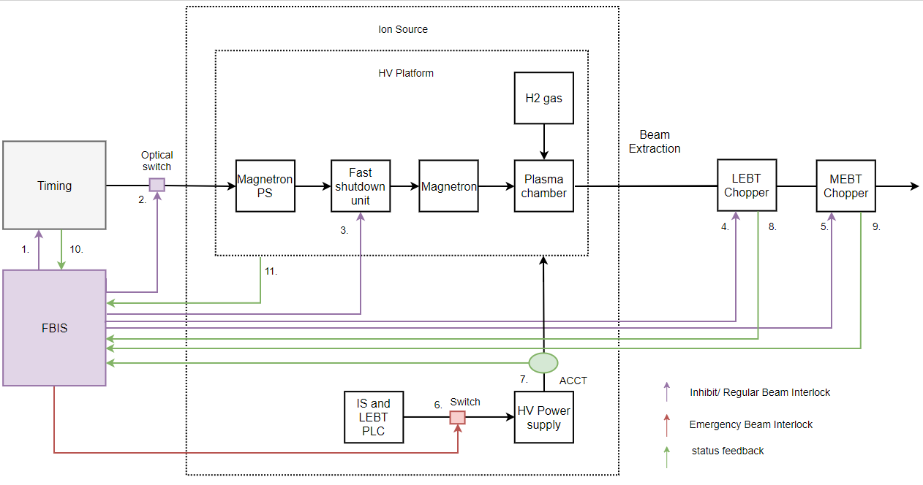
Actuator Systems/ How to Stop Beam: ESS-0231457
Theory
Implementation Status
(1) Isrc Mezzanine Card
(2) Because LEBT chopper HV PS broken
(3) Power supplies not at ESS yet
(4) BCM link
(5) to be checked when LEBT chopper is working
(6) decided (MEBT uTCA, IFC1410, DIO3118 with SDR connector)
(7) HW common to all 3 actuators. HW design on-going.
(8) Wait for LEBT chopper to be tested
(9) Wait for MEBT chopper to be tested
See also backup slides for more details
In addition: Allow producing plasma without extraction by acting on HVPS switch but not on timing, optical switch and FSU. Check feedback from HV readout and HV ACCT. If something goes wrong, ISrc-PLC will inform FBIS to stop plasma and then FBIS will act on timing, optical switch and FSU.
It is crucial to test the LEBT chopper together with the FBIS and with beam asap to ensure we can stop beam on time!
All other actuators are not as fast and as robust as the LEBT chopper (MEBT chopper is fast, but can take only 200us).

Slide 7
Status Interface Documentation/MP-Systems
Interface Control Document | CHESS Number | Status in CHESS
Normal Conducting LINAC-Systems
FBIS-Ion Source (Isrc-PLC & actuators) | ESS-0401425 | Review
FBIS- LEBT chopper system (feedback) | ESS-0117248 | Released
FBIS-LEBT chopper (actuator) | ESS-0870909 | Review
MPS-Vac and vacuum valves | ESS-0100091 | Released
MPS-Vac and Vacuum Interlock PLC (PBVI) | ESS-0288085 | Released
MPS-Vac and EPICS | ESS-0403411 | Released
MPS-ID and IDs (insertable devices) | ESS-0110223 | Released
MPS-ID and ID Motion Controllers | ESS-0151690 | Released
MPS-ID and EPICS | ESS-0419512 | Released
MPS-Mag and MEBT PLC | ESS-0494755 | Review
FBIS and RF-LPS | ESS-0879723 | Review
FBIS and BCMs | ESS-0105298 | Review
Interface Control Document | CHESS Number | Status in CHESS
FBIS and BLMs | ESS-0515969 | Released
FBIS and BPMs | JIRA | Work on-going
MPS PLCs and FBIS | ESS-0440607 | Released
FBIS and MEBT chopper | JIRA | Work on-going
Target-Systems
MPS-Trg and Primary Target water cooling | ESS-0216049 | Draft ready
MPS-Trg and Target Wheel | ESS-0400026 | Draft Ready
Target Electrical Infrastructure and MP | ESS-0198548 | Released
MPS-Trg and Proton Beam Window | ESS-0400027 | Work on-going
MPS-Trg and Tuning Beam Dump | ESS-0213023 | Draft ready
7

Slide 8
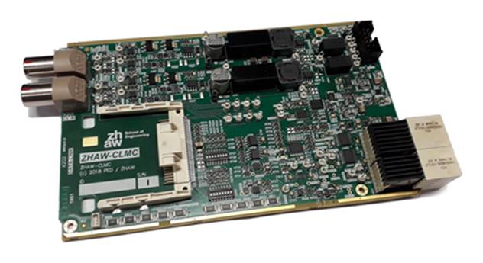
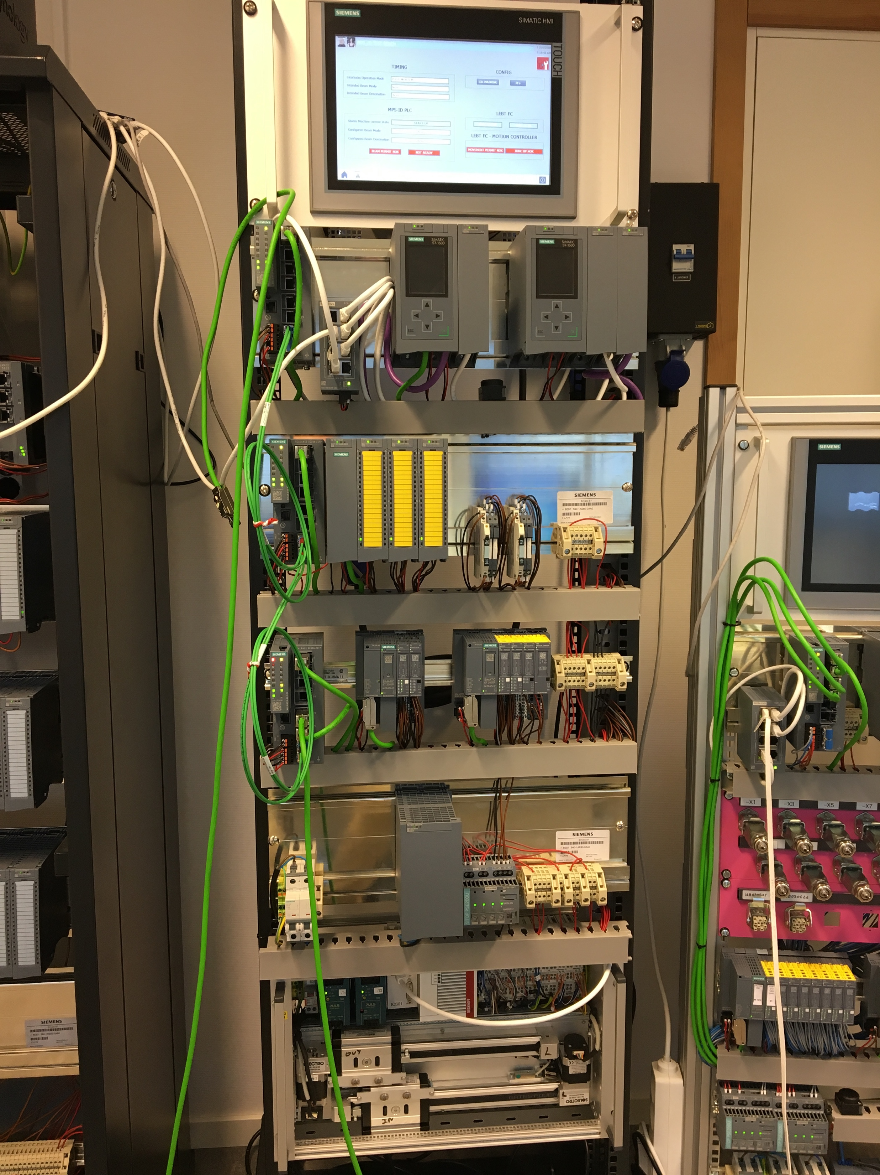
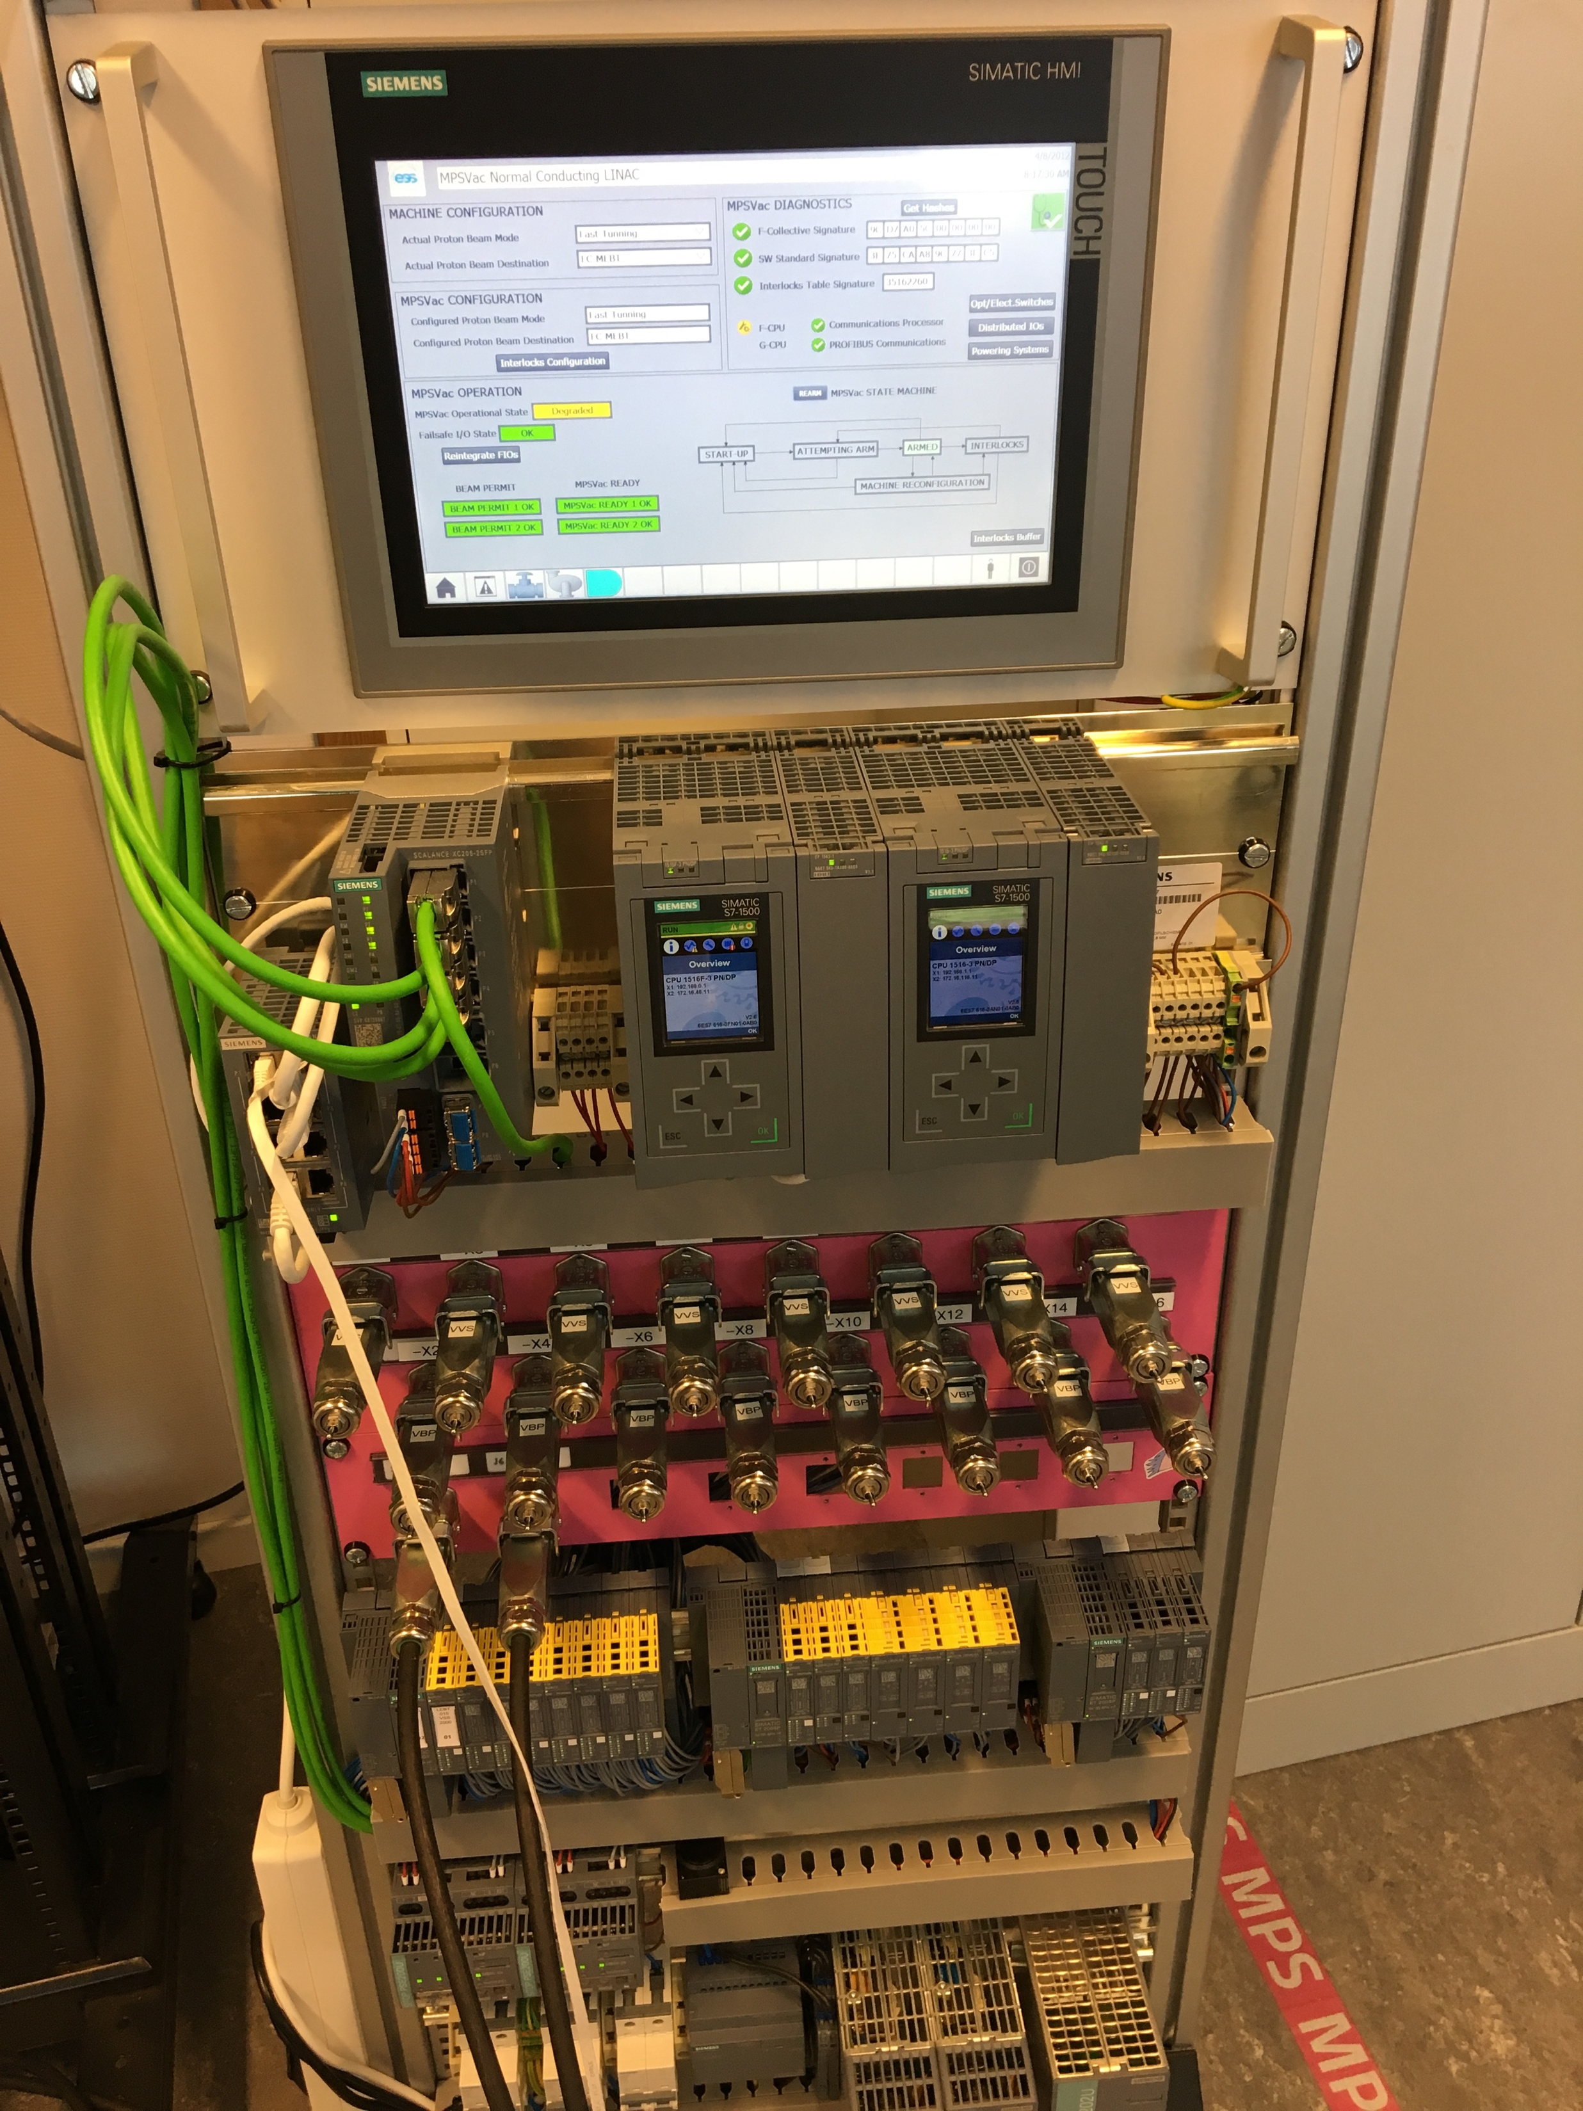
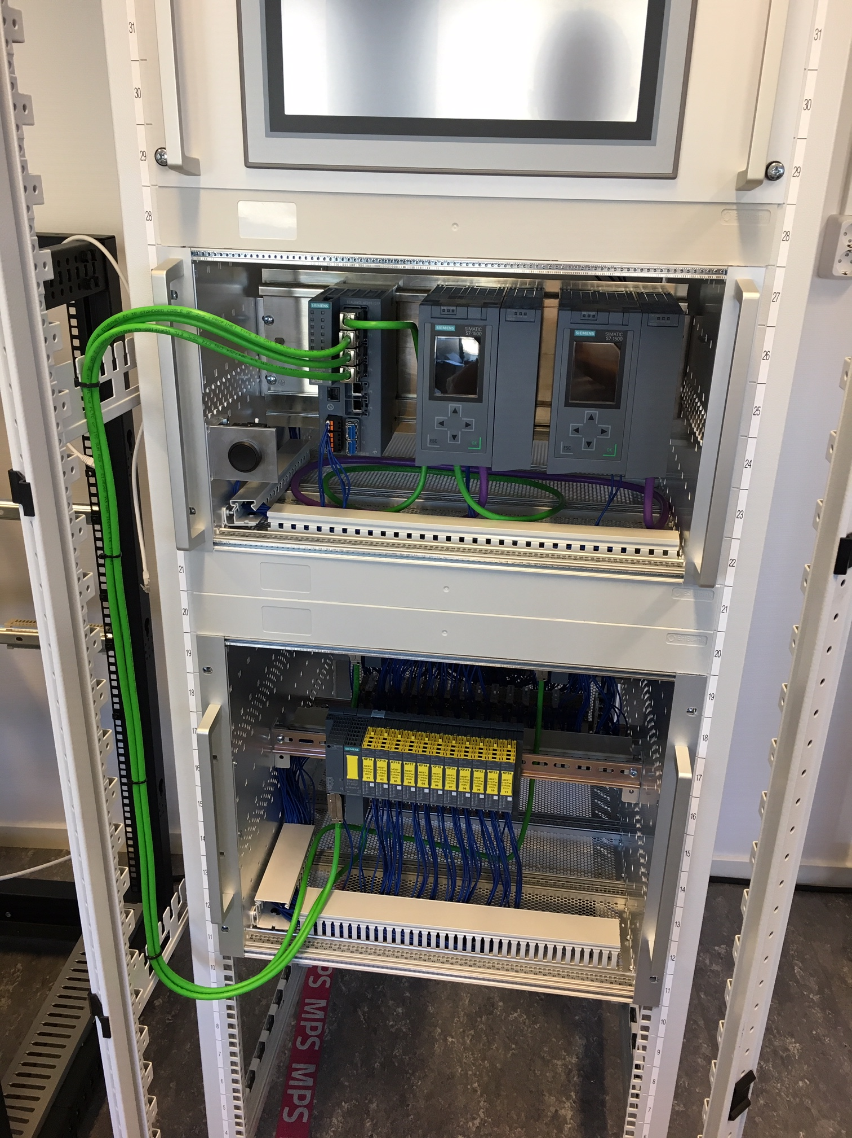
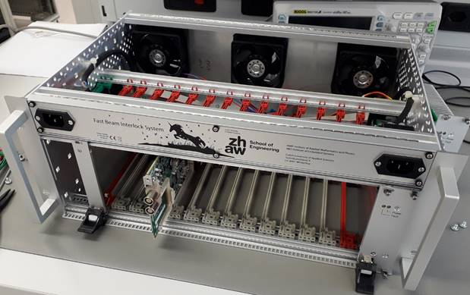
Prototypes in the Labs at ESS and ZHAW: Status
MPS-Vac and MPS-ID: fully tested and ready for final sw testing, sw freeze & version control, deployment, installation
MPS-Mag: prototype in ESS lab (Critical Design Review: 2019-05-22)
FBIS: Demonstrator/prototype in Lund/installed at Ion Source-LEBT test stand for testing and FBIS existing at ZHAW (finalization of hw, fw, sw)
Mezzanine Card to connect SCU with PLCs
MPS-ID
MPS-Vac
MPS-ID Rack for NCL
FBIS SCU Crate

Slide 9
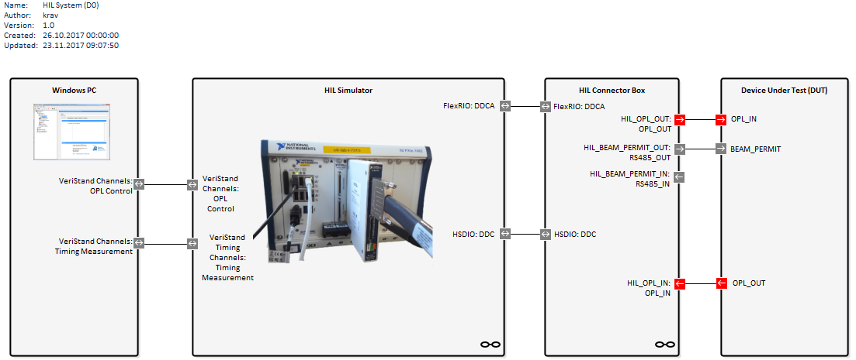
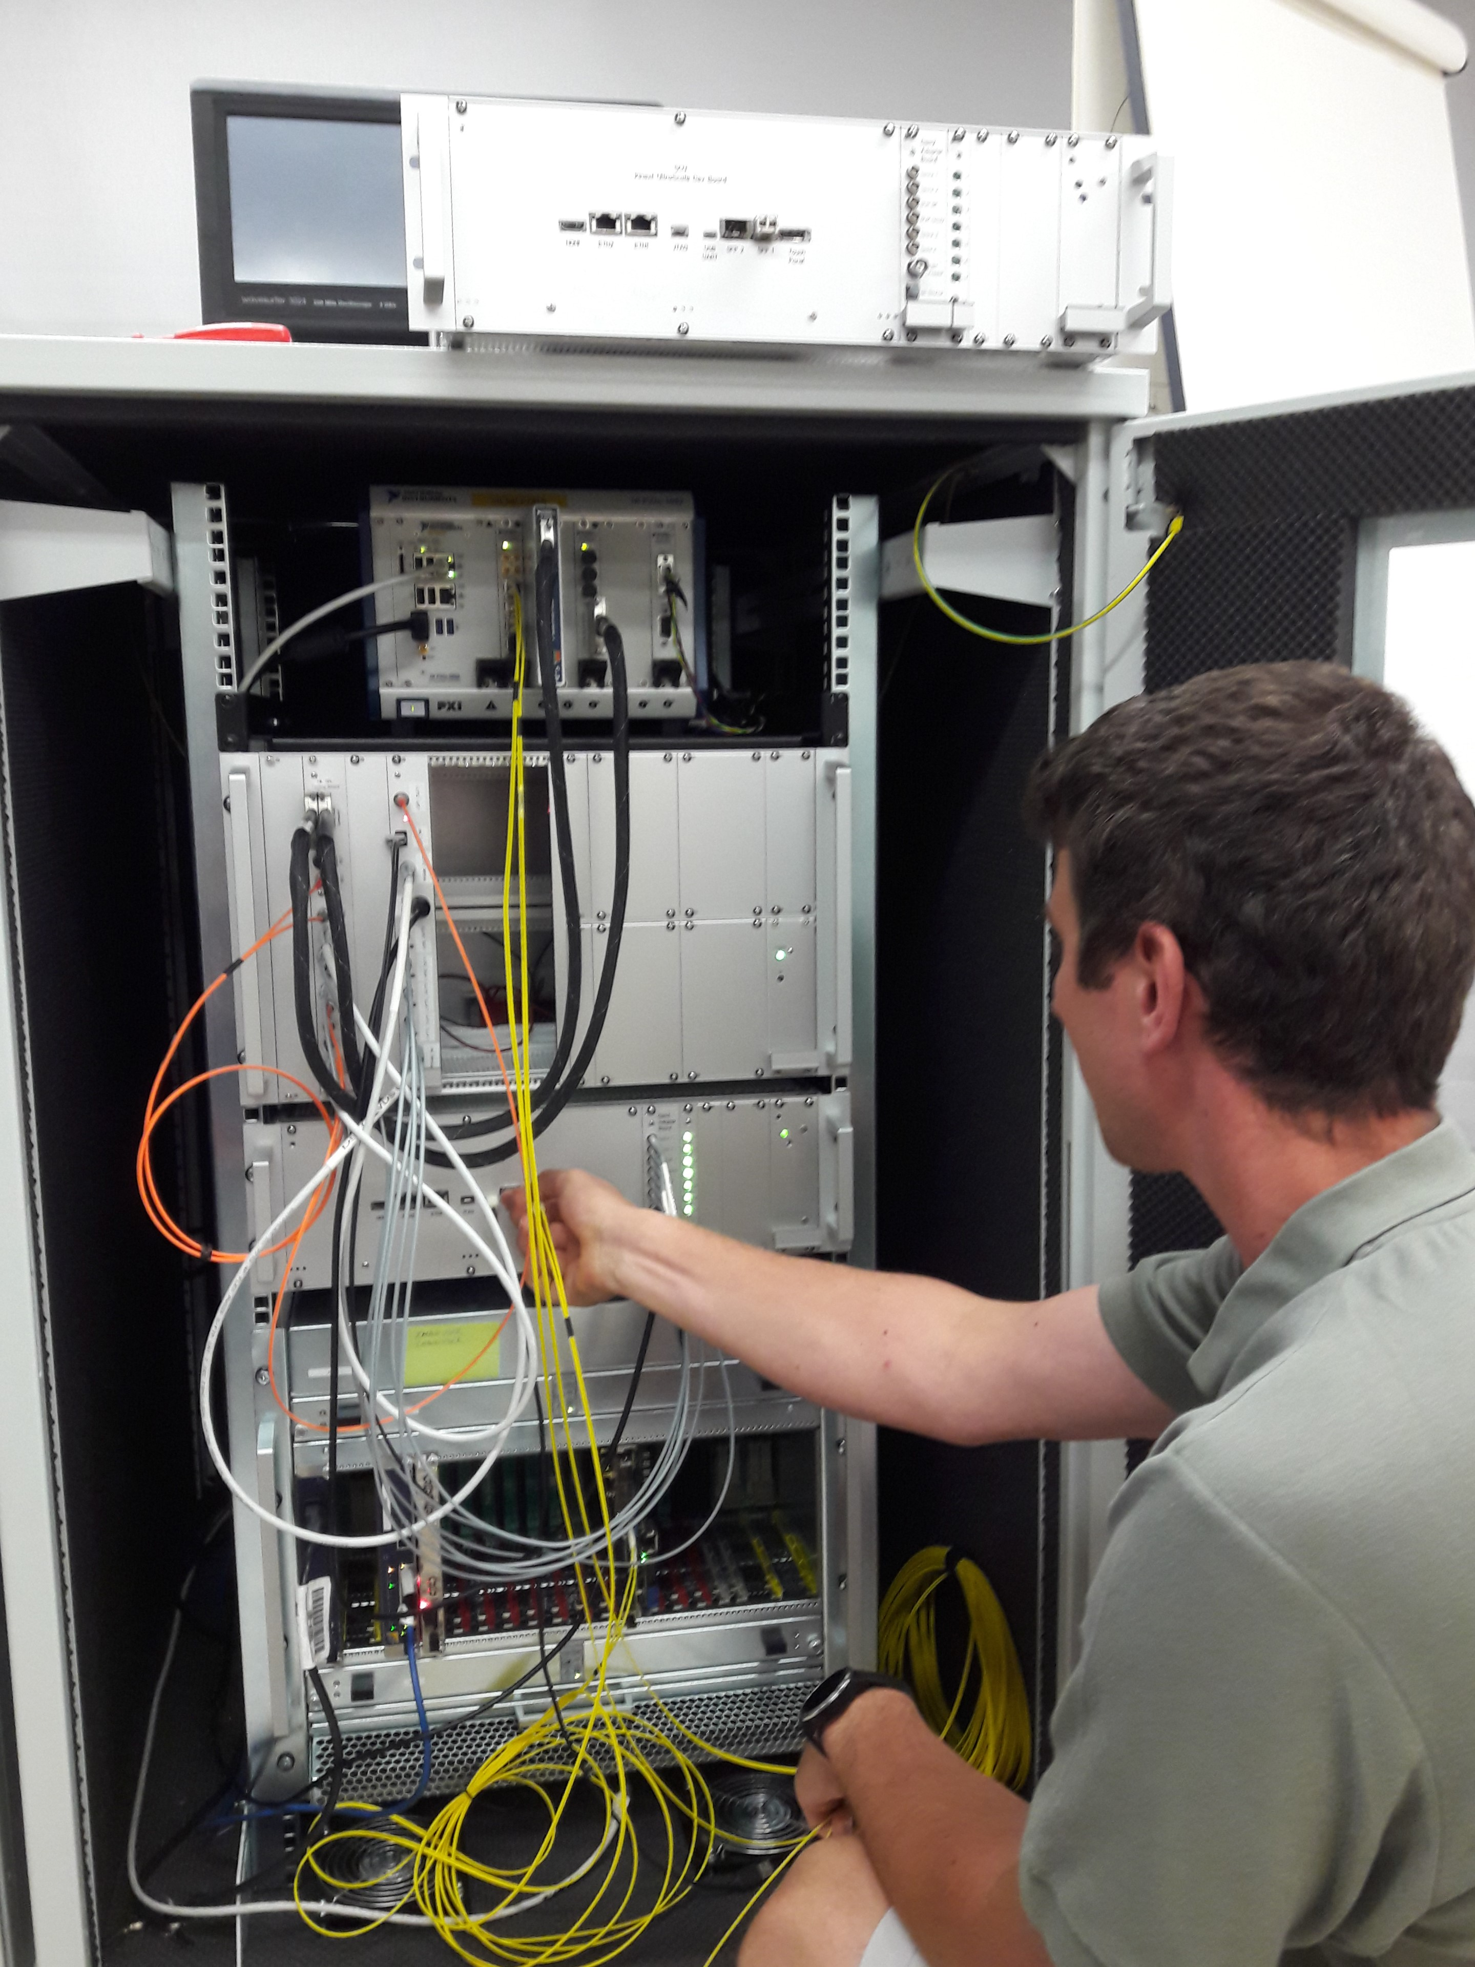
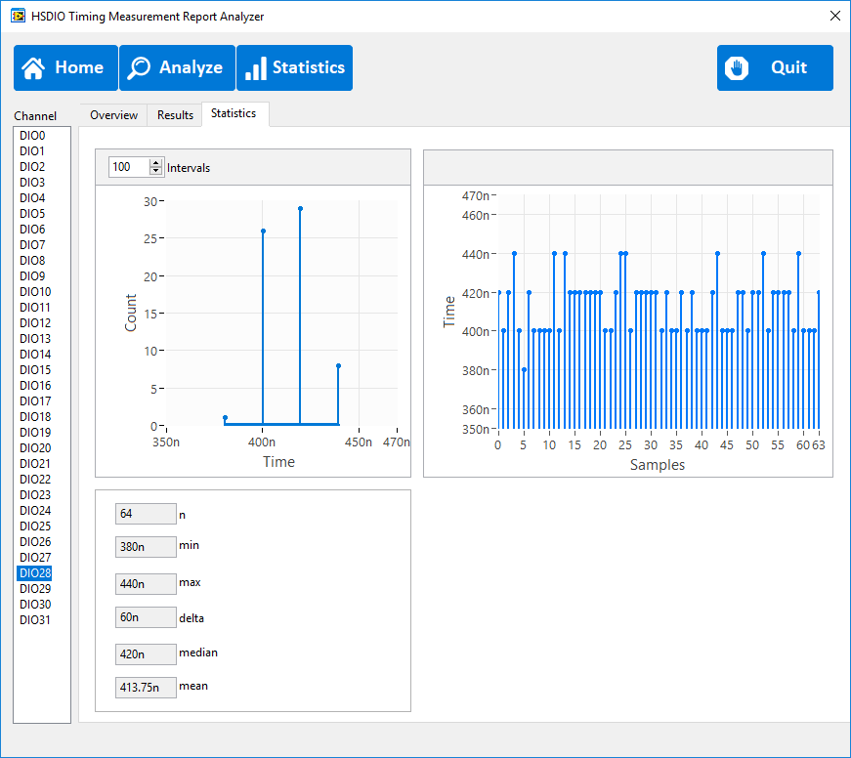
Hardware in the Loop (HIL): FBIS Test System
FBIS and HIL at ZHAW / 1 HIL to be kept at ZHAW for development and FBIS FAT/ 1 HIL to be send to ESS in 2019-06 for FBIS SAT & SIT
HIL Simulator
Signal Generation and Acquisition
HIL Connector Box
Hardware Interfaces
Set up:
PXIe-1082, 8-Slot 3U PXI Express Chassis
PXIe-8880 RT (PharLab) Intel® Xeon® E5-2618L v3 Octa-Core Processor 2,3 GHz
PXIe-7975R NI FlexRIO FPGA Kintex7 2GB
NI6581B, 100 MHz, 54 Single-Ended-Channel Digital I/O Adapter Module
PXIe-6547-64, HSDIO 64 DIGIO 100 MHz
SCU
DLN
Test Script Execution
Device under Test
Results:
9

Slide 10
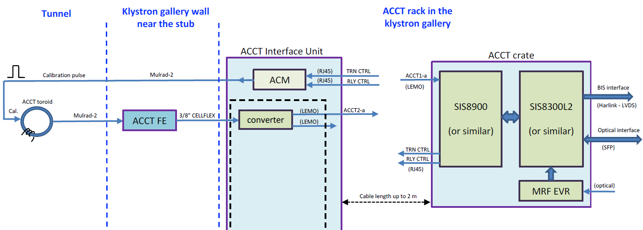
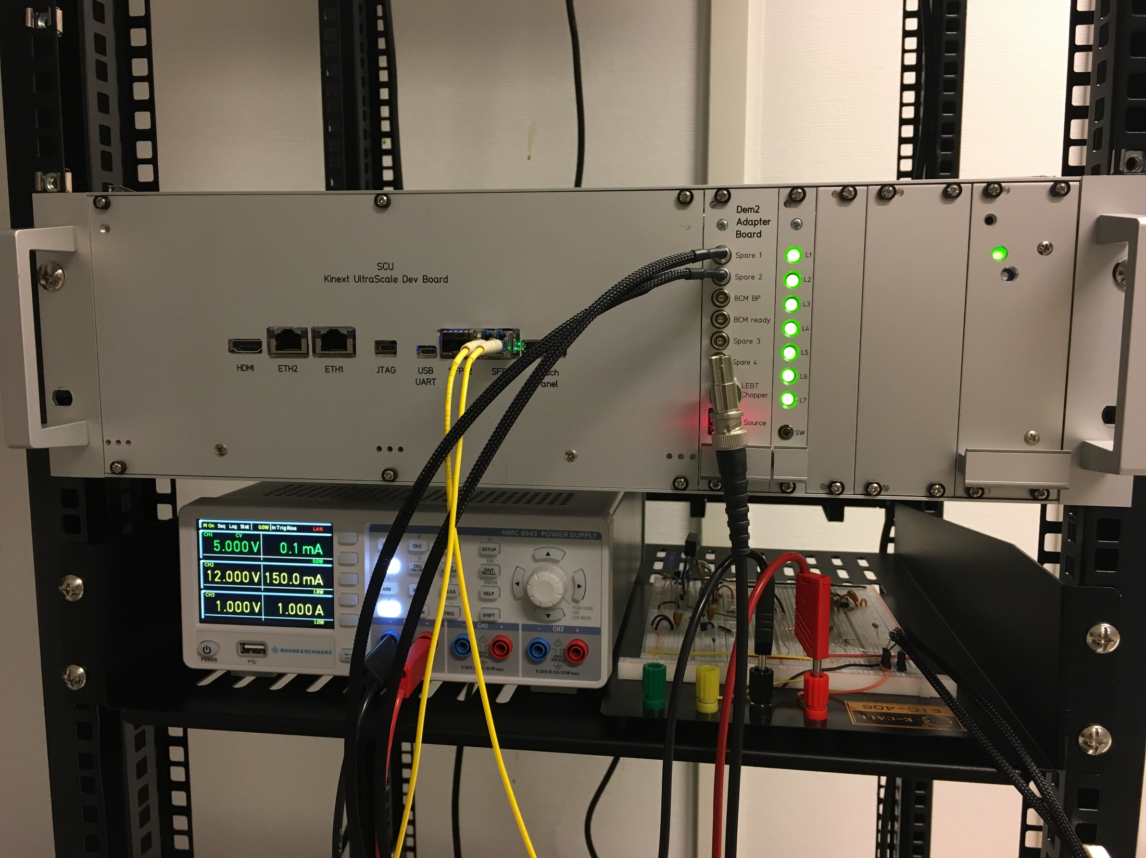
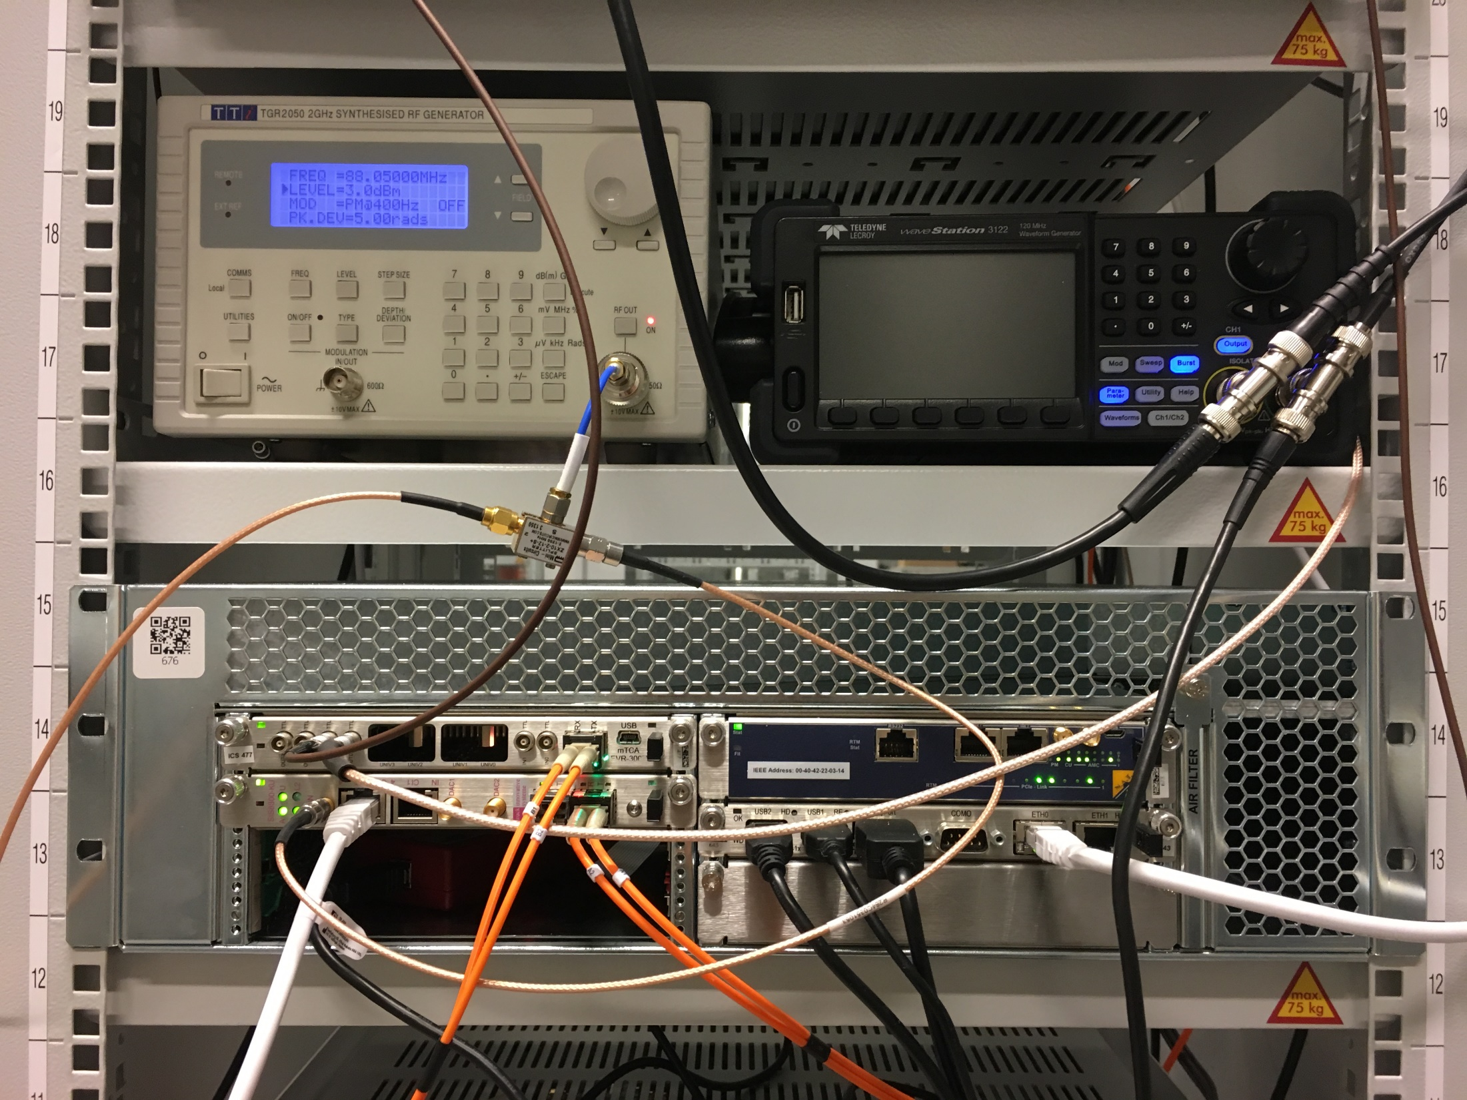
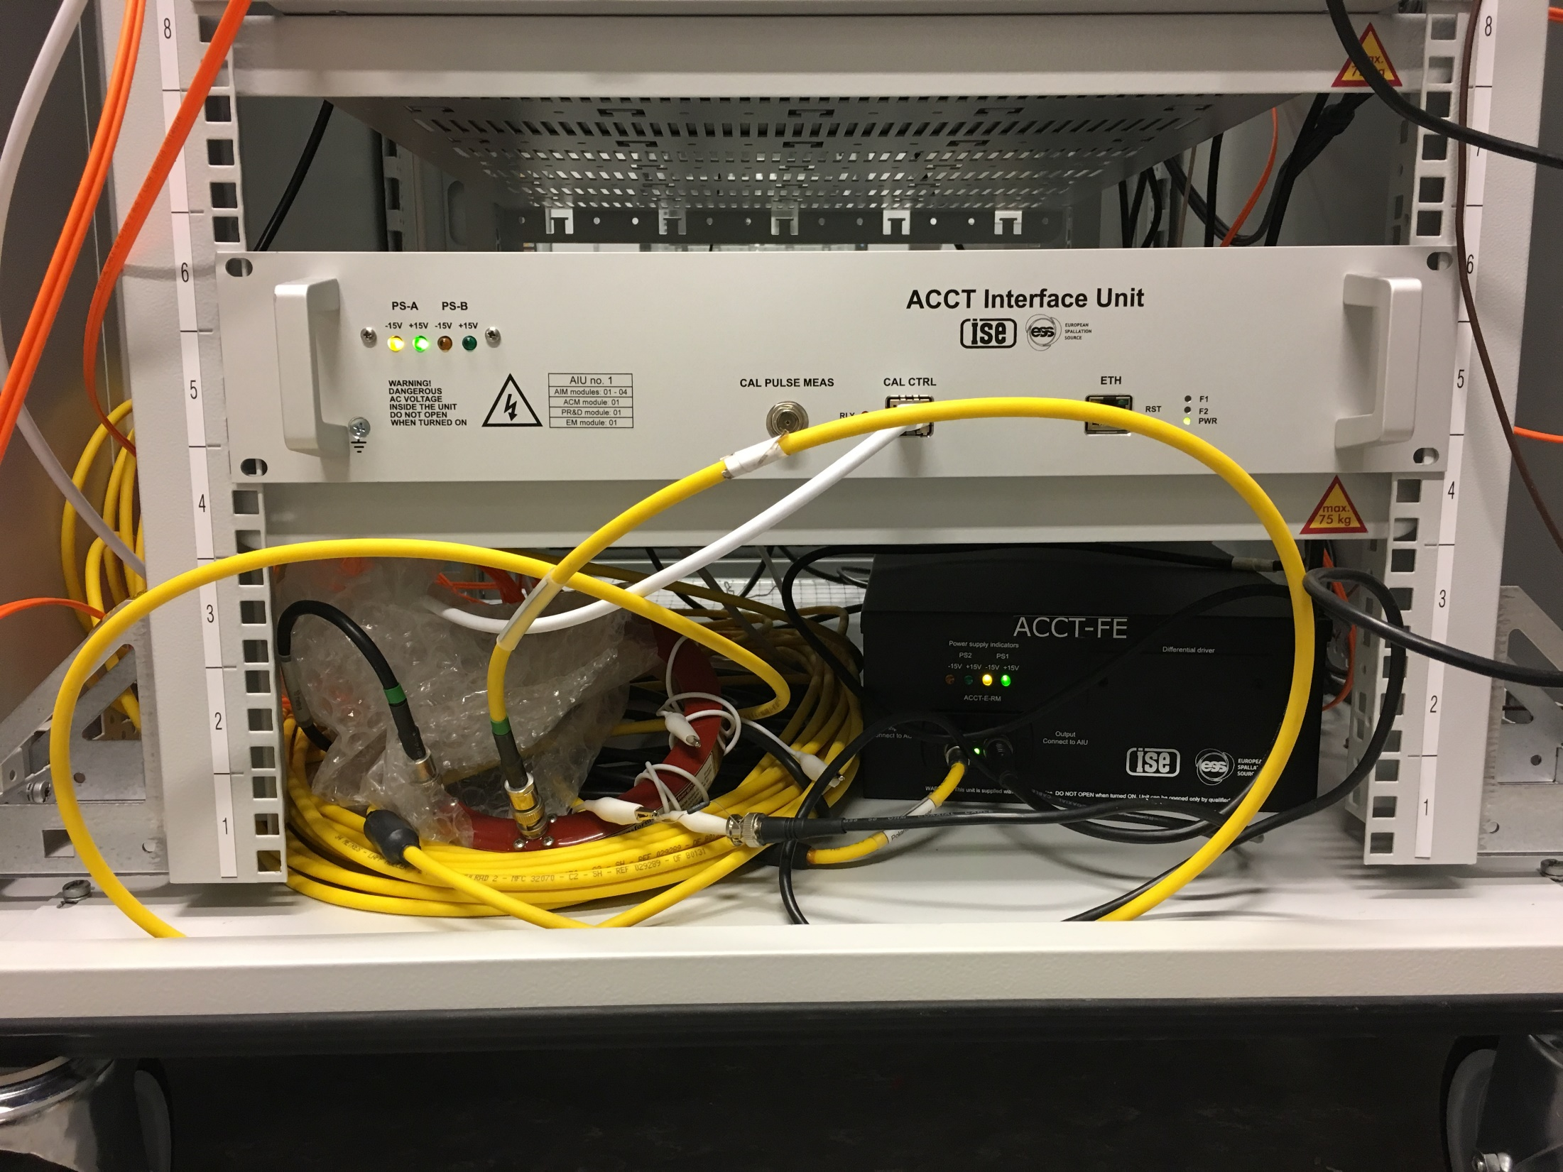
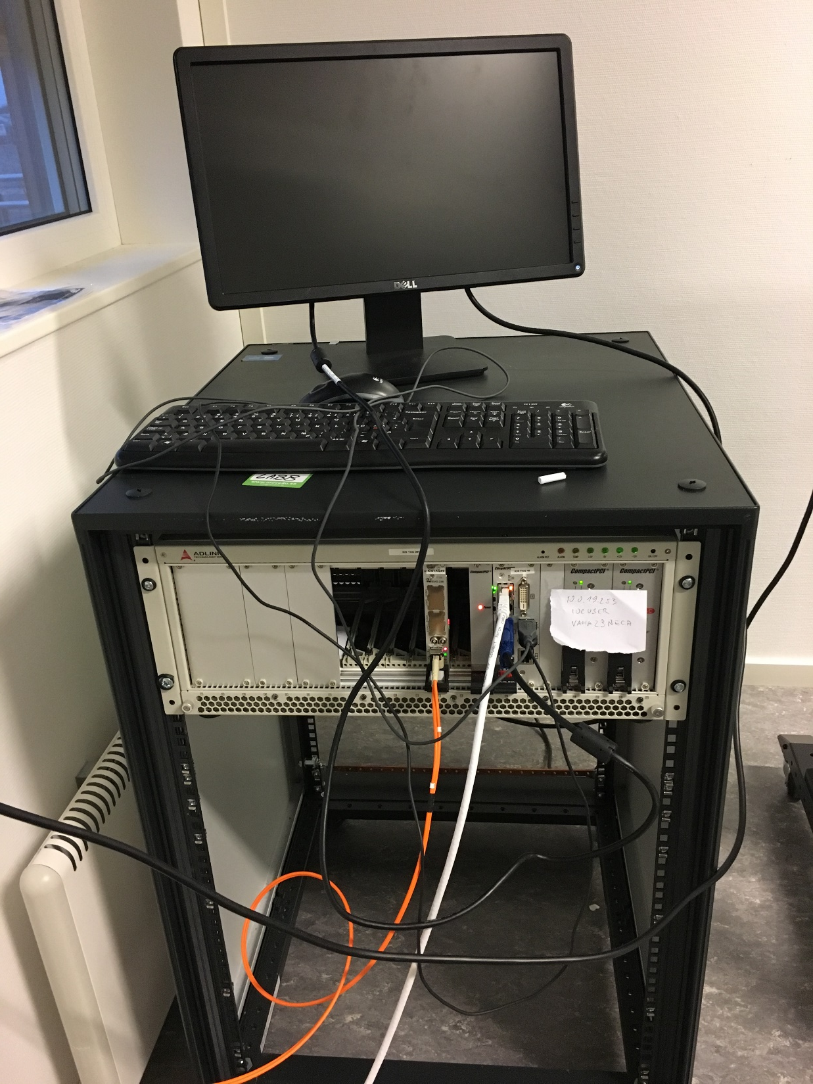
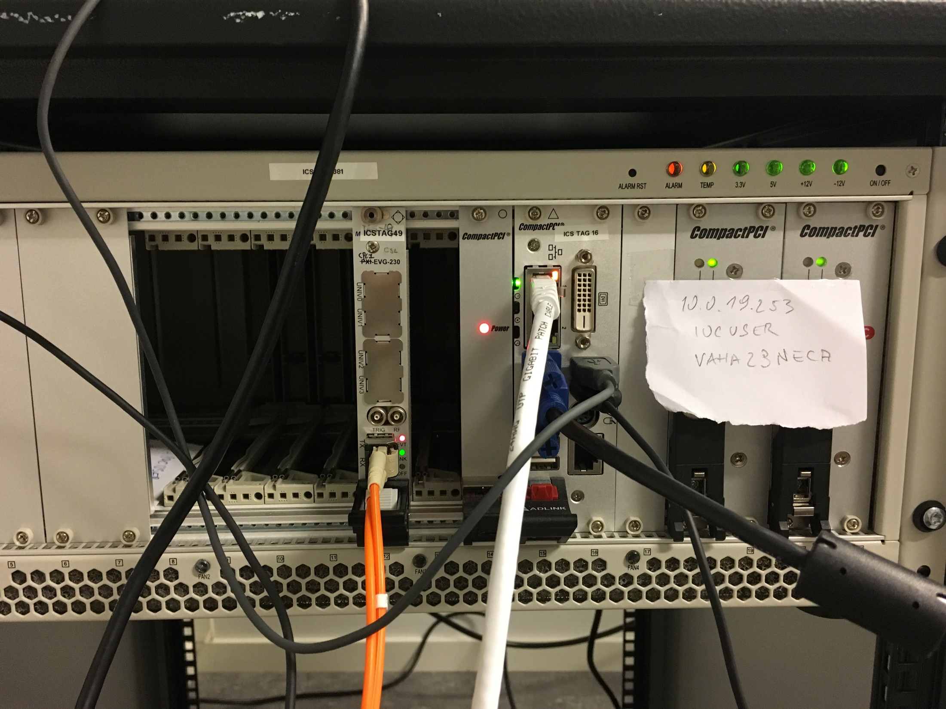
BCM-FBIS-Timing System Test Stand: Scope
Scope: Test Timing System, BCMs, FBIS together. Check that for a given Beam Mode (sent via Timing System) the BCM detects an “anomaly” (over current, too long pulse…) and removes its Beam Permit to the FBIS, which then requests a Beam Stop towards the Actuators.
Beam mode (BM)
Beam permit (BP)
FBIS
Demonstrator
Global BP
Timing system
BCM
FBIS
25m
EVG
Generator

Slide 11
BCM-FBIS-Timing System Test Stand: Results
The total BCM response time from the moment that the extra current (i.e. glitch) goes through the toroid until the moment that the BEAM_PERMIT signal switches on the SIS8300-KU output port is measured at 1.02 us.
From the total delay 0.47 us is due to the toroid, ACCT cable and the FE unit.
The required BCM-FBIS response time is 1-2 us.
The measured total time is 1.7 us.
25m
EVG

Slide 12
From Prototyping Towards Production
Project
Lifecycle
PLC / FBIS
Simulation Only
PLC / FBIS (HIL)
Sensors
PLC / FBIS
Sensors
Actuators
Timing
(EPICS)
PLC / FBIS
Sensors
Actuators
Timing
EPICS
Developed?
FAT
SAT
Integrated Systems without Beam
Integrated Systems
with
Beam
Hardware
Software
Development
SST
Local-SIT
SIT
FIT
Production
SAT
Procured?
Software
Lifecycle
Development Code Major Code REV: 0.0.#
Deployment Code Major Code REV: 0.#.0
Released Code Major Code REV: #.0.0
Code Review
Complete Date: xxxx-xx-xx
SST Complete
Date: xxxx-xx-xx
SIT Complete
Date: xxxx-xx-xx
FIT Complete
Date: xxxx-xx-xx

Slide 13
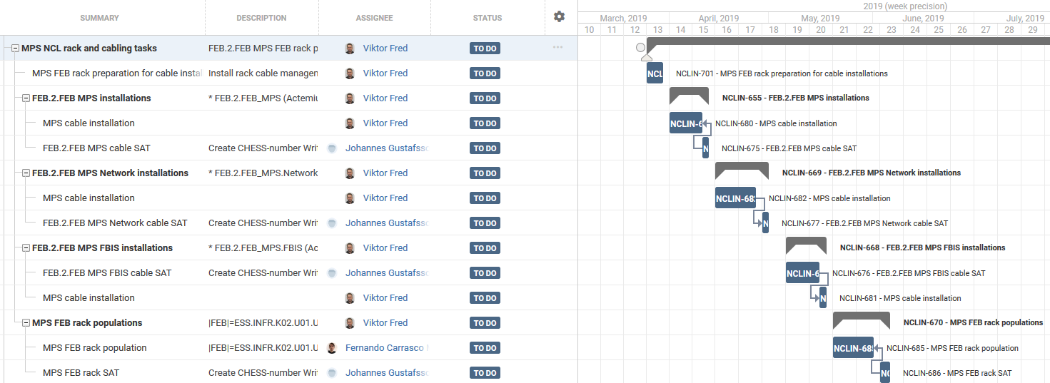
Installation Schedule Near Term
Extract of MP plan as part of NCL installation plan (https://jira.esss.lu.se/plugins/servlet/softwareplant-bigpicture/gantt)
We attend regularly the NCL integration meetings and provide pro-actively feedback.
We use our own installation team (PK)/ shared with PSS installation activities.
In case AD installation plans change, we adjust (MP is AD sequence independent and 80% flexible/ potentially we’ll have a standing army/ but plan is optimised by sharing with PSS).
MP will perform as many tests as possible as soon anything in NCL is installed to not push too many activities to the very end.
Detailed design for MP Systems:
ESS-0308178 MPS1 - Electrical Drawings for NCL_Rev2.0 <- released
ESS-0513301 FBIS1 - Electrical Drawings for NCL_Rev1.0 <- detailed design in work
13

Slide 14
Machine Protection Systems: Test Documentation
An Overview Matrix of all Verification & Validation Test Templates & Reports can be found in: ESS-0515344
14

Slide 15
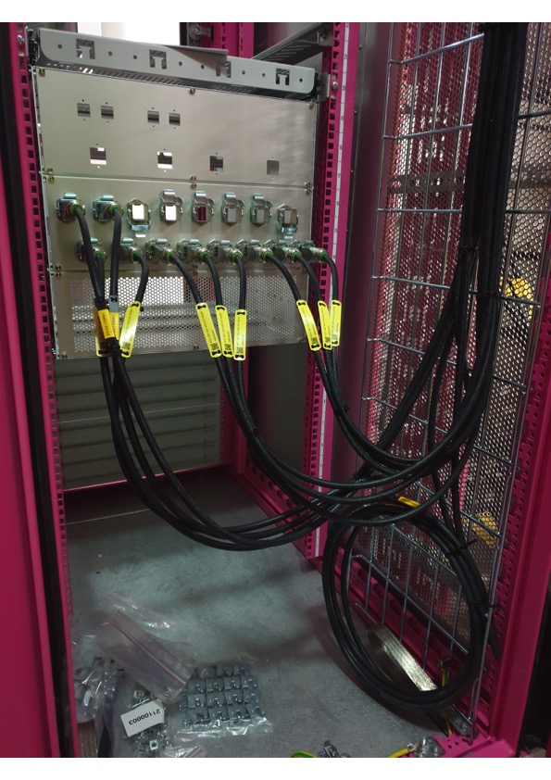
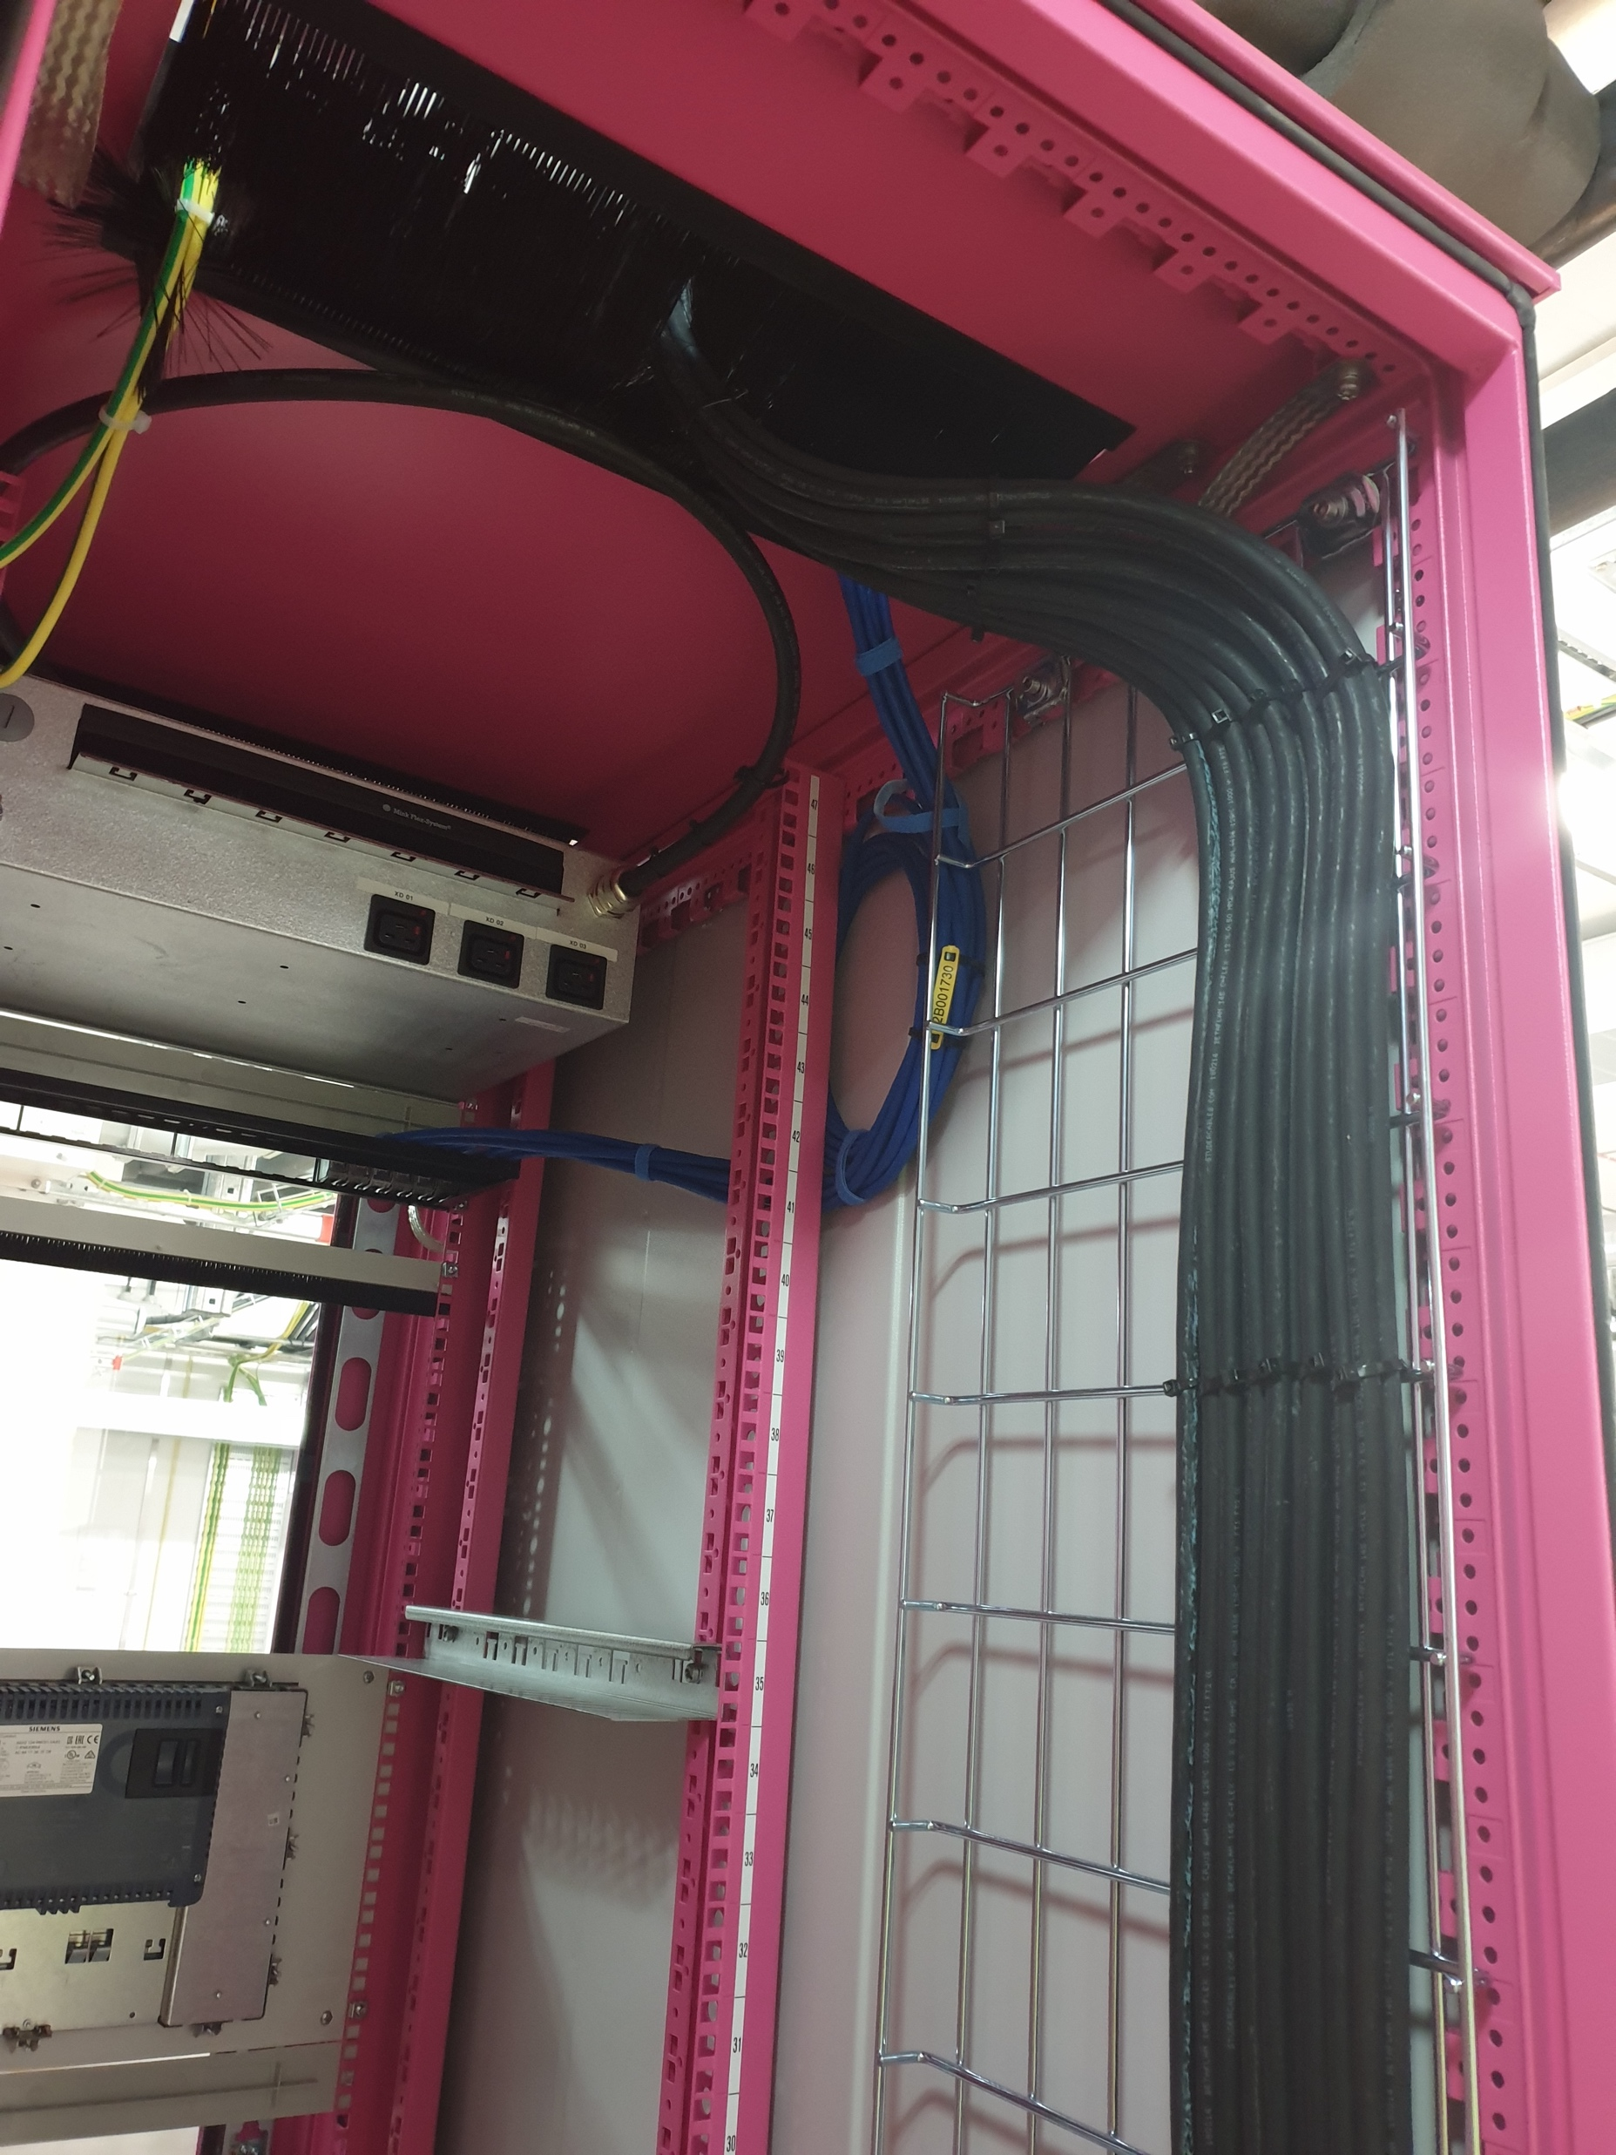
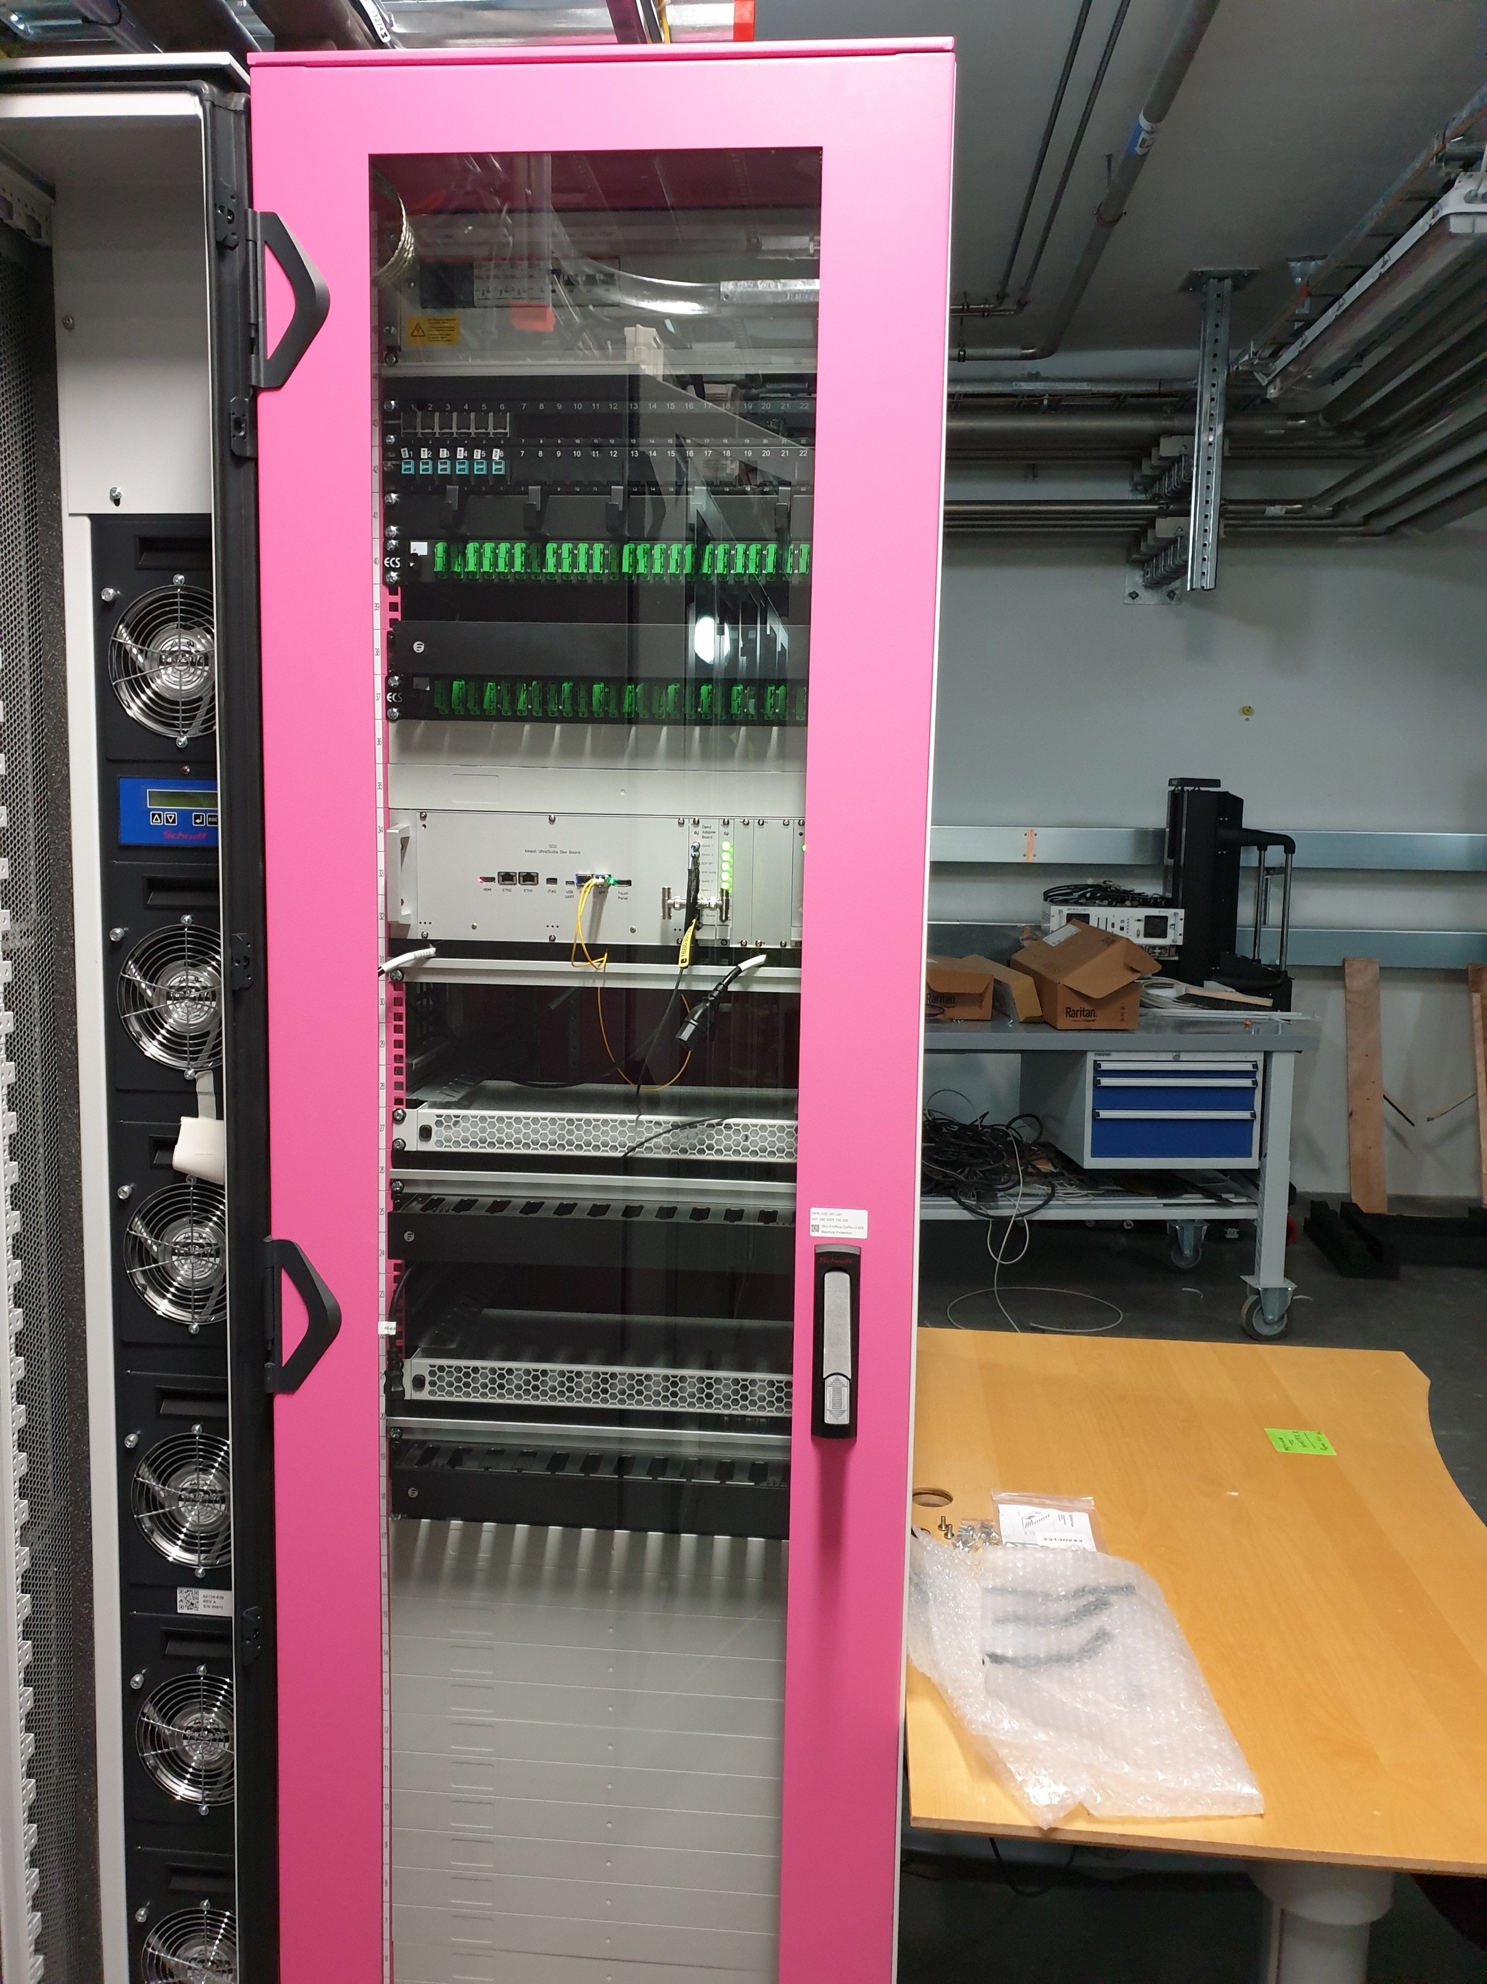
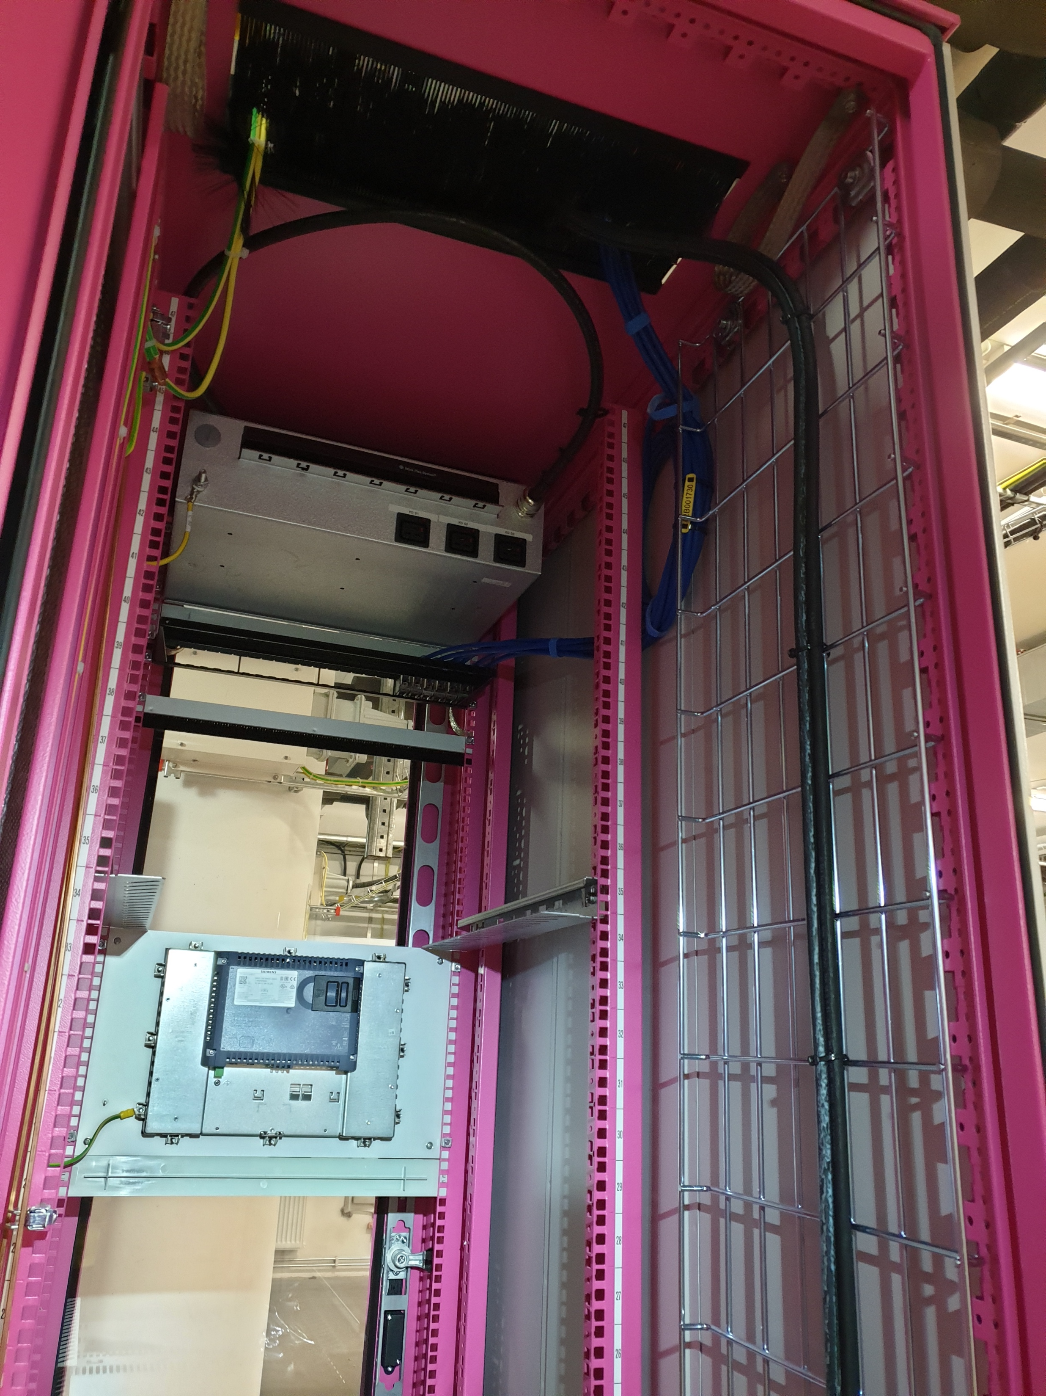
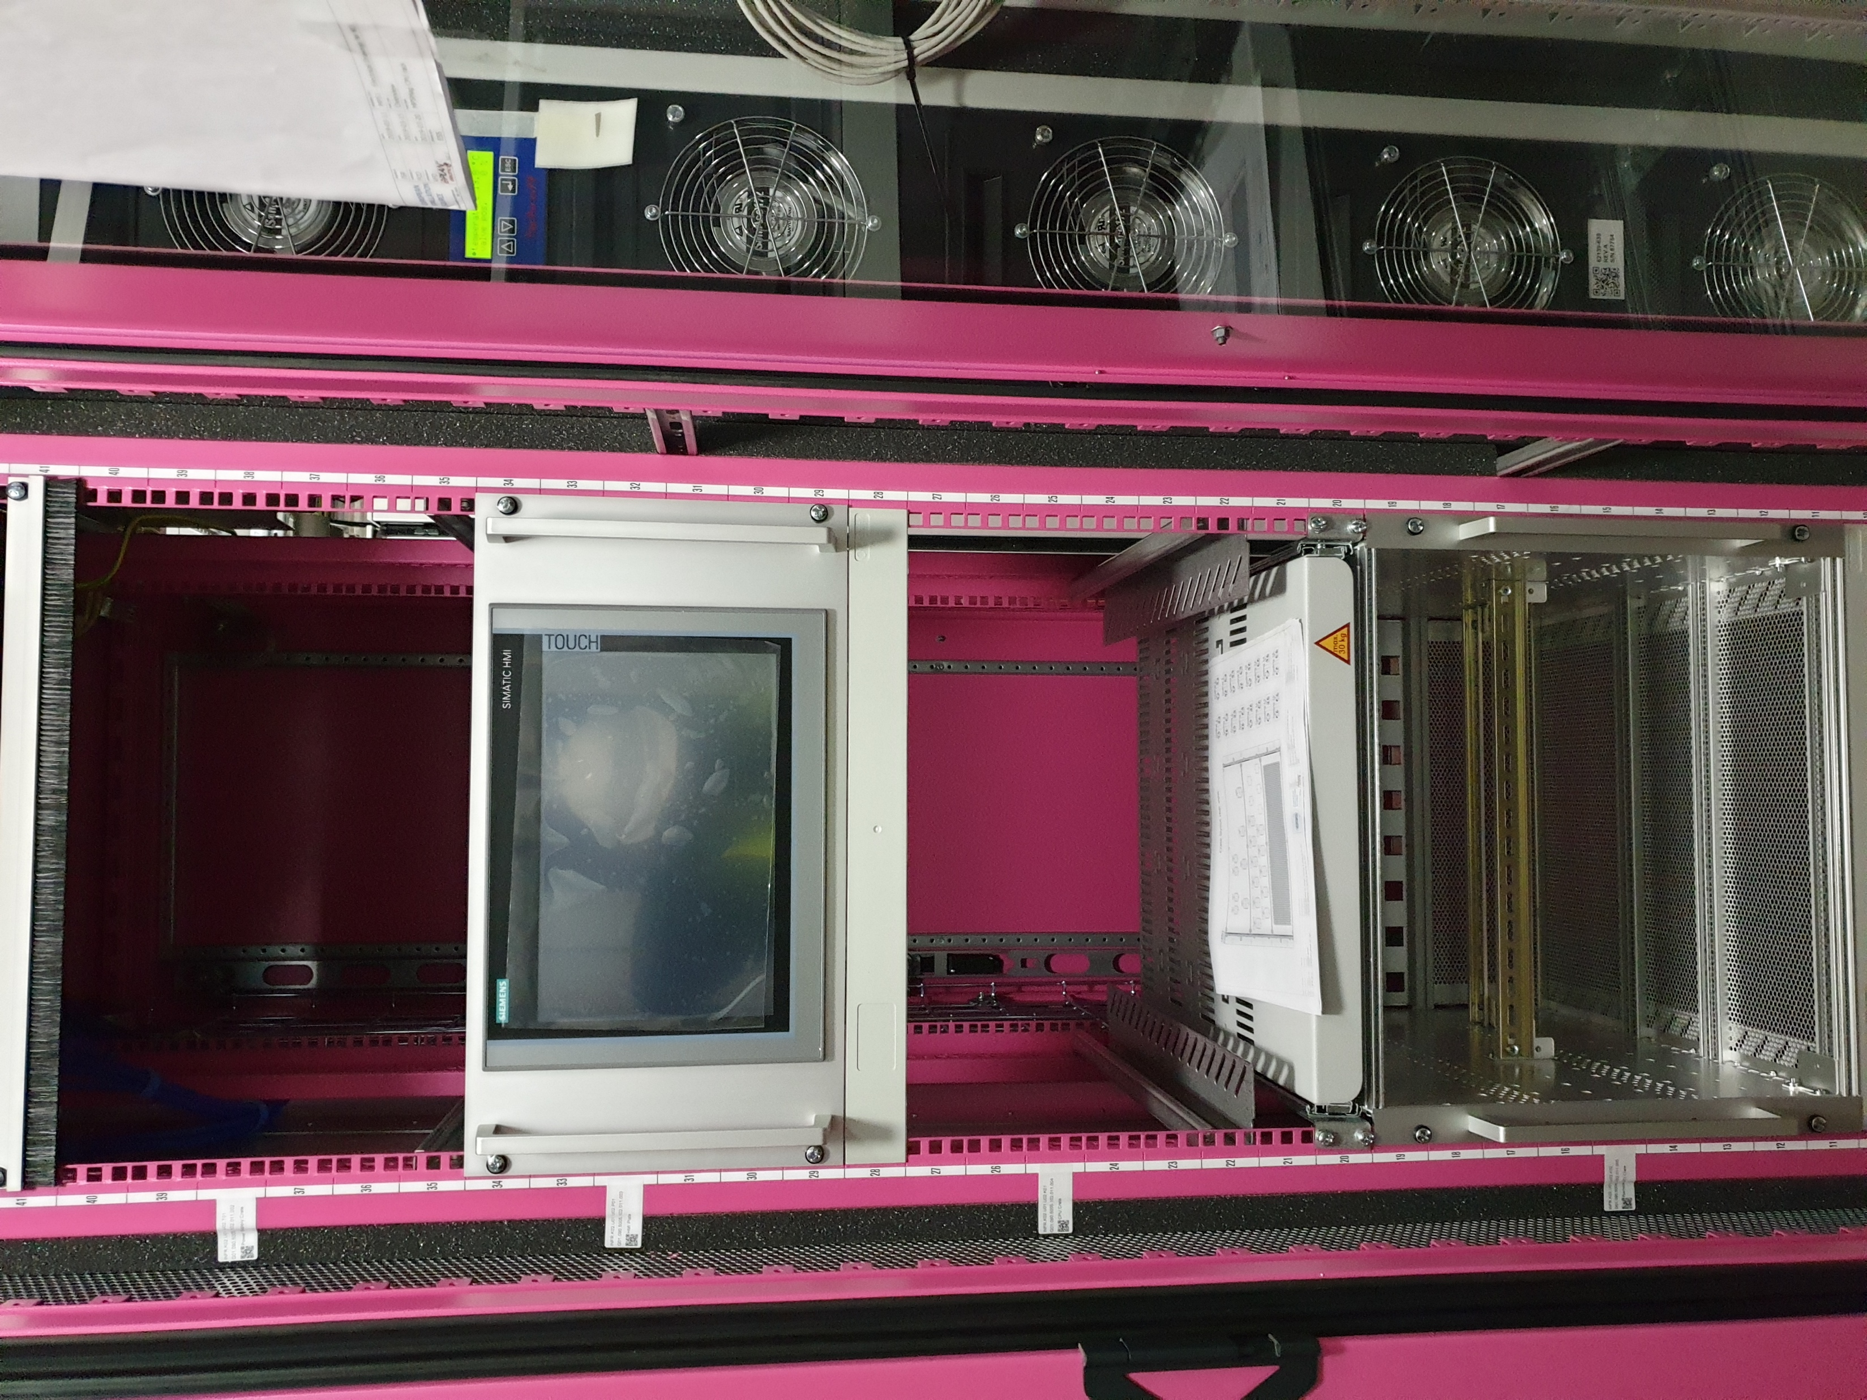
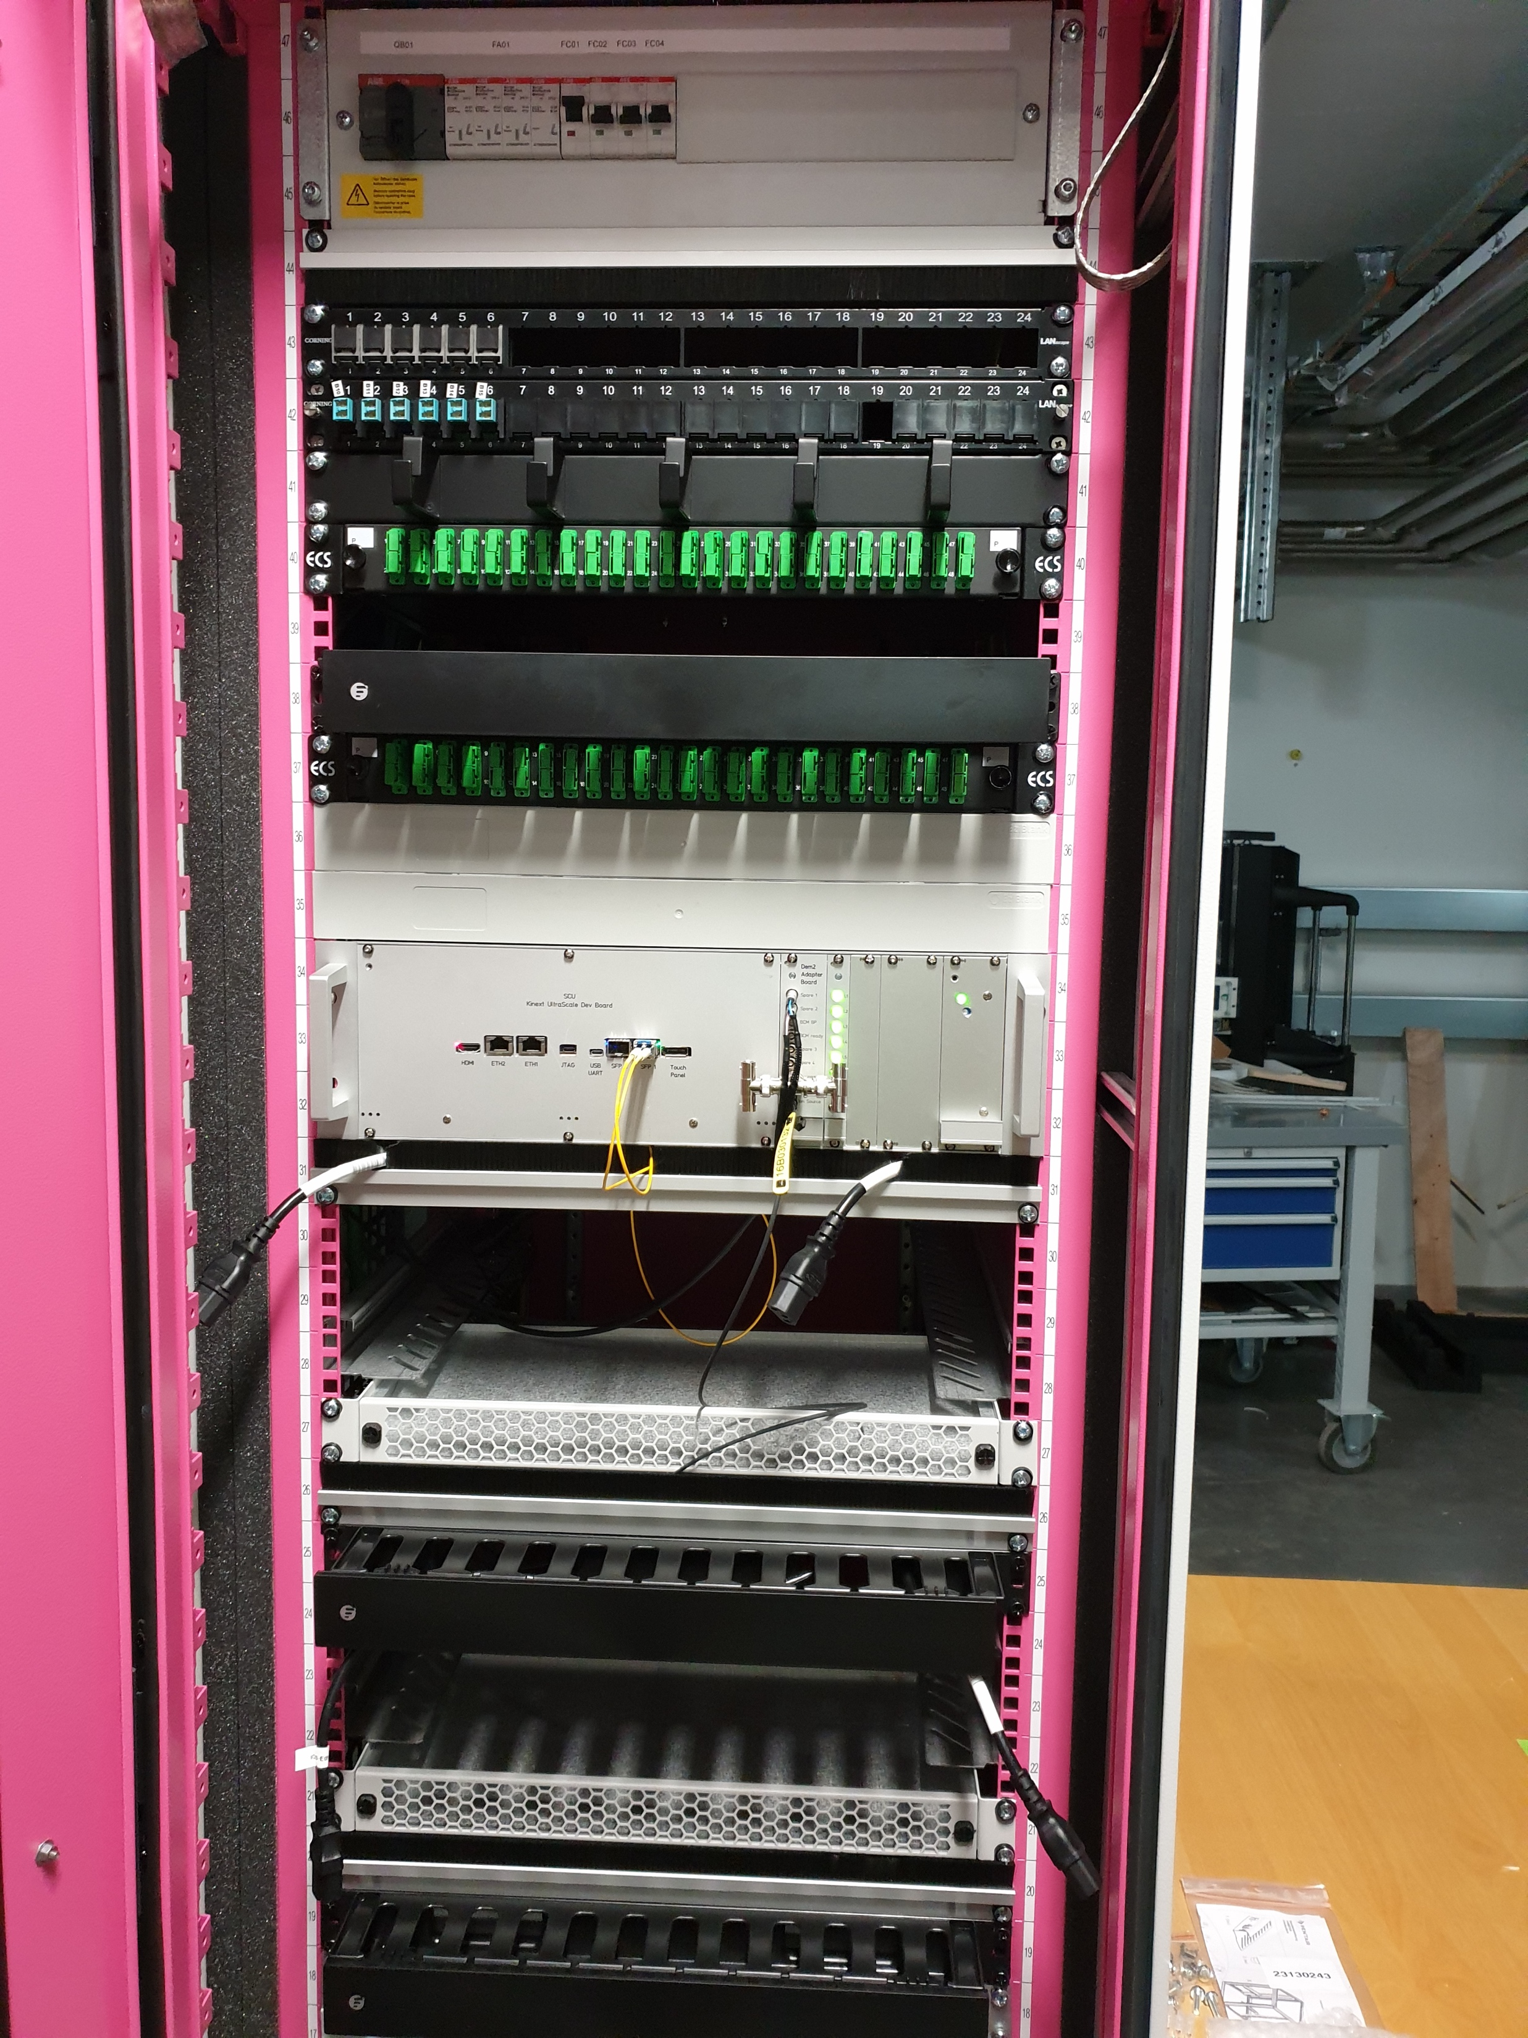
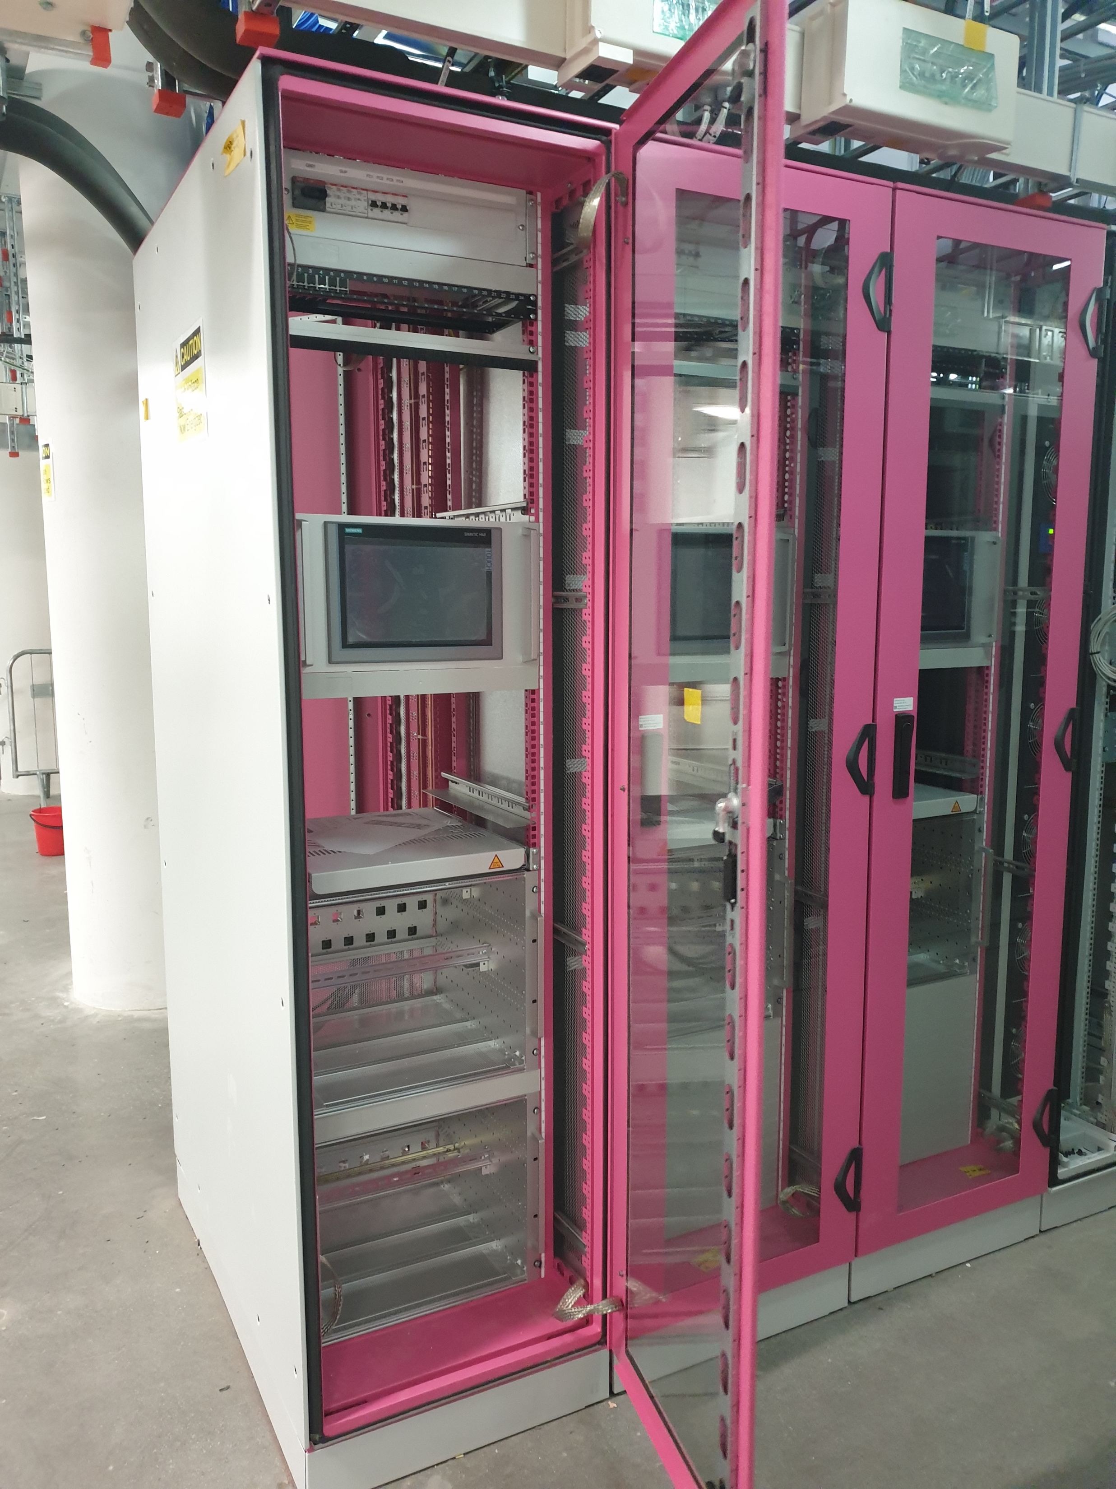
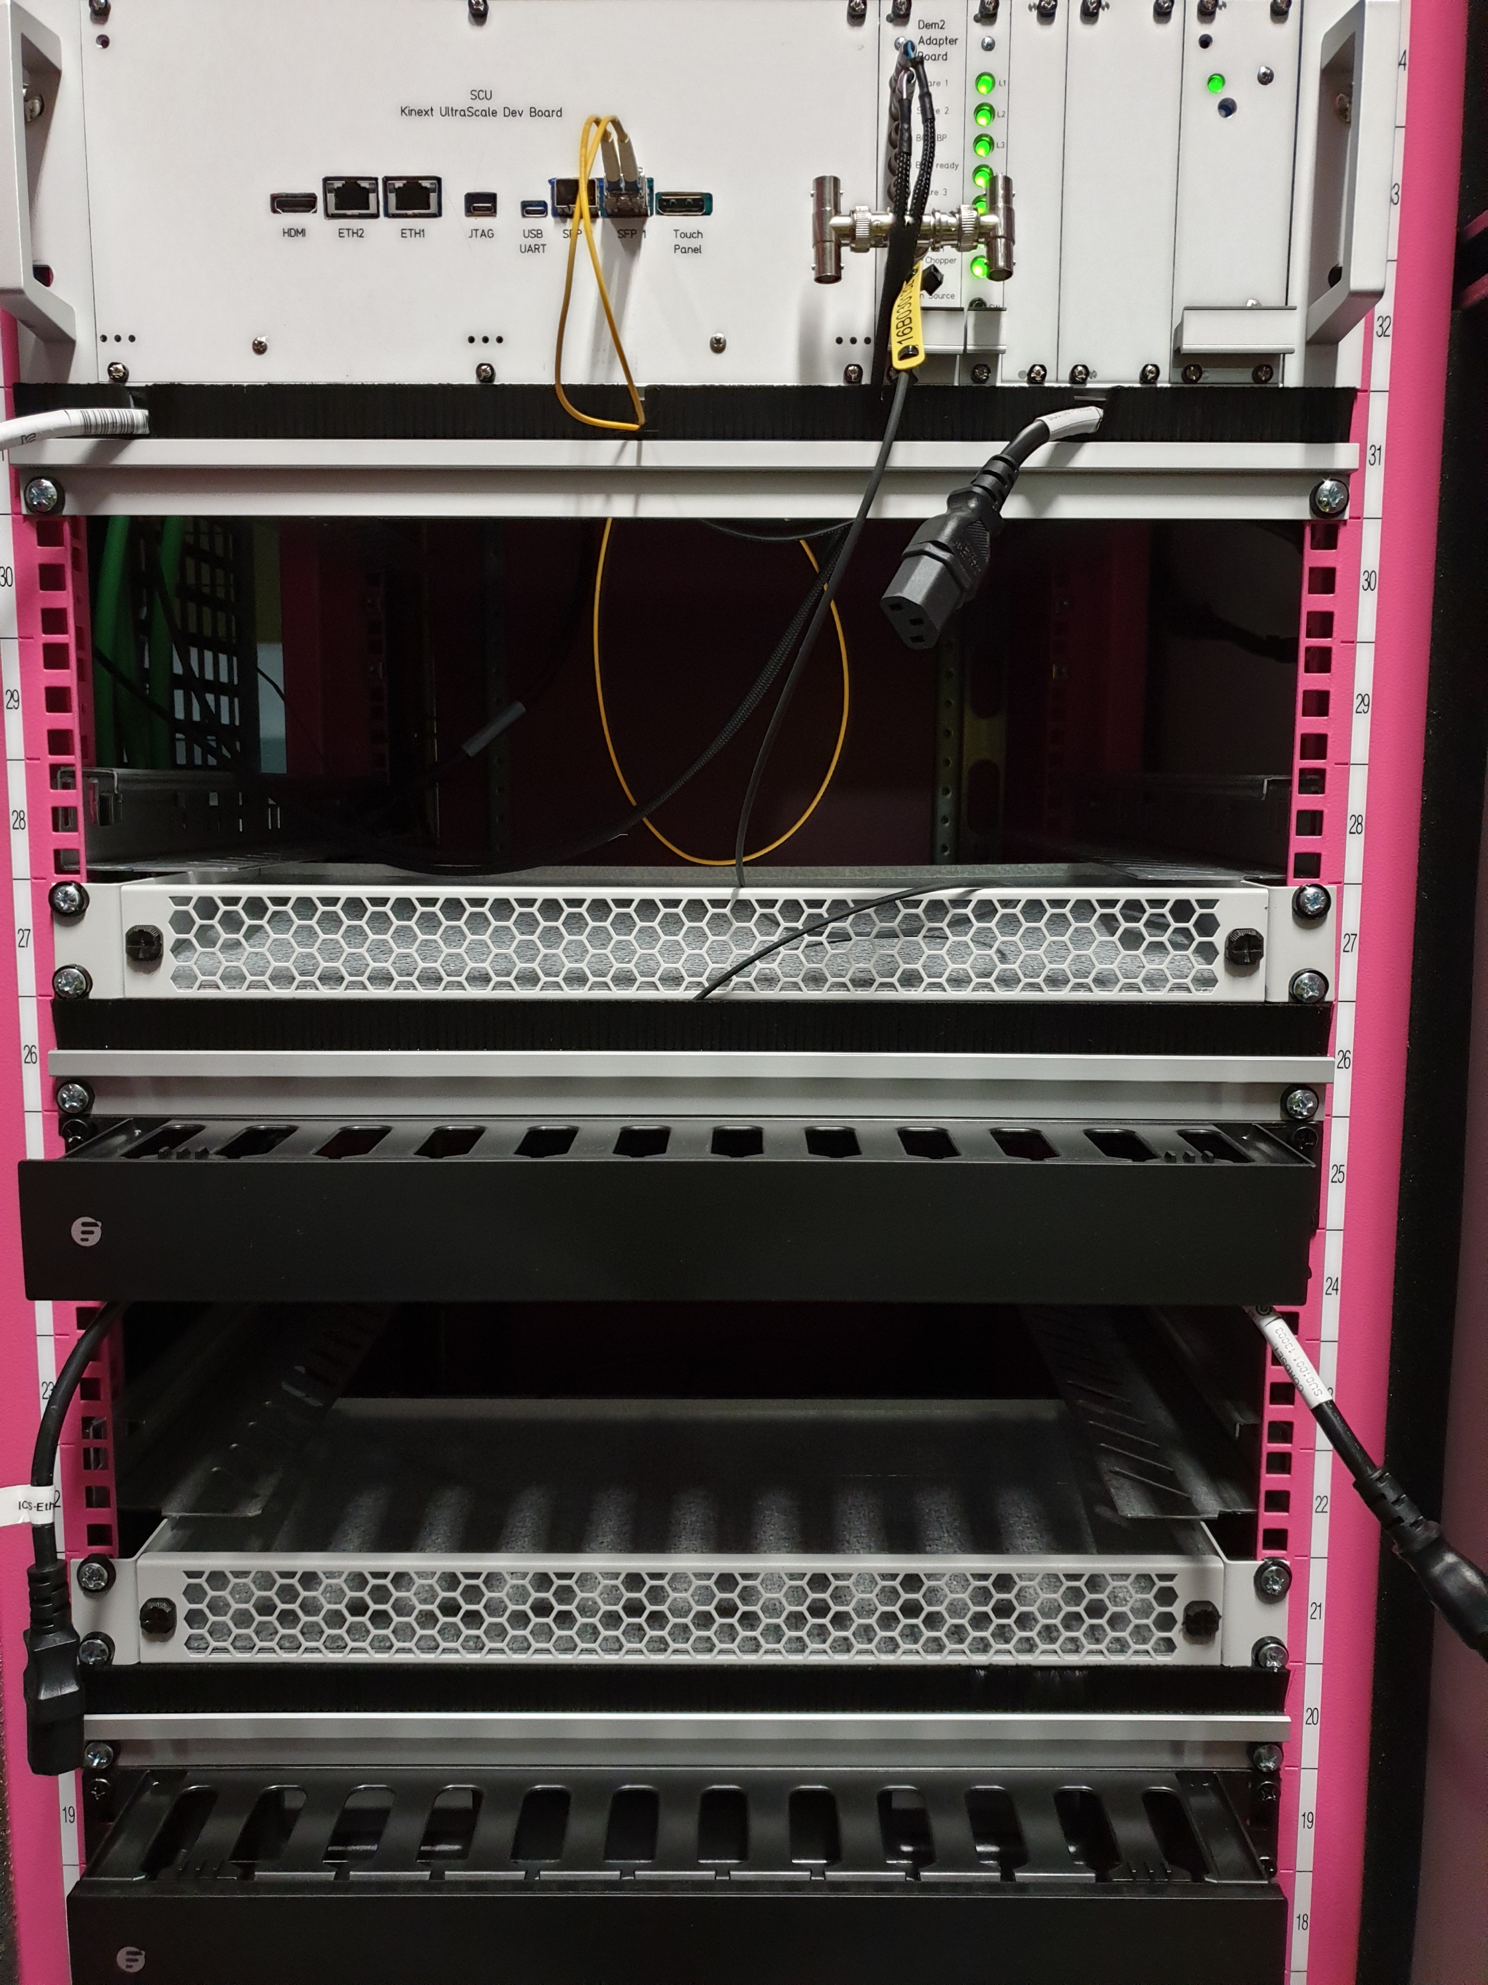
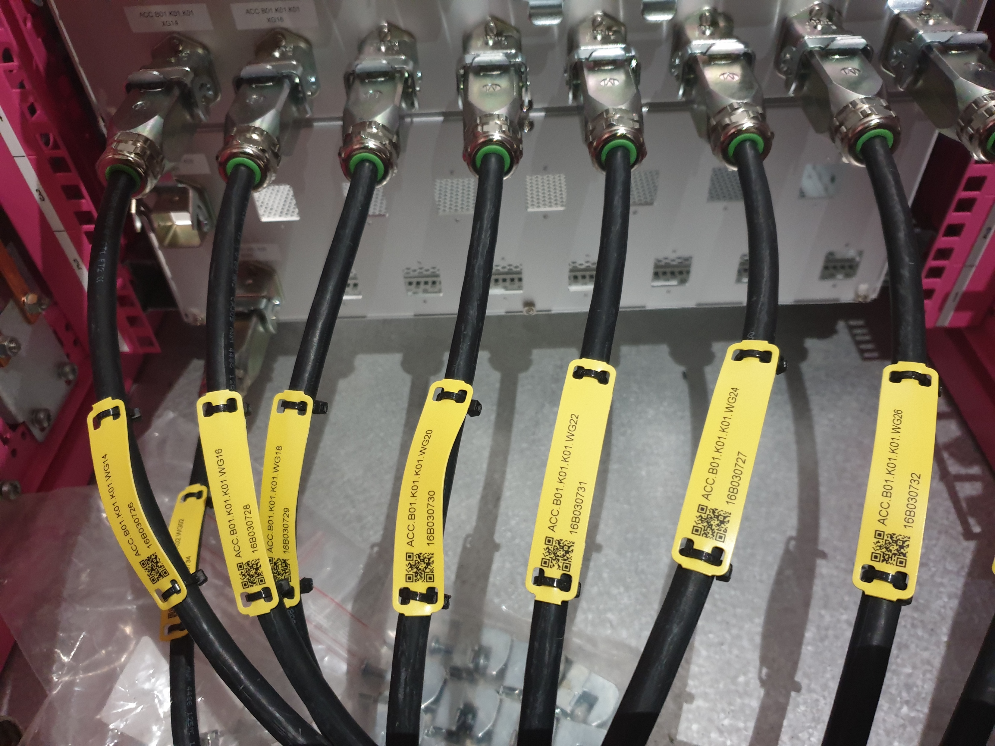
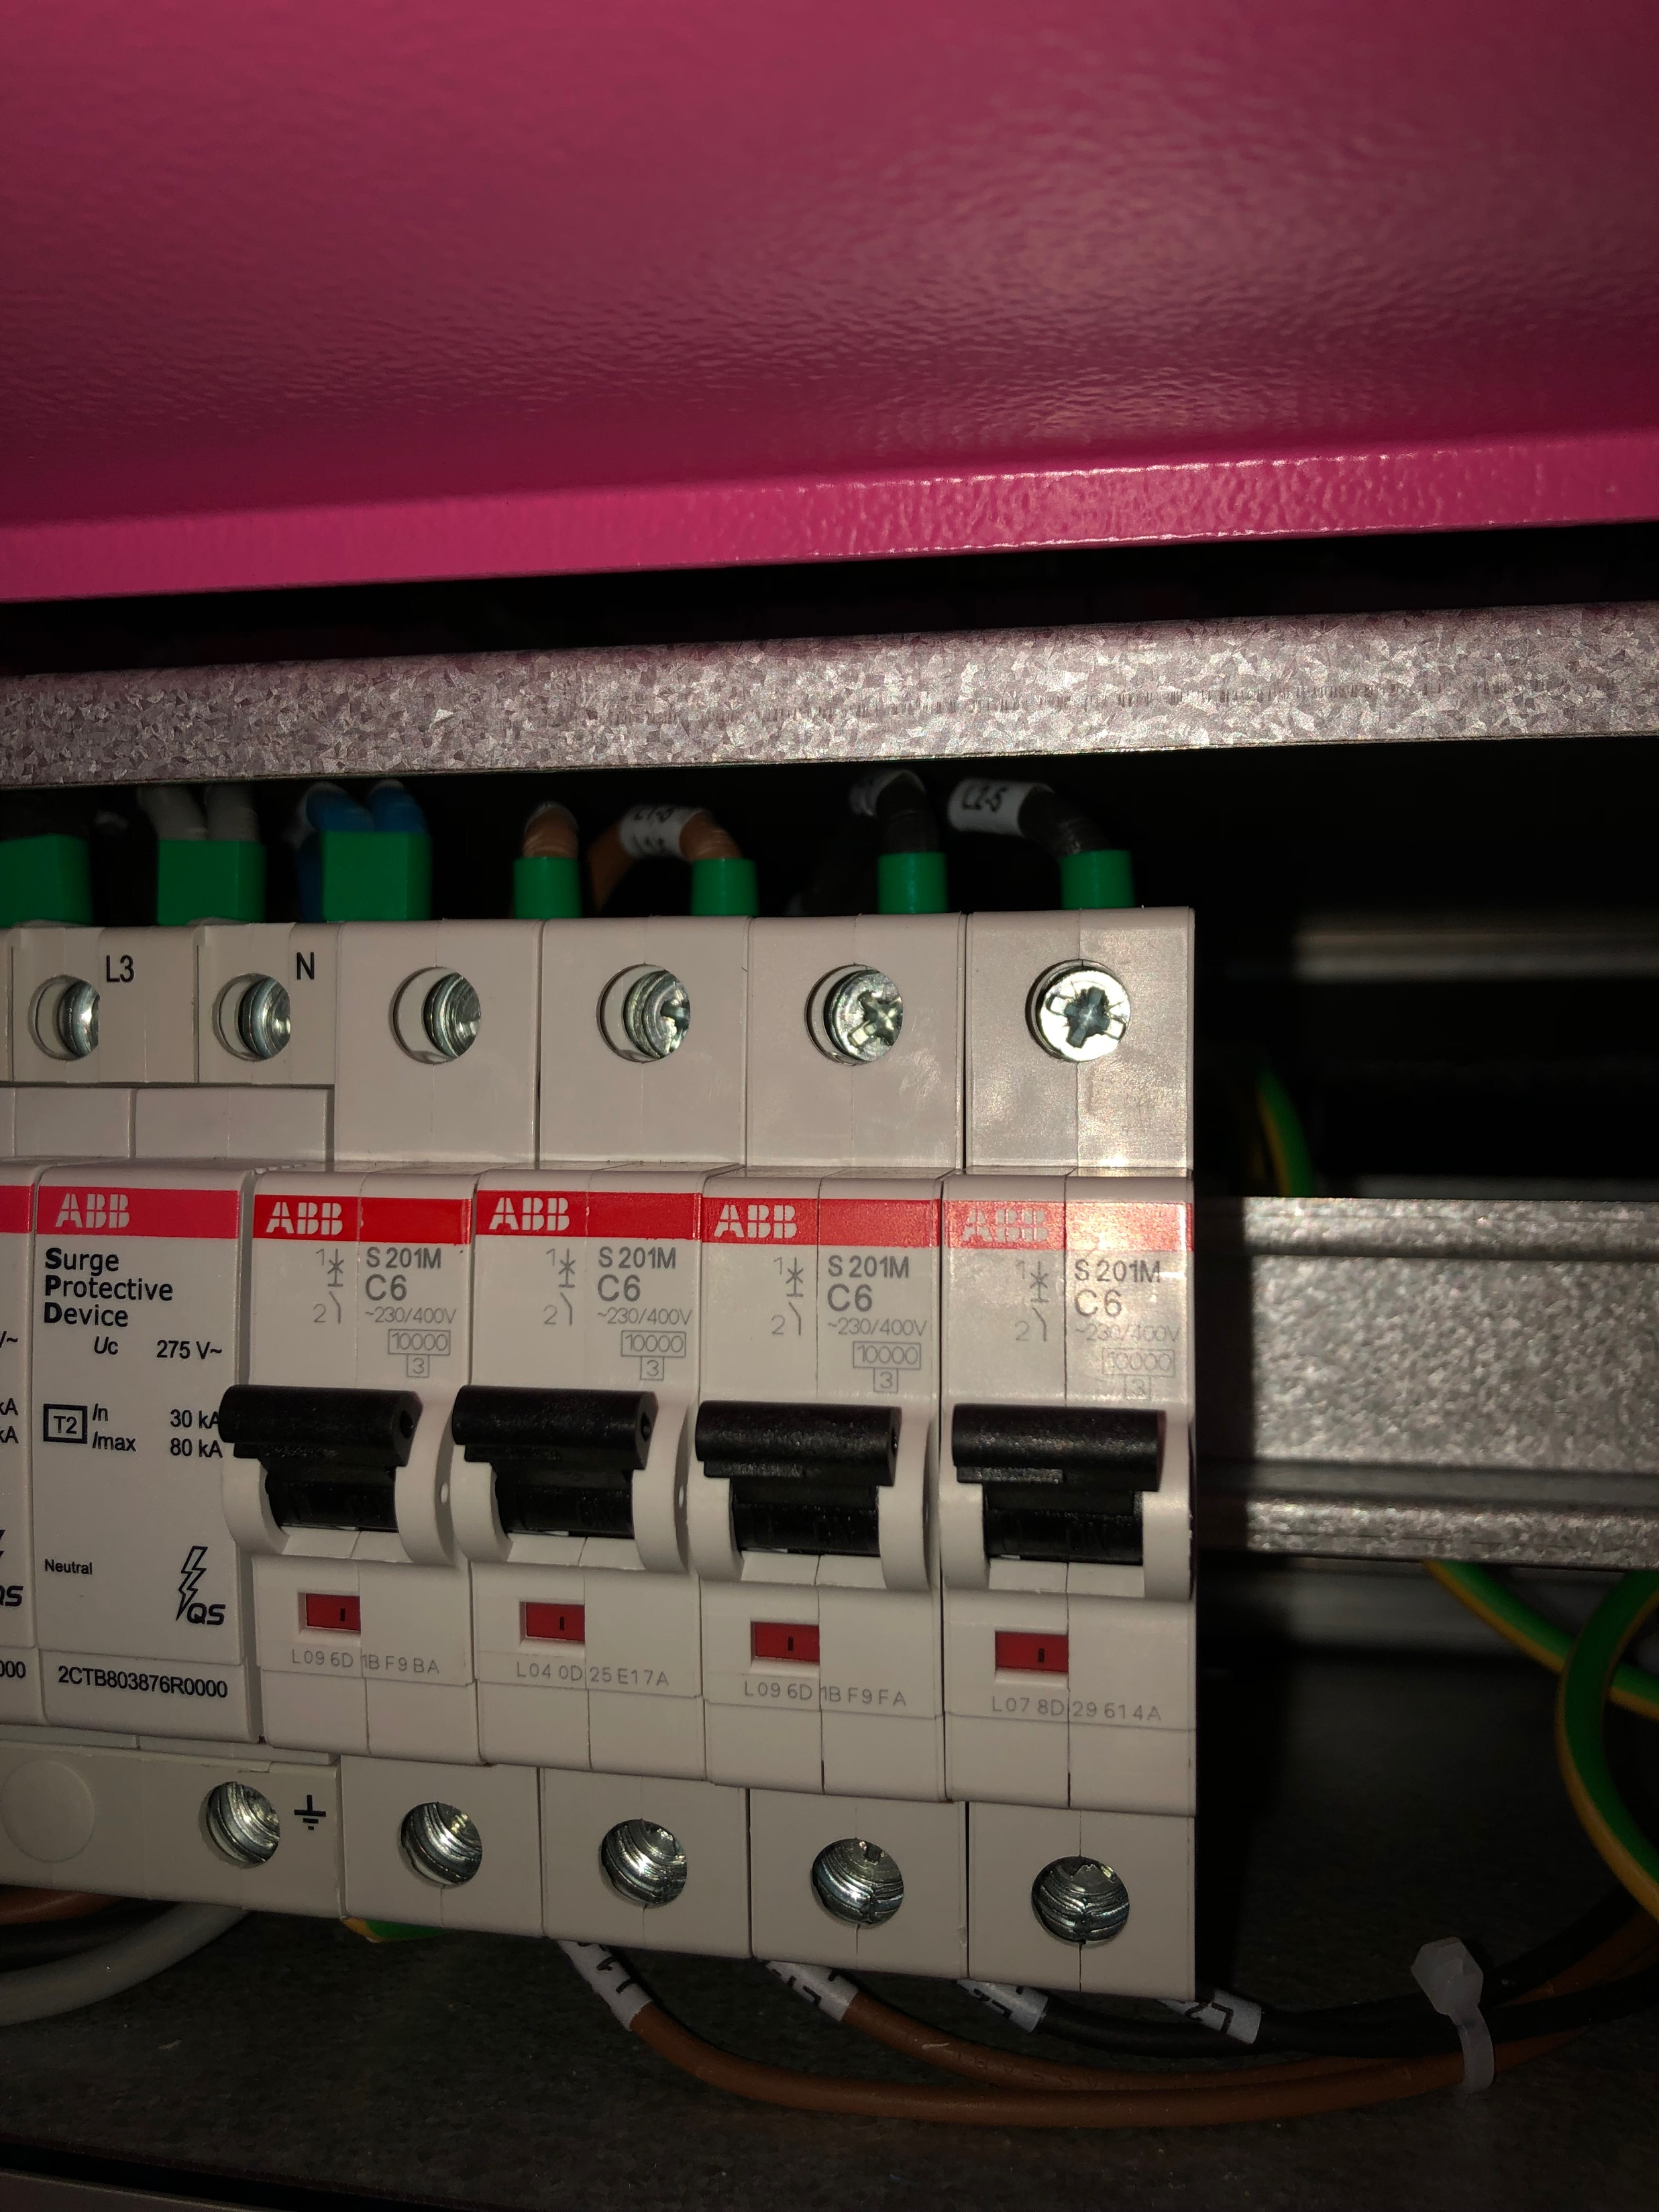
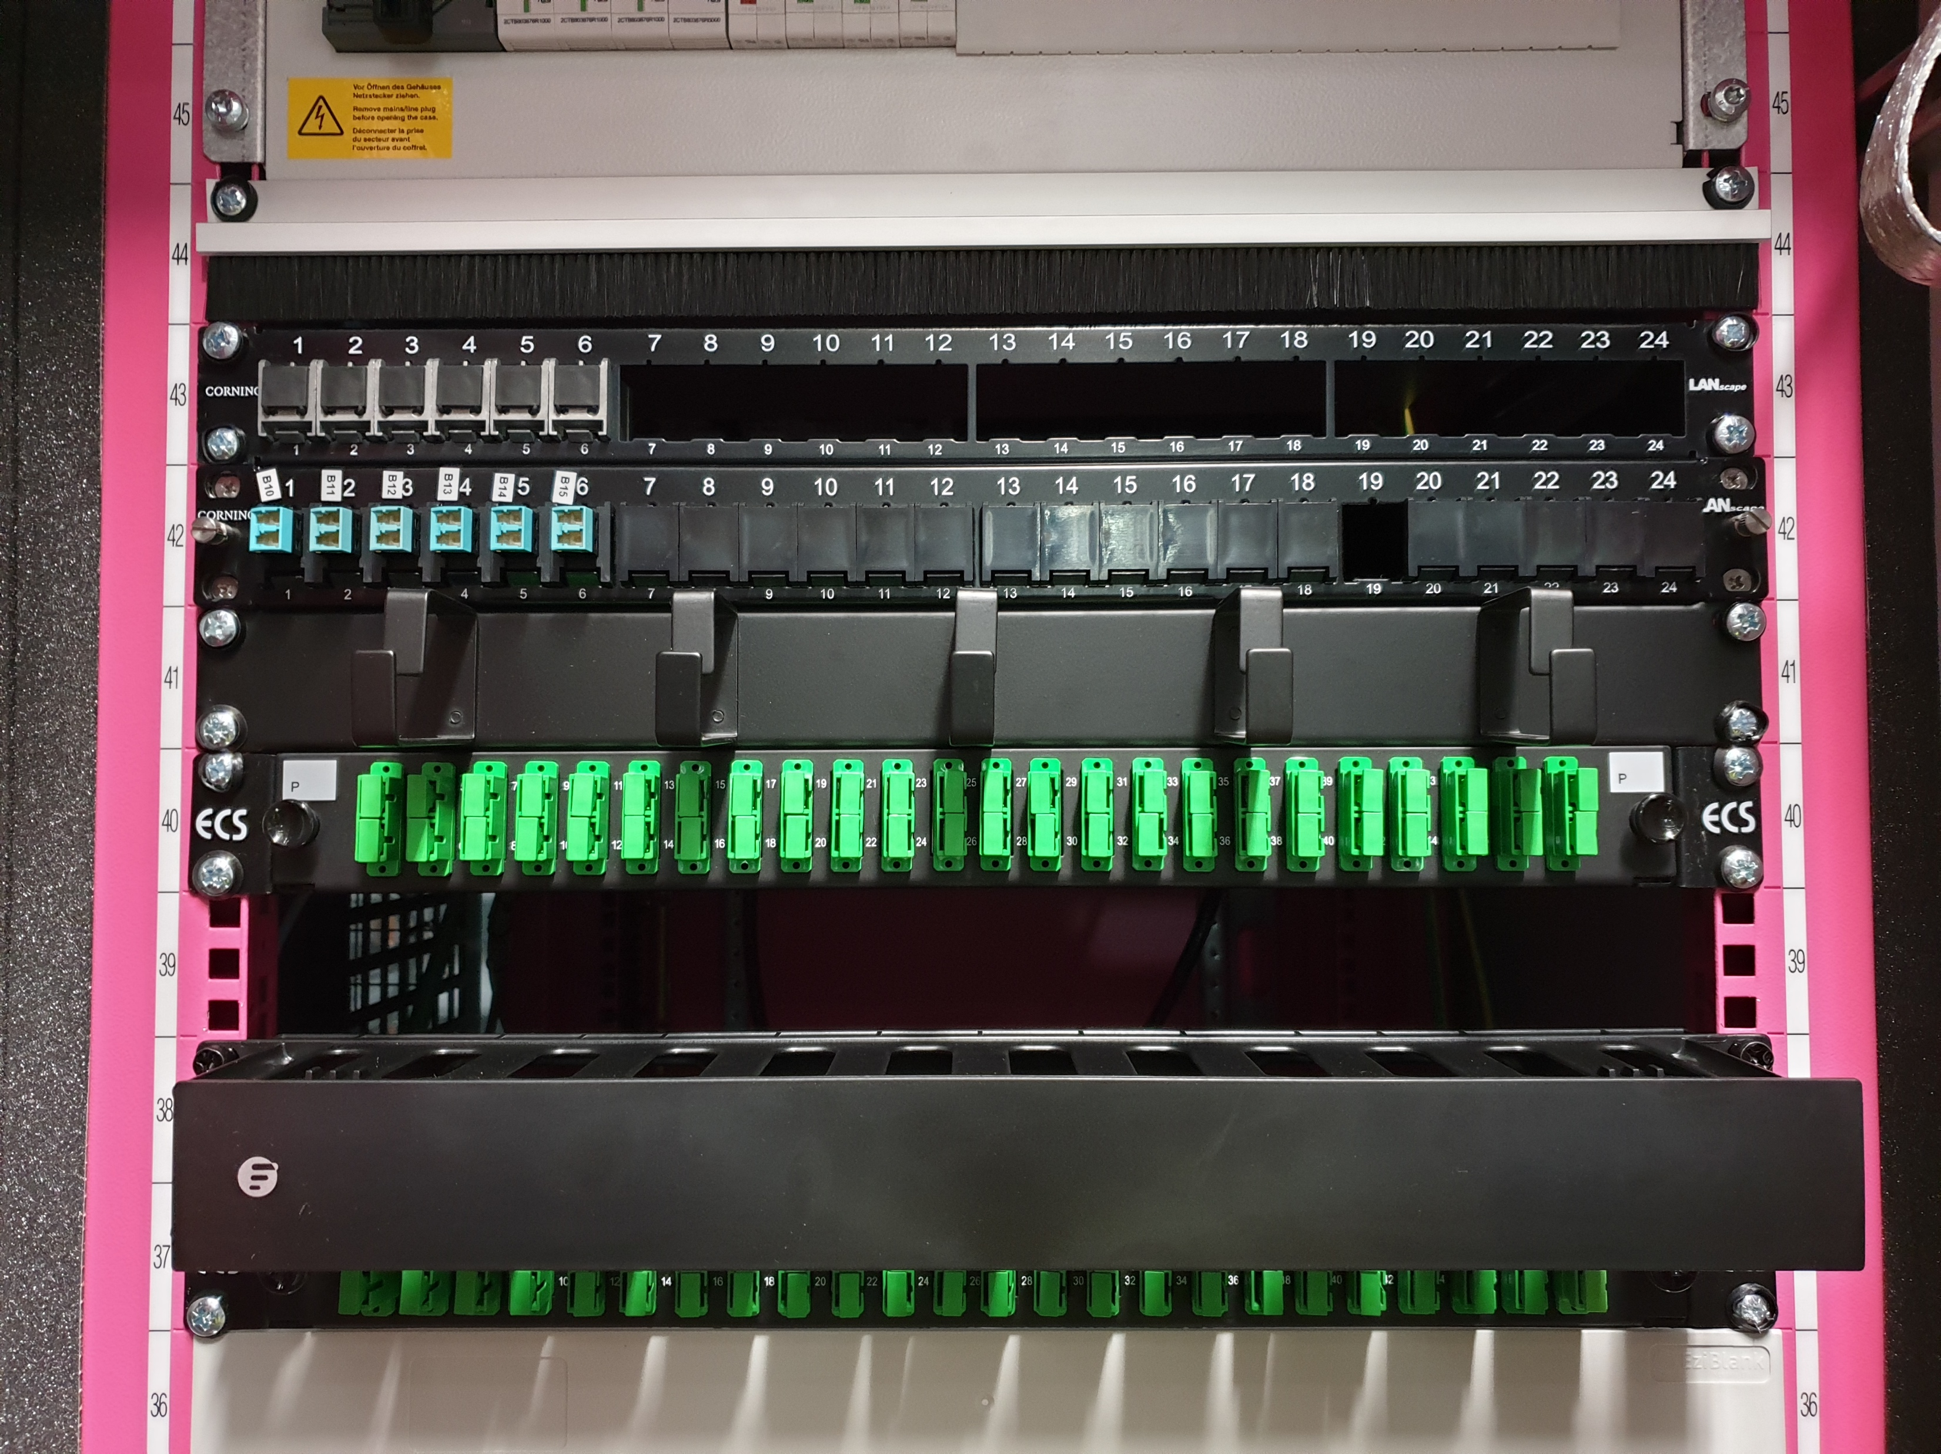
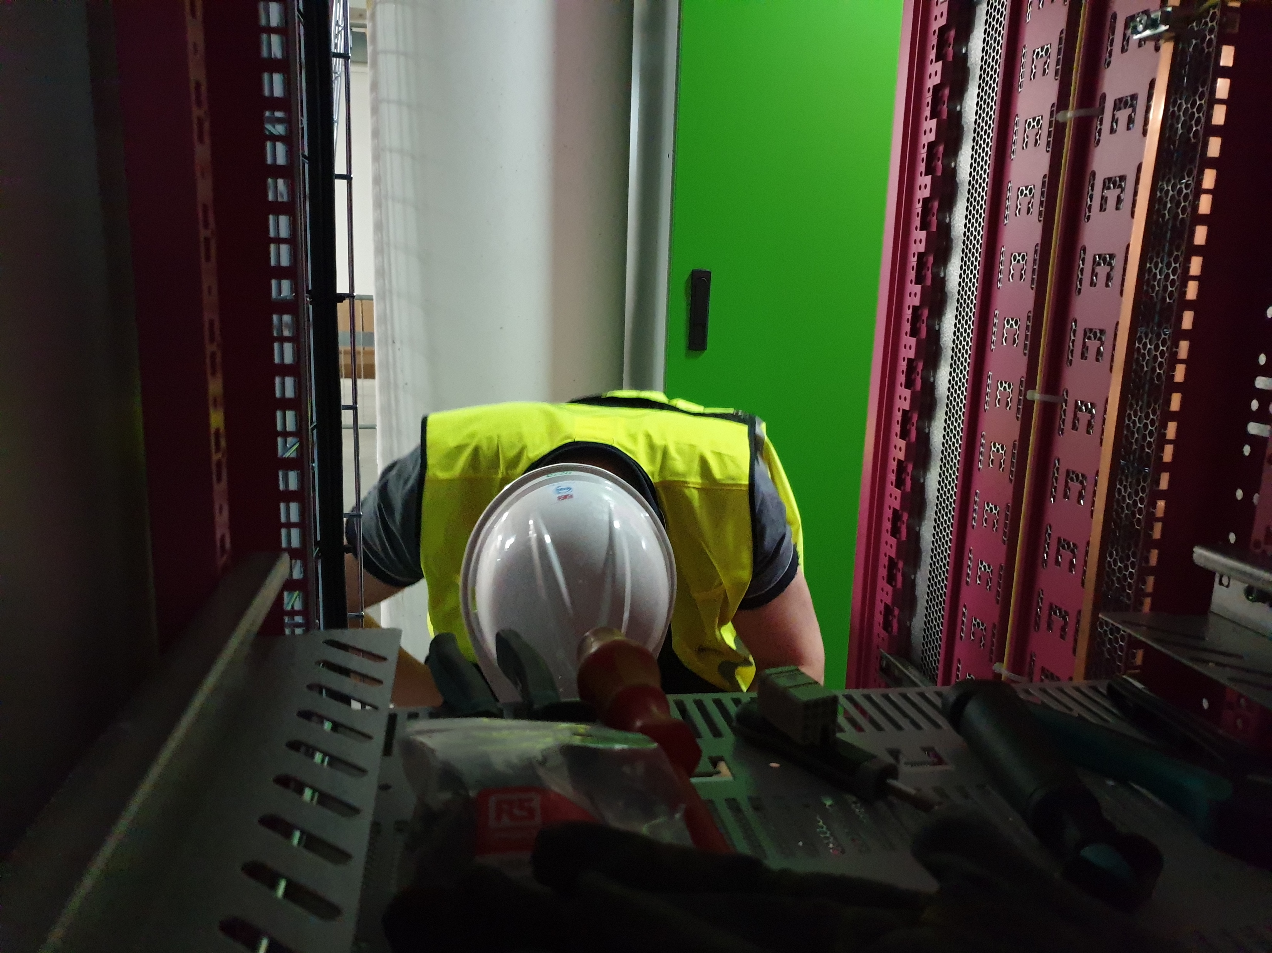
On-Site: FEB Rack Preparation for Cable Installation
Cable installation
Start: 2019-04-01
15

Slide 16
Summary
Presented FBIS Commissioning Plan for Normal Conducting LINAC (2 DLNs and 4 SCUs are needed for FBIS, will be delivered in July 2019).
Presented how to stop beam, and which systems we could test so far. Crucial: to test LEBT chopper with beam! Possible now in April.
Overview on Interface Documentation: status is ok, details need to be finalized, but overall on good track. BPMs and MEBT chopper are considered less urgent, hence it is ok that these interfaces are not yet fully developed.
Prototypes and Hardware In the Loop: Results from prototyping and using the HIL indicate that the MP systems and FBIS will fulfill their mission. Reaction times are according to specification. Tests in the field/real installation can be performed soon (May – September 2019).
BCM-FBIS-Timing System Test Stand: Results show that the overall reaction time is between 1-2us. However tests in the field/real installation are needed to confirm this. Some changes in the BCM fw may be required (work on-going together with BI teams).
From Prototyping Towards Production: Life cycle has been presented, templates and reports are being created and all FAT, SAT, SIT, FIT reports shall be finalized by October 2019 (to be ready for the Safety Readiness Review).
Installation: we started with installation in March 2019 and expect to be done by September 2019 (incl. all tests that can be done wo beam).

Slide 17
Backup Slides

Slide 18
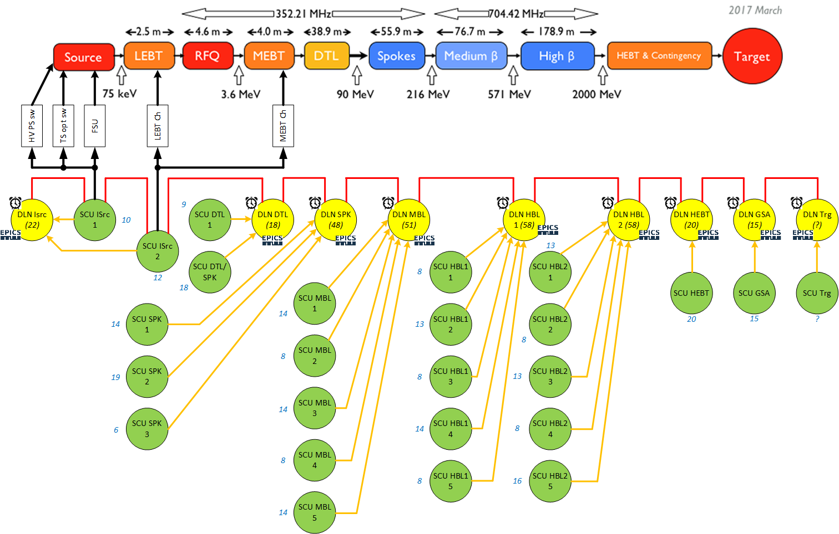
FBIS Deployment for LINAC
Sensor Systems provide critical signals (Beam Permit) to a SCU (Signal Condition Unit), which serializes and sends this information to the DLN (Decision Logic Node).
All DLN are connected together via the OPL (Optical Protection Loop).
Dedicated SCUs connect also to the OPL and request a Beam Stop to the five Actuators if the GPB (Global Beam Permit) becomes FALSE.
FBIS needs connection to the Timing system (Beam Destination and Beam Mode).
FBIS interfaces EPICS for Monitoring, Diagnostic and Test purposes (at DLNs).
25 SCUs concentrating around 290 Sensor Systems into 9 DLNs

Slide 19
Actuator Systems: An Overview
Actuator Timing system:
No hardware to add, all is done through the uTCA and the EVR.
The logic is clear (send a signal to stop beam), the implementation a bit less.
The feedback will follow the same logic but in the other direction.
Actuator Optical switch:
SCU ISrc MC interface defined and documented in the electrical design. Detailed Requirement Specifications ready.
Feedback is coming from the Magnetron power supply. On average, the feedback comes 4ms after the actuation (this has been measured on Ion Source-LEBT test stand with FBIS demonstrator).
Actuator FSU:
Same Mezzanine Card used as for the optical switch.
Feedback is not implemented yet. HW PCB design needs to be finished in order to interface the RF guide power with FBIS giving a RF Power ON/OFF status on a fibre.

Slide 20
Actuator Systems: An Overview
Actuator LEBT Chopper:
Logic is known but the polarity needs to be confirmed.
Same for the feedback. This will be done as soon as the LEBT chopper power supply is repaired/replaced.
The SCU MC needs to be specified/designed after the tests and when the behaviour of the LEBT chopper will be known.
Actuator MEBT Chopper:
Logic is known but no hardware is available.
Feedback from the uTCA. Logic and interface already discussed.
The SCU MC will be realized after the one of the ISrc and after checking the behaviour of the MEBT chopper.
Actuator HV PS:
Same MC than the Actuator optical switch. The hardware will be differentiated from Optical switch and FSU when the components and connectors will be mounted on the PCB.
Feedback is foreseen through the BCM link. Still to be confirmed by MP and BI.

Slide 21
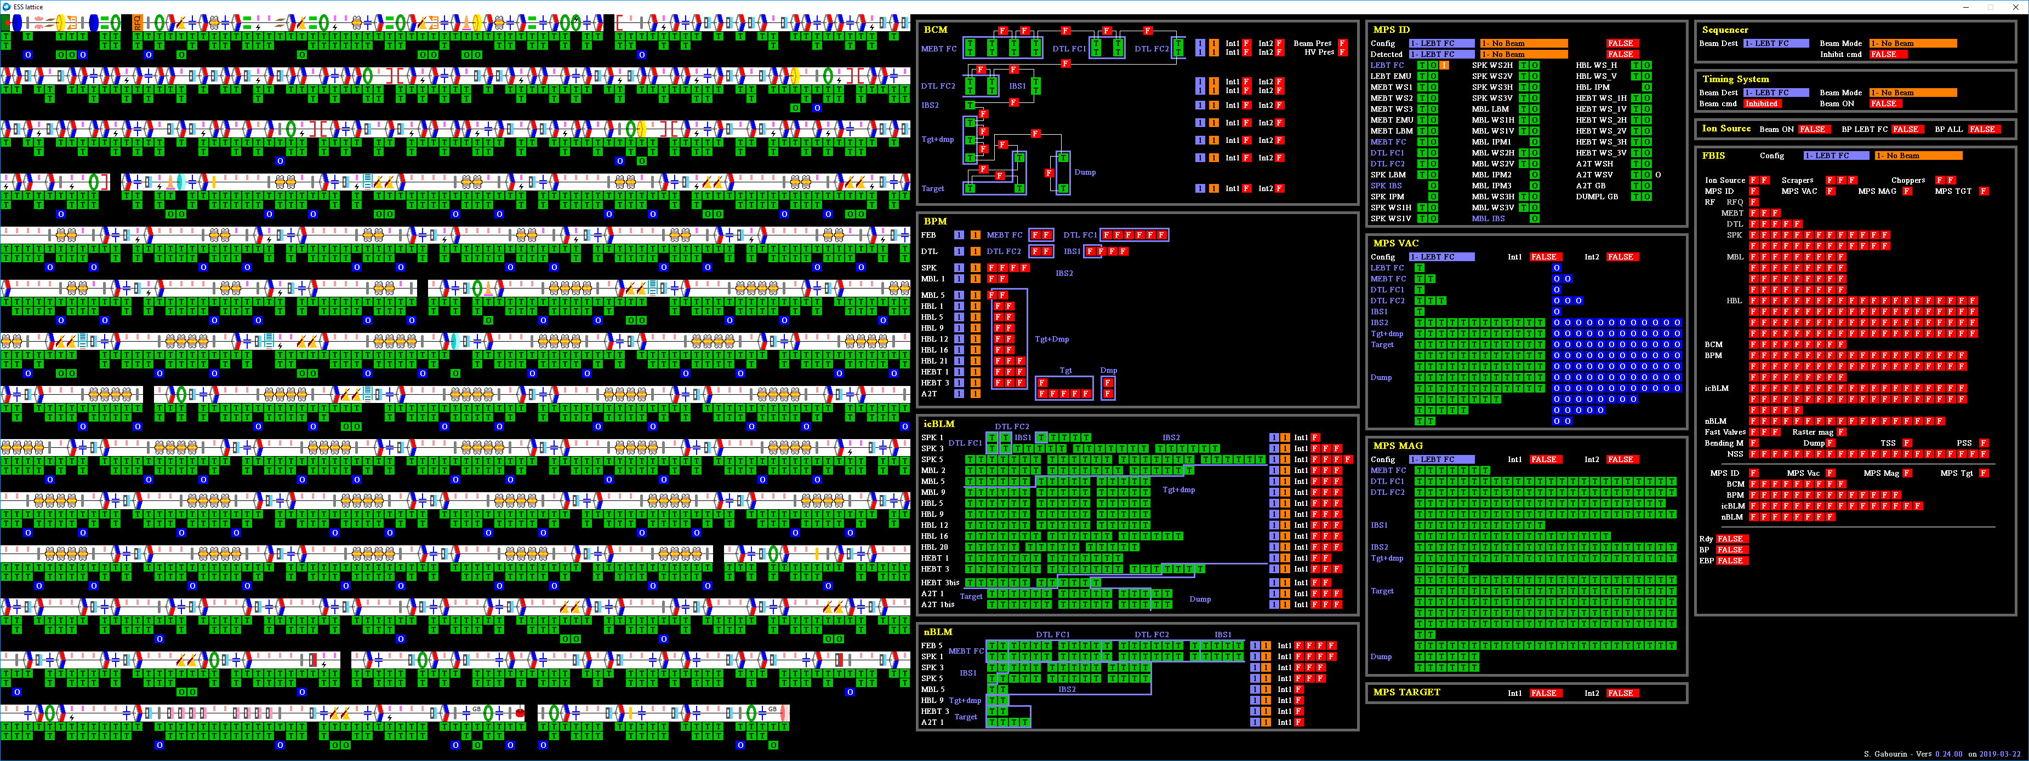
The Full Logic / Eventually an Operator View
Lattice and Interlock Status per Element
Interlock Status per System (BCMs, FBIS, MPS-Vac, etc.)

