Slide 1

Target Wheel Design
Ulf Odén
WP Manager Target System
Kristoffer Sjögreen
WU Leader Target Wheel Drive&Shaft
www.europeanspallationsource.se
11 April 2019

Slide 2
Outline of the presentation
Target Wheel Design
Prototyping
Alternative Design
Discussion
Conclusion

Slide 3
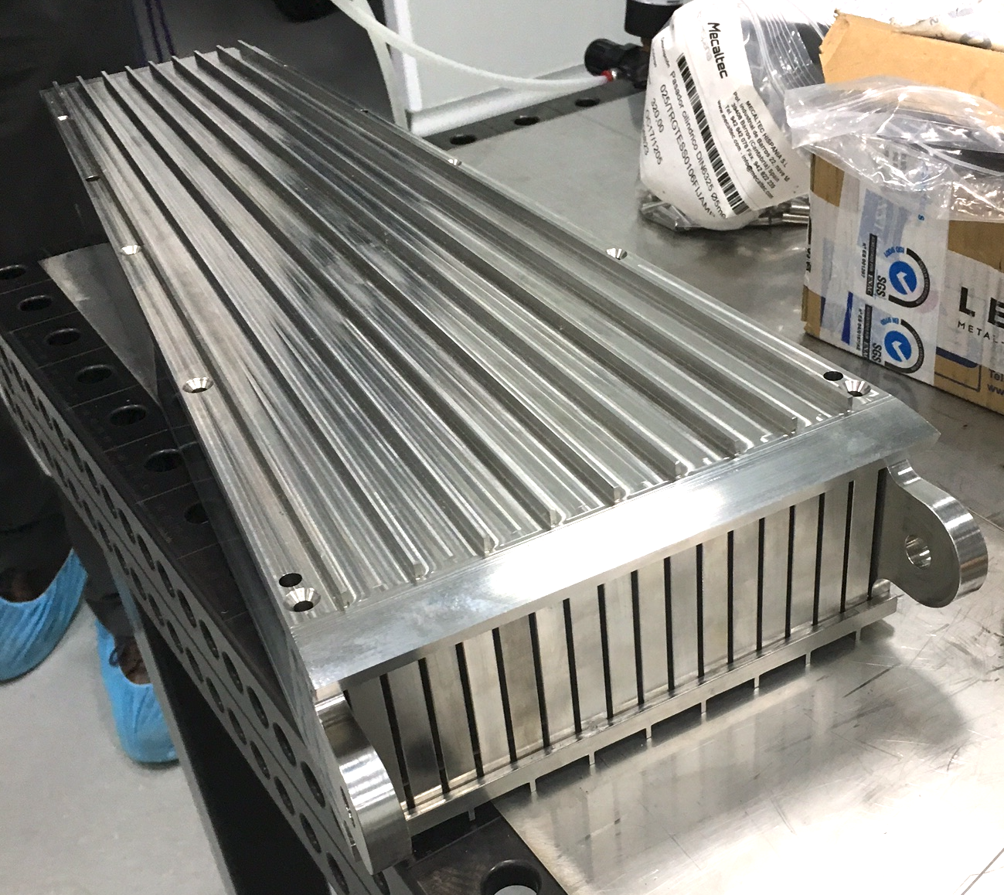
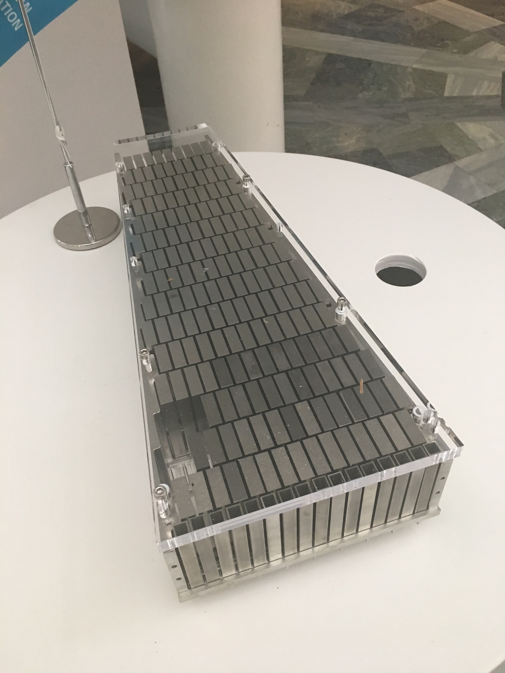
Target Wheel Design

Slide 4
Prototyping #1

Slide 5
Prototyping #3

Slide 6
Prototyping
Lessons learned:

Slide 7
Alternative Design
Plan B1
Plan B2

Slide 8
Discussion
Massive welding in a stainless steel structures with narrow tolerances is challenging.
Clamped design will escalate the deformations
prototype #3, also displays deformations.
The performed metrology (#3) indicates 1 mm between the ribs. Theoretically this is a reduction of 36 mm on the outer circumferences of the wheel.

Slide 9
Discussion
There are two design issues connected to the welding deformation:
  One is that the cassette has to fit into the position and prevent by-pass flow of helium.
  The maximum gap during 5 MW proton beam power should be less then 0,2-04 mm.
  The other is the flatness tolerance of the target wheel.
  The wheel has a narrow gap to the moderator and the flatness requirement to prevent the wheel from clashing in to the moderator is +/- 0,2-0,4

Slide 10
Conclusions
The prototype #3 demonstrates the possibility to manufacture the target wheel according to plan A
B1 and B2 is unmatured. It is judged to introduce more risks to change the design concept this late in the project.
The ramp up of ESS is stretched out. The stresses on the target wheel is considerably reduced.
The cassette position design and the welding procedure needs further engineering:
  The cassette position, should be enlarged to allow for compression and the helium bypass flow between the cassette and the wheel should be limited by some mechanical sealing.
  The welding area needs to be further elaborated to optimise the welding and allow for 100% inspection.
  The welding sequence must allow for radius compression. The target wheel shroud shall not be attached to the target wheel central piece before finalising the target wheel rib welding.

Slide 11
Conclusions
Even if the plan A design is the preferred design for the first ESS target wheel, it is recommended to start the engineering of the second ESS target wheel immediately. This to have as the backup plan if manufacturing of the first ESS target wheel fails or if the first ESS target wheel for some reason fails during operation.
Substantial knowhow is developed during the WP2 project within the WP2 staff and the ESS Bilbao. This should be taken into consideration organising the second ESS target wheel project.

