Slide 1

Target Wheel Design
Ulf Odén WP Manager Target System
Fernando Sordo- Head of Target Division ESS Bilbao
Kristoffer Sjögreen WU Leader Target Wheel Drive&Shaft
www.europeanspallationsource.se
11 April 2019

Slide 2
Outline of the presentation
Target Wheel Design
Prototyping
Alternative Design
Discussion
Conclusion

Slide 3
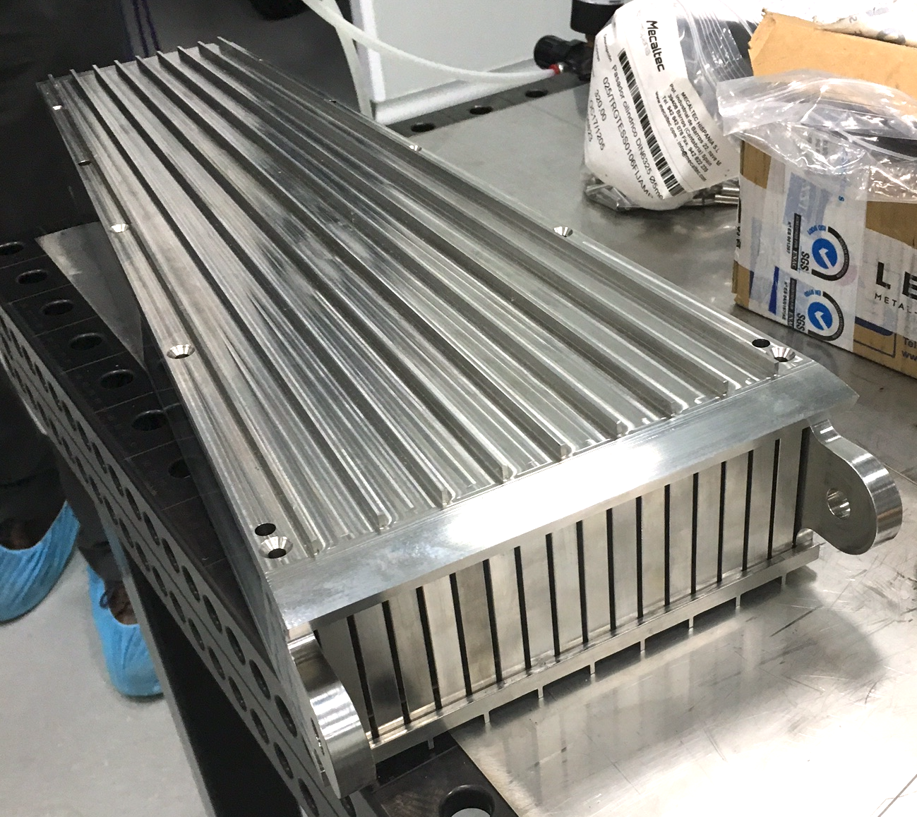
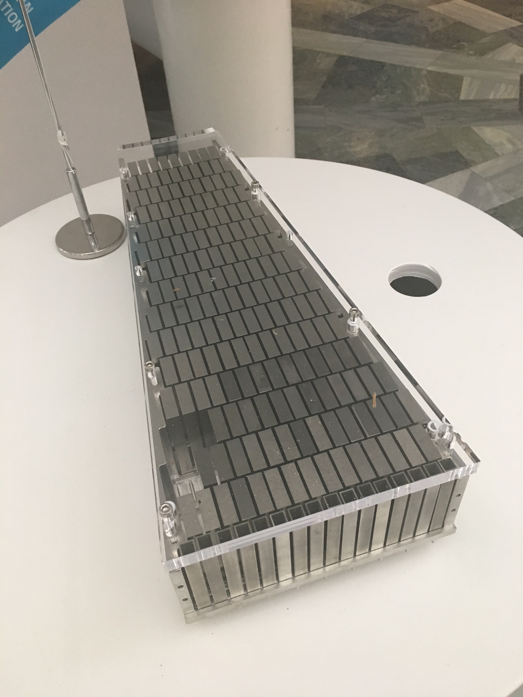
Target Wheel Design

Slide 4
Cassette- shroud interface

Slide 5
Main problem
Maintaining the cassette interface (order of magnitude +/- 0.1—0.5 mm) in a heavy welded stainless steel structure, guaranteeing structural stability throughout target lifetime.

Slide 6
Lessons learned
It is not possible to maintain the cassette interface (order of magnitude +/- 0.1—0.5 mm) in a heavy welded stainless steel structure, guaranteeing structural stability throughout target lifetime.
Instead, the target must be manufactured with larger tolerances and the cassettes shimmed/ machined in place.
The welding volume must be minimized as much as the structural requirements allows

Slide 7
Prototyping #1
Prototype 1 was an attempt to produce the full target geometry, by the right welding method, following the RCC- MRx code framework.
The deformations were not measured, but it was clear that the structure was too deformed.

Slide 8
Lessons learned – Prototype 2
In prototype 2, the
approach from prototype 1
was repeated, but with
welding fixtures, and strict
control of the welding process

Slide 9
Lessons learned – Prototype 2

Slide 10
Lessons learned – Prototype 2
After welding 50 % of weld volume, it was clear that the deformations could not be controlled with fixtures.

Slide 11
Prototyping #3
Prototype 3 is the baseline design.
There are still deformations, but controllable.
However,
some adjustments
to the design will be
necessary.

Slide 12
Changes implemented– Prototype 3

Slide 13
Changes implemented- Prototype 3

Slide 14
Changes implemented- Prototype 3
There is an internal structure consisting of 3 mm plates needed to separate the
inlet flow from the outlet flow. Experience from prototype 2 showed this structure needs
to be free in the radial direction but at the same time controlled in vertical direction.

Slide 15
Changes implemented- Prototype 3
Temperature measured during welding was reduced

Slide 16
Remaining work before the baseline design is verified
Thermal cycling, simulating temperature fluctuations (Operating conditions) up to 450º C up to 10 times, again measuring deformation
Qualification of mechanical TIG- welding robot- assuring repeatability in welding
Shim strategy
Do we need additional mockups?
When can we say that the approach is verified?

Slide 17
Alternative Design
Plan B1
Plan B2

Slide 18
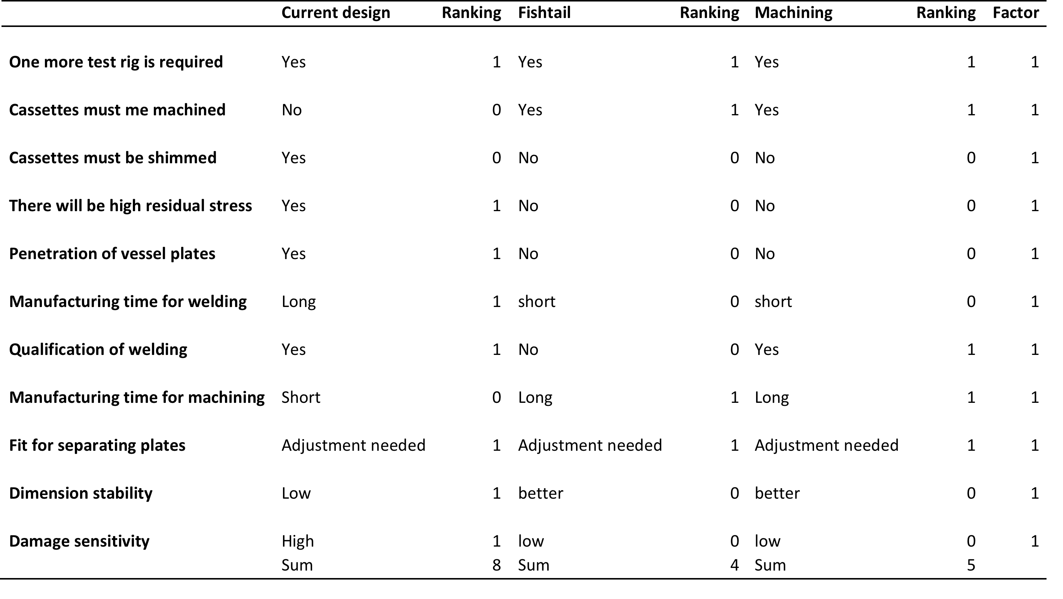
Comparison

Slide 19
Discussion
Massive welding in a stainless steel structures with narrow tolerances is challenging.
Clamped design will escalate the deformations
prototype #3, also displays deformations.
The performed metrology (#3) indicates 1 mm between the ribs. Theoretically this is a reduction of 36 mm on the outer circumferences of the wheel.

Slide 20
Discussion
There are two design issues connected to the welding deformation:
  One is that the cassette has to fit into the position and prevent by-pass flow of helium.
  The maximum gap during 5 MW proton beam power should be less then 0,2-0,4 mm.
  The other is the flatness tolerance of the target wheel, after final machining.
  The wheel has a narrow gap to the moderator and the flatness requirement to prevent the wheel from clashing in to the moderator is +/- 0,2-0,4

Slide 21
Conclusions
The prototype #3 demonstrated the possibility to manufacture the target wheel according to the baseline design with modifications.
The alternative designs B1 and B2 is unmatured. It is judged to introduce more risks to change the design concept this late in the project.
The ramp up of ESS is stretched out. The stresses on the first target wheel will be lower than the baseline design, which is based on 5 MW beam power.
The cassette position design and the welding procedure needs further engineering:
  The cassette position, will be enlarged to allow for compression and the helium bypass flow between the cassette and the wheel will be limited by some mechanical sealing.
  The welding area will to be further elaborated to optimise the welding and allow for 100% inspection.
  The welding sequence will be fine- tuned to allow for as much free movement of the structure during welding as possible, to minimize building in stress or getting unwanted deformation. One such measure would be to rearrange the order of welding the geometry together, and attach the shroud to central piece after the shroud is welded (and deformed)

Slide 22
Conclusions
Even if the baseline design is the preferred design for the first ESS target wheel, it is recommended to start the engineering of the second ESS target wheel immediately. This to have as the backup plan if manufacturing of the first ESS target wheel fails or if the first ESS target wheel for some reason fails during operation.
Substantial knowhow is developed during the WP2 project within the WP2 staff and the ESS Bilbao. This should be taken into consideration organising the second ESS target wheel project.

