Slide 1
European Spallation Source
TAC-19
Water Cooling Systems
Håkan Carlsson
Group Leader Fluid Systems – Target Division
European Spallation Source ERIC
2019-04-11

Slide 2
Outline
Overview
Primary Water Cooling Systems
Radiolysis Gas Treatment System
Water Purification
Drainage
Control system & Commissioning

Slide 3
Overview

Slide 4
Radiation Safety
ESS rule
Limit external exposure to ionizing radiation:
  this function has to be achieved to prevent external exposure to public and personnel from both prompt radiation and residual radiation,
Limit internal exposure:
  ensuring the personnel, public and the environment are protected against radioactive material releases. This function is achieved with static and dynamic confinement at the process level and/or at the building level and also by controlling the access to the different areas according to their contamination level.
Monitor releases:
  in order to check planned releases and to enable reacting in case of unexpected releases in compliance with GSO [2],
Control heat:
  to avoid confinement failure and associated radioactive releases. Controlling heat source and heat distribution ensures this function by using active and/or passive heat removal systems according to the facility state.

Slide 5
Main functions of cooling systems
Primary Water Cooling
  Cool the components affected by nuclear heating (4)
  Confine radioactivity (1, 2)
    Closed systems
  Support systems
    Drainage (2)
    Purification (1, 2)
      Purify the water to reduce corrosion
      Reduce activation products in the system
    Radiolysis Treatment – primary cooling systems (1)
      Remove and treat the gases from the systems – mainly hydrogen
    Sampling (3)
Intermediate Cooling
  Cool the primary cooling systems and act as a barrier to Conventional Facility (CF) cooling (1, 2, 4)
  Support systems
    Drainage

Slide 6
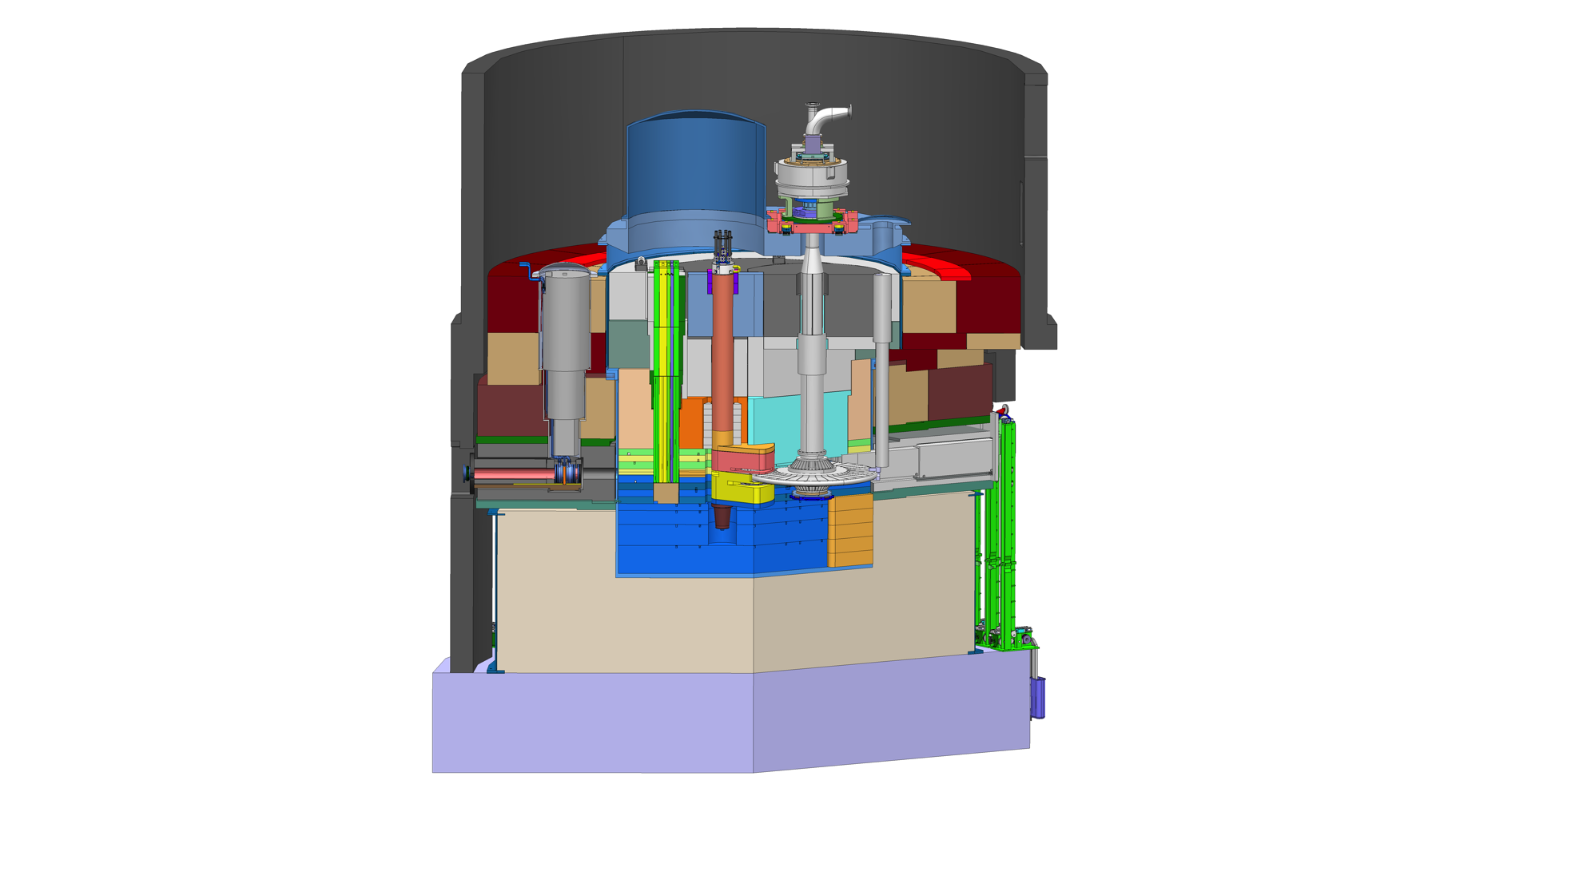
Heat deposition in Monolith Structure
Cooled component | Cooling demands, (kW) | T_{in} (ºC)
Thermal water moderators | 160
Proton Beam Window & Plug | 6
Water Moderator Primary Cooling | 166 | 20
Reflectors | 250
Reflectors Primary Cooling | 250 | 20
Steel shielding | 500
Moderator/Reflector Frame | 650
Target Monitoring Plug | 2
Proton Beam Instrumentation | 5
Neutron Beam Inserts | 16
Proton Beam Window Port Block | 10
Shielding & Plugs Primary Cooling | 1183 | 35
Total | 1599
Proton Beam Window
Target Monitoring
Target Wheel
NBI
Shielding
Moderators/Reflectors
Proton Beam
Instrumentation Plug
Target Wheel (Helium Cooled) 3 MW
Notes:
Three water cooling loops
Thermal Moderator + PBW 178 kW
Reflectors + PBW
Shielding & Plugs
5 MW = 9 % mass, 2 % neutronos, 89 % heat 4450 kW

Slide 7
Target Station - Cooling Systems
Central Utility
Block
Intermediate
Systems
A
Primary Cooling Systems
Monolith
Thermal Moderators
CUB 8ºC
Water Moderators
Intermediate 15ºC
Proton Beam Window
“District Heating”
Reflectors
Reflectors
Proton Beam Instrumentation Plug
Intermediate 30ºC
Monitoring Plug
CUB 25ºC
Target Intermediate 30ºC
Shielding & Plugs
Shielding
Neutron Beam Inserts
Target Intermediate 30ºC
Moderator plug
Target Helium Cooling
PBW Port Block
CUB 50ºC
Target Intermediate 55ºC
Target Wheel

Slide 8
Design considerations Primary Water Cooling systems
Safety Analysis done
  Safety Related Systems
  Mechanical Quality Class 4
Radionuclides in the primary water cooling systems
  Confine the water
  Minimize release of radioactive gases to public
  Protect workers from γ-radiation
    All systems in non-accessible rooms during operation
    Minimum 4h before entering after beam stop
    Extra shielding outgoing pipes & delay tanks
    High corrosion resisting material – SS 1.4404 (316L)
    Purify the water to avoid hotspots in components (maintenance)
    Hard-facing in valves must not consist of or be lined with alloys with a cobalt content exceeding 0,20%
  Protect components
    Delay tank
  ³H needs to be considered during maintenance (opening up systems)
Hydrogen production – radiolysis process
  Slope of pipes from components in monolith until GLS-tank (no pockets)
  Vent gases (hydrogen) from the systems

Slide 9
Primary Water Cooling Systems

Slide 10
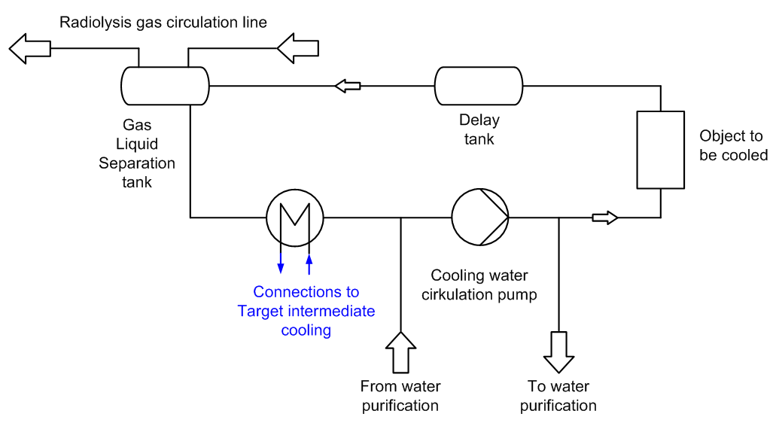
Primary Water Cooling System
Considerations
Water activation
  Delay tank
  Non-accessible rooms
Radiolysis
  GLS tanks
  Re-combiner system
300s
90s
Isotope | Half-life | Decay mode | Time step [0s] | Time step [90s]
³H | 12.3 y | β | 621.3 | 621.3
⁷Be | 53d | ECβ + γ[477keV ] | 445.1 | 445.1
¹¹C | 1223 s | β | 1473 | 1400
¹⁴O | 70.6 s | ECβ + γ[2.3MeV ] | 92.3 | 38.5
¹⁵O | 122 s | β | 4511 | 2723
¹⁶N | 7.1 s | β + γ[6.1MeV ] | 4462 | 0.8
Total |  |  | 12380 | 5657
Total activity in Curies, only isotopes contributing in excess of 10Cu at 60 s cooling are listed
(Esben Klinkby)

Slide 11
Moderator Primary Water Cooling
P: 166 kW
T_{in} = 20 ºC (to cooled object)
T_{ut} = 29 ºC (from cooled object)
Pump
  Redundant
  Magnetic & hermetic
  Flow 22,3 m³/h
  TDH: 44 m
Pressure
  Controlled by frequency converter on pump & pressure transmitter
  All transmitters outside room
Flow
  Flow Control Valves
  Pneumatic controlled

Slide 12
Reflectors Primary Cooling
P: 250 kW
T_{in} = 20 ºC (to cooled object)
T_{ut} = 49,9 ºC (from cooled object
Pumps:
  Redundant
  Magnetic & hermetic
  Flow: 18,4 m³/h
  TDH: 44 m
Pressure
  Controlled by frequency converter on pump & pressure transmitter
  All transmitters outside room
Flow
  Flow Control Valves
  Pneumatic controlled

Slide 13
Shielding & Plugs Primary Cooling
P: 1183 kW
T_{in} = 35 ºC (to cooled object)
T_{ut} = 49,3 ºC (from cooled object
Pumps:
  Redundant
  Magnetic & hermetic
  Flow: 96,4 m³/h
  TDH: 53 m
Pressure
  Controlled by frequency converter on pump & pressure transmitter
  All transmitters outside room
  Pressure switches – hardwired to pump power supply
Flow
  Flow Control Valves
  Pneumatic controlled
  Flow switches (for cooling circuits without flow measurement)

Slide 14
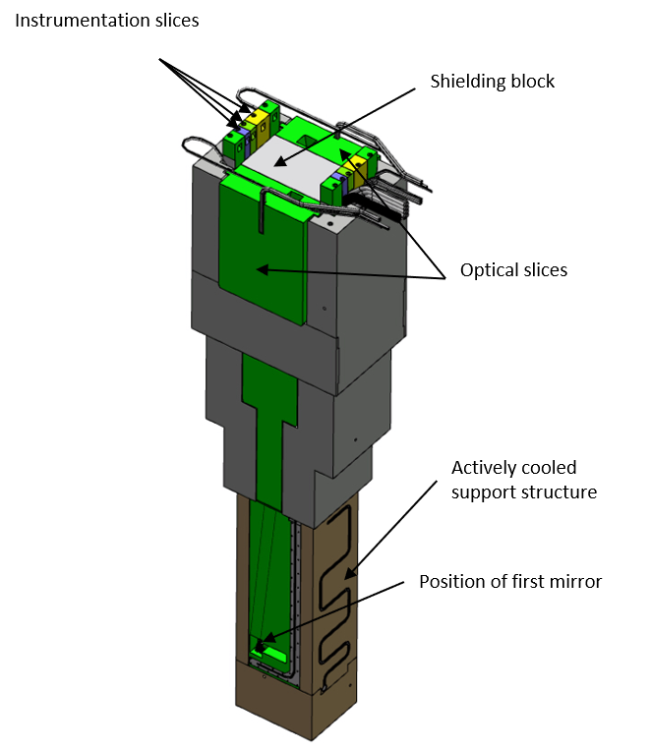
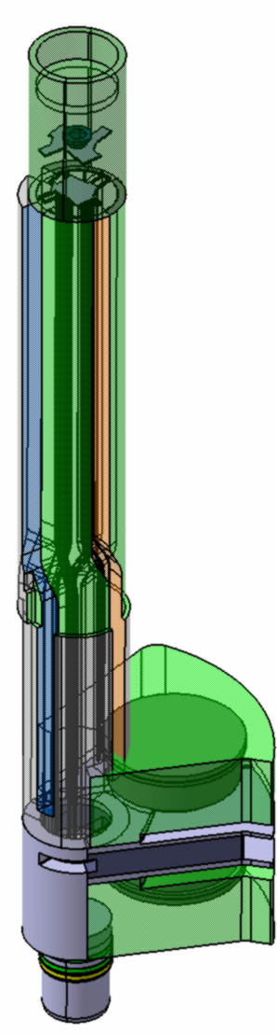
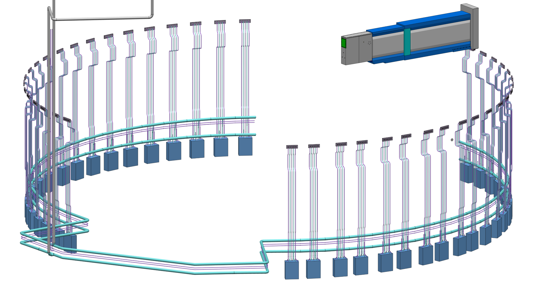
Shielding & Plugs Primary Cooling

Slide 15
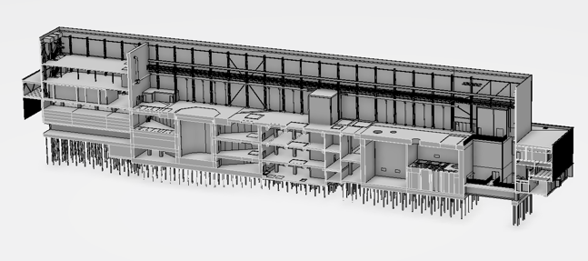
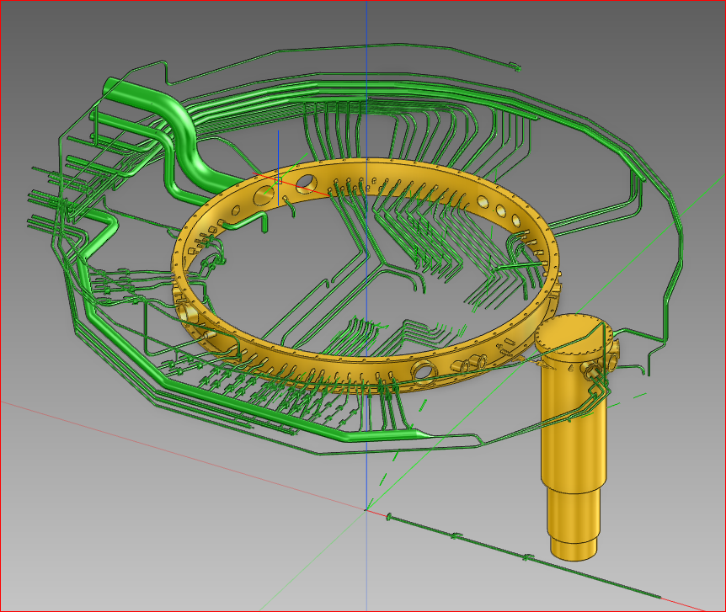
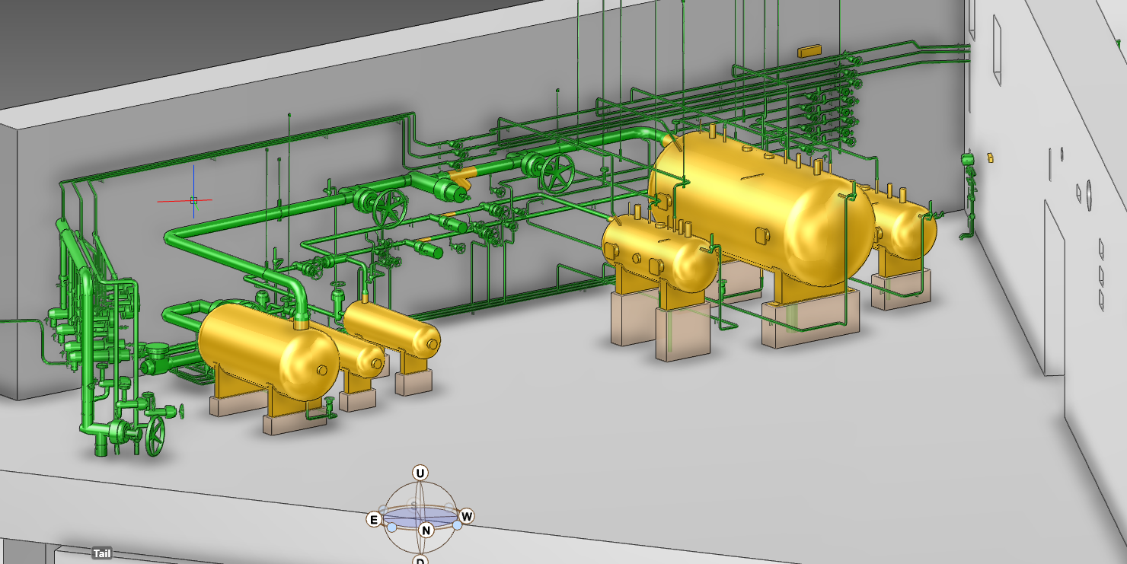
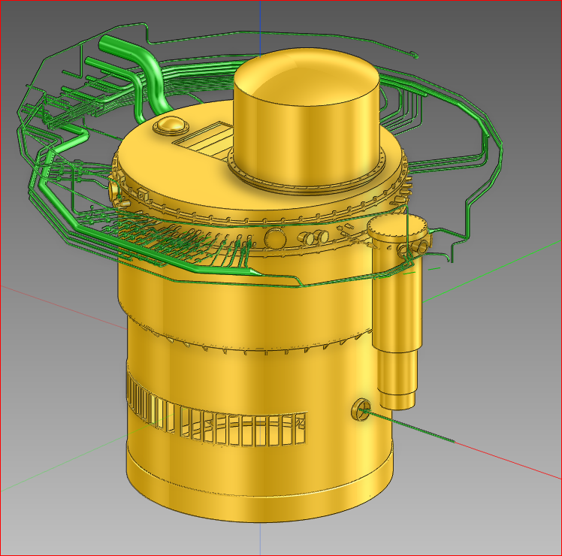
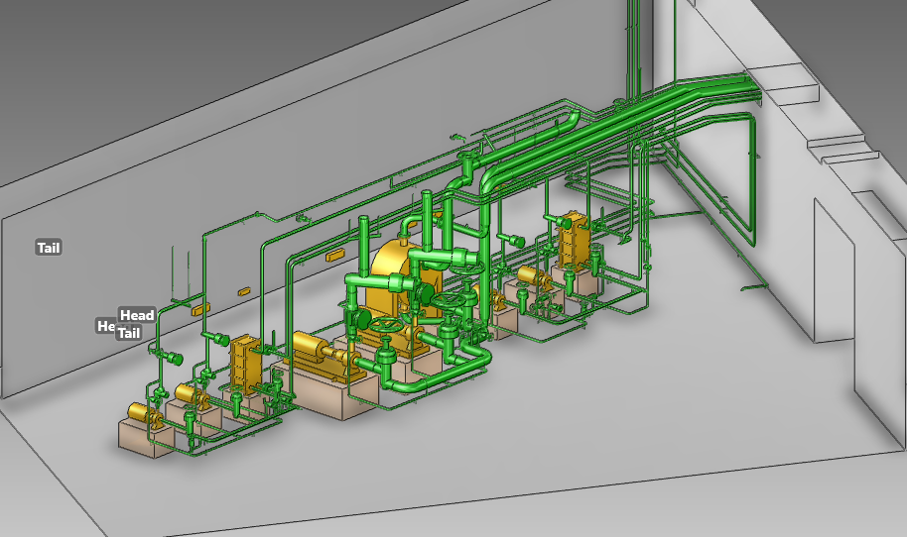
Primary Water Cooling Systems
Connection Cell
Level 115
GLS tanks
Delay tanks
Control Valves
Monlith Vessel
Connection Cell
Level 100
Pumps
HX:s

Slide 16
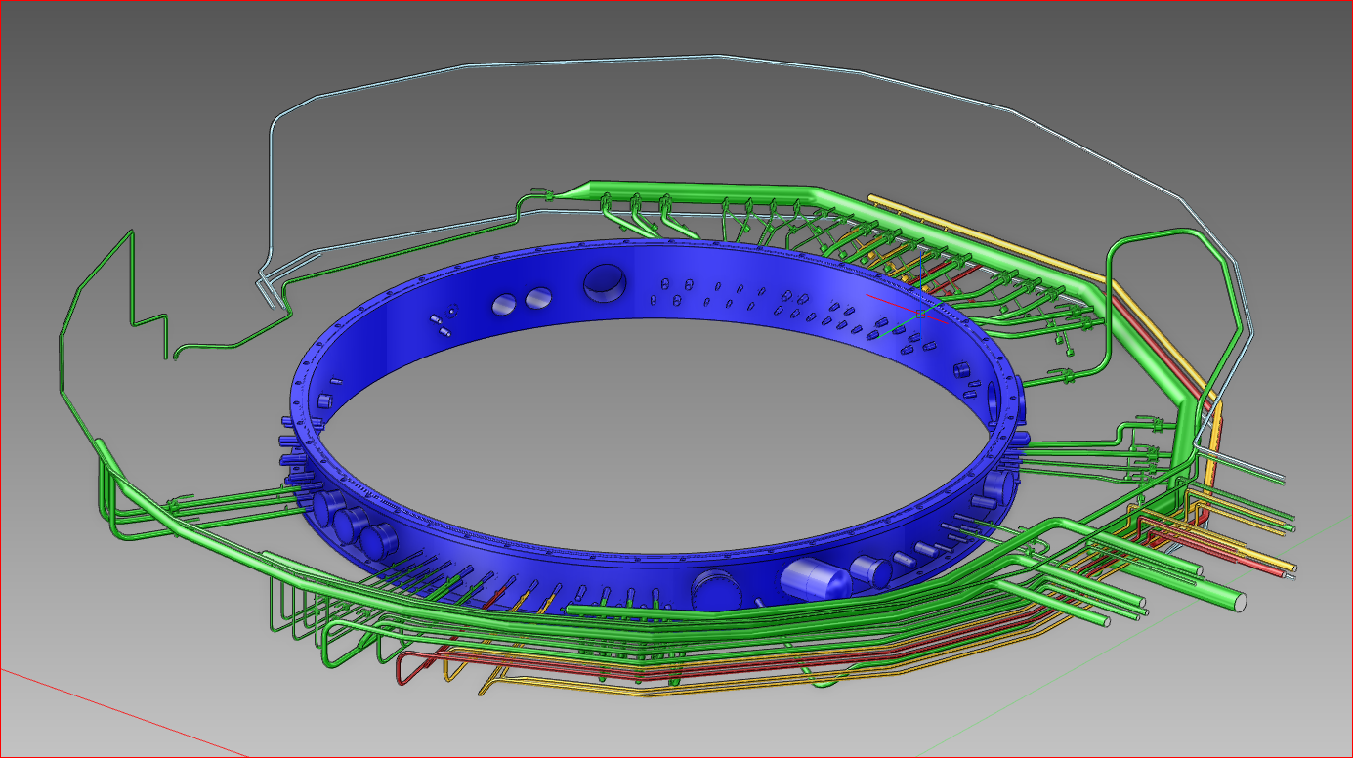
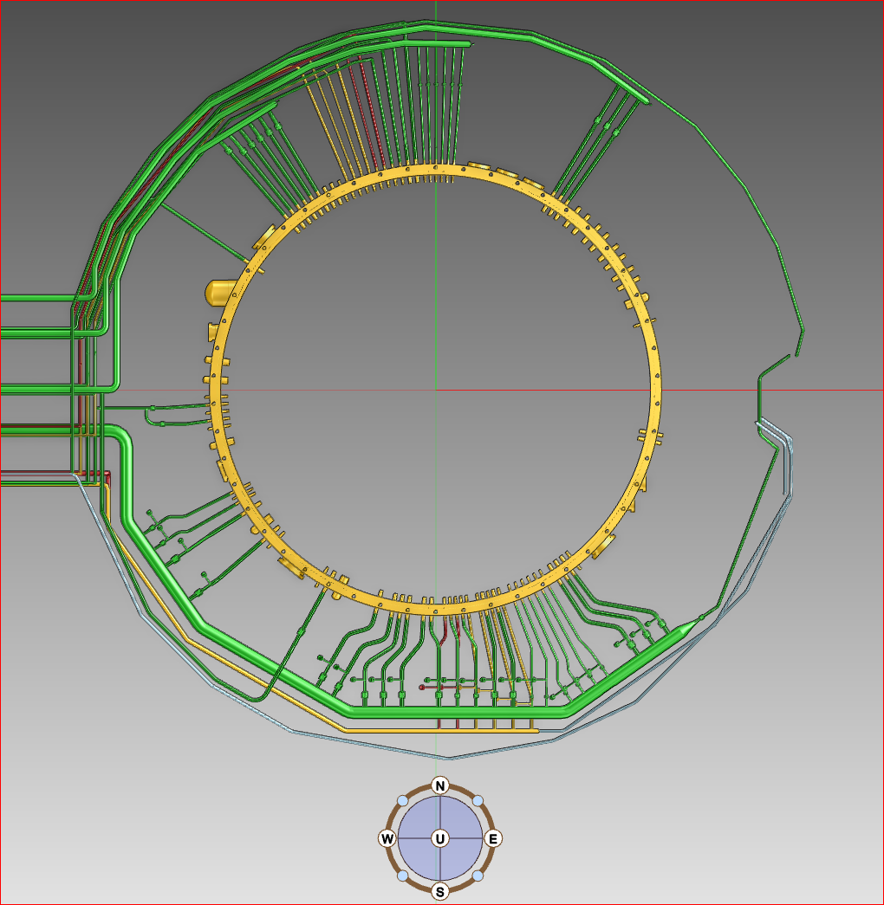
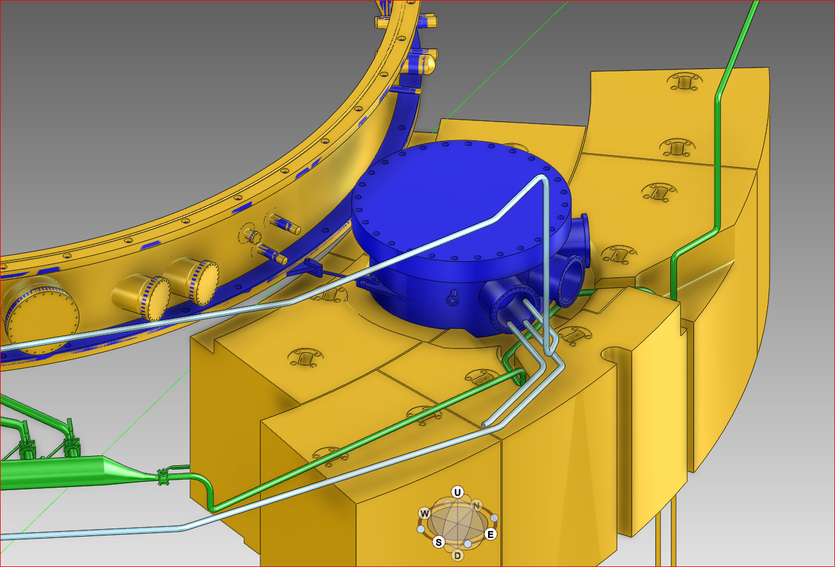
Primary cooling systems inside connection cell
Proton Beam Window
& Proton Beam Window Plug
Moderator Reflector
Shielding & Plugs Proton Beam Window

Slide 17

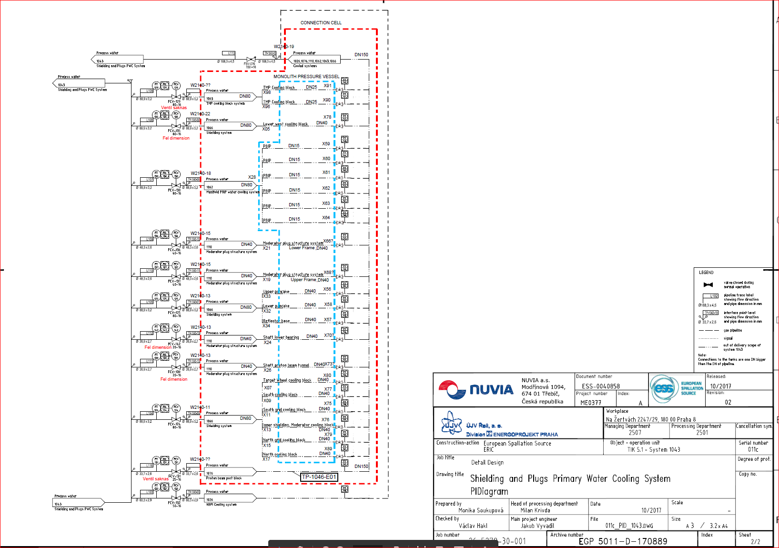
P&ID, Shielding & Plugs
Connection Cell
Design pressure:
Main Loop = 10 bar (a)
Components = 10 bar (a) or 5 bar (a)
Connection Ring
DN150
Flow Distribution
Valve
FS
TT
Ball
Valve
DN40
DN40
125
FT
FCV
PS
Flow Distribution
Valve
FS
TT
Ball
Valve
DN40
DN40
DN80
FCV-125
80-16
Flow Distribution
Valve
FS
TT
Ball
Valve
DN40
DN40
TP-1043-07
FT = Flow Transmitter
FCV = Flow Control Valve
PS = Pressure Switch
FS = Flow Switch
TT = Temperature Transmitter

Slide 18

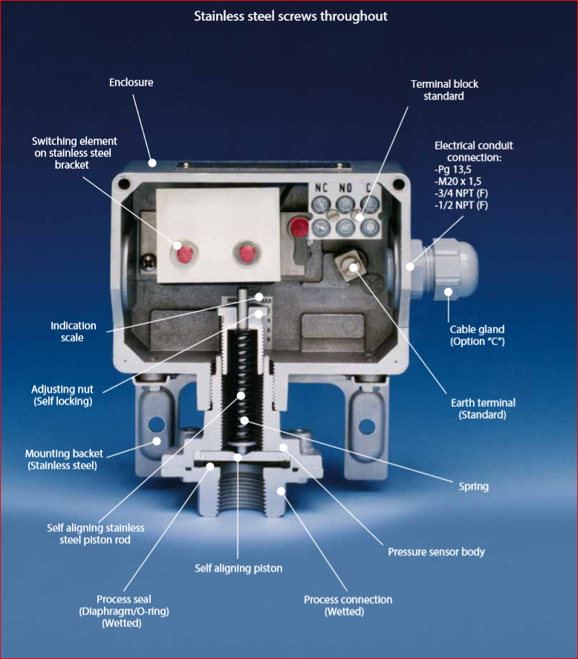
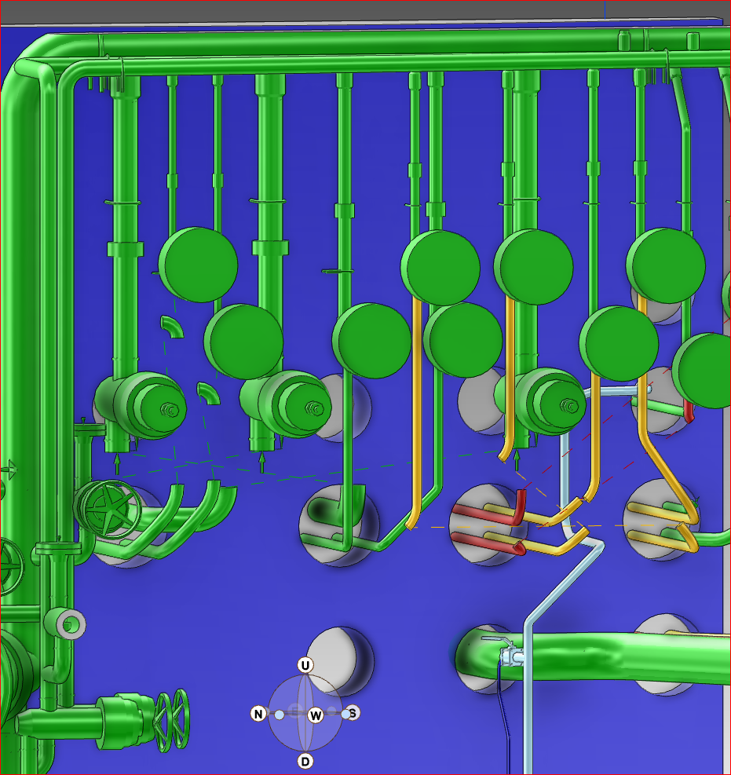
Pressure Switch (example)
BETA B type

Slide 19

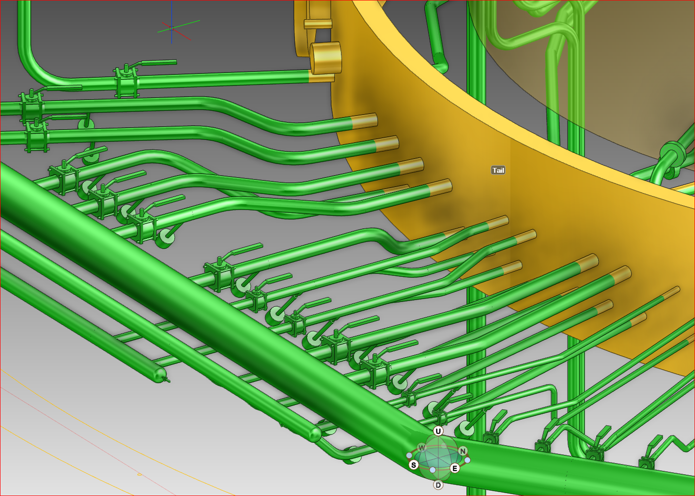
Flowswitch (example)
Type DW-R

Slide 20
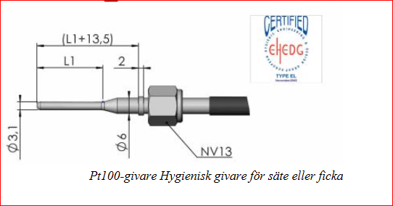
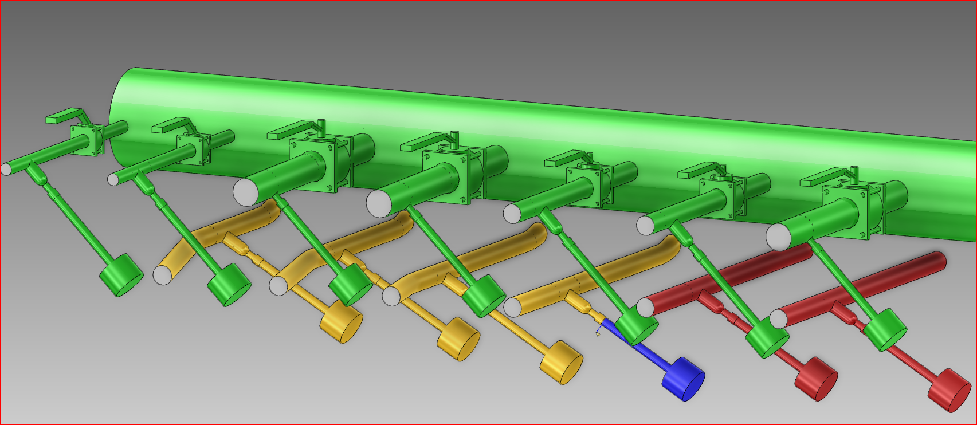
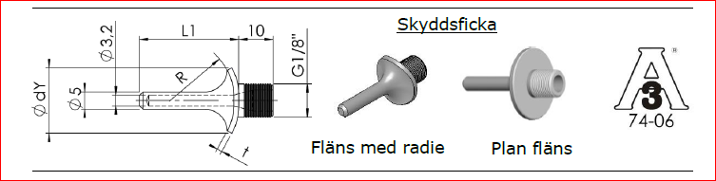
Temperature Sensor (example)
PT-100

Slide 21
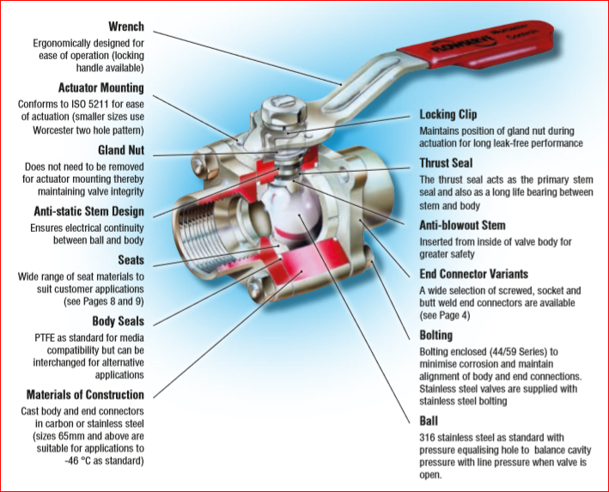
Shut off valve / Ball valve (example)
Worcester A44
Purpose:
Drain & drying

Slide 22
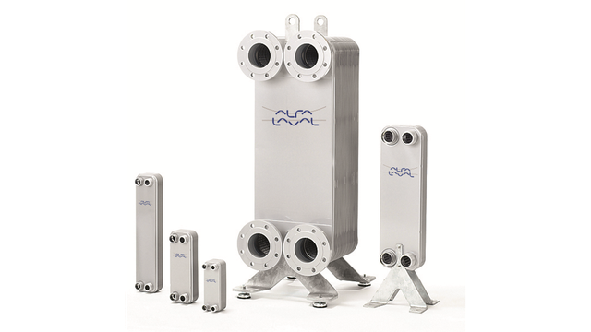
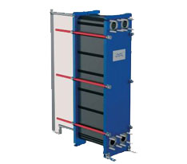
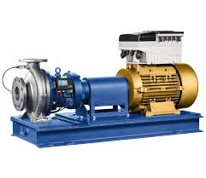
Some of the main components
Primary Water Cooling Systems
(Alfa Laval – not decided yet)
Intermediate Water Cooling Systems
Alfa Laval
Magnetic Hermetic Pumps (KSB)

Slide 23
Radiolysis Gas Treatment System

Slide 24
Connection to Radiolysis Treatment System

Slide 25
Radiolysis Gas Treatment System
Radiolysis
Decomposition of water, H₂O => H₂ + ½ H₂O₂
Generation of oxygen, H₂O₂ + radical => H₂ + ½ O₂ (secondary reaction)
Requirements
Recombine the hydrogen formed
Keeping the concentration of hydrogen below the lower flammability level
Keeping the non re-combinable spallation gases contained until decay
allows release to the atmosphere (¹¹C, ¹⁴O, ¹⁵O)

Slide 26
Water Purification System

Slide 27
Water Purification System

Slide 28
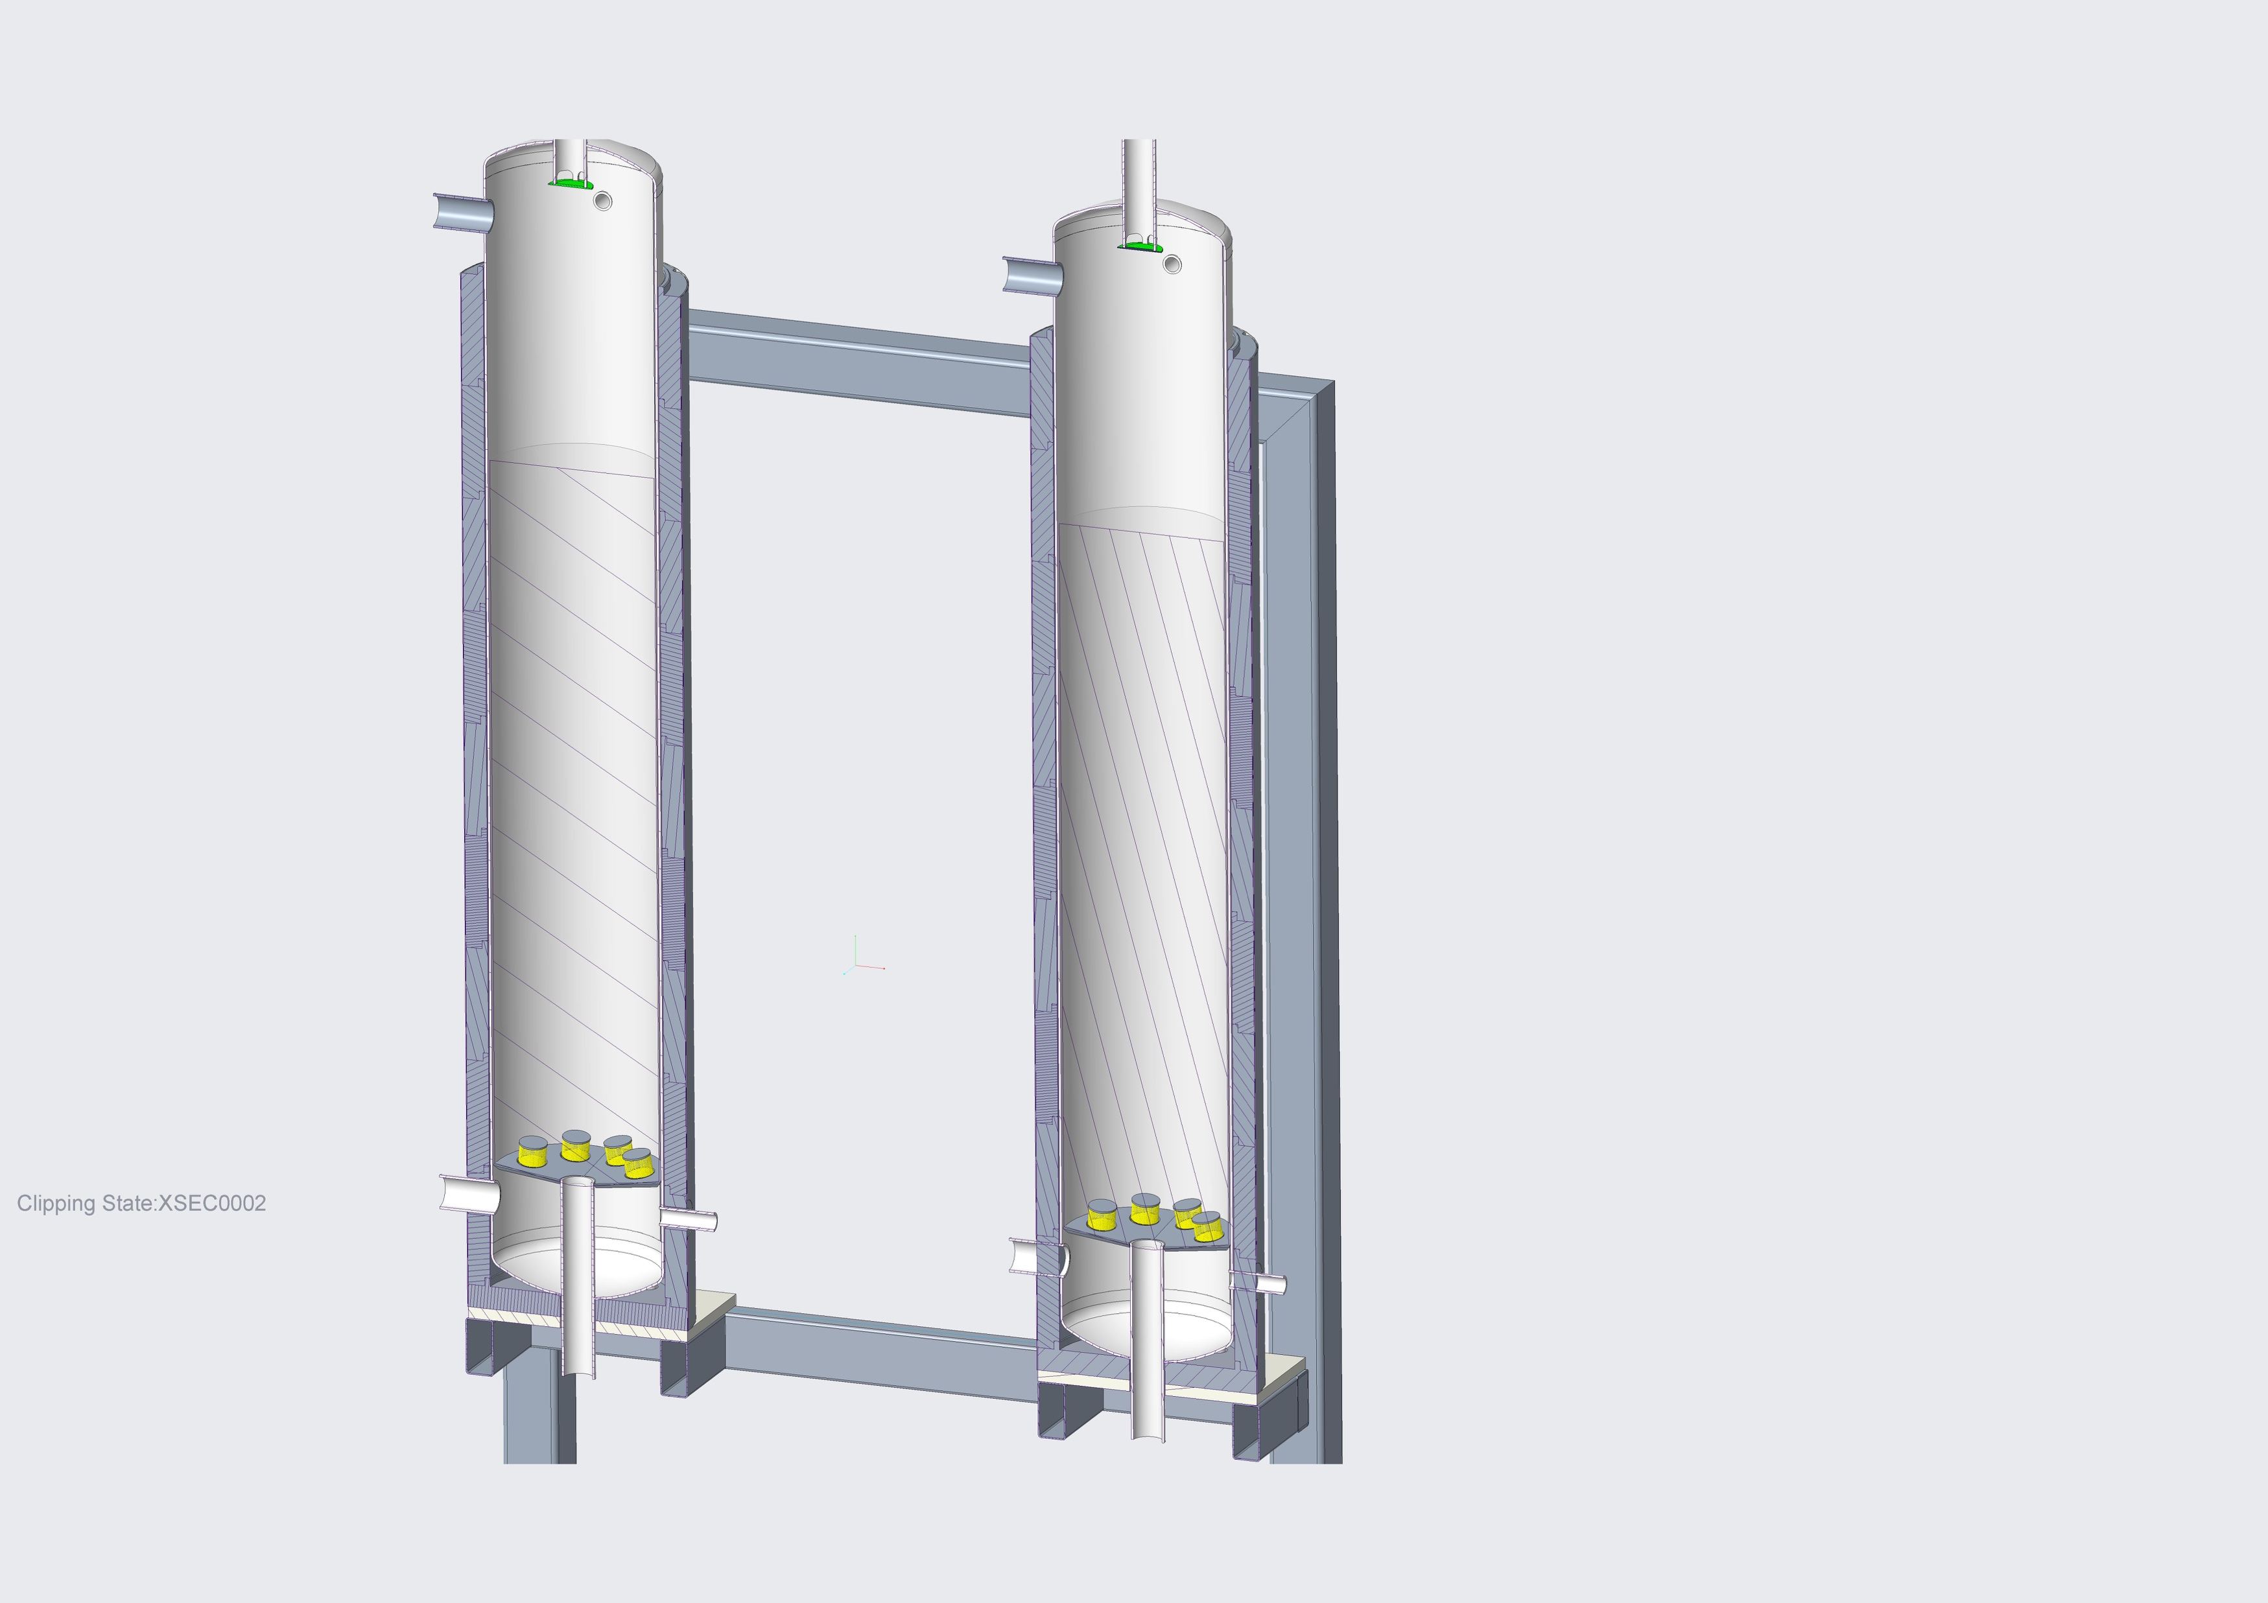
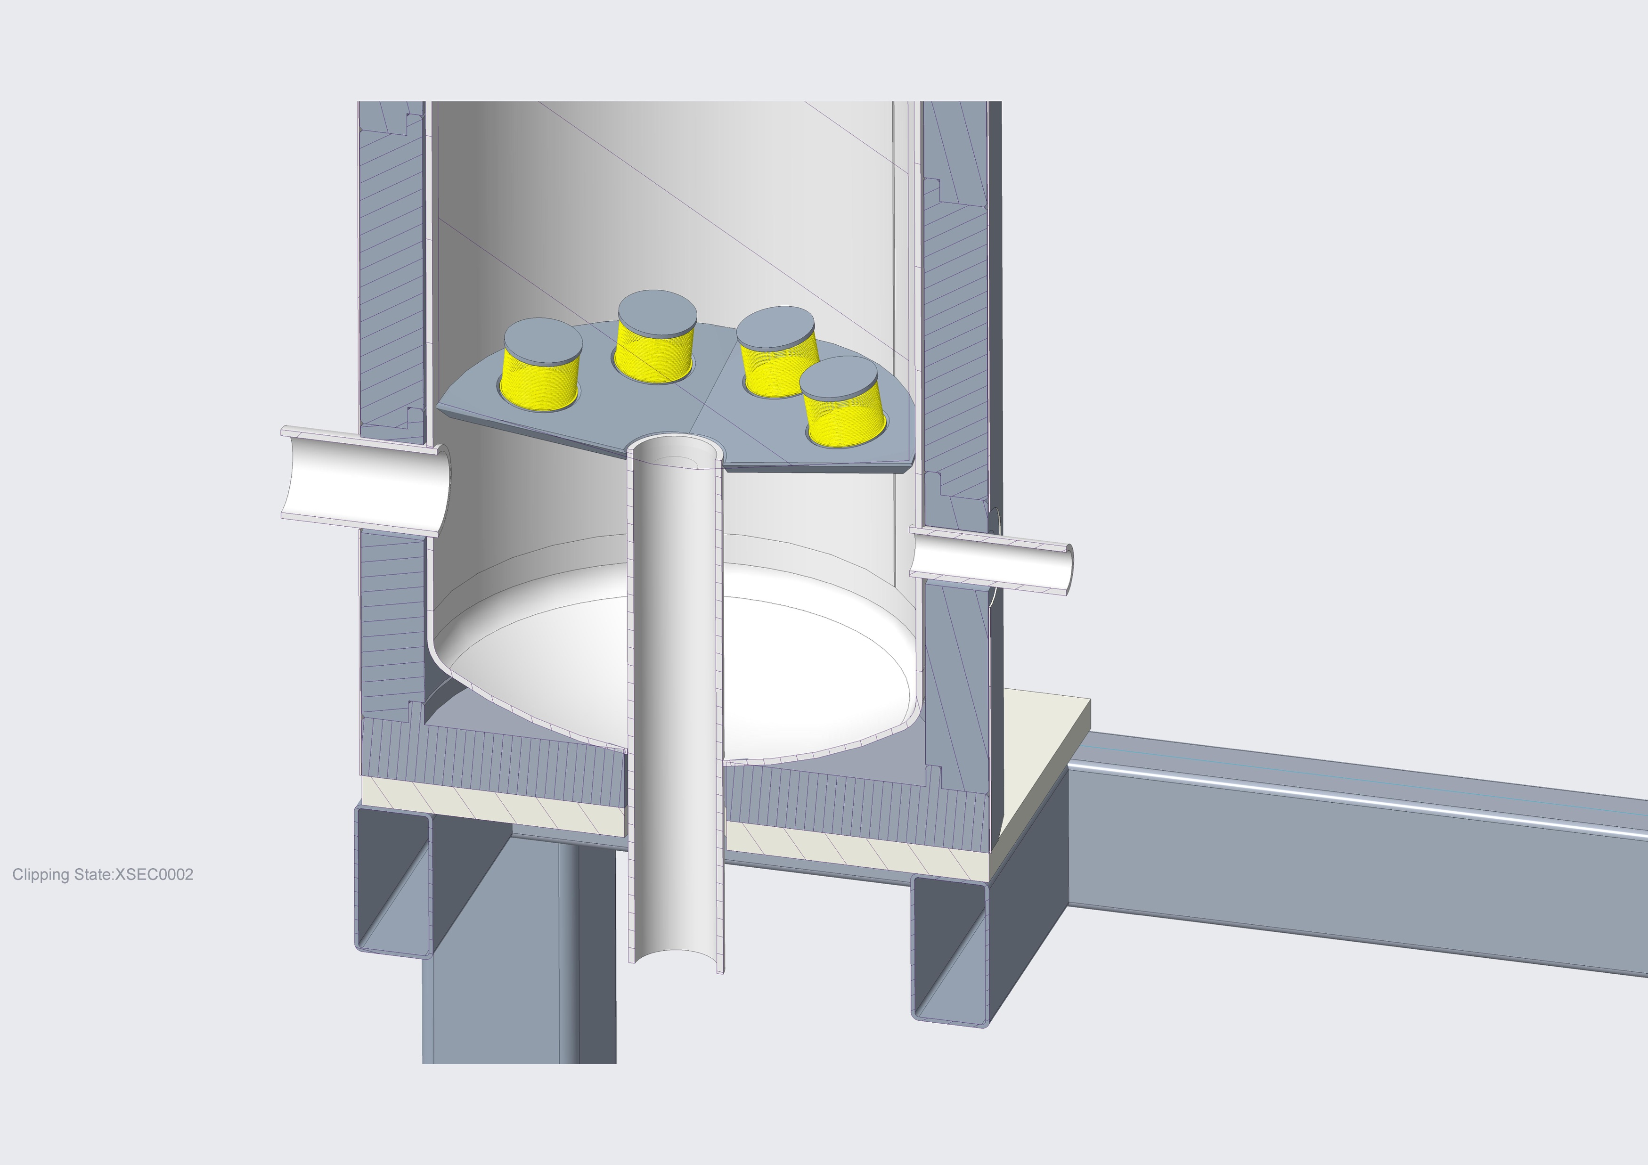
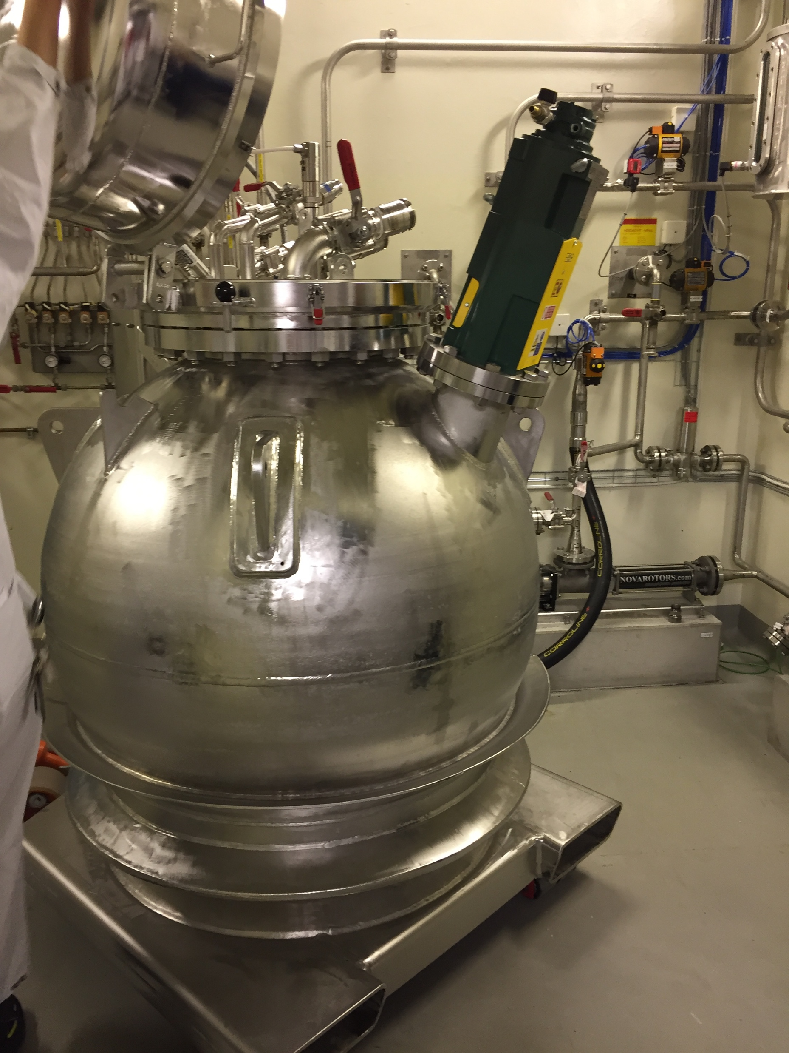
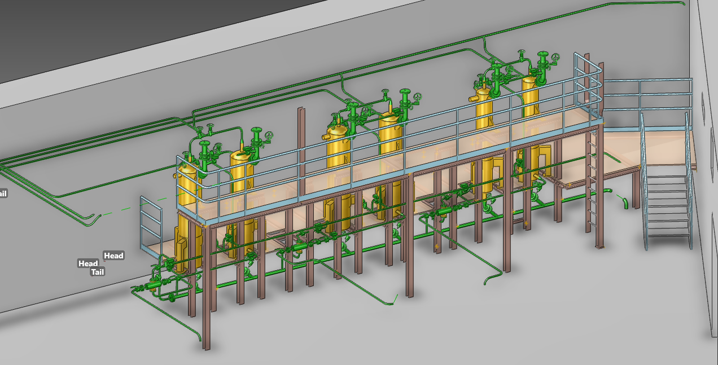
Water purification – Primary Cooling Systems
2 columns/system
  Fixed columns
  Lead shielded 4 cm
  One running and one standby or decay
Exchange of resin
  At most once/year
  Conductivity > 0,5 𝜇Sm/cm ?
  Transport Vessel
  Mock-up

Slide 29
Drainage

Slide 30
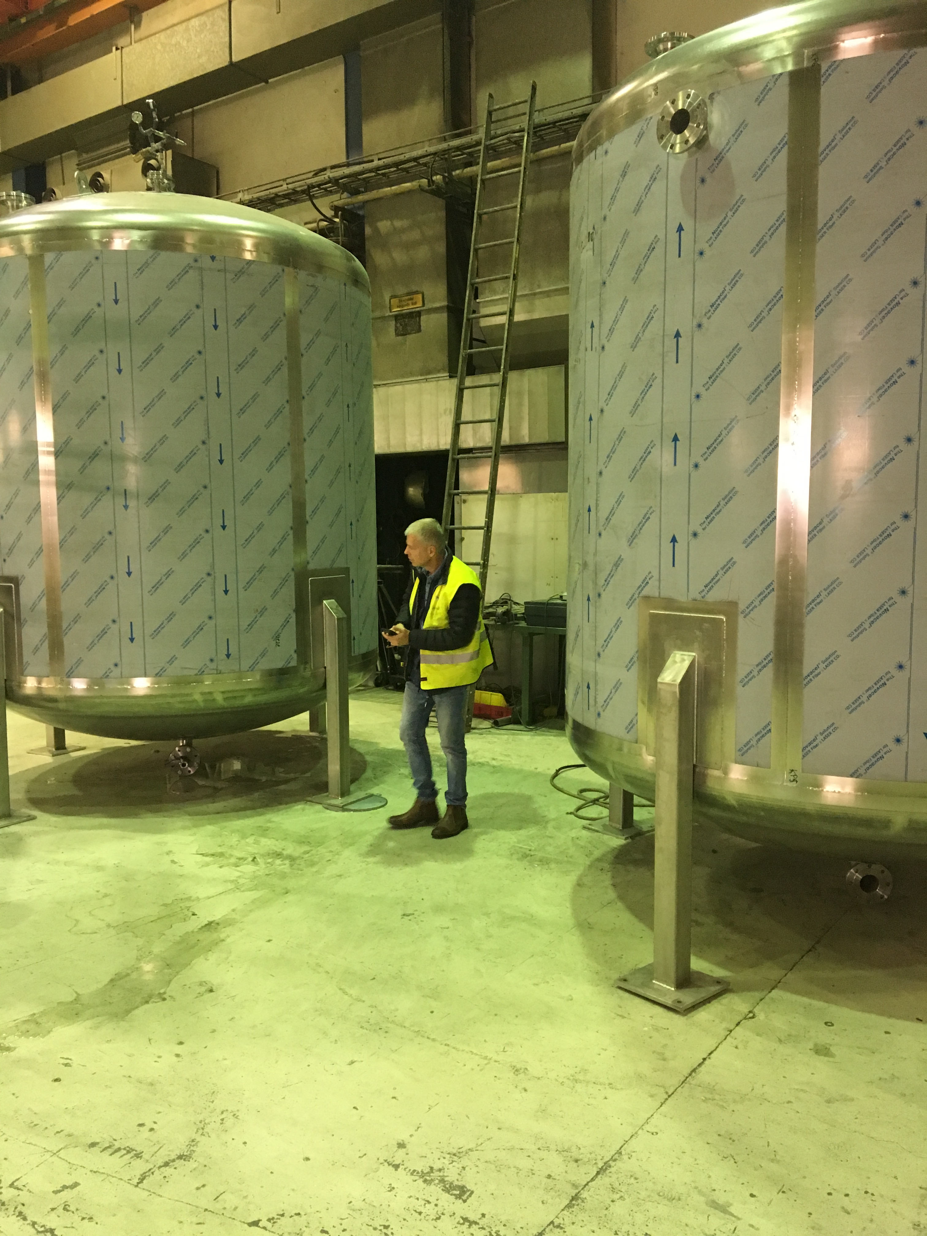
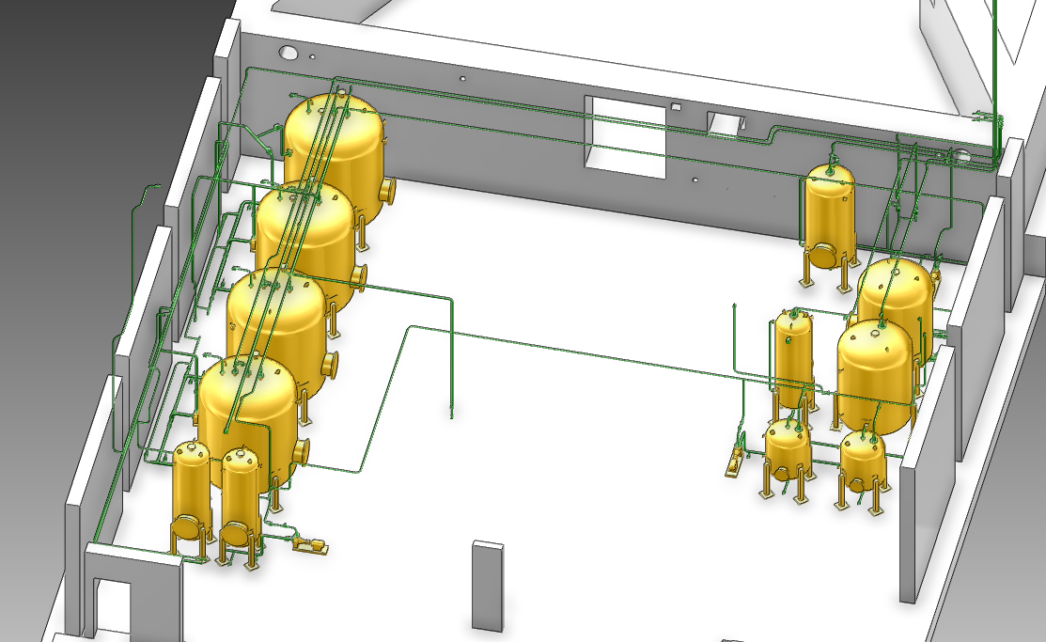
Drainage
Re-use the water as much as possible
Seperate vessels for:
All three primary cooling systems
All three intermediate cooling systems
Storage vessels:
  2 x 17 m³ floor drain (sprinkler water)
  1 activated water => waste
  1 non-activated water => waste
Connection to waste ?

Slide 31
Shielding

Slide 32
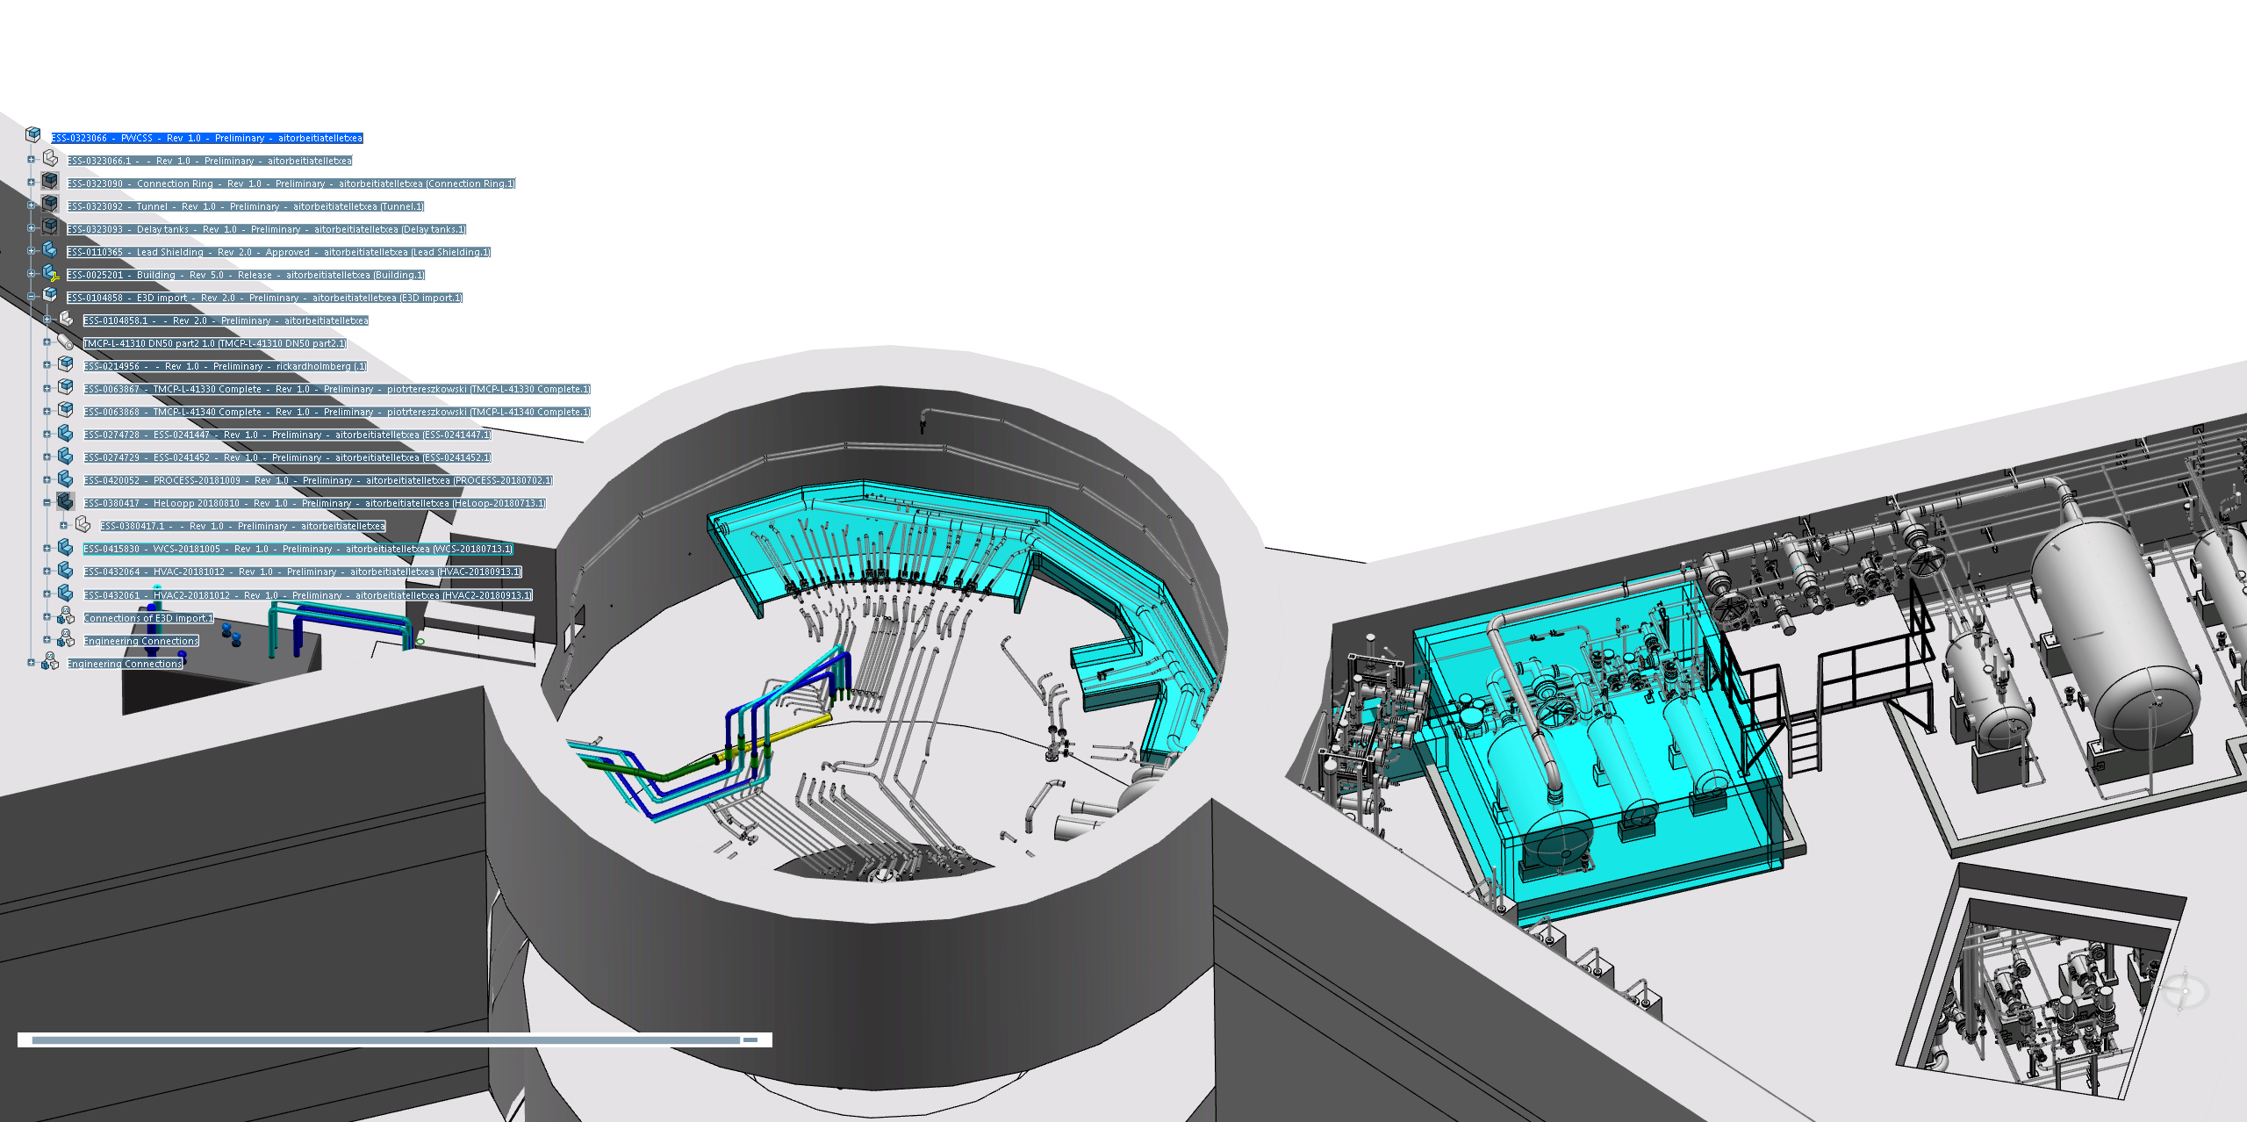
Shielding of Primary Water Cooling Systems
10 t
90 t
Pipes in connection cell
● No shielding is required downward
● 4 cm lead shielding is required upward
● 8 cm lead shielding is required toward instrument hall
Delay tanks
● 4 cm lead shielding is required downward
● 14 cm lead shielding is required upward
● 14 cm lead shielding is required toward instrument hall

Slide 33
Intermediate Water Cooling Systems

Slide 34
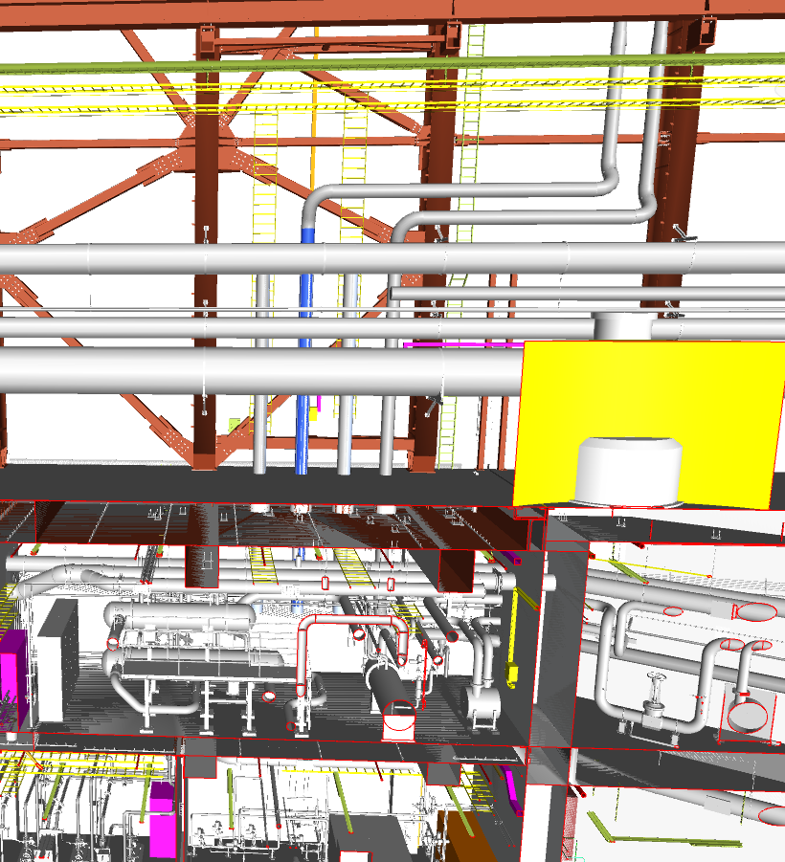
Target Intermediate Water Cooling
Helium
Three independent loops
Heat Exchangers (Alfa Laval)
  1500 kW
  1600 kW
  437 kW
Pumps (KSB magnetic)
  26,1 m³/h
  27,9 m³/h
  27,9 m³/h
Control:
He-temp after HX:s
  Frequency converter
  (Control valve)
Relief system from water side of He-heat exchangers

Slide 35
Control system & Commissioning

Slide 36
Control System design & Commissioning
Responsibility
Target
Specification of function
  State machine concept
  System chains
  Individual systems
  Target Station
Electrical design of automation cabinets
System testing & commissioning
ICS
Implementation of control system
PLC:s
Control room
System testing & commissioning

Slide 37
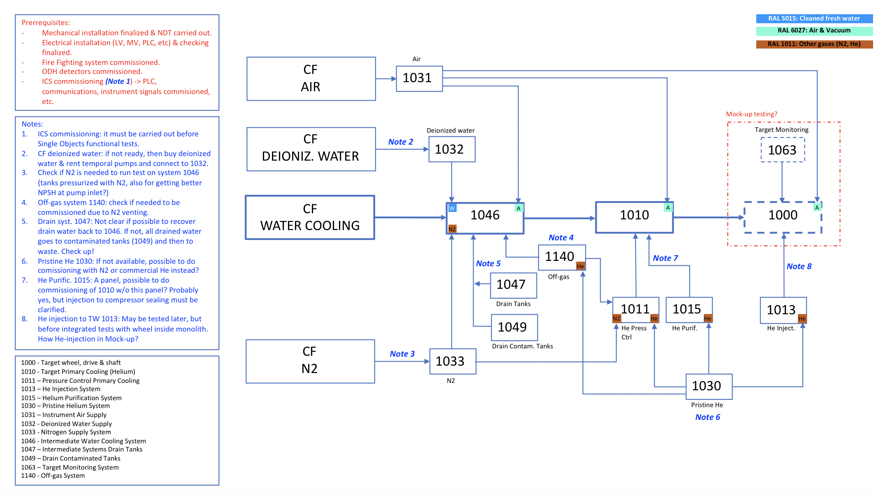
Target Systems – System Relations

Slide 38
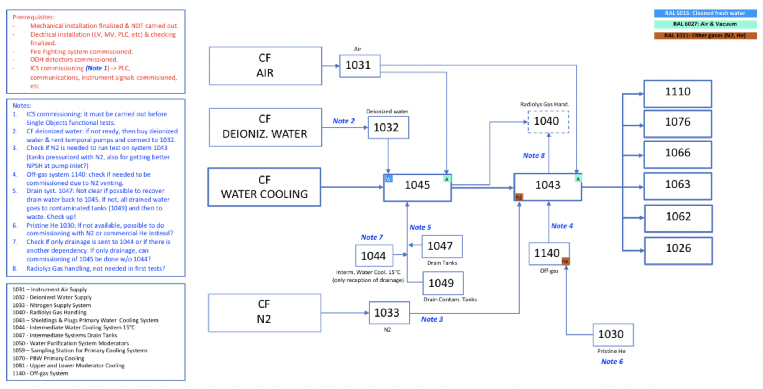
Shielding & Plugs Cooling – System relations

Slide 39
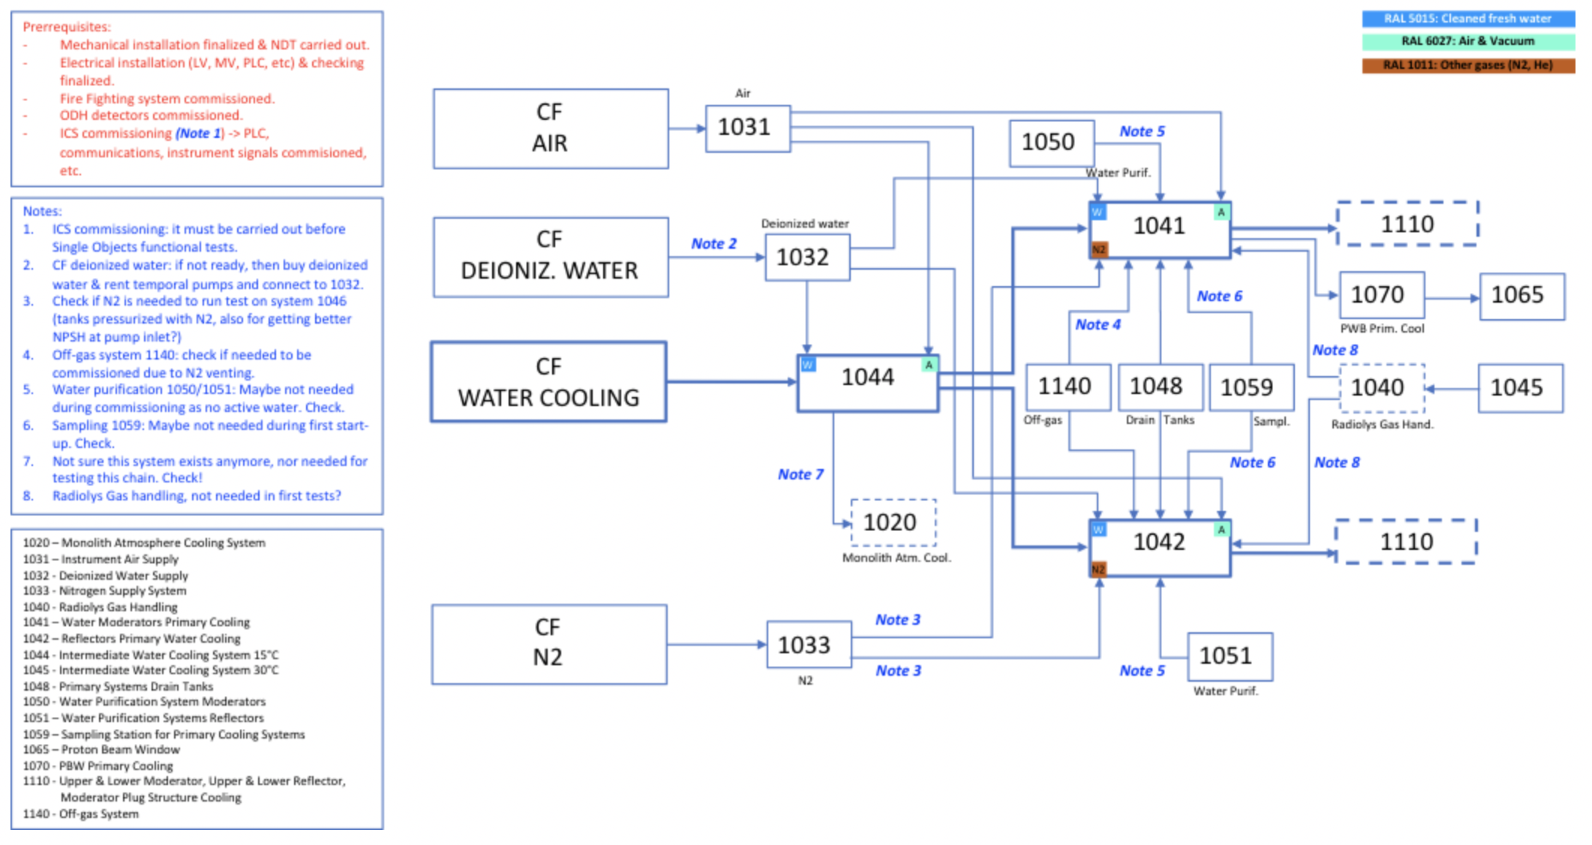
Moderator & Reflector – System relations

