Slide 1
Monolith Inner Shielding Design
Ulf Odén
WP Manager Target System
Mats Segerup
WU Leader Monolith Shielding
www.europeanspallationsource.se
11 April 2019

Slide 2
Outline of the presentation
Recap of the TAC #18 presentation
Accomplishments since the TAC #18
Conclusions from the prototyping
Final design
Present status and manufacturing
Conclusion

Slide 3
Recap of the TAC #18 presentation
Presented at the TAC #18: Design requirements Monolith Inner Shielding Design Fatigue and fracture mechanics Pipe connection (Mock-Up) Water Channels (Prototype) Testing of final shielding block

Slide 4
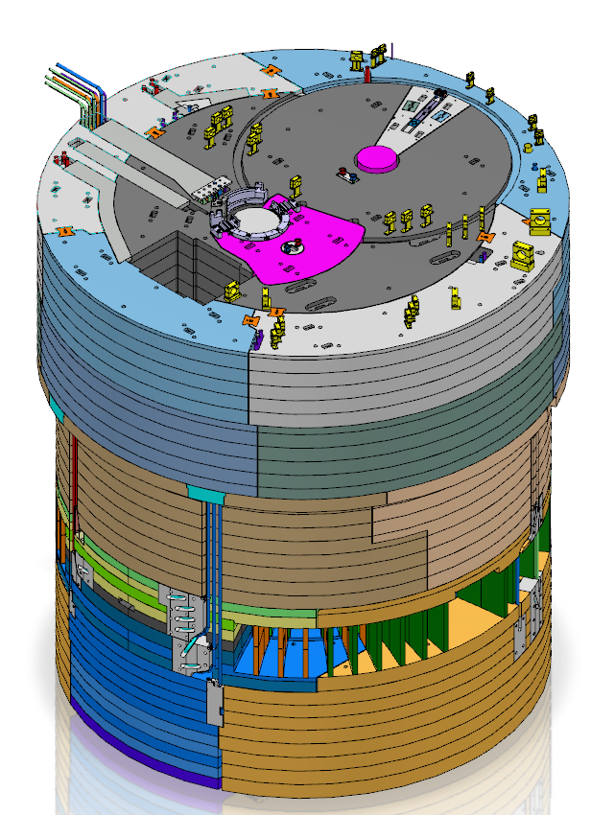
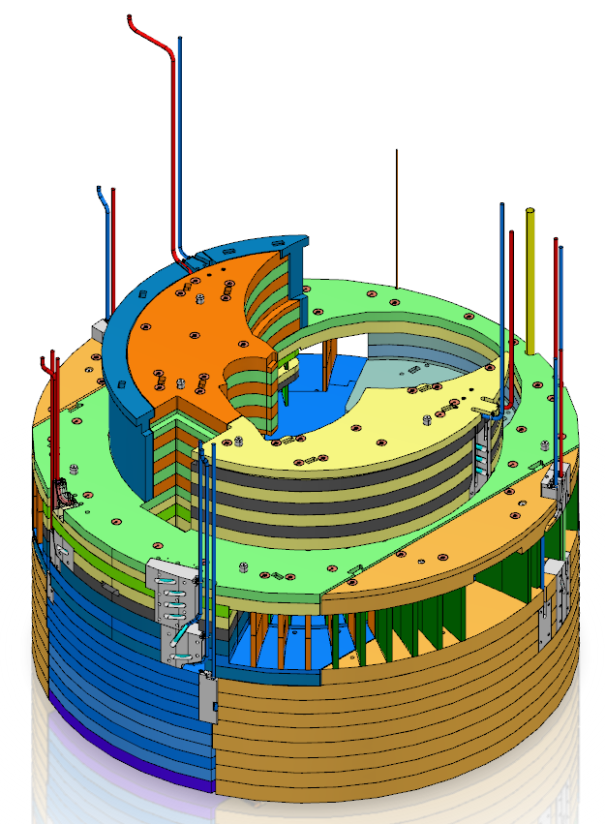
Recap of the TAC #18 presentation
Main Design Requirements:
Maximum leakage 1g water/h
Minimum 40 year of operation

Slide 5
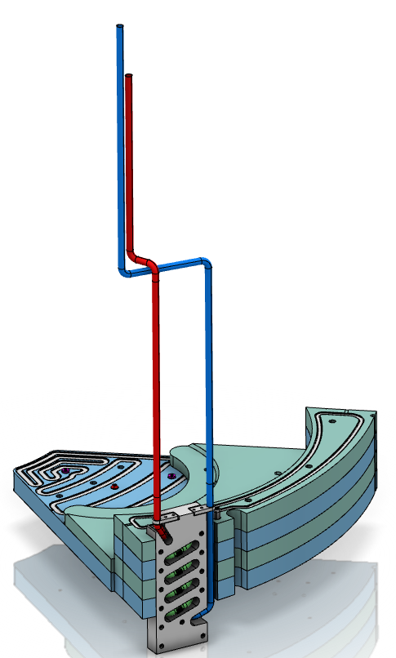
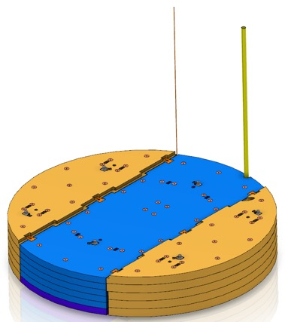
Recap of the TAC #18 presentation
Monolith inner shielding design

Slide 6
Recap of the TAC #18 presentation
Fracture mechanics
Postulated initial surface crack 1 mm depth and 5 mm width (x, y)
During the plant life this initial crack growths to 2.7 mm depth and 7.5 mm width
2.7 x 7.5 don´t penetrate the cover
This result follows from upper bound considerations of fatigue loading and is valid for all locations of the inner shielding.
y
Vacuum
x
Water

Slide 7
Recap of the TAC #18 presentation
Detect crack during manufacturing
Based upon the RCC-MRx leak rate analysis procedures, the through wall penetrating crack needs be 1.5 mm wide (y) to generate leak rate 1 gr/h,
The initial penetrating crack needs to be 0.75 mm wide (y) to reach 1.5 mm during the plant life
Liquid penetrant testing is classified to detect surface cracks from 1 mm and with borescope 2 mm
y
Vacuum
Water

Slide 8
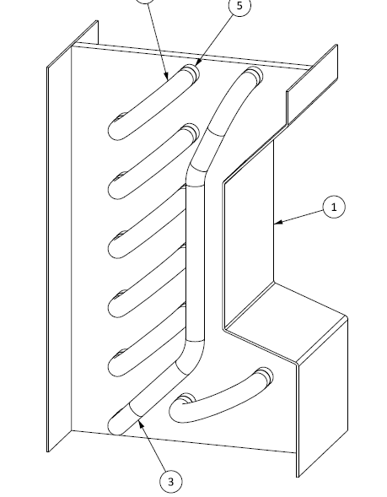
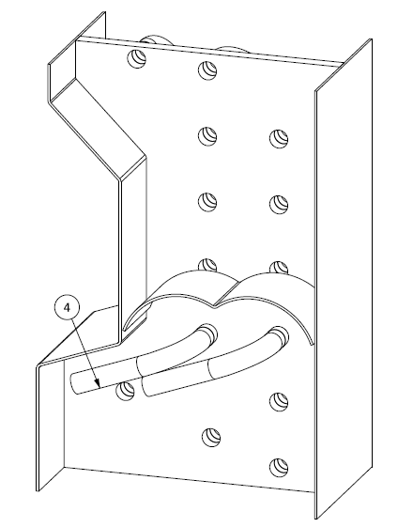
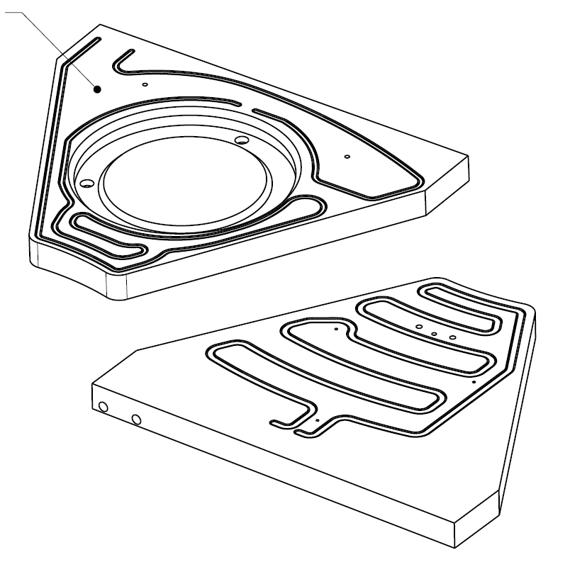
Recap of the TAC #18 presentation
Prototype and Mock-Up
Mock-Up
Prototype

Slide 9
Recap of the TAC #18 presentation
Additional material testing requirements
The inclusion content is limited and tested according to ASTM E45
Each individual plate is volumetrically tested with Ultrasonic testing according to EN 10307 S3/E4
IK-corrosion test is performed
The chemical composition is restricted regarding Sulphur and Aluminium content

Slide 10
Recap of the TAC #18 presentation
Additional weld inspection requirements
The root pass and the following weld layers are tested 100% with liquid penetrant test to verify that there are no cracks or imperfections between the weld layers
The internal of the cooling channels are inspected 100% with borescope to guarantee full penetration and that there are no surface penetrating defects or dangerous welding oxides
Welding procedures and testing procedures are tested on a mock-up

Slide 11
Recap of the TAC #18 presentation
Final inspection requirements:
Every single cooling block is pressure tested at 1.43 x design pressure
Every single cooling block is helium leak tested according to the high vacuum rules

Slide 12
Accomplishments since the TAC #18
Finalised the prototyping of cooling channels
Finalised the pipe welding tests in the test rig
Answer to the CDR committee question concerning water leaks in Inner Shielding (ESS-0806624)
CDR approved

Slide 13
Conclusions from the prototyping and test rig
It was concluded from the manufacturing of the prototype that it is possible both to manufacture and weld the plates and the cooling channel lids, and to bend and weld the tubes transporting the cooling water according to the set design.
The result from the mock-up was that successful welding can be achieved manually by a skilled welder provided that recommended adjustments are made to the plate connection to reduce the heat sink effect.

Slide 14
Final design
The design has been developed with finalised placement of all water-cooling channels so that they make the variations of temperature as mild as possible. This will limit stress in the shielding blocks and weldings.
The welding geometry is optimized to secure a high quality welding.
Inspection plan for 100% NDT of the welds
Material specifications

Slide 15
Present status and manufacturing
2.000 tons of stainless steel procured
Production started
#1 part of the machining procured, waiting for the material delivery
Started procurement of the #2 part machining
Published the #3 part machining
Preparing OCT the #4 part machining

Slide 16
Conclusions
“all water cooling systems will leak at some point”!!
The Inner Shielding requirement is to prevent leaks during the life time of the facility
Strategy:
The design is manufacturable
Analyzed the largest acceptable defects
NDT that can detect defects with in margin to acceptable defect
100% NDT

